Slide 1


Phase structure and properties of QCD matter produced in relativistic heavy-ion collisions
SN0598 : Studying the Phase Diagram of QCD Matter at RHIC
The present and future of QCD
arXiv:2303.02579
A journey through QCD
ALICE: arXiv:2211.04384
Bedanga Mohanty (NISER)

Slide 2

Relativistic heavy-ion collisions at LHC
Time evolution of heavy-ion collisions
Phase diagram of QCD

Slide 3
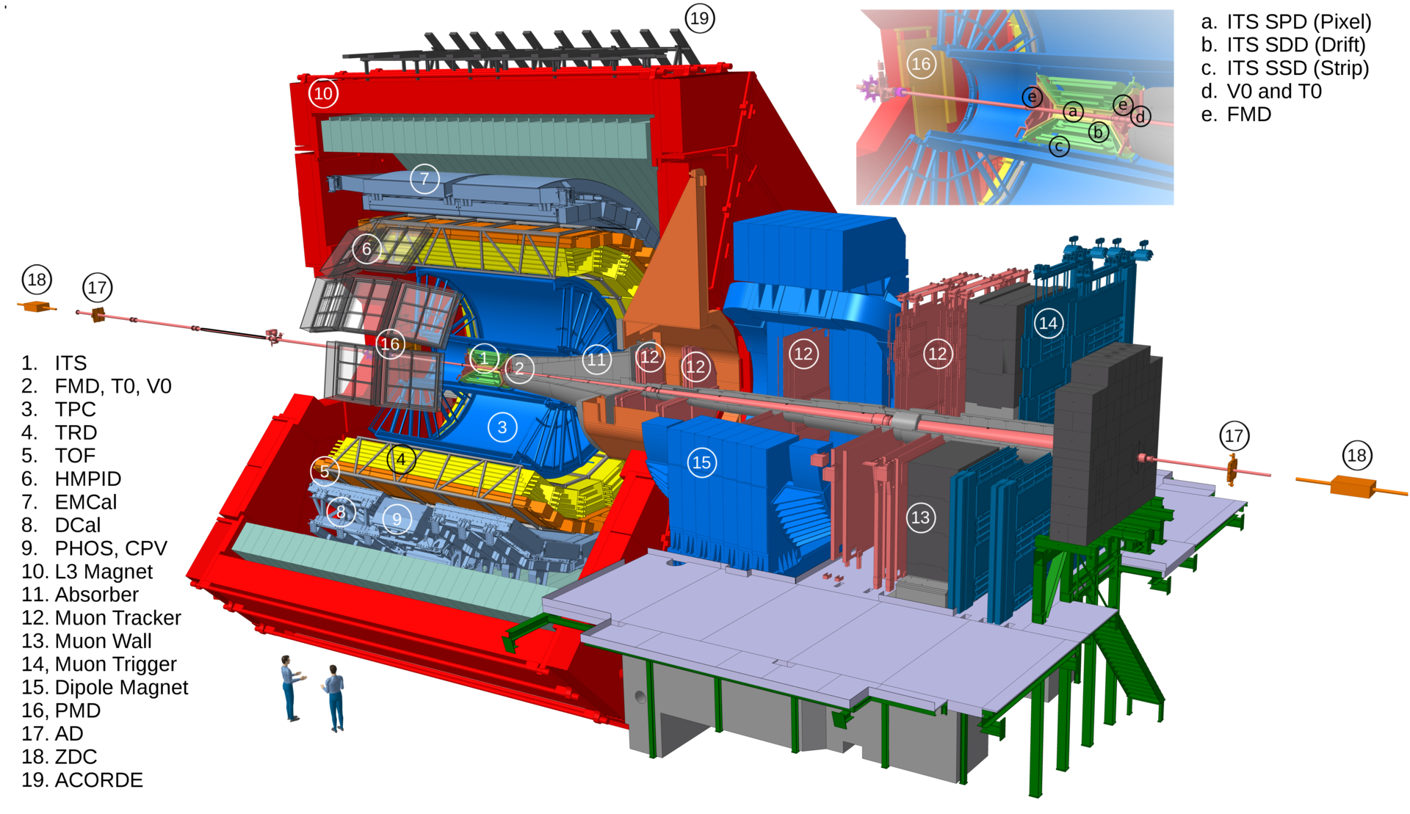
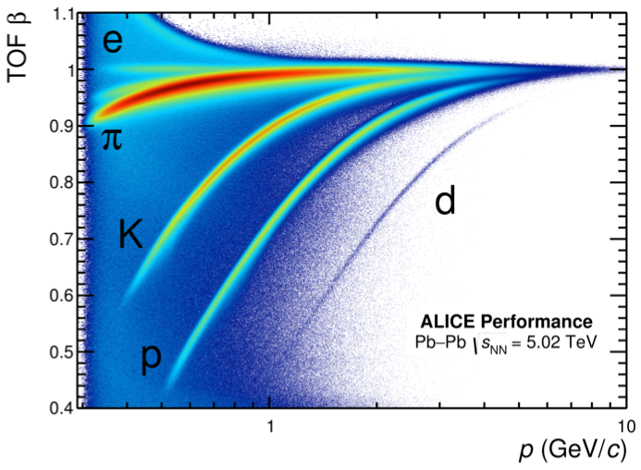
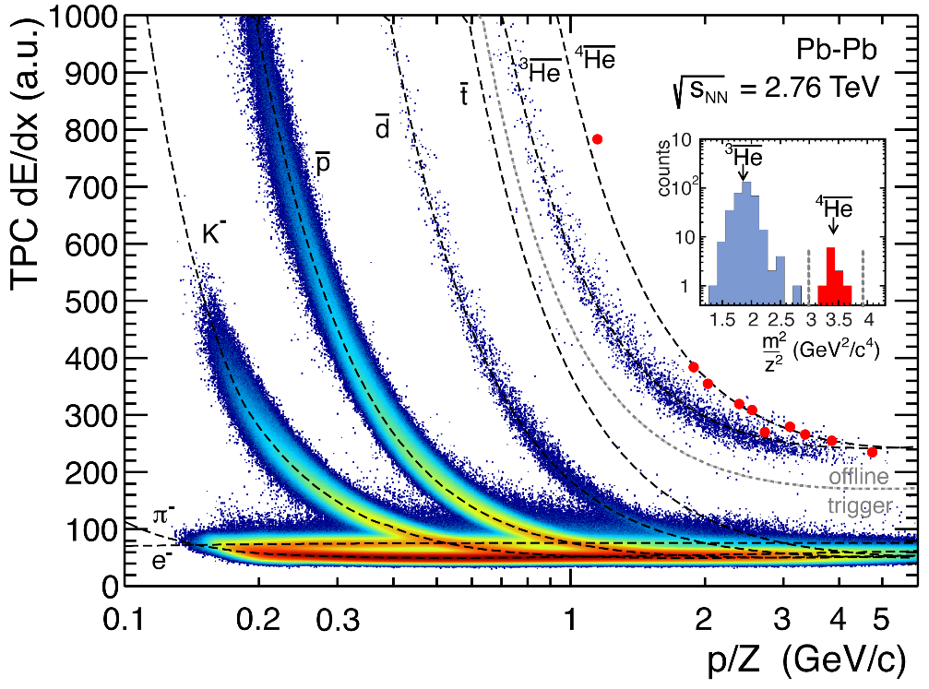
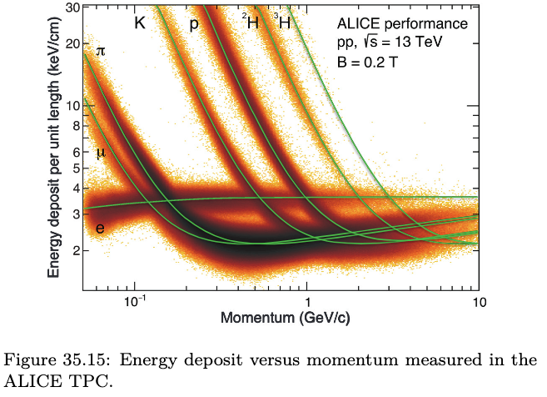
ALICE detector
Uniform acceptance at midrapidity and excellent particle identification capability
(Particle Data Group),
Prog. Theor. Exp. Phys. 2022, 083C01 (2022)
Part of PDG

Slide 4
Dataset collected
System | Year | Centre of mass energy (TeV) | Integrated luminosity
Pb-Pb | 2010, 2011 2015, 2018 | 2.76 5.02 | 75 mb⁻¹ 800 mb⁻¹
Xe-Xe | 2017 | 5.44 | 0.3 mb⁻¹
p-Pb | 2013 2016 | 5.02 5.02, 8.16 | 15 nb⁻¹ 3 nb⁻¹ , 25 nb⁻¹
p-p | 2009-2013 2015, 2017 2015-2018 | 0.9, 2.76, 7, 8 5.02 13 | 200 mb⁻¹, 100 nb⁻¹, 1.5 pb⁻¹, 2.5 pb⁻¹ 1.3 pb⁻¹ 136 pb⁻¹
Run 3 – 700 billion pp events at 13.6 TeV collected.
Target for 2023 – 30 pb⁻¹
2023: 4-5 weeks of Pb-Pb run expected
Target for 2023 – 3.25 nb⁻¹

Slide 5
Multiplicity, energy density, source size & decoupling time
Assuming formation time ~ 1 fm/c,
ε = 12.3 ± 1.0 GeV/fm³ in 0–5% Pb–Pb collisions at √s_{NN} = 2.76 TeV.
Stronger energy dependence than pp. Heavy-ion collisions are more efficient in transferring the initial beam energy into particle production.
RHIC to the LHC - homogeneity region ~ twice larger. The decoupling time for midrapidity pions is ~ 40% larger.

Slide 6
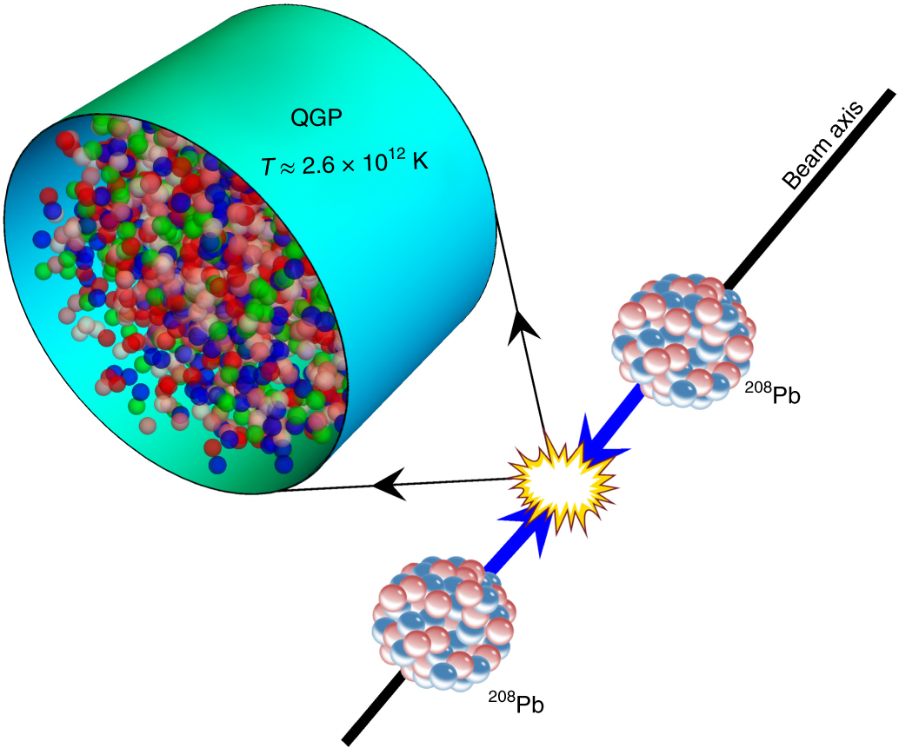
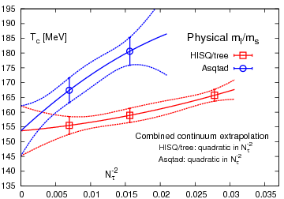
Temperatures measured in ALICE at LHC
Phys.Rev.D 85 (2012) 054503
Lattice QCD – transition temperature
T_{c}=156.5 ± 1.5 MeV
Nature Physics 16, 615–619 (2020)
Phys. Lett. B 795 (2019) 15–21

Slide 7
Temperatures from direct photons at ALICE
Effective temperature ~ 300-400 MeV.
Much larger than T_{c} from LQCD (156 MeV).
QGP formation at LHC.
Photon spectra are blue shifted by radial flow and in future we will measure it with dileptons (p_{T} integrated) invariant mass spectra.

Slide 8
Temperature from particle yields – chemical freeze-out
Inelastic collisions cease at ~ 155 MeV.
Chemical freeze-out and quark-hadron transition around similar temperatures.
8th International Conference on. Physics and Astrophysics of Quark Gluon Plasma (ICPAQGP-2023)

Slide 9
Temperature from particle spectra and flow – kinetic freeze-out
Elastic collisions cease at a lower temperature than chemical freeze-out
Fast expansion ~ 0.65 c (central collisions)
Temperature and radial flow anti-correlated
Evidence of hadronic phase ?

Slide 10
Finite duration between chemical and kinetic freeze-out
τ_{ρ}~1.3 fm/c
τ_{Κ∗}~4.16 fm/c
τ_{Λ∗}~12.6 fm/c
τ_{φ}~46.3 fm/c
Evidence of rescattering in hadronic phase.
Lower limit on duration ~ 10 fm/c for central collisions.

Slide 11
The temperatures ranges probed by central heavy-ion collisions at the LHC derived from ALICE measurements
Thermal direct photons T_{eff}
Temperatures needed to describe the relative bottomonia Υ(2S) and Υ(1S) yields.
The effective charged-hadron temperature obtained using a hydrodynamic model to describe ALICE spectra measurements.
The chemical freeze-out temperature from a statistical model fit to particle yields.
Kinetic freeze-out temperature from blast-wave fits to spectra and identified particle v_{n} measurements.
Earliest times, which correspond to
the highest temperatures of the QGP, the temperatures obtained in Pb–Pb collisions are ∼ 0.8 GeV, that is roughly five times higher than the pseudocritical QGP transition temperature predicted by lattice QCD,
Tpc ≈ 0.155 GeV

Slide 12
Transport properties of QGP
(using ALICE data)
Shear viscosity
Bulk viscosity
Diffusion coefficient
Jet transport coefficient

Slide 13
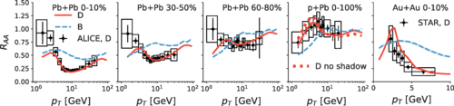
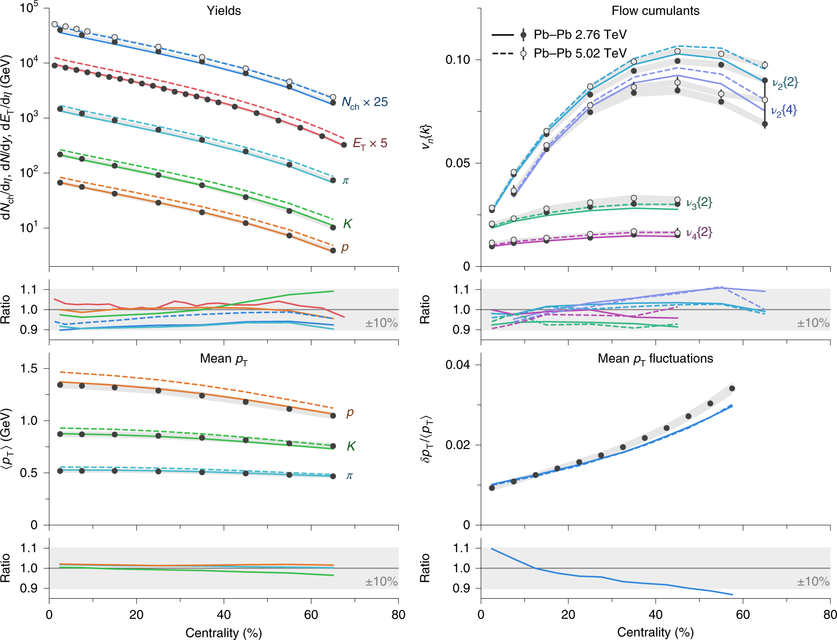
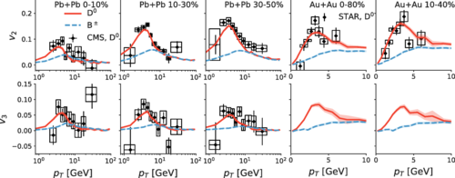
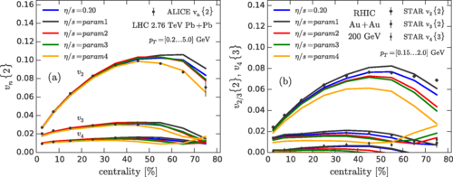
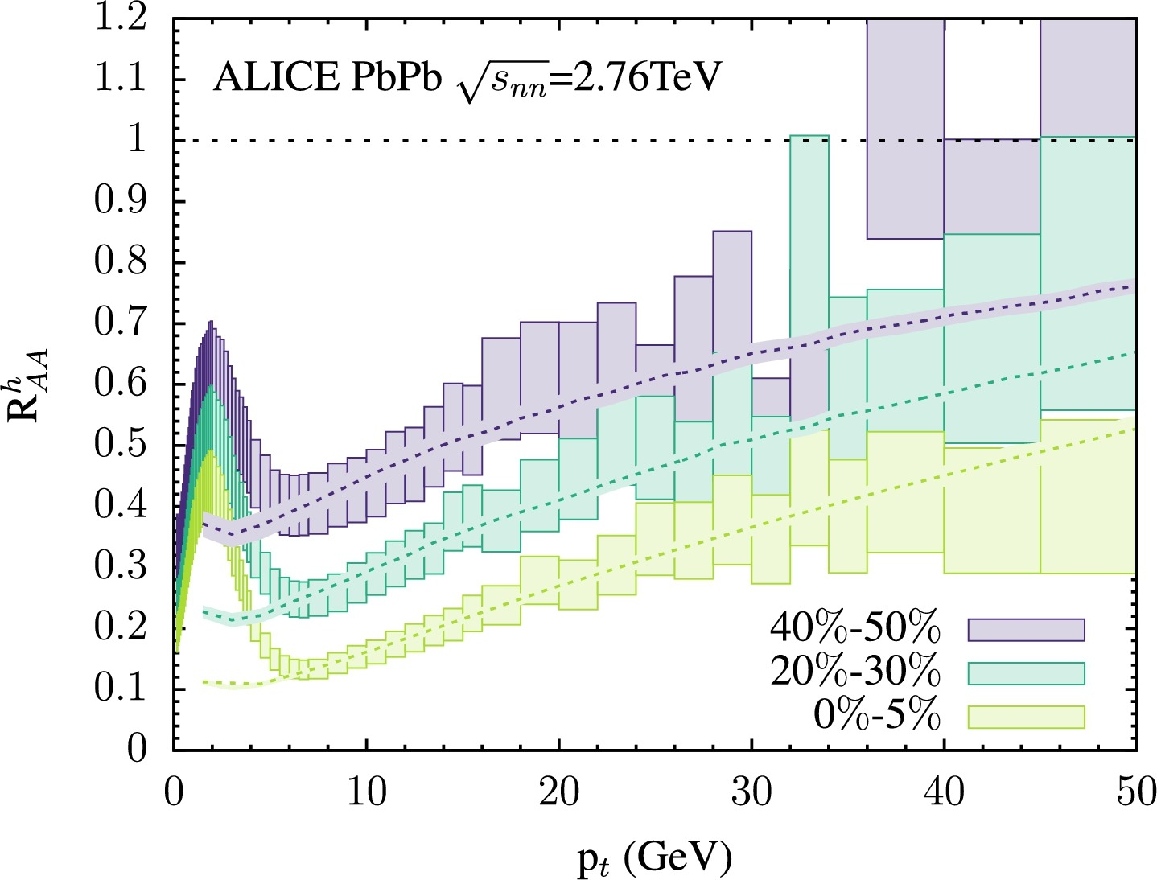
Theory vs. ALICE data
Nature Physics 15, pages 1113–1117 (2019)
Phys. Rev. C 98, 064901 (2018)
Phys. Rev. C 93, 024907 (2016)
Physics Letters B 816, 136251 (2021)

Slide 14
Transport properties
Using the D-meson v₂ and R_{AA} measurements
Strongly coupled perfect fluid
Using R_{AA} and v_{n} for light and charmed hadrons at high-p_{T}.
Using measurements of anisotropic flow and spectra by ALICE
The ranges on the right of the plots represent 90% posterior intervals from the Bayesian analyses.

Slide 15
Summary (selected)
How does the QGP affect the formation of hadrons?
Statistical hadronization models describe the yields of various light-flavour and heavy-flavour hadron over many orders of magnitude.
The chemical freeze-out temperature of about 156 MeV ~ deconfinement temperature, suggesting chemical equilibrium cannot be maintained easily after the QGP hadronizes.
Measurements of resonance yields and femtoscopic radii show that hadronic phase is prolonged, and the decoupling of particles is likely to be a continuous process, rather than a sudden kinetic freeze-out of all particle species at the same temperature.
What are the thermodynamic and global properties of the QGP at the LHC ?
LHC create conditions that very much exceed those needed to form the QGP.
The initial QGP temperature ~ 5 times higher than deconfinement temperature T_{pc} = 155–158 MeV.
Largest QGP energy densities ∼ 12 GeV/fm³ at the early time of 1 fm/c.
Volume at freeze-out is about 7000 fm³ and about twice higher than at top RHIC energy.
What are the hydrodynamic and transport properties of the QGP?
System is strongly-coupled at the scale of the QGP temperatures
Extracted shear viscosity over entropy density (η/s) values in the range 1/4π < η/s < 0.3.
The charm spatial-diffusion coefficient D_{s} in the range 1.5 < 2πD_{s}(T )T < 4.5 at T_{pc}. Evidence that charm quarks couple strongly with the QGP at low momenta.
Exciting set of upgrades in place and planned - stay tuned to exciting results from ALICE.

Slide 16
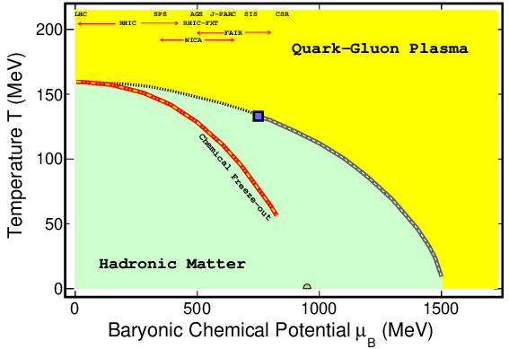
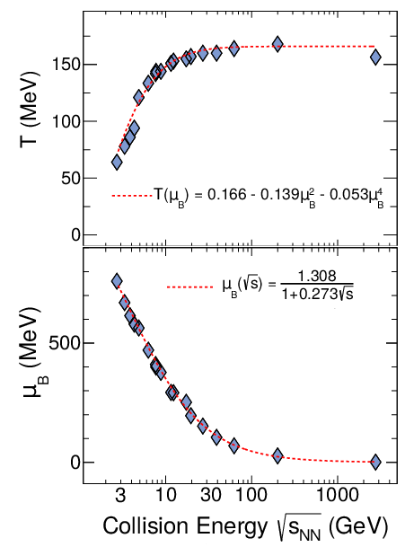
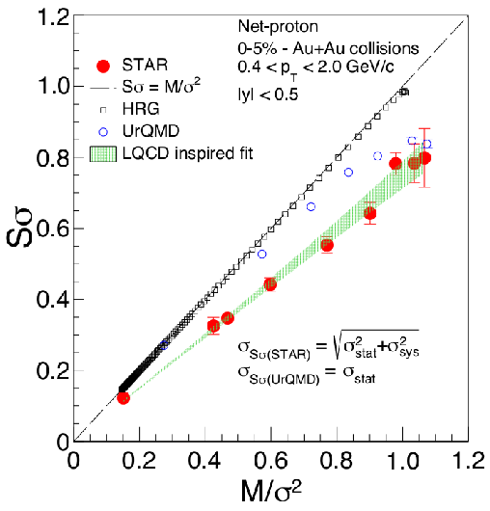
QCD phase diagram
Known (Theory/Experiment)
Two distinct phases – quark-gluon degrees of freedom/hadronic d.o.f
Transition temperature at μ_{B} = 0 MeV
Small μ_{B} - crossover
Theory: LQCD, Thermal, transport, hydro etc.
Prog.Part.Nucl.Phys. 125 (2022) 103960
Relativistic heavy-ion collisions allows access to the phase diagram of QCD

Slide 17
Thermalization
ALICE: arXiv:2211.04384
Why address this topic ?
To establish quark-gluon plasma
To establish the QCD phase diagram
To understand several physics conclusions at Relativistic Heavy Ion Collisions
Ways to address the topic
Maximum entropy - dS/dt = 0 (Our system short lived) -- To show experimentally is challenging (impossible?)
Interactions among constituents saturate. (State in thermal equilibrium has no knowledge of past) -- Can we demonstrate this experimentally ?
Space-momentum distributions reach equilibrium value -- Can we access this experimentally ?
Mean yields have been successfully explained by thermal models. But that is not the full distribution.
Phys.Lett.B 829 (2022) 137021

Slide 18
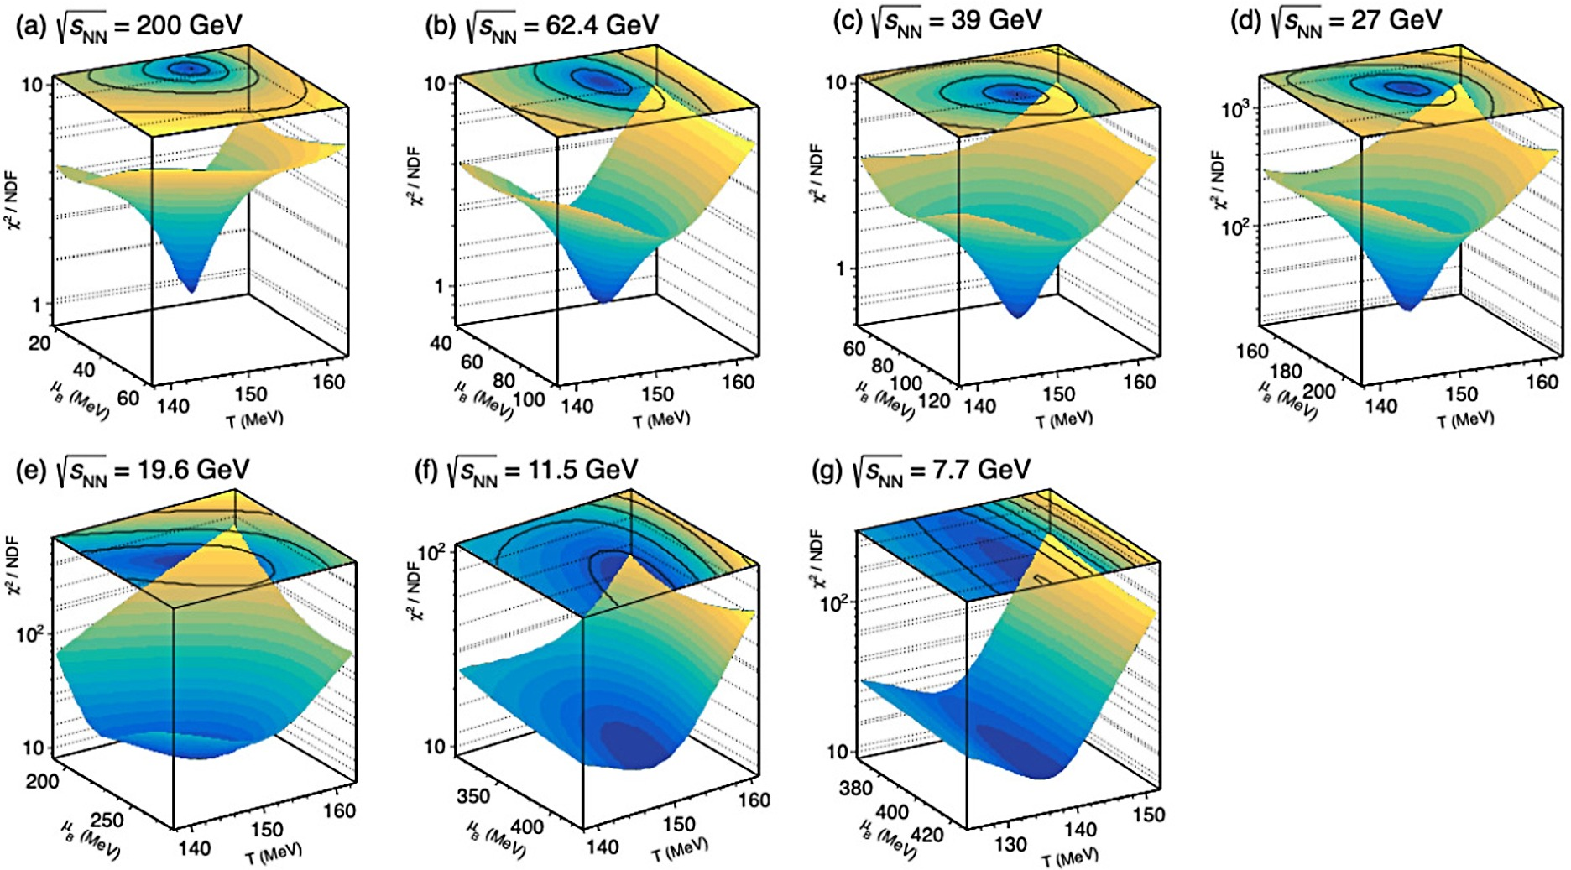
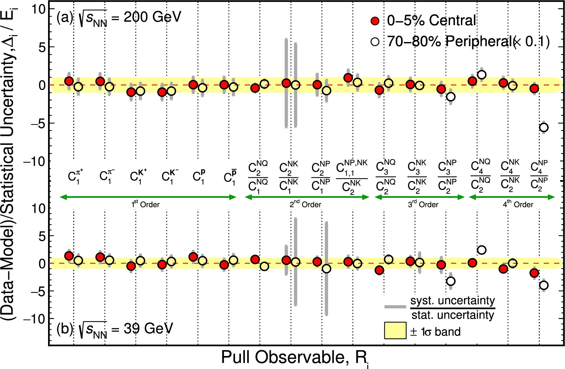
Higher moments and thermal model
Measurements in central collisions agrees with thermal model
Peripheral collisions do not.
Fits to moments of multiplicity distributions

Slide 19
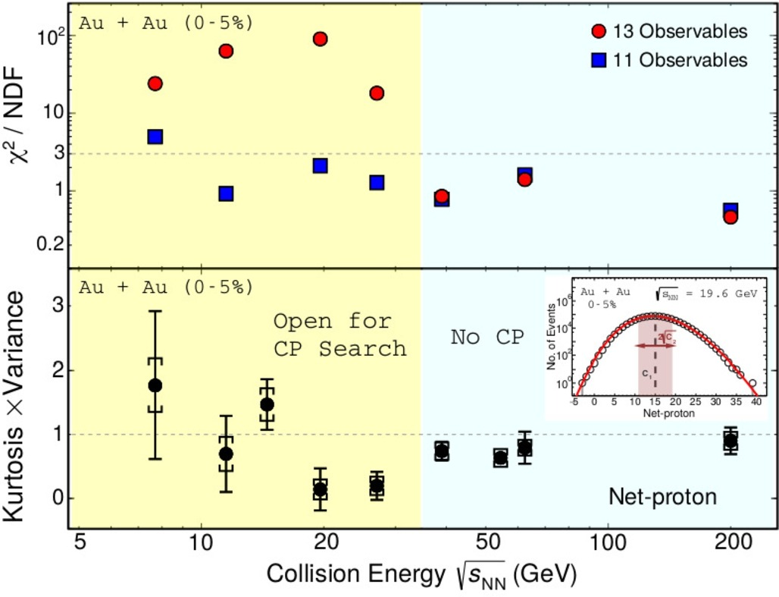
Higher moments and thermal model
Temperature versus Baryonic chemical potential
Favors a thermal system for collision energies > 30 GeV
Future: (1) Try canonical approach specially at lower collision energies. (2) Fixed target energies and (3) Try the approach in multiplicity dependent proton-proton collisions

Slide 20

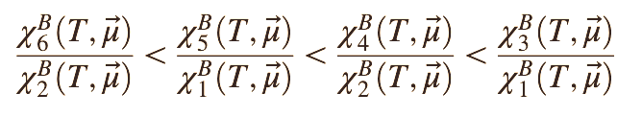
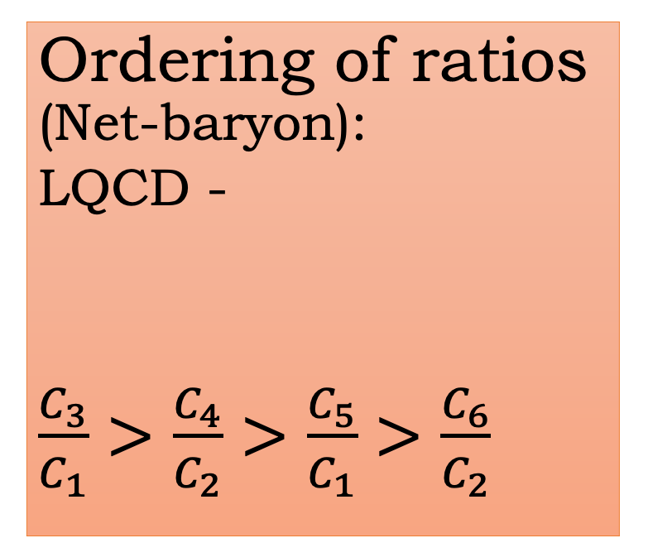
QCD thermodynamics
Measurements
Ordering of ratios (Net-baryon):
LQCD -
$\frac{C_{3}}{C_{1}}>\frac{C_{4}}{C_{2}}>\frac{C_{5}}{C_{1}}>\frac{C_{6}}{C_{2}}$
Ordering of ratios as per QCD thermodynamics observed for collision energies > 7 GeV
Reverse ordering observed for collision energy = 3.0 GeV.
STAR: PRL 130 , 82301 (2023)
STAR: PRL128, 202303 (2022)
STAR: PRL 127, 262301 (2021)
STAR: PRL 126, 092301 (2021)
STAR: PRC 104, 024902 (2021)
Susceptibility ratio ordering
PHYS. REV. D 101, 074502 (2020)

Slide 21
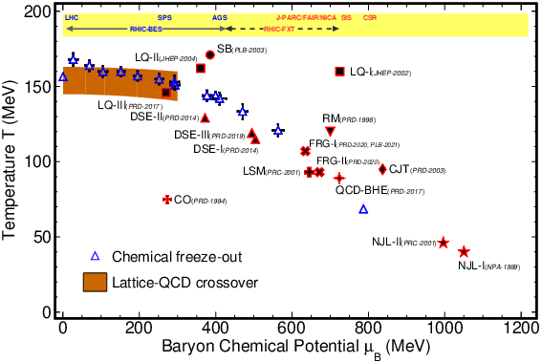
QCD critical point
Landmark point on the QCD phase diagram
If present beyond μ_{B} = 200 MeV

Slide 22
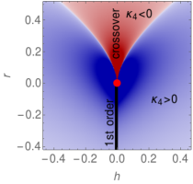
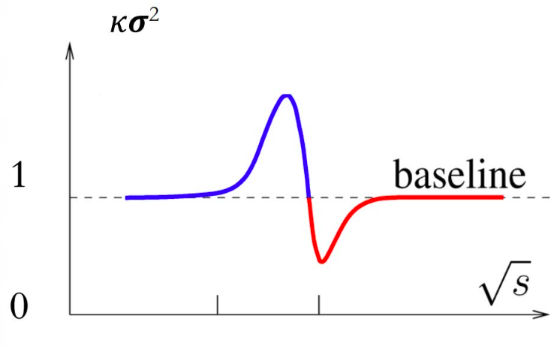
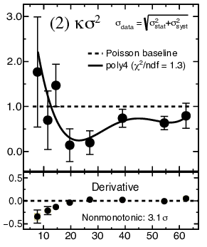
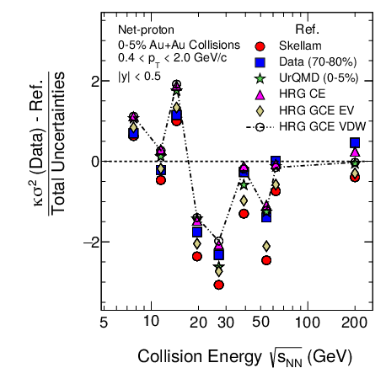
QCD critical point search
Beam energy scan phase - I
Collision energy (GeV)
M. A. Stephanov, Phys.Rev.Lett. 107 (2011) 052301
Expected signature
Measurements
Deviations from baseline
HADES: PRC 102,024914(20)
HRG CE: P. B Munzinger et al, NPA1008, 122141(2021)
STAR: PRL 130 , 82301 (2023)
STAR: PRL128, 202303 (2022)
STAR: PRL 127, 262301 (2021)
STAR: PRL 126, 092301 (2021)
STAR: PRC 104, 024902 (2021)

Slide 23
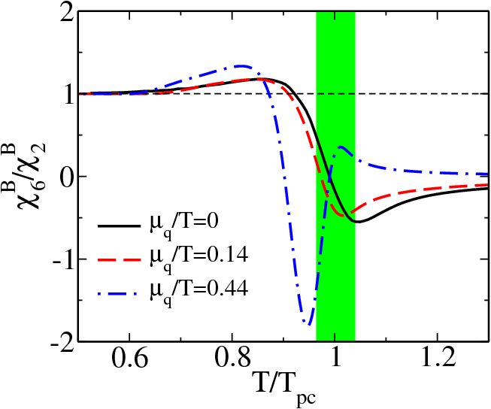
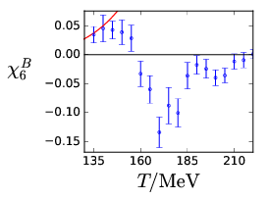
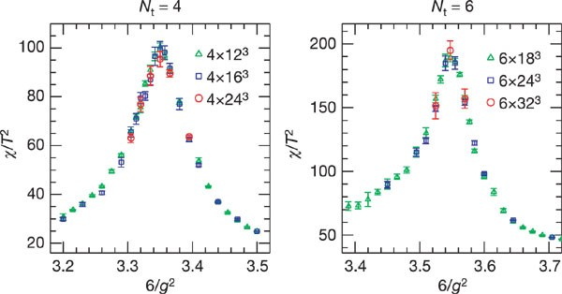
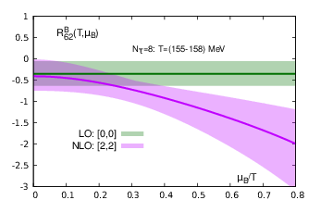
Crossover at μ_{B} = 0 MeV
Eur. Phys. J. C 71 1694 (2011)
JHEP 10 (2018) 205
Nature 443 (2006) 675-678
PHYSICAL REVIEW D 101, 074502 (2020)
χ₆/χ₂ or C₆/C₂ < 0

Slide 24
Search for direct experimental evidence of crossover
Sixth order cumulant ratios sign consistent with lattice QCD calculation with a crossover
Except for Au+Au collisions at 3 GeV and proton-proton collisions at 200 GeV
Lower collision energies have large statistical uncertainties
|y| < 0.5, 0.4 < p_{T} < 2.0 GeV/c
Charged Particle Multiplicity
STAR: PRL 130 , 82301 (2023)
STAR: PRL 127, 262301 (2021)
HRG CE: P. B Munzinger et al, NPA1008, 122141(2021)
H.-S. Ko, STAR Collaboration, QM22

Slide 25


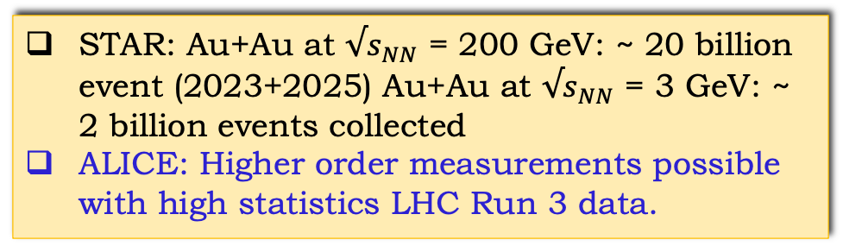
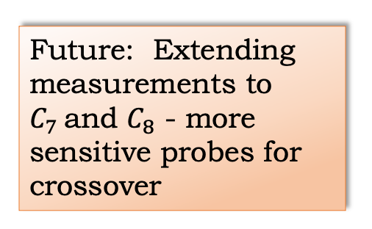
Going to still higher moments
A. Pandav, STAR Collaboration, SQM22
$$C_{6}$$
Future: Extending measurements to $C_{7}$and $C_{8}$ - more sensitive probes for crossover
0-40%
STAR Preliminary
$$C_{8}$$
STAR: Au+Au at $√s_{NN}$ = 200 GeV: ~ 20 billion event (2023+2025) Au+Au at $√s_{NN}$ = 3 GeV: ~ 2 billion events collected
ALICE: Higher order measurements possible with high statistics LHC Run 3 data.
HotQCD: PRD101, 074502 (2020),
S. Borsanyi et al, JHEP10 (2018) 205, B. Friman et al,EPJC71, 1694(2011)
STAR BUR Run22, STAR note 0773, ALICE: arXiv1812.06772

Slide 26
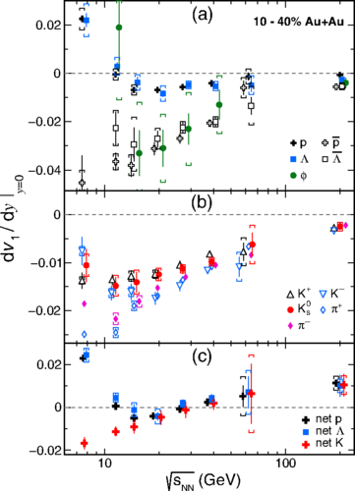
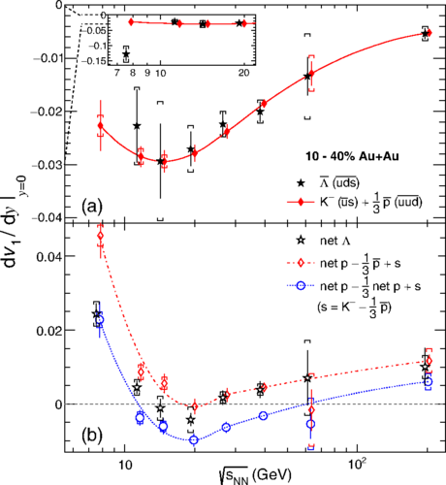
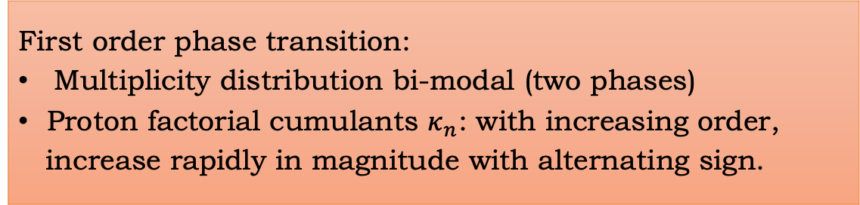
Search for signals of first order phase transition
First order phase transition:
Multiplicity distribution bi-modal (two phases)
Proton factorial cumulants $κ_{n}$: with increasing order,
increase rapidly in magnitude with alternating sign.
A. Bzdak and V. Koch,
PRC100, 051902(R) (2019)
Phys.Rev.Lett. 120 (2018) 6, 062301
Proper theory calculations with 1st order phase transition needed for interpretation the data

Slide 27
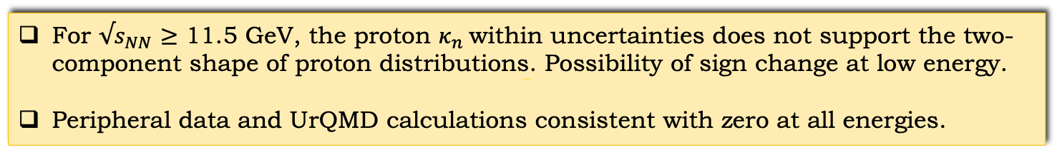
Search for 1st order phase transition signals
For $√s_{NN}$ $≥$ 11.5 GeV, the proton $κ_{n}$within uncertainties does not support the two-component shape of proton distributions. Possibility of sign change at low energy.
Peripheral data and UrQMD calculations consistent with zero at all energies.
STAR: PRL 130 , 82301 (2023)
STAR: PRL128, 202303 (2022)
STAR: PRL 127, 262301 (2021)
STAR: PRL 126, 092301 (2021)
STAR: PRC 104, 024902 (2021)

Slide 28
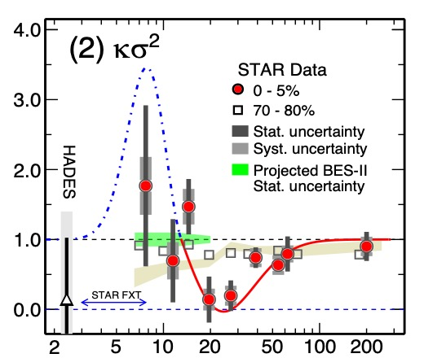
Summary – QCD phase structure
Programs to carry out systematic study of the phase structure of QCD phase diagram through relativistic heavy ion collisions underway
Higher moments measurements seem to follow
QCD thermodynamics except at 3 GeV
Experimental evidences of signatures related
to critical point observed at a 3 σ level
Lattice QCD clearly shows cross over at μ_{B} = 0.
Experimental indications of cross over at μ_{B} =
20 MeV observed at < 2 σ level
Hints of change of equation of state at high μ_{B}
Need to continue the dedicated programs in the
high baryon density regime to unfold the QCD
phase diagram. This includes looking for Moat
Quarkyonic matter regimes
Experiments: STAR@RHIC BES-II, CBM@FAIR,
NICA@JNIR, SHINE@CERN-SPS, J-PARC-HI
and CEE-HIAF complementary to each other

Slide 29
Thanks
Acknowledgement: All members of the STAR Collaboration, ALICE Collaboration, CBM Collaboration, D. Mishra, S. Bass, Kenji Fukushima, R. Pisarski, F. Karsch, S. Gupta, R. Gavai, A Jaiswal, V. Roy, N. Haque, S. Chatterjee, M. Stephanov and Krishna Rajagopal

