Slide 1
ALICE3 - Possible contribution from India
Subhasis Chattopadhyay
Variable Energy Cyclotron Centre
Kolkata, India

Slide 2
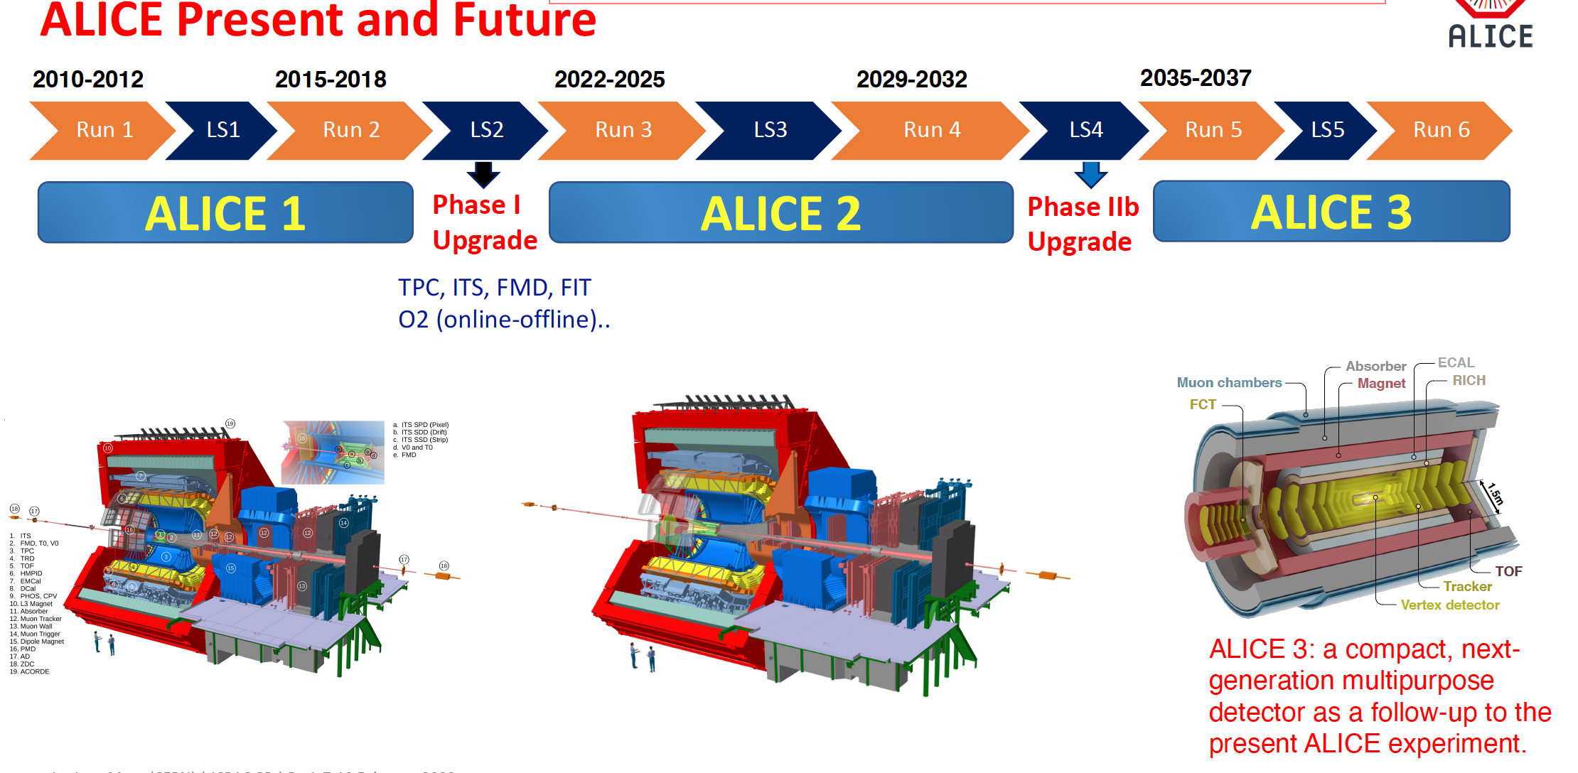

Slide 3
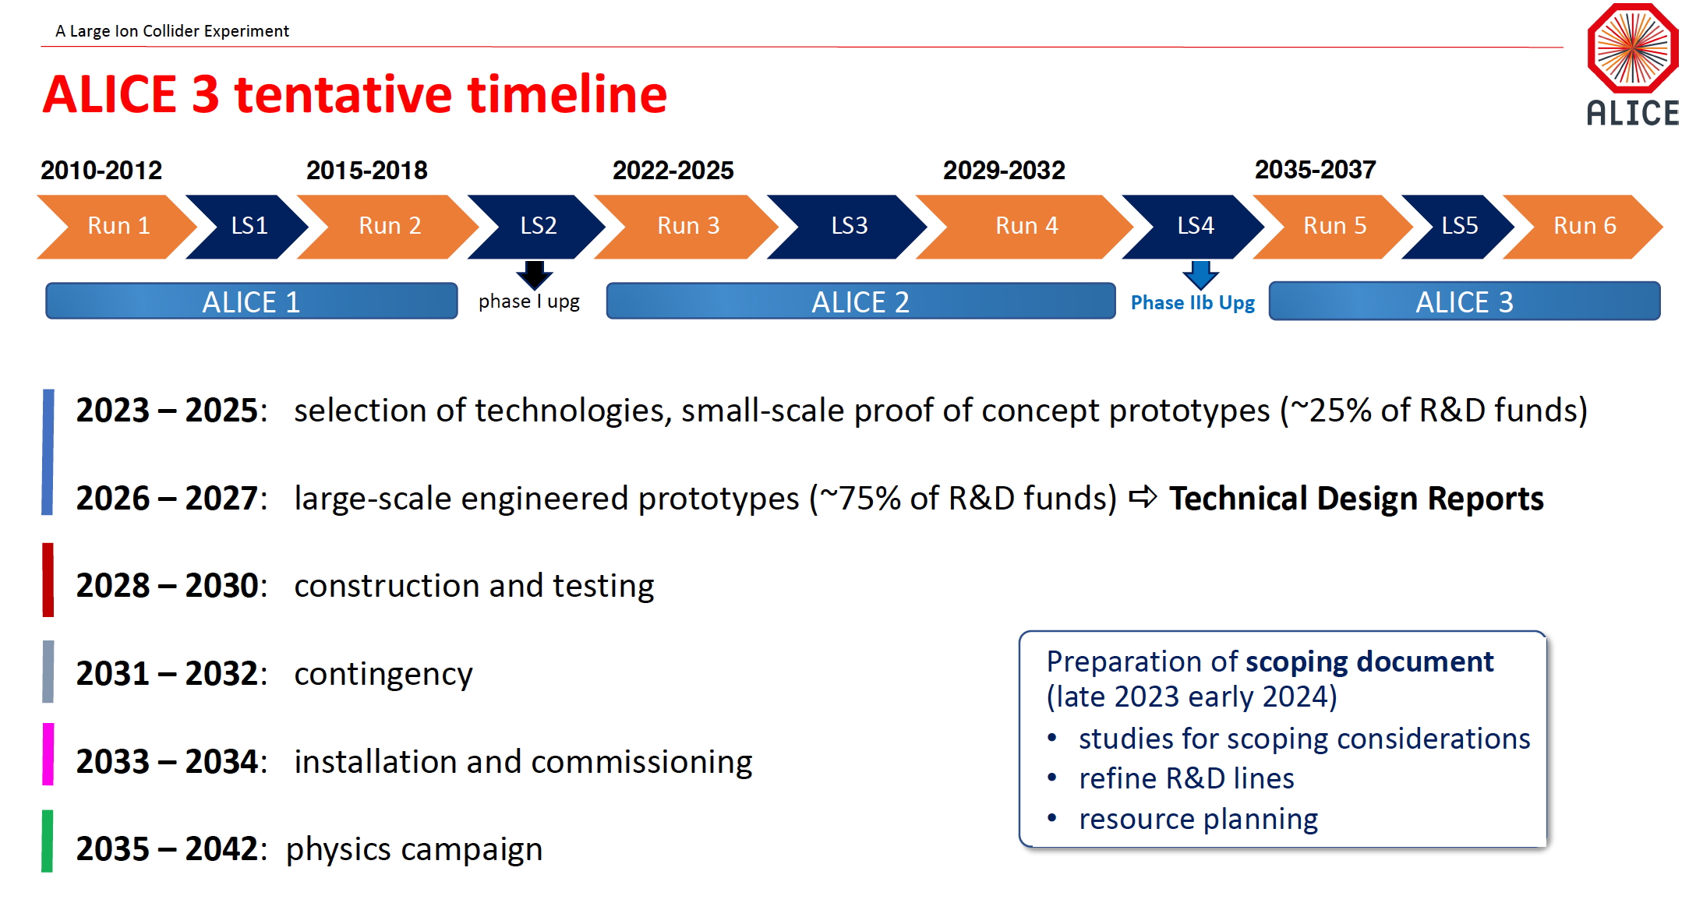

Slide 4
Why do you need to have a completely new detector after 25 years of operation and an upgrade?
What have we learnt so far and what’s missing?
Key scientific questions addressed so far in ALICE
What are the thermodynamic and global properties of the QGP produced at the LHC?
At LHC energy density and effective temperature are high for QGP formation
2. What are the hydrodynamic and transport properties of the QGP?
Hydrodynamics collective motion is developed with QGP EOS, studied the temperature dependence and the “perfectness” of the fluid ,details for the first time using heavy-flavours (do they follow collectivity?), polarization studies add to the hydro properties.
3. How does the QGP affect the formation of hadrons?
Statistical model of hadronization holds at LHC for thermal particles (protons??), fragmentation and recombination play significant roles (even for heavy flavours?)
4. How does the QGP affect the propagation of energetic partons?
Parton energy loss is established for the first time via direct Jet measurement, jet structures describes lost energy, establishes dense medium, spatial diffusion constants (Ds) for favours strongly coupled QGP in the heavy flavour sector, dead cone effect observed directly by mass dependence energy loss in heavy flavours.
5. How does deconfinement in the QGP affect the QCD force?
Apart from suppression (affecting the QCD force), regeneration of quarkonia from free quarks establishes deconfinement, for the first time at LHC, bottomonia plays a crucial role in pinpointing the effects of sequential suppression.
6. Can the QGP lead to discovery of novel QCD effects?
CME and CMW investigated, inconclusive at LHC due to large background.
7. What are the limits of QGP formation?
High multiplicity pp and pAu collisions show similar results at LHC in the soft sector as in PbPb, QGP in small systems??
8. What is the nature of the initial state of heavy-ion collisions? Glauber and CGC are the competing effects, important for concluding the medium properties
9. What is the nature of hadron–hadron interactions?
10. Can ALICE elucidate specific aspects of perturbative QCD and of related “long distance” QCD interactions?
2211.04384

Slide 5
Redefining the questions after decades of experimentation
– What is the nature of interactions between high-energy quarks and gluons and the quark–gluon plasma? How do transport properties arise from first-principle quantum chromodynamics?
– Which mechanisms drive strongly-interacting matter towards equilibrium? To what extent
do quarks of different mass reach thermal equilibrium within the plasma? How do they
behave close to the diffusion regime?
– How do partons transition to hadrons as the quark–gluon plasma cools down? How does
this process differ from hadron formation in elementary collisions?
– What are the mechanisms for the restoration of chiral symmetry in the quark–gluon plasma?
2211.02491

Slide 6
Requirements of measurements even after Run3 and Run4 data taking
  – accurate measurements of charm and beauty hadrons, including their correlation over a wide rapidity range, to determine the interactions of heavy quarks of different mass in the quark–gluon plasma down to the thermal scale.
  – systematic measurements of multiply heavy-flavoured hadrons for which the production from the quark–gluon plasma is expected to be enhanced by orders of magnitude, providing sensitivity to how quarks combine into hadrons depending on their degree of thermalisation.
  – comprehensive data on the production and behaviour of the charmed exotic states in the quark–gluon plasma and their structure, for example by determining the strong interaction potential between hadrons from measurements of their momentum correlations.
  – high-precision, multi-differential measurements of electromagnetic radiation from the quark–gluon plasma to probe its early evolution and the restoration of chiral symmetry through the coupling of vector and axial-vector mesons.
  – measurements of net-quantum number fluctuations over a wide rapidity range to constrain the susceptibilities of the quark–gluon plasma and to test the realisation of a cross-over phase transition as predicted by lattice QCD.

Slide 7
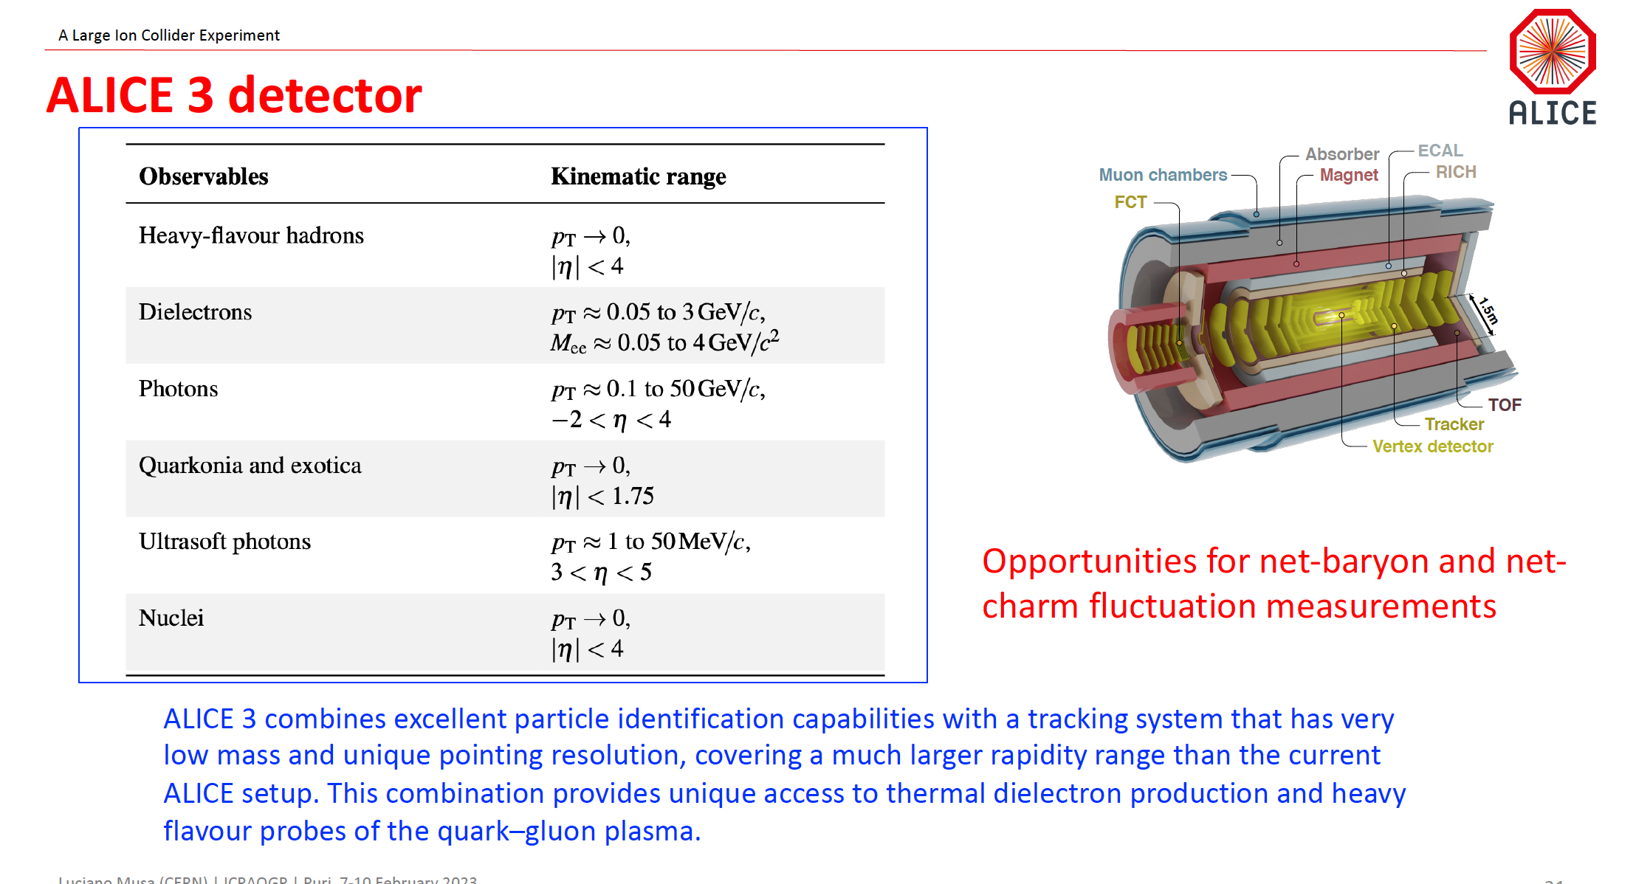

Slide 8


Slide 9
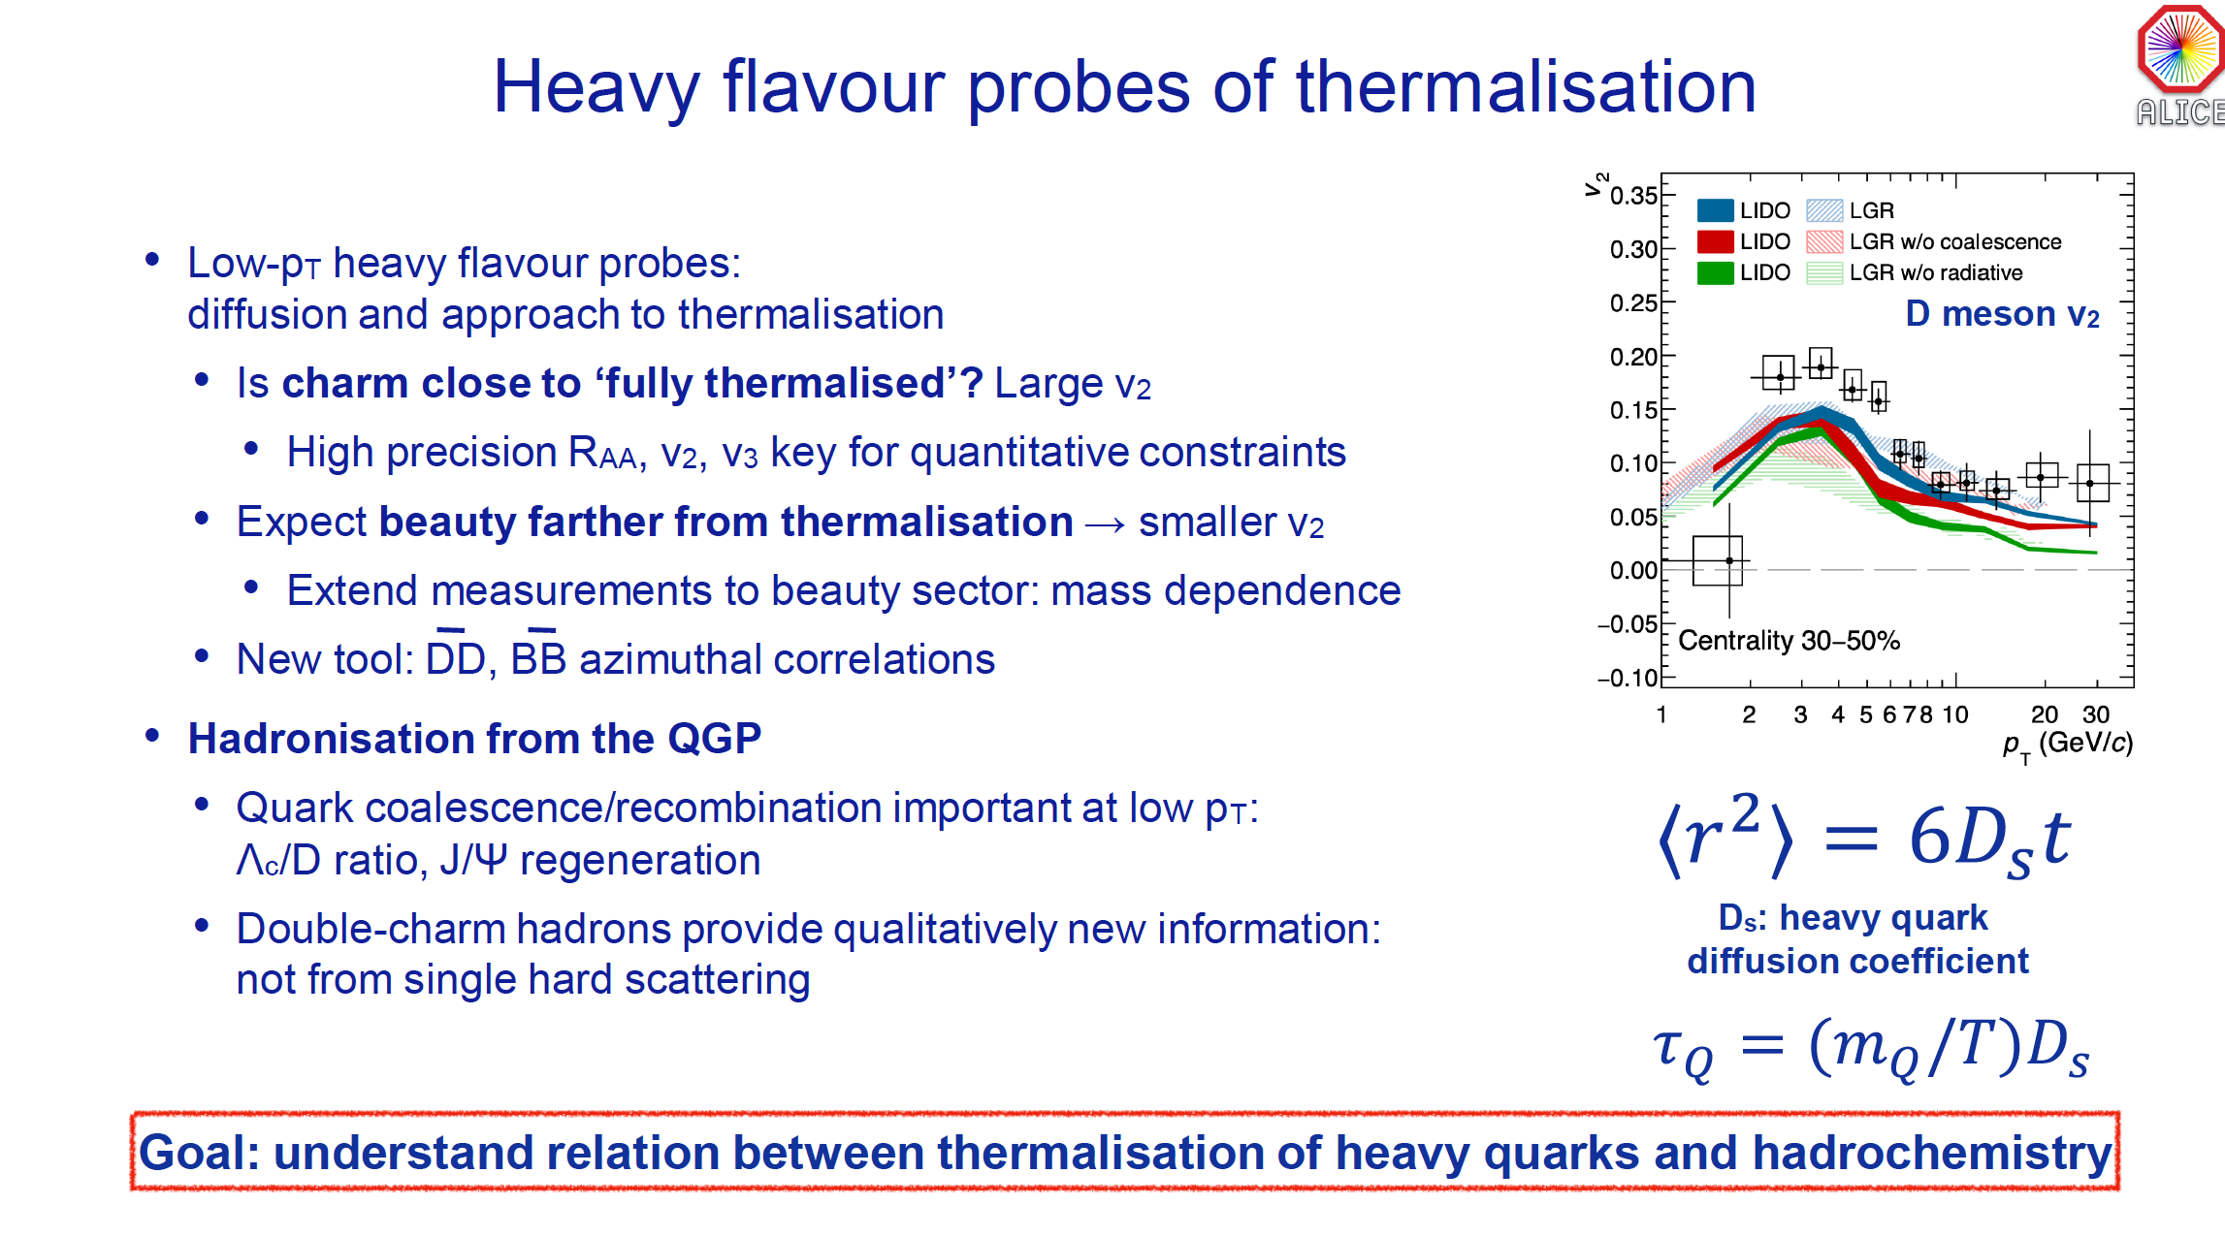

Slide 10
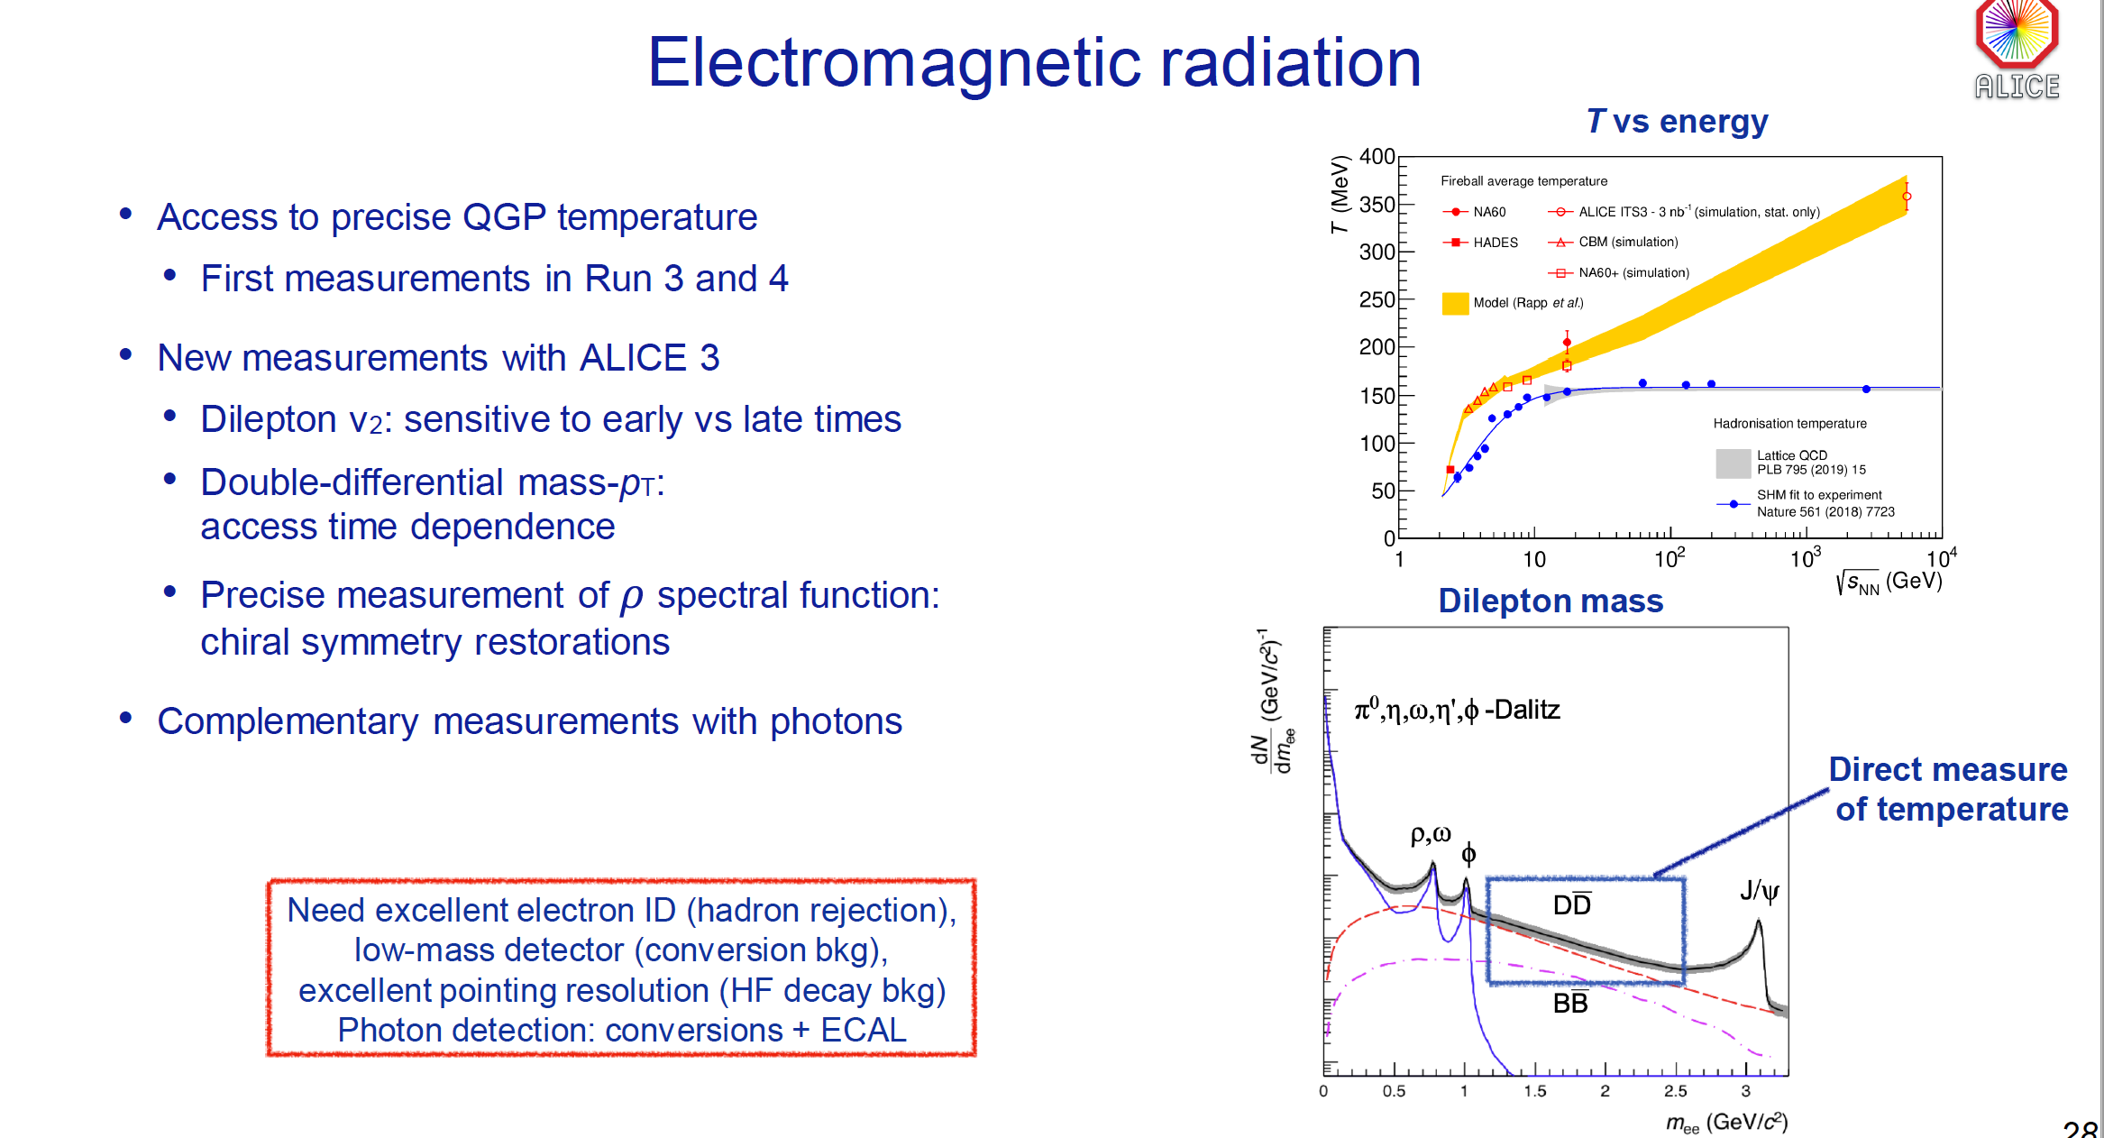

Slide 11
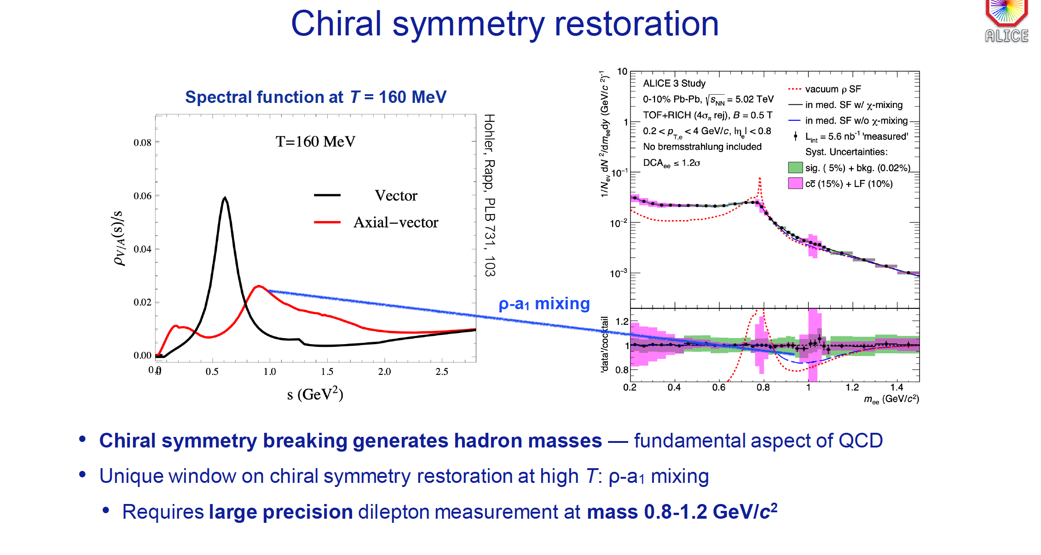

Slide 12
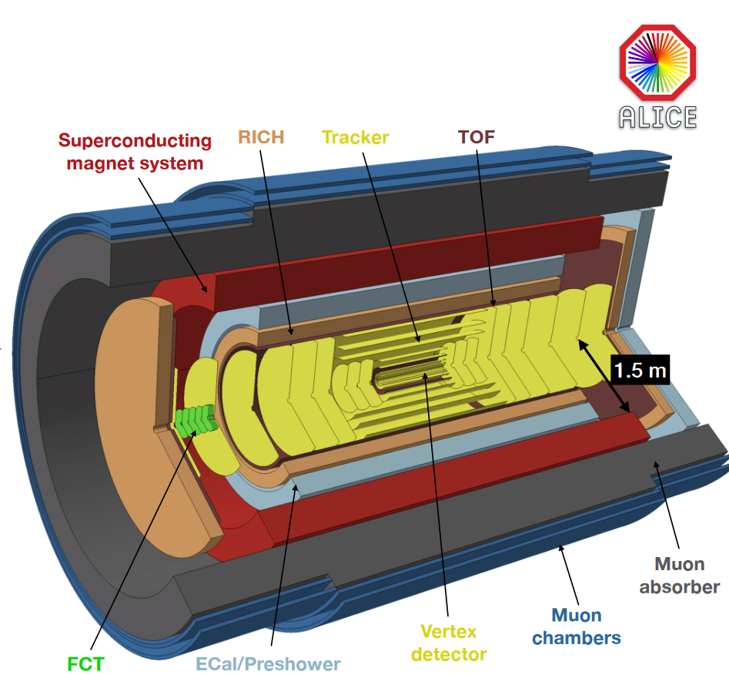
ALICE3
Mostly silicon based detector
Heavy-flavour hadrons (pT → 0, |η| < 4)
  vertexing (decay chain), tracking (inv. mass resolution) and hadron ID (background suppression)
Dielectrons (pT 0.1 - 3 GeV/c, Mee 0.1 - 4 GeV/c2)
  vertexing (HF background suppression), tracking (inv. mass resolution) and electron ID
Photons (100 MeV/c - 50 GeV/c, wide η range)
  electromagnetic calorimetry
Quarkonia and Exotica (pT → 0)
  muon ID
Ultrasoft photons (pT = 1 - 50 MeV/c)
  dedicated forward detector
Nuclei
  identification of z > 1 particles
key requirements:
  Tracking over large rapidity range
  Excellent vertexing
  Excellent particle identification
  High rate capability
Ref.: Jochen Klein (CERN) talk: https://indico.cern.ch/event/1086533/contributions/4567787/attachments/2327224/3969507/2021-10-18_ALICE3workshop_detector.pdf

Slide 13
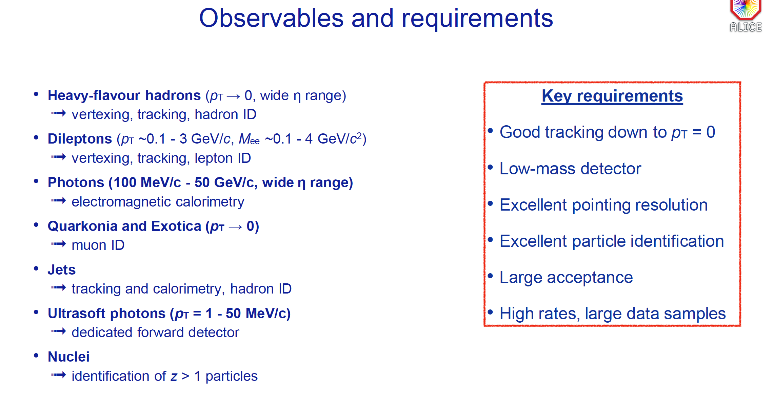

Slide 14
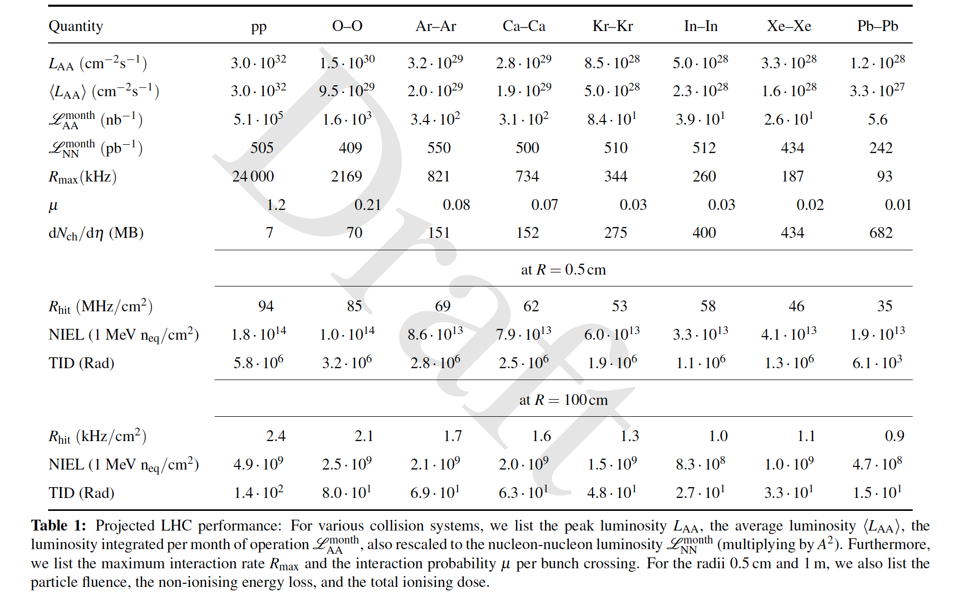

Slide 15
ALICE3 - Proposed detector technologies
Vertex: ALICE ITS3 type Si pixel sensor (superALPIDE) - 𝛔pos ~ 2.5 μm
Tracking: ALICE ITS2 type Si pixel sensor (ALPIDE) - 𝛔pos ~ 10 μm
Time of Flight: CMOS/LGAD/SPAD based - 𝛔t ~ 20 ps
RICH: Aerogel + SiPM - 𝛔𝛉 ~ 1.5 mrad
Muon system: RPC or plastic scintillator + SiPM (required time resolution??)
EMCAL: PbWO4 crystal + SiPM - high energy resolution
Ultrasoft photon detection: ALICE ITS2 type Si pixel sensor (ALPIDE)

Slide 16
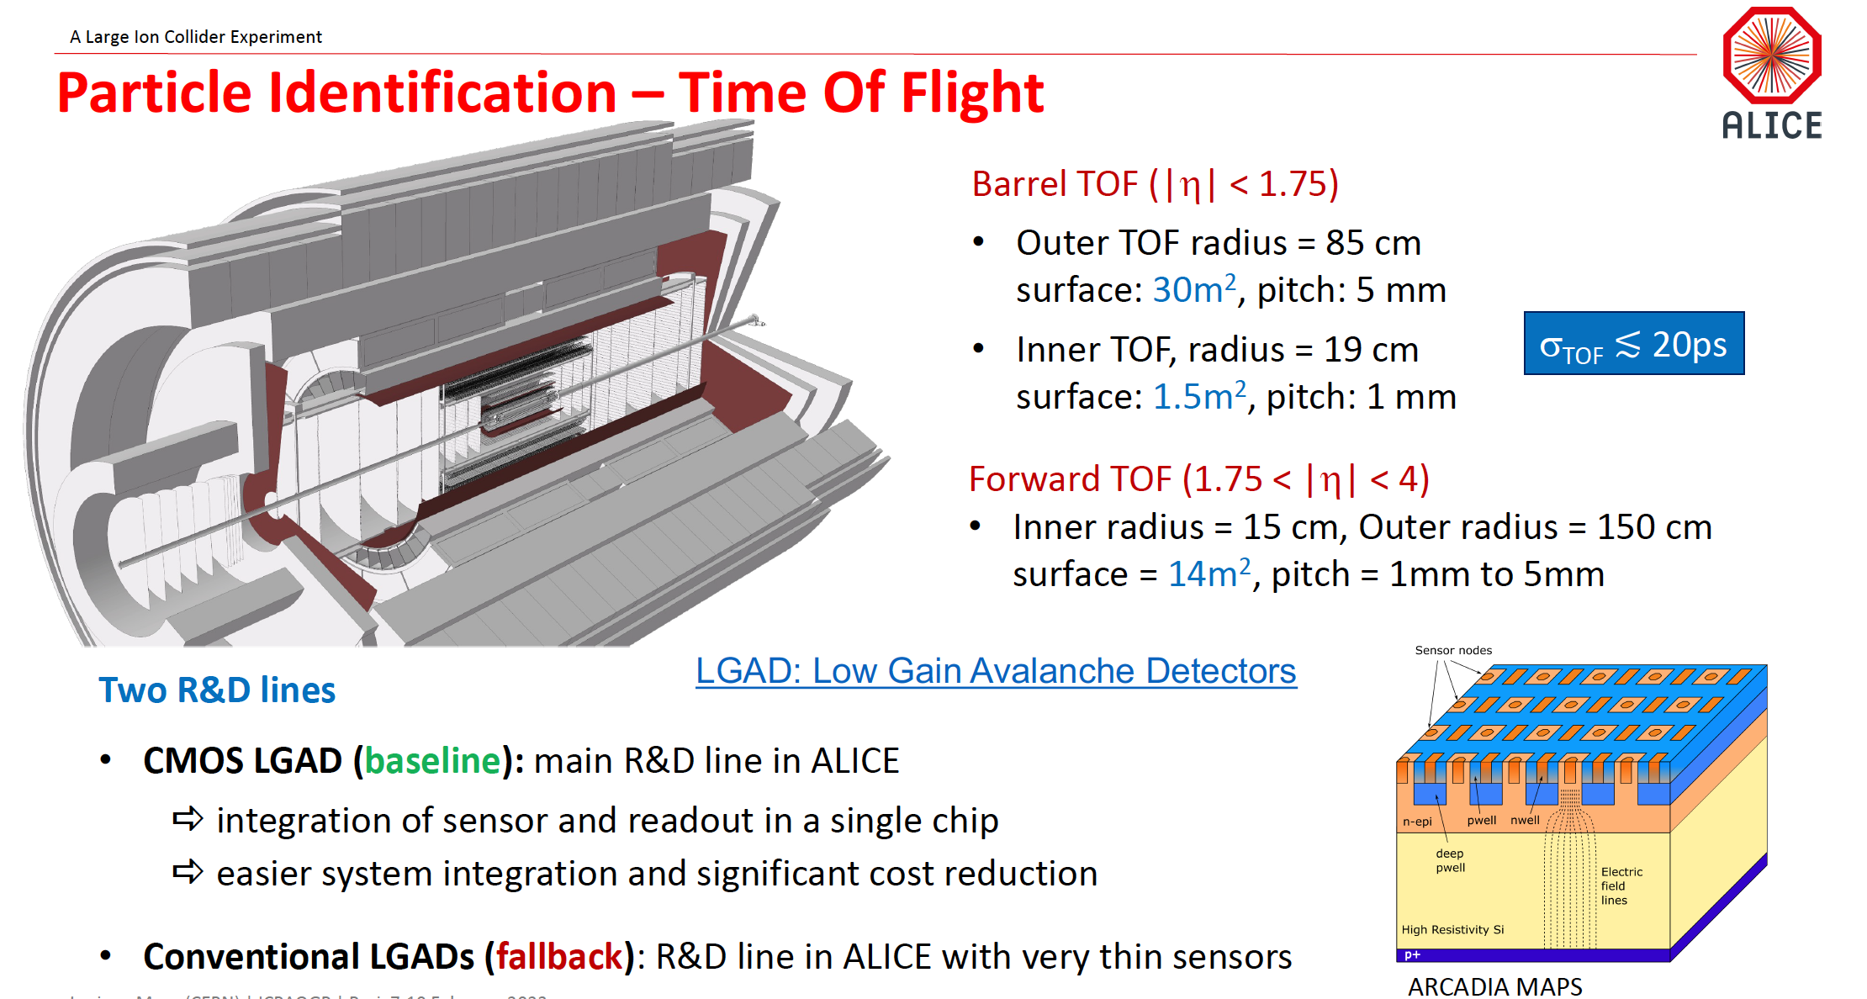

Slide 17
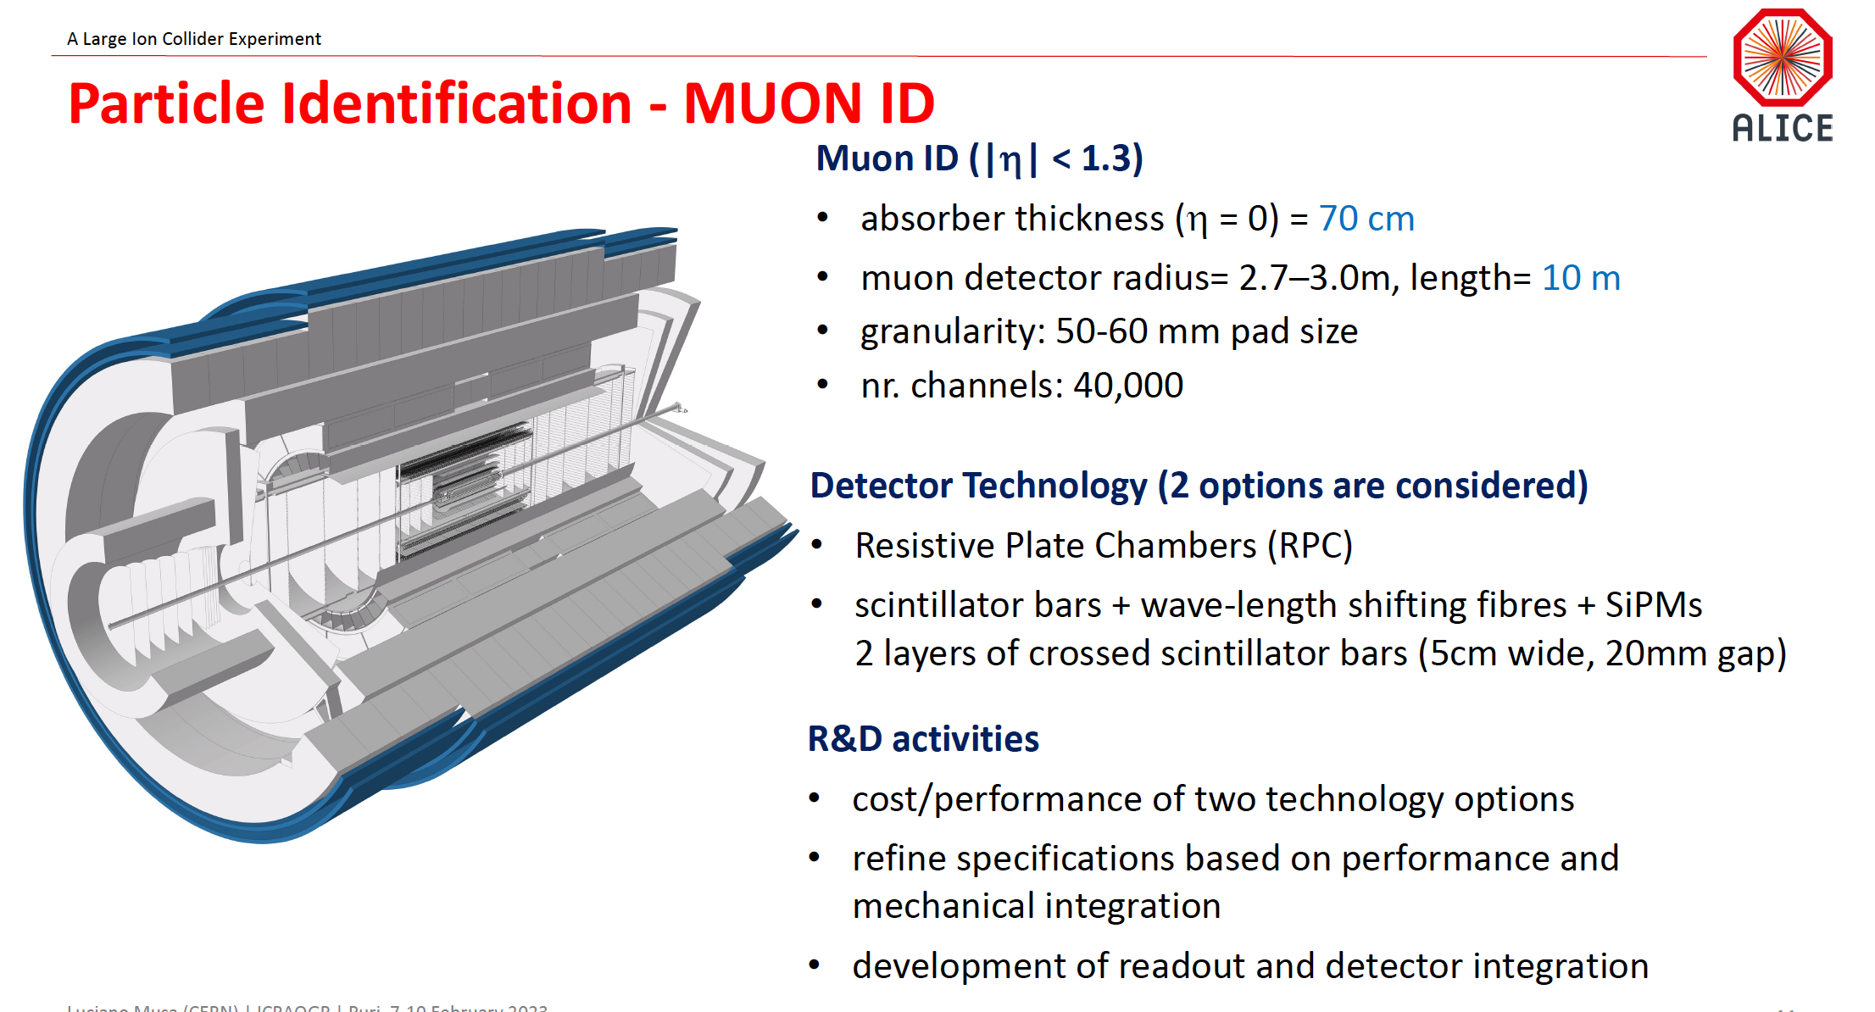

Slide 18
Muon detection system
ALICE3 solutions: Resistive Plate Chambers (RPC), Plastic scintillator coupled to SiPM
The moderate charged particle rate of 3 Hz/cm²
Granularity of ~ 5x5 cm² pad size
Readout channels ∼ 40k
Option – I (RPC)
  Well established and proven system - good background in RPC in Indian group
  RPC operated in avalanche or streamer mode – scope for R&D on eco- friendly gas mixtures
  RPC with 3 mm thick electrodes (glass, Bakelite or new material) – 10¹² ohm.cm bulk resistivity would suffice
Option – II (Plastic scintillator + SiPM)
  5 cm wide scintillator strips placed orthogonally in 2 layers (20 cm gap between layers)
  Indigenous SiPM based readout
  Only caveat is that the scintillators and WLS fibers may have to be commercially purchased
  Explore possibilities to produce SiPMs in Indian Foundries (SCL, BEL, SITAR etc.)

Slide 19
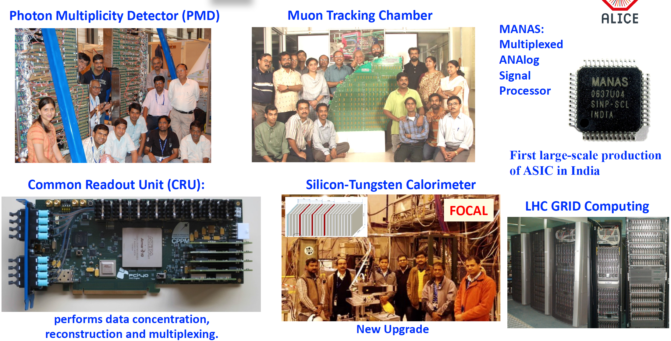

Slide 20
Over the years, gathered experience on
Gaseous detectors
Scintillators
Electronics
(matured to take up any tasks)
Started working on,
Si-pad in a big way through FOCAL (industries are being developed for the tasks)
(discussed in detail earlier)
ALICE3 subsystems with potential gaseous detectors:
Muon system
TOF(??

Slide 21
Major ongoing RPC development activities in Indian labs
India-based neutrino Observatory
51 kton muon detector
1.9 m x 1.9 m x 2.4 cm single-gap chamber
30,000 modules
R&D in several ALICE institutes
(VECC, SINP, NISER, BI)
700psec time resolution (glass electrode)
800 pico-sec (bakelite electrode)
Indigenous developments of
HV, LV, readout boards
Industries developed for mass production
Electrodes
Skin printing
pickup strip fabrication
High-rate RPC for CBM muon system
Resistivity ~ 10^10 Ohm-cm
Sector-shaped
Projective Pad readout (pad size varies from 1cm to 5 cm)
R&D on readout:
NINO
PADI
STS/MUCH XYTER (CBM ASIC)
Tested at GIF++, SIS18 upto 10 KHz
Several MRPC developed for different applications

Slide 22
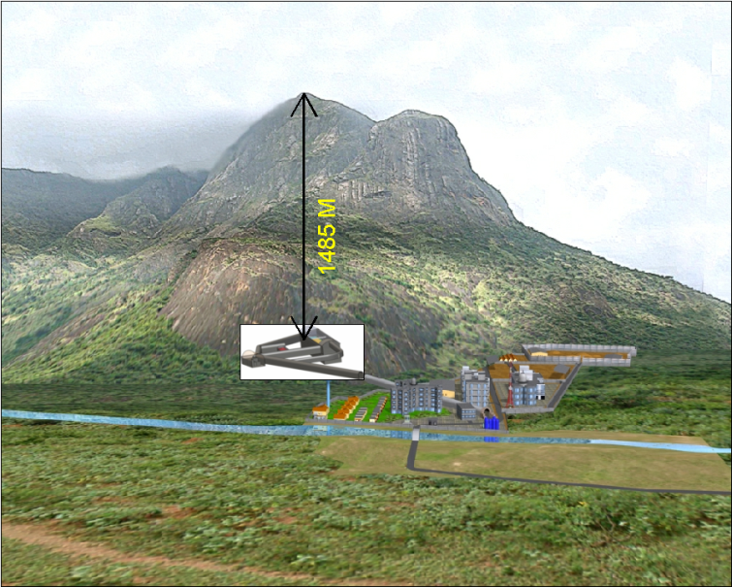
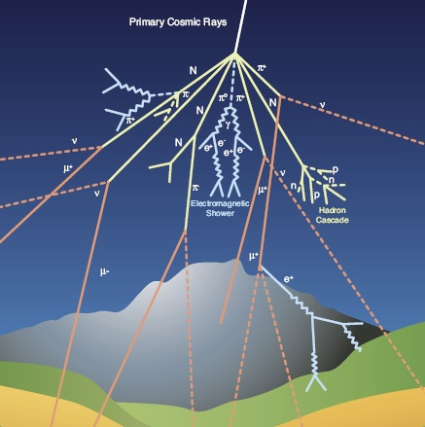
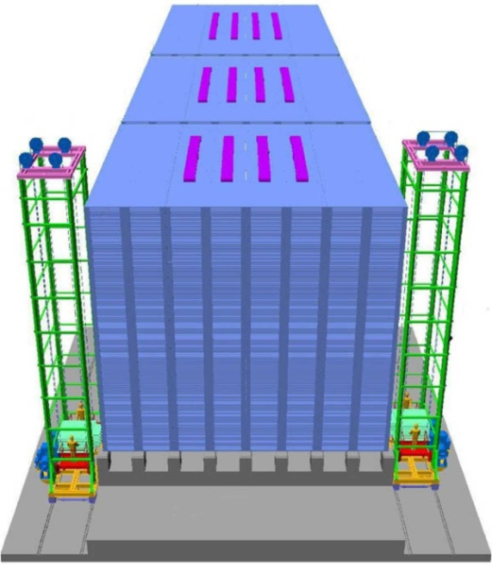
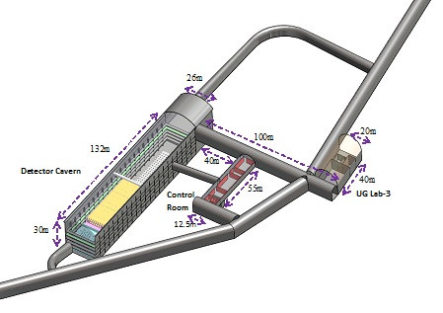
India-based neutrino Observatory (INO)-ICAL Project
All major facilities are inside an underground cavern
Atmospheric neutrino
The magneised ICAL detector will study neutrinos naturally produced in Earth's atmosphere.
Underground complex
50Kton ICAL neutrino Detector

Slide 23
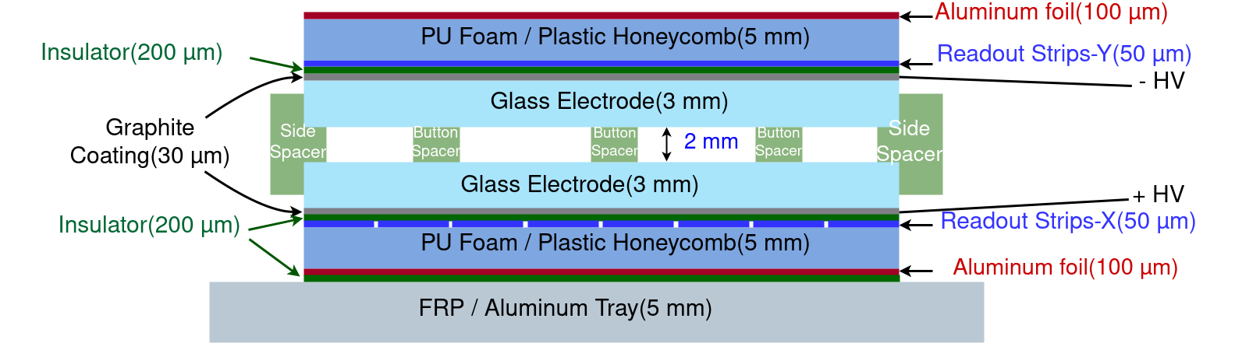
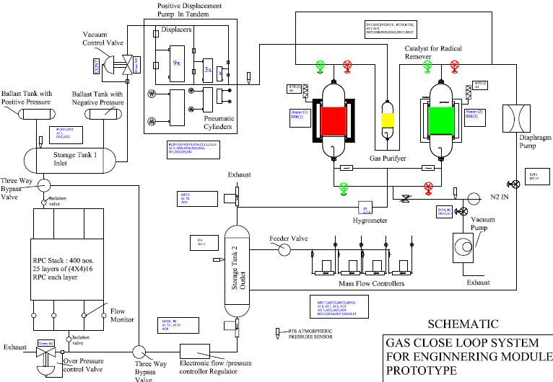
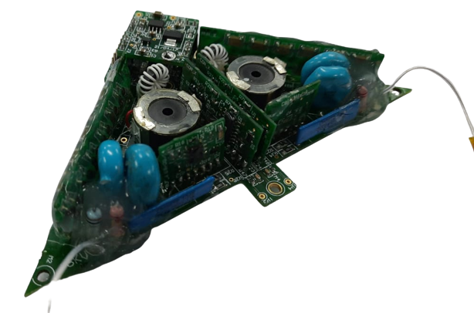
RPC R&D : The main detector component
HV supply. Output voltage range is 0 to ±6KV and upto 2μA current. Developed by BARC
Close loop gas recirculation system

Slide 24
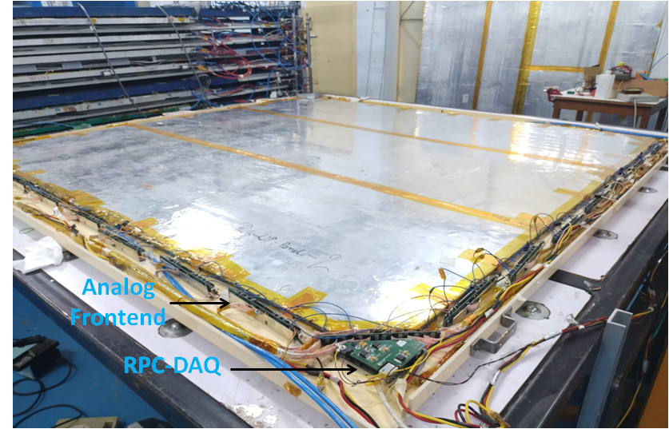
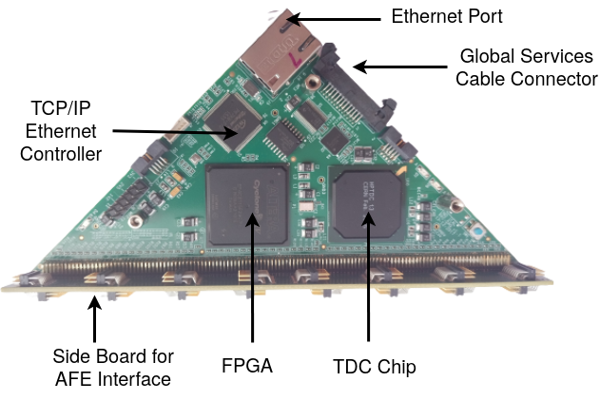
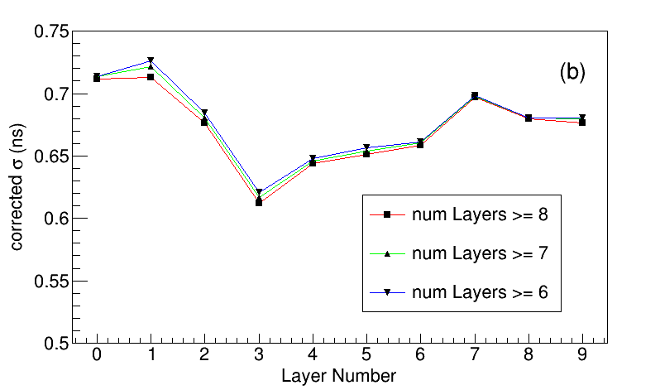
Fully assembled glass-RPC module (2m x 2m) (TIFR)

Slide 25
Oil-free large-size bakelite RPC (VECC)
Gas gap specifications:-
Dimension – 245 cm X 125 cm X 0.2 cm.
4 gas inputs
4 gas outputs

Slide 26
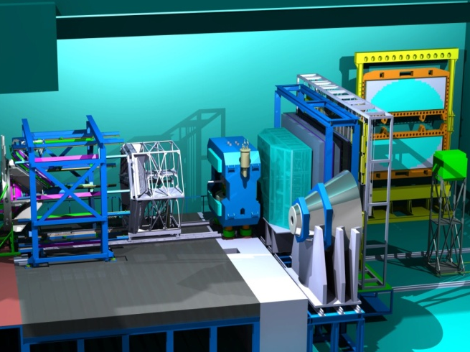
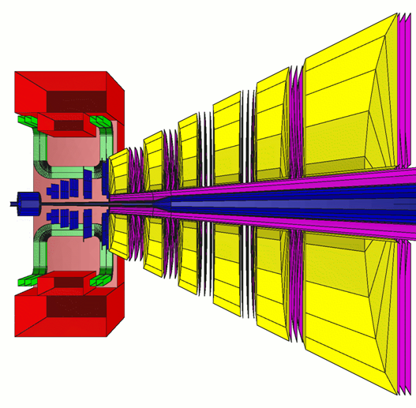
The Compressed Baryonic Matter Experiment
1st two stations: GEM, upto 400 KHz/cm^2 (SIS100)
3rd, 4th statios: RPC, upto 30 KHz/cm^2 (SIS100)
10 MHz interaction rate
STSXYTER readout
Muon Detection System
(parking position)

Slide 27
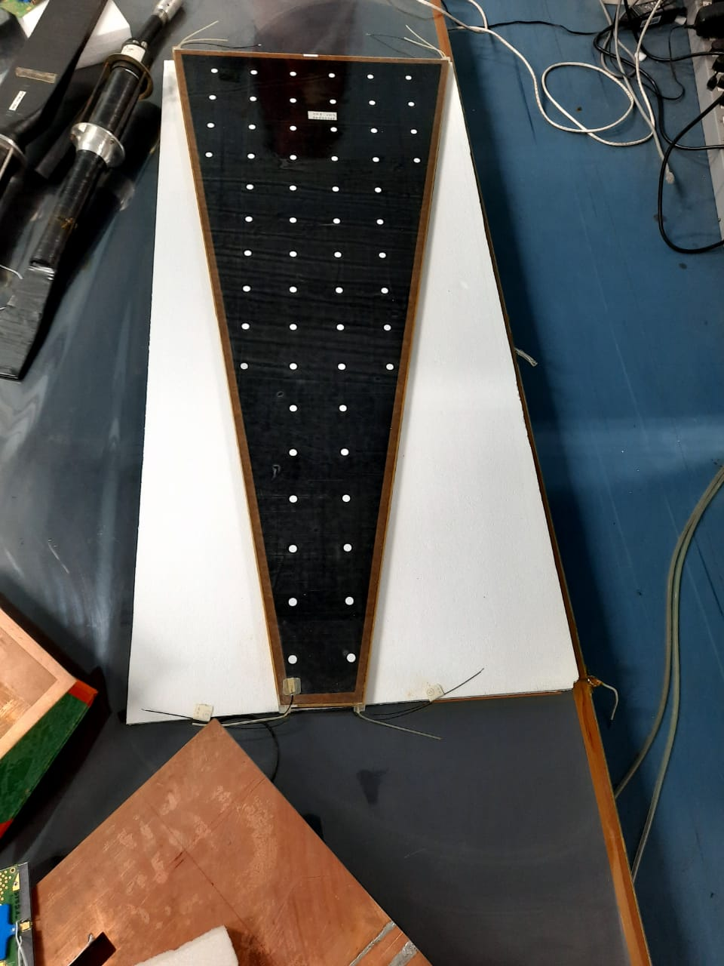
Real size bakelite-RPC for CBM-MuCh
Bulk resistivity of the electrodes of the
RPC is ~( 3 x 10⁹ – 1 x 10¹⁰ )Ω*cm
Each electrode thickness is 1.2 mm
(down by a factor of 1.7).
Gas gap is 2.0 mm (for one chamber)
1.0 mm (for another chamber).
100.26 mm X 509.8 mm X 1179.21 mm
1
Notes:
27

Slide 28
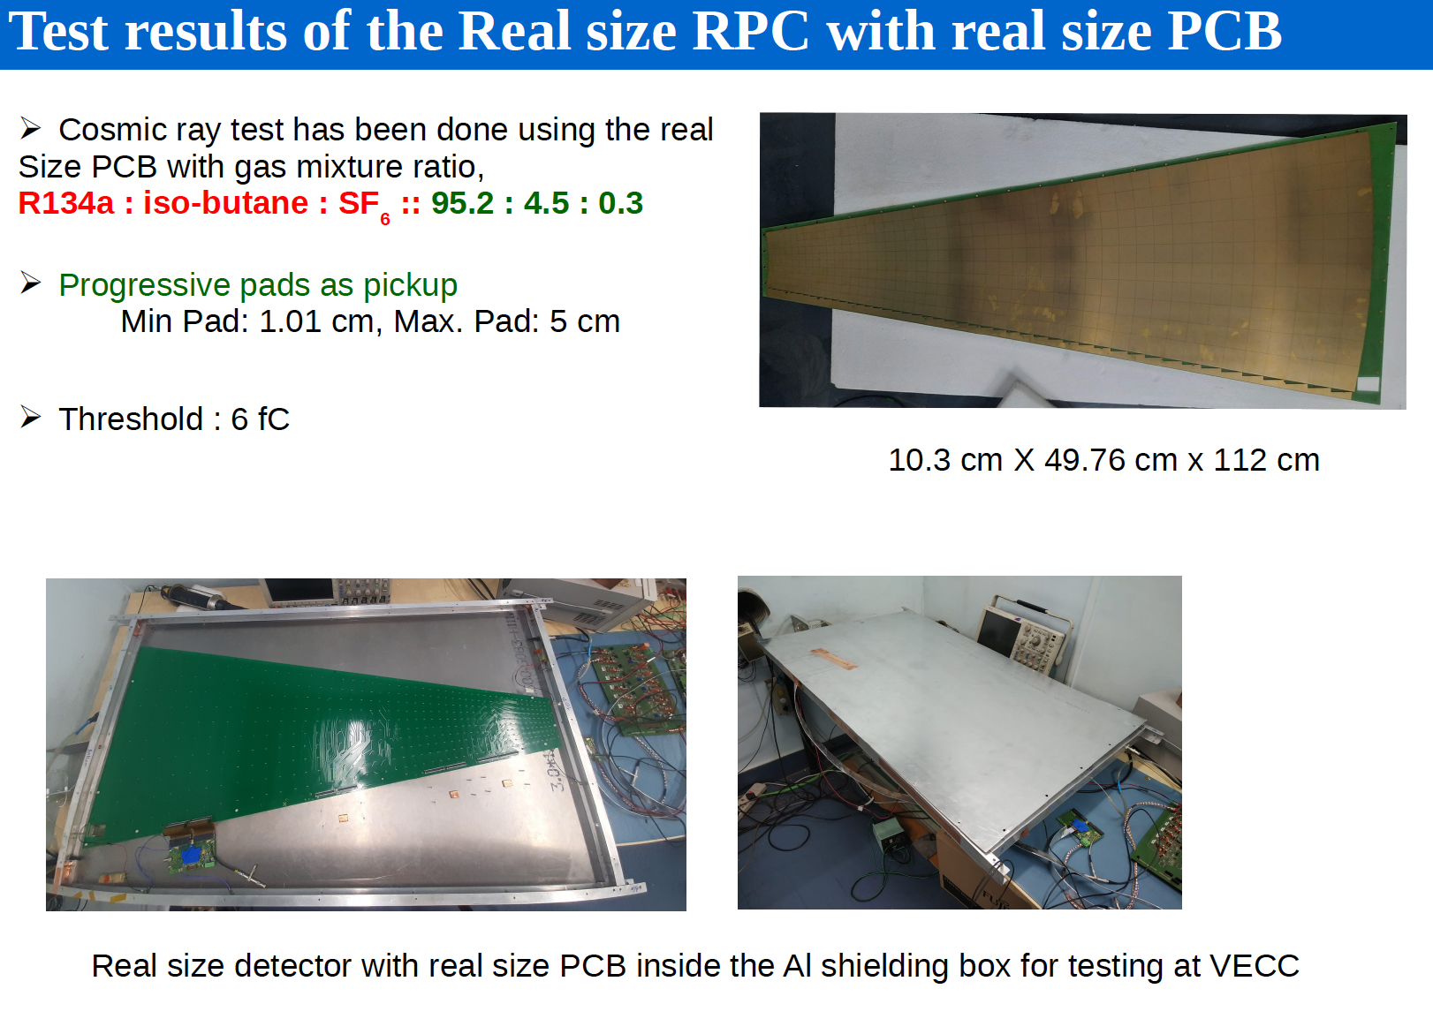
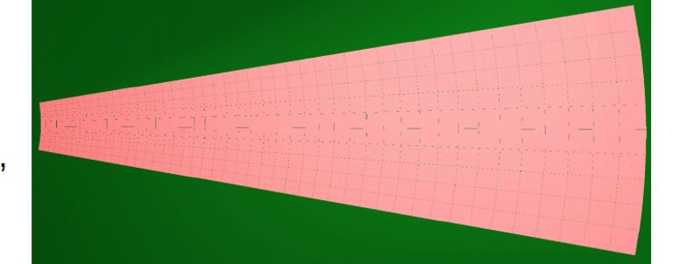
Tested at GIF++ and at SIS18 using
STS-MuCh XYTER board,
Tested upto 10 KHz/cm^2 at GIF++

Slide 29
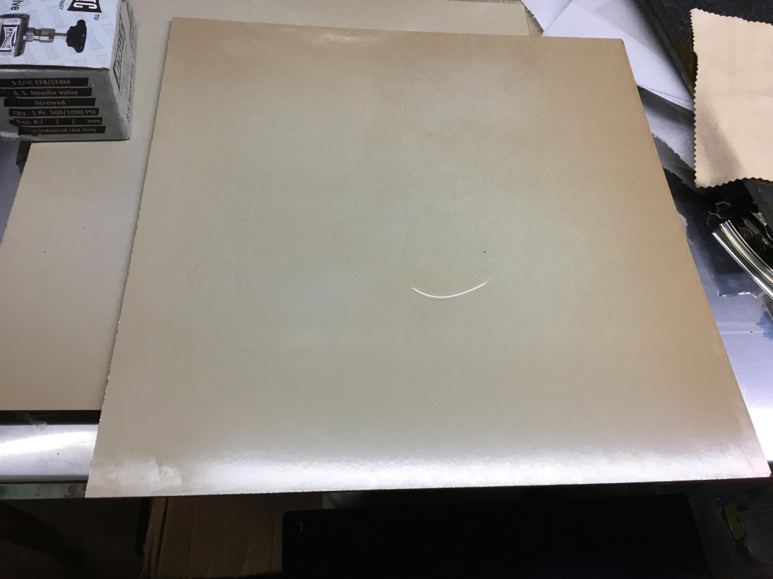
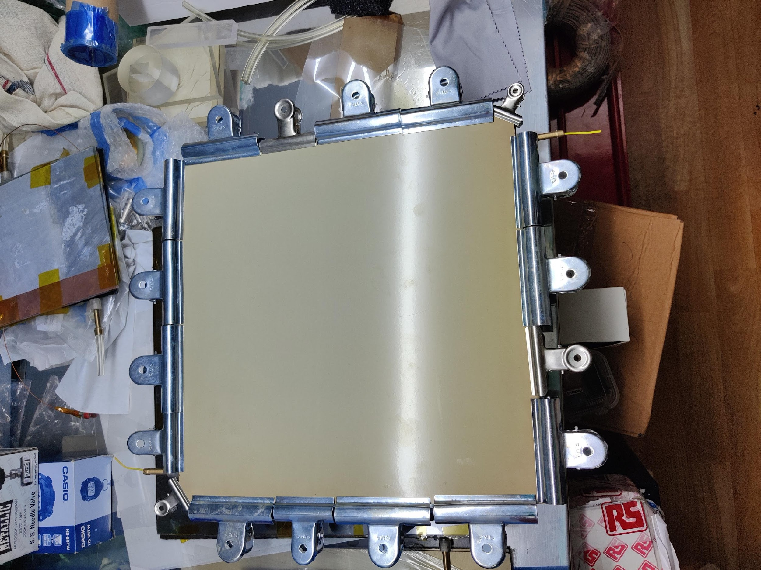
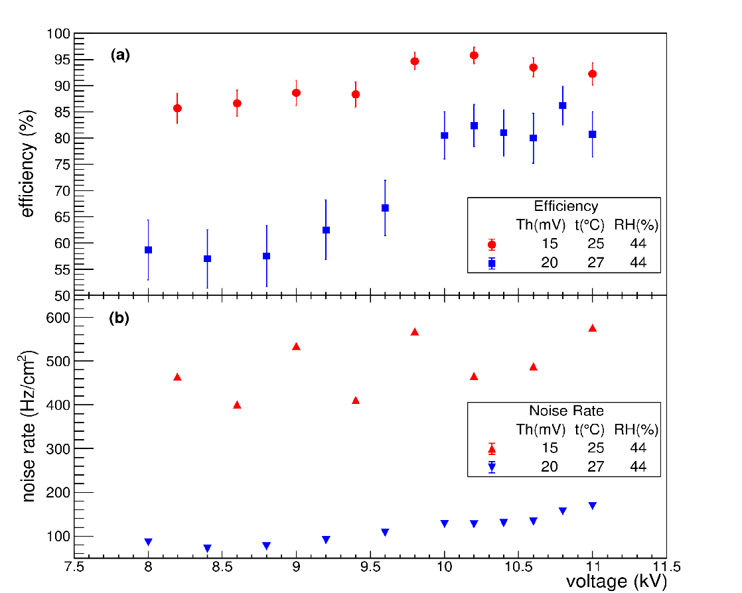
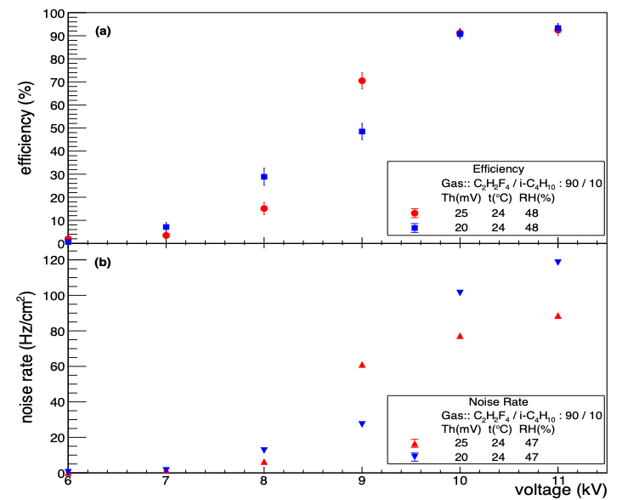
Fabrication of the RPC prototype with linseed oil coating (BI)
Linseed oil smoothen the electrode surface, reduce the after-pulse / noise rate, reduces the surface UV sensitivity of the electrodes and protect it from the Hydrofluoric Acid (HF) vapor attack.
Uncured droplet of linseed oil can form stalagmite easily and also can form sort conducting paths through the gas gap.
The advantage of this procedure is that after linseed oil coating it can be checked visually whether the curing is properly done, or any uncured droplet of linseed oil is present.
Oil
𝝆 ~ 3 × 10¹⁰ Ω cm
Efficiency
∼ 95%
Efficiency
∼ 95%
NIM A 1024 (2022) 166095
C₂H₂F₄ / i-C₄H₁₀ : 90/10
100% C₂H₂F₄
arXiv: 2206.04259

Slide 30
Large-size GEM chambers

Slide 31
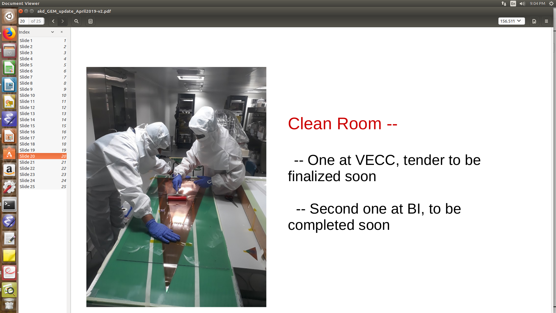
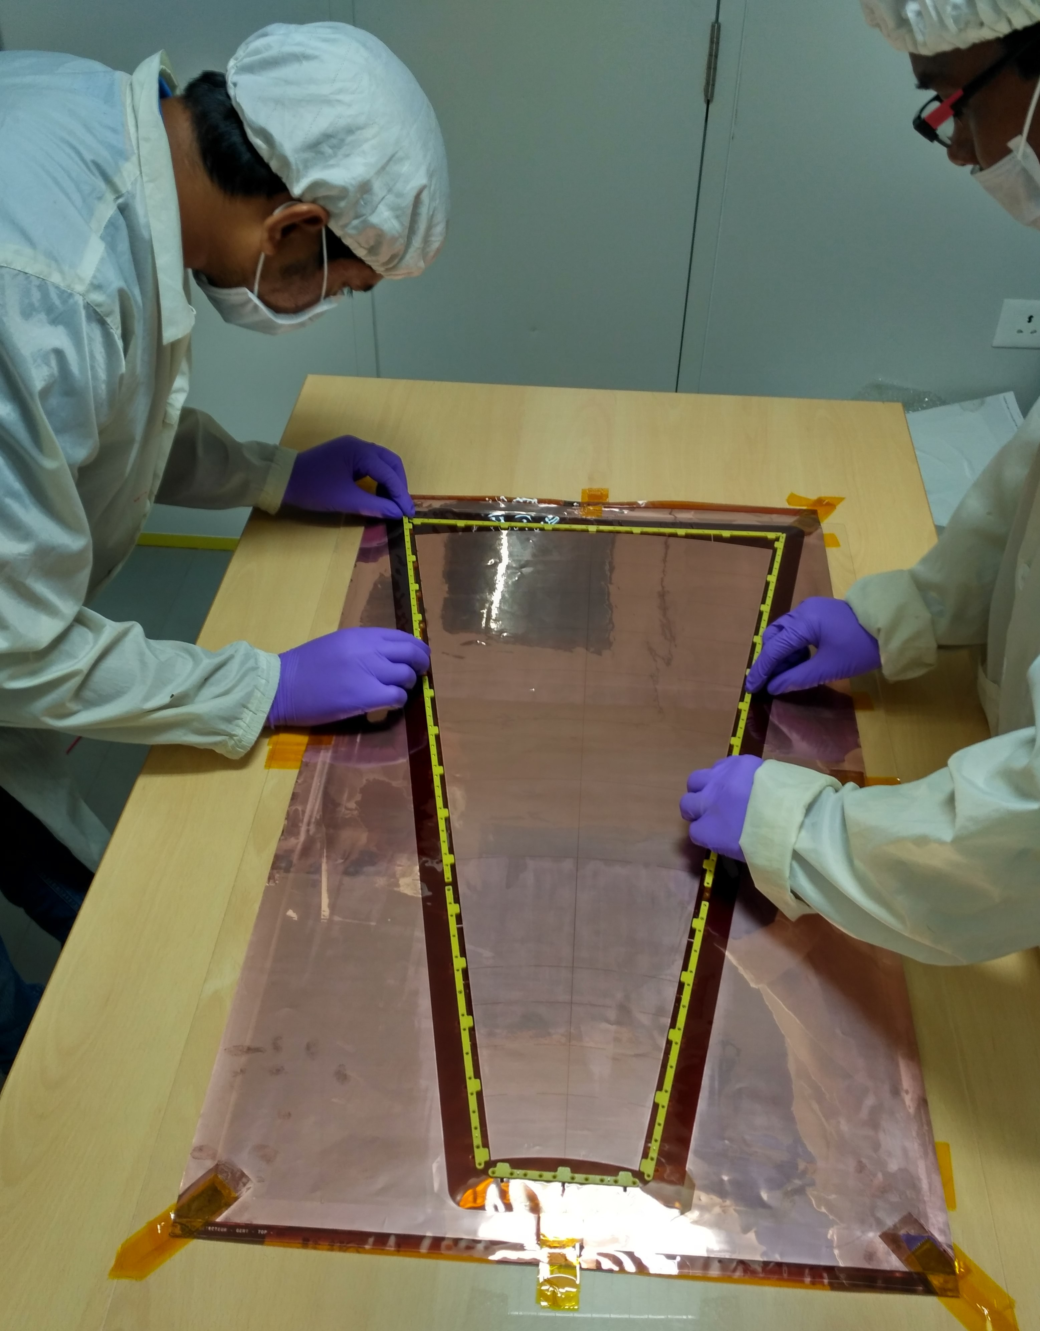
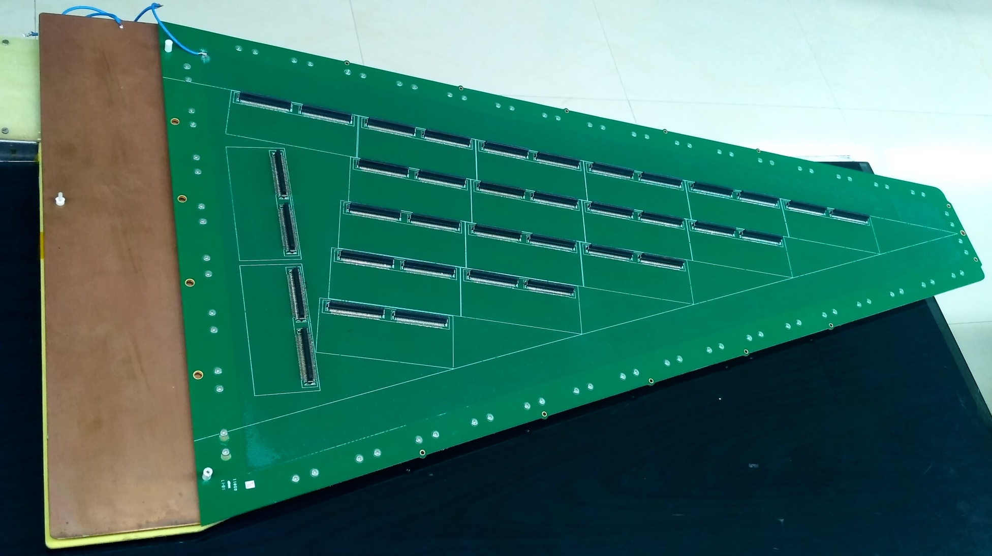
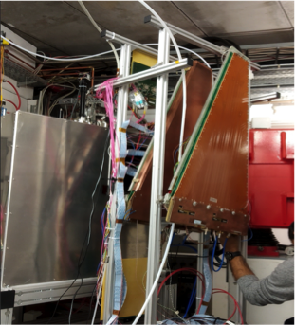
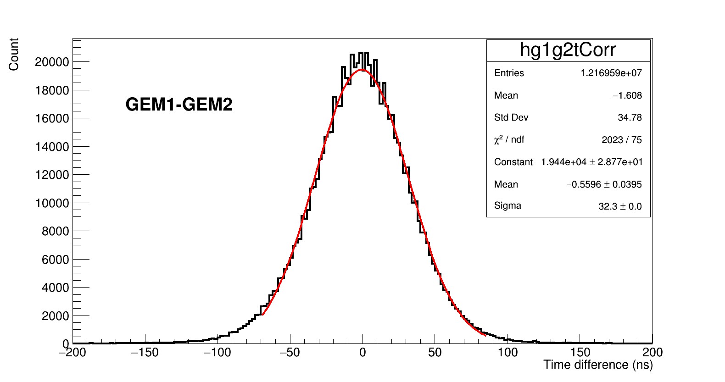
CBM-MuCh GEM Module Fabrication (VECC)
Dimension:
1 m length, 40 cm bigger width, 3-2-2-2 configuration
About 150 modules for two CBM-MuCh station
Handles upto 400KHz/cm^2 (SIS100)
Readout by self-triggered STS/MuCh XYTER
large size GEM foils
Real size module tested at SIS18 beam
Time correlation with TOF

Slide 32
Samples of large scintillator detector activities

Slide 33
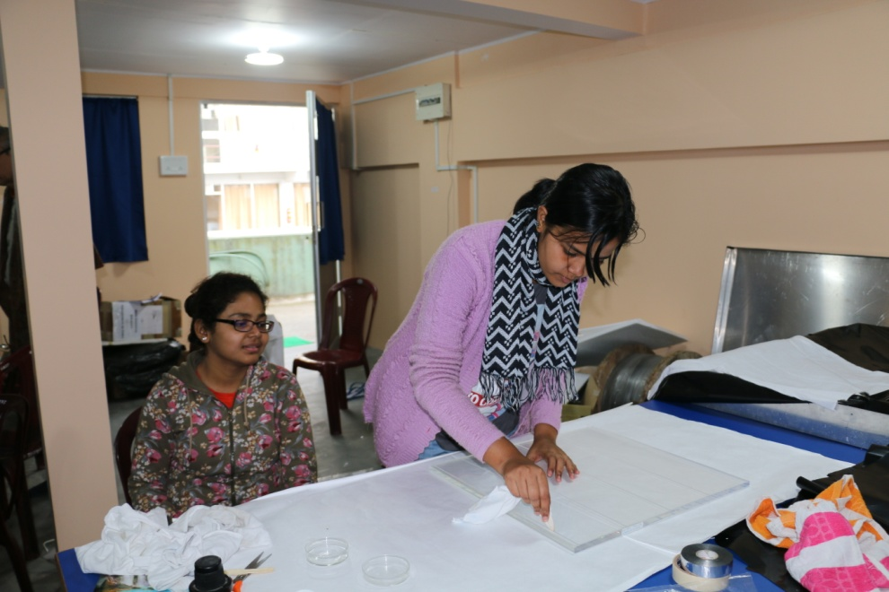
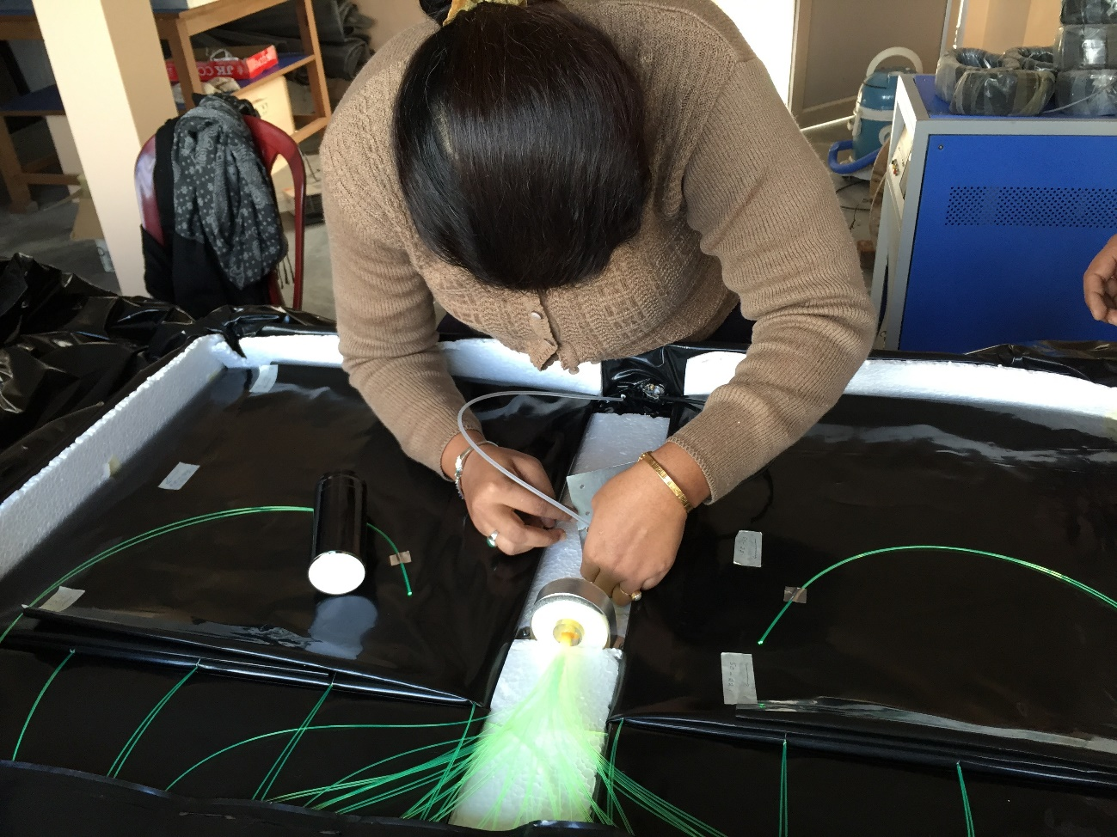
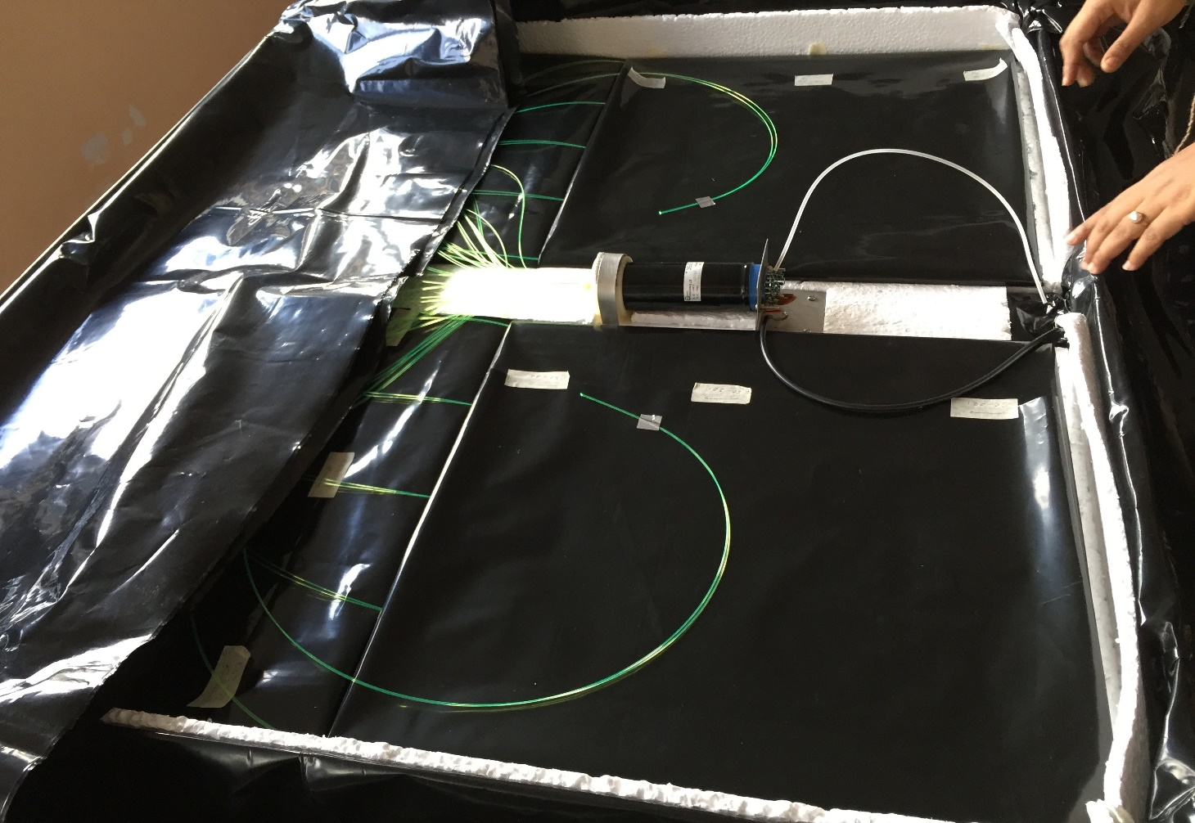
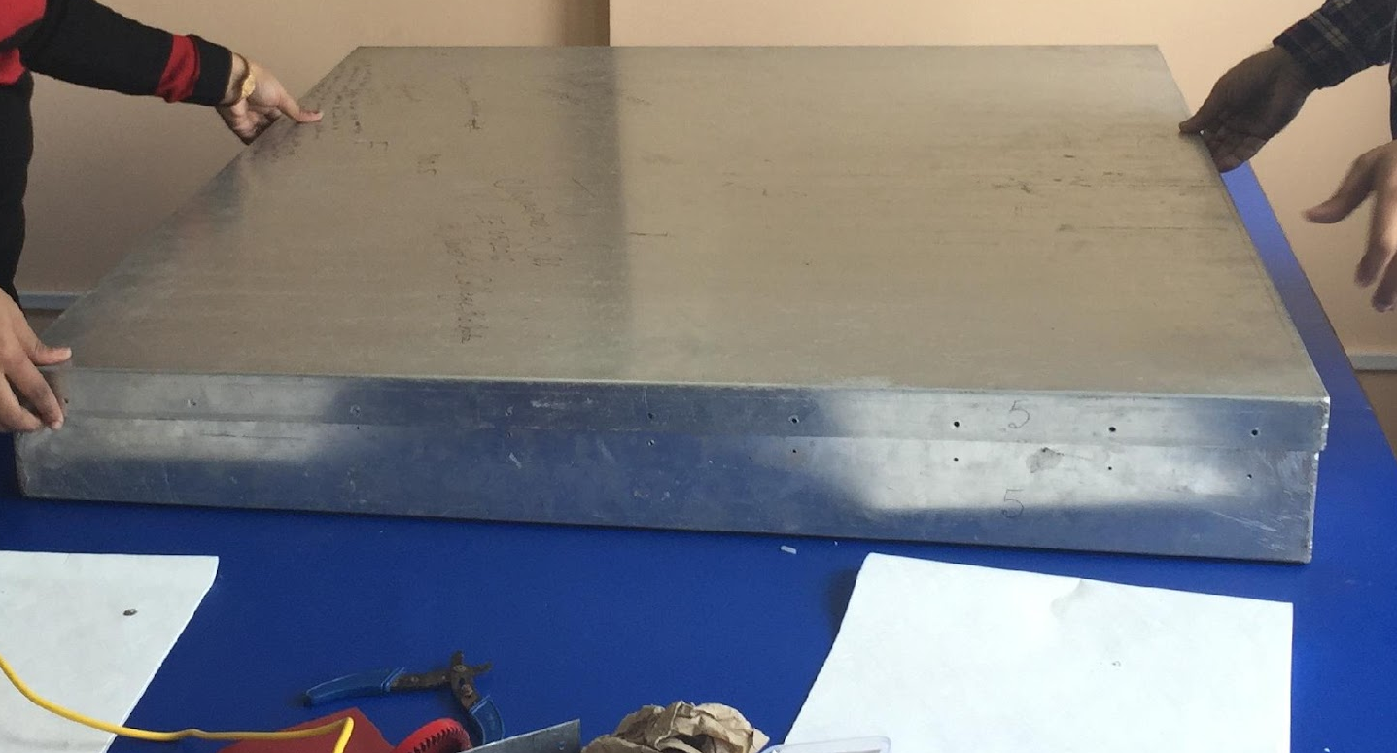
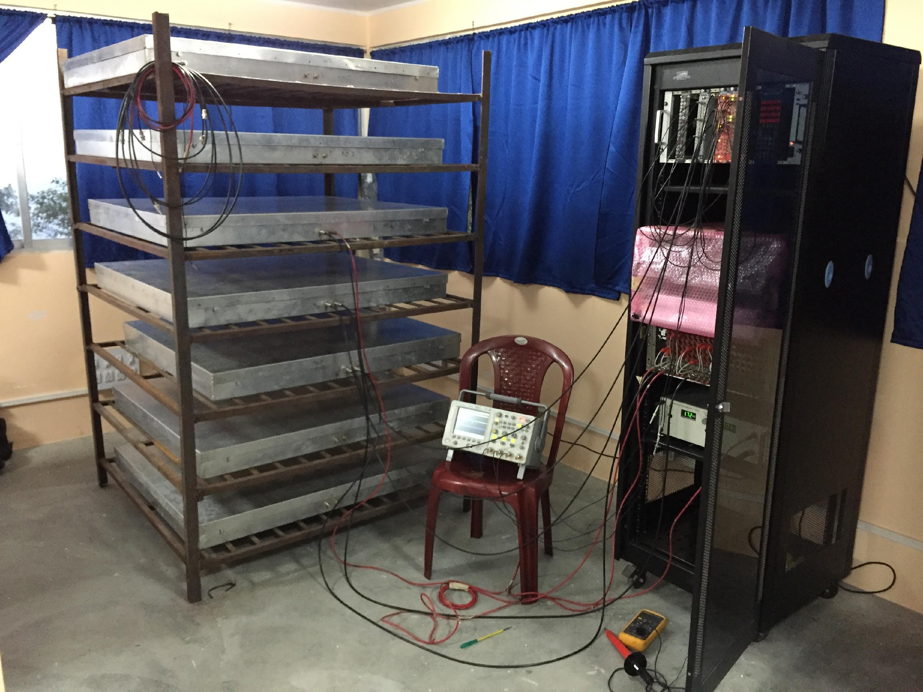
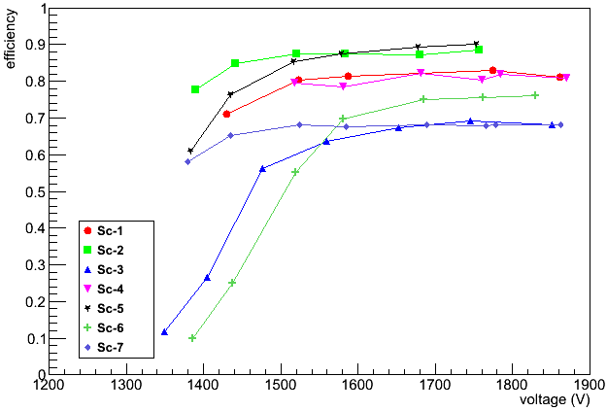
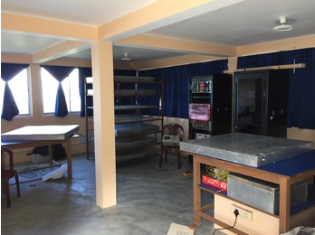
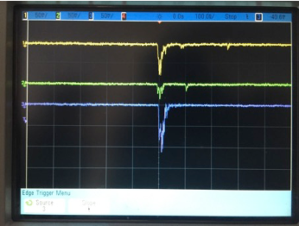
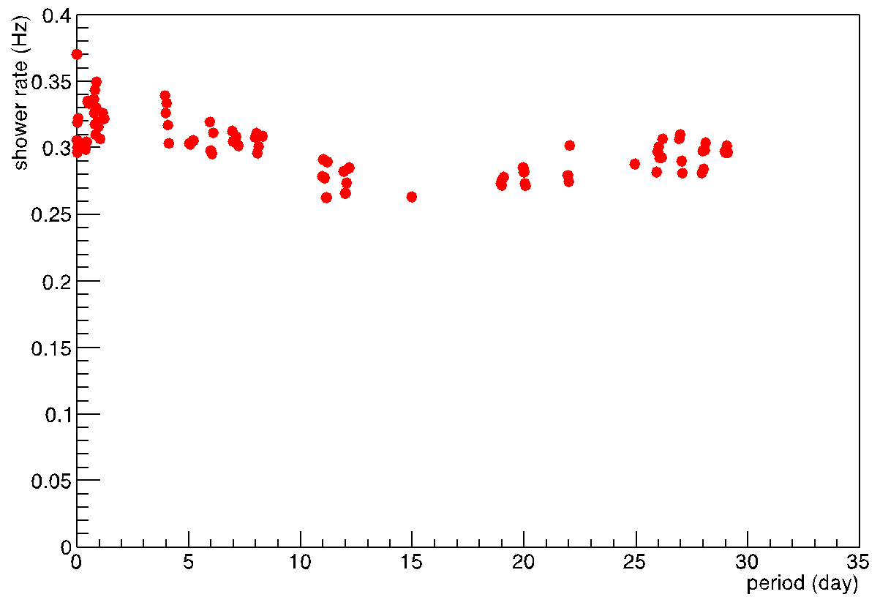
Assembly and testing of the scintillator detectors for cosmic ray shower at Darjeeling hills
Phase 1 : Hexagonal array of 7 detectors (Including one at the centre)
Dimension of each scintillator block: 0.5 m x 0.5 m; One detector consists of 4 such blocks
7 plastic scintillator detectors array is commissioned
Stack of Scintillator detectors
Efficiency as a function of applied voltage
Coincidence signals
3F rate vs. time during mid November - mid December 2016
Set-up with 3 detectors
JINST 12 C06026 2017

Slide 34
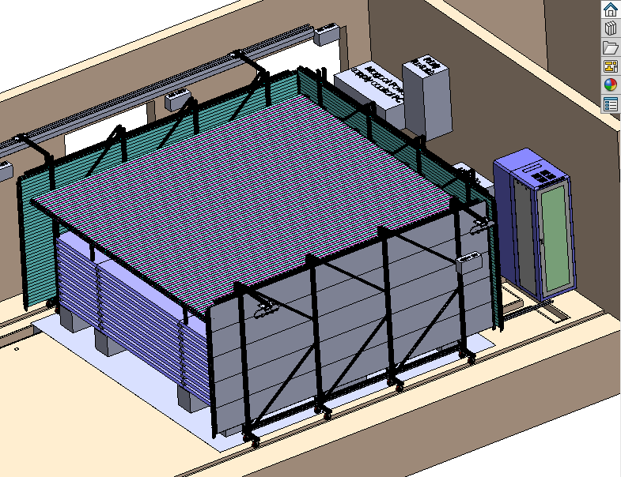
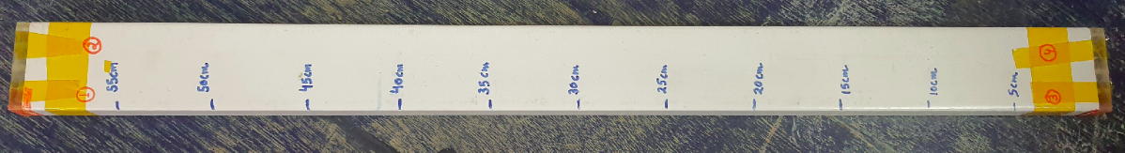
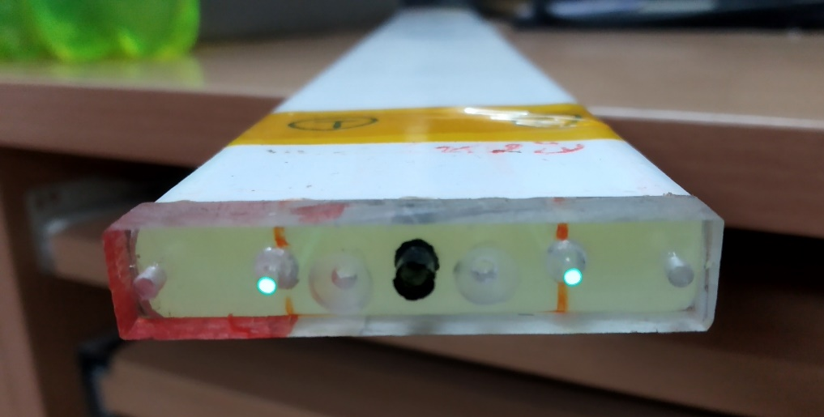
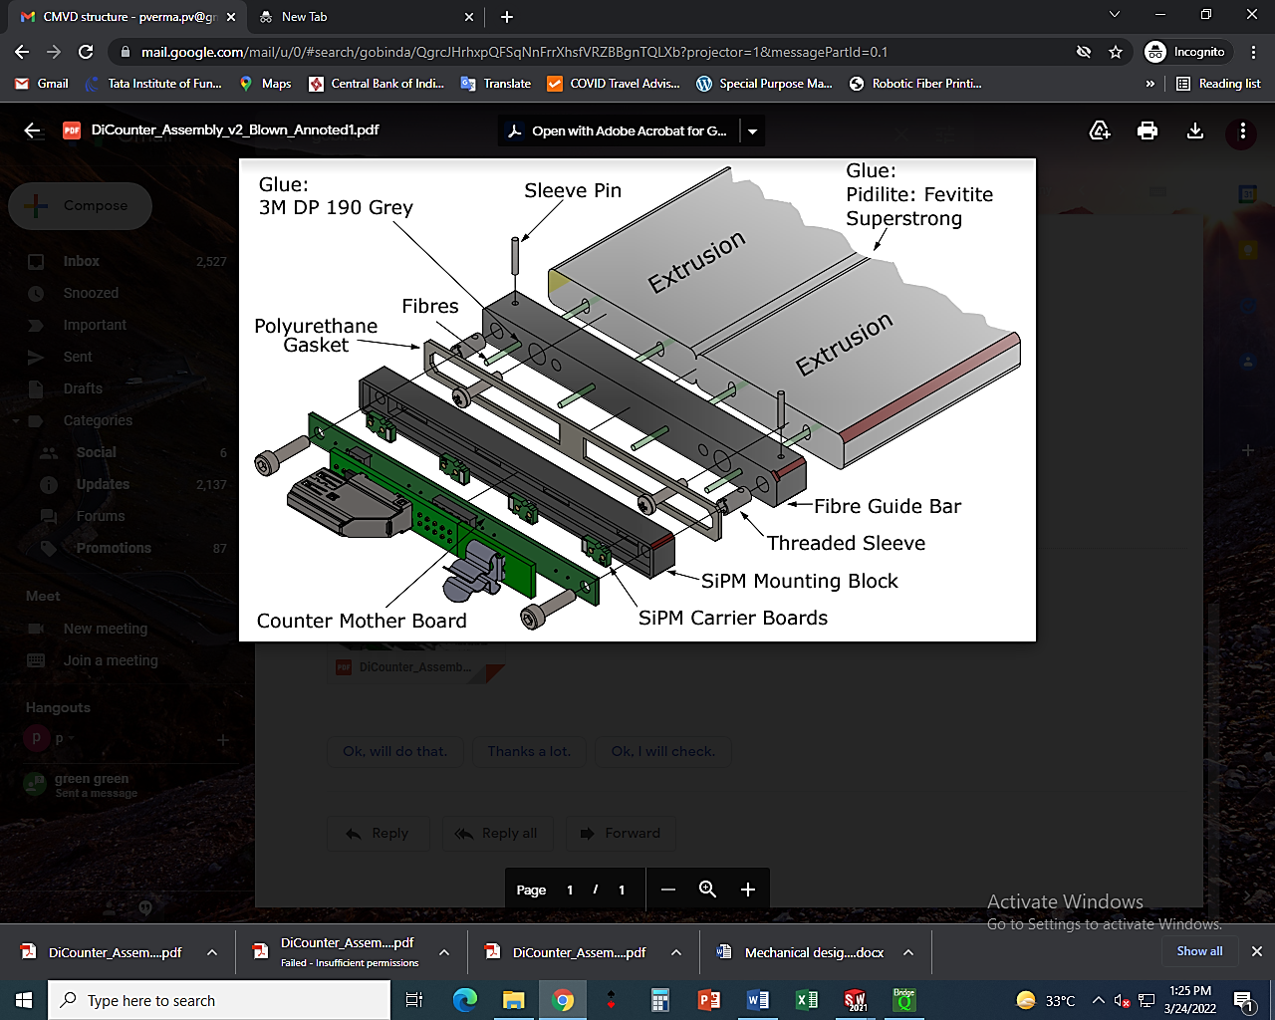
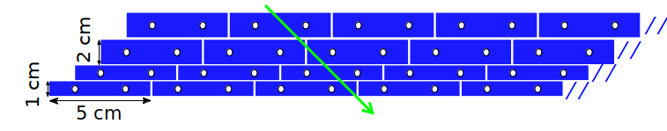
Scintillator with SiPM readout for Cosmic muon veto detector (CMVD) for INO-ICAL
Cosmic muon veto detector requires
  Total 712 extruded scintillator of size ~5 m × 5 cm × 1(1.8)cm
  Total 2848 SiPM readout

Slide 35
Interests in other detector areas (Si-based detectors):
Production of SiPM by Indian industry (good experience)
R&D (and if successful participation) in LGAD (extension of the Si-pad detector activities)

Slide 36

Time Of Flight (TOF)
TOF: Inner (central barrel) and outer (forward disks)
Surface area:
  Inner (1.5 m²),
  Outer (30 m²),
  Forward (14 m²),
  Granularity (1 x 1 mm² to 5 x 5 mm²)
Large area system: not yet built on this scale: R&D is required!
Planned system: Sensor bonded to ASIC (front-end and TDC), clock management and readout
Key requirements:
  time resolution (~20 ps),
  low material budget (1-3%X0)
Three solutions are under consideration:
Monolithic fully depleted CMOS sensor:
  favored due to integrated electronics, low cost (but R & D required to achieve ps time resolution)
LGAD (meets ~ 30 ps time resolution): system level development is needed to achieve 20 ps resolution (costly, needs ASICs for readout)
SPADs or SiPM (also used in RICH with aerosols, common readout): (dark current, fill factor are issues of concern!)

Slide 37




Ideas for possible contribution – LGAD & SiPM
Focal like pad design: Develop LGAD and SiPM in India
LGAD - Modification in Si diode (planned for ALICE FOCAL)
  Work with BEL Bangalore (6’’ wafer), and SCL Mohali (8’’ wafers, 180 nm process)
  SiPM were successfully produced in India [Ref1] by SITAR*
Simulations using
  TCAD (Process and Geometry), MC (Garfield++ and Allpix²) on monolithic detectors with gain as LGAD
LGADs require dedicated ASIC:
  Either borrow or purchase such ASIC
  Explore the possibilities to produce simple ASIC in Indian Si fab and perform electrical qualification studies in lab (with sources, lasers, cosmic rays) and teat beam
SiPM produced on 6’’ wafers at SITAR, India
Si diode vs. LGAD
SiPM schematic
LGAD + ASIC
Ref. Y. Musienko (Iouri.Musienko@cern.ch)
*Society For Integrated Circuit Technology And Applied Research (SITAR)
[Ref1] Anita Topkar et al., Development of SiPM in India using CMOS Technology, https://inspirehep.net/files/2f05f40e82377fddbcaff41ae24635d1

Slide 38
Possible contributions from India
Muon:
  Building of RPC using indigenous materials and delivery
TOF:
  Explore possibilities to design, fabricate and test LGADs and SiPMs in Indian foundries (India is active contributor in ALICE FOCAL E-PAD array project),
  Participate in qualification studies of LGAD photosensors developed by collaboration and learn from them and improve our design
  SiPM: In various detectors (e.g. EMCal..) by Indian industries
Should have a detailed plan for R&D and submit projects to move forward

Slide 39
Thank you

Slide 40
ALICE-India involvement in Si based detectors

Slide 41




India In ALICE FOCAL project: 6x6 Si PAD

Slide 42


India In ALICE FOCAL project: 8x9 Si Pad
sr-90 signal
P-type (1x1 cm2)
MIP
IV curve

Slide 43




Slide 44


