Slide 1


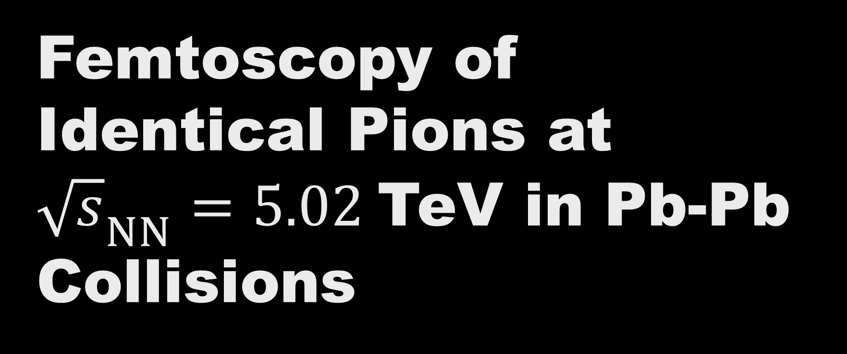
Femtoscopy of Identical Pions at ${\sqrt{s}}_{NN}=5.02$TeV in Pb-Pb Collisions
Deependra Sharma
Pritam ChAKRABORTY
Sadhana Dash
Georgy Kornakov

Slide 2
Outline
Introduction
Collision Geometry
Theoretical Construction
Some Previous Results
Analysis Details
Observation
Issue of Event Mixing / Merging

Slide 3
Introduction
Femtoscopy in heavy-ion collision indirectly unfold the information at femtoscopic scale of the system formed
Study of relative pair momentum of final state particles gives information about source region
If Femtoscopic study is combined with study of bulk collective flow, It gives information about internal dynamics of medium.
Notes:
Since, direct measurement of system of femto-scale formed in heavy ion collision is not possible now, So we do indirect measurement of system using correlation study of any variable. Here we study correlation study of relative pair momentum of two primary pions.

Slide 4
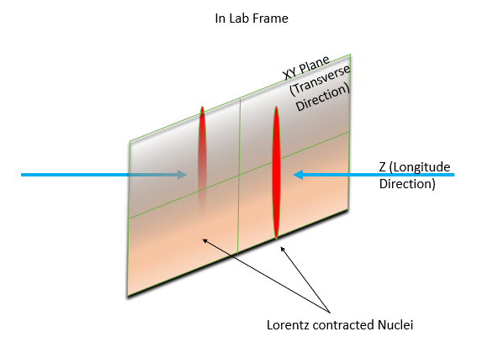
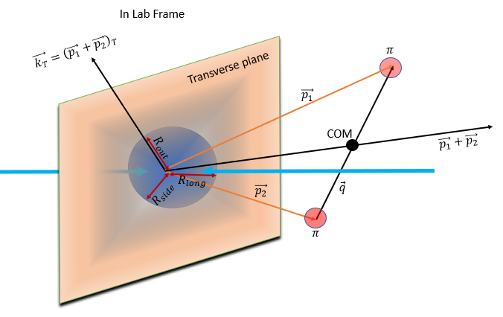
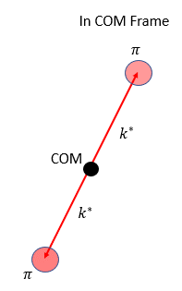
Collision Geometry
/2

Slide 5






Theoretical Construction
Considering point-like single particle sources, probability density of emission of two particle
$1+b_{p_{1} p_{2}}\left(ΔX\right)={\left|ψ_{p_{1} p_{2}}\left(X_{1},X_{2}\right)\right|}^{2}$
($X_{1}{,p}_{1}$)
($X_{1}{,p}_{1}$)
FSI
($X_{2}{,p}_{2}$)
($X_{2}{,p}_{2}$)
Where $X_{i}=(t_{i},\vec{{ r}_{i}} )$ & $p_{i}=(E_{i},\vec{p_{i}})$
Averaging $b_{p_{1} p_{2}}\left(ΔX\right)$correlation function over full source region keeping $p_{1} \& p_{2}$ fixed
Notes:
Since source does not only have two particle at fixed x1 and x2. There are multiple point-like source at varying relative positions. So, we average it over full source region to include effect of all other pair of point-like single particle sources. Here we define parameterized source function as a distribution of relative position r and time difference t.

Slide 6

Theoretical Construction
$C\left(p_{1},p_{2}\right)=\int_{Δx}{W(ΔX)}b_{p_{1} p_{2}}\left(ΔX\right)$
Space-time parametrization of source :
$$W\left(X_{1},X_{2}\right)=\frac{1}{{\left(2π\right)}^{4} r_{0}^{6}τ_{0}^{2}}exp⁡[−\frac{r_{1}^{2}+r_{2}^{2}}{2r_{0}^{2}}−\frac{t_{1}^{2}+t_{2}^{2}}{2τ_{0}^{2}}]$$
Using transformation rule $ΔX=X_{1}−X_{2}$ & $ΣX=X_{1}+X_{2}$
$$W\left(ΔX\right)=\frac{1}{4π^{2} r_{0}^{3}τ_{0}}exp⁡[−\frac{r^{2}}{4r_{0}^{2}}−\frac{t^{2}}{4τ_{0}^{2}}]$$

Slide 7
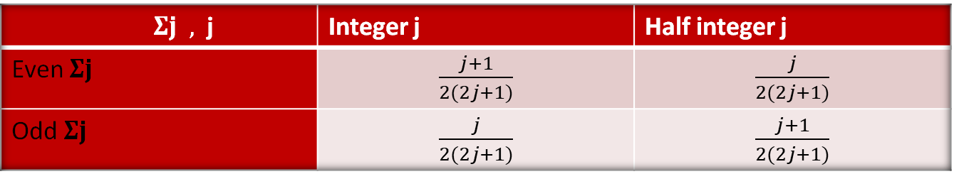

Theoretical Construction
Considering production mechanism and interaction are spin independent, for identical particles with spin j
$$b_{p_{1} p_{2}}=\frac{j+1}{2\left(2j+1\right)} {\left|ψ_{p_{1} p_{2}}+{\left(−1\right)}^{2j} ψ_{p_{2} p_{1}}\right|}^{2}$$
$$+\frac{j}{2(2j+1)}{\left|ψ_{p_{1} p_{2}}−{\left(−1\right)}^{2j} ψ_{p_{2} p_{1}}\right|}^{2} −1$$
$Σj ,$j | Integer j | Half integer j
Even $Σj$ | $\frac{j+1}{2(2j+1)}$ | $\frac{j}{2(2j+1)}$
Odd $Σj$ | $\frac{j}{2(2j+1)}$ | $\frac{j+1}{2(2j+1)}$

Slide 8


Theoretical Construction &
Statistical Definition
Final function to be used to fit experimental data
$$C\left(q_{inv}\right)=\left(1−λ\right)+λK_{c}[1+exp⁡(−q_{inv}^{2}R_{inv}^{2})]$$
where $λ$ accounts for the contribution from primary particles, does not include long lived decay particles.
& $K_{c}$ is coulomb interaction part and integrated separately over source region.
Statistical Definition
$$C\left(k^{∗}\right)=\frac{A(k^{∗})}{B(k^{∗})}$$
where $A(k^{∗})$ & $B(k^{∗})$ are events pair counts from same & identical mixed events.
This ratio is also scaled by a number so that it tends to unity in non-femtoscopic region.
Notes:
Pions means j=0 and non-interacting means take plane wave solution. Coulomb wave function is a confluent hypergeometric series.

Slide 9
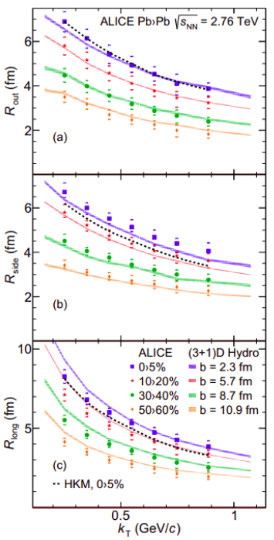
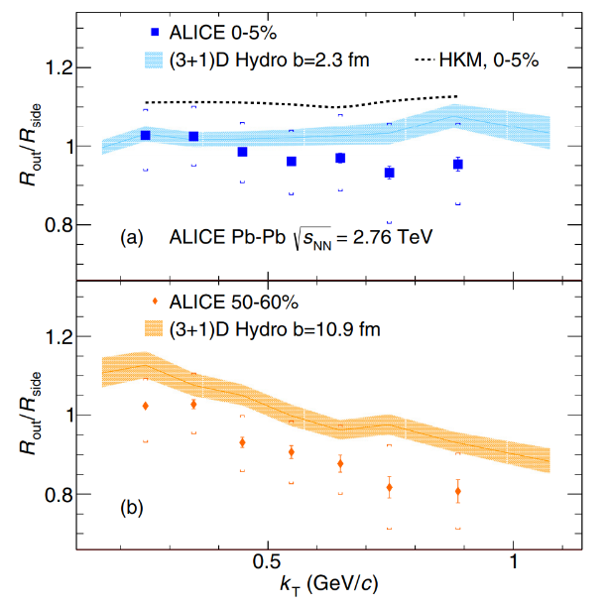


Some Previous Results
Decreasing size with $k_{T}$ is explained by hydrodynamic model with collective flow feature
It is seen, ratio $\frac{R_{out}}{R_{side}}$ decreases with energy. Reason attributed to freezeout phenomena
PHYSICAL REVIEW C 93, 024905

Slide 10
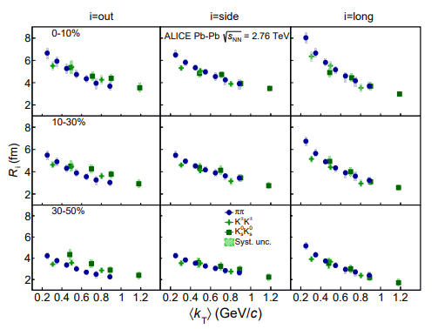
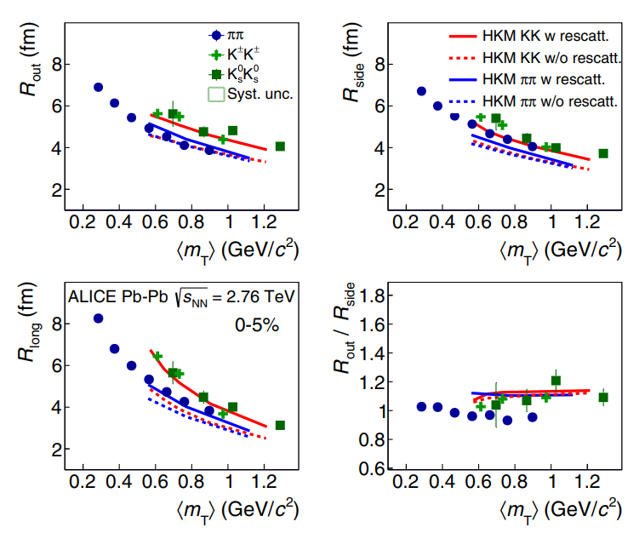
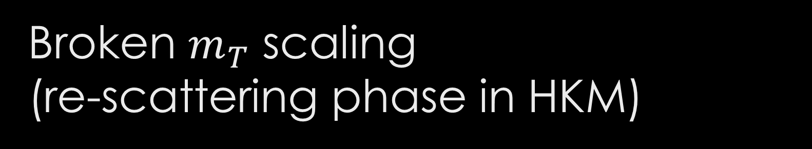
Broken $m_{T}$ scaling
(re-scattering phase in HKM)
PHYSICAL REVIEW C 96,064613

Slide 11
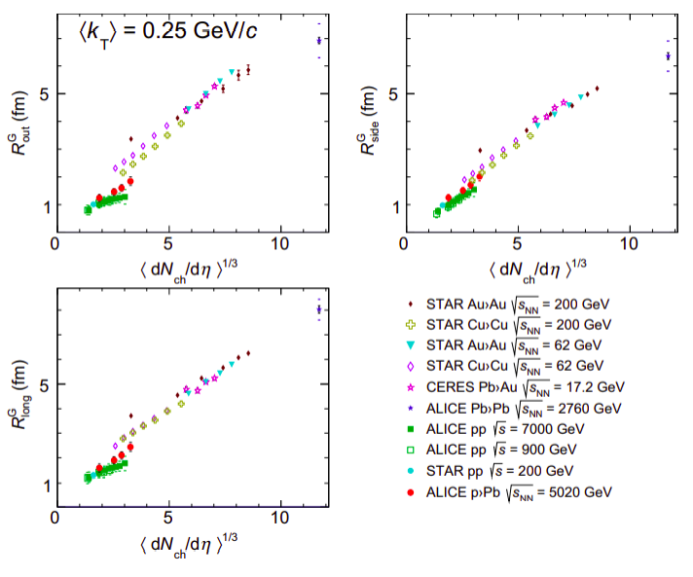
Some Previous Results
A comparison study from ALICE collaboration results on size of the emission sources is done
Radii increase vs multiplicity expected by hydrodynamic models
EPJ Web Conf., 141:01012, 2017

Slide 12
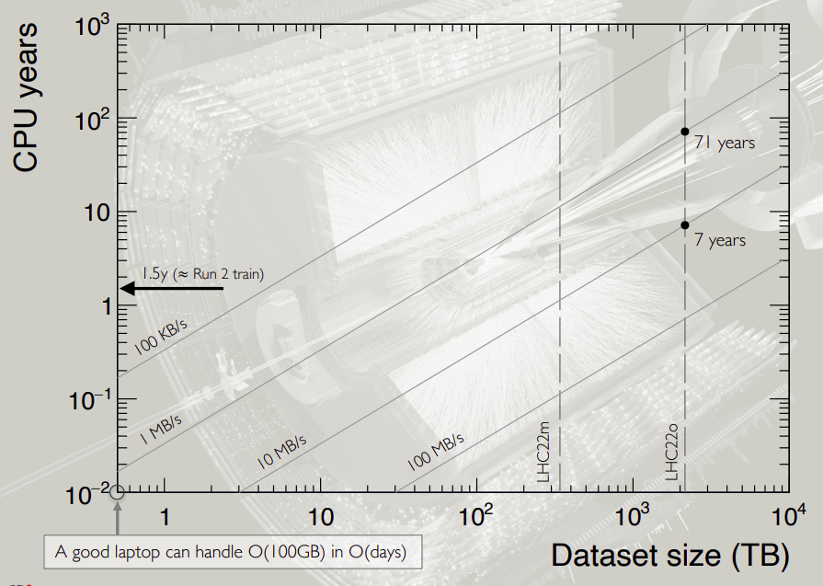
Why New Framework
Run 3 has very large datasets!
Full pp dataset 3.0 PB
Full Pb-Pb dataset 680 GB
Convenient metric: data processed per unit time
Typical O2Physics analysis task speed: 1-10 MB/s
Bulk Operation:
Filter
Partition
Expression Columns
Modular Structure

Slide 13

Analysis Details
Data Set:
  Run2Conversion-LHC18q (Pb-Pb collision at $\sqrt{S_{NN}}=5.02$TeV)
Event Cuts:
  $\left|V_{Z}\right|<10 cm$ ; Total events passing this criteria: 17094
Track Cuts:
  $\left|η\right|<0.8 \& {0.14 \text{GeV}\text{/}c<p}_{T}<1.5$ GeV/c
  $\left|DCA_{xy}\right|<2.3 cm \& \left|DCA_{z}\right|<3.1 cm$
  $Nσ_{TPC}<3 ; p<0.5 GeV/c$ $\&$
  $$\sqrt{\left(Nσ_{TPC}^{2}+Nσ_{TOF}^{2}\right) }<\frac{3}{\sqrt{2}} ; 0.5GeV/c<p<1.5GeV/c$$

Slide 14
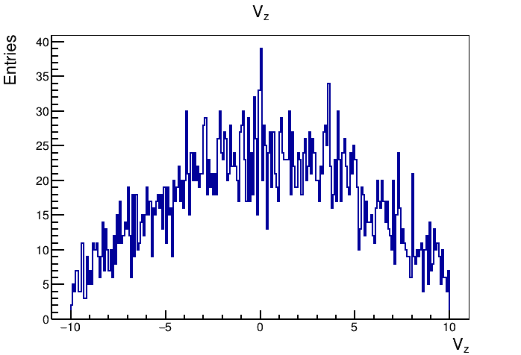
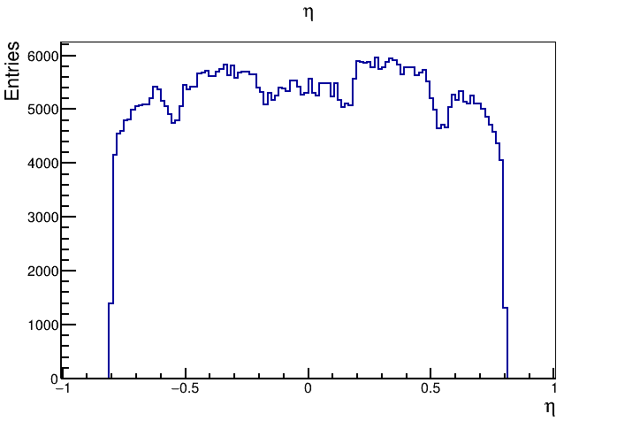
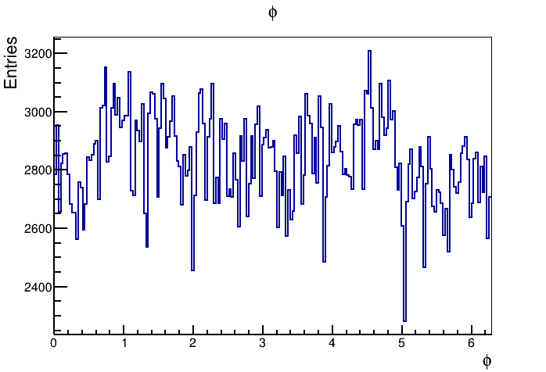
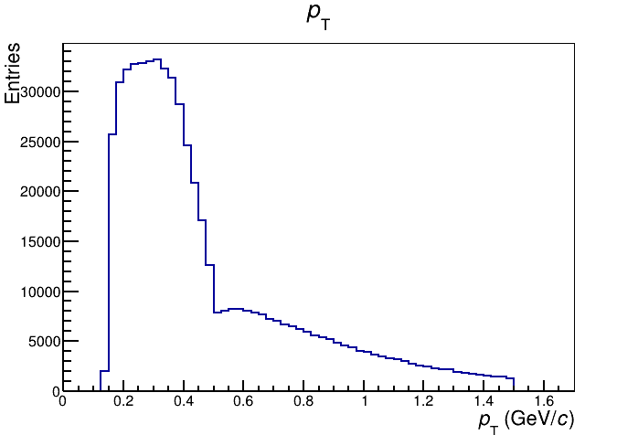
QA Plots

Slide 15
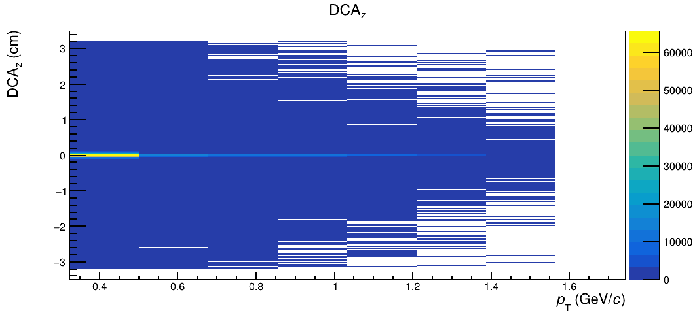
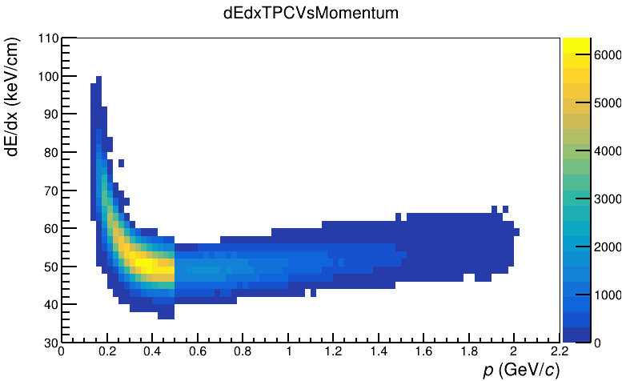
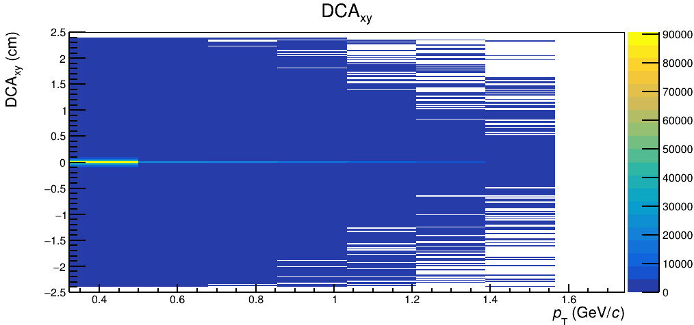
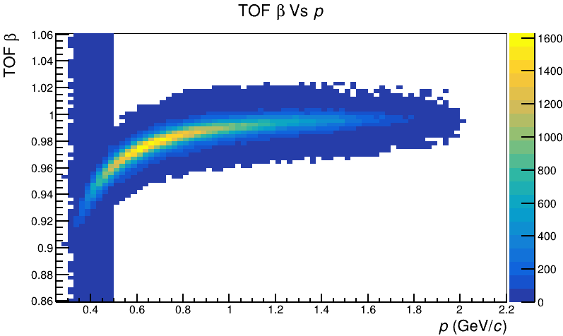
QA Plots

Slide 16
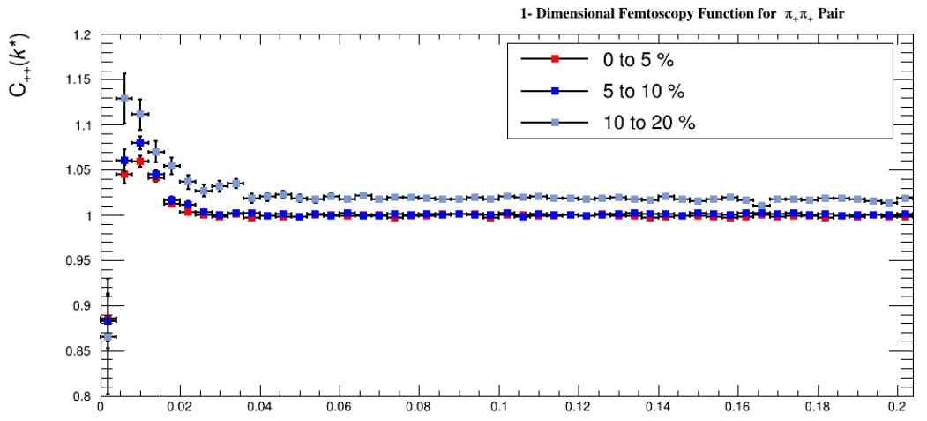

Observation (Like-Sign)
$$k^{∗} (GeV/c)$$

Slide 17
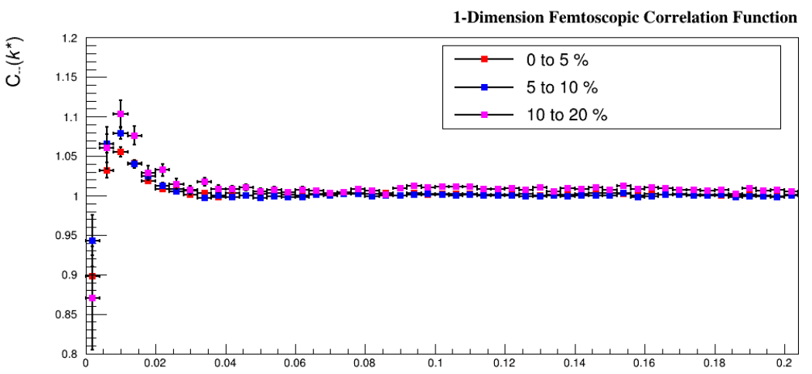
Observation (Like-Sign)
$$k^{∗} (GeV/c)$$

Slide 18
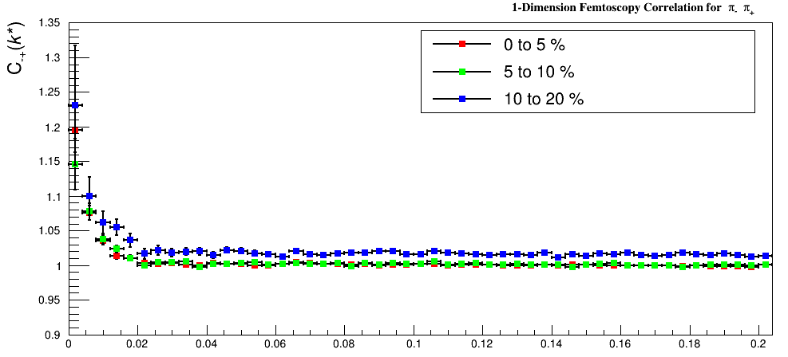
Observation (Unlike-Sign)
$$k^{∗} (GeV/c)$$

Slide 19
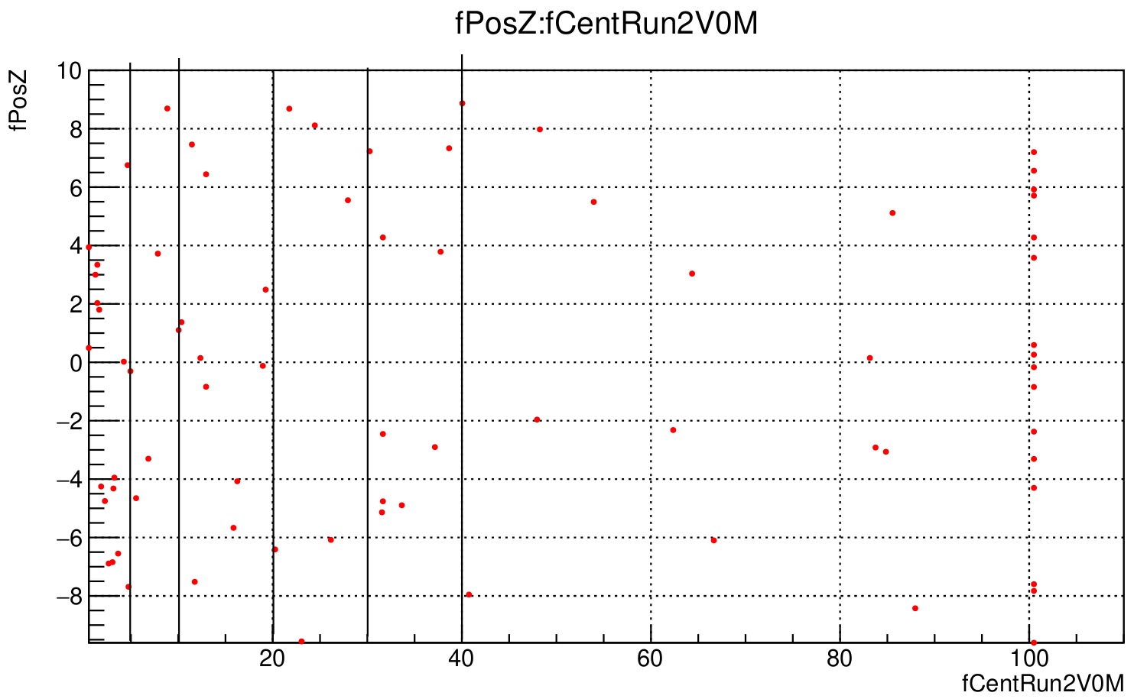
Event Mixing Bins
0-5,5-10,10-20,20-30,30-40,40-60,60-80,80-100
Lack of statistics in each mixing bins
Let us try to increase statistics per bin by merging Data Frames.

Slide 20


Summary
Peak in like-sign correlation due to BE effect
Dip at very low $k^{∗}$ region in like-sign due to coulomb repulsion
No dip in unlike-sign due to coulomb attraction
Next to do
Merge Derived Data and obtain correlation distribution
Fit the statistical correlation function with parametrized theoretical correlation function
Same study in different $k_{T}$ bins to get $k_{T}$ dependence of source parameters

