Slide 1



Born-Oppenheimer Effective Theory (BOEFT):
Hybrids, Tetraquarks, Pentaquarks
QWG workshop 2024, IISER-Mohali
Chandigarh, February 27, 2023
Abhishek Mohapatra (TU Munich)

Slide 2
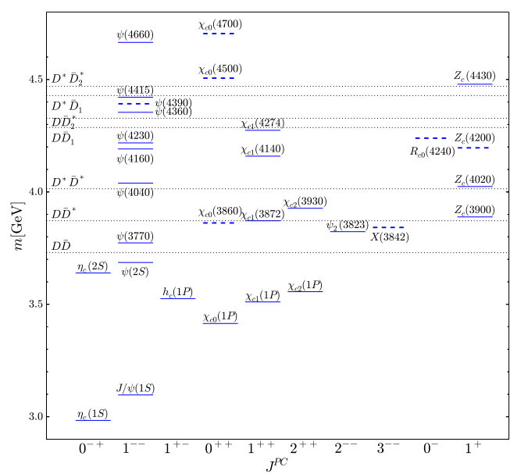
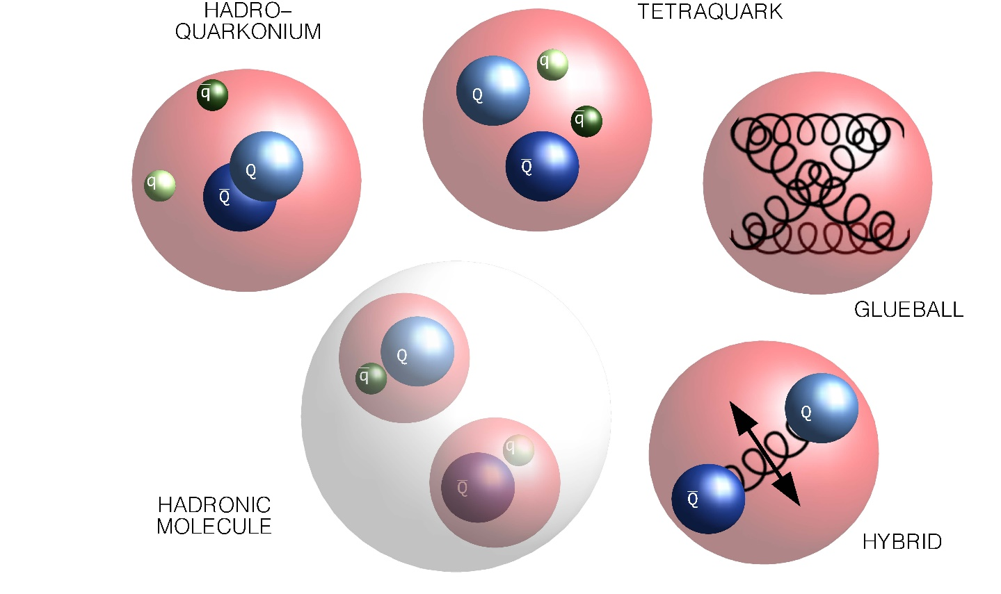

Exotic Hadron
Dozens of XYZ mesons discovered since 2003.
Multiple Models for Exotics:
Exotic sector
Figure from https://www.fz-juelich.de/en/ias/ias-4/research/exotic-hadrons/exotics_pad.jpg
……….
Physics Reports 873 (2020)
2
Individual success in describing some XYZ hadrons. No success in revealing general pattern.

Slide 3

Exotic Hadron
Multiple Models for Exotics:
Hybrids $\text{(}\text{Q}\overline{\text{Q}}\text{g}\text{)}$: Isospin scalar exotic state.
Figure from https://www.fz-juelich.de/en/ias/ias-4/research/exotic-hadrons/exotics_pad.jpg
Use EFT + lattice for describing hybrid
Brambilla, Lai, AM, Vairo Phys. Rev. D 107, 054034 (2023)
Berwein, Brambilla, Castellà , Vairo
Phys. Rev. D. 92, (2015), 114019
……….
Non-zero isospin states. Can be described in the EFT.
However, lack of lattice inputs on the static energies for these states
Brambilla, AM, Vairo arXiv 2402.xxxxx

Slide 4
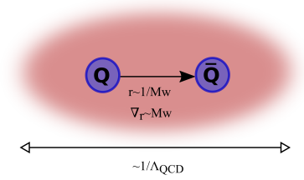
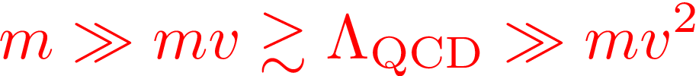
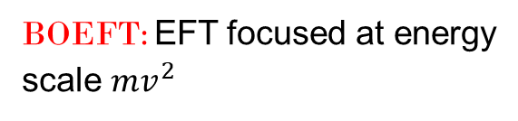
BOEFT: Exotic Hadron
Exotic hadron $(Q\overline{Q}X,QQX, …..)$, $X$: any combination of light quark and gluons
to obtain color singlet hadron
:
Example: Quarkonium hybrids $Q\overline{Q}g$, Tetraquarks $Q\overline{Q}q\overline{q}$
Hierarchy of scales:
BOEFT: Effective theory based on
Born-Oppenheimer Approximation
BOEFT: EFT focused at energy
scale $mv^{2}$
Heavy quark: slow-degrees of freedom
X: fast-degrees of freedom
Time-scale for dynamics of $\text{Q}\overline{\text{Q}}:∼\frac{\text{1}}{\text{m}{\text{v}}^{\text{2}}}\text{≫}\frac{1}{{\text{Λ}}_{\text{QCD}}}$
Castellà , Soto Phys. Rev. D. 102, (2020)
Brambilla, AM, Vairo arXiv 2402.xxxxx
Born-Oppenheimer (BO) Approximation
Braaten, Langmack, Smith Phys. Rev. D. 90, 014044 (2014)
Notes:
Non-relativistic because v~alpha<<1. This can be seen from the virial theorem.
Top quark mass ~ 180 GeV. Top quark unstable and short-lived and decays into bottom quark + W-boson.

Slide 5
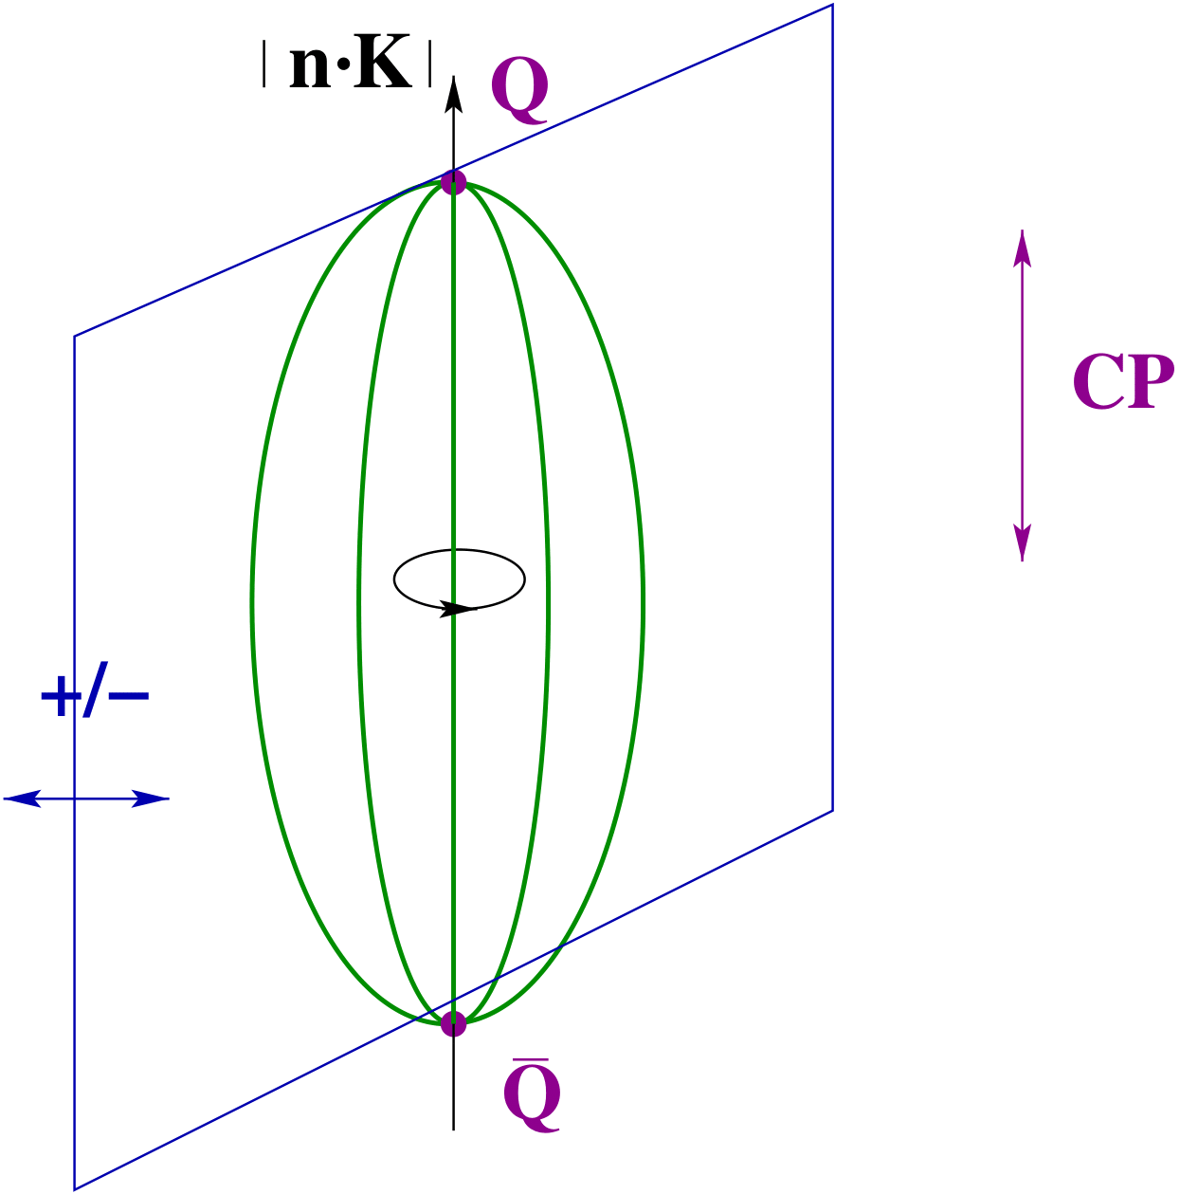



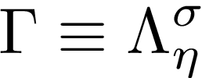


BOEFT: Quantum #’s
CP
BOEFT potentials $( V_{Γ}\left(r\right))$: LDF (light quarks, gluons) static energies.
Potential between $Q \& \overline{Q}$
$V_{Γ}\left(r\right)$: $Γ$ labelled by cylindrical symmetry $(D_{∞h})$ representation (diatomic molecules):
Absolute value of component of angular momentum of light d.o.f
$$\left|r⋅K_{light}\right|≡Λ=0, 1, 2,…….. (or Σ, Π, Δ, Φ,…..)$$
Product of charge conjugation and parity ($CP$):
$η=+1 \left(g\right),$ $−1 \left(u\right)$
$σ$: Eigenvalue of reflection about a plane containing static sources.
$$σ=P {\left(−1\right)}^{K_{light}}=±1$$
Braaten, Langmack, Smith Phys. Rev. D. 90, 014044 (2014)
$\text{r}\text{→ }\text{0}$: Spherical symmetry restored: Labelled by gluon quantum #’s ${κ=\text{K}}^{\text{PC}}$.
Brambilla, Pineda , Soto, and Vairo Nucl. Phys. B566 (2000)
Berwein, Brambilla, Castellà , Vairo Phys. Rev. D. 92, (2015), 114019
Notes:
D_{infinity}h-→cylindrical symmetry group. O(3)*C: spherical symmetry group. In the centreof-mass system gluonic excitations between static quarks are, therefore, classified according to representations of O(3)× C, which we summarize by L, the angular momentum, CP and reflection with respect a plane passing through the quark-antiquark axes5x

Slide 6










BOEFT: Exotic
Brambilla, AM, Vairo
arXiv 2402.xxxxx
Exotic hadron $(Q\overline{Q}X,QQX, …..)$, $X$ is light d.o.f.
$$Q\overline{Q}X$$
$$QQX$$
$Q$
$\overline{Q}$
$Q$
$Q$
r
r
color:
color:
X= gluon $→$ Hybrid
X= q $→$ Double heavy baryon
X= $q\overline{q}→$ Tetraquark / Molecule
X= $\overline{q}\overline{q}→$ Tetraquark
X= $q\overline{q}q→$ Pentaquark
X= $qqq→$ Pentaquark / Molecule
and so on
and so on
BOEFT can address all these states with inputs from Lattice QCD on BOEFT (static) potentials
Notes:
Non-relativistic because v~alpha<<1. This can be seen from the virial theorem.
Top quark mass ~ 180 GeV. Top quark unstable and short-lived and decays into bottom quark + W-boson.

Slide 7
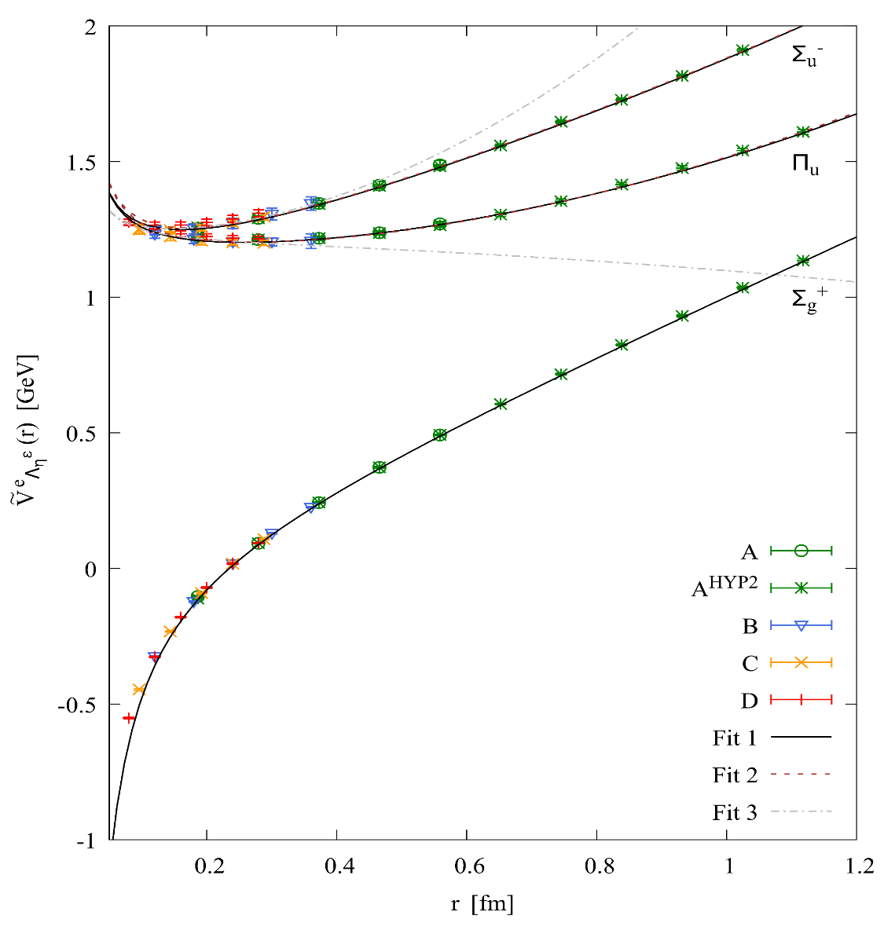
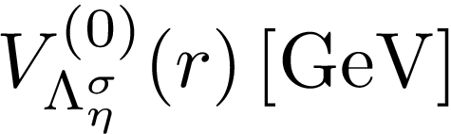

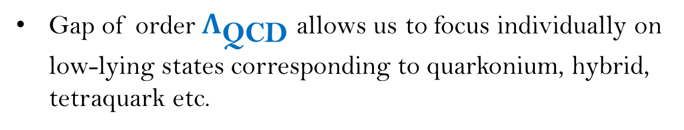

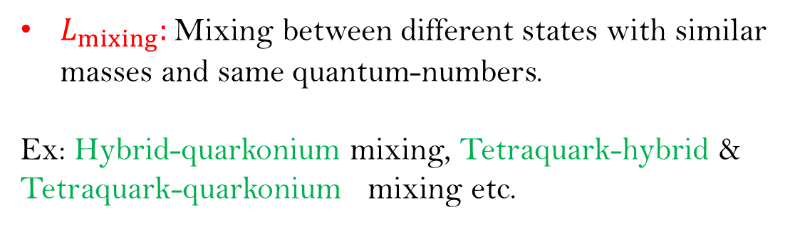
BOEFT
Brambilla, AM, Vairo arXiv 2402.xxxxx
BOEFT Lagrangian:
Castellà , Soto Phys. Rev. D. 102, (2020)
Hybrid
Static energy
Gap of order ${\text{Λ}}_{\text{QCD}}$ allows us to focus individually on low-lying states corresponding to quarkonium, hybrid, tetraquark etc.
Energy gap ~ ${\text{Λ}}_{\text{QCD}}$
$L_{mixing}:$ Mixing between different states with similar masses and same quantum-numbers.
Ex: Hybrid-quarkonium mixing, Tetraquark-hybrid & Tetraquark-quarkonium mixing etc.
Quarkonium
Static energy
Notes:
In the static limit, quarkonium (the lowest potential ) and heavy hybrids (the remaining potentials) do not mix by construction (they are built as orthogonal states). Hence, the mixing must be due to 1/m corrections to the Born-Oppenheimer approximation

Slide 8
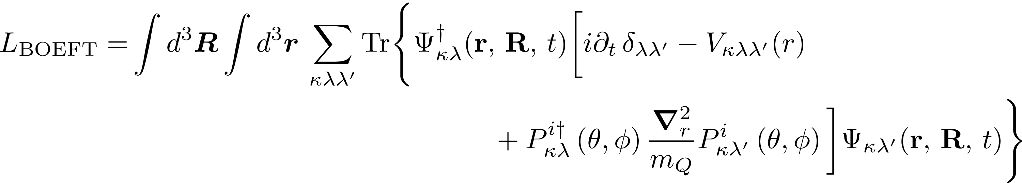


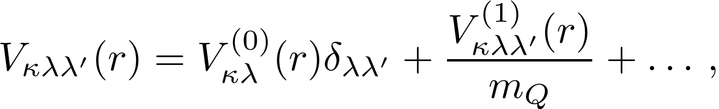


BOEFT
Brambilla, AM, Vairo
arXiv 2402.xxxxx
BOEFT Lagrangian:
Light d.o.f quantum number
Castellà , Soto
Phys. Rev. D. 102, (2020)
v
BOEFT potential:
Static potential
Matching procedure:
NRQCD
BOEFT
exotic hadron $Q\overline{Q}X$:
: Operator that characterizes the light d.o.f X corresponding to quantum # $Κ$, isospin, color etc..
Notes:
In the static limit, quarkonium (the lowest potential ) and heavy hybrids (the remaining potentials) do not mix by construction (they are built as orthogonal states). Hence, the mixing must be due to 1/m corrections to the Born-Oppenheimer approximation

Slide 9
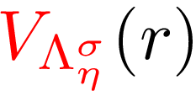
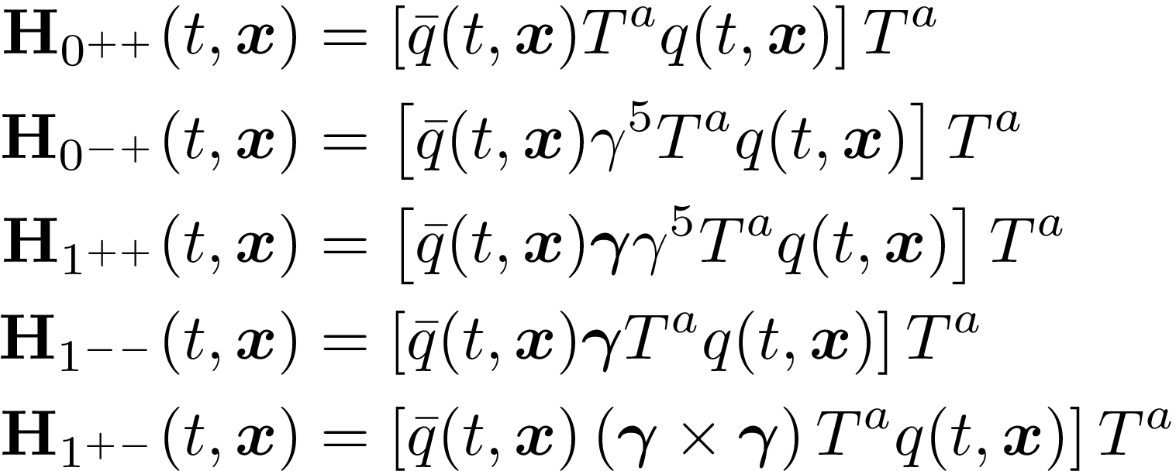
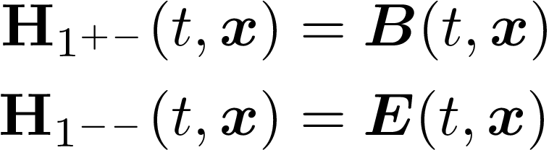
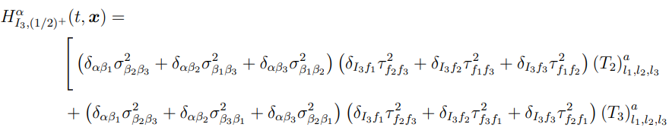
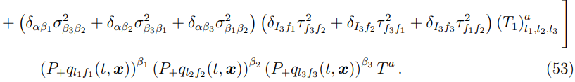
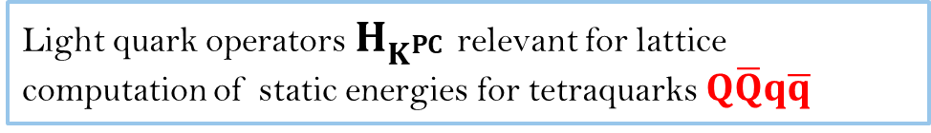
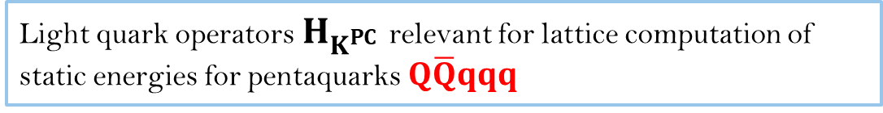
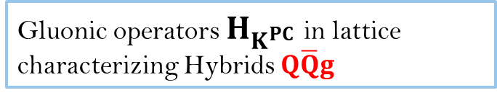
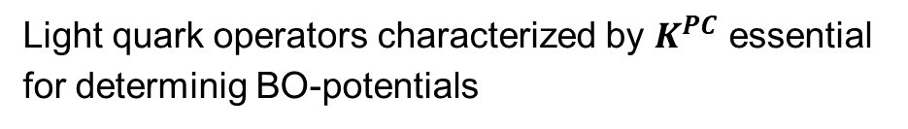
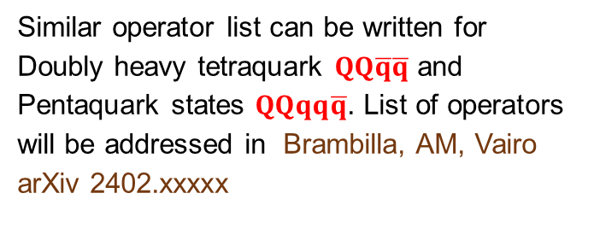
Brambilla, AM, Vairo arXiv 2312.xxxxx
Light quark operators characterized by $K^{PC}$ essential
for determinig BO-potentials
Light quark operators $H_{K^{PC}}$ relevant for lattice computation of static energies for tetraquarks $Q\overline{Q}q\overline{q}$
Gluonic operators $H_{K^{PC}}$ in lattice characterizing Hybrids $Q\overline{Q}g$
Light quark operators $H_{K^{PC}}$ relevant for lattice computation of static energies for pentaquarks $Q\overline{Q}qqq$
Castellà , Soto Phys. Rev. D. 102, (2020)
Similar operator list can be written for
Doubly heavy tetraquark $QQ\overline{q}\overline{q}$ and
Pentaquark states $QQqq\overline{q}$. List of operators
will be addressed in Brambilla, AM, Vairo
arXiv 2402.xxxxx

Slide 10

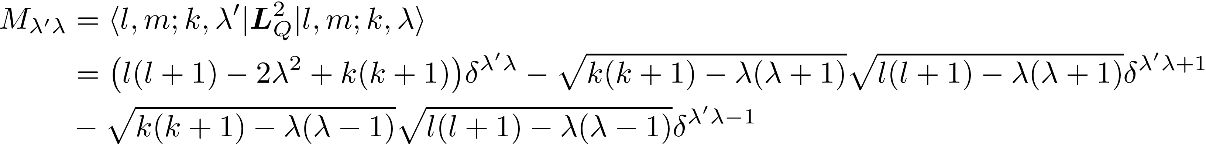
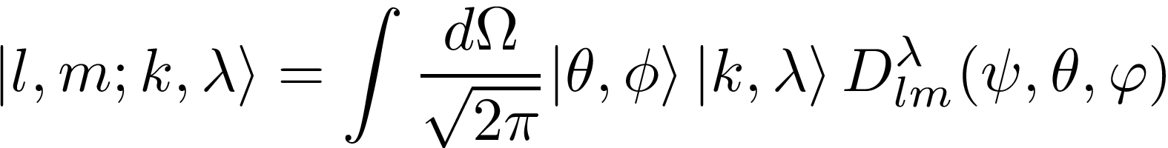

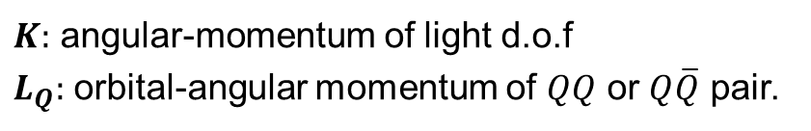
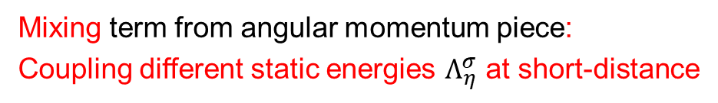
BOEFT
Brambilla, AM, Vairo
arXiv 2402.xxxxx
Adiabatic Radial Schrödinger equation: Mixing different static energies at short-distances:
Mixing term from angular momentum piece:
Coupling different static energies $Λ_{η}^{σ}$ at short-distance
General expression of $M_{λ^{′}λ}$ (matrix in $λ^{′}−λ$ basis) :
Angular wave-function:
$K:$ angular-momentum of light d.o.f
$L_{Q}:$ orbital-angular momentum of $QQ$ or $Q\overline{Q}$ pair.

Slide 11
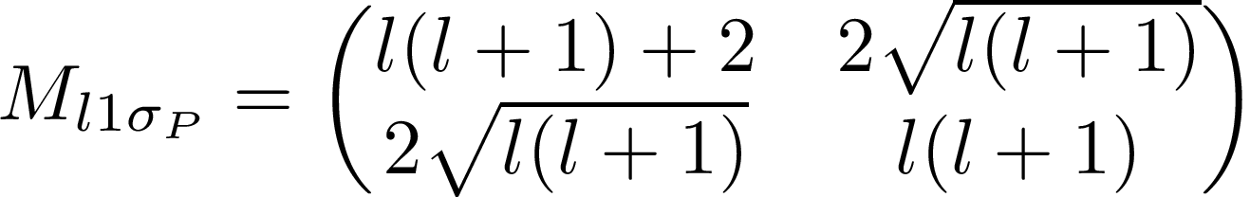
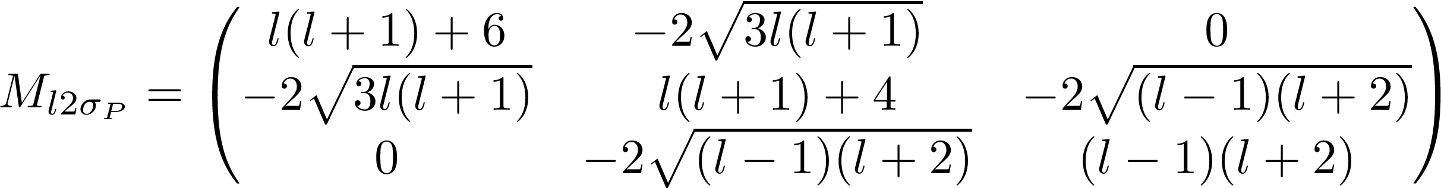
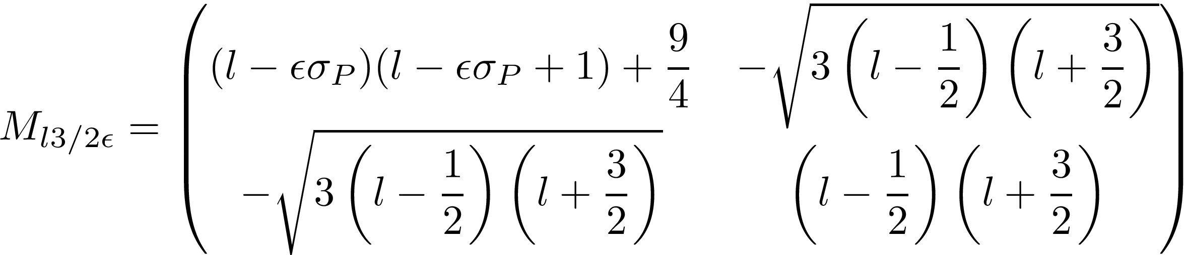

BOEFT
Brambilla, AM, Vairo
arXiv 2402.xxxxx
Lastly construct parity eigenstates (specifically for $λ>0$) : $M_{λ^{′}λ}$ in block-diagonal form.
Example of (adiabatic) mixing matrices $M_{λ^{′}λ}$ (accounting for parity) :
Mixing matrix for hybrid with $K^{PC}=1^{+ −}.$

Slide 12
Hybrids

Slide 13
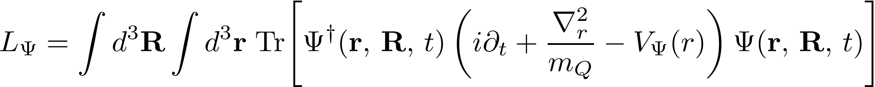
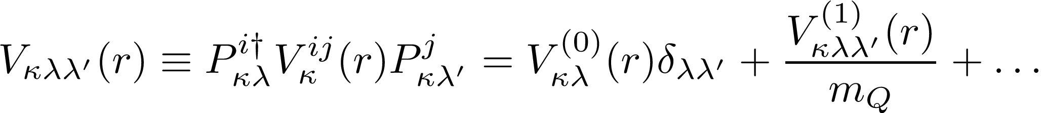
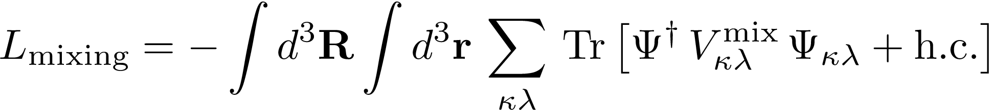
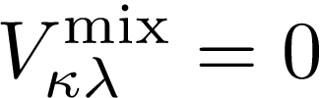


BOEFT: Hybrids
BOEFT Lagrangian:
Brambilla, Lai, AM, Vairo Phys. Rev. D 107, 054034 (2023)
Brambilla, Krein, Castellà , Vairo Phys. Rev. D. 97, (2018)
Quarkonium:
Trace over spin indices.
$r:$ relative coordinate
Hybrid:
$R:$ COM coordinate
v
Hybrid potential:
Brambilla, Lai, Segovia, Castellà, Vairo Phys. Rev. D. 101, (2020)
Static potential
Spin-dependent
potential
Brambilla, Lai, Segovia, Castellà, Vairo Phys. Rev. D. 99, (2019)
Hybrid-Quarkonium mixing:
Soto, Valls, arXiv 2302.01765
R. Oncala, J. Soto,
Phys. Rev. D96, 014004 (2017).
No lattice calculations on mixing potential. Current work, ignore mixing,
Notes:
In the static limit, quarkonium (the lowest potential ) and heavy hybrids (the remaining potentials) do not mix by construction (they are built as orthogonal states). Hence, the mixing must be due to 1/m corrections to the Born-Oppenheimer approximation

Slide 14
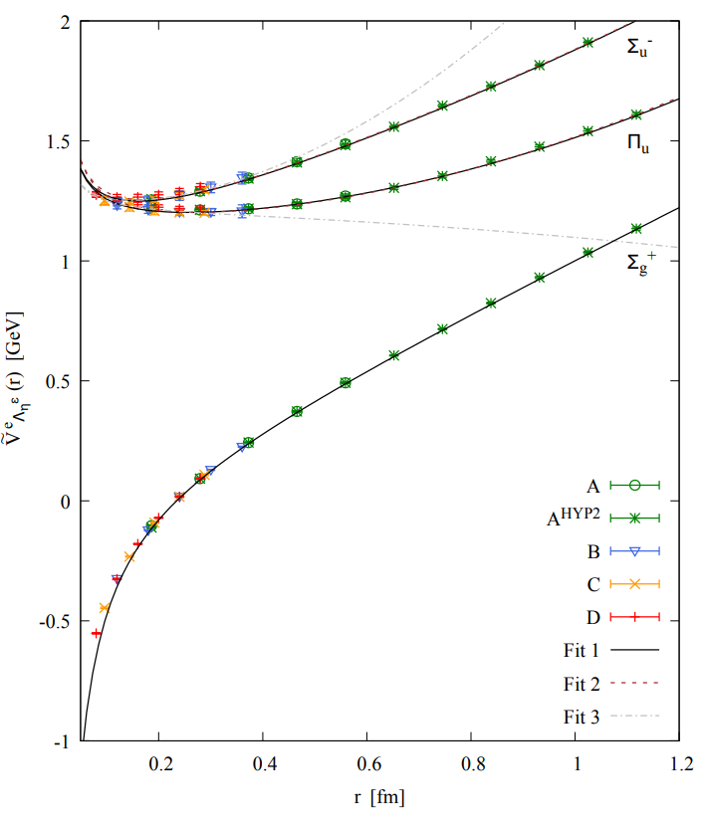

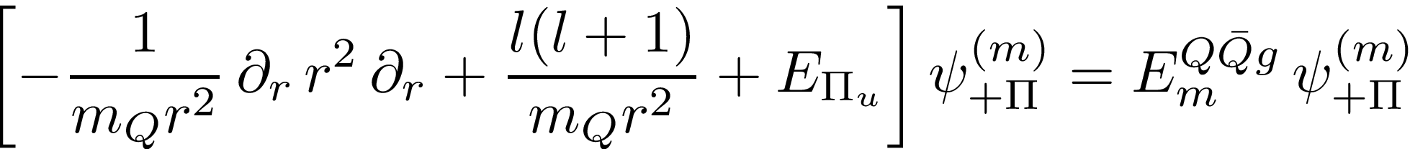

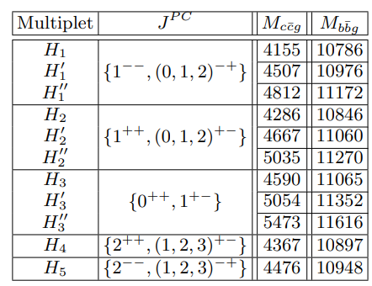
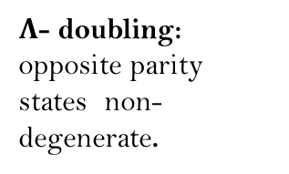
BOEFT: Hybrids
Degeneracy at $r→0$ , mixes $Σ_{u}^{−}$ and $Π_{u}$ potential
Coupled Schrödinger Eq:
Hybrid
Spectrum:
$Λ$- doubling:
opposite parity states non-degenerate.
Brambilla, Lai, AM, Vairo Phys. Rev. D 107, 054034 (2023)
Berwein, Brambilla, Castellà , Vairo Phys. Rev. D. 92, (2015)

Slide 15
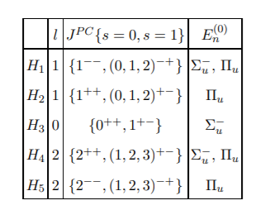
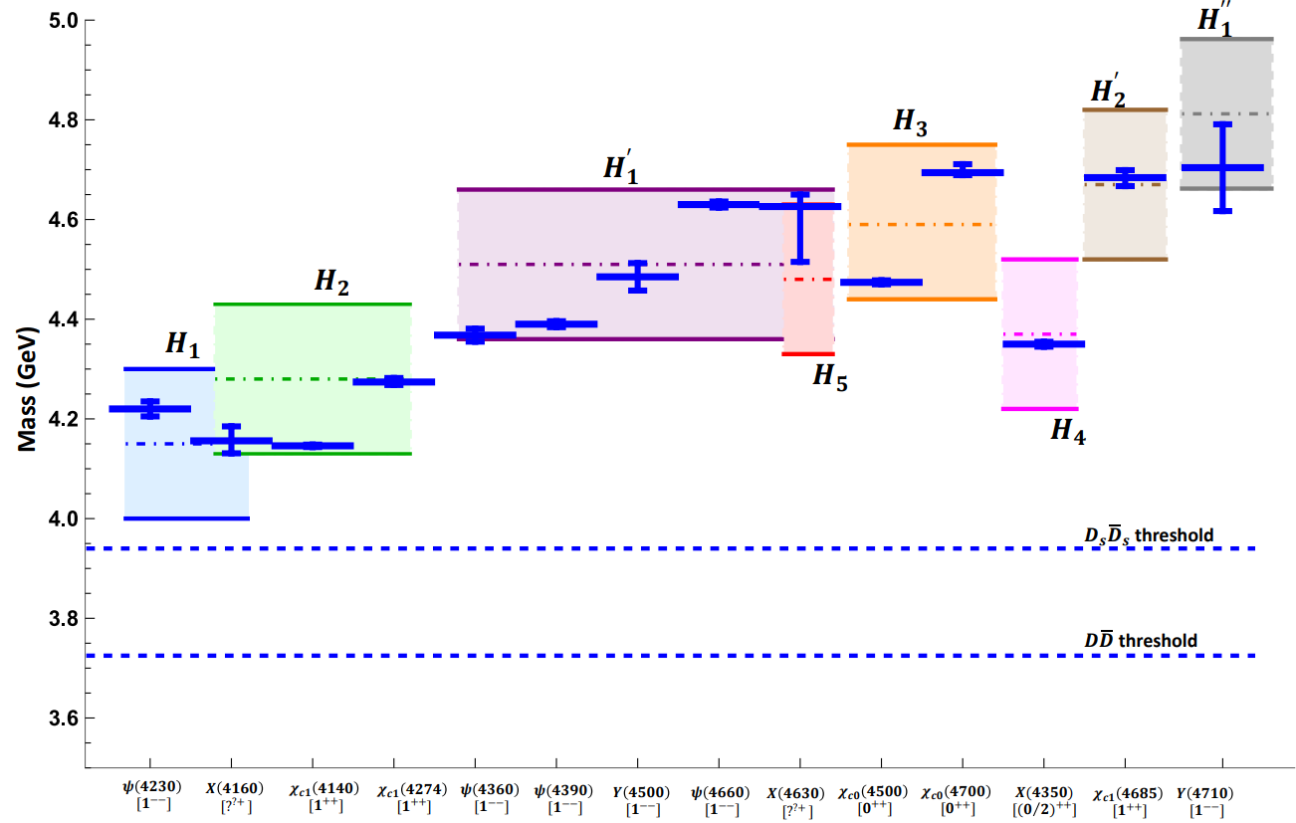
BOEFT: Hybrids
Charmonium hybrids: comparison with experimental results:
PDG 2022
Brambilla, Lai, AM, Vairo
Phys. Rev. D 107, 054034 (2023)
Spectrum with spin-dependence
potential: see J. Soto talk !!!

Slide 16
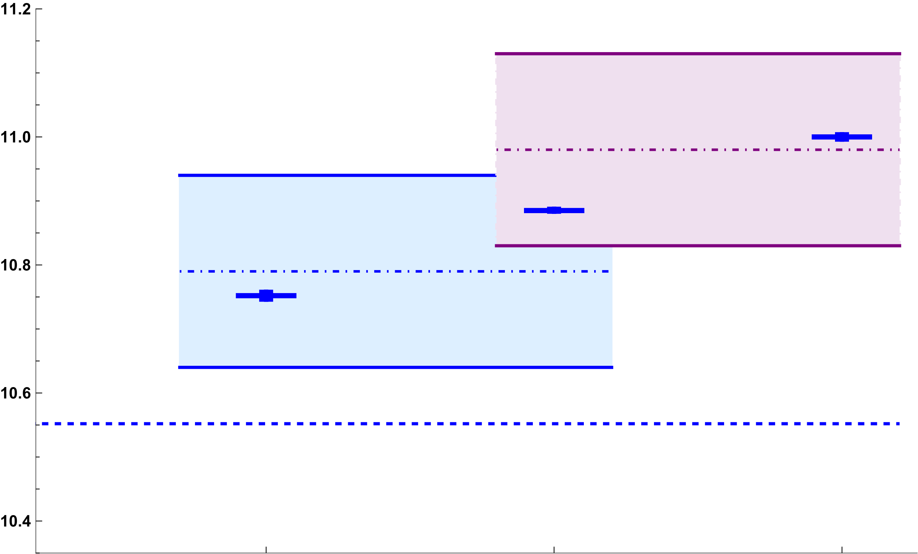






BOEFT: Hybrids
Bottomonium hybrids: comparison with experimental results:
$$H_{1}^{′}$$
$$H_{1}$$
Mass (GeV)
$B\overline{B}$ threshold
Spectrum with spin-dependence
potential: see J. Soto talk !!!
$$Υ\left(10753\right)$$
$$[1^{−−}]$$
$$Υ\left(10860\right)$$
$$[1^{−−}]$$
$$Υ\left(11020\right)$$
$$[1^{−−}]$$
PDG 2022
Brambilla, Lai, AM, Vairo arXiv:2212.09187

Slide 17
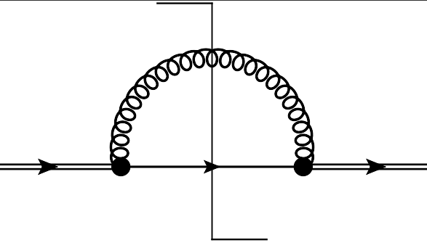
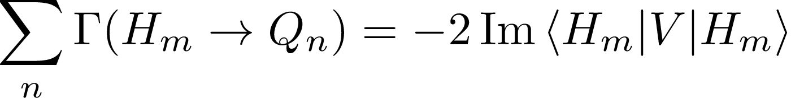
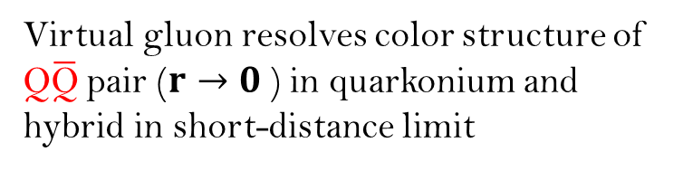


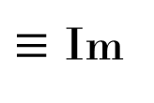






Hybrid Decays
Brambilla, Lai, AM, Vairo Phys. Rev. D 107, 054034 (2023)
BOEFT can describe decays of hybrids to quarkonium.
Semi-inclusive process: $H_{m}→Q_{n}+X$; $Q_{n}$: low-lying quarkonium (states below threshold) & X: light hadrons.
$ΔE$: Large energy difference $⇒ΔE≡ E_{H_{m}} −E_{Q_{n}}≿$ 1 GeV.
Hierarchy of scales: $\text{∆}\text{E} \text{≫ }{\text{Λ}}_{\text{QCD}}≫mv^{2}$
Constituent gluon of the hybrid is a spectator.
Perturbative computation
matching pNRQCD and BOEFT:
Virtual gluon resolves color structure of
$\text{Q}\overline{\text{Q}}$pair ($r→0$) in quarkonium and
hybrid in short-distance limit
$≡$ Im
$$H_{m}$$
$$H_{m}$$
$$Q$$
r
$\overline{Q}$
octet
singlet
octet
Quarkonium Singlet
pNRQCD
BOEFT
Hybrid Octet
Decays are computed from local imaginary terms in the hybrid potential (BOEFT potential).
DISCLAIMER!!!
Decay to open-flavor threshold states
not accounted here.
Optical theorem:
Notes:
The exclusive decay widths Γ(Hm → Qn) may be computed by selecting a suitable decay channel in the right-hand side of the above equation.

Slide 18
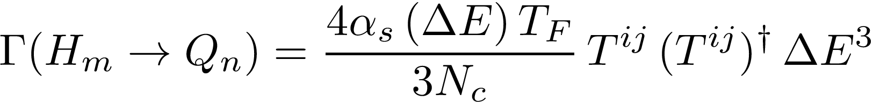
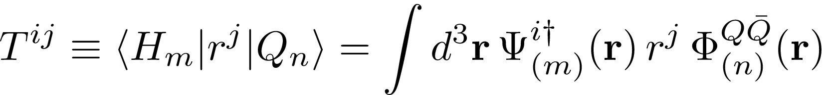
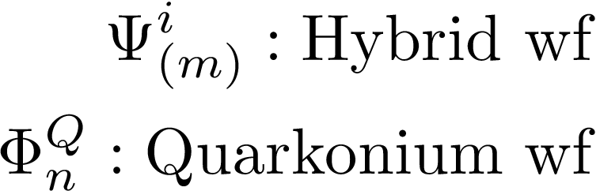
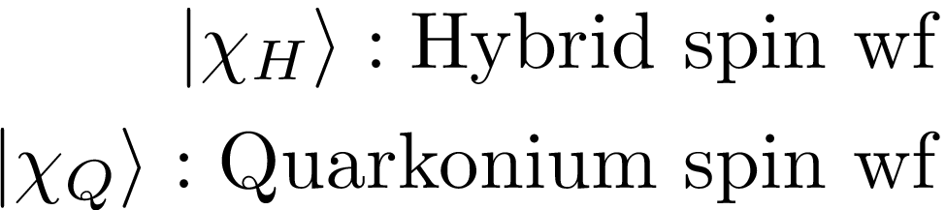
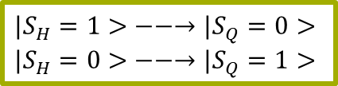


Hybrid Decays
Brambilla, Lai, AM, Vairo Phys. Rev. D 107, 054034 (2023)
Spin-conserving decay due to $r⋅E$ term :
DISCLAIMER!!!
Decay to open-flavor threshold
states not accounted here.
$|S_{H}=1> −−→|S_{Q}=1>$
$|S_{H}=0> −−→|S_{Q}=0>$
R. Oncala, J. Soto,
Phys. Rev. D96, 014004 (2017).
J. Castellà, E. Passemar,
Phys. Rev. D104, 034019 (2021)
$$〈H_{m}\left|r\right|Q_{n}⟩=\sqrt{T^{ij}{\left(T^{ij}\right)}^{†}}$$
Spin-flipping decay due to $S.B$ term:
$|S_{H}=1> −−→|S_{Q}=0>$
$|S_{H}=0> −−→|S_{Q}=1>$
Depends on overlap of quarkonium and hybrid wavefunctions.
Hybrid-to-Quarkonium transition decay rate
= spin-conserving + spin-flipping decay rates.
Our estimate of decay rate are lower-bounds for the total width of hybrids

Slide 19



Brambilla, Lai, AM, Vairo Phys. Rev. D 107, 054034 (2023)
Comparison: charm exotic states with corresponding charmonium hybrid state:
$H_{m}→Q_{n}+X$
spin-conserving + spin-flipping decays
=
lower bound on the total decay widths of hybrids which is compared with inclusive rate of physical states in PDG.
Notes:
Spin singlet member of the H2 multiplet, the spin-conserving decay leads to spin singlet ηc(1S) quarkonium in the final state and the spin-flipping decay leads to spin triplet χc(1P) quarkonium in the final state. However, these 681 states: χc1(4140) and χc1(4274) only decays to ϕJ/ψ which disfavours the hybrid interpretation. It has been suggested that these states could be isospin−0 charmonium tetraquark state.
The JPC quantum number of X(4160) have not yet been determined. However, the charge conjugation and mass suggest that it can be a candidate for the spin triplet 1−+ member of the H1 multiplet or the spin singlet 1++ member of the H2 multiplet. Since, X(4160) only decays into D∗ ¯D∗ mesons, this disfavors hybrid interpretation and favors a molecular interpretation of this state

Slide 20






Brambilla, Lai, AM, Vairo Phys. Rev. D 107, 054034 (2023)
Comparison: bottom exotic states with corresponding bottomonium hybrid state:
$H_{m}→Q_{n}+X$
spin-conserving + spin-flipping decays
=
lower bound on the total decay widths of hybrids which is compared with inclusive rate of physical states in PDG.
$Γ$ (MeV)
$$Υ\left(10753\right)$$
$$[1^{−−}]$$
$$Υ\left(10860\right)$$
$$[1^{−−}]$$
$$Υ\left(11020\right)$$
$$[1^{−−}]$$
Notes:
Upsilon(10753): Candidate of upsilon(3d) quarkonium state. And upsilon(10860) candidate for upsilon (5s) quarkonium state.

Slide 21




Hybrid: Mixing with heavy-light
Hybrid decays to meson-pair threshold states: $ΔE ≲Λ_{QCD}$
Conventional Wisdom: Hybrid decays to two S-wave mesons forbidden!
Kou & Pene, Phys Lett B 631 (2005)
Page, Phys Lett B 407 (1997)
Farina, Tecocoatzi, Giachino, Santopinto & Swanson, Phys Rev D 102 (2020)
Born Oppenheimer quantum numbers for hybrids and ground state meson pair
does allow for decay to two s-wave mesons.
Bruschini 2306.17120
Most quarkonium hybrids can decay into pair of s-wave mesons !!!
forbidden for decay into pair of s-wave mesons
see R. Bruschini talk !!!
Recent lattice computation for $c\overline{c}$ hybrid $1^{− +}$ decay to
Shi et al 2306.12884
Computing these decays of hybrid to threshold states in BOEFT framework ??
Notes:
Hybrid-quarkonium mixing can introduce corrections to the selection rules of Kou and Pene. Hybrid and meson-antimeson threshold states should have narrow avoided crossing since $g→q\overline{q}$

Slide 22




Hybrid: Mixing with heavy-light
Brambilla, AM, Vairo
arXiv 2402.xxxxx
Hybrid decays to meson-pair threshold states: $ΔE ≲Λ_{QCD}$
Conventional Wisdom: Hybrid decays to two S-wave mesons forbidden!
Kou & Pene, Phys Lett B 631 (2005)
Page, Phys Lett B 407 (1997)
Farina, Tecocoatzi, Giachino, Santopinto & Swanson, Phys Rev D 102 (2020)
BOEFT: Mixing allowed if $Λ_{η}^{σ}$(BO-quantum numbers) are same.
Hybrid
Meson-antimeson threshold
s-wave+s-wave
Ex. $D\overline{D}$ threshold
s-wave+p-wave
Ex. $D_{1}\overline{D}$ threshold
$Σ_{u}^{−}$ component in hybrids mix with $Σ_{u}^{−}$ component in s-wave+s-wave threshold!!!!
Bruschini 2306.17120
Bruschini & Gonzalez, 1912.07337
J. Castella 2401.13393
Notes:
Hybrid-quarkonium mixing can introduce corrections to the selection rules of Kou and Pene. Hybrid and meson-antimeson threshold states should have narrow avoided crossing since $g→q\overline{q}$

Slide 23
Tetraquarks &
Pentaquarks

Slide 24






BOEFT: $QQ\overline{q}\overline{q}$ multiplets
Brambilla, AM, Vairo arXiv 2402.xxxx
Defines the Born-Oppenheimer
static potentials $Σ_{g}^{+}, \{Σ_{g}^{−}, Π_{g}\}$
$J^{P}$ for $T_{cc}^{+}$
Limited lattice inputs available on Born-Oppenheimer static potentials $Σ_{g}^{+}, \{Σ_{g}^{−}, Π_{g}\}$
Bicudo, Cichy, Peters, & Wagner
PRD 93, 034501 (2016)

Slide 25





BOEFT: $Q\overline{Q}q\overline{q}$ multiplets
Brambilla, AM, Vairo arXiv 2402.xxxx
$J^{PC}$ for neutral partner of
$Z_{c},Z_{b}$ states. Probably mixing between both channels required ?
$J^{PC}$ for $X(3872)$
Limited lattice inputs available on Born-Oppenheimer
static potentials $Σ_{u}^{−}, \{Σ_{g}^{+}, Π_{g}\}$
Mixing of BO-potentials with pair of heavy-light states relevant for states near threshold. More on this mixing see Brambilla, AM, Vairo arXiv 2402.xxxx
Prelovsek, Bahtiyar, & Petkovic
Phys. Lett. B 805 (2020)

Slide 26




BOEFT: Pentaquark multiplets
$$Q\overline{Q}qqq$$
Brambilla, AM, Vairo arXiv 2402.xxxx
No lattice inputs available on Born-Oppenheimer
static potentials for pentaquarks
$$QQqq\overline{q}$$
Coupled Schrödinger equation for
these pentaquark states derived in
Brambilla, AM, Vairo arXiv 2402.xxxxx.

Slide 27

Takeaway message
Brambilla, Lai, AM, Vairo Phys. Rev. D 107, 054034 (2023)
Brambilla, AM, Vairo arXiv 2402.xxxxx
BOEFT provides a model-independent & systematic way to study heavy quark exotics.
BOEFT results for hybrid-to-quarkonium transition widths
Hybrid-to-Quarkonium transition decay rate = spin-conserving + spin-flipping decay rates.
Our analysis disfavors: $ψ(4230)$, $χ_{c1}(4140)$, $χ_{c0}(4500)$, $χ_{c0}(4700)$, and $X(4350)$ as pure hybrid states.
DISCLAIMER!!!
All the above interpretation can differ accounting for decays to
meson-pair threshold states and hybrid-quarkonium mixing.
Our analysis suggests:
$X\left(4160\right)$ : could be charm hybrid $H_{1}[2^{−+}](4155)$.
X$\left(4630\right)$ : could be charm hybrid $H_{1}[{(1/2}^{− +})](4507)$.
$ψ\left(4390\right)$ : could be charm hybrid $H_{1}[1^{−−}](4507)$.
$ψ\left(4710\right)$ : could be charm hybrid $H_{1}[{(1}^{− −})](4812)$.
$Υ\left(10753\right)$ : could be bottom hybrid $H_{1}[{(1}^{− −})](10786)$.
Obtained new results for tetraquark and pentaquark multiplets based on BOEFT.
BOEFT: describes static potential (BO-potential) mixing with heavy-light states .
Notes:
the recent observation of the transition Y (4260) → X(3872)γ makes the identification of Y (4260) as a hybrid highly unlikely. Also in Soto and Oncala find Y(4260) mass to be close to the spin-1 2d charmonium state in their analysis.

Slide 28
Thank you!!

Slide 29
Backup Slides

Slide 30

Virial theorem: Nonrelativistic Bound State
EFT lectures by A. Vairo
Notes:
In mechanics, the virial theorem provides a general equation that relates the average over time of the total kinetic energy of a stable system of discrete particles with that of the total potential energy of the system.

Slide 31






Born-Oppenheimer Philosophy
Sharp difference between time or energy scales of heavy & light degrees of freedom.
Ex. $H_{2}^{+}$ molecule: 2 protons &1 electron.
$$p$$
Protons (nuclei) move very slowly compared to electrons and can be considered static (fixed) when considering the motion of the electrons
$$r$$
electron
$$p$$
Electrons instantaneously adjust as r changes
Solve electron Schrödinger eq. for fixed r
Solve nuclei (proton) Schrödinger eq. with $E_{el}^{i}(r)$ as potential.
QCD states with 2-heavy quarks (XYZ mesons): analogous of molecules in atomic systems !!!
Heavy quarks $↔$ nuclei
Gluons & light quarks $↔$ electrons
Notes:
A complete understanding of exotic quarkonia in terms of these pictures has not yet been obtained

Slide 32


Comparison: charm exotic states with corresponding charmonium hybrid state:
Disfavors hybrid interpretation !
M. Ablikim et al, Chin.Phys.C,46,111002(2022).
Recent BESIII result for $ψ$(4230) decay: $72±33$ MeV
$$χ_{c0}\left(4500\right) \&χ_{c0}\left(4700\right)$$
Decay to $χ_{c}(1P)$ not seen !!!. Major contribution to theoretical estimate from this decay channel.
Brambilla, Lai, AM, Vairo
Phys. Rev. D 107, 054034 (2023)
Notes:
Spin singlet member of the H2 multiplet, the spin-conserving decay leads to spin singlet ηc(1S) quarkonium in the final state and the spin-flipping decay leads to spin triplet χc(1P) quarkonium in the final state. However, these states: χc1(4140) and χc1(4274) only decays to ϕJ/ψ which disfavours the hybrid interpretation. It has been suggested that these states could be isospin−0 charmonium tetraquark state.
The JPC quantum number of X(4160) have not yet been determined. However, the charge conjugation and mass suggest that it can be a candidate for the spin triplet 1−+ member of the H1 multiplet or the spin singlet 1++ member of the H2 multiplet. Since, X(4160) only decays into D∗ ¯D∗ mesons, this disfavors hybrid interpretation and favors a molecular interpretation of this state

Slide 33






Brambilla, Lai, AM, Vairo Phys. Rev. D 107, 054034 (2023)
Hybrid-to-quarkoniunium transition widths:
Could have a significant hybrid component.
$Υ\left(10860\right)$
Inclusive rate: $37±4$ MeV. Branching fraction for decay to open-bottom mesons: 76.6%. Decay rate to quarkonium: ${8.8}_{−1.8}^{+2.6}$ MeV. Good agreement with our lower-bound estimate for $H_{1}[1^{−−}](10786)$.
Candidate for $Υ(5S)$ state
$Γ$ (MeV)
$Υ\left(11020\right) \& Υ\left(10753\right)$
Large branching fraction for decays to open-bottom mesons expected. Different quark model calculations predict large branching fraction. Need experimental input on branching fraction.
See H$\ddot{u}$sken, Mitchell & Swanson, Phys Rev D 106 (2022).
$Υ\left(10753\right)$: Candidate for $Υ(3D)$ state.
$$Υ\left(10753\right)$$
$$[1^{−−}]$$
$$Υ\left(10860\right)$$
$$[1^{−−}]$$
$$Υ\left(11020\right)$$
$$[1^{−−}]$$
Notes:
Upsilon(10753): Candidate of upsilon(3d) quarkonium state. And upsilon(10860) candidate for upsilon (5s) quarkonium state.

Slide 34

pNRQCD
Notes:
Fermi theory of weak interaction: EFT for energy scale less than W and Z-boson mass ( roughly 80 GeV). Hydrogen atom is an EFT for energy scale less than electron mass, lambda_QCD or proton mass etc.

Slide 35

pNRQCD
Notes:
Fermi theory of weak interaction: EFT for energy scale less than W and Z-boson mass ( roughly 80 GeV). Hydrogen atom is an EFT for energy scale less than electron mass, lambda_QCD or proton mass etc.

Slide 36





Hybrid Decays
Brambilla, Lai, AM, Vairo Phys. Rev. D 107, 054034 (2023)
Hierarchy of scales: $\text{∆}\text{E} \text{≫ }{\text{Λ}}_{\text{QCD}}≫mv^{2}$. Integrate out the scale $ΔE$ perutbatively.
matching pNRQCD and BOEFT:
Virtual gluon resolves color structure of
$\text{Q}\overline{\text{Q}}$pair ($r→0$) in quarkonium and
hybrid in short-distance limit
$≡$ Im
$$H_{m}$$
$$H_{m}$$
Quarkonium Singlet
Hybrid Octet
singlet
BOEFT
octet
octet
pNRQCD
Spin preserving decays $[O\left(r^{2}\right)]$
Spin flipping decays $[O\left(1/m^{2}\right)]$
Notes:
The exclusive decay widths Γ(Hm → Qn) may be computed by selecting a suitable decay channel in the right-hand side of the above equation.

Slide 37


Hybrid Decays
Brambilla, Lai, AM, Vairo Phys. Rev. D 107, 054034 (2023)
Color configuration of $\text{Q}\overline{\text{Q}}$pair ($r→0$): quarkonium and hybrid in short-distance limit
$$Q$$
r
$\overline{Q}$
Quarkonium Singlet
Hybrid Octet
Quarkonium and Hybrid fields in short-distance limit $r→0$ (matching condition)
singlet (S) and octet (O)
Fields:
$G_{κ}^{ia}$: Gluon fields
$V_{s} \& V_{o}$: singlet and octet
potential
Potentials:
$Λ$: gluelump mass
For decay rate computation, start with effective theory of singlet and octet fields and match to
BOEFT of quarkonium and hybrid fields
Notes:
The potential term contains the imaginary term.

Slide 38







BOEFT
Brambilla, Lai, AM, Vairo arXiv:2212.09187
Quarkonium static potential:
Quarkonium Potential:
Hybrid static potential:
Gluonic Static energies from lattice:
Hybrid Potential:
$Λ_{RS}$ : 0.87 (15) GeV
Gluelump mass definition:
Schlosser and Wagner Phys. Rev. D. 105, (2022)
Perturbative RS-scheme potentials $V_{o}^{RS}$ upto order$α_{s}^{3}.$
Berwein, Brambilla, Castellà , Vairo Phys. Rev. D. 92, (2015)
Bali and Pineda Phys. Rev. D. 69, (2004)

Slide 39








Hybrid-Quarkonium mixing and impact on
hybrid interpretation of Exotics ?
Brambilla, AM, Vairo, Wagner, Schlosser (in progress)
Hybrid states in the same energy range and with same quantum #’s as quarkonium can mix.
Mixing impacts spectrum and decay properties of hybrid. Implications for exotic hadrons !!.
Oncala & Soto, PRD (2017).
Ex.
Effect on decay:
Hybrid-quarkonium mixing through heavy-quark spin dependent operator. Mixing potential at $O(1/m)$ in BOEFT.
Matching two-point correlators in NRQCD and BOEFT:
Expression after matching:
$$H_{m}$$
$${Q′}_{m}$$
$$=$$
Above expression can be computed on lattice if we identify:
NRQCD
BOEFT
Notes:
Behavior of mixing potential at short and long distances determined from the pNRQCD and effective string theory. At short distances, pNRQCD will imply there is degeneracy.

Slide 40






pNRQCD/BOEFT: Potentials
(Light d.o.f)
Short-distance behavior of BO-Potentials:
$${(x}_{1}, −T/2)$$
$${(x}_{1}, T/2)$$
$${(x}_{1}, −T/2)$$
$${(x}_{1}, T/2)$$
$$H(0,−T/2)$$
$$H(0,T/2)$$
Long-distance behavior of BO-Potentials:
String behavior (pure SU(3) gauge theory)
$${(x}_{2}, −T/2)$$
(a)
$${(x}_{2}, T/2)$$
$${(x}_{2}, −T/2)$$
(b)
$${(x}_{2}, T/2)$$
Mixing with pair of heavy-light states
based on BO-quantum numbers or $Λ_{η}^{σ}$
representations
Wilson loop for quarkonium
Wilson loop for exotics
Brambilla, AM, Vairo
arXiv 2402.xxxxx
K. Juge, J. Kuti, C. Morningstar,
Phys. Rev. Lett. 90 (2003)
Bali et al (SESAM collaboration),
Phys. Rev. D. 71 (2005)
Bulava et al, Phys. Lett. B. 793 (2019)

