Slide 1

B anomalies: an experimental perspective
Jim Libby (IIT Madras)
15th December 2022

Slide 2
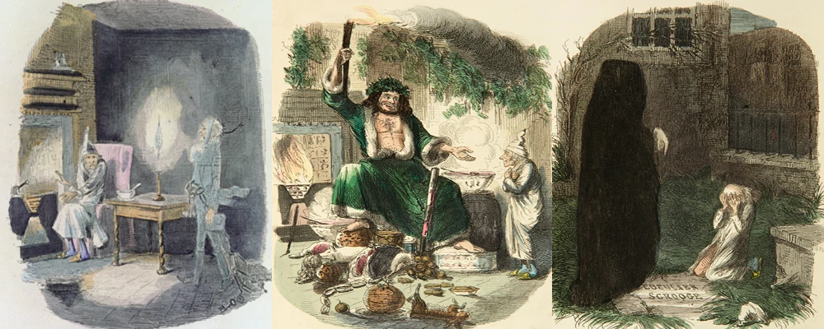
A Dickensian overview
B-anomalies past
  continuation of flavour history
B-anomalies present
  review of the measurements
B-anomalies future
  LHC experiments
  Belle II

Slide 3
Flavour physics – history of discovery
Several aspects of the SM came about through flavour predictions
  GIM mechanism to explain rate of
  results in prediction of charm quark
  Kobayashi-Maskawa extend to three generations to explain CP violation
  B mixing ⇒ heavy top
Common: low energy phenomena probing higher mass scales

Slide 4
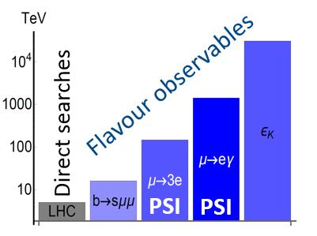

Complementarity to direct searches
Loop-mediated processes in quark and lepton flavour allow probes of higher masses scales
Names of the game
  Precise measurement
  Rare process search
Pattern of deviations from SM can point to toward what is next
Figure from A. Crivellin talk to Belle II Summer Workshop

Slide 5
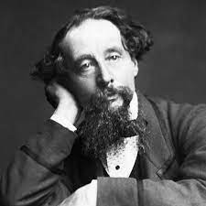
B anomalies Present
“There are books talks of which the backs conclusion and covers titles are by far the best parts”, paraphrasing Dickens

Slide 6
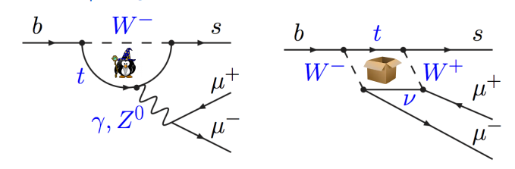
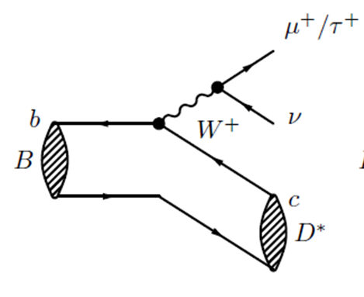
Overview of B modes with anomalies
Flavour changing neutral current b→sll at loop level only
Tree level b→cτν semileptonic
 | Pro | Con
b→sll | New physics reach O(10 TeV) | One experiment
b→cτν | Three experiments | New physics near the EW scale

Slide 7

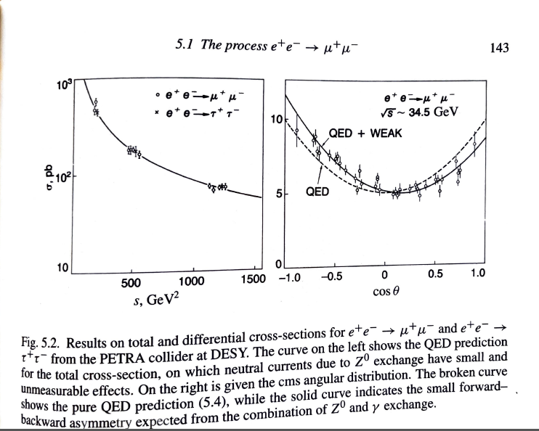
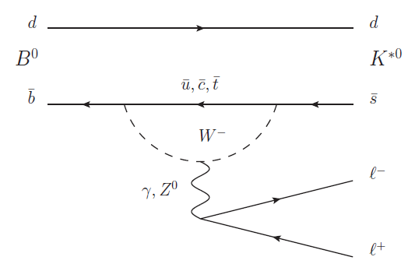
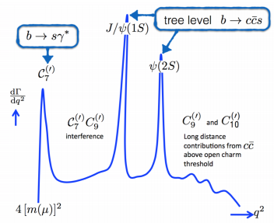
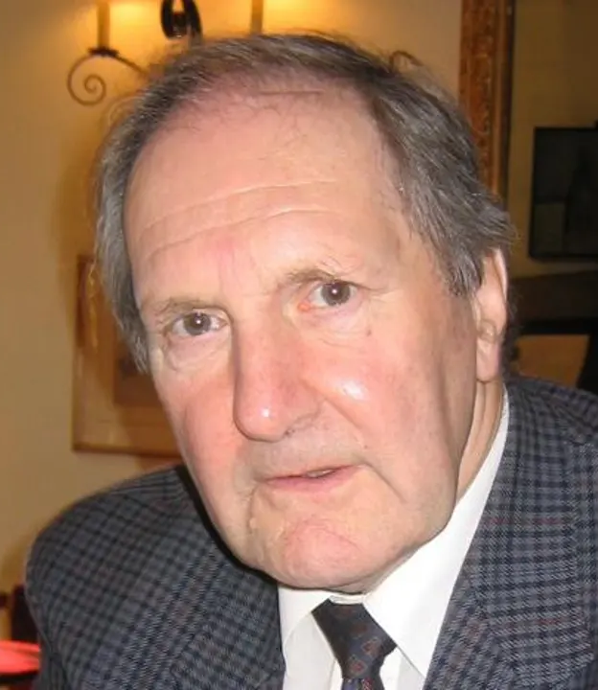
B→K*(892)l⁺l⁻
The K*→Kπ decay leads to four-body final state
Allows differential distributions to be probed
  Large new physics contributions possible as they appear via interference
  Textbook example forward-backward asymmetries in e⁺e⁻
Also variation with the invariant mass of the l⁺l⁻ system - q²
1925 - 2022

Slide 8
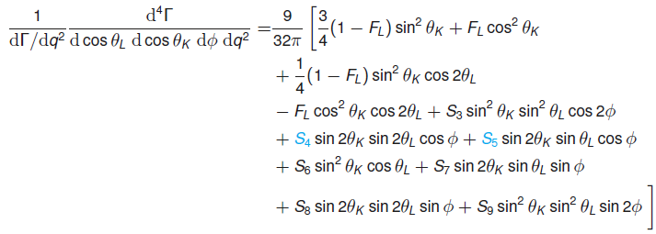
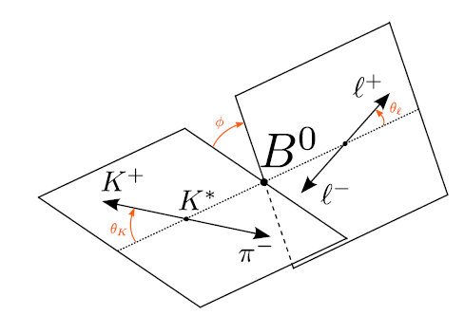
B→K*(892)l⁺l⁻ nomenclature
Goal is to measure this 4D differential distribution and extract the coefficients from data to compare to the SM predictions
Much work on defining observables with minimal theoretical uncertainties
Let us focus on S₅ which get normalized as
to minimize form factor uncertainties

Slide 9
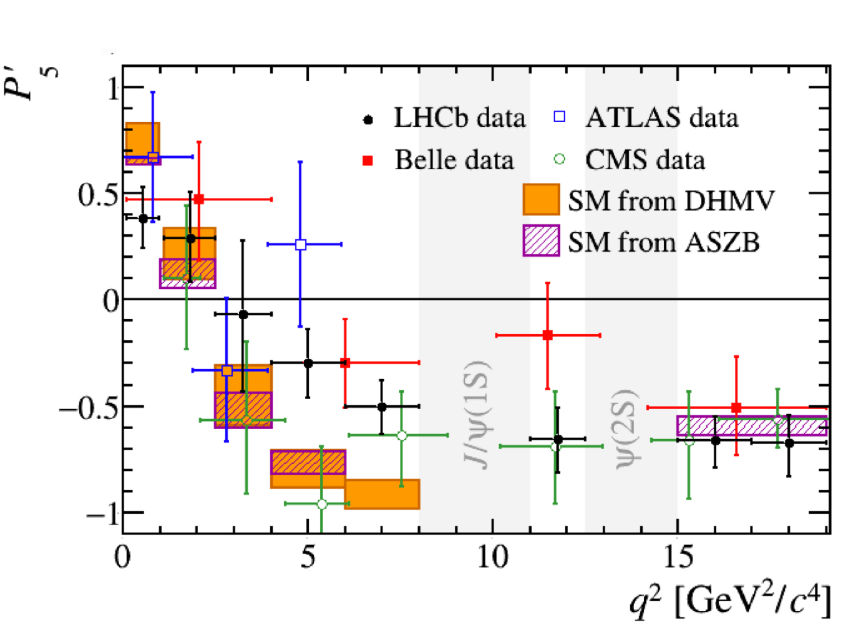
P₅′ anomaly: the first in b→sl⁺l⁻
Constructed in such a way that the form factor dependence is minimized
Note this is just for
B⁰→K*⁰ (K⁺π⁻)μ⁺μ⁻ -
time to talk about LHCb
PRL 125, 011802 (2020)
PLB 781, 517 (2018)
JHEP 10 (2018) 047
PRL 118, 111801 (2017)
JHEP 12 (2014) 125
JHEP 09 (2010) 089
> 3 σ disagreement with Standard Model

Slide 10
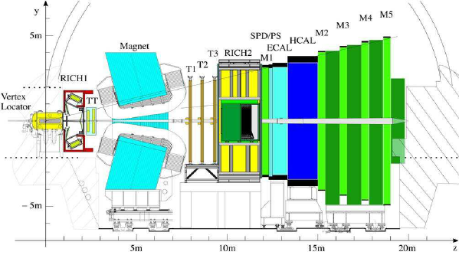
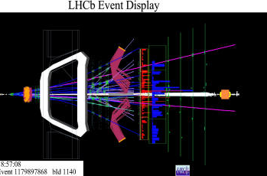
LHCb in a slide
13 TeV pp collisions
  trillion bb/2 fb⁻¹
  6 fb ⁻¹ @ 13 TeV
  + 3 fb ⁻¹ @ 7/8 TeV
Forward geometry gets both b quarks in acceptance and boosted – exploit b lifetime to separate background
RICHes for π/K separation
Full trigger bandwidth for B physics

Slide 11
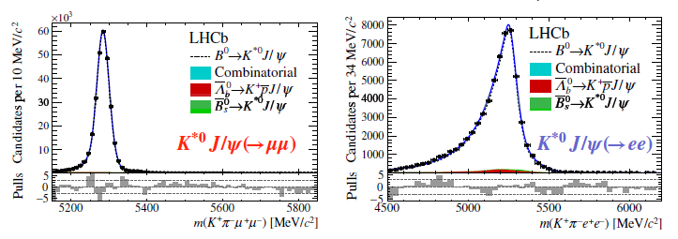
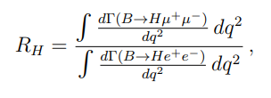
Tests of Lepton Universality Violation (LUV)
JHEP 08 (2017) 055
H=K or K*
Standard Model prediction ~1 to a few %
  limited theoretical uncertainties
B→K^{(*)}J/ψ(l⁺l⁻) bountiful control channel

Slide 12
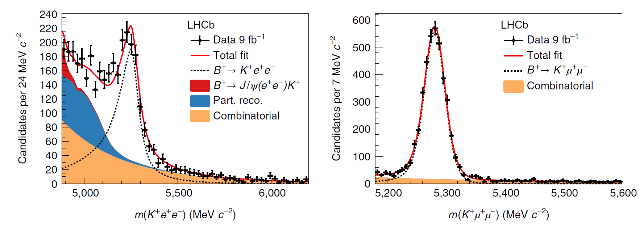
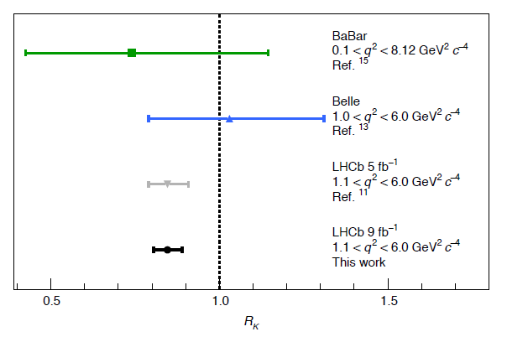
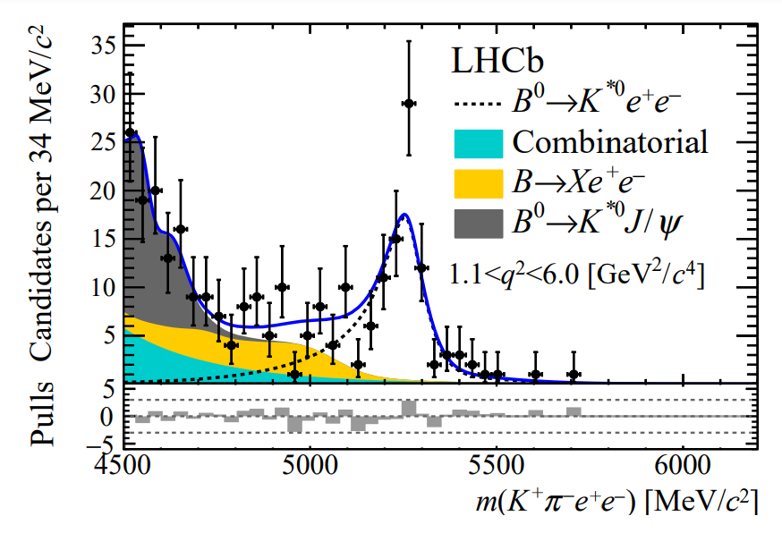
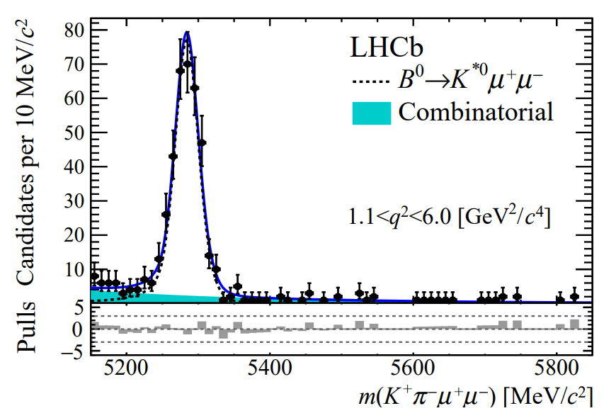
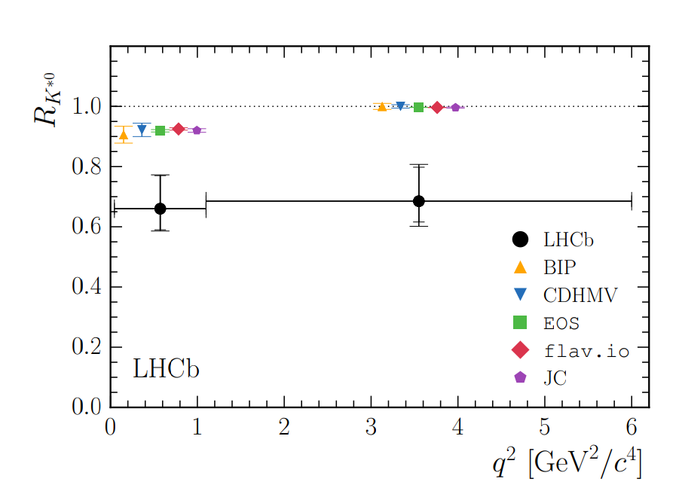
The results: muons low
Consistent picture in other
modes (backup)
B→K*l⁺l⁻ PRL Nature Physics 18 (2022) 277 – Run 1 + 2
3.1σ
B→K*l⁺l⁻ JHEP 08 (2017) 055 – Run 1 (25% data)
2.1σ
2.4σ

Slide 13
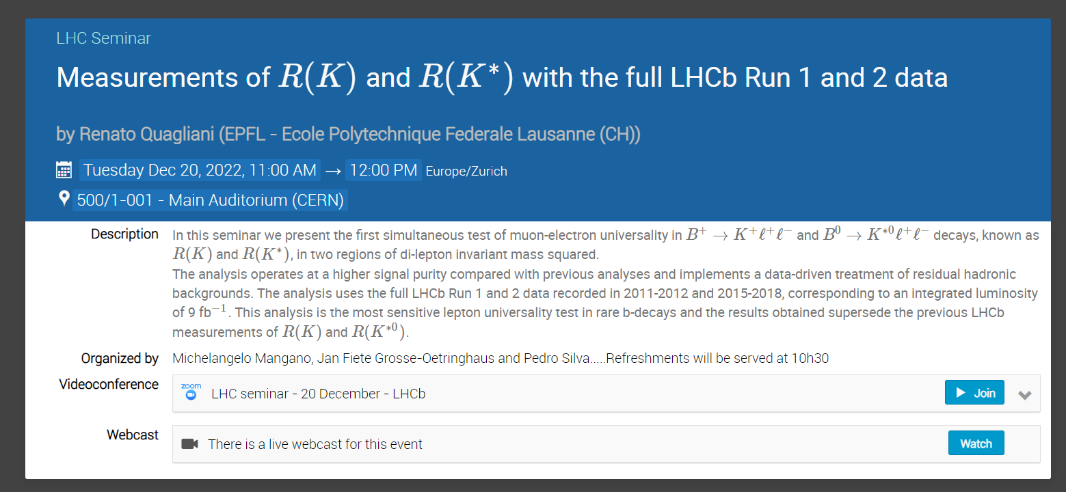

Slide 14
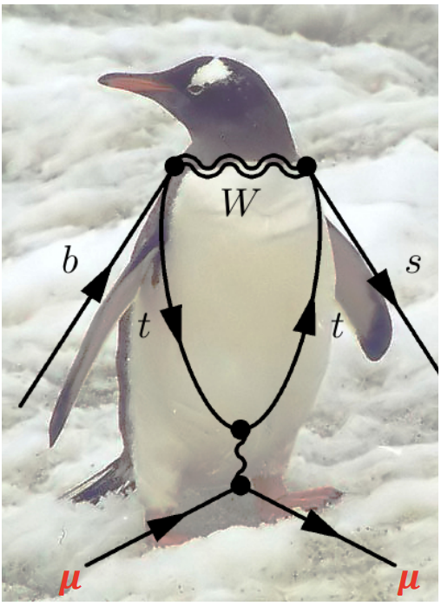
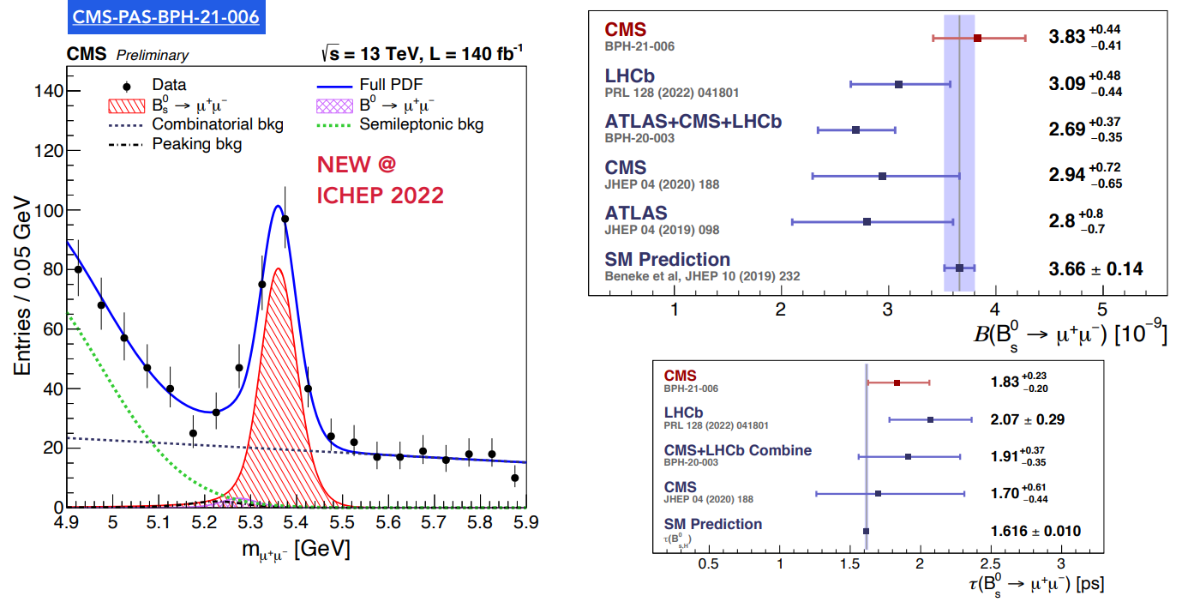

Anomaly related: B_{(s)}→μ⁺μ⁻
Highly suppressed in the SM
Therefore, readily enhanced by non-SM contributions
Clean experimental signature
Theoretically clean: decay constant vs form factors

Slide 15
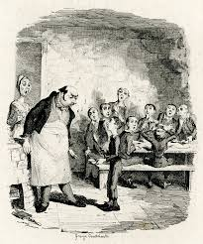
“Please SIR, I WANT SOme More”

Slide 16
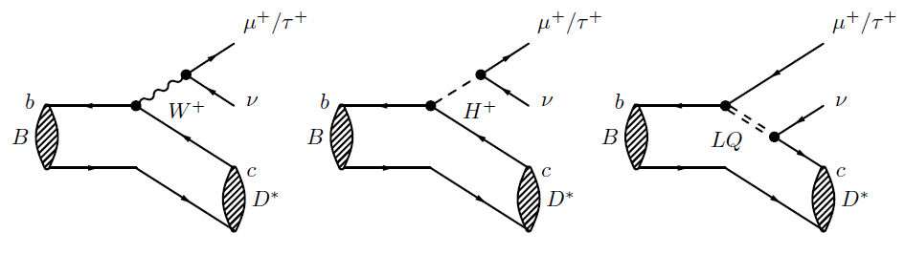
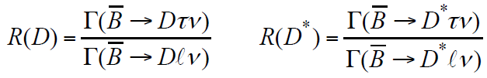
Semi-tauonic decays
Tree level in the SM but allows lepton universality tests
Measure ratios to reduce theoretical and experimental uncertainties
BaBar reported an anomalous result PRL 109, 101802 (2012) much activity since

Slide 17

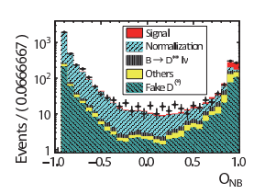
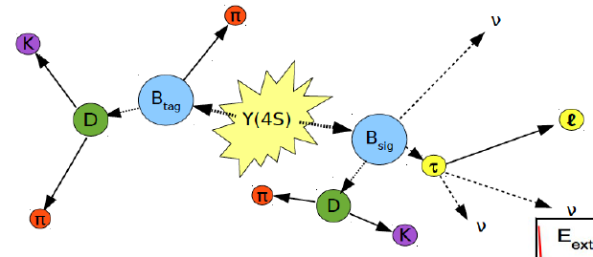
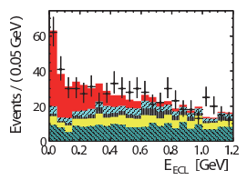
Belle results
Tag signal by fully reconstructing or identifying a semileptonic (SL) decay of the other B
Then use residual energy in ECL, missing mass, multivariates and/or lepton momentum to separate signal
Example: Phys. Rev. D 94, 072007 (2016)
  Semileptonic tag

Slide 18
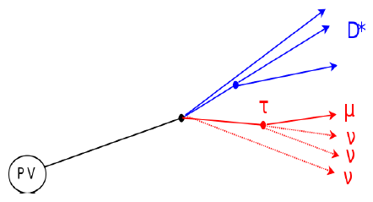
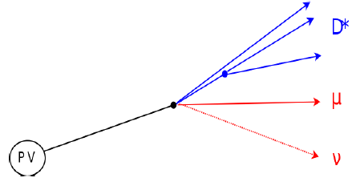

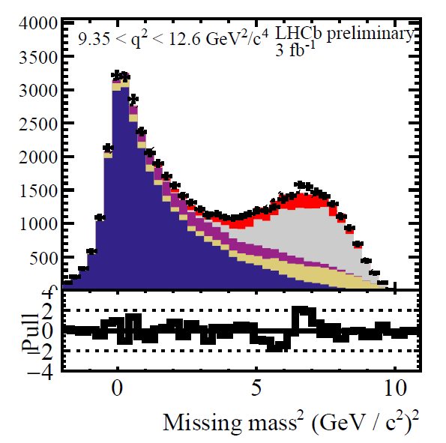
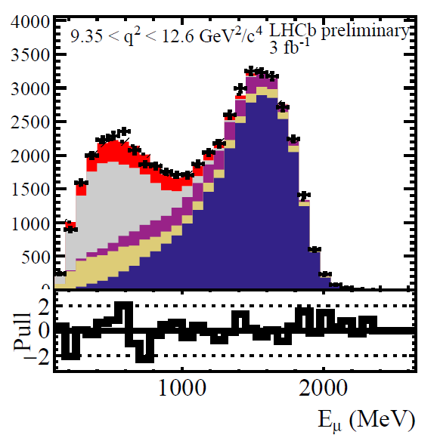
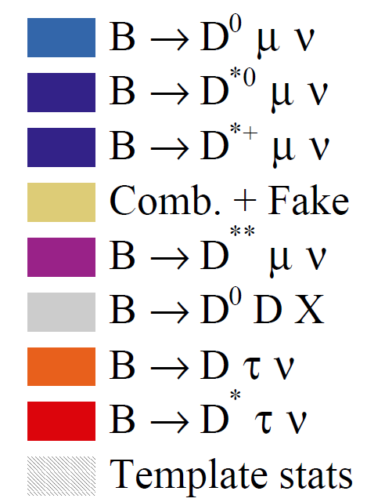
LHCb-PAPER-2022-039 in preparation
LHCb also in the game using their vertexing prowess – Run 1 data only 3 fb⁻¹
Use B flight for transverse momentum and approximate full longitudinal boost to measured component → 20% B momentum resolution
Template fit in bins of q², E_{μ} and missing-mass square in B’s frame
  New: simultaneously fit to D and D* signal + control samples
Signal
Norm

Slide 19
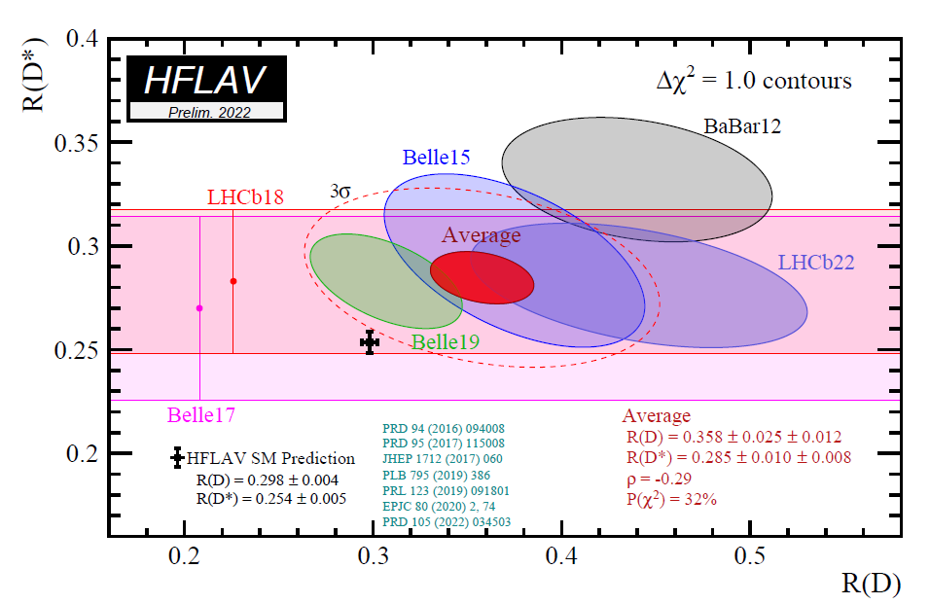
3.2σ deviation w.r.t. SM

Slide 20
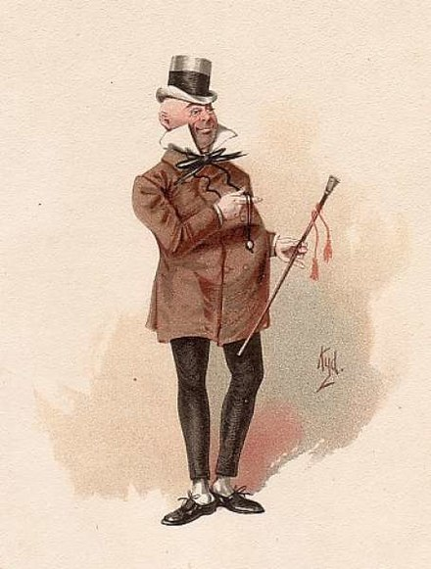
B AnomAlIES: The Future
‘Something will turn up’, Mr. Micawber (David Copperfield)

Slide 21
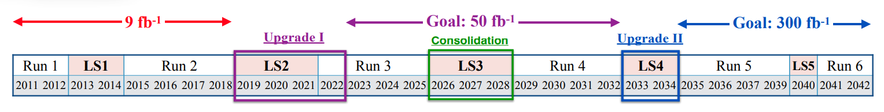
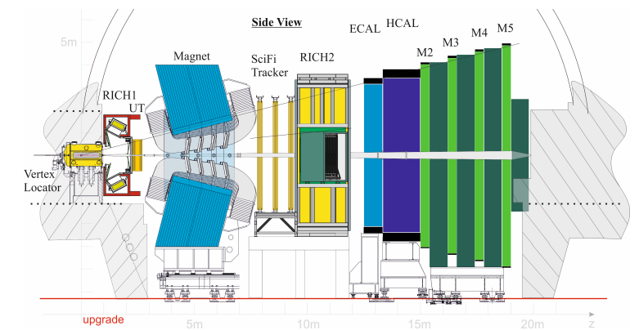
LHCb status
New silicon vertex, tracker and SciFi tracker
40 MHz readout – factor 2-4 more in the trigger efficiency for hadrons (not so important for anomalies)
LHCb will continue to have a big impact
CMS and ATLAS also focusing more on B-physics in the future

Slide 22

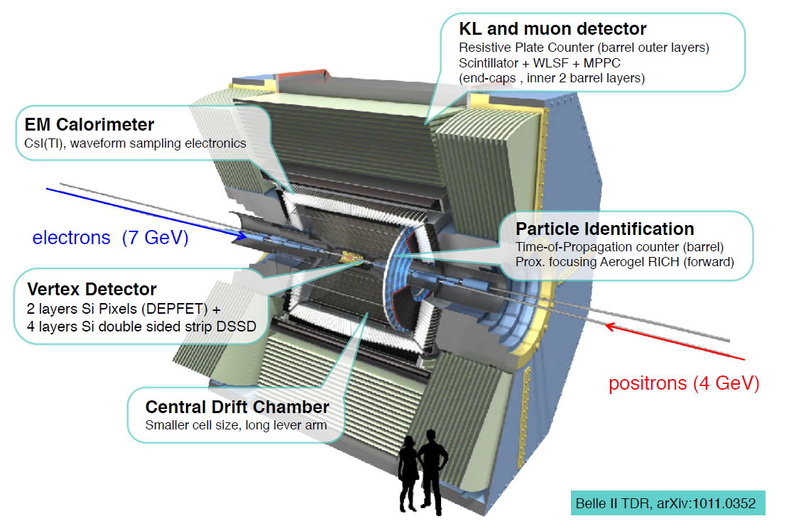
Belle II
See K. Trabelsi plenary
Key advantages for anomaly measurements
Hermiticity
Known initial state kinematics, i.e., good missing momentum resolution
Similar electron and muon identification efficiencies
Disadvantage: sample size

Slide 23
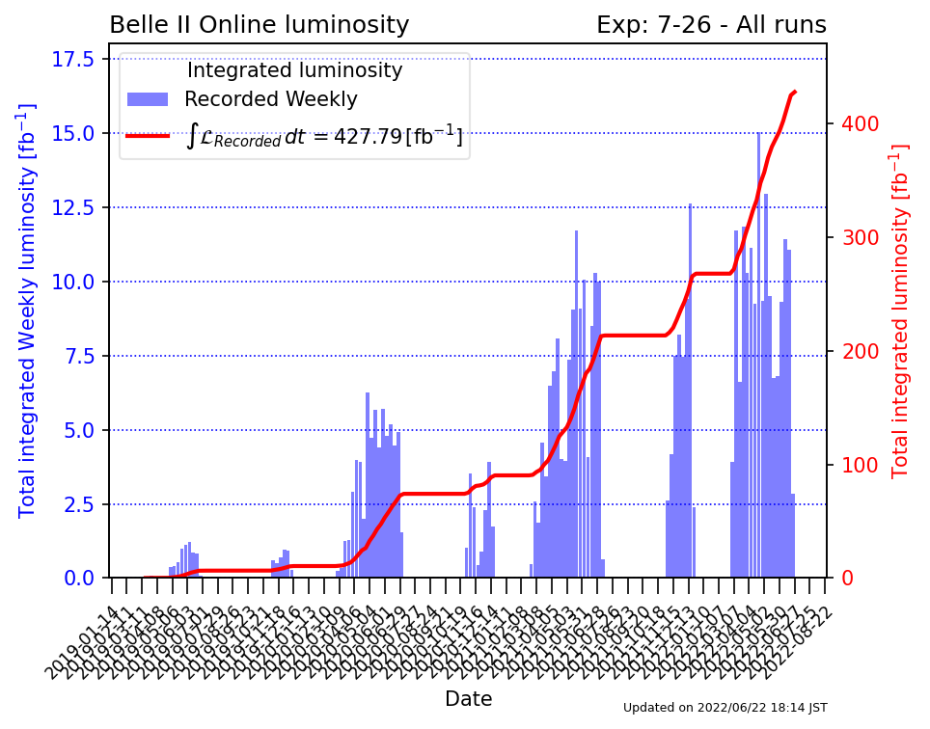

Integrated luminosity so far
2021 2022
2019 2020

Slide 24
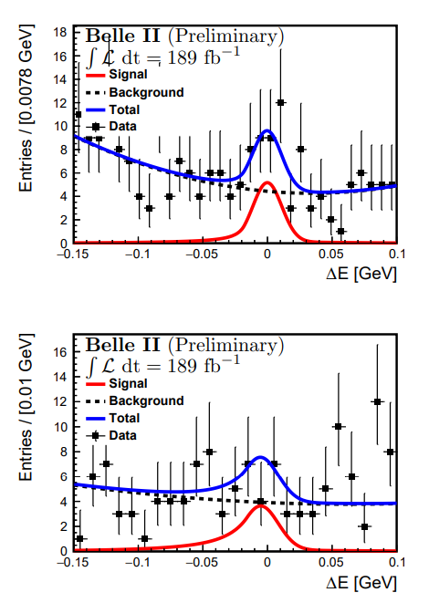
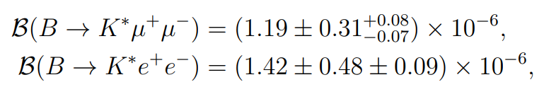
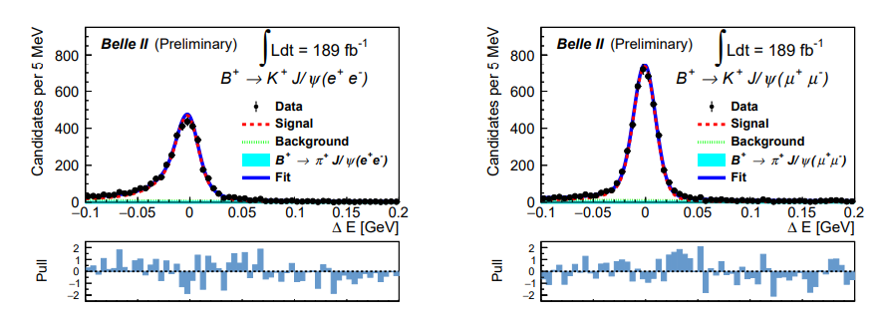
b → sll related results from Belle II
B→K*ll (charged and neutral) studied
  Similar efficiency for e and μ
  Absolute measurement possible
  arXiv:2206.05946 [hep-ex]
B→J/ψK also studied - arXiv:2207.11275 [hep-ex]

Slide 25
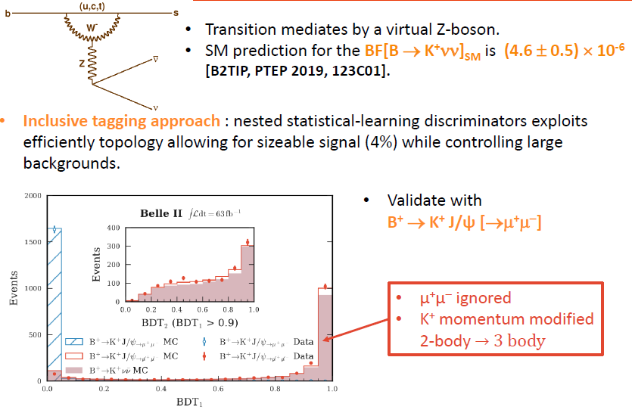
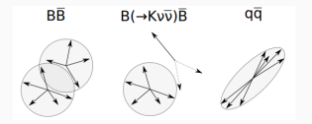
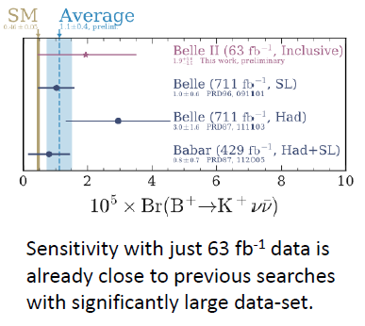
b→sνν - PRL 127, 181802 (2021)
ICTS Horizons meeting
25

Slide 26
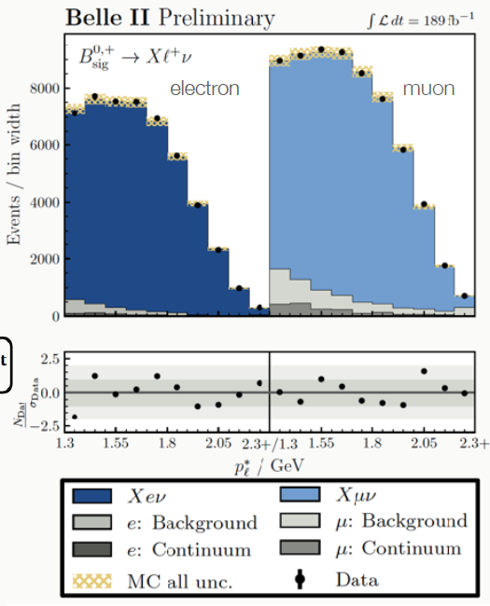
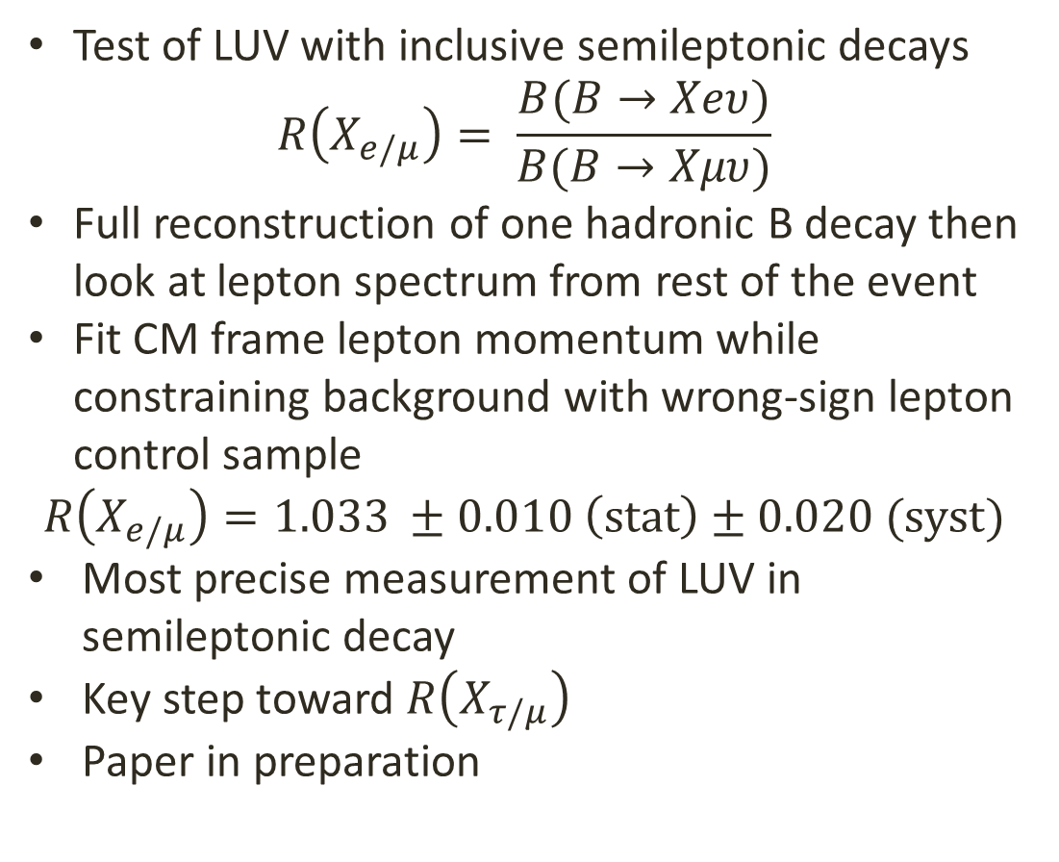
Semileptonic LUV results from Belle II
Test of LUV with inclusive semileptonic decays
$$R\left(X_{e/μ}\right)= \frac{B(B→Xeυ)}{B(B→Xμυ)}$$
Full reconstruction of one hadronic B decay then look at lepton spectrum from rest of the event
Fit CM frame lepton momentum while constraining background with wrong-sign lepton control sample
$$R\left(X_{e/μ}\right)=1.033 ±0.010 \left(stat\right)±0.020 (syst)$$
Most precise measurement of LUV in semileptonic decay
Key step toward $R\left(X_{τ/μ}\right)$
Paper in preparation

Slide 27
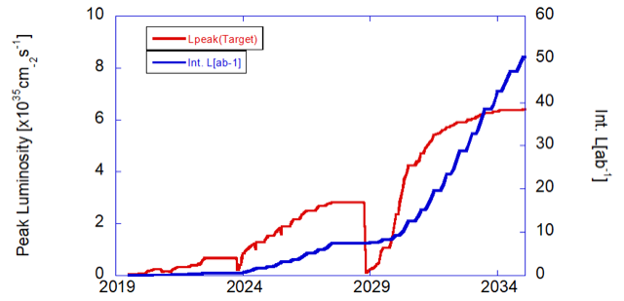
Belle II data-taking plan
High backgrounds from the beams have made stable running at high luminosity difficult
We have not accumulated data at the rate anticipated
Long shutdown ongoing: accelerator and detector improvements
Path to 2 x 10³⁵ cm⁻²s⁻¹
but thereafter more work required
Long shutdown 2 for upgrade of detector and IR

Slide 28






Some Belle II prospects
arXiv:2110.03871
PRL 120 (2018) 181802
https://arxiv.org/pdf/2207.06307.pdf - Belle II Snowmass
Nitty gritty and up to date predictions of what we can achieve

Slide 29

Conclusion
‘It was the best of times, …..’
  Many measurements in B decay (and elsewhere) showing deviations from the SM – several related to lepton flavour universality violation
‘it was the worst of times.’
  No single 5σ observation in a robust observable
  No corroboration between two experiments
However, more data coming for LHC and Belle II
Let us see where we are by the XXVIth DAE-BRNS

Slide 30
BACKUP

Slide 31

Guy Wilkinson ECFA Open Session July 2022

