Slide 1
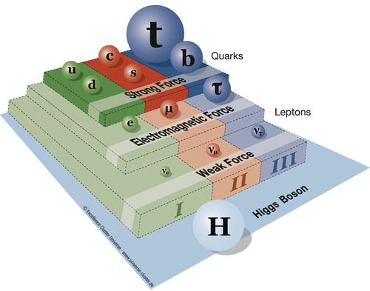


Probing new physics with top quarks at LHC
Dr. Soureek Mitra
Institute of Experimental Particle Physics (ETP),
Karlsruhe Institute of Technology (KIT),
Karlsruhe, Germany
DAE HEP 2022, IISER Mohali

Slide 2
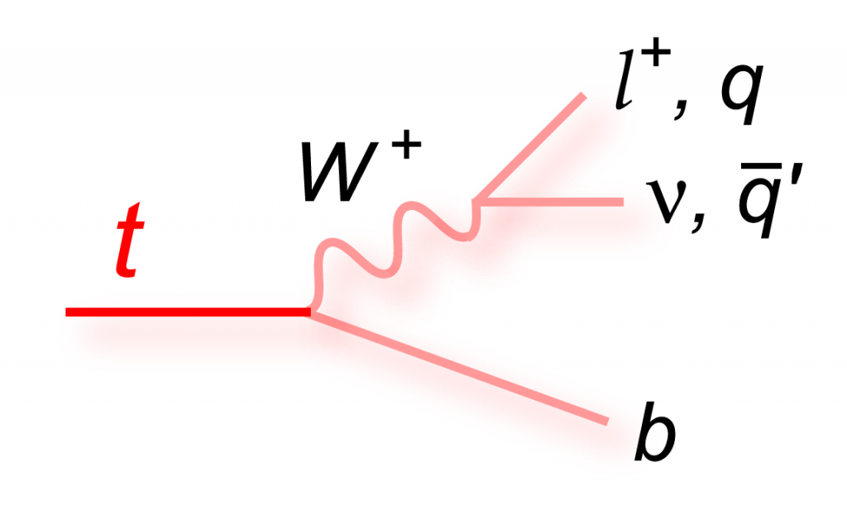
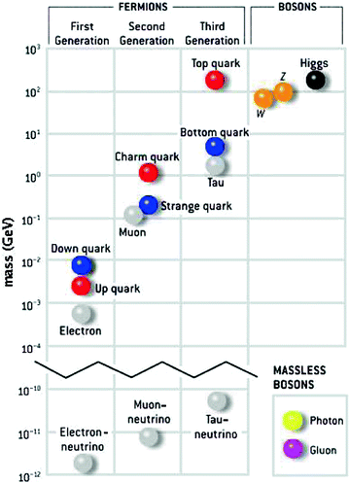


The top quark
Heaviest known elementary particle (m_{t} ~ 172 GeV) ➛ largest coupling to the Higgs boson
Discovered 27 years ago at TeVatron, Fermilab, USA
Sensitive to stability of EW vacuum
Decays almost exclusively to bW pair
Unique behavior:
τdecay (≈10⁻²⁵ s) < τhad. (≈10⁻²⁴ s) ➛ access to bare quark properties via its daughters
$$beν$$
$$bμν$$
$$bτν$$
$$bq\overline{q^{′}}$$

Slide 3
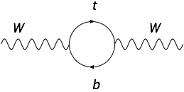
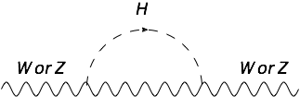
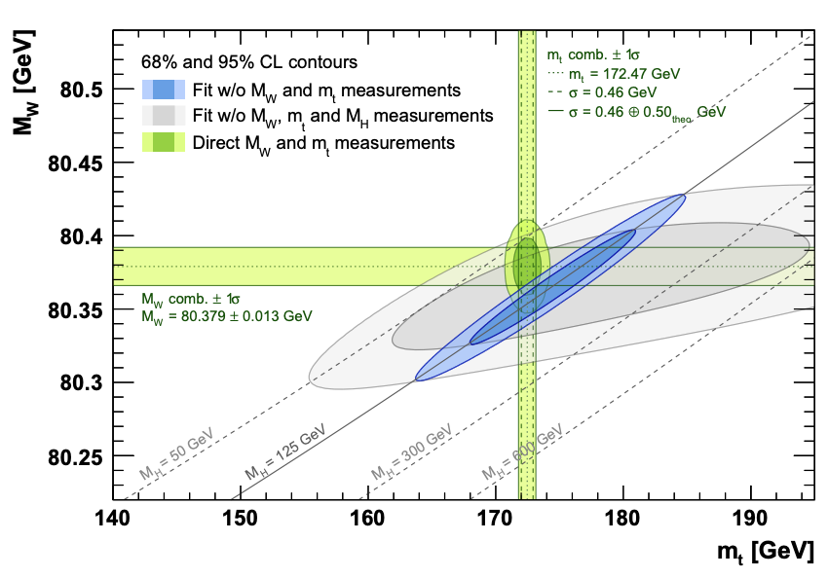
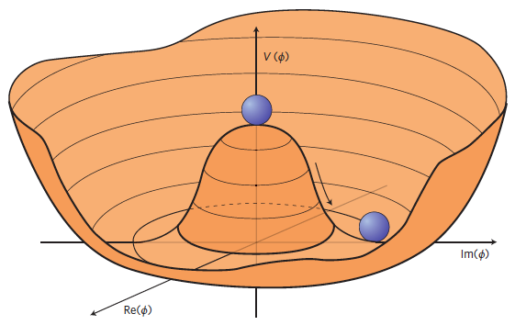
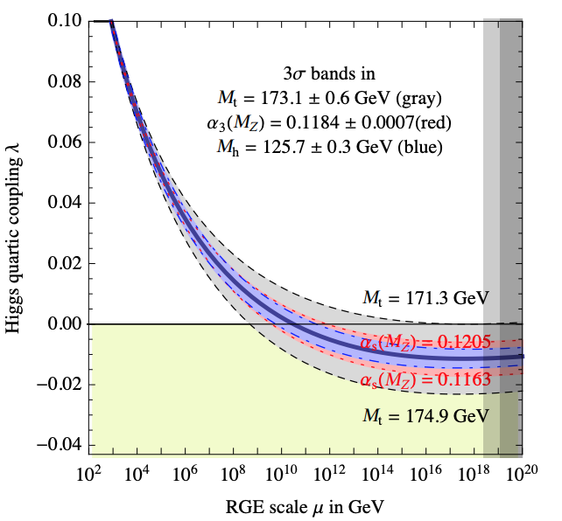
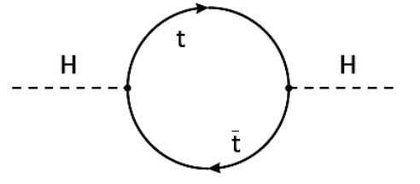
m_{t} and EWSB
$$ΔM_{W}∝m_{t}^{2}$$
$$ΔM_{W}∝lnM_{H}$$
EPJC 78, 675 (2018)
Higgs Potential: $V(ϕ)=-μ_{H}^{2}ϕ^{†}ϕ+λ_{H}(ϕ^{†}ϕ)^{2}$
Mexican hat only if $λ_{H}>0$
JHEP 08 (2012) 098
$λ_{H}$ receives radiative corrections from all SM particles ➛ mostly from top quark $⇒Δλ_{H}∝m_{t}^{4}$
Evolve $λ_{H}$ up to Planck scale (~10¹⁹ GeV)
Knowing m_{t} accurately might just reveal the fate of our universe

Slide 4
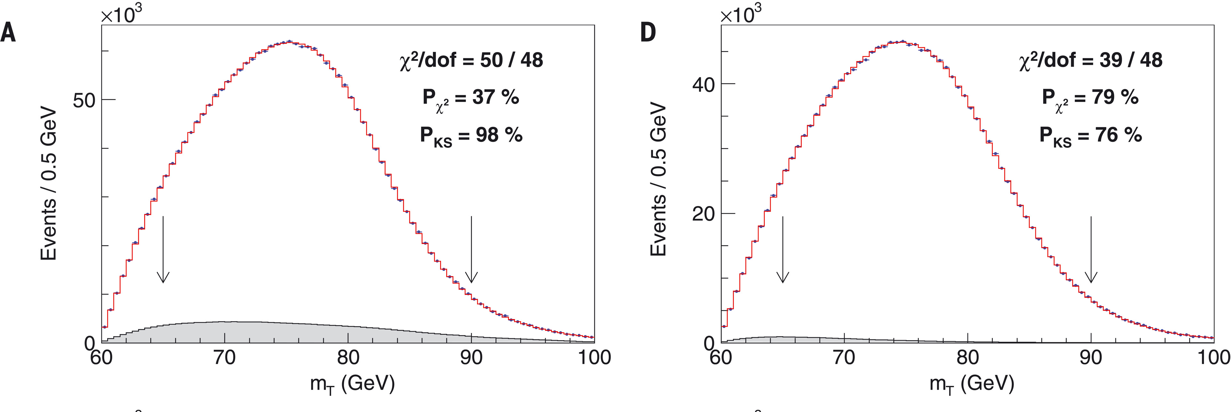
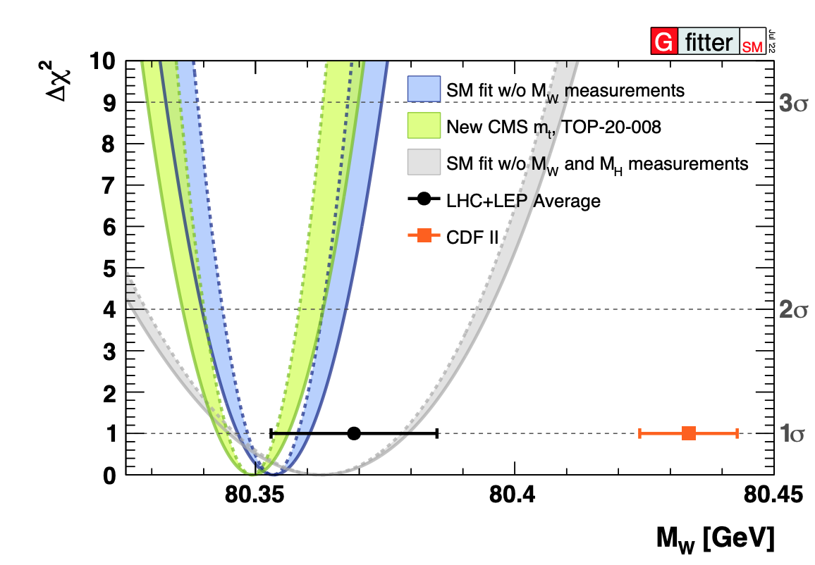
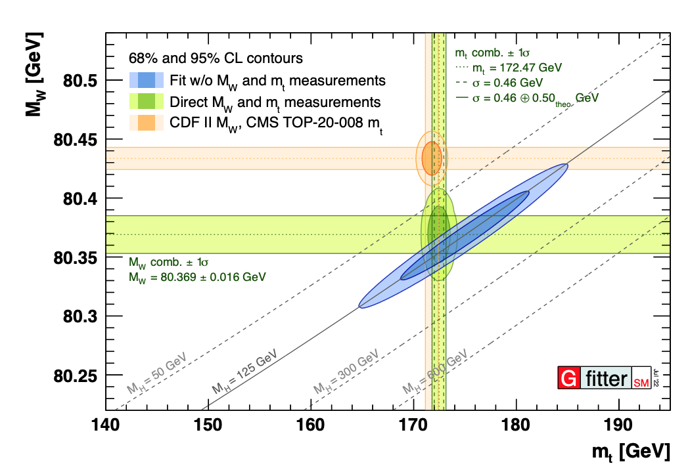
m_{W} conundrum
Life becoming difficult at EW sector with the new CDF measurement of m_{W}
  ➛ 6.8σ deviation from prediction (Blue Band)
SM predictions consistent with LEP + LHC measurements
Using mt from CMS-PAS-TOP-20-008 the deviation is even larger (Green Band)
PDFs are key inputs ➛ need to resolve differences and harmonize PDF+generators usage in different measurements before combination
Science 376, 170 (2022)
$$m_{W}^{comb.}=80433.5±6.4(stat)±6.9(syst)MeV=80433.5±9.4MeV$$
PoS(ICHEP2022)897

Slide 5
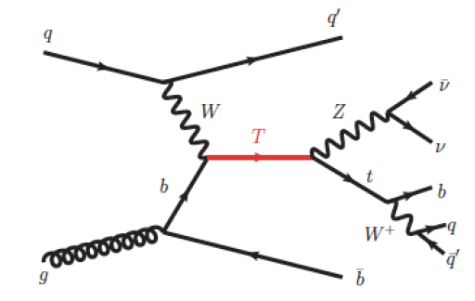
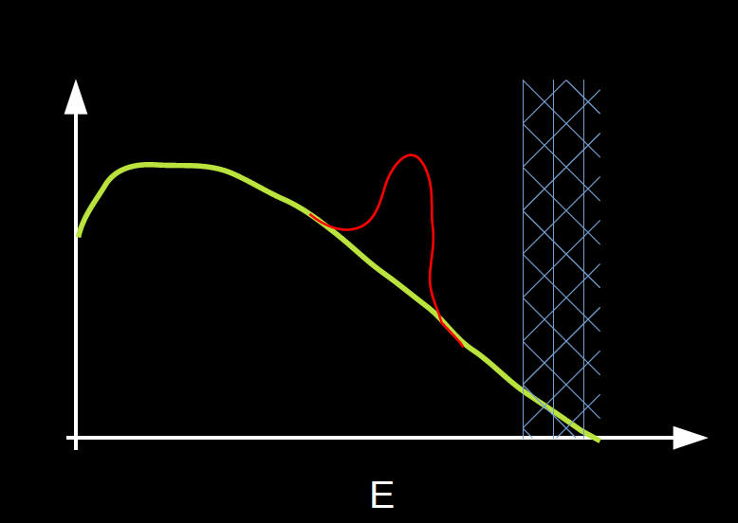
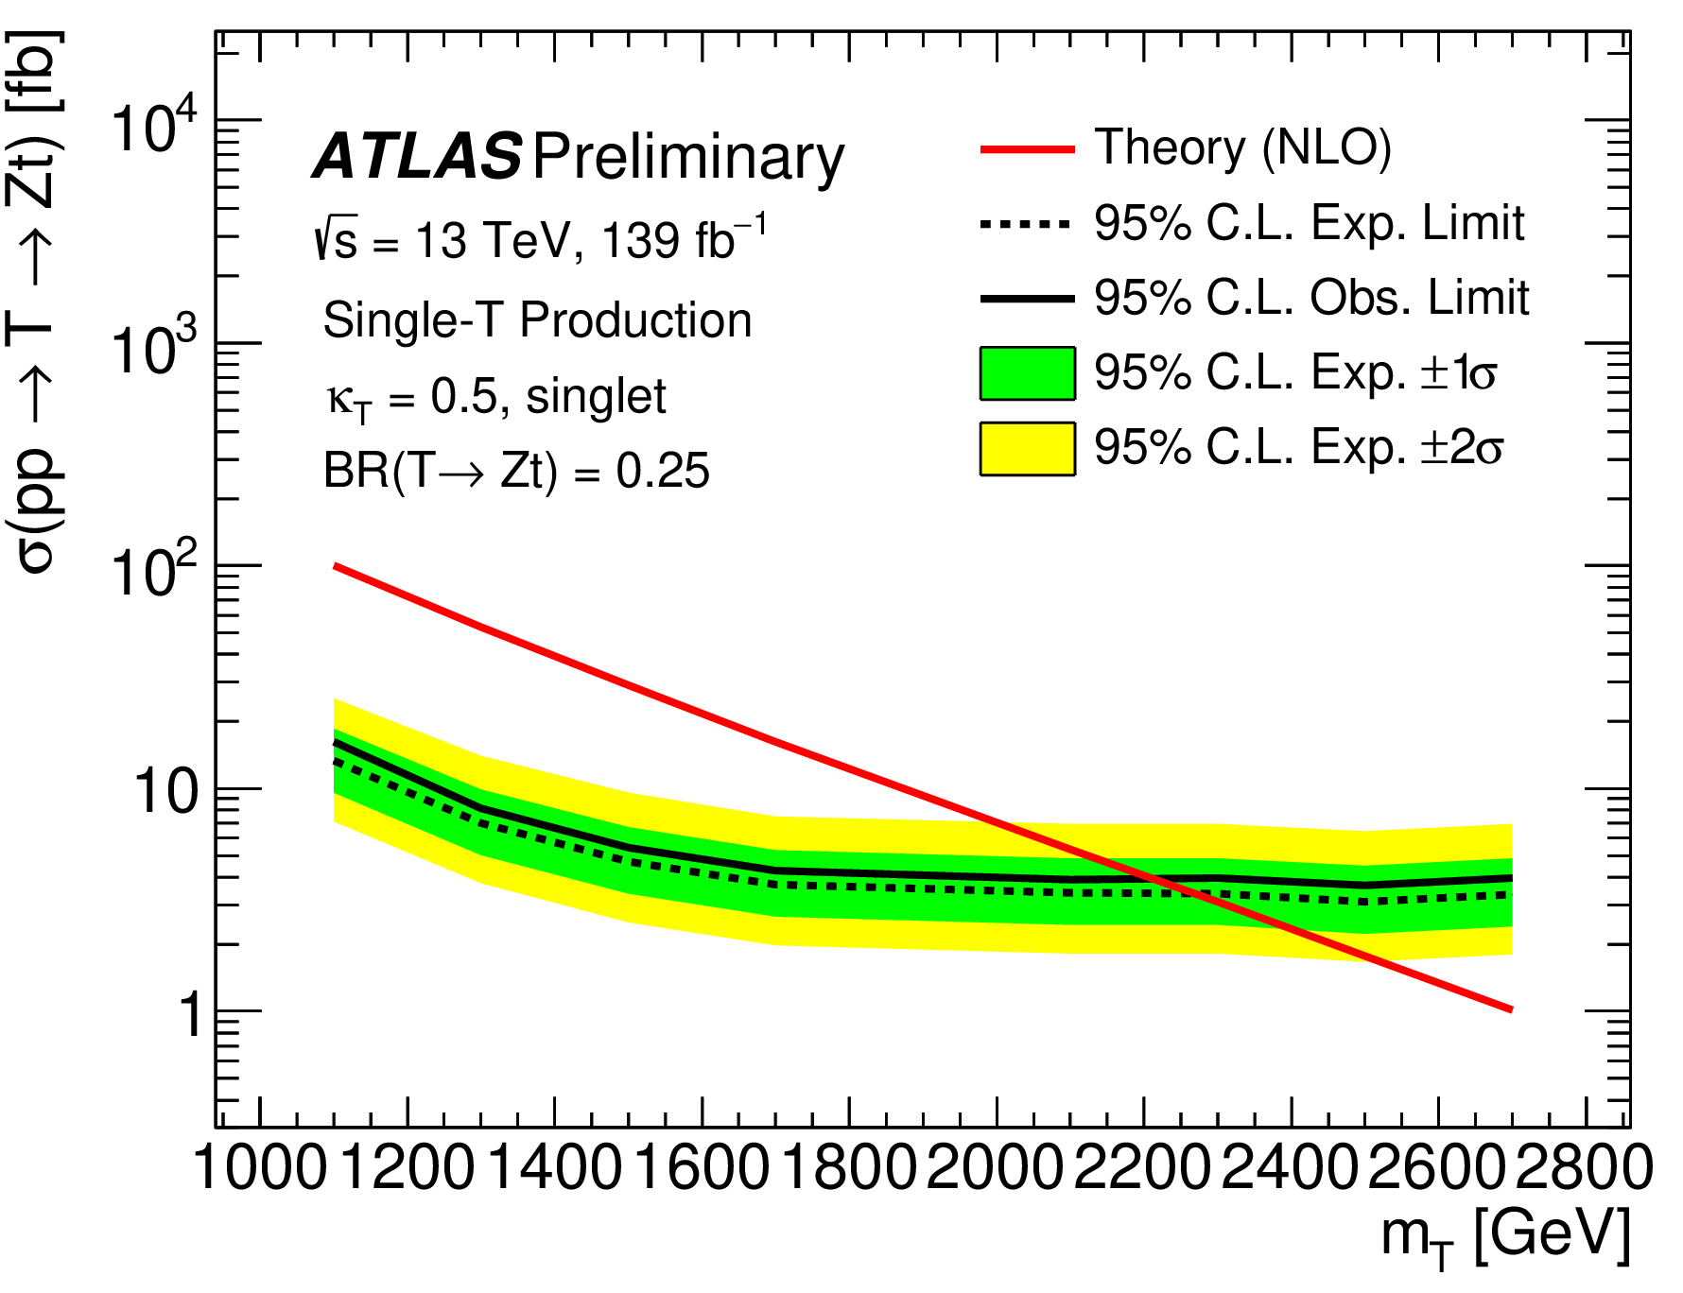
Top portal to new physics - direct search strategy
New resonance such as VLQ with $m<E_{LHC}$ decaying to top quarks
Accessible at LHC
Can attempt for a direct search
Dependent on the new physics model
ATLAS-CONF-2022-036
New search from ATLAS in the mono-top final state
Benchmark scenario: kT = 0.5 and BR (T→tZ)= 25%
mT > 2.2 TeV @ 95% CL (Gain by 500 GeV ! )

Slide 6
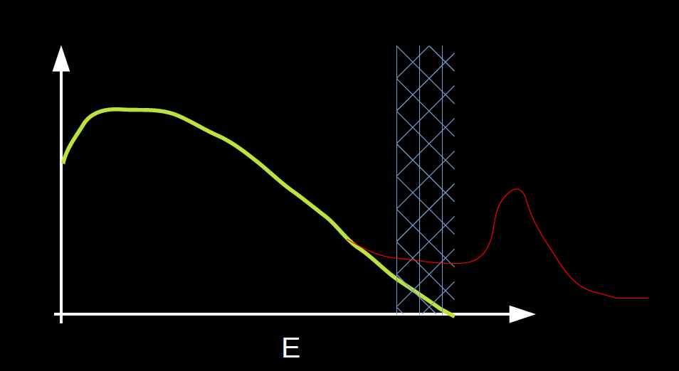
Top portal to new physics - indirect search strategy
New physics scale out of range $Λ≫E_{LHC}$
Expand SM: $L_{eff}=L_{SM}+\underset{i}{∑}\frac{c_{i}O_{i}^{D}}{Λ^{D-4}}$ (D = 6 so far)
Wilson coefficients $c_{i}$ modify SM vertices
  ➛ Deviations from SM in precision measurements
Independent of new physics model
In the top sector, EFT effects visible in various final states: $t\overline{t},t\overline{t}V,t\overline{t}q\overline{q},tZq$ etc.
Two ways of using EFT:
  ☞ Re-parametrization of cross section measurements
  ☞ Dedicated estimation of EFT couplings
This talk primarily focusses on this approach for probing physics beyond the SM

Slide 7

LHC - The top Factory
Rate = σ 𝓛
Top quarks are produced in abundance at the LHC
Dominant production modes:
  ➛ Pair production via QCD interactions ~ 10 Hz @13 TeV
  ➛ Single top quark production via EW interactions ~ 1 Hz @13TeV
This talk focuses mostly on the cherry-picked results from the latest measurements

Slide 8
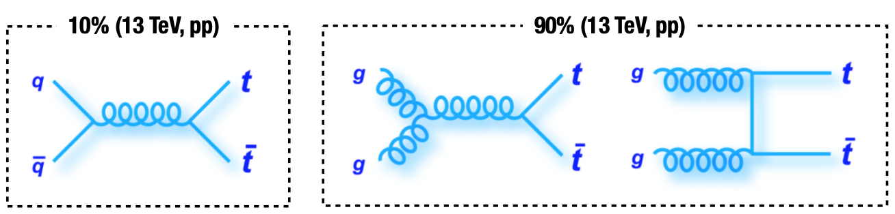
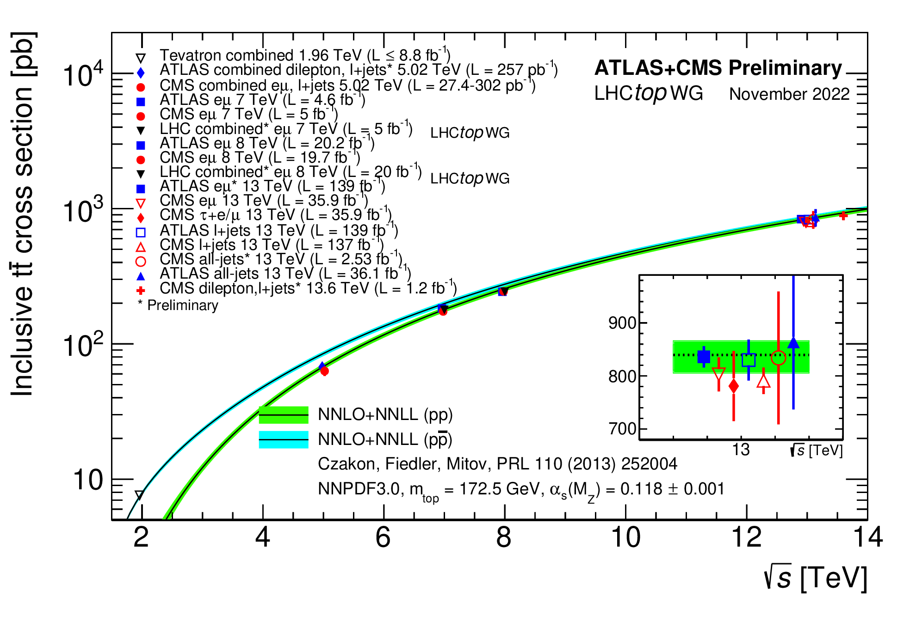
$t\overline{t}$ production
≈15% (pp,13 TeV)
≈ 85% (pp,13 TeV)
https://twiki.cern.ch/twiki/bin/view/LHCPhysics/TtbarNNLO
√s | 𝜎_{tt¯} (NNLO + NNLL)
7 TeV
8 TeV
13 TeV
$${177.3}_{-10.8}^{+10.1}pb(6.6\%)$$
Theoretical uncertainties due to variations in µR & µF scales, PDF and 𝛼_{S}
$${252.9}_{-16.3}^{+15.3}pb(6.2\%)$$
$${831.8}_{-49.9}^{+45.5}pb(5.7\%)$$
Most precise (2.4%) inclusive $σ_{t\overline{t}}$ meas. (EPJC 80 (2020) 528) in events with OS eµ pair + 1 or 2 b-tagged jets
Dominant systematics:
➛ Luminosity(1.9%)
➛ tW bkg. cross-section (0.52%)
➛ hadronization model (0.49%)
➛ PDF (0.45%)
➛ ISR/FSR model (0.45%)
New
$$σ_{t\overline{t}}={887}_{-41}^{+43}(stat+syst)±53(lumi)pb@13.6TeV$$
CMS-PAS-TOP-22-012
LHCTOPWGSummaryPlots

Slide 9
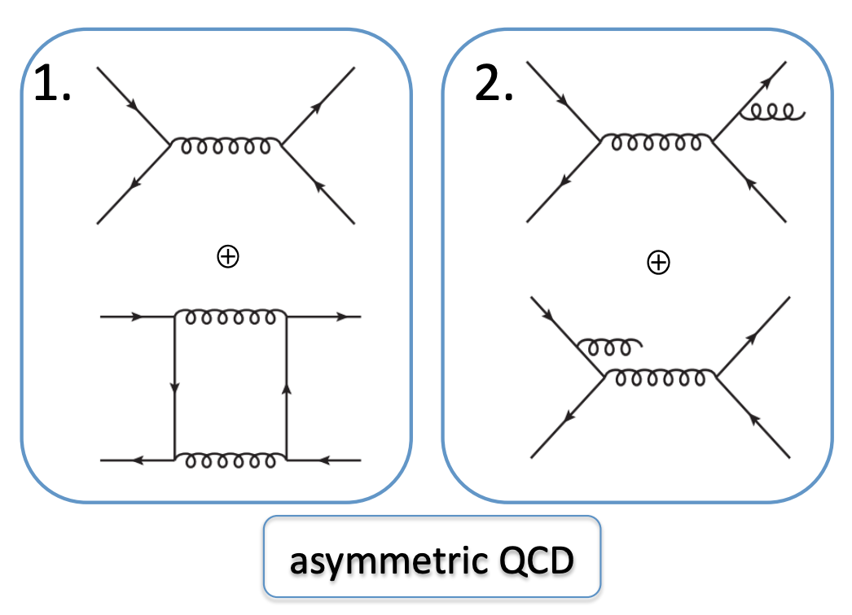
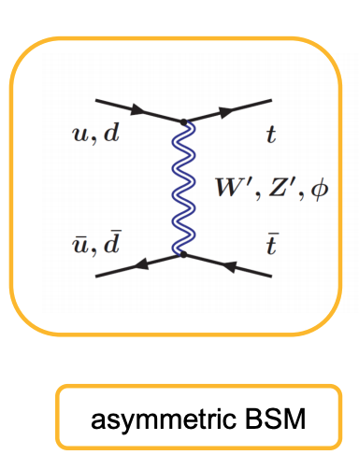
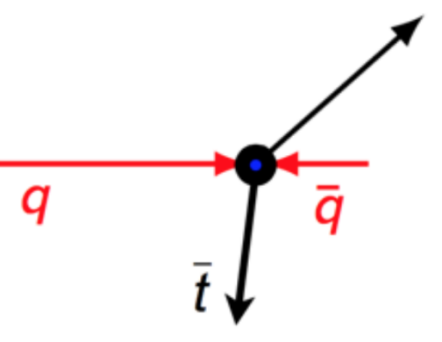
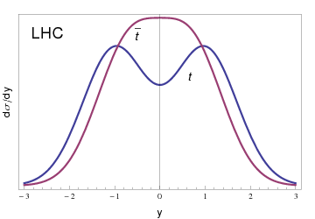
$t\overline{t}$ asymmetry at LHC
Production of top quark pairs charge symmetric at LO
No charge asymmetry in gg ➛ tt¯ at all orders ⇒ dilutes measurable asymmetry
Small charge asymmetry at NLO due to QCD qq¯ annihilation allowed in SM
  ➛ interference between tree and box diagram ➛ interference between gluon ISR and FSR diagrams
LHC, a pp collider ➛ no preferential direction for the incoming (anti-) partons
High momenta valence quarks collide with lower momenta sea anti-quarks ➛ More forward top quarks & more central anti-top quarks leading to charge asymmetry (A_{C})
t
arXiv:1207.0331
$$A_{C}=\frac{N(Δ|y|>0)-N(Δ|y|<0)}{N(Δ|y|>0)+N(Δ|y|<0)},Δ|y|=|y_{t}|-|y_{\overline{t}}|$$
New Physics models can enhance A_{c} ➛ indirect search for new physics

Slide 10
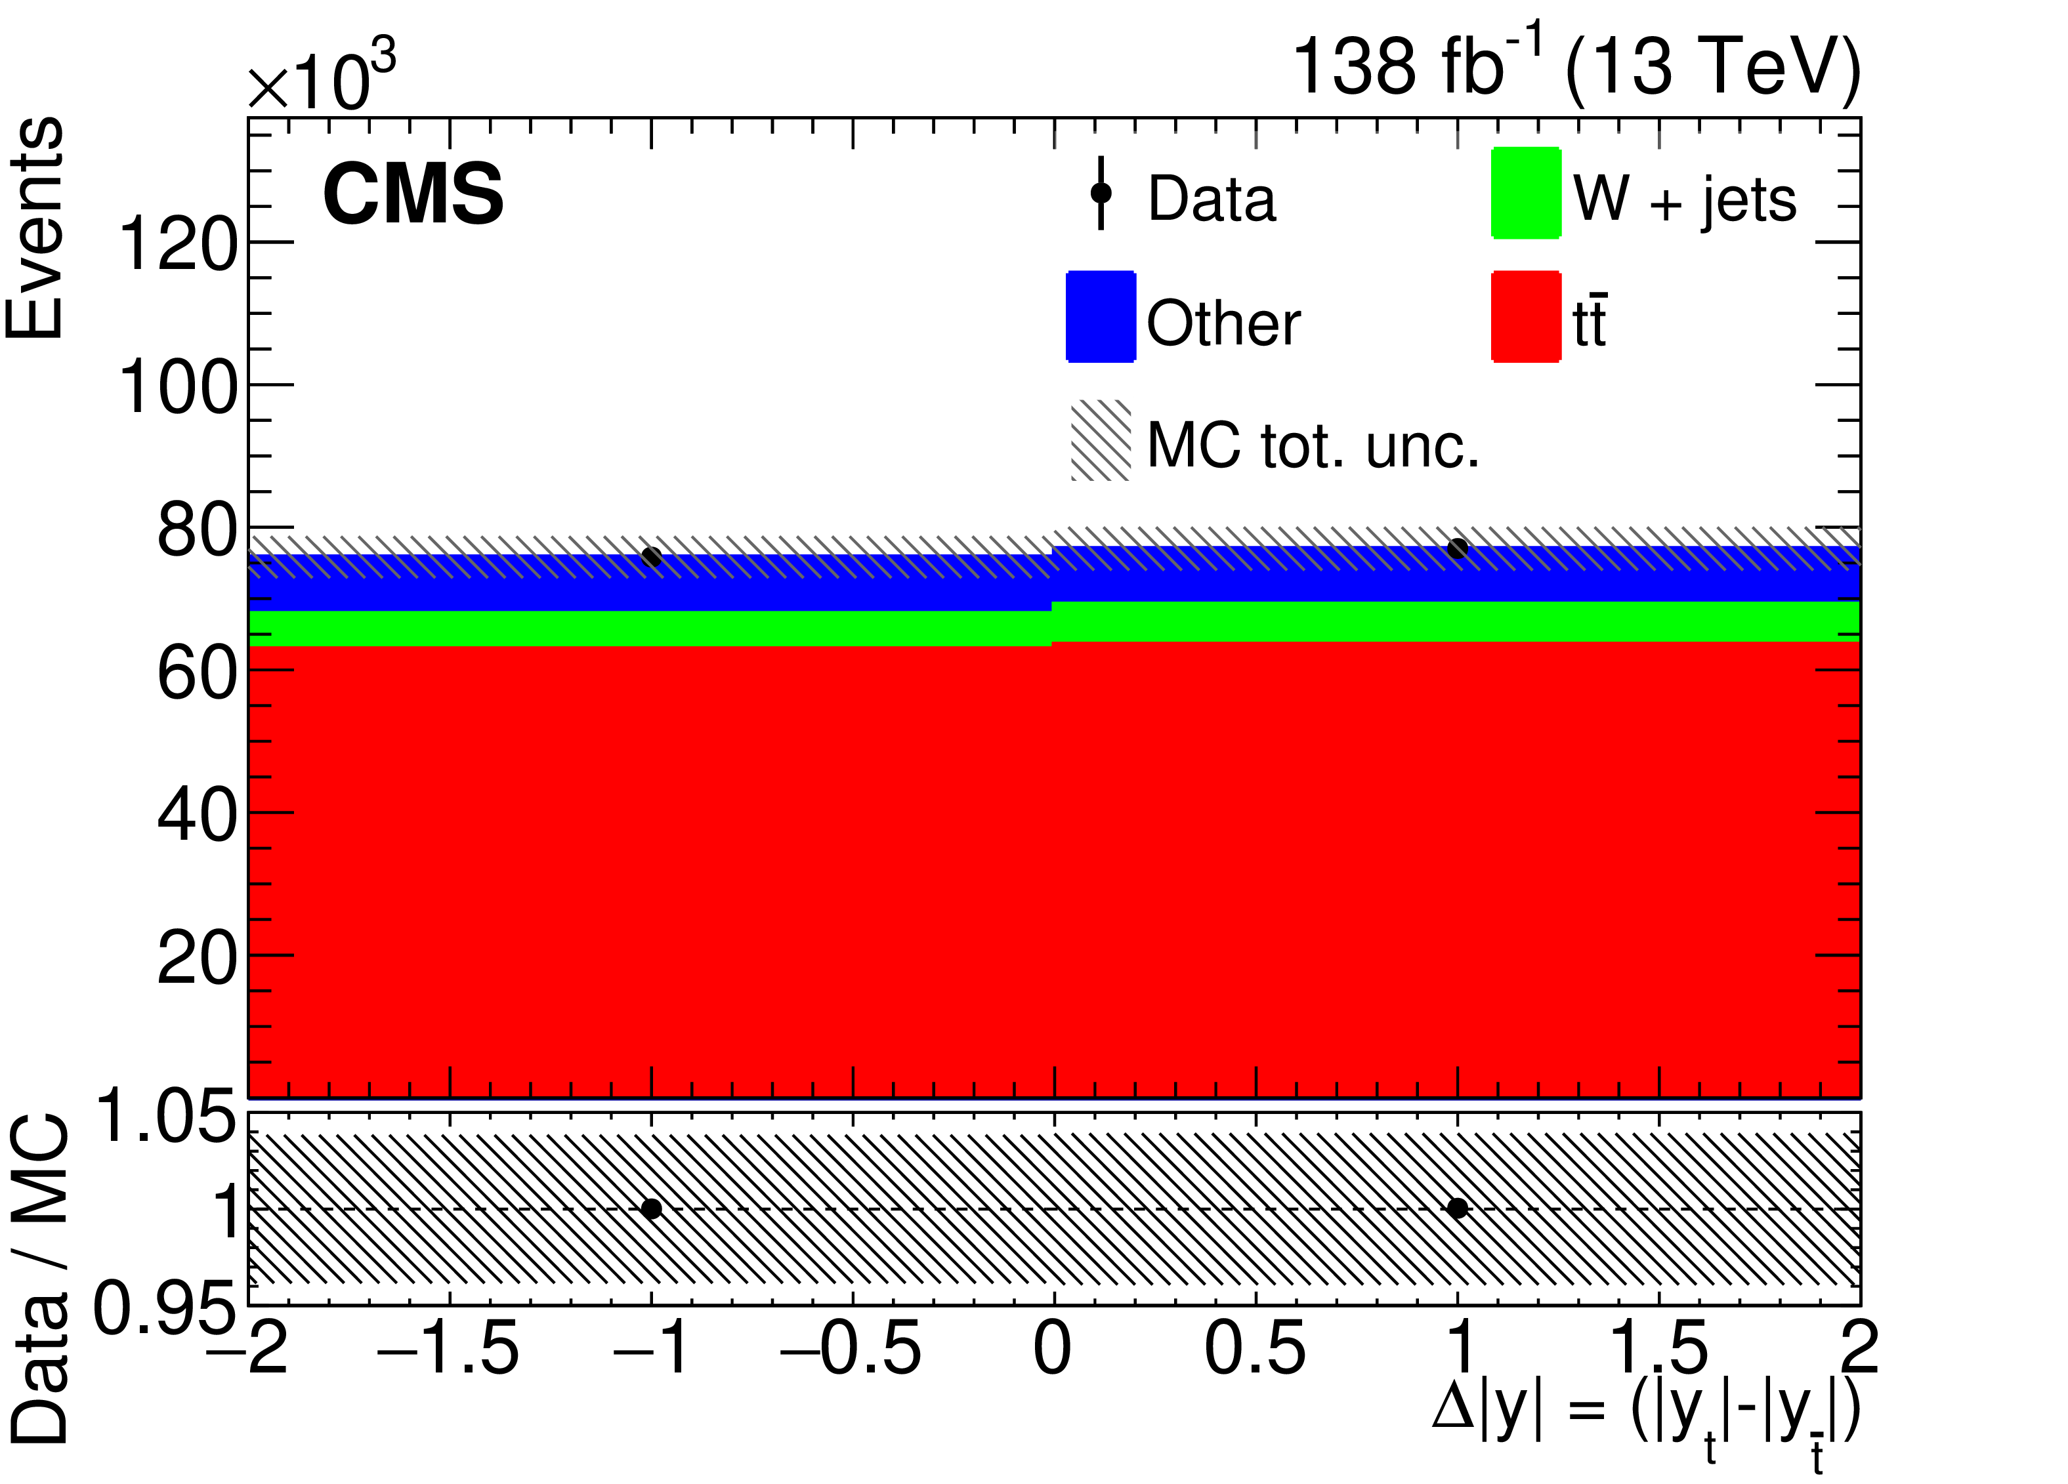
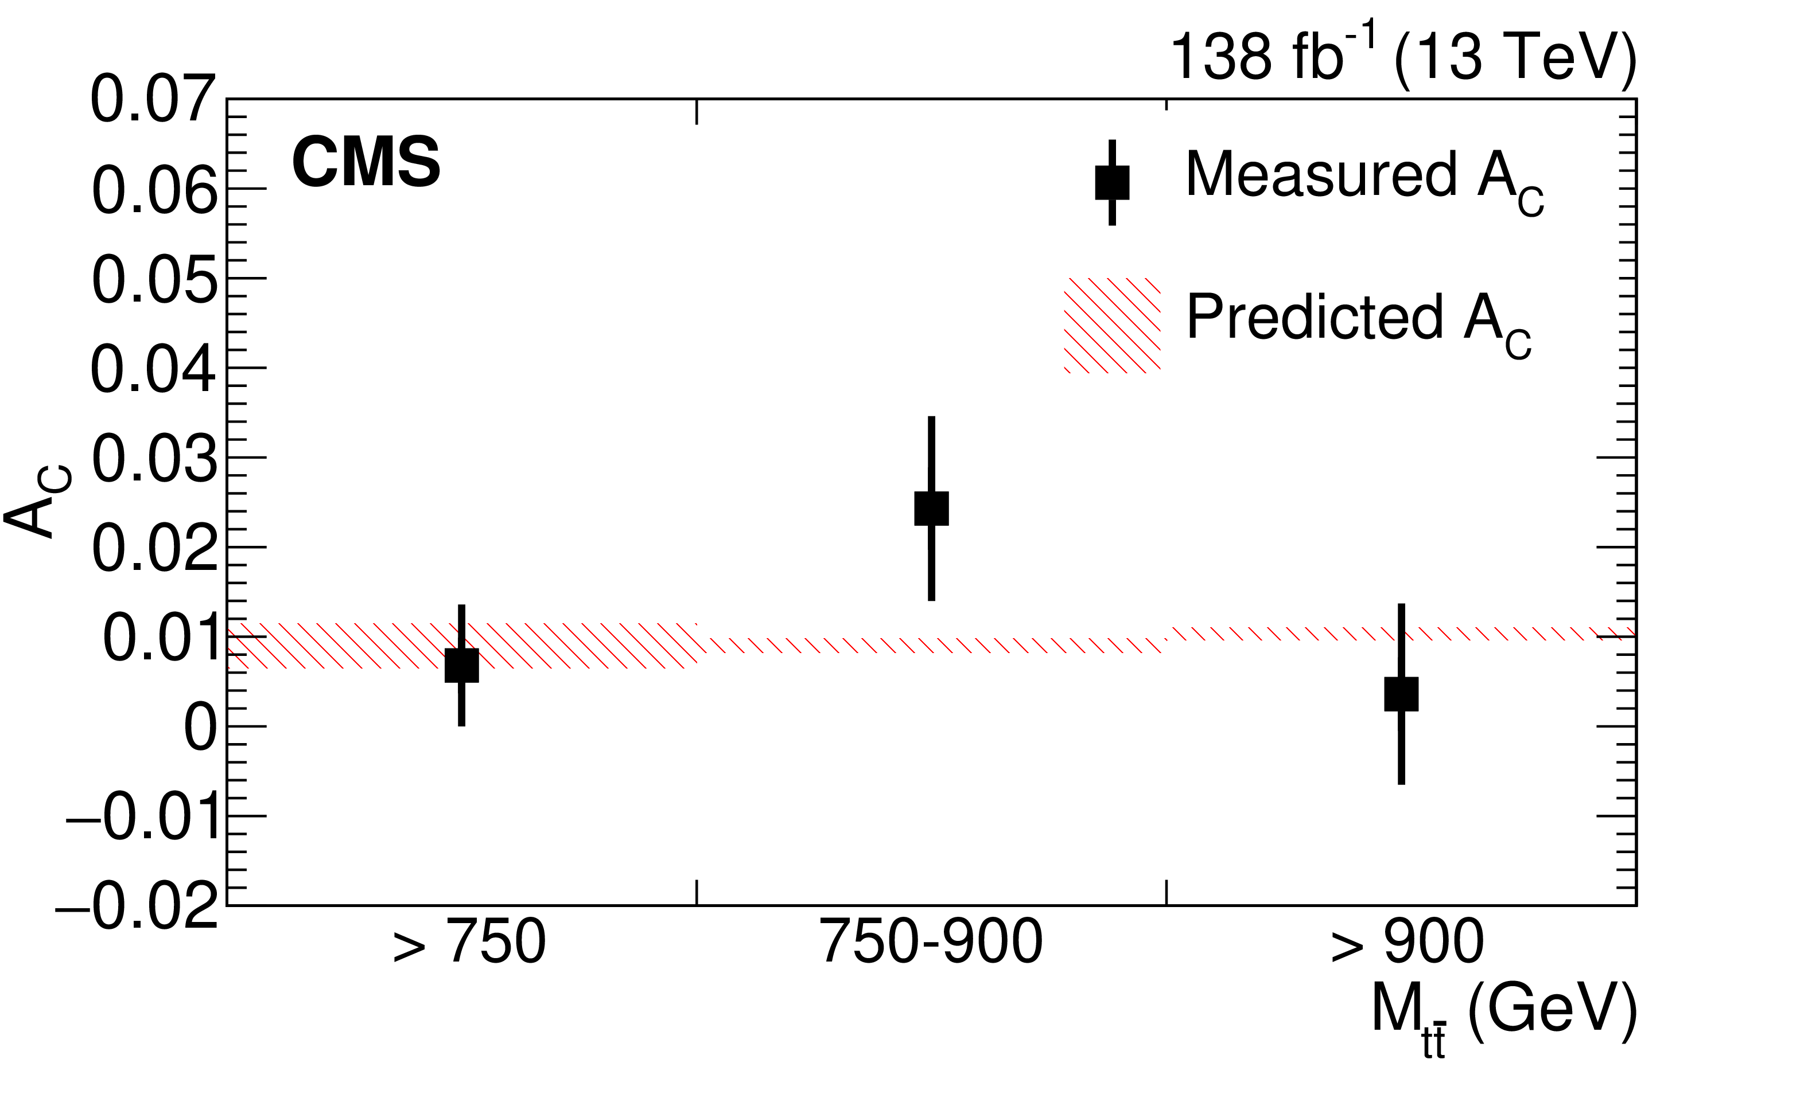
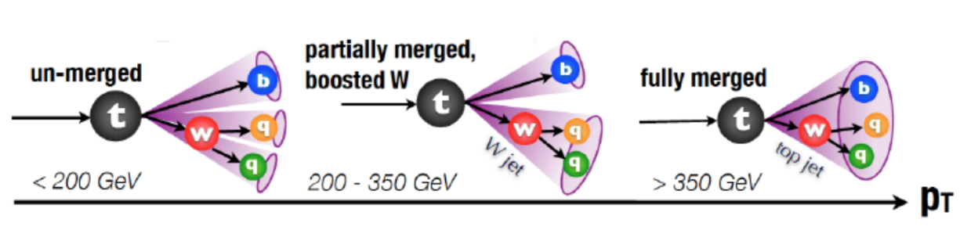
$t\overline{t}$ charge asymmetry with boosted tops
CMS-TOP-21-014
Final state consists of 1𝓁 ($e,μ$), 1 AK8 jet , 1 b-tagged jet (AK4)
Event categories based on the boosted jet tagging
Measurement performed inclusively as well as in bins of $M_{t\overline{t}}∈[750,900]or>900GeV$
Bkg. rate is determined directly from the fit
Inclusive measurement agrees well with SM prediction
Dominant sources: $μ_{F}$ scale, PDF etc.

Slide 11
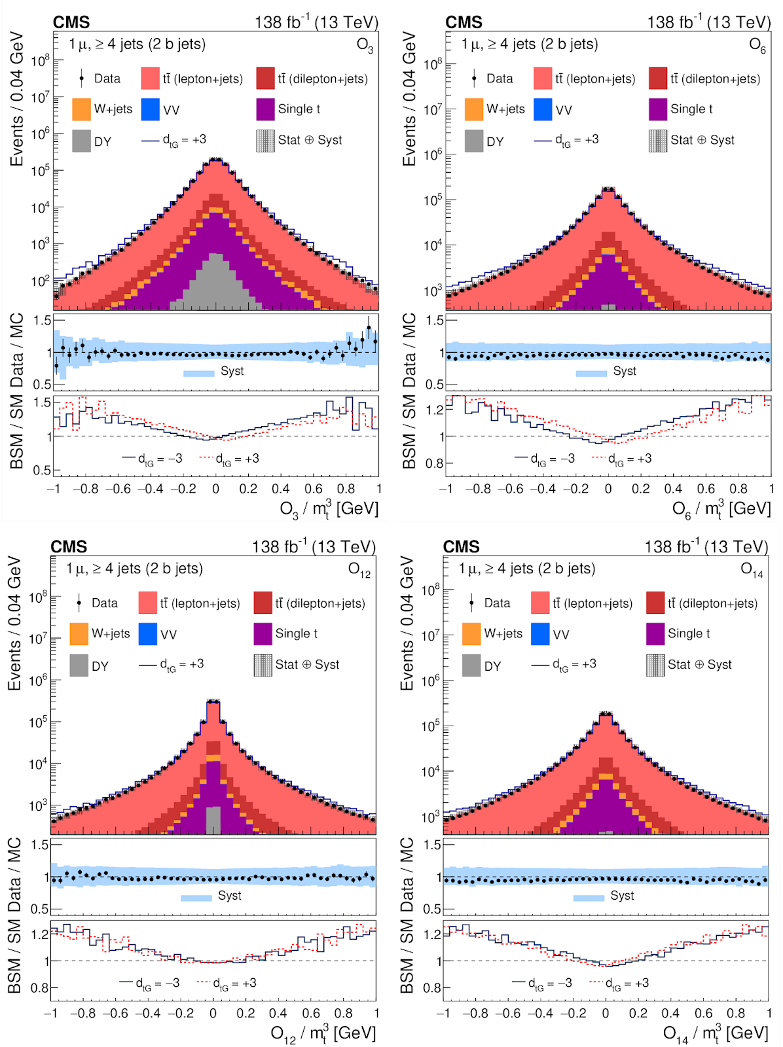
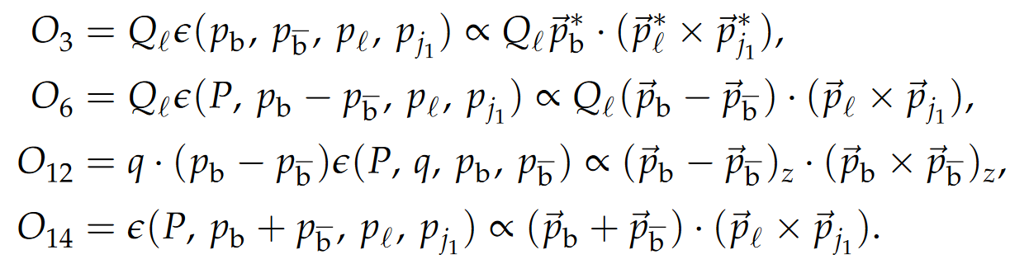
Search for CP violation in $t\overline{t}$ lepton + jets events
BSM interaction modifies $tg$ coupling
  ☞ invokes Chromo-electric-dipole-moment (CEDM) $d_{tG}$ [ref]
  ☞ possible source of CP violation in strong interaction
Following Dim-6 operators are considered
CEDM contribution can be ~ 8% & 0.4% for $A_{CP}(O_{3})$ & $A_{CP}(O_{12})$
CMS-TOP-20-005

Slide 12
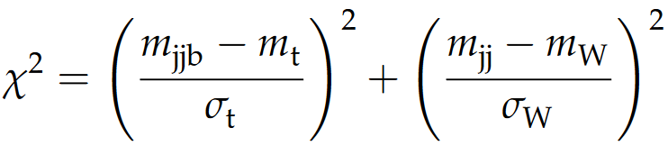
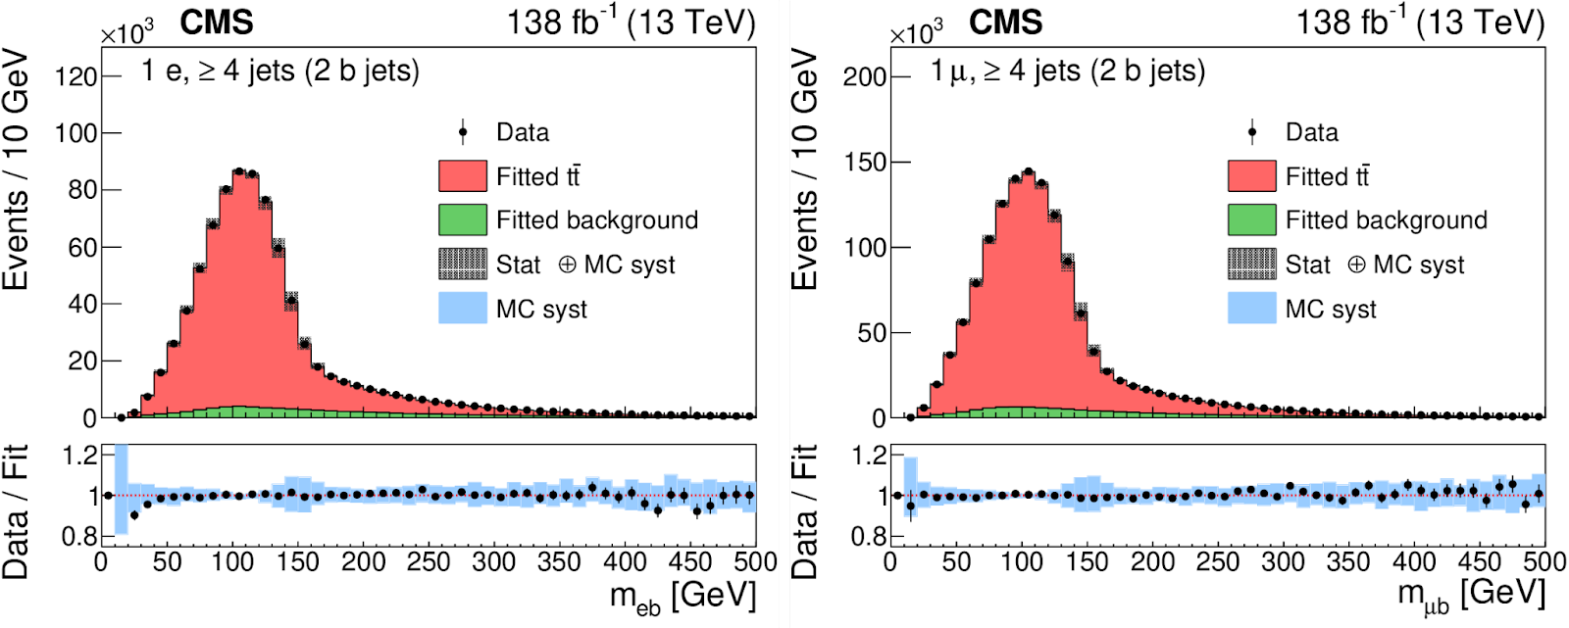
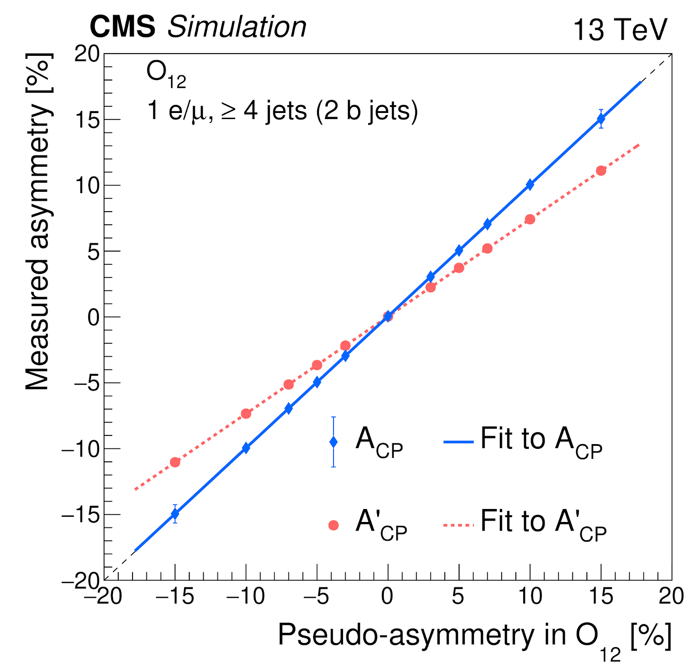
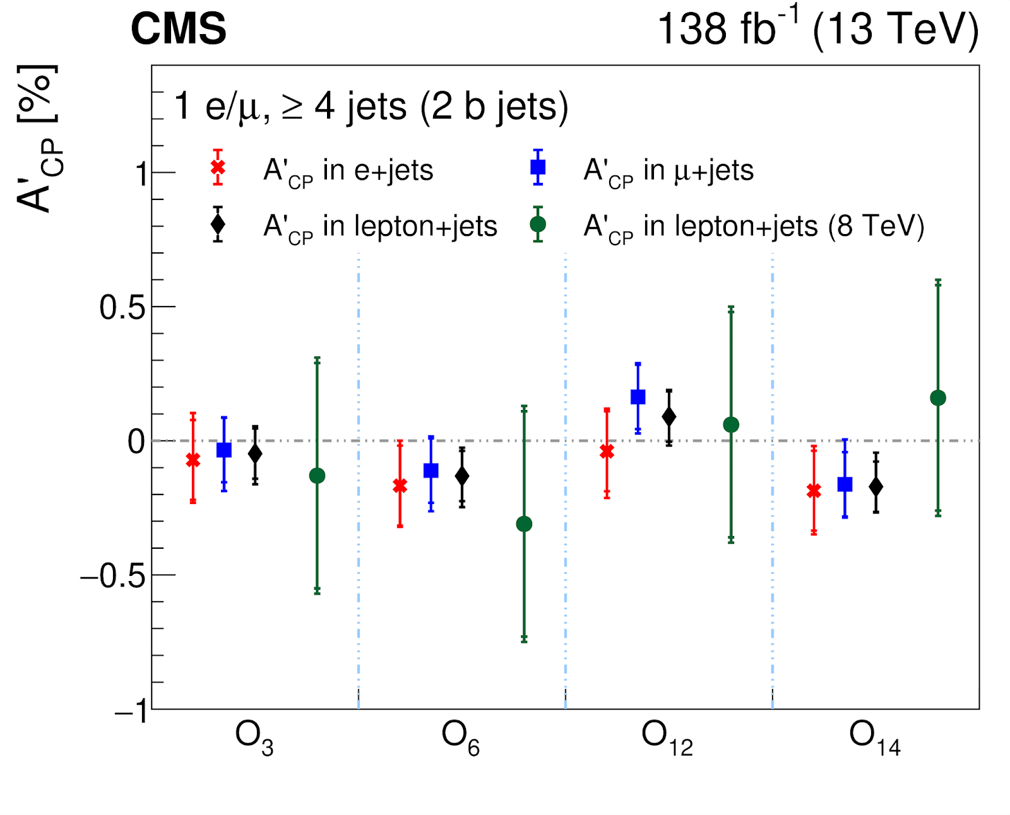
Search for CP violation in $t\overline{t}$ lepton + jets events
Hadronic top quark reco. based on min. $χ^{2}$
Data-driven bkg. estimation
ML fit to data using the $m_{ℓb}$ template
Measured $A_{CP}^{′}$ calibrated w.r.t $A_{CP}$ at truth level
$d_{tG}$ determined from $A_{CP}$ : $A_{CP}=\frac{d_{tG}+a}{bd_{tG}^{2}+cd_{tG}+d}$
$d_{tG}=0.04±0.10(stat)±0.07(syst)$
  ☞ consistent with SM prediction $d_{tG}=0$
CMS-TOP-20-005

Slide 13
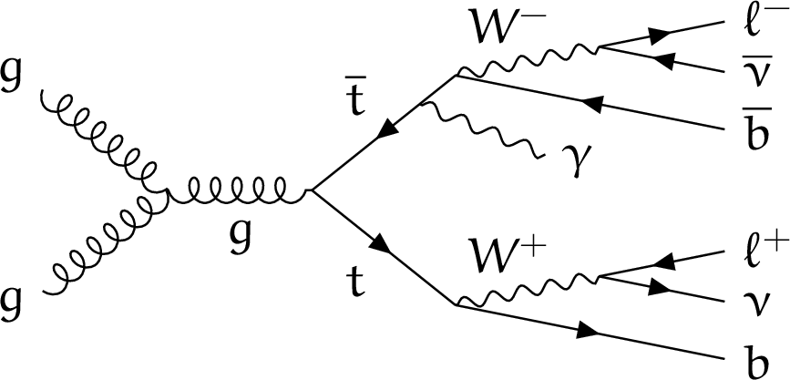
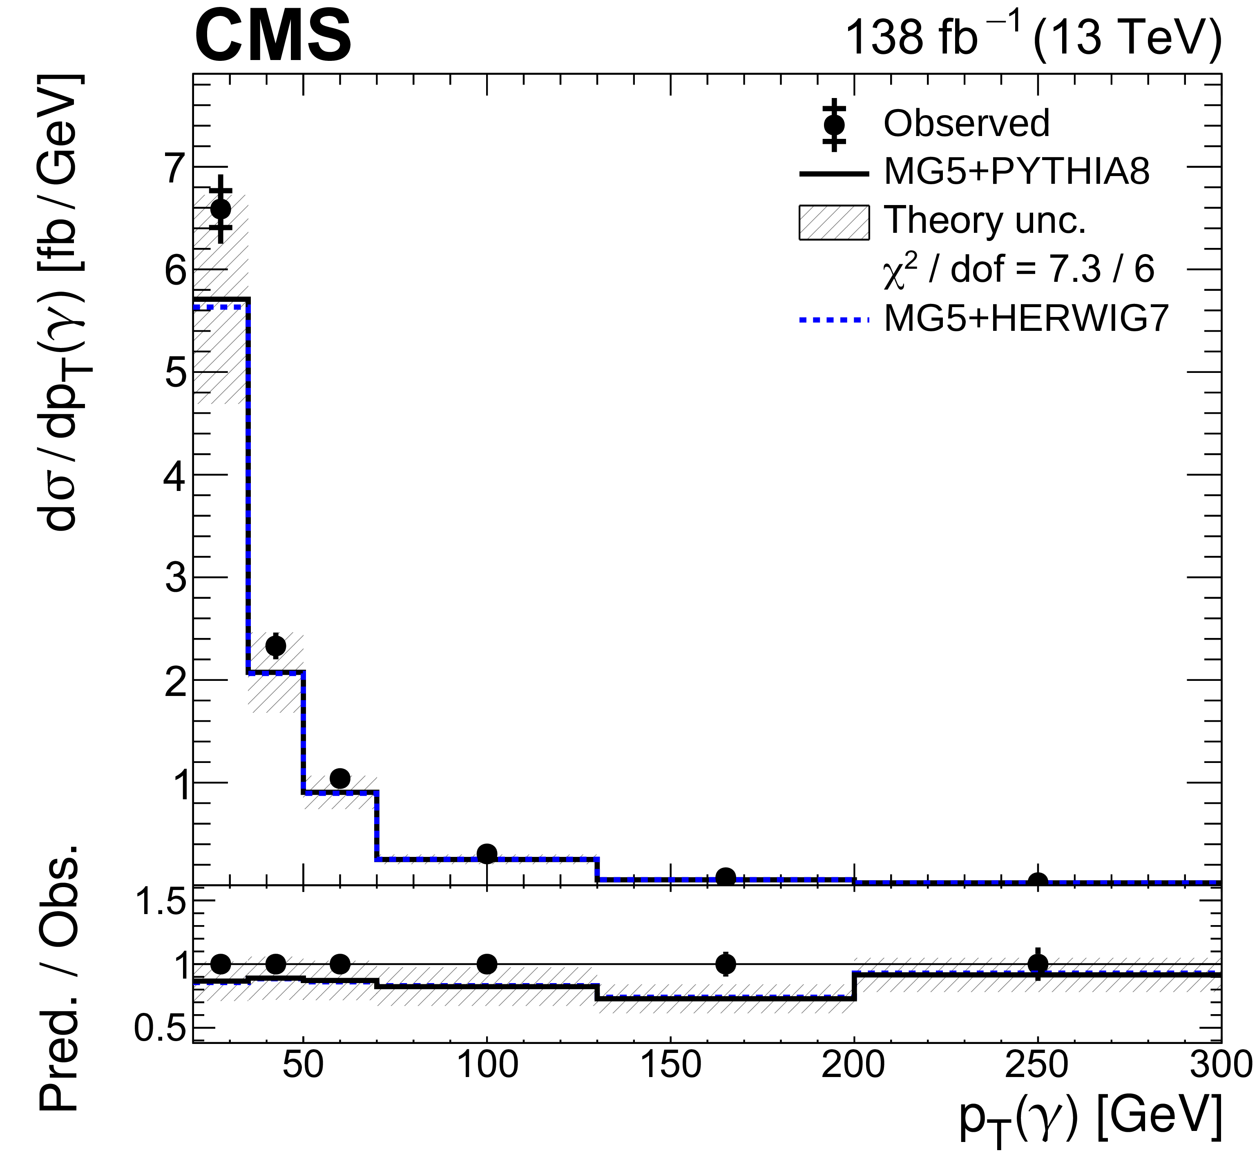
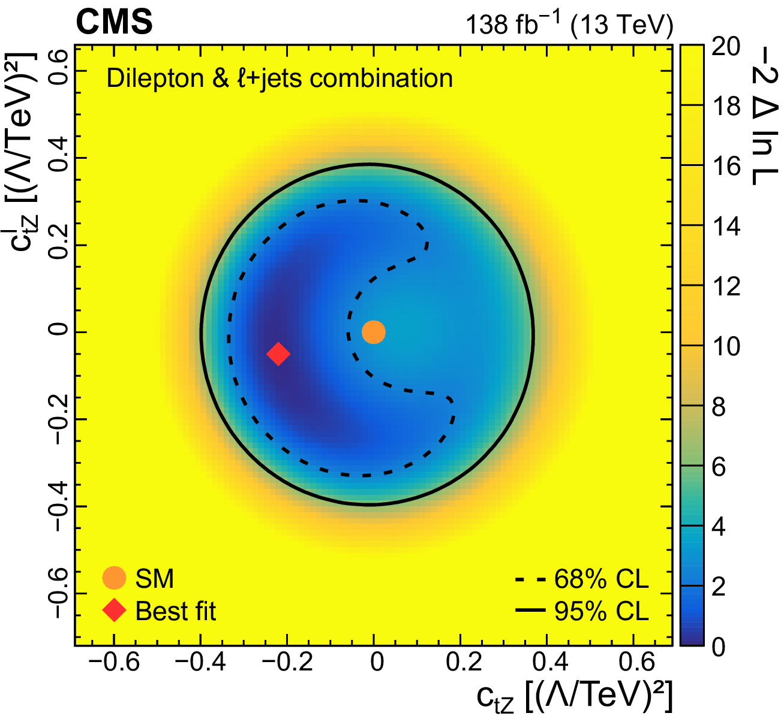
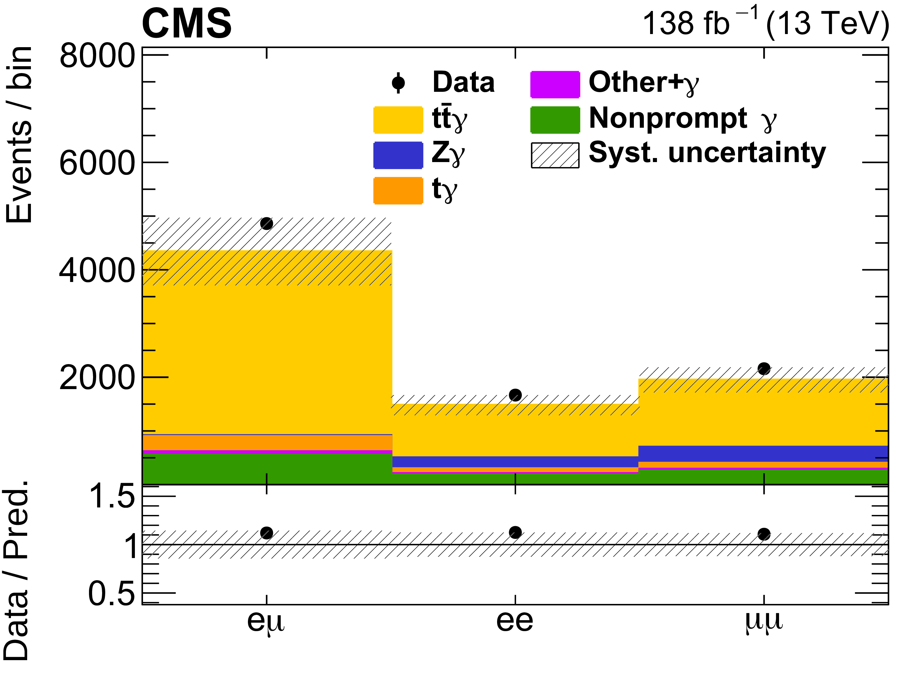
Inclusive and differential $t\overline{t}$𝛾 cross section - 2𝓁
NLO prediction: $σ_{t\overline{t}γ}=155±27fb\left[p_{T}(γ)>20GeV|η(γ)|<1.442\right]$
JHEP 05 (2022) 091
Exactly 1 𝛾, exactly 2 OS 𝓁, ≥ 1 b-tagged jet in the final state
  ➛ Bkgs.: Non-prompt $γ$ (data-driven), Z$γ$ (from Z peak), others from simulation
Measured: $σ_{t\overline{t}γ}=175.2±2.5(stat)±6.3(syst)fb(4\%)$
  ➛ Dominant sources: Luminosity, signal model, bkg. normalization
Differential measurements used to extract combined (2𝓁 & 𝓁 + jets ) limits on EFT coupling CtZ

Slide 14
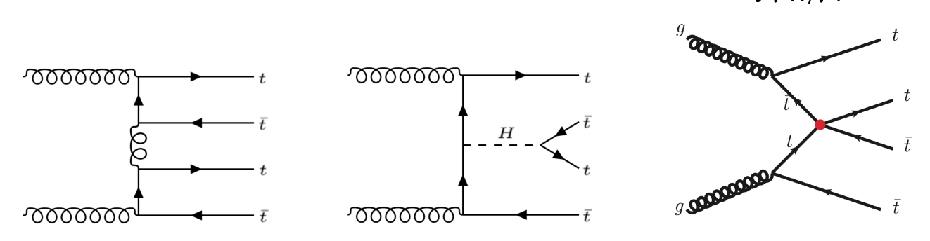
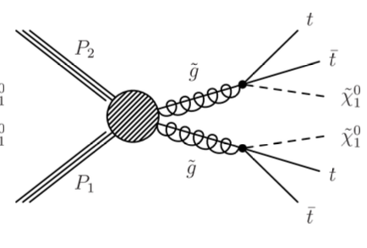
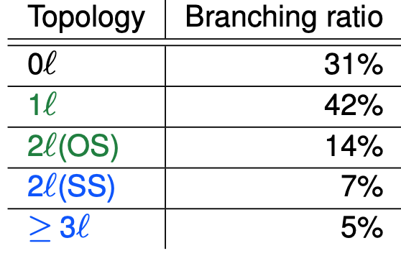
Production of 4 tops ($t\overline{t}t\overline{t}$)
QCD
EWK
Four-fermion EFT coupling
SUSY
Prediction:
$$σ_{t\overline{t}t\overline{t}}=12fb±20\%$$
JHEP 02 (2018) 031
Final state consists of 4 b-jets, other jets and leptons
1𝓁 or 2𝓁 (OS) | SSML: 2𝓁(SS) or ≥ 3𝓁
Combined BR ~ 57% | Combined BR ~13%
Dominant tt¯ + HF bkg. | Dominant tt¯V bkg
Negligible fake or non-prompt 𝓁 | Fake or non-prompt 𝓁 significant
Extensive use of MVA techniques to extract signal in both types of final states
SSML: limits on top-Yukawa coupling
1𝓁/2𝓁OS : EFT interpretation with limits on Wilson coefficients

Slide 15
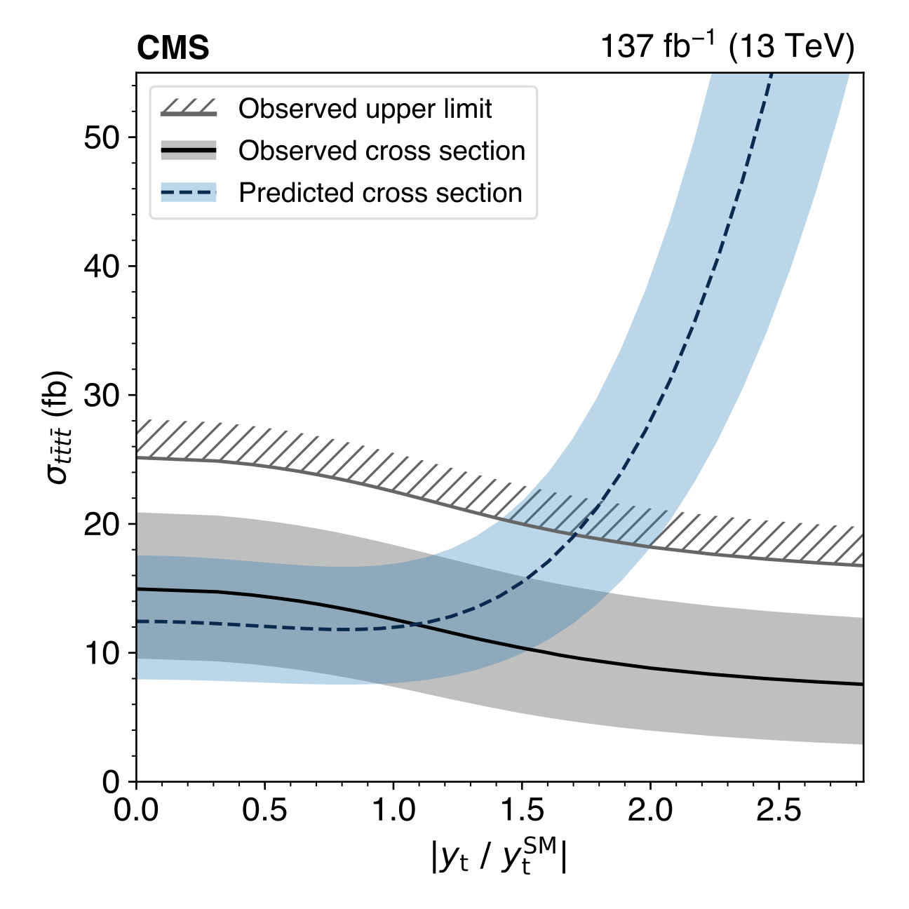

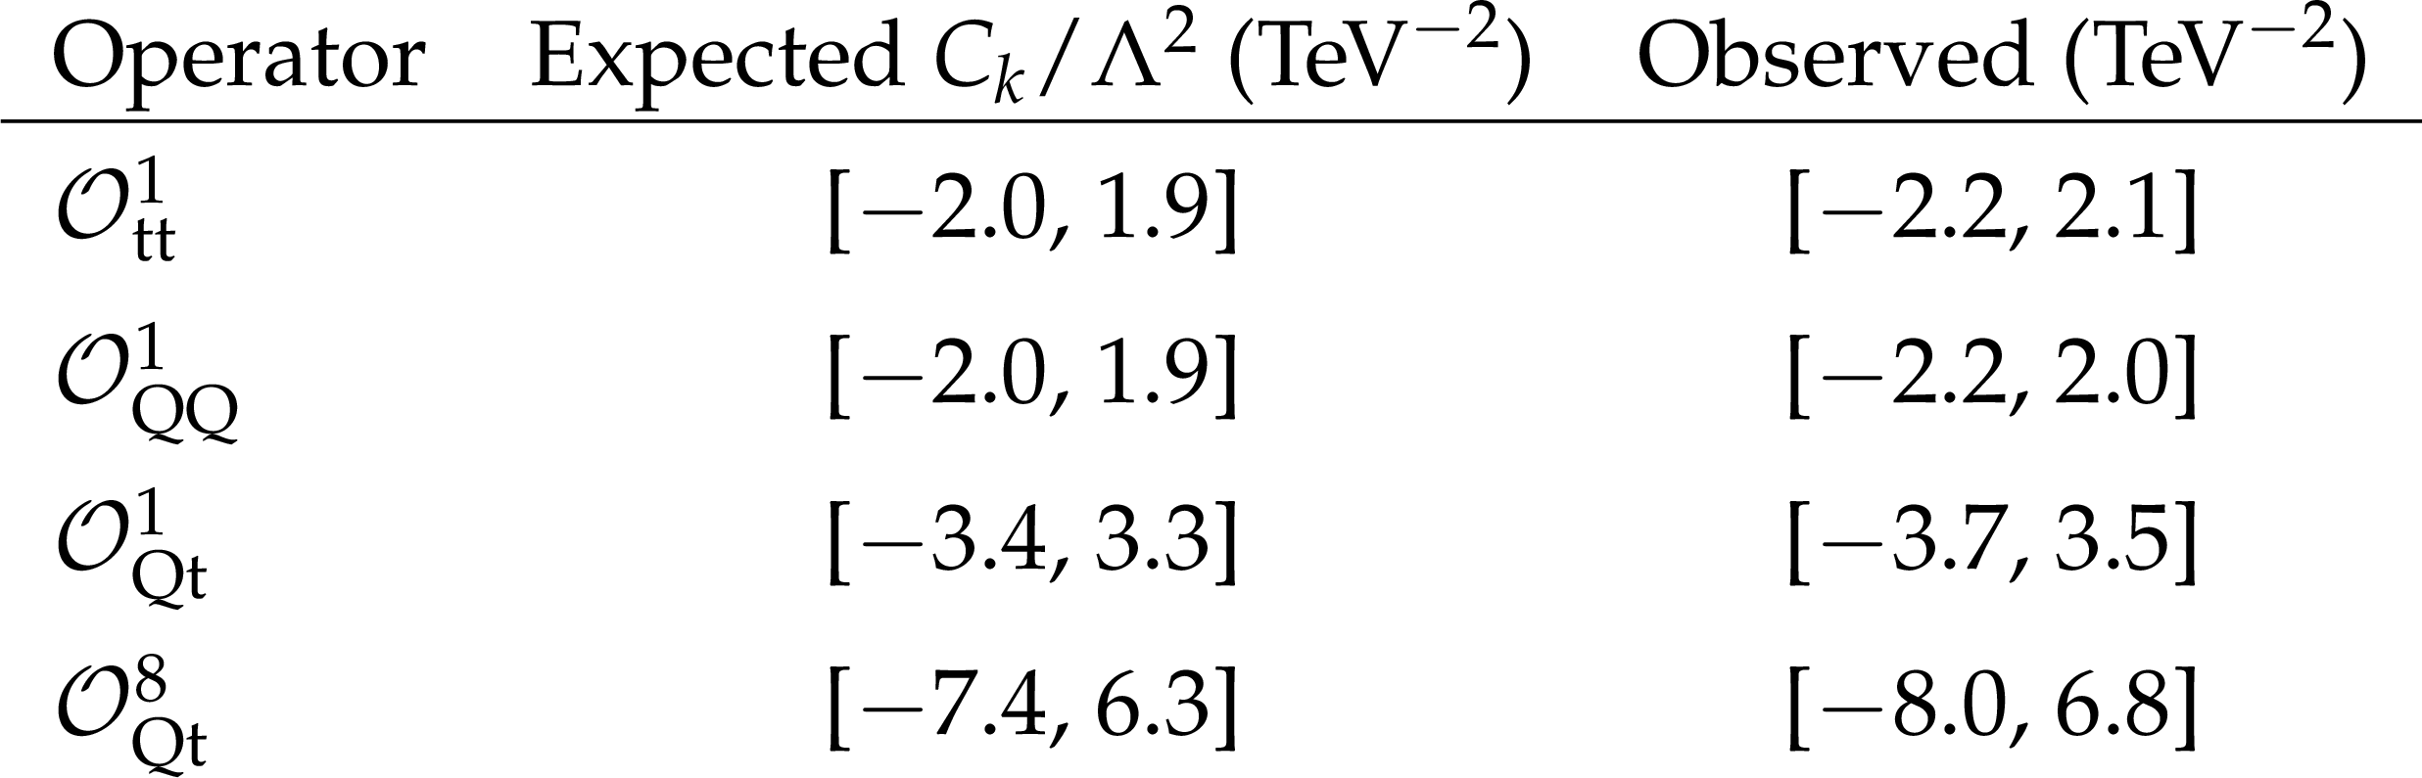
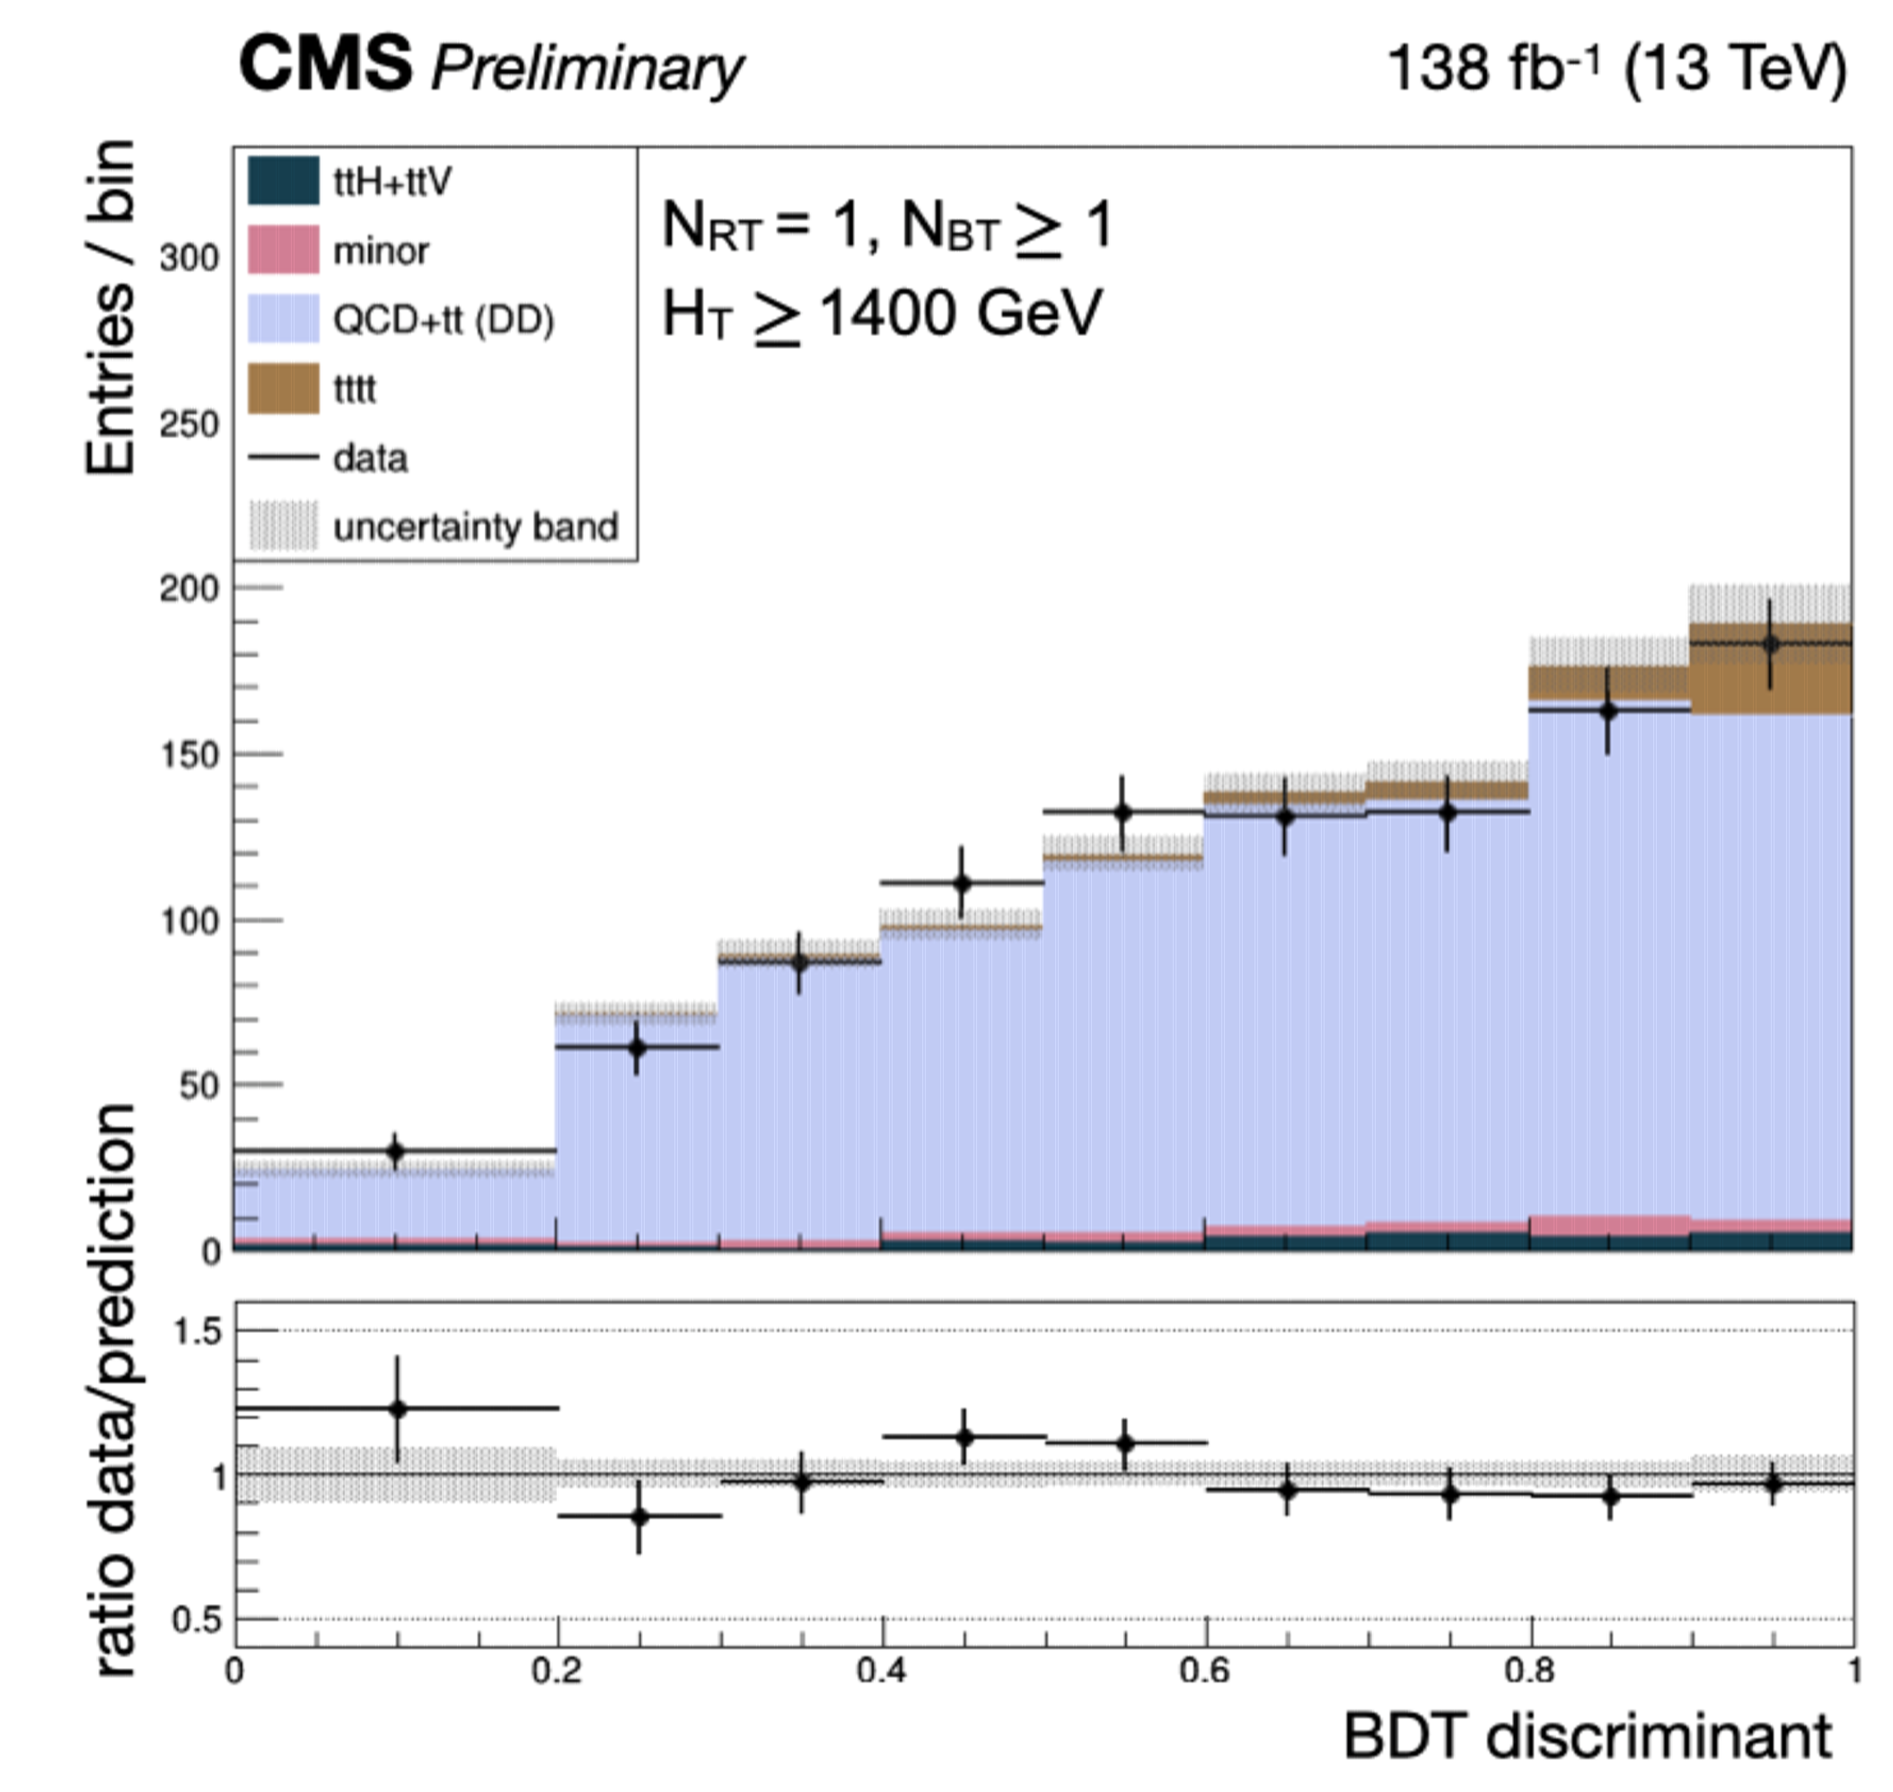
Production of 4 tops ($t\overline{t}t\overline{t}$)
JHEP 11 (2019) 082
EPJC 80 (2020) 75
CMS-PAS-TOP-21-005
First time the all-hadronic channel is used in 4 top searches!
Fit to BDT score for signal / multijet separation
Event categories of based on resolved / boosted top candidates and H_{T}
Data-driven estimation of multijet / tt+jets backgrounds

Slide 16
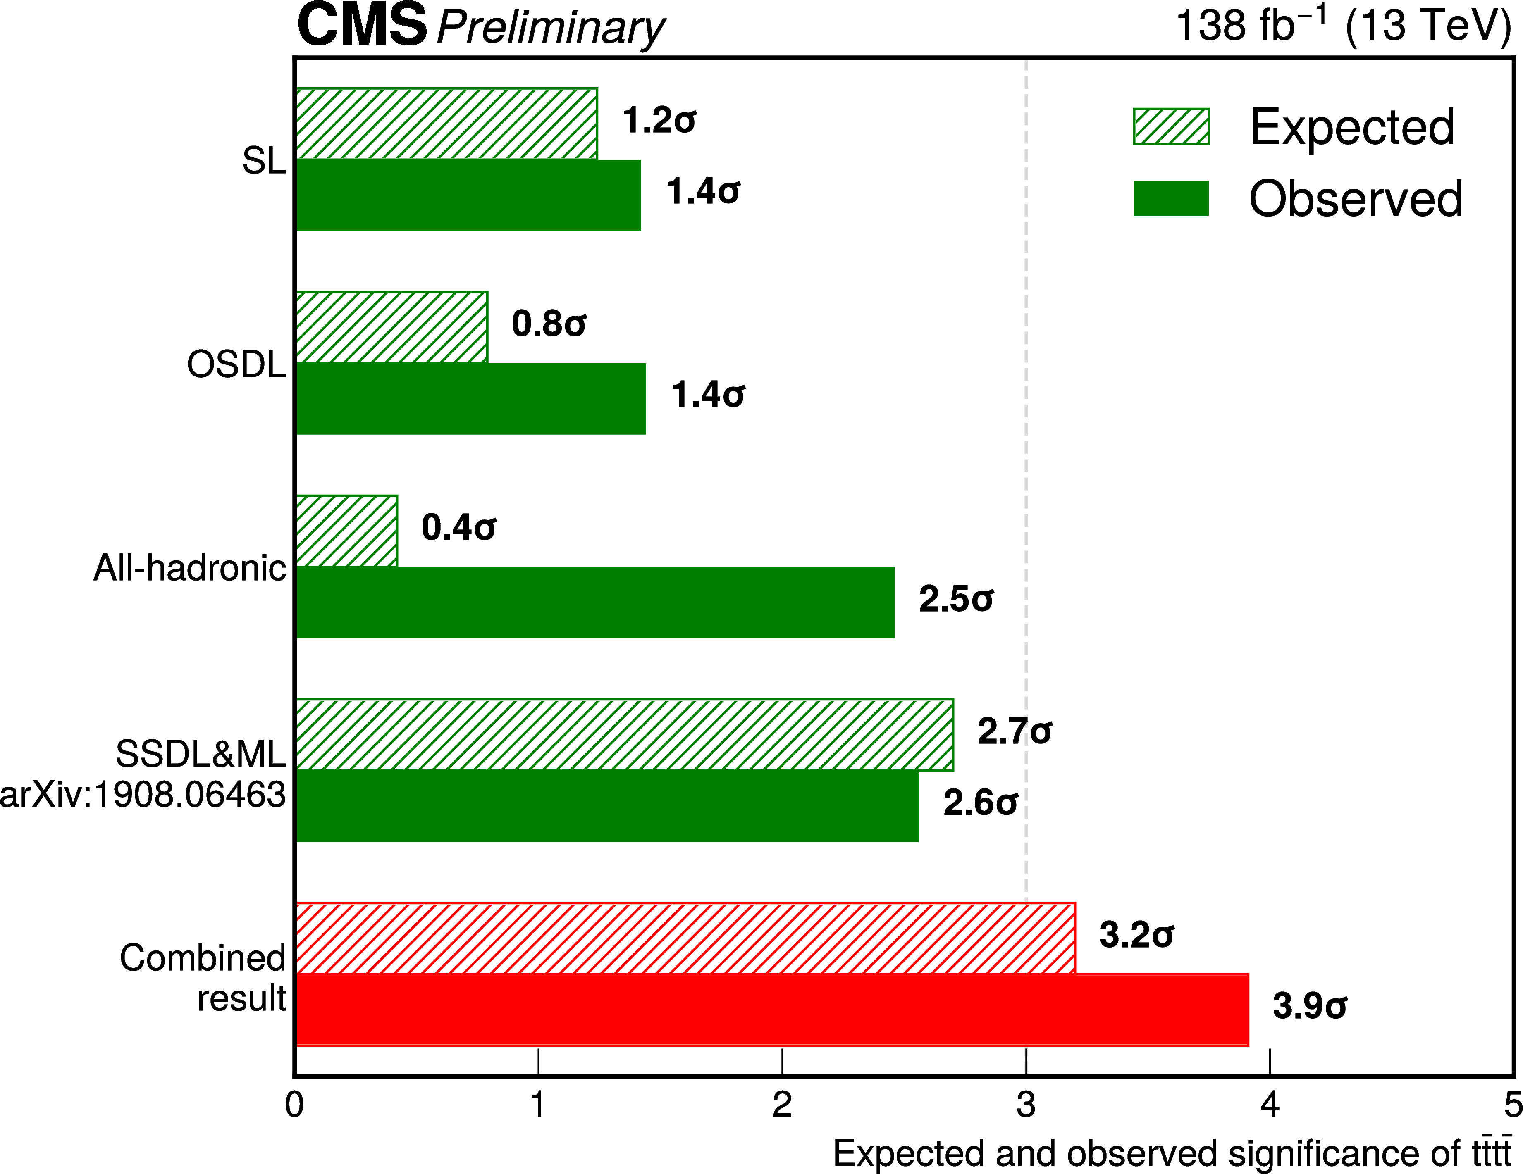
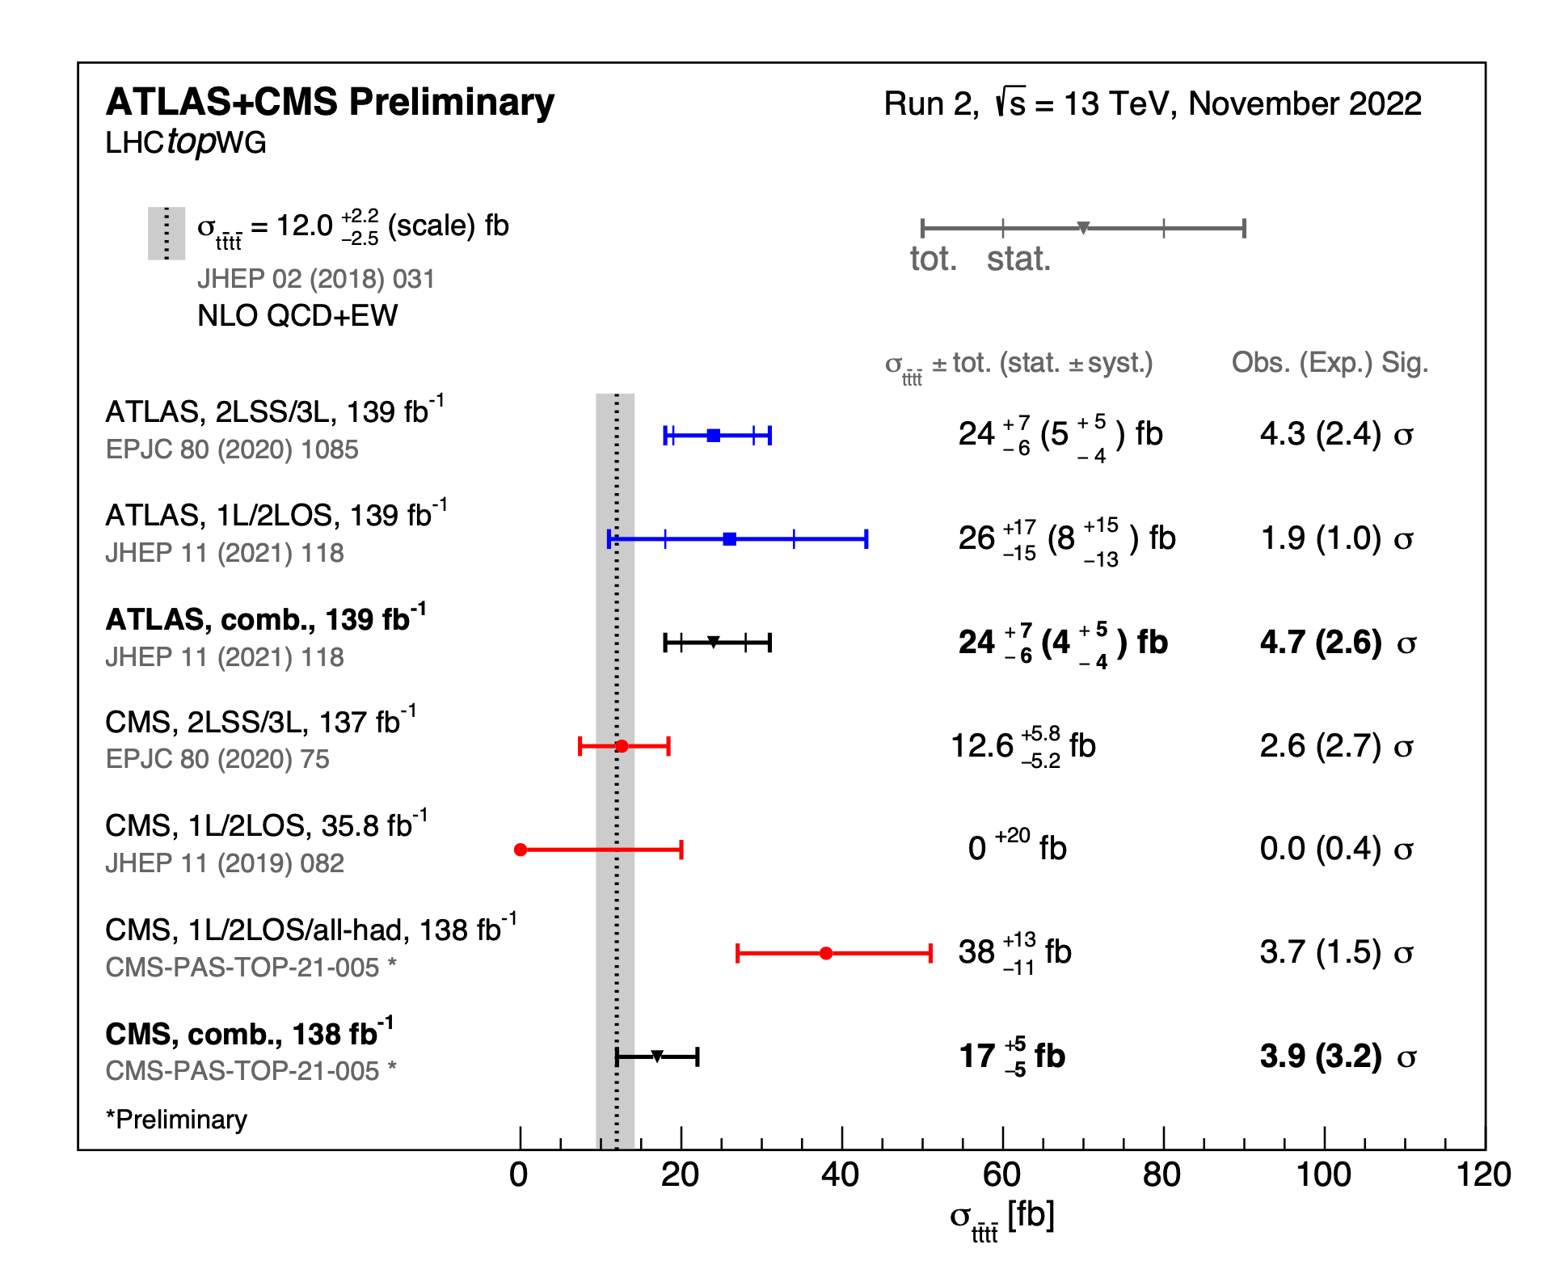
Production of 4 tops ($t\overline{t}t\overline{t}$)
CMS-PAS-TOP-21-005
LHCTOPWGSummaryPlots

Slide 17
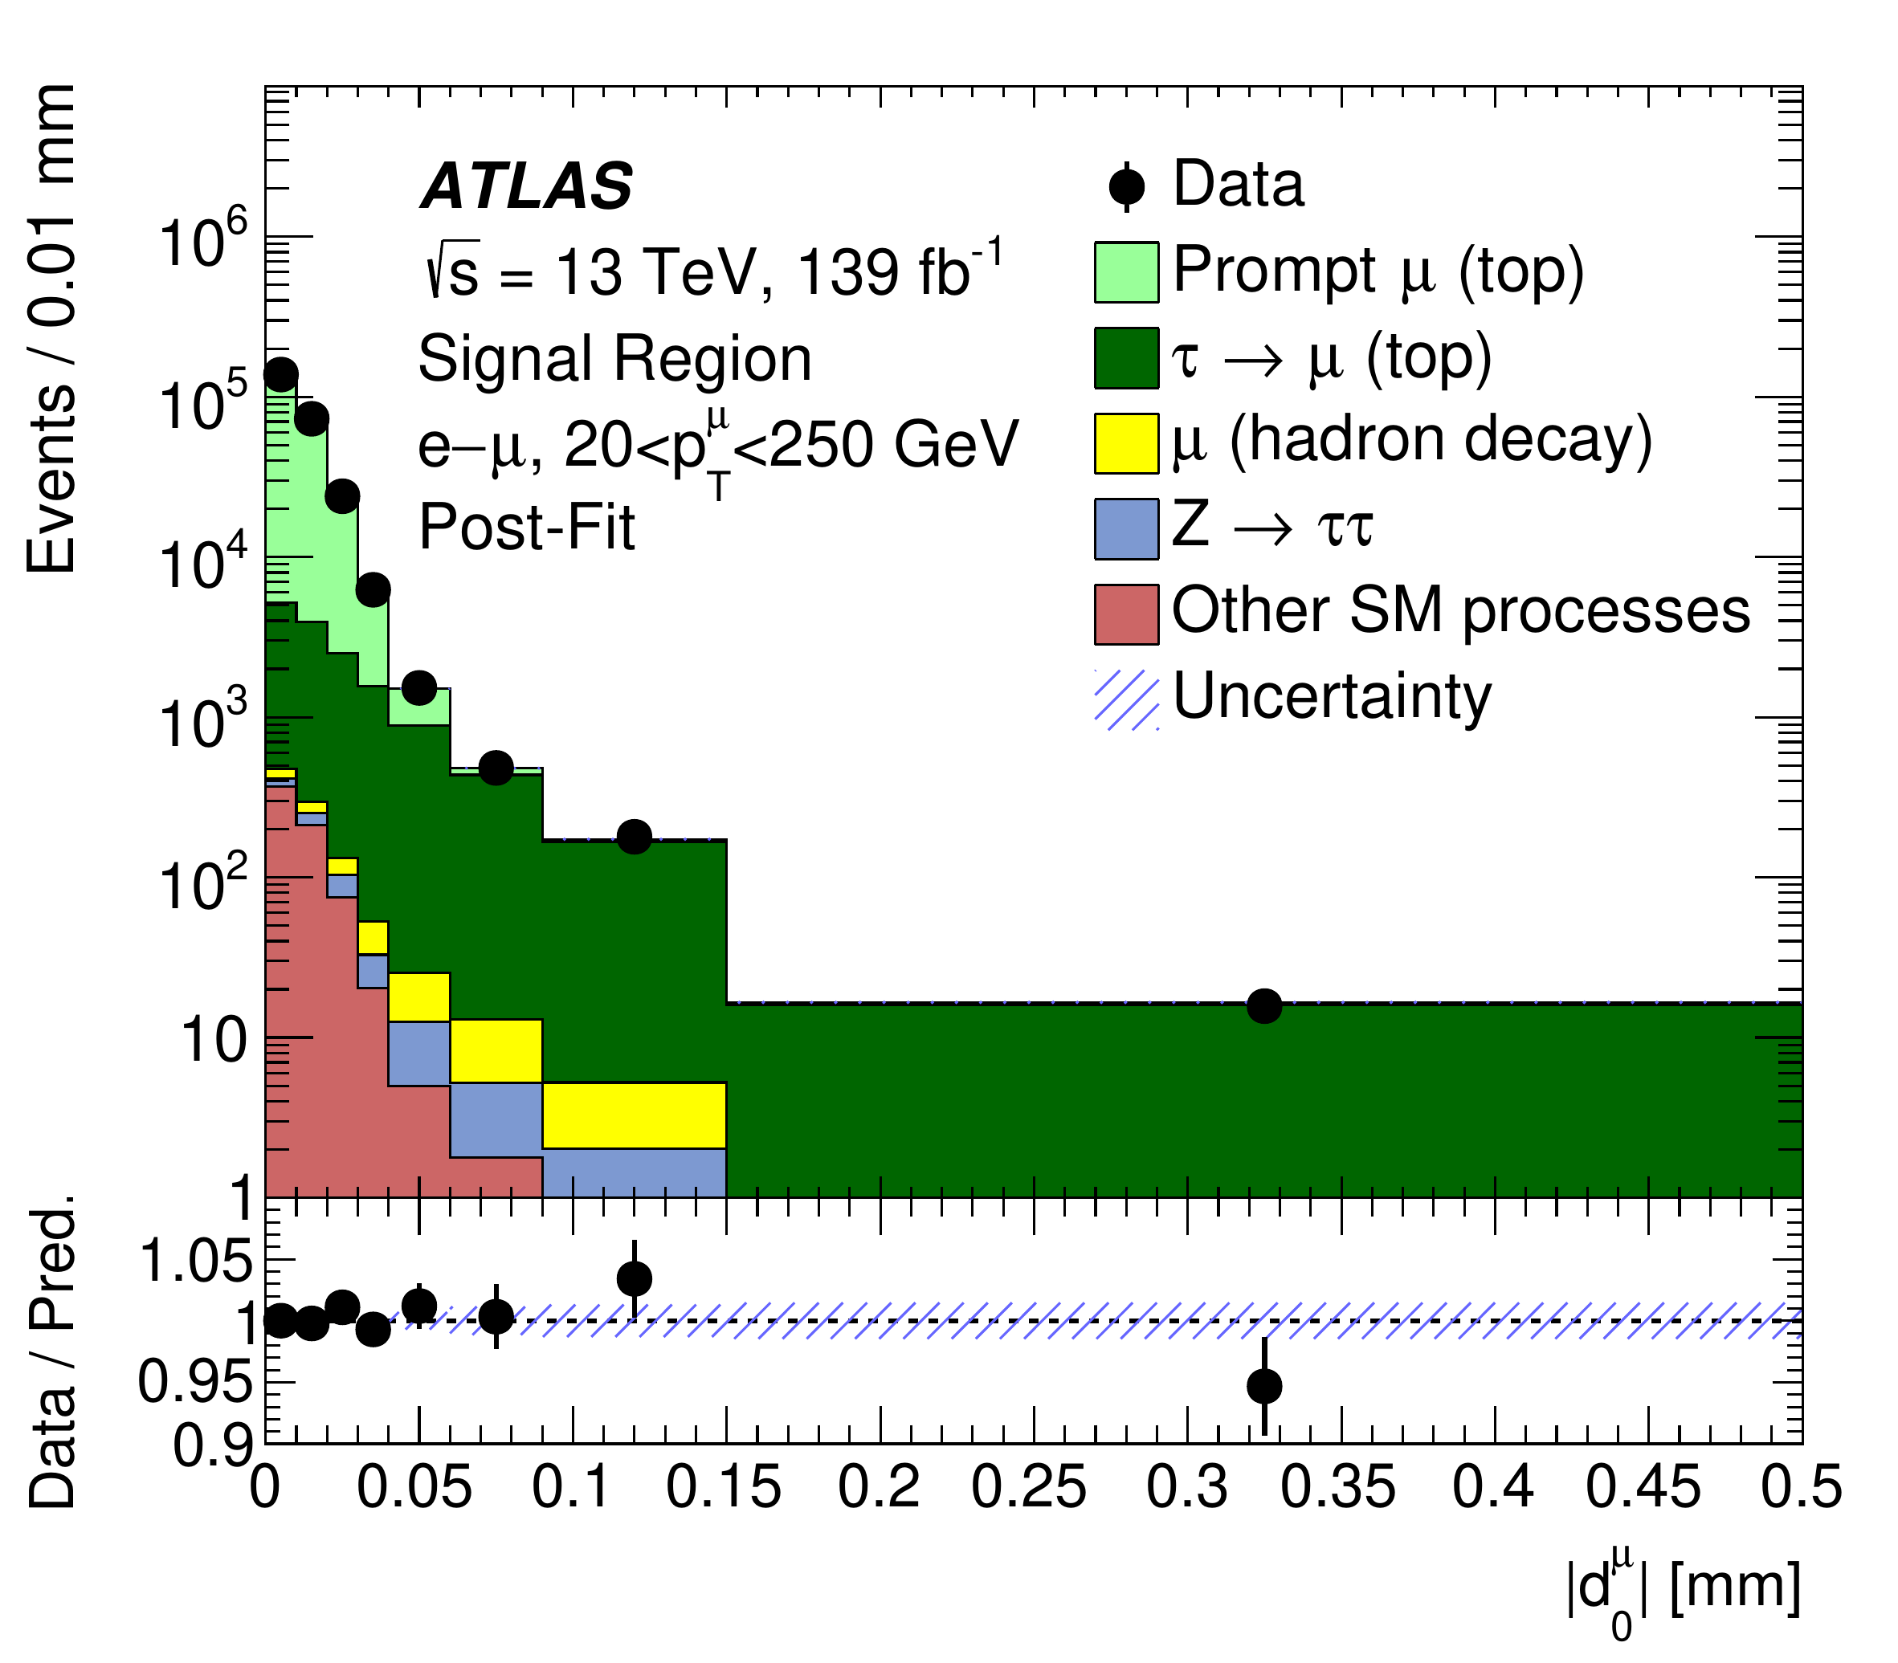
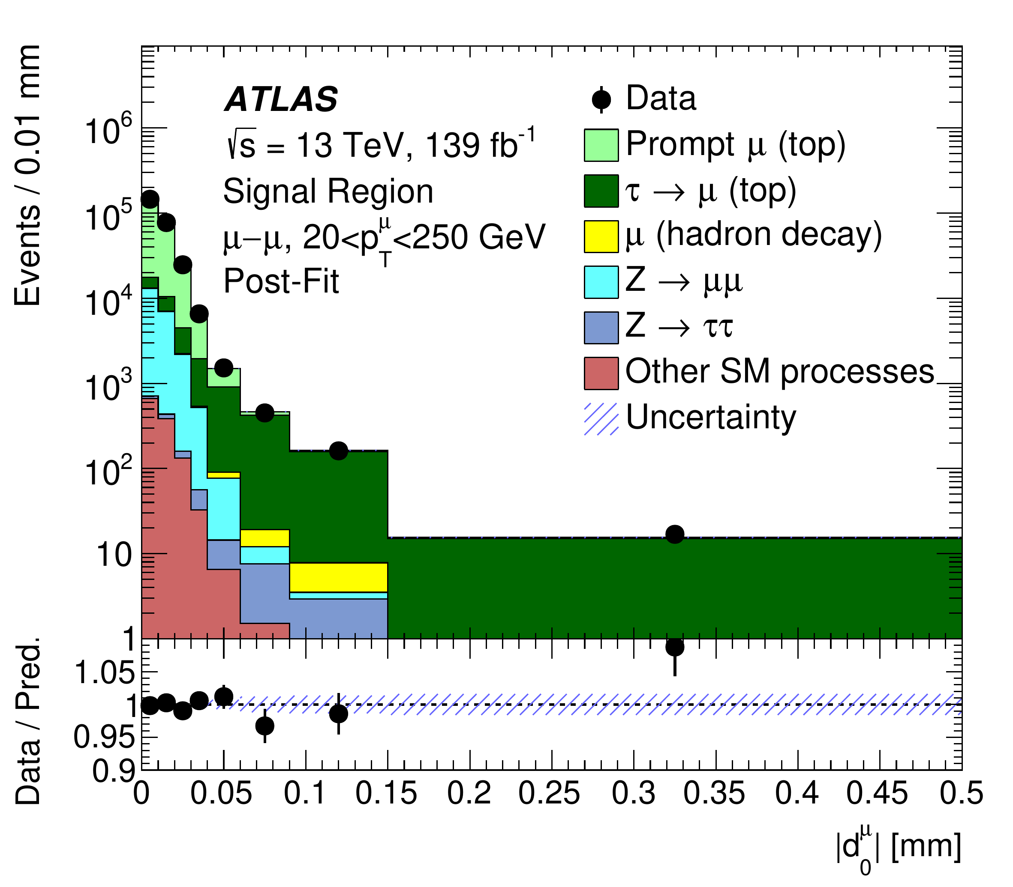
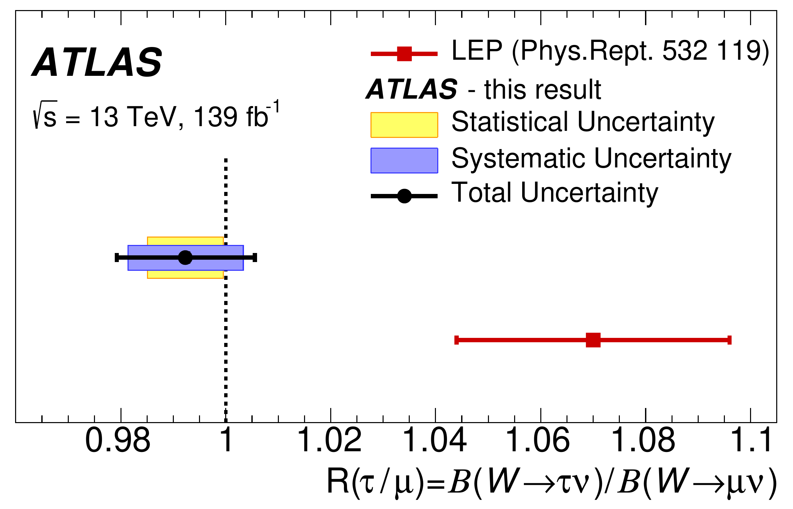
Lepton flavor universality using $t\overline{t}$ events
$$R(τ/μ)=B(W→τν)/B(W→μν)$$
Previous LEP result 2.7𝜎 away from SM prediction
Measurement in tt¯ dilepton events using Tag&Probe
➛ tight e/μ , check second μ
Impact parameter ( d₀ ) discriminant
low d₀ : Likely W ➛ μ
high d₀ : Likely W ➛ τ ➛ μ
d₀ calibrated using Z ➛ μ μ
Most Precise result :
Unc. dominated by syst.
$$R(τ/μ)=0.992±0.007(stat)±0.011(syst)=0.992±0.013$$
Dominant syst. sources
➛ d₀ template modelling
➛ μ isolation and reconstruction
NP 17, 813–818 (2021)

Slide 18
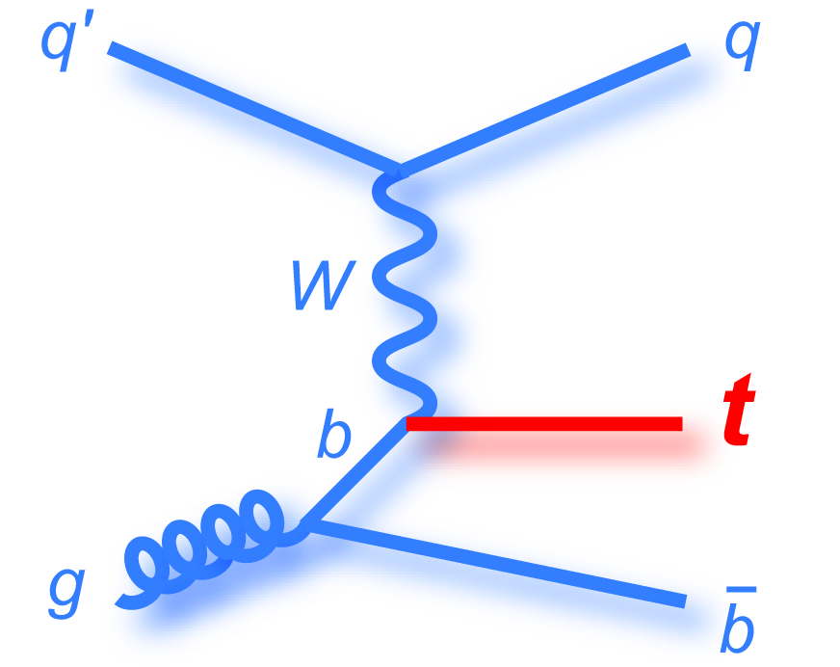
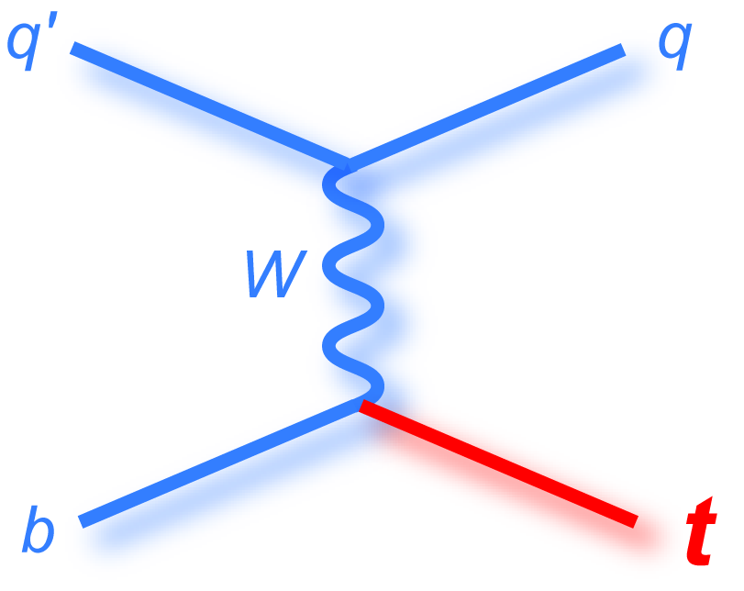
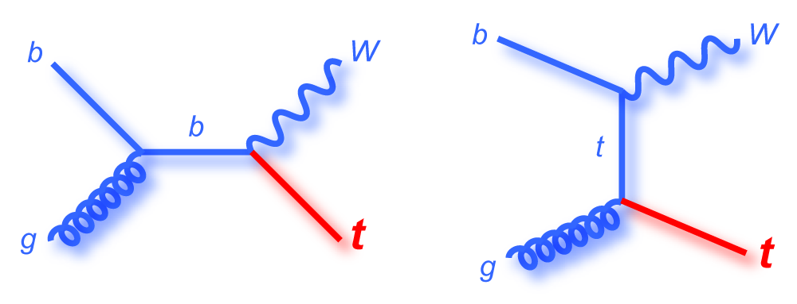
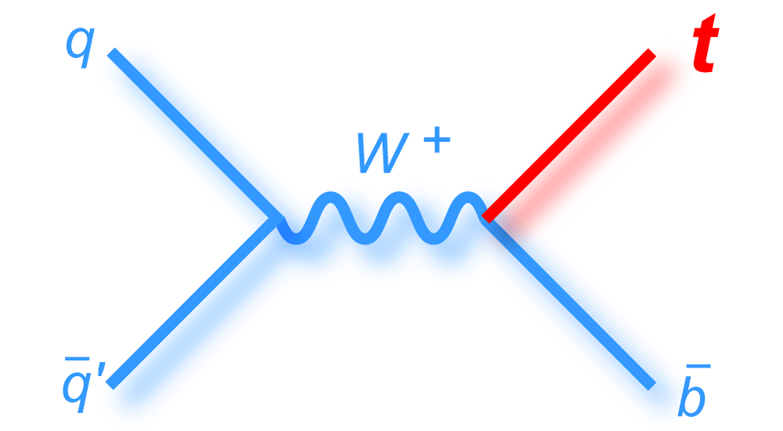


Electroweak production
t-channel (∼ 73% at LHC)
tW (∼ 24% at LHC)
s-channel (∼ 3% at LHC)
Golden Channel, sensitive to FCNC
Observed at LHC, sensitive to BSM couplings
Challenging at LHC
4FS
5FS
$$σ∝|V_{tb}|^{2}$$
$$|f_{LV}V_{tb}|=\sqrt{\frac{σ_{meas.}}{σ_{theo.}(|V_{tb}|=1)}},Assuming|V_{td}|,|V_{ts}|≪|V_{tb}|$$
f_{LV} accounts for possible BSM contribution ➛ f_{LV} = 1 for SM
$$σ_{t+\overline{t}}^{t-ch}(13TeV)=207±2(stat)±31(syst)pb=207±31pb$$
LHCTOPWGSummaryPlots
PLB 800 (2019) 135042

Slide 19



|V_{tq}| in t-channel
PLB 808 (2020) 135609
SM scenario
BSM scenario 1
BSM scenario 2
Only partial widths altered (keeping total width fixed) because of modified CKM matrix elements
Partial widths unchanged, but the total width increases due to BSM decays
$$\underset{q=b,s,d}{∑}|V_{tq}|^{2}=1$$
$$|V_{tb}|=0.988±0.051$$
$$|V_{tb}|=0.988±0.024$$
$$|V_{tb}|>0.9$$
$$|V_{td}|^{2}+|V_{ts}|^{2}=0.06±0.06$$
$$|V_{td}|^{2}+|V_{ts}|^{2}<0.057$$
$$|V_{td}|^{2}+|V_{ts}|^{2}=0.06±0.06$$
$$Γ_{t}^{Obs}/Γ_{t}=0.99±0.42$$

Slide 20





Test of CPT invariance in single top events
Separate meas. of top quark and antiquark masses based on the charge of the lepton
JHEP 12 (2021) 161
Optimized selection threshold on BDT discriminants to select event sample with high (≈ 60 %) signal purity
ML fit to $ζ=ln(\frac{m_{t}}{1GeV})$ using analytic templates to extract mass
$$Δm_{t}=m_{t}-m_{\overline{t}}={0.83}_{-1.35}^{+1.79}GeV$$
➛ sensitive to violation of local gauge invariance and/or Lorentz symmetry

Slide 21

Summary
LHC ≡ top quark Factory ⇒ precision lab for studying top quark production and properties ⇒ portal to new physics beyond SM
Most measurements agree with SM prediction within uncertainties
Provides good understanding of the various modeling aspects such as PDF, PS, UE and CR etc.
Stringent limits on couplings are placed with EFT interpretation using Run2 data
Rare processes involving top quarks waiting to be fully exploited during Run3 and HL-LHC
More information : ATLAS Top Public Results , CMS Top Public Results, LHC Top WG
Thank you for your attention

Slide 22
Back up

Slide 23




Inclusive and differential tt¯𝛾 cross section - 𝓁 + jets
NLO Prediction:
$$σ_{t\overline{t}γ}=773±135fb\left[p_{T}(γ)>20GeV|η(γ)|<1.442\right]$$
JHEP 12 (2021) 180
Final state consists of exactly 1 𝛾, exactly 1 𝓁, ≥ 3 jets, ≥ 1 b-tagged jet
Measured inclusive cross section:
$$σ_{t\overline{t}γ}=798±7(stat)±48(syst)fb$$
Differential measurements used to extract limits on EFT coupling CtZ

Slide 24


JHEP 05 (2022) 091

Slide 25


JHEP 12 (2021) 161
NP 17, 813–818 (2021)

Slide 26



CMS-TOP-20-005
Science 376, 170 (2022)

Slide 27


CMS-TOP-21-014
PLB 808 (2020) 135609

Slide 28


CMS-PAS-TOP-21-005

Slide 29

Summary of tt¯V measurements
LHCTOPWGSummaryPlots

Slide 30


LHCTOPWGSummaryPlots

Slide 31


CMS-SUSY-Summary-Plots

Slide 32


Lepton flavor universality using WW and W+jets events
PRD 105 (2022) 072008

Slide 33





Cross section ratios
tt¯ cross section ratios and double ratios ( tt¯ / Z ) estimated at different √s & compared with various PDF predictions
Results mostly agree within 2 s.d with predictions with the exception of ABM12LHC ➛ lower gluon density at high Bjorken-x for ABM12LHC compared to others
EPJC 80 (2020) 528

Slide 34



DeepAK8
DeepAK8 is a multi-classification algorithm for the identification of hadronically decaying particles, with five main categories ☞ W/Z/H/t/QCD
PF candidates and secondary vertex information as inputs.
It is a one-dimensional CNN based on the ResNet architecture
JINST 15 (2020) P06005

