Slide 1
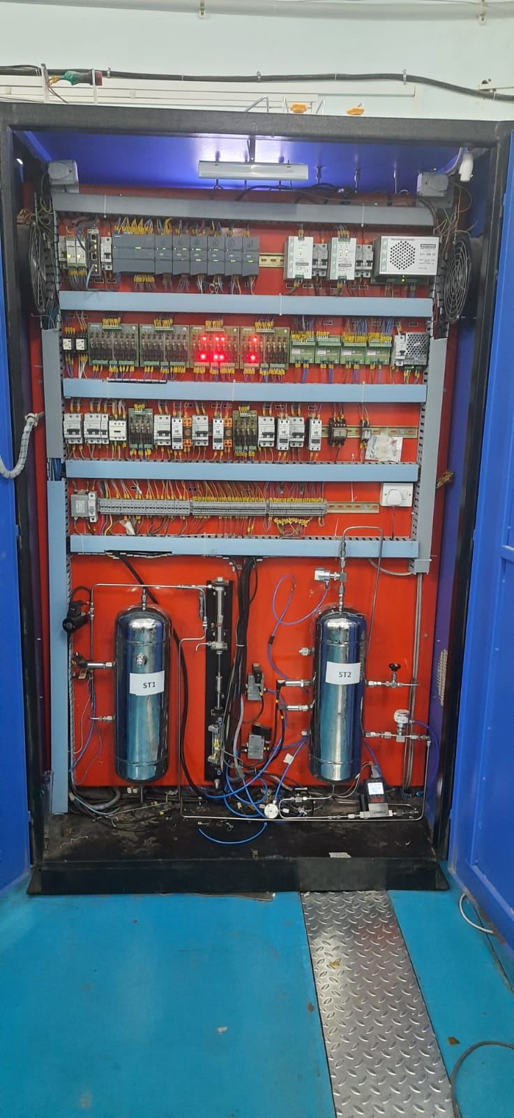
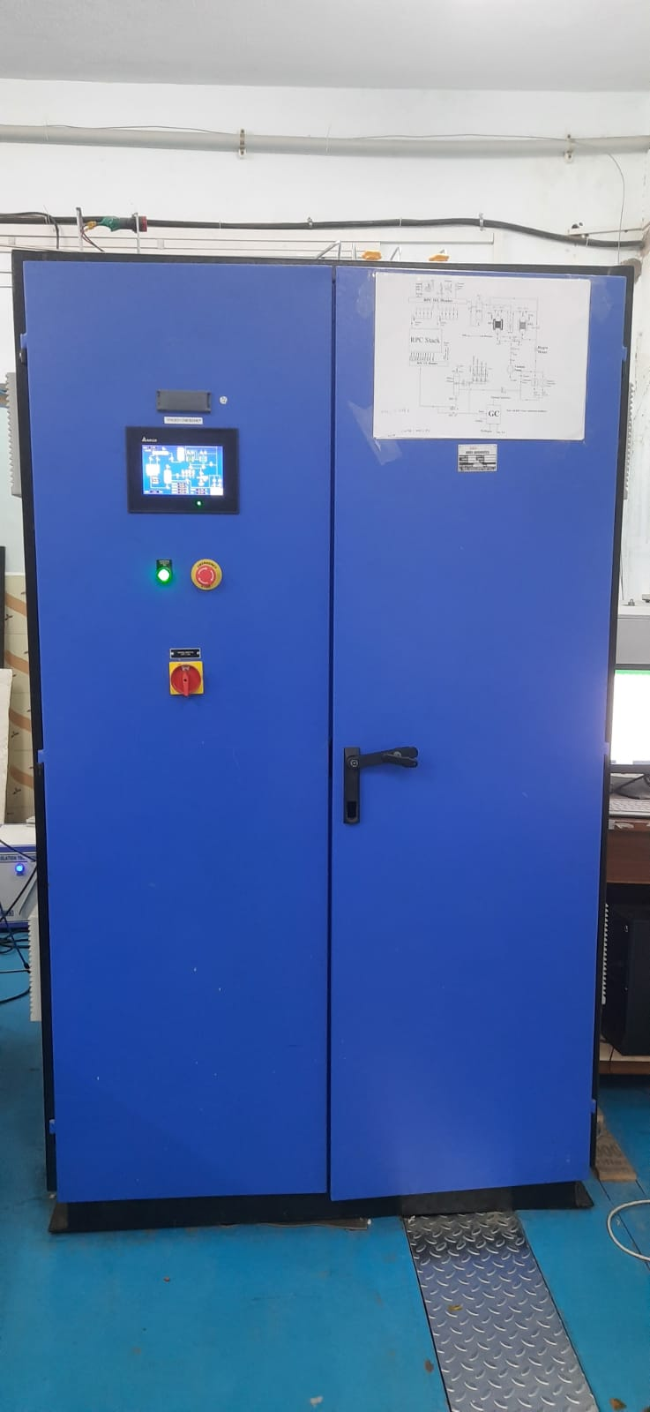
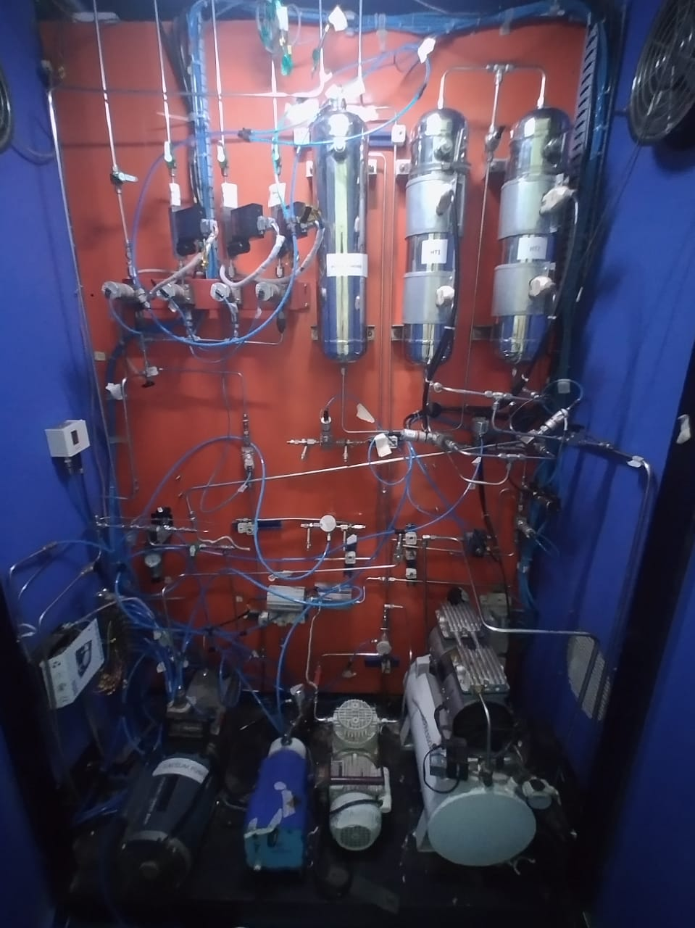
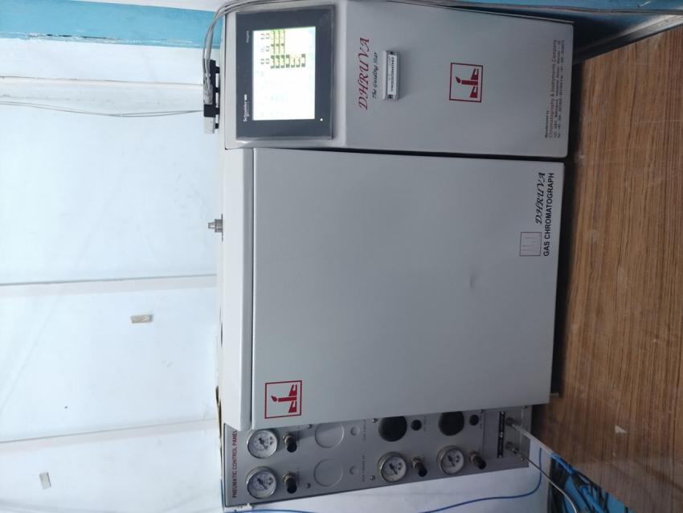
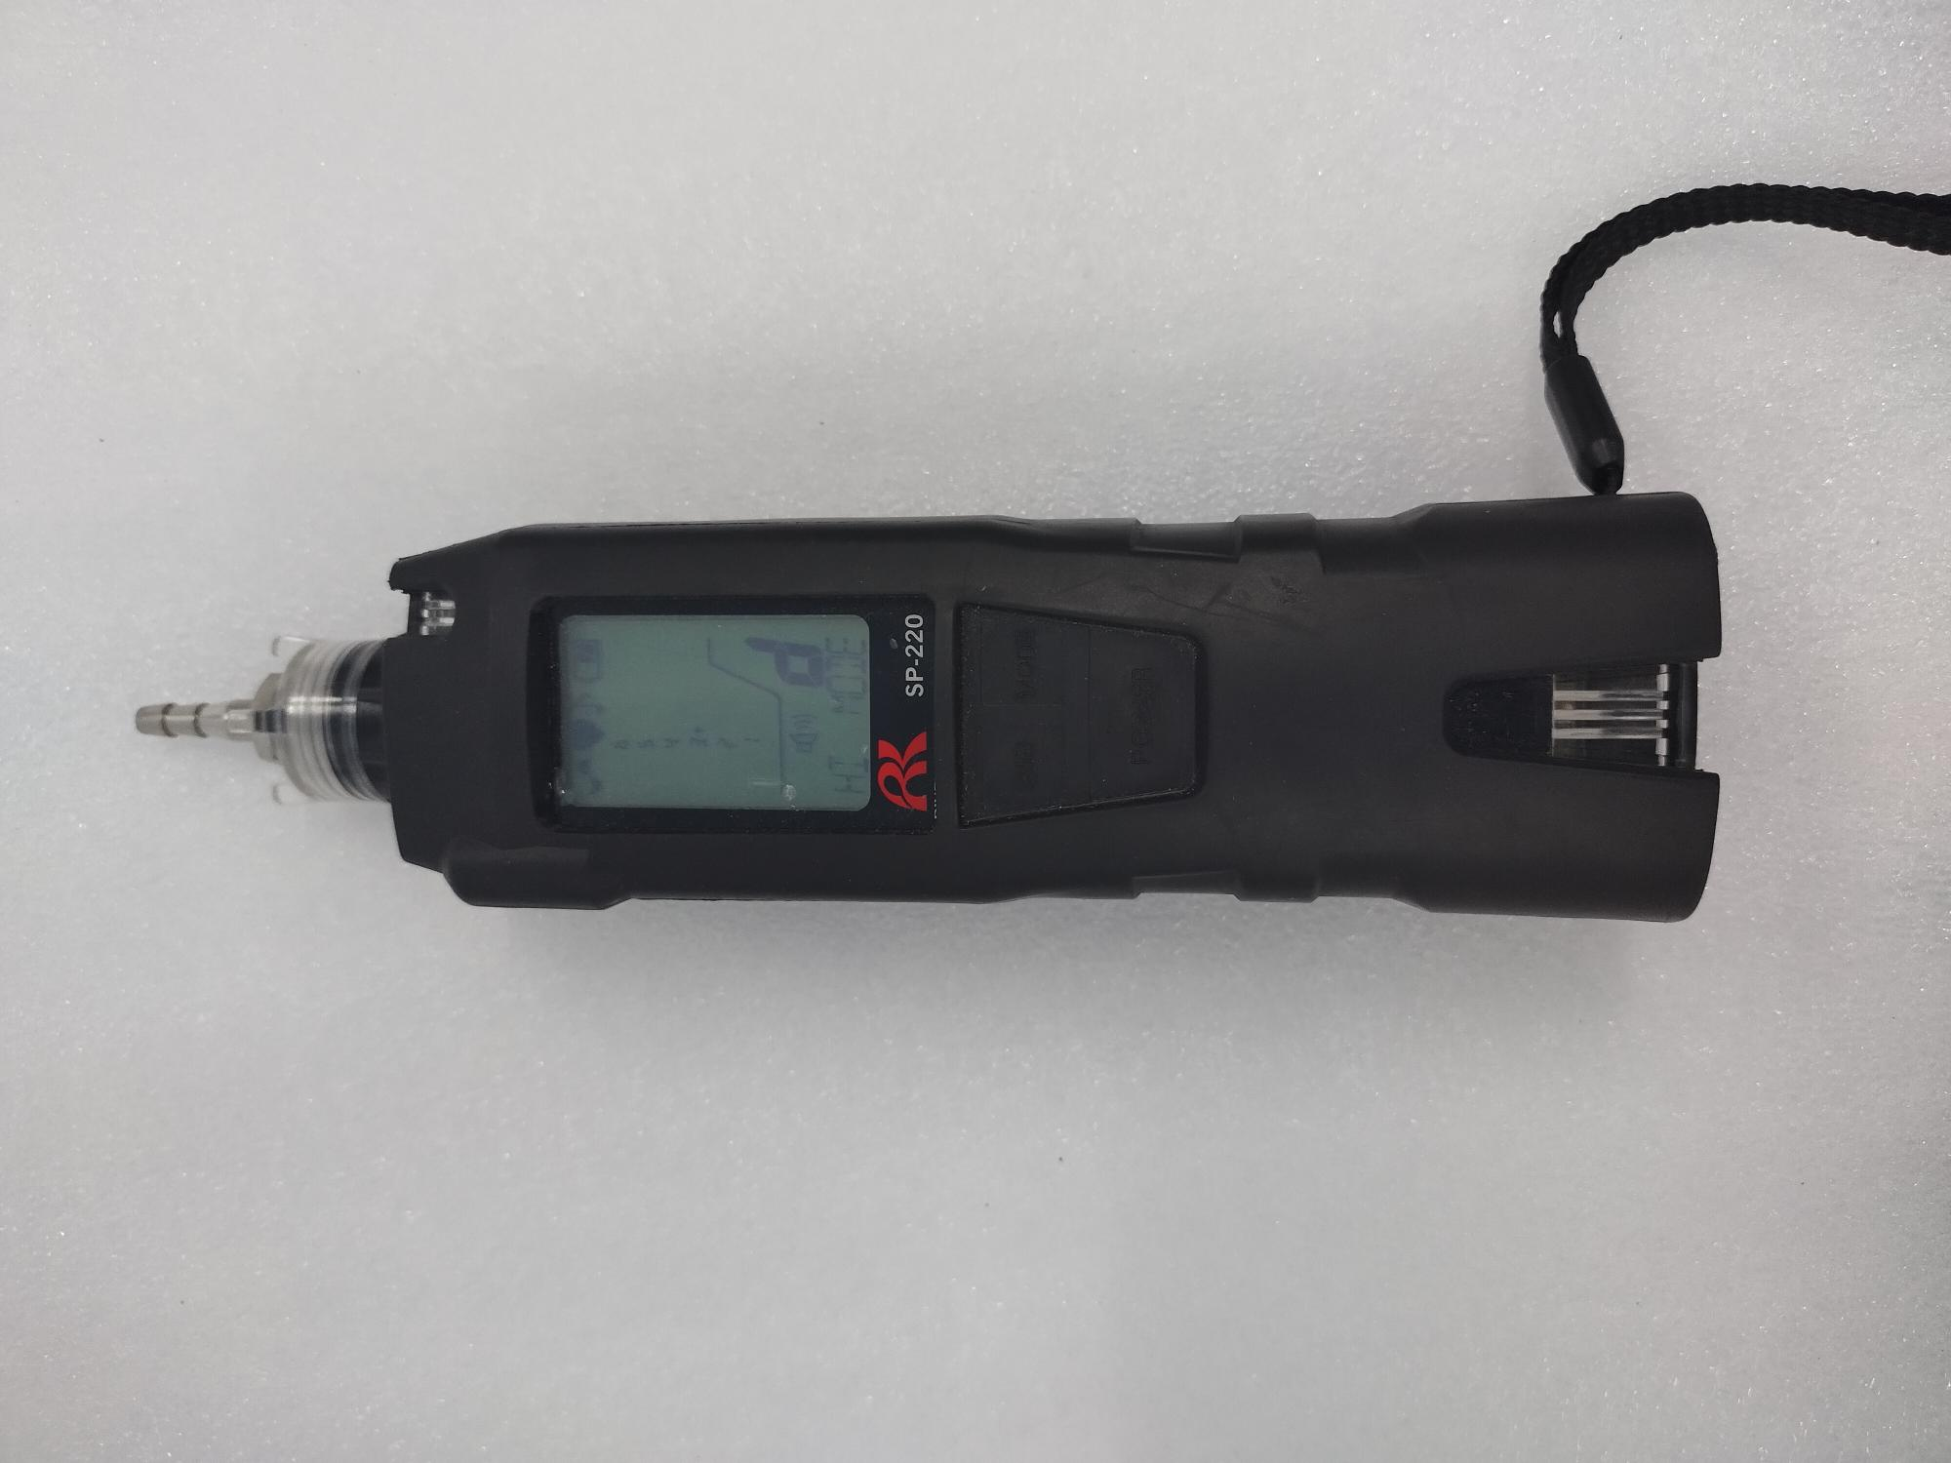
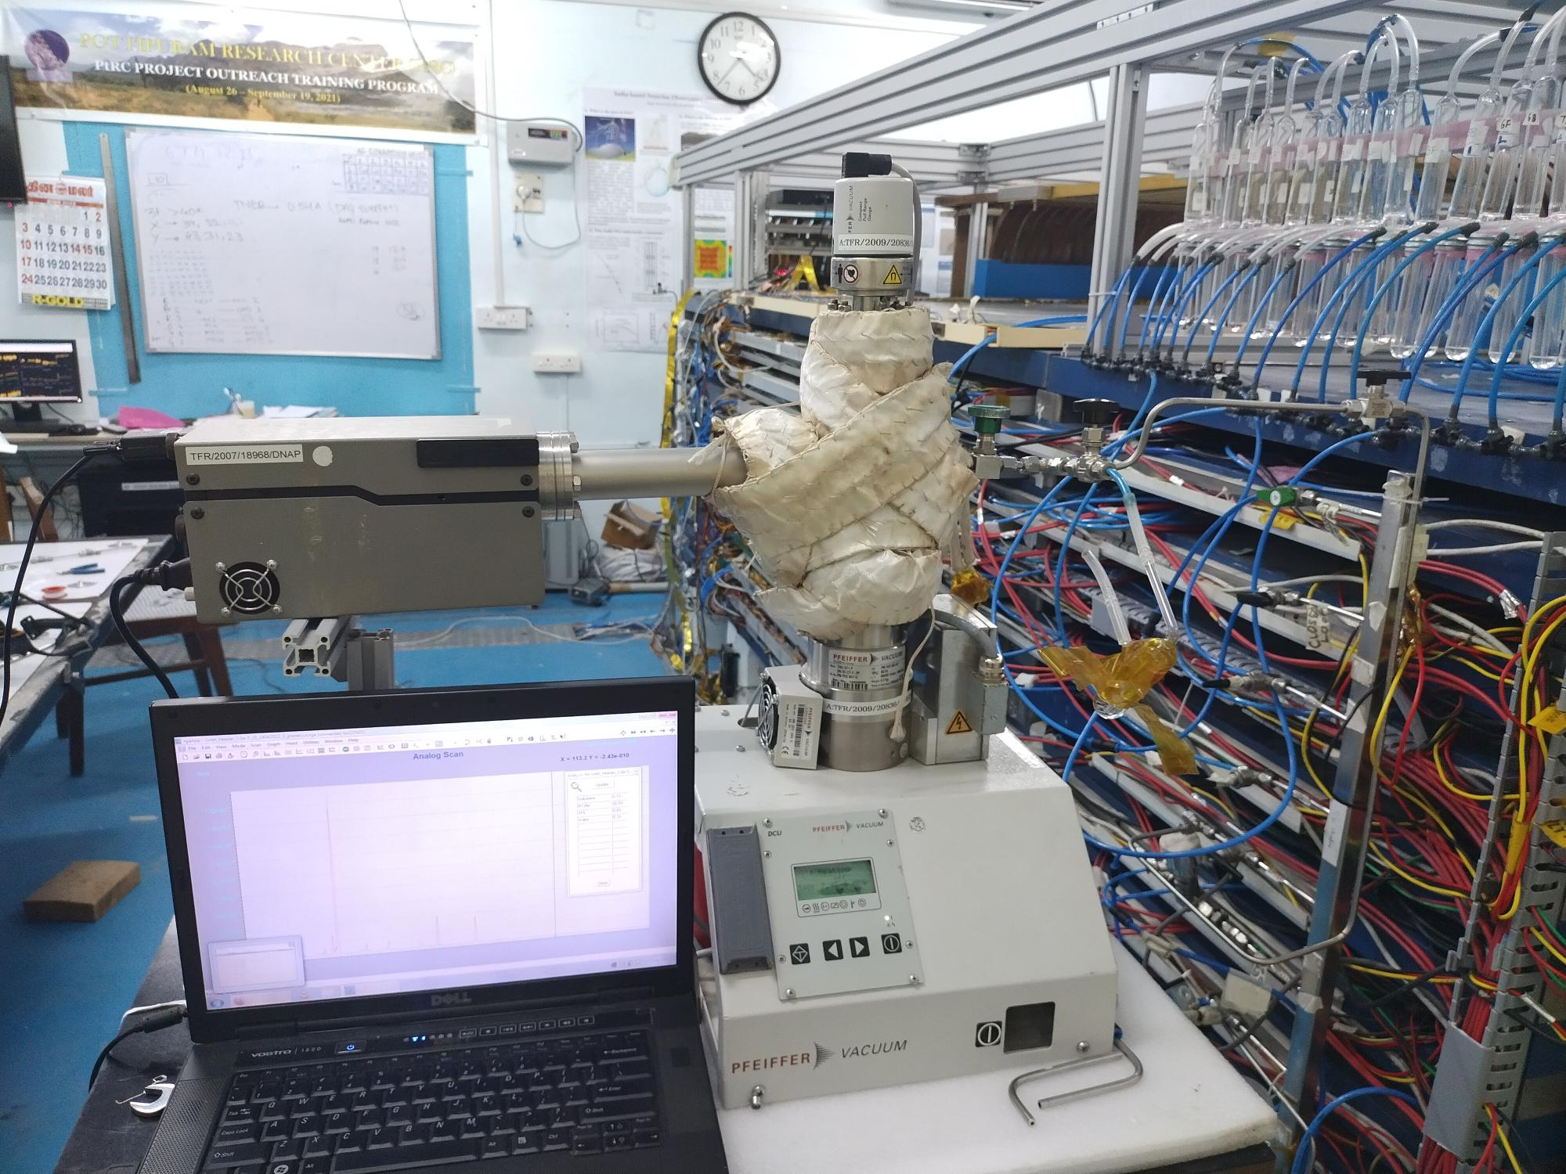
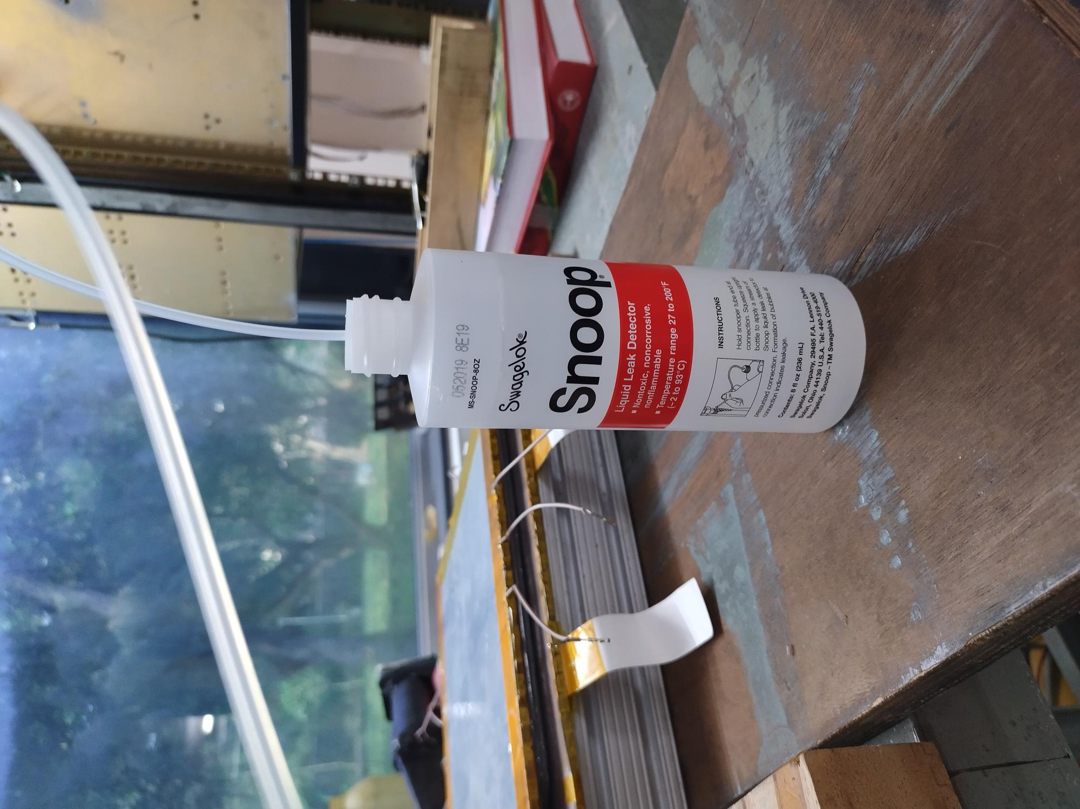
Refurbishment of CLS system for mini- ICAL detector
R.R. Shindeª, G. Majumderª , K.C. Ravindranª, M.N. Saraf ª, B. Satyanarayanaª, M. Shah^{b}, K.P. Sharmaª, P. Vermaª , L. Umesh^{a,c}
ªTata Institute of Fundamental Research, Mumbai
^{b}Bhabha Atomic Research Center, Mumbai
^{c}American College, Madurai
Introduction
RPC, the active element in the INO experiments, is a gaseous detector.
Mode of operation is determined by the mixture of gas flowing through the RPCs.
Avalanche mode: R134a+Isobutane+SF₆
Streamer mode: R134a+Argon+Isobutane
Gas system is required to circulate proper gas mixture in the detectors.
System at Glance
Gas system
There are 3 types of gas systems
Open ended gas system: No reuse of the output gas mixture from the detector
Open loop gas system: collect the output gas mixture from the detector and segregate the gases and reuse in the system
Closed loop gas system: Collect the output gas mixture from the detector, purify it and recirculate it.
We have an open ended system and a Closed loop gas system operational at mini-ICAL.
Parameters | mini- ICAL
Size | 4 m x 4 m
No of Layers | 10
No of RPCs Per Layer | 2
Total No. of RPCs | 20
Size of gas gap in the RPC | 184.5*174*0.2 cm³
Gas Volume of Each RPC | 6.42 Litres
Total Gas Volume | 128.4 Litres
Mode of RPC Operation | Avalanche
Required gases | R134a (95.2%)
 | Iso-Butane (4.5%)
 | SF₆(0.3%)
Open End
Closed Loop
Refilling
Vacuum
Regeneration of molecular Sieves
Manual ON-OFF
Line Diagram of CLS
Important components
Operations in the Closed loop gas system installed at IICHEP, Madurai
Problem faced
Presence of air detected
More number of top-up cycles
Rise in the current in the RPCs
Diagnosis Tools
CLS Parameters performance
Current Status
Intensive leak arrest tasks completed.
Operational, fine tuning is going on.
Initial results show gas mixture top-up happens after 3.5 days.
Gas Chromatograph
Leak Detector (SP220)
Future plan
Replacement of faulty pneumatically operated valves
Implementation of capillaries of short length for all RPCs
Improve the operation and control scheme for the e-ICAL, based on experience at mini-ICAL
RGA SRS300
Snoop Solution
Acknowledgement: We are Thankful to Shri. S.S.Chavan, Shri. V.V.Asgokar , Shri. G.K.Ghodke and Smt. D.S. Gonji for their technical help in the CLS work. We also acknowledge the efforts of Scientific staff at IICHEP, Madurai, INO Research Scholars and Interns in the gas system.
XXV DAE-BRNS High Energy Physics Symposium 2022
12-16 December 2022, IISER, Mohali
1

