Slide 1
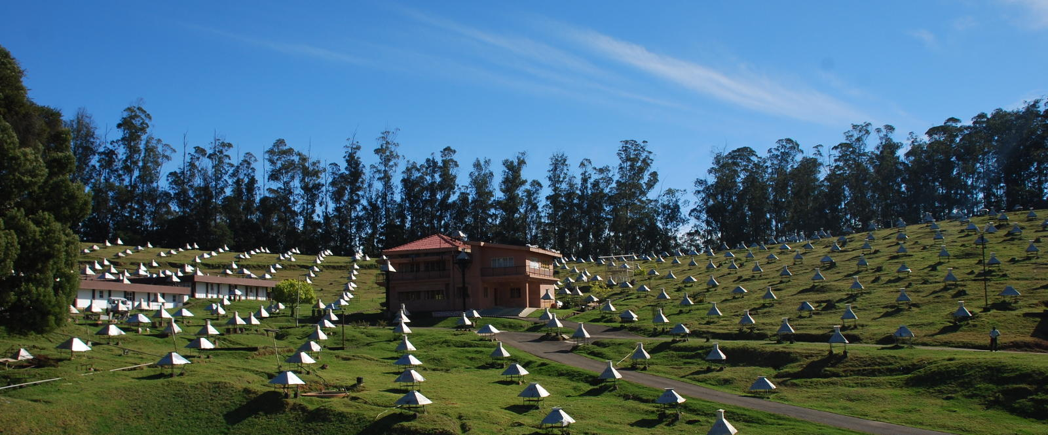
Trigger-less Muon Data Acquisition (TM-DAQ) system for the GRAPES-3 muon telescope
R SURESH KUMAR
On Behalf of GRAPES-3 Collaboration
CRL, TIFR, Ooty

Slide 2
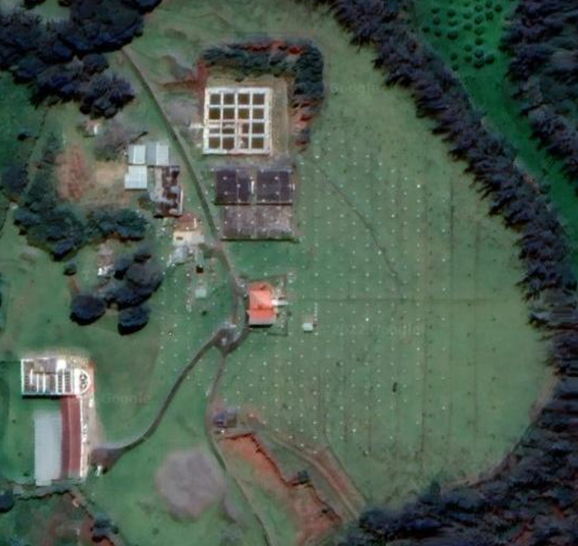

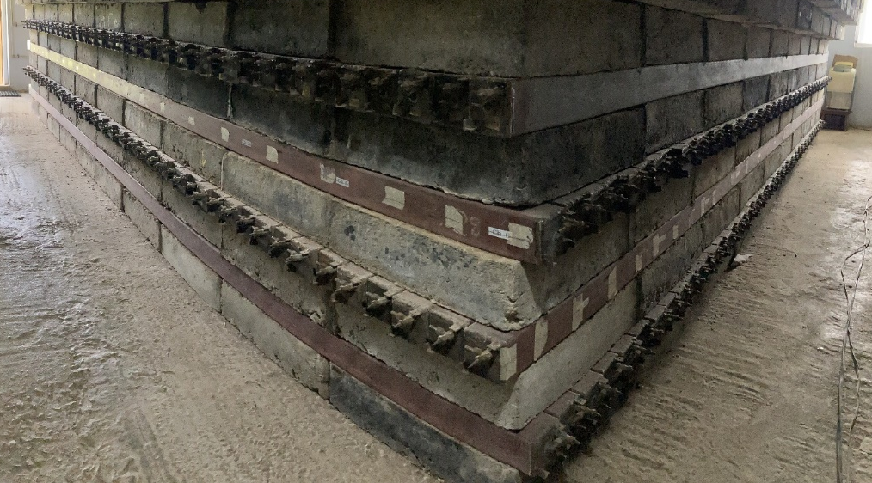
The GRAPES-3 EXPERIMENT
B
16 Upcoming Muon Modules (3776 PRC’s)
16 Muon Modules in Operation
(3712 PRC’s)
400 Scintillator Detectors
3
2
1
0
A
VIEW OF EXISTING MUON MODULE
C
Notes:
This is the satellite image of the Grapes-3 Experiment. The dots you see here are 400 no’s of scintillation detectors and the red colour box u see here is the 16 Muon modules with 3712 PRC’s which is in operation and the yellow dotted line are the 16 upcoming muon modules with 3776 Prc’s. For better view I have put a picture on the right hand side, where the new muon modules are clearly visible
The right side bottom picture is how a module looks like. As shown in picture each module will have four layers and each layer will have 59 Proportional counters. Every alternate layers are placed orthogonally

Slide 3
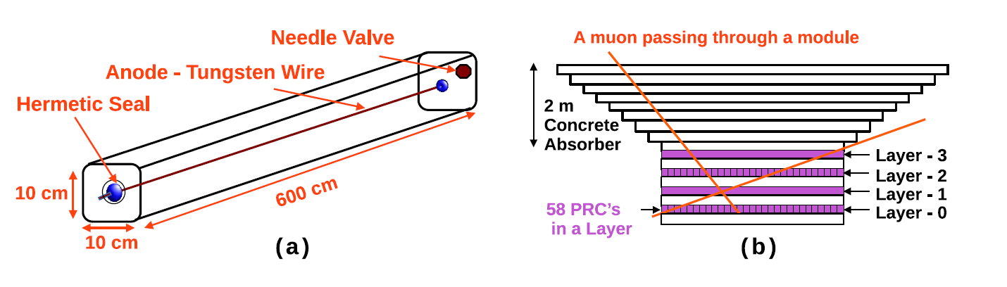
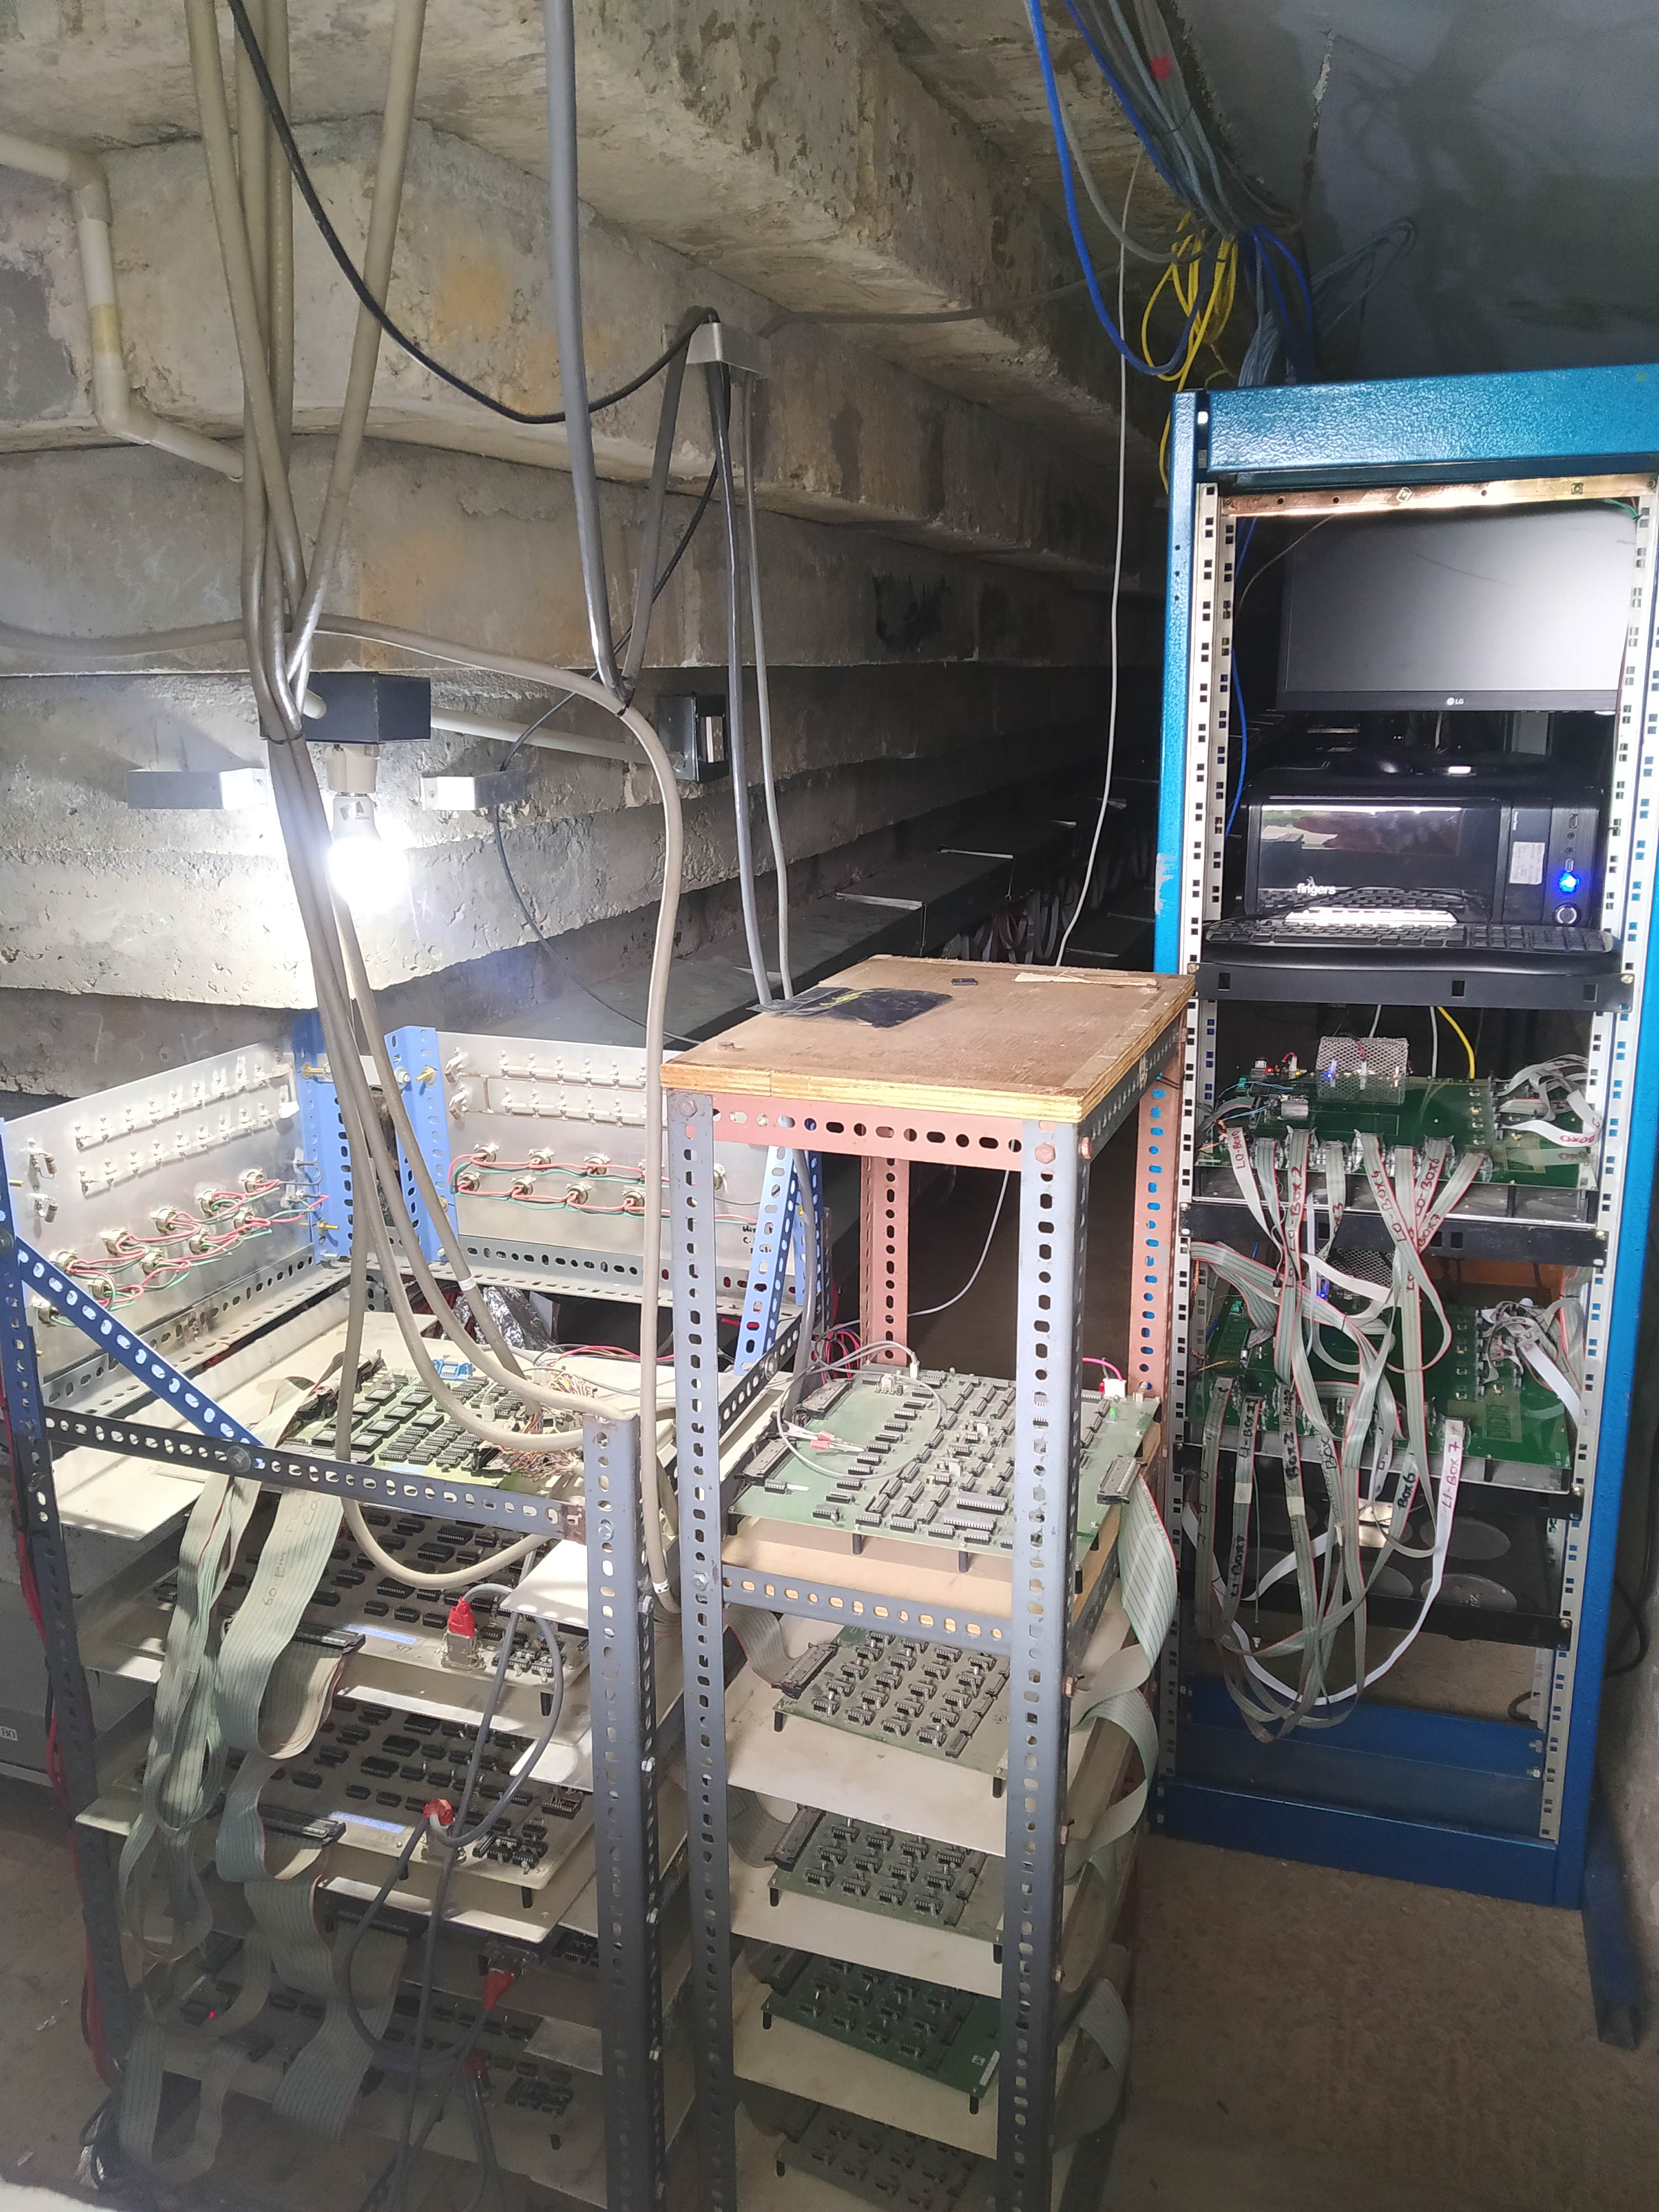

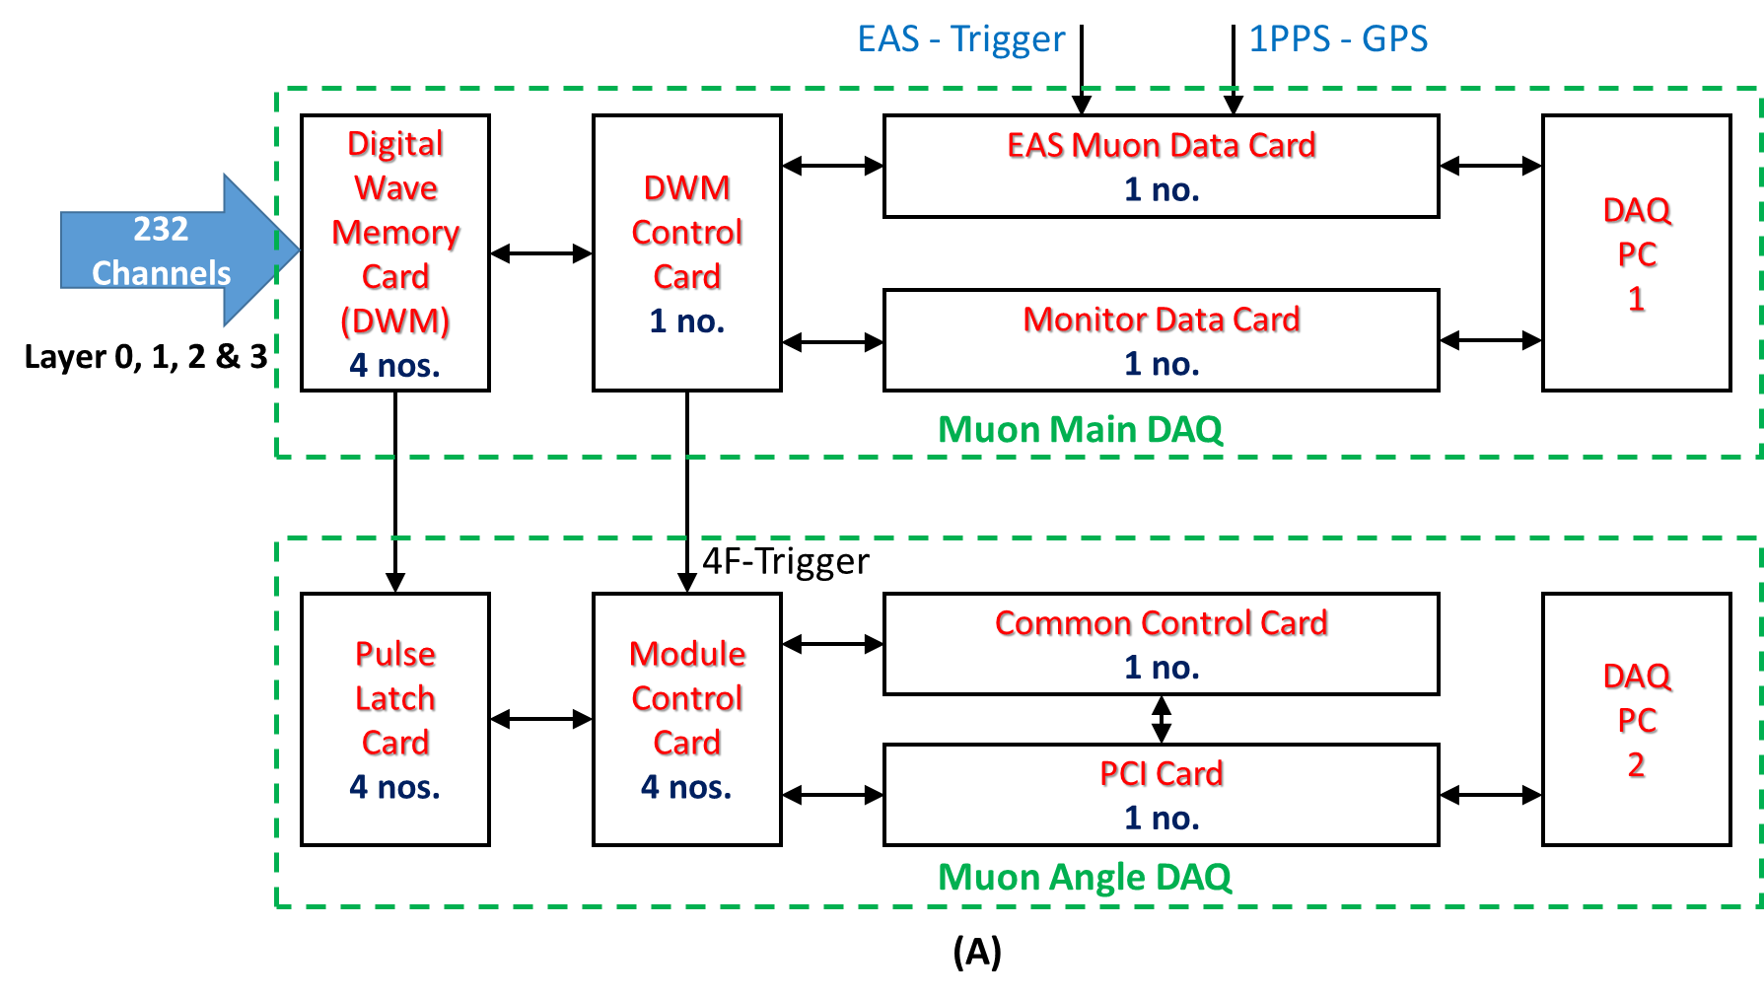
Existing Conventional DAQ for Muon Detector
Proportional Counter (PRC)
Muon Module
Designed and developed several decades back, using discrete component with challenges due to the limitation of technology available at that point of time
Working fine, but difficult to maintain as the discrete components used are becoming obsolete
The communication interface is outdated
Challenges in Existing DAQ
Two DAQ streams: Mu-Main and Mu-Angle
Mu-Main: Width and Time of each PRC w.r.t. Air shower trigger
Mu-Angle: 4- fold (whenever a Muon passes through all 4 layers of PRC’s as show in picture b)
It uses 10+ large area PCB per modules
Large Dead time: 12 – 20 %
Pulse Arrival Time: Not measured
Pulse Width is measured for 1 channel (1000 sec) at a time in each layer time
No direct CRM for PRC’s Only 4F and Any3F at every second Other folds – time multiplexed
Restricts the measurement of Muon angle up to Up to 45⁰
Amp
h
Muon Main DAQ records the data w.r.t air shower trigger generated by Scintillation Detector
DISC
w
1
6
2
7
3
8
4
Muon Angle DAQ records data w.r.t. 4-fold trigger (a Muon passing through all 4 layers of PRCs )
9
5
3
10
Notes:
the PRC is a 6 m long hollow metal tube of cross-section 10cm x 10cm. It has anode made up of Tungsten wire and its body acts as cathode.
P10 gas filled inside and the PRC operates at High voltage of around 3000V.
The output of the PRC is connected to the amplifier and the out put of the amplifier is connected to a discriminator with Varying width output. The width is proportional to the logarithm of PRC pulse amplitude.
As shown in figure b 58 PRC’s are placed adjacent to each other to form a layer. Every alternate layer placed in orthogonal fashion.
There are 4 layers of PRC’s that forms a Muon Module. We have 16 modules that are operational from past 20 years.
The existing conventional DAQ was designed and developed several decades back with discrete components with limitations due to the limitation of technology available at that point time
The existing daq has two DAQ streams Mu main and mu angle as shown in block diagram.
Mu main records width and time of PRC’s hits with respect to eas trigger and muangle records when ever muon passes through all four layers of PRC’s
These two daq uses more than 10 large area pcb’s to record one module data and has large dead time ~12% to 20%
There is no provision to measure the pulse arrival time
The pulse width is measured for one channel at a time in each layer
There is no direct count rate measurement
Maintaining the existing DAQ becomes difficult as the discrete components are getting obsolete and the communication used are also outdated

Slide 4
Triggerless Muon DAQ Concepts and Physics Horizon
Trigger less Muon Data
  Records the arrival time and the pulse width for each and every hit from the proportional counter
  Record the hit rate of PRC, various triggers, temperature etc.
    Pulse Width measurement is done with a resolution of 10 nano-second
    Absolute pulse arrival time is measured with a resolution of 10 nano-second
Physics dependent reconstruction of raw data can be done in offline mode
  Rigidity dependent study of Moon Shadow
  Transient Phenomenon
    Thunderstorm Physics
    Solar Physics
  Air Shower Physics
    Air showers at large zenith angles, muon rich showers
  New Physics (This enables users to do Physics beyond standard model)
    Search for tachyons, low beta particles (monopoles, WIMP etc.), serendipitous searches
Notes:
We will see what is trigger less muon data
The triggerless muon data will have arrival time and the pulse width information for each and every proportional counter
We also record hit rates of the PRC, various trigger and temperature information
With this, we can do physics dependent reconstruction of raw data in offline mode
Which helps us in doing
Rigidity dependent study of moon shadow
And various transient phenomenon's like
Thunder storm and solar physics
It also helps us to study about the air shower at large zenith angle and about Muon rich air shower.
It also helps us to look for new physics outside the standard model

Slide 5
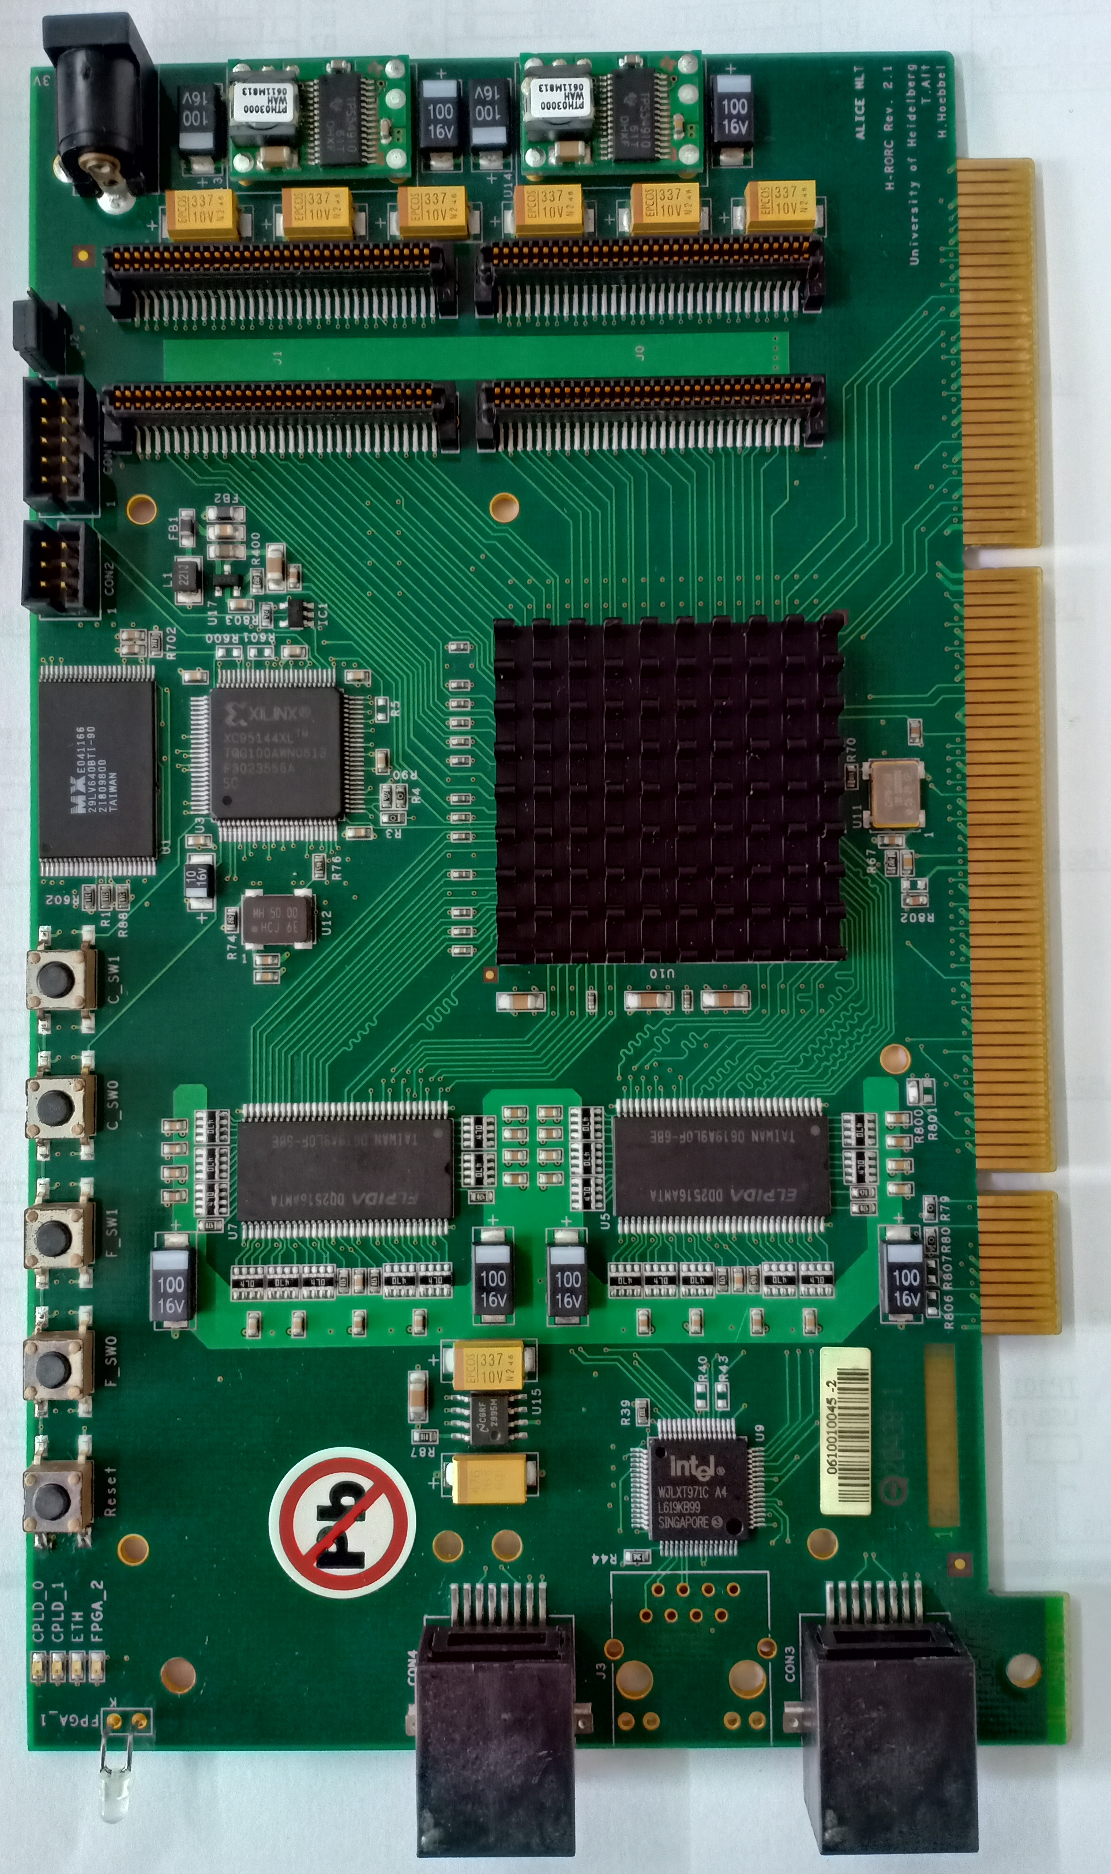
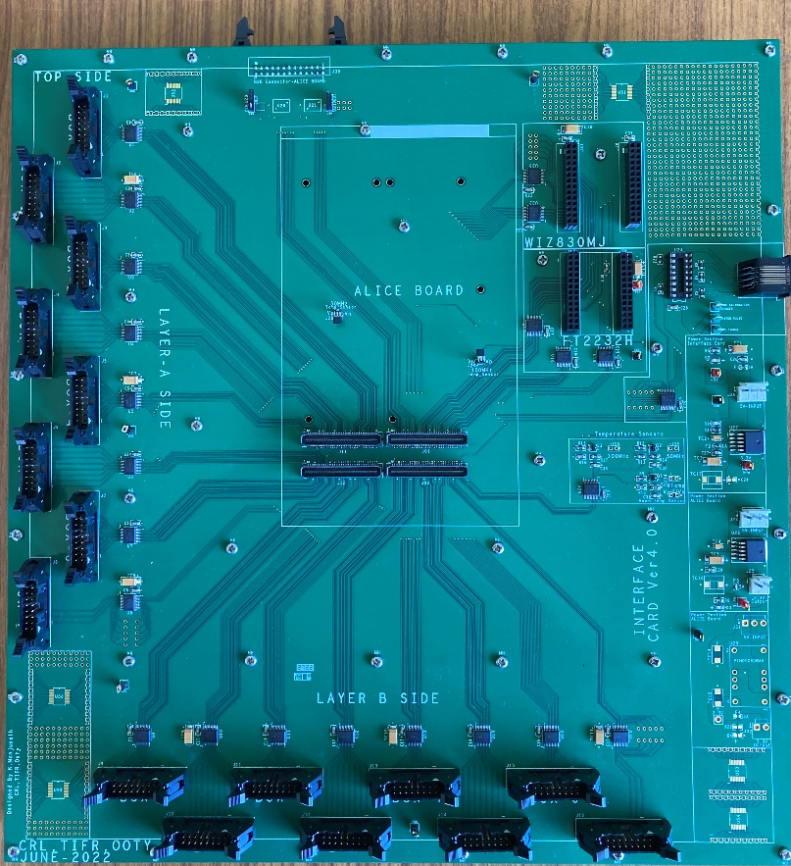
Architecture of TM-DAQ System
System requirement
  A device with adequate I/O’s to process all the PRC channel in parallel, better timing resolution, excellent signal processing capability and memory
Solution: FPGA based embedded systems
Received large number of ALICE Boards (~150 number) from ALCIE Collaboration as gratis
Designed interface card to access the FPGA I/O’s
ALICE Board
Interface Board
Tyco Connectors
Communication Section
Designed by GRAPES Team
Tyco connector for ALICE Board
FPGA Chip
  Due to the limitation of I/O’s, 2 No’s Alice Board + interface Board combination is used to process 1 module
DDR Memories
B
Power Section
ALICE BOARD
+
INTERFACE BOARD
PRC inputs
AMP
DISC
MASTER
A
Xilinx Virtex-4 FPGA (XC4VLX40)
Clocks: 100 MHz & 50 MHz
DDR SDRAM (EDD2516A)- 4 Physical chips Each with 32MB
Tyco connector - 158 Usable I/O Pins
Board Size : 17.4 X 10.6 CM
Designed interface card to access the FPGA I/O’s
Level translator section
Power section (to the ALICE board)
Communication section
Size 36 X 34 Cm
ALICE BOARD
+
INTERFACE BOARD
SLAVE
AMP
DISC
Notes:
requirements for trigger-less DAQ would be –
A device with adequate I/O’s to process all the 236channel in parallel, better timing resolution, excellent signal processing capability and memory
And the solution is FPGA based embedded systems
It was decide to use FPGA board brought from Alice experiment( Since these boards were brought from Alice Experiment, we refer this board as ALICE board (Alice board is as shown in Picture A)
This board has a FPGA, A 100Mhz crystal, 50Mhz crystal And 4 DDR chips. This board has a Tyco connector through which 158 I/O pins can be accessed
To mount the ALICE board and access the I/O’s in Tyco Connector, we have designed interface card as shown in Picture B which will have
Level translator section
Power section (to the ALICE board)
Communication section
Since the ALICE card has only 158 accessible I/o’s , we need to have 2 Alice boards to process one module.
This is the block diagram of The board which process the signals from Layer 0 and 2 and connected to the data taking computer is called Master and the board which process Layer 1 and 3 is called Slave

Slide 6

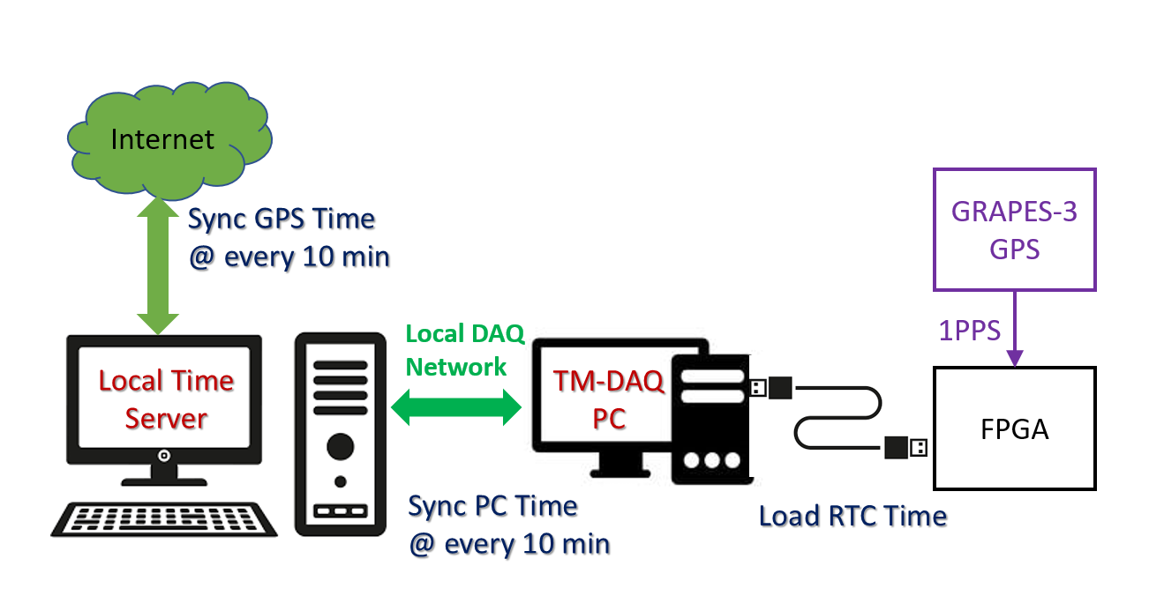
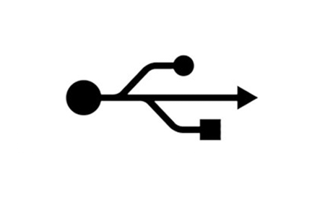
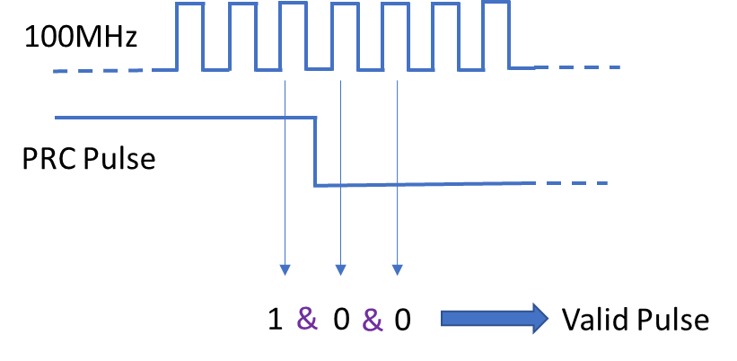
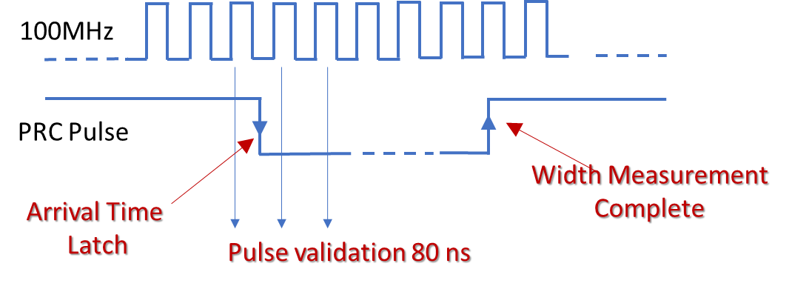
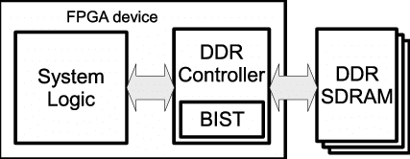
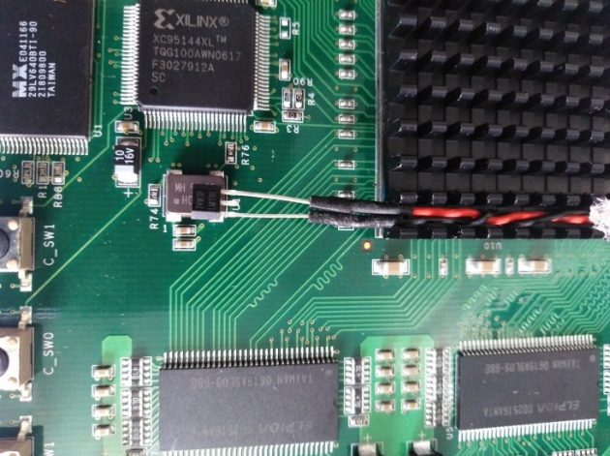

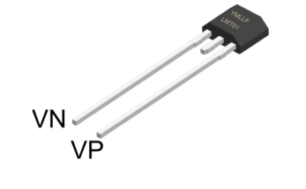
    FIRMWARE MODULES FOR TM-DAQ
PRC
L0 & L2
PRC
L1 & L3
MASTER
SLAVE
FTDI
DDR1
CRM
SVM
DDR1
CRM
SVM
Amp &
Discr
Amp &
Discr
PWT
PWT
DDR2
TEMP
DDR2
TEMP
PTM
1PPS
SENSOR
1PPS
PTM
DDR3
SPI
MASTER
SPI
SLAVE
Inter Board Communication
Since the ALICE card has only 158 accessible I/O’s , we need to have 2 Alice boards to process one module. So we should have proper inter board communication for which we have
SPI communication Module for Master and slave
DDR Controller for SPI DDR (DDR3) in Master
Count Rate Monitoring Module
Count rate monitoring module records the number of hits for all the PRC channels and various combinational rates in 1 sec time window
Signal Validation module
  The analogue signal from PRC is pre-processed by a amplifier and discriminator giving rise to a digital output, which is carried to TM-DAQ using ~8m long flat ribbon cable, which is susceptible to noise pickups
So the pulse is validated by checking the minimum pulse width
DDR
We have 4 no’s DDR each with 32 MB capacity
Dedicated Controller for performing auto-refresh, prefetch, read, write operations.
FTDI Module
FTDI module is responsible for reading the DDR and sending the data to the data taking computer
Precision Time Management Module
Each Muon hit time measurement should be very precise and as accurate as possible
Muon hit time measurement will play a vital role in collating data between all module
4 Sub-modules
  Real Time Clock (RTC) /Time Synchronization/Clock Counter/Time Calibration Trigger (TCT)
    Complete time information ranging from year to nanosecond is managed inside FPGA by using smart algorithms
    GPS synchronization ensures the accuracy of time
    All raw data is recorded and any correction (e.g. w.r.t. temperature) can be done offline during analysis
Temperature Monitoring Module
The quality of muon measurement depends on, how accurately the pulse arrival time is recorded.
The accurate time measurement depends on the stability of the onboard crystal oscillators.
Temperature is monitored using LMT01 (Digital Pulsed/Accuracy 0.5 ˚C/Resolution 0.0625°C
Recording interval 250ms
The temperature and the Counting rates of crystals are recorded as part of data
Pulse Width and Time Measurement Module
PWT makes precise measurement of pulse arrival time and pulse width information with 10 ns resolution
We have PWT provision for all 118 PRCs and various trigger logics
The trigger generation can be done offline using all hit information available
Notes:
To perform various operation of the DAQ we have developed various firmware modules.

Slide 7




TM-DAQ
 | USB Protocol | SPI Protocol
Max Theoretical Speed | 8 MBytes/Sec | ~1 MBytes/sec
Speed in TM-DAQ | The data transfer speed using USB protocol is ~1.5 MBytes/Sec | The data transfer speed using SPI protocol is ~500 KBytes/Sec
Data Volume in TM-DAQ | 600 KBytes/Sec ~60 GBytes/Day/Module | 300 KBytes/Sec ~30 GBytes/Day/Module
Master Board RTC loading
The GPS synced RTC information from the data taking computer is loaded to the RTC module in the Master Board
Data Communication
After sending the Master data, the slave data stored in DDR3 will be sent to computer via FTDI
Data Processing
The data processing modules(CRM/PWA) start processing the data after validating the input signals and the processed data is stored in DDR1
PC establishes Connection with FTDI
Data Processing / Data communication
Next second, we will start storing the processed data in DDR2
Simultaneously the previous second data stored in the Master DDR1 will be sent to data taking computer via FTDI
Simultaneously the previous second data stored in the Slave DDR1 will be sent to Master DDR3 using SPI communication
GPS Sync
Dedicated 1PPS Signal from the Meinberg GPS unit syncs the RTC every second
Slave board RTC loading
The GPS synced RTC information is sent to the Slave board using SPI communication
Control Word Exchange
On successful 3 way handshake, the communication is started successfully
Hardware Monitoring and Auto reset option
All the critical signals are continuously monitored in the Master board and Slave board
Any abnormality for more than 2 sec will initiate the Auto reset feature
Auto reset will reset the DAQ and re initialize all the parameters
This feature is very unique, which reduces the down time drastically
 
 
PRC
L0 & L2
PRC
L1 & L3
MASTER
SLAVE
3
FTDI
DDR1
CRM
SVM
CRM
SVM
RTC
1
2
Master data
DDR1
Amp &
Discr
Amp &
Discr
PWT
PWT
DDR2
TEMP
DDR2
TEMP
RTC
1PPS
1PPS
RTC
RTC
DDR3
SPI
SLAVE
Slave data
SPI
MASTER

Slide 8
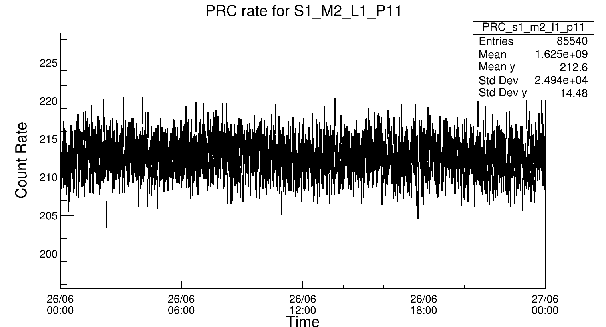
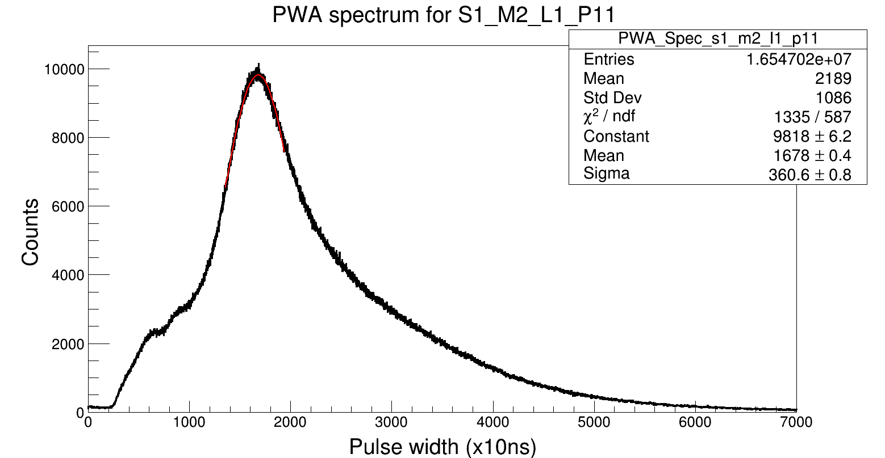
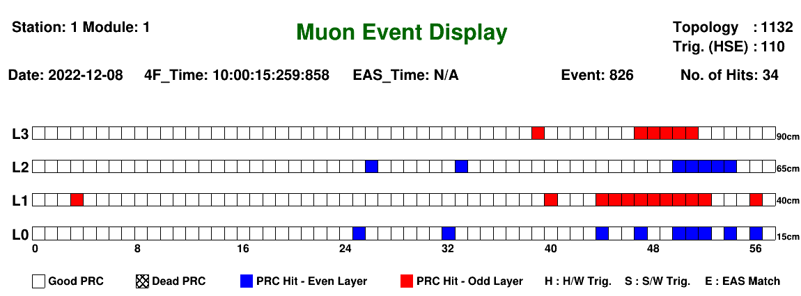
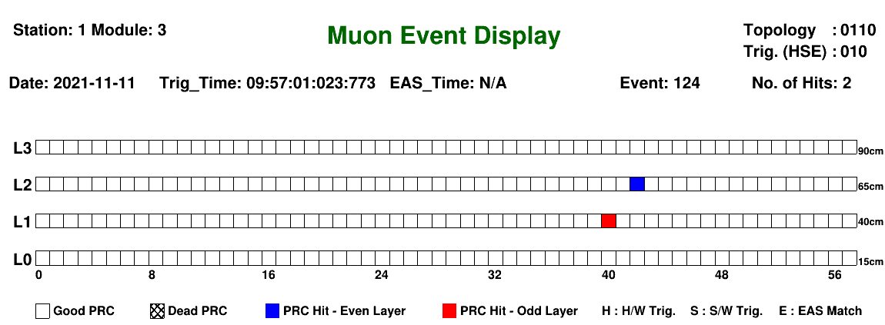
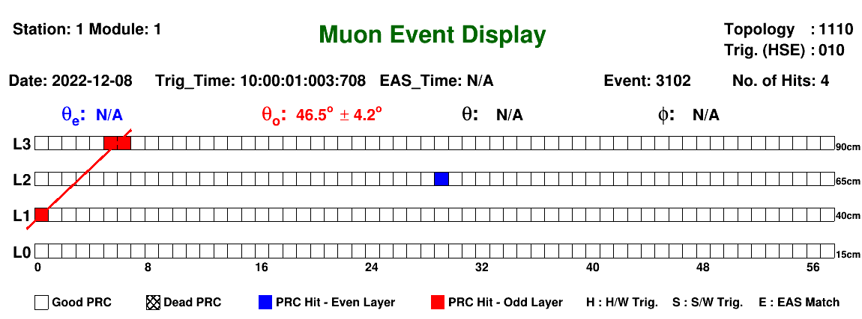
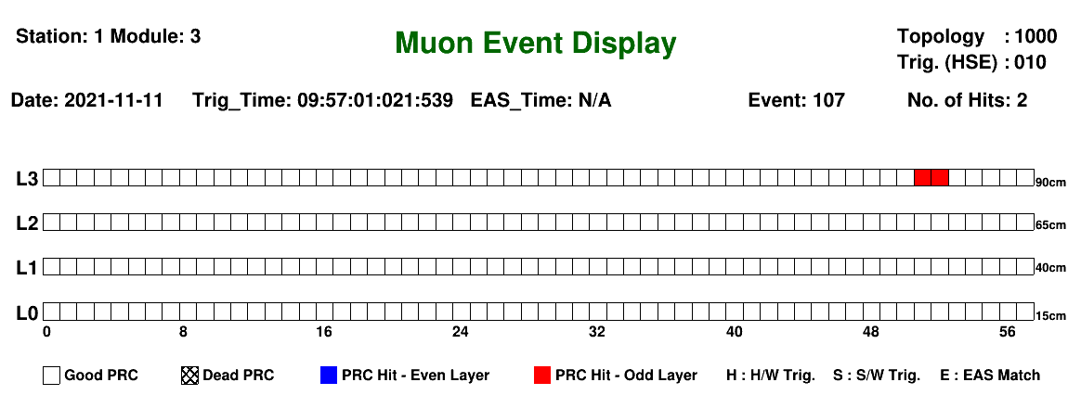
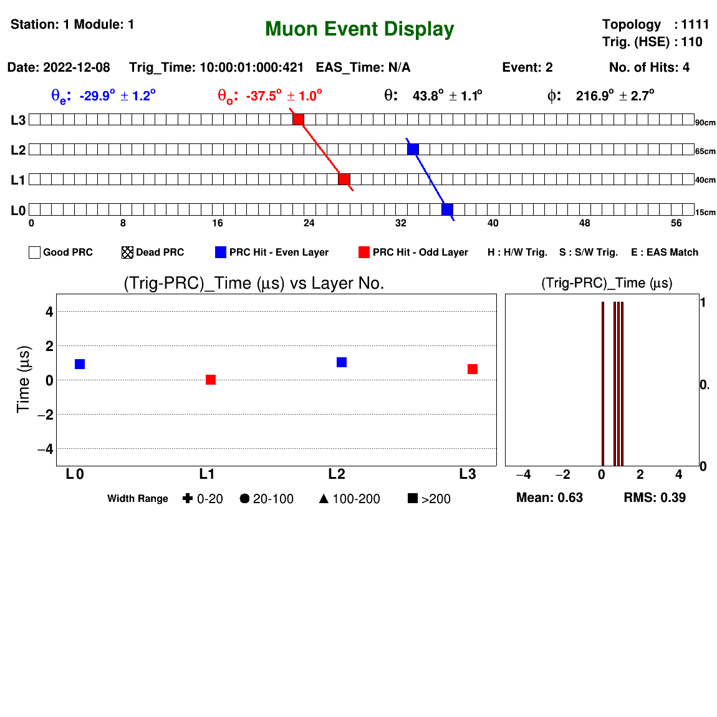
Observation
The stability and data quality of TM-DAQ seems to be very good and last several months we have not seen any failures (one module is continuously since 02nd Jan 2022 (~350days) without any break)
Mu
Zn
Fe
(B)
(A)
(C)
Notes:
Since, PWA data for all PRC’s is being recorded in parallel, we can now “truly” monitor the PWA Gain for each PRC
Typical rate for a PRC is ~200 to 250 counts, but noisy counters will have higher counts and in some cases as per fig it can go up to 5000 counts also.
Here I am showing one sample muon track, that passed through all the four layers
Here I am showing one sample muon track, that passed through only through three layers
Here is an another example of multiple muon track passing through same time window

Slide 9
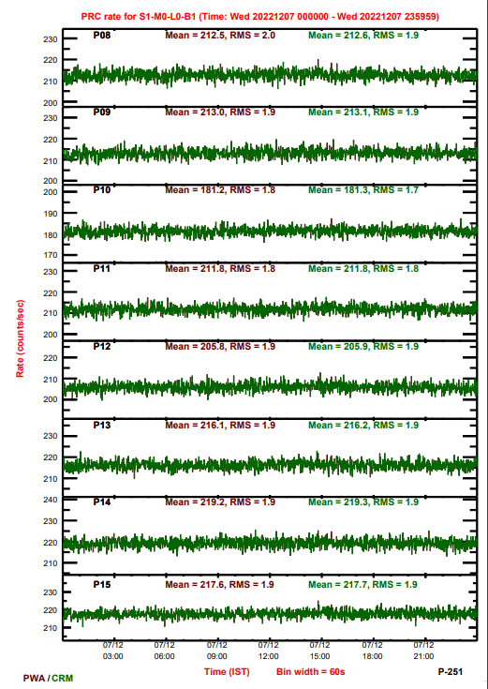
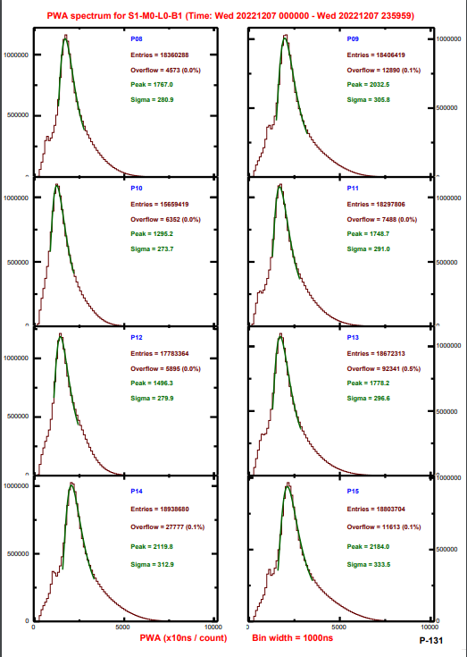
Daily Monitoring Plots

Slide 10
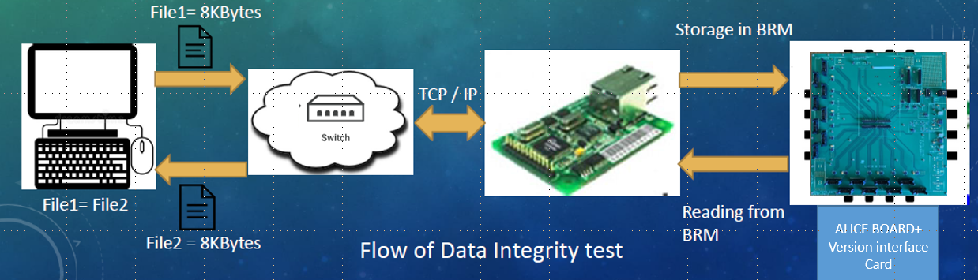
Ethernet Communication for TM-DAQ (Presently working on)
The TM-DAQ in present version uses USB protocol for data recording ,Since we are using USB protocol for data recording, the Data taking PC has to be in close vicinity of the module thus we require one data taking PC per module.
To avoid having one computer for each module, We are working on Ethernet protocol using WIZNET chip for transferring the data from the DAQ to the data taking computer.
  Data integrity test completed
  Bandwidth test completed (Speed = ~ 5Mbytes/sec)

Slide 11
Summary
Installation completed in 8 Muon modules with USB communication (50% of the existing Muon modules)
Ethernet testing is in advanced stage and expected to complete in Jan 2023
Daily data quality monitoring programs are developed and commissioned
Muon reconstruction algorithm is developed
For more details https://g3indico.tifr.res.in/event/858/contributions/2420/
(Mini Workshop on Triggerless Muon DAQ System for GRAPES-3 Muon Detector-6 Dec 2021)

Slide 12
Thank You!!!

