Slide 1


Overview of the Cosmic Muon Veto for the mini-ICAL at IICHEP, Madurai
Mandar Saraf on Behalf of the INO Collaboration
Department of High Energy Physics
Tata Institute of Fundamental Research, Mumbai

Slide 2
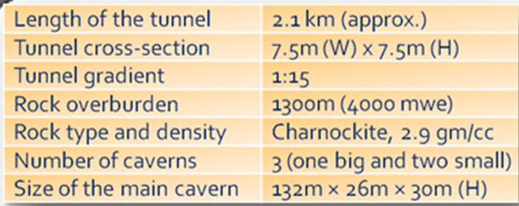
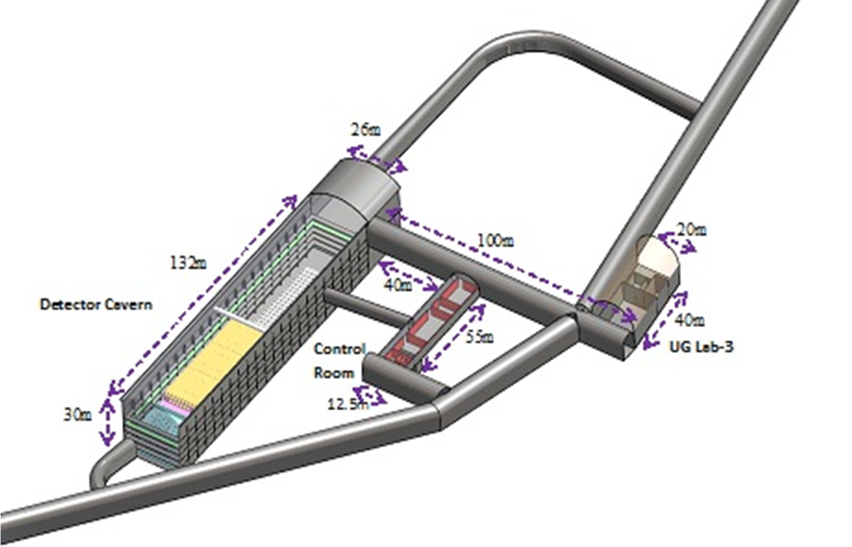
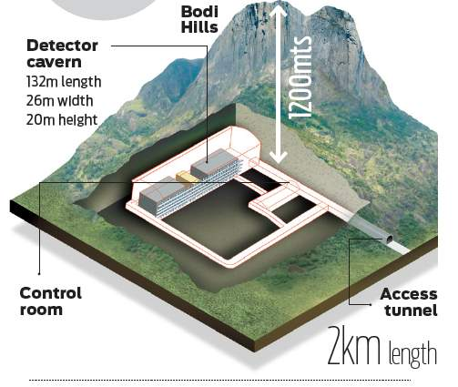
ICAL in an underground Lab
What ICAL can do?
Measure atmospheric muon neutrinos & antineutrinos, separately.
Main goal is the ordering of the three tiny neutrino masses - Mass Hierarchy.
A. Kumar, et al, Pramana – J. Phys. (2017) 88:79

Slide 3
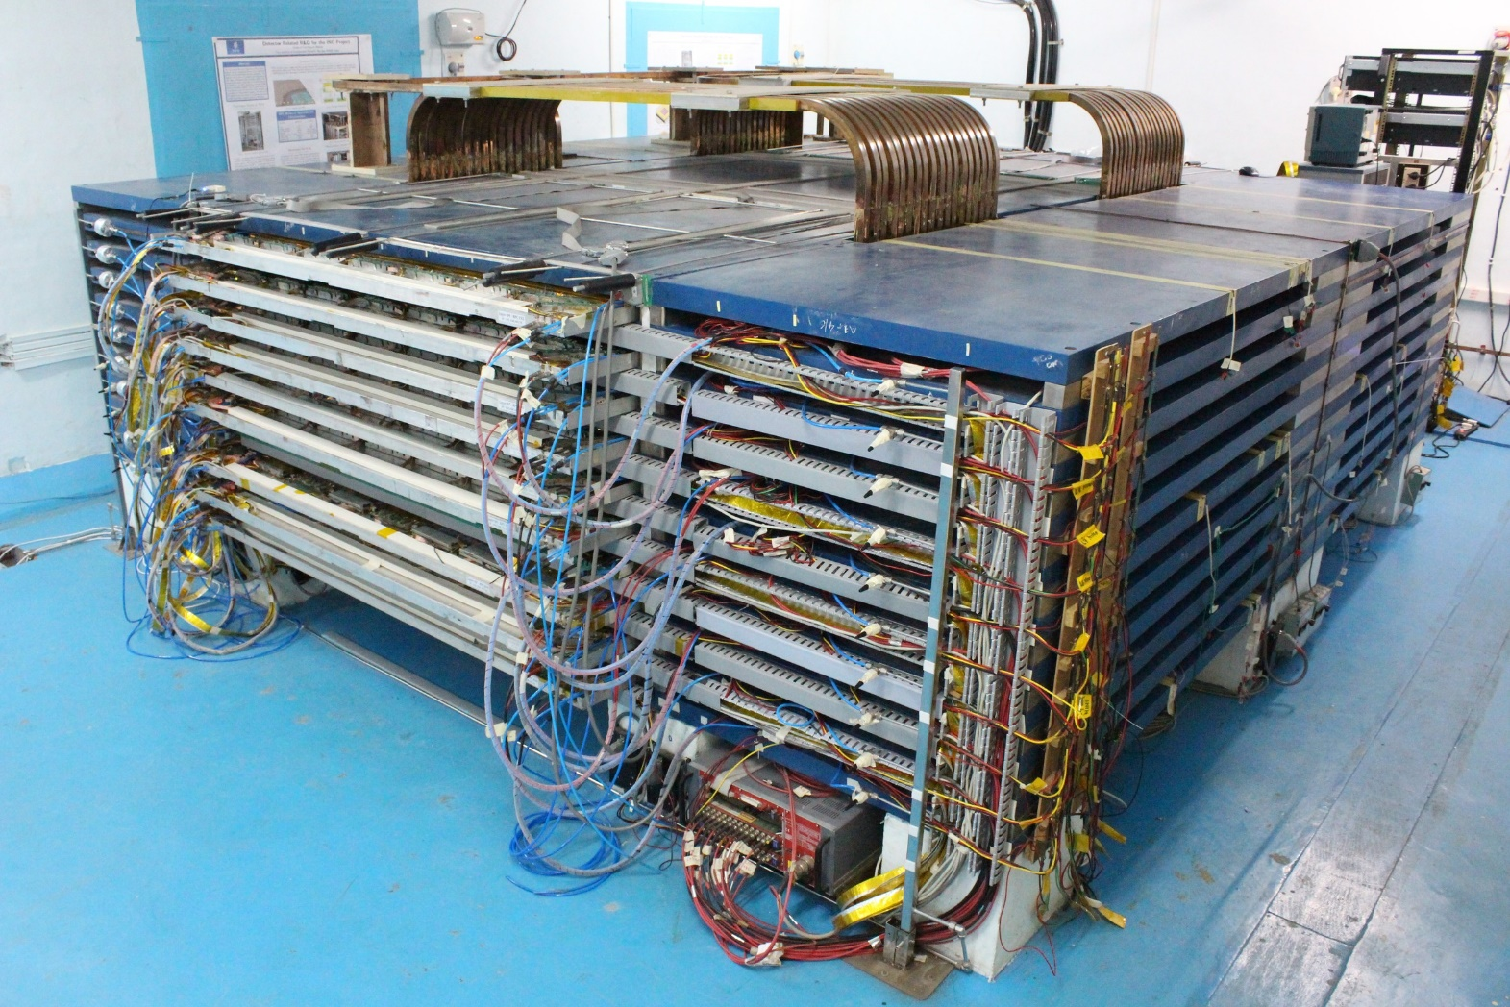
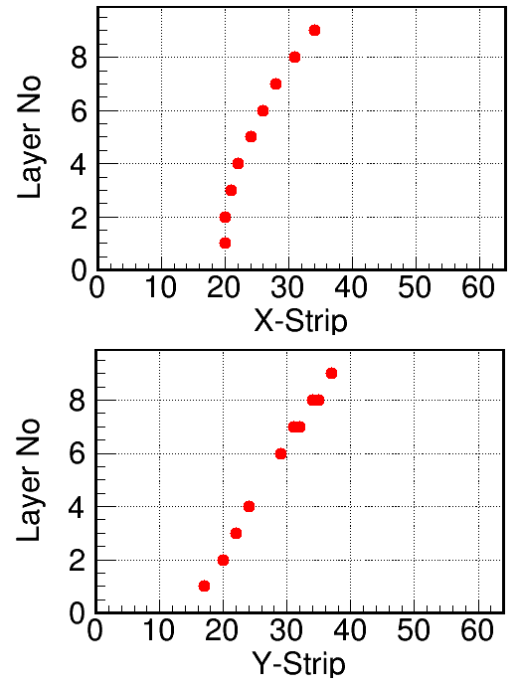
Mini-ICAL Operational at IICHEP
85-ton, 4m×4m×11 layered magnet, with 20, 2mx2m RPCs and ICAL electronics operating for 4 years.

Slide 4
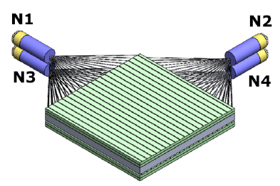
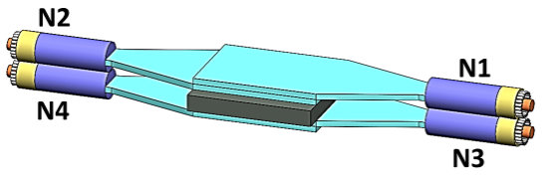
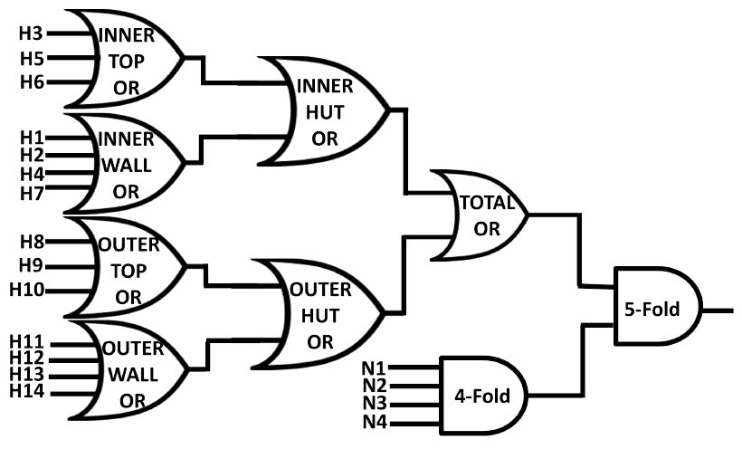
Early Studies with a Compact Muon Veto Detector
320mm×960mm
Muon trigger rate ~2 Hz
150mm×200mm
440mm×440mm
N. Panchal, et al, 2017 JINST 12 T11002
N. Panchal, et al, 2019 JINST 14 P02032
Veto Efficiency for anyone Layer: 99.978% ± 0.003

Slide 5
Shallow depth?
The advantages of locating a large detector such as ICAL at a shallow depth of 100 m, are obvious
If a CMVD with a muon detection efficiency > 99.99% is built, then similar fraction of muons would go undetected as would pass through a 1 km rock cover
The possibility of constructing a CMV for a shallow depth ICAL, needs to be validated
Such a proof-of-principle CMV is being built around the mini-ICAL detector at IICHEP, Madurai

Slide 6
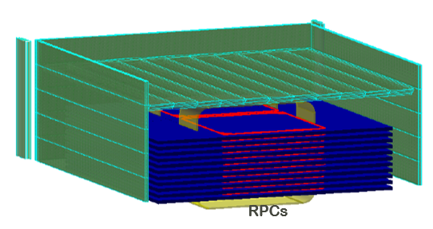
CMVD Simulation in Geant4
Back Wall
Isometric View
Top View
Auxiliary Wall
Left Side Wall
RPC Stack
Right Side Wall
Tiles in Top Wall
Veto Wall | # of Layers | Layer Staggering | # of EPS/Layer | EPS Dimensions
Top | 4 | 12.5 mm | 88 | 4.5 m x 5 cm x 1-2 cm
Right | 3 | 15 mm | 40 | 4.6 m x 5 cm x 1-2 cm
Left | 3 | 15 mm | 40 | 4.6 m x 5 cm x 1-2 cm
Back | 3 | 15 mm | 40 | 4.7 m x 5 cm x 1-2 cm
Aux | 3 | 15 mm | 8 | 2 m x 5 cm x 2 cm
Poster #311 by Raj Shah on Friday: Expected Performance of Cosmic Muon Veto Detector at IICHEP

Slide 7
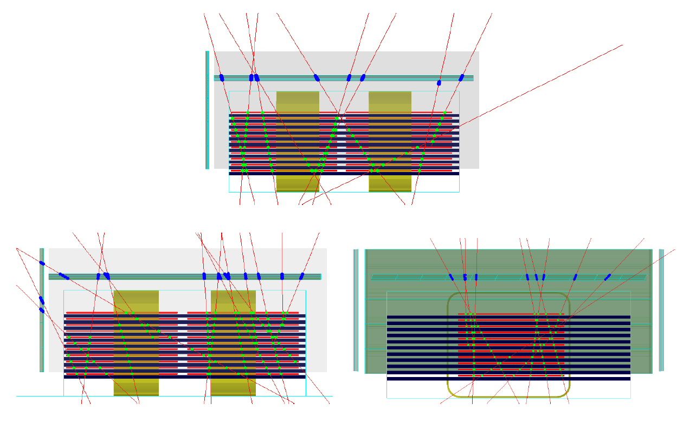
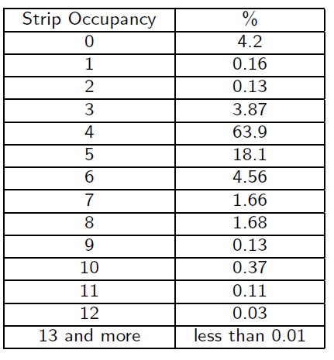
Visualisation
CORSIKA generated muon flux

Slide 8
Effective Volume of the CMVD
Exclusion of up to 40 cm from (450 cm) front Side of CMVD Walls
in order to remove uncertainties due to muon reconstruction.
Extrapolated x-y positions

Slide 9
Veto Detector Requirements
Design Requirements
  Efficiency 99.99%, false trigger rate < 10-5
  Charge and relative arrival time for SiPM signal on mini-ICAL trigger
  Event marker used to collate the CMVD event data with that of the mini-ICAL data
  Charge: Dynamic range of 80 pC, least count of 20 fC
  Relative arrival time: Least Count of 100ps
  In-situ detector calibration – Noise data and LED source
Supporting results from test studies
  Single PE avalanche charge: 0.28 pC @ 2.5 Vov
  Average PE yield for a cosmic muon trajectory in 10 mm scintillators: 16

Slide 10
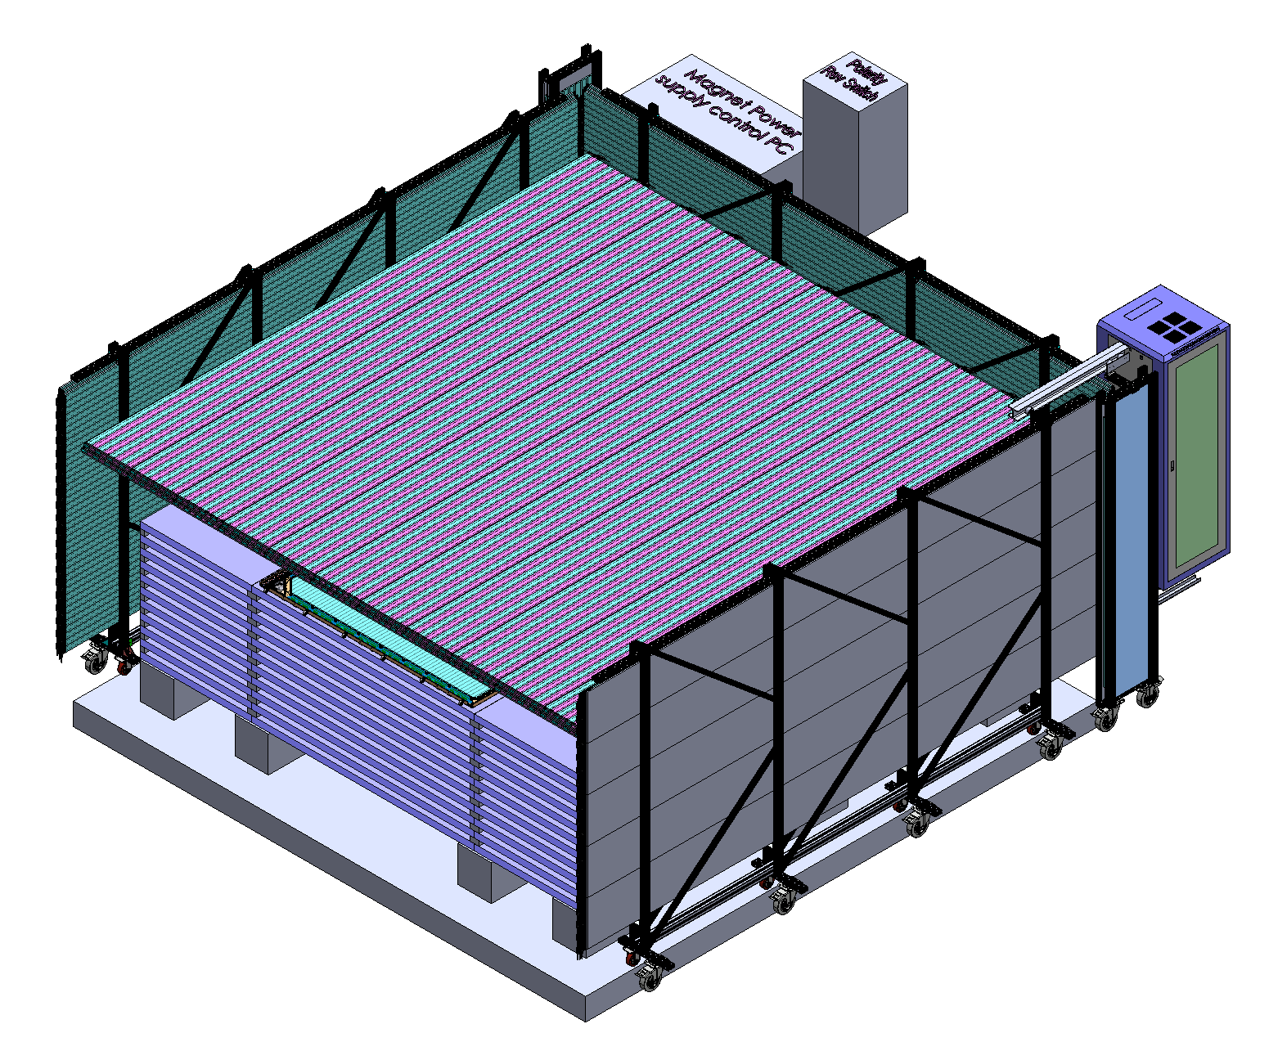
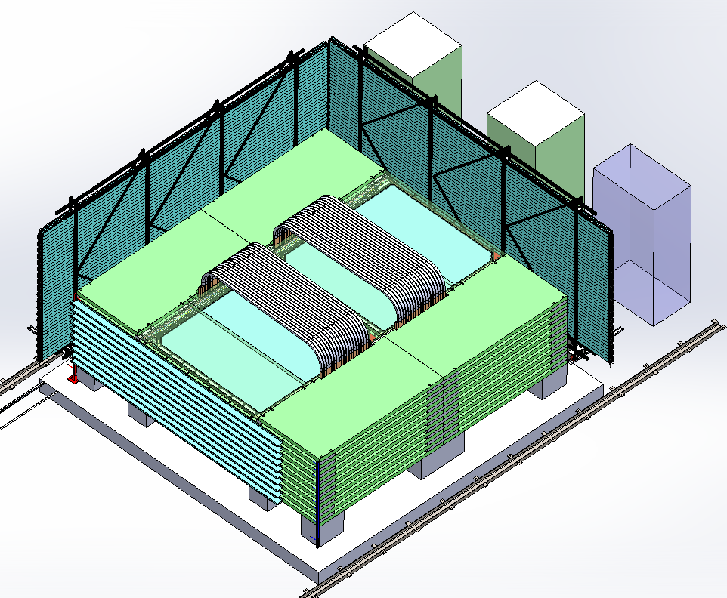
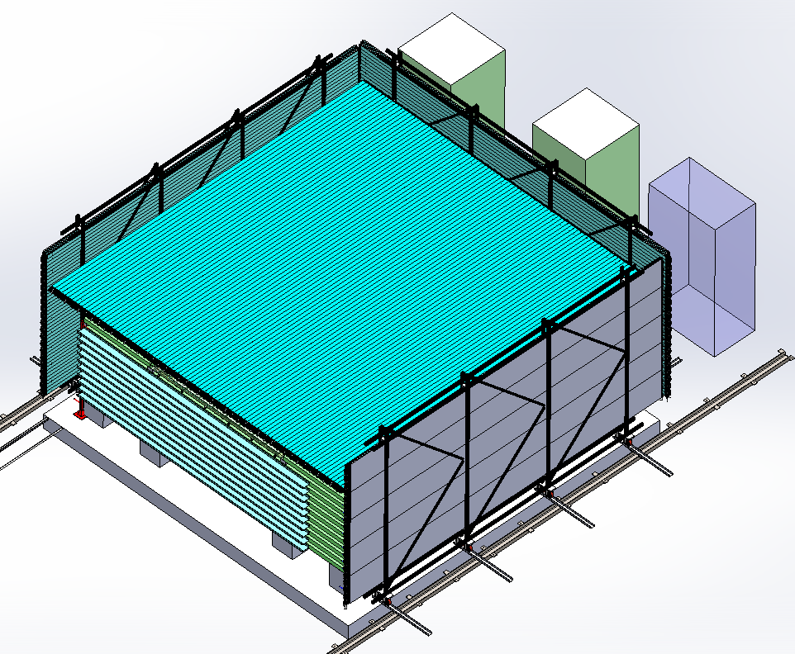
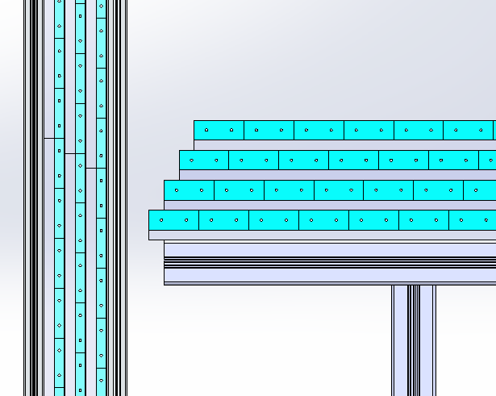
Structure of the CMVD
LEFT Veto Wall
RIGHT Veto Wall
Magnet
RPCs

Slide 11
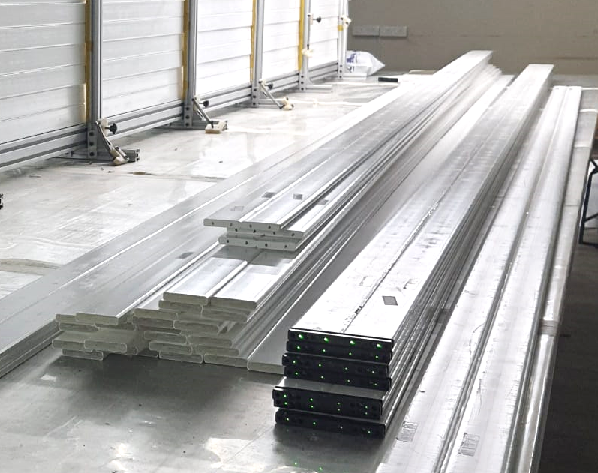
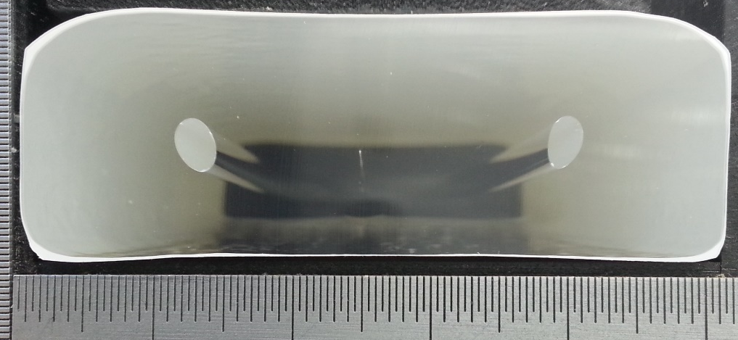
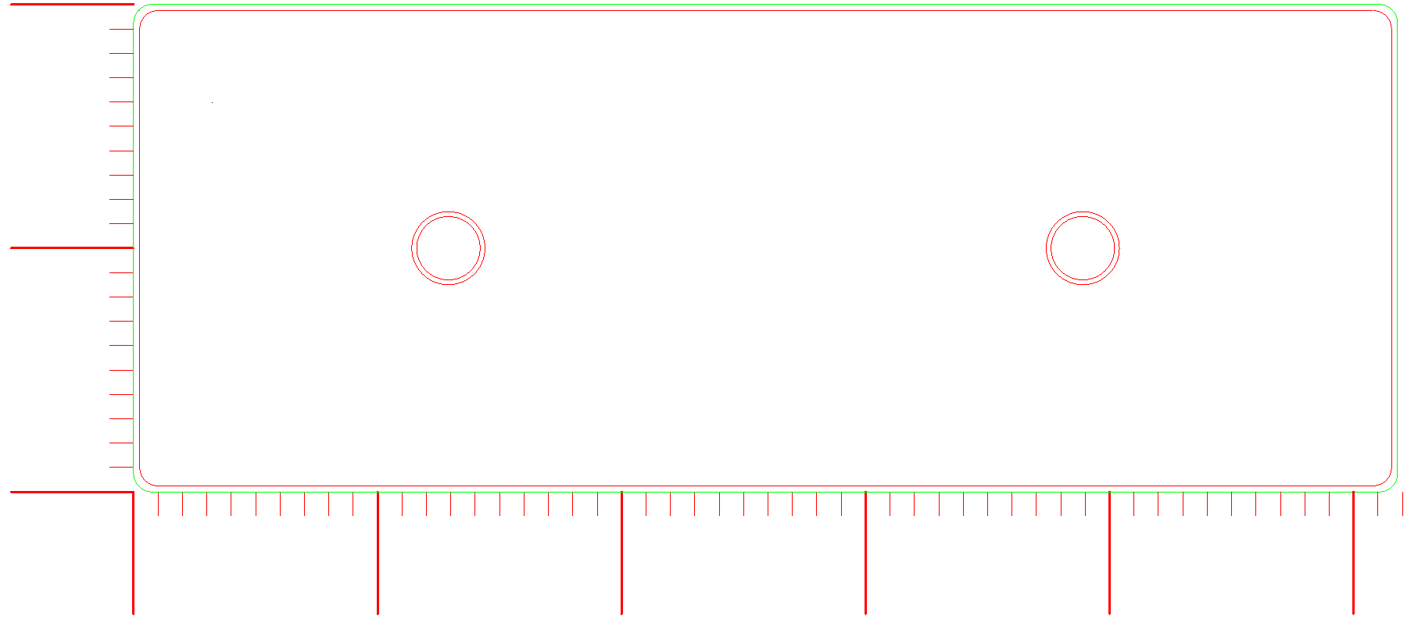
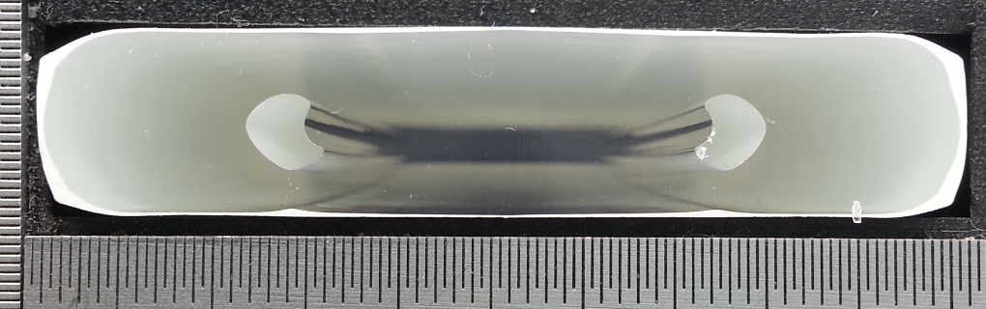
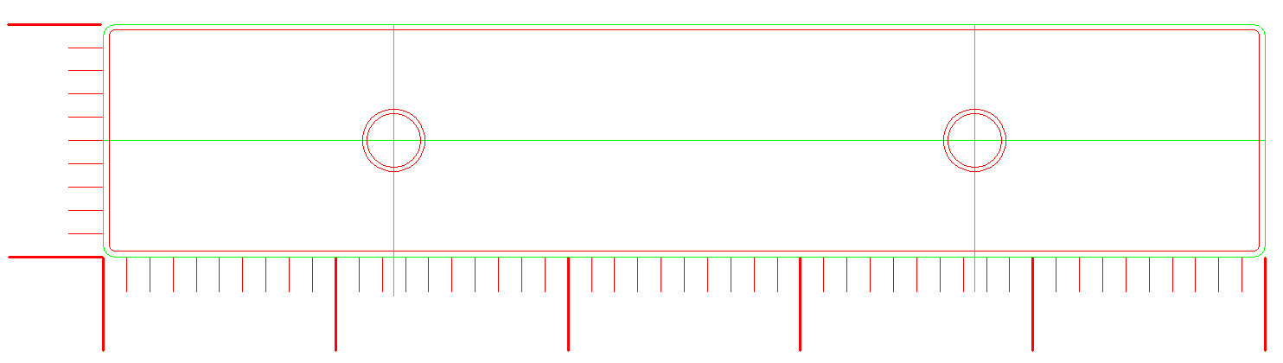
Extruded Plastic Scintillators Provided by Fermilab
Active Detector: Extruded Plastic Scintillator – Polystyrene + POPOP & PPO Dopants | From Fermilab’s in-house factory
50 x 20 mm counter
Scintillators assembled into di-counters
4.7m long scintillators
50 x 10 mm counter

Slide 12
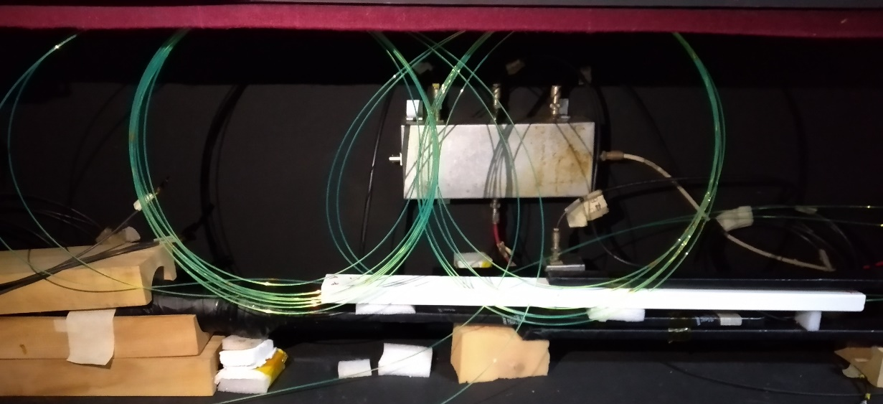
Kuraray WLS fibres
Light Collection: Wavelength Shifting (WLS) Fibre
Fibre type: Y-11 (175) MJ.
K-27 dye in core material that controls light yield optimization is at 175 ppm concentration.
M is for multi(double)-cladding fiber.
J is a long term stable type for attenuation length.
non-S type: good attenuation length, but mechanically weak.
Core: Polystyrene (n_{d} = 1.59).
Inner cladding: Polymethylmethacrylate (PMMA, n_{d} = 1.49).
Outer cladding: Fluorinated polymer (n_{d} = 1.42).
Thickness of claddings each is 2% of the fiber diameter.
Attenuation length: > 9m.
Diameter: 1.400 ± 0.006mm, RMS ≤ 0.037mm.
Fibre Testing at TIFR

Slide 13
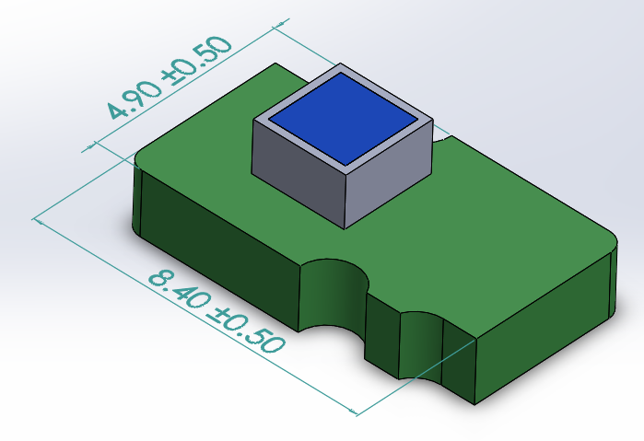
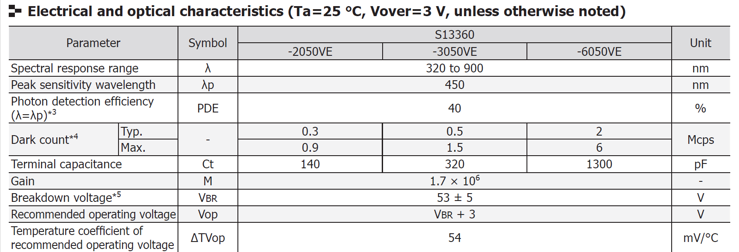
Hamamatsu S13360-2050VE SiPM
Readout: Hamamatsu MPPC (SiPM) – S13360-2050VE
SiPM Mounted on
a Carrier Board

Slide 14
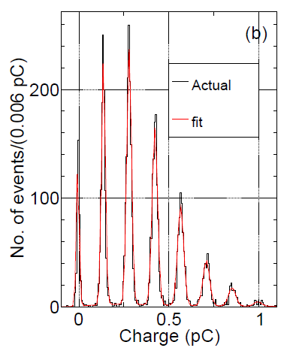
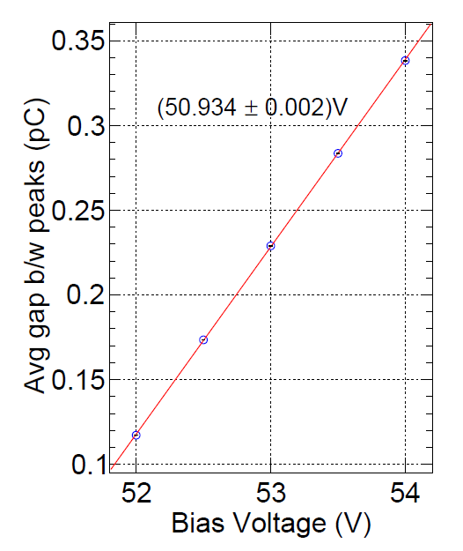
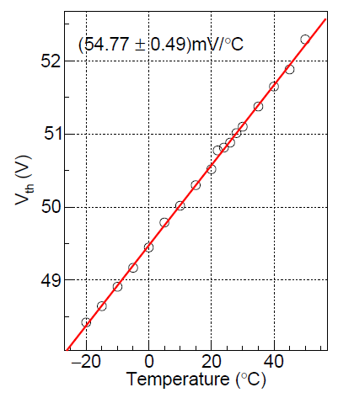
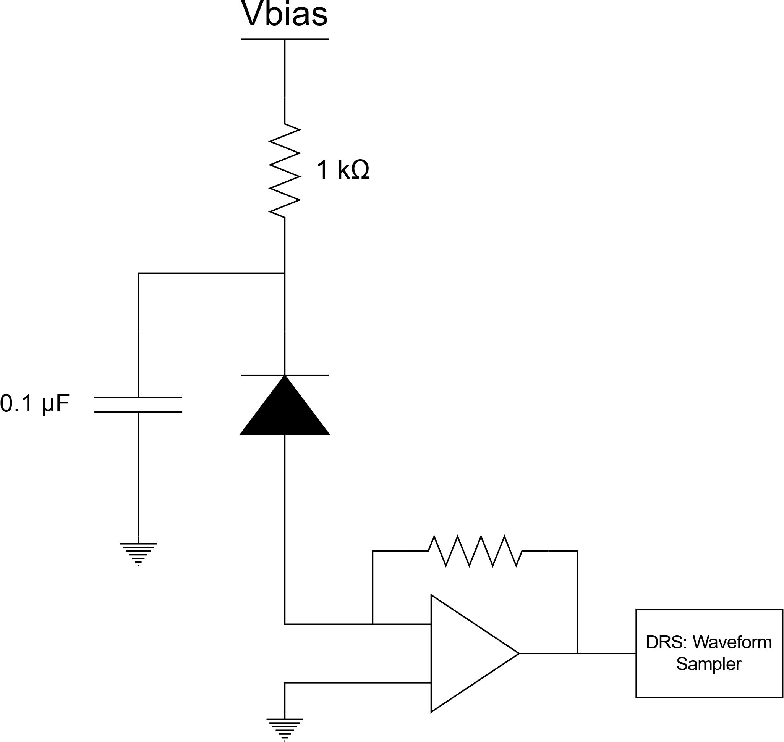
Characterisation of the SiPM
V_{bd}
Testing SiPMs in a
Thermal Chamber
M. Jangra et al 2021 JINST 16 P11029

Slide 15
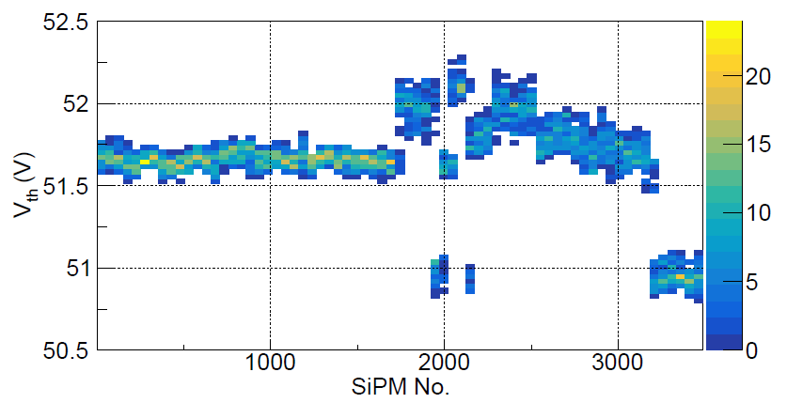
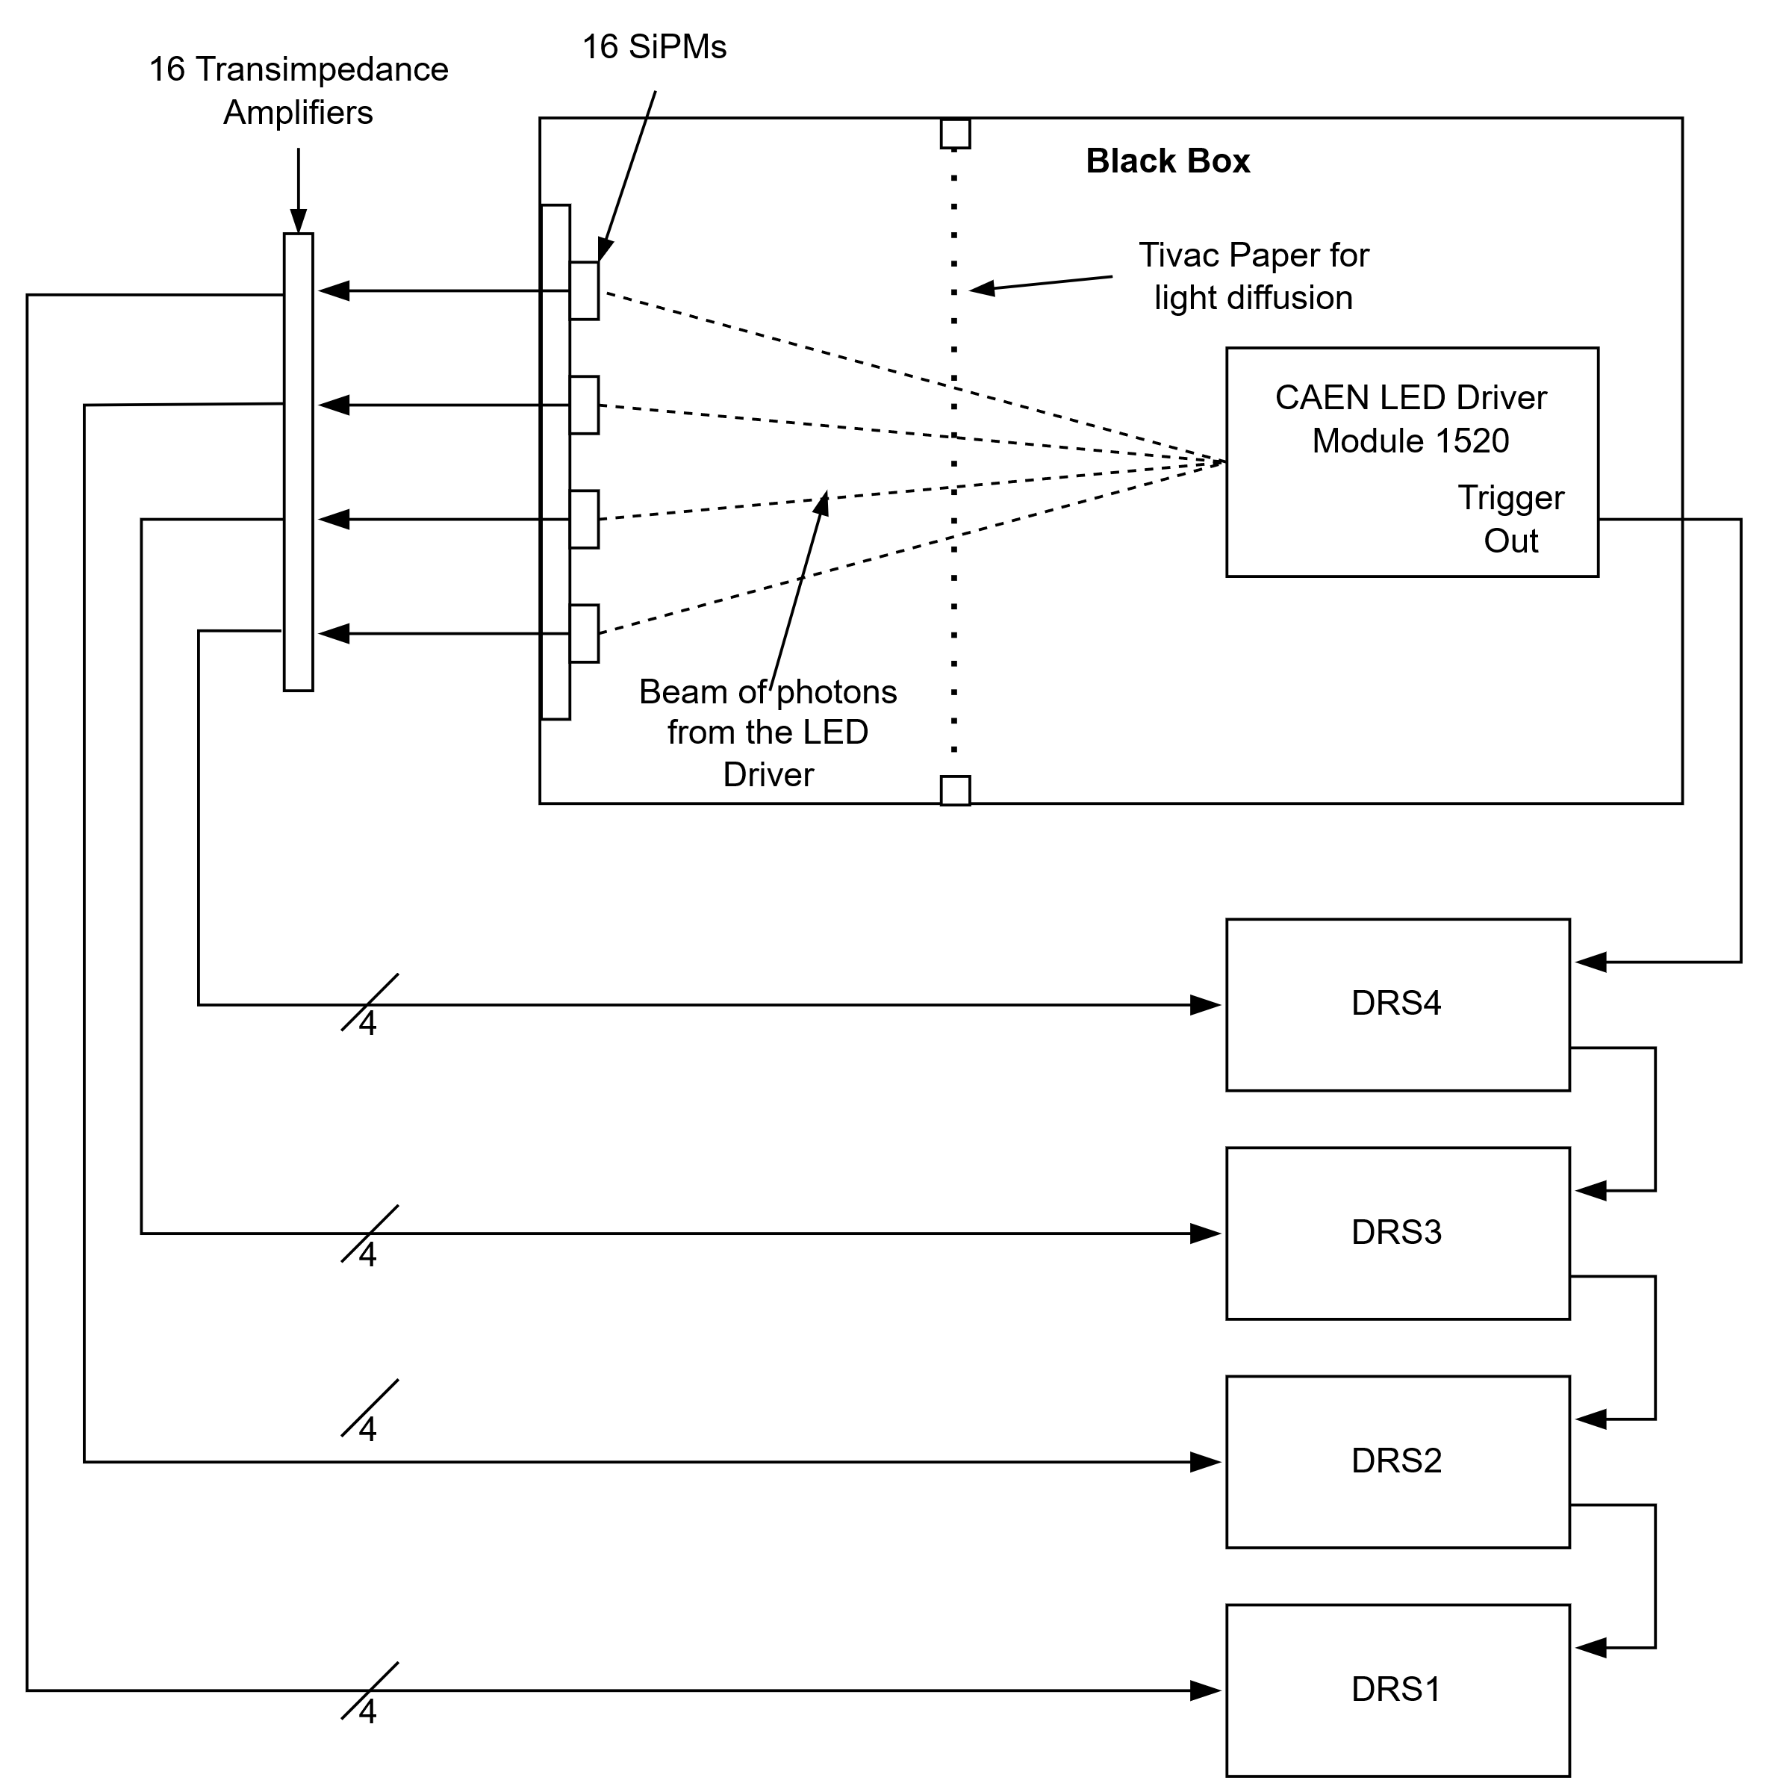
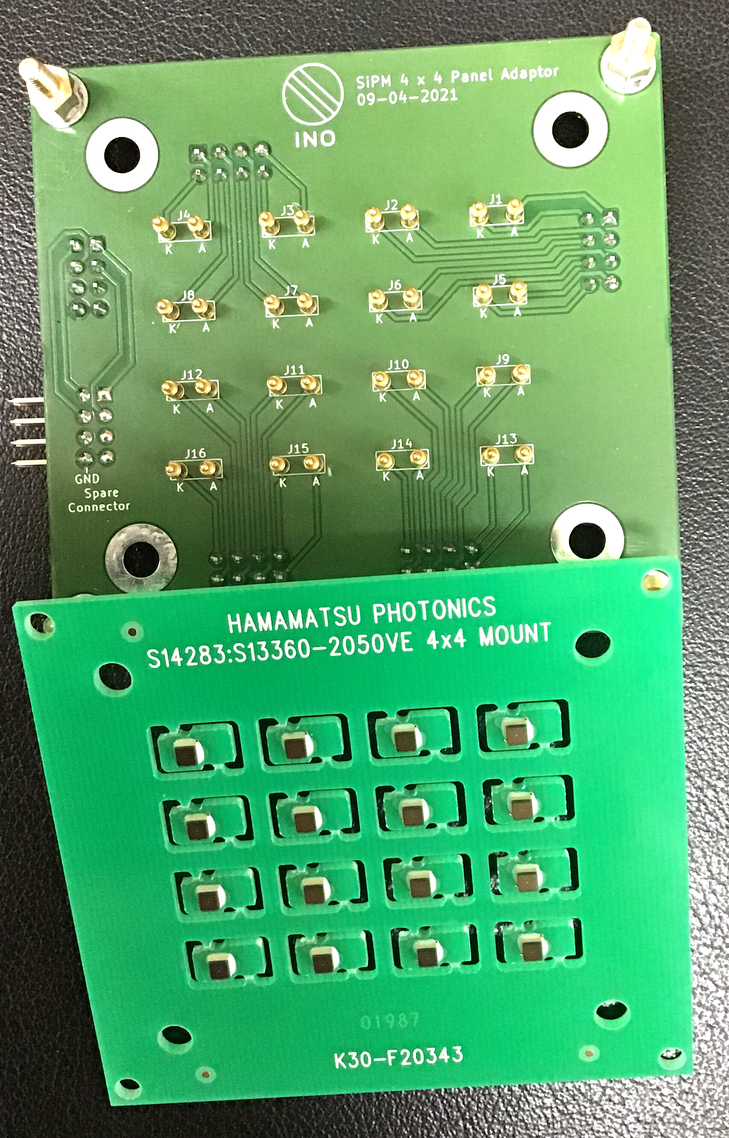
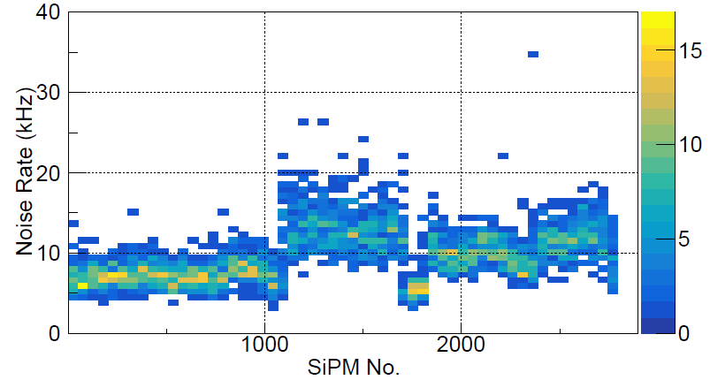
Mass Testing of SiPMs
𝑉_{ov} = 3V
Mamta Jangra et al 2022 JINST 17 P07019

Slide 16
Scintillator Assembly (Di-counter)
Blown up view of a Di-Counter Assembly
Cross sectional view of a Di-Counter Assembly

Slide 17
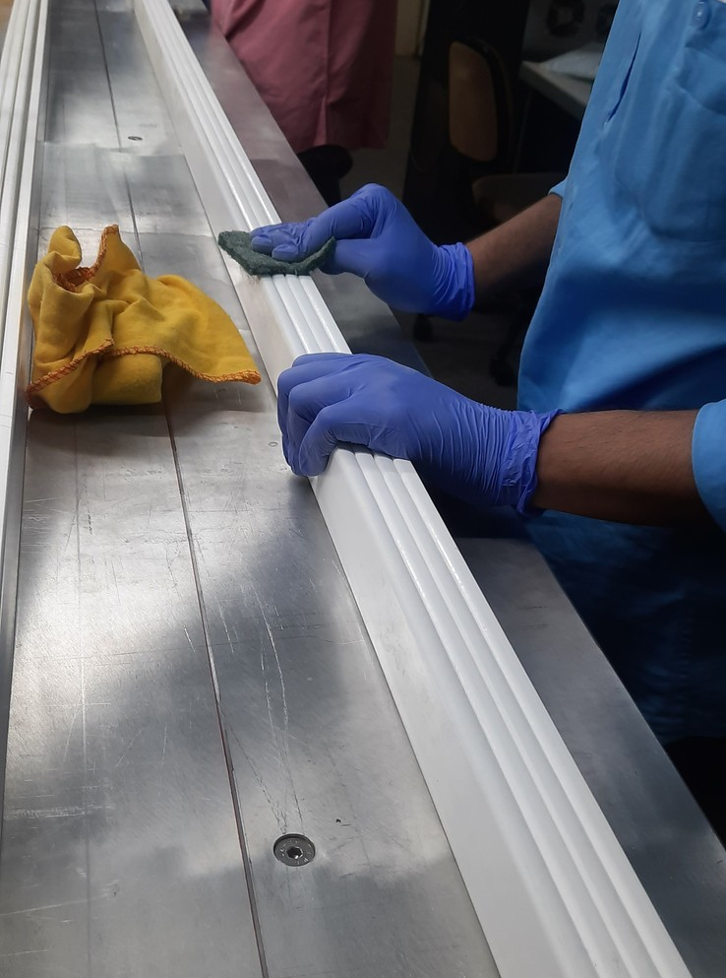
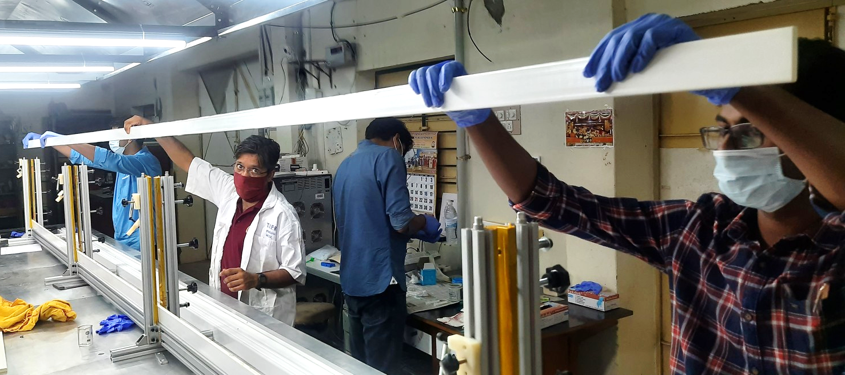
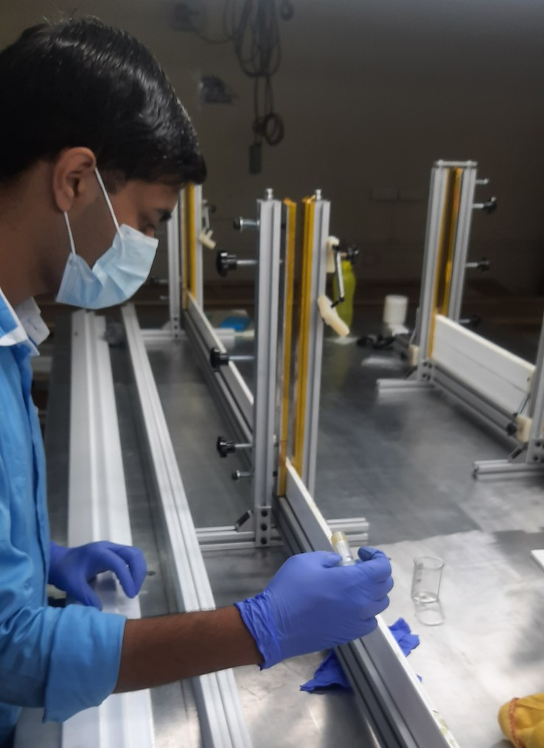
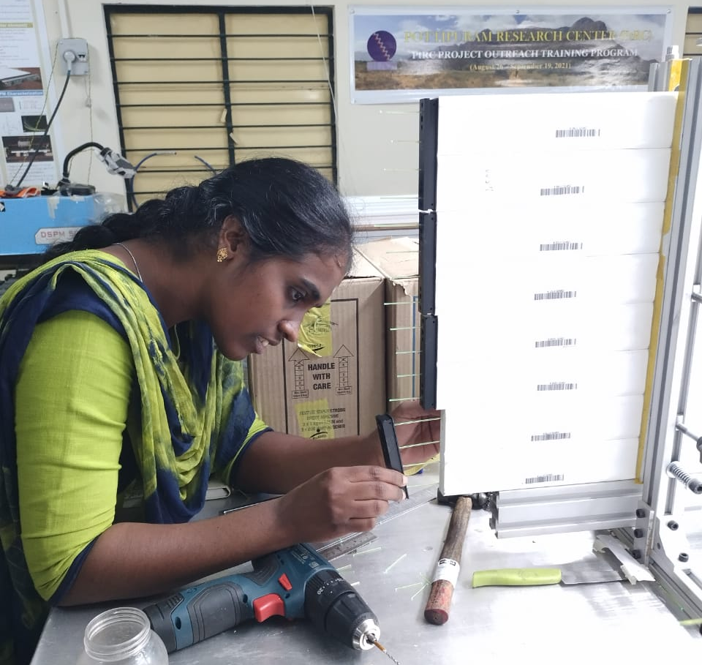
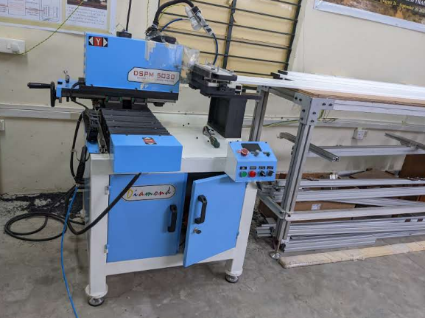
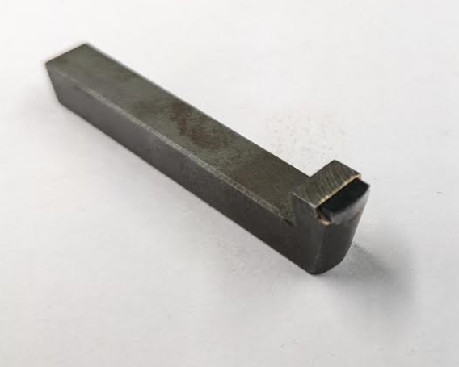
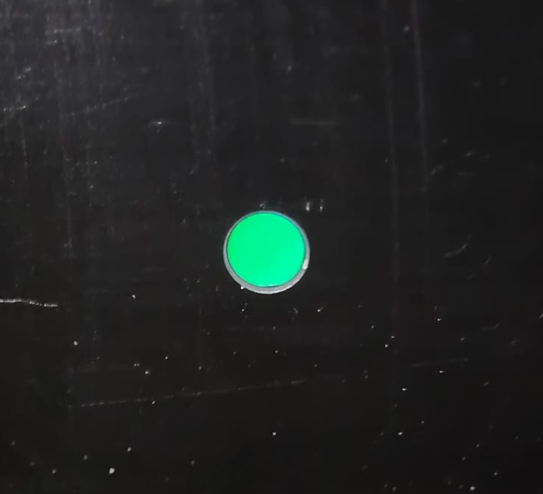
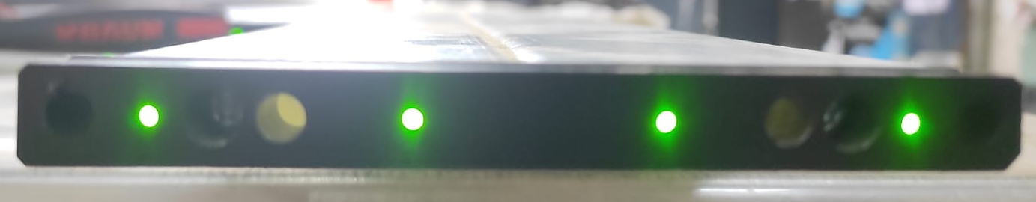
Di-Counter Making
Glue: Fevitite Superstrong

Slide 18
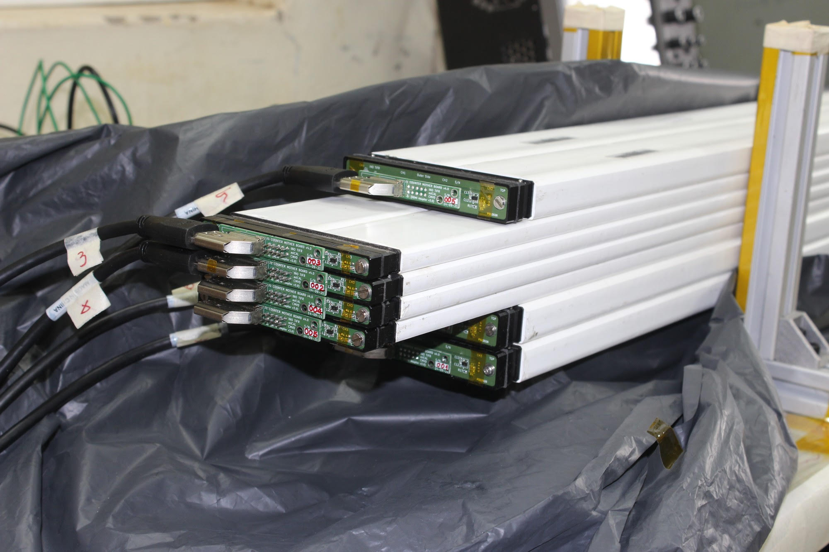
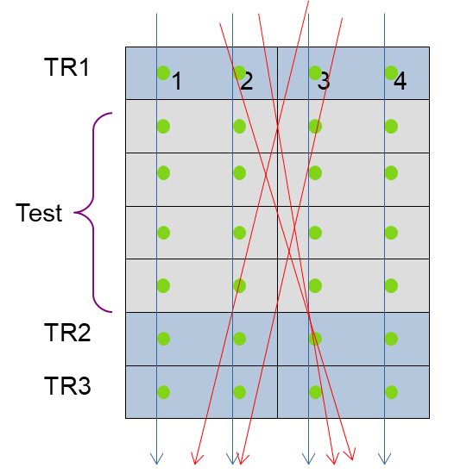
Di-Counter Testing using Cosmic ray muons
Poster #221 by Mamta Jangra: Testing of the extruded
plastic scintillators on a large-scale for the CMVD

Slide 19
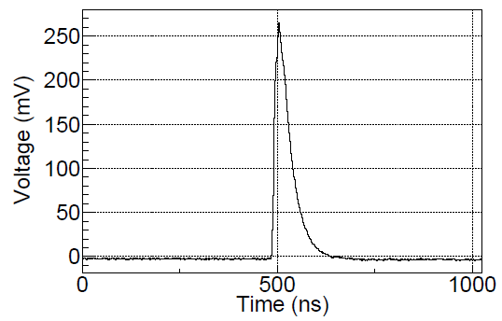
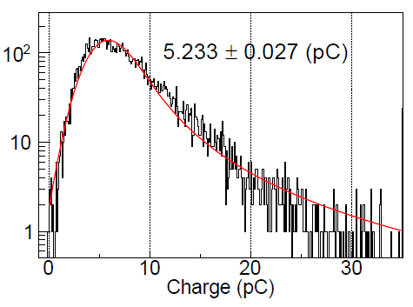
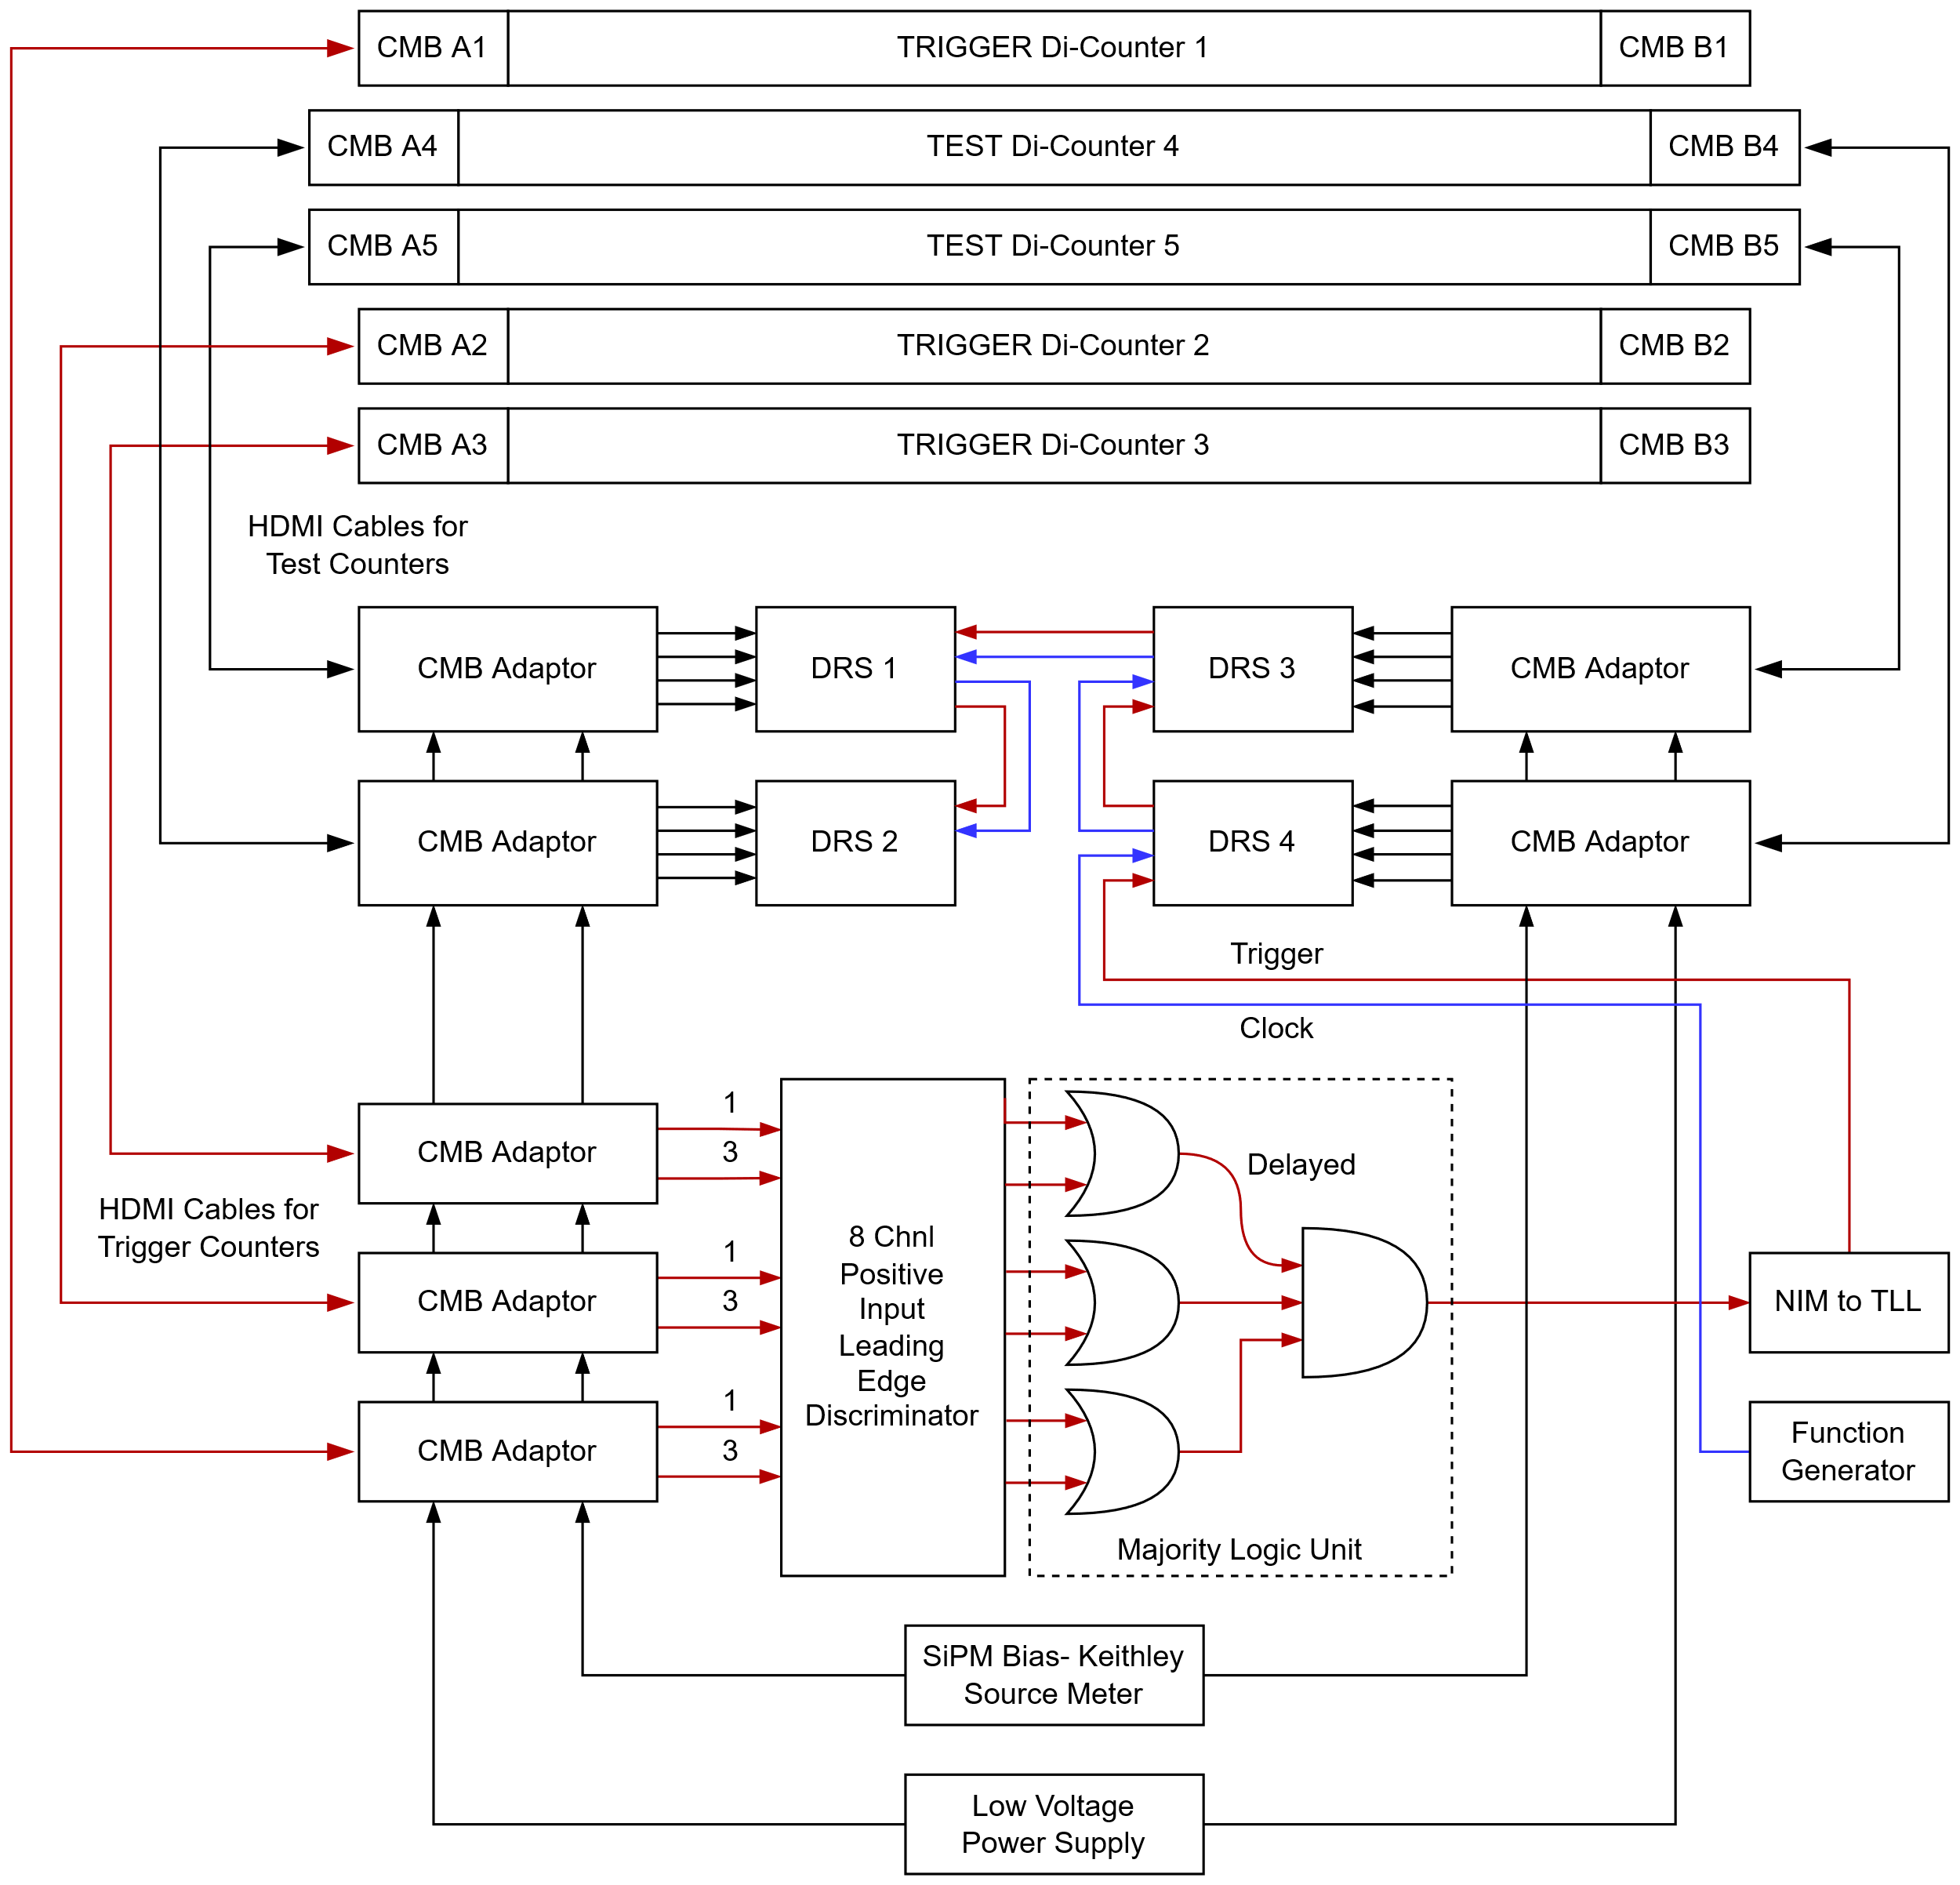
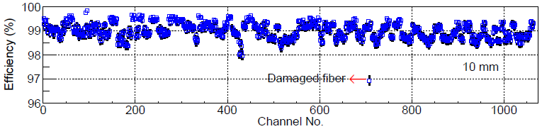
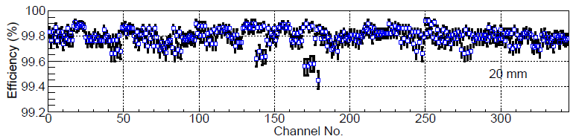
Di-Counter Testing using Cosmic ray muons
e.g. Cosmic Muon Signal
Charge Spectrum
10 mm Di-Counters
20 mm Di-Counters
Cosmic muon efficiency measurements at 2.5 PE threshold

Slide 20
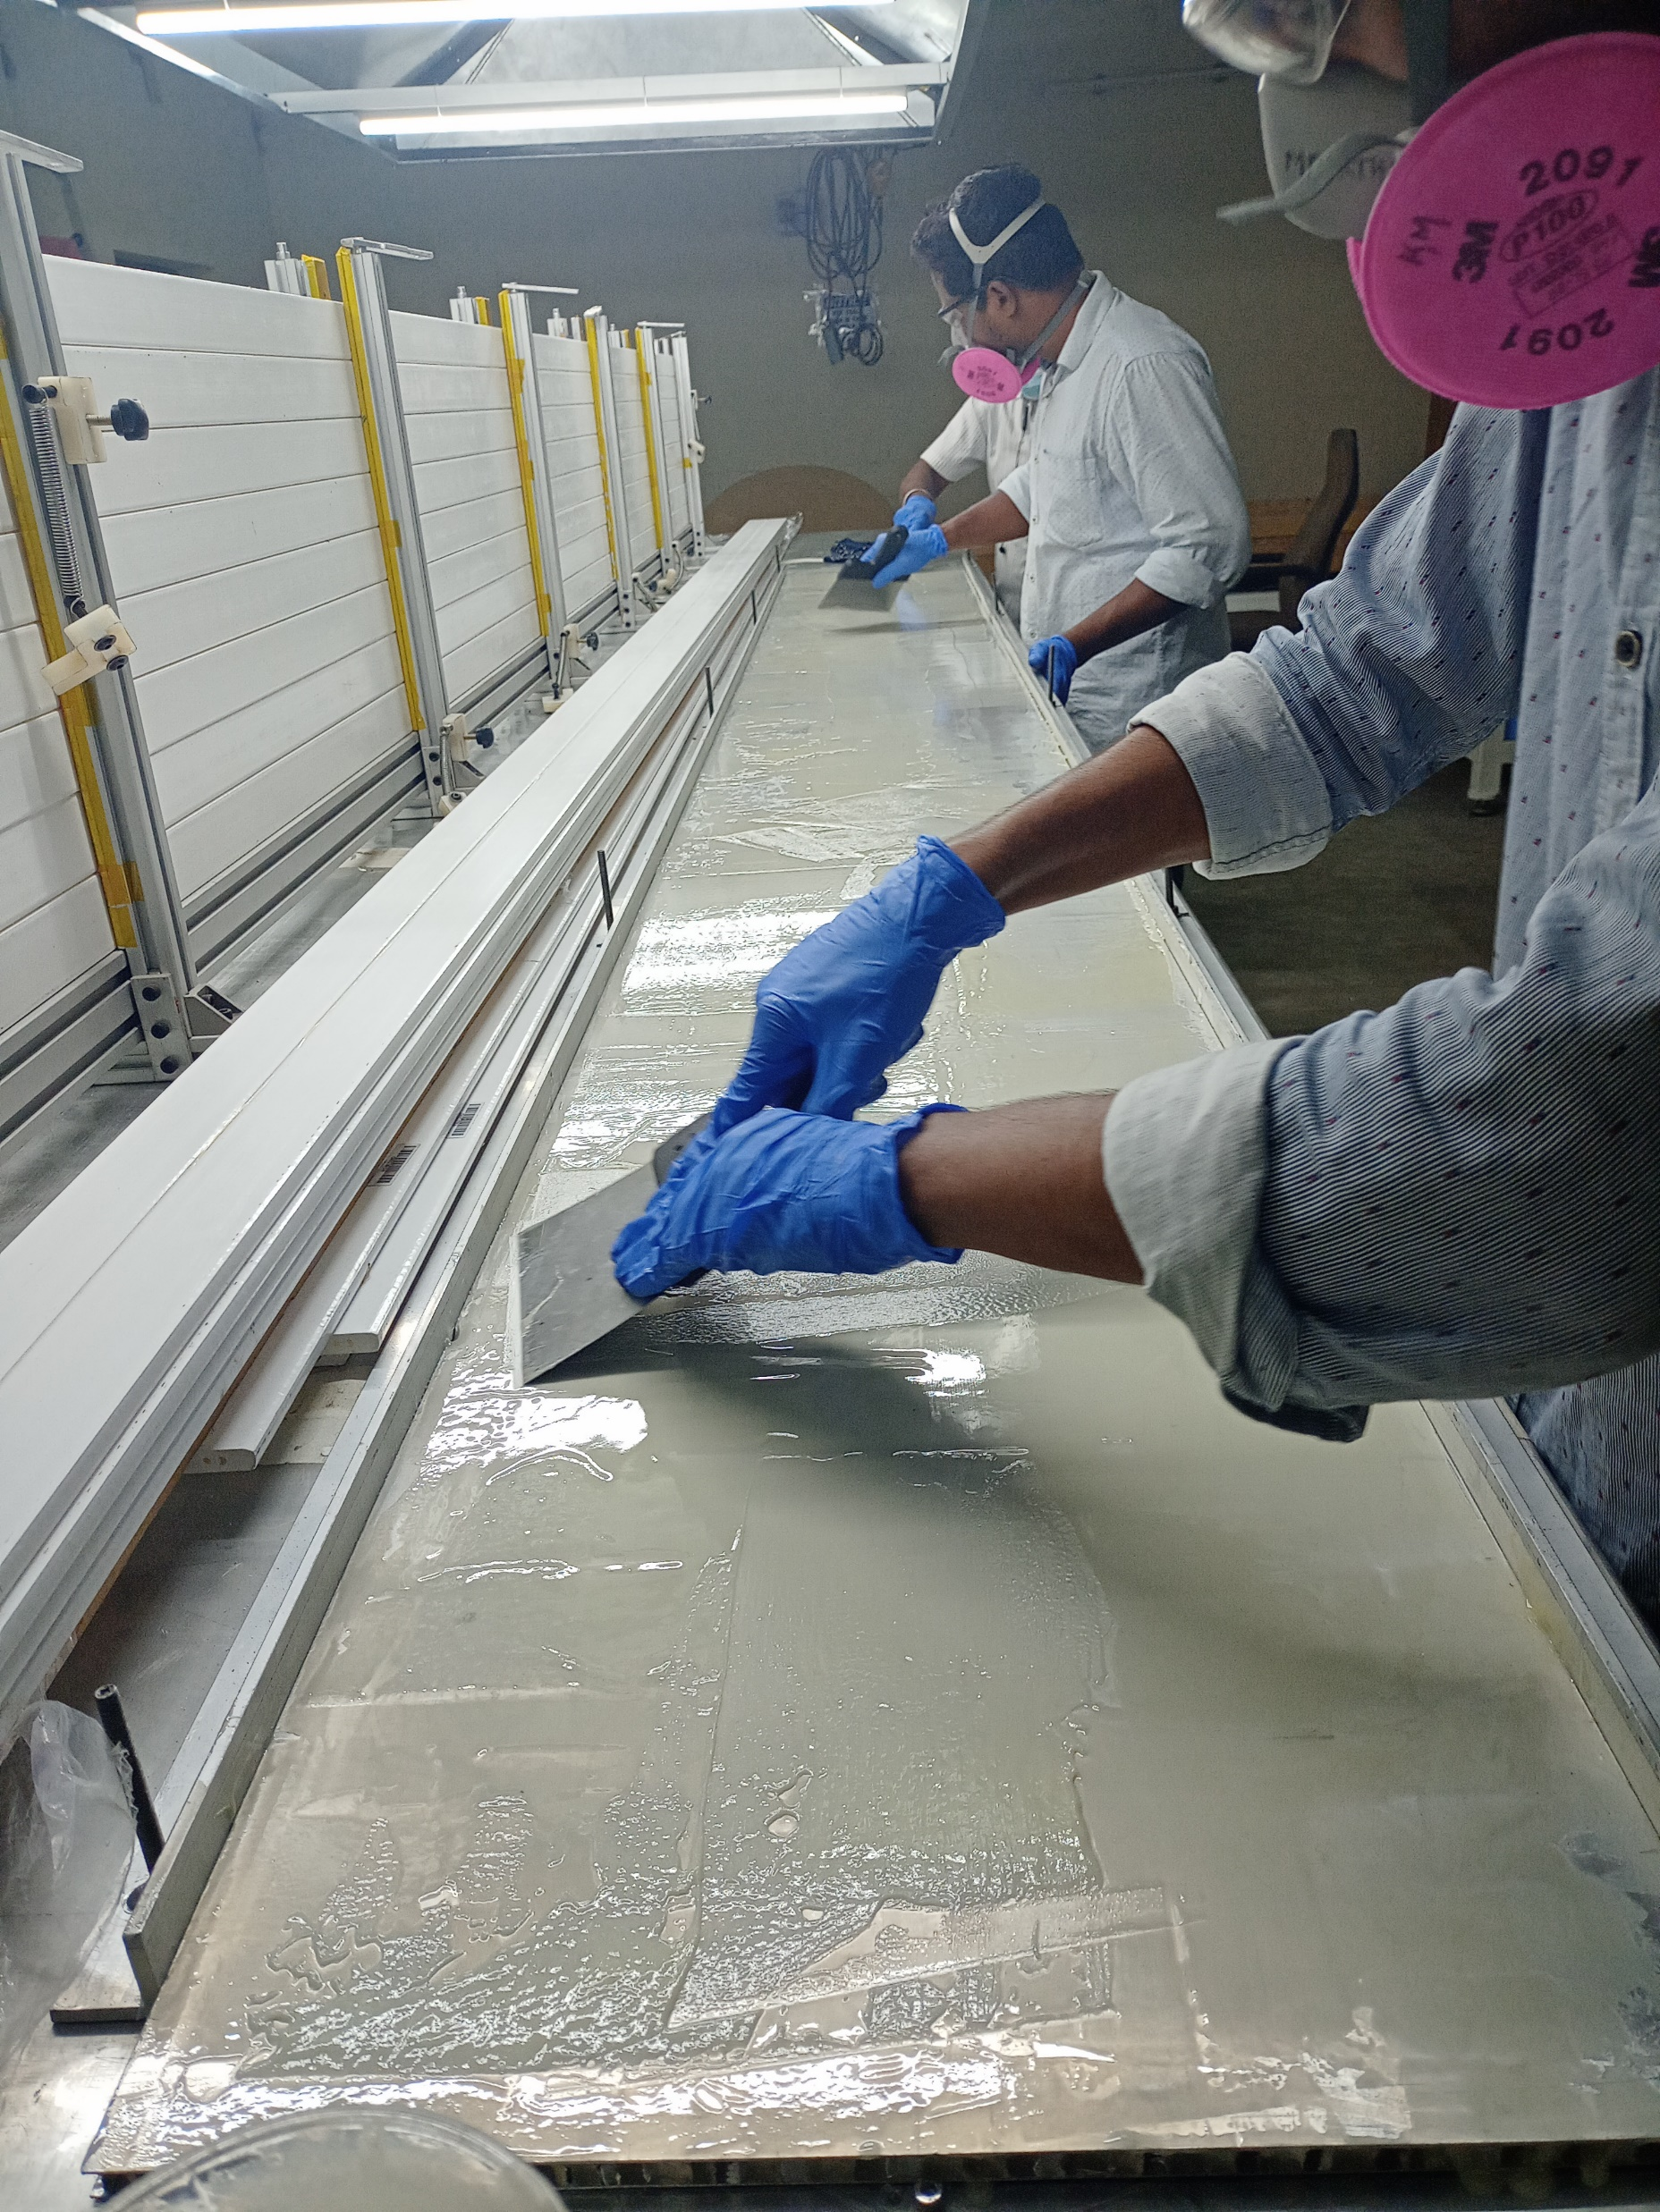
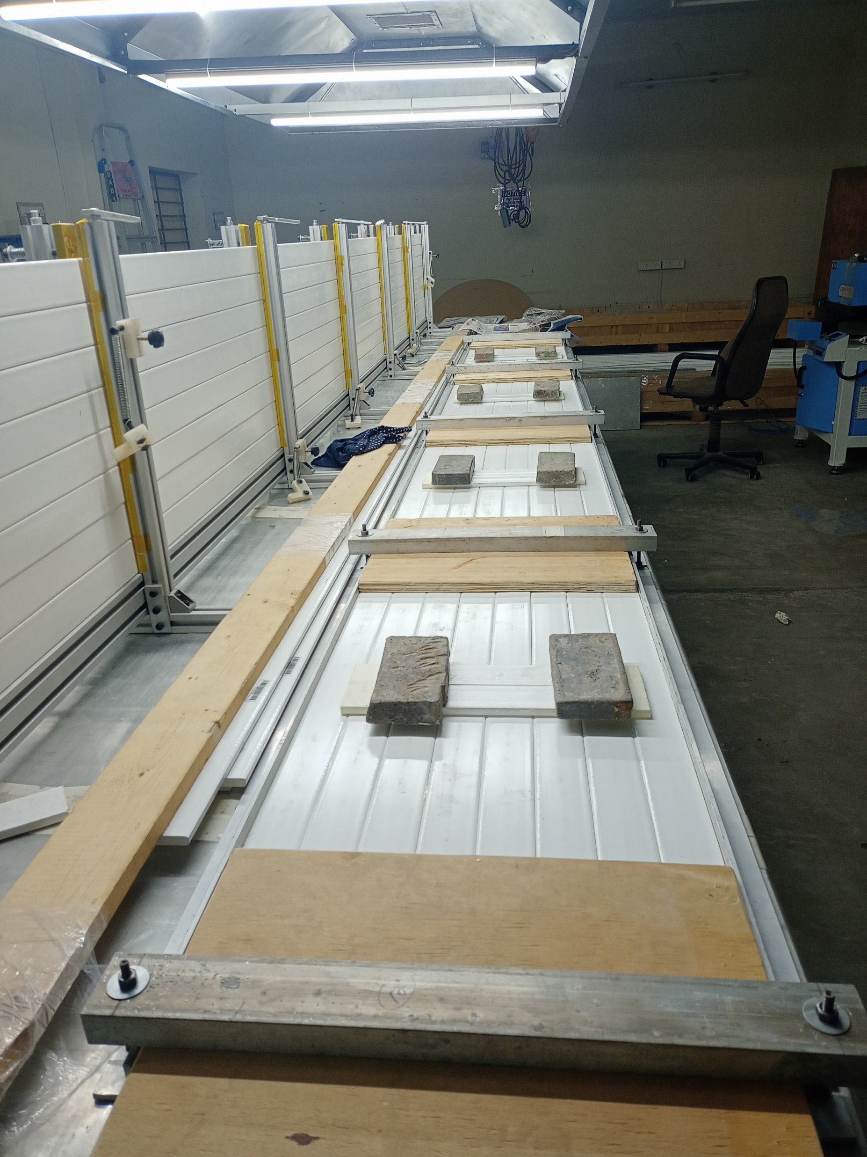
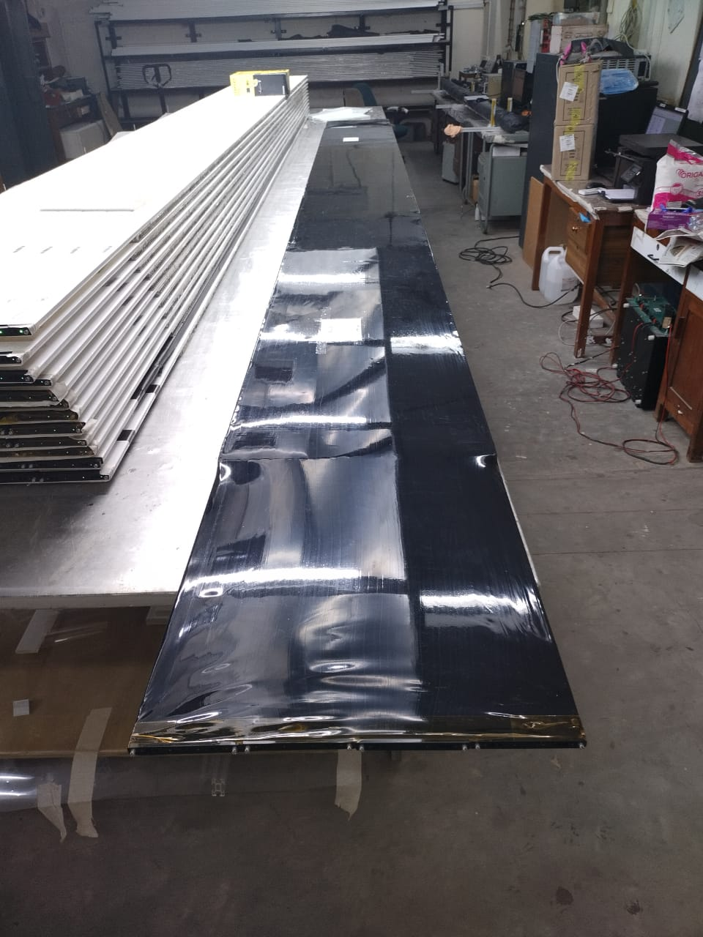
Tile Fabrication
Poster #336: Plastic Scintillator Tile Fabrication and its
Qualification for the Cosmic Muon Veto Detector at IICHEP

Slide 21
DRS4 Based DAQ Module for CMVD

Slide 22
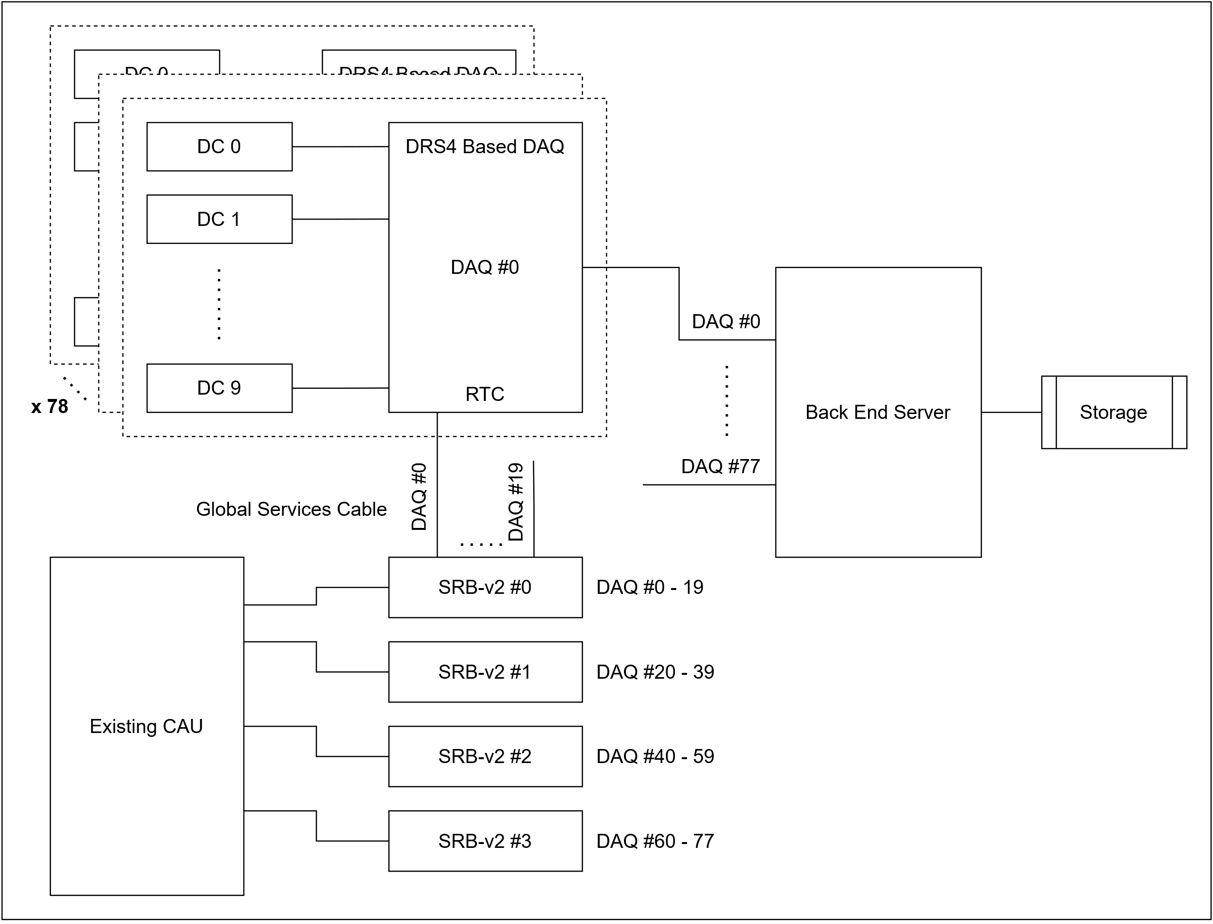
Architecture of DAQ System for the CMVD

Slide 23

A View of the mini-ICAL + the CMVD Structure that will hold the Veto Walls

Slide 24
Summary
Fabrication and QC of all the veto detector modules has been completed
Assembly and installation of the detector mounting structures is done
Prototyping of DRS4 based electronics is in progress
The detector will be up and collecting data in the coming months

Slide 25

Thank you
¹Satyanarayana Bheesette, ¹S.R. Bharathi, ¹Pandi Chinnappan, ³V.M. Datar, ¹Aditya Deodhar, ¹Kiran Gothe, ^{1,4}Mamta Jangra, ^{1,4}Jim John, ¹S.R. Joshi, ¹J. Krishnamoorthi, ¹Karthikk K.S, ¹Gobinda Majumder, ¹Veera Padmavathy, ^{1,4}N. Panchal, ¹Nagaraj Panyam, ¹Nandkishor Parmar, ¹S. Pethuraj, ¹Jayakumar Ponraj, ¹Shobha K. Rao, ¹K.C. Ravindran, ¹Mahima Sachdeva, ¹Mandar Saraf, ^{1, 4}Raj Bhupen Shah, ¹Kirti Prakash Sharma, 1R.R. Shinde, ^{2,4}Hariom Sogarwal, ^{1,5}L. Umesh, ¹S.S. Upadhya, ¹Piyush Verma, ¹E. Yuvaraj.
¹Tata Institute of Fundamental Research, Mumbai - 400005, India.
²Bhabha Atomic Research Centre, Mumbai - 400085, India.
³Institute of Mathematical Sciences, Chennai - 600113, India.
⁴Homi Bhabha National Institute, Mumbai - 400094, India.
⁵The American College, Madurai - 625002, India.

Slide 26

The ICAL Detector

Slide 27
Electronics – Devices Studied
Features | CMVD Spec | VMM3a | Petiroc 2a | Triroc 1A | DRS4
Channels | 64 or 32 | 64 | 32 | 64 | 9
Architecture | LG Charge, HG Charge and Timing | Amplifier, shaper, Peak Detector, TAC and ADCs, | Amplifier, LG CR-RC Shaper, SCA/ Peak detector, TAC, ADCs | Amplifier, LG and HG CR-RC Shaper, SCA/ Peak detector, TAC, ADCs | Domino Ring waveform Sampler, 1024 cells, up to 5GHz sampling rate
AMP gain | Reasonable gain | 0.5, 1, 3, 4, 5, 6, 9, 12, 16 mV/fC | Fixed gain 40 | 13mV/p.e positive 16.5mV/p.e negative | NA
Shaper peaking time | Tunable to capture Peak amplitude | Adjustable 25, 50, 100 and 200ns | Adjustable 25, 50, 75 & 100 ns | Adjustable 10ns to 1.28us (10ns res) | NA
ADCs | 10 bit or higher | 10 bit – Peak, 8 bit – TAC, | 10 bit – Peak or SCA 10 bit - TAC | 10 bit – Peak or SCA 10 bit - TAC | None, analog output
Charge Dynamic range & resolution | 50 pC with res of 0.04 pC | 0.1 to 2pC resolution : less than 1fC | 0-480 pC i.e. 3000 pe | HG : 100 pe, LG : 3000 pe, | 0.1pC, 28pC
Timing resolution (With 40 MHz ref clk) | 100ps – 150ps | 97 ps | 100 ps | 88 ps | 1 ns
Multiplexed Analog out | Required if ext ADC needed | PDO, TDO, MO (amp all 64 channels) & more | LG Peak or SCA out | LG (Peak or SCA), HG (Peak or SCA) and TAC | Available
Trigger Out | ToT or ORed Time or charge trigger | Disc out all 64 | Disc out all 32, Charge OR32, Time OR32 | Time trig ch, Charge OR64, Time OR64, | NA
Detecting method | Capturing and digitizing of CMVD signals on RPC stack muon trigger. | L0 mode (refer VMM document) | Local trig using 32 ch Disc out and issue hold signal when RPC trigger and local trigger matches | Issue Hold signal when RPC trigger comes, Note: shapers peaking time to be set close to RPC trigger latency. | Pre-sampling of analog signal, readout through ADC on ext trigger
LG, HG and TAC | At least 32 channel LG charge, HG charge and Timing from one card. | 32 Ch in LG peak and 32 CH in HG peak, TAC only with HG. | 32 Ch LG charge INT ADC, 32 CH TAC INT ADC. | LG 64 ch charge INT ADC , HG 64 Ch TAC INT ADC and MUX HG charge (peak or SCA) EXT ADC | NA

Slide 28


Veto Efficiencies for different CCMVD Configurations
N. Panchal, et al, 2017 JINST 12 T11002
N. Panchal, et al, 2019 JINST 14 P02032
The advantages of locating a large detector such as ICAL at a shallow depth of 100 m, are obvious
If a CMVD with a muon detection efficiency > 99.99% is built, then similar fraction of muons would go undetected as would pass through a 1 km rock cover
The possibility of constructing a CMV for a shallow depth ICAL, needs to be validated
Such a proof-of-principle CMV is being built around the mini-ICAL detector at IICHEP, Madurai

