Slide 1
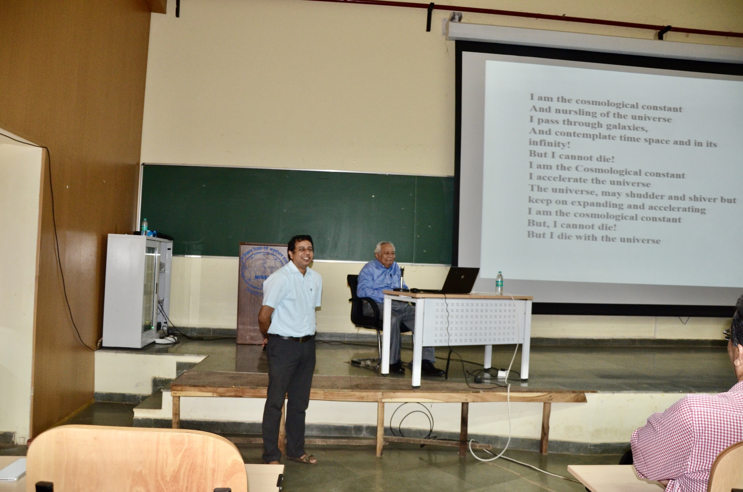
A tribute to Prof. Bikash Sinha
Prof. Sinha could traverse the canvas of nuclear physics to high energy QGP physics to early Universe cosmology with an enviable ease. He was a visionary, an institution builder, a keen and much acclaimed theoretical physicist who also built several vibrant experimental physics groups, but more so – he was a man of renaissance, large-hearted and generous.
He was a mentor and a father figure to me.
1/25

Slide 2
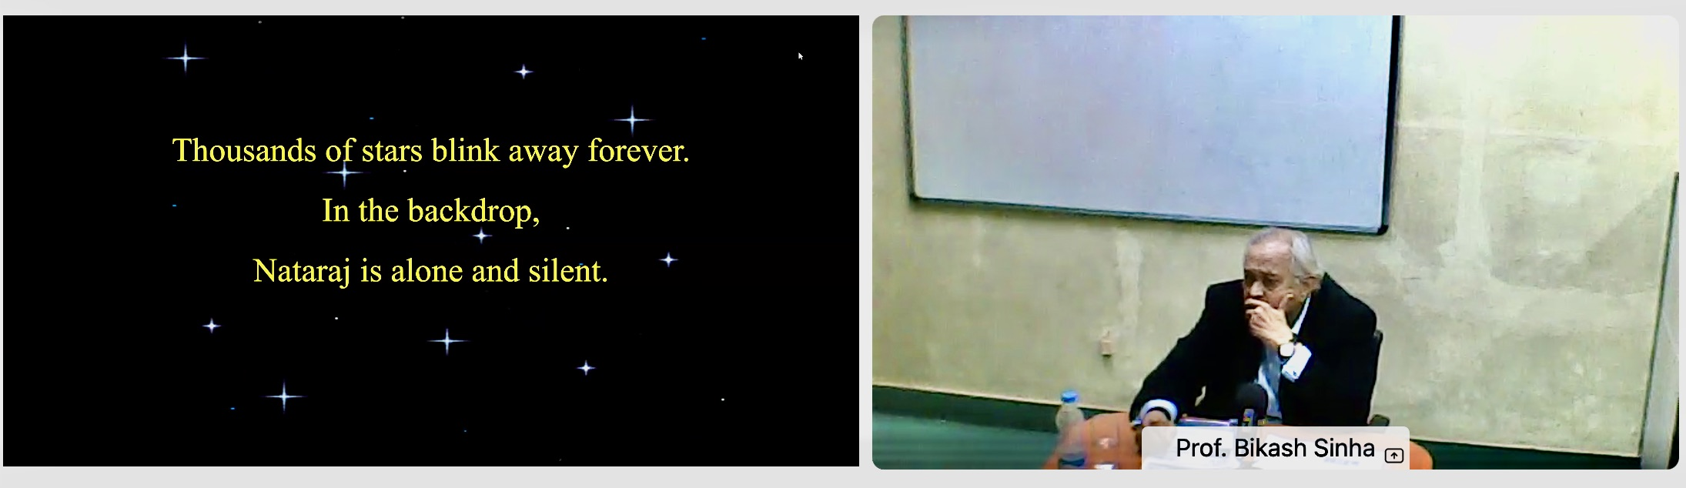
A tribute to Prof. Bikash Sinha
My pranam to Prof. Bikash Sinha, he will be remembered for pioneering contributions to several fields of science, institutions, service to the country, support for worldwide scientific programs and nurturing several young colleagues across different fields. We will miss him and may his soul rest in peace.
2/25

Slide 3

Observation of polarized hadrons in high energy heavy-ion collisions
Outline
Introduction
Experimental observable
Results
  Vector meson spin alignment at RHIC & LHC
  Hyperon polarization at RHIC & LHC
  Quarkonium polarization at LHC
  Open cham polarization at LHC
Conclusions
Bedanga Mohanty
(NISER and CERN)
India-ALICE-STAR Meeting
Jammu University, Jammu
November 21, 2023
3/25

Slide 4
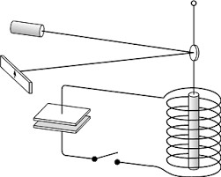
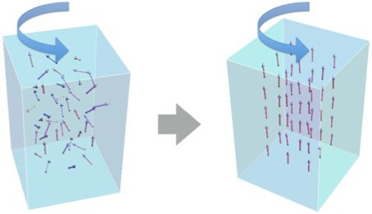
Barnett Effect and Einstein-de Haas Effect
Rotation ➔ Polarization
Polarization ➔ Rotation
Barnett, Phys. Rev. 6 (4) 239, (1915)
Barnett, Rev. Mod. Phys. 7, 129 (1935)
Einstein, de Hass, DPG Vanhandlungen 17, 152 (1915)
Can we see any such effects in heavy-ion collisions ?
4/25

Slide 5
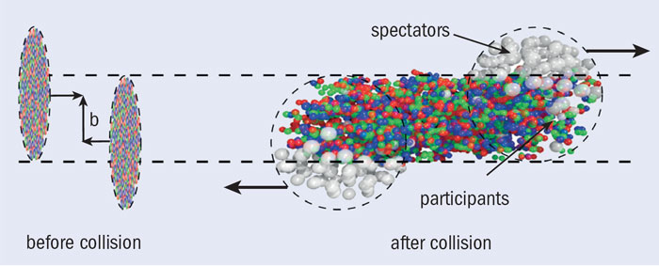
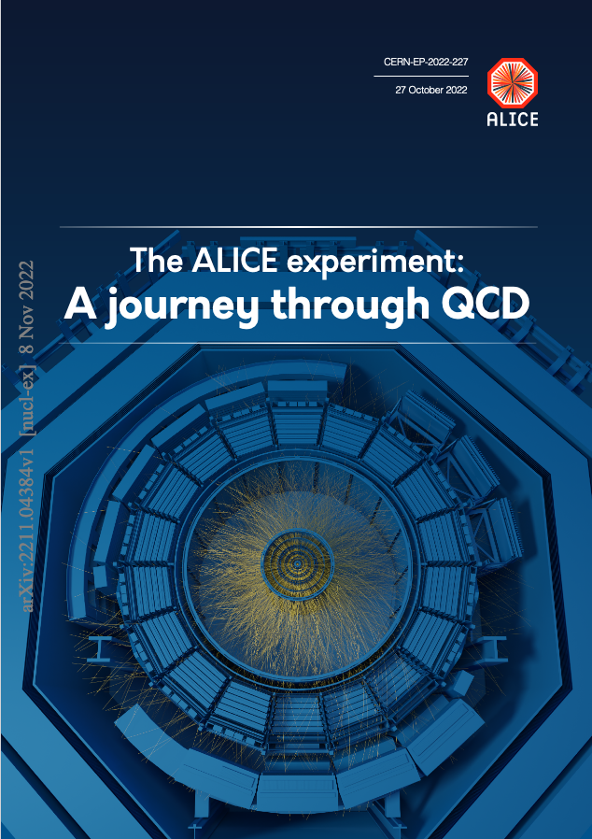
Time evolution of heavy-ion collisions
Two interesting large initial state effects
    Angular momentum
    Magnetic field
5/25

Slide 6
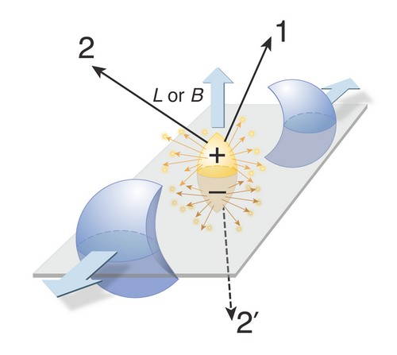
Angular momentum and magnetic field
M²_{p} ~ 2 x 10⁴ MeV² ~ 3 x 10¹⁴ Tesla ~ 3 x 10¹⁸ Gauss
Transient effect
Retention time depends
on QGP conductivity
Conserved
F. Becattini et al.,
Phys.Rev.C 77 (2008) 024906
D. E. Kharzeev et al.,
Nucl.Phys.A 803 (2008) 227
6/25

Slide 7
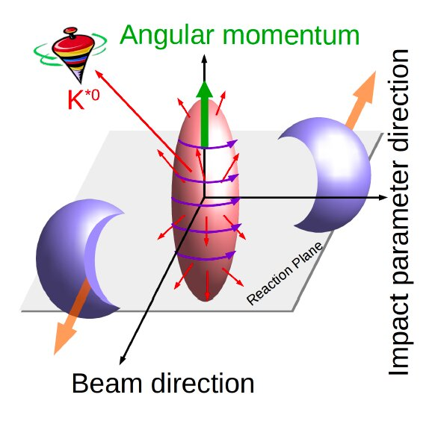
Vector meson spin alignment
7/25

Slide 8
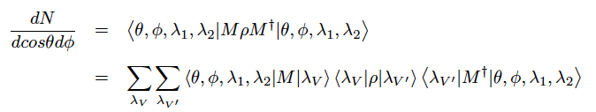
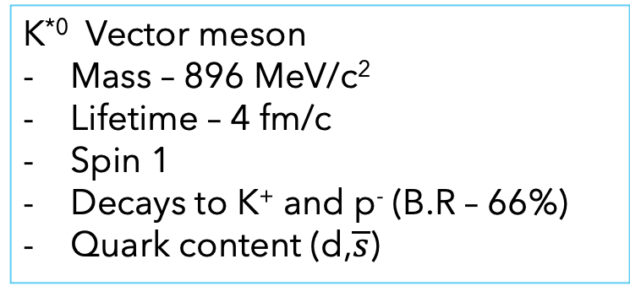
Observable: Angular distribution of vector meson
Quantization axis
K^{*0} Vector meson
Mass – 896 MeV/c²
Lifetime – 4 fm/c
Spin 1
Decays to K⁺ and p⁻ (B.R – 66%)
Quark content (d,$\overline{s}$)
K⁺
Impact parameter
θ*
K^{*0}
π⁻
Beam axis
K. Schilling et al., Nucl. Phys. B 15 (1970) 397
Quantization axis
Normal to production plane
(Momentum of vector meson and beam axis)
Normal to reaction plane
(Impact parameter and beam axis)
λ = Helicities
= spin density matrix
M = Decay amplitude
8/25

Slide 9

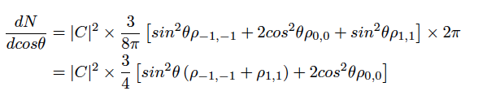

Observable: Angular distribution of vector meson
In terms of spherical harmonics
Integrating over azimuthal angle
Normalized spin density matrix – Trace = 1
ρ₀₀: Probability vector meson is in spin state = 0
ρ₀₀ = 1/3 → No spin alignment
9/25

Slide 10
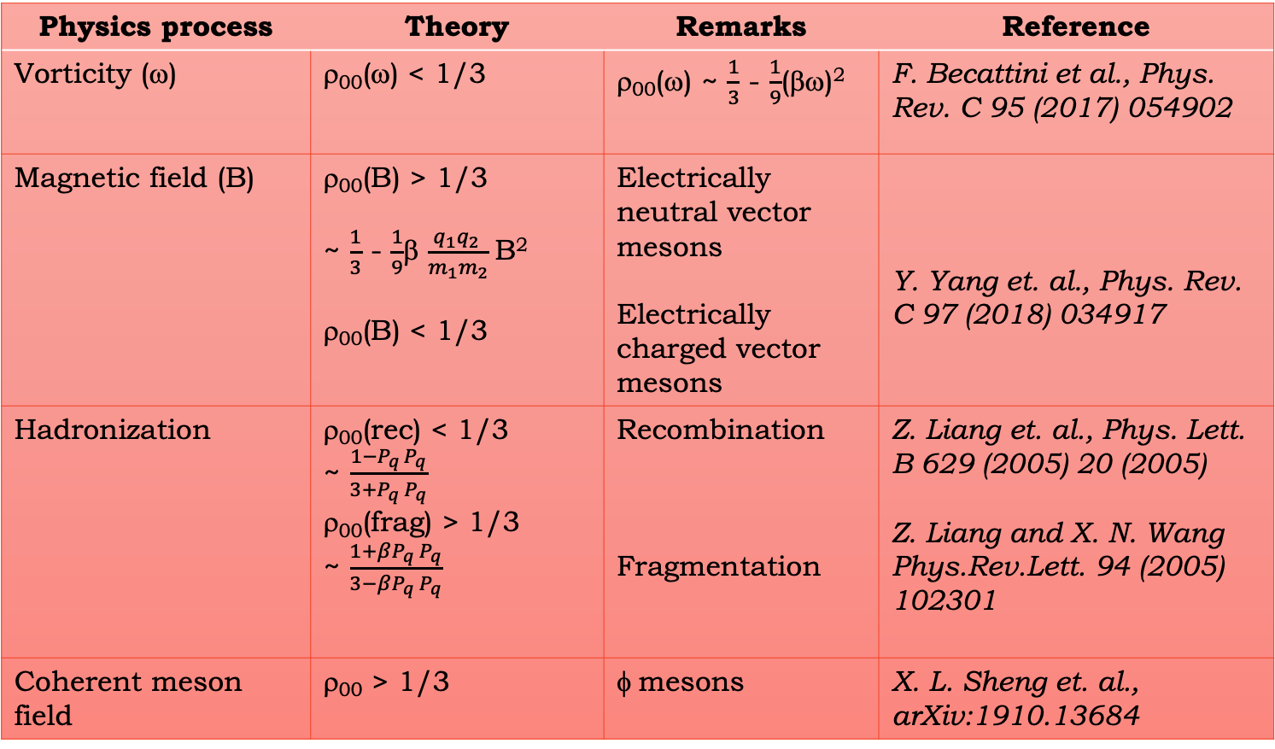
Physics process and theory expectation
Physics process | Theory | Remarks | Reference
Vorticity (ω) | ρ₀₀(ω) < 1/3 | ρ₀₀(ω) ~ $\frac{1}{3}$ - $\frac{1}{9}$(βω)² | F. Becattini et al., Phys. Rev. C 95 (2017) 054902
Magnetic field (B) | ρ₀₀(B) > 1/3 ~ $\frac{1}{3}$ - $\frac{1}{9}$β $\frac{q_{1}q_{2 }}{m_{1}m_{2}}$B² ρ₀₀(B) < 1/3 | Electrically neutral vector mesons Electrically charged vector mesons | Y. Yang et. al., Phys. Rev. C 97 (2018) 034917
Hadronization | ρ₀₀(rec) < 1/3 ~ $\frac{1−P_{q }P_{q}}{3+P_{q} P_{q}}$ ρ₀₀(frag) > 1/3 ~ $\frac{1+βP_{q} P_{q}}{3−βP_{q} P_{q}}$ | Recombination Fragmentation | Z. Liang et. al., Phys. Lett. B 629 (2005) 20 (2005) Z. Liang and X. N. Wang Phys.Rev.Lett. 94 (2005) 102301
Coherent meson field | ρ₀₀ > 1/3 | φ mesons | X. L. Sheng et. al., arXiv:1910.13684
10/25

Slide 11
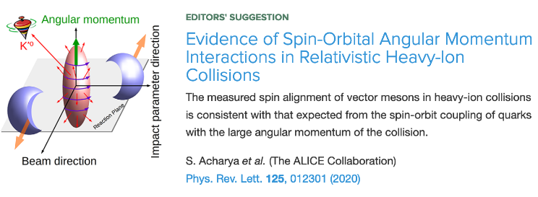
Spin alignment of vector mesons
3σ effect
No spin alignment
Quantization axis
K⁺
Impact parameter
θ*
K^{*0}
π⁻
Beam axis
ALI-DER-342828
11/25

Slide 12
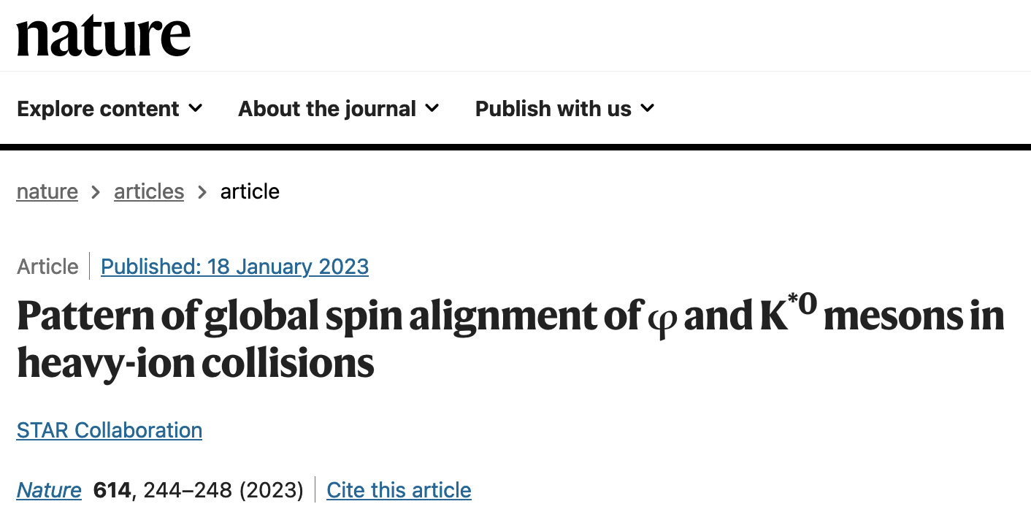
Phi-meson spin alignment – RHIC and LHC
𝞺₀₀ 𝟇 = 1/3 + 𝐶_{𝞚} + 𝐶_{s} + 𝐶_{𝐸} + 𝐶_{𝐹} + 𝐶_{𝐿} + 𝐶_{𝐴} + 𝐶_{𝟇}
Physics Mechanisms | (ρ₀₀)
c_{Λ}: Quark coalescence vorticity & magnetic field^{[1]} | < 1/3 (Negative ~ 10⁻⁵)
c_{ε}: E-comp. of Vorticity tensor^{[1]} | < 1/3 (Negative ~ 10⁻⁴)
c_{E}: Electric field^{[2]} | > 1/3 (Positive ~ 10⁻⁵)
c_{F}: Fragmentation^{[3]} | > or, < 1/3 (~ 10⁻⁵)
c_{L}: Local spin alignments^{[4]} | < 1/3
c_{A}: Turbulent color field^{[5]} | < 1/3
c_{ϕ}: Vector meson strong force field^{[6]} | > 1/3 (Can accommodate large positive signal)
8σ effect
12/25

Slide 13
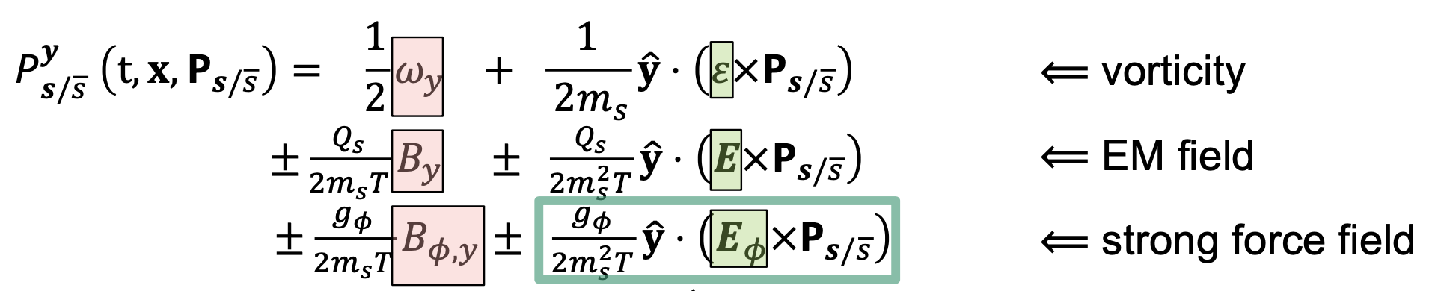
Phi meson spin alignment – Physics
Requires presence of a new strong force field – phi-meson vector field
Like electric charges in motion can generate an EM field, 𝑠 and 𝑠bar quarks in motion can generate an effective ϕ-meson field.
The ϕ-meson field can polarize 𝑠 and 𝑠 quarks with a large magnitude due to strong interaction, in analogy to how EM field polarize (anti)quarks.
13/25

Slide 14

Global hyperon polarization observable
Lambdas are “self-analyzing”
reveal polarization by preferentially emitting daughter proton in the spin direction
Magneto-hydro equilibrium interpretation
  for small polarization:
  vorticity from the average:
  B-field from the difference*:
E. Cummins, Weak Interactions (McGraw-Hill, 1973)
14/25

Slide 15
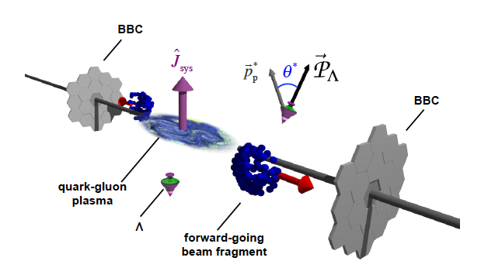
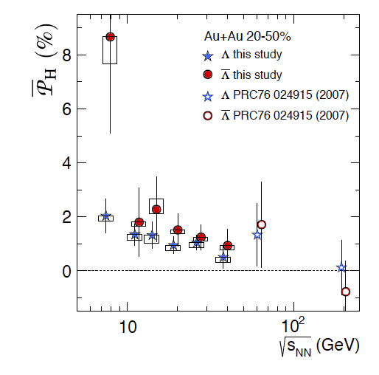
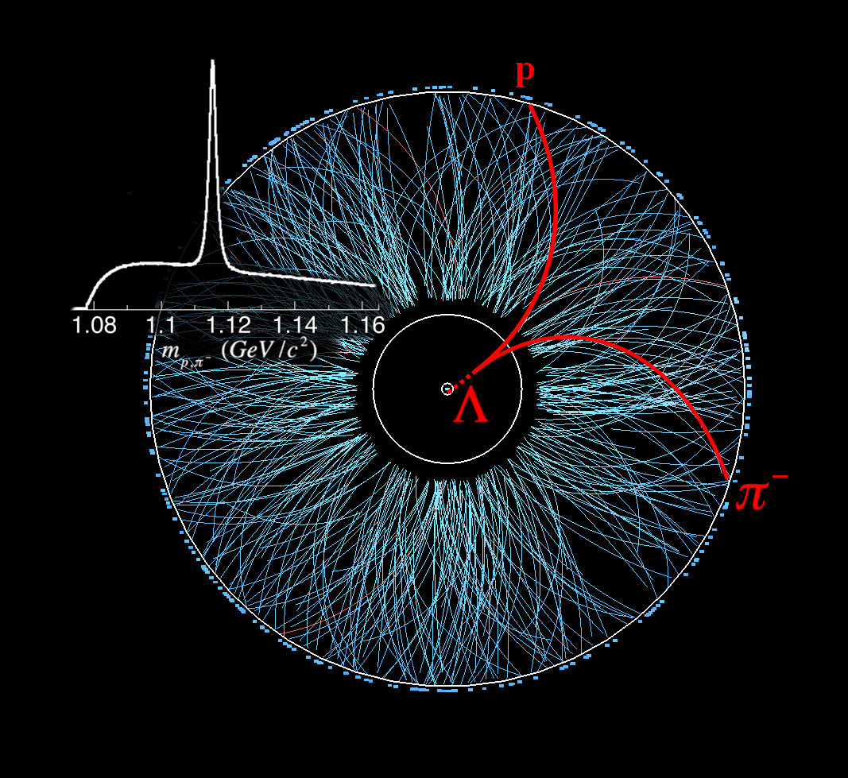



Hyperon polarization at RHIC and LHC
 | BES average
Λ | 6.8σ
anti-Λ | 3.7σ
Nature 548, 62 (2017) (STAR Collaboration)
Phys Rev C 98, 14910 (2018) (STAR Collaboration)
15/25

Slide 16
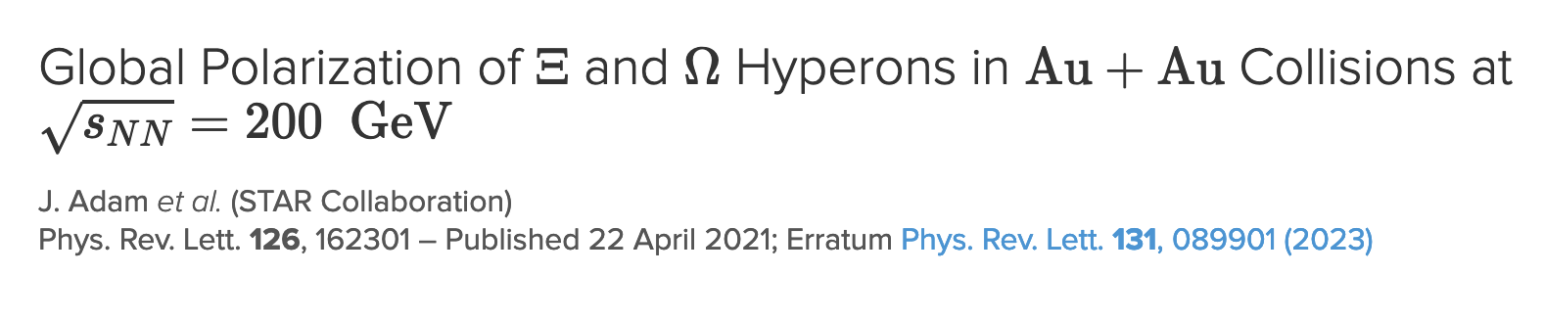
Hyperon polarization at RHIC and LHC
Global polarization of Ξ and Ω hyperons
⟨PΞ⟩=0.47±0.10(stat)±0.23(syst)% for the collision centrality 20%–80%.
⟨PΩ⟩=1.11±0.87(stat)±1.97(syst)% was obtained by measuring the polarization of daughter Λ in the decay Ω→Λ+K, assuming the polarization transfer factor CΩΛ=1.
16/25

Slide 17
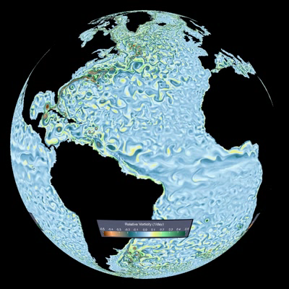
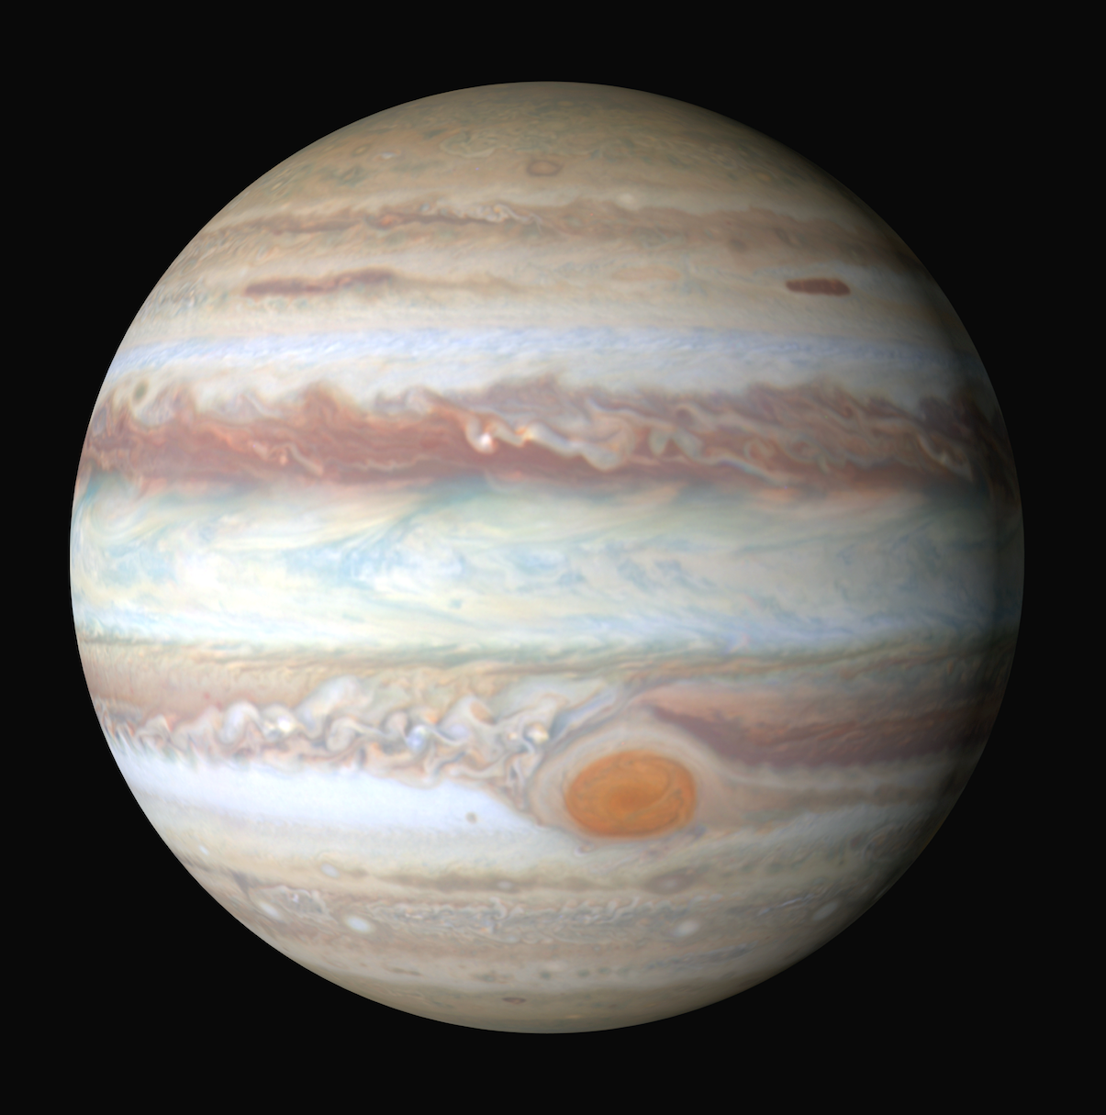
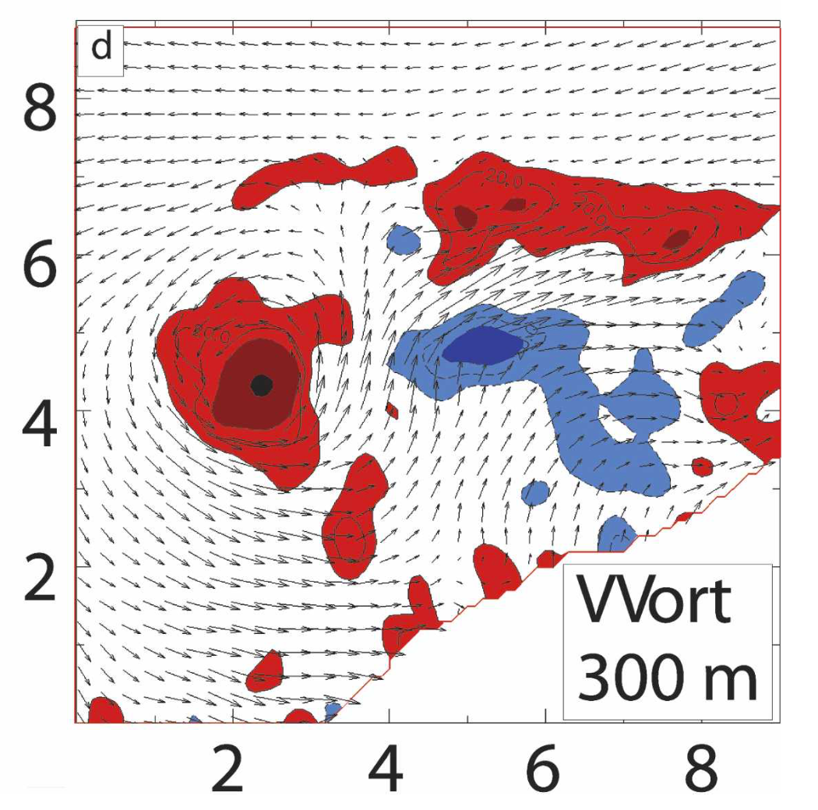
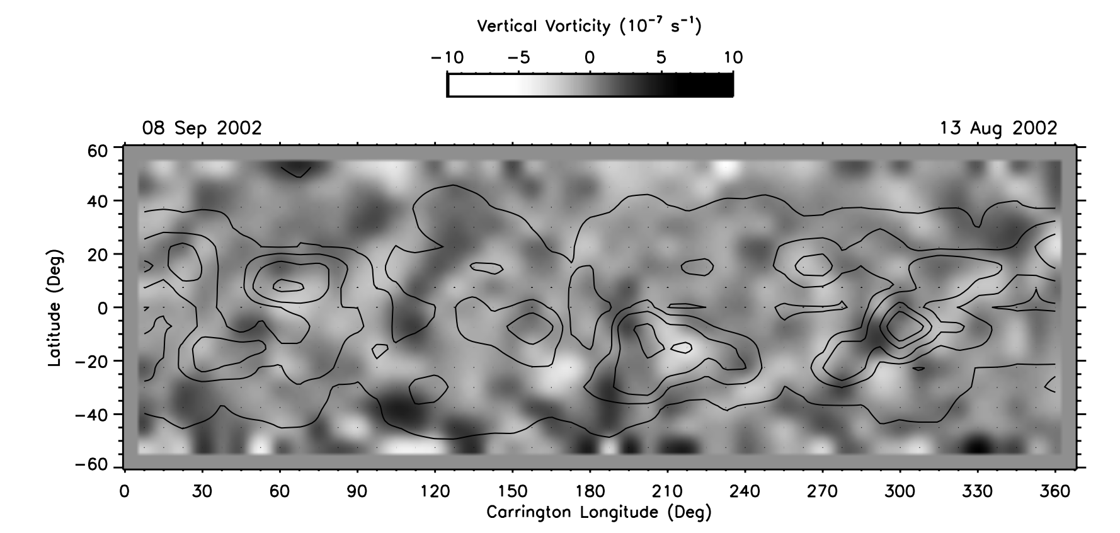
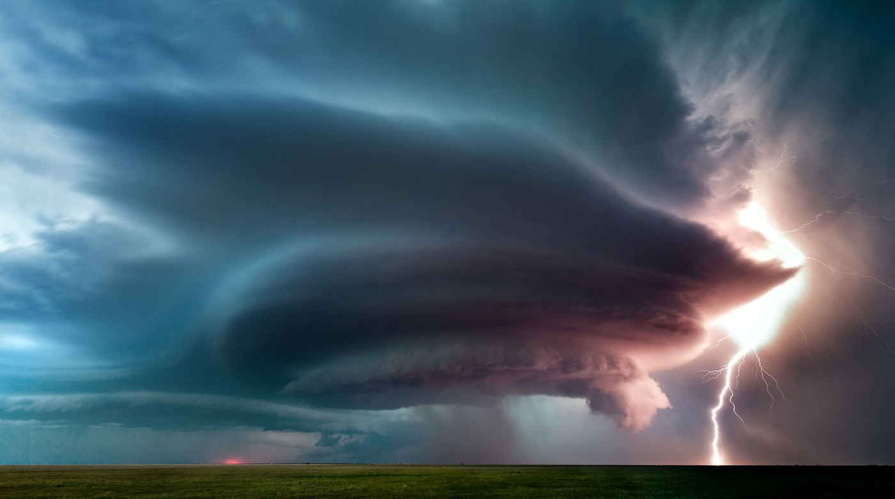
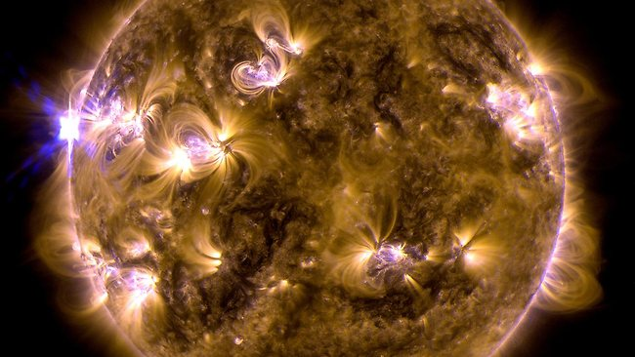
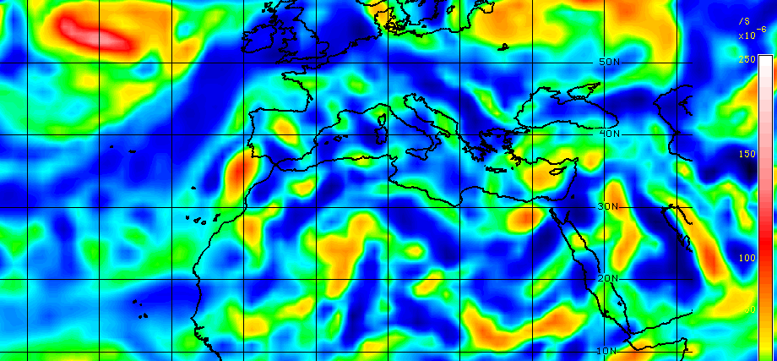
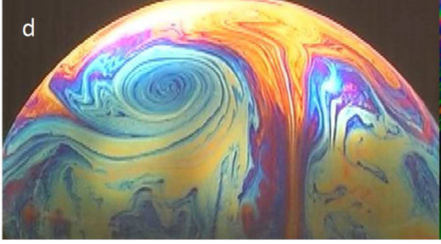
World data on vorticity
ocean flows: ω ~ 10⁻⁵ s⁻¹
terrestrial atmosphere: ω ~ 10⁻⁴ s⁻¹
core of supercell tornado : ω ~ 10⁻¹ s⁻¹
solar subsurface flow: : ω ~ 10⁻⁶ s⁻¹
high vorticity (10⁻⁴ s⁻¹) in the “collar”
of Jupiter’s Great Red Spot
Heated, rotating soap bubbles (10² s⁻¹)
Atmospheric vorticity
Largest values in heavy-ion collisions
Heated soap bubble
17/25

Slide 18
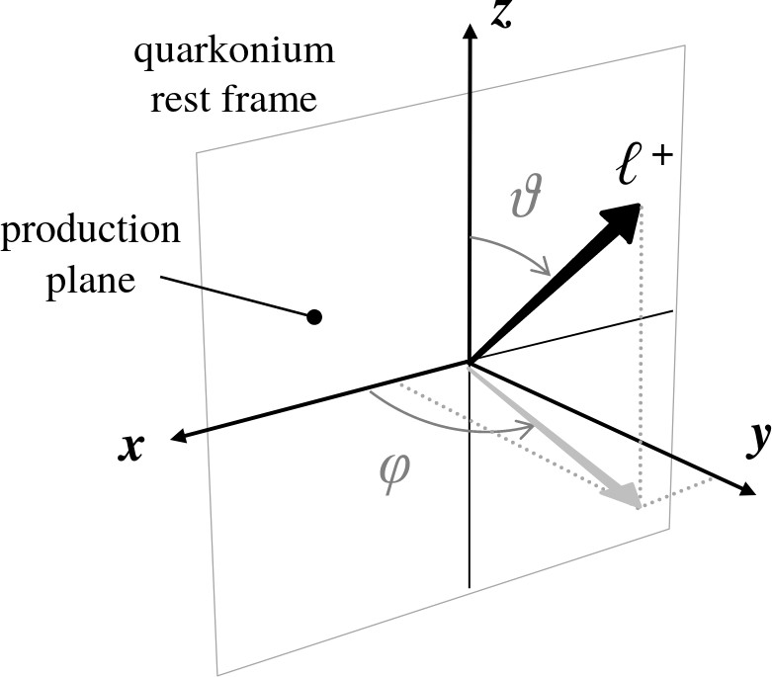
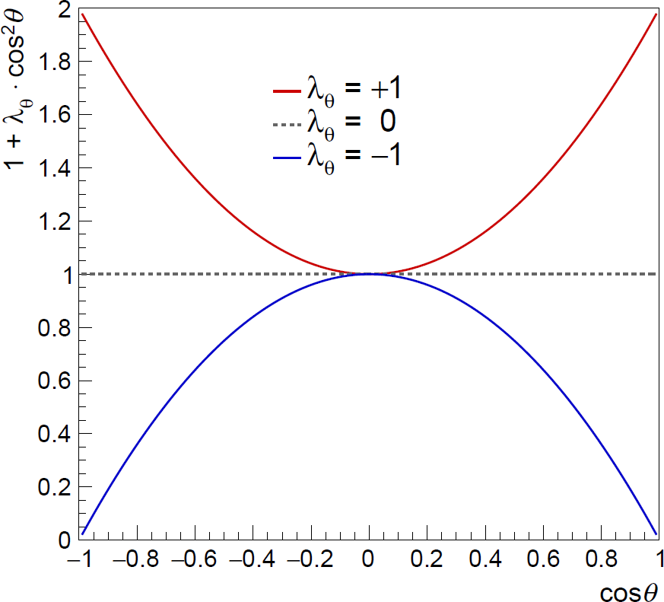
Quarkonia polarization - observable
Heavy quark pair production occurs early in the collision (t ∼ 0.1 fm/c) and can experience both the short living B and the L of the rotating medium
Dilepton decay angular distribution
𝑊 cos𝜃, 𝜙 ∝ ¹ ⋅ (1 + 𝝀_{𝜽} cos² 𝜃 + 𝝀_{𝝓} sin² 𝜃 cos2𝜙 + 𝝀_{𝜽𝝓}sin2𝜃 cos𝜙)
3+𝝀_{𝜽}
Polarization parameters
𝜆_{𝜃}, 𝜆_{𝜙}, 𝜆_{𝜃𝜙}
𝜆_{𝜃}, 𝜆_{𝜙}, 𝜆_{𝜃𝜙}
𝜆_{𝜃}, 𝜆_{𝜙}, 𝜆_{𝜃𝜙}
= 0,0,0 ⟹ No polarization
= +1,0,0 ⟹ Transverse polarization
= −1,0,0 ⟹ Longitudinal polarization
18/25

Slide 19
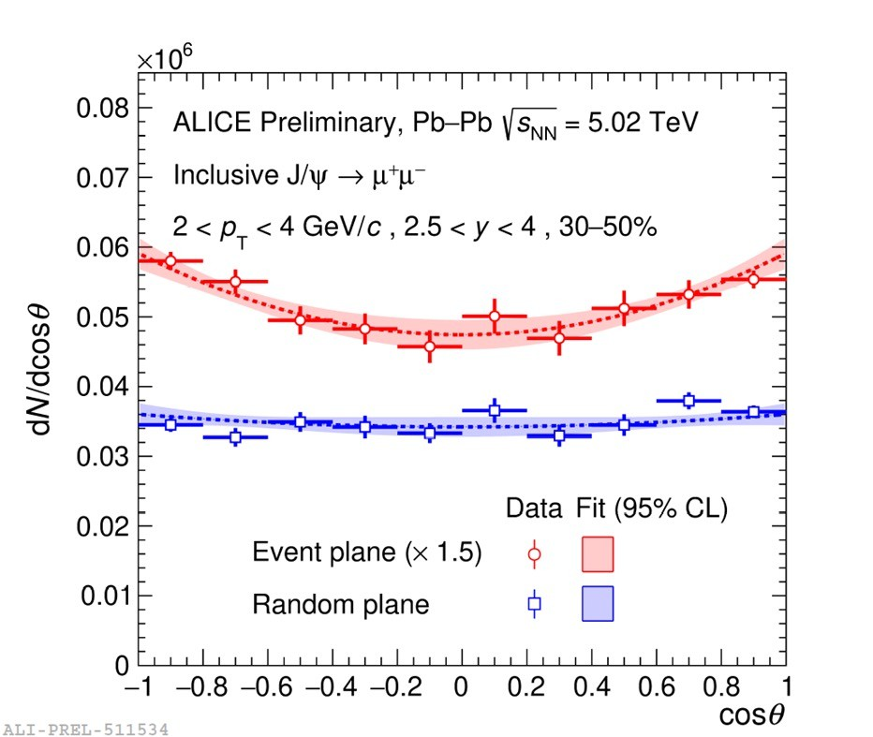
J/Ψ polarization
λ_{θ}
0.5
ALICE, Pb−Pb s_{NN} = 5.02 TeV
Inclusive J/ψ → μ⁺μ⁻
2 < p < 6 GeV/c , 2.5 < y < 4
T
0.4
0.3
0.2
0.1
0
−0.1
Stat. uncert. Syst. uncert.
Event plane
−0.2₀
ALI-PUB-521052
10 20 30 40 50 60 70 80 90 100
Centrality (%)
3.5 σ effect
19/25

Slide 20
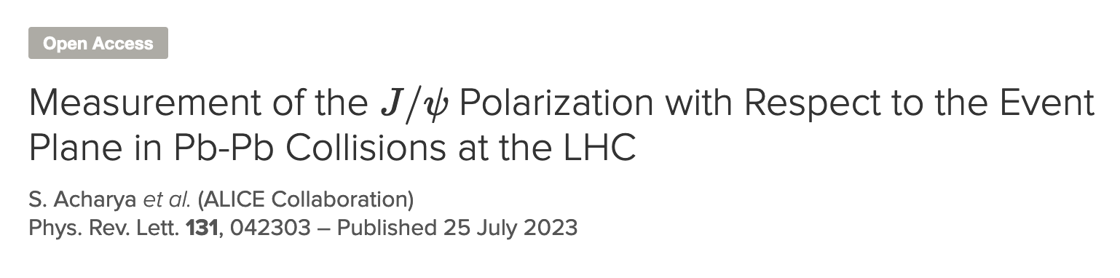
J/Ψ polarization and spin alignment
0.6
0.5
0.4
0.3
0.2
0.1
0
−0.1
−0.2
λ_{θ}
ALICE, Pb−Pb s
NN
= 5.02 TeV
Inclusive J/ψ → μ⁺μ⁻, 2.5 < y < 4
In the dilepton channel:
₌ 1 − 3𝜌₀₀
𝜆_{𝜃} > 0 → 𝜌₀₀ < 1⁄3
𝜆
𝜃
1 + 𝜌₀₀
^{S}𝜆_{𝜃} < 0 → 𝜌₀₀ > 1⁄3
0−20%
30−50%
Reaction plane
Event plane
−0.3₀
2
4
6
8 10 12
p (GeV/c)
T
ALI-PUB-521057
20/25

Slide 21
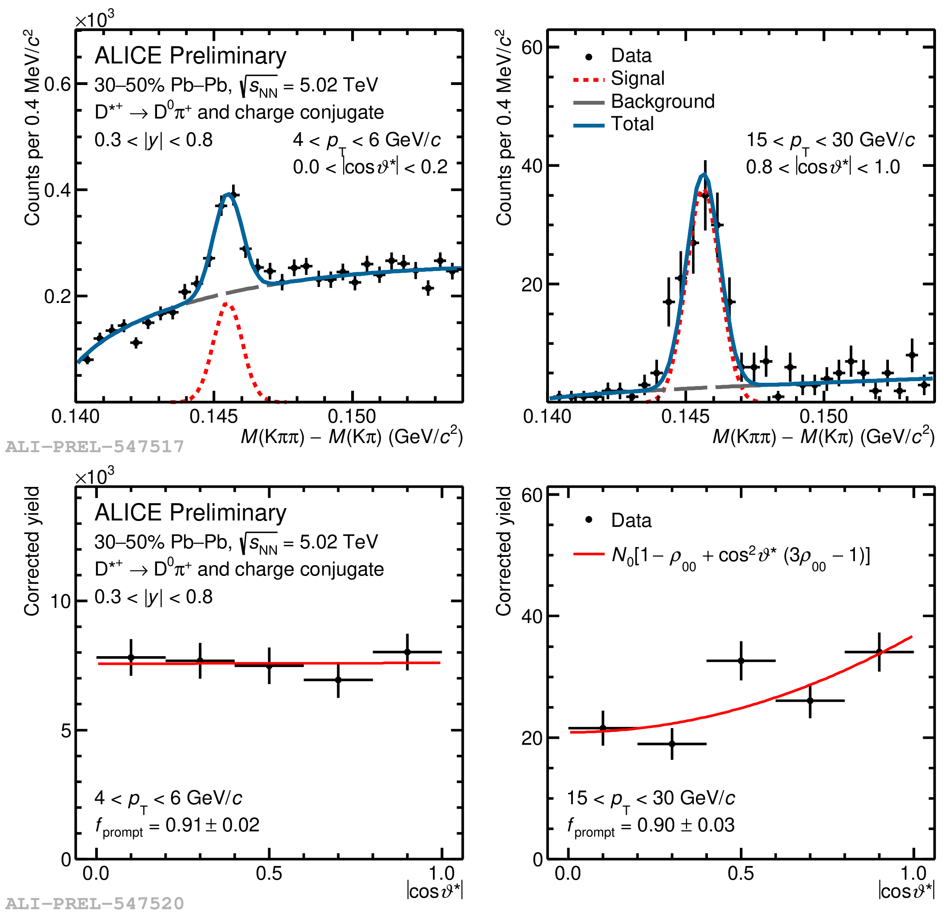
Open charm polarization
ALICE: QM2023
21/25

Slide 22
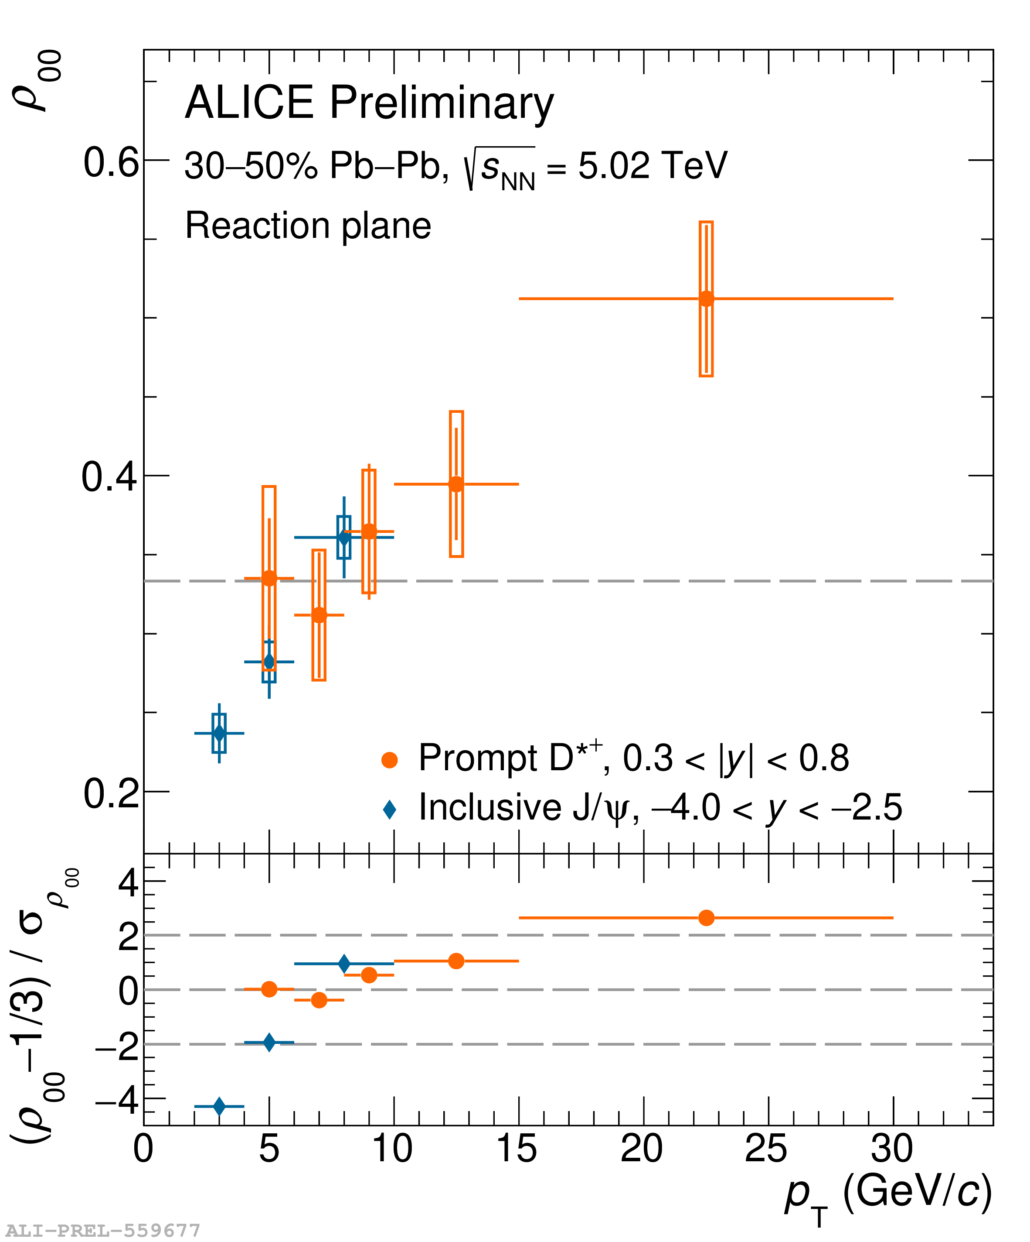
Open charm polarization
First measurement of D^{∗+} polarization with respect to the Reaction plane
ALICE: QM2023
< 1
𝜌
quark recombination at low p
T
00
3
> 1
𝜌
quark fragmentation at high p
T
00
3
22/25

Slide 23
Summary
 | _{K}∗ | 𝛟 |  | _{D}∗a |  | J⁄ψ | ψ(2S) | χ_{c} | Υ(nS)
pp | 𝜌₀₀~1/3 | 𝜌₀₀~1/3 |  | 𝜌₀₀~1/3 |  | 𝜌₀₀~1/3 | 𝜌₀₀~1/3
Pb–Pb | 𝜌₀₀ < 1/3 low p_{T} | 𝜌₀₀ < 1/3 low p_{T} 𝜌₀₀ > 1/3 _{At RHIC} |  | 𝜌₀₀ > 1/3 high p_{T} |  | 𝜌₀₀ < 1/3 low p_{T}
23/25

Slide 24
Conclusions
Polarization and spin alignment measurements indicate response of the medium to large initial angular momentum and magnetic fields
Large global spin alignment for ϕ--meson. It cannot be explained by conventional mechanisms. However, it can be accommodated by a model with strong force field. Global spin alignment for K* meson seen at LHC
Polarization of hyperons suggest creation of a medium with large vorticity
Measurements have driven this area and seems to have brought new observations in the field. However, a comprehensive understanding of the underlying mechanisms at play lacking. Theory calculations required to understand these phenomena across collision energies.
24/25

Slide 25


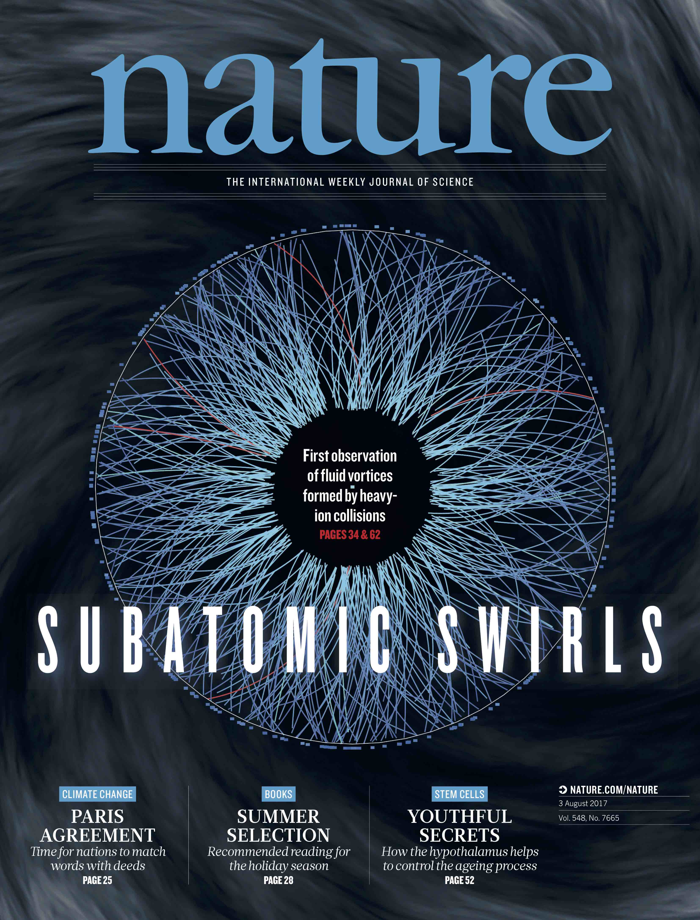
Talk based on …
Thanks to experimental collaborations
Thank you
25/25

