Slide 1
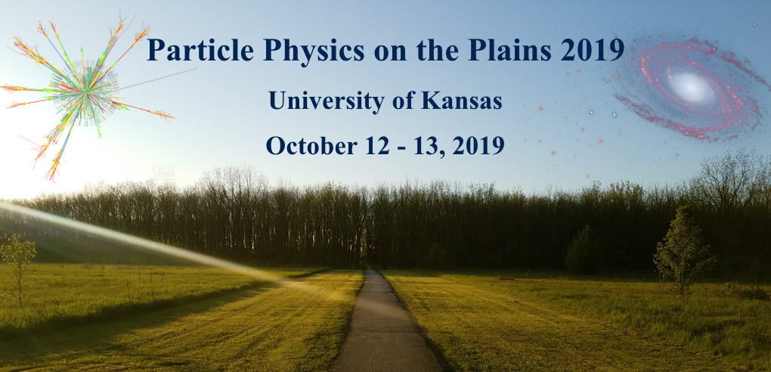


PASSAT: Particle Accelerator helioScopes for Slim Axion-like-particle deTection
Doojin Kim
Particle Physics on the Plains 2019
University of Kansas, October $13$^{th}, $2019$
In collaboration with Walter Bonivento and Kuver Sinha [arXiv:$1909.03071$]
Walter Bonivento and Kuver Sinha, in progress

Slide 2

Motivation for Axion-like Particle Searches
QCD axion for solving dynamically the strong CP problem [Weinberg (1978); Wilczek (1978); Peccei and Quinn (1977)], more general pseudo-scalar axion-like particles (ALPs) which share similar properties/ pheno. wiith QCD axion, both of which are ubiquitous also in string theory [Arvnitaki, Dimopoulous, Dubovsky, Kaloper, March-Russell (2010); Cicoli, Goodsell, Ringwald (2012)]
A plausible extension of the SM
Axion/ALPs could be dark matter candidates.
Axion/ALP searches in the low-energy frontier of particle physics (vs. new physics searches at the LHC in the (high-)energy frontier of particle physics)
Many experimental search techniques are based on the ALP-photon coupling.

Slide 3

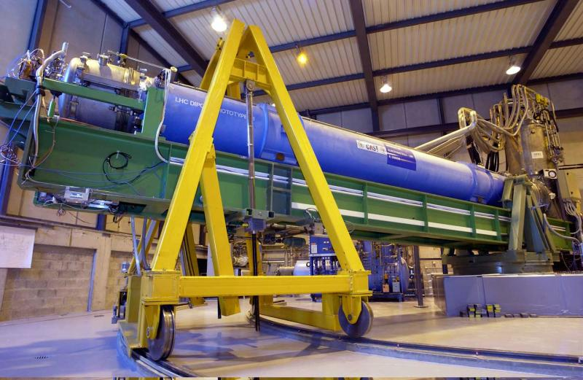



ALP Searches: CAST
Magnetic field
Detector
Sun
$$γ$$
$$γ$$
$$a$$
$$γ$$
$$γ$$
Plenty of photons inside the Sun
  Large signal flux expected

Slide 4
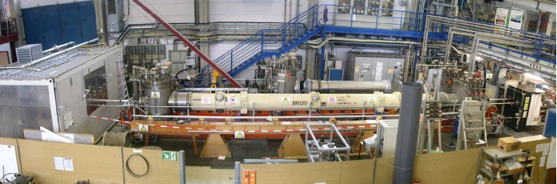
ALP Searches: LSW
Laser
Magnetic field
Optical barrier
Magnetic field
Detector
$$γ$$
$$γ$$
$$a$$
$$γ$$
$$γ$$
Lab-produced ALP search, i.e., direct probe
High intensity laser beam available
  Large signal flux expected
Accessible mass range set by the energy of the laser
[ALPS experiment]

Slide 5
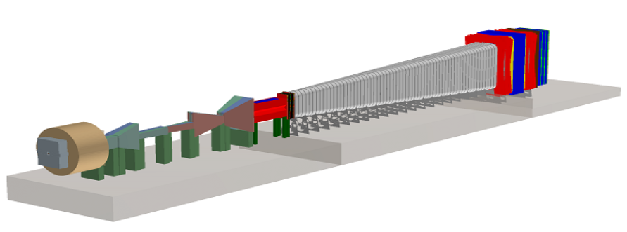




ALP Searches: Beam-Dump Experiments
Particle
Beam
Target
Detector
$$γ$$
$$γ$$
$$a$$
$$γ$$
$$N$$
$$N$$
Lab-produced ALP search, i.e., direct probe
High intensity particle beams available
  Large signal flux expected (photons from bremsstrahlung and meson decays)
Heavier ALPs are preferred, as they can decay within detector complex
[SHiP experiment]

Slide 6
Lab-Based Searches vs. Non-Lab-Based Searches
The PVLAS Collaboration (a polarization experiment and a lab-produced ALP search) claimed an anomaly [Zavattini et al., PRL 96 (2006) 110406] (which was later identified as a spurious effect of unknown systematics [Zavattini et al., PRD 77 (2008) 032006]) which would be explained by the oscillation of photons into ALPs.
The preferred values for the ALP mass and the coupling were inconsistent with the astrophysical bounds (e.g., CAST), motivating a number of theoretical speculations to make the ALPs compatible with them [E.g., Jaeckel, Masso, Redondo, Ringwald, Takahashi (2006); Ahlers, Gies, Jaeckel, Ringwald (2007); Brax, van de Bruck, Davis (2007)].
The coupling or the ALP mass can depend on a host of environmental parameters, such as the temperature, matter density, or plasma frequency, as well as the momentum transfer at the ALP-photon vertex.
Lab-based searches:
Not only complementary to astrophysical searches but also more conservative!

Slide 7
PASSAT: Main Idea
Particle
Beam
Target
Magnetic field
Detector
$$γ$$
$$γ$$
$$a$$
$$N$$
$$N$$
$$γ$$
Particle Accelerator helioScopes for Slim Axion-like-particle deTection (PASSAT): Utilizing the principle of the axion helioscope but replaces ALPs produced in the Sun with those produced in a target material.
ALP-photon conversions: Probing light (slim) ALPs that are otherwise inaccessible to laboratory-based experiments which rely on ALP decay, and complements astrophysical probes that are more model-dependent.

Slide 8
PASSAT vs CAST
Particle
Beam
Target
Magnetic field
Detector
Sun
$$γ$$
$$γ$$
$$γ$$
$$a$$
$$N$$
$$γ$$
$$N$$
$$γ$$
Sun is replaced by the target material as the source of ALPs.

Slide 9
PASSAT vs Beam-Dump Exp.
Particle
Beam
Target
Magnetic field
Detector
$$γ$$
$$γ$$
$$γ$$
$$a$$
$$γ$$
$$N$$
$$N$$
$$γ$$
ALP decay process is replaced by the ALP conversion process.

Slide 10
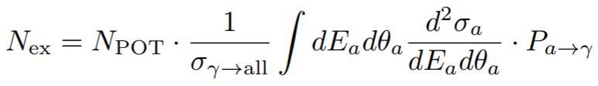
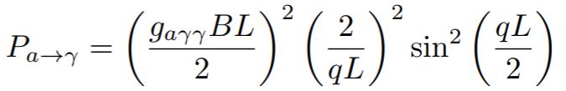
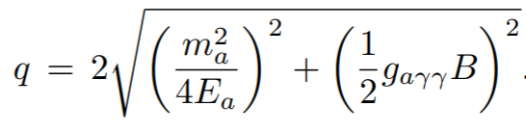
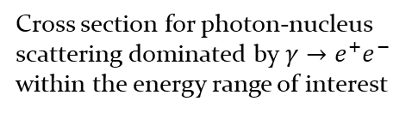
Calculating Signal Rates
Number of protons
Total cross section of the Primakoff process weighted by the photon number density profile per proton
Cross section for photon-nucleus scattering dominated by $γ→e^{+}e^{−}$ within the energy range of interest
Probability of ALP-to-photon conversion
with
Form factor reflecting the coherence of the conversion

Slide 11
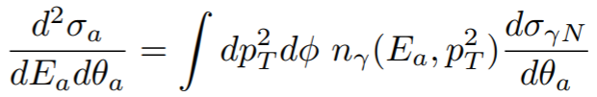


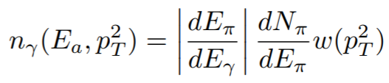

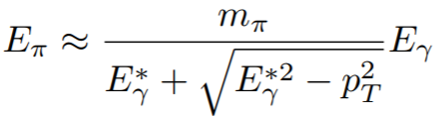
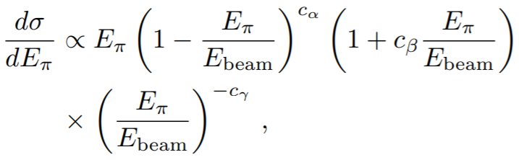
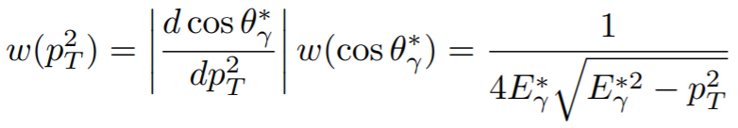

Calculating Signal Rates: Primakoff Process
Differential cross section of the Primakoff process
In the massless ALP limit,
with
Photon number density profile
Meson (e.g., $π^{0}$) decays are the dominant source of the photons.
BMPT model [Bonesini, Marchionni, Pietropaolo, Tabarelli (2001)] for our initial estimate

Slide 12


Application: NOMAD
Horn
(for beam focusing)
NOMAD detector
($B=0.4$T)
Target
(Beryllium)
p-beam (450 GeV)
$$γ$$
$$γ$$
Shield
$$γ$$
$$γ$$
835 m
7.5 m
Original ALP search in NOMAD: Similar to the idea of LSW, but the laser is replaced by the target material
Selecting events with energy between 5 and 140 GeV

Slide 13

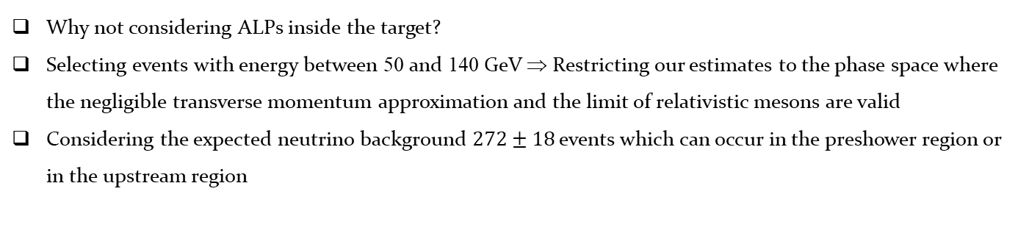
Application: NOMAD
Horn
(for beam focusing)
NOMAD detector
($B=0.4$T)
Target
(Beryllium)
p-beam (450 GeV)
$$γ$$
$$γ$$
Shield
$$N$$
$$N$$
$$γ$$
835 m
7.5 m
Why not considering ALPs inside the target?
Selecting events with energy between 50 and 140 GeV ⇒ Restricting our estimates to the phase space where the negligible transverse momentum approximation and the limit of relativistic mesons are valid
Considering the expected neutrino background $272±18$ events which can occur in the preshower region or in the upstream region

Slide 14
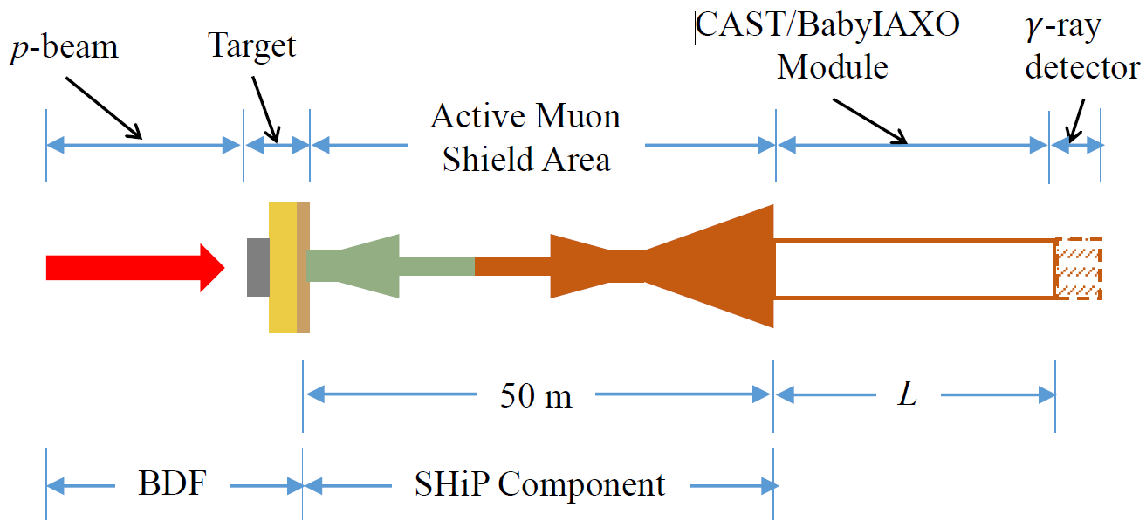

Application: BDF/SHiP+CAST/BabyIAXO
Recycling the magnets from CAST or BabyIAXO experiments, after they are decommissioned, and locating them at the BDF complex (400 GeV proton beam), possibly after its first use with the SHiP experiment. ⇒ Possibly low-cost experiments!

Slide 15

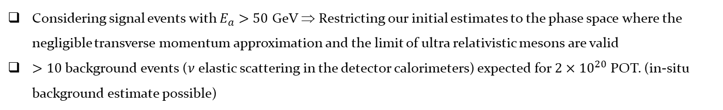
Application: BDF/SHiP+CAST/BabyIAXO
$$γ$$
$$γ$$
$$N$$
$$N$$
$$γ$$
Considering signal events with $E_{a}>50$ GeV ⇒ Restricting our initial estimates to the phase space where the negligible transverse momentum approximation and the limit of ultra relativistic mesons are valid
$>10$background events ($ν$ elastic scattering in the detector calorimeters) expected for $2×{10}^{20}$ POT. (in-situ background estimate possible)

Slide 16
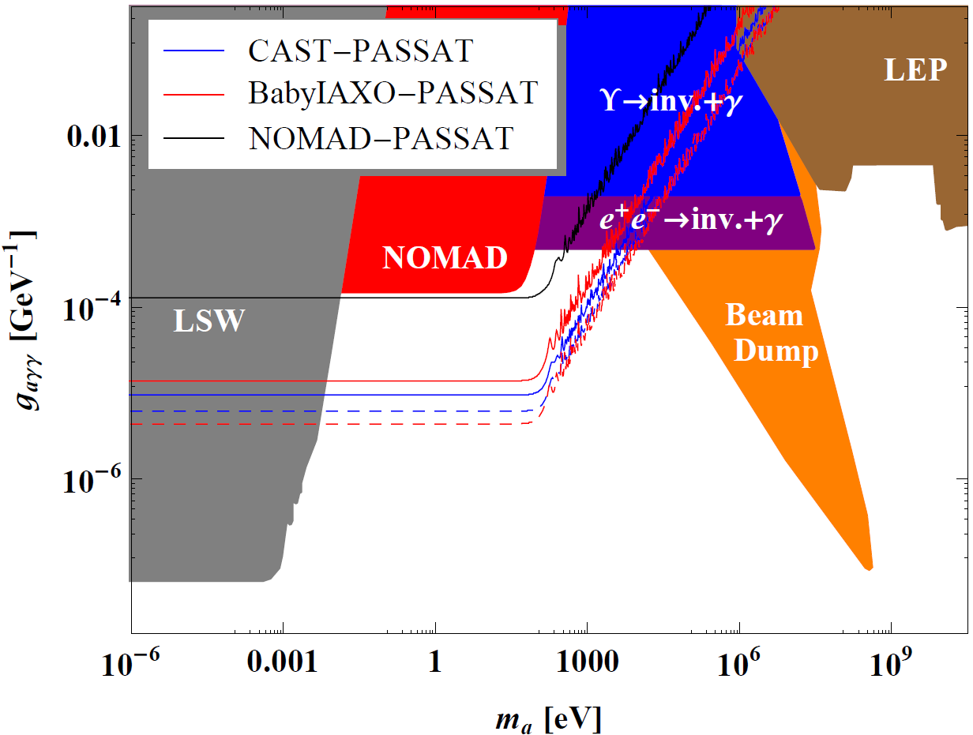
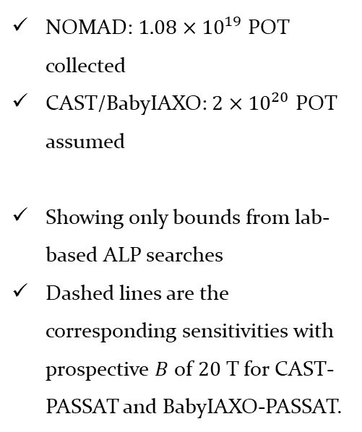
Expected Experimental Sensitivities
NOMAD: $1.08×{10}^{19}$ POT collected
CAST/BabyIAXO: $2×{10}^{20}$ POT assumed
Showing only bounds from lab-based ALP searches
Dashed lines are the corresponding sensitivities with prospective $B$ of $20$T for CAST-PASSAT and BabyIAXO-PASSAT.

Slide 17
Conclusions
We have proposed a novel method to search for ALPs at particle accelerator experiments.
The results suggest that PASSAT should probe a wide range of parameter space that none of the lab-produced ALP search experiments have ever explored.
The expected experimental sensitivity covers regions explored by the CAST helioscope experiment, providing a conservative and complementary probe.
The experimental sensitivity also extends into regions that are currently solely constrained by astrophysical observations (e.g., HB stars).
A more dedicated study with detector effects included (by GEANT and Fluka) is being prepared. Please stay tuned!

