Slide 1

Minimal Realizations of Dirac Neutrino Mass from Generic One-loop and Two-loop Topologies
VISHNU PADMANABHAN KOVILAKAM
OKLAHOMA STATE UNIVERSITY
Based on: arxiv: 1904.07407 (accepted for publication in EPJC), arxiv: 1910.xxxx
(In Collaboration with Sudip Jana and Shaikh Saad)
Particle Physics on the Plains​,
University of Kansas
13th Oct, 2019

Slide 2
Outline
Motivation
Minimal Dirac Neutrino Mass Models: One-loop Topology
Minimal Dirac Neutrino Mass Models: Two-loop Topology
Phenomenology of Specific Models
Neutrino Mass Models
Summary

Slide 3
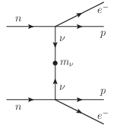
Neutrino Mass and Nature of Neutrinos
Neutrino Oscillation data suggests that neutrinos have tiny masses
→ Physics Beyond SM.
Neutrinos can be either Dirac type or Majorana type in nature.
Can be resolved by neutrinoless double beta decay.
Origin of neutrino mass is still unknown
No Conclusive Evidence

Slide 4


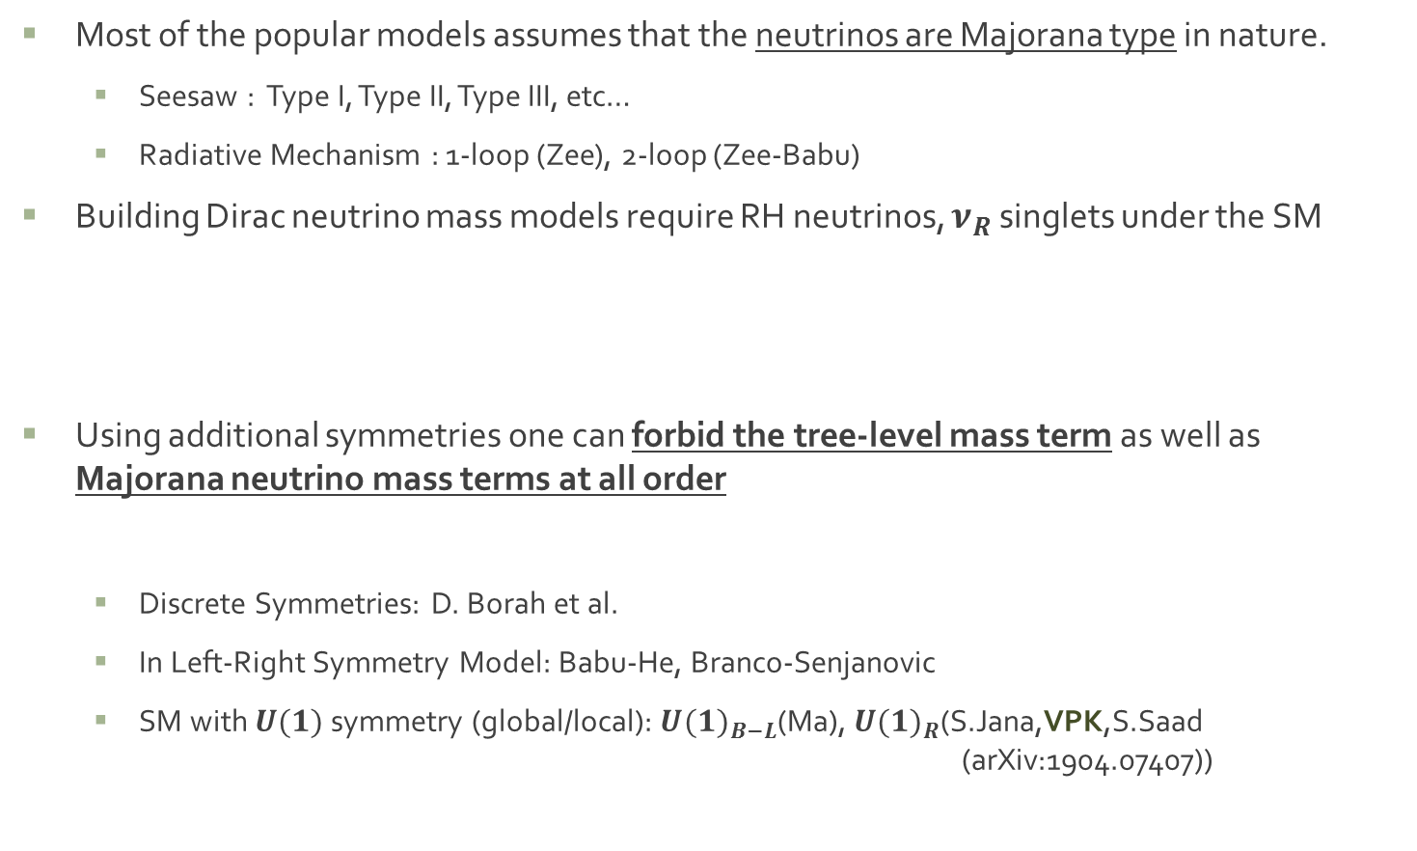
Neutrino Mass Models
Most of the popular models assumes that the neutrinos are Majorana type in nature.
  Seesaw : Type I, Type II, Type III, etc…
  Radiative Mechanism : 1-loop (Zee), 2-loop (Zee-Babu)
Building Dirac neutrino mass models require RH neutrinos, $ν_{R}$ singlets under the SM
Using additional symmetries one can forbid the tree-level mass term as well as Majorana neutrino mass terms at all order
  Discrete Symmetries: D. Borah et al.
  In Left-Right Symmetry Model: Babu-He, Branco-Senjanovic
  SM with $U(1)$ symmetry (global/local): ${U(1)}_{B−L}$(Ma), ${U(1)}_{R}$(S.Jana,VPK,S.Saad (arXiv:1904.07407))

Slide 5
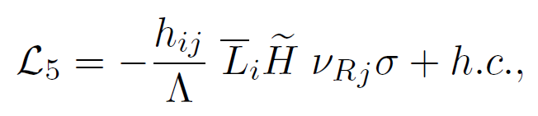
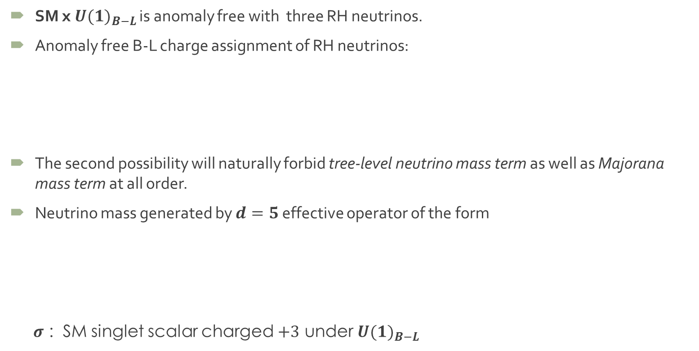

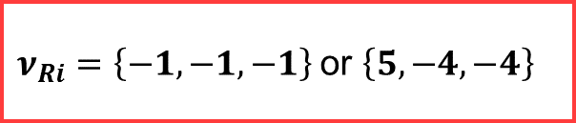
Dirac Neutrino Mass: SM x ${U(1)}_{B−L}$
SM x ${U(1)}_{B−L}$ is anomaly free with three RH neutrinos.
Anomaly free B-L charge assignment of RH neutrinos:
The second possibility will naturally forbid tree-level neutrino mass term as well as Majorana mass term at all order.
Neutrino mass generated by $d=5$ effective operator of the form
$σ$ : SM singlet scalar charged $+3$ under ${U(1)}_{B−L}$
$ν_{Ri}=\left\{−1,−1,−1\right\}$or $\left\{5,−4,−4\right\}$

Slide 6
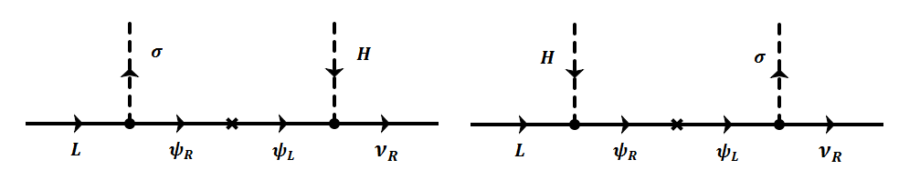

Dirac Neutrino Mass: SM x ${U(1)}_{B−L}$
Dirac Neutrino Mass via Seesaw mechanism
With $ψ_{L/R}=\left(1,1,0,−1\right)$ or $\left(1,2,−1/2,−4\right)$
Interested in NP at TeV Scale
Radiative Models

Slide 7


Dirac Neutrino Mass: SM x ${U(1)}_{B−L}$
Systematically search for the minimal Dirac neutrino mass models arise from this $d=5$ effective operator.
Strategy: Construct the generic one-loop and two-loop topologies and then build the associated minimal models .
Minimality refers to
Models with minimum number of BSM states are preferable.
${SU(2)}_{L}$ singlet BSM states are preferred. If BSM particles are required not to be iso-singlet, then we minimize the number of states that are charged under ${SU(2)}_{L}$.
If possible, introduction of any BSM fermion is prohibited. If the presence of BSM fermionic state is required, we assume it to be vector like under SM x ${U(1)}_{B−L}$.
BSM states with lowest dimensional representation under ${SU(2)}_{L}$ are preferred.

Slide 8
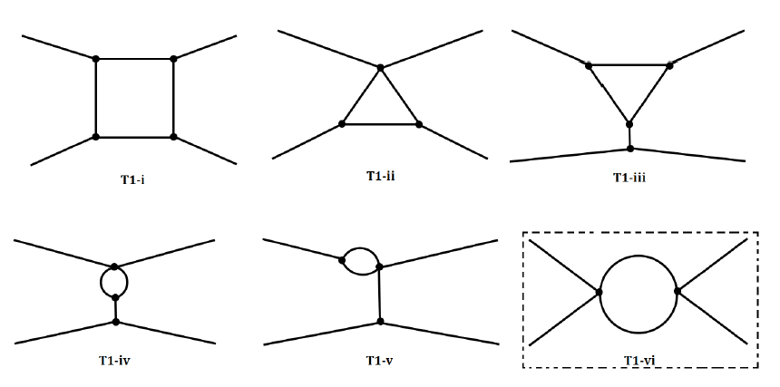
One-loop topologies: Viable topologies
All possible one-loop topologies with four external legs
Not all these topologies can be lead to successful one-loop neutrino mass in our framework
F.Bonnet, M.Hirsch, T. Ota, W. Winter JHEP 1207 (2012)153

Slide 9
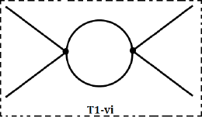
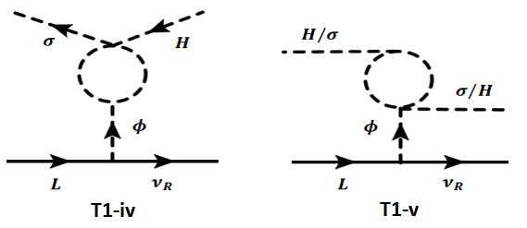
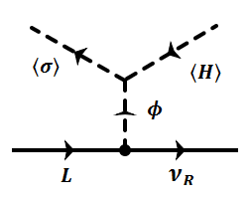

One-loop topologies: Viable topologies
$T1−vi$corresponds to non-renormalizable topologies
$T1−iv /v$ can’t give viable one loop models in our framework.
$T1−iii$ can’t give viable one loop models in our framework.

Slide 10
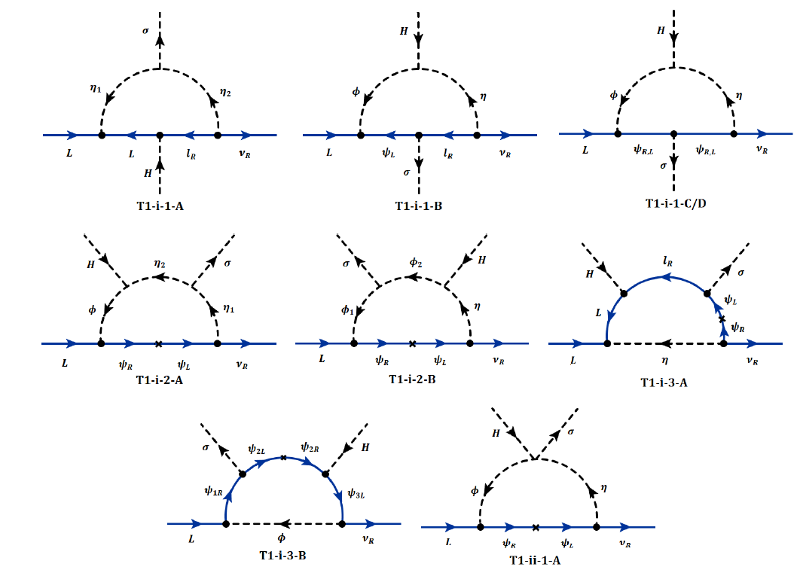

Minimal One-loop models
Constructing minimal models arising from $T1−i,ii$
  S.Jana,VPK,S.Saad (arXiv:1910.xxxx)

Slide 11
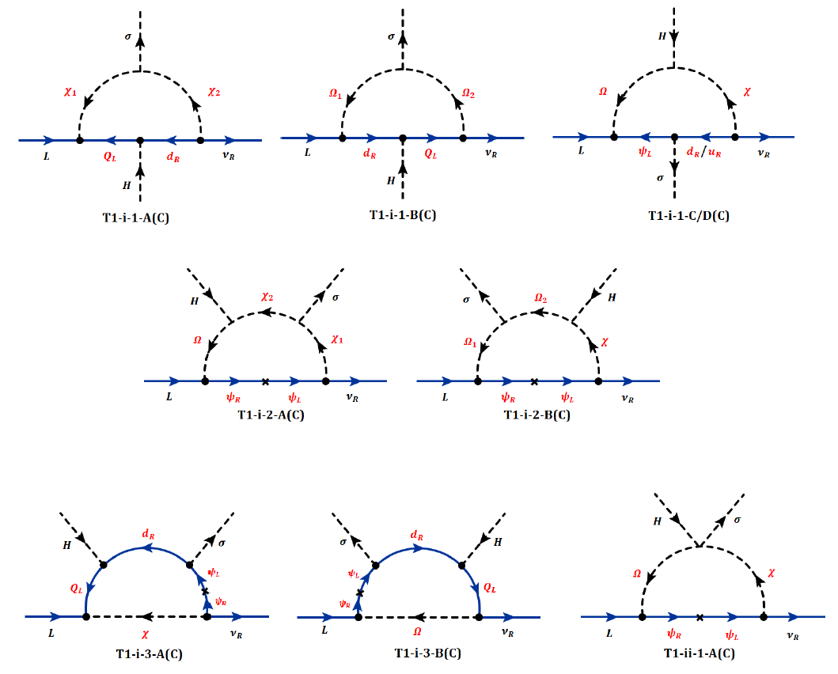
Minimal One-loop models – Colored version
Corresponding minimal models for the colored version
  S.Jana,VPK,S.Saad (arXiv:1910.xxxx)

Slide 12
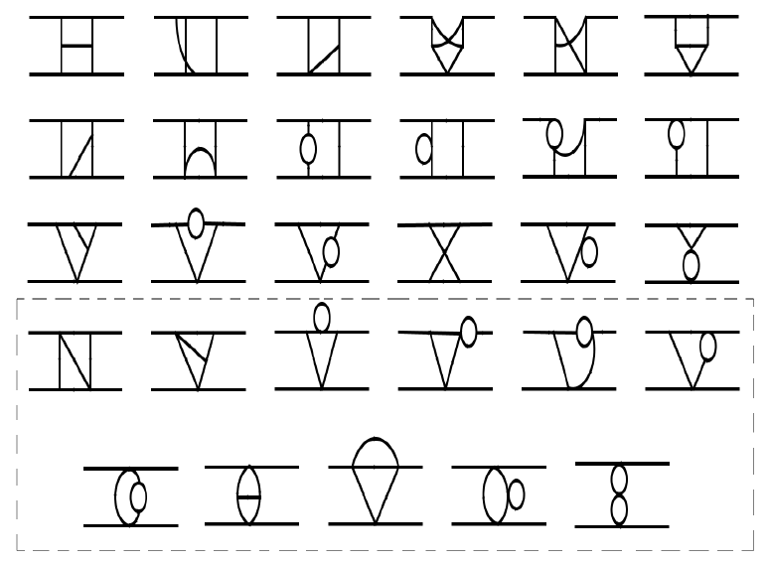
Two-loop topologies
All possible two-loop topologies with four external legs
Not all the topologies can be lead to successful two-loop neutrino mass in our framework. For example, last 11 topologies corresponds to non-renormalizable topologies
D.A.Sierra,A.Degree,L.Dorame,M.Hirsch JHEP 1503 (2015) 040

Slide 13
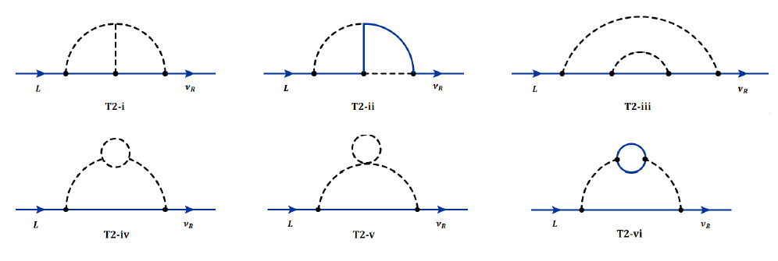
Two-loop Skeleton Diagrams
Remaining 18 topologies can give vast number of diagrams.
By suppressing the external scalar legs, all these diagrams can be reduced into six basic diagrams → Skeleton diagrams
Constructing minimal models arising from each of the skeleton diagrams.
D.A.Sierra,A.Degree,L.Dorame,M.Hirsch,JHEP 1503 (2015) 040

Slide 14
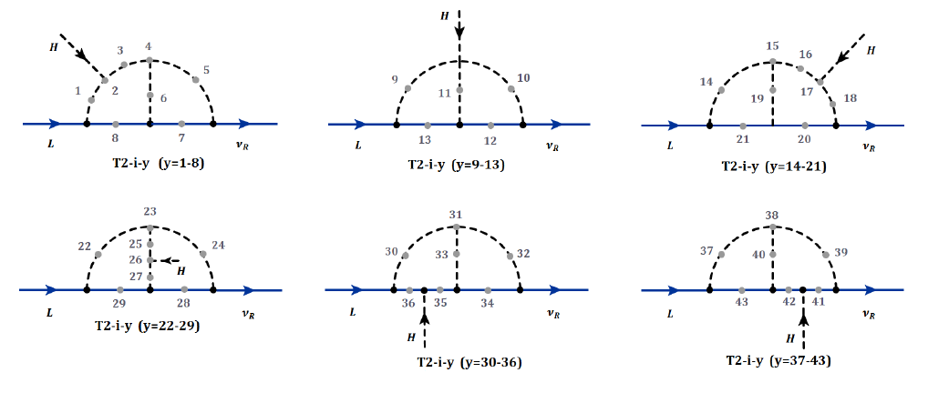

Search for Minimal Two-loop Models
All possible diagrams emerging from $T2−i$
Discarding 22 viable diagrams, $T2−i−y$, $y =\{7−8,12−13,20−21,28−29,$ $34− 36,41−43\}$
Required introduction of BSM fermions

Slide 15

Search for Minimal Two-loop Models
Fixing internal fermion lines to be $l_{R}$,
excluding all diagrams other than $T2−i−y$, $y=\{2−6,10−11\}$, required more than one isodoublet
Among these 7 diagrams selecting diagrams with minimal number of BSM scalars.

Slide 16
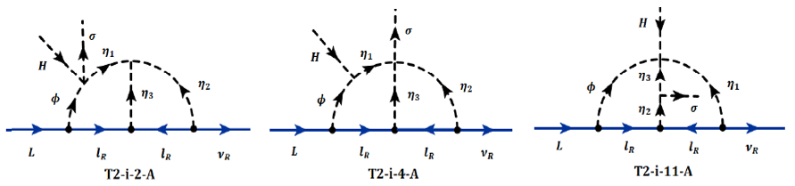
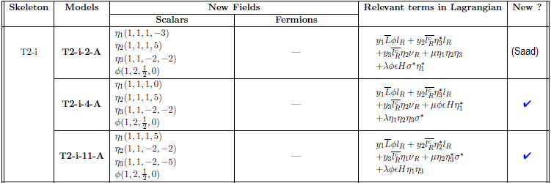
Minimal Two-loop Models
  S.Jana,VPK,S.Saad (arXiv:1910.xxxx)

Slide 17
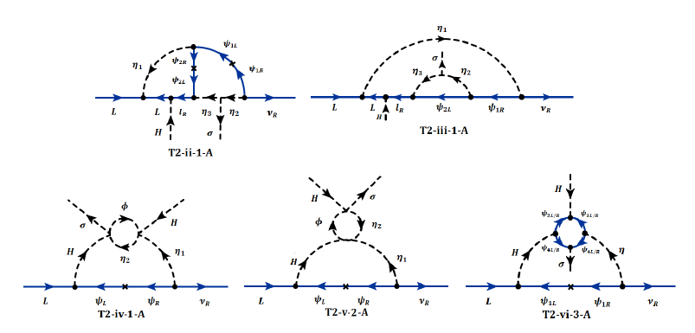

Minimal Two-loop Models
Repeating similar strategy for $T2−ii to vi$

Slide 18
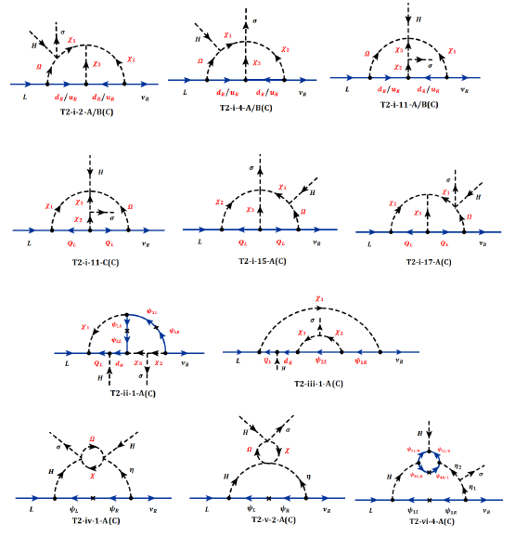
Minimal Two-loop models – Colored version
Corresponding minimal models for the colored version

Slide 19
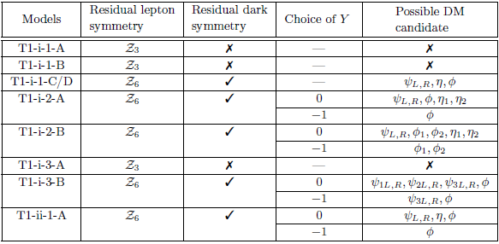
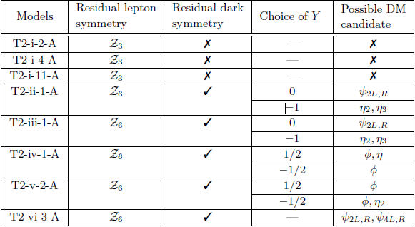

Possible DM Candidates
Spontaneously broken ${U(1)}_{B−L}$ symmetry, may leave a residual unbroken symmetry that can potentially stabilize the DM particle.
One-Loop Models
Two-Loop Models
  S.Jana,VPK,S.Saad (arXiv:1910.xxxx)

Slide 20
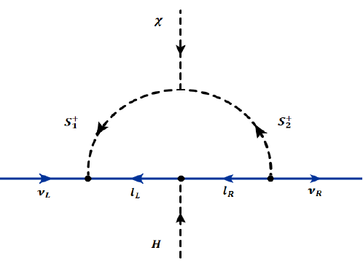
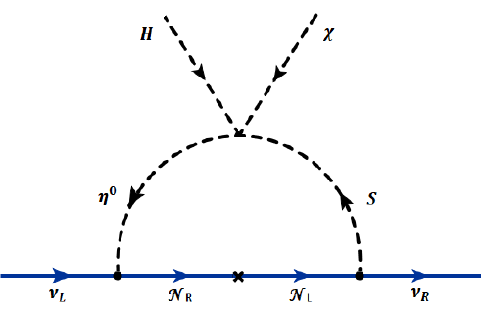
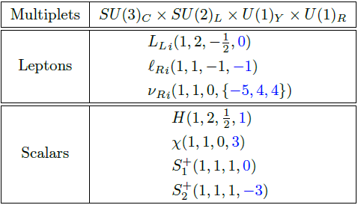
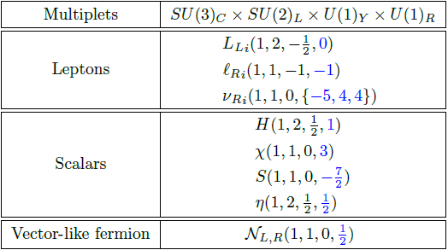
Phenomenology of Specific Models
  S.Jana,VPK,S.Saad (arXiv:1904.07407)

Slide 21
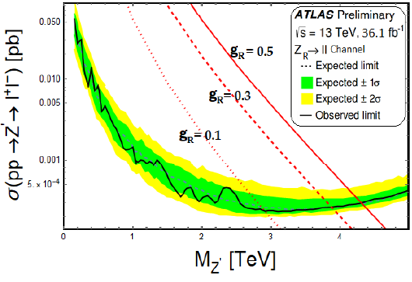
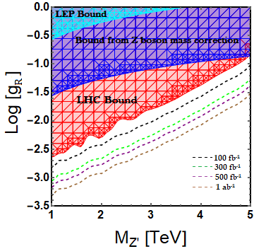
Constraints from LEP and LHC

Slide 22

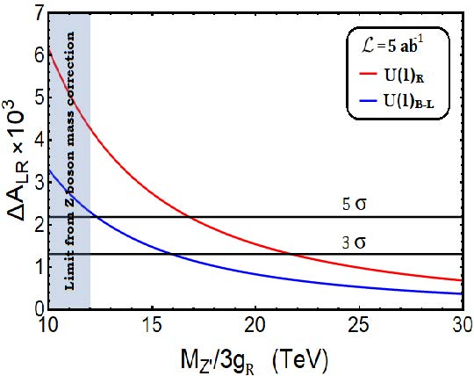
Heavy Gauge Boson Z’ at ILC : Left-Right Asymmetry
Analysis with the polarized initial states at ILC can be used to understand the chirality structure of the effective interaction

Slide 23
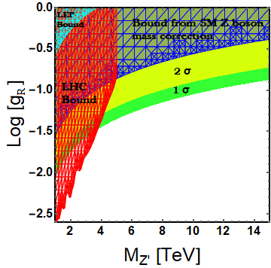
Phenomenology of Z’
  S.Jana,VPK,S.Saad (arXiv:1904.07407)

Slide 24
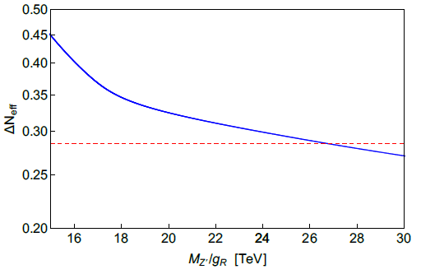

Constraints from Cosmology
The Right-handed neutrino $ν_{R}$ can increase the effective number of relativistic degree of freedom $N_{eff}$.
To be compatible with the current cosmological constraints on $N_{eff}$, the interaction of $ν_{R}$ with the primordial plasma must be highly suppressed.

Slide 25
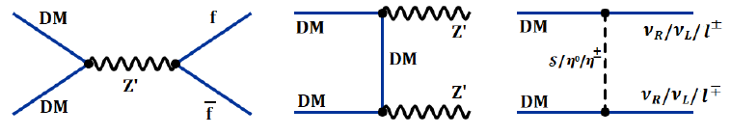
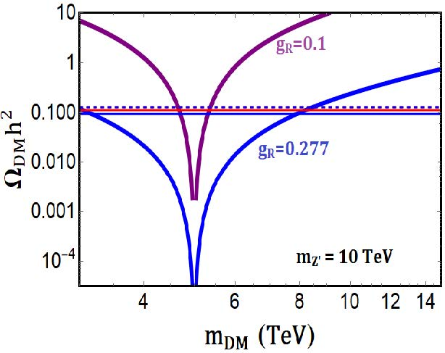
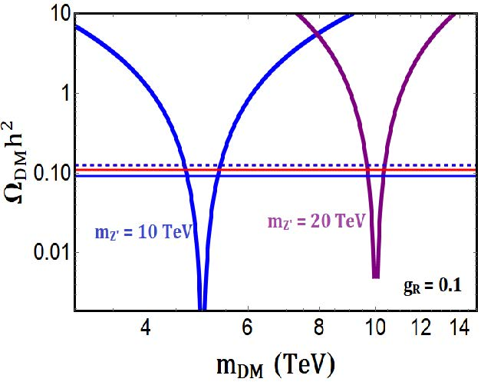

Dark Matter Phenomenology
Spontaneously broken ${U(1)}_{R}$ symmetry, leave a $Z_{2}$ residual symmetry that can potentially stabilize the DM particle (considering for the case of vector-like fermion).

Slide 26
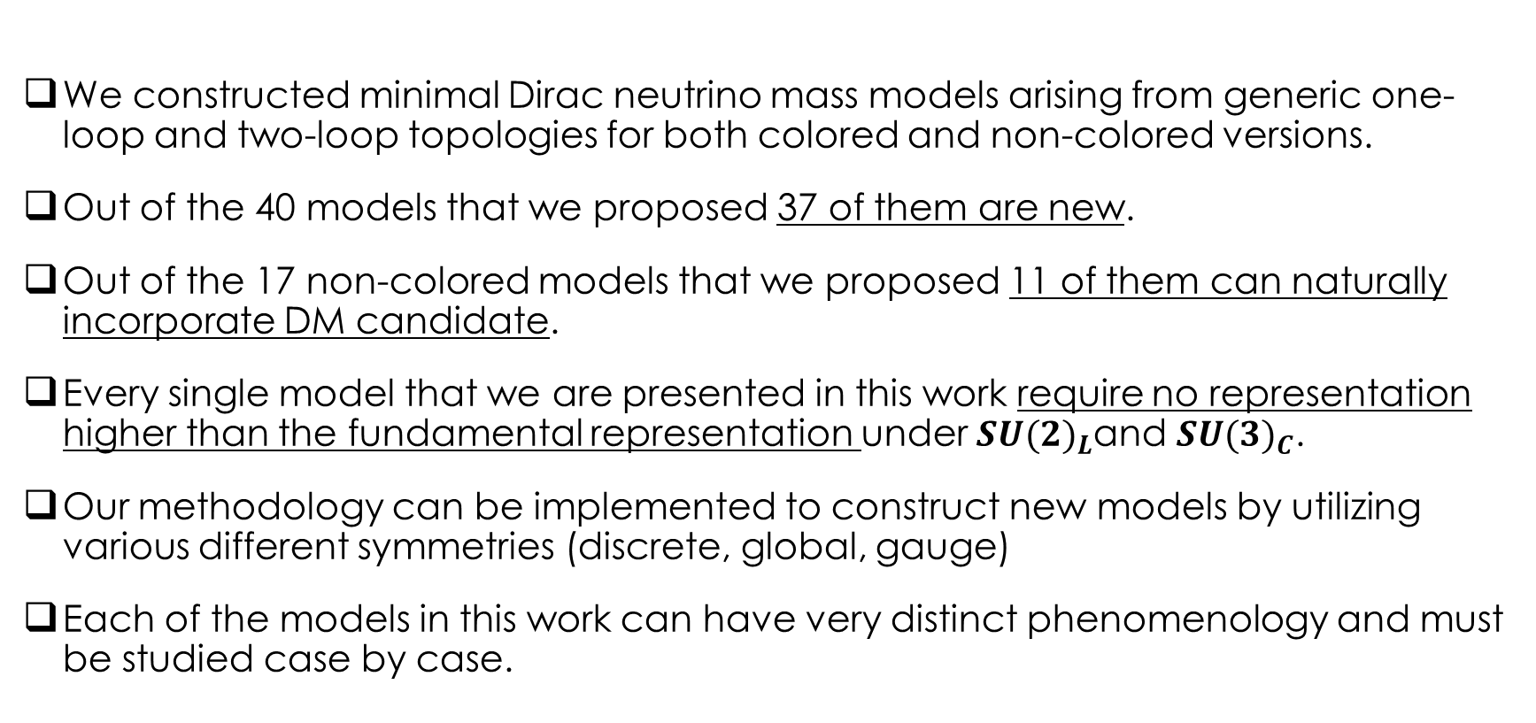
Summary
We constructed minimal Dirac neutrino mass models arising from generic one-loop and two-loop topologies for both colored and non-colored versions.
Out of the 40 models that we proposed 37 of them are new.
Out of the 17 non-colored models that we proposed 11 of them can naturally incorporate DM candidate.
Every single model that we are presented in this work require no representation higher than the fundamental representation under ${SU(2)}_{L}$and ${SU(3)}_{C}$.
Our methodology can be implemented to construct new models by utilizing various different symmetries (discrete, global, gauge)
Each of the models in this work can have very distinct phenomenology and must be studied case by case.

Slide 27


Slide 28
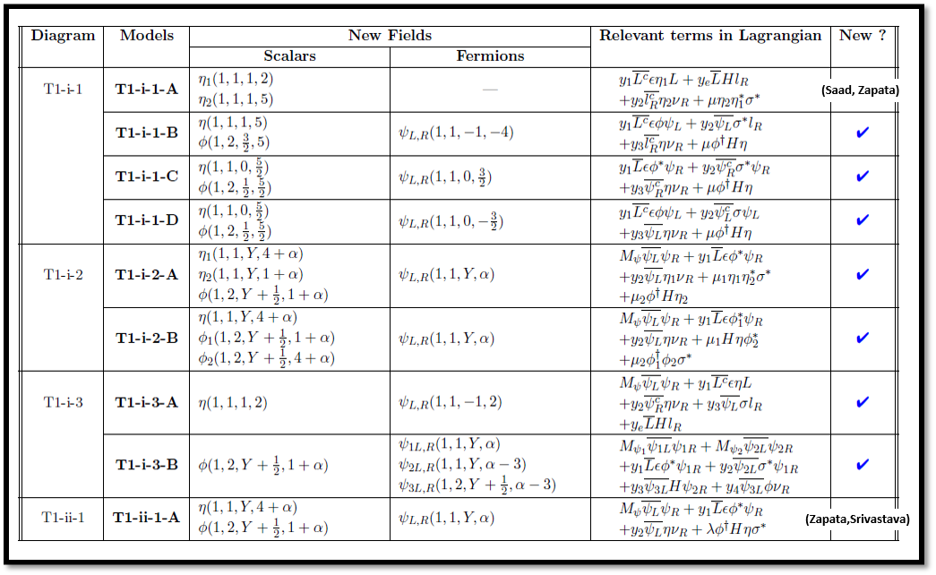
One-loop Models

Slide 29
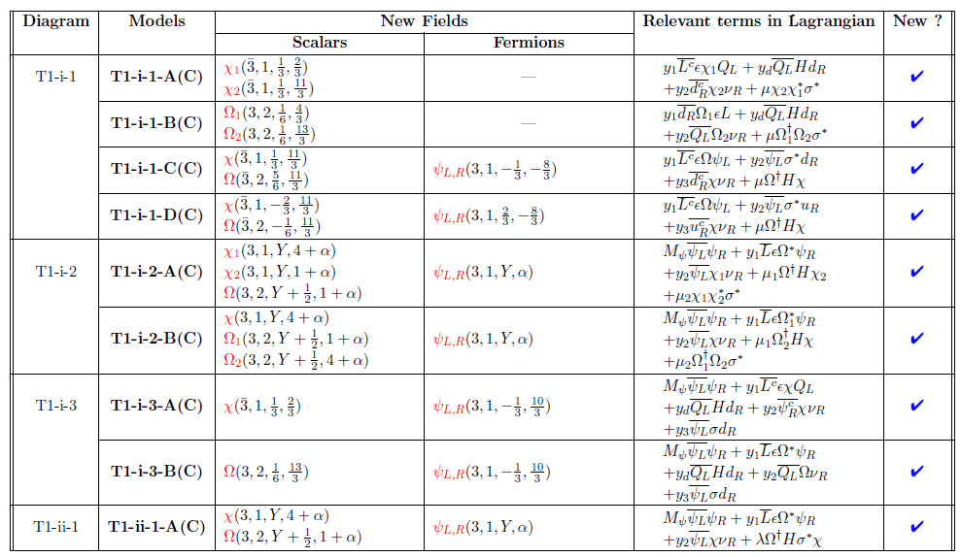
One-loop Models: Colored version

Slide 30
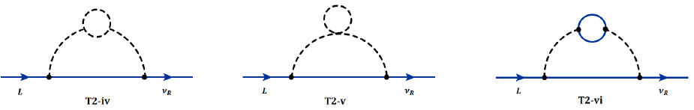
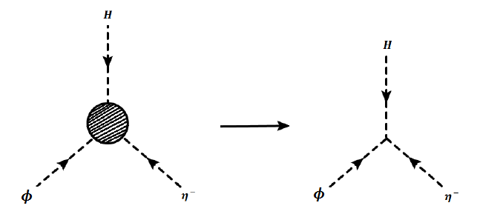
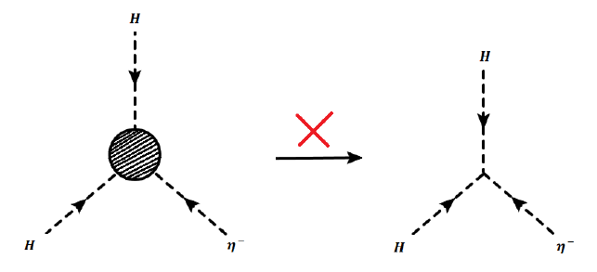
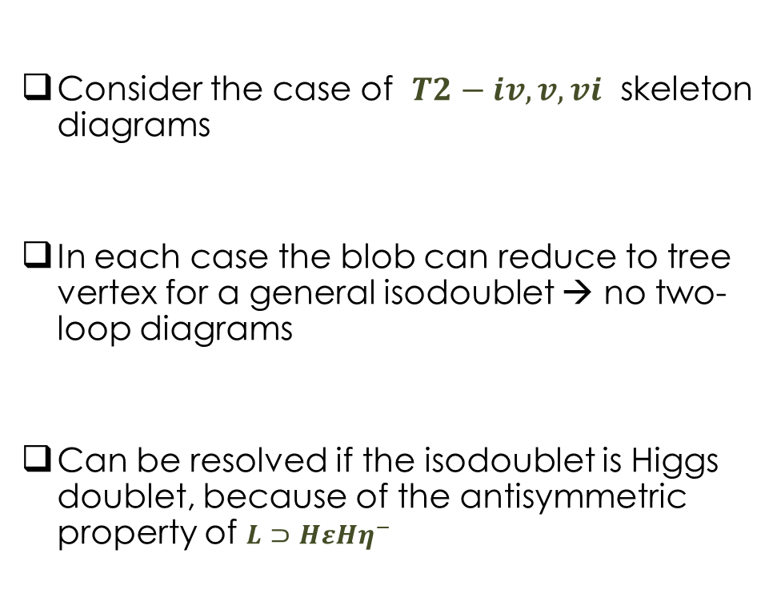
Search for Minimal Two-loop Models
Consider the case of $T2−iv,v,vi$ skeleton diagrams
In each case the blob can reduce to tree vertex for a general isodoublet → no two-loop diagrams
Can be resolved if the isodoublet is Higgs doublet, because of the antisymmetric property of $L⊃HεHη^{−}$
R.Cepedello, R.M. Fonseca,M.Hirsch JHEP 1906 (2019) 034

Slide 31

Two-loop Models

Slide 32

Two-loop Models: Colored version

