Slide 1
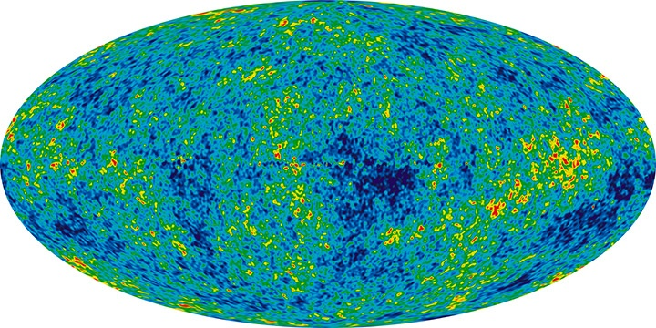
Dark Energy Constraints from Expansion Rate and Density Fluctuation Data
Joseph Ryan, Sanket Doshi, and Bharat Ratra
Monthly Notices of the Royal Astronomical Society, Volume 480, Issue 1, 11 October 2018 (arXiv:1805.06408)
Notes:
1

Slide 2
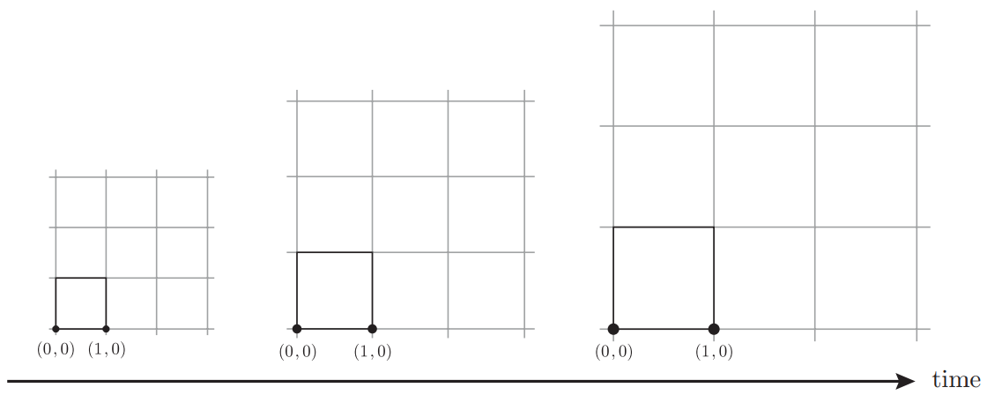
The Expanding Universe (1/2)
The universe is expanding.
Source: Cosmology, Daniel Baumann
Notes:
2

Slide 3

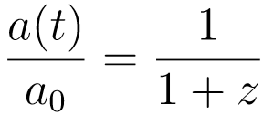
The Expanding Universe (2/2)
Physical distance x_{p} changes with time:
a(t) is the scale factor:
Notes:
3

Slide 4
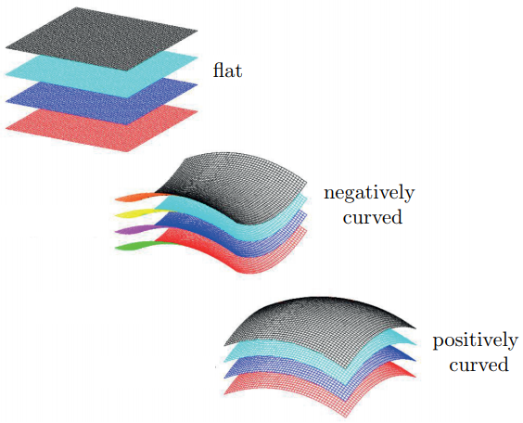
The Curved Universe
k = 0
k = -1
k = +1
Source: Cosmology, Daniel Baumann
Notes:
4

Slide 5
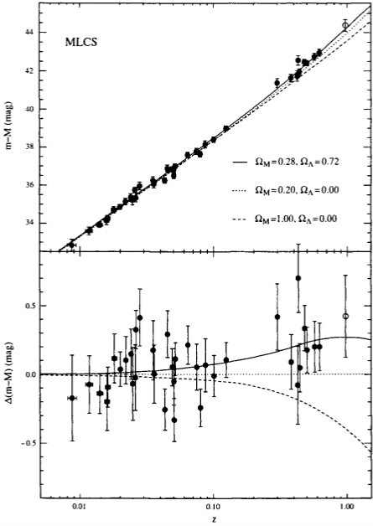
The Accelerating Universe
This expansion is accelerating today.
Why?
Source: Modern Cosmology, Scott Dodelson
Notes:
5

Slide 6
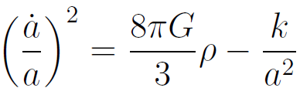
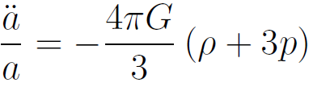
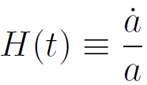

The Friedmann equations
The scale factor evolves by
;
Where
                ;
Notes:
6

Slide 7
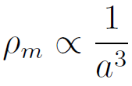
The Second Friedmann Equation
Matter has p = 0; acceleration requires an extra energy density with p < -ρ/3.
Notes:
7

Slide 8
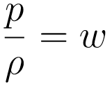
Three Dark Energy Models (1/2)
ΛCDM (constant; has w = -1)
XCDM (time-evolving; has w ≠ -1)
φCDM (time-evolving scalar field with w = w(t))
Define:
Notes:
8

Slide 9
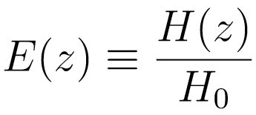
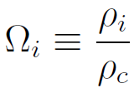
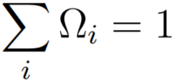
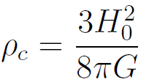
Three Dark Energy Models (2/4)
Define
and
such that
where
Notes:
9

Slide 10

Three Dark Energy Models (3/4)
The expansion factor becomes
or
Recall
                and
Notes:
10

Slide 11

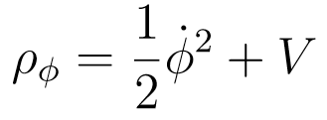

φCDM (1/2)
Assume a homogeneous scalar field
with energy density
and potential
Notes:
11

Slide 12
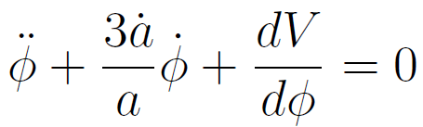
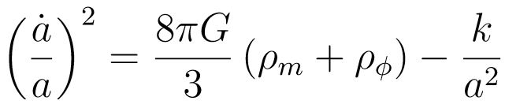
φCDM (2/2)
The field evolves by
and the scale factor evolves by
Notes:
12

Slide 13
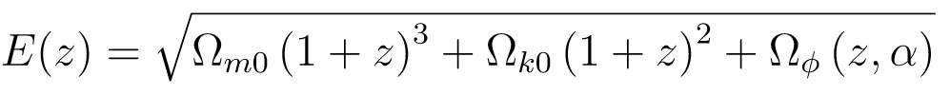
Three Dark Energy Models (2/2)
ΛCDM:
XCDM:
φCDM:
Notes:
13

Slide 14
Data
We collected 42 data points in total.
31 H(z) measurements from refs. [4] and [5]
11 BAO measurements from refs. [6]-[11]
4.) Omer Farooq et al., “Hubble Parameter measurement constraints on the redshift of the deceleration-acceleration transition, dynamical dark energy, and space curvature", 15 November 2016. arXiv:1607.03537v2.
8.) Metin Ata et al., “The clustering of the SDSS-IV extended Baryon Oscillation Spectroscopic Survey DR14 quasar sample: First measurement of Baryon Acoustic Oscillations between redshift 0.8 and 2.2", 21 May 2017.
5.) A.L. Ratsimbazafy et al., “Age-dating luminous red galaxies observed with the Southern African Large Telescope”, MNRAS, 467 (3), 1 June 2017.
9.) Julian E. Bautista et al., “Measurement of BAO correlations at z = 2.3 with SDSS DR12 Lyα-Forests", 27 March 2017. arXiv:1702.00176v2.
6.) Shadab Alam et al., “The clustering of galaxies in the completed SDSS-III Baryon Oscillation Spectroscopic Survey: cosmological analysis of the DR12 galaxy sample", 11 July 2016. arXiv: 1607.03155v1.
10.) Florian Beutler, et al., “The 6dF Galaxy Survey: Baryon Acoustic Oscillations and the Local Hubble Constant", 16 June 2011. arXiv:1106.3366v1.
7.) Ashley J. Ross et al., “The Clustering of the SDSS DR7 Main Galaxy Sample I: A 4 per cent Distance Measure at z = 0.15", 21 January 2015. arXiv:1409.3242v2.
11.) Andreu Font-Ribera, et al., “Quasar-Lyman α Forest Cross-Correlation from BOSS DR11: Baryon Acoustic Oscillations”, 20 May 2014. arXiv:1311.1767v2.
Notes:
14

Slide 15
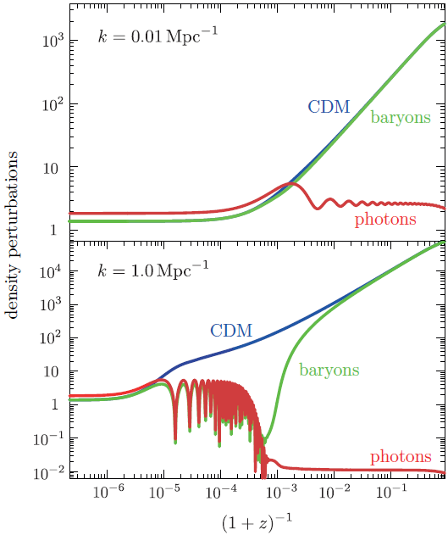
BAO (theory)
Acoustic oscillations in coupled photon-baryon fluid
Apparent in CMB and matter distribution
Source: Advanced Cosmology, Daniel Baumann
Notes:
15

Slide 16
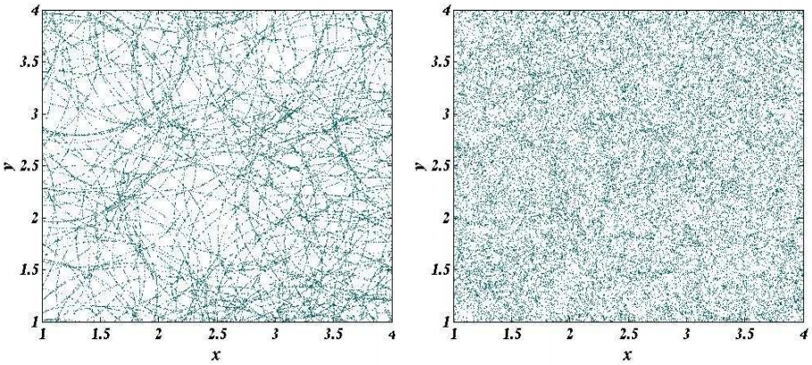
BAO in galaxy distribution (schematic)
Source: “Baryon Acoustic Oscillations”, arXiv: 0910.5224v1
Notes:
16

Slide 17
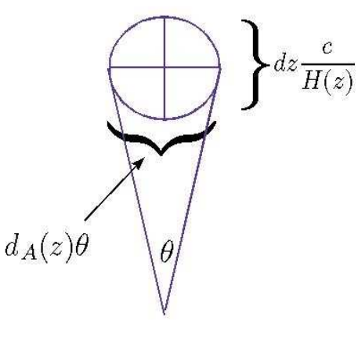
Distances from BAO
Can use D_{A} and 1/H(z) to calculate other distances: D_{M}, D_{V}, D_{H}
Source: “Baryon Acoustic Oscillations”, arXiv: 0910.5224v1
Notes:
17

Slide 18
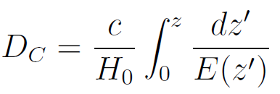
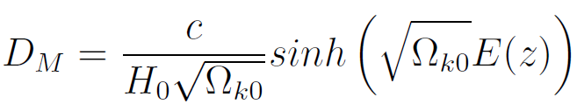
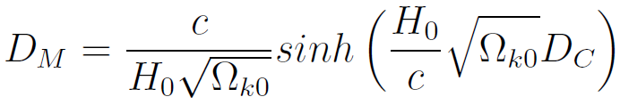
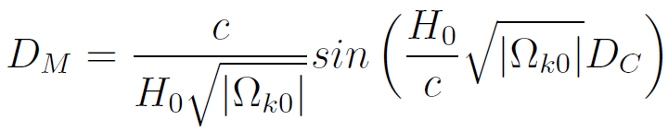

Distances from BAO
Ω_{k0} > 0:
Ω_{k0} < 0:
Ω_{k0} = 0:
Notes:
18

Slide 19
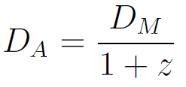
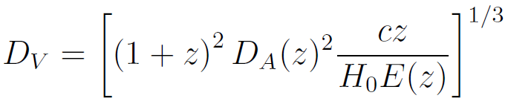
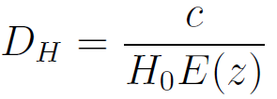
Distances from BAO
Notes:
19

Slide 20
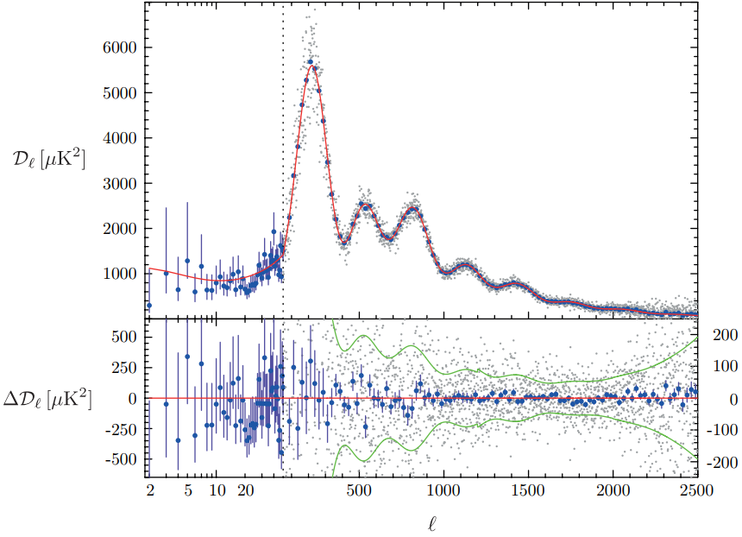
BAO (CMB power spectrum)
Source: Cosmology, Daniel Baumann
Notes:
20

Slide 21
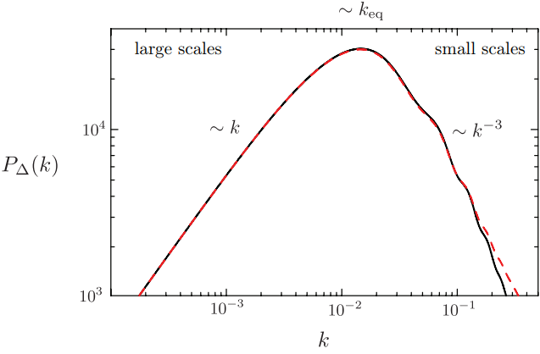
BAO (matter power spectrum)
Source: Cosmology, Daniel Baumann
Notes:
21

Slide 22
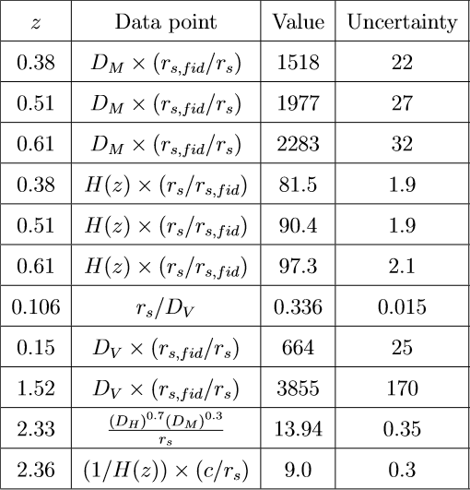
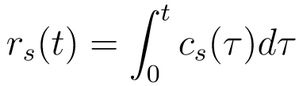
BAO (data)
r_{s} = sound horizon distance
r_{s,fid} = fiducial sound horizon distance
Notes:
22

Slide 23
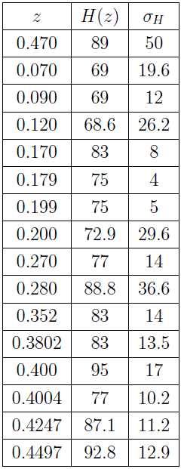
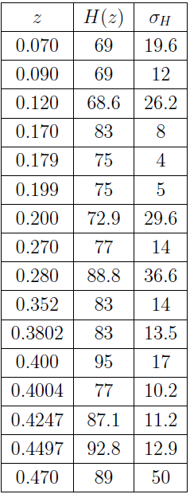
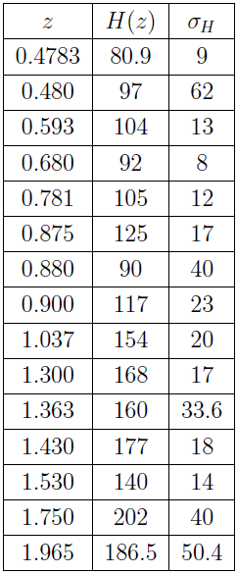

H(z)
Recall:
E(z) can be calculated; H₀ is marginalized
Notes:
23

Slide 24
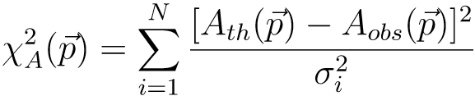
Data Analysis (preliminaries, 1/2)
χ²
  Uncorrelated:
  Correlated:
Notes:
24

Slide 25


Data Analysis (preliminaries, 2/2)
Likelihood function:
Marginalized likelihood:
Notes:
25

Slide 26
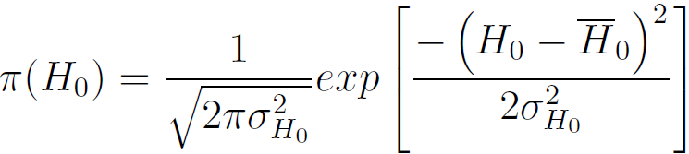
Data Analysis (priors)
Gaussian prior assumed for H₀.
  Two cases (from ref. [4]):
    H₀ = 68 +/- 2.8 km/s/Mpc (1 pc = 3.26 ly)
    H₀ = 73.24 +/- 1.74 km/s/Mpc
For all other parameters, flat prior assumed.
Notes:
26

Slide 27
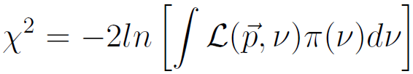


Data Analysis (Best Fit)
Record parameters p_{i} that minimize:
these are the best fit parameters.
If two models have different numbers of parameters and/or data points, use
;
k = # of parameters, N = # of data points.
Notes:
27

Slide 28
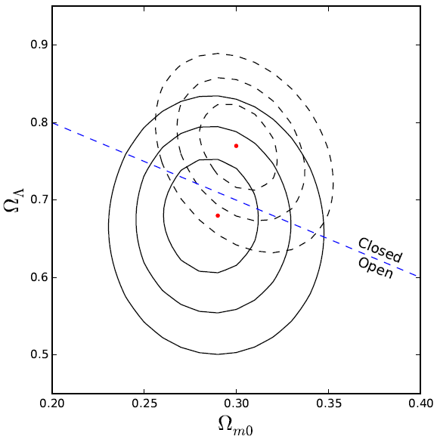
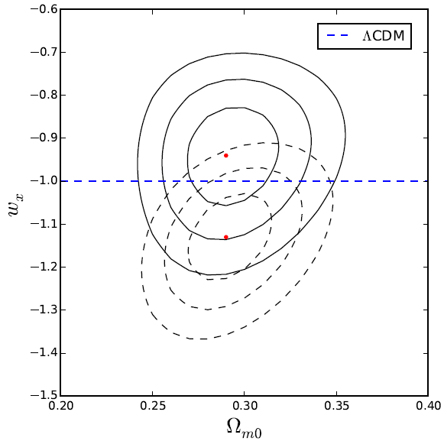
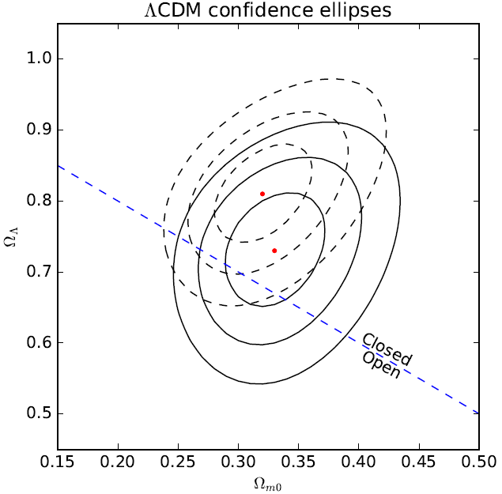
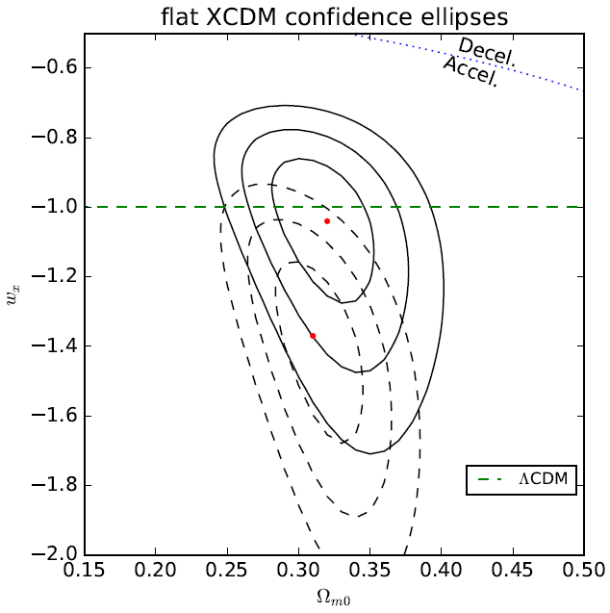
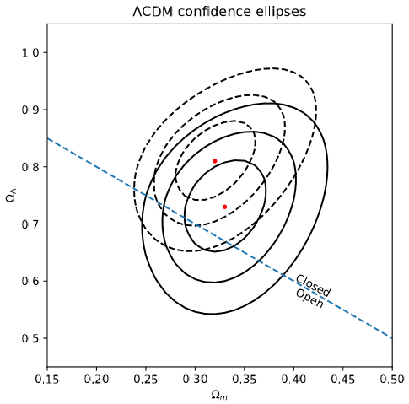
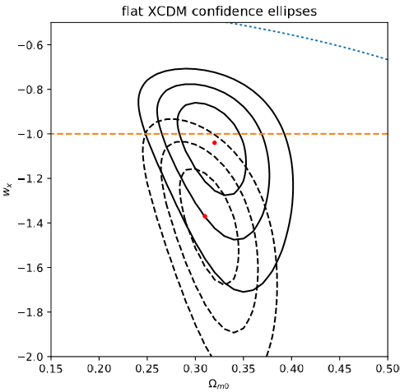
Two-parameter Models (1/2)
Solid black: H₀ = 68 km/s/Mpc; Dashed black: H₀ = 73.24 km/s/Mpc
Notes:
28

Slide 29
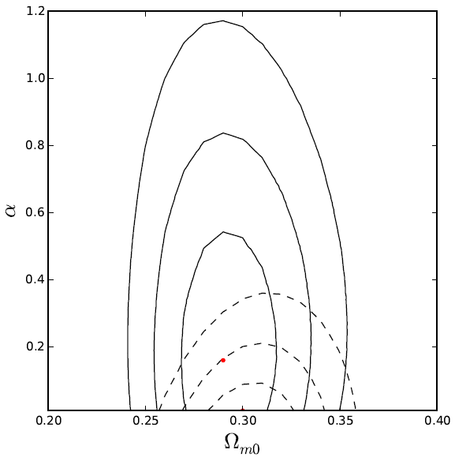
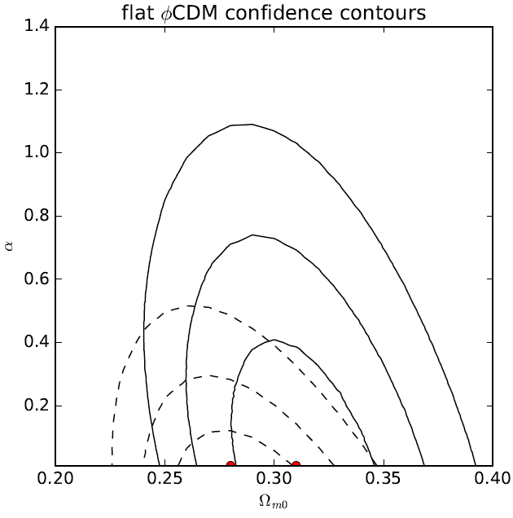
Two-parameter models (2/2)
Solid black: H₀ = 68 km/s/Mpc; Dashed black: H₀ = 73.24 km/s/Mpc
Notes:
29

Slide 30
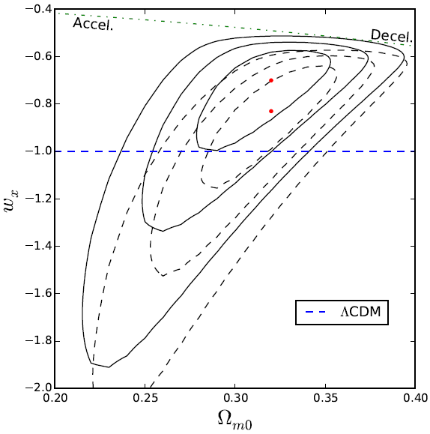
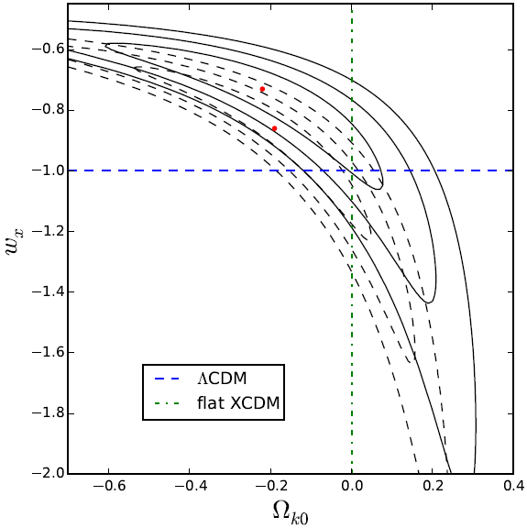
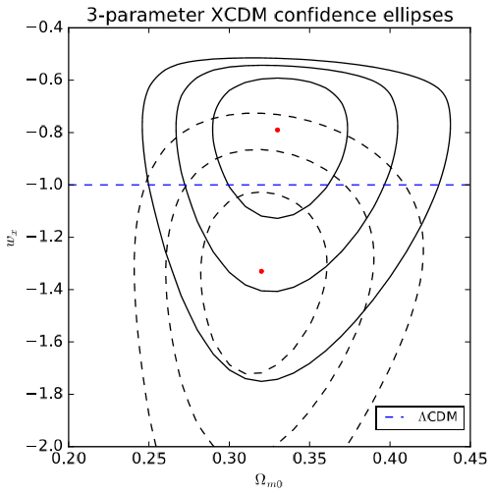
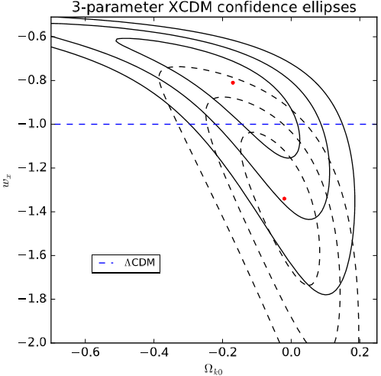
Three-parameter XCDM (1/2)
Solid black: H₀ = 68 km/s/Mpc; Dashed black: H₀ = 73.24 km/s/Mpc
Notes:
30

Slide 31



Three-parameter XCDM (2/2)
Solid black: H₀ = 68 km/s/Mpc; Dashed black: H₀ = 73.24 km/s/Mpc
Notes:
31

Slide 32





Three-parameter φCDM (1/2)
Solid black: H₀ = 68 km/s/Mpc; Dashed black: H₀ = 73.24 km/s/Mpc
Notes:
32

Slide 33



Three-parameter φCDM (2/2)
Solid black: H₀ = 68 km/s/Mpc; Dashed black: H₀ = 73.24 km/s/Mpc
Notes:
33

Slide 34


Best Fit Parameters
Notes:
34

Slide 35
Conclusion
The flat ΛCDM model is consistent with our data, although it does not always provide the best fit.
Our results are consistent with (but not conclusive proof of) mild dark energy dynamics and non-flat spatial hypersurfaces.
Notes:
35

Slide 36
Acknowledgments
This work was funded in part by DOE Grant DE-SC0011840.
Thanks to Lado Samushia (KSU) and Omer Farooq (ERAU) for useful discussions. Thanks also to Tyler Mitchell (KSU) for help with computational resources.
Notes:
36

Slide 37
References
1.) Advanced Cosmology, Daniel Baumann.
2.) Cosmology, Daniel Baumann.
3.) Modern Cosmology, Scott Dodelson.
4.) Omer Farooq et al., “Hubble Parameter measurement constraints on the redshift of the deceleration-acceleration transition, dynamical dark energy, and space curvature", 15 November 2016. arXiv:1607.03537v2.
Notes:
37

Slide 38
References
5.) A.L. Ratsimbazafy et al., “Age-dating luminous red galaxies observed with the Southern African Large Telescope”, MNRAS, 467 (3), 1 June 2017.
6.) Shadab Alam et al., “The clustering of galaxies in the completed SDSS-III Baryon Oscillation Spectroscopic Survey: cosmological analysis of the DR12 galaxy sample", 11 July 2016. arXiv: 1607.03155v1.
Notes:
38

Slide 39
References
7.) Ashley J. Ross et al., “The Clustering of the SDSS DR7 Main Galaxy Sample I: A 4 per cent Distance Measure at z = 0.15", 21 January 2015. arXiv:1409.3242v2.
8.) Metin Ata et al., “The clustering of the SDSS-IV extended Baryon Oscillation Spectroscopic Survey DR14 quasar sample: First measurement of Baryon Acoustic Oscillations between redshift 0.8 and 2.2", 21 May 2017.
Notes:
39

Slide 40
References
9.) Julian E. Bautista et al., “Measurement of BAO correlations at z = 2.3 with SDSS DR12 Lyα-Forests", 27 March 2017. arXiv:1702.00176v2.
10.) Florian Beutler, et al., “The 6dF Galaxy Survey: Baryon Acoustic Oscillations and the Local Hubble Constant", 16 June 2011. arXiv:1106.3366v1.
Notes:
40

Slide 41
References
11.) Andreu Font-Ribera, et al., “Quasar-Lyman α Forest Cross-Correlation from BOSS DR11: Baryon Acoustic Oscillations”, 20 May 2014. arXiv:1311.1767v2.
12.) David W. Hogg, “Distance Measures in Cosmology”, 16 Dec 2000. arXviv:astro-ph/9905116v4.
13.) Muhammad Omer Farooq, “Observational Constraints on Dark Energy Cosmological Model Parameters”, 14 Sep 2013. arXiv:1309.3710v1.
Notes:
41

Slide 42
References
Bassett, Bruce A., and Renée Hlozek. “Baryon Acoustic Oscillations, 27 Oct 2009. arXiv:0910.5224v1.
Title image: NASA/WMAP Science Team. Retrieved from https://map.gsfc.nasa.gov/media/121238/index.html
Notes:
42

