Slide 1

Two Higgs Doublet Model with New Mass Matrix Ansatz
Sudip Jana
Oklahoma State University
( in collaboration with K.S. Babu )
K.S. Babu and Sudip Jana, arXiv : 18XX.XXXXV [hep-Ph]
Particle physics on the plains, 2018
University of Kansas, ks, OCT 13-14, 2018

Slide 2
  Why Two Higgs Doublet Model (2HDM) ?
The 2HDM is a simple and testable extension of SM.
Some BSM theories require a 2nd doublet like DFSZ axion model, or supersymmetric models. This extension provides a foil to test the properties of the SM Higgs boson.
EW T parameter has a tree level value of 1.
SM is unable to generate a baryon asymmetry of the Universe of sufficient size. Two-Higgs-doublet models can do so, due to the flexibility of their scalar mass spectrum and the existence of additional sources of CP violation. There have been many works on baryogenesis in the 2HDM. Exciting new possibilities for explicit or spontaneous CP violation constitute one of the attractive features of 2HDM.
It offers rich phenomenology at the LHC.

Slide 3
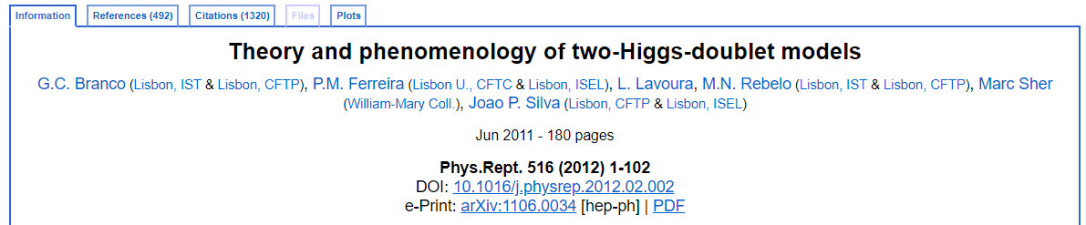
  “ The ” Two Higgs Doublet Model (2HDM)
  What is new here ?

Slide 4
  “ The ” Two Higgs Doublet Model (2HDM)
  What is new here ?
New Mass Matrix Ansatz : Allows both the doublets couple to fermions in same hierarchical pattern.
It offers rich phenomenology at the LHC
Properties of the 125 GeV SM-like Higgs may be significantly modified, consistent with known Higgs properties.
The model is very predictive, implying unavoidable new physics signals like di-boson resonances (hh, ZZ and Zh) from novel decays of CP- even and CP- odd Higgs fields at the Large Hadron Collider (LHC) and that may lead to an explanation of some intriguing di-boson signatures (Zh excess at 440 GeV and hh) observed at the ATLAS experiment.
Flavor Observables : µ eγ, Muon g-2 anomaly, R_{D} / R_{D}* Anomaly
etc….

Slide 5
  “ The ” Two Higgs Doublet Model (2HDM)
  Why New Mass Matrix Ansatz?
The 2HDM has a potential problem with flavor changing neutral currents (FCNC) mediated by the neutral scalars, which arises when both Higgs doublets couple to up and down type quarks, and FCNC could be induced at large rates that may jeopardize the model.
Assumption about specific Yukawa structure of the model can be the possible solutions to this FCNC problem in 2HDM.
Depending upon the specific choices for the Yukawa matrices, the versions of the 2HDM are defined as type-I, type-II or type-III, which involve the following mechanisms, that are aimed either to eliminate the otherwise unbearable FCNC problem or at least to keep it under control

Slide 6
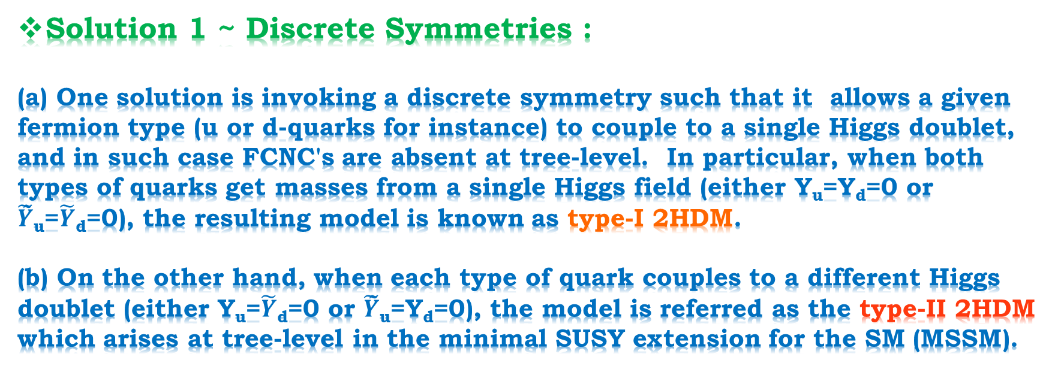
  “ The ” Two Higgs Doublet Model (2HDM)
  Why New Mass Matrix Ansatz?
Solution 1 ~ Discrete Symmetries :
(a) One solution is invoking a discrete symmetry such that it allows a given fermion type (u or d-quarks for instance) to couple to a single Higgs doublet, and in such case FCNC's are absent at tree-level. In particular, when both types of quarks get masses from a single Higgs field (either Y_{u}=Y_{d}=0 or $\tilde{Y}$̃_{u}=$\tilde{Y}$_{d}=0), the resulting model is known as type-I 2HDM.
(b) On the other hand, when each type of quark couples to a different Higgs doublet (either Y_{u}=$\tilde{Y}$_{d}=0 or $\tilde{Y}$̃_{u}=Y_{d}=0), the model is referred as the type-II 2HDM which arises at tree-level in the minimal SUSY extension for the SM (MSSM).

Slide 7
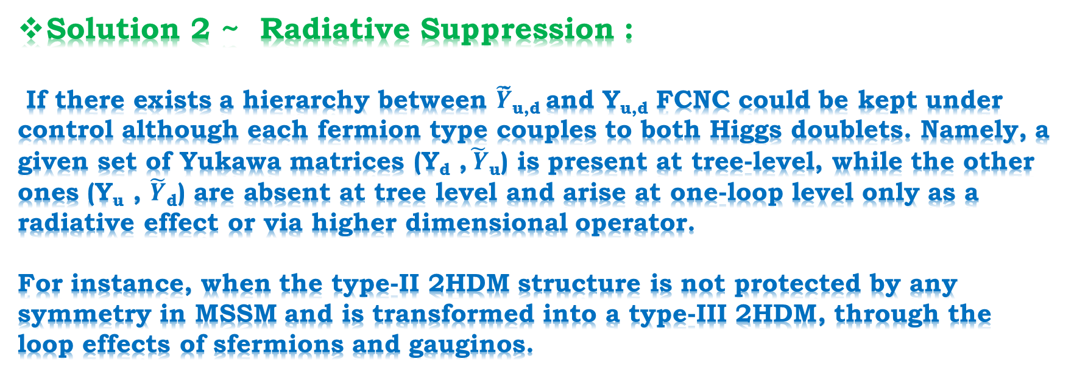
  “ The ” Two Higgs Doublet Model (2HDM)
  Why New Mass Matrix Ansatz?
Solution 2 ~ Radiative Suppression :
If there exists a hierarchy between $\tilde{Y}$̃_{u,d} and Y_{u,d} FCNC could be kept under control although each fermion type couples to both Higgs doublets. Namely, a given set of Yukawa matrices (Y_{d} ,$\tilde{ Y}$_{u}) is present at tree-level, while the other ones (Y_{u} , $\tilde{Y}$_{d}) are absent at tree level and arise at one-loop level only as a radiative effect or via higher dimensional operator.
For instance, when the type-II 2HDM structure is not protected by any symmetry in MSSM and is transformed into a type-III 2HDM, through the loop effects of sfermions and gauginos.

Slide 8
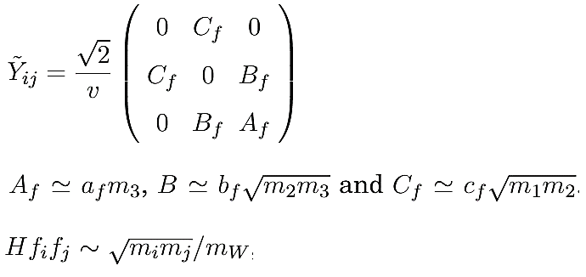
  “ The ” Two Higgs Doublet Model (2HDM)
  Why New Mass Matrix Ansatz?
Solution 3 ~ Flavor Symmetry :
There is another way to achieve FCNC suppression by considering a certain form of the Yukawa matrices that reproduce the observed fermion masses and mixing angles, while both the doublet couple to each fermions and which is termed as type III 2HDM. This could be done either by adopting the Frogart-Nielsen mechanism to generate the fermion mass hierarchies, or by considering a certain ansatz for the fermion mass matrices.
Cheng-Sher Ansatz (1987) :

Slide 9


  “ The ” Two Higgs Doublet Model (2HDM)
  Why New Mass Matrix Ansatz?
Problem :
Solution ?????
( FCNC )
FCNC
Removing/Killing all FCNC effects is not necessary for consistency with flavor violation constraints, hierarchical yukawa couplings of each Higgs with fermions is sufficient. It is this general 2HDM that we study here.

Slide 10
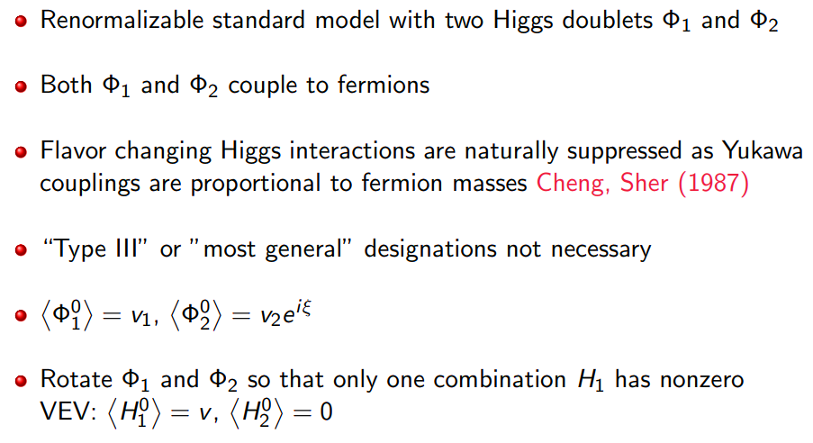
  “The” Two Higgs Doublet Model (2HDM)
*Babu (DPF 2017)

Slide 11
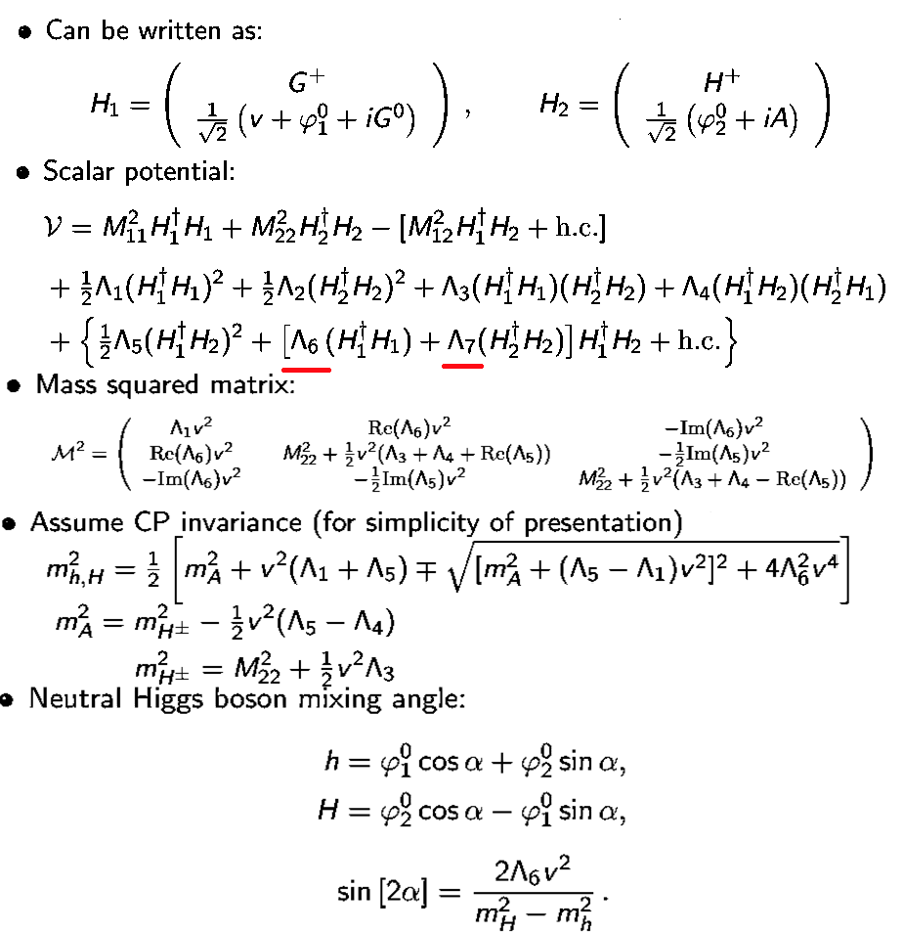
  Scalar Potential in the 2HDM

Slide 12
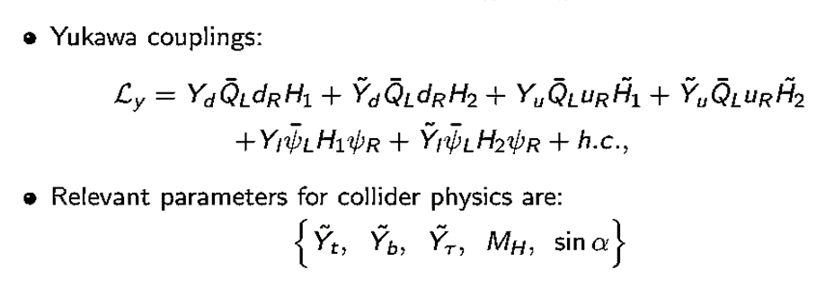
  2HDM : Parameters

Slide 13
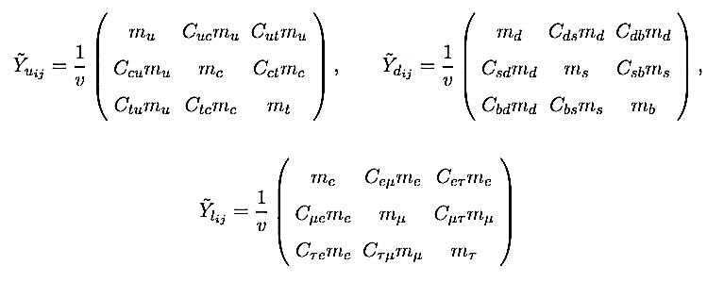
  “ The ” 2HDM with New Mass Matrix Ansatz :

Slide 14
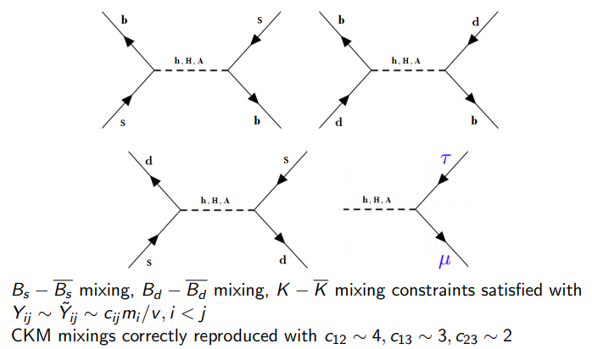
  T2HDM : Flavor Constraints

Slide 15
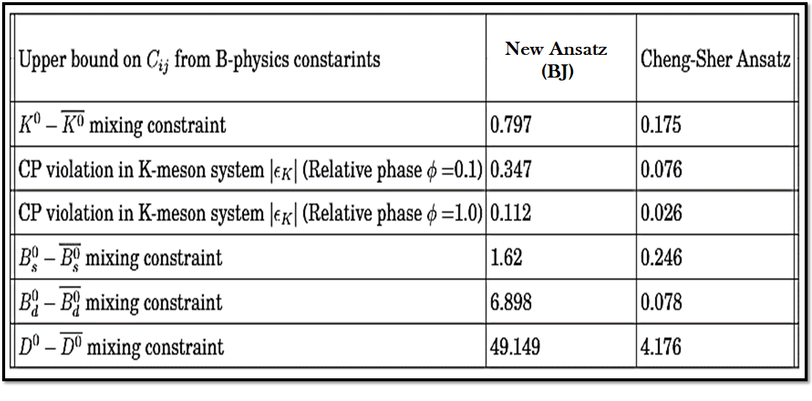
  T2HDM : Flavor Constraints

Slide 16
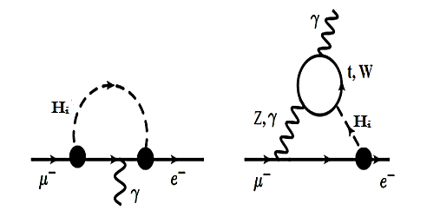
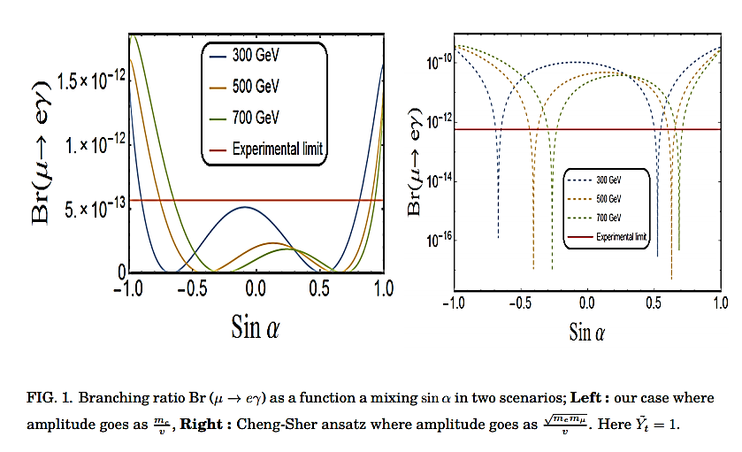
  T2HDM : Flavor Observable
Chang, Hou , Keung (1993)

Slide 17
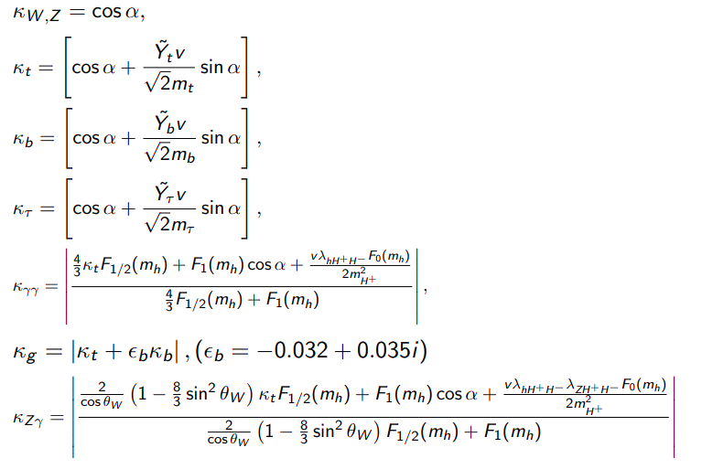
  T2HDM : Modified couplings width of SM Higgs Boson

Slide 18
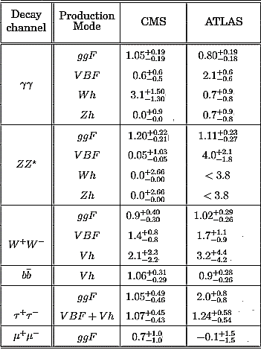
Knowledge about 125 GeV Higgs Boson
Moriond conference 2018,
Babu, Jana (2017),
Jana, Nandi (2017),
Murphy et al. (2017), etc.

Slide 19
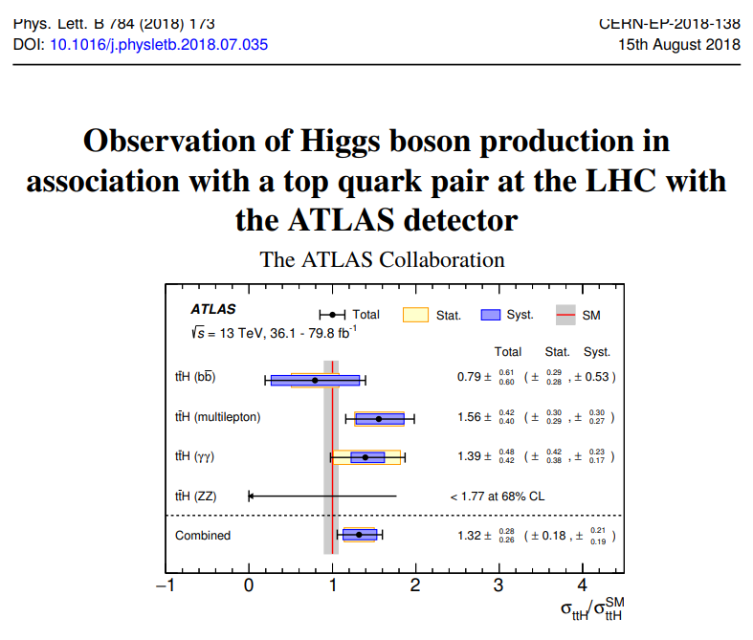
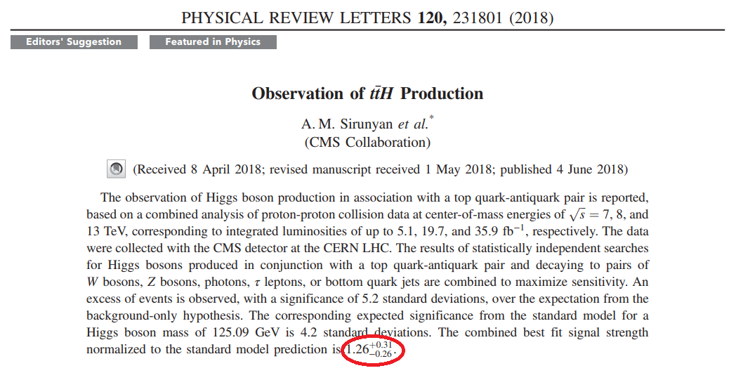
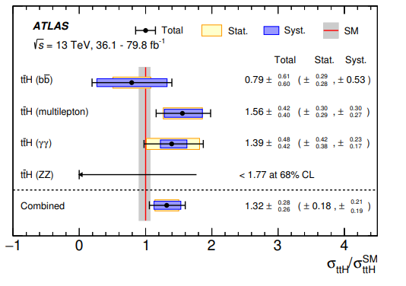
Knowledge about 125 GeV Higgs Boson
ATLAS : Phys. Lett. B784, 173 (2018)
CMS : Phys. Rev. Lett.120, no. 23, 231801 (2018)

Slide 20
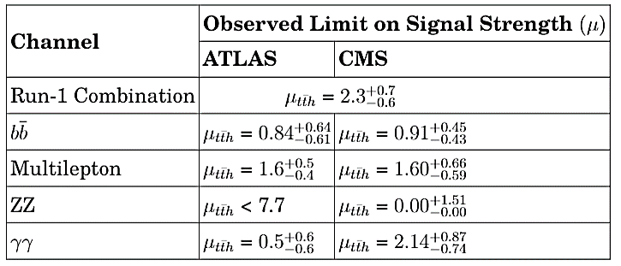
Knowledge about 125 GeV Higgs Boson
ATLAS : Phys. Lett. B784, 173 (2018)
CMS : Phys. Rev. Lett.120, no. 23, 231801 (2018)

Slide 21
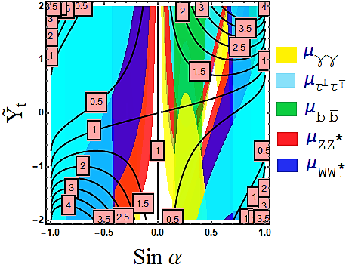
  T2HDM : Constraints on Model Parameters

Slide 22
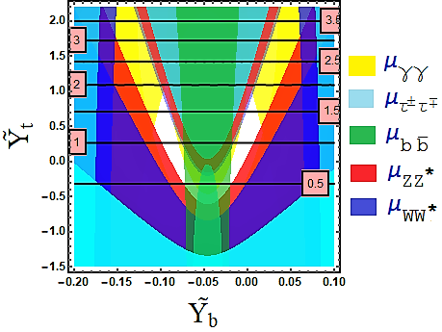
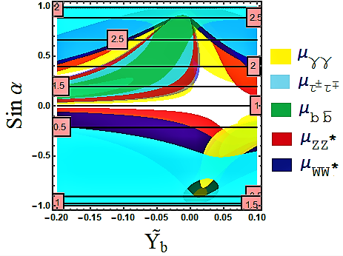

  T2HDM : Constraints on Model Parameters

Slide 23


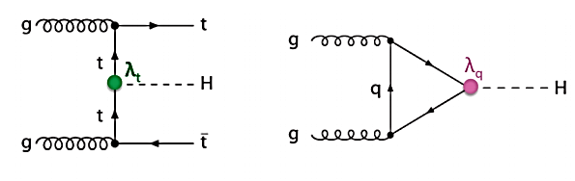
  production in SM
Probes Yukawa coupling of the top quark directly.
Cross-section ~ 508.5 fb in SM, which is ~1/100 of resonant
single Higgs production.
CMS and ATLAS have evidences for seeing tth process.
It is easier to get suppressed top Yukawa, difficult to enhance it.
Signature of new physics : Golden “eliminator” channel.

Slide 24
Phenomenology
We have three new particles in the model :
CP- even Neutral Heavy Higgs : H
CP- odd (pseudo)-scalar : A
Singly Charged Higgs : H⁺
Discovery of these Higgs bosons below a TeV will be confirmation of the scenario

Slide 25
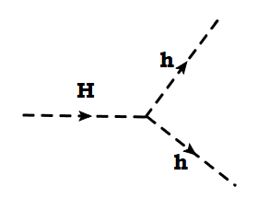
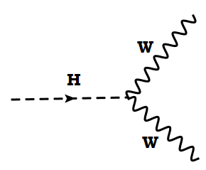
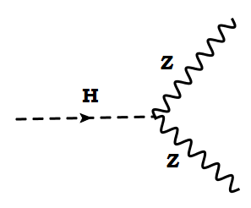
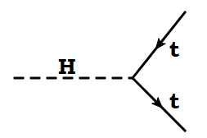
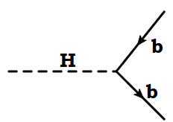
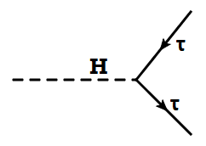
CP- even Neutral Heavy Higgs (H) Phenomenology :
Main decay modes :

Slide 26
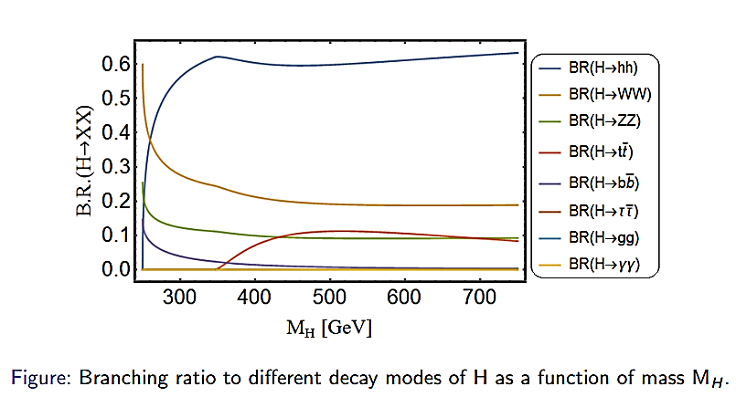
  Branching Ratio of Heavy Higgs H

Slide 27
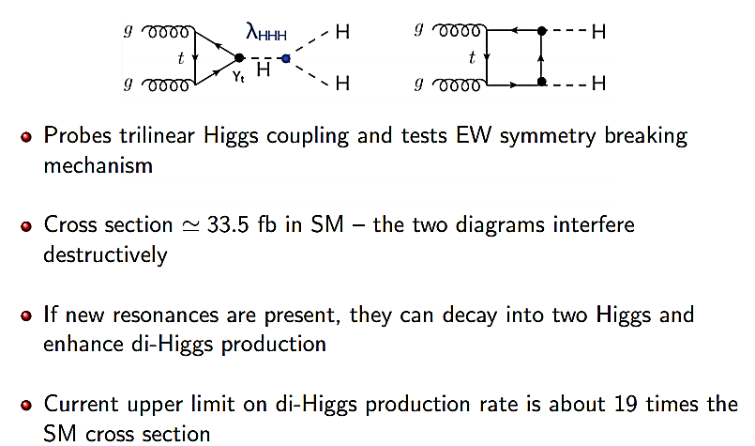
  Di-Higgs Production in SM

Slide 28
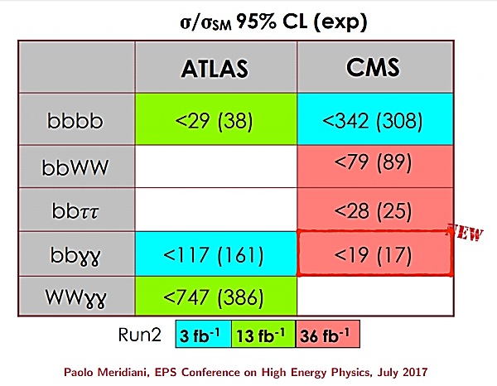
  Constarint on Di-Higgs Production

Slide 29
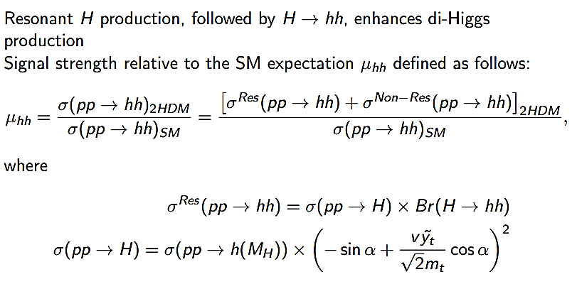
  Di-Higgs Production in the 2HDM

Slide 30
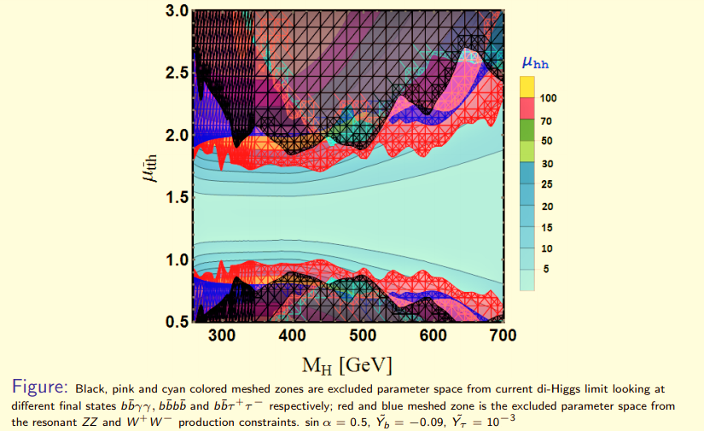
  Di-Higgs Production in the 2HDM

Slide 31
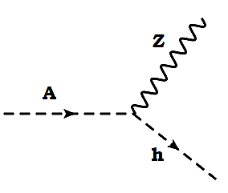
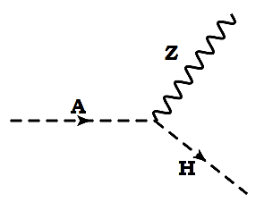
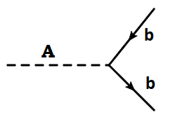
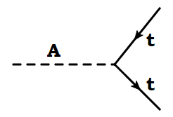
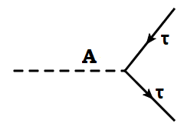
CP- odd Neutral Pseudo-scalar (A) Phenomenology :
Main decay modes :

Slide 32
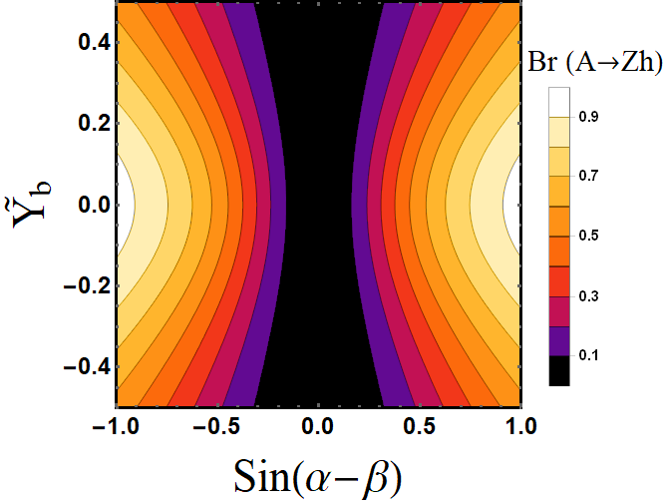
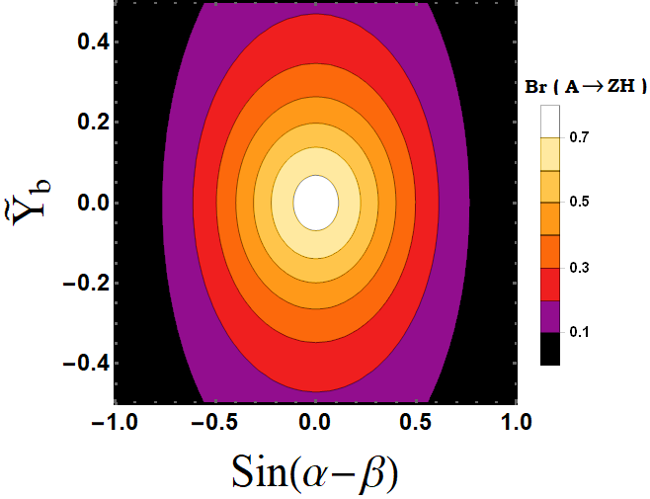

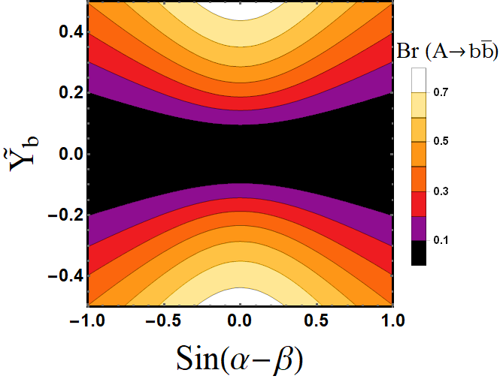
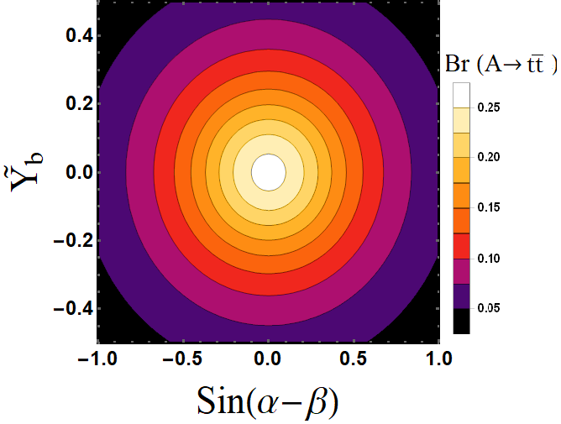
CP- odd Neutral Pseudo-scalar (A) Phenomenology :

Slide 33
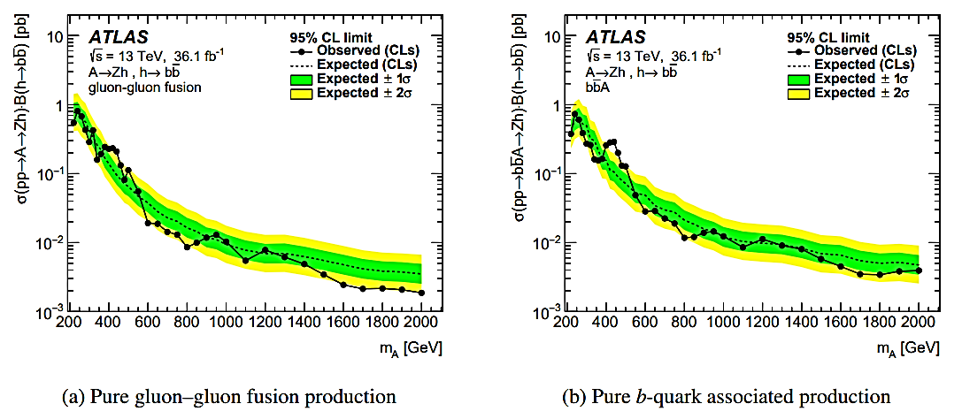
Zh Resonance at 440 GeV : with 3.6 σ local significance
e-print : arXiv:1712.065186
Ferreira et al. arXiv:1711.00024
C. Wagner et al. arXiv:1802.09122

Slide 34
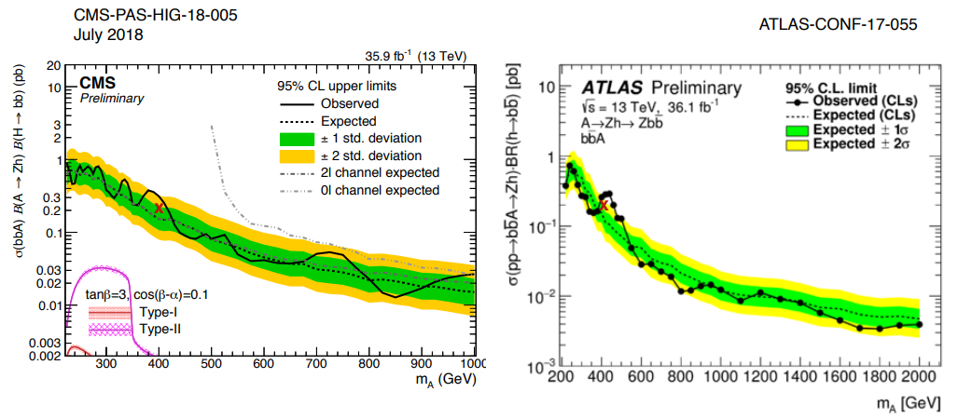
Zh Resonance at 440 GeV : with 3.6 σ local significance
e-print : arXiv:1712.065186
C. Wagner’s slide : PPP 2018

Slide 35
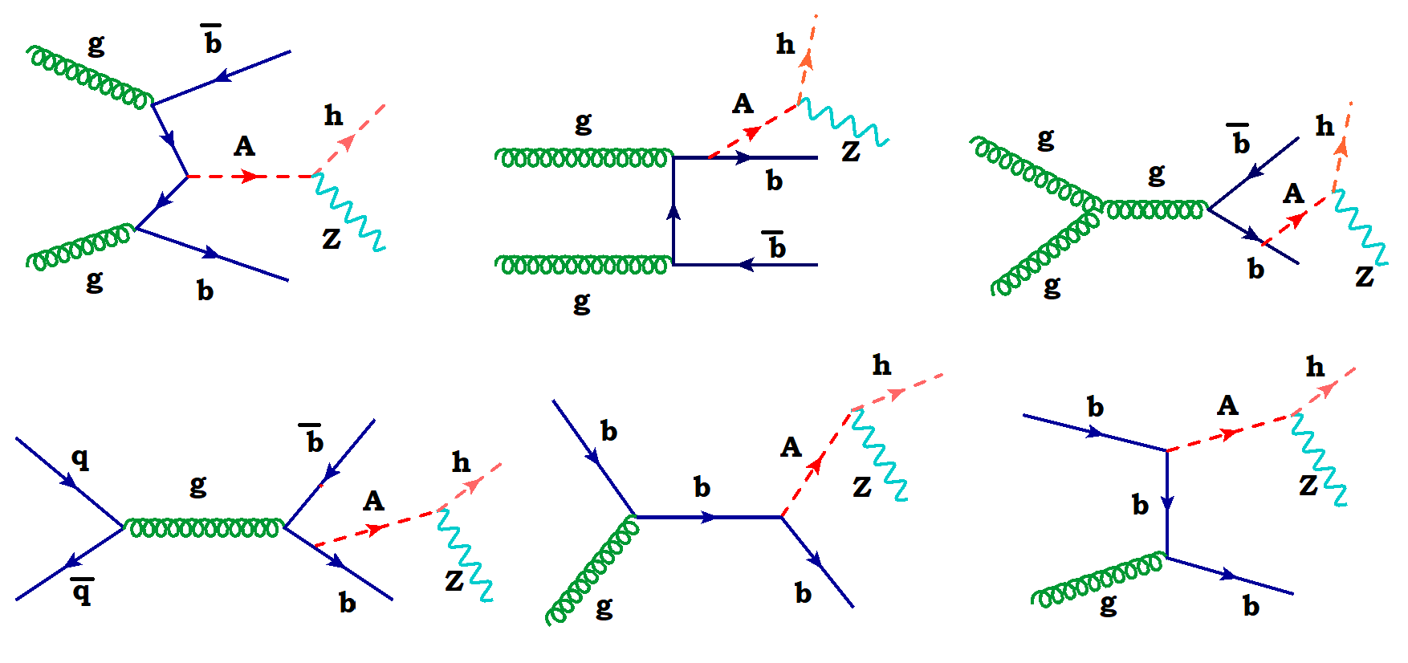
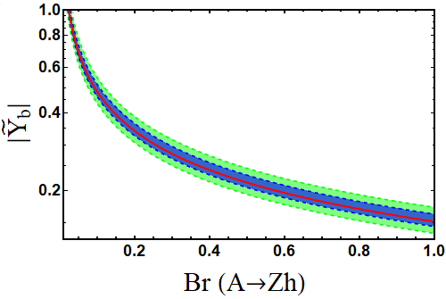
Zh Resonance Explanation :

Slide 36
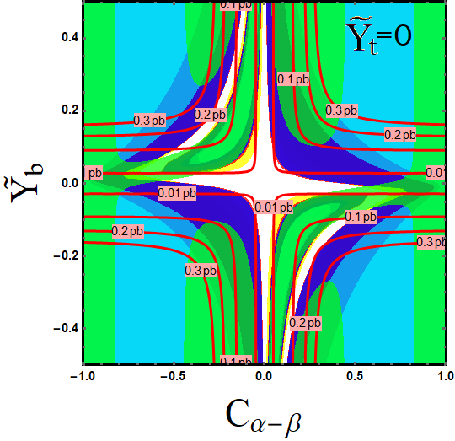
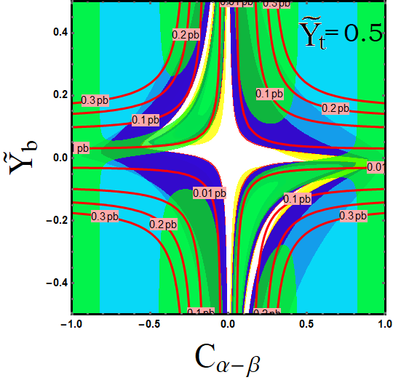
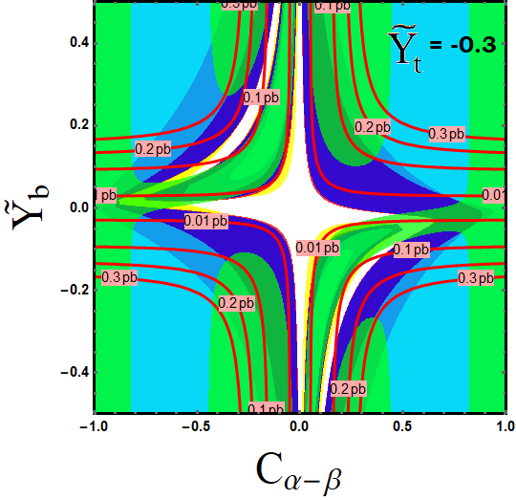
Zh Resonance Explanation :

Slide 37
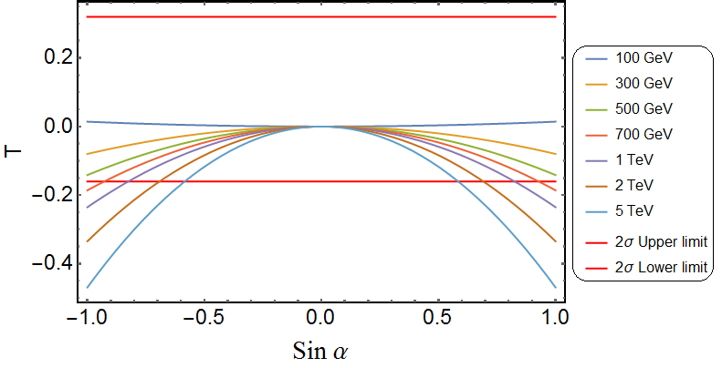

  S and T Parameters

Slide 38

  Boundedness of Higgs Potential

Slide 39



  Mapping to existing 2HDM
Our Model
Sin α = 0
Aligned
2HDM
Y_{u}=Y_{d}=0 or $\tilde{Y}$̃_{u}=$\tilde{Y}$_{d}=0
Y_{u}=$\tilde{Y}$_{d}=0 or $\tilde{Y}$̃_{u}=Y_{d}=0
$\tilde{Y}$̃_{ij}=0, i≠j
Type I
2HDM
Type II
2HDM
MFV
2HDM

Slide 40
Conclusions
All current observations are consistent with the predictions of the SM Higgs sector at the 2 sigma level
There are still relatively large uncertainties in some measurements, in particular the relevant couplings to top and bottom quarks
If deviations are real, they may be interpreted in the context of extensions of the SM at the weak scale. However, delicate correlations in the coupling values should be present.
On the contrary, if deviations are not present, the Higgs sector may be in the decoupling or alignment limit
Double Higgs production detection is challenging, but it may serve to probe the nature of the Higgs potential or the presence of additional particles at the TeV scale
If any deviation (enhanced) in higgs fermion couplings is discovered, we have to switch to our 2HDM framework from the SM*.
( *If no exotic colored particles are introduced )
The model is very predictive, implying unavoidable new physics signals like di-boson resonances (hh, ZZ and Zh) from novel decays of CP- even and CP- odd Higgs fields at the Large Hadron Collider (LHC).
Flavor observables like : µ eγ, Muon g-2 anomaly, RD / RD* Anomaly etc...

Slide 41



Slide 42

  Benchmark Points :
Babu and Jana (2017)

Slide 43

  Benchmark Points :

Slide 44




CP- even Neutral Heavy Higgs (H) Phenomenology :
0.5 (top left), 0 (top right), -0.3 (bottom)

Slide 45




CP- even Neutral Heavy Higgs (H) Phenomenology :

Slide 46



Slide 47





  S and T Parameters
Grimus, Lavoura et al. (2007)

Slide 48

Preliminary Result : Fitting 3 Resonances

Slide 49


Slide 50



Slide 51

  Benchmark Points :
Babu and Jana (2017)

Slide 52
  Benchmark Points :
Babu and Jana (2017)

Slide 53
  Benchmark Points :

Slide 54
  S and T Parameters

Slide 55
  Boundedness of Higgs Potential

Slide 56

  2HDM : Remarks

Slide 57



Score card for the Higgs interpretation at the Large Hadron Collider (LHC)

Slide 58



Higgs Production at the LHC

Slide 59

Production and Decay Modes of Higgs Boson at the LHC

Slide 60
  Benchmark Points :
Babu and Jana (2017)

Slide 61
  Benchmark Points :
Babu and Jana (2017)

Slide 62
  Benchmark Points :
Babu and Jana (2017)

Slide 63
  S and T Parameters
Babu and Jana (2017)

Slide 64


ZZ Resonance : with 3.6 σ local significance
Eur. Phys. J. C 78 (2018) 293
e-print arXiv:1712.06386

Slide 65

hh Resonance at 280 GeV : with 2.3σ global significance
eprint : arxiv : 1804.0617

