Slide 1

Gamma Ray Constraints on New Physics Interpretations of IceCube Data
Yicong Sui
Washington University in St. Louis
In collaboration with Bhupal Dev

Slide 2
Outline
Motivation:
PeV bump in IceCube data
Astrophysical explanation:
Multi messenger method (Gamma Ray Constraint)
Particle explanation:
Dark Matter Decay
Other Application of the Gamma Ray Constraint:
Z’ model
Conclusion

Slide 3
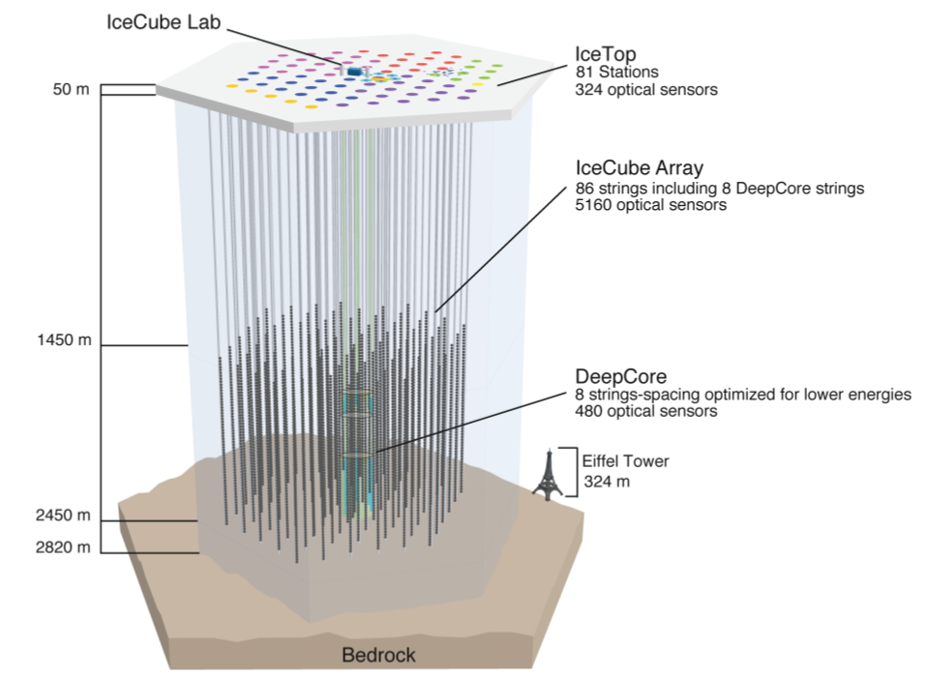

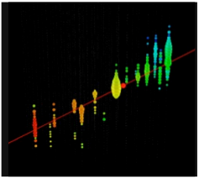
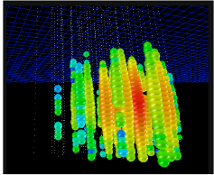
Brief Introduction of IceCube Experiment
Mechanism:
Cherenkov radiation from interaction products: leptons and hadrons
track
cascade

Slide 4
Outlines
Motivation:
PeV bump in IceCube data
Astrophysical explanation:
Multi messenger method
Particle explanation:
Dark Matter Decay
Other Application of the Multi messenger method:
Z’ model
Conclusion

Slide 5
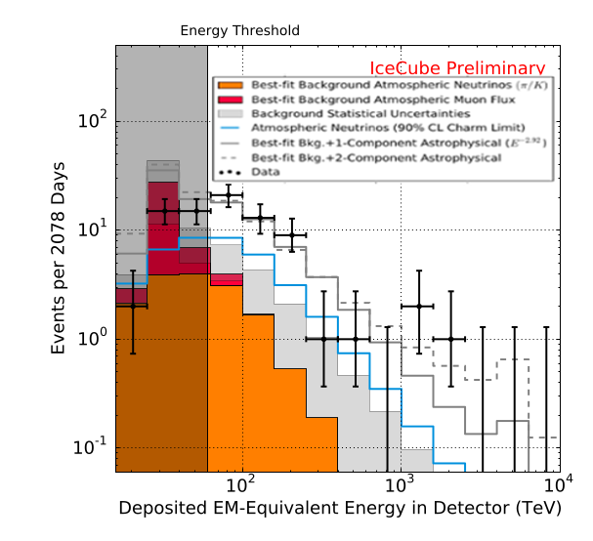
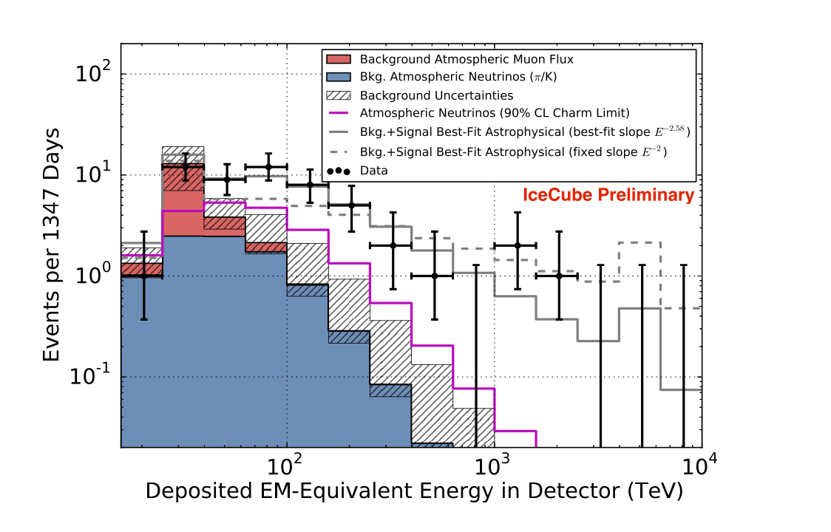
Motivation
IceCube 6 years data
IceCube 4 years data
How to explain this PeV Bump?

Slide 6
Outlines
Motivation:
PeV bump in IceCube data
Astrophysical explanation:
Multi messenger method
Particle explanation:
Dark Matter Decay
Other Application of the Multi messenger method:
Z’ model
Conclusion

Slide 7





Astrophysical Explanation:Multi Messenger Method
Astrophysical source
typical source of astrophysical neutrinos and gamma photons
2/3
1/3
1 : 1 : 1
K=1 for p case
K=2 for p p case
is the flux for only one flavor. Aassuming at earth, we have then, this is could be think of as the flux averaged over flavor
K. Murase arXiv:1410.3680
I is the integrated flux
Gamma ray Bound uHE neutrino bound

Slide 8
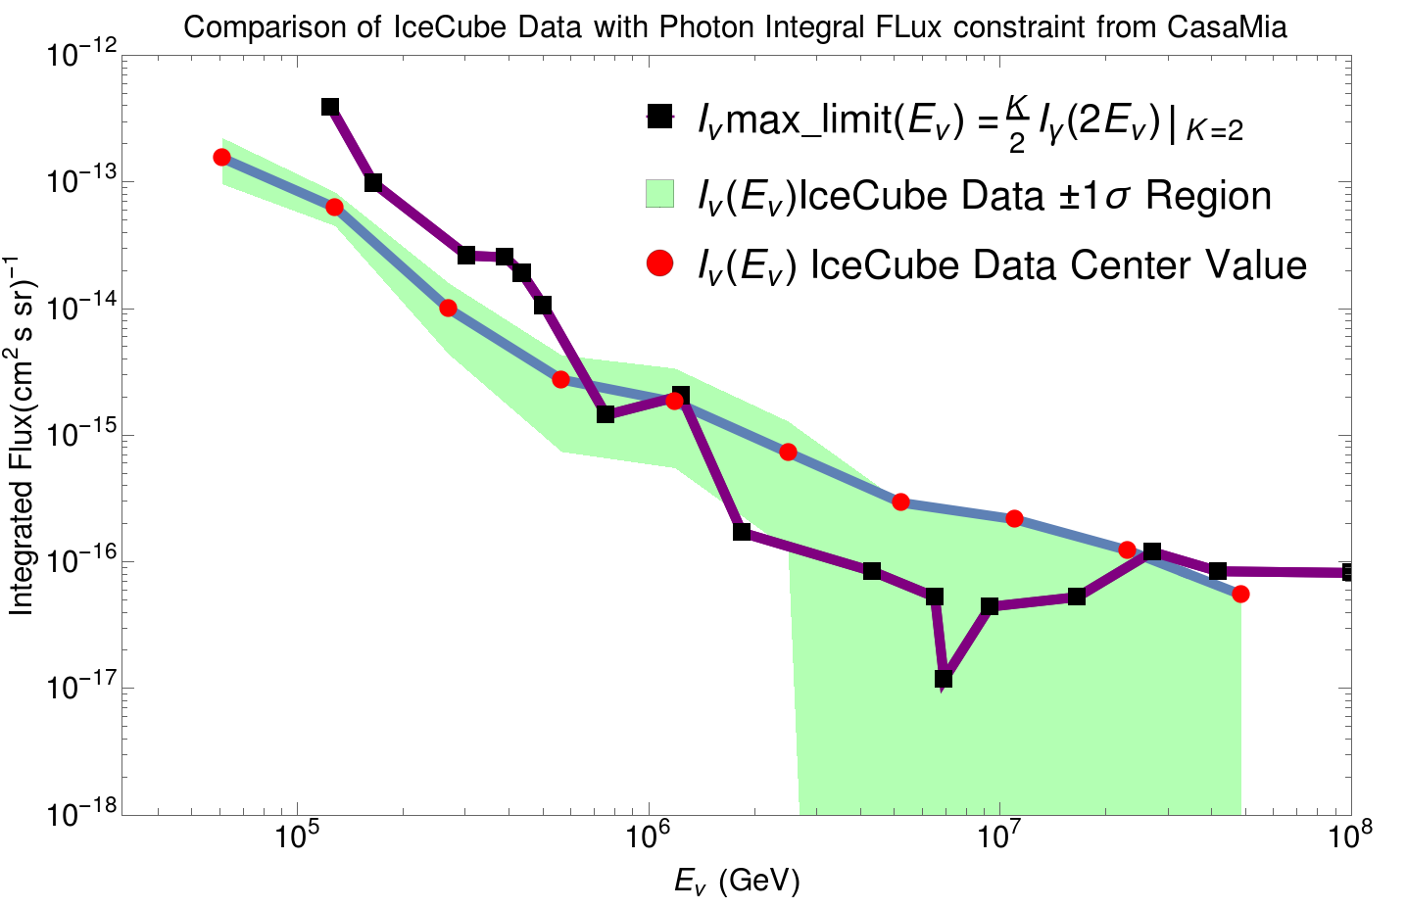
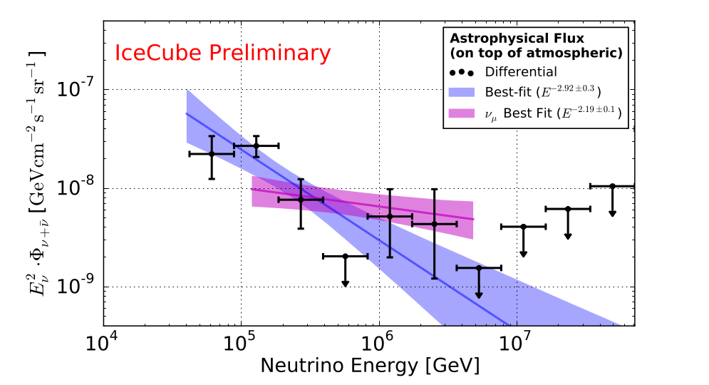
Typical astrophysics explanation fails to explain the bump
Neutrino limit is derived from a combined Gamma Ray bound
(CASAMIA+HAWC+milargo+ARGO+Fermi-LAT)
PeV events dominant, causing excess
IceCube 6 years

Slide 9
Outlines
Motivation:
PeV bump in IceCube data
Astrophysical explanation:
Multi messenger method
Particle explanation:
Dark Matter Decay
Other Application of the Multi messenger method:
Z’ model
Conclusion

Slide 10

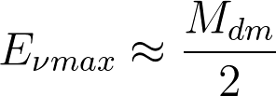

New Physics Model
Main channel
everything
everything
Maximum Energy neutrino
Explaining the high energy bump
Always have high energy neutrino yields for this model:
Effective Lagrangian of DM model:
A model independent Decay Process with and ( ) being free parameters.
Feldstein et al (PRD '13); Esmaili, Serpico (JCAP '13); Murase et al (PRL '15); Boucenna et al (JCAP '15); Dev et al (JCAP '16); di Bari et al (JCAP '16); Cohen et al (PRL '17)
Inspired by neutrino Dirac mass model
Dark Matter 3 Body Final State Decay

Slide 11
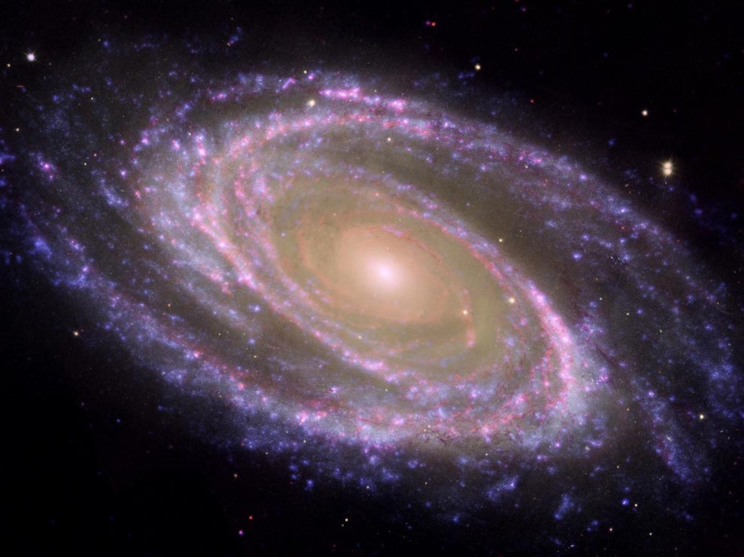
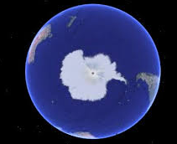
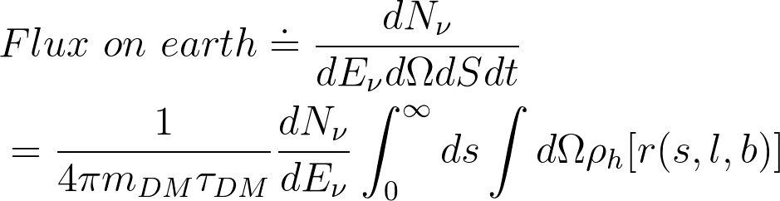
Simulation Process to get Flux at Earth
All kins of
interactions
Monte Carlo :
Madgraph5 + pyhtia 8
Deal with
decay of one DM particle
h
Spectrum at Production
DM
e
Average over all directions
for fluxes at production;
Integration of contributing
DM in the whole galaxy;
…...
NFW profile
J factor or D factor
Neutrino flux on earth
This page is an example float chart for galactic flux, similar for extragalactic

Slide 12
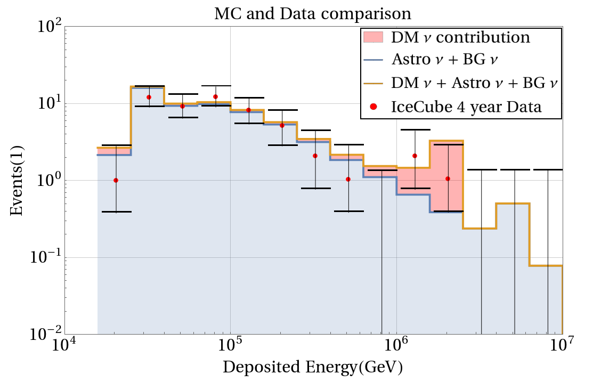
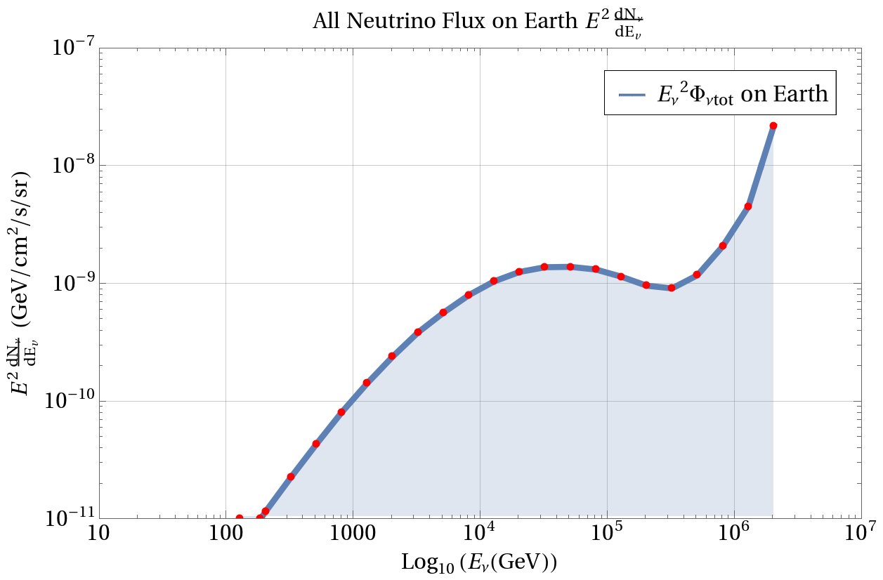

Monte Carlo of DM model
High energy neutrino peak
Event reconstruction:
A is the effective area provided by Icecube group that converts fluxes to events

Slide 13
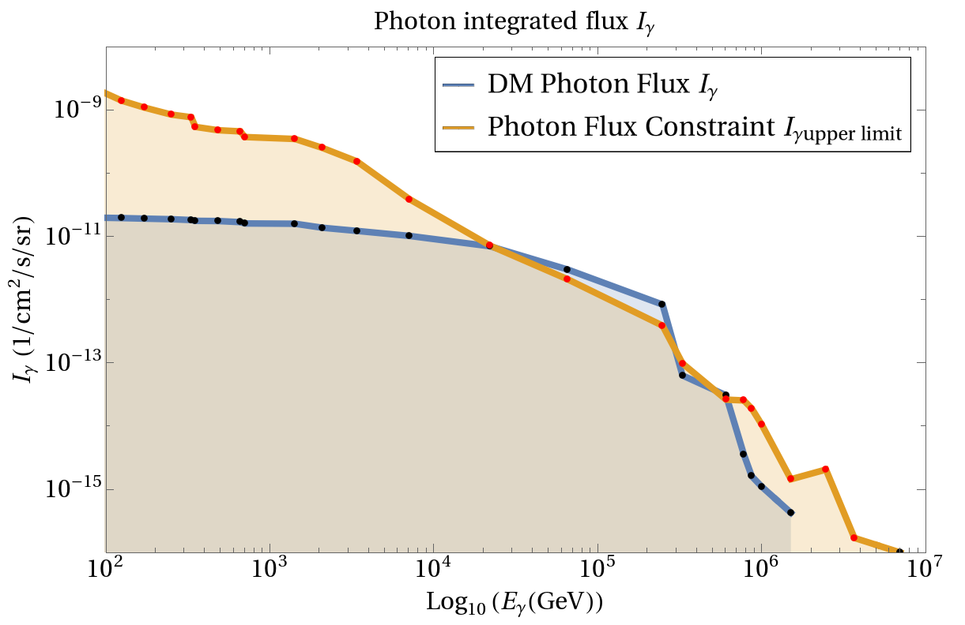
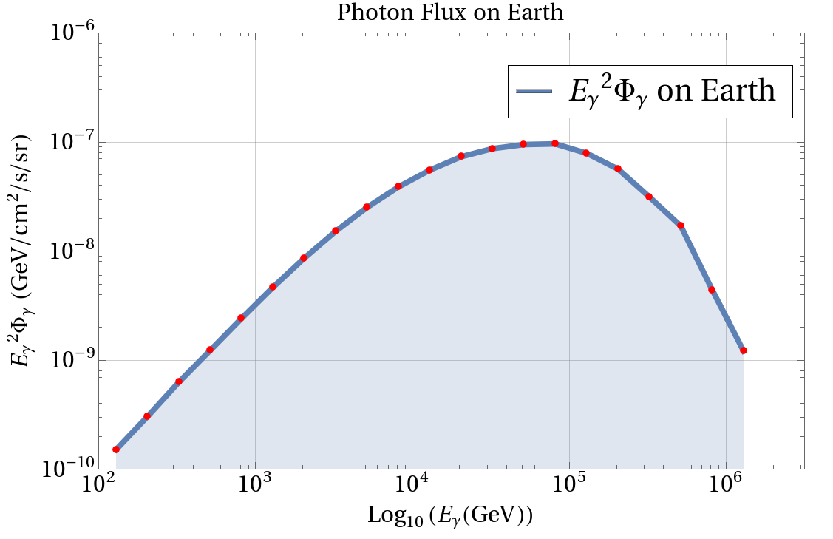
Photon flux graph
Photon Flux Constraint is the combined result of
CASAMIA+HAWC+milargo+ARGO+Fermi-LAT
integration

Slide 14




Constraining the DM parameters
goodness of fit test:
The likelihood ratio is:
where
Given a CL
Favored
parameters
region
Comparison with Gamma ray constraint:
T
veto
F
allow region

Slide 15
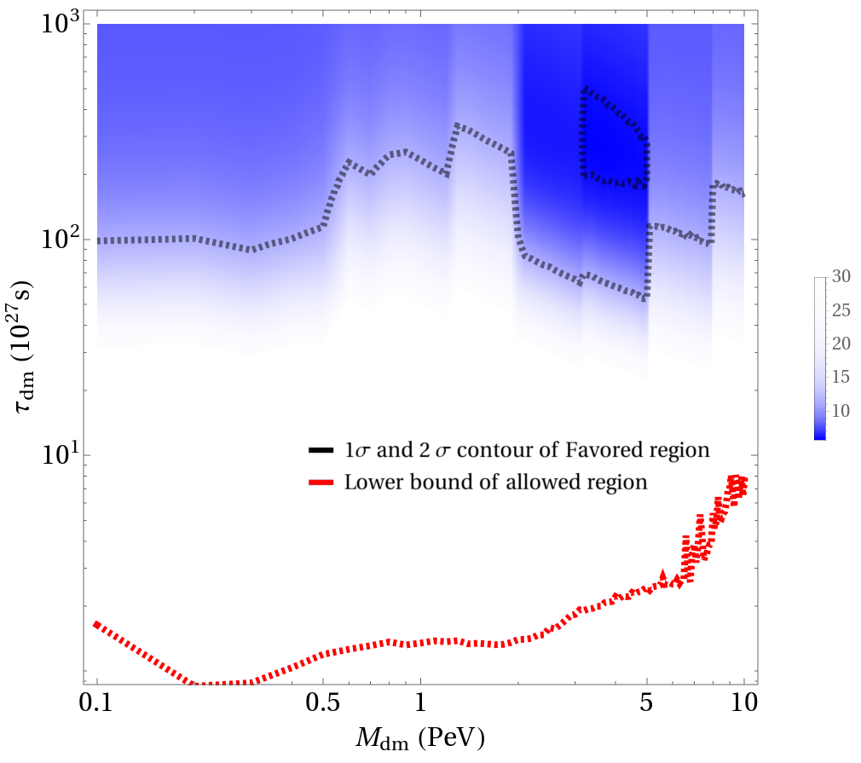
Favored parameters region from Goodness of fit and Gamma ray constraint
Due to less statistics, only one sigma region is closed area.
Lower bound(Red) is very conservative, so much lower than the favored region from goodness of fit.

Slide 16
Outlines
Motivation:
PeV bump in IceCube data
Astrophysical explanation:
Multi messenger method
Particle explanation:
Dark Matter Decay
Other Application of the Multi messenger method:
Z’ model
Conclusion

Slide 17

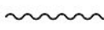




Gap of IceCube Data and Z’ model
Gap of icecube data at
High E
Final state
Background
Final state
Assumption: interaction only among muon and tau generation
T. Araki et al (PRD '15); Cherry, Friedland, Shoemaker '14; DiFranzo, Hooper (PRD '15); Heeck (PLB '16); Dev et al (PLB '16)

Slide 18
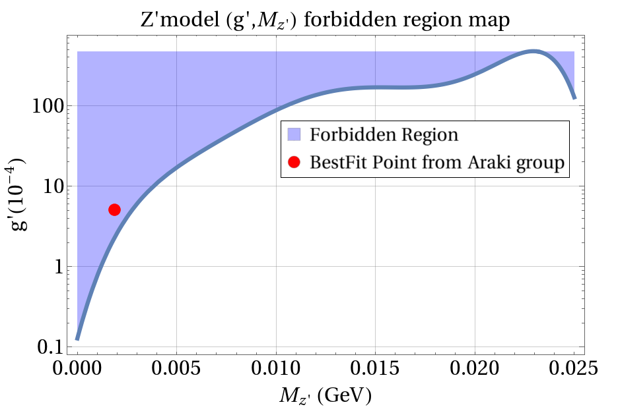


Gamma radiation for the expanded model
If we do take e generation into account:
High E
Final state
Gamma photons get radiated
Background
Final state
Upper bound for g’. Excluding the BestFit point given by Araki group. Therefore, this assumption of e generation not interacting with Z’ is crucial for their model to hold.

Slide 19
Outlines
Motivation:
PeV bump in IceCube data
Astrophysical explanation:
Multi messenger method
Particle explanation:
Dark Matter Decay
Other Application of the Multi messenger method:
Z’ model
Conclusion

Slide 20
Conclusion
Pure astrophysical explanation for the Icecube PeV bump is disfavored by the gamma ray constraint
The DM decay model: DM→ b b~ v could explain the bump with parameters confined in favored region
Gamma ray constraint could also be used to test the validity of New Physics models, for example, light Z’ model.

Slide 21
Thank you!

Slide 22
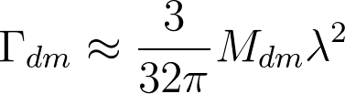
Back up slides, haven’t done yet
Reminder of the relations between coupling constant and decay width:
Derivation of the flux identity
Derivation of Z’ model’s D factor
Higher order cascades

Slide 23



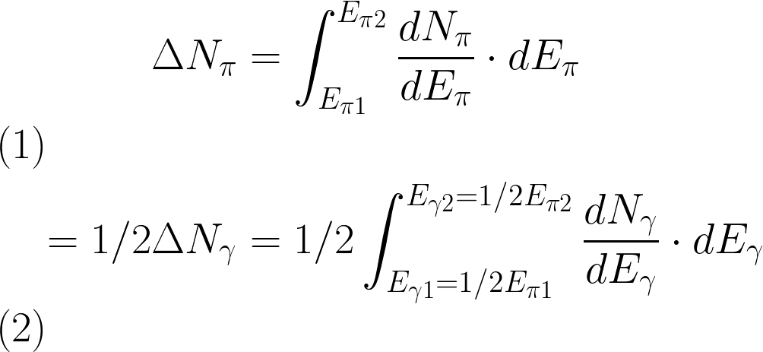

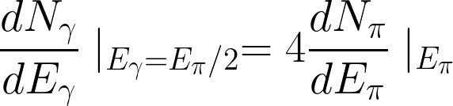

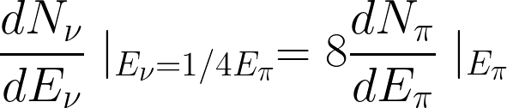

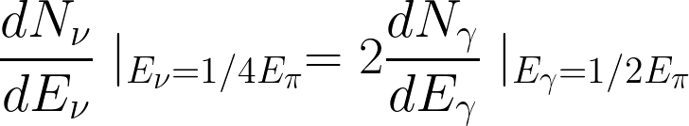
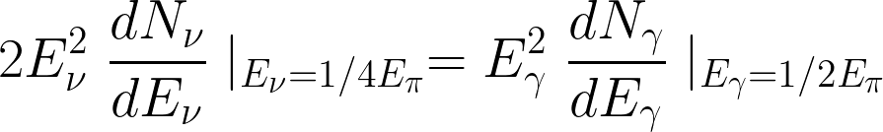
Same amount of 3 pions, and they have approximately same energy:
1 pion goes to 4 leptons,share share the E
Derivative for Epi2
oscillation
Derivative for Epi2

Slide 24
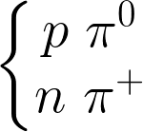



Same amount of 3 pions, and they have approximately same energy:
2/3
1/3
1 pion goes to 4 leptons,share share the E
0
0
pi0
0
Derivative for Epi2
0
0
Due to only pi+,no pi-
oscillation
pi+
4
+
Derivative for Epi2
+
+
+
2
8
Twice more than Murase’s Formula, I think he took pi0 and pi+ to have same amount

Slide 25
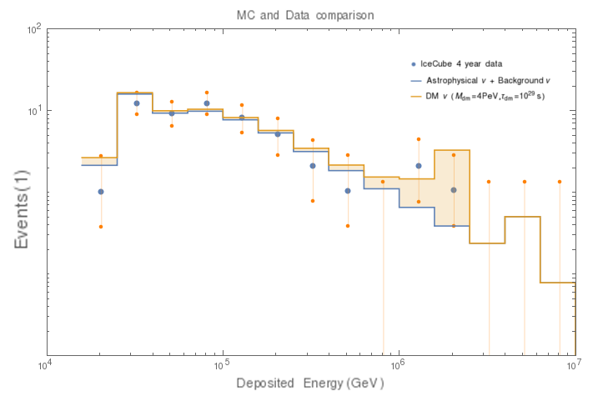
Details of goodness of fit
goodness of fit test:
We use this statistical method to provide favored region of the parameters
For binned data, we could take it as Poisson distribution:
The likelihood ratio is:
= icecube data in ith bin
= total MC events
where
We choose the test statistic as:
To acquire the TS distribution of Mdm and tdm, we perform a grid calculation:
Mdm=(0.1, 0.2,…,10)PeV
Tdm=10^(1,1.03,1.06,…,3)*10^27 s
TS will be a function of theta and thus we could find out the region that is statistically favored

