Slide 1
Stress-Testing the VBF Approximation with Higgs Boson plus Three Jet Production
Dr. Terrance Figy
Assistant Professor
Department of Mathematics, Statistic, and Physics
Wichita State University
September 30, 2017
University of Kansas
Particle Physics on the Plains

Slide 2
Vector Boson Fusion
Energetic jets in the forward/backward directions.
Higgs decays products in central rapidity region.
Suppressed QCD radiation in central rapidity region.

Slide 3
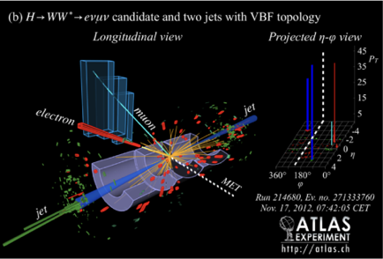
Vector Boson Fusion
Energetic jets in the forward/backward directions.
Higgs decays products in central rapidity region.
Suppressed QCD radiation in central rapidity region.

Slide 4
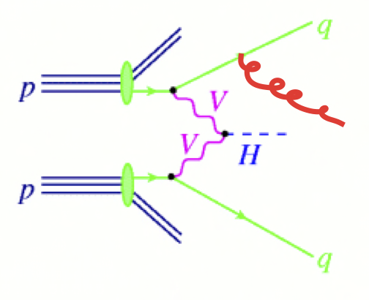
Vector Boson Fusion + Jet

Slide 5
Vector Boson Fusion + Jet

Slide 6
H+3 Jets via VBF (only t-channels)
Total Cross Section
Scale Variations:
LO: +26% to -19%
NLO: less than 5%
JHEP 0802 (2008) 076 [arXiv:0710.5621]

Slide 7
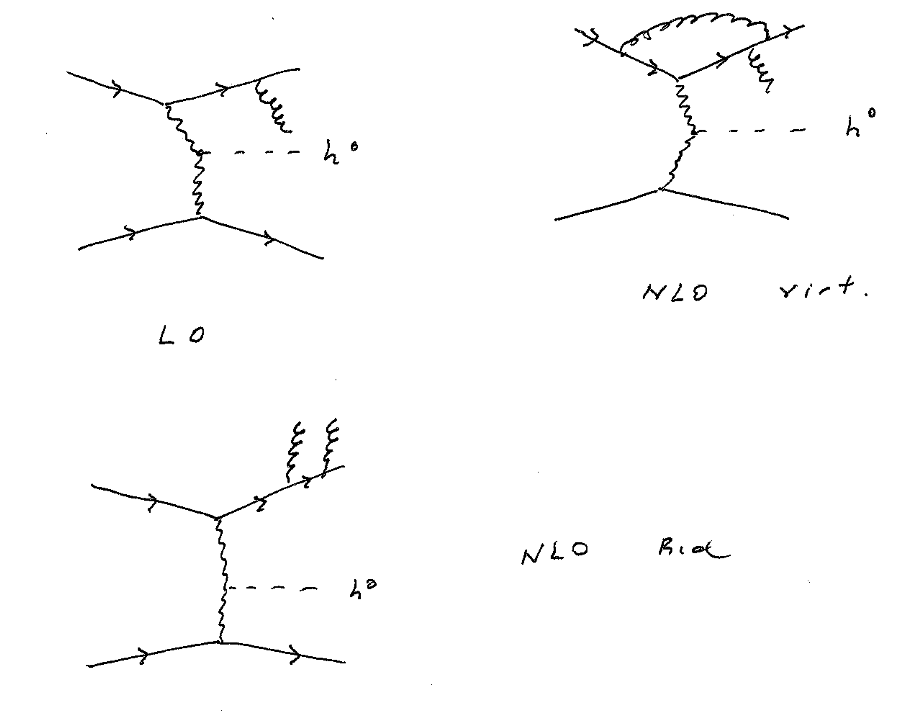
H+3 Jets via VBF (only t-channels)
No pentagon or hexagon diagrams included.
Approximate as two deeply inelastic scattering processes that exchange a gauge boson.
JHEP 0802 (2008) 076 [arXiv:0710.5621]

Slide 8
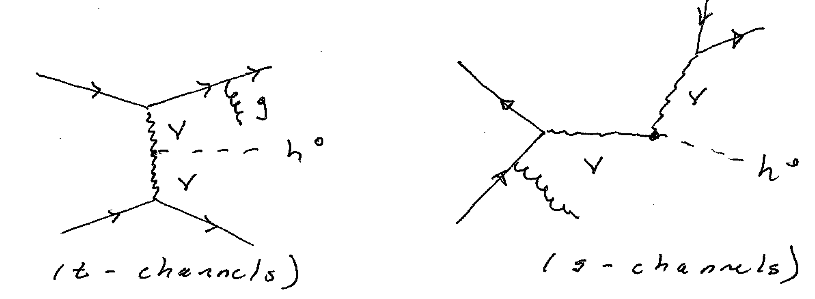
Going for all of it: EW H+3 Jets

Slide 9
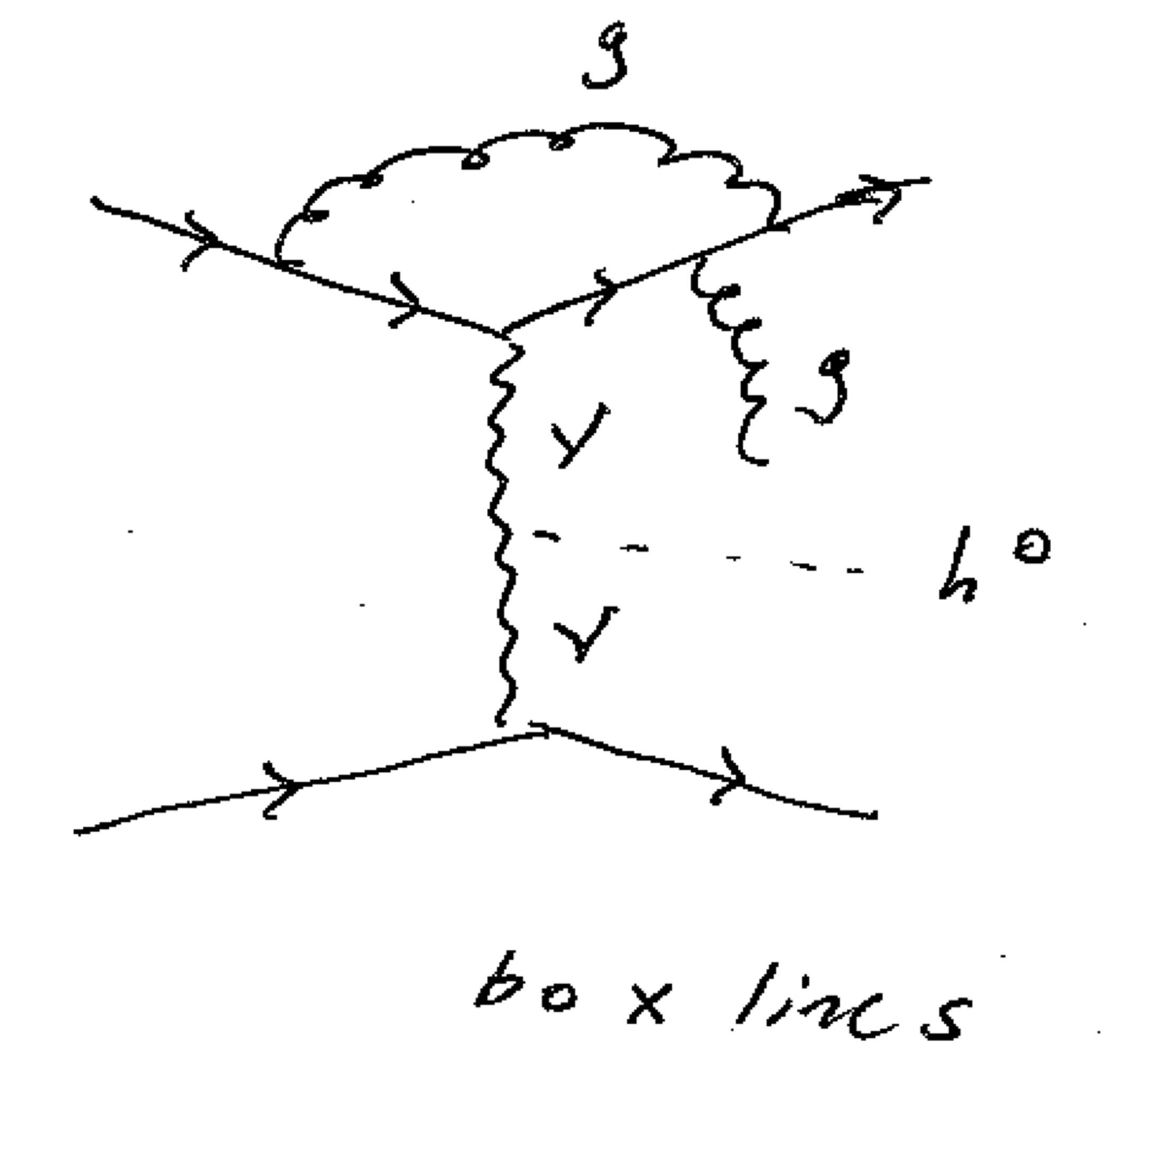
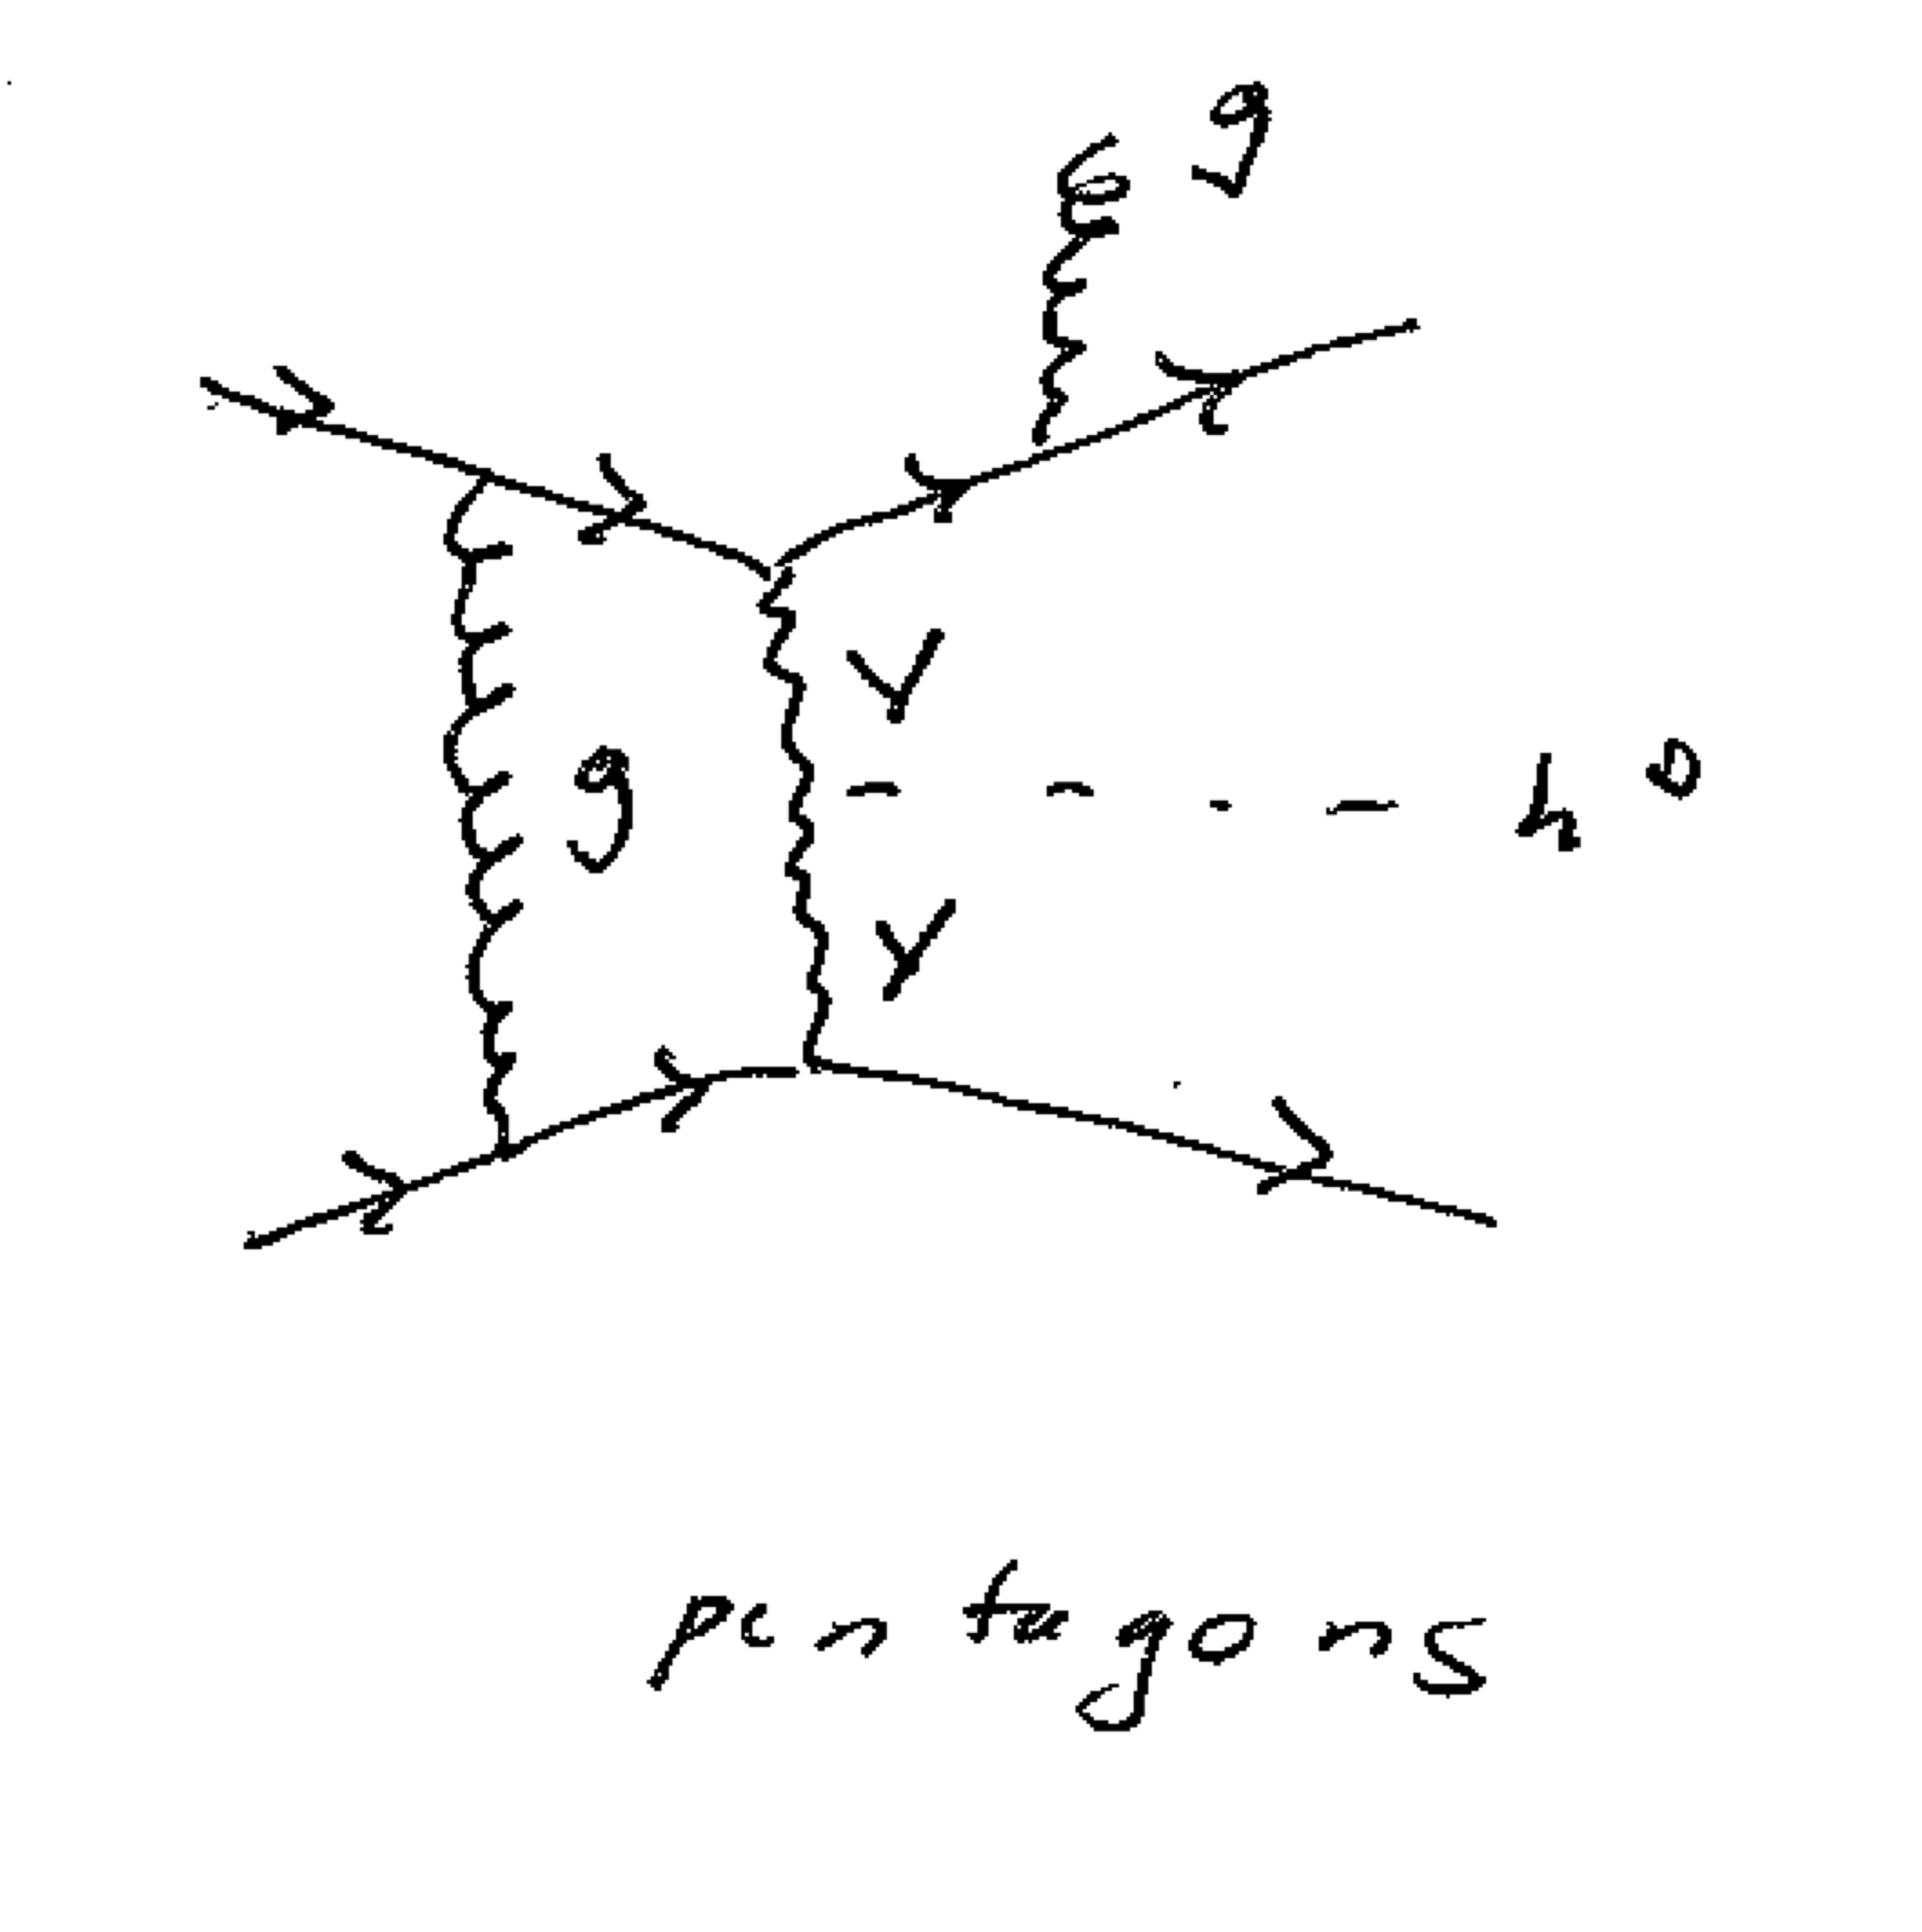
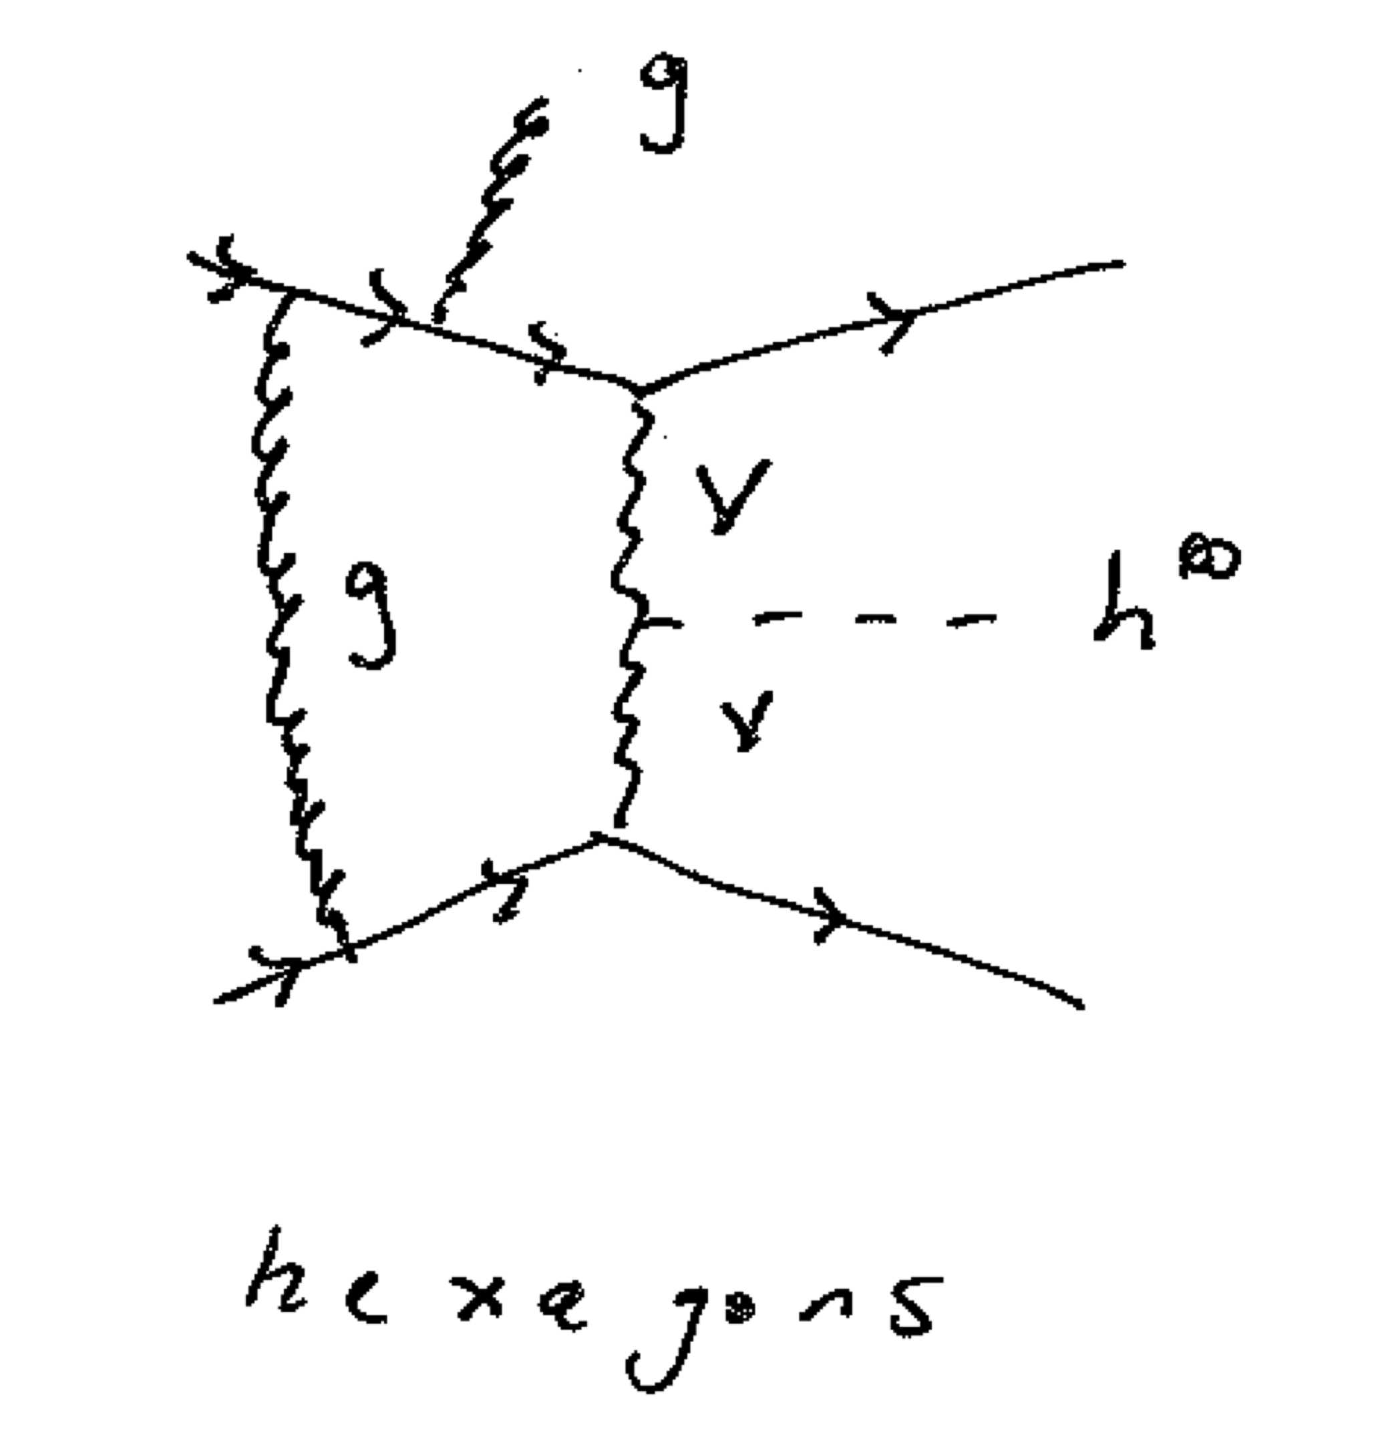
Going for all of it: EW H+3 Jets
Virtual Corrections

Slide 10
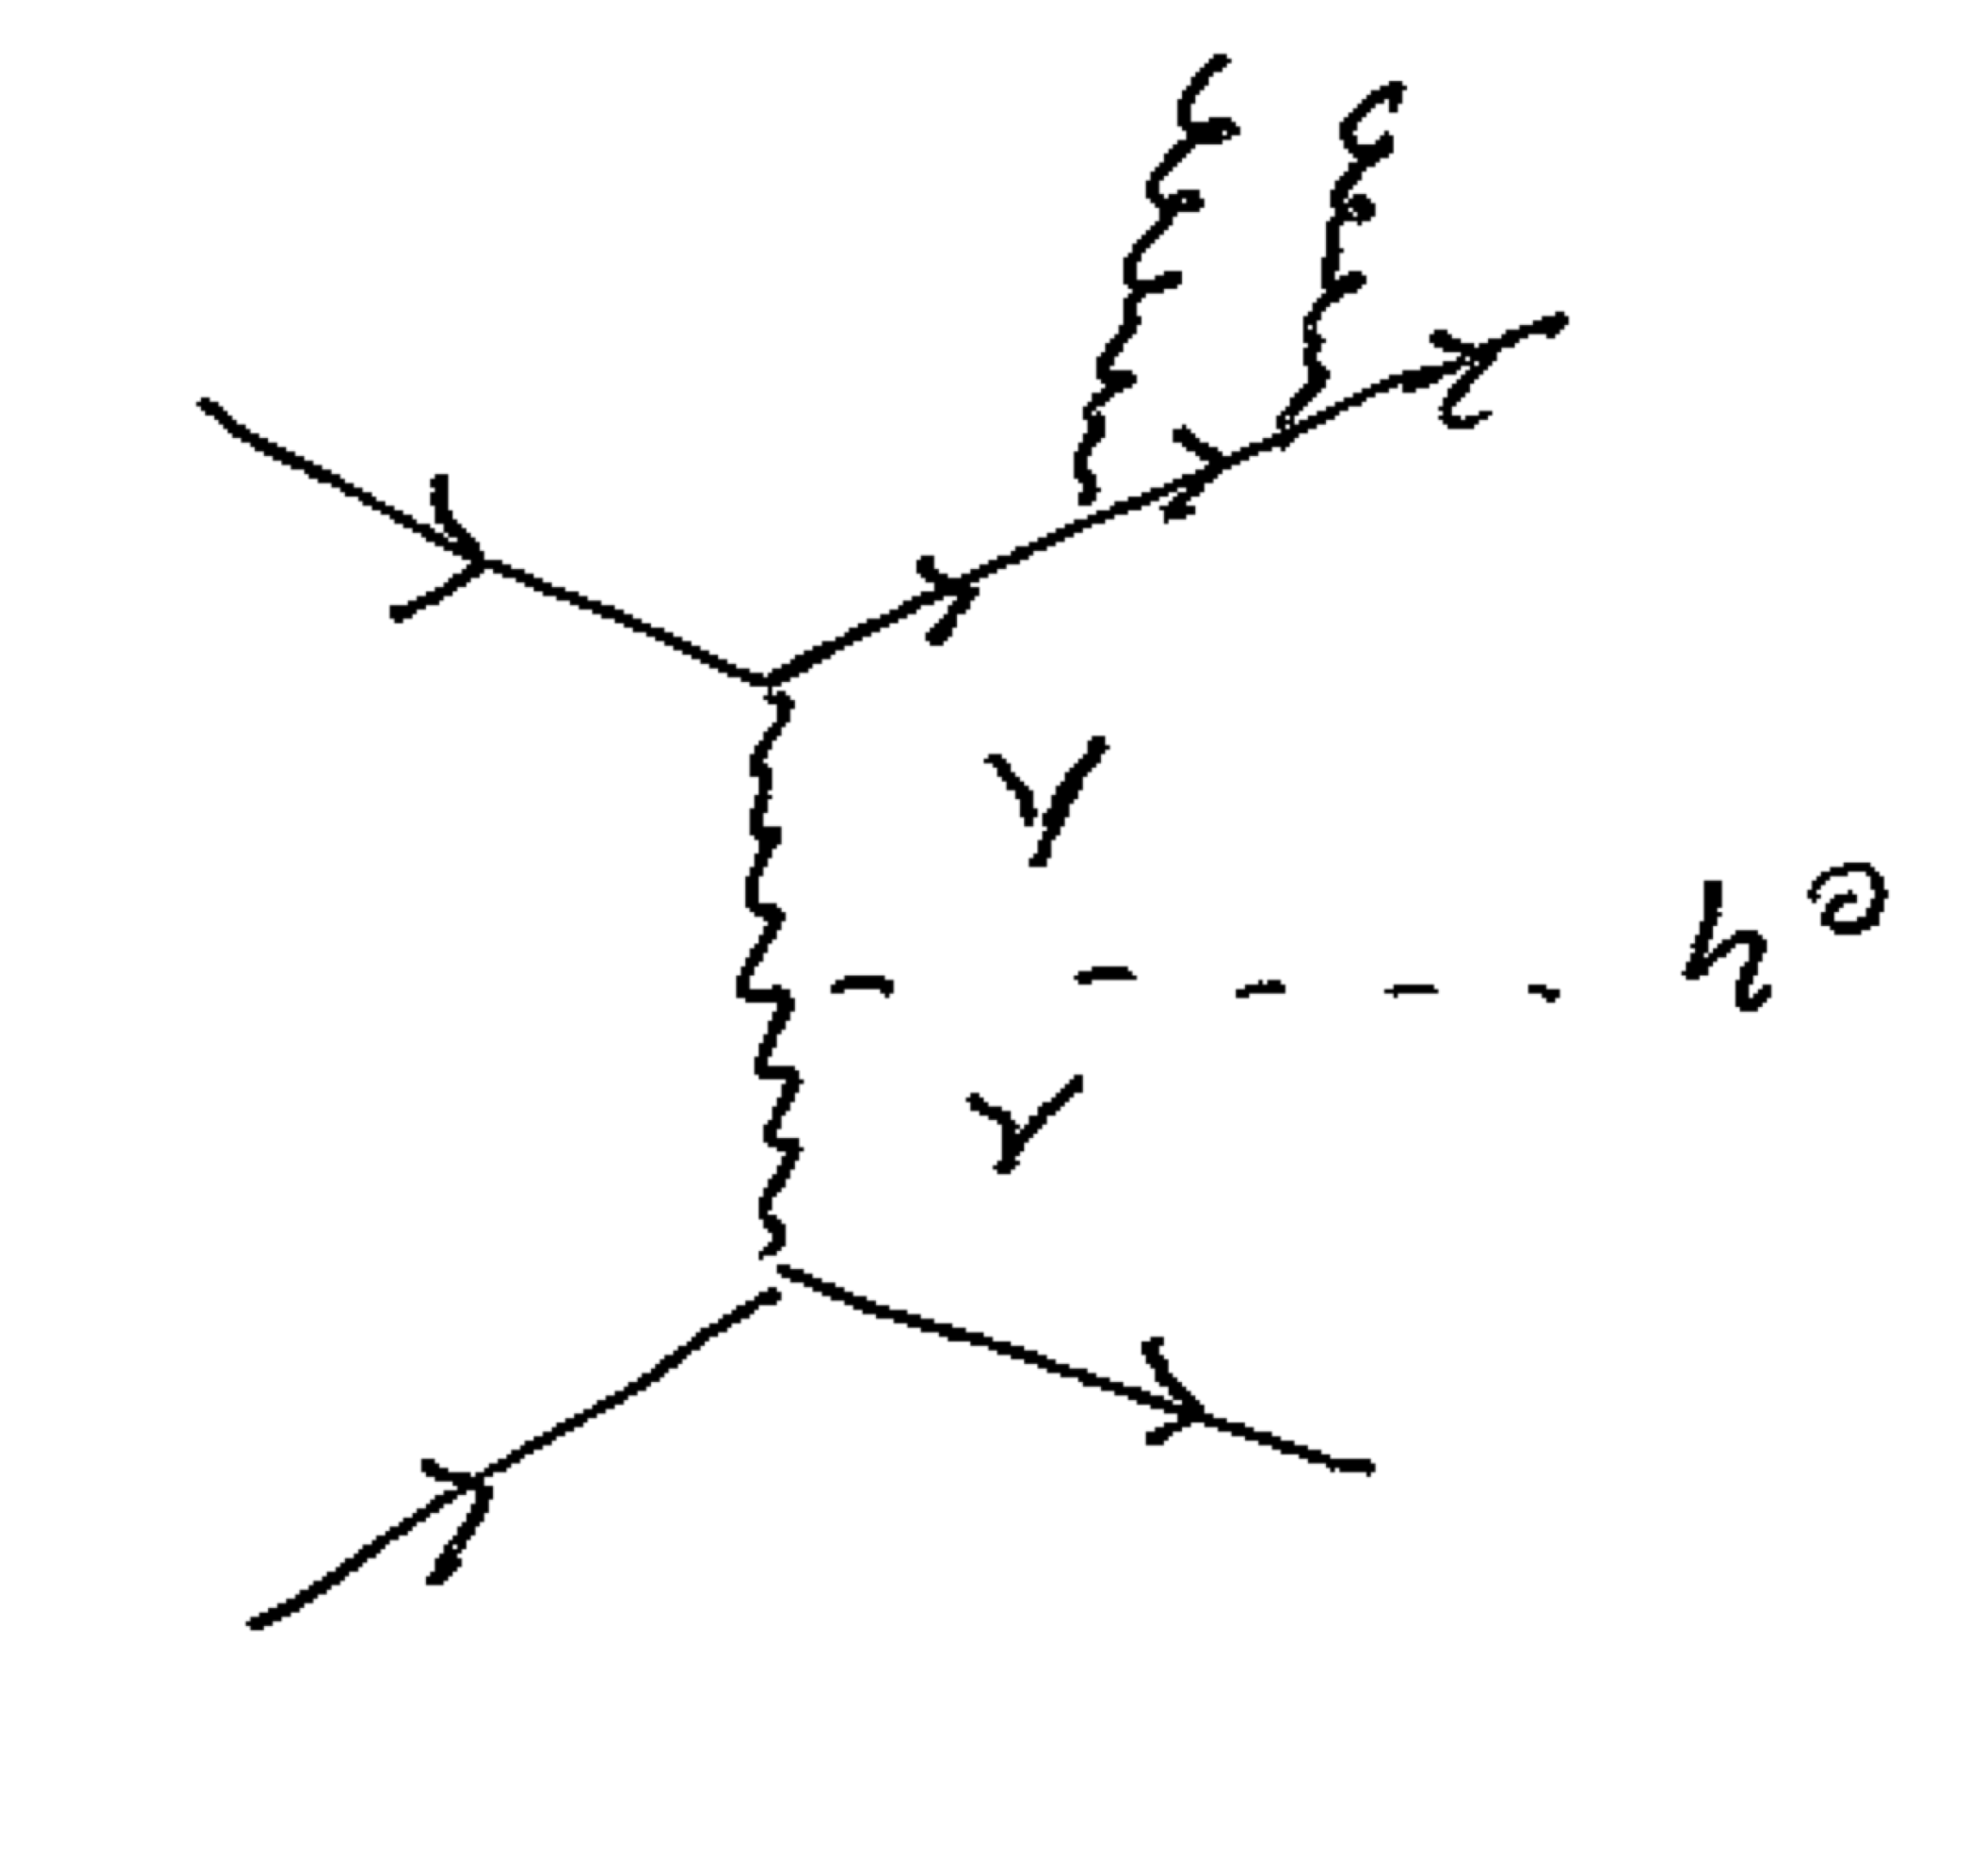
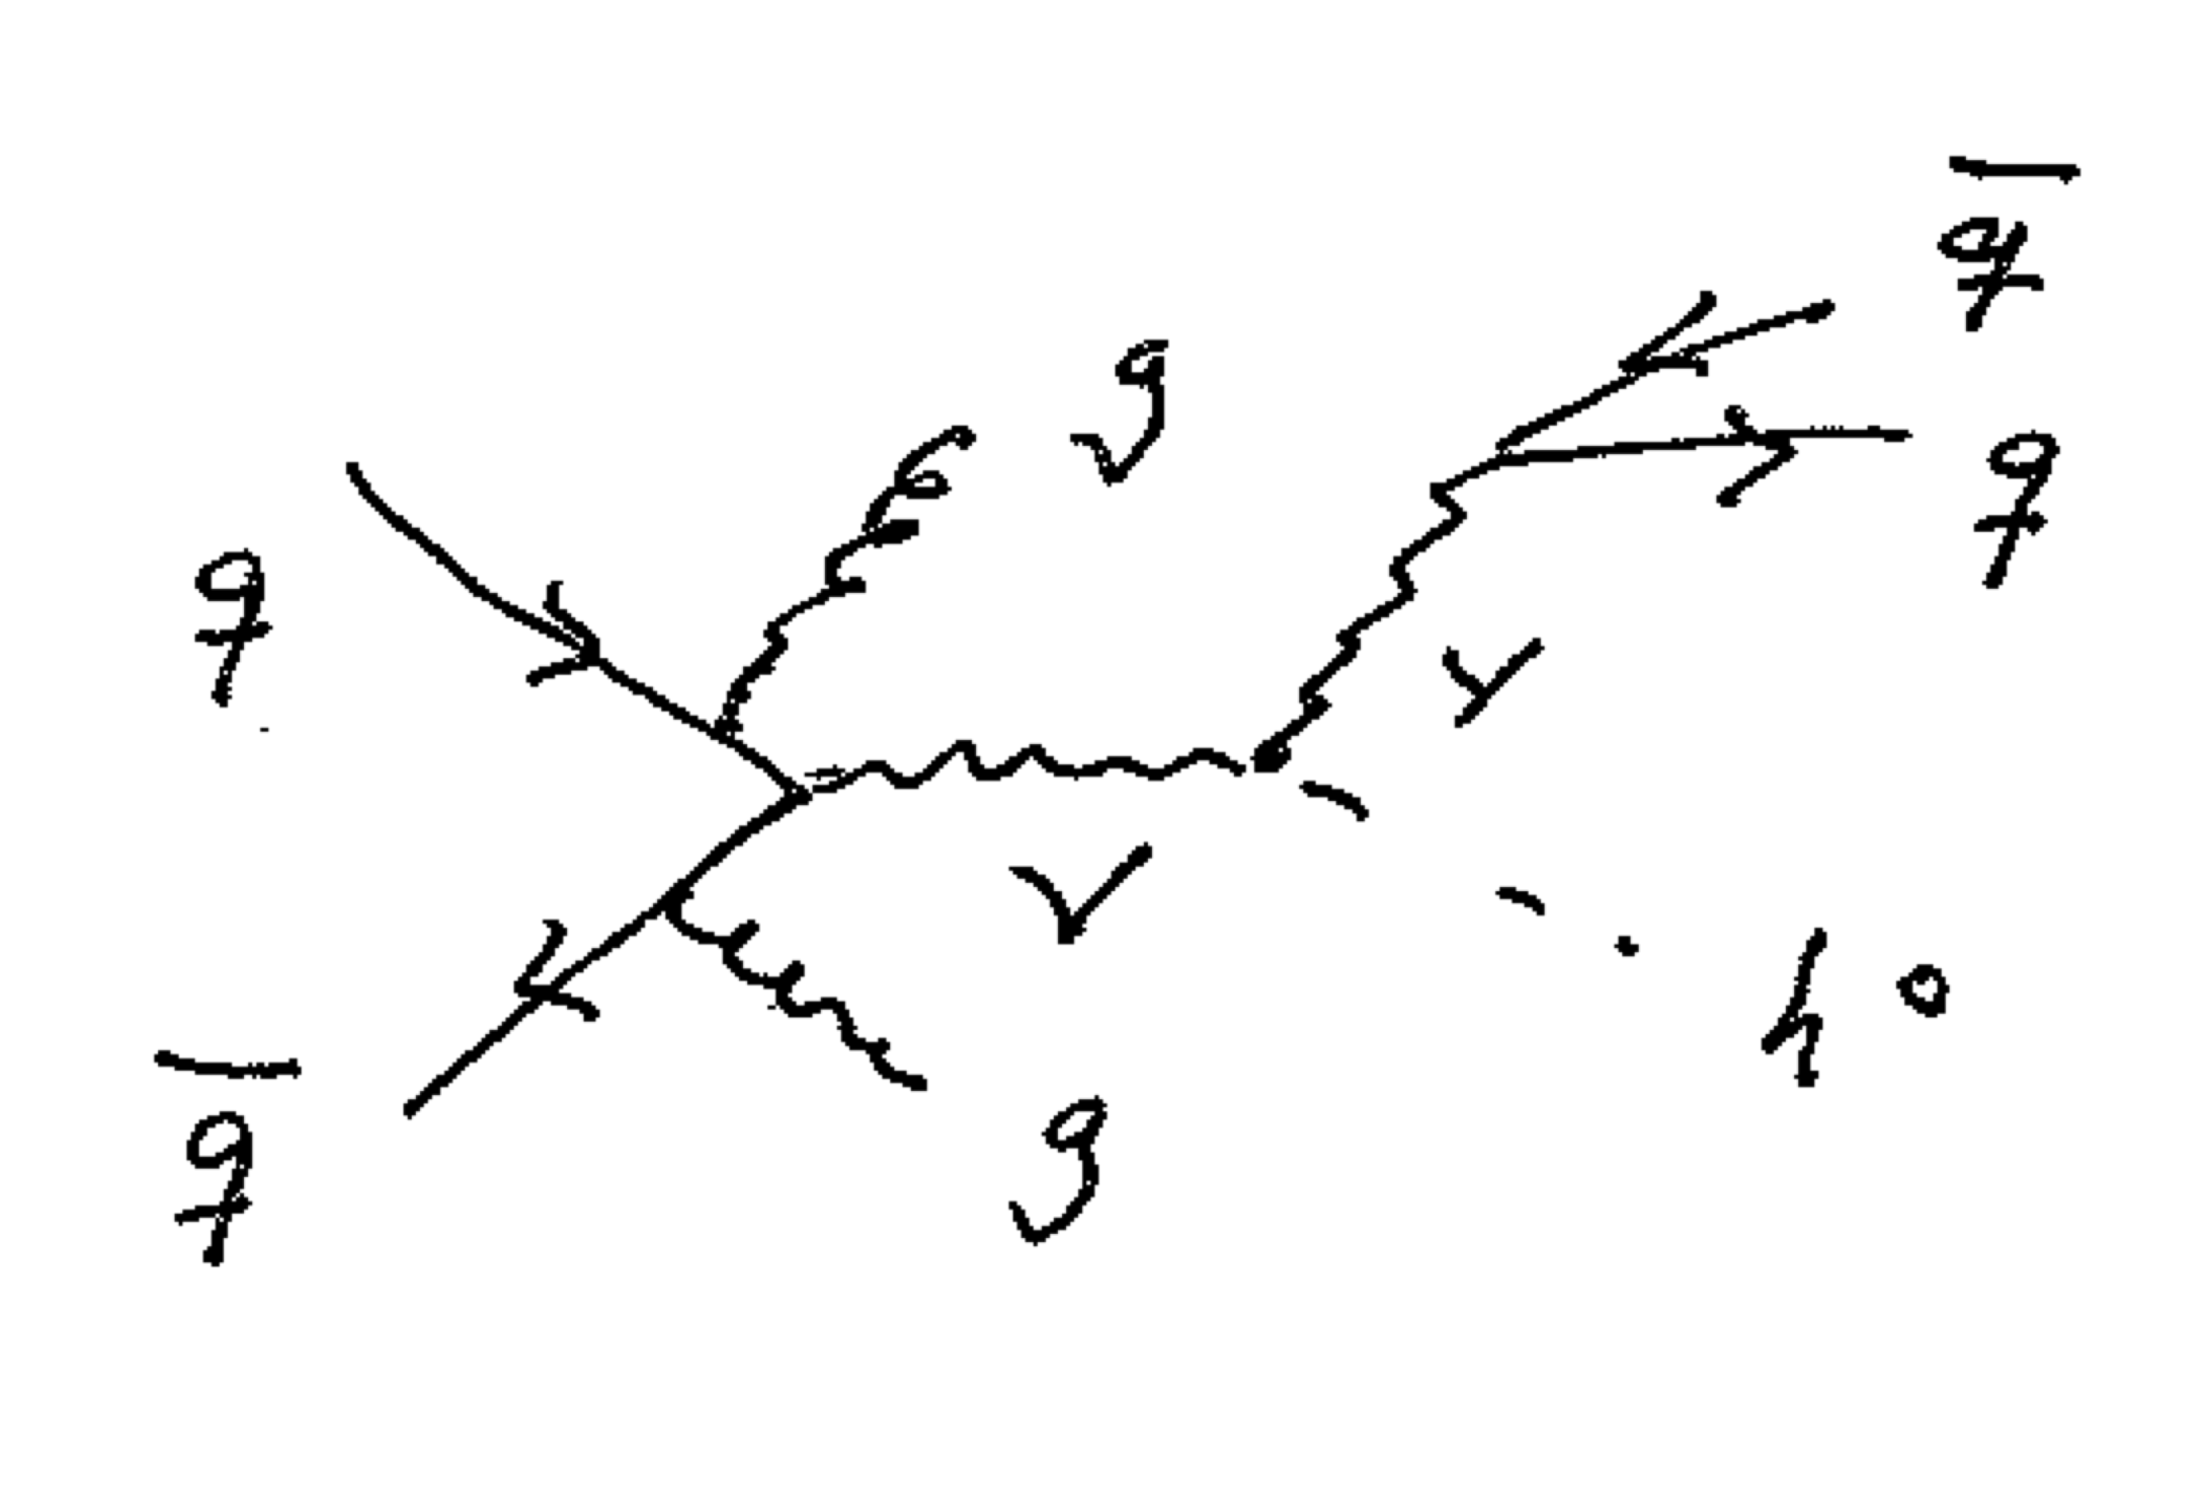
Going for all of it: EW H+3 Jets
Real Corrections

Slide 11
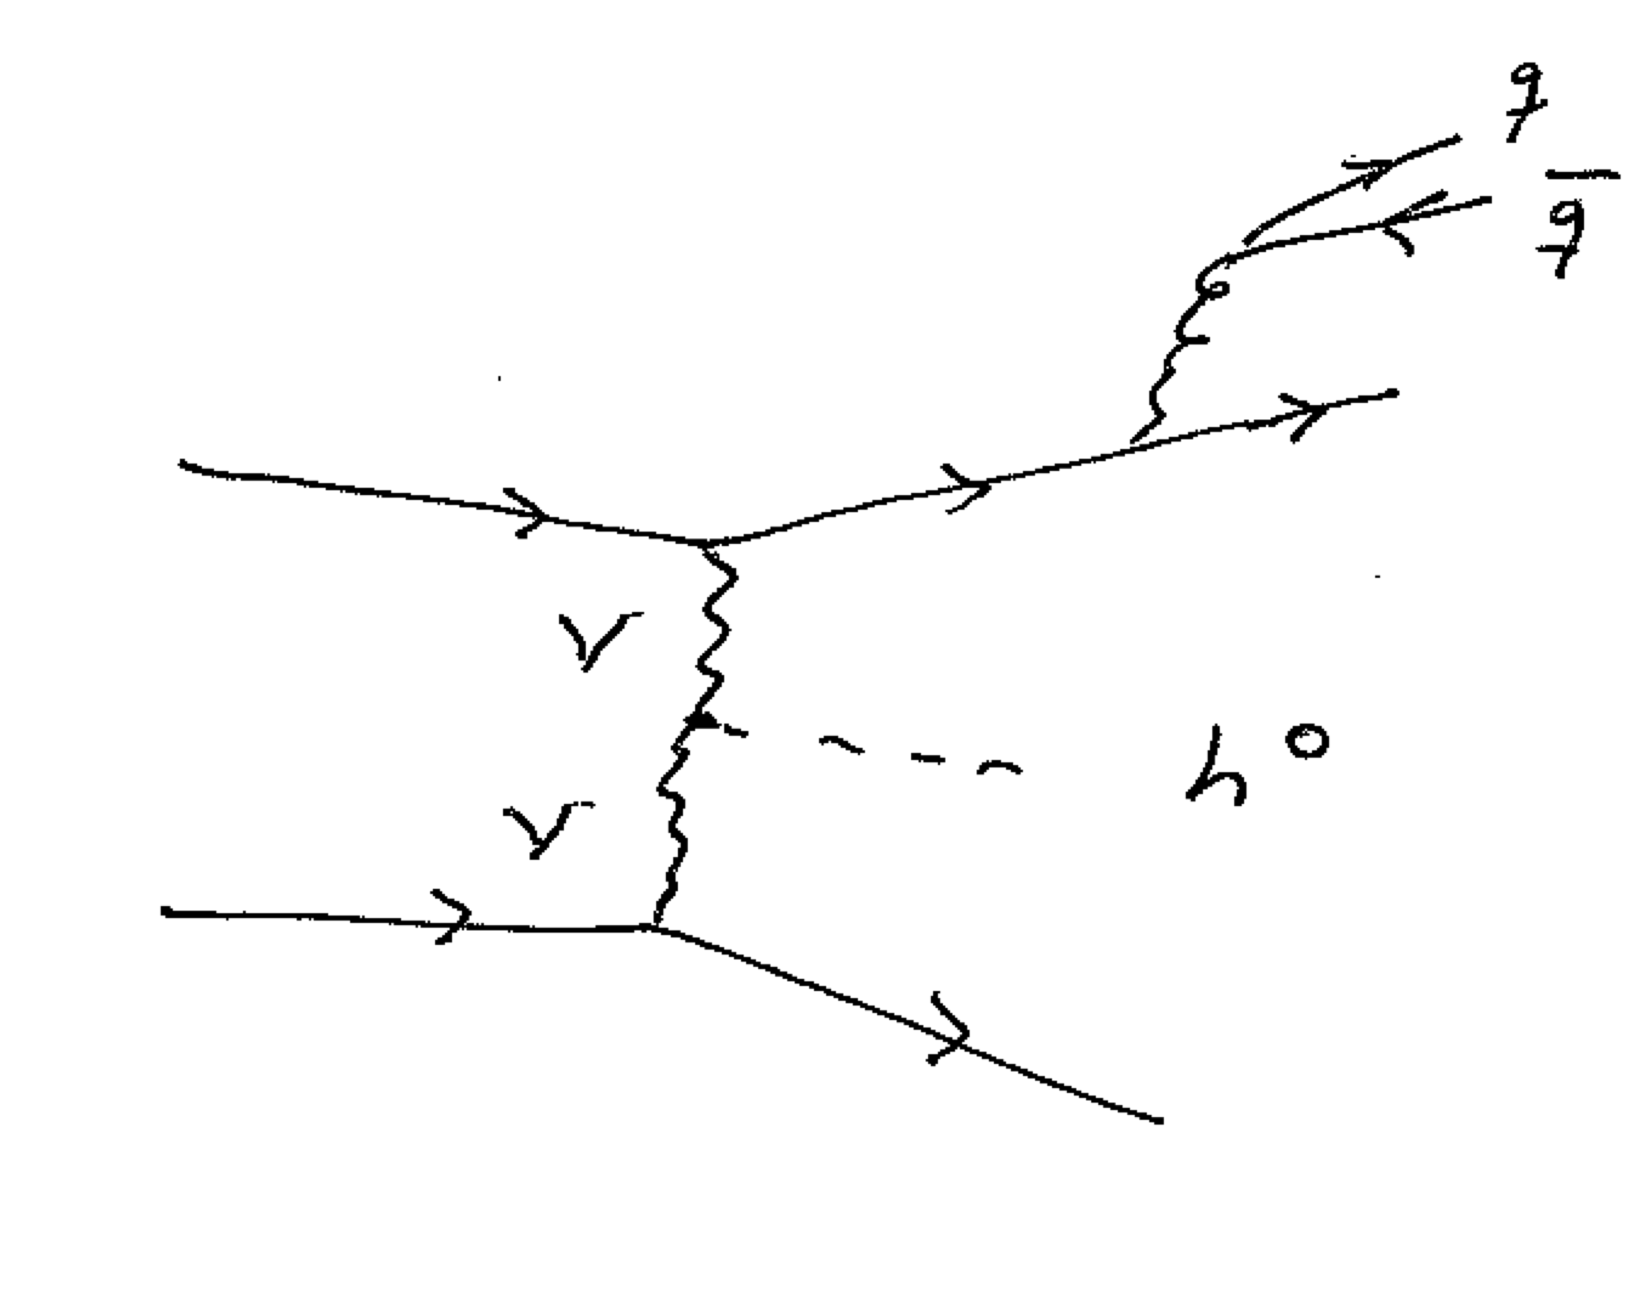
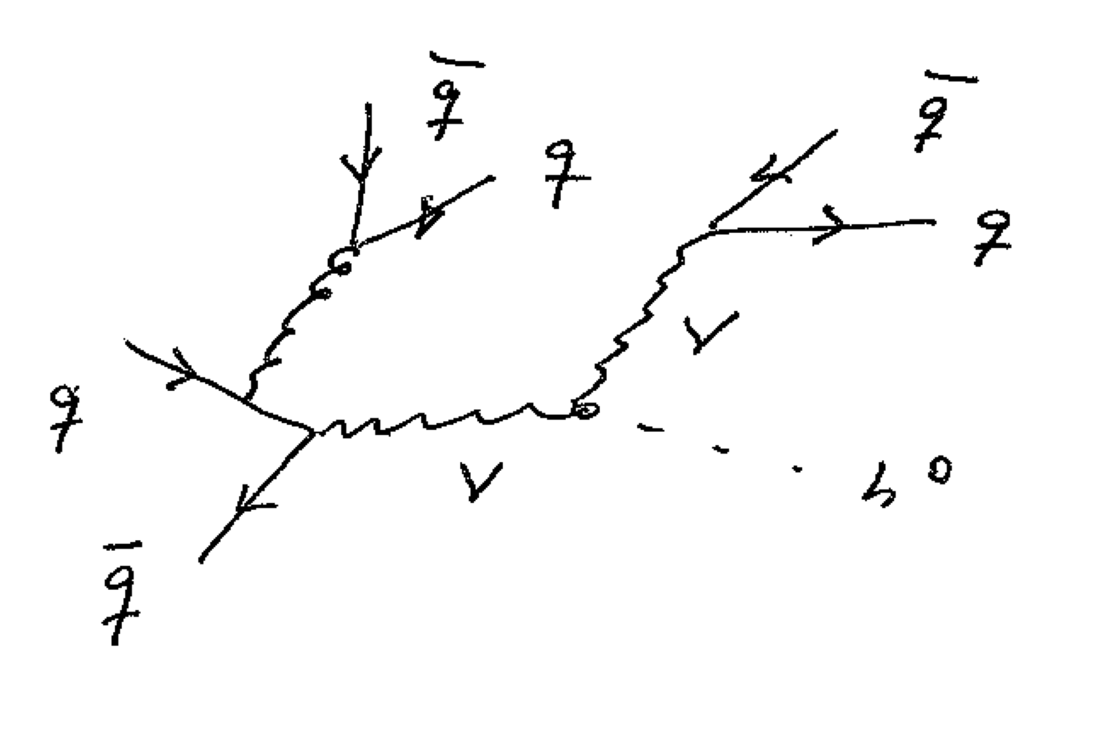
Going for all of it: EW H+3 Jets

Slide 12
EW H+3 Jets: Implementation Details
F. Campario, T. M. Figy, S. Platzer, and M. Sjodahl, PRL 111, 211802
Matchbox [S. Platzer and S. Gieseke, arXiv:1109.6256]
  Catani-Seymour Dipole subtraction [hep-ph/9605323]
  Subtractive and POWHEG style matching to parton shower
  ColorFull [M. Sjodahl, arXiv:1211.2099, http://colorfull.hepforge.org]
Tensorial Reduction [F. Capanario, arXiv:1105.0920]
Scalar Loop Integrals: OneLOop [A. van Hameren arXiv:1007.4716 ]

Slide 13
EW H+3 Jets: Publicly Available
HJets++ (https://hjets.hepforge.org)
Herwig 7 (https://herwig.hepforge.org)
  Herwig 7/Herwig++ 3.0 Release Note

Slide 14
Input Parameters
  14 TeV (proton - proton LHC)
  At least three anti-KT D=0.4 (E-scheme recombination) of 20 GeV and rapidity within -4.5 and 4.5 using FastJet [arXiv:0802.1189, arXiv:1111.6097]
  PDF choices: CT10 for NLO and CTEQ 6L1 for LO [arXiv:hep-ph/0201195, arXiv:1007.2241]
  Scales: W-boson mass (MW) and sum of transverse momentum of reconstructed jets (HT)

Slide 15
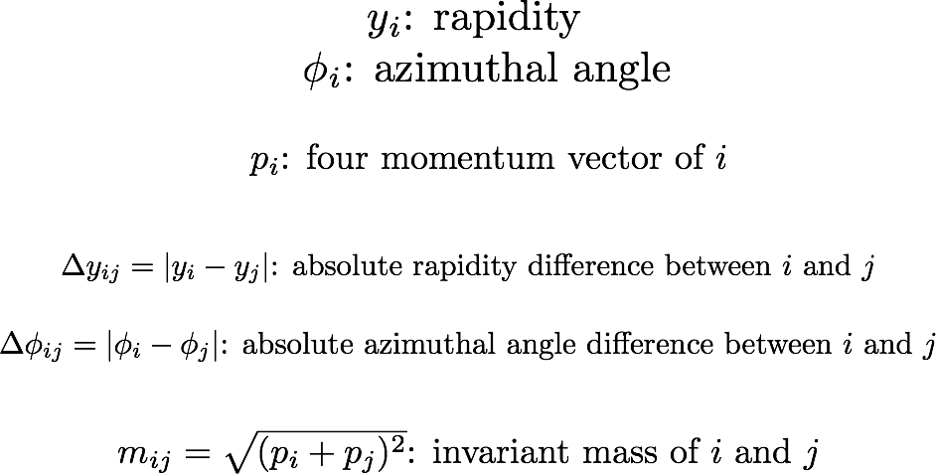
Notation:

Slide 16
EW H+3 Jets: Scale Uncertainties

Slide 17
EW H+3 Jets: The Third Jet

Slide 18
EW H+3 Jets: The Third Jet
Transverse momentum of third jet.

Slide 19
EW H+3 Jets: Jet Masses

Slide 20
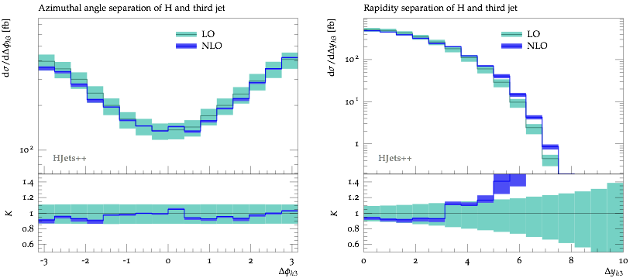
EW H+3 Jets: Higgs Boson

Slide 21
Comparison to VBFNLO
In collaboration with Simon Platzer, Peter Schichtel, and Michael Rauch.
Collider Energy and Cuts used: Anti-kt jet clustering with R=0.4
PDF set: MMHT2014
Scales: HT(jets)
Notes:
You must update all plots in this section.

Slide 22
Comparison to VBFNLO: Inclusive Cuts
HJets
VBFNLO

Slide 23
Comparison to VBFNLO: VBF cuts

Slide 24
Comparison to VBFNLO: VBF cuts
HJets
VBFNLO

Slide 25
LO Comparison to VBFNLO
Inclusive Cuts
VBF cuts

Slide 26
LO Comparison to VBFNLO
Inclusive Cuts
VBF cuts

Slide 27
NLO Comparison to VBFNLO
Inclusive Cuts
VBF Cuts

Slide 28
NLO Comparison to VBFNLO
Inclusive Cuts
VBF Cuts

Slide 29
NLO+Parton Shower Results
Compared HJETS++ with POWHEG BOX at the level of NLO+PS.
Deviations between the results of HJETS++ and POWHEG BOX due the various approximations implemented in POWHEG BOX. (The core matrix elements in POWHEG BOX are essentially taken from VBFNLO).

Slide 30
NLO+Parton Shower Results
Collider Energy and Cuts used: Anti-kt jet clustering with R=0.4
PDF set: four flavor CT10
Results included in the “Handbook of LHC Higgs Cross Section: 4”, LHC HXWG, arXiv:1610.07922.

Slide 31
NLO+Parton Shower Results

Slide 32
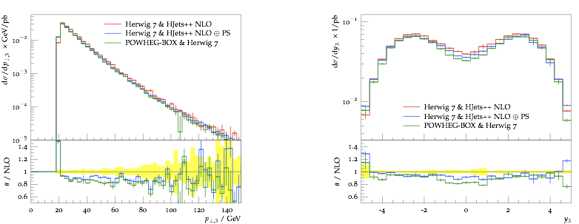
NLO+Parton Shower Results

Slide 33
Conclusions
I have discussed the implementation of the full NLO QCD corrections for electroweak Higgs boson production in association with three jets at the LHC within the Matchbox framework of Herwig 7.
Kinematic distributions have been presented at fixed order at NLO and at NLO+PS.
Questions?

