Slide 1

Probe of TeV Scale Left Right Symmetric Seesaw Model at the LHC for Photon Initiated Processes
(in collaboration with Prof. K. S. Babu)
Particle Physics on the Plains​,
University of Kansas
30th Sept, 2017
Sudip Jana
Oklahoma State University, USA

Slide 2
References
This talk is based on :
K. S. Babu and Sudip Jana, arXiv : 17xx.xxxxx
K. S. Babu and Sudip Jana, Phys.Rev. D 95 (2017) no.5, 055020

Slide 3
Outline
Motivation
LHC Accessible Neutral Heavy Higgs phenomenology
Doubly Charged Higgs Phenomenology
Conclusion
Brief Overview of the Model

Slide 4

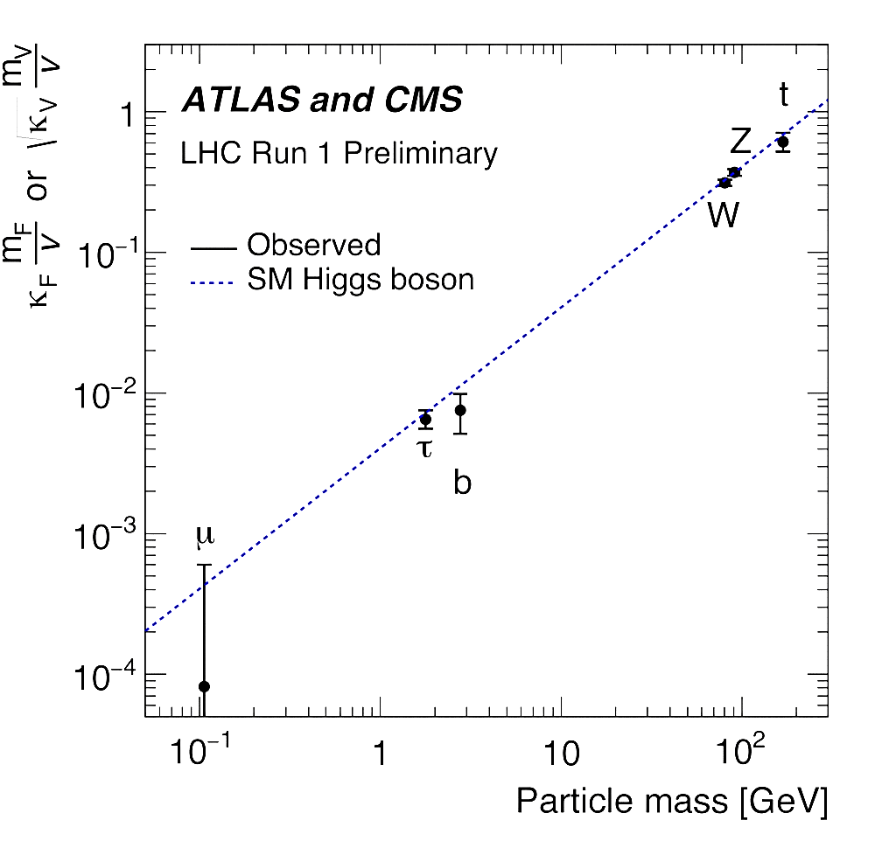
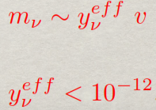
Neutrino Mass New physics beyond SM:
⌫
⌫

Slide 5

Small Neutrino masses
“ Technically natural ” in t’Hooft sense. Small values are protected by symmetry. At a cut-off scale Λ :
“ natural ” - 𝛅m_{f} ~ g²/(16𝛑²) m_{f} ln(Λ²/m_{f}²)
“ unnatural ” - 𝛅m_{H}² ~ - y_{t}²/(8𝛑²) Λ²
Two ways to generate small values naturally :
Suppression by integrating out heavy states :
the higher dimension 1/Λ^{n}, the lower Λ can be.
Suppression by loop radiative generation:
the higher loops 1/(16𝛑²)^{n}, the lower cut off scale can be.

Slide 6
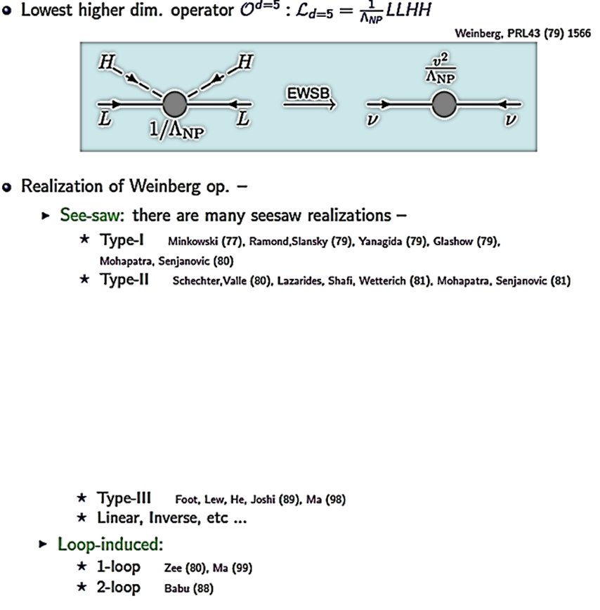
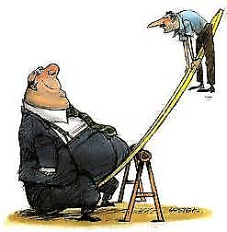
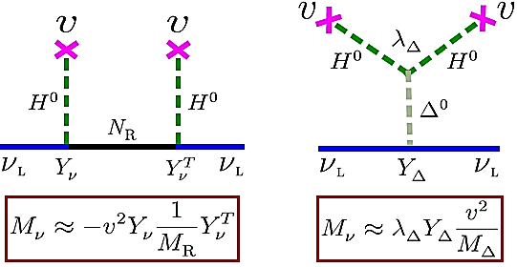
Neutrino Mass Models

Slide 7















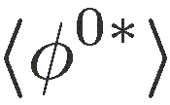

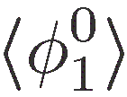
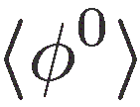

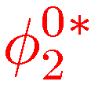










Higher-loop models with DM
R. 1 loop
Seesaw
Krauss-Nasri-Trodden model
II
III
M.L. Krauss, S. Nasri and M. Trodden,
Seesaw I
PRD67, 085002 (2003)
SM
R. 3 loop
R. 2 loop
Seesaw I
Many models of
Which is the true one ?
Aoki-Kanemura-Seto model
M. Aoki, S. Kanemura and O. Seto,
PRL102, 051805 (2009)
Gustafsson-No-Rivera model
M. Gustafsson, J.M. No, and M.A. Rivera,
PRL110, 21802 (2013)

Slide 8
Higher-loop models with DM
R. 1 loop
Seesaw
Krauss-Nasri-Trodden model
II
III
M.L. Krauss, S. Nasri and M. Trodden,
Seesaw I
PRD67, 085002 (2003)
SM
R. 3 loop
R. 2 loop
Seesaw I
Can we test / falsify these models at the LHC ?
Can we explore the new Physics Scale M ?
Aoki-Kanemura-Seto model
M. Aoki, S. Kanemura and O. Seto,
PRL102, 051805 (2009)
Gustafsson-No-Rivera model
M. Gustafsson, J.M. No, and M.A. Rivera,
PRL110, 21802 (2013)

Slide 9

Why Left Right Symmetry ?

Slide 10
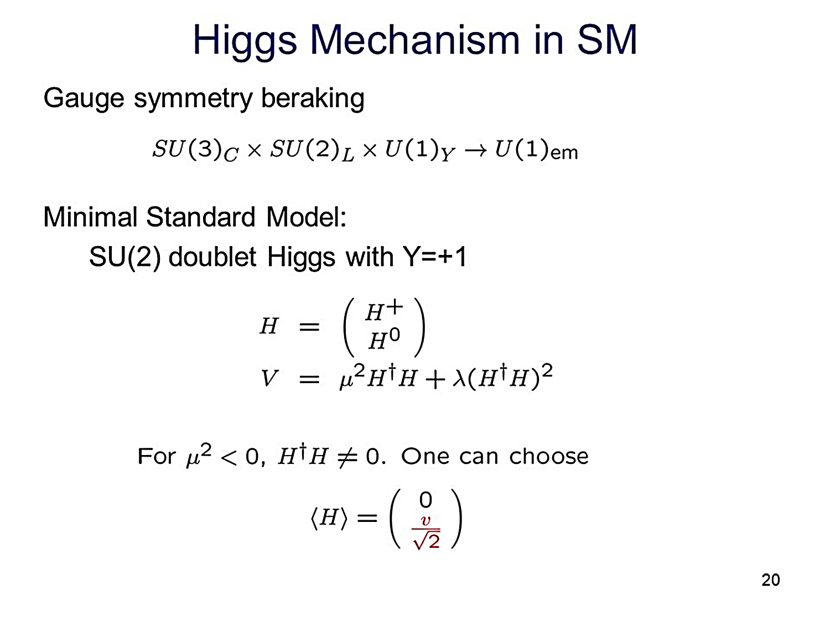

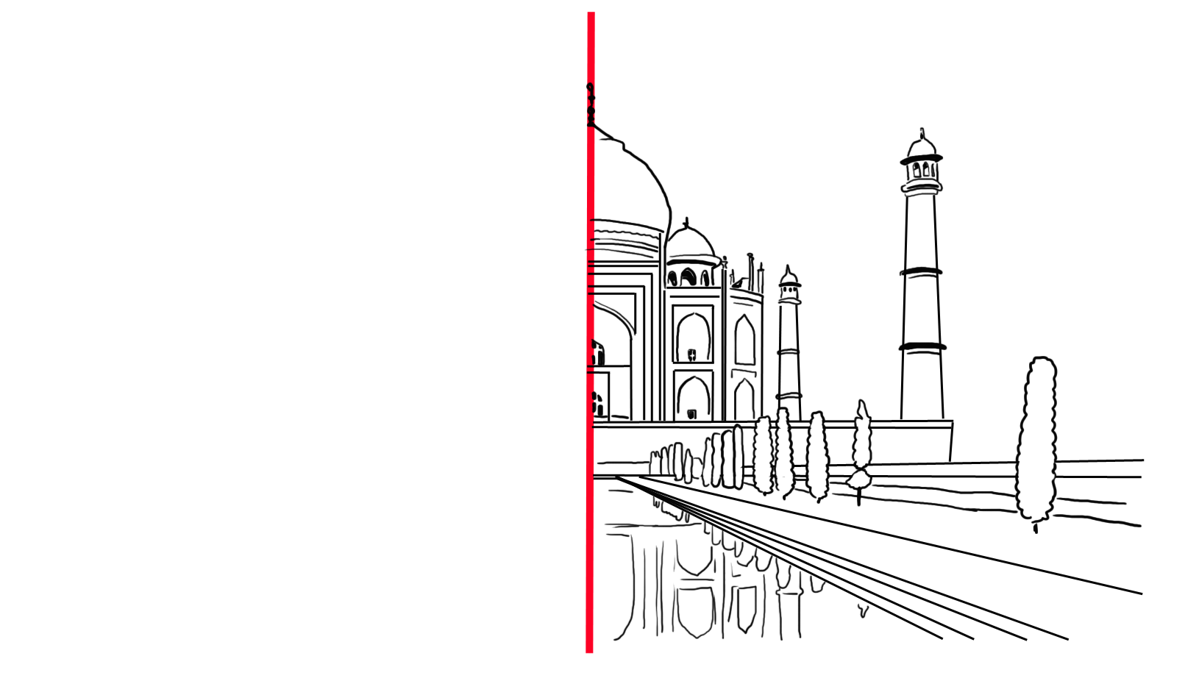

SM Gauge Symmetry :

Slide 11
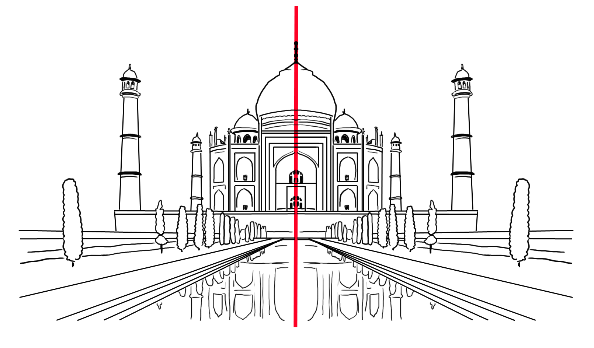
Left-Right symmetry

Slide 12
Why Left Right Symmetry ?
Understanding the origin of the parity violation.
Generates small neutrino mass via seesaw mechanism.
These models place quarks and leptons on the same footing in the weak interactions.
The gauge group is very simple extension of the SM gauge group. Provide a simple formula for the electric charge.
Pati, Jogesh C. et al. Phys.Rev. D10 (1974) 275-289,
Pati, Jogesh C. et al. Phys.Rev. D10 (1974) 275-289,
Mohapatra, Rabindra N. et al. Phys.Rev. D11 (1975) 566-571
Senjanovic, G. et al. Phys.Rev. D12 (1975) 1502

Slide 13
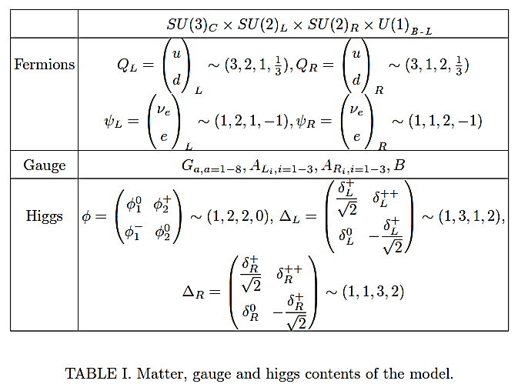
Particle Spectrum of MLRSM

Slide 14
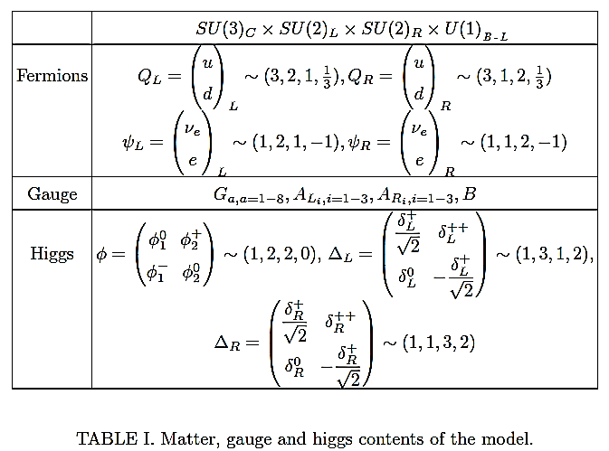
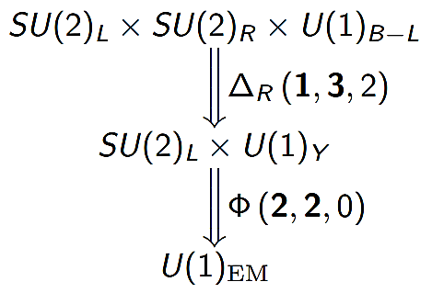
Particle Spectrum of MLRSM

Slide 15
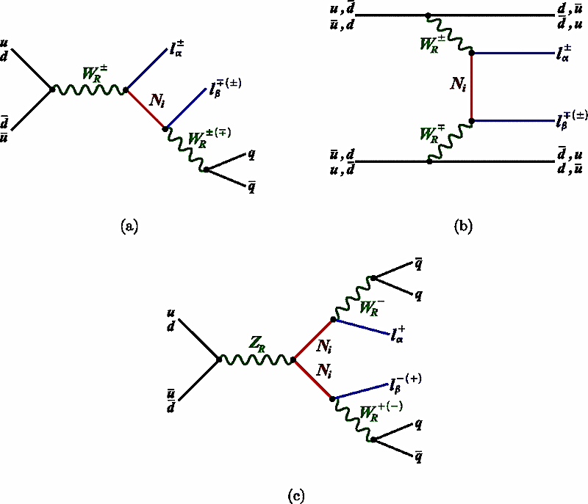
Conspicuous Signatures for MLRSM

Slide 16
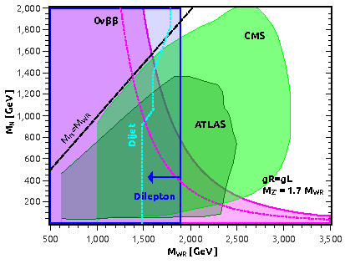
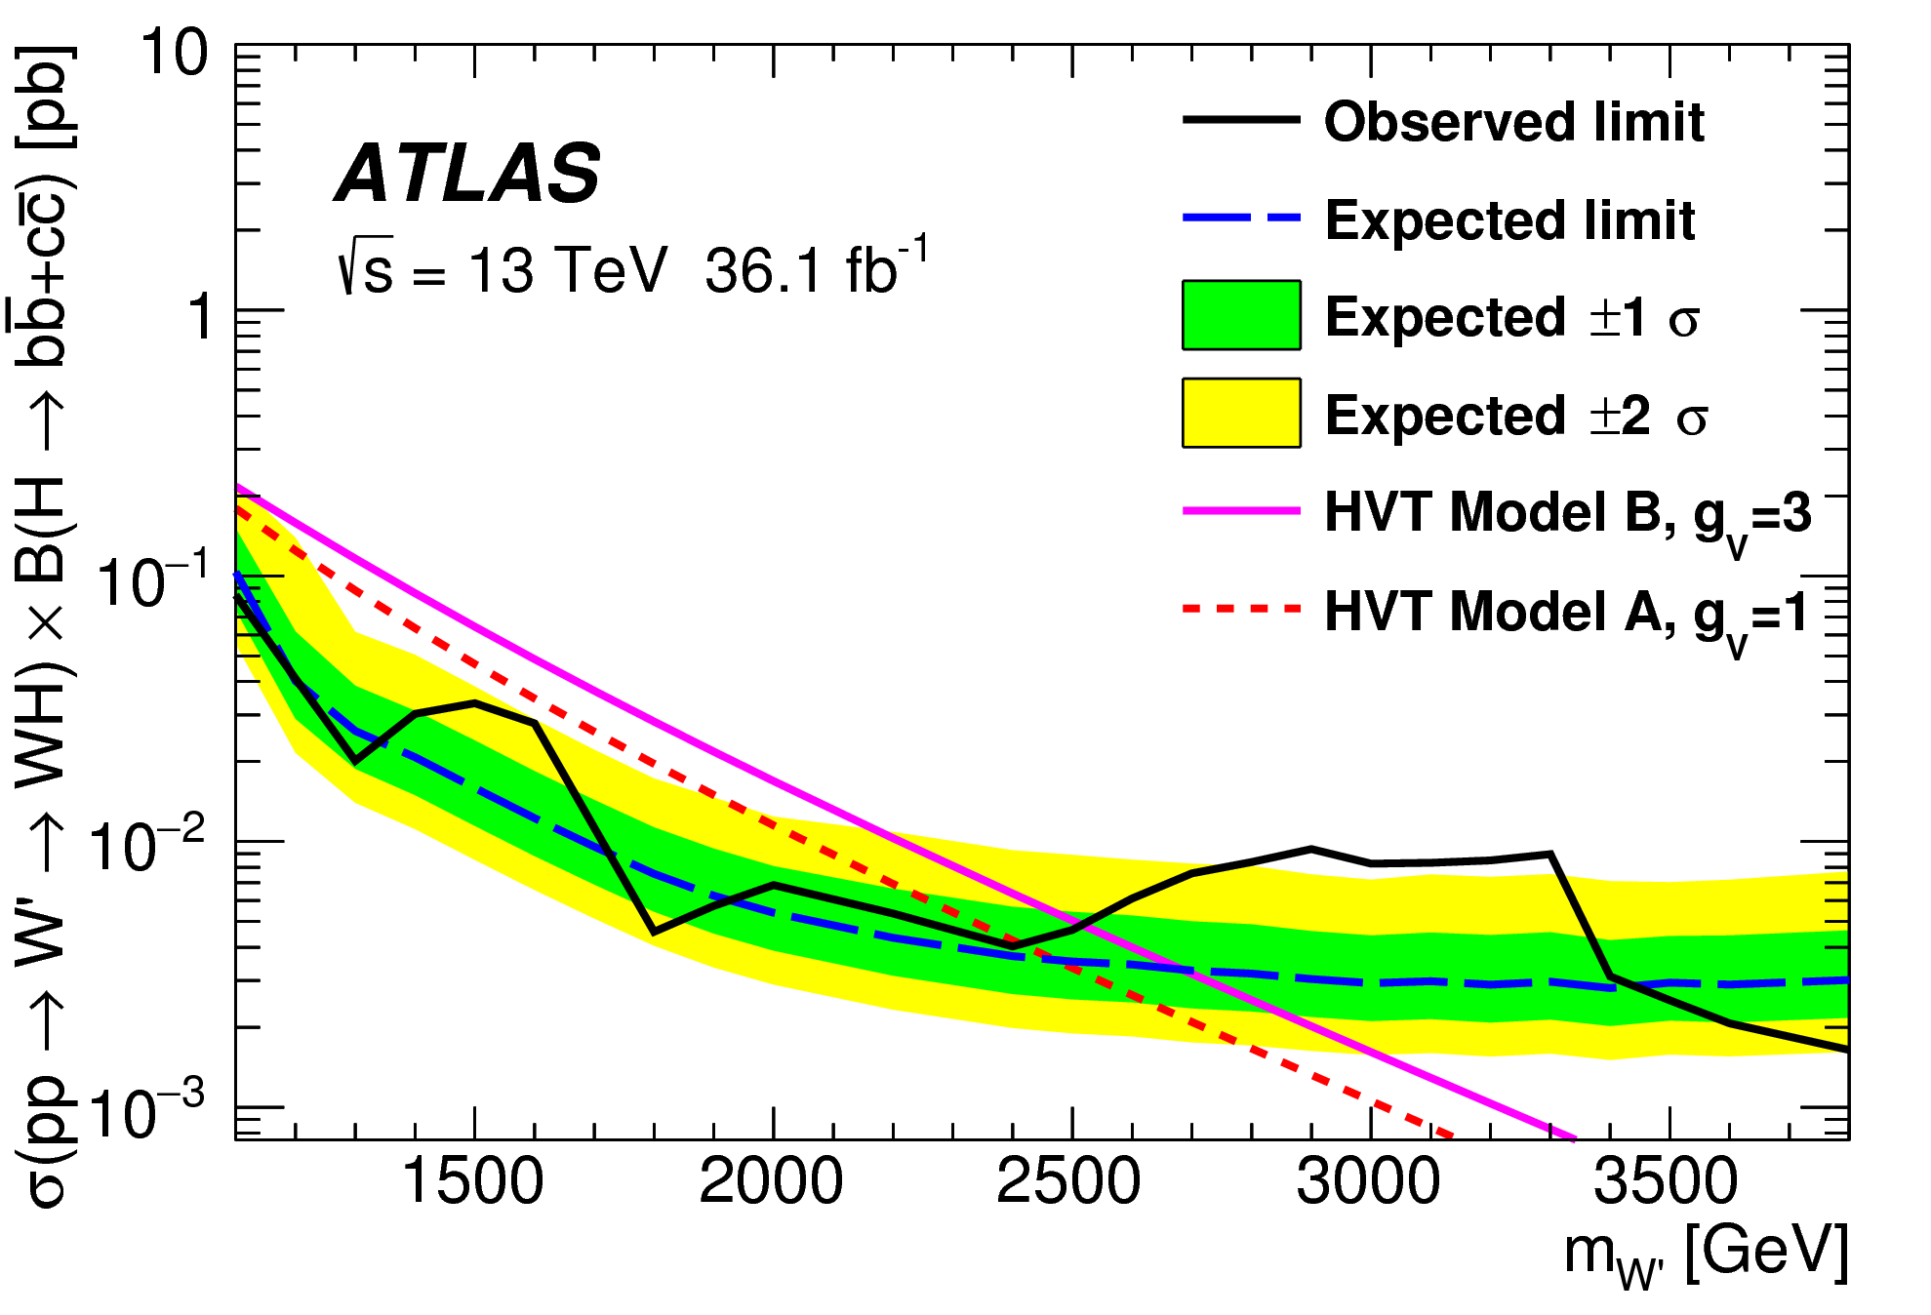
Mass Limits on Heavy Gauge Bosons
arXiv:1707.06958
Lindner, Manfred et al. Phys.Lett. B762 (2016)

Slide 17
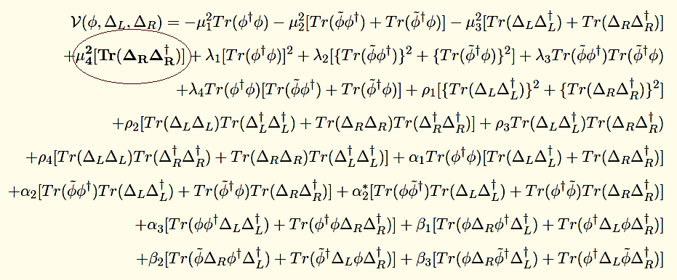
MLRSM Higgs Potential
Adding one extra soft breaking term, the most general renormalizable scalar potential is given by :
Mohapatra, Rabindra N. et al. Phys.Rev. D23 (1981) 165
Gunion, J.F. et al. Phys.Rev. D40 (1989) 1546
Deshpande, N.G. et al. Phys.Rev. D44 (1991) 837-858

Slide 18
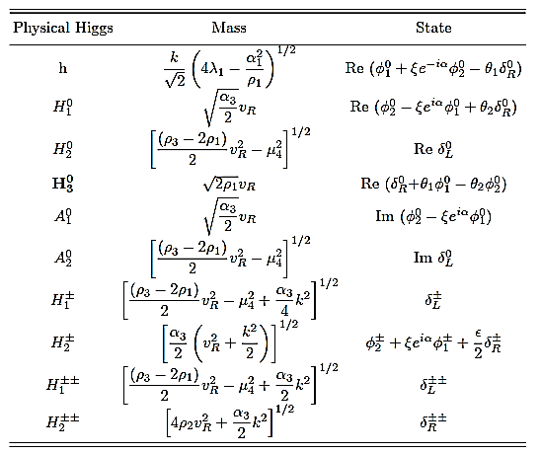
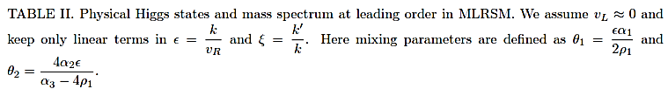
Physical Higgs States and Mass Spectrum

Slide 19
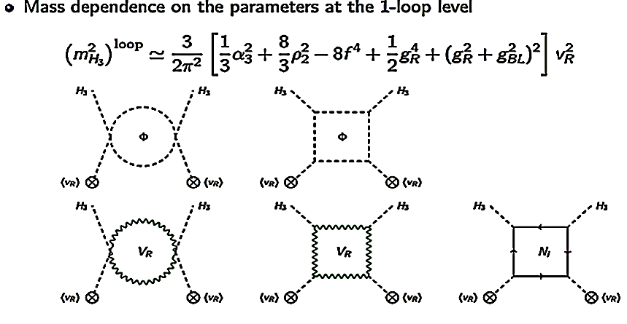
Physical Higgs States and Mass Spectrum
Mohapatra, Rabindra N. et al. JHEP 1605 (2016) 174

Slide 20
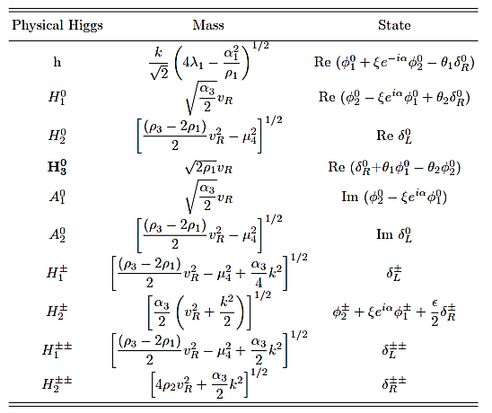
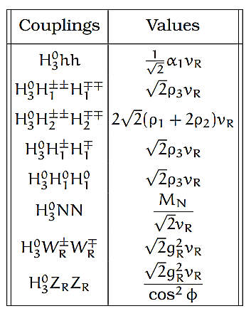
Physical Higgs States and Mass Spectrum

Slide 21
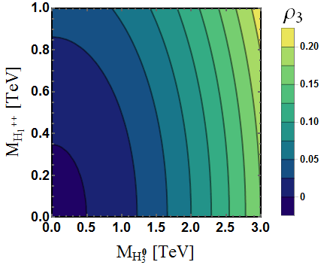
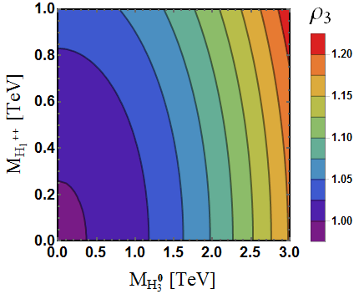
Higgs Mass and Couplings

Slide 22
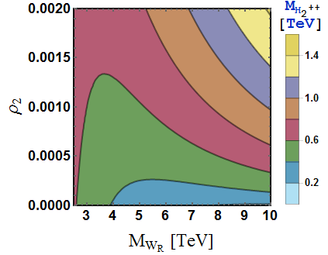
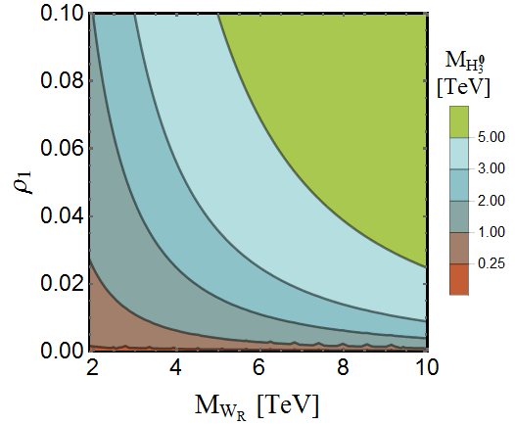
Higgs Mass and Couplings

Slide 23
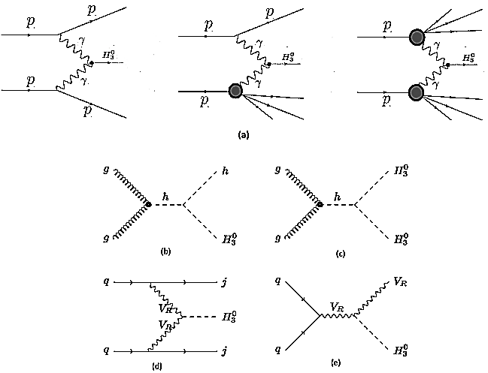
H₃⁰ Production at the LHC
Dev, P. S. Bhupal et al. JHEP 1605 (2016) 174
Huitu, K. et al. Nucl.Phys. B487 (1997) 27-42
Dutta, Bhaskar et al. Phys.Rev. D90 (2014) 055015
Bambhaniya, G. et al. Phys.Rev. D92 (2015) no.1, 015016
Babu, K.S. et al. Phys.Rev. D88 (2013) 055006

Slide 24
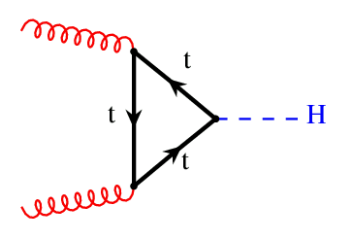
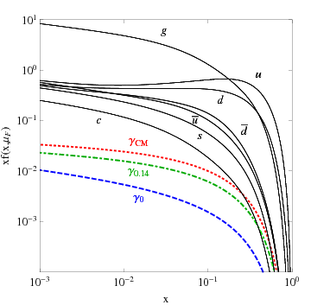
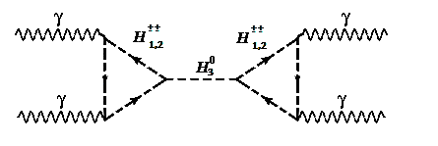

      Gluon vs Photon Production
g
g
~ 1
~ 10 TeV
Schmidt, Carl et al. Phys.Rev. D93 (2016) no.11
2
Again Charge Factor ~ (4+4+1+1)
Loss in the parton luminosity is compensated by cubic coupling and charge factor enhancement ….

Slide 25
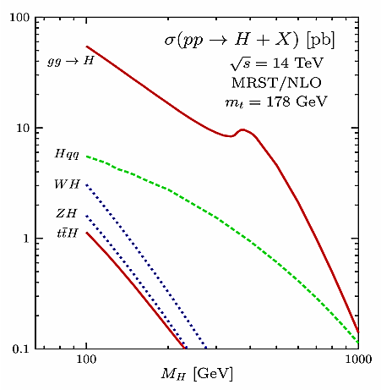
      Gluon vs Photon Production
g
g
~ 1
~ 10 TeV
2
Again Charge Factor ~ (4+4+1+1)
Loss in the parton luminosity is compensated by cubic coupling and charge factor enhancement ….

Slide 26
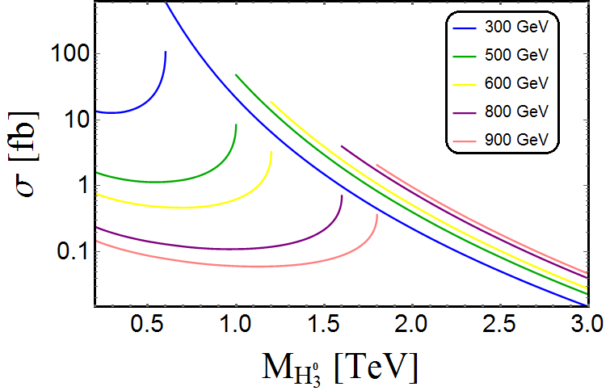
      H₃⁰ Production at the LHC through photon initiated processes
NNPDF Collaboration (Ball, Richard D. et al.) JHEP 1504 (2015) 040

Slide 27
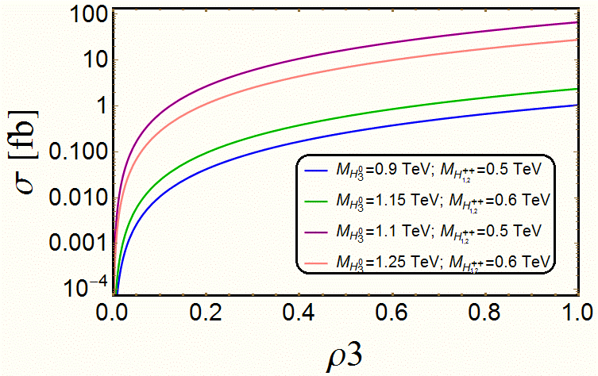
      H₃⁰ Production at the LHC through photon initiated processes
NNPDF Collaboration (Ball, Richard D. et al.) JHEP 1504 (2015) 040

Slide 28

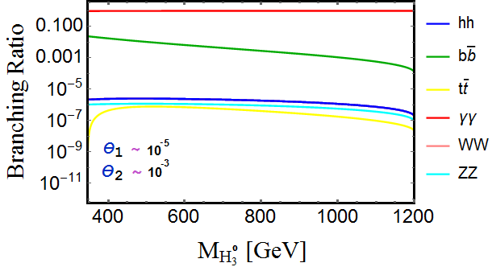
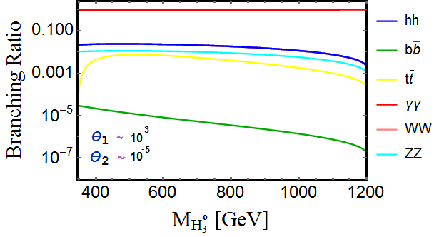
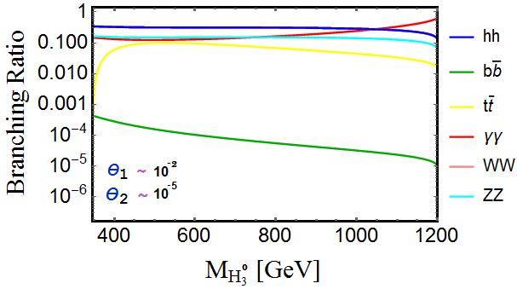
Region 1 :
      Decay modes of H₃⁰ :
0

Slide 29

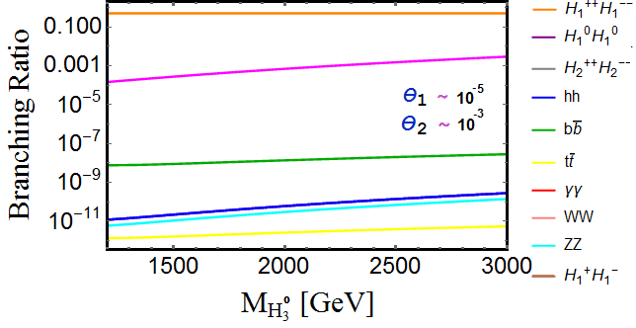
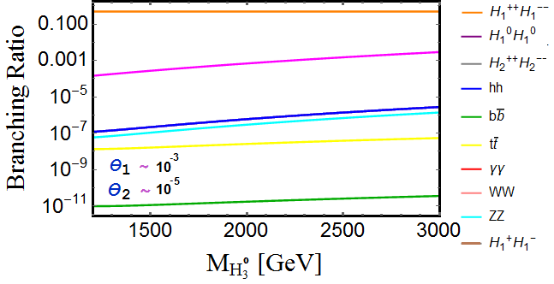
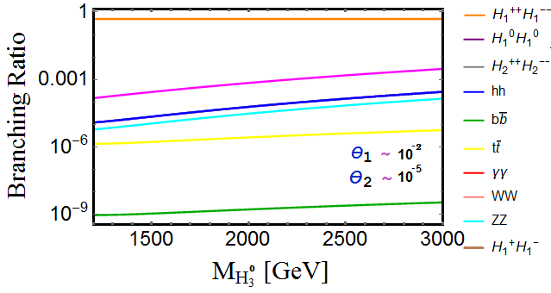
Region 2 :
      Decay modes of H₃⁰ :

Slide 30

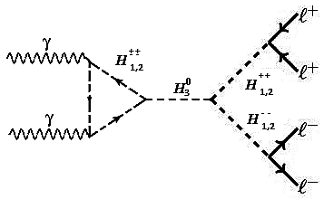
Potential discovery signals of H₃⁰ at LHC :

Slide 31
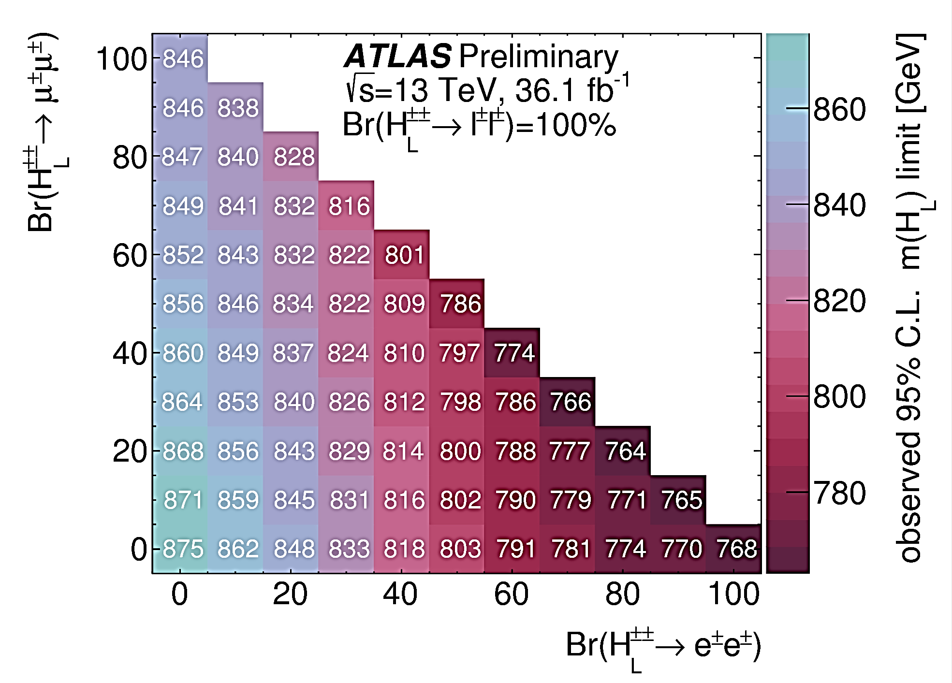
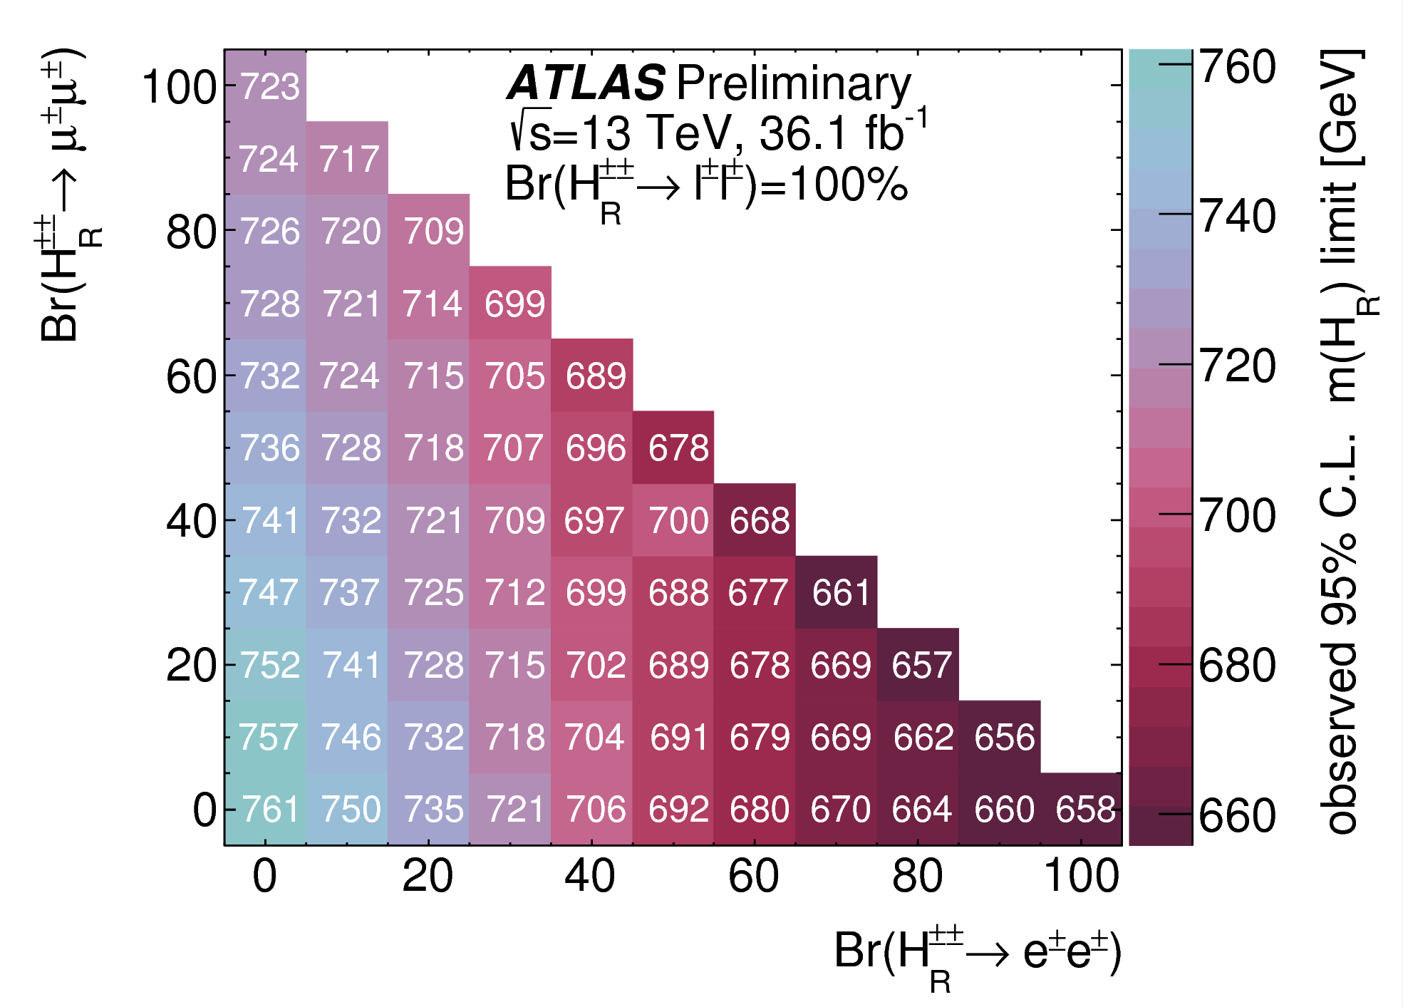
Present Status of Doubly Charged Higgs
ATLAS-CONF-2017-053

Slide 32
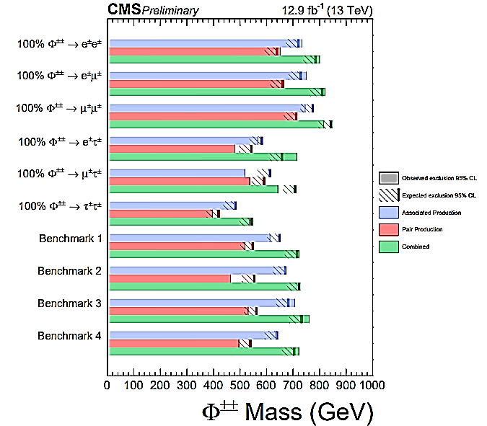
Present Status of Doubly Charged Higgs
CMS-PAS-HIG-16-036

Slide 33
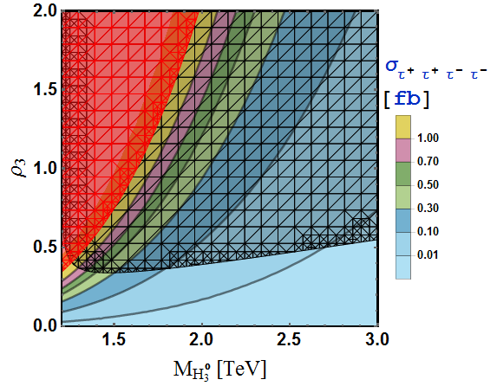
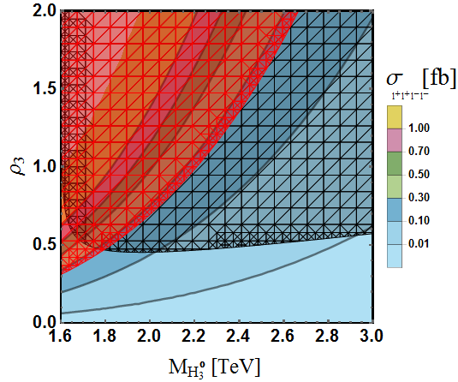
H₃⁰ as four lepton resonance at LHC:
0
0
0

Slide 34
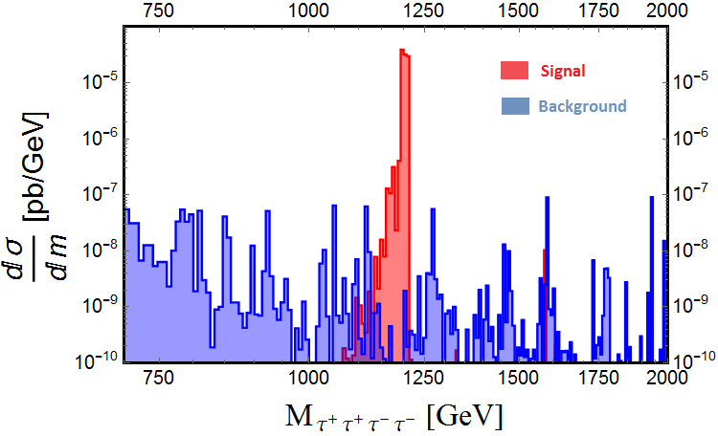
H₃⁰ as four lepton resonance at LHC:

Slide 35
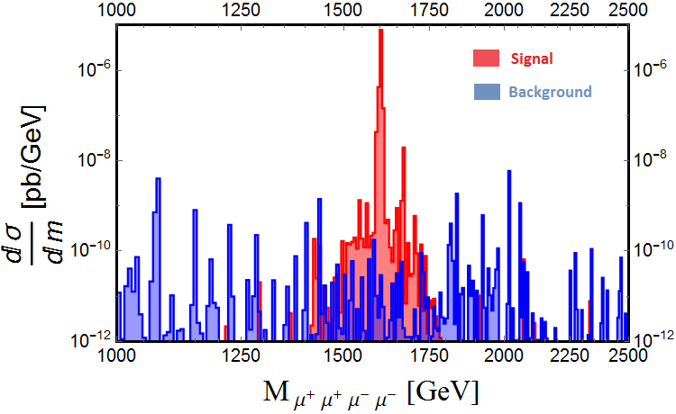
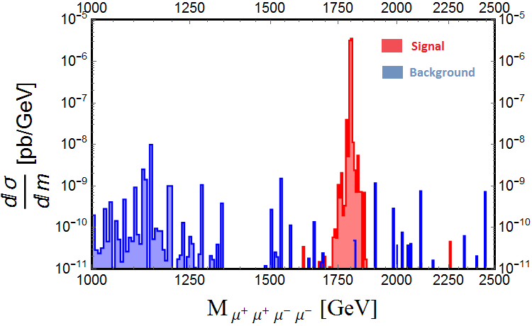
H₃⁰ as four lepton resonance at LHC:

Slide 36


H₃⁰ as di-photon resonance at LHC:

Slide 37

Discovery Reach of H₃⁰ at LHC:

Slide 38


Discovery Reach of H₃⁰ at LHC:
0

Slide 39


Charge Breaking Minima :
( Preliminary Result )
Unstable Minima: in this case the minima are deeper than the electroweak minima in the field space and the electroweak vacuum will have a life time less than the age of the Universe and thus unstable.
Meta-stable Minima: in this case, even though there are deeper CCB minima compared to the electroweak minima, the decay time is greater than the age of the universe and thus the Universe resides in a meta-stable vacuum.
Stable Minima: there are no deeper minima in the vicinity of the electroweak vacuum which is now stable.
0

Slide 40

Charge Breaking Minima :
( Preliminary Result )
0

Slide 41

Summary
Neutrino physics is rich!
Neutrinos remain to be most mysterious!
Seesaw models are attractive, but where is the new physics scale?
𝛬 ~ 10¹³ GeV > 100 GeV > keV ?
Only if we determined this, could we make fundamental progress in underlying theory!
Can we observe the new physics associated with the neutrino mass at colliders ? YES!
Must we see the new physics effects ? NO.

Slide 42
Conclusion
1
2
The sensitivity reach for new hadrophobic neutral and doubly-charged Higgs bosons can go up to a few TeV depending on the RH scale and the couplings.
3
The results presented here can be taken as an initial guide in the exploration of the heavy fermiphobic as well as hadrophobic Higgs at colliders via photon initiated process.
The photon fusion process, which has been neglected in the theoretical and experimental analyses thus far, could provide a new probe of the TeV scale left right models.

Slide 43



Slide 44

Neutrino Mass Generation

Slide 45

















Seesaw Models
A natural theoretical way to understand why 3 ν-masses are very small.
Type-I: SM + 3 right-handed Majorana ν’s
(Minkowski 77; Yanagida 79; Glashow 79; Gell-Mann, Ramond, Slanski 79; Mohapatra, Senjanovic 79)
Type-II: SM + 1 Higgs triplet
(Magg, Wetterich 80; Schechter, Valle 80; Lazarides et al 80; Mohapatra, Senjanovic 80; Gelmini, Roncadelli 80)
Type-III: SM + 3 triplet fermions
(Foot, Lew, He, Joshi 89)

Slide 46

Doubly Charged Higgs Phenomenology
K. S. Babu and Sudip Jana( Phys.Rev. D95 (2017) no.5, 055020)

Slide 47

Doubly Charged Higgs Phenomenology
K. S. Babu and Sudip Jana( Phys.Rev. D95 (2017) no.5, 055020)

Slide 48


Decay Modes of Doubly Charged Higgs
Melfo, Alejandra et al. Phys.Rev. D85 (2012) 055018

Slide 49

Doubly Charged Higgs Phenomenology
K. S. Babu et al.( Phys.Rev. D95 (2017) no.5, 055020)

Slide 50

Doubly Charged Higgs Phenomenology
K. S. Babu et al.( Phys.Rev. D95 (2017) no.5, 055020)

Slide 51


Doubly Charged Higgs Phenomenology
ATLAS-CONF-2016-051
K. S. Babu et al.( Phys.Rev. D95 (2017) no.5, 055020)

Slide 52

Doubly Charged Higgs Phenomenology
K. S. Babu et al.( Phys.Rev. D95 (2017) no.5, 055020)

Slide 53


Doubly Charged Higgs Phenomenology
K. S. Babu et al.( Phys.Rev. D95 (2017) no.5, 055020)

Slide 54

Doubly Charged Higgs Phenomenology
K. S. Babu et al.( Phys.Rev. D95 (2017) no.5, 055020)

Slide 55


Doubly Charged Higgs Phenomenology

Slide 56


Doubly Charged Higgs Phenomenology

Slide 57

Doubly Charged Higgs Phenomenology

Slide 58

Doubly Charged Higgs Phenomenology

Slide 59

Doubly Charged Higgs Phenomenology

Slide 60




Future Goals :
Maiezza, Alessio et al. Phys.Rev.Lett. 115 (2015) 081802

Slide 61
Summary
It is of fundamental importance to test the Majorana nature of ν’s.
  Type I See-saw:
    τ, K, D, B rare decays sensitive to
140 MeV < m₄ < 5 GeV, 10⁻⁹ < |V_{ℓ4}|² < 10⁻²;
• LHC sensitive: 10 GeV < m₄ < 400 GeV, 10⁻⁶ < |V_{µ4}|² < 10⁻².
Difficulty! May be helped with the “inverse seesaw” mechanism.
Type II See-saw: for a scalar triplet Φ±±
  LHC sensitive: M_{φ} ∼ 600 − 1000 GeV (ℓ±ℓ± or W ±W ±).
  Distinguish Normal/Inverted Hierarchy; Probe Majorana phases.
  With W ′± → N ℓ±, reach M_{N} < M_{W} ′ ∼ 4 − 5 TeV.
Type III See-saw: for a lepton triplet T ±,
_{T} 0
LHC sensitive: M_{T} ∼ 800 GeV.
Also distinguish Normal/Inverted Hierarchy.
Radiative seesaw : rich physics in extended Higgs sector.
If lucky, hadron colliders may serve
as the discovery machine for Majorana nature of ν’s.

Slide 62

Back up Slides :

Slide 63


Slide 64


Slide 65


Slide 66


Slide 67




Neutrino Mass Generation in the Model
EWSB induces a VEV on the CP -even neutral component of the quadruplet
This leads to d=7 neutrino mass at tree level –

Slide 68

However
This model does not prevent loop-level d = 5 mass generation
Bambhaniya, Chakrabortty, Goswami, Konar, arXiv:1305.2795

Slide 69
d=7 v d=5 Mass Generation
_{mΝ} loop _{/ mΝ} tree
6000
10.00
5.00
5000
4000
1.00
0.50
^{M}< ^{[GeV]}
_{mΝ} loop _{/ mΝ} tree
3000
2000
1
0.1
0.10
0.05
1000
M < = 0.5 TeV
M < = 1 TeV
M < = 5 TeV
200 400
600 800 1000
^{M}A ^{[GeV]}
500
1000 1500
^{M}A ^{[GeV]}
2000
This model does not prevent loop-level d = 5 mass generation
_{m}loop
tree
/m_{ν} ∼ 1 upto M∆ ≈ 500 GeV for M_{Σ} ∼ 5 TeV
ν
Regardless of neutrino mass origin, Higgs sector offers reach phenomenology
We choose M_{Σ} = 5 TeV =⇒ Integrate out M_{Σ} =⇒ computationally less expensive

Slide 70


Slide 71


Slide 72


















Neutrino mass
The standard model (SM)
Massless
Neutrino oscillation
Non-zero masses
Two possible neutrino masses
Dirac mass :
(introduce )
( )
Unnaturally small
Majorana mass :
(Lepton # violation)
：
Specific to neutrinos
We take this in this talk

Slide 73
Small Neutrino masses
One would need to introduce:
--- new states of heavy mass M
--- new weak couplings, mixings k, V_{ij} , etc.
Their values may be subject to some expt. constraints, but wide open in theory space.
From phenomenological/experimental point of view: It is to explore the new scale M !
Will search EVERY WHERE
Without theory prejudice: Explore the high-energy regime,
including LHC & other collider sensitivity.

Slide 74



(A). The Models
. _{νa} .
la
La =
, a = 1, 2, 3
L
The leading SM gauge invariant operator is at dim-5:∗
1
_{y}2_{v}2
(yνLH)(yνLH) + h.c.
ν c
⇒ ν_{L} v .
Λ
Λ
R
∗S. Weinberg, Phys. Rev. Lett. 1566 (1979)
’
The See-saw spirit: †
f₁
f₁
If mν ∼1 eV, then Λ ∼ y² (10¹⁴ GeV).
_{W} −
l
−
i
ν
.
×
10¹⁴ GeV for yν ∼ 1;
W
−
_{l} −
Λ ⇒
j
100 GeV for yν ∼ 10⁻⁶.
f₂
These are the “most wanted” processes to
f ’
2
Discover Majorana neutrinos
Access the new mass scale
(Michelle Dolinski’s lectures)
Probe the lepton flavor structure yν ∼ U_{ℓm}
†Yanagita (1979); Gell-Mann, Ramond, Slansky (1979), Minkowski (1976);
S.L. Glashow (1980); Mohapatra, Senjanovic (1980) ...

Slide 75

Left-Right symmetry
• Aesthetics

Slide 76
Left-Right symmetry
•
Aesthetics
•

Slide 77

Left-Right symmetry
• Aesthetics
• Origin of P parity violation naturally explained

Slide 78

Doubly Charged Higgs Phenomenology

Slide 79

Model
K. Ghosh, Sudip Jana and S. Nandi, arXiv : 1705.01121
We focus on the model proposed by – Babu, Nandi and Tavartkiladze, Phys. Rev.D 80, 071702 (2009)
Particle content of the model :
One Y = 3, SU (2)-quadruplet scalar; and two SU (2)-triplet vector like leptons with Y = 2, and -2

Slide 80

Higgs Sector of the Model
K. Ghosh, Sudip Jana and S. Nandi, arXiv : 1705.01121
The Higgs sector contains exotic doubly and triply-charged Higgs
Striking SS2l or SS3l signatures at the LHC from ∆±± and ∆±±± decay

Slide 81


Higgs Sector Phenomenology
K. Ghosh, Sudip Jana and S. Nandi, arXiv : 1705.01121

Slide 82


Higgs Sector Phenomenology
K. Ghosh, Sudip Jana and S. Nandi, arXiv : 1705.01121

Slide 83


H₃⁰ as di-Higgs resonance at LHC:

Slide 84


H₃⁰ as di-Higgs resonance at LHC:

