Slide 1
Impact of Cosmic Ray Transport on Galactic Winds
Ryan Farber, Mateusz Ruszkowski, Karen Yang, Ellen Zweibel
9 August 2017

Slide 2
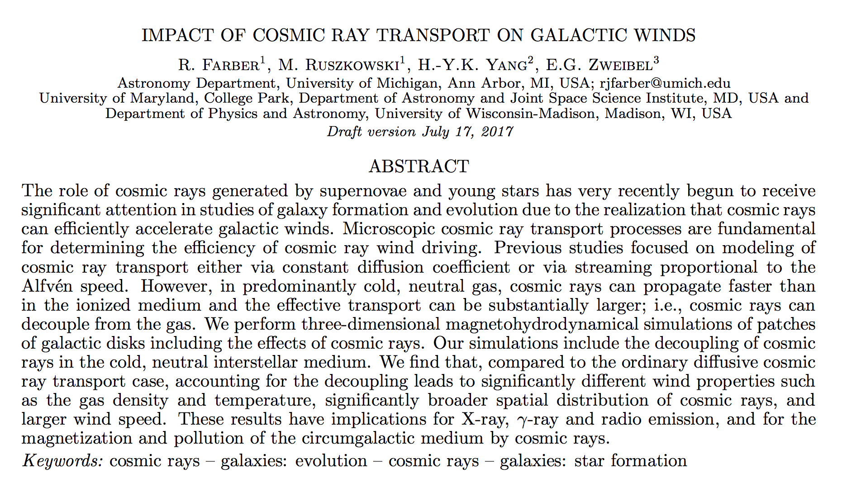
https://arxiv.org/pdf/1707.04579.pdf
Notes:
Gals missing large fraction baryons vs cosmological average (Bell et al. 2003).
Obs’d lum. funcs vs sim’d halo mass funcs -> 20% baryons in L∗ gals (Guo et al. 2010).
80% halo mass abundance in 19 magnitudes in mass (Mo & White 2002; Angulo & White 2010),
80% stellar mass distribution within 2.4 magnitudes in mass (Li & White 2009) ->> efficiency baryons -> stars = strong func halo mass

Slide 3


Missing Baryons in L < L* halos:
Stellar Feedback Driven Galactic Winds
10⁶
Dark Matter Halos (simulations)
10⁴
Galaxies
(observed)
100
Relative Number
1
0.01
Dwarf Galaxy
Milky Way
Giant Galaxy
Galaxy Group
Galaxy Cluster
10⁹
10¹¹
10¹³
10¹⁵
Mass (solar masses)
Notes:
Gals missing large fraction baryons vs cosmological average (Bell et al. 2003).
Obs’d lum. funcs vs sim’d halo mass funcs -> 20% baryons in L∗ gals (Guo et al. 2010).
80% halo mass abundance in 19 magnitudes in mass (Mo & White 2002; Angulo & White 2010),
80% stellar mass distribution within 2.4 magnitudes in mass (Li & White 2009) ->> efficiency baryons -> stars = strong func halo mass

Slide 4
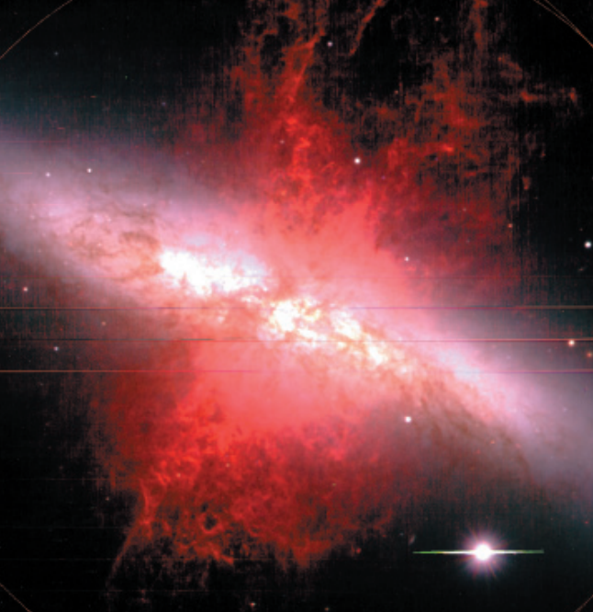
M82
Ohyama+ 2002
Notes:
True color from B, V, and 650nm continuum images. Total H⍺ and [NII] is superimposed (Subaru).

Slide 5
Cosmic Rays (CR)
Accelerated by diffusive shock acceleration in SNR shocks (Blandford & Eichler 1987; Caprioli 2015)
U_{dyn} ~ U_{B} ~ U_{CR} in the ISM (Cox 2005)
10⁻³ TeV CR: dominate CR pressure in ISM (Grenier, Black, & Strong 2015)
Notes:
https://arxiv.org/pdf/astro-ph/0607109.pdf
cf Julia Tjus’s talk on part below knee being Galactic origin w/ SNRs best candidate (intensity is easily explained by 10% SN energy going to CR)

Slide 6
How Do CR Drive a Wind
CR cool slowly
CR exert a force on the gas = ∇P_{cr}/ ⍴
g_{z}
⍴
∇P_{cr}/ ⍴
z

Slide 7
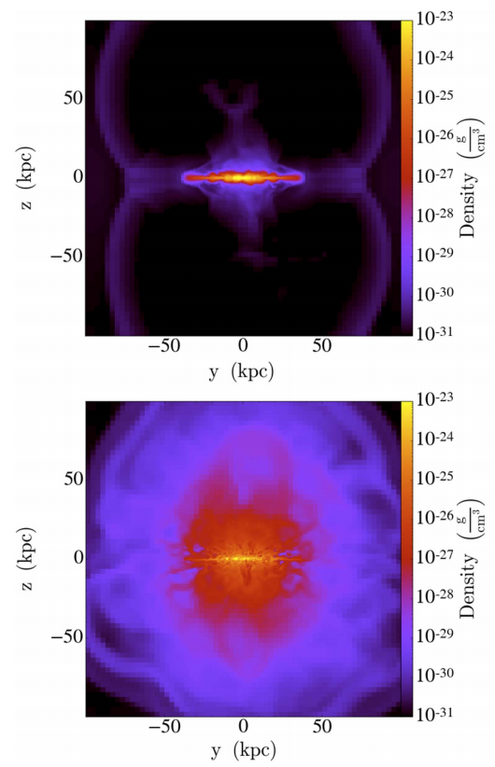
CR Driven Galactic Winds
Ruszkowski+ 2017: CR transport can significantly boost wind driving
Advection
No diffusion
Streaming
Ryan Farber TeVPA 2017

Slide 8
CR Enhanced Transport
By The Decoupling Mechanism
CR transport inhibited by perturbations.
Damping of perturbations -> faster transport!
We consider ion-neutral damping.
We model the enhanced transport as a boosted diffusion coefficient in cool regions

Slide 9
Simulation Setup
Slab of ISM: 2 kpc x 2 kpc x 40 kpc
Boundary Conditions: Periodic x Periodic x Diode
NFW dark matter halo (10¹² M☉)
Gas surface density = 100 M☉/pc²
Physics
  self-gravity of the gas, radiative cooling, star formation and feedback, magnetic fields, cosmic rays

Slide 10

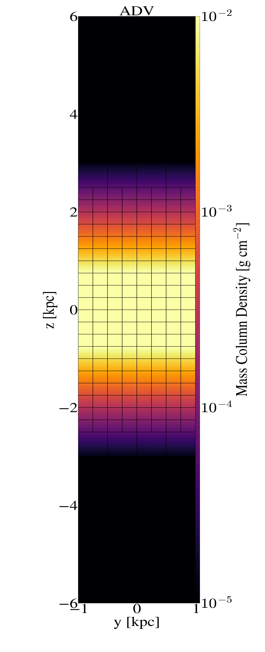


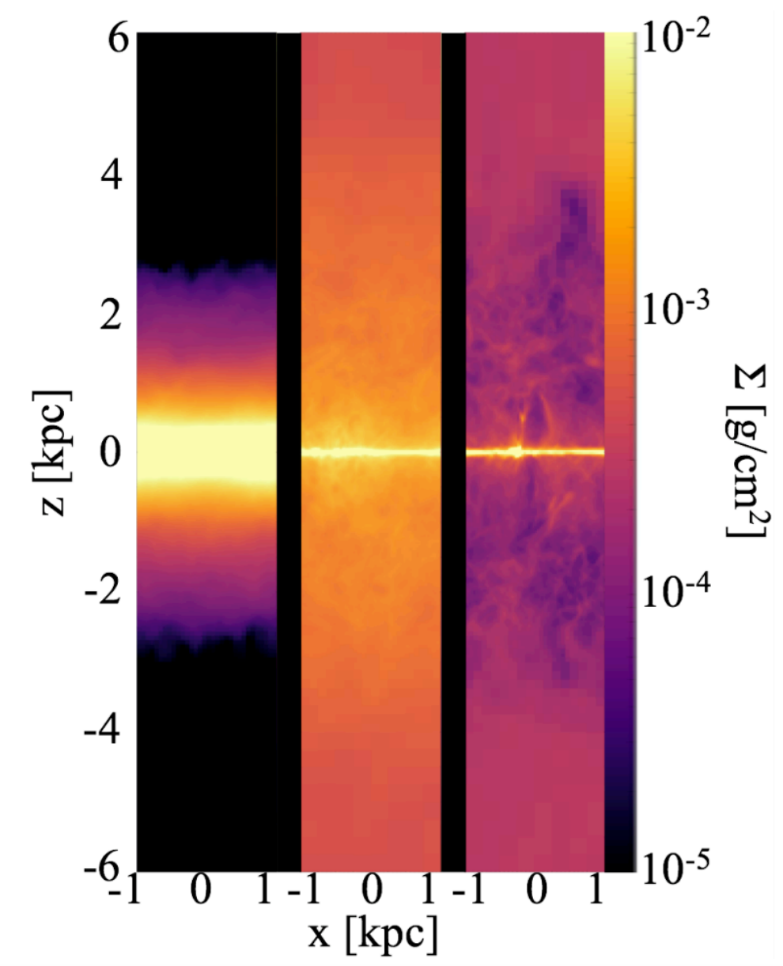
Results: Mass Column Density
time = 170 Myr
arXiv 1707.04579
Notes:
8/9/17
10
10
~50 Myr: Decoupling looks significantly less dense than Diffusion

Slide 11
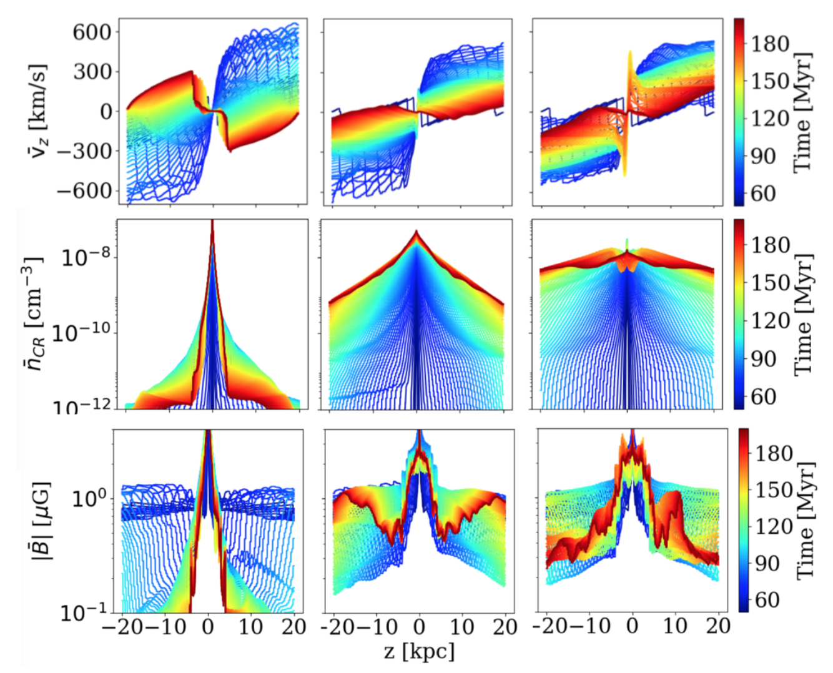
Notes:
8/9/17
11
11
Elevated CR # density and advection time < synchrotron time could imply more extended radio emission in DEC than DIF

Slide 12
Results
We observe hot evacuated bubbles in decoupling simulations.
  Enhanced soft x-ray emission in edge-on galaxies?
Simulations with decoupling have much higher n_{CR} in the halo.
  Extended radio emission?
With decoupling, the wind is much faster but lower density which conspire to produce similar mass loading factors.

Slide 13

Star Formation and Feedback
Star Formation Criteria (all must simultaneously be true)
  n_{gas} > 10 cm⁻³
  _
  t_{cool} < t_{dyn} or T < 300 K
  M_{cell} > M_{jeans}
SN Feedback
  SN energy = 10⁵¹ erg
  10% of SN energy -> CR
  90% of SN energy -> Thermal

Slide 14
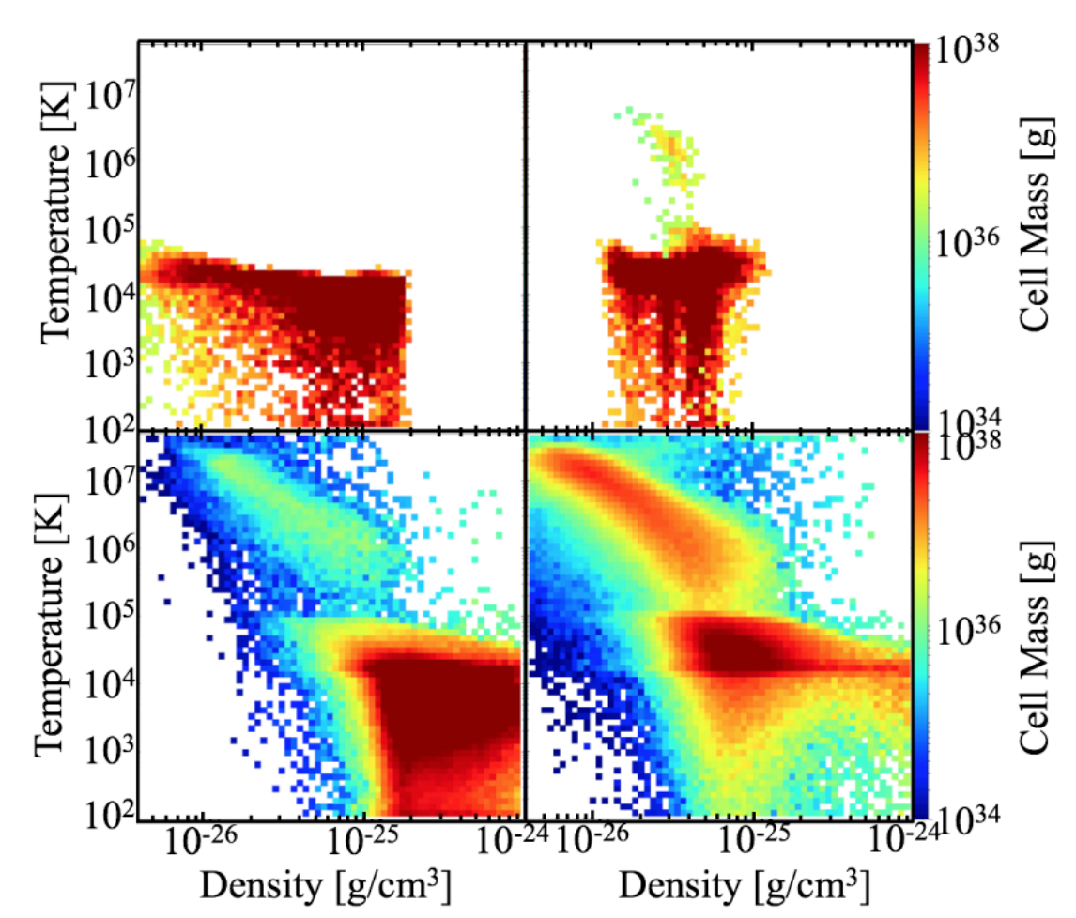
Phase Plots at 170 Myr
Diffusion
Decoupling
|z| > 4 kpc
|z| < 4 kpc
Notes:
8/9/17
14
14

Slide 15
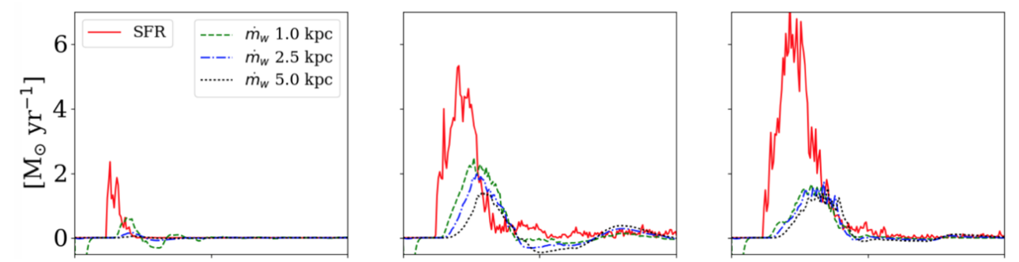

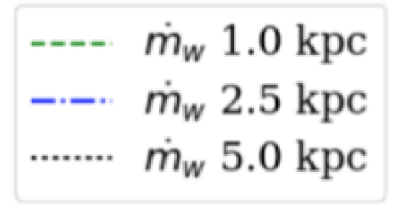

SFR, Mass Outflow Rate
Notes:
8/9/17
15
15

Slide 16
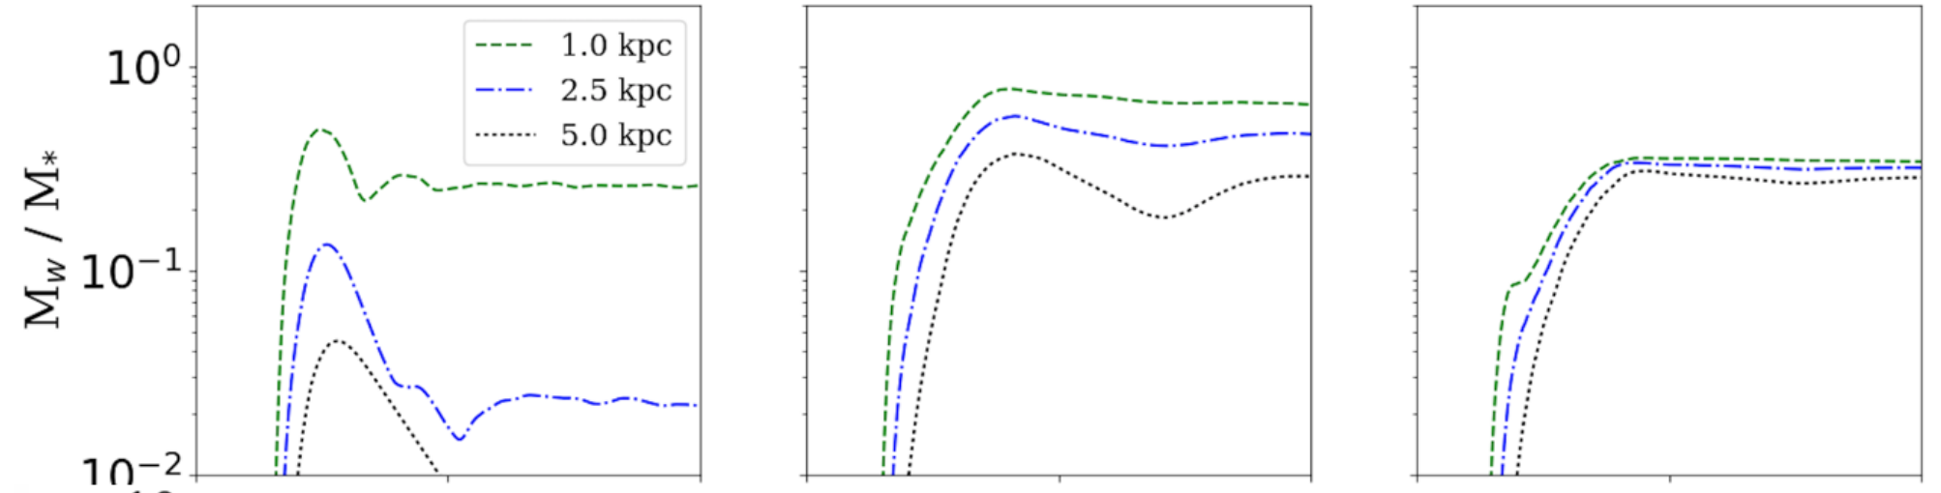

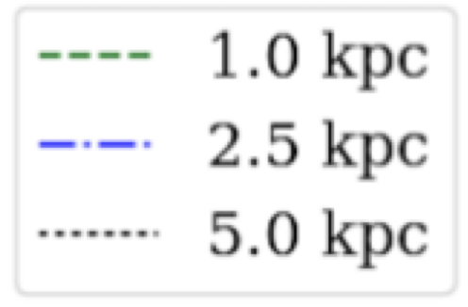
Integrated Mass Loading
10⁻²
Notes:
8/9/17
16
16

Slide 17
Instantaneous Mass Loading
10⁻²
Notes:
8/9/17
17
17

Slide 18
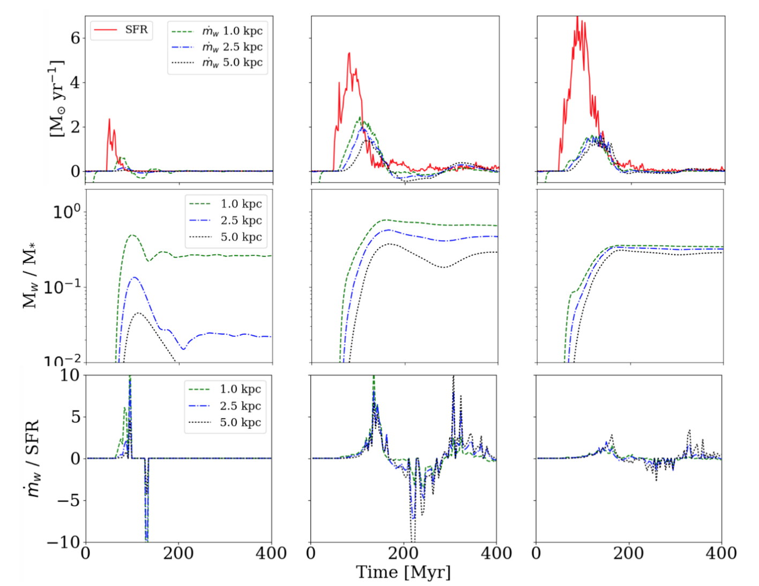
Notes:
8/9/17
18
18
Going to be too hard to see

