Slide 1
A hardronic Origin for the High-energy Gamma Rays from the Large-scale Disk of the Large Magellanic Cloud
Qingwen Tang LMC gamma-ray break TeVPA 2017
Qing-Wen Tang^{1,2}
with Xiang-Yu Wang, Ruo-Yu Liu, Fang-Kun Peng and P.H.T. Tam
[1] CCAPP , Ohio State University, USA (with John Beacom)
[2] Department of Physics, Institute of Astronomy, Nanchang University, China

Slide 2
Outline
Qingwen Tang 01/22 LMC gamma-ray break TeVPA 2017
High-energy gamma rays from the star-forming galaxies
Templates for LMC field
Physical origin of gamma-ray emission from the LMC Disk
Conclusion

Slide 3
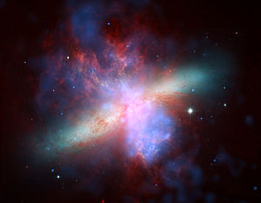
Ⅰ. High-energy gamma rays from the star-forming galaxies
Qingwen Tang 02/22 LMC gamma-ray break TeVPA 2017
Properties of Star-forming (SF) galaxies
  Large and intensive star-forming regions
  High gas density to form numerous stars
Example
  LMC, SMC
  M82, NGC 253 (starburst galaxy)
M82 [Chandra-HST-Spitzer]

Slide 4
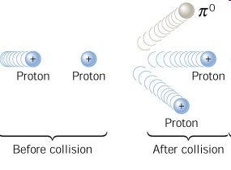

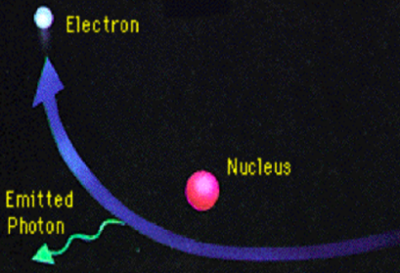
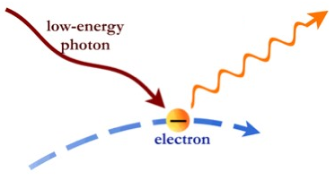
CR-induced HE gamma rays (>~100MeV)
SFR∝Lγ
Qingwen Tang 03/22 LMC gamma-ray break TeVPA 2017
Hadronic gamma-ray emission
Bremsstrahlung radiation
Up-scatter interstellar radiation
Foreman+2015 ApJ 808, 44

Slide 5
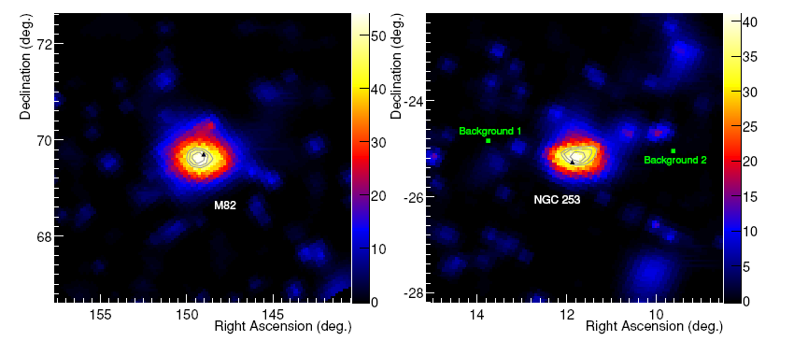
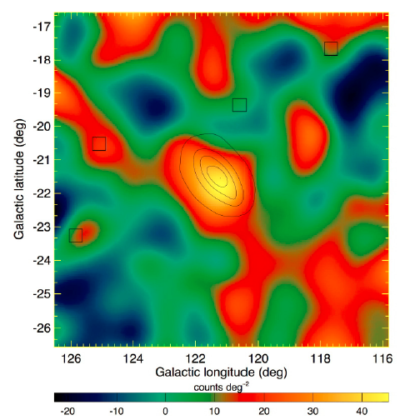
Detection of HE gamma rays in SF galaxies
Qingwen Tang 04/22 LMC gamma-ray break TeVPA 2017
M31
M82 and NGC 253 Fermi LAT Collaboration (2010) ApJL 709, L152
M31 Fermi LAT Collaboration (2010) A&A 523, L2

Slide 6
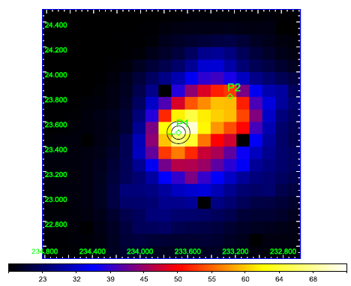
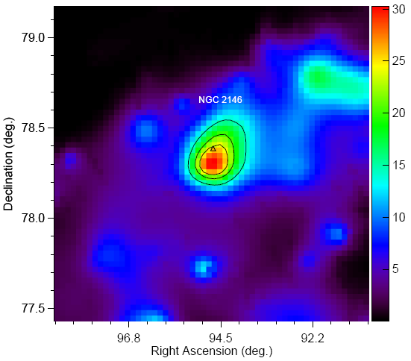
LIR and ULIR SF galaxies (SFR∝L_{IR})
Qingwen Tang 05/22 LMC gamma-ray break TeVPA 2017
Arp 220
NGC 2146 Tang+2014 ApJ 794, 26
Arp 220 Peng+2016 ApJ 820, L20
Fermi LAT detection

Slide 7
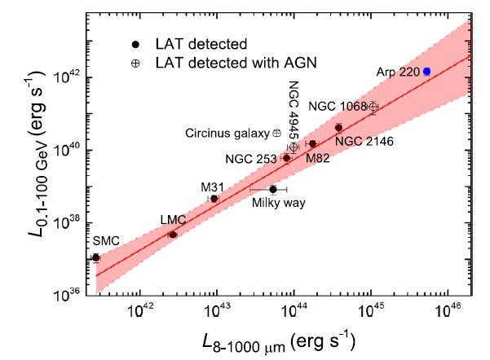
L_{IR} and Lγ
Qingwen Tang 06/22 LMC gamma-ray break TeVPA 2017
Low energy break studies
LMC
spatially resolved in GeV Band
Far from the Galactic plane, less contaminated by diffusion background than IC 443 and W44
A good sample to resolve
its components in gamma rays!
Peng+ 2016 ApJL 820, L20

Slide 8
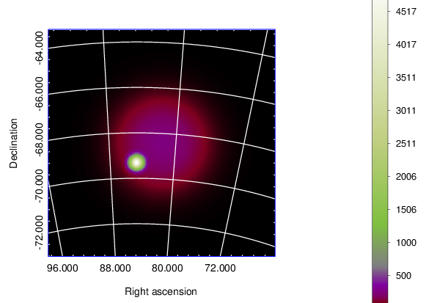
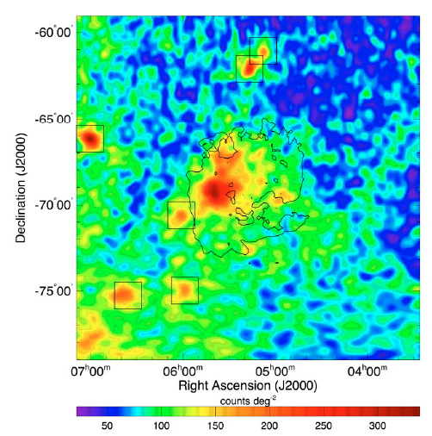
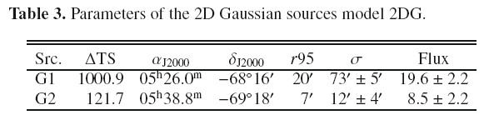
Ⅱ. Templates for LMC field
Qingwen Tang 07/22 LMC gamma-ray break TeVPA 2017
Disk
30 Dor
Disk
30 Dor
Abdo et al. (2010) A&A 512, A7
First 11 months of Fermi-LAT observations
Template 1 +3FGL (T1)
Note: it is used in standard LAT analysis as of now.

Slide 9
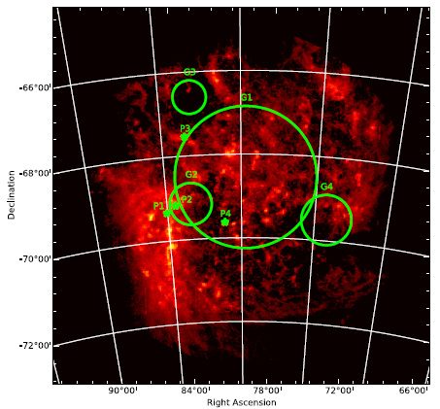
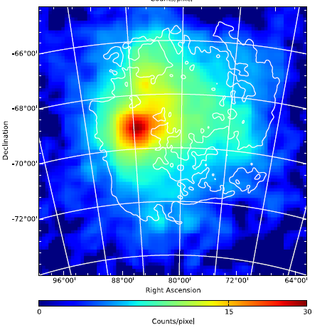
6 years’ observations of Fermi-LAT
Qingwen Tang 08/22 LMC gamma-ray break TeVPA 2017
Ackermann et. al. (2016) A&A 586, A71

Slide 10
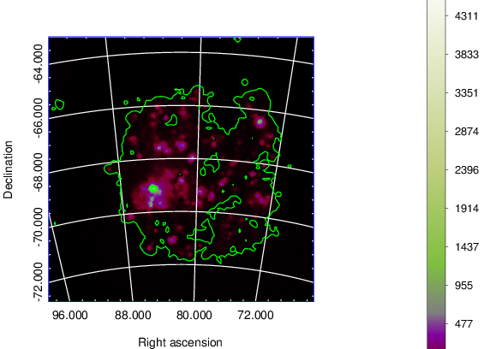
Template 2 (T2)
Qingwen Tang 09/22 LMC gamma-ray break TeVPA 2017
Remove the LMC field source in the 3FGL (LMC H Ⅱregion)
Add the P1 (PSR 0540-6919, N158A), P2 (PSR 0537-6910, N157B), P3 (Gamma-ray binary), P4 (SNR, N132D) and four extended sources (G1-G4)
Ackermann et. al. (2016) A&A 586, A71
Note: it is not employed in the standard LAT analysis.

Slide 11
Fermi-LAT analysis with 8 years’ data
Qingwen Tang 10/22 LMC gamma-ray break TeVPA 2017
Data coverage:
  2008-2016, 8years
Date base: P8_Source, 10°× 10° (ROI)
  1-100 GeV
  0.2-100 GeV
Template for LMC region :
  T1
  T2
First, any new sources detected?
Second, which one is better?

Slide 12
Template comparison with data of 8 years
Qingwen Tang 11/22 LMC gamma-ray break TeVPA 2017
T1: (Disk+30 Dor) + 3FGL sources
T2: G1-G4+P1-P4 (LMC field) +3FGL sources (outer of the LMC field)
Which one is better? → Likelihood fit (L) + Residual TSmap→

Slide 13
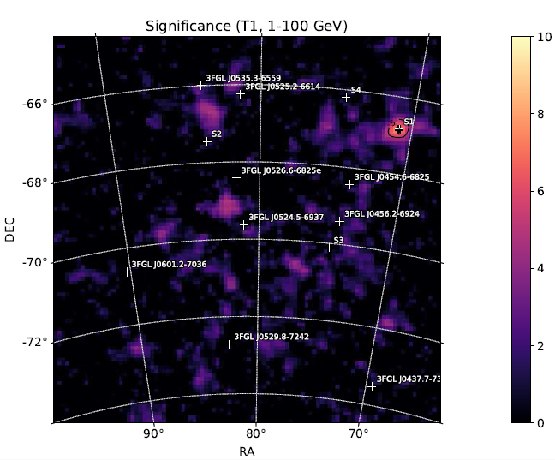
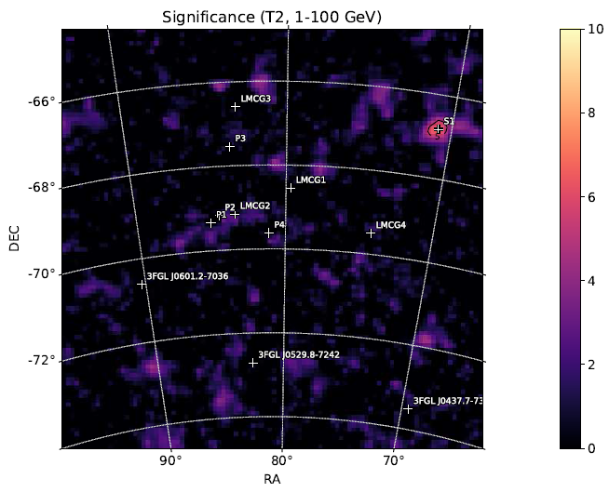
Comparison in 1-100 GeV
Qingwen Tang 12/22 LMC gamma-ray break TeVPA 2017
S1, S2… are new sources
Significance maps, 1-100 GeV, 8 years. (Left) T1, (Right) T 2.

Slide 14
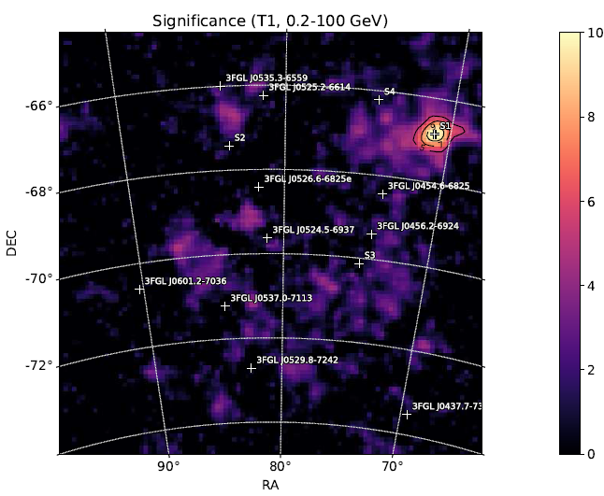
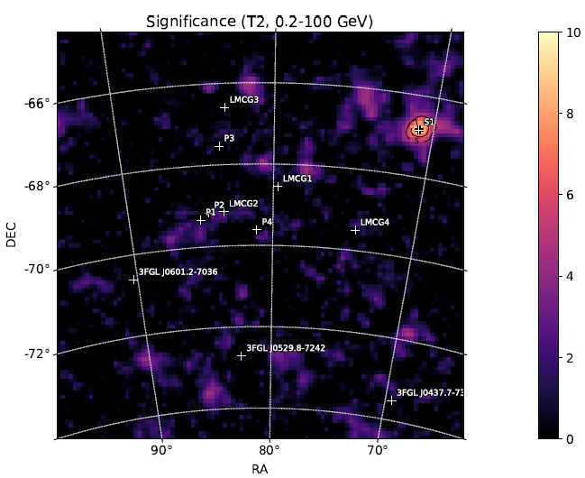
Comparison in 0.2-100 GeV
Qingwen Tang 13/22 LMC gamma-ray break TeVPA 2017
Significance maps, 0.2-100 GeV, 8 years. (Left) T1, (Right) T2.

Slide 15
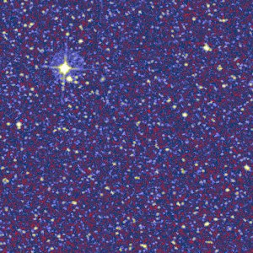
Candidates for the new point source S1
Qingwen Tang 14/22 LMC gamma-ray break TeVPA 2017
Search four catalogs for the candidate source
  CRATES Flat-Spectrum Radio Source Catalog
  Veron-Cetty Catalog of Quasars & AGN
  Candidate Gamma-Ray Blazar Survey Source Catalog
  The ATNF Pulsar Catalog version 1.56
Only one source within r₉₅, CRATES J044318-665155.
0.037 degrees away from the new point source.
0.14² degrees
RA | Dec | r_68 | r_95
70.856 | -66.833 | 0.056 | 0.091

Slide 16
Results
Qingwen Tang 15/22 LMC gamma-ray break TeVPA 2017
T2 is a good template for modelling the gamma rays from the LMC observed by Fermi-LAT.
A new point source (S1) is detected near the LMC region.

Slide 17
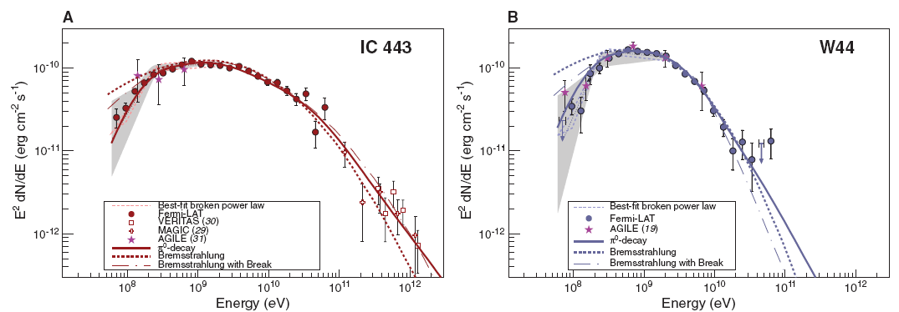
Ⅲ. Physical origin of gamma-ray emission from the LMC Disk
Qingwen Tang 16/22 LMC gamma-ray break TeVPA 2017
Galatic SNRs
Breaks between 0.06-2.0 GeV, evidence of pion-decay gamma rays.
Ackermann et. al. (2013) Science, 339

Slide 18
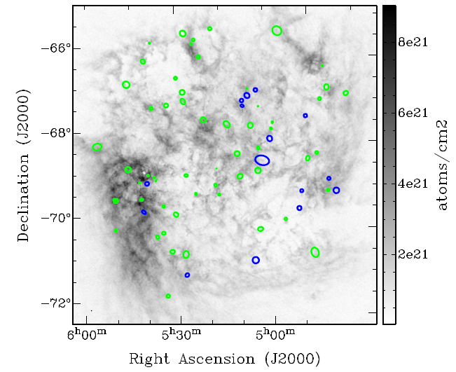
SNRs in the LMC region
Qingwen Tang 17/22 LMC gamma-ray break TeVPA 2017
Green: 59 confirmed
Blue : 15 candidates
Bozzetto et. al. (2017) ApJS, 230,2

Slide 19
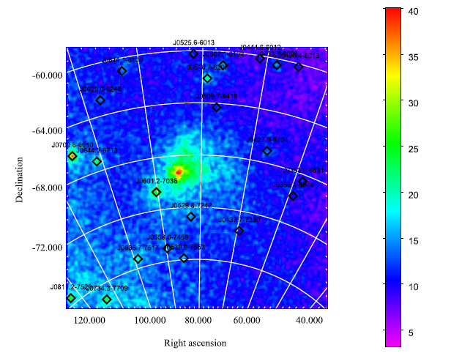
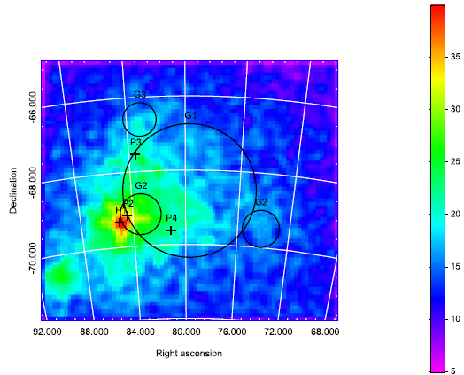
Low-energy data of LMC by LAT
Qingwen Tang 18/22 LMC gamma-ray break TeVPA 2017
0.06-2.45 GeV, with Model 2
Tang+2017 ApJ, 843,42

Slide 20
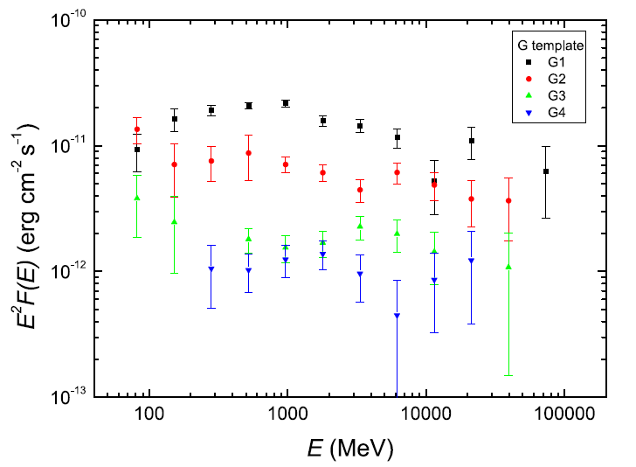
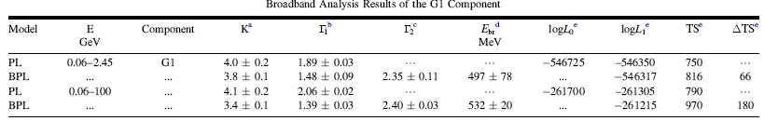
Detection of Low-energy Break
Qingwen Tang 19/22 LMC gamma-ray break TeVPA 2017

Slide 21
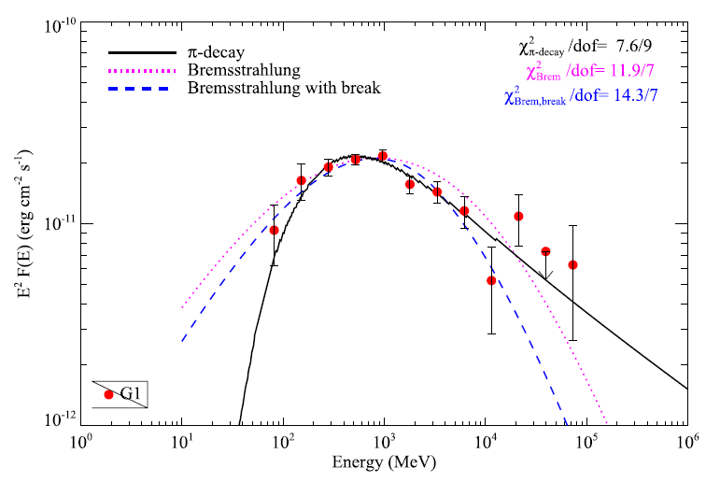
Modelling Results
Qingwen Tang 20/22 LMC gamma-ray break TeVPA 2017
Pion decay model can be a better model!

Slide 22
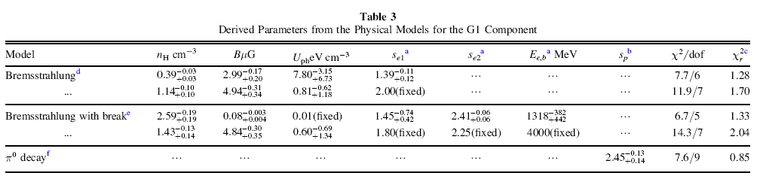
Results
Qingwen Tang 21/22 LMC gamma-ray break TeVPA 2017
It favors for the pion decay model.

Slide 23
Ⅳ. Conclusion
Qingwen Tang 22/22 LMC gamma-ray break TeVPA 2017
The template with 4 point sources and 4 extended sources is a good one to reproduce the LMC observations by Fermi-LAT.
A new point source S1 is detected significantly and possibly linked with a AGN.
The gamma-ray emission of the large-scale Disk of LMC favors for a hadronic origin, e.g., π⁰ decay.
Thank you for your attention!

