Slide 1
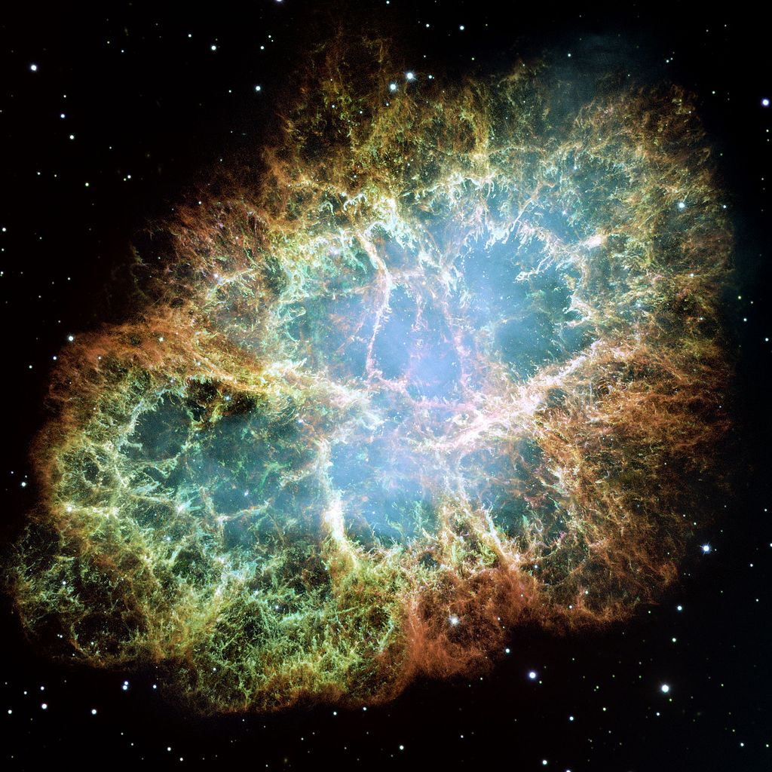
Yu-Dai Tsai (PhD student)
Cornell University
with Joe Bramante, Tim Linden
arXiv:1706.00001
Optical, Gravitational, and Radio Signatures of DM-induced NS Implosions

Slide 2

Ongoing Research
Yu-Dai Tsai, TeVPA 2017
1
Sub-GeV Thermal DM:
ELDER
as a busy PhD student
Perelstein
Kuflik
Lorier
Slatyer
Xue
Liu
ELDER / ELDER + NFDM
Experimental /Observational Signatures
- 1512.04545,1706.05381...
ν Hopes for New Physics
2
3
New Lampposts from Astrophysics
Maxim Pospelov
Gabriel Magill
Ryan Plestid
Talk on Friday 2:30 PM
Joseph Bramante
Tim Linden
Optical, Gravitational, and Radio Signatures of DM-induced NS Implosions
- arXiv: 1706.00001 …
Constraints and signatures of new physics in neutrino detectors, including BoreXino, LSND, SBND, Mini/MicroBooNE, and SHiP
-arXiv: 1706.00424 …

Slide 3
Outline
Intro to DM-induced neutron star (NS) implosions
Astrophysical Signatures:
  Kilonova Events and r-Process Elements
  Optical Signature
  Gravitational Signature
  Optical + Merger Signature
  Possible Radio Signature
Conclusion and Outlook
Please ask me questions & a joke in the end / after the talk
FRB mentioned by
Professor Kamionkowski
Yu-Dai Tsai, TeVPA 2017

Slide 4
NS Implosion & Asymmetric Dark Matter
Asymmetric Dark Matter (ADM): dark matter with particle/anti-particle asymmetry, often linked to baryon/ lepton asymmetry.
The asymmetry often sets the DM relic abundance.
see, e.g., reviews from Petraki and Volkas 2013, Zurek 2013 …
Dark matter asymmetry allows efficient collection and collapse in stars without annihilating to lighter particles
See e.g. Goldman and Nussinov 1989, Kouvaris and Tinyakov 2010, Lavallaz and Fairbairn 2010, McDermott, Yu, Zurek 2011, Bell, Melatos, Petraki 2013 …
Yu-Dai Tsai, TeVPA 2017

Slide 5
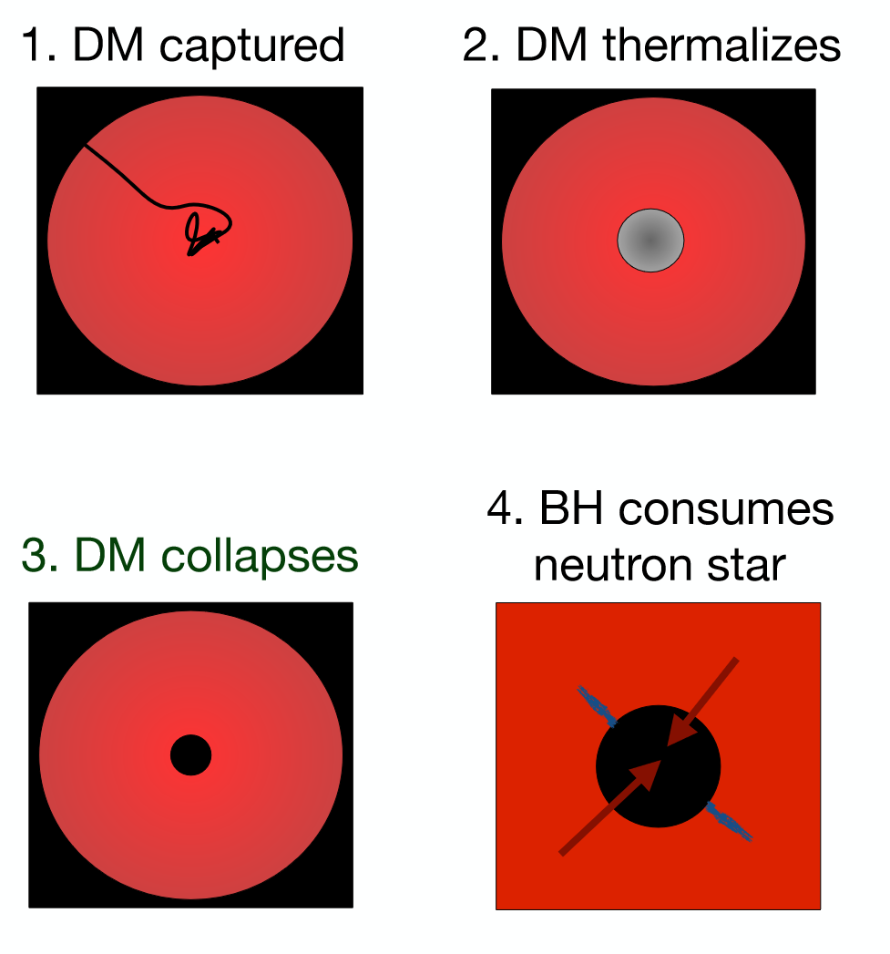
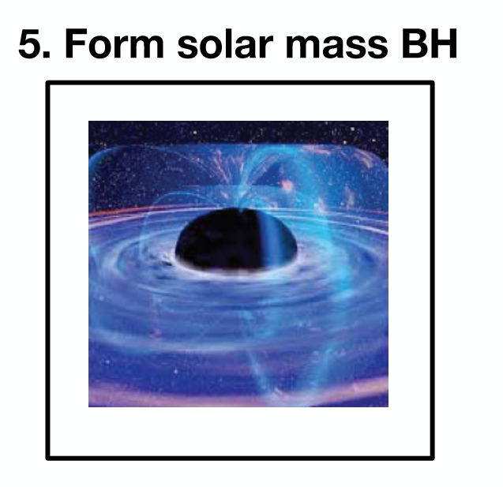
DM-induced NS Implosions
Repeated scattering: DM reach the same temperature and settle at center of neutron star
Collapse into a black hole once reach critical mass
Black hole Bondi accretes inside the neutron star
Consider the implosion using PeV-EeV (10¹⁵ -10¹⁸eV) DM as an example
Super heavy ADM: see e.g. Bramante, Unwin, 2017
Other mass ranges: see e.g. Bramante, Kumar, et al. 2013, Bramabte, Elahi 2015
As Joe explained & motivated us!

Slide 6
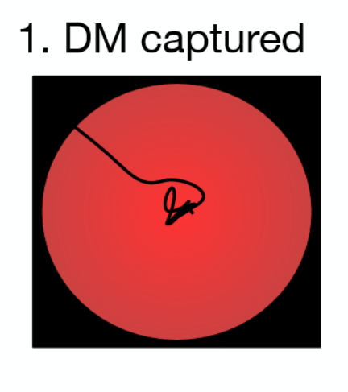
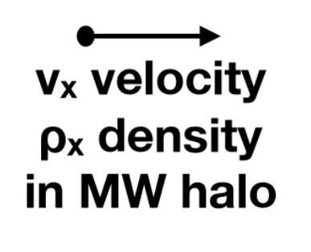
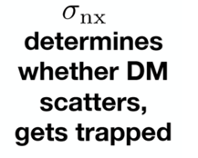


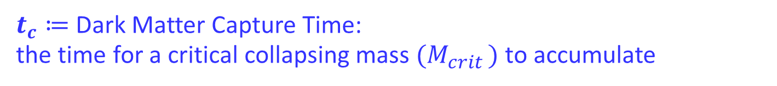
Dark Matter Capture
DM-nucleon cross section,
implies maximum mass capture rate
$t_{c}≔$ Dark Matter Capture Time:
the time for a critical collapsing mass ${(M}_{crit })$ to accumulate
See also Bramante, Linden, YT, 1706.00001
+ Bramante, Delgado, Martin, 2017
+ Baryakhtar, Bramante, Li, Linden, Raj, 2017
(the topic of the next talk!)
Nirmal will explain this more later!

Slide 7




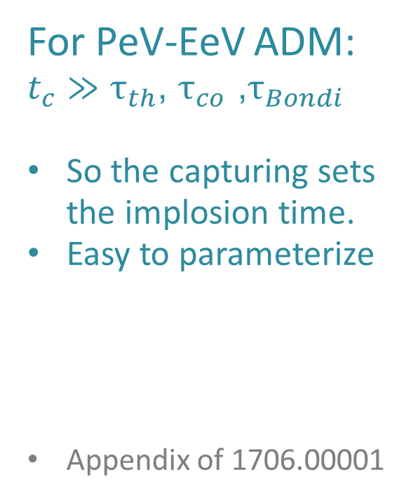
Determining the Implosion Time
For PeV-EeV ADM:
$t_{c}≫τ_{th}$, $τ_{co}$ ,$τ_{Bondi}$
So the capturing sets the implosion time.
Easy to parameterize
Appendix of 1706.00001

Slide 8
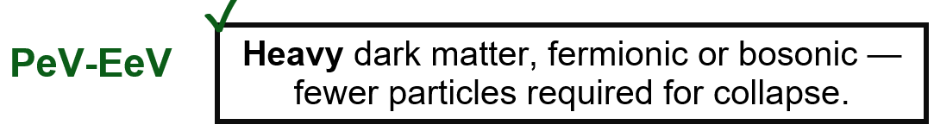


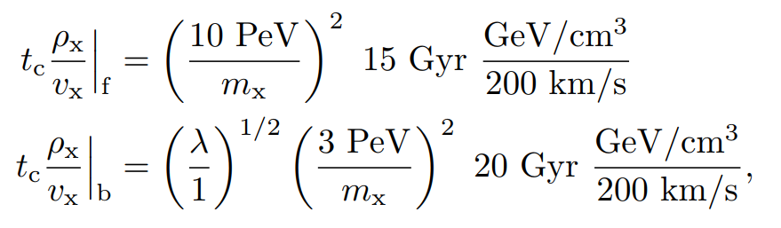

Normalized Implosion Time
We propose this normalized implosion time,
Colpi, Shapiro, and Wasserman, 1986
Yu-Dai Tsai, TeVPA 2017

Slide 9
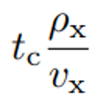
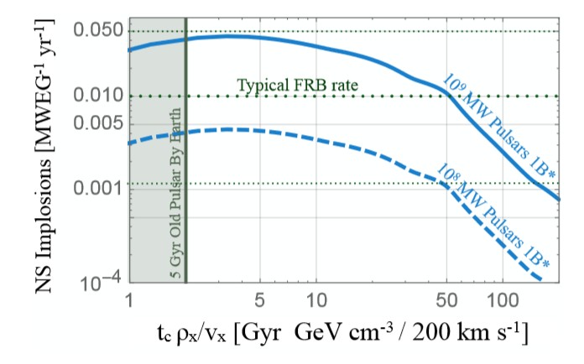
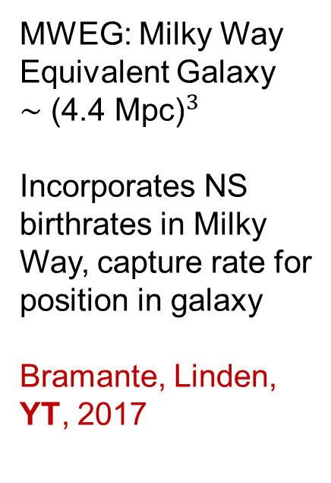
Total NS Implosion Rate in terms of
MWEG: Milky Way Equivalent Galaxy
$${∼\text{(}\text{4}\text{.}\text{4 }\text{Mpc}\text{)}}^{3}$$
Incorporates NS birthrates in Milky Way, capture rate for position in galaxy
Bramante, Linden, YT, 2017
Yu-Dai Tsai, TeVPA 2017

Slide 10
r-Process and Kilonova
Preferred/Constrained DM-implosion Parameter Space

Slide 11
r-Process (Rapid Neutron Capture Process)
& Kilonova Events
Postulated r-process sources:
- Core collapse supernovae (frequent, ~1/100 years)
- Merging neutron star binaries (rare, ~1/10⁴ years)
- Neutron star implosion tidally ejects neutron star fluid (rate see e.g. 1706.00001)
Neutron-rich fluid then beta decays, create kilonova events, and forms heavy neutron-rich elements,
total 10⁴ M⨀ r-process elements produced in Milky Way
(see, e.g., Freeke et al, 2014)

Slide 12
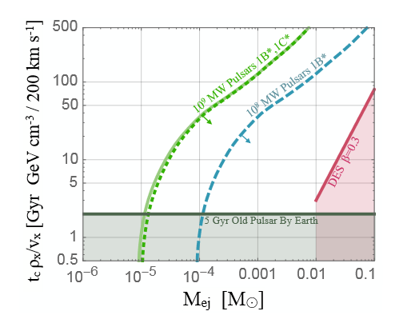

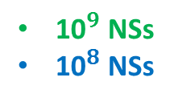
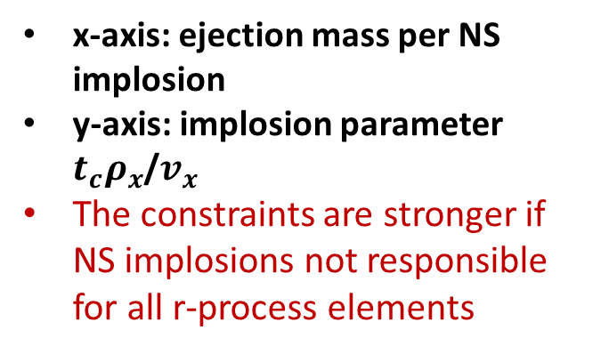
r-Process Element Abundance & Bounds
If NS implosions are responsible for all the r-process elements, we have the “matching” curves and constraints set by requiring
total NS mass ejected to ≤ ${\text{10}}^{4}$ ${\text{M}}_{\text{⊙}}$ in the Milky Way.
${\text{10}}^{9}$ NSs
${\text{10}}^{8}$ NSs
Bramante, Elahi, 2015
x-axis: ejection mass per NS implosion
y-axis: implosion parameter $t_{c}ρ_{x}$/$v_{x}$
The constraints are stronger if NS implosions not responsible for all r-process elements
ejection mass per NS implosion
Bramante, Linden, YT, 2017
Yu-Dai Tsai, TeVPA 2017

Slide 13
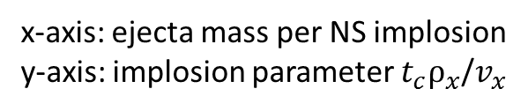

Kilonova Bound
Kilonova light curves depend mainly on the mass and velocity of NS ﬂuid ejected (Kasen et al, 2013)
Dark Energy Survey (DES) published a null wide ﬁeld optical search for kilonovae (Doctor et al., DES, 2017)
We set bounds from (not-seeing) kilonova events by DES, assuming ejection velocity β = 0.3c
The kilonova bound may eventually exclude the r-process matching curves
$$DES$$
Bramante, Elahi, 2015
x-axis: ejecta mass per NS implosion
y-axis: implosion parameter $t_{c}ρ_{x}$/$v_{x}$
Bramante, Linden, YT, 2017
Yu-Dai Tsai, TeVPA 2017

Slide 14
Quiet Kilonova and its Morphology
Optical Signature from NS Implosions

Slide 15
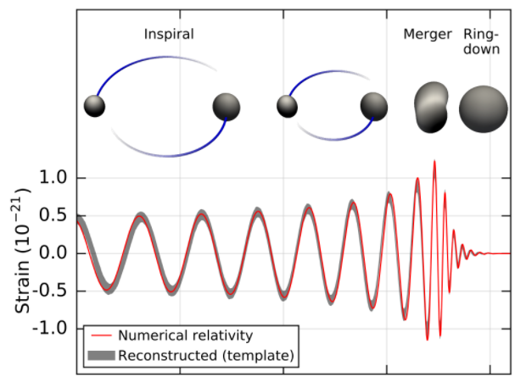



Quiet Kilonova
Quiet Kilonova:
Kilonova events from NS implosions, but NOT from the NS-NS or NS-BH mergers.
WITHOUT detectable merger signatures, so we call them “Quiet Kilonova” (Bramante, Linden, YT, 2017)
Abbott et al., LIGO/VIRGO, PRL 2016
Yu-Dai Tsai, TeVPA 2017

Slide 16
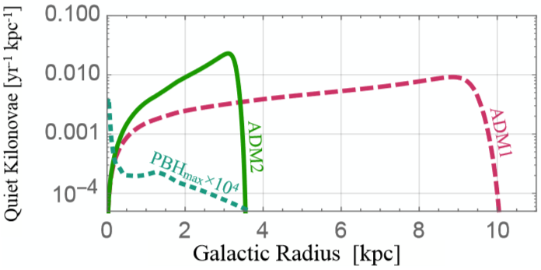

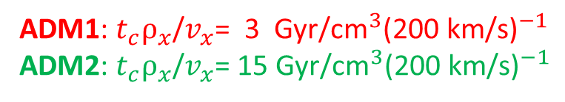





Quiet Kilonova Morphology
… or “Gold Donut”, since its related to r-process that can give you gold
Imploding
ADM1 implosion faster than ADM2;
ADM1 is the larger donut
Imploding
Imploded
Imploded
ADM2
ADM1
ADM1: $t_{c}ρ_{x}$/$v_{x}$= 3 Gyr/${\text{cm}}^{3}{\text{(}\text{200 }\text{km}\text{/}\text{s}\text{)}}^{−1}$
ADM2: $t_{c}ρ_{x}$/$v_{x}$= 15 Gyr/${\text{cm}}^{3}{\text{(}\text{200 }\text{km}\text{/}\text{s}\text{)}}^{−1}$
Yu-Dai Tsai, TeVPA 2017

Slide 17
Black Merger
Gravitational-wave Signature form Converted NS-NS(BH) Merger

Slide 18

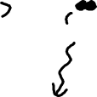
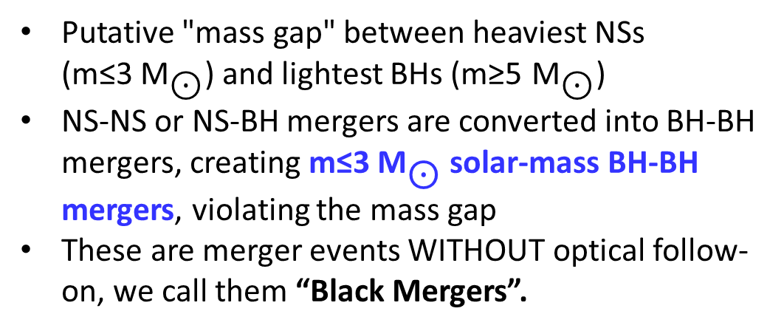

G-Wave Signature: Black Mergers
Putative "mass gap" between heaviest NSs (m≤3 ${\text{M}}_{\text{⊙}}$) and lightest BHs (m≥5 ${\text{M}}_{\text{⊙}}$)
NS-NS or NS-BH mergers are converted into BH-BH mergers, creating m≤3 ${\text{M}}_{\text{⊙}}$ solar-mass BH-BH mergers, violating the mass gap
These are merger events WITHOUT optical follow-on, we call them “Black Mergers”.
Yu-Dai Tsai, TeVPA 2017

Slide 19
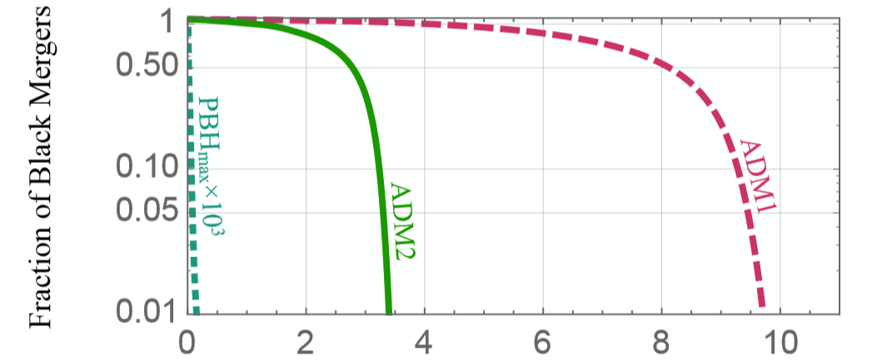

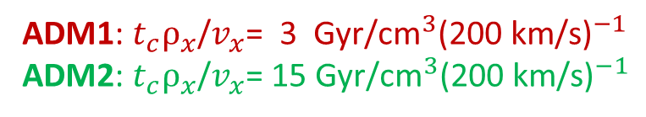
G-Wave Signature: Black Mergers
ADM1: $t_{c}ρ_{x}$/$v_{x}$= 3 Gyr/${\text{cm}}^{3}{\text{(}\text{200 }\text{km}\text{/}\text{s}\text{)}}^{−1}$
ADM2: $t_{c}ρ_{x}$/$v_{x}$= 15 Gyr/${\text{cm}}^{3}{\text{(}\text{200 }\text{km}\text{/}\text{s}\text{)}}^{−1}$
No NS-NS merger in the Galactic Center
Can use LIGO/VIRGO to see merger signatures, that are without optical signatures by BlackGEM telescope
Not easy to confirm a black merger

Slide 20
Merger Kilonova
(Bright Merger)
Using the altered NS-NS(BH) galactic merger distribution to test DM-induced implosions

Slide 21
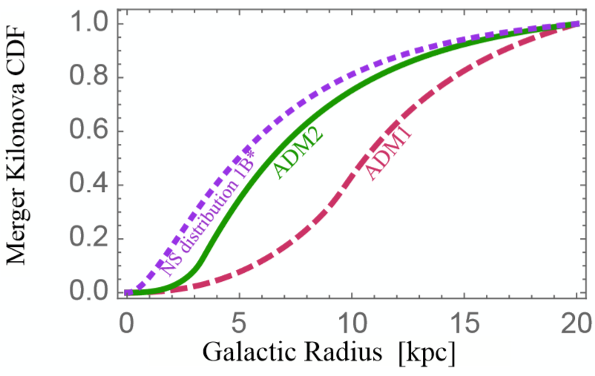
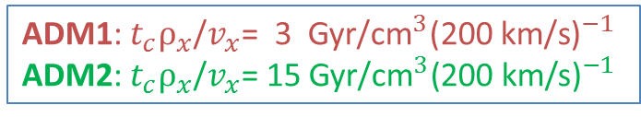

Combined Signature: Merger Kilonova
Having Black Mergers means the usual NS-NS(BH) mergers have the distributions altered by NS implosions
Merger Kilonova: NS-NS(BH) mergers
Merger signatures detectable by LIGO/VIRGO
The associated Kilonova signature can be confirmed by BlackGEM
No Implosion
CDF(Cumulative distribution function) of the Merger Kilonova
Sartore et al, 09
ADM1: $t_{c}ρ_{x}$/$v_{x}$= 3 Gyr/${\text{cm}}^{3}{\text{(}\text{200 }\text{km}\text{/}\text{s}\text{)}}^{−1}$
ADM2: $t_{c}ρ_{x}$/$v_{x}$= 15 Gyr/${\text{cm}}^{3}{\text{(}\text{200 }\text{km}\text{/}\text{s}\text{)}}^{−1}$
/28

Slide 22
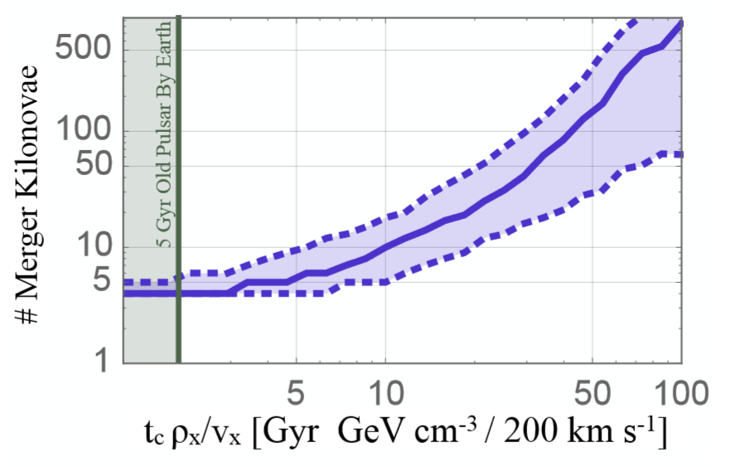
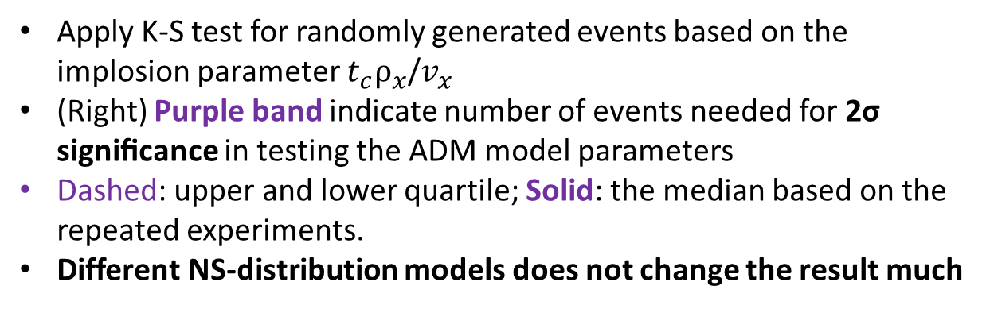
Statistics of Merger Kilonova Events
No Implosion
ADM2
ADM1
Apply K-S test for randomly generated events based on the implosion parameter $t_{c}ρ_{x}$/$v_{x}$
(Right) Purple band indicate number of events needed for 2σ signiﬁcance in testing the ADM model parameters
Dashed: upper and lower quartile; Solid: the median based on the repeated experiments.
Different NS-distribution models does not change the result much
Yu-Dai Tsai, TeVPA 2017
/28

Slide 23
Fast Radio Bursts
A Possible Radio Signature
/28

Slide 24
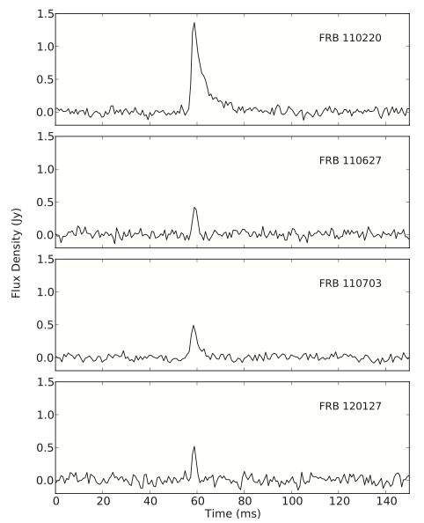
Fast Radio Burst and DM Implosions
Mentioned briefly by Professor Kamionkowski in the morning
Fast radio bursts (FRBs) from DM:
millisecond-length & ∼Ghz radio pulses
all sky rate ∼ 10^4/day.
The source is not determined.
DM-induced NS implosions may be the source of FRBs.
The EM energy released by a NS implosion matches what is required for an FRB
[Fuller and Ott, 2014].
We improve on the rate calculations by using a realistic star formation history [Hopkins and Beacom, 06] and NS distribution [Sartore et al, 09]
Thornton et al., 2013
Yu-Dai Tsai, TeVPA 2017
/28

Slide 25
Match NS Implosion Rate to the FRB Rate
Incorporate NS birthrates in Milky Way
& capture rate for given position in galaxy
Bramante, Linden, YT, 2017
The dotted lines indicate high, median, and low FRB rate estimates from surveys [arXiv: 1505.00834 and 1612.00896].
Yu-Dai Tsai, TeVPA 2017
/28

Slide 26
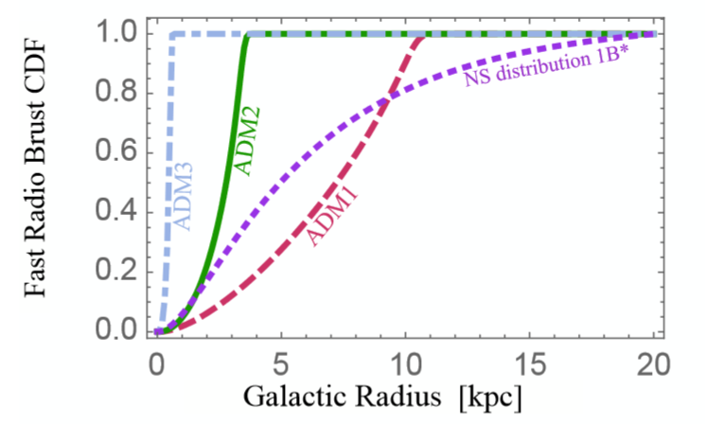
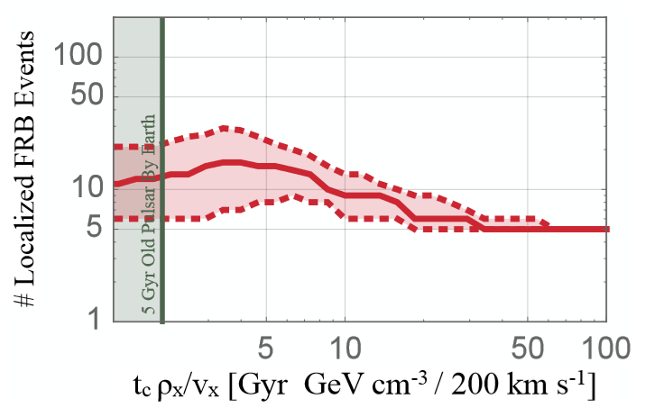

Statistics of Located FRBs
FRB caused by DM-induced NS-implosions
vs FRB come from a non-imploding population of NSs,
at 2σ signiﬁcance.
Need localized to ∼ 1 kpc in a host galaxy
FRBs could possibly be located by
CHIME - The Canadian Hydrogen Intensity Mapping Experiment & HIRAX- The Hydrogen Intensity and Real-time Analysis eXperiment
ADM1
Non-imploding
ADM2
ADM1
ADM2
(Milky Way Equivalent)
Bramante, Linden, YT, 2017
FRB
donuts
ADM2
ADM1
/28

Slide 27
Conclusion and Outlook
(Asymmetric) Dark Matter implodes neutron stars and give novel astrophysical signatures.
  Kilonova events seen by telescopes like Dark Energy Survey (DES) and BlackGEM
  Merger signatures by LIGO/VIRGO
  located FRBs by radio arrays like CHIME and HIRAX
can be applied to test the DM implosion scenarios.
Explore similar/different models, extend to other mass ranges for NS-implosions and conduct more detailed analysis
Yu-Dai Tsai, TeVPA 2017
/28

Slide 28
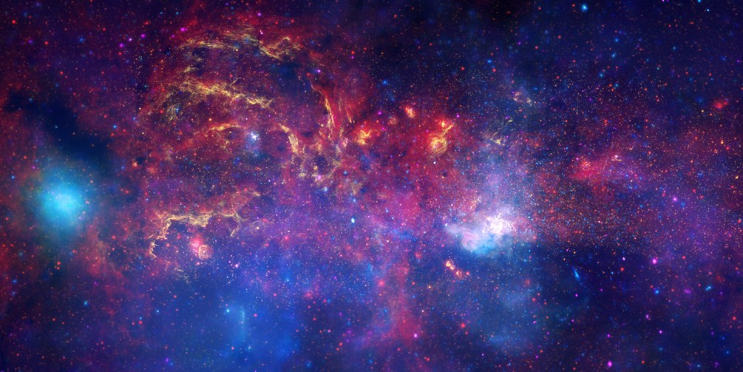
‘We are all in the gutter, but some of us
are looking at the stars.’
– Oscar Wilde, on searching for new physics
Thanks you! Special thanks go to Joe and Tim.
“Self-detecting” dark matter? cue the joke!
NASA/CXC/UMASS/D. WANG ET AL./STSCI/JPL-CALTECH/SSC/S.STOLOVY
Yu-Dai Tsai, TeVPA 2017

Slide 29
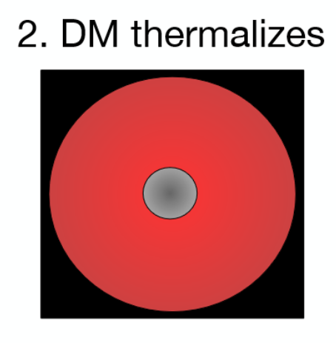

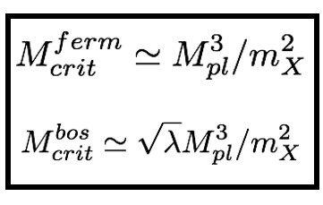

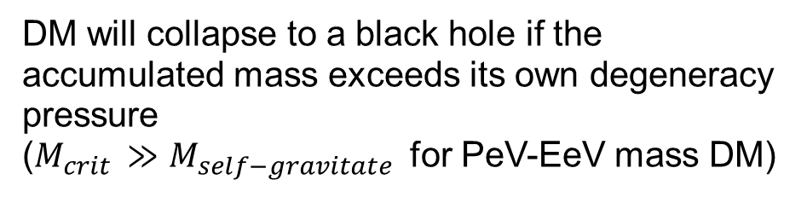
Repeated scattering results in DM with same temperature and settle at center of neutron star
3. DM collapses
( ~${10}^{−14}$ ${\text{M}}_{\text{⊙}}$ for PeV DM )
DM will collapse to a black hole if the accumulated mass exceeds its own degeneracy pressure
($M_{crit }≫$ $M_{self−gravitate }$ for PeV-EeV mass DM)
4. BH consumes neutron star
Bondi accretion from the black hole consumes the host neutron star
Yu-Dai Tsai, TeVPA 2017

