Slide 1

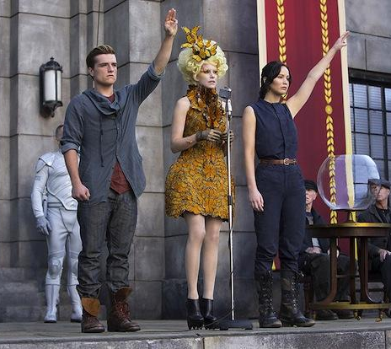


The Next Generation Dark Matter Project LUX-ZEPLIN
SuperCDMS
ADMX
LZ
Matthew Szydagis,
on behalf of the LZ Collaboration
(a merger of 2 collaborations, separate from LUX)
The victors of the DoE G2 hunger games
TeVPA OSU August 8, 2017
adapted from slides by M.E. Monzani, SLAC

Slide 2
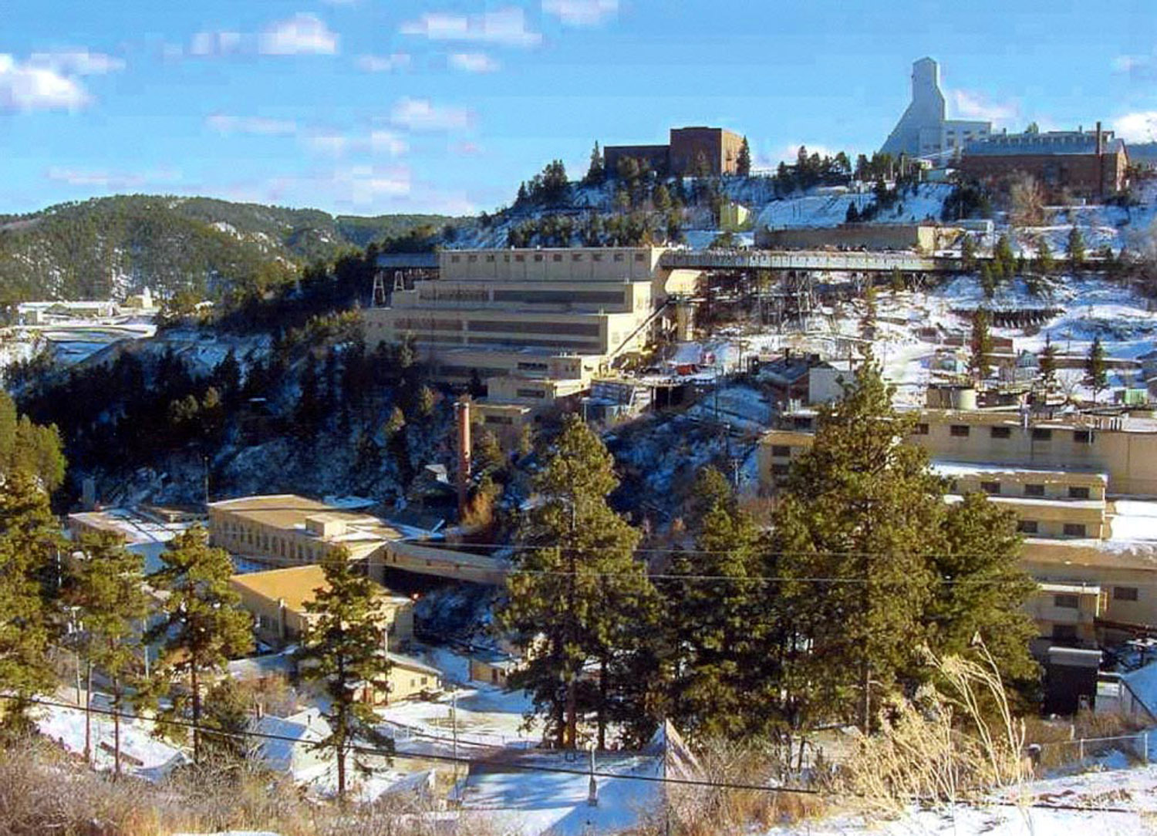
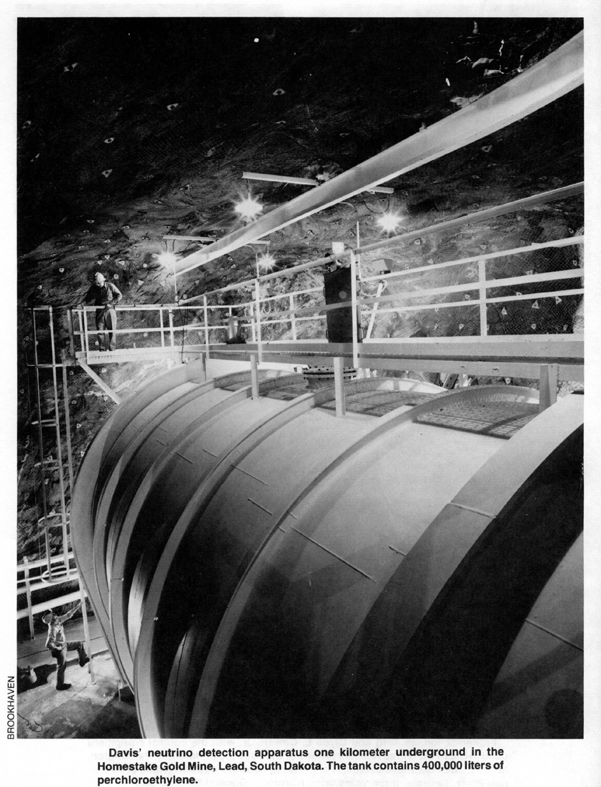


Sanford Underground Research Facility SURF
2
4,850 feet below Lead, SD: the former site of the Homestake gold mine
LZ, like LUX, will be installed in the Davis Cavern, once home to the Nobel prize-winning Ray Davis solar neutrino experiment

Slide 3
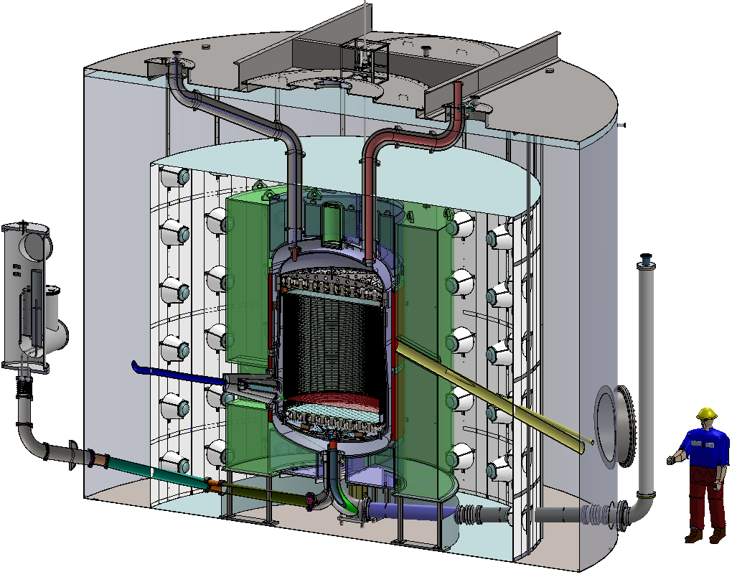
The Onion-Like Layers of the Beast
Instrumentation Conduits
A bigger and better version of LUX, and ZEPLIN.
Existing
Water Tank, and SURF Infrastructure
The Cathode
High-Voltage
Feedthrough
Gadolinium-Loaded
Liquid Scintillator Veto
LXe Heat Exchanger
The Outer
Detector
PMTs (120)
Dual phase xenon TPC, with
494 TPC + 131 Xe skin PMTs
D-D neutron tube

Slide 4
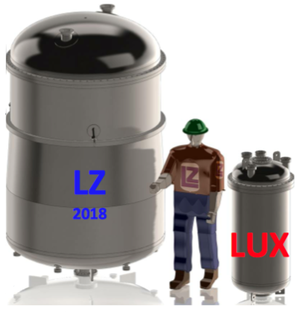
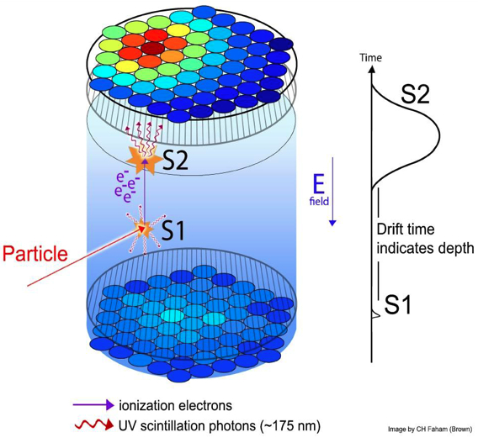
A Big Liquid Noble Time Projection Chamber
10 tons, to find WIMP nuclear recoil (NR)
  7 tons in the active volume (drift E-field)
5.6 ton total fiducial mass nominally
  Thanks to unique *triple* veto system
Spin-independent WIMP search sensitivity goal of <= 2.3 x 10^-48 cm^2 interaction cross-section for a mass-energy of 40 GeV
  Clip the neutrino “shoulder” at low mass
Turning on by 2020, with 1,000 initial live-days: get within order mag. high-m ν floor
6 keVnr threshold with at least 99.5% discrimination are baseline assumptions
  Threshold means energy at which efficiency (sigmoid-like) is 50%
  Electron recoil (ER) leakage of 0.5% below NR band Gaussian centroid

Slide 5
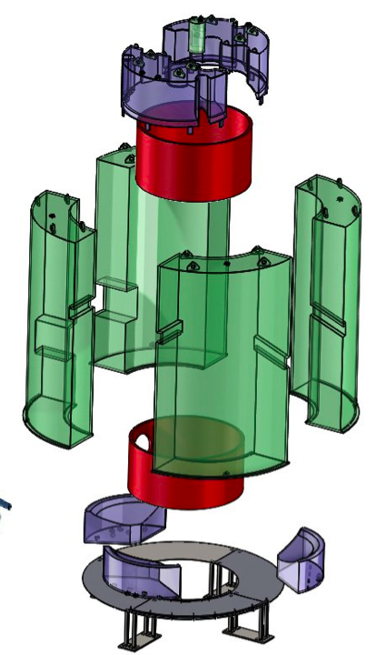
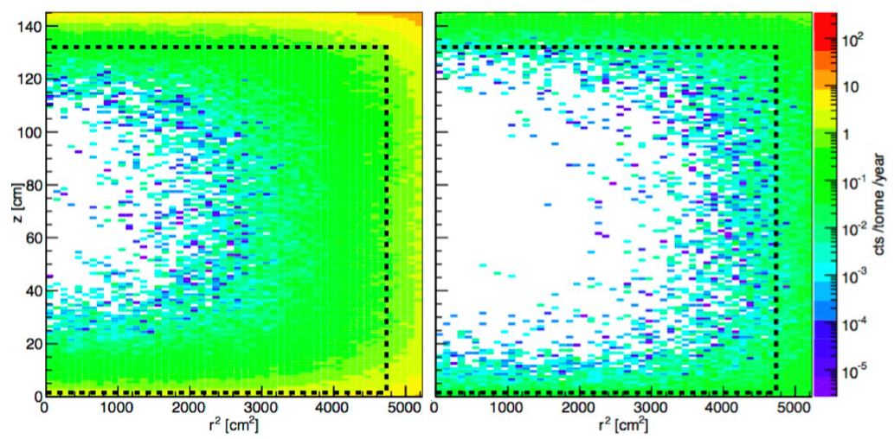
Discovery Machine
  61-cm thick Gd-loaded scintillator
  instrumented xenon “skin” layer
  water shield, an active muon veto
  in-situ monitoring of residual backgrounds
  We will be able to tag both neutrons (muon-induced and other) & gammas
Energy RoI + Single Scatter
RoI + SS Cut + All Vetoes
5

Slide 6
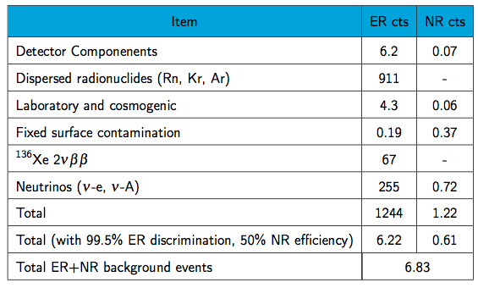
Screening and Simulations: Background Table
Expected counts in 1,000 live days in an indicative 5.6-ton fiducial mass in (1.5-6.5 keV_{ee}) and (6-30 keV_{nr}) energy ranges:
ER vs. NR discrimination is critical to success of experiment
PLR analysis: very powerful at rejecting residual ER events

Slide 7
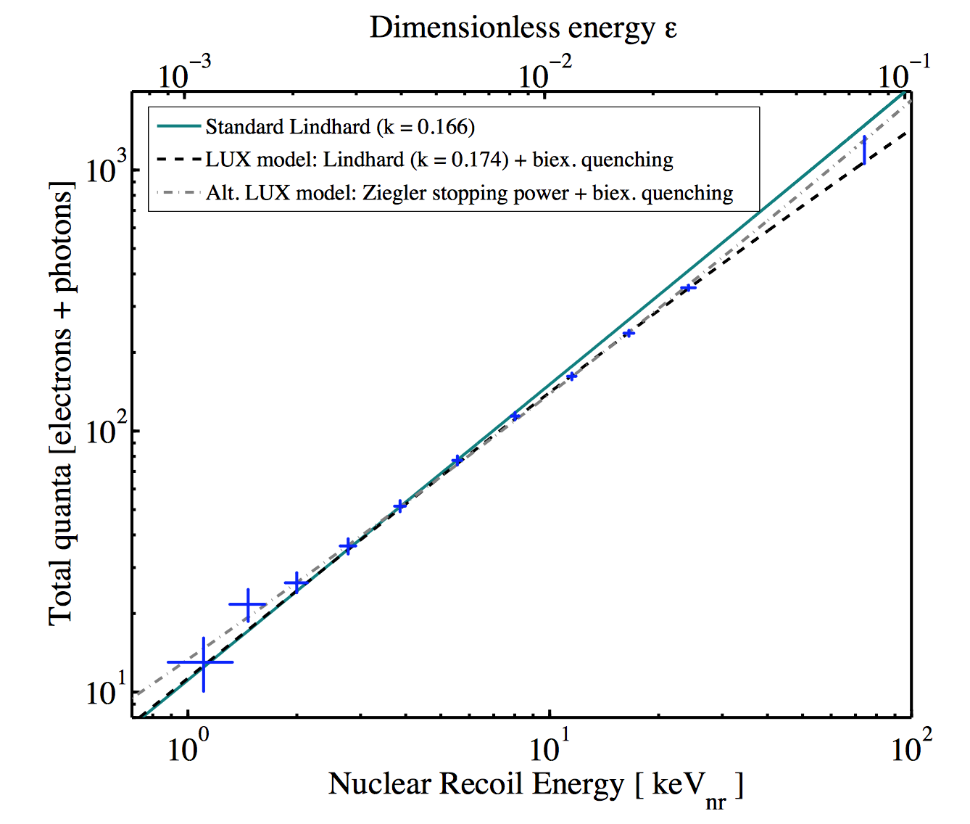
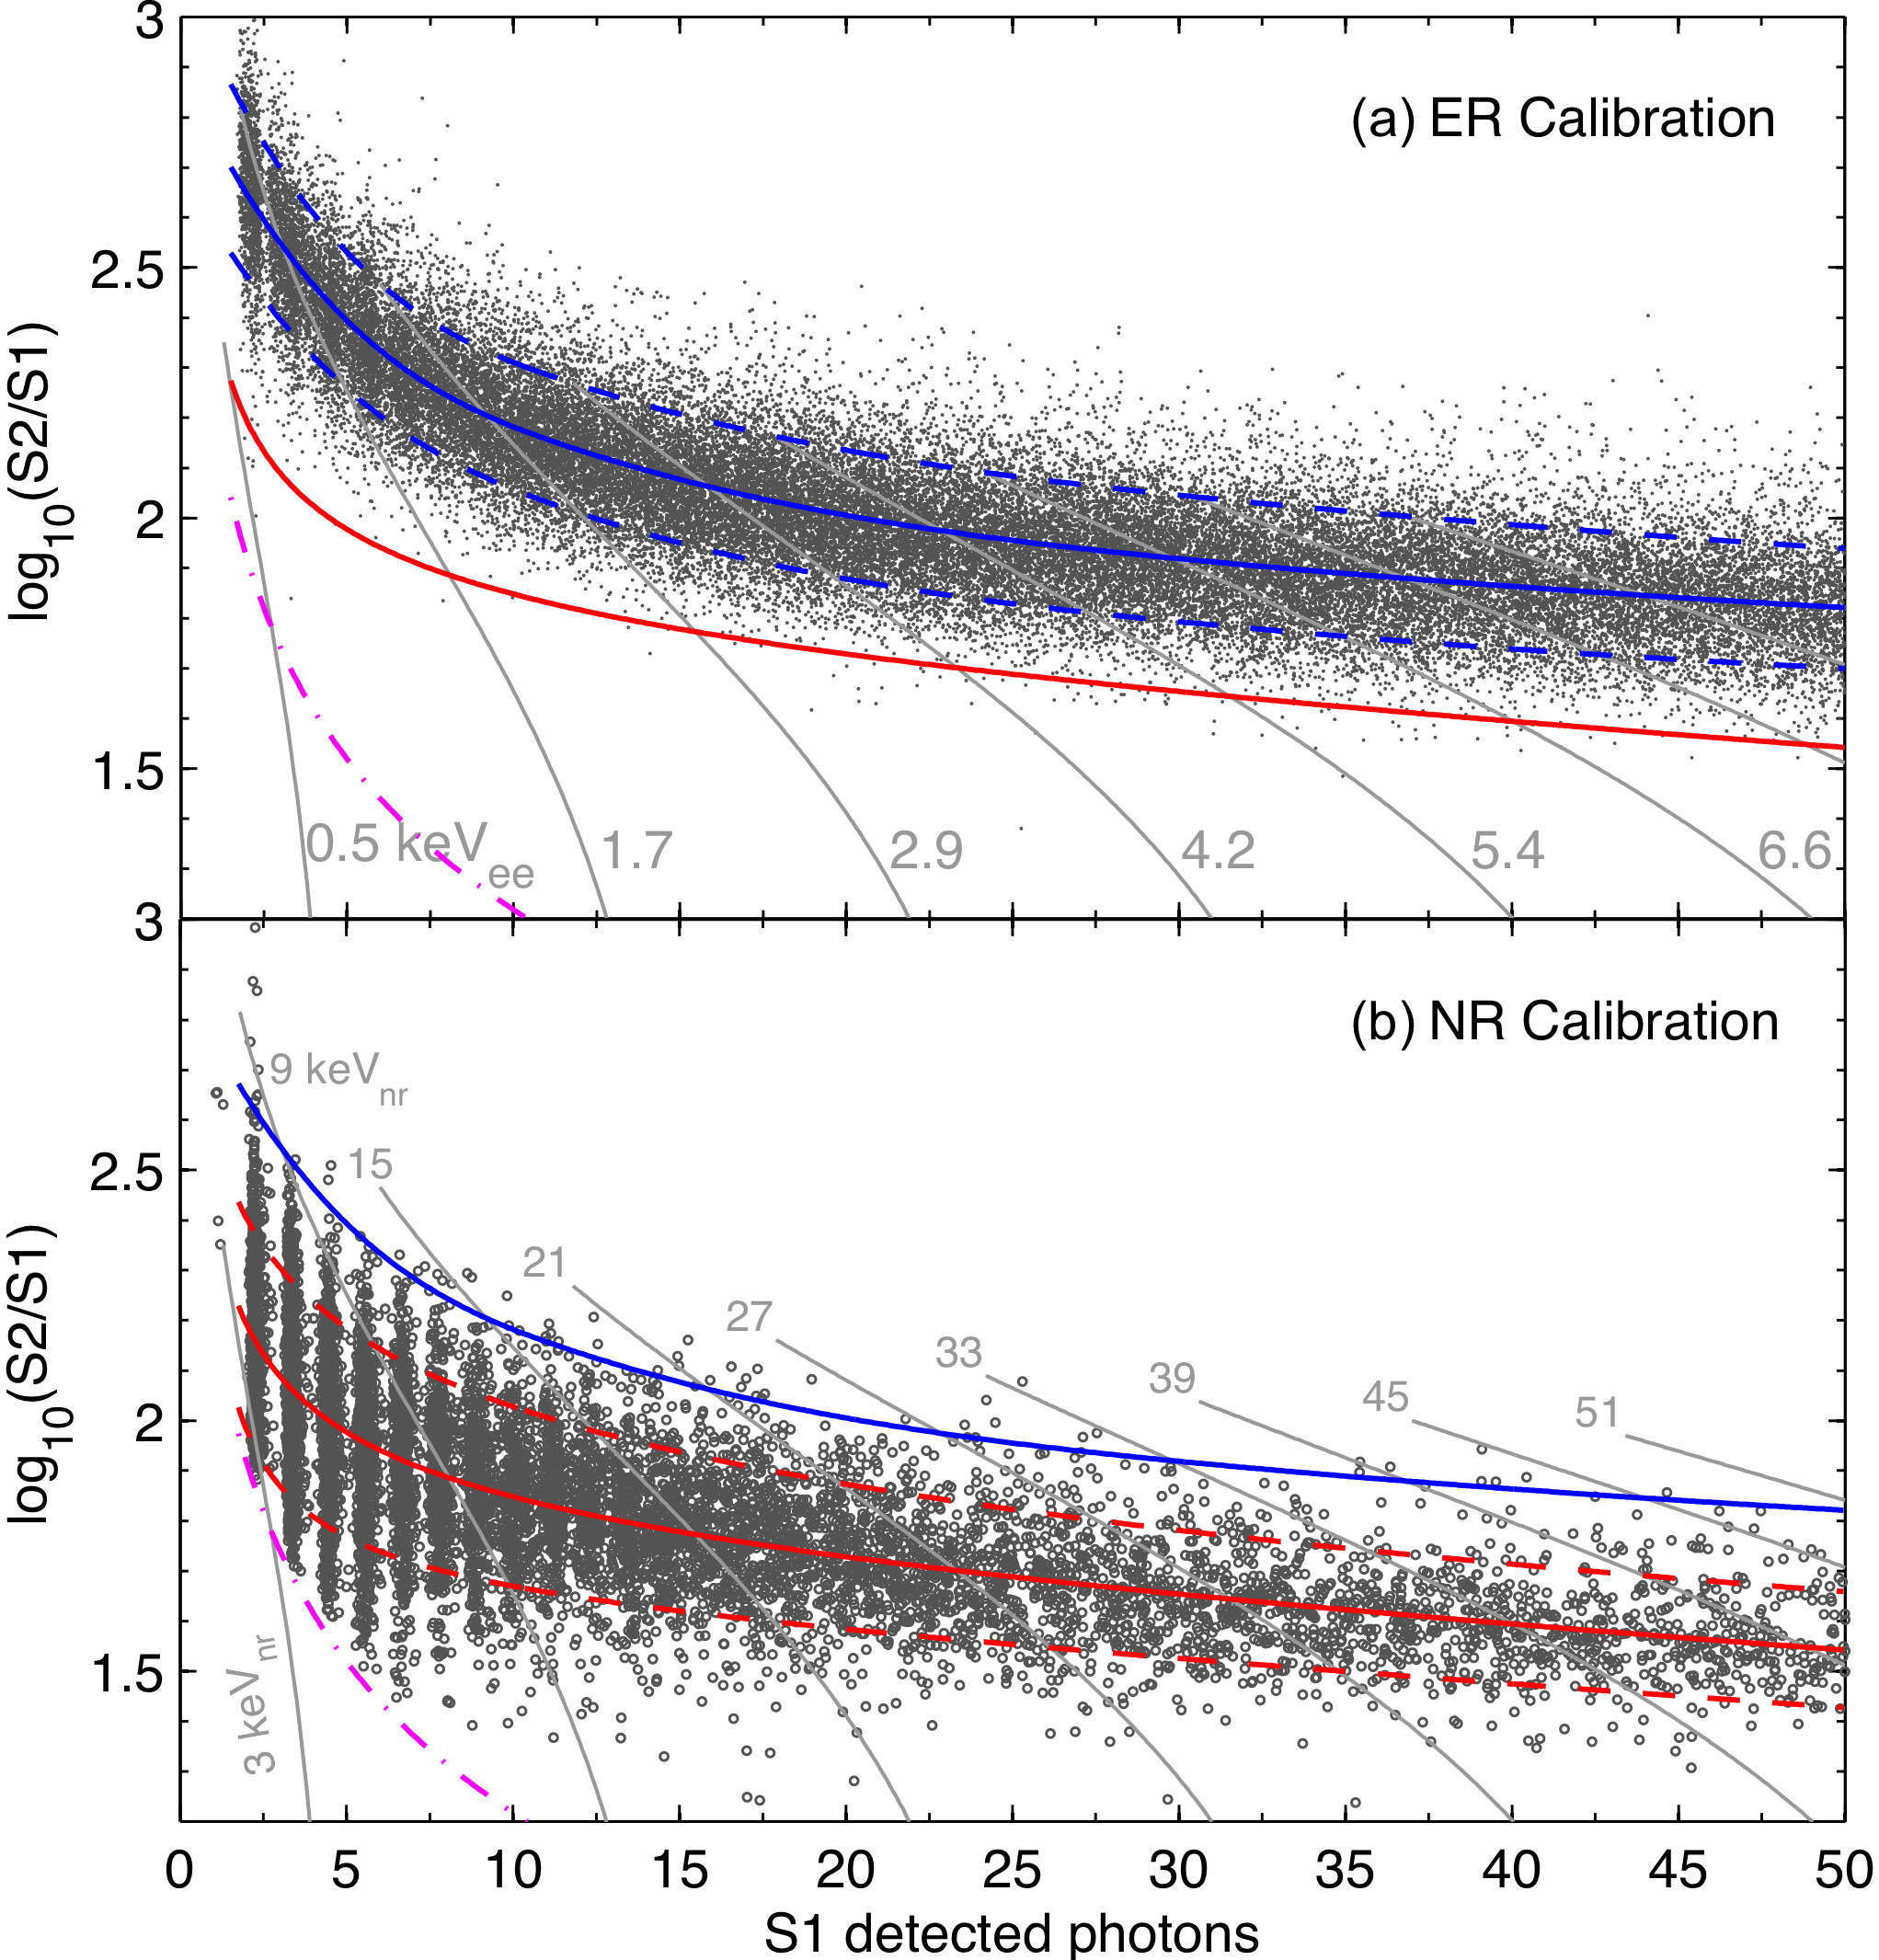
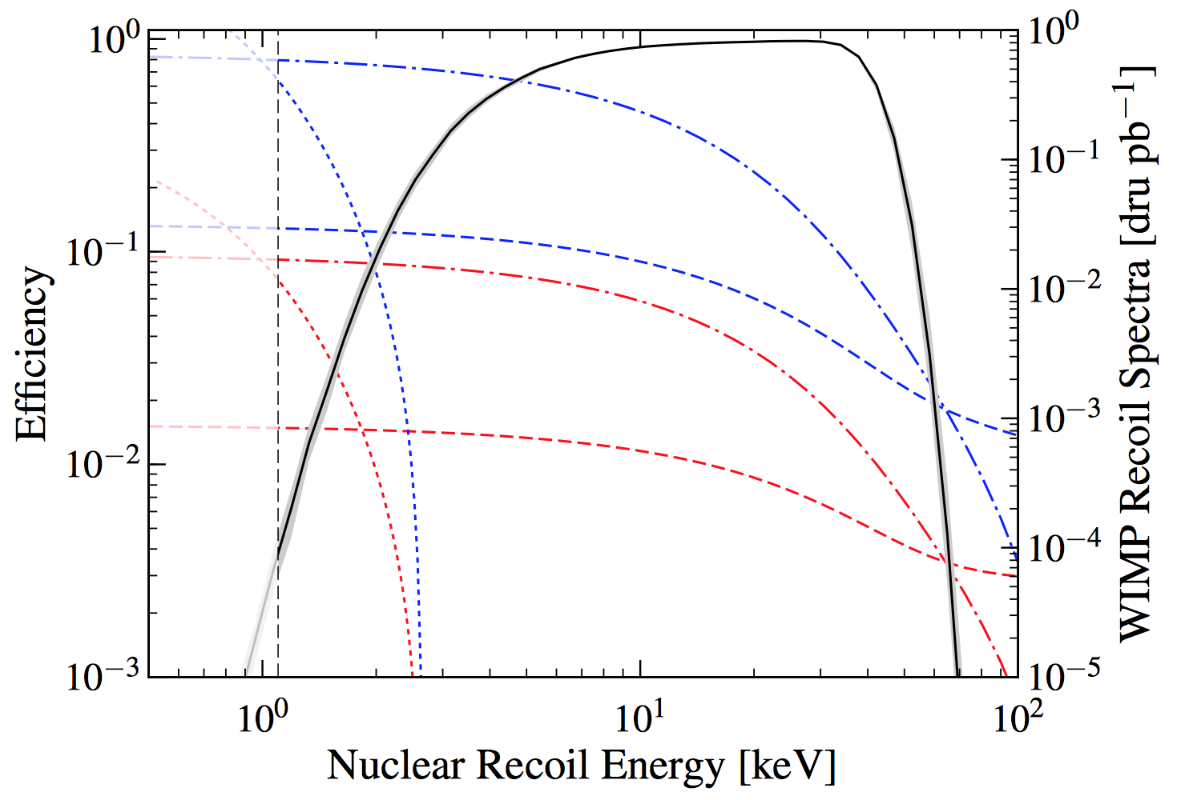
High-stat LUX Calibrations + NEST
ER
(tritiated methane)
arXiv:1608.05381
sum of light and charge yields, found to be a great match to the famous Lindhard “quenching” factor
LUX 2015: 1.1 keVnr
NR
(D-D neutron generator)
LUX 2013: 0 quanta was assumed below 3 keVnr
2nd science run (~1 live-year)
Phys. Rev. Lett. 116, 161301 (2016)
Efficiency
Phys. Rev. Lett. 118, 251302 (2017)

Slide 8
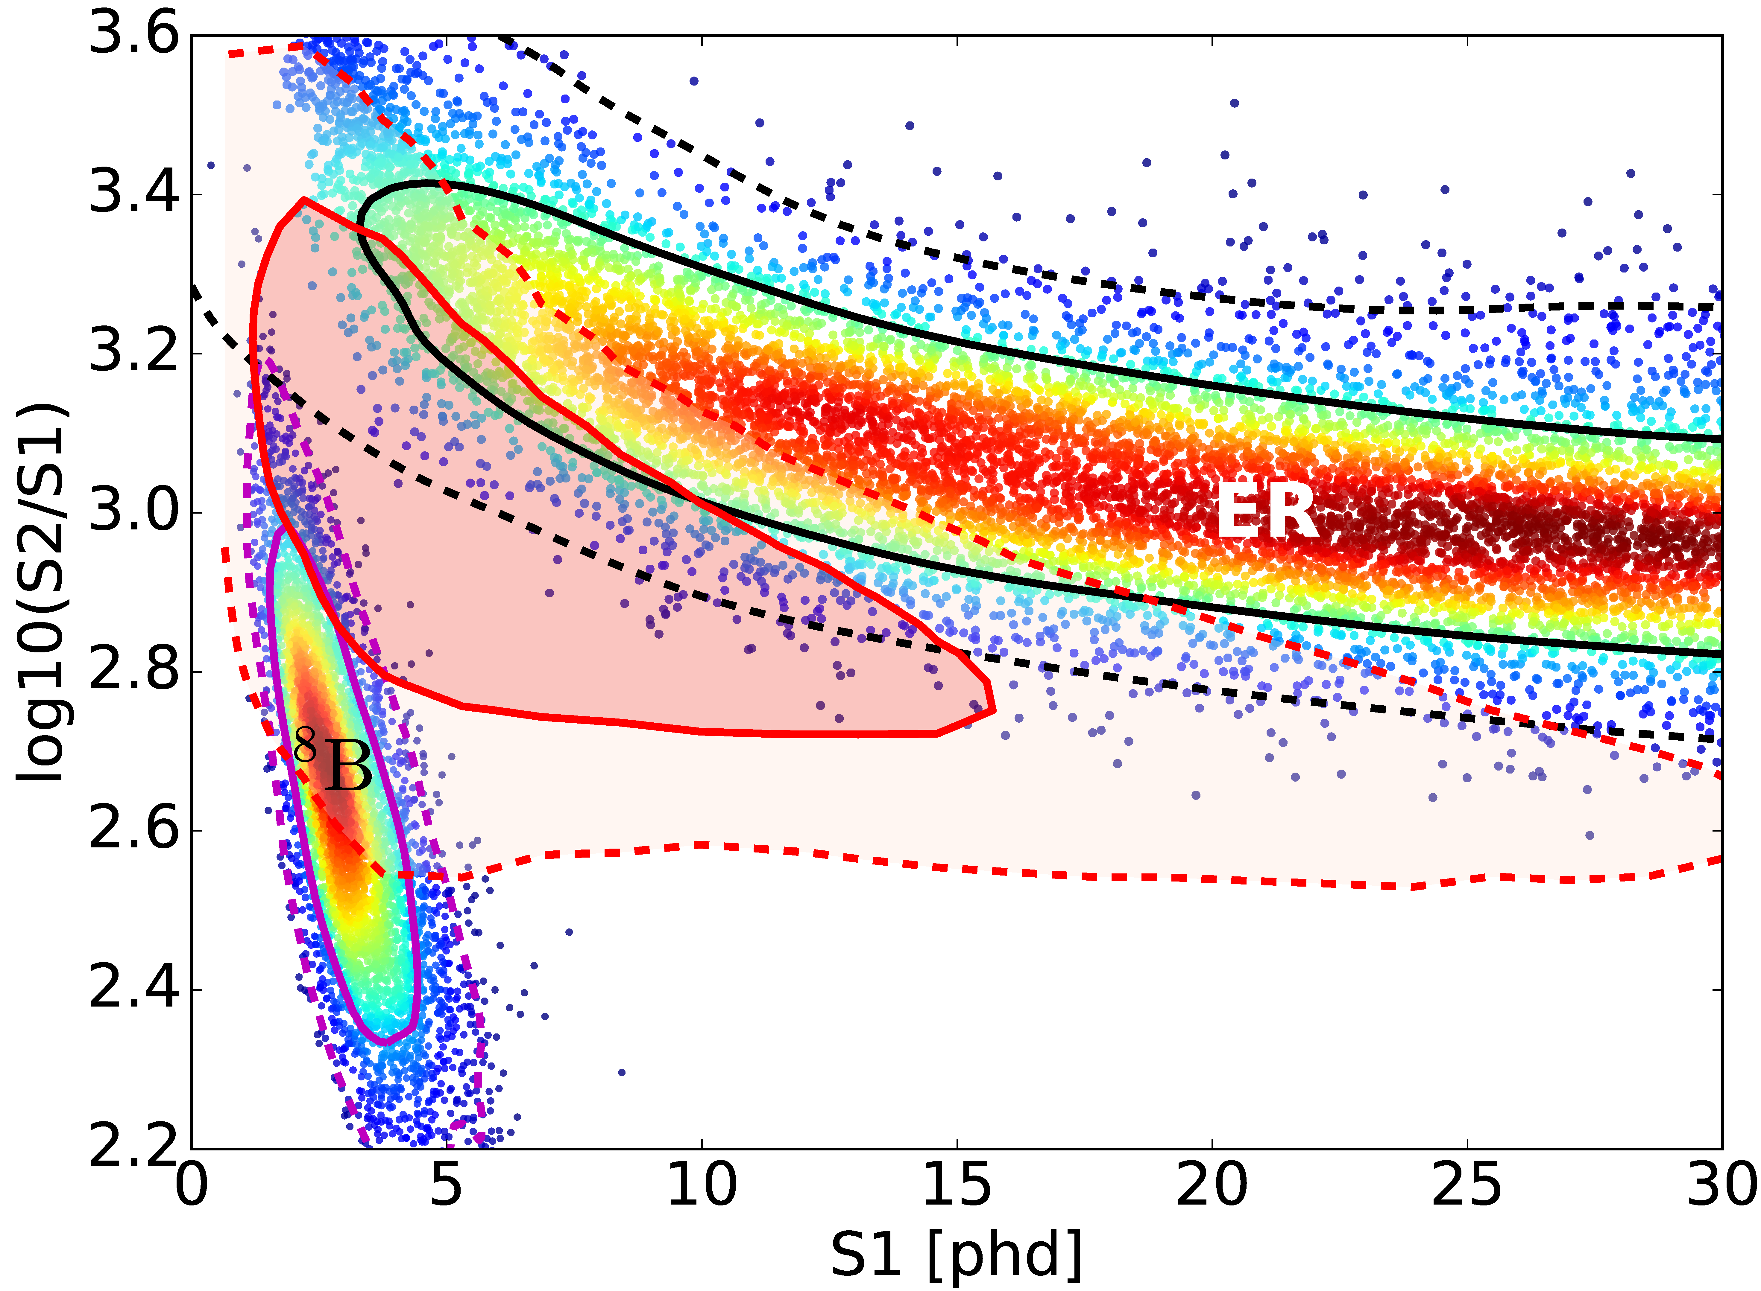
An Example WIMP Signal Region
Technical Design Report (TDR) arXiv:1703.09144
(x5)
40 GeV WIMP
1σ
(x500)
2σ
PDF known with great precision

Slide 9
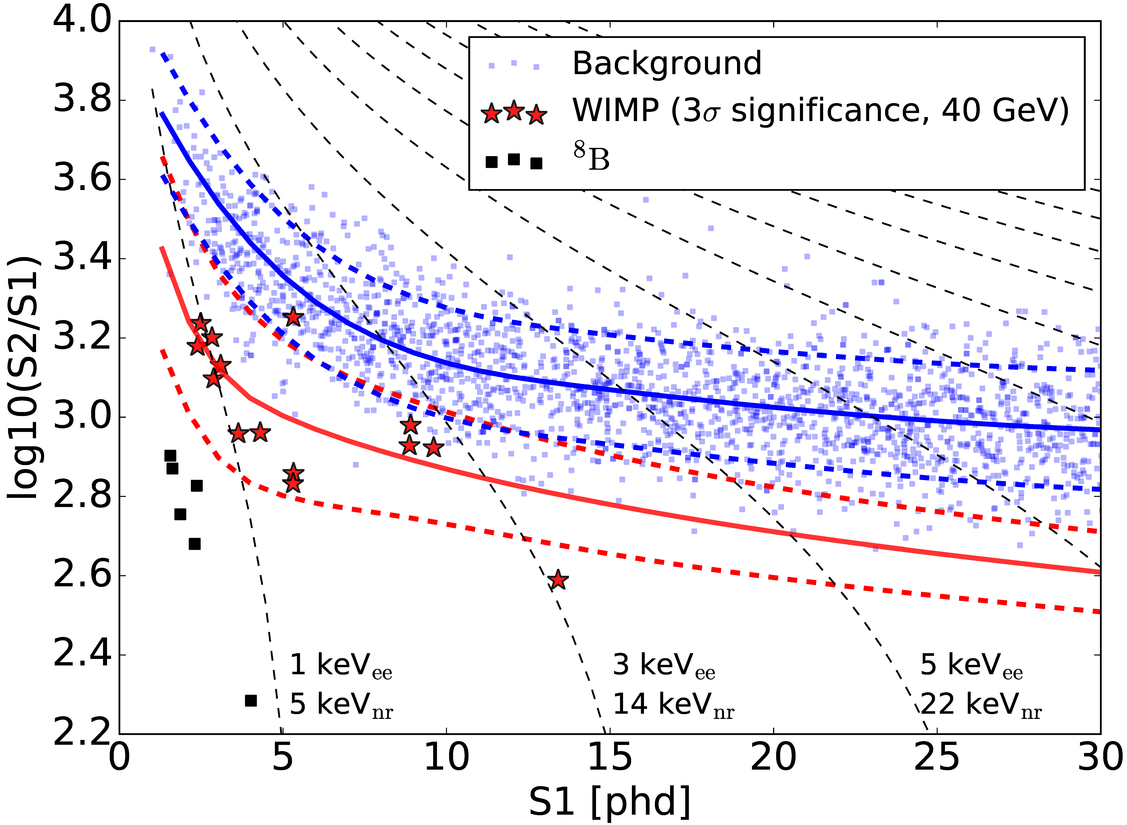
Simulation of LZ’s Full Initial Exposure
solar ν’s
σ = 6 x 10⁻⁴⁸ cm²
arXiv:1703.09144

Slide 10
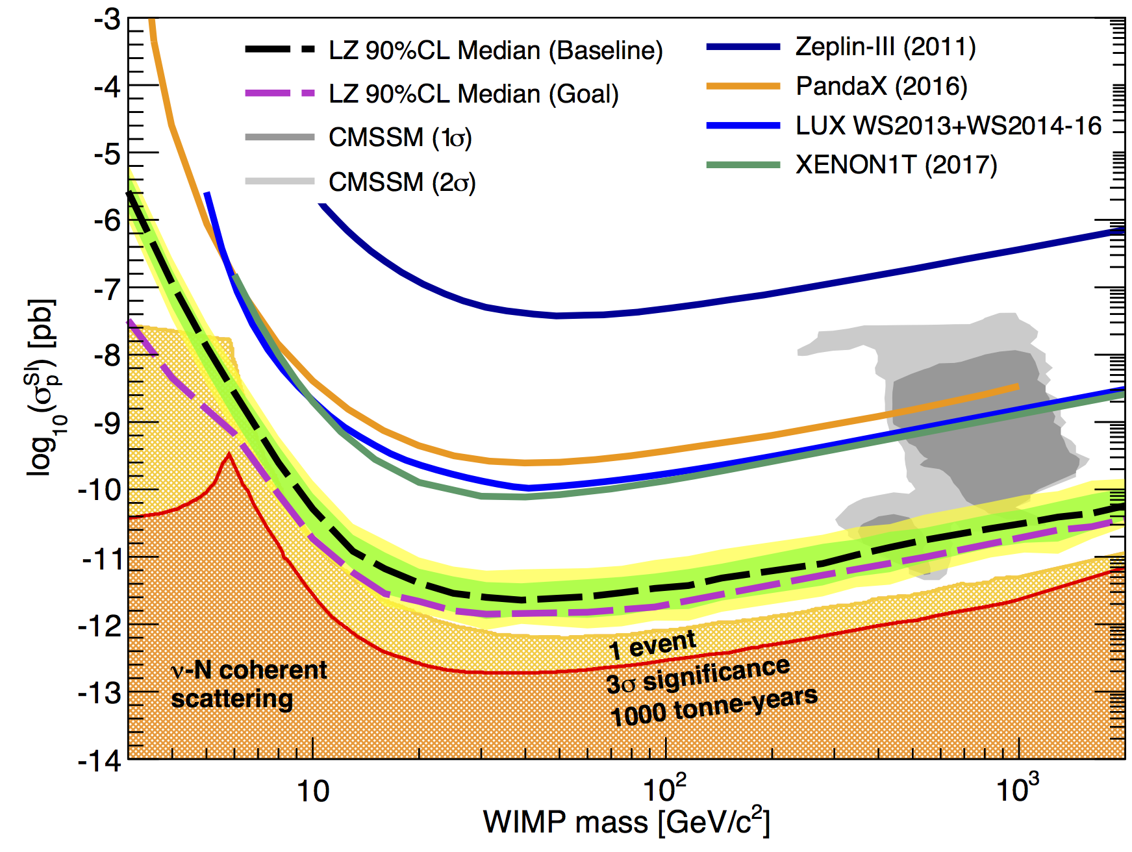
Latest Sensitivity Projections: Spin-Independent

Slide 11
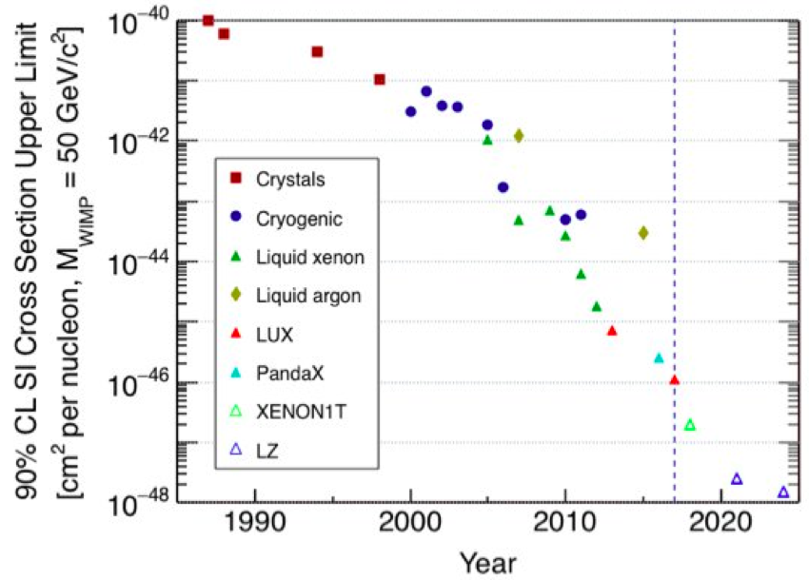
Moore’s-like Law for WIMP SI Direct Detection
Ge, NaI no background discrimination
Ge, with discrimination
LXe, with discrimination
LUX
XENON1T
LZ < 2.3×10⁻⁴⁸ cm²
(~XENONnT)

Slide 12
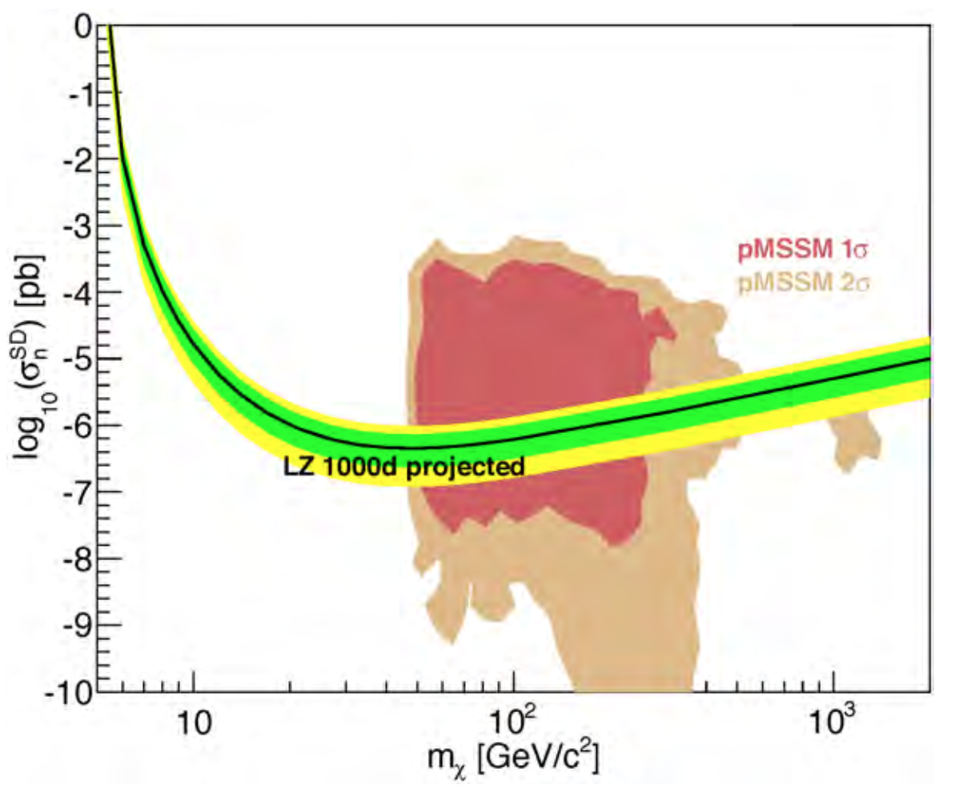
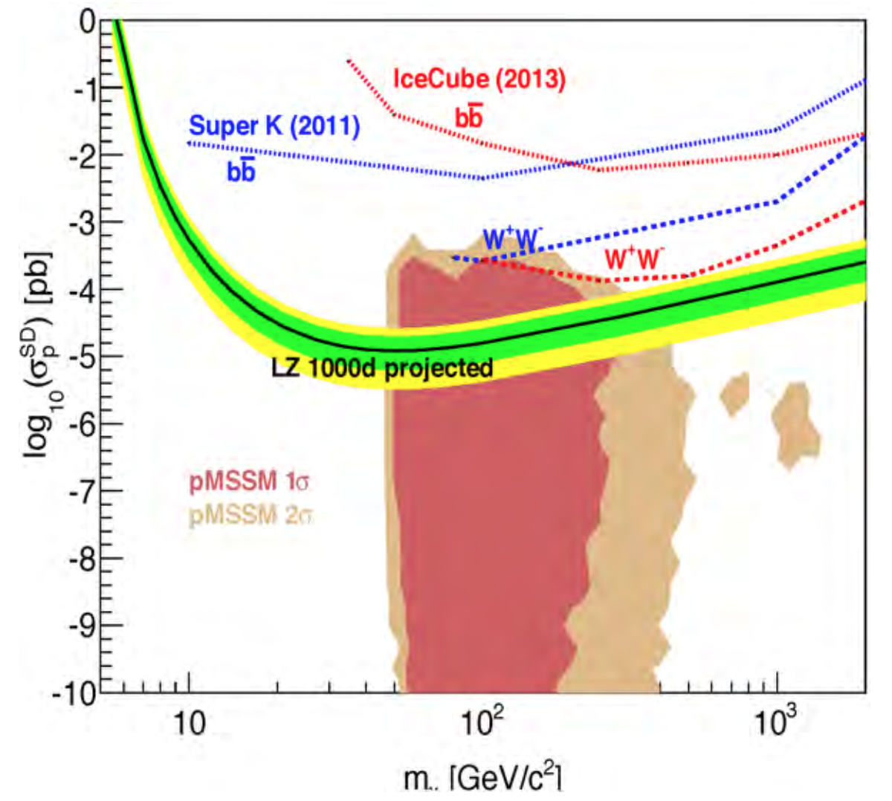
Spin-Dependent Neutron and Proton
Conceptual Design Report (CDR) arXiv:1509.02910
(apologies that slightly outdated: latest PICO SD-p results missing for instance)

Slide 13
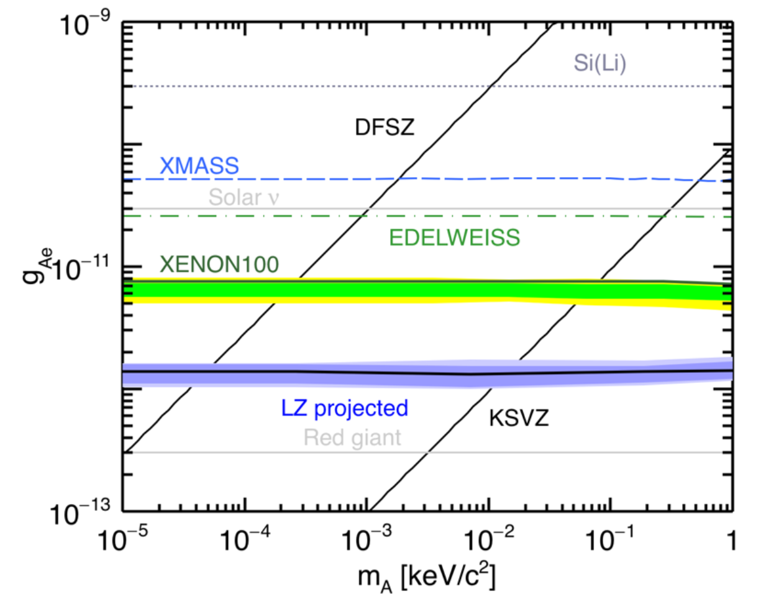
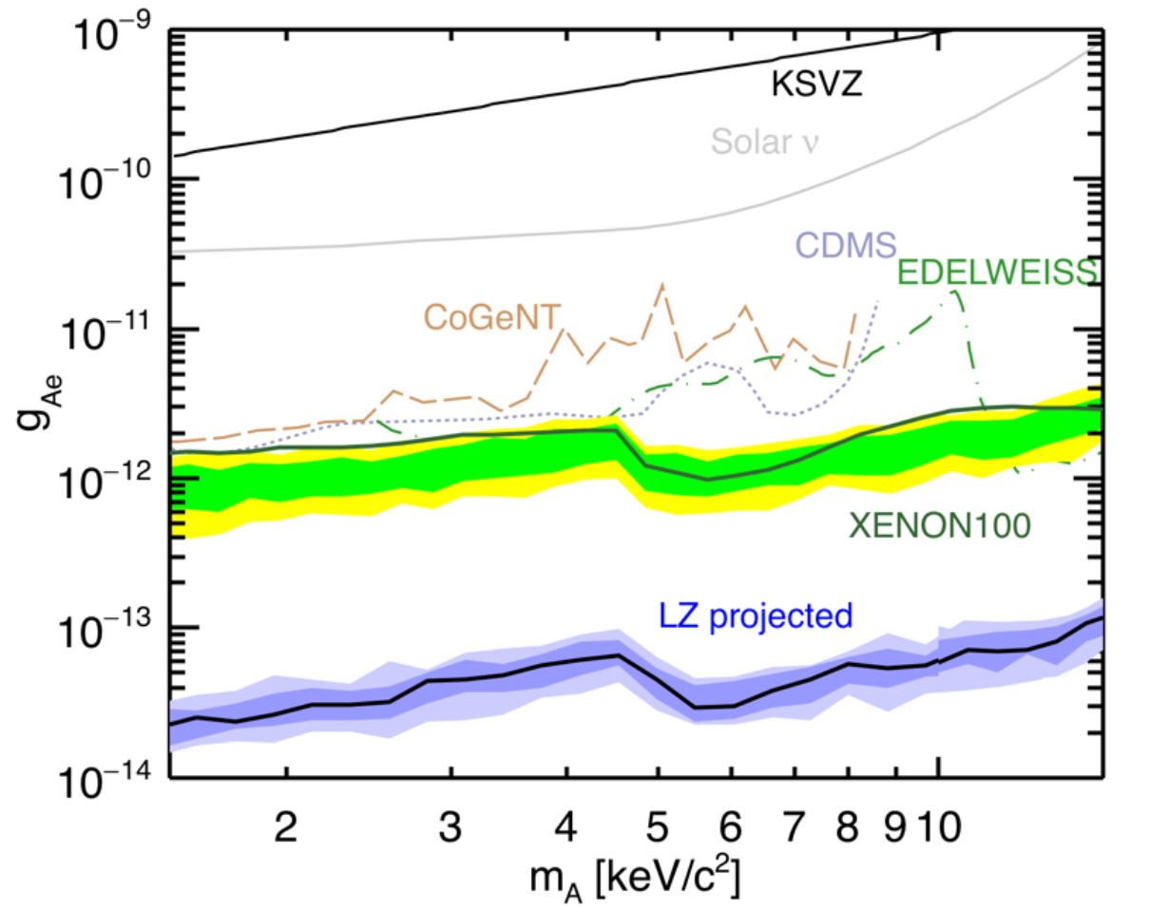
Solar Axions, and Galactic ALPs
Note LUX not here because plots predate that work. See LUX talk for recent results

Slide 14
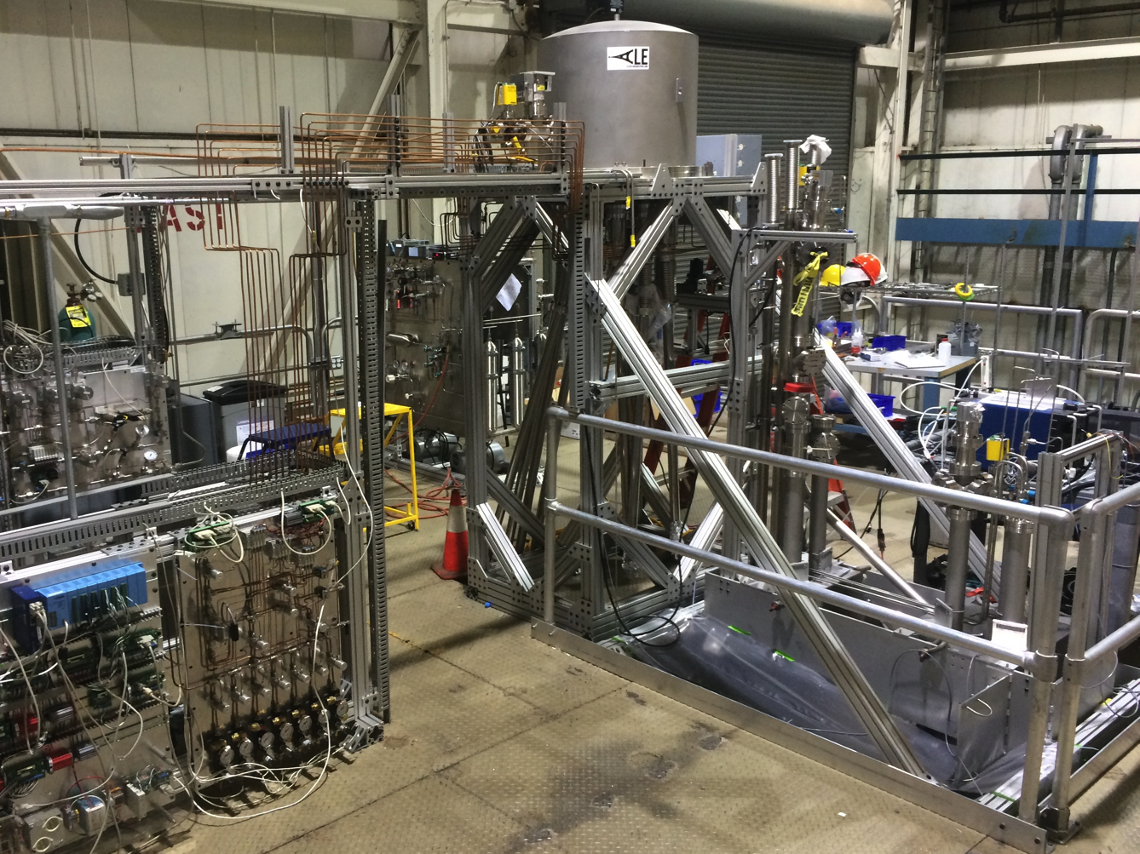
The SLAC “System Test” Platform

Slide 15
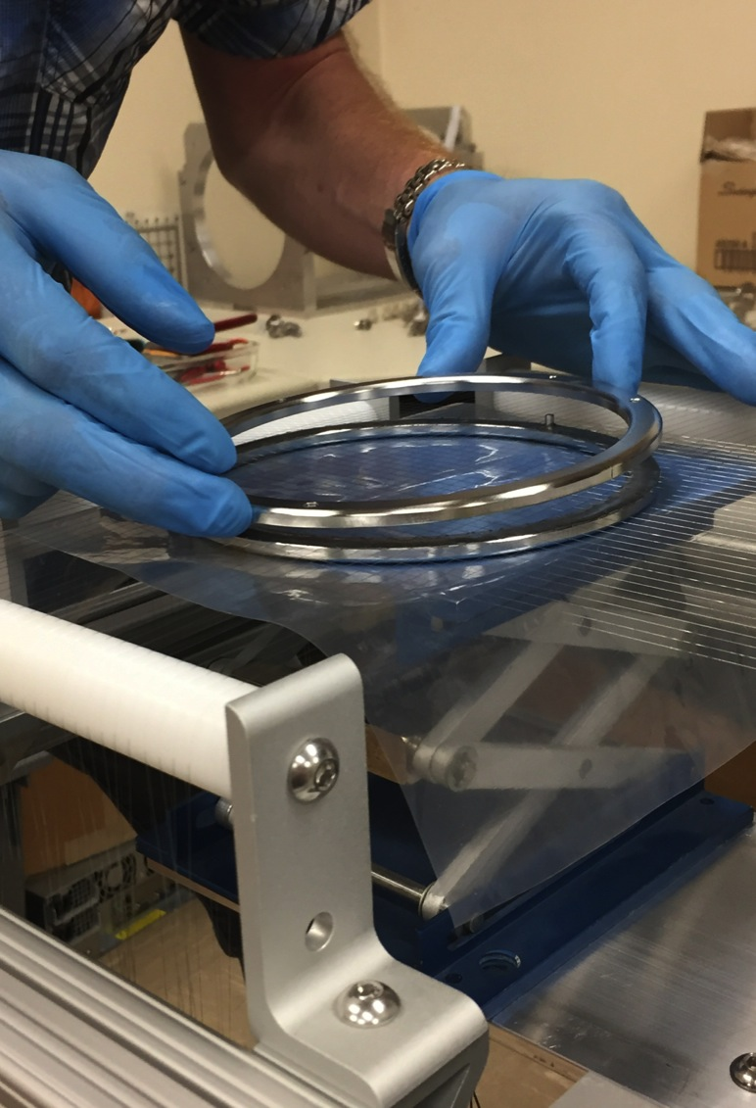
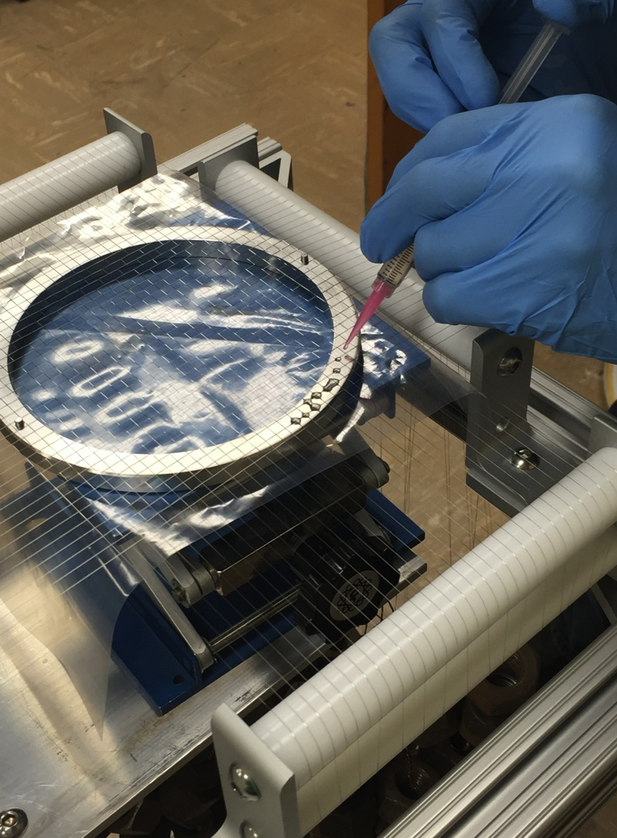
SLAC Noble Liquid Test Platform
Grid Prototyping and Testing

Slide 16
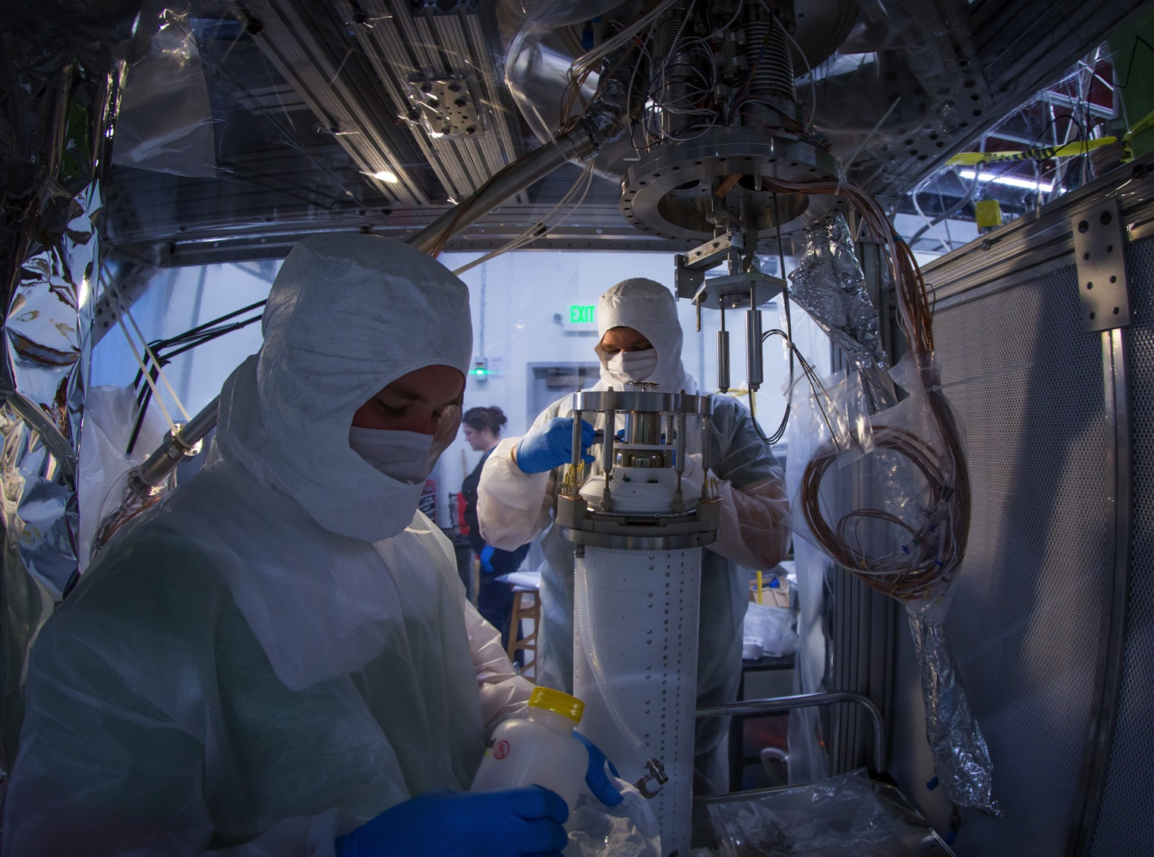
Phase I Test Detector

Slide 17
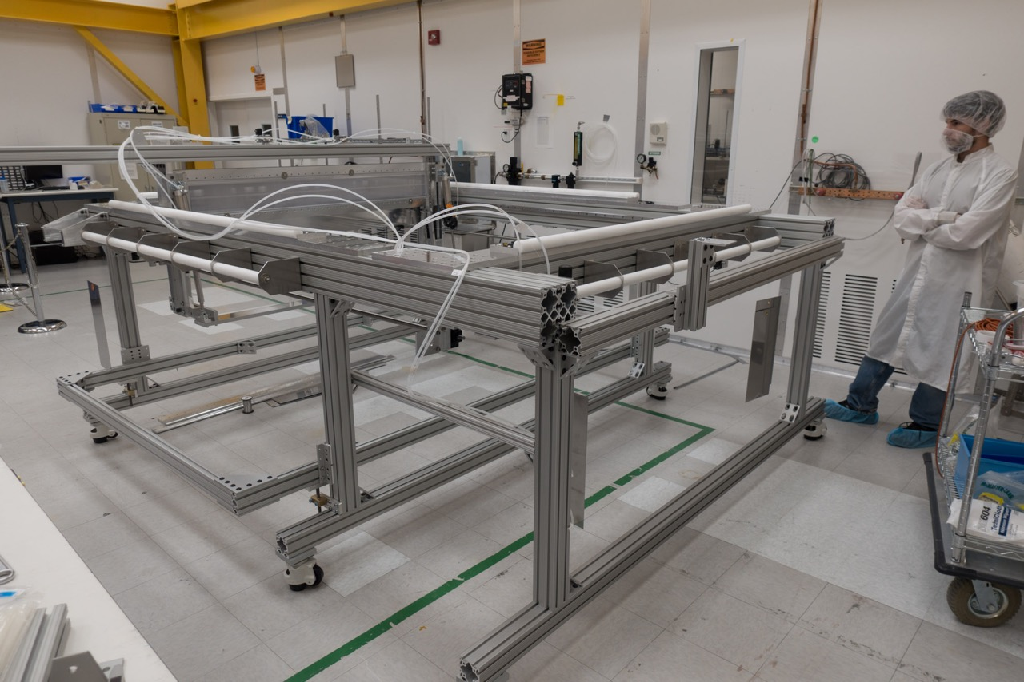
(My Student, Jack Genovesi)
Full-Scale Grid Loom at SLAC

Slide 18
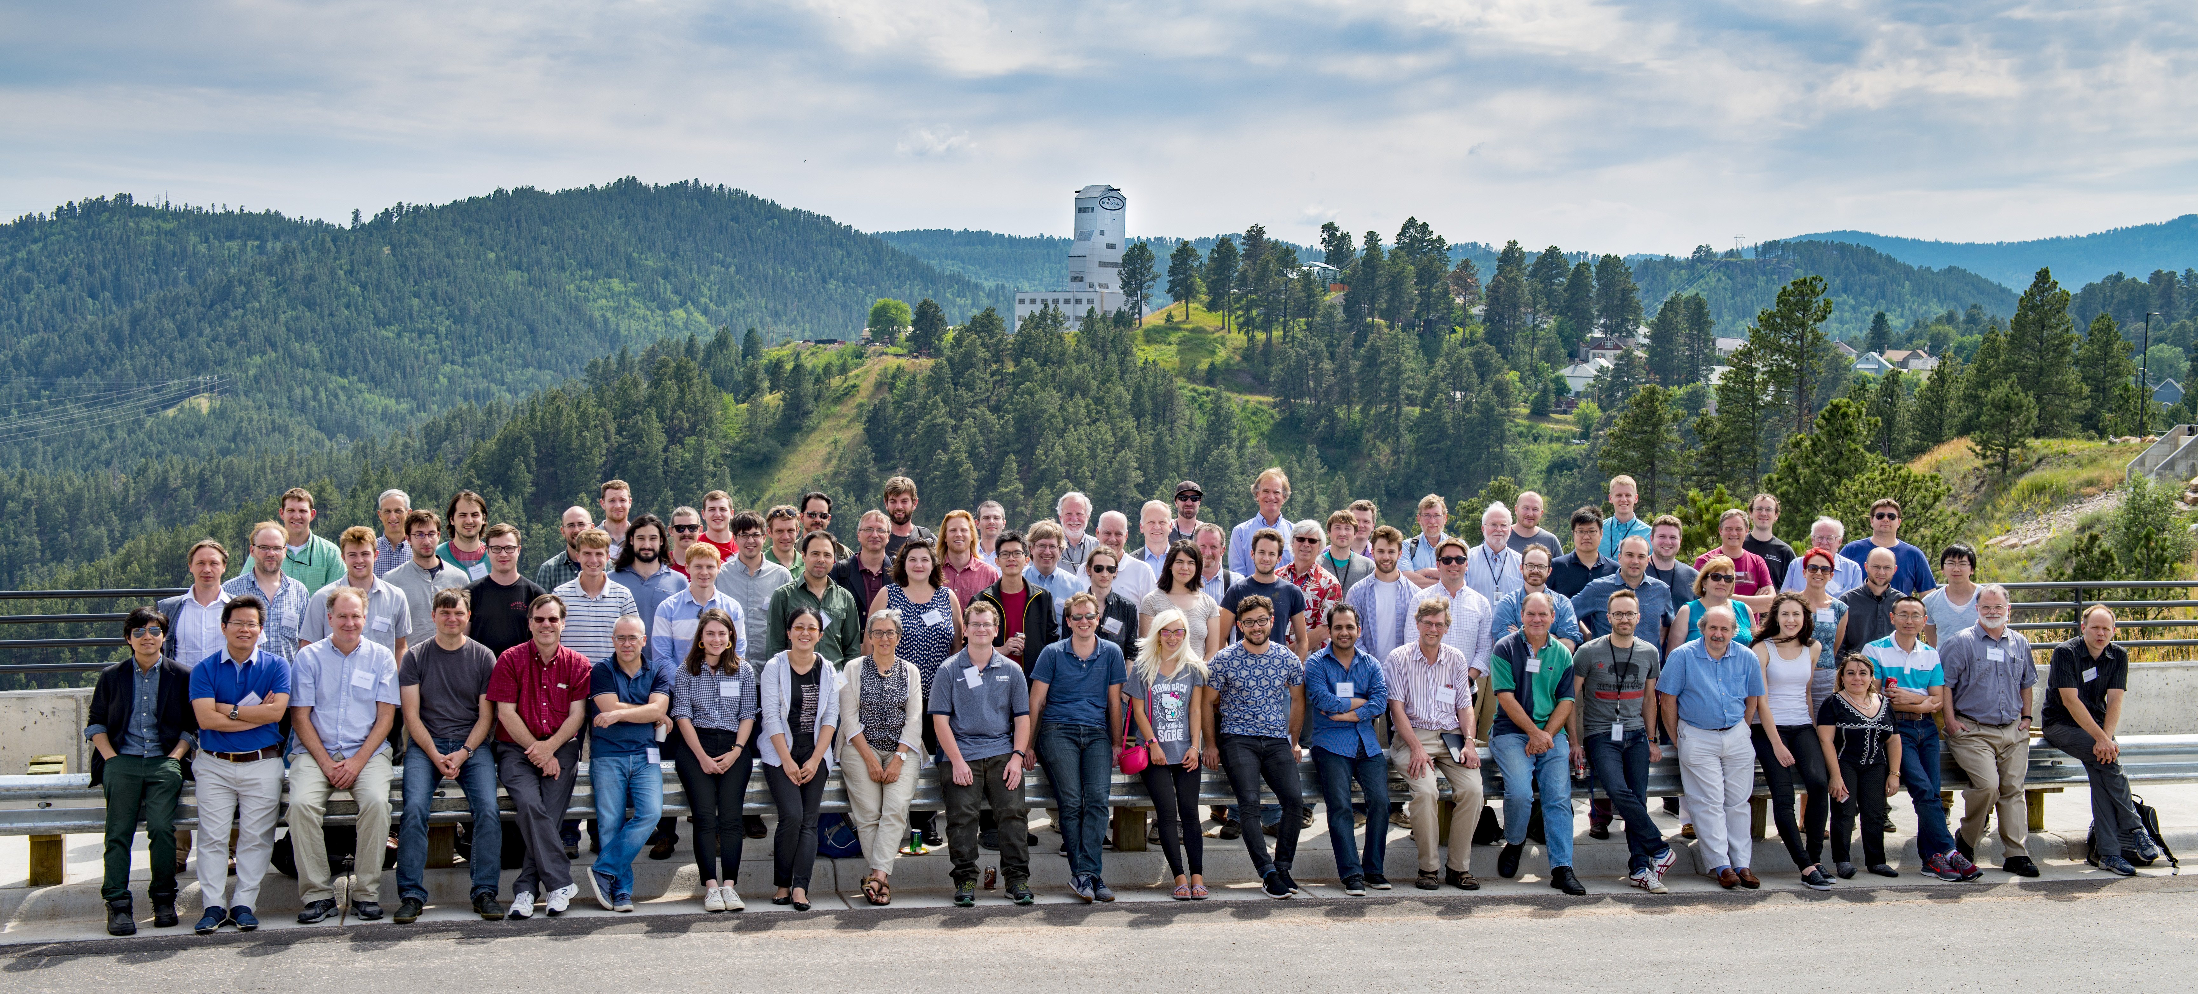
LZ = LUX + ZEPLIN
  A large collaboration, for the field of dark matter:
    38 institutions (US, UK, Portugal, Russia, + South Korea)
    >250 laboratory staff scientists, university faculty, postdocs, graduate students, engineers, & technicians
  The most recent LZ collaboration meeting, at SURF, July 2017

Slide 19
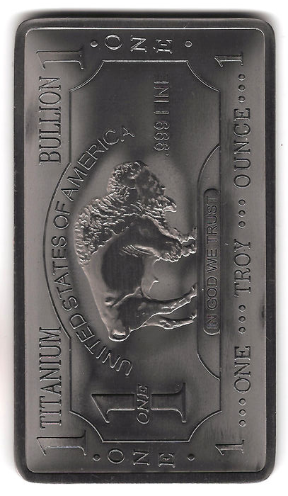
Summary and Outlook
LZ achieved CD-3 milestone on 02.09.17
  March 2016: LUX removed from Davis
  July 2017 (NOW): surface assembly prep
  July 2018: underground installation
  2020: beginning of LZ commissioning
Long lead-time procurements are underway
Quality assurance and testing for hardware underway; material screening program busy
LZ benefits from excellent LUX calibrations plus understanding of BGs, and from NEST
LZ science run planned to start in 2021:
  1,000 live-days and 5.6T fiducial mass
  Baseline SI sensitivity of 2.3×10⁻⁴⁸ cm²
  Start probing the ν floor at <10 GeV/c²

Slide 20
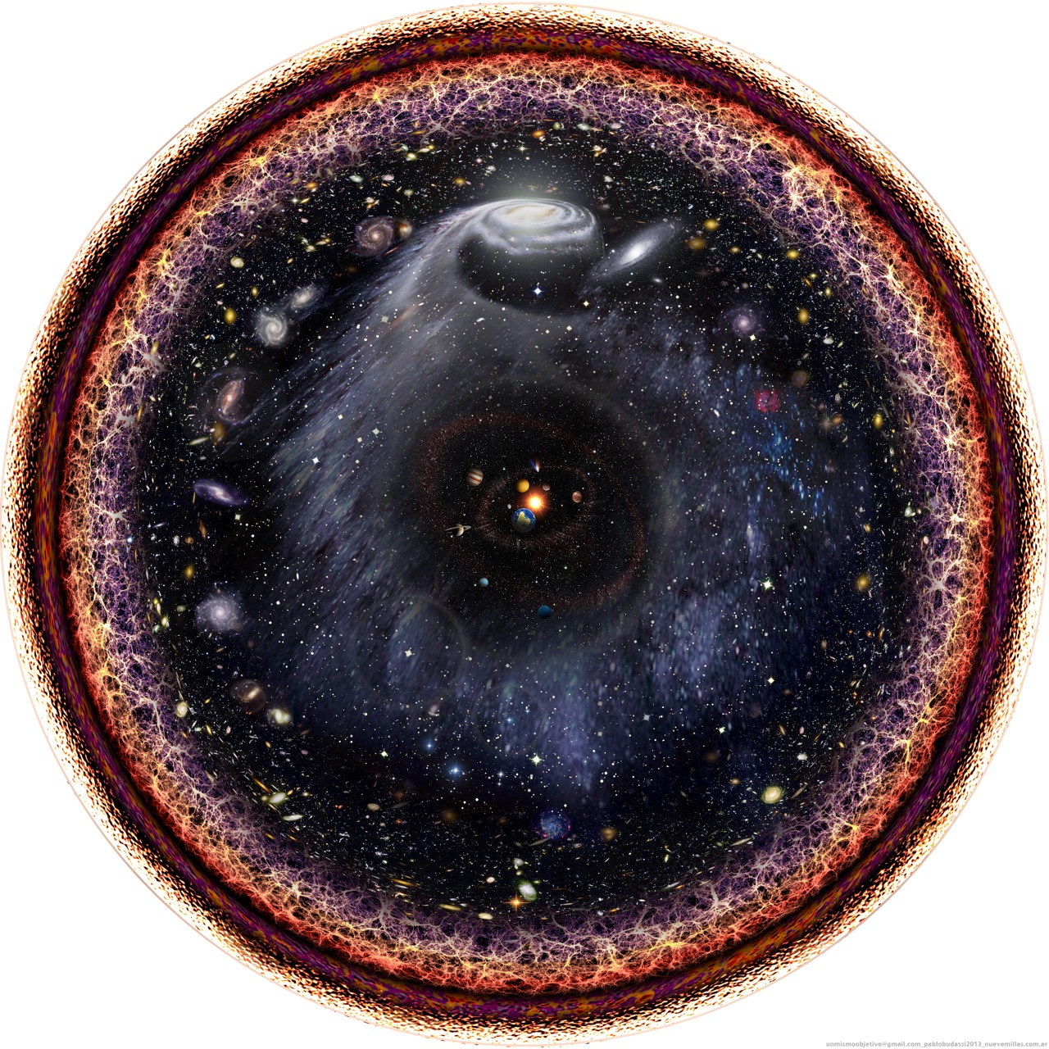
Backup Slides

Slide 21
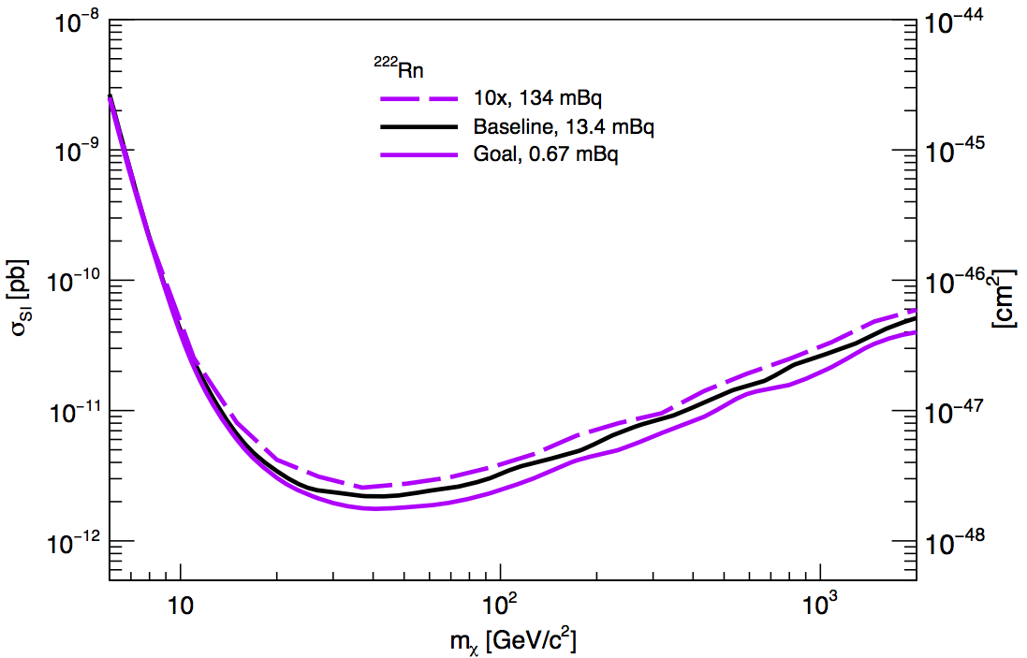
Hypothetical ²²²Rn Scenarios
Powerful background rejection thanks to Profile-Likelihood-Ratio (PLR) analysis
Sensitivity estimate is robust!

Slide 22
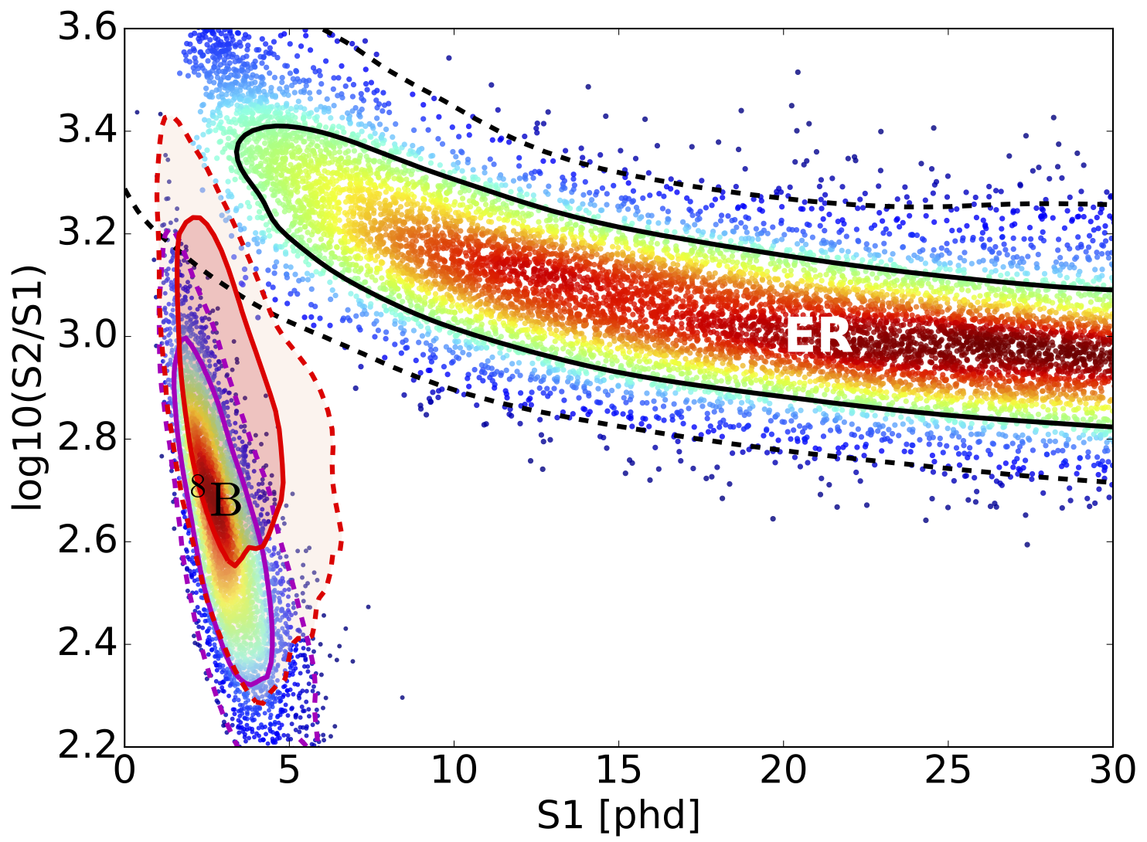
WIMP Signal Region in LZ
(x5)
1σ
10 GeV WIMP
(x500)
2σ

Slide 23
WIMP Signal Region in LZ
(x5)
40 GeV WIMP
1σ
(x500)
2σ
PDF known with great precision

Slide 24
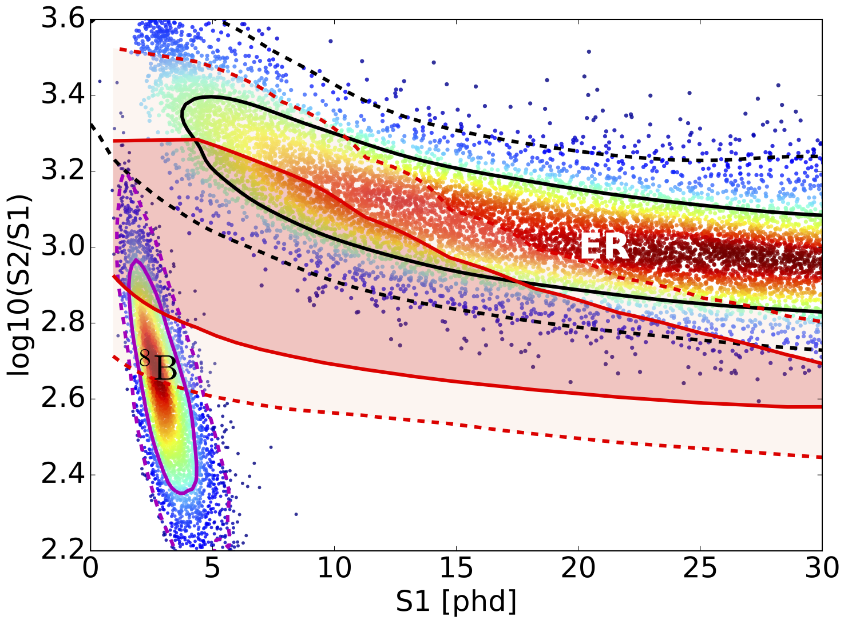
WIMP Signal Region in LZ
(x5)
1 TeV WIMP
(x500)
1σ
2σ

Slide 25
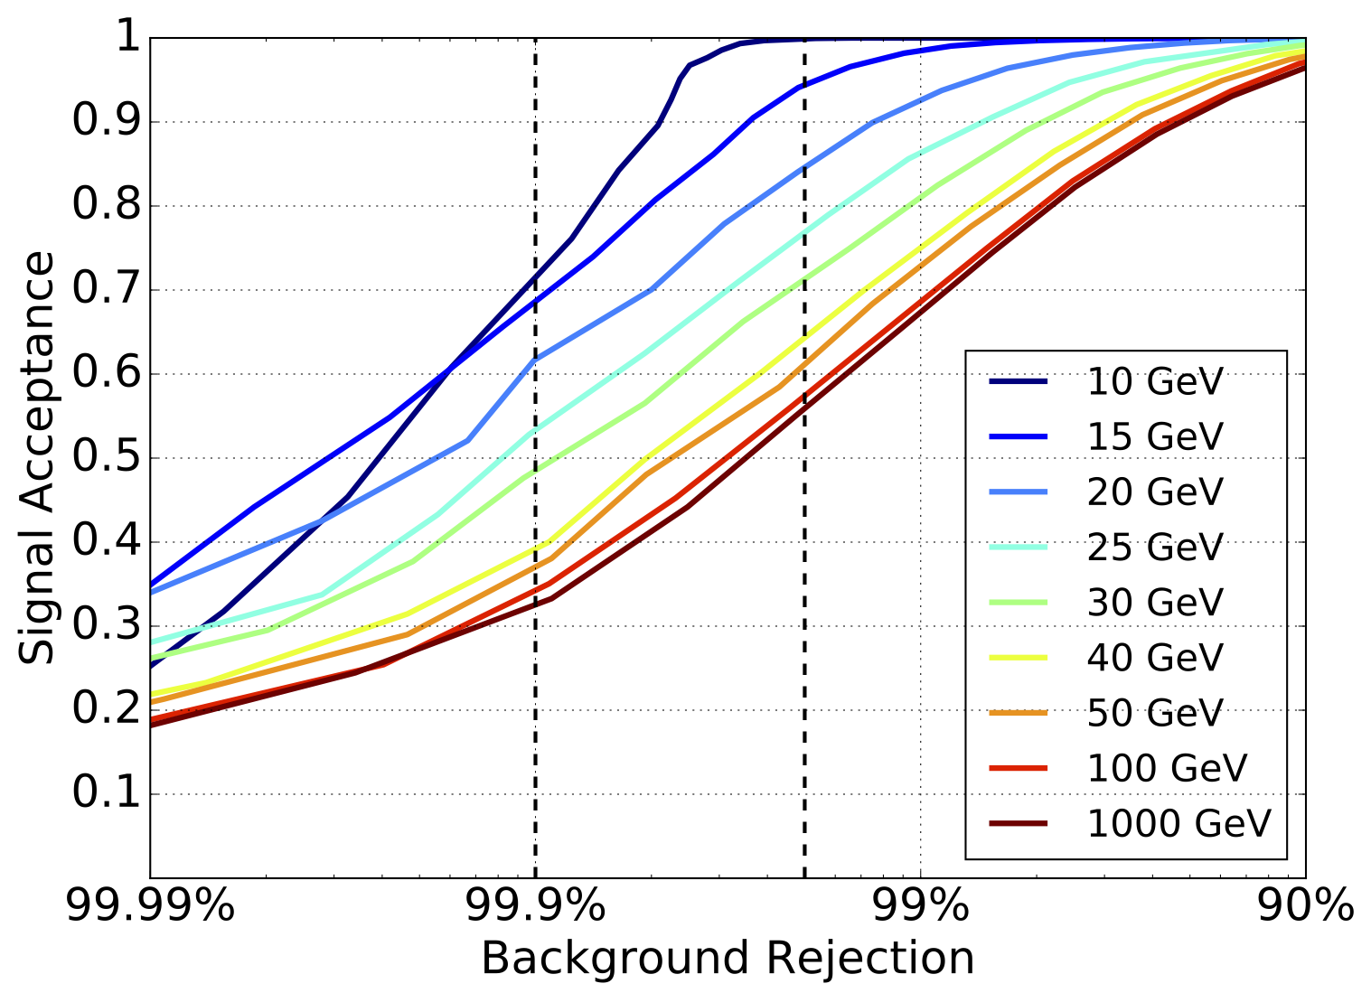
Effective background rejection with PLR
ER + ⁸B

Slide 26
What is NEST?
Noble Element Simulation Technique
Simulates excitation, ionization, and elastic scattering processes
Simulates electron recombination and escape/drift
Pulse shapes: S1 triplet and singlet decay times, and photon travel times
http://nest.physics.ucdavis.edu/site/
  See website for publications list
Used by LUX, LZ, XENON100, XENON1T/nT, PandaX

