Slide 1
Observations of the Very Local Interstellar Medium with the IBEX and Voyager Spacecraft
Eric J. Zirnstein
Department of Astrophysical Sciences
Princeton University
TeVPA 2017
Columbus, Ohio

Slide 2
Outline
The Heliospheric Boundaries
Observing Energetic Neutral Atoms (ENAs) with the Interstellar Boundary Explorer (IBEX)
  The IBEX Ribbon and the Very Local Interstellar Magnetic Field
Voyager 1 in situ Observations of the Very Local Interstellar Medium (VLISM)
  Magnetic Field Draped Around the Heliosphere, Turbulence Spectrum

Slide 3
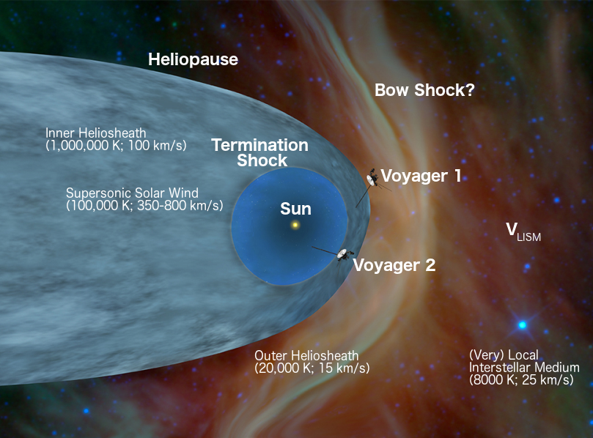
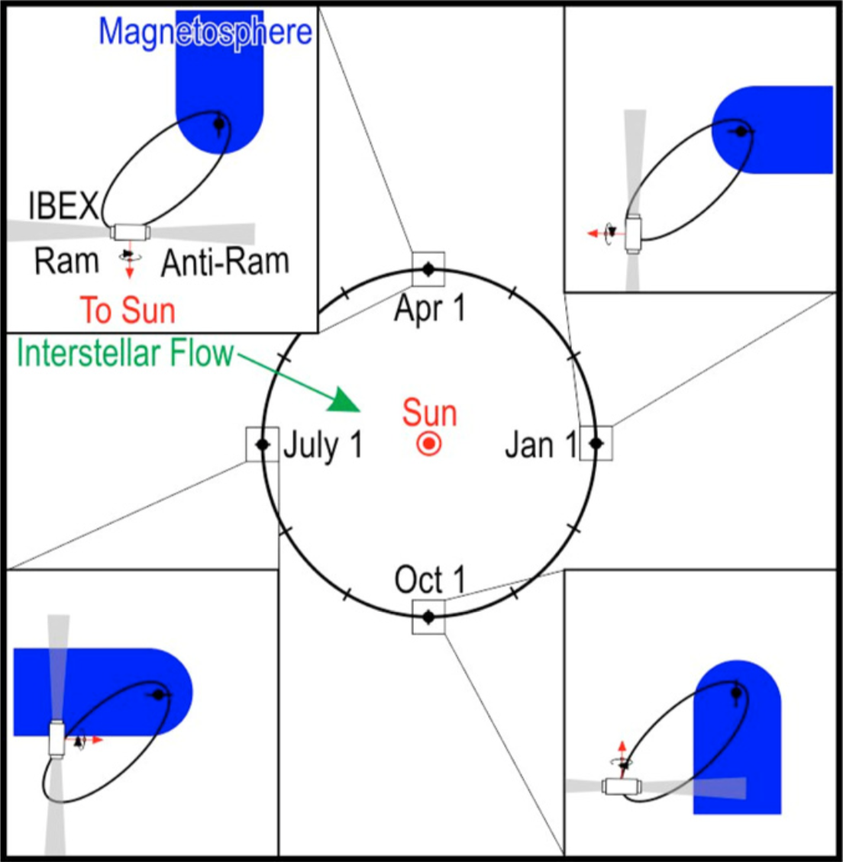
Boundaries of the Heliosphere

Slide 4
Observing Energetic Neutral Atoms (ENAs) with IBEX

Slide 5
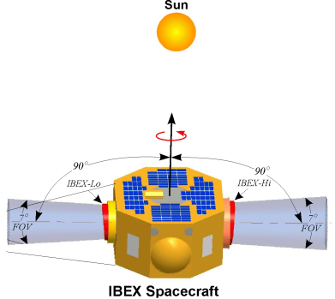
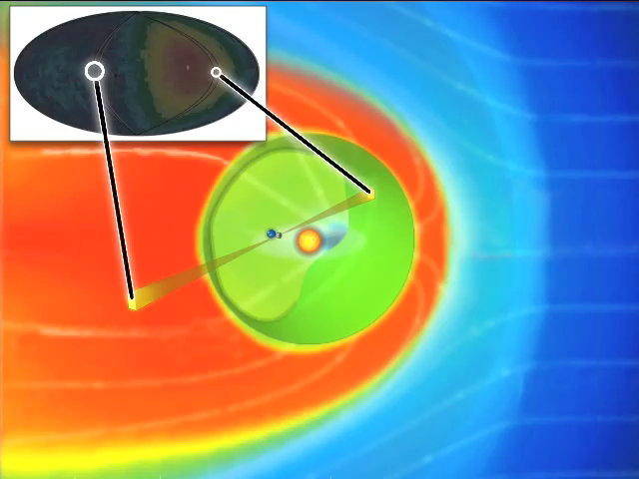
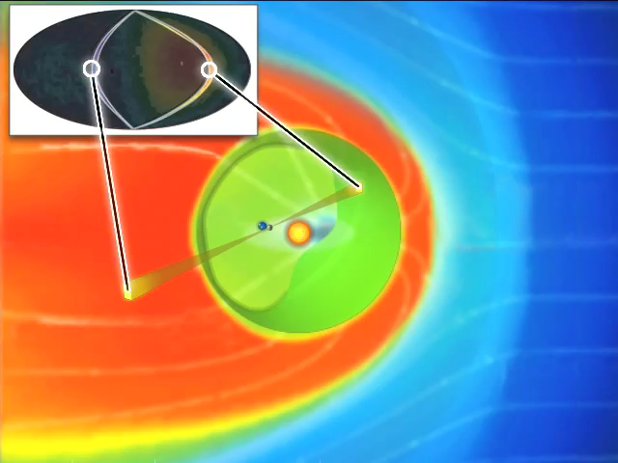
Observing ENAs:
Creating All-sky Maps in 6 Months
Nose/Upwind
Nose/Upwind
Credit: IBEX Team/SwRI

Slide 6
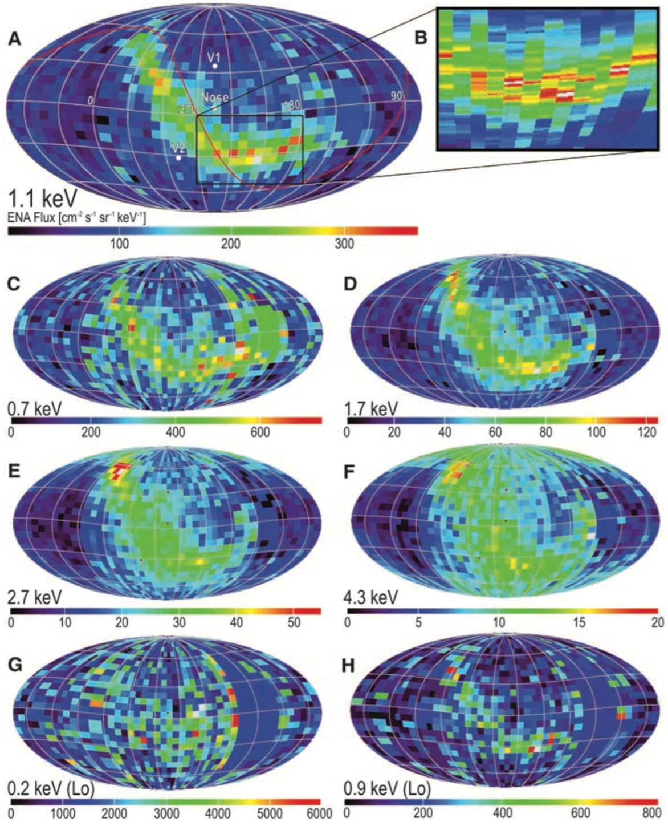
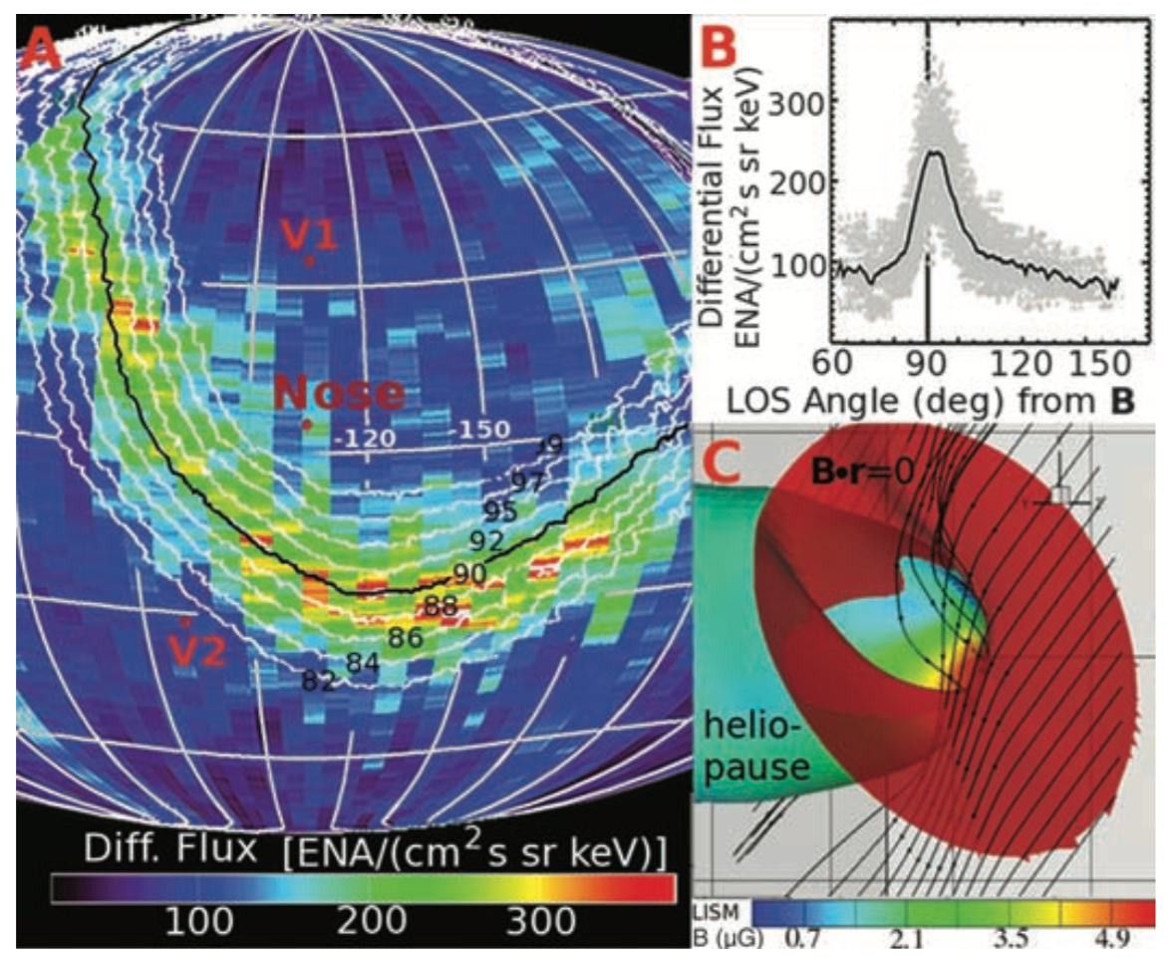
First IBEX
Observations
McComas et al. (2009, Sci)
First all-sky maps produced/published in 2009
“Ribbon” completely unexpected, but realized to be connected to the local ISMF:
Schwadron et al. (2009, Sci)

Slide 7
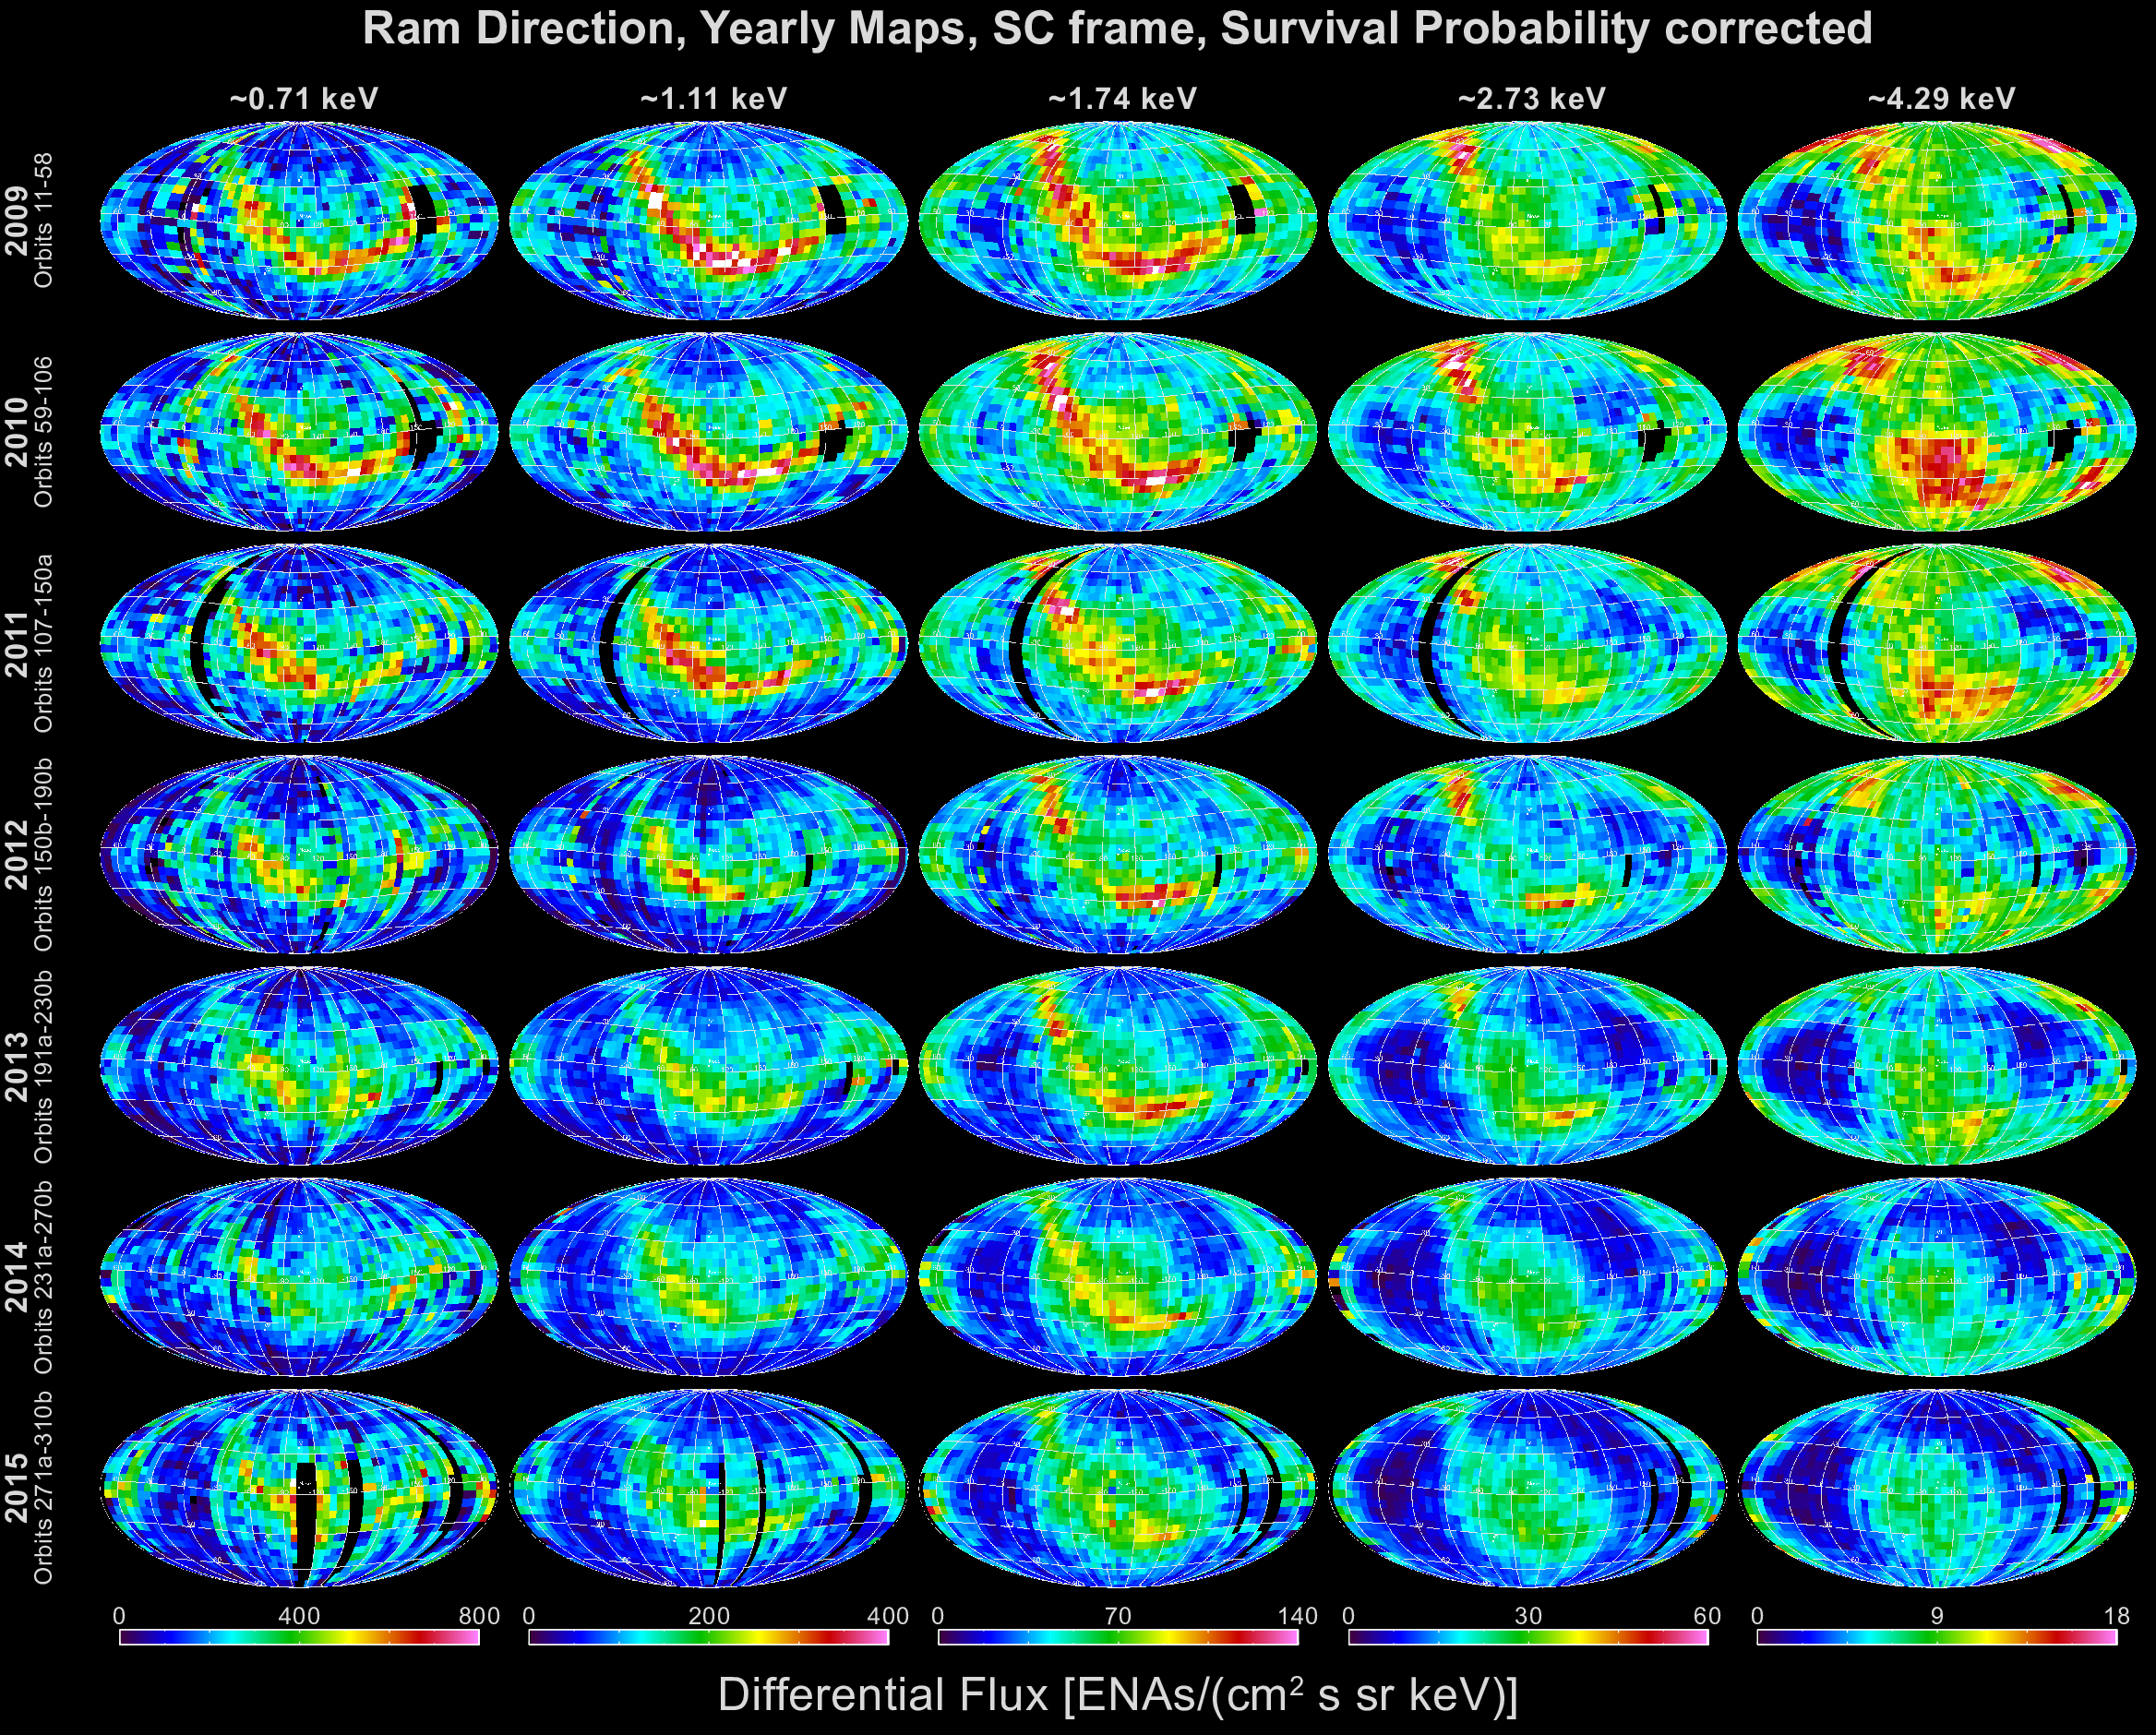
First 7 Years of IBEX Observations
(McComas et al. 2017, ApJS)

Slide 8
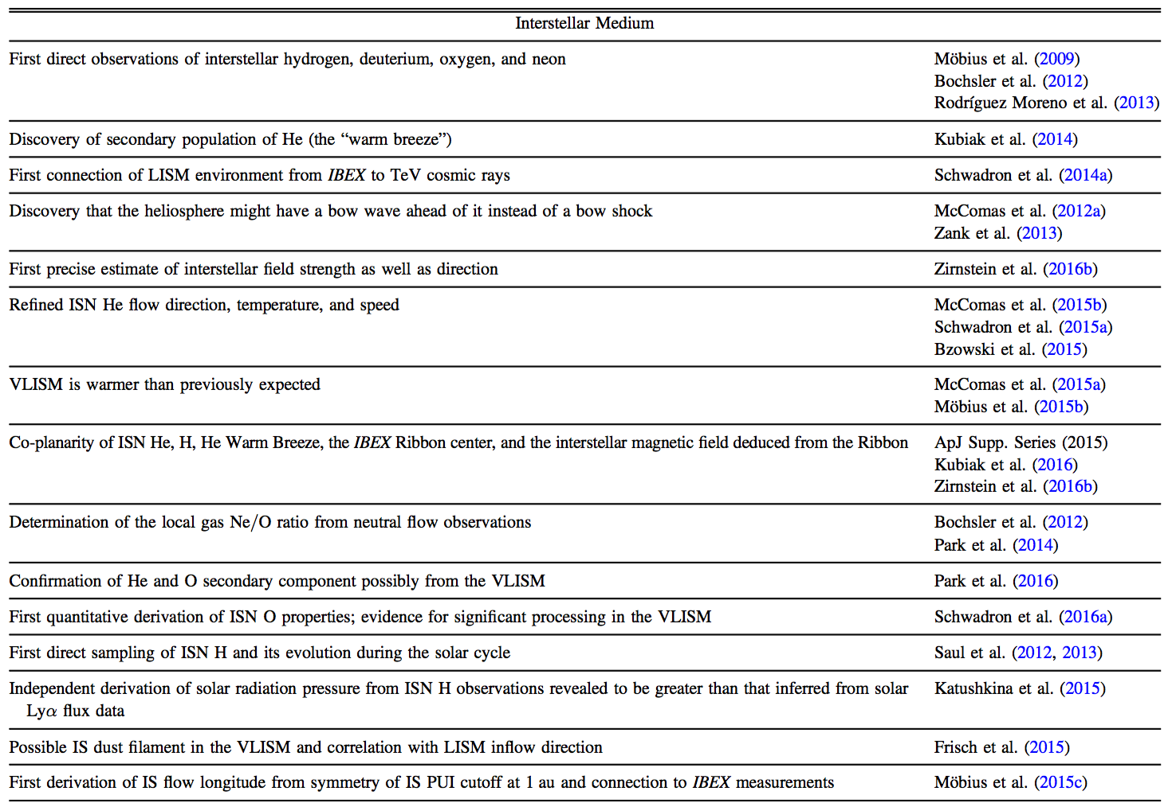
Some IBEX Discoveries of the VLISM
McComas et al. (2017, ApJS)

Slide 9
The IBEX Ribbon and the Interstellar Magnetic Field

Slide 10
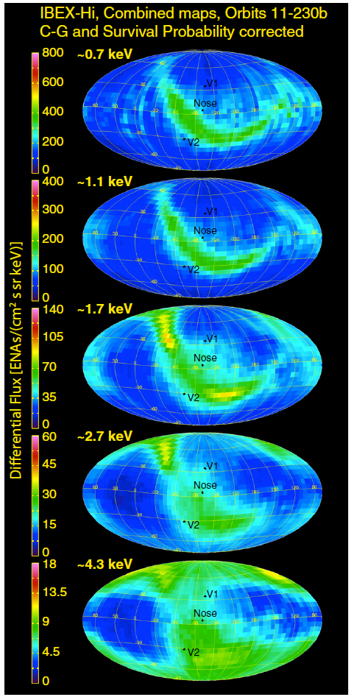
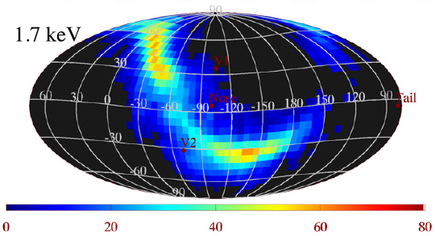
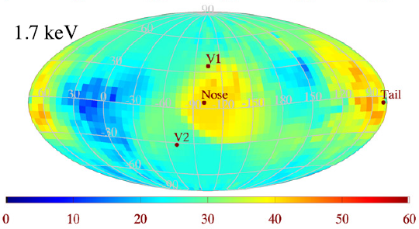
The IBEX Ribbon
McComas et al. (2014, ApJS)
Schwadron et al. (2014, ApJS)

Slide 11
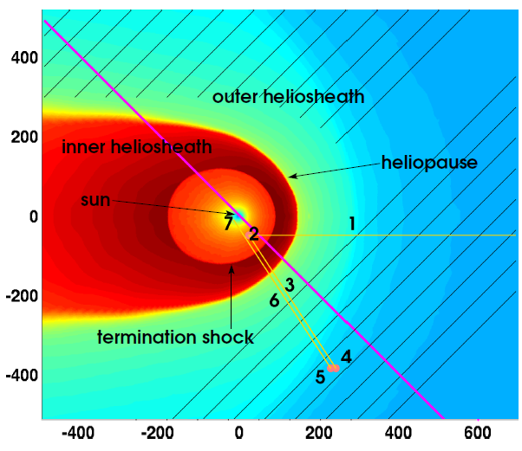
How is the Ribbon created? Likely via the “Secondary ENA” Process
Interstellar neutral atoms travel inside heliosphere
Neutral atom charge-exchanges with solar wind ion
New “primary” ENA travels outside heliosphere
Primary ENA charge-exchanges with interstellar ion, creating pickup ion
Pickup ion charge-exchanges with interstellar neutral atom, creating “secondary” ENA
Secondary ENA travels back inside heliosphere
Secondary ENA may be detected by IBEX
B∙r = 0

Slide 12
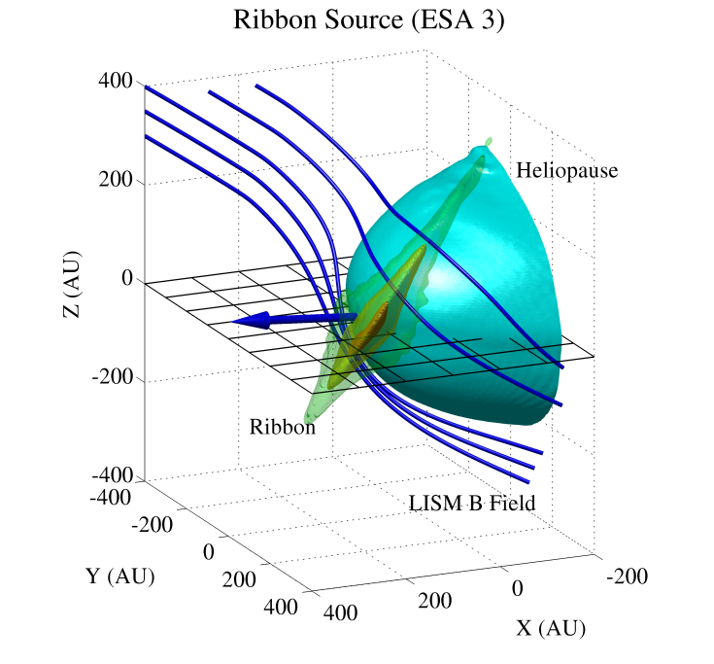
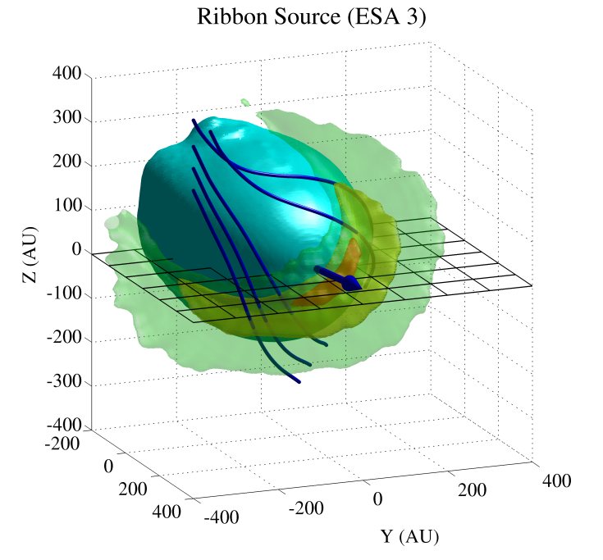
Ribbon Production Rate (E = 1.11 keV)
(cm³ s sr keV)⁻¹
Isocontour levels: 70% (orange), 25% (yellow), 10% (green)
Zirnstein et al. (2015, ApJL)

Slide 13
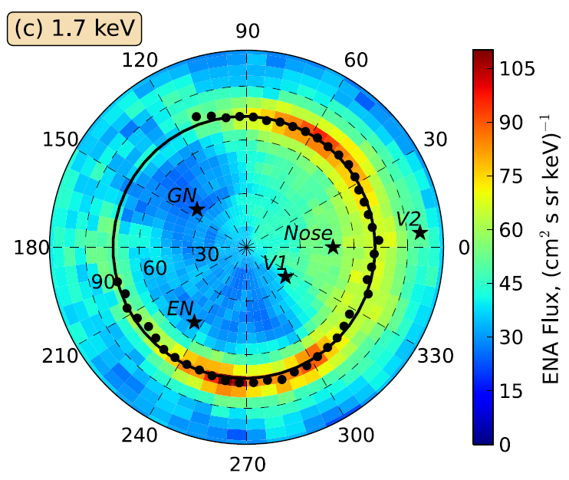
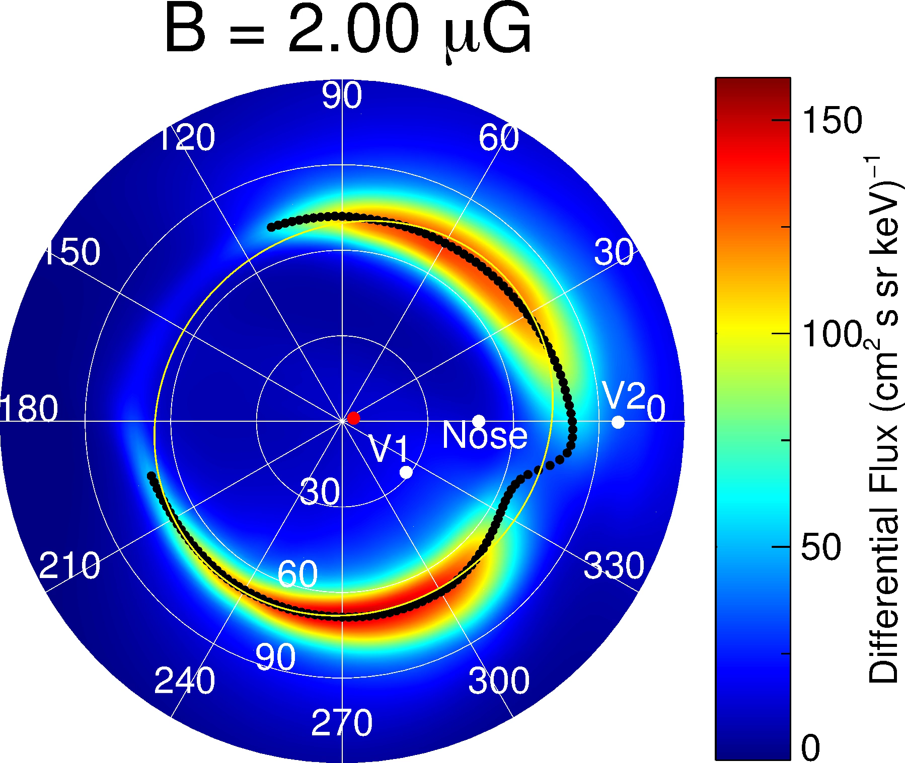
Simulate Ribbon in Different Configurations of B_{LISM}
IBEX Data
Simulation
Funsten et al. (2013, ApJ)
Zirnstein et al. (2016, ApJL)

Slide 14
Derive B_{LISM} Based on Model-Data Ribbon Comparison
ENA Energy (keV) | Magnitude (μG)
0.71 | 3.06 ± 0.12
1.11 | 2.92 ± 0.11
1.74 | 2.79 ± 0.13
2.73 | 2.98 ± 0.21
4.29 | 2.86 ± 0.31
Combined | 2.93 ± 0.08
B_{LISM} Direction:
Ecliptic Coord. - (227.3°, 34.6°)
Galactic Coord. – (26.0°, 50.1°)
Zirnstein et al. (2016, ApJL)

Slide 15
Voyager 1 In Situ Observations of the VLISM

Slide 16
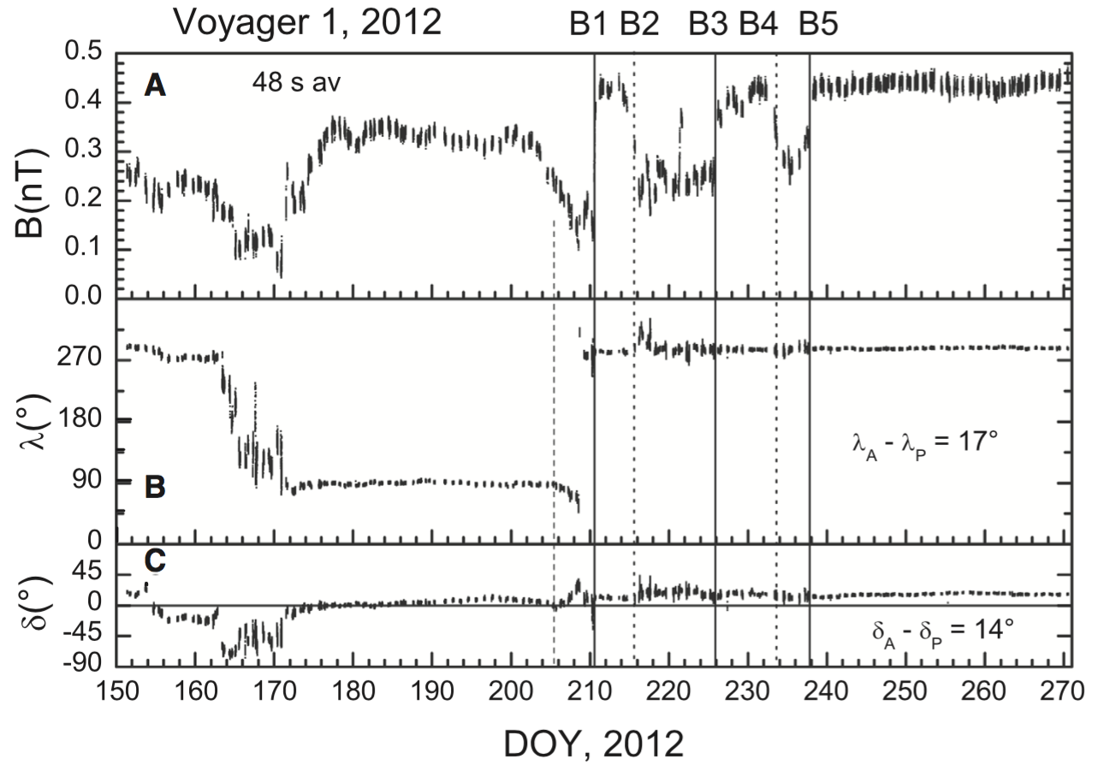
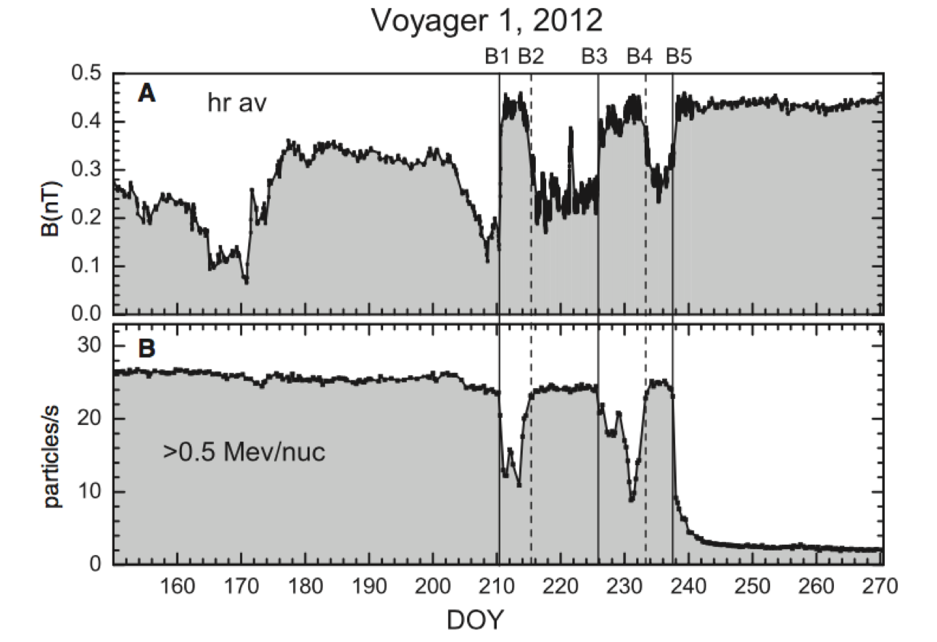
Voyager 1 Observations of the VLISM Magnetic Field (Burlaga et al. 2013, Sci)

Slide 17
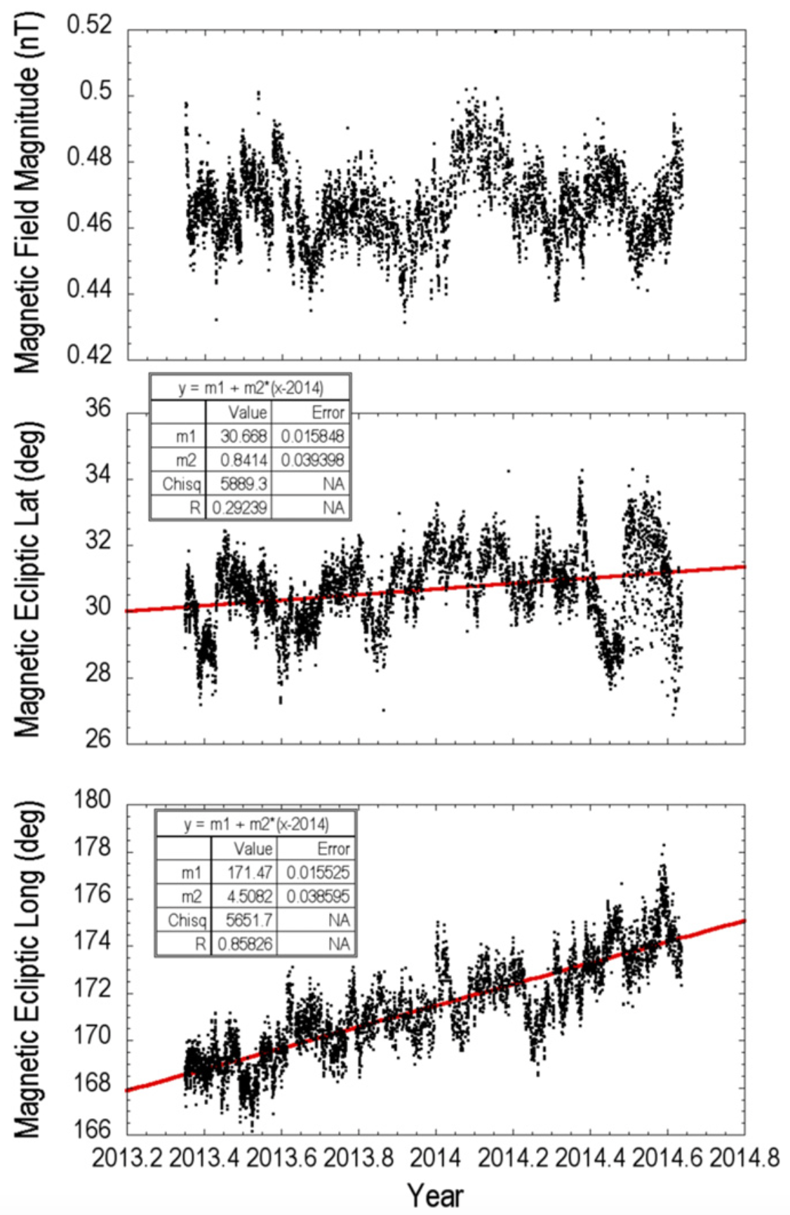
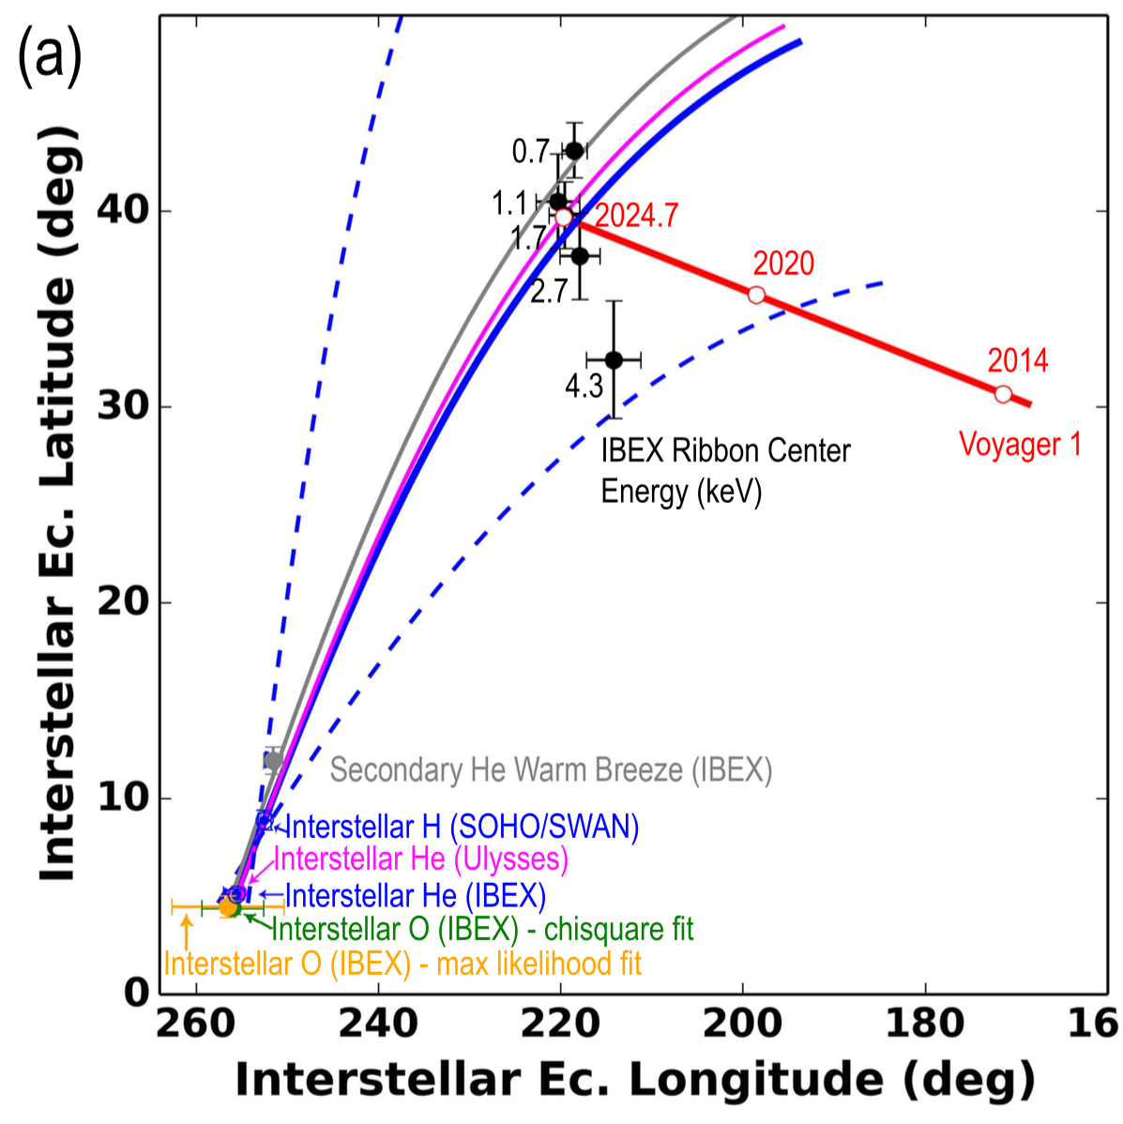
Connecting V1 ISMF Observations to IBEX Neutral Observations
Schwadron et al. (2015, 2016)

Slide 18
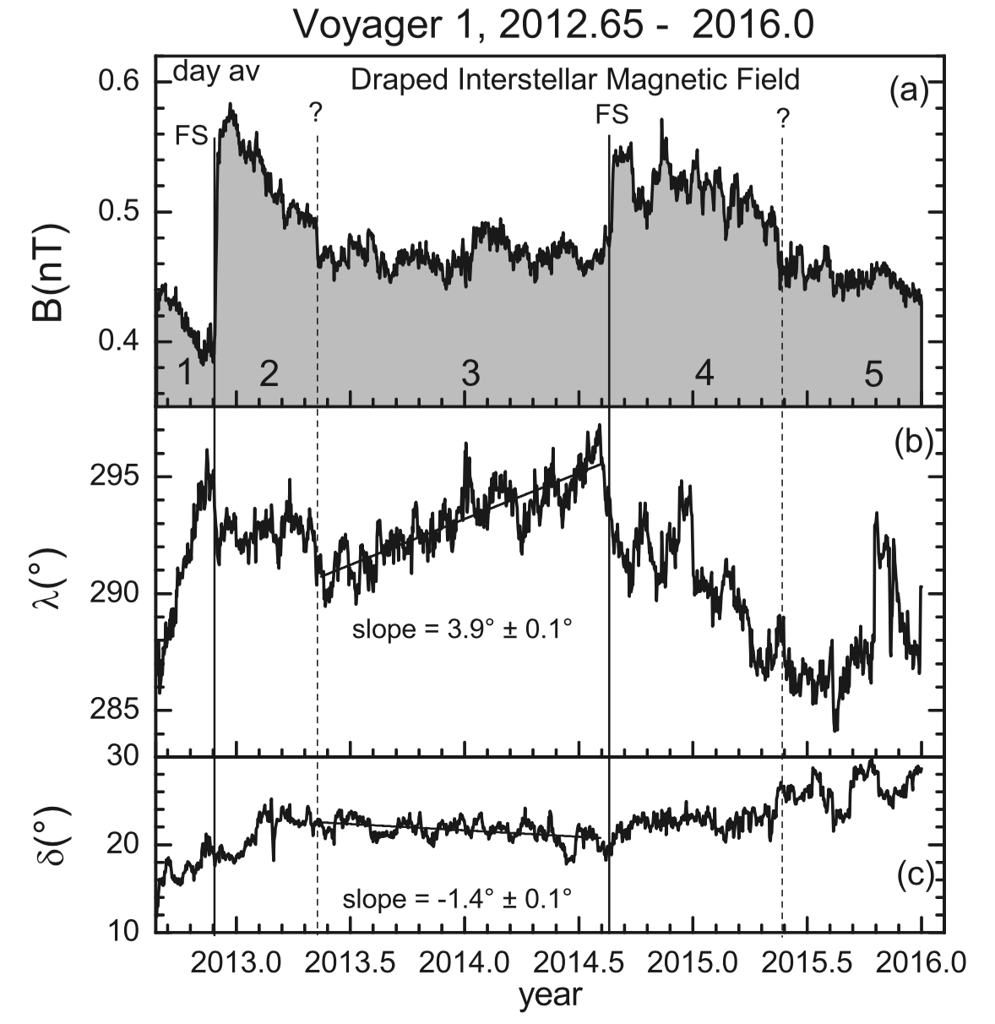
Voyager 1 Observations of the VLISM Magnetic Field (Burlaga et al. 2016, ApJ)
The “unfolding” of the VLISM magnetic field is much more complicated
Voyager observes evidence of heliospheric shocks propagating through the VLISM

Slide 19
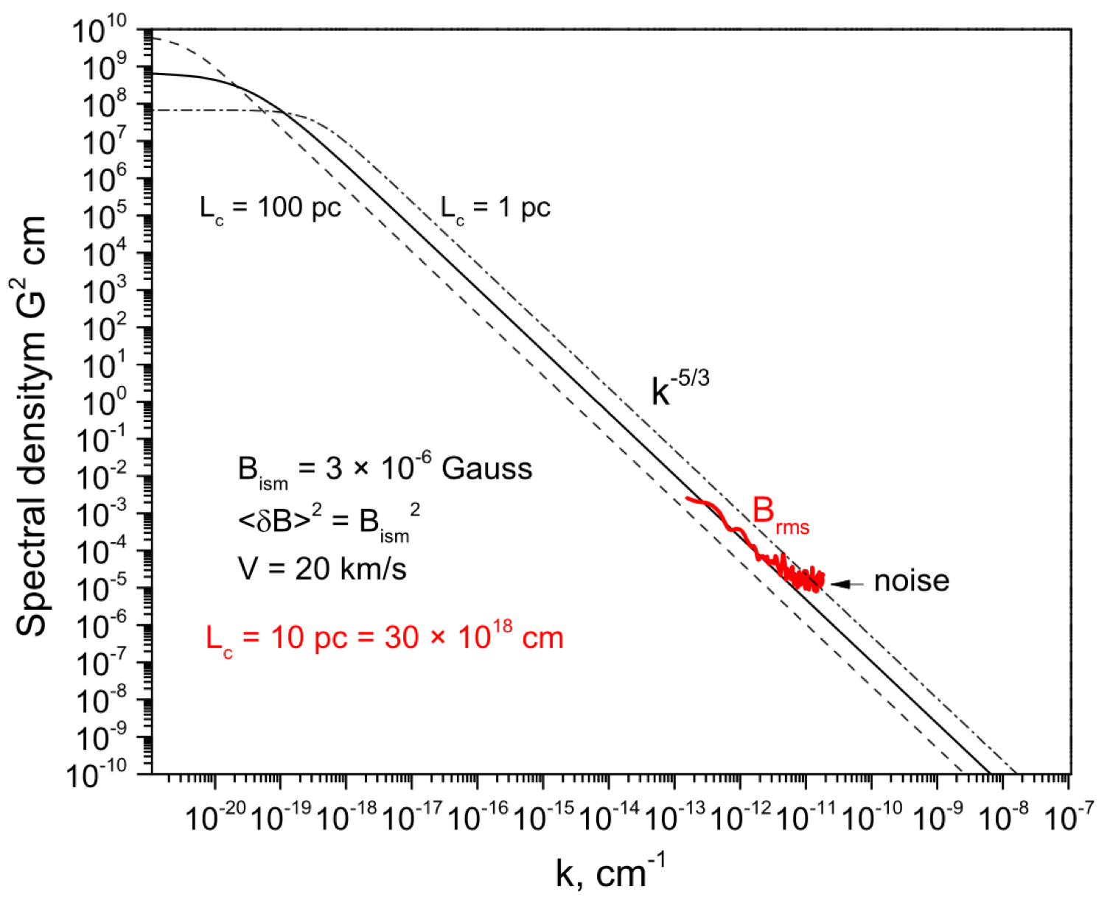
The VLISM Turbulence Spectrum
Burlaga et al. (2015, ApJL)
Voyager 1 observations of the interstellar spectral density (red), and Kolmogorov power law spectra for different outer scale lengths.
NOTE: The model and data were plotted incorrectly in the published figure. The observed spectral density is actually ~100 times higher than the predicted Kolmogorov spectrum for L_{c} = 10 pc.

Slide 20
Conclusions
IBEX observes interstellar matter (H, He, Ne, O) and energetic neutral atoms produced in the solar wind – VLISM interaction
IBEX observations of the Ribbon at ~keV energies reveal the VLISM magnetic field draped around the heliosphere
  Derive magnitude (2.9 μG) and direction (227°, 35°) of local magnetic field (undisturbed by the heliosphere)
Voyager 1 has been observing the VLISM since August 2012, including the interstellar magnetic field, (indirectly) interstellar plasma density, and galactic cosmic ray spectrum
Voyager 2 is still in the inner heliosheath, models predict it could cross the heliopause within the next few years
  Voyager 2 has a working plasma instrument!
  Some models predict Voyager 2 will cross the heliopause at a distance similar to Voyager 1 (~120 AU), which is in early 2019

Slide 21
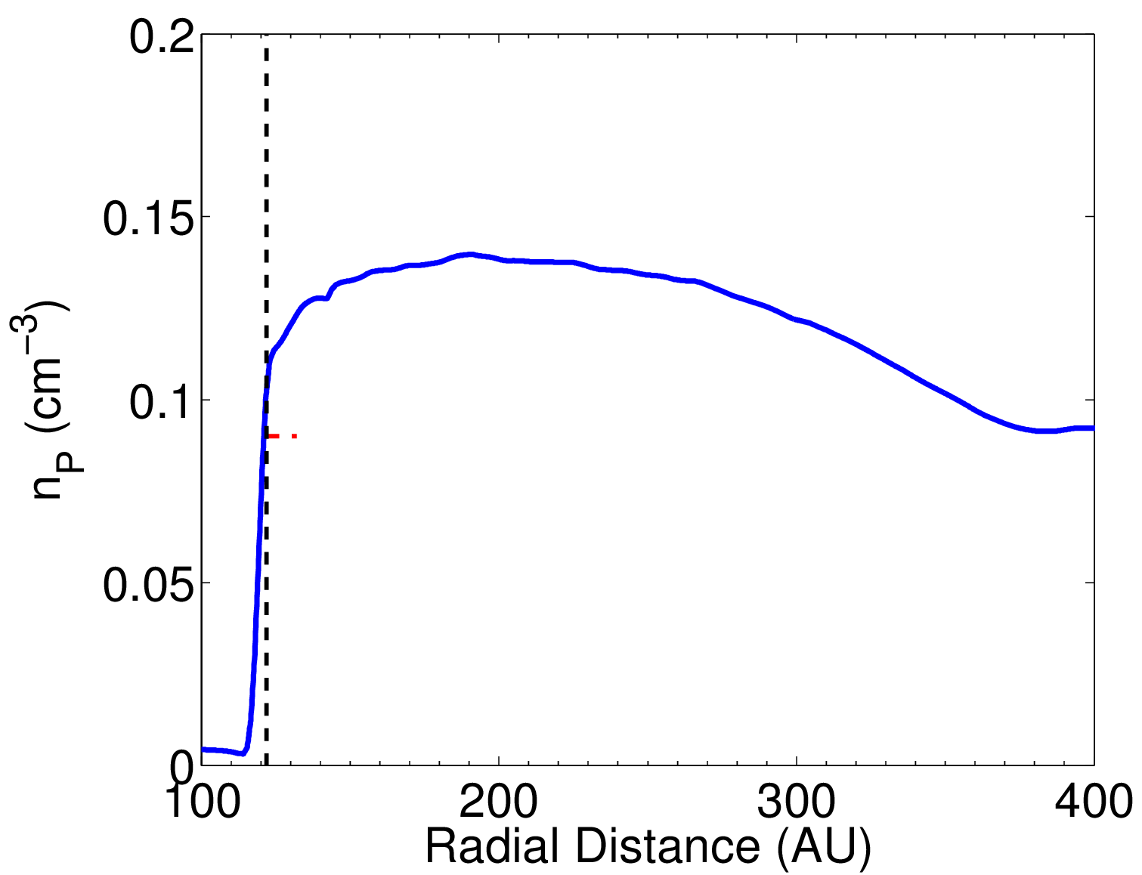
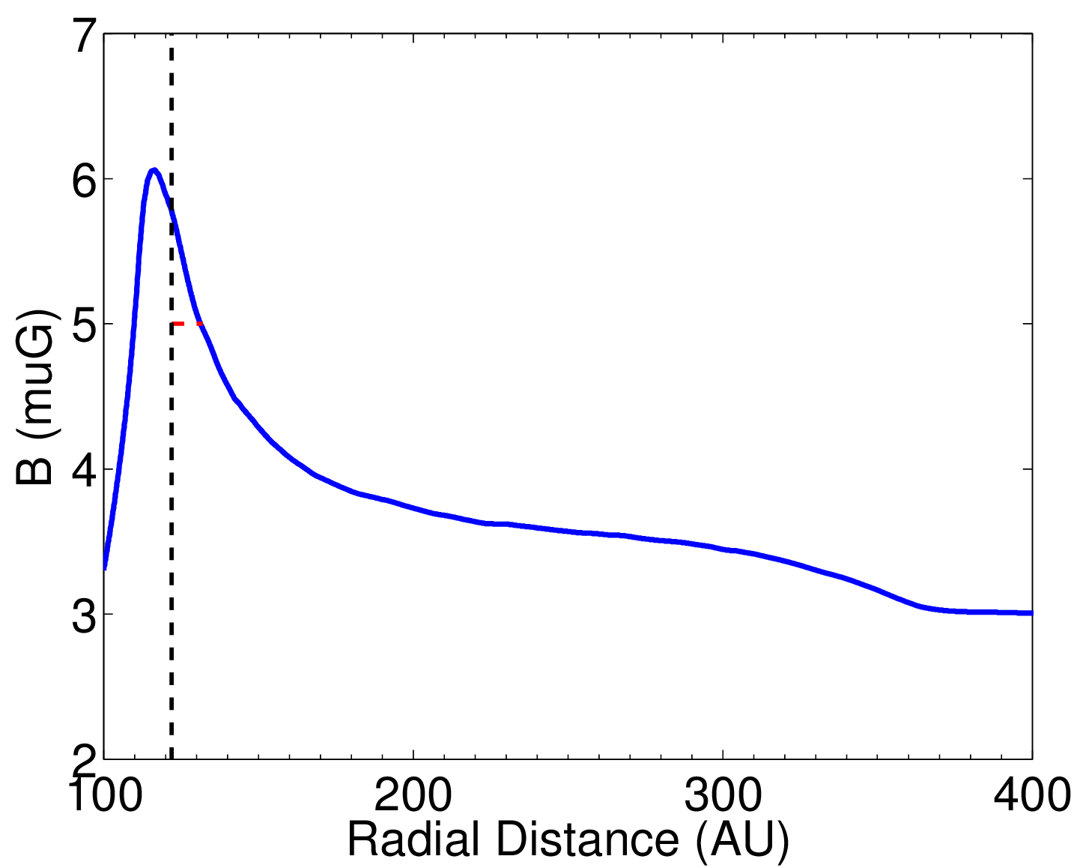
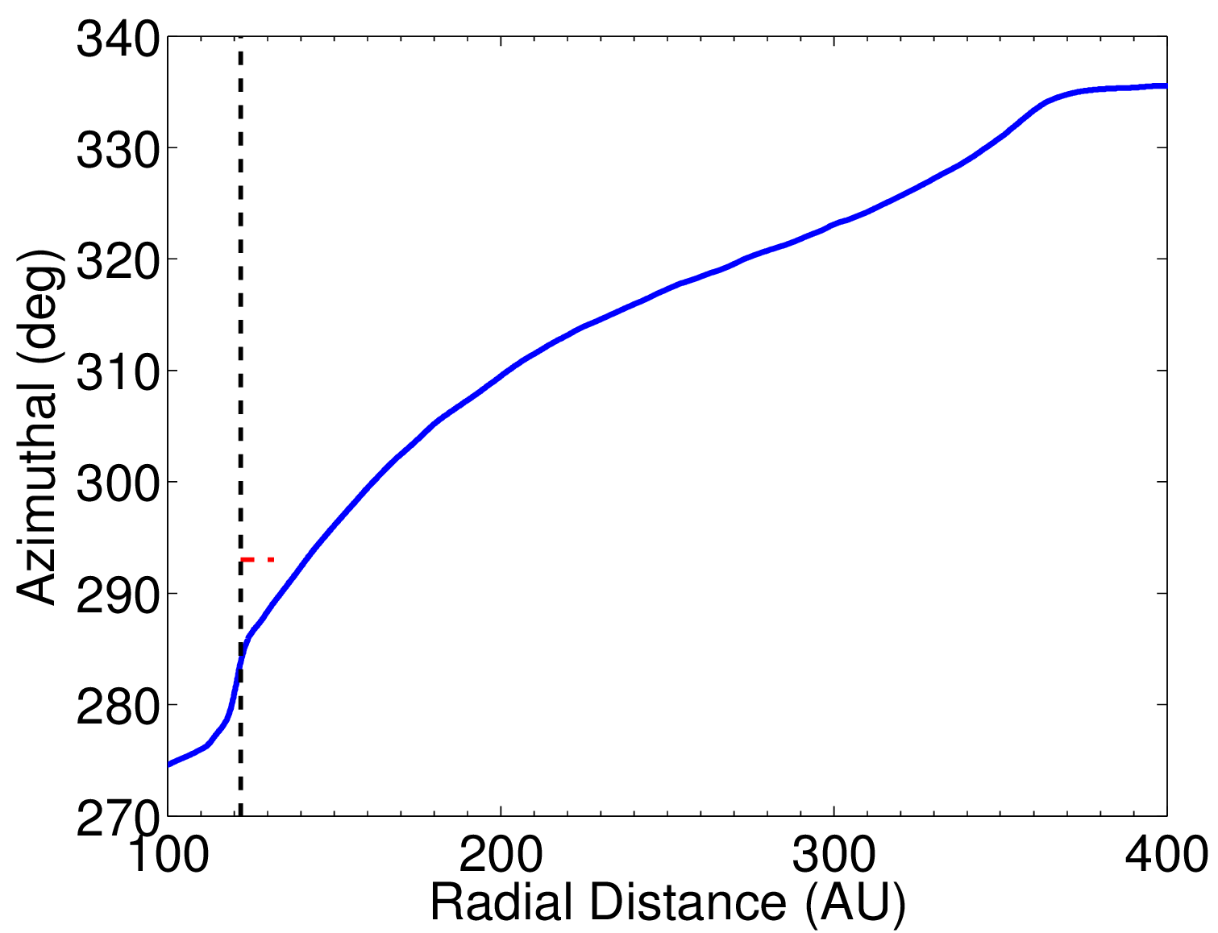
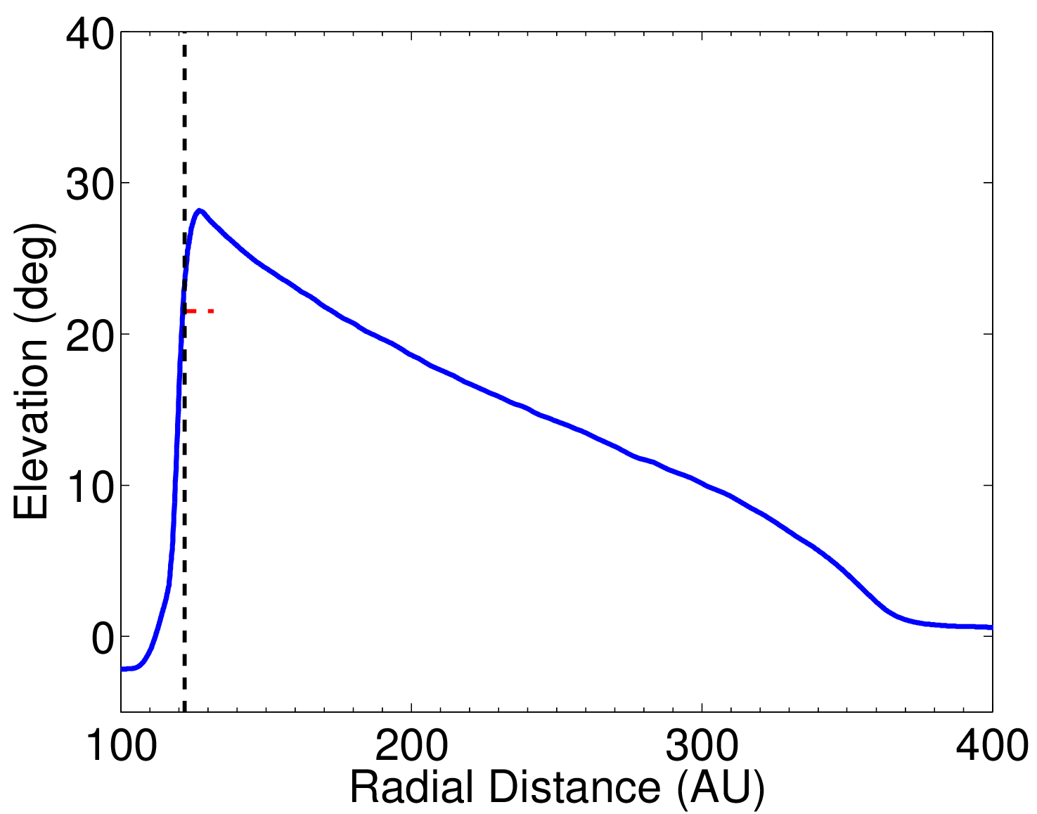
Simulation Comparison to Voyager 1 Measurements outside the HP
HP
HP
V1
V1
HP
HP
V1
V1

Slide 22
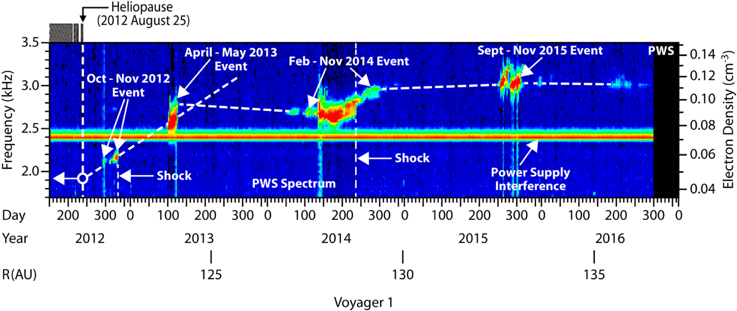
(Indirect) Observation of the Compressed Interstellar Plasma Density
Pogorelov et al. (2017, ApJ)
Voyager 1 does not have a working plasma particle detector (stopped working in 1981), but has used the Plasma Wave Instrument (PWS; Gurnett et al. 2015) to determine the plasma density via the detection of electron plasma oscillation events associated with heliospheric shocks

