Slide 1
Cosmology With The Lyα Forest
David Weinberg, Ohio State Astronomy and CCAPP
Results from the SDSS-III BOSS Lyα Forest
Baryon acoustic oscillations (BAO):
J. Bautista, M. Blomqvist, N. Busca, T. Delubac, H. du Mas des Bourboux A. Font-Ribera, J. Guy, D. Kirkby, P. McDonald, J. Miralda-Escude, M. Pieri, J. Rich, A. Slosar
1-d power spectrum:
N. Palanque-Delabrouille, C. Yèche, J. Baur, A. Borde, J.-M. Le Goff, C. Magneville, G. Rossi, M. Viel

Slide 2
Cosmology With The Lyα Forest
David Weinberg, Ohio State Astronomy and CCAPP
Best probe of expansion and matter clustering at z = 2 – 4
(together with CMB lensing)
Observational accessibility
Simplicity of first-order physical interpretation
Best probe of primordial power spectrum on ~ Mpc scales
(together with dwarf galaxies/strong lensing/tidal streams)
Primordial structure not erased by non-linearity
Neutrino masses, warm dark matter

Slide 3
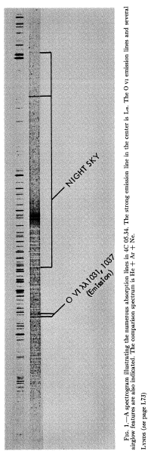
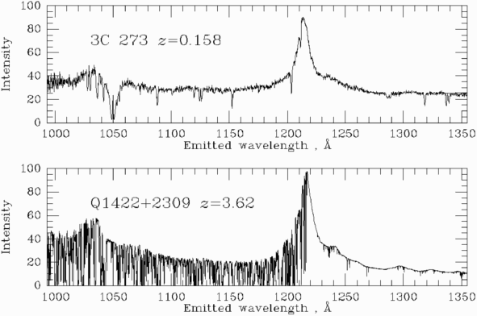
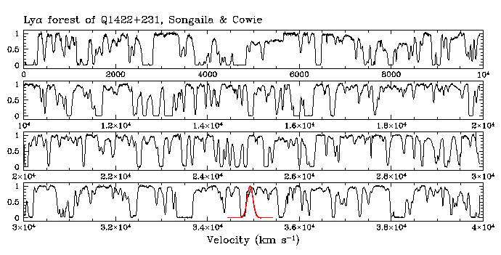
Lynds 1971, Kitt Peak 2.2m
Songaila & Cowie 1994, Keck 10m

Slide 4
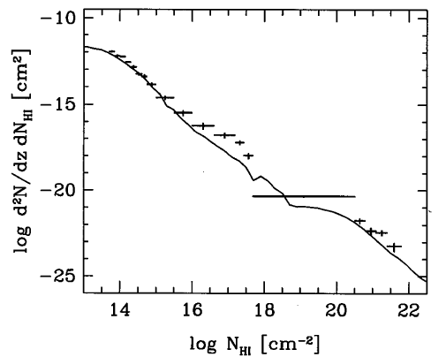
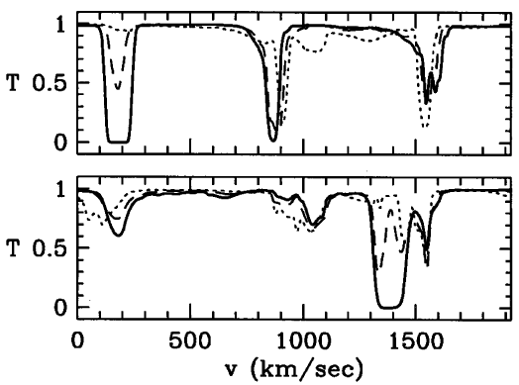
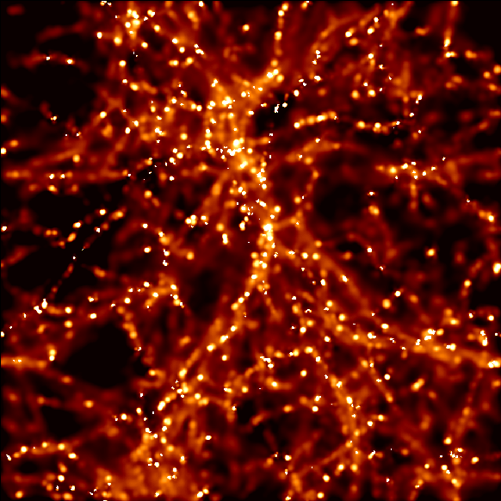
Mid-1990s: Properties of Lyα forest well explained by 3-d cosmological hydro simulations
Cen, Miralda-Escudé, Ostriker, Rauch 1994
Zhang, Anninos, Norman 1995
Hernquist, Katz, Weinberg, Miralda-Escudé 1996
Bi & Davidsen 1997; Hui & Gnedin 1997
Hernquist et al. 1996
Katz et al. 1996

Slide 5
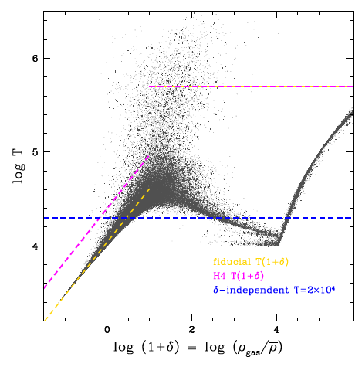
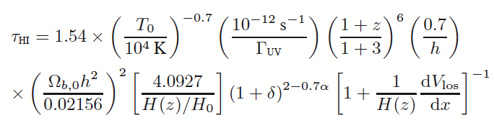
Power-law temperature-density relation => Lyα absorption is a local non-linear map of baryonic matter density
F ≈ exp [- A (1+δ)^{1.6} ]
Fluctuating Gunn-Peterson Approximation (FGPA)
Weinberg, Katz, & Hernquist 1997
Croft, Weinberg, Katz & Hernquist 1998
Density & velocity fields
IGM parameters
Cosmological parameters

Slide 6
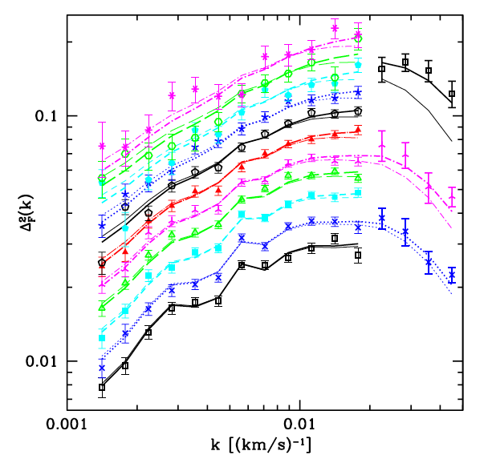
Line-of-sight Lyα power spectrum is proportional to 1-d matter P(k)
R. Croft, Weinberg, Katz, Hernquist ++
P. McDonald, Miralda-Escudé, Seljak ++
With a sufficiently large, dense survey, one can measure 3-d structure and BAO in the Lyα forest
M. White 2003
McDonald & Eisenstein 2007
And in QSO-Lyα cross-correlations
Font-Ribera, Kirkby, Busca et al. 2014
Seljak, Makarov, McDonald, Trac 2006

Slide 7
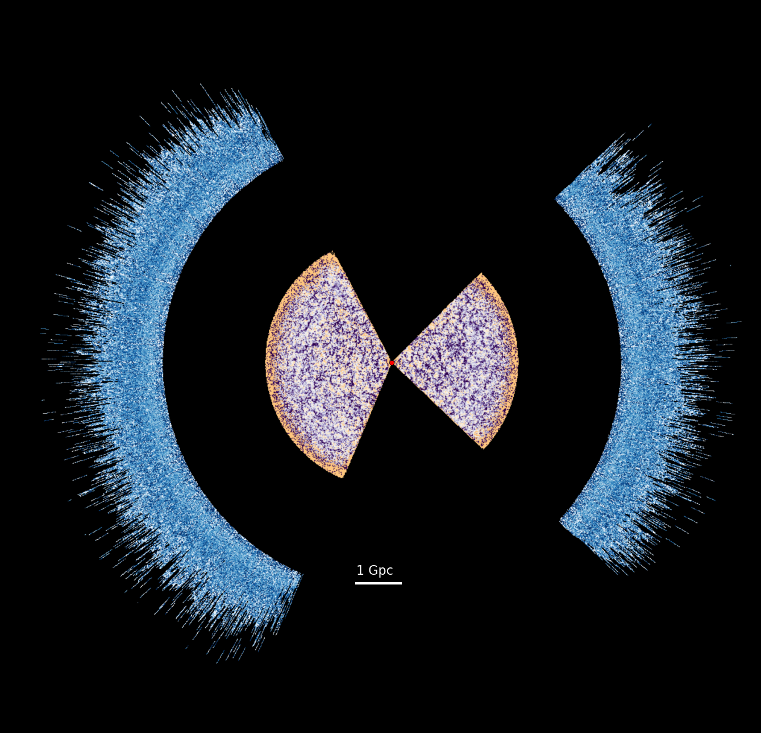
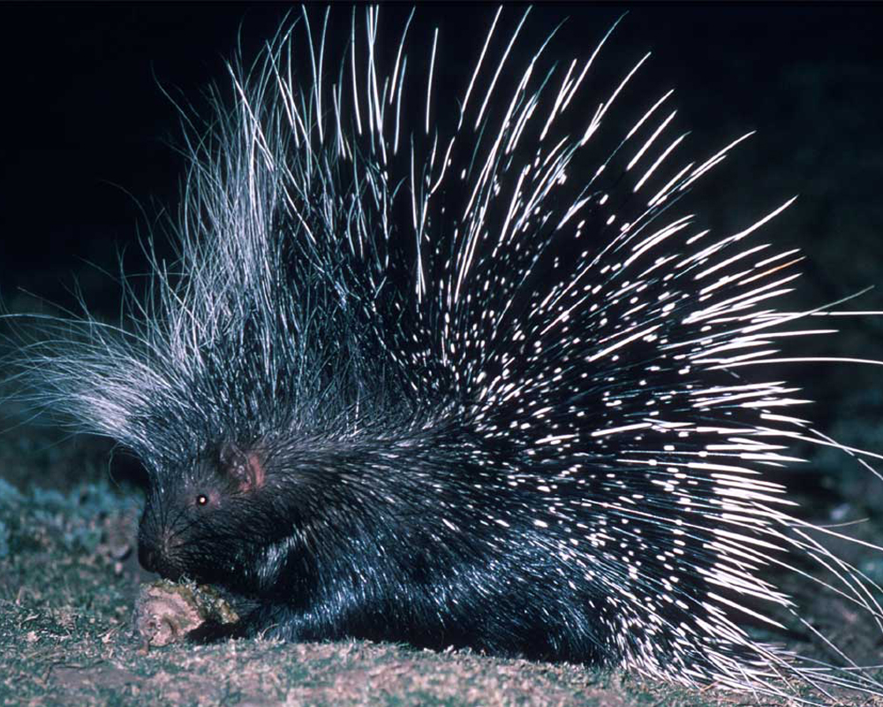
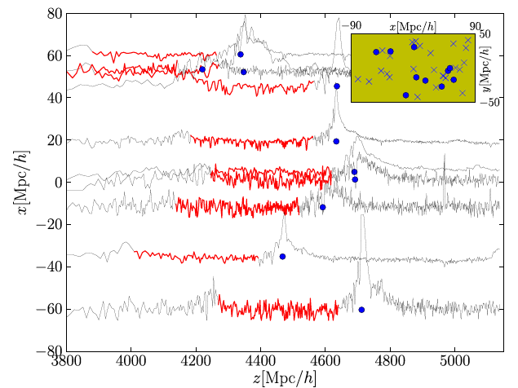
SDSS-III BOSS: 3-d correlations in the Lyman-α forest
Slosar, Font-Ribera, Pieri et al. 2011

Slide 8
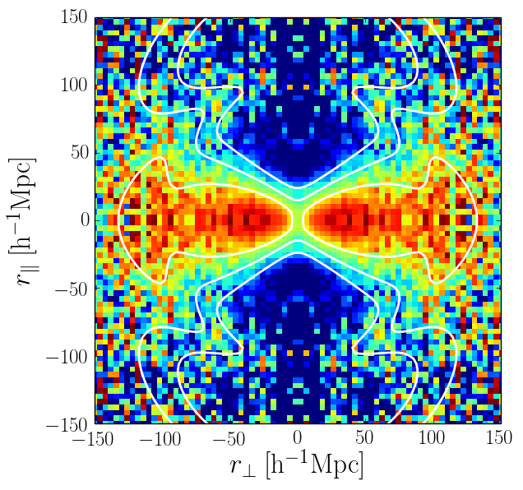
SDSS-III BOSS: 3-d correlations in the Lyman-α forest
Figure: N. Busca
Figure: A. Slosar

Slide 9
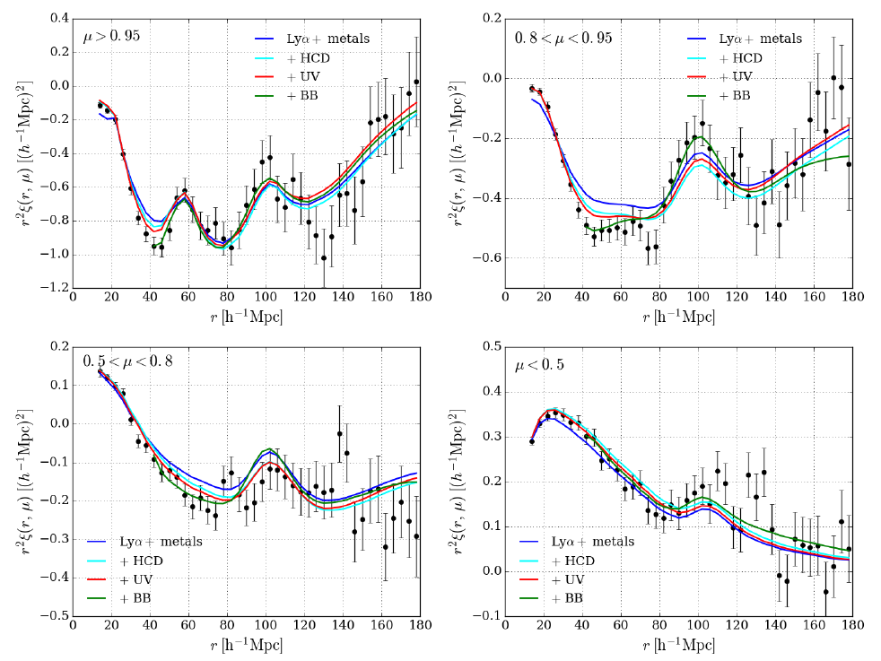


BAO in BOSS DR12 Lyα forest auto-correlation
Measures H(z) to 3.4%
D_{A}(z) to 5.7%
Best combo to 2.5%
At effective z = 2.3
line-of-sight
transverse
Bautista, Busca, Guy et al. 2017
D_{A} = L / θ ; H = c Δz / L

Slide 10
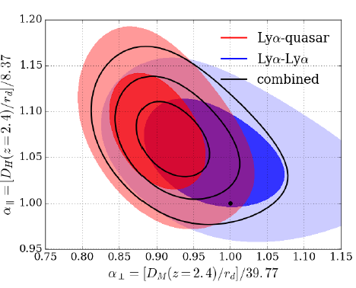
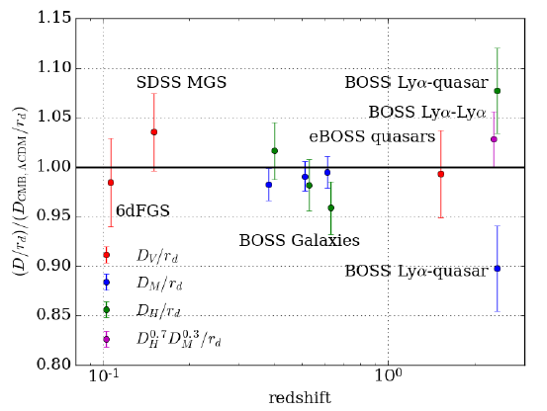
Combined with BOSS DR12 QSO - Lyα cross-correlation sharpens precision to
2.5% on H(z)
3.3% on D_{A}(z)
Combined constraint is ~ 2.3σ from best Planck ΛCDM model.
Hard to explain with new physics: D_{A} and (cz/H) off in opposite directions.
Ensemble of BAO data consistent with Planck ΛCDM.
du Mas des Bourboux, Le Goff, Blomqvist et al. 2017

Slide 11
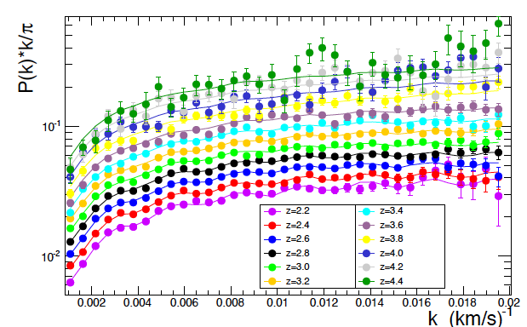
High-precision measurement of 1-d P(k) from ensemble of BOSS spectra, z = 2.2 – 4.4
Palanque-Delabrouille, Yèche, Borde et al. 2013

Slide 12
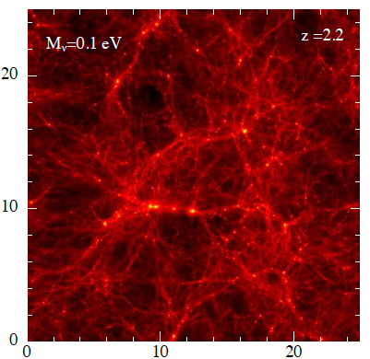
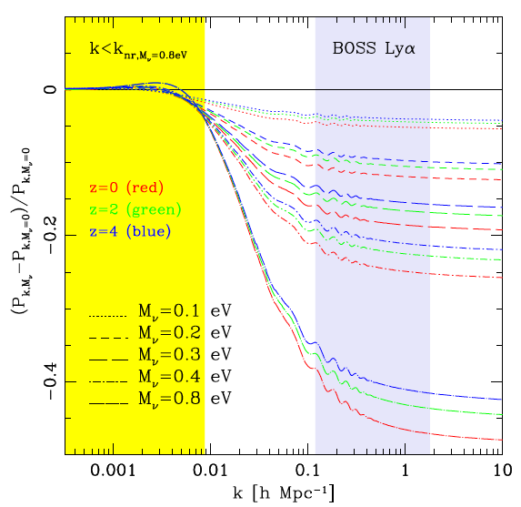
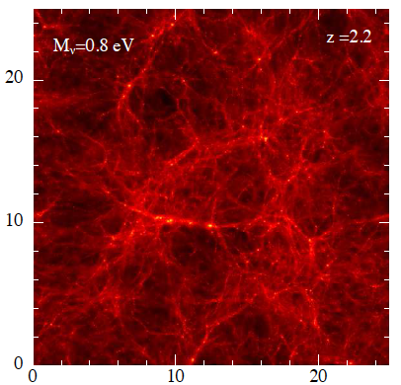
Non-zero neutrino mass suppresses linear P(k) on Lyα forest scales relative to CMB.
Rossi, Palanque-Delabrouille, Borde et al. 2015

Slide 13
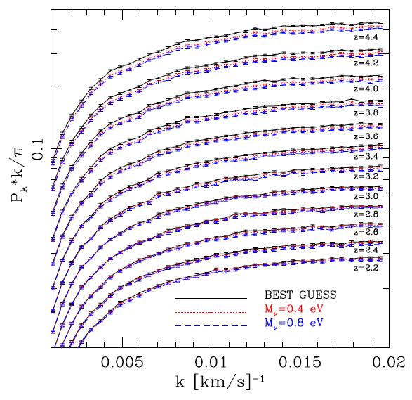
Non-zero neutrino mass suppresses linear P(k) on Lyα forest scales relative to CMB.
Impact on flux P(k) is few % for m_{ν} ~ 0.5 eV
Rossi, Palanque-Delabrouille, Borde et al. 2015

Slide 14
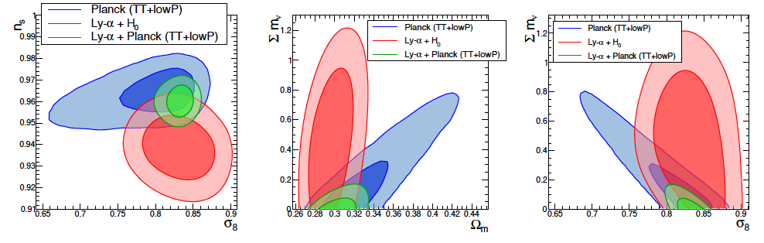
Blue = CMB
Red = Lyα
Palanque-Delabrouille, Yèche, Baur et al. 2015
For Planck CMB, high Σm_{ν} implies low σ₈, high Ω_{m.}
Lyα P(k) measures these independent of CMB.
Combined 95% C.L. constraint is Σm_{ν} < 0.12 eV.
Some tension between CMB and Lyα value of n_{s.}

Slide 15
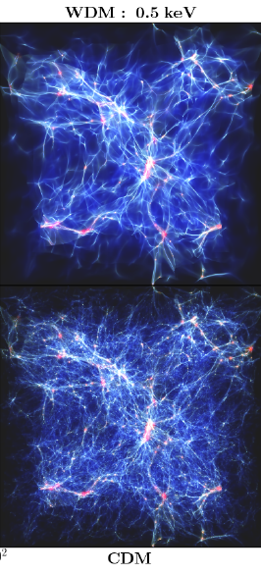
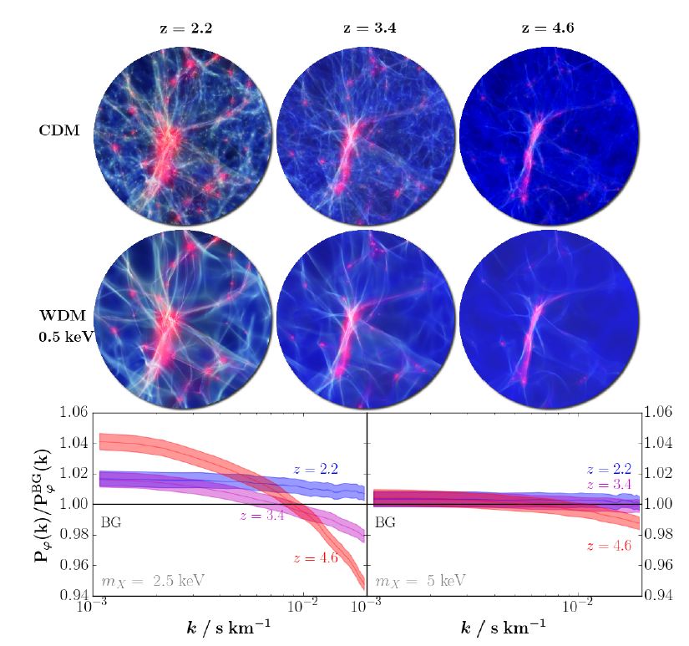
Warm dark matter suppresses small scale P(k)
Larger suppression at higher redshift
2.5 keV
5 keV
Baur, Palanque-Delabrouille, Yeche, Magneville, Viel 2016

Slide 16
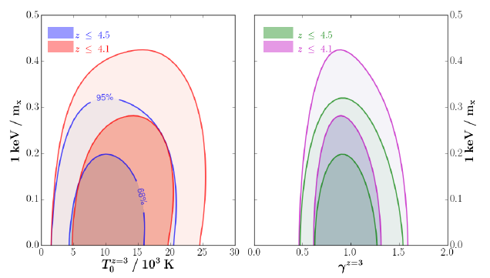
BOSS DR9 1-d P(k):
Thermal relic 95% C.L. lower limit of 3.0 keV
Baur, Palanque-Delabrouille, Yèche, Magneville, Viel 2016

Slide 17
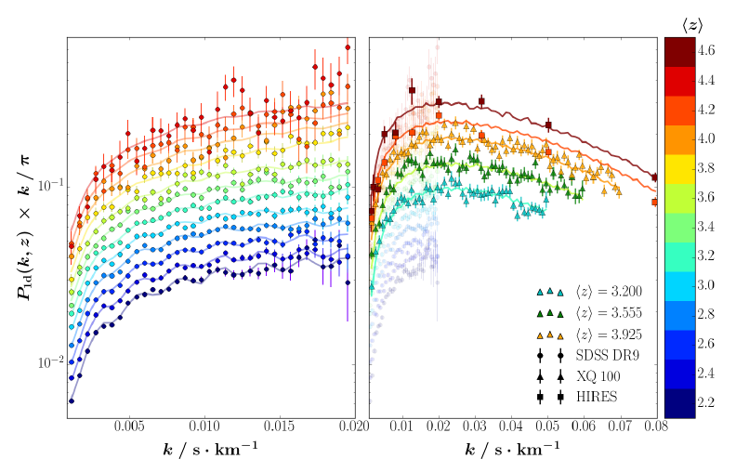
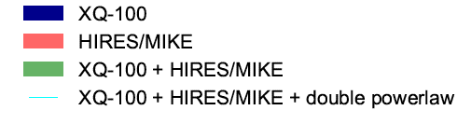
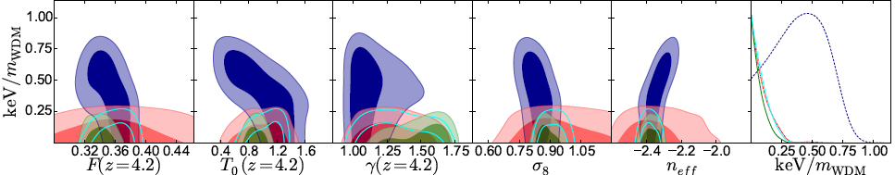
Baur, P.-D., Yèche++ 2017
Higher resolution data provide greater leverage on WDM, especially at high z.
Iršič, Viel, Haehnelt++ 2017:
High-res data => m_{wdm} > 5.3 keV
Baur, P.-D., Yèche++ 2017:
Compared to BOSS, high-res data show suppression, could be WDM or IGM physics
Iršič, Viel, Haehnelt++ 2017

Slide 18
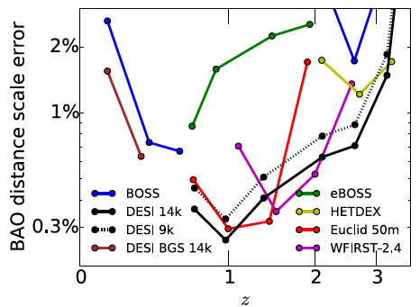
DESI: 700,000 Lyα QSOs (z > 2.1)
(vs. 158,000 for BOSS)
DESI Collaboration 2016

Slide 19
The “nuisance parameters” are astrophysically interesting:
Hydrogen and helium reionization
Sources of the ionizing background radiation
Heating mechanisms of the diffuse intergalactic medium
Nature of high column density absorbers & metal-line systems
Influence of CDM-baryon streaming velocities on Lyα forest
Density & velocity fields
IGM parameters
Cosmological parameters

Slide 20
Cosmology With The Lyα Forest
Best probe of expansion and matter clustering at z = 2 – 4
Observational accessibility
Simplicity of first-order physical interpretation
BAO in slight tension w/ ΛCDM, probably statistical fluke
Best probe of primordial power spectrum on ~ Mpc scales
Primordial structure not erased by non-linearity
Consistent w/ΛCDM, limits neutrino or WDM suppression
Challenges
Removal of instrumental/observational signatures
Highly accurate modeling of IGM physics

