Slide 1

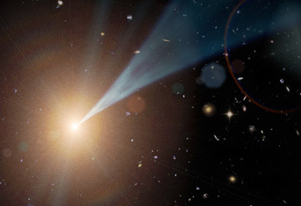
Determining the Intergalactic Photon Densities from Deep Galaxy Surveys and the γ-ray Opacity of the Universe
Floyd W. Stecker
Collaborators:
Mathew A. Malkan (UCLA) and Sean T. Scully (JMU)

Slide 2
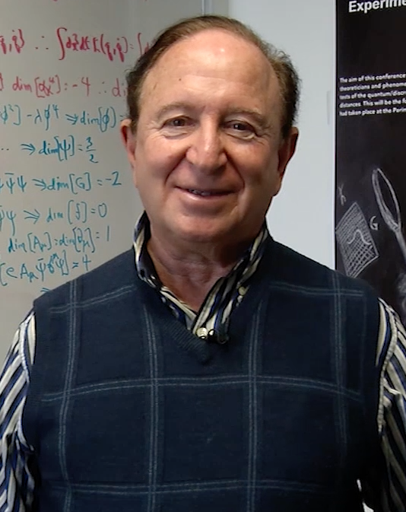


Stecker (GSFC) Malkan (UCLA) Scully (JMU)

Slide 3
Intergalactic Photon Fields
Emission from stars and dust re-radiation of starlight in galaxies produces IR, optical and UV photons.
These low energy photons escape to intergalactic space.
If we know enough about galaxy UV-Op-IR spectra as a function of redshift from deep astronomical surveys, we can calculate the evolution of intergalactic photon densities.

Slide 4
Our Motivations
The intergalactic background light can now be fully constructed using deep galaxy survey data covering the whole wavelength range from the far UV to the far IR.
This has the advantage over modeling galaxy SEDs,
since we are using real, observationally determined
error bands on galaxy luminosity densities.
This approach compliments blazar γ-ray absorption method approach suggested by Stecker et al. (1992) for determining the γ-ray opacity of the universe and for probing modification of γ-ray spectra by axions, Lorentz invariance violation or secondary γ-ray components.

Slide 5
FUV
Budavari 05
Schiminovich 05
Burgarella 07
Iwata 07
Bouwens 07
Sawicki 06
Paltani 07
Reddy 08
Yoshida 06
Reddy 08
Ly 09
Ryder 05
Dahlen 07
Tresse 07
Bouwens 10
Oesch 10
Cucciati 12
Bouwens 12
Bouwens 14
U
Tresse 07
Dahlen 07
J
Hill 10
Stephanon
Jones
Pozzetti 03
Feulner03
15 μm
Xu 98
Pozzi 04
LeFloc’h 05
Magnelli 09
Magnelli 11
Rodighiero 10
250 μm
Lapi 10
Guy 12
B
Tresse 07
Dahlen 05
Faber 07
Marchesini 07
Wolf 03
350 - 850 μm
Negrello 13
K
Arnouts 07
Heath 06
Bell 03
Kochanek
Hill 10
Feulner 03
Cole 01
Pozzetti 03
24 μm
Shupe 98
Rujopakarn 10
Magnelli 11
Rodighiero 10
Babbedge 06
β’s
Bouwens 09
Budavari 05
Castellano 12
Cucciatti 12
Dunlop 12
Wilcot 12
Wyder 05
Arnouts 07
Brammer 11
Tresse 07
Ly 09
Marchesini 07
Gonzalez 11
Dai 09
Kriek 10
Kriek 11
V
Tresse 07
Marchesini 07
Marchesini 12
35 μm
Magnelli 11
Gruppioni 13
8 μm
Magnelli 11
Caputi 07
Huang 06
Rodighiero 10
Goto 15
R
Dahlen 05
Tresse 07
Marchesini 07
Chen 03
Wolf 03
60 μm
Gruppioni 10
Gruppioni 13
NUV
Budavari 05
Dahlen 07
Wyder 05
Tresse 07
Cucciati 12
Wolf 03
12 μm
Toba 14
Perez-Gonzalez 05
Rodighiero 10
Goto 15
90 μm
Gruppioni 10
Gruppioni 13
Lapi 10
I
Tresse 07

Slide 6
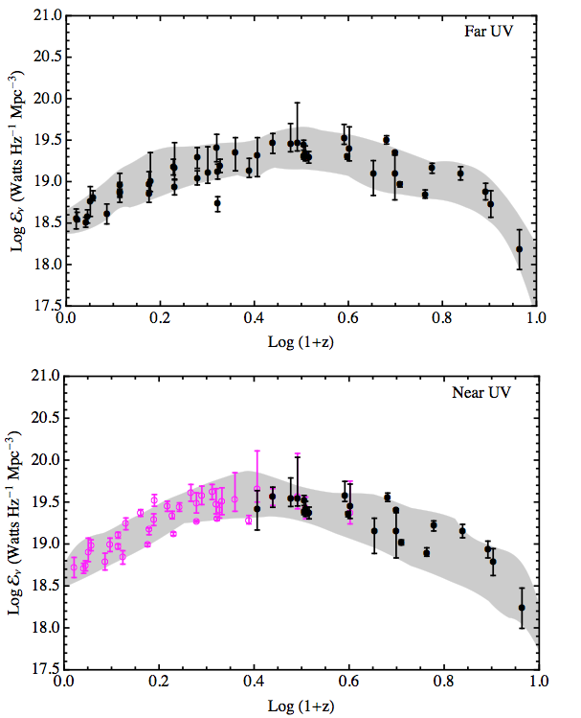
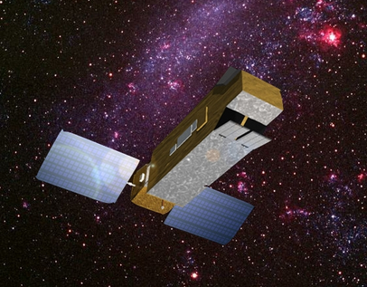
UV Luminosity Densities:
Galaxy Evolution Explorer

Slide 7
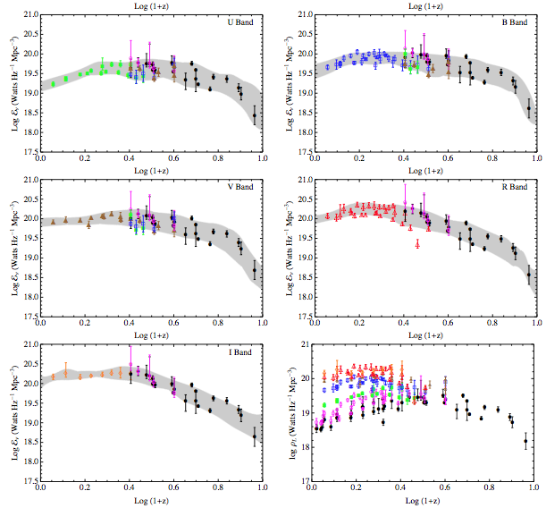
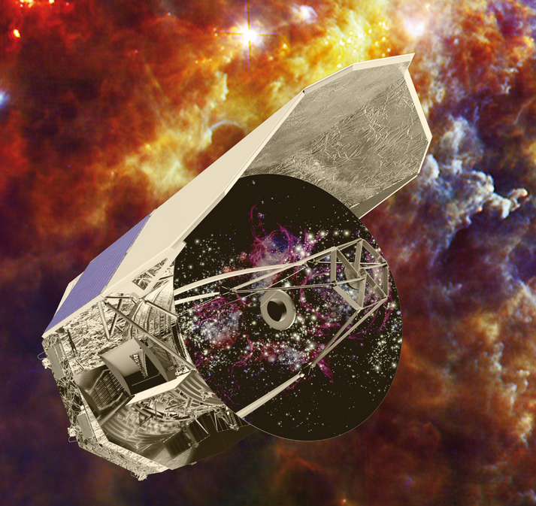
Optical
Luminosity
Densities:
Hubble

Slide 8
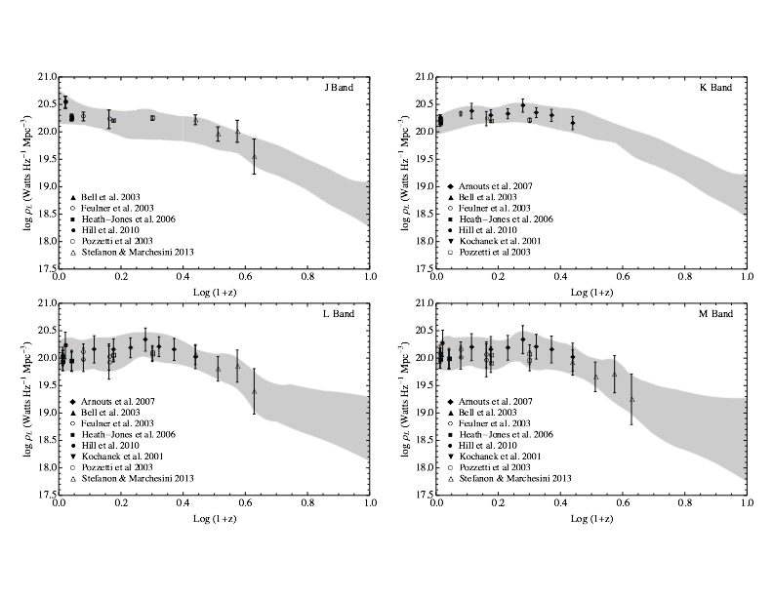
Near IR Luminosity Densities:

Slide 9
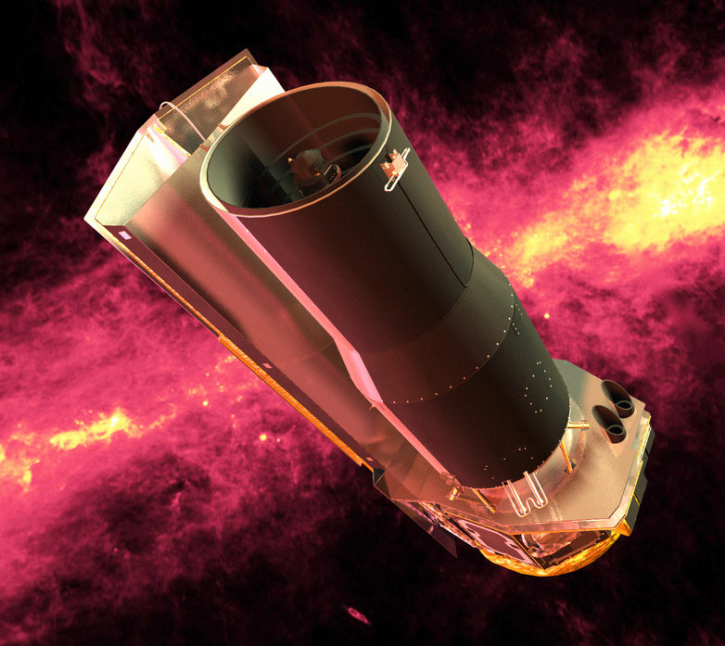
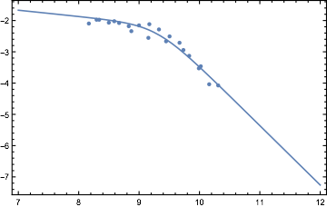
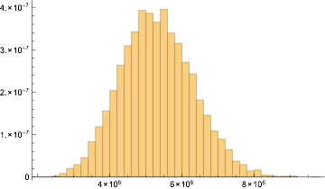
Mid-IR and far-IR Luminosity Densities
Spitzer
For λ ≥ 8 μm, we integrated
luminosity function fits, typically broken power-laws.
Herschel
We generated 10,000 realizations of the fit parameters to characterize the errors.

Slide 10
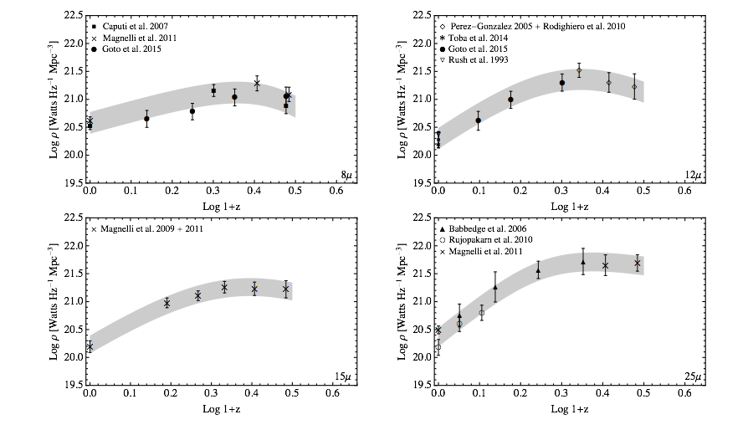
8 to 25 Micron Luminosity Densities:

Slide 11
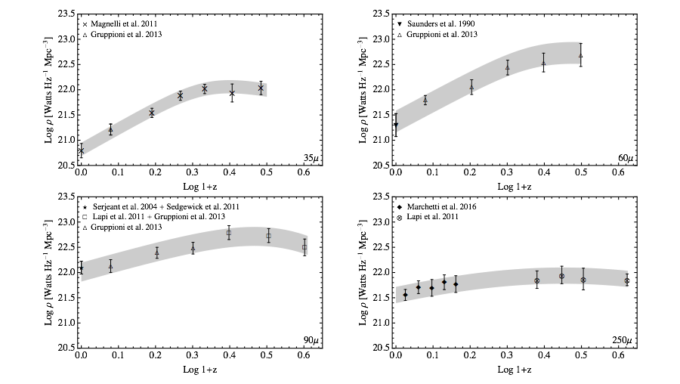
35 Micron to 250 Micron Luminosity Densities:

Slide 12
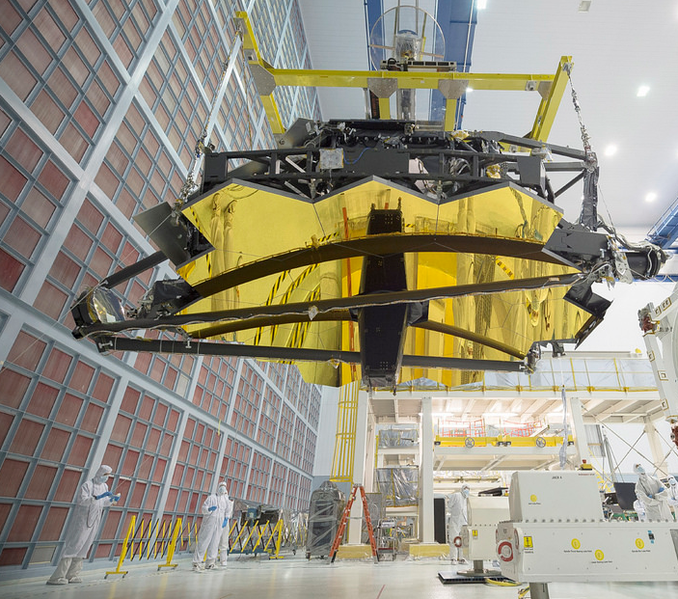
Coming Soon!
James Webb Space Telescope

Slide 13
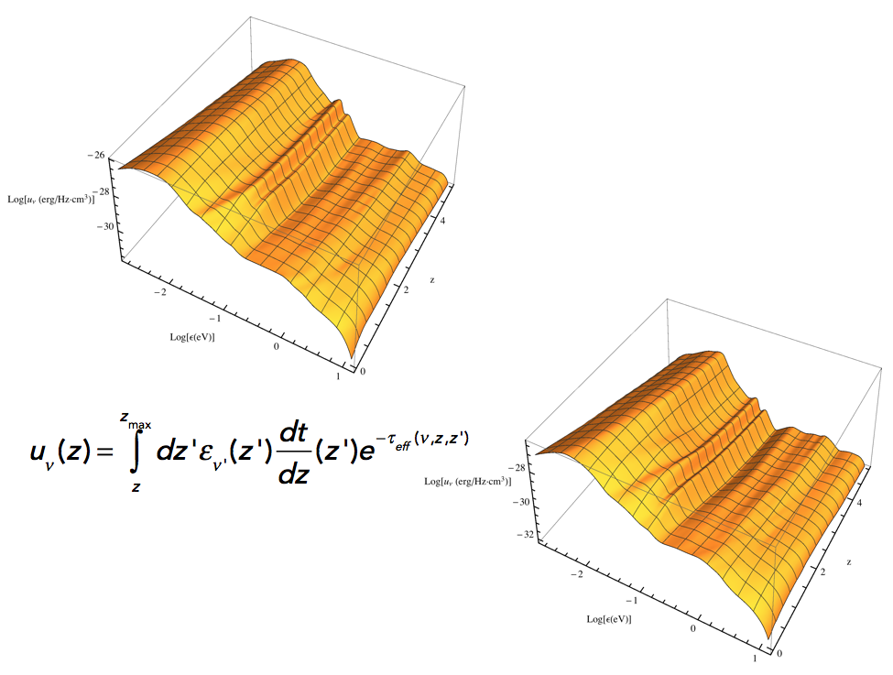

Slide 14
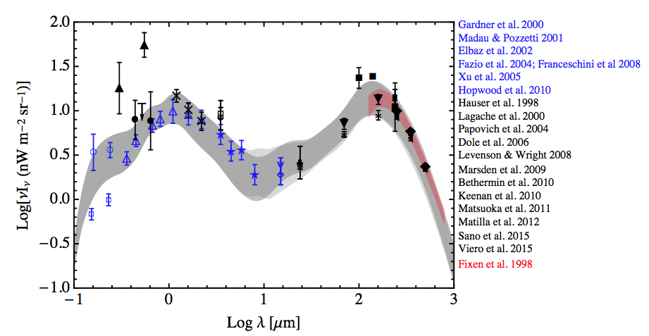
Spectral Energy Distribution of the EBL:
Comparison of our uncertainty band with
measurements (black) and lower limits (blue)

Slide 15
γ-ray extinction through mutual annihilation with intergalactic UV-IR photons.
γ-ray Opacity from Pair Production from Deep Survey Data Compared with Observations
High energy γ-rays can interact with UV-IR photons emitted by galaxies through annihilation into electron-positron pairs:
γ + γ e⁺ + e⁻

Slide 16
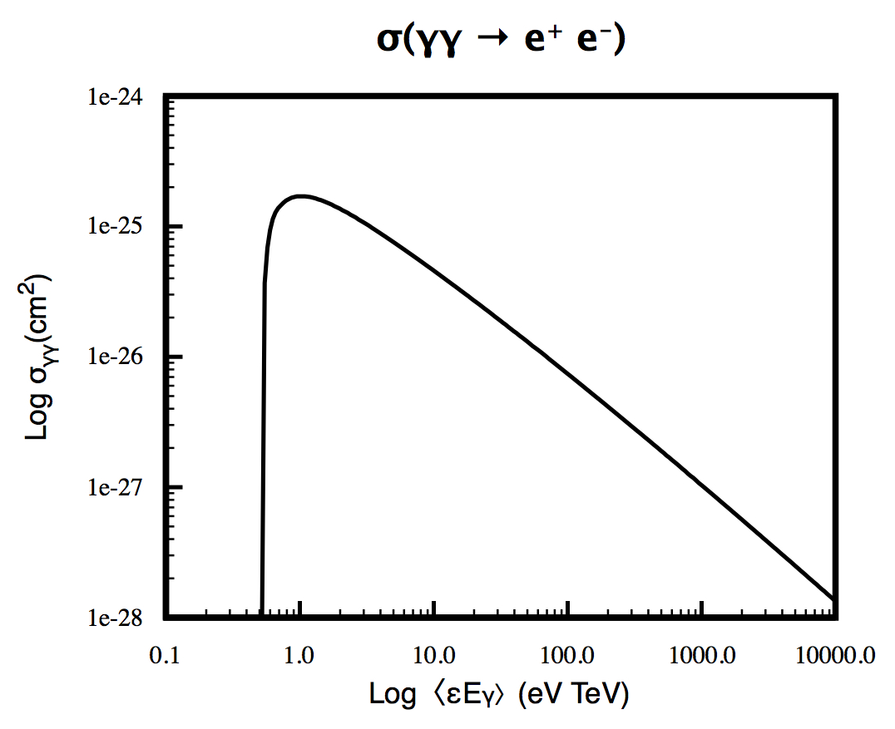
Pair Production Cross Section

Slide 17
Our opacity results cover the whole energy range of the Fermi Space Telescope and Air Cherenkov Telescopes
Fermi Space Telescope
(GeV energies)
Future Cherenkov Telescope Array
(TeV energies)

Slide 18
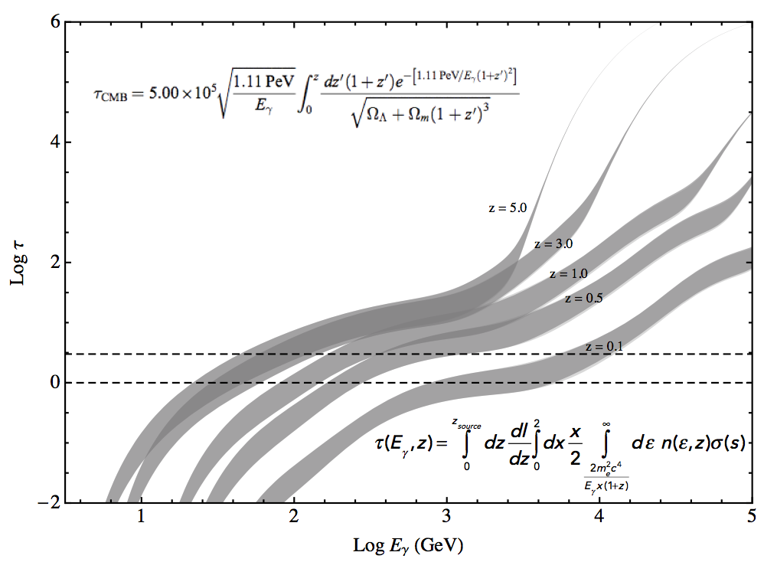
γ-ray opacity through pair production versus energy

Slide 19
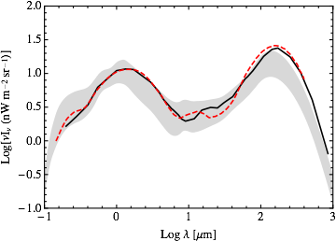
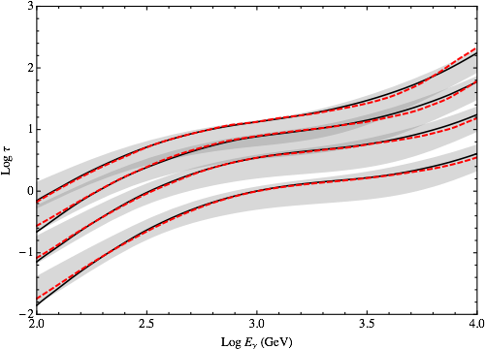
EBL SED
Comparison of our
68% confidence bands
with previous model results
Solid black lines:
Franceschini et al. 2008*
Opacity
Dashed red lines:
Dominguez et al. 2011
*new model of Franceschini & Rodighero (2017) gives a smaller FIR flux at ~ 100 microns.
Z= 0.1, 0.5, 1, 3, 5

Slide 20
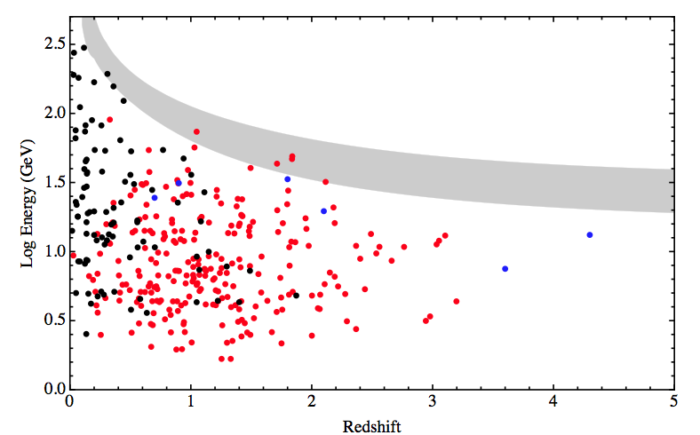
A τ = 1 energy-redshift plot (Fazio & Stecker 1970) showing our uncertainty band results compared with the Fermi plot of their highest energy photons from FSRQs (red), BL Lacs (black) and GRBs (blue) vs. redshift (from Abdo et al. 2010).

Slide 21
EBL from γ-ray observations (Biteau & Williams 2015)

Slide 22
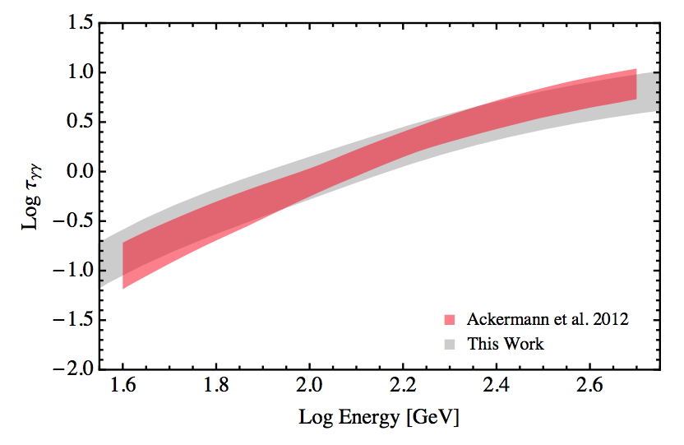
A comparison of our z = 1 opacity band with the results
derived from Fermi data given by Ackermann et al. (2012).

Slide 23
Conclusions
Our results as obtained by using deep galaxy survey data generally
agree with recent results from modeling, but our method allows us
to derive real empirically-based error bars and uncertainties.
The overlap of our absorption results with previous results derived from Fermi γ-ray spectral data implies that there is no evidence for other modifications of γ-ray spectra from effects such as photon-axion oscillations or secondary γ-ray components.
Next generation ground-based γ-ray telescopes such as the Cherenkov Telescope Array will probe the universe in the tens of TeV range. Our far-IR results will enable the interpretation of extragalactic source spectra from these telescopes and can also place strong constraints on Lorentz invariance violation.

