Slide 1
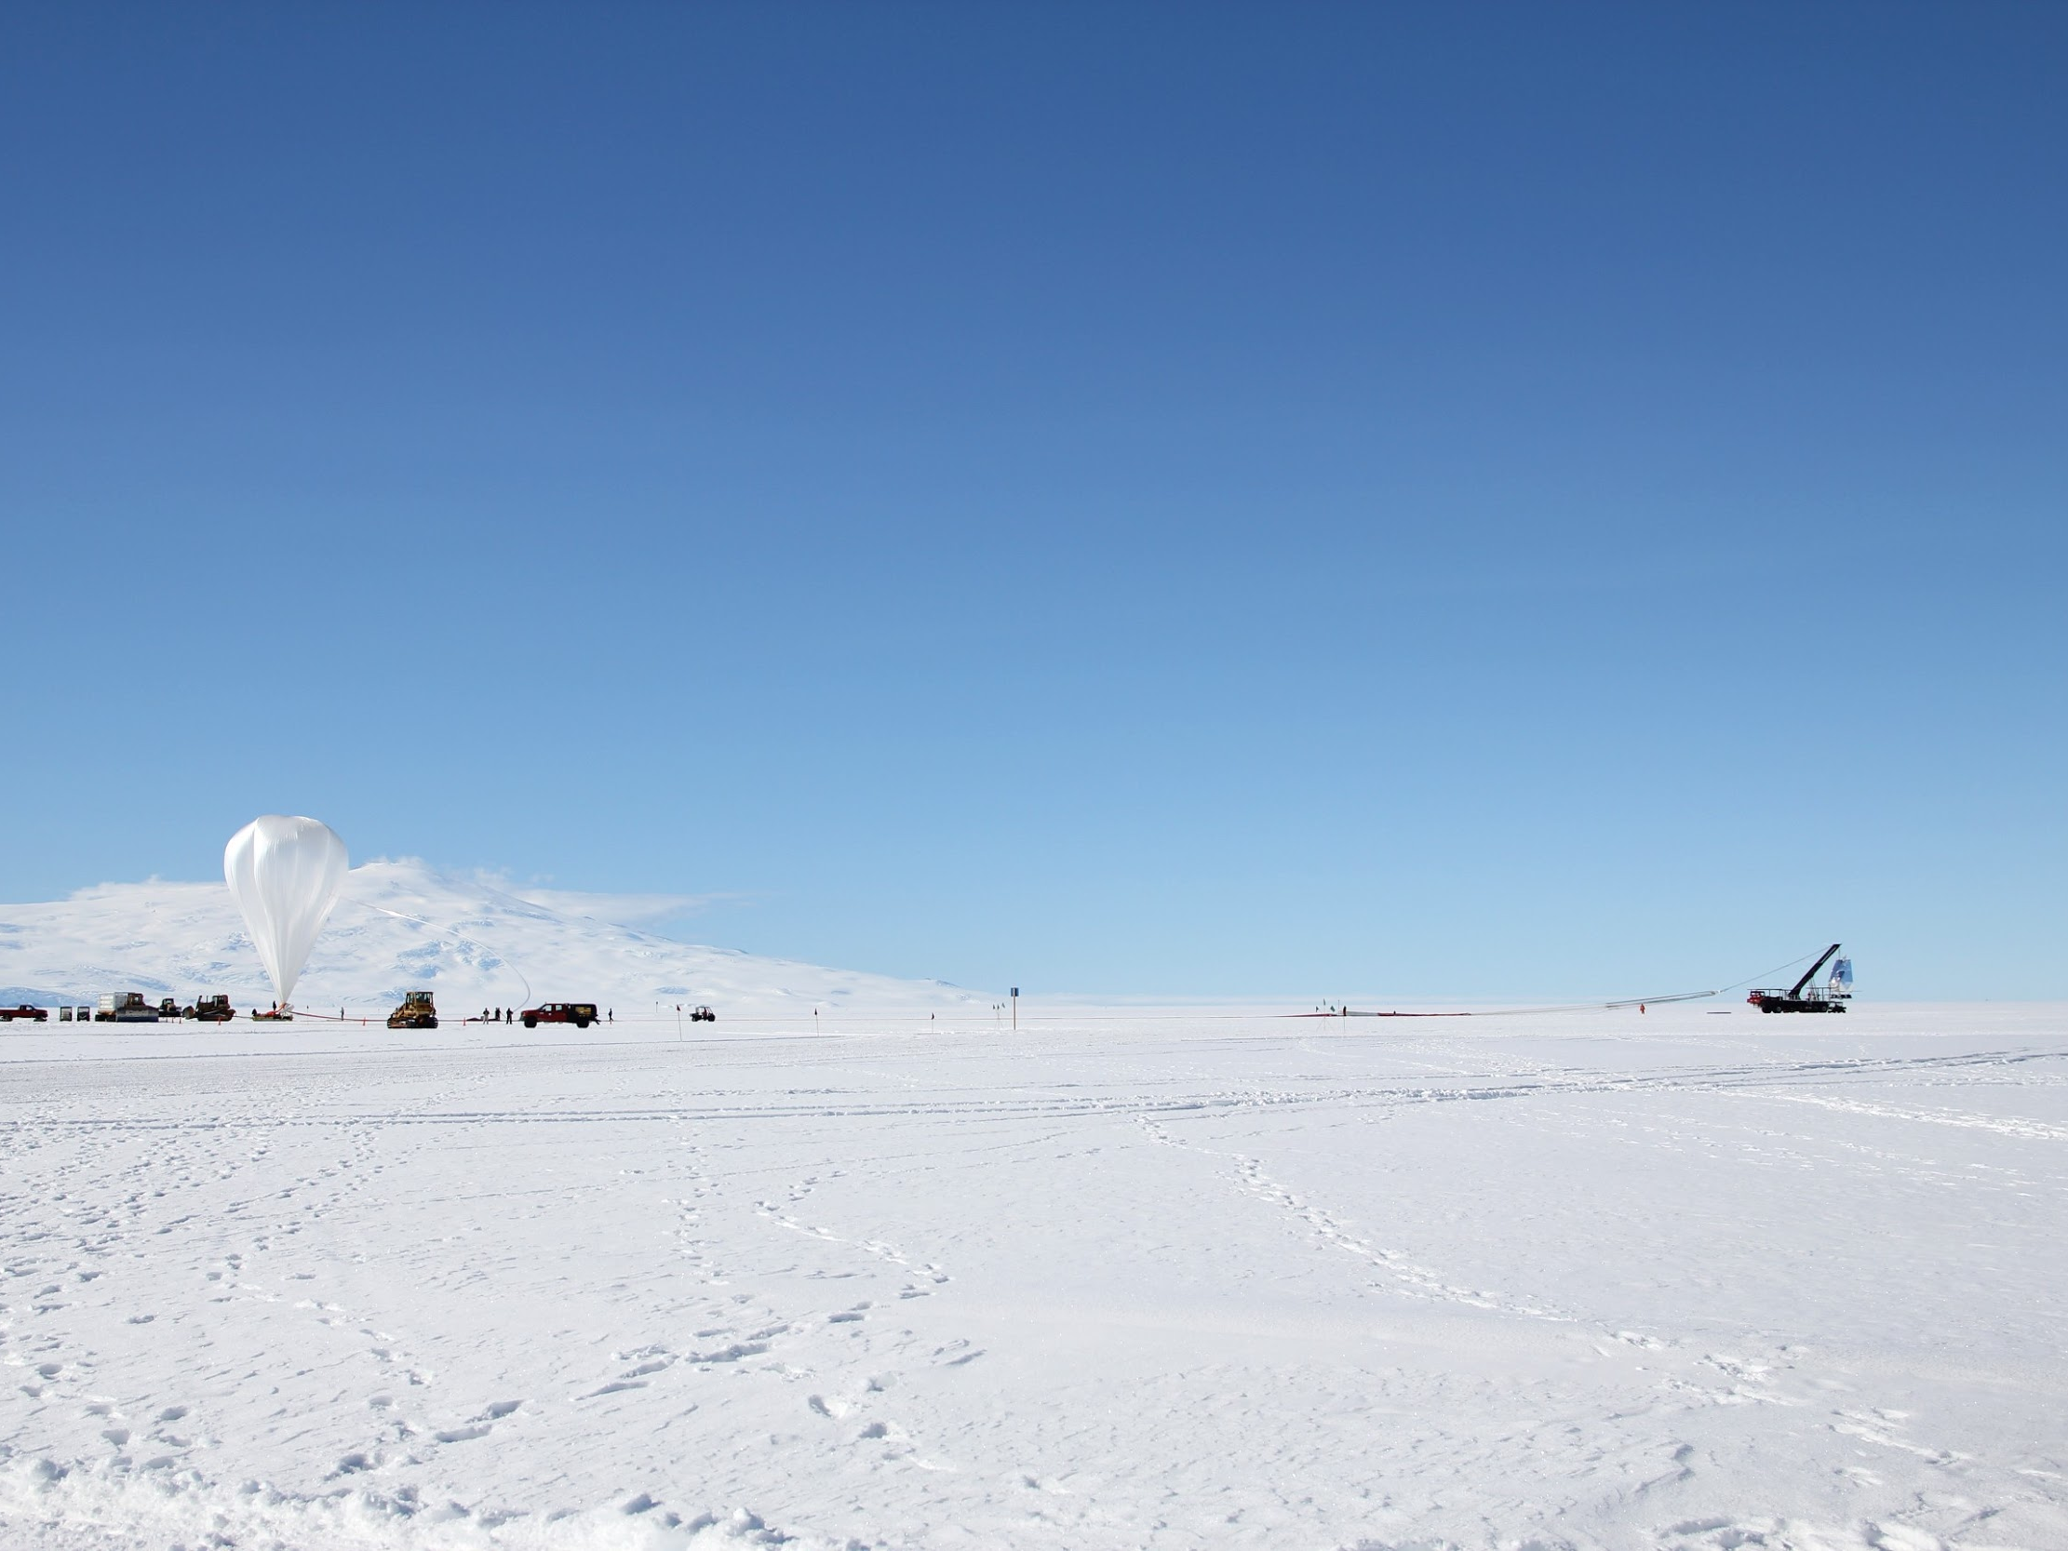

A New Limit on
CMB Circular Polarization from SPIDER
Johanna Nagy
for the SPIDER collaboration
arXiv: 1704.00215 Published in ApJ
TeVPA 2017
Notes:
Hi, my name is Johanna Nagy, and I’m currently a postdoc at Case Western. Today I’m excited to talk about the first science result from the SPIDER experiment, which Sasha just described. This is based on a paper which has just been published in the ApJ.
I’m going to be talking about a new upper limit on CMB circular polarization, which is not Spider’s main science goal. Spider was designed to measure linear polarization in the CMB, but it turns out that we can also measure circular polarization. Today I’m going to give you some background about CMB circular polarization and describe how Spider measures it, and then I’ll show you our results.

Slide 2
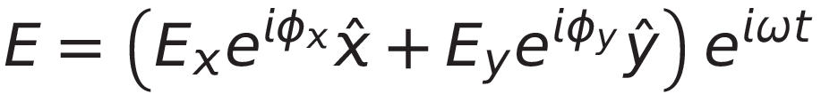




Stokes Parameters
Plane wave traveling in the z direction
Notes:
I want to start off by reminding you how we typically describe polarization. If you have an electromagnetic plane wave, it can be described by the Stokes parameters which represent, the intensity I, and the polarization

Slide 3
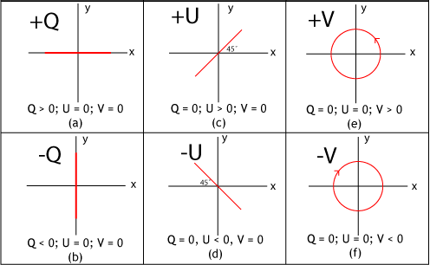
Stokes Parameters
Plane wave traveling in the z direction
Polarization
Notes:
with Q and U for the linear polarization and V for the circular polarization.
People often talk about CMB polarization, but they usually mean the linear polarization, Q and U.

Slide 4
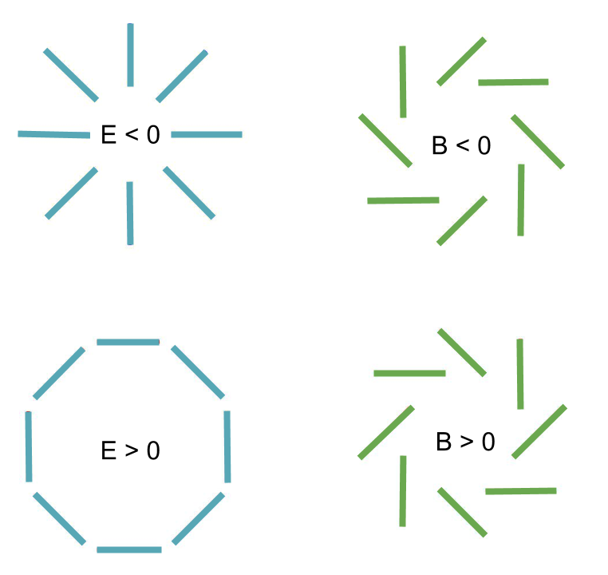
Stokes Parameters
Plane wave traveling in the z direction
Polarization
Notes:
Since these aren’t invariant under arbitrary rotations of the coordinate system, these are usually transformed into the so-called E and B-modes. The circular polarization, V, is different, and although you rarely hear about it in the context of the CMB, it’s going to be the focus for the rest of my talk.

Slide 5
Methods of Generating
Circular Polarization
1. Magnetic Fields
Primordial magnetic fields
Galaxy clusters
Pop III supernova remnants
Scattering from neutral H
Cosmic neutrino background
2. Interactions with Known Particles
Quantum vacuum corrections
Lorentz invariance violating operators
Axion fields
3. Extensions to QED
More complete list and references in King and Lubin 2016 (1606.04112)
Notes:
Unlike linear polarization, circular polarization has never been measured in the CMB, but there have been many methods proposed to generate it, all at relatively small levels. This slide lists some examples of proposed generation mechanisms, but it is by no means complete.
For instance, primordial magnetic fields would lead to circular polarization in the CMB, and you can also generate it through Faraday conversion of linear polarization in the magnetic fields of galaxy clusters or population 3 star remnants. Circular polarization can also be generated through interactions with known particles like scattering from neutral hydrogen or the cosmic neutrino background. Additionally, there are extensions to QED that would create CMB circular polarization, like quantum vacuum corrections, Lorentz invariance violating operators, or axion fields, among others. I’m not going to talk about any of these particular mechanisms in detail, but I refer you to the review in King and Lubin 2016 or the references in Spider’s circular polarization paper, if you are interested.

Slide 6
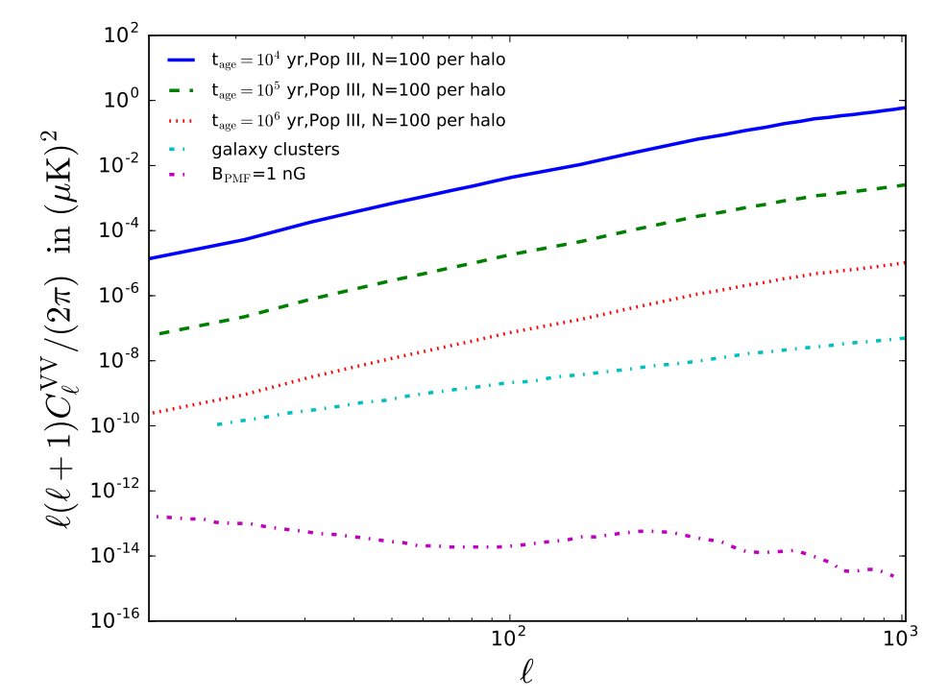
Predicted V Signals are Small
King and Lubin 2016 1606.04112
Signal predictions rely on many assumptions
(some poorly constrained)
Notes:
For my talk today, the most important thing about these generation mechanisms is that they predict very small signals even in the most optimistic cases. Since there are a variety of proposed generation mechanisms, and many assumptions that go into these signal predictions, I don’t want to focus on any of them in particular, but here’s a plot taken from King and Lubin showing a few theoretical signals. The curves on this plot show a predictions from Faraday conversion in POP 3 star remnants, Faraday conversion in galaxy clusters, and primordial magnetic fields. Of course, a lot of assumptions went into these calculations, and these plots show optimistic estimates.

Slide 7
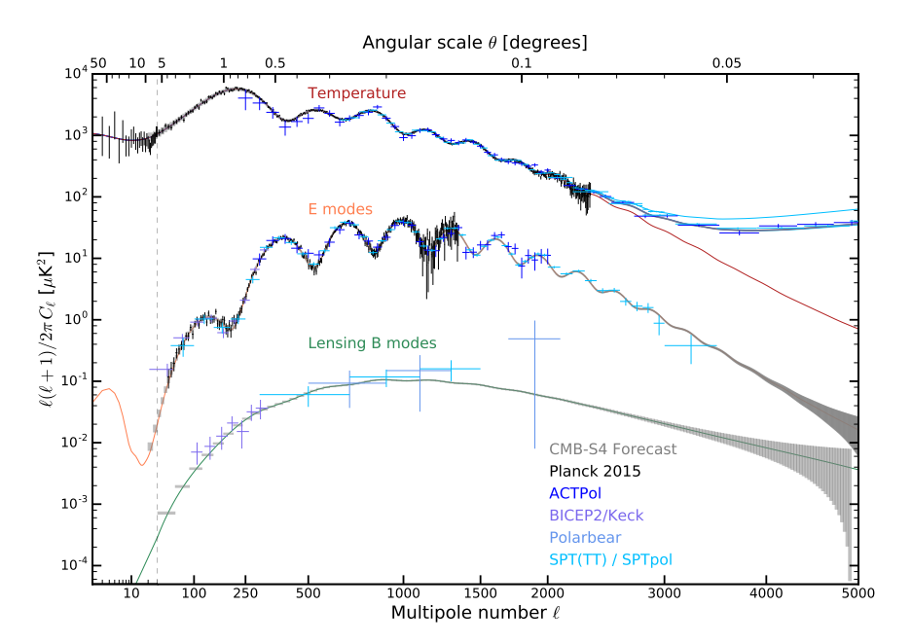
Predicted V Signals are Small
V Predictions
I, Q, and U Measurements
King and Lubin 2016 1606.04112
CMB-S4 Science Book
1610.02743
V predictions are much smaller than linear polarization measurements
Notes:
To place this in context, we can compare these predictions to the sensitivity of modern linear polarization experiments. This plot shows actual measurements and future measurement projections for the I, Q, and U Stokes parameters. Current linear polarization experiments are measuring signals at roughly 10^-2 micro-Kelvin squared on the relevant angular scales. The future experiments, like CMB Stage-4 could much better, but they won’t get anywhere near the say 10^-10 mu-K squared sensitivities in the optimistic circular polarization limits.

Slide 8
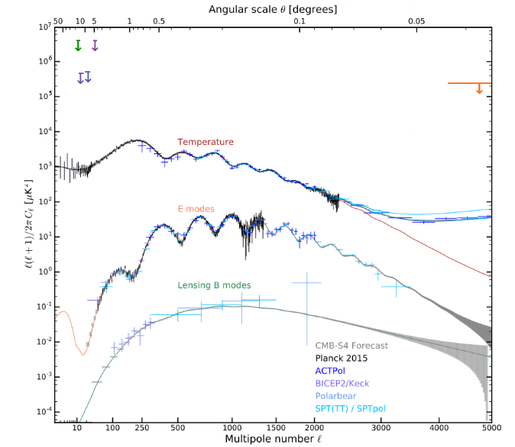
CMB Circular Polarization
Measurements
Lubin et al 1983
MIPOL: Mainini et al 2013
1307.6090
VLA: Partidge et al 1988
Notes:
And in part because the predicted signals are so small, there have been far fewer measurements on circular polarization. Before Spider’s recent paper, there were only 3 published limits and they are summarized on this plot.
On small angular scales, there is one measurement from the VLA in 1988. On large angular scales, there was a limit set by Lubin et al in 1983, which was improved upon by the MIPOL experiment in 2013. You can see from this plot that at the large angular scales, there are roughly 7 orders of magnitude between these limits and modern linear polarization measurements, and this is why Spider can make an interesting measurement even though it wasn’t designed to measure Stokes V.

Slide 9
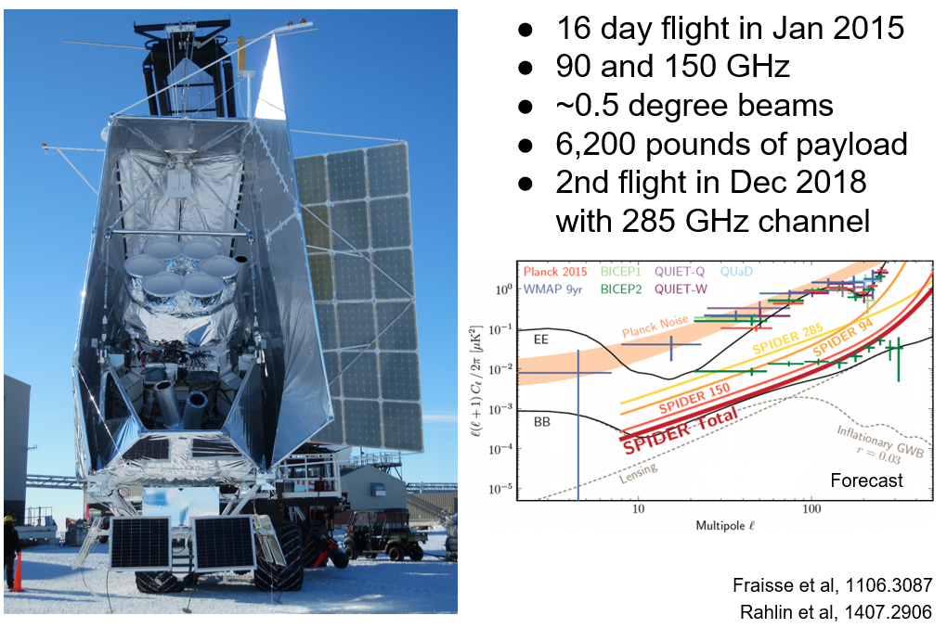
SPIDER Overview
16 day flight in Jan 2015
95 and 150 GHz
~0.5 degree beams
2nd flight with 285 GHz receivers planned for Dec 2018
Fraisse et al 2013, 1106.3087
Rahlin et al 2014, 1407.2906
Notes:
Sasha just gave a great overview of Spider and told you about the first flight in 2015. Now I’m going to tell you about how we can use the data from that flight to measure circular polarization. The key is that we exploit non-idealities of our half-wave plate polarization modulators.

Slide 10
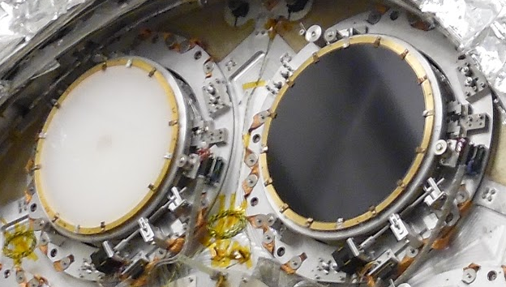
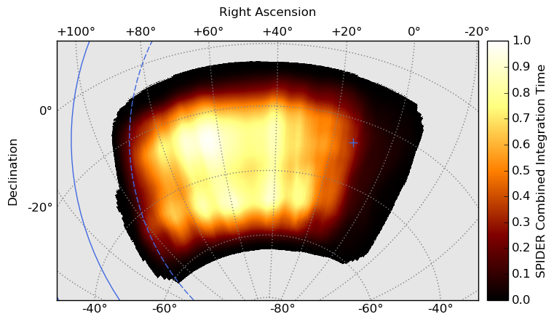
HWP Polarization Modulators
Flight Operation
95 GHz
150 GHz
Step in integer multiples of 22.5° every half day
Use complementary angles for good Q/U coverage at each frequency
8 distinct HWP positions
Modulate instrument polarization sensitivity
Birefringent single-crystal sapphires
4 K operation
Rotated in discrete steps
2015 Flight Sky Coverage
Notes:
Each SPIDER receiver includes a HWP to reduce the impact of systematic errors due to beam asymmetries and instrument polarization.
In Spider the HWPs are made from birefringent sapphires, which are anti-reflection coated so that they will have high transmission. During flight, we make maps with the HWPs at fixed angles, and then we rotate them in discrete steps between maps to change the polarization sensitivity of our instrument. We cycle through 8 different HWP positions over the course of the flight, and make multiple maps at each HWP angle.

Slide 11
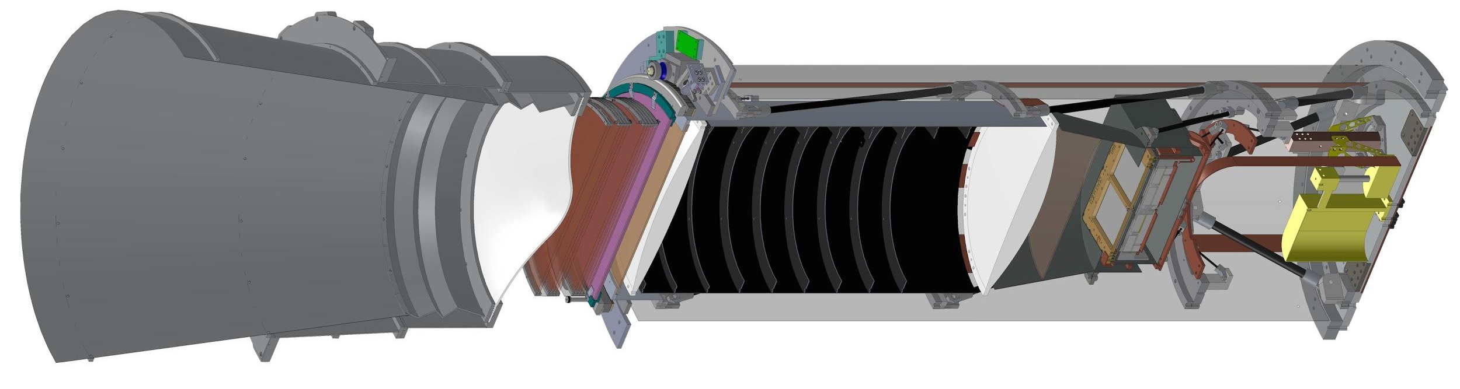
HWPs and Circular Polarization
A non-ideal HWP partially transforms circular polarization to linear
Incoming circularly polarized radiation
Linearly
polarized
radiation
Linear polarization detectors
HWP
Power detected
d_{V} ~ s γ sin(2θ_{HWP}-2ξ_{det})
HWP V-coupling
Notes:
A half-wave plate induces a half-wave length phase delay between waves polarized along the crystal axes. This phase delay causes linearly polarized light to rotate as it passes through the plate, ideally independent of the light’s frequency. But in reality, that can only be true at a single frequency, and non-idealities arise over the frequency band, particularly if the half-wave plates are not optimized for the exact band centers.
In that regard, all of SPIDER’s half-wave plates are a little bit like really bad quarter wave plates, which means that rotate a small amount of incoming circular polarization to linear, which we could then see with our detectors. It’s a tiny effect, but we know what to look for. The power at our detectors depends on the relative angle of the half-wave plate and the polarization sensitivity of the detectors, an overall polarization efficiency called gamma that also affects the Q and U signals, and this parameter that we’ll call s, which represents that circular polarization coupling of the half-wave plate.

Slide 12
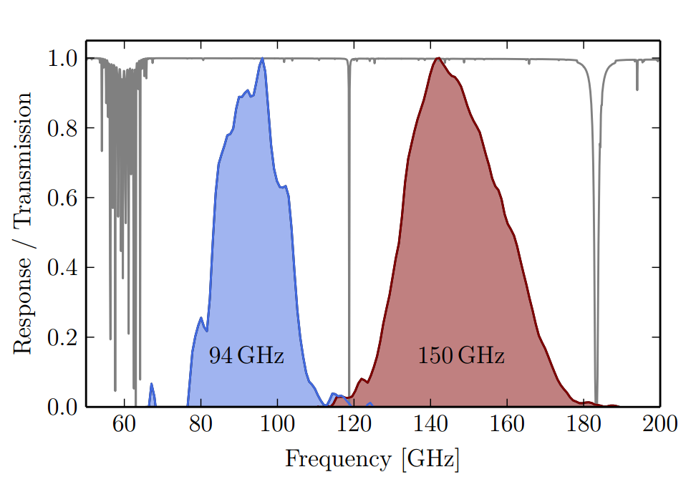
Calculating SPIDER’s V-Coupling
Theoretical procedure can be found in Bryan et al 2010 and Savini et al 2006
Calculate s for each HWP based on
Measured physical HWP properties
Measured observing bands (for each receiver)
Source spectrum (CMB blackbody)
Average SPIDER Observing Bands
HWP Properties
Refractive index and thickness of
a
-sapphire
-both AR coats
-bonding layers
a
for each HWP
Rahlin et al 2014, 1407.2906
Notes:
It would be difficult for us to measure s, but we can calculate it from the properties of our system. This calculation is described in more detail in these references, but there are only a few things you need to know to do it. You need to know some physical properties of the half-wave plates, in particular the thicknesses and refractive indices of the sapphires and their anti-reflection coatings. You also need to know the observing bands, which we have for Spider from pre-flight calibration measurements. And finally, the circular polarization coupling depends on the spectrum of the source you are observing. For the rest of this talk, I will use a thermal blackbody spectrum for a CMB source, but in the paper we discuss spectra for foregrounds and other sources.
When we do these calculations in practice, there is some uncertainty in the measured quantities, and that means that we don’t have exact s values, we have probability distributions of s values.

Slide 13
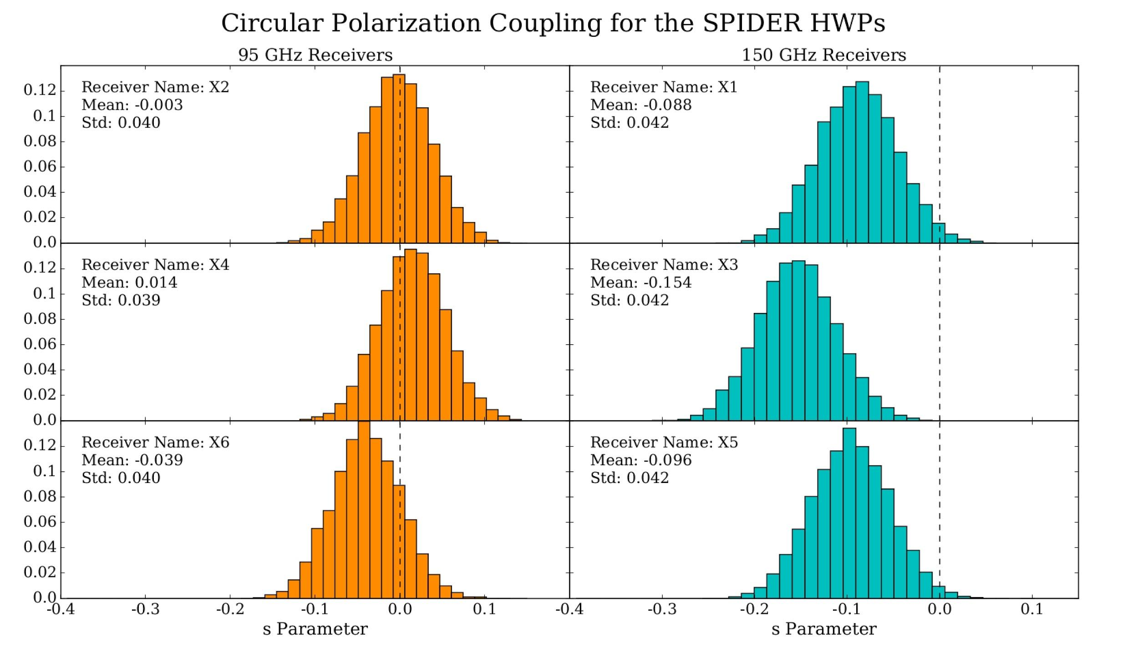
Calculating SPIDER’s V-Coupling
3 independent measurements at each frequency improves V sensitivity
Notes:
Which is what I’m showing here. These are the probability distributions of the s values calculated for all 6 Spider receivers. The 95 GHz receivers are shown in orange, and the 150 GHz receivers are shown in teal. They are all slightly different because of both the differences in the component thicknesses and in the observing bands. The dashed line through the histograms show where s=0. You’ll notice that the 150 GHz receivers generally have larger absolute values of s than the 95s, and this is one of the reasons we expect a stronger limit at 150. Although the 95 GHz distributions include s=0 within 1 sigma , there is a significant probability of non-zero s, especially when you consider that we have three separate HWPs at each frequency, which really improves our statistical power in the combined limit.

Slide 14
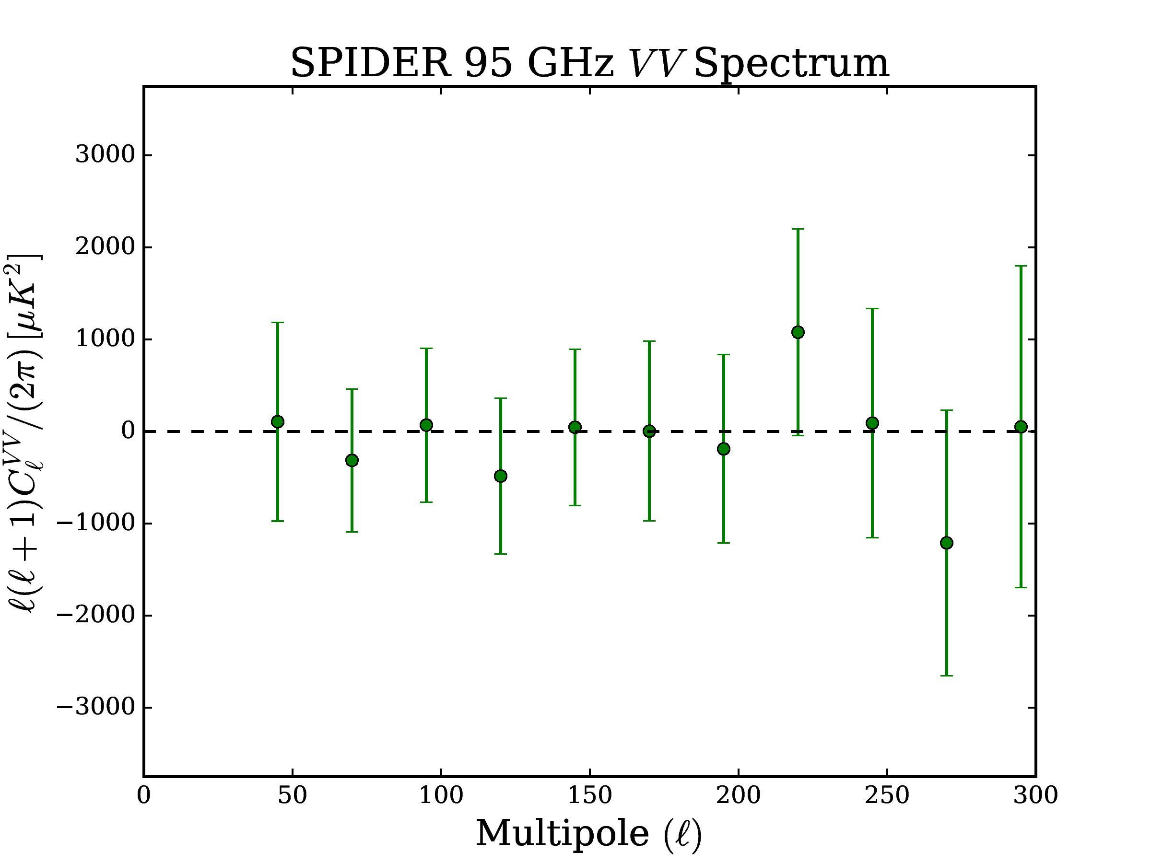
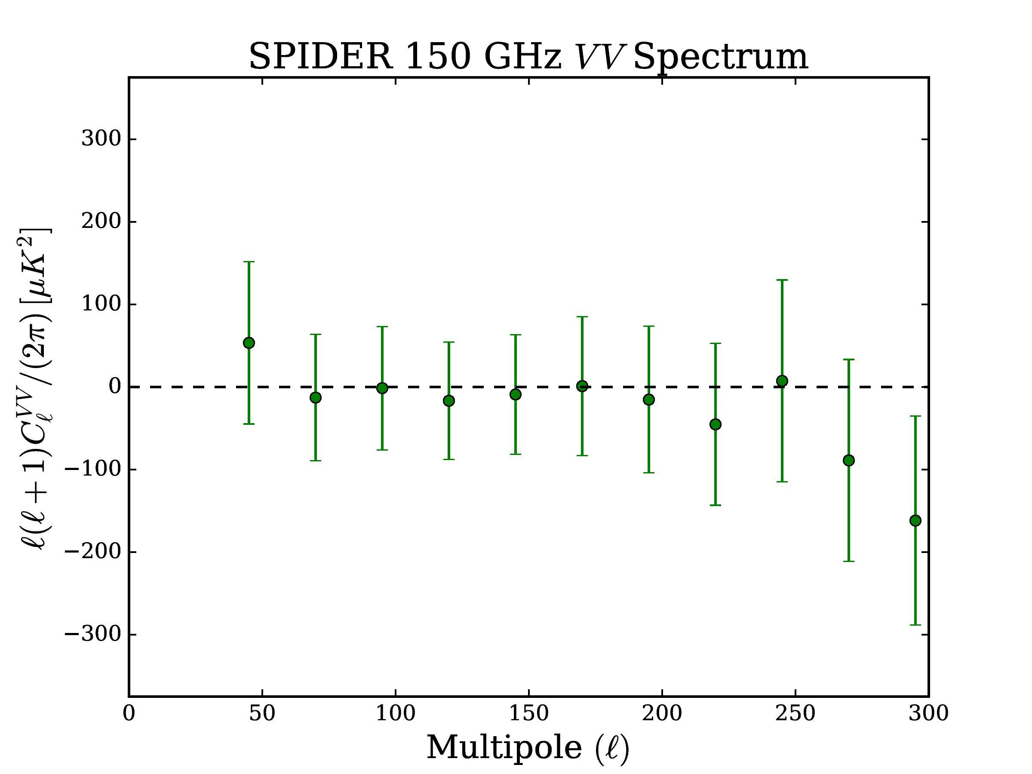
Making V Spectra
Compute cross-spectra for pairs of s = 1 maps at each frequency
Use Monte Carlo sims to combine with s distributions
No detection of circular polarization
Error in s is highly correlated between bins
Notes:
Once we have these s distributions, we can look for CMB circular polarization in the Spider data. Since we don’t know the circular polarization coupling exactly, we start by making V maps with s=1. Then for each map pair at a given frequency, we compute the s=1 cross-spectra and use Monte Carlo simulations to combine them with the appropriate s distributions.
This gives us the spectra shown here, with 95 GHz on the left and 150 GHz spectrum on the right. Note that the y axis is an order of magnitude smaller in the 150 GHz plot, so we are more sensitive at 150 than 95, and the scatter in the points is small compared to the error bars because the uncertainty in the circular polarization coupling is highly correlated between ell bins.
Neither of these spectra show a significant detection of circular polarization, but we can convert these to 2-sigma upper limits and compare with previous measurements.

Slide 15
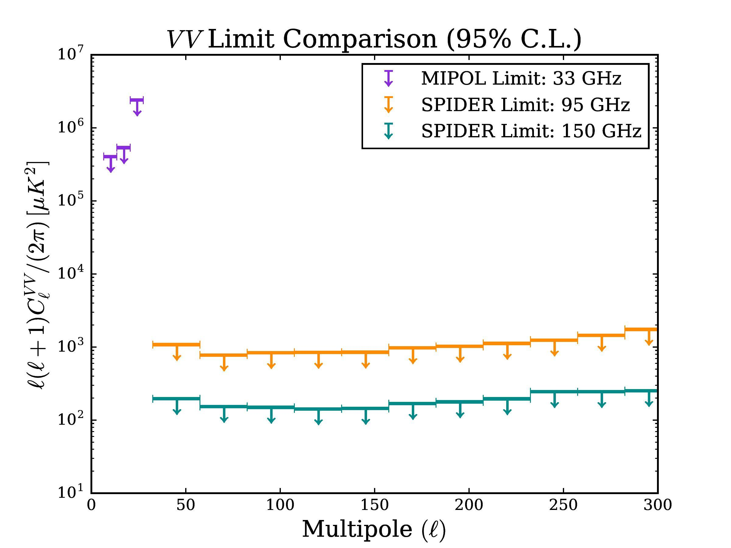
SPIDER’s CMB V Limit
Convert spectra to 2σ upper limits and
compare to other measurements
Notes:
This plot shows show Spider’s CMB VV limits, with the 95 GHz limit in orange and the 150 GHz limit in teal. The Mipol limit is up here in purple, so you can see that Spider gets a few orders of magnitude improvement and covers a broader range of angular scales.

Slide 16
SPIDER’s CMB V Limit
Can be extended to a limit on foregrounds and other source spectra
E-modes ~10⁰ μK²
Notes:
It is important to remember that we assumed a CMB source spectrum when we computed the s distributions. We can extend this limit to foregrounds and other sources by recomputing s, and we do that in the paper, but the limits are roughly the same order of magnitude.
And to place this result in context, this y-axis is in micro-Kelvin squared, so the CMB E-mode spectrum is still mostly off the plot at these angular scales, so this limit is still not as sensitive as modern linear polarization measurements, including the ones that Spider will eventually publish.

Slide 17
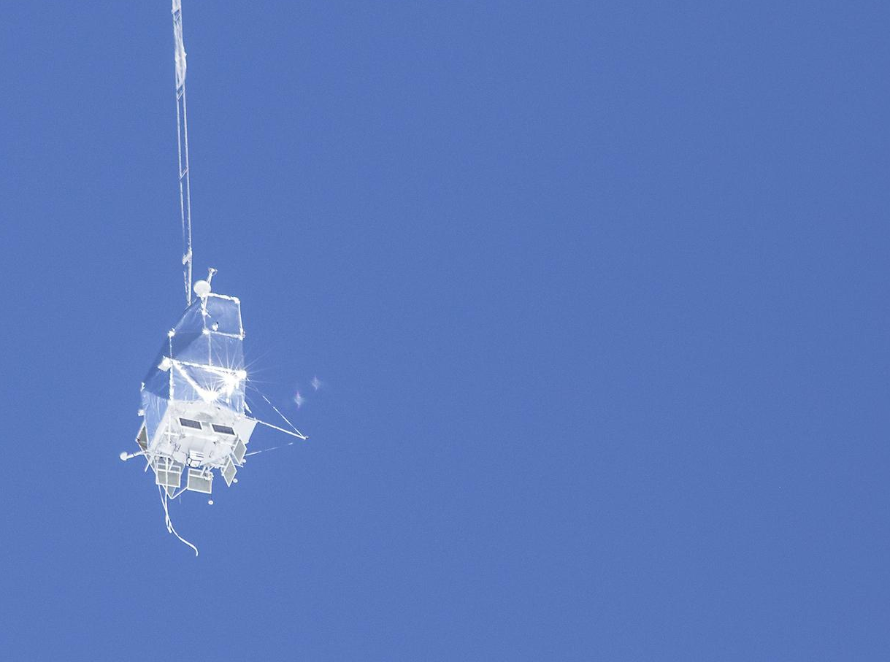
Conclusions
SPIDER is primarily a linear polarization experiment, but can measure V through
HWP non-idealities.
New upper limit on CMB V V spectrum of
141 to 255 μK² from 33 < l < 307 at 150 GHz.
No proposed generation mechanisms predict signals at this level, but this is a free
sanity check on the universe.
Other CMB experiments may be able to apply this technique to their data to improve this limit (including SPIDER2).
Nagy et al, 1704.00215
Notes:
In conclusion, SPIDER is primarily a linear polarization experiment, but we are able to measure circular polarization by exploiting non-idealities of our half-wave plate polarization modulators. This has allowed us to improve the upper limit on CMB circular polarization by several orders of magnitude and probe a wider range of large angular scales. Although we don’t expect to see any circular polarization at this level, it’s basically a free sanity check on the universe. Other linear polarization experiments may be able to apply this technique to their data to improve the limit, including SPIDER2. Thank you very much for your attention, are there any questions?

Slide 18
Bonus Slides

Slide 19
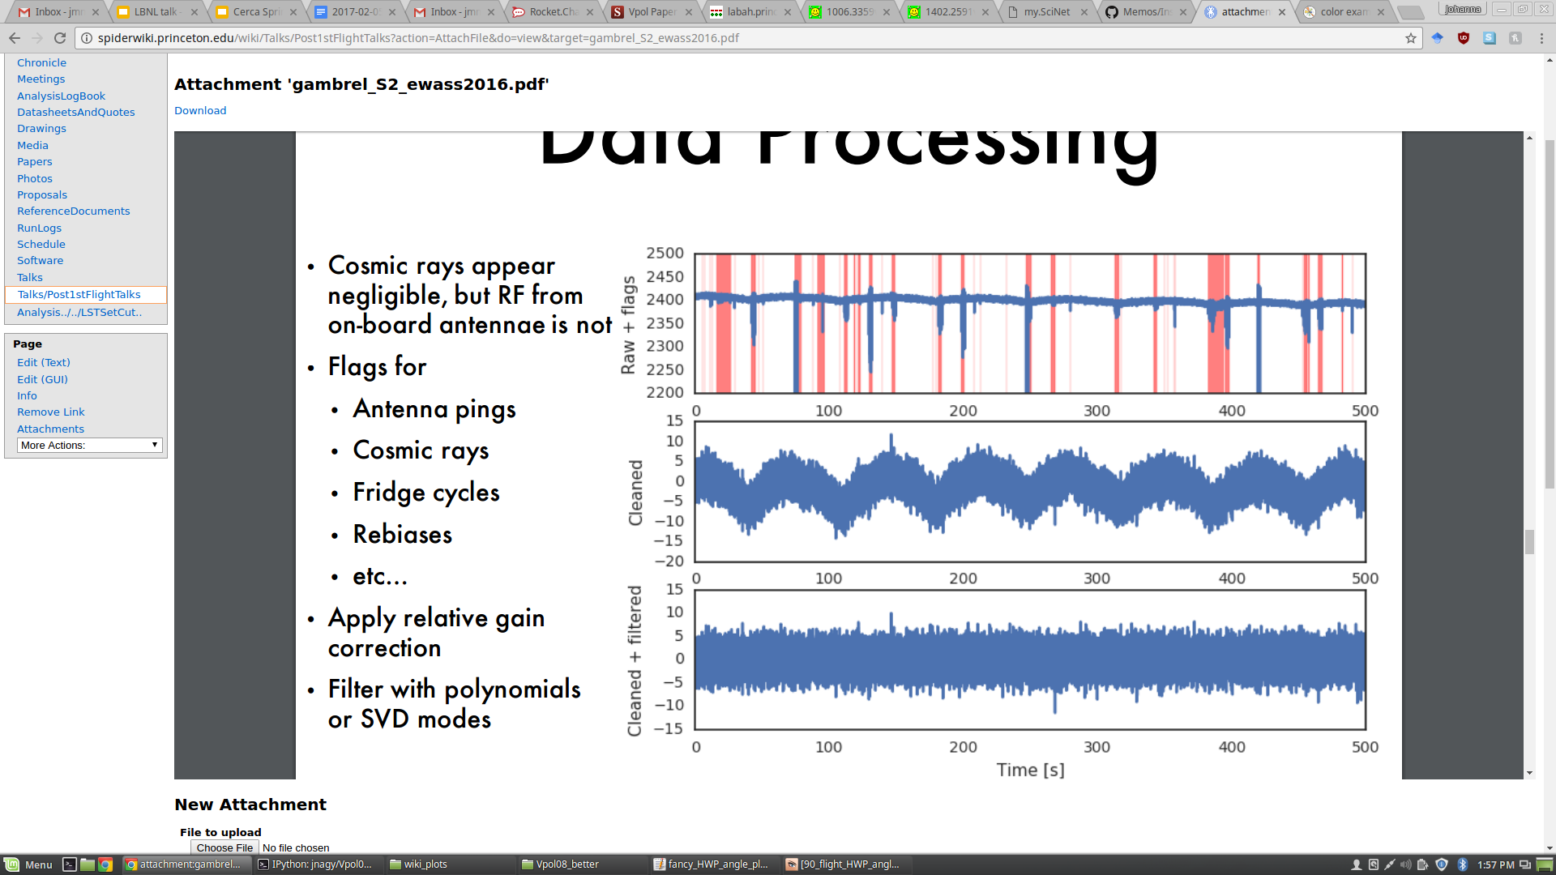
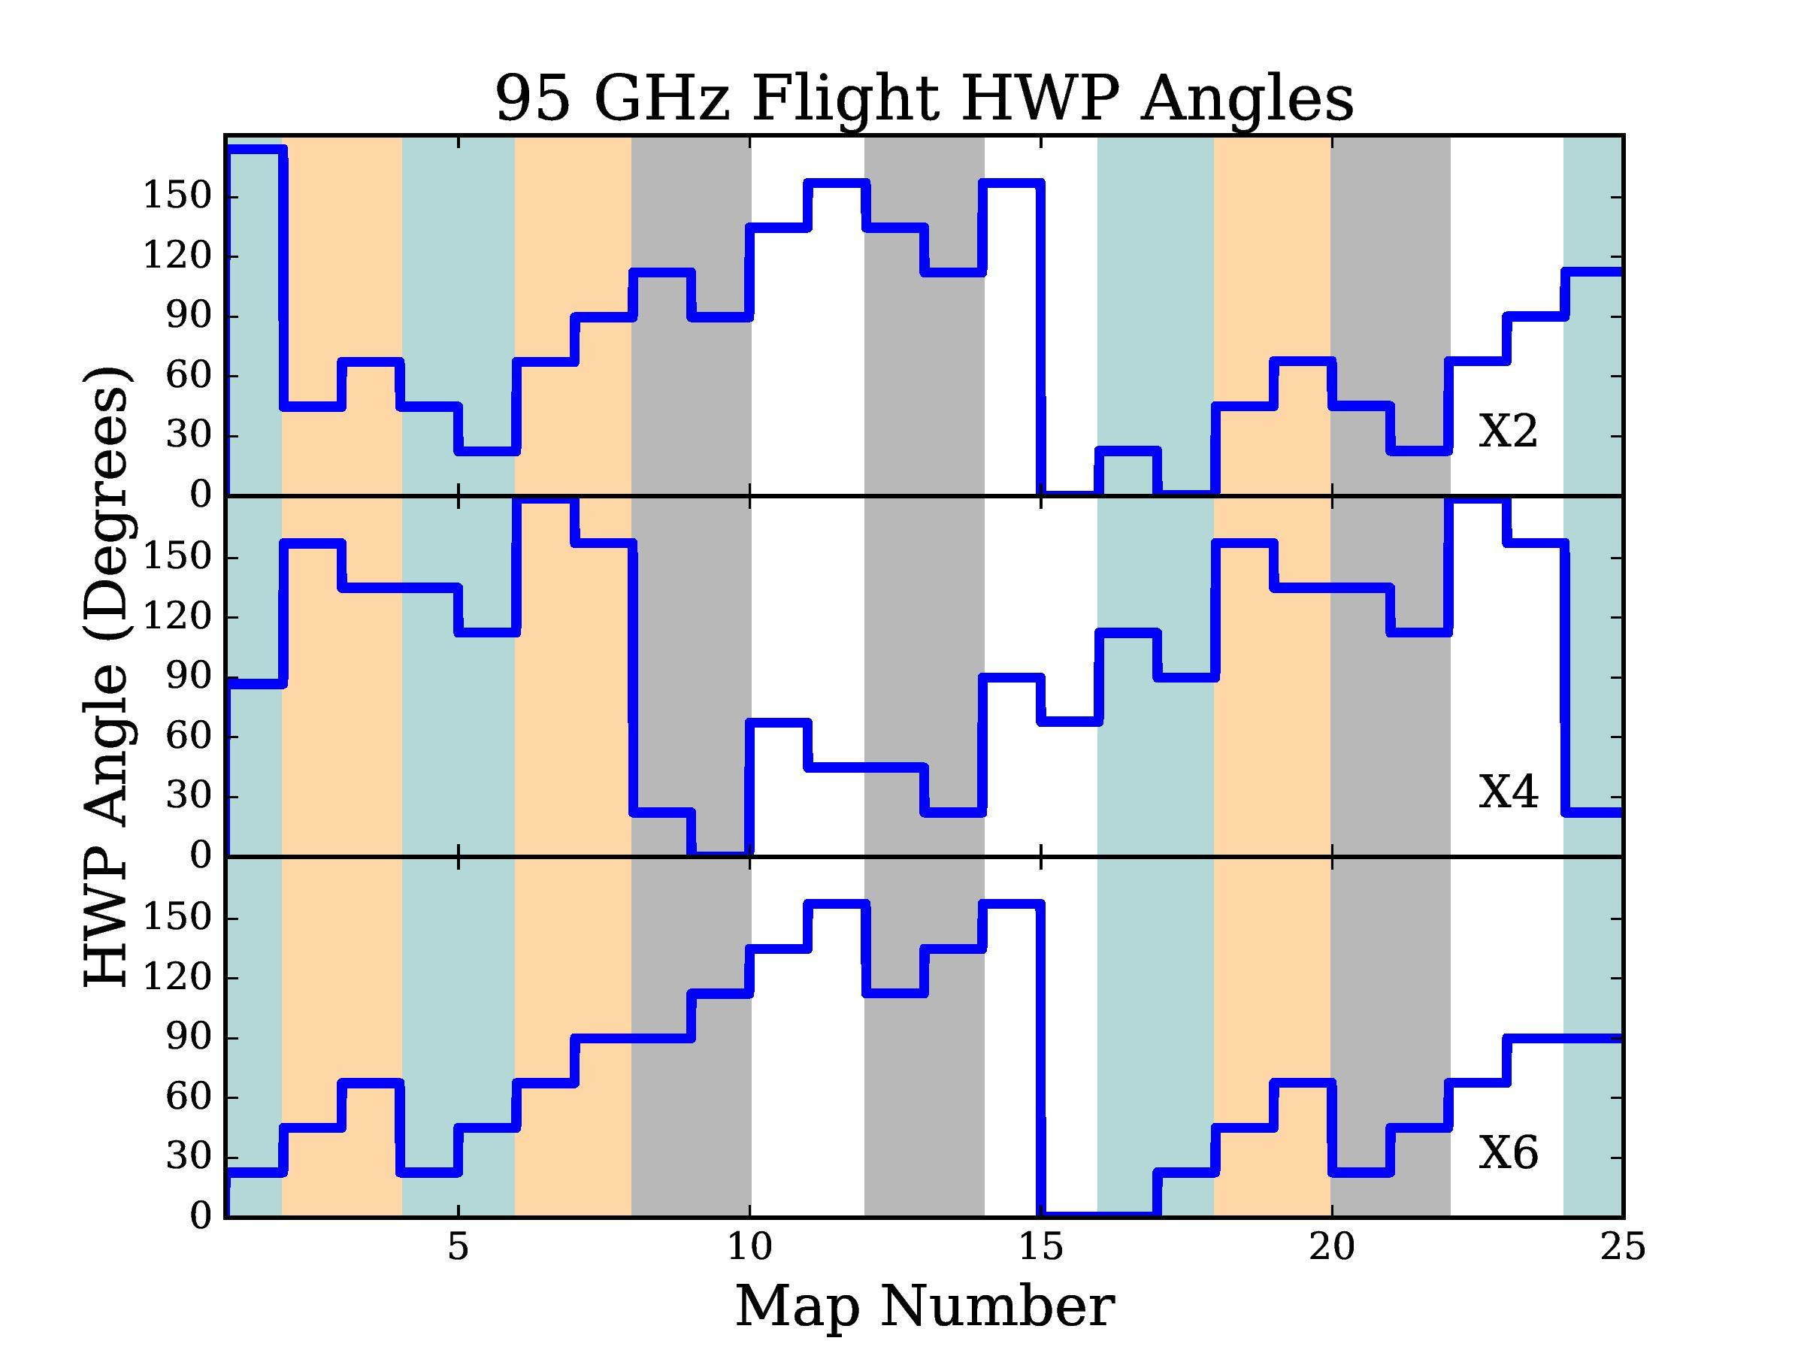
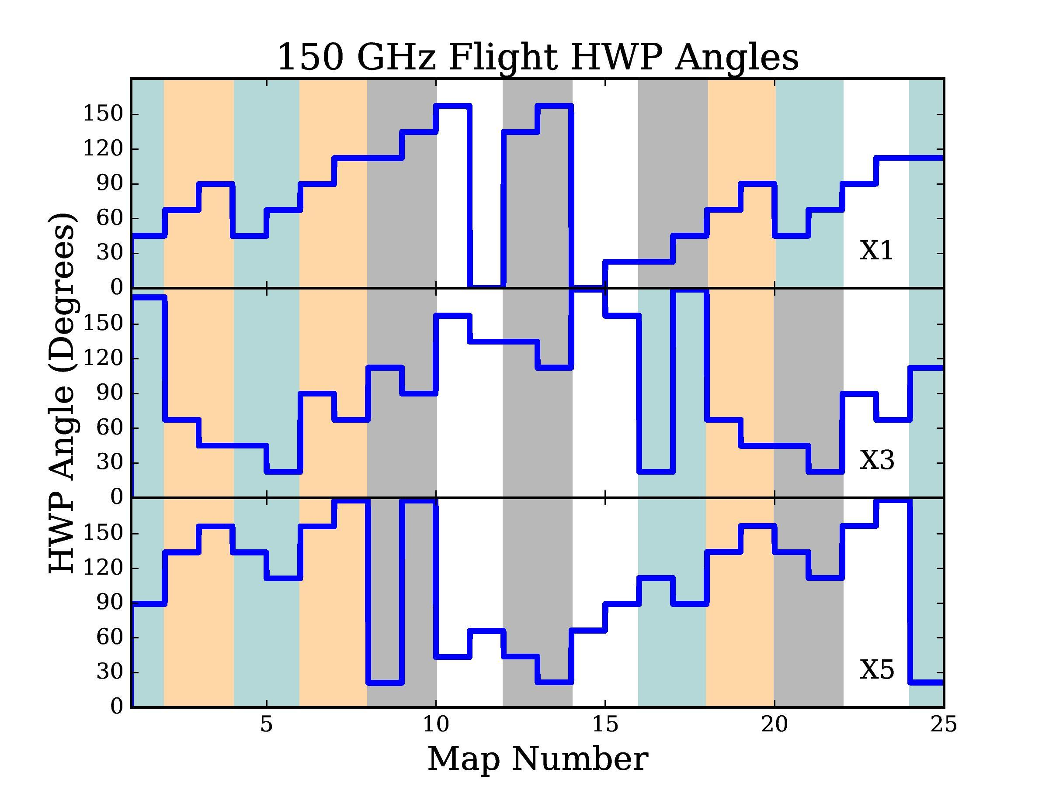
Making V Maps
Deglitch and filter
the raw data
Split data into 4 independent maps for each receiver
Notes:
Once we have these s distributions, we can look for CMB circular polarization in the Spider data. Starting from the raw detector timestreams, we have to remove all sort of glitches like cosmic ray hits and payload transmitter signals,, and then we filter out the scan-synchronous noise. This part of the pipeline is all shared with the linear polarization analysis.
We then take the cleaned timestreams, we and turn them into maps, which we can used to make VV power spectra. For this analysis we chose to use cross-spectra, and for each receiver, we construct 4 independent maps based on combinations of data made at different HWP angles. These are shown by the four different colored bands in this figure. Since we don’t know the circular polarization coupling exactly, we do this with s=1

Slide 20
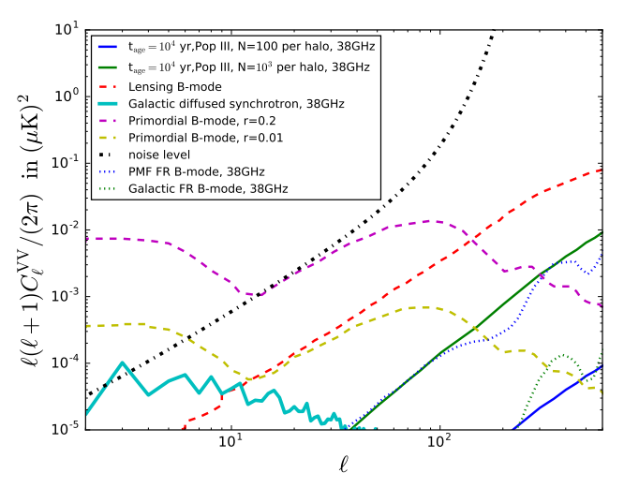
Circularly Polarized Foregrounds
Predicted Foreground Signals
Galactic foregrounds are the primary concern
Dominated by synchrotron at the low frequencies of interest
Can extend SPIDER’s limit to foregrounds, but expected signals are small (though typically larger than expected cosmological signals)
King and Lubin 2016
1606.04112
Notes:
SPIDER’s limits are off of this plot

Slide 21
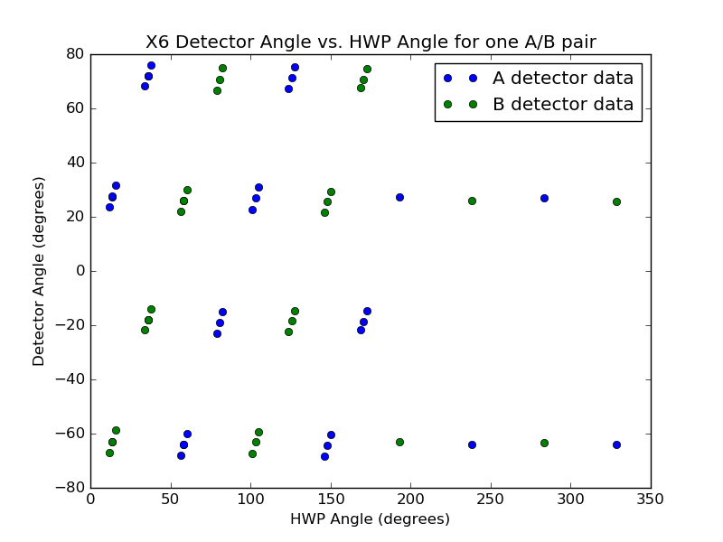
HWP Non-Idealities
Arise due to wide band and imperfect AR coating
See evidence from them in our angle calibration
Create changes in linear polarization modulation
SPIDER Calibration Data

Slide 22
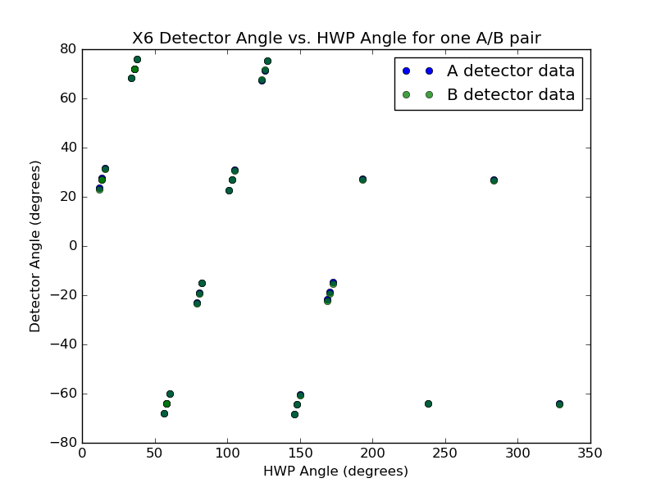
HWP Non-Idealities
Arise due to wide band and imperfect AR coating
See evidence from them in our angle calibration
Create changes in linear polarization modulation
SPIDER Calibration Data

Slide 23
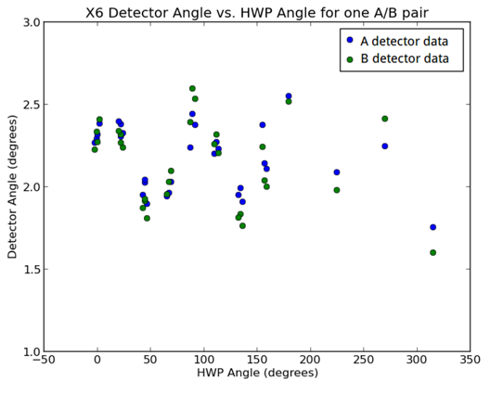
HWP Non-Idealities
Arise due to wide band and imperfect AR coating
See evidence from them in our angle calibration
Create changes in linear polarization modulation
SPIDER Calibration Data

