Slide 1
GPS Timing and Synchronization:
Characterization and Spatial Correlation
8/11/2017
Rob Halliday
High Energy Astrophysics Group, CWRU

Slide 2
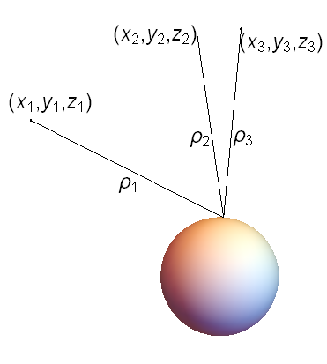


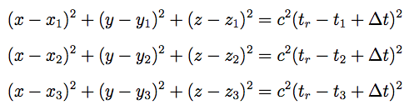
GPS Basics
GPS Constellation: 30+ Satellites, orbiting earth at 26.6Mm, each carrying a Cesium atomic clock, updated periodically by the US Air Force (~ every 4 hrs)
t_{r} is the time the message is received, and t_{i} is the broadcast time of each satellite.
GPS works by finding ‘pseudoranges’ from satellites through timing, then solving the above equations. If position is not needed, they can be used as an over-determined system to obtain the time and time error.

Slide 3
Why do we care? – Auger
Molecules in atmosphere
Detector Array
Timing is used to reconstruct point of first interaction, which along with shower core gives arrival direction
UHECR

Slide 4
Why do we care? – Auger
Detector Array
GPS is used to synchronize the clocks between Auger stations

Slide 5
Why do we care? – Overall
Many experiments in disparate fields use GPS for time synchronization:
  Auger
  LIGO
  ICARUS
  Axion Dark Matter Detection
Detector Array

Slide 6
The Question
Occasionally overheard at Auger meetings:
“GPS receivers can have fluctuations between then as large as 30ns which will affect our timing”
How independent or correlated are two GPS receiver’s timing solutions as a function of distance?

Slide 7
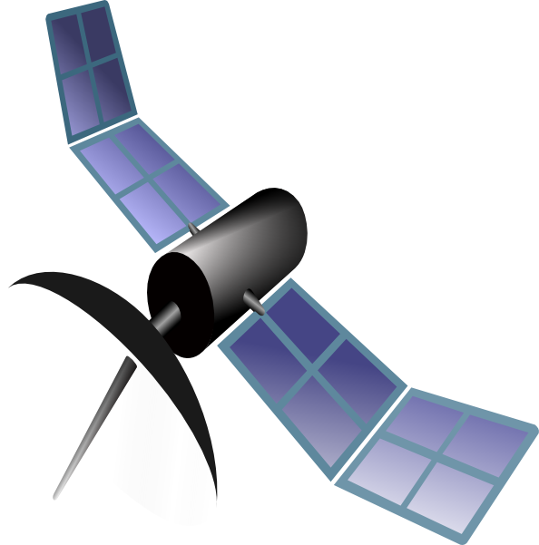

The Experiment:
Setup
Reference FS725 Atomic Clock and GPS Receiver
FS725+GPS Test Platform
“Local”
~0m
1-5km
“Remote”

Slide 8
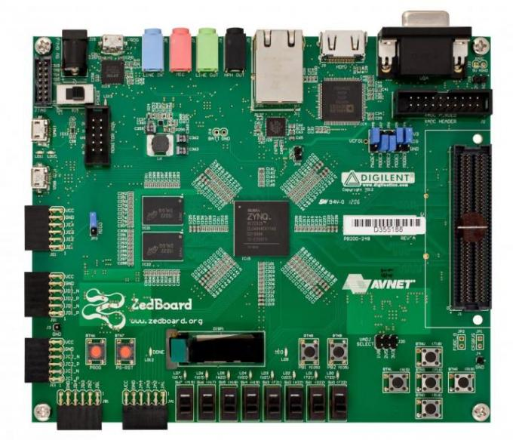
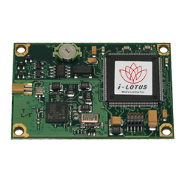
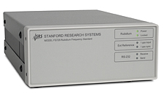
The Experiment:
Timing Instrumentation Module
Ideally you have:
  A time-tagging (TTAG) system with a higher resolution than the accuracy of the GPS Receiver
  A frequency standard that is more stable than GPS on short and medium time scales
We use an FS725 Rubidium Frequency Standard (aka Atomic Clock or AC) and ZedBoard (SoC+FPGA) to measure timing of M12M GPS Receiver make up Timing Instrumentation Module (TIM)
FS725
~.2ps/100s
1ns TTAG resolution
ZedBoard
Timetagging:
750Mhz, 1.33ns
M12M GPS Timing Receiver
“2ns”, really ~4ns

Slide 9
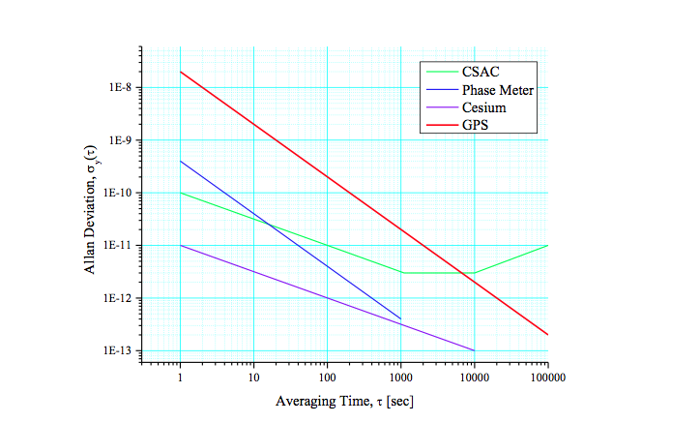
Procedure:
Atomic Clock Training
There are a few caveats to using an atomic clock to measure GPS:
They must be trained/disciplined to a GPS unit to maintain long term stability
Allan Deviation (ADEV) is a measure of frequency stability-basically the running standard deviation of the difference in frequency between successive measurements

Slide 10
Procedure:
Atomic Clock Training
There are a few caveats to using an atomic clock to measure GPS:
They must be trained/disciplined to a GPS unit to maintain long term stability – Acts as low-pass filter for timing, training accuracy increases over operating time
1st second
3rd second, etc
2nd second
Finer points:
GPS constellation trains to UTC
GPS receiver trains to constellation
Atomic clock trains to receiver and attempts to pick out the true frequency corresponding to 1PPS
Hypothetical True Second
GPS Time
Atomic Clock Time
Measured Time Difference

Slide 11
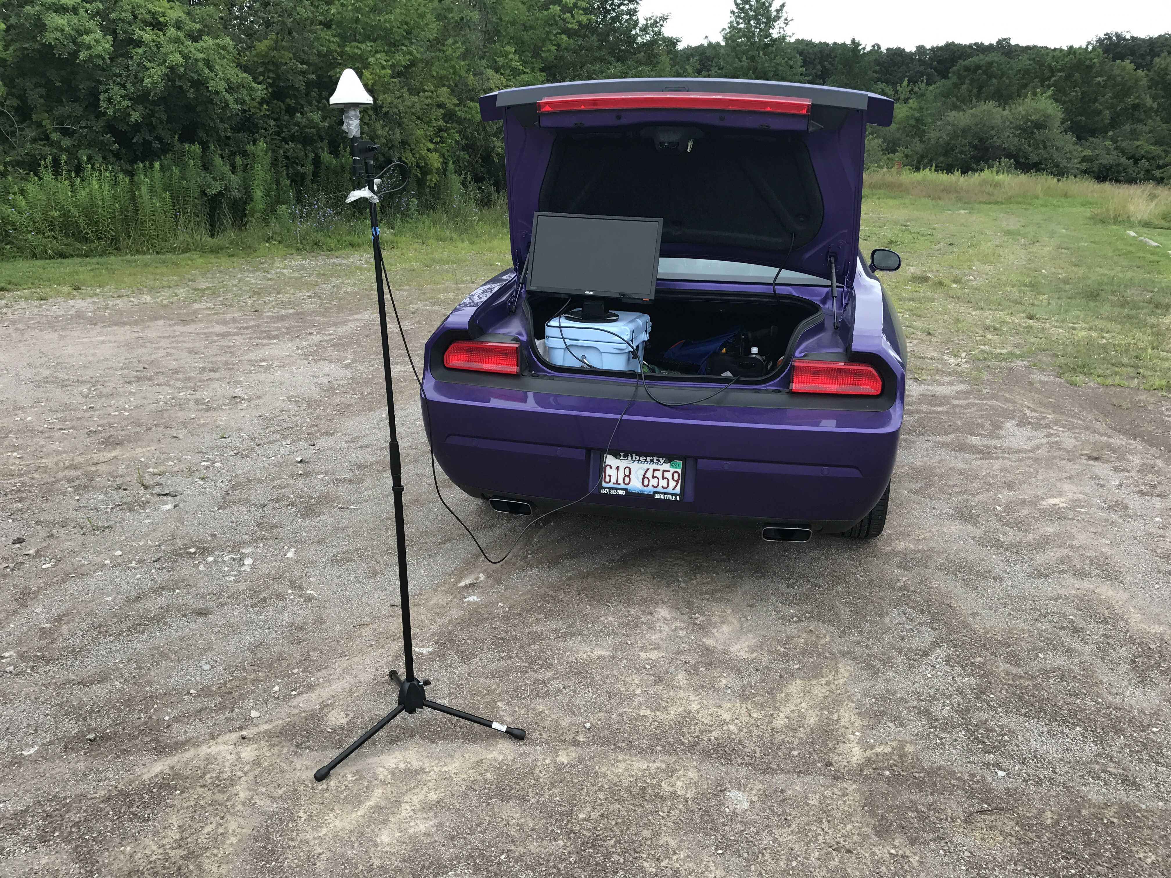
Procedure:
Data Taking
We made a handful of separate attempts to measure this quantity:
Using Chip Scale Atomic Clocks and about 30 min data runs
Fixed set-up in radio tower using week long data runs
Moving setup in running car, stopping and surveying for 4 hours at a time
Move set up between “sites”
  Clocks must be running for 6-8 hours to fully acquire the 1PPS frequency of the GPS constellation
  Antennae mounted for maximum sky coverage
  Run for 24-48 hours and move

Slide 12
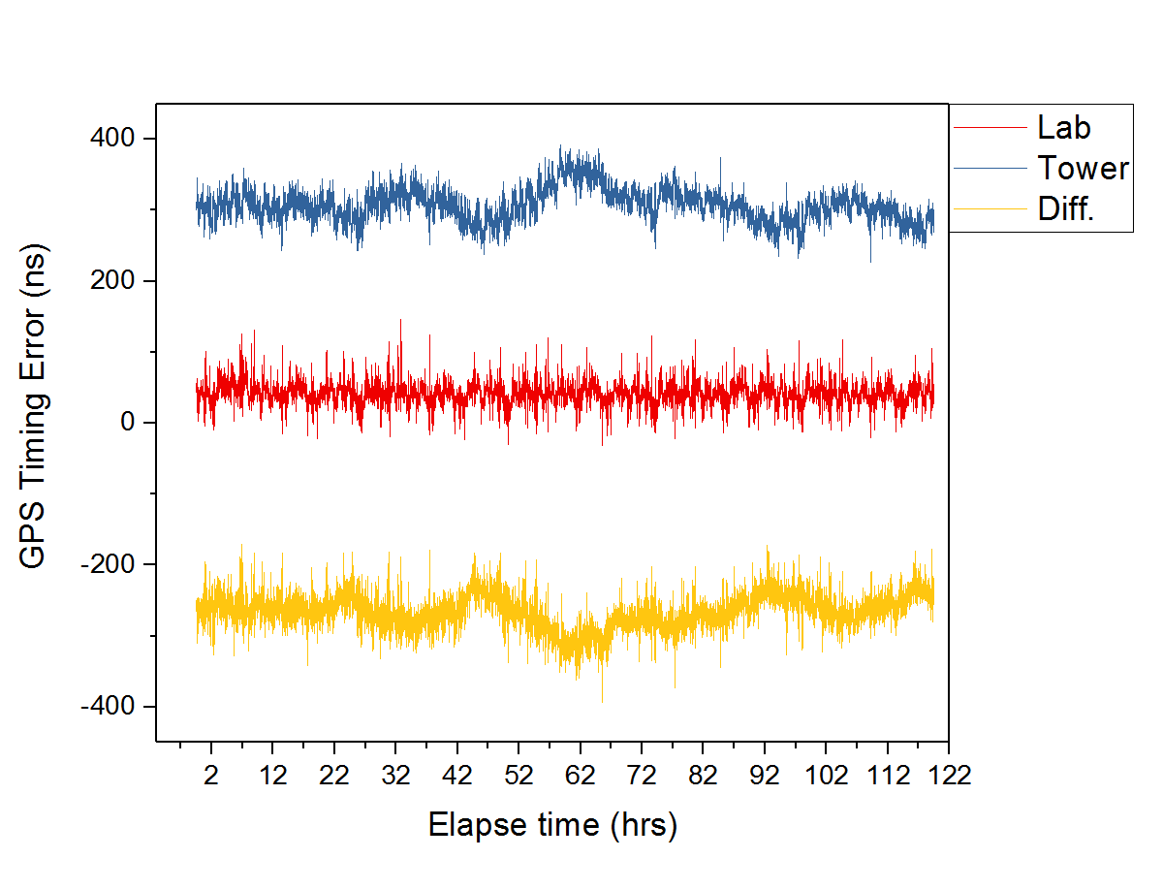
Analysis:
The Measurement

Slide 13
Analysis:
The Measurement
Point-wise:
-blue + red = yellow

Slide 14
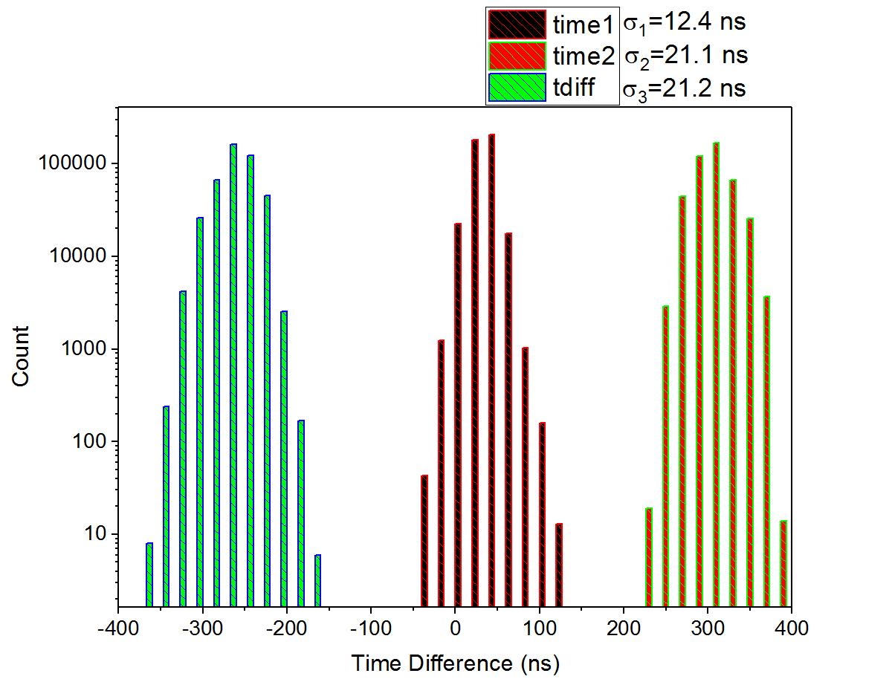
Analysis:
The Measurement
Gives one data point
(From an engineering run, not actual measurement data)

Slide 15
The Experiment:
Setup
Reference FS725 Atomic Clock and GPS Receiver
FS725+GPS Test Platform
“Local”
~0m
1-5km
“Remote”

Slide 16
Results:
Error vs. Distance
Window chosen by looking for lowest error sampling from previous versions of the experiment
Error bars are statistical, sky coverage, run duration and weather are folded in

Slide 17
Results:
Correlation
*Note: This plot has been adjusted to exclude training errors from the atomic clocks

Slide 18
Conclusions:
Correlation
GPS timing solutions are correlated, but the inaccuracies in the solution due to the receiver, at least for the M12M, dominate the noise of the units. For practical purposes, they can be viewed as being independent timing sources.
In the context of Auger, the lack of correlation is only worrisome if the deviation of each receiver is greater than one time bin.
  For the current Auger detector, even the largest fluctuations are within one bin, that said, the m12m receivers will only be installed in the upgrade
  For the Prime upgrade, we may want to have each station collect it’s own calibration histogram (as is currently done), since the largest fluctuations can be as much as 4 timing bins, however the standard deviation of the timing coming out of the M12M is about half a bin.
We plan to do another run of the experiment to try to get more data points with better statistics at each one over the course of the next month.

Slide 19
Results:
Characterization
Data from “site4”, unused
Weather effects:
  Before storm: SD=6.7 ns
  During Storm: SD=15.0 ns
Fairly violent thunderstorm hits

Slide 20
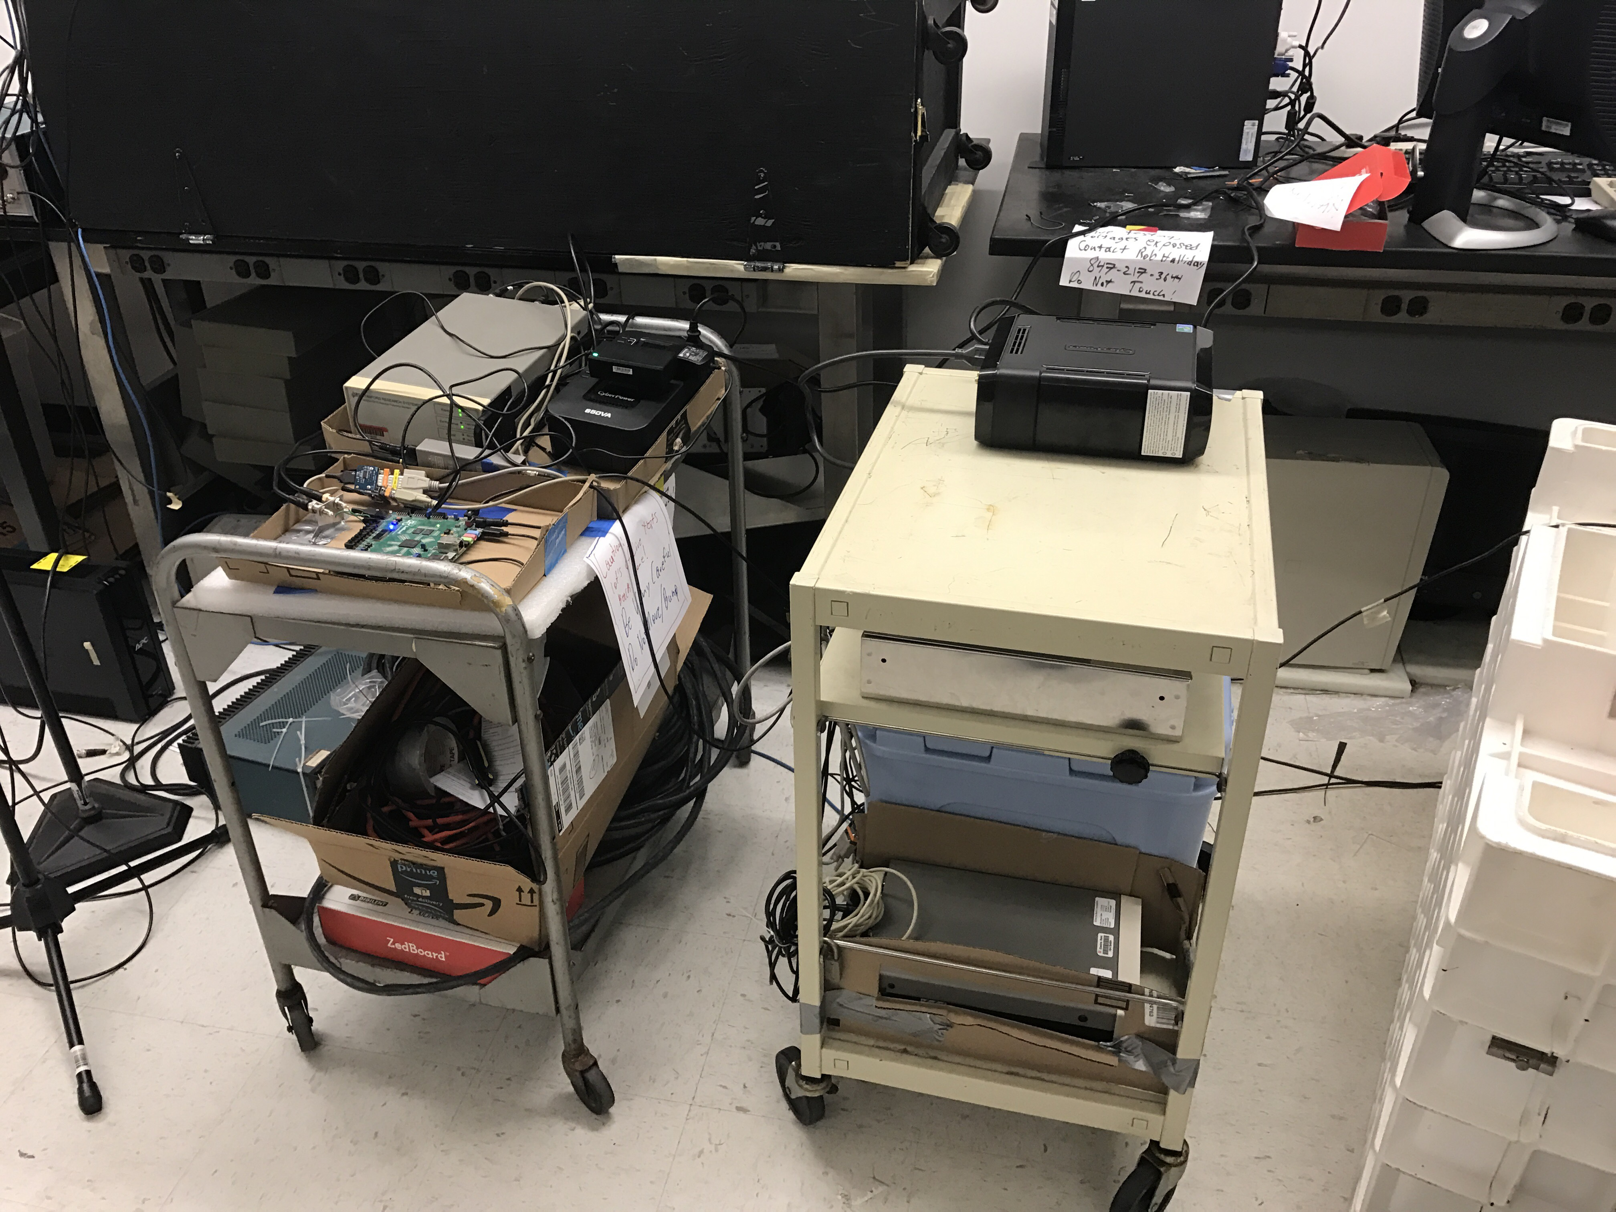
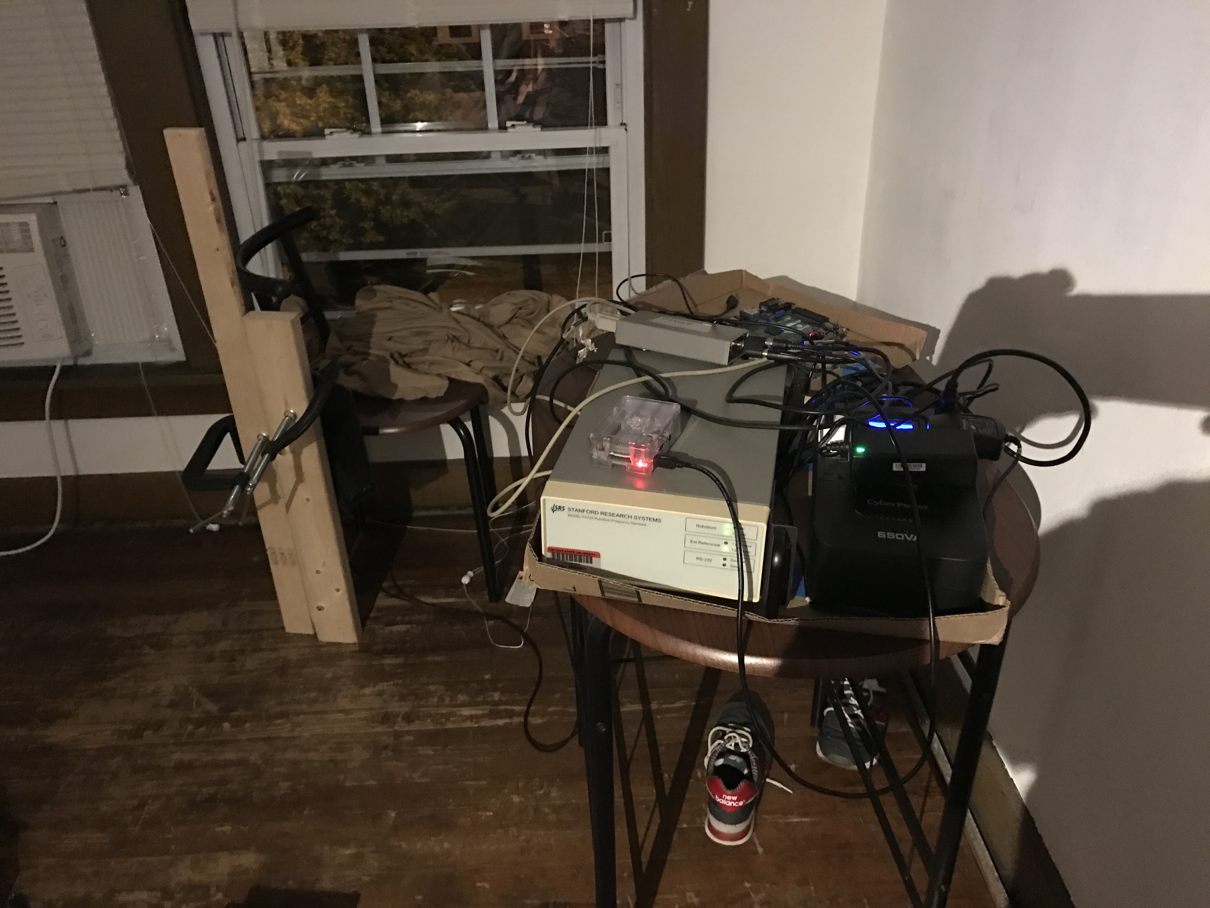
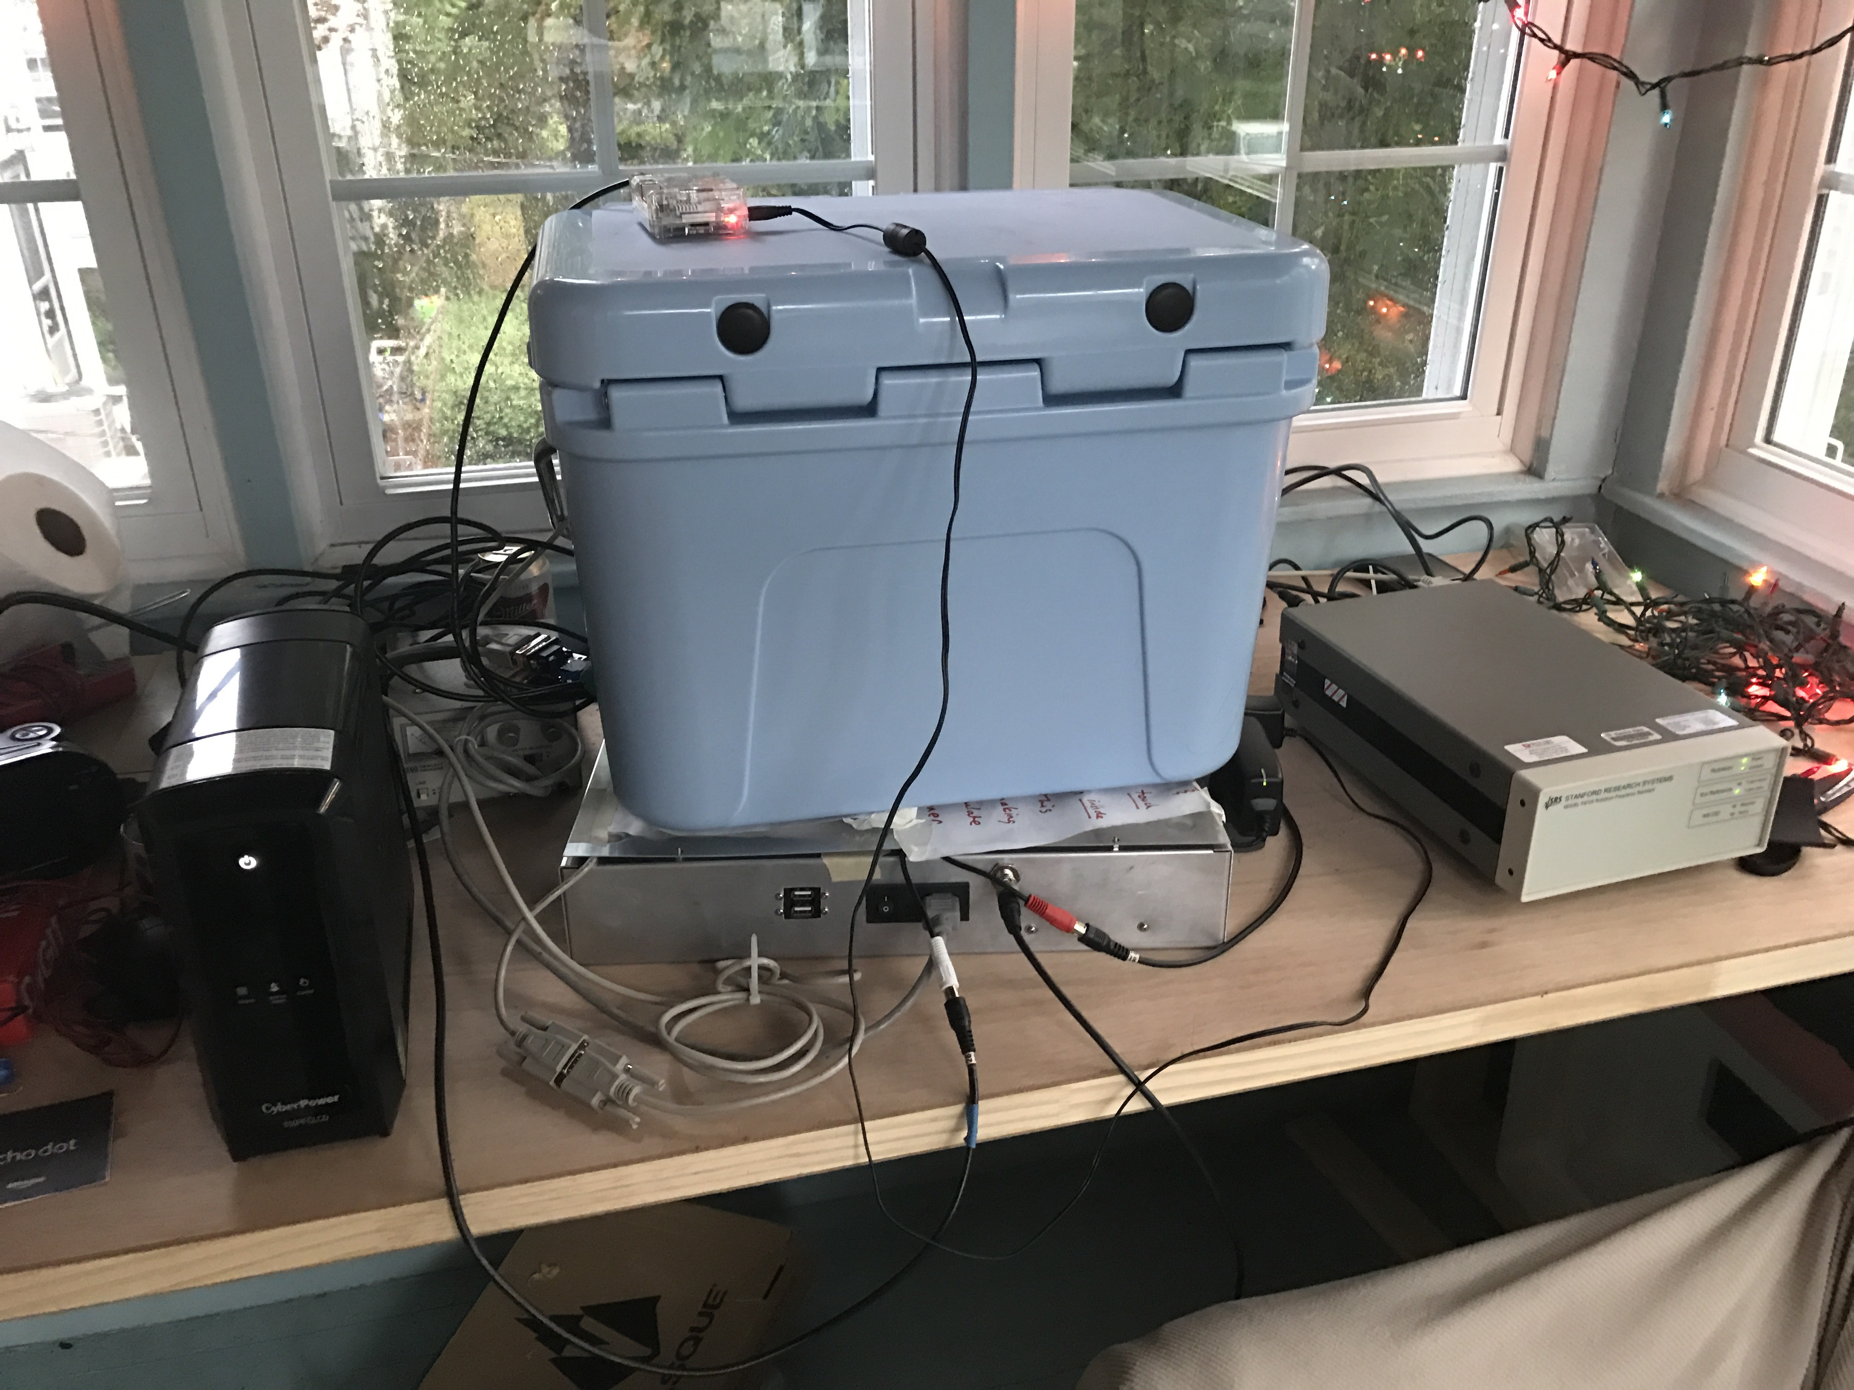
Thank you for listening!
Extremely high tech mounting hardware (c-clamps and leftover woodshop pieces)
Contact me at rph32@case.edu for more information
Local
Remote
Thanks to Sean Quinn, Ryan Lorek, Jackson Kishbaugh-Maish, and Corbin Covault for their help in completing this measurement. Special thanks to Patrick Allison and Jim Beatty for lending us their clock and vetting some of our ideas!
Thermal low-pass filter aka cooler

Slide 21
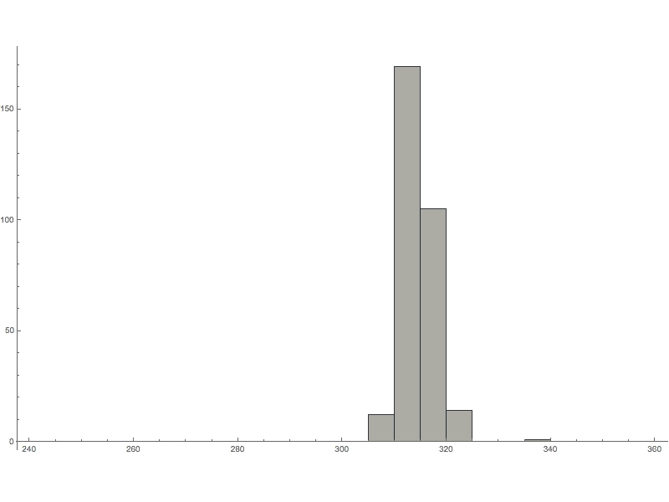
Results:
Characterization
BACKUP
Gaussian of Gaussians:
As small shifts in ionospheric conditions and satellite visibility occur, the distribution being sampled moves around.

Slide 22
Conclusions:
Characterization
BACKUP
Gaussian of Gaussians
Weather effects:
  Before storm: SD=6.7 ns
  During Storm: SD=15.0 ns
Minimum and maximum differences:
  -29 ns to 24 ns
A finer point- the sawtooth correction varies in how necessary it is, there are different “phase alignments” that the receiver can have relative to the GPS constellation
  This is its own talk

Slide 23
Procedure:
Atomic Clock Training
BACKUP
There are a few caveats to using an atomic clock to measure GPS:
They must be trained/disciplined to a GPS unit to maintain long term stability
They are exceptionally sensitive and therefore need to train for 8+ hours to obtain a good fix on the GPS constellation’s frequency
  Training can be played with to be faster but less accurate
  Chosen to minimize “co-training” error
  Moving them tends to destabilize training (~200ns tops, ~20ns min)

Slide 24
Results:
Unadjusted Correlation
BACKUP

