Slide 1

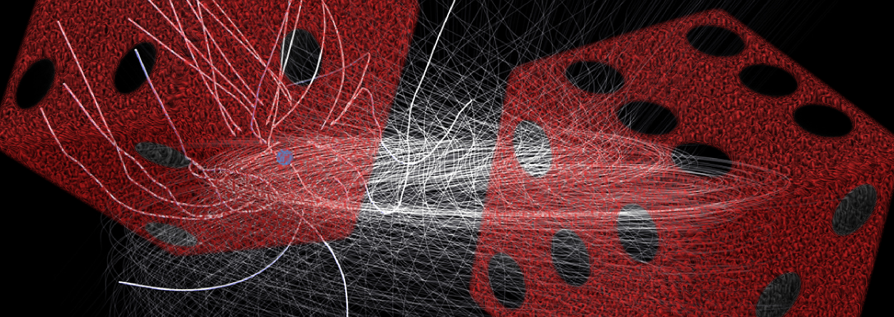

Propagation of TeV-CR using SDEs in CRPropa3.1
TeVPA 2017
Columbus, OH 08-07-2017
FAKULTÄT für Physik und Astronomie
Lehrstuhl für Theoretische Physik IV
Plasma Astroteilchen
Lukas Merten

Slide 2



Collaboration
Ruhr-Universität Bochum
Julia Tjus
Björn Eichmann
University of Hamburg
Günter Sigl
Andrej Dundovic
RWTH Aachen
Horst Fichtner
Gero Müller
David Walz
University of Wisconsin-Madison
Ellen Zweibel
Daniel Kümpel
Chad Bustard
Lukas Merten

Slide 3
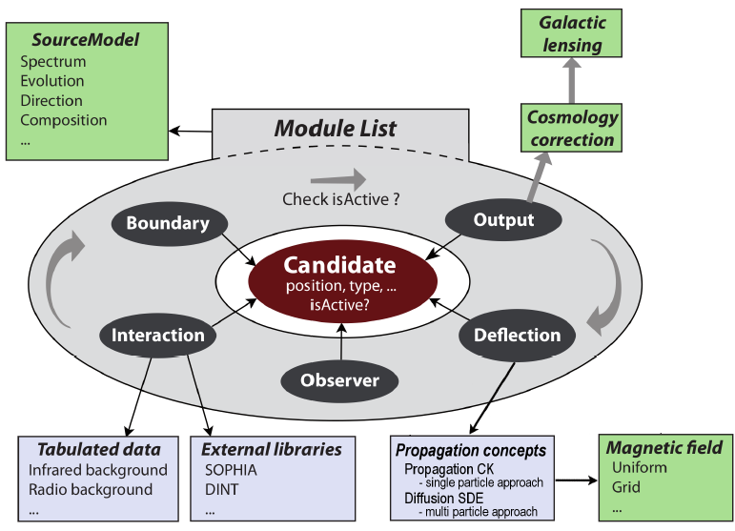
CRPropa
Batista et al. (2016)
Fig 1. The modular structure makes it easy to extend CRPropa 3.

Slide 4
Propagation Models
Singleparticle
picture
Solving the equation of motion
Backtracking and Reweighting of results is possible
Multiparticle
picture
Solving the transport equation
Collective behavior, e.g. advection and diffusion is easy to implement
Numeric
Physics
Stochastic Differential Equations

Slide 5
Parker Transport Equation
Spatial Diffusion
Adiabatic cooling
Advection
Momentum Diffusion
Sources

Slide 6

Spatial Diffusion and Advection
Simple Example:
Homogeneous background field
Anisotropic diffusion with respect to the background field:$0.1 κ_{∥}=κ_{⊥}$
Wind in $x$-direction
Fig 2. Spatial distribution of 10,000 pseudo-particles positions for anisotropic diffusion and advection.

Slide 7
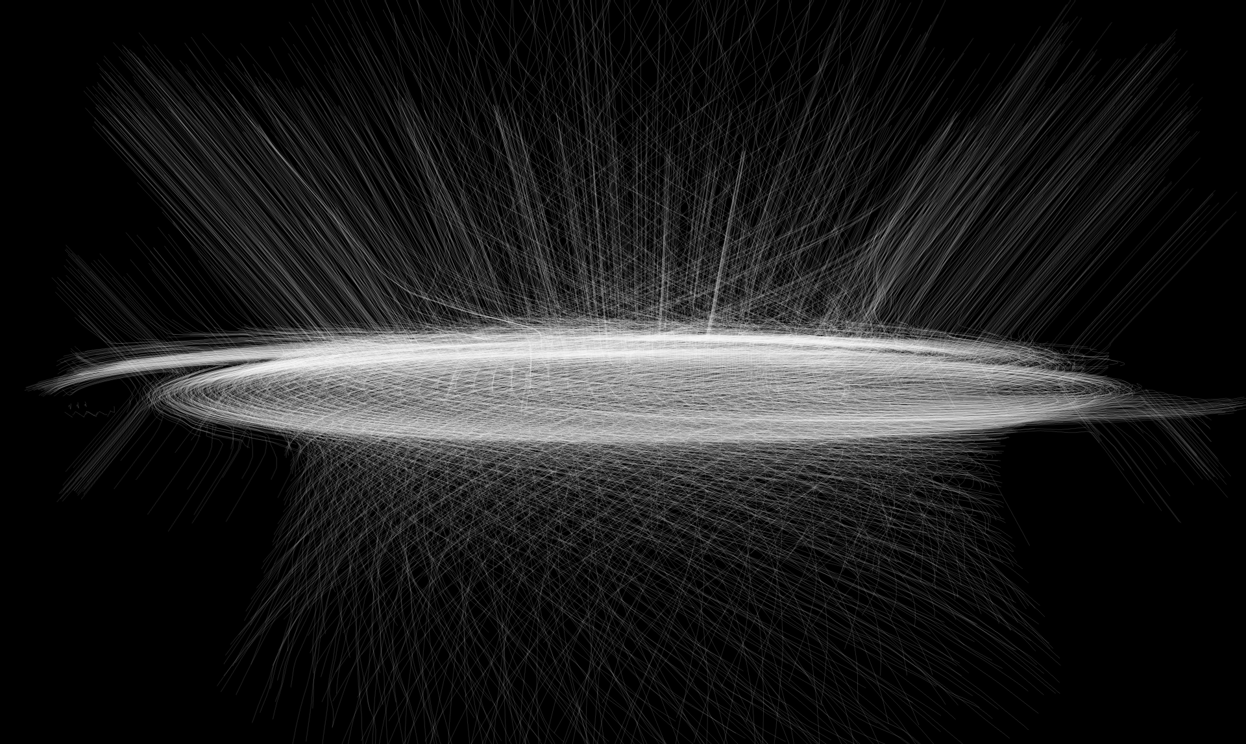
The Laboratory
Jansson and Farrar (2012)
Fig 3. The coherent, regular component of the Galactic Magnetic field which is used as the background field in our simulations.

Slide 8
Example – Galactic Termination Shock
Acceleration is possible up to ${E=10}^{16}eV$ (see Bustard et al. 2016).
Acceleration is possible up to 〖𝐸=10〗^16 𝑒𝑉 (see Bustard et al. 2016).
Isotropic (?) flux in the „knee“ to „ankle“ region.
Build a model in CRPropa to find out.
Possible explanation for the transition region
Can CRs diffuse back to the Galactic disk?

Slide 9
Model Assumption
Symmetry
Radial
Diffusion
D$∝E^{δ}$
D∝𝐸^𝛿
Advection
$$v_{0}=600\frac{km}{s}$$
𝑣_0=600 𝑘𝑚/𝑠
$$D_{0}={10}^{28}\frac{cm^{2}}{s}$$
𝐷_0=〖10〗^28 (𝑐𝑚^2)/𝑠
$$r_{0}=250 kpc$$
𝑟_0=250 𝑘𝑝𝑐
Boundaries
$$r_{obs}=10 kpc$$
𝑟_𝑜𝑏𝑠=10 𝑘𝑝𝑐
$$r_{loss}=350 kpc$$
𝑟_𝑙𝑜𝑠𝑠=350 𝑘𝑝𝑐
Simulation details
$$N={10}^{7}−8.5⋅{10}^{8}$$
𝑁=〖10〗^7−8.5⋅〖10〗^8
$$τ_{CPU}=O\left(10\right)h−O\left(1000\right)h$$
𝜏_𝐶𝑃𝑈=𝑂(10)ℎ−𝑂(1000)ℎ

Slide 10
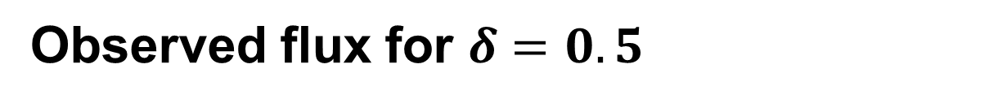
Observed flux for $δ=0.5$
Fig 5. CR Flux for a 100 Myr shock.

Slide 11
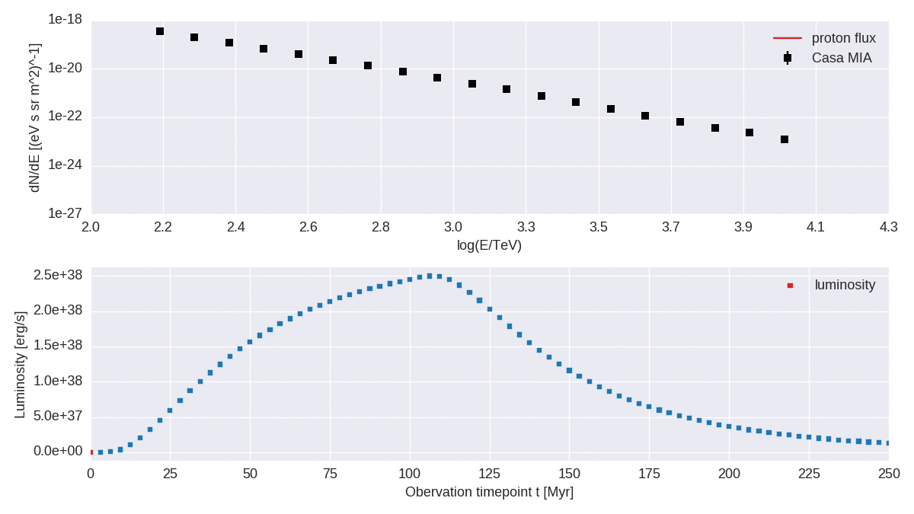
Observed flux for $δ=0.5$

Slide 12
Summary
Observation challenge theoretical models
Complex anisotropic (space dependent) diffusion tensors, advection and interaction models are needed
CRPropa 3.1 uses anisotropic diffusion tensors in arbitrary background fields. Simple advection models are also included.
CRPropa 3.1 uses SDE and is therefore trivial to parallelize on huge Clusters
Not yet a finished ‚Out-of-the-box-solution‘ like GALPROP, …
…but easy to extend to fit your needs.

Slide 13
Outlook
Quantitative investigation of anisotropy, composition and spectrum with realistic magnetic field/diffusion tensor
Realistic neutrino and gamma maps for the Galaxy (once hadron-hadron interactions have been implemented)
Investigation of Fermi bubbles and WMAP haze possible, with precise calculation of implied neutrino signatures

Slide 14
Backup

Slide 15
Observation

Slide 16
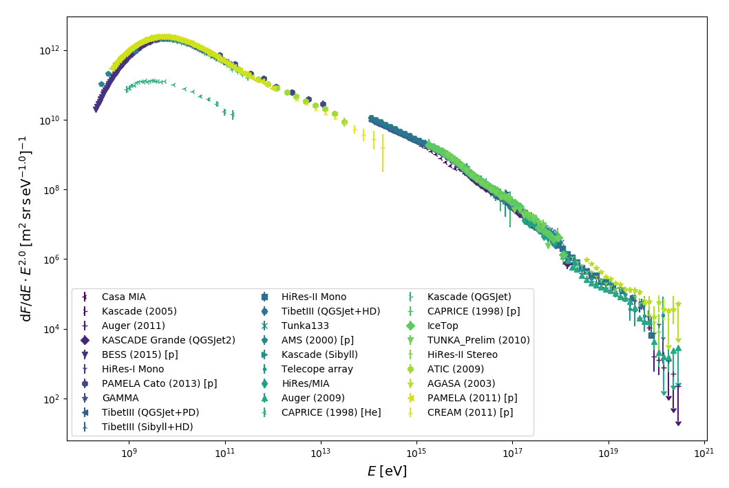
Observation – Energy Spectrum
github.com/lukasmerten/CosmicRayDataBase
Fig 2. The energy spectrum of Cosmic rays.

Slide 17
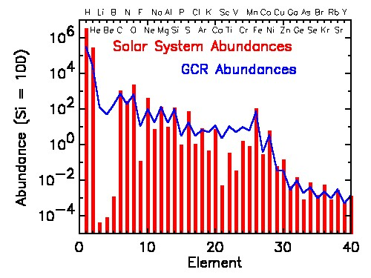
Observation - Composition
NASA. Imagine the Universe. access: (23.02.2015)
Fig 3. Boron to carbon ratio as a measure for the column depth.

Slide 18
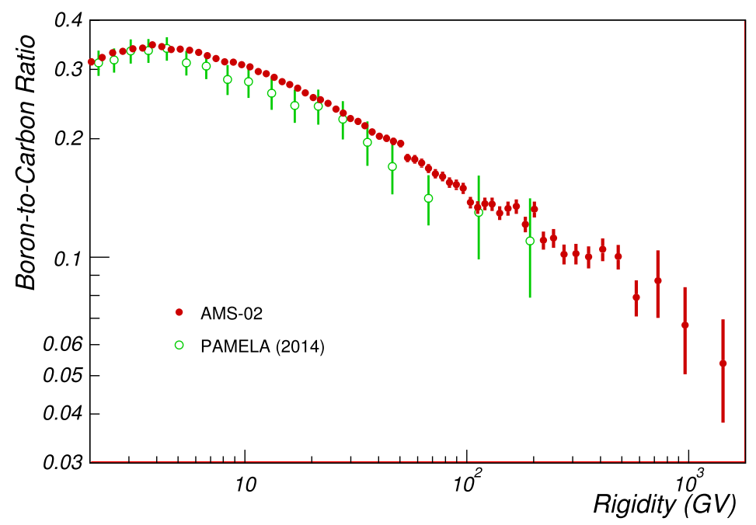
Observation – B/C ratio
Oliva, A. for AMS-02 (2015)
Fig 3. Boron to carbon ratio as a measure for the column depth.

Slide 19
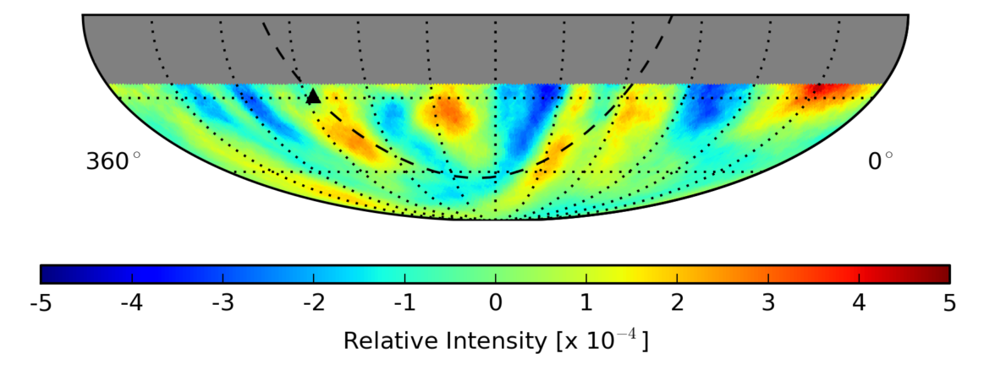
Observation – Arrival Directions
IceCube coll. (2017)
Fig 4. Cosmic ray arrival anisotropy at a median energy E=20 TeV after the subtraction of the best fit dipole and quadrupole.

Slide 20
SDE Mathematics

Slide 21

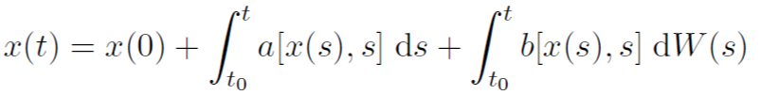

Stochastic Differential Equation
Langevin Equation
Stochastic Integral Equation
These equations can be treated mathematically consistently.
Numerical algorithm to solve them are available.

Slide 22



From Fokker-Planck Equ. to SDE
General Fokker-Planck Equation
Corresponding Stochastic Differential Equation
Calculation of stochastic tensor D
In the case of decoupled momentum und spatial operators
And diagonal diffusion tensor

Slide 23
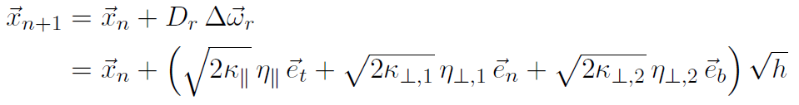
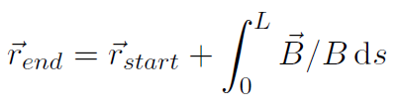
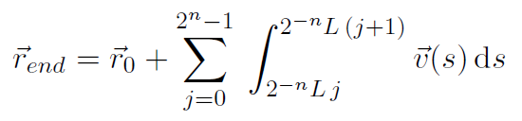
Integration scheme
Magnetic field line implementation (e.g. JF12 field) is not trivial.
Calculation of the local trihedron is the crucial part.
Use adaptive field line integration → e.g. Cash-Karp algorithm.

Slide 24
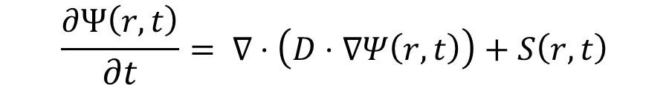
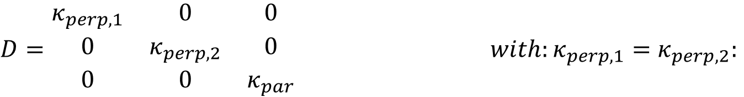

SDE and FPE
Ito’s lemma leads to equivalence between stochastic differential equation (SDE) and Fokker-Planck transport equation (FPE)
$$\frac{∂Ψ\left(r,t\right)}{∂t}= ∇⋅\left(D⋅∇Ψ\left(r,t\right)\right)+S\left(r,t\right)$$
$$dr=A dt+B dω with:dω=η\sqrt{dt}$$
$$B=\sqrt{2⋅D,} A=0$$
Diffusion tensor is diagonal in frame with $\vec{B}=B_{0}⋅\vec{e_{z}}$
$D=\begin{matrix}κ_{perp, 1} & 0 & 0 \\ 0 & κ_{perp, 2} & 0 \\ 0 & 0 & κ_{par}\end{matrix}$ $with:κ_{perp, 1}=κ_{perp, 2}:$

Slide 25
CRPropa

Slide 26
CRPropa: Interactions
Nucleons
ElectronPairProduction (Bethe Heitler)
PhotoPionProduction
PhotoDisintegration
Electro-Magnetic
EMPairProduction
InverseCompton-Scattering
Nuclear Decay
General
Redshift (accounts for adiabatic energy loss)
SynchrotronRadiation
EMDoublePair-Production
EMTripletPairProduction

Slide 27
Performance

Slide 28
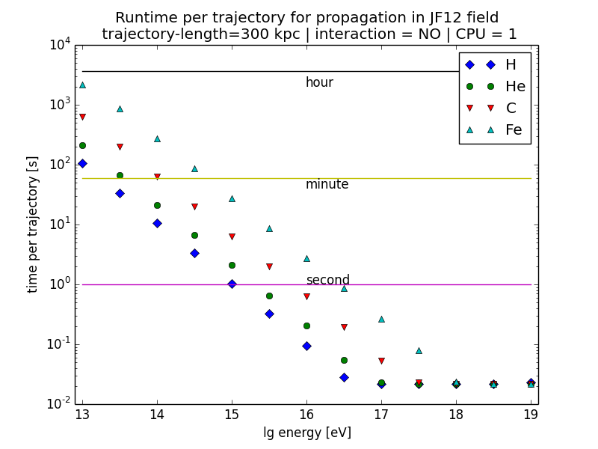
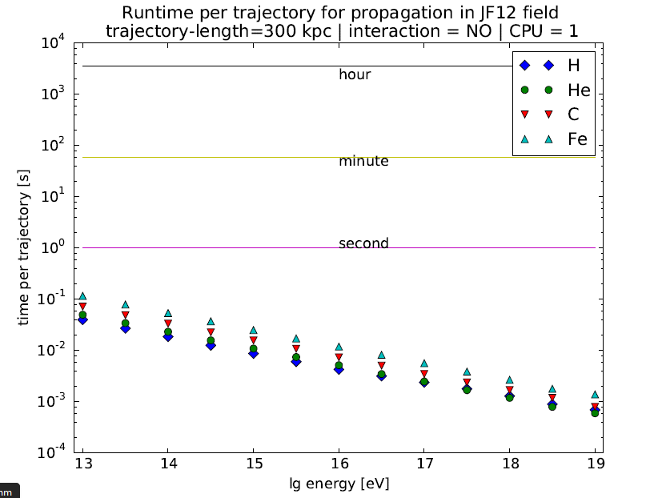
Performance
Fig 15: Comparison of computation times. Conventional CRPropa3 (left) and propagation with the DiffusionModule (right)

Slide 29
Problems with the JF12-field

Slide 30
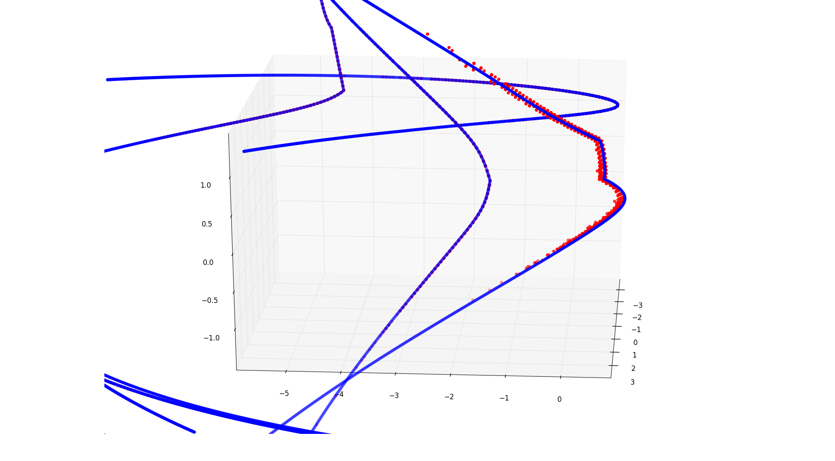
Problem: Fixed step length
Fig 19: Magnetic field line (blue) and end position after diffusion process (red dots).

Slide 31
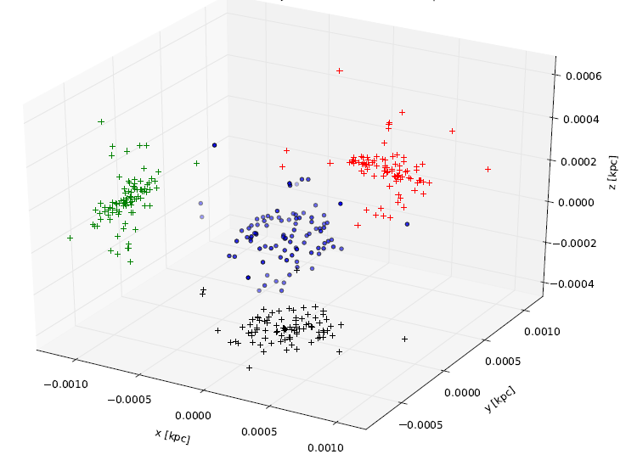
Deviation vectors
Fig 20: Ninty smallest deviation vectors for E=10TeV

Slide 32
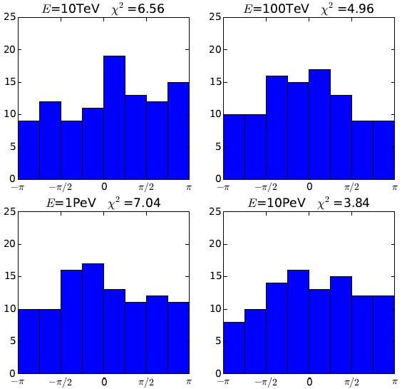
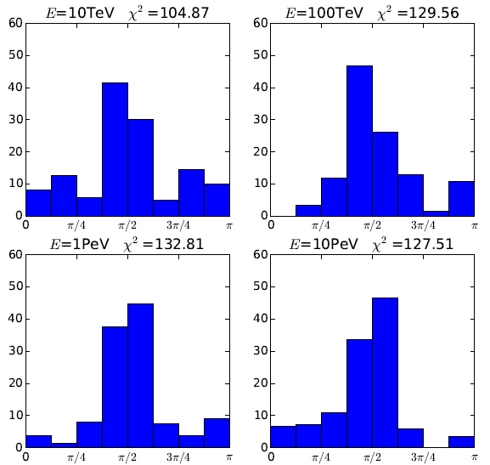
Deviation from field line II
Fig 21: Deviation from ideal trajectory is uniformly distributed in Φ.
Fig 22: Deviation from ideal trajectory peaks around the plane perpendicular to magnetic field line.

Slide 33
Validation

Slide 34
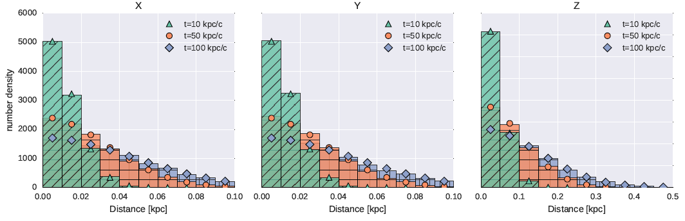

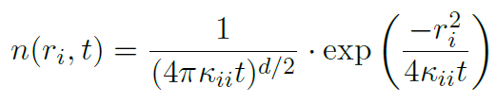
Validation I
First test of the diffusion in a homogeneous magnetic background field.
A simple anisotropic diffusion tensor is implemented.
Fig 7. The algorithm reproduces the expected analytic results (simulation-barplot, theory-solid lines).

Slide 35

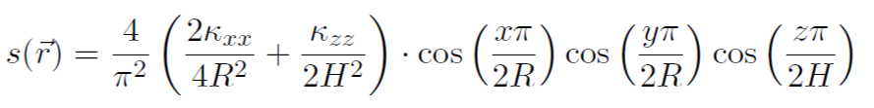


Stationary Test I
Stationary equation of anisotropic diffusion
Not possible?
Source term
Indirect solution

Slide 36
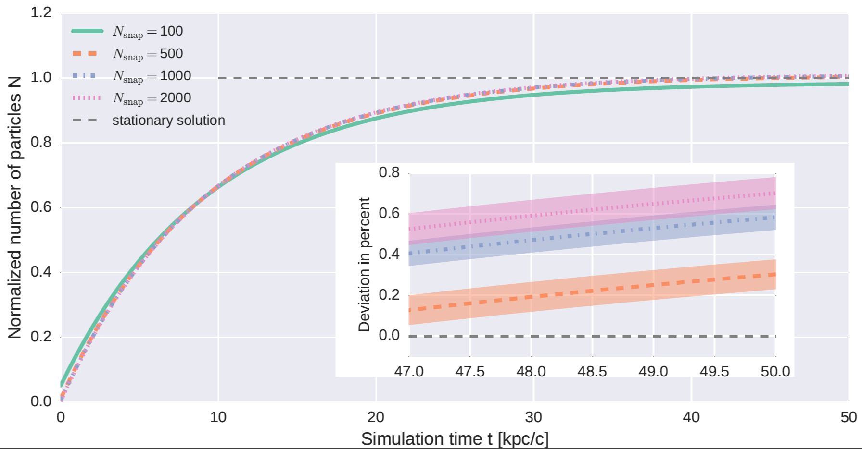
Stationary Test II
Fig 8. Total number density depending on maximum integration time for different numbers of snapshots.

Slide 37
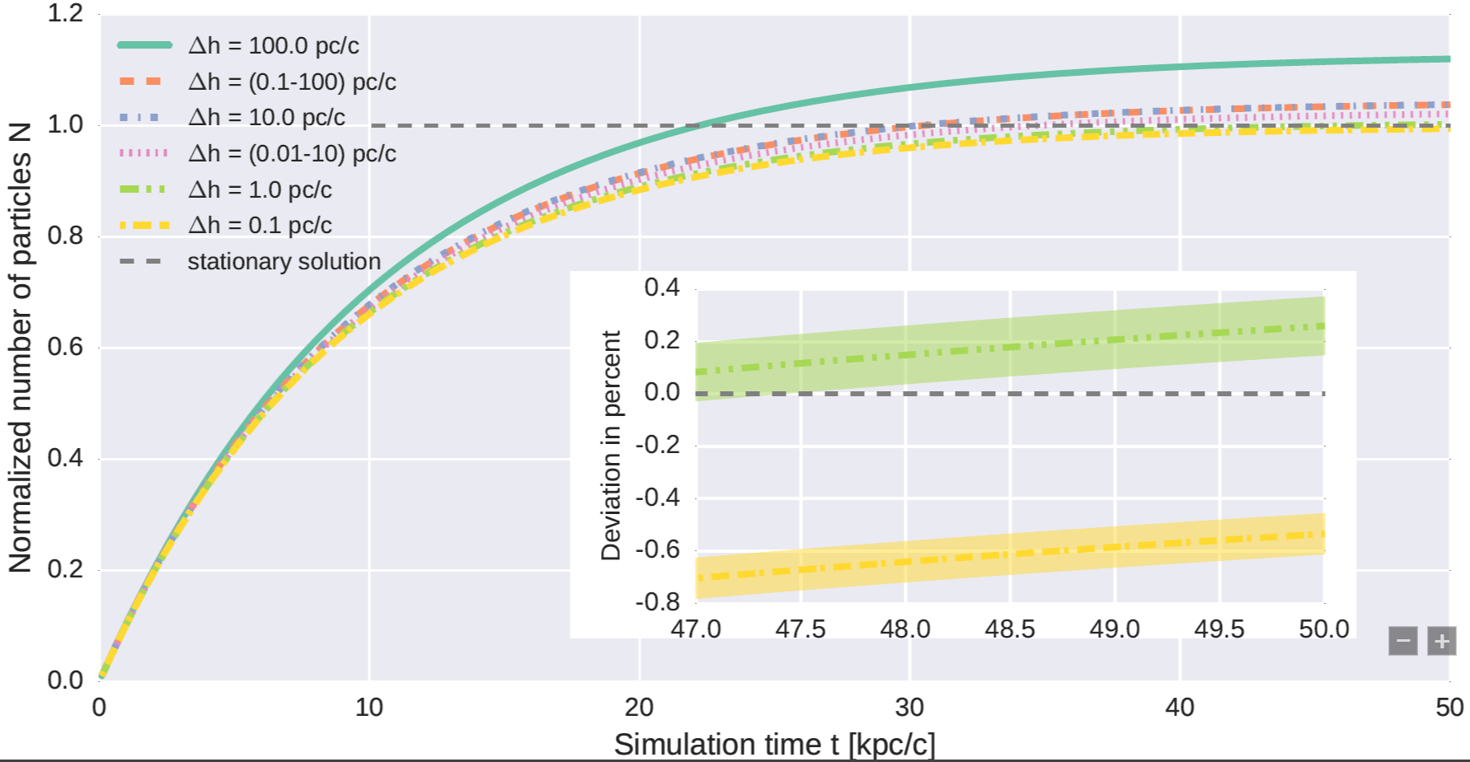
Stationary Test III
Fig 25. Total number density depending on maximum integration time for different integration time steps.

Slide 38
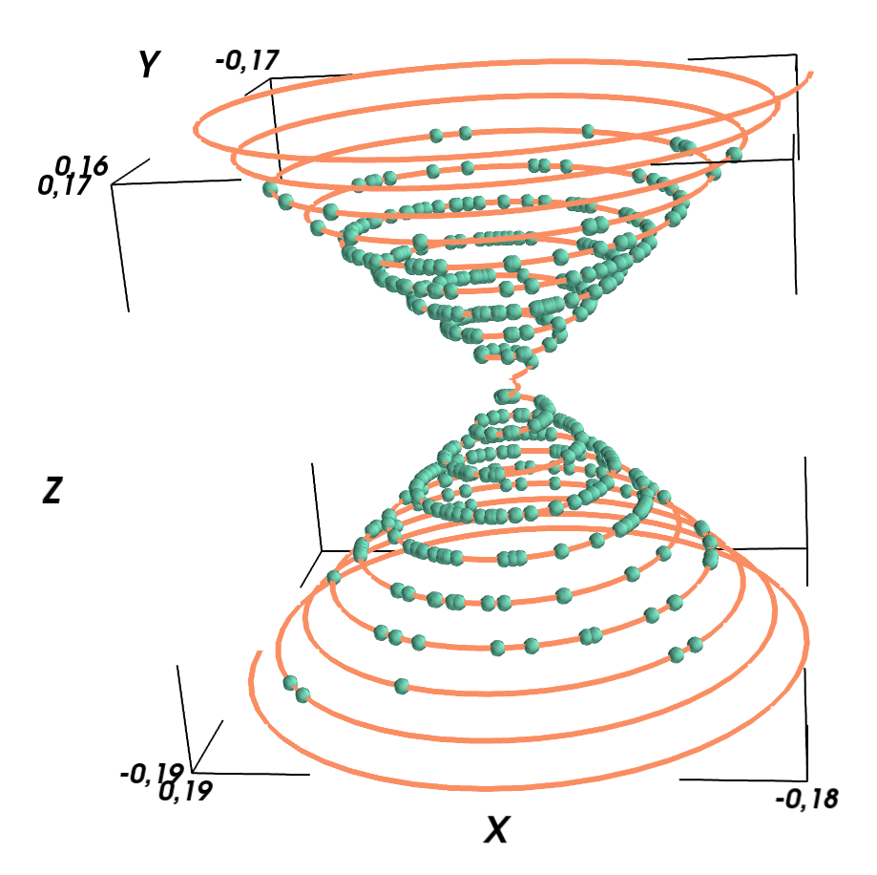
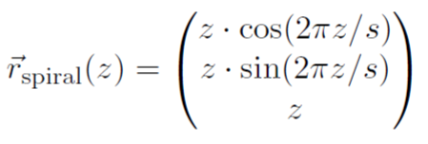
Validation IIa
We test the accuracy of the algorithm in an artificial situation.
A spiral with varying radius is used as the magnetic field line.
The distance to the field line after the diffusion is taken as a measure for the algorithm accuracy.
Fig 9: Example of a spiral field line and a sample of end positions.

Slide 39
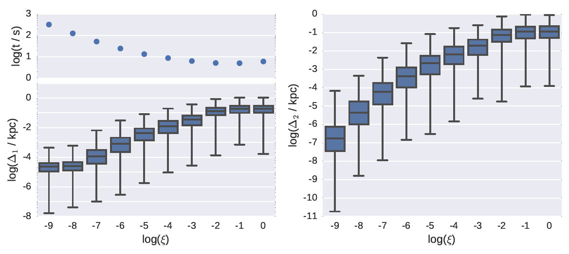
Validation IIb
Fig 10: Results for the accuracy test. The algorithm allows a user chosen precision for a pure parallel diffusion.

Slide 40
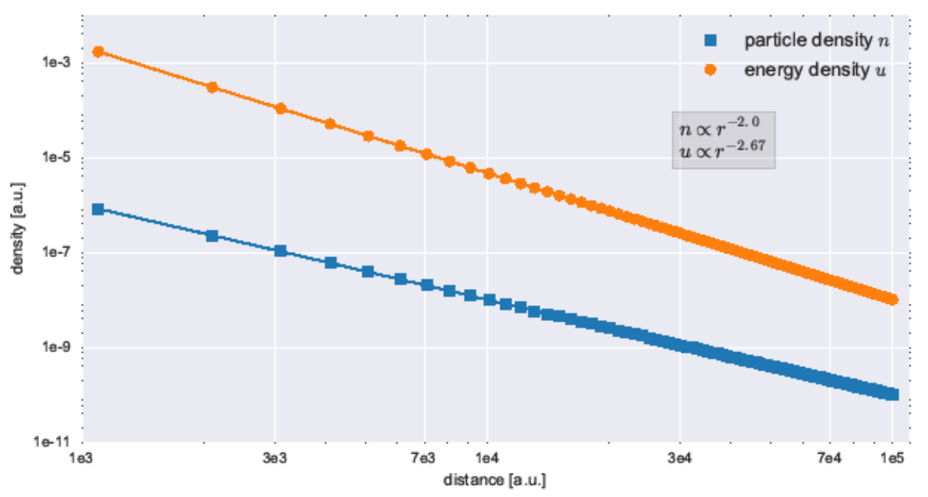
Adiabatic Cooling
Physics
Energy loss or gain, depending on the sign of the wind divergence.
Implementation
Simple Euler-Forward in momentum
Linearly proportional to wind divergence
Caused by adiabatic expansion or compression of the plasma
Shocks not possible CRPropa
Fig 4. Particle and energy density for advective test case.

Slide 41
Examples

Slide 42
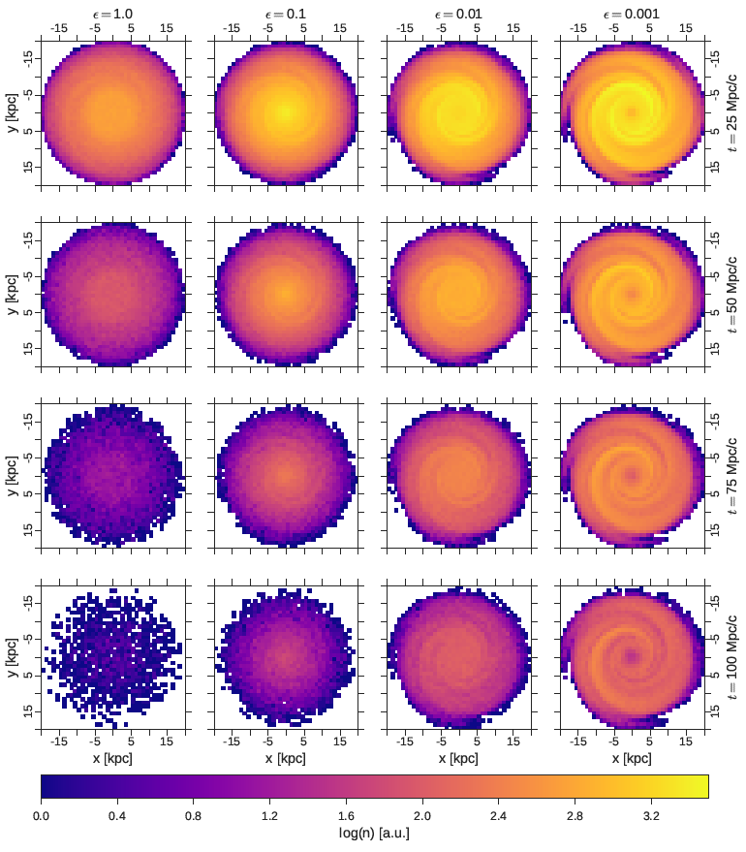
First applications – Diffusion tensor
Magnetic field structure becomes clearly visible for strong parallel diffusion.
Highest density at Galactic center for stron perpendicular diffusion
Differences in loss time become visible.
Fig 11: Density inside the Galactic disc.

Slide 43
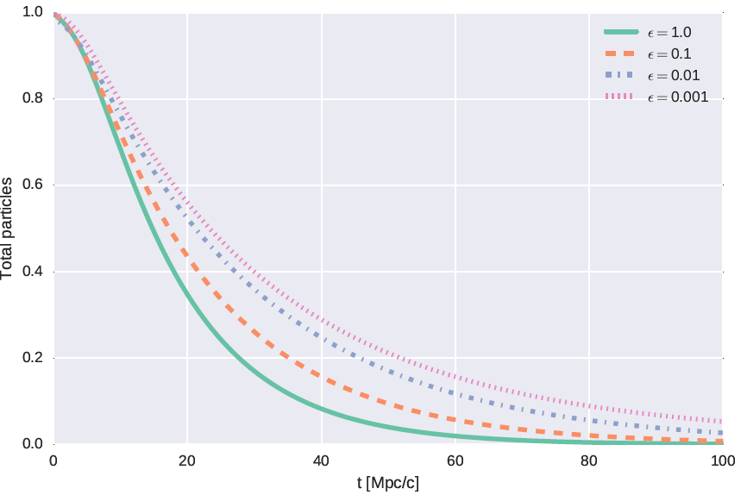
First applications – Diffusion tensor
Fig 12: Time Evolution of the total particle number.

Slide 44
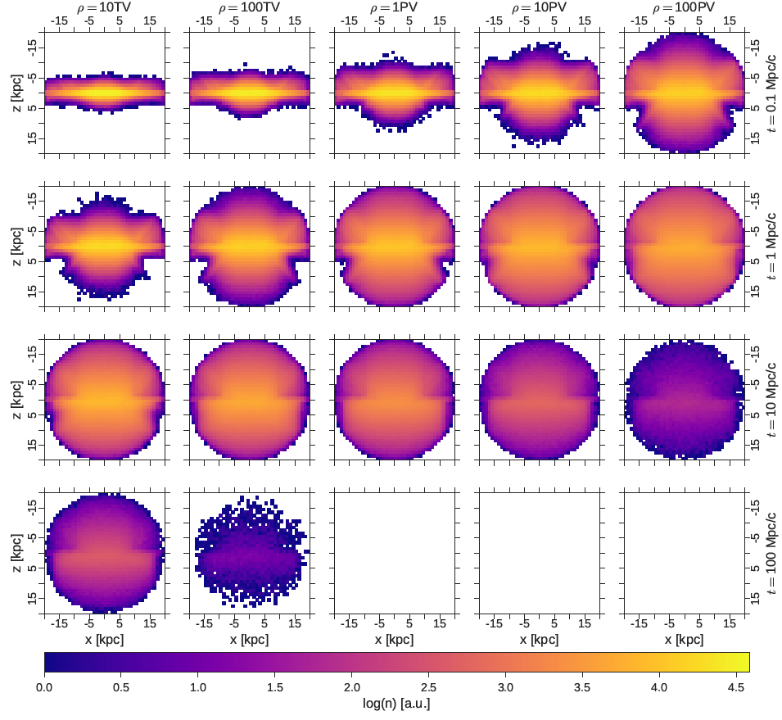
First applications – Rigidity
Outflow along the magnetic field lines is visible
Differences in loss time depending on rigidity is huge
Structures are washed out with time
Fig 13: Projected density inside simulation volume.

Slide 45
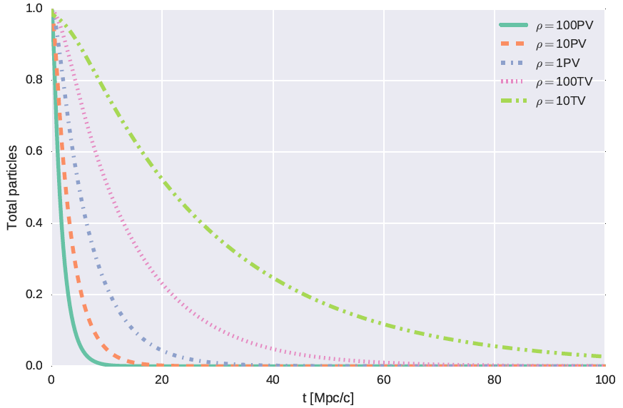
First applications – Rigidity
Fig 14: Time Evolution of the total particle number.

Slide 46
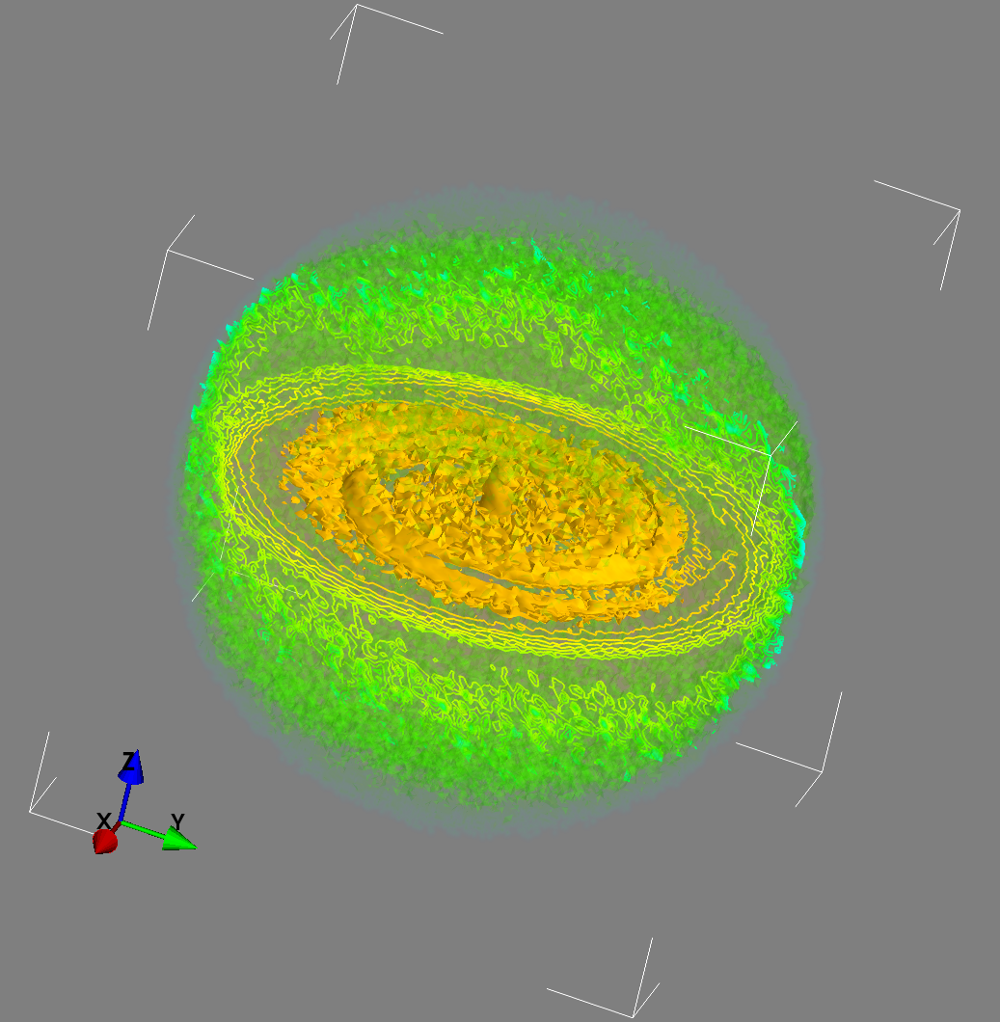
Continuous source
Fig 24: Cosmic ray density for continuous uniform emission inside the Galactic disc.

Slide 47
Extension

Slide 48
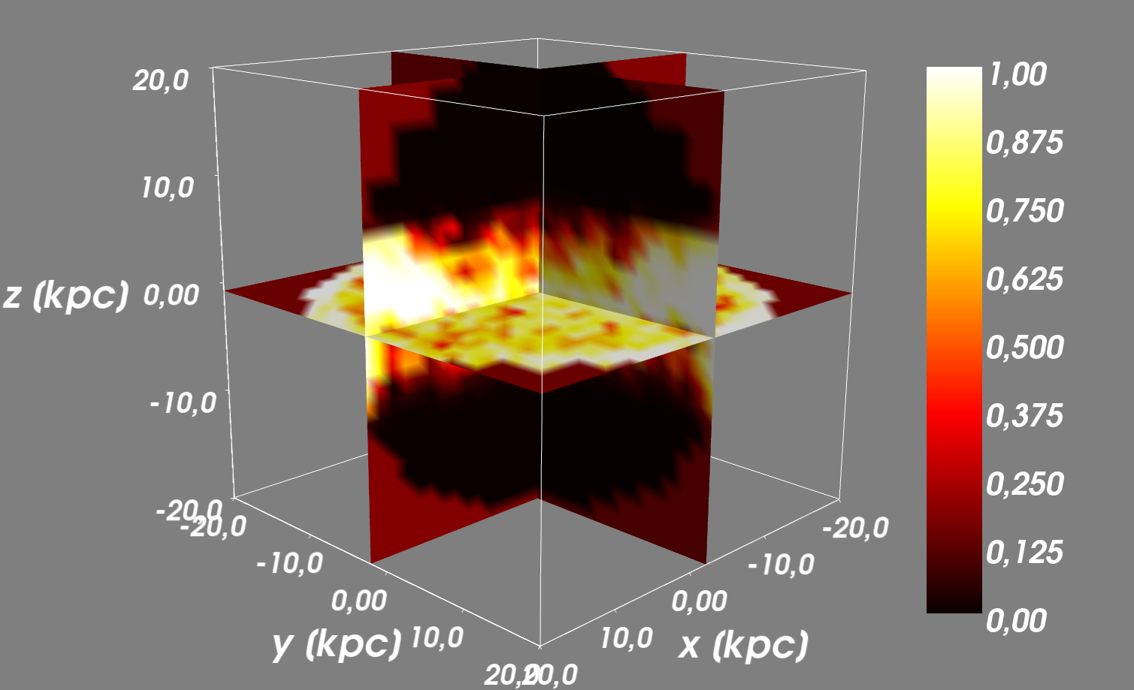
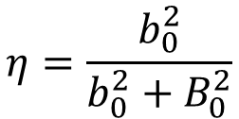
Outlook
$$η=\frac{b_{0}^{2}}{b_{0}^{2}+B_{0}^{2}}$$
Use the local turbulence ratio η with:
to calculate diffusion tensor.
Fig 23: The turbulence ratio of the JF12 field.

Slide 49
Competitors

Slide 50
Comparison of Tools
Tab. 1: Popular Propagation Programs
Name | Propa-gation | Diffusion | Integration | Inter-action | Remarks | Cite
GALPROP | Trans. Equ. | Scalar | Grid (Crank Nicolson) | Yes | Quasi stand. | Strong et al. (2011)
DRAGON 2 | Trans. Equ. | 3dim anisotr. | Grid | Yes |  | Evoli et al. (2016)
PICARD | Trans. Equ. | 3dim anisotr. | Grid | Yes | Dedicated stat. Solver | Kissmann et al. (2014)
CRPropa 3 (PropagationCK) | Equ. of Motion | No | Cash Karp | Partly | UHECR | Batista et al. (2016)
CRPropa 3.1 (DiffusionSDE) | Trans. Equ. | 3dim const. Eigenvalues | SDE adaptive | Partly | Arbitrary magn. field | Merten et al. (t.b.s.)
 | Trans. Equ. | Fully anisotropic | SDE Euler-Mayurama | No |  | Koppet al. (2011)

