Slide 1
Empirical Determination of Dark Matter Velocity Distribution
Next week!
Lina Necib, MIT
Based on 1704.04499 & 1708.XXXX
In collaboration with Jonah Herzog-Arbeitman and Mariangela Lisanti
Notes:
----- Meeting Notes (8/9/17 23:00) -----
Hi! I am very excited to tell you today about our new results on how we empirically determined the velocity distribution of dark matter. This work has been done in collaboration with Jonah and Mariangela at Princeton.

Slide 2
Empirically Determined Velocity Distribution of DM!
Notes:
----- Meeting Notes (8/9/17 23:00) -----
We do not have much time, so let's get straight to the chase. What you should remember from my talk is that we have a new velocity distribution of dark matter intown, and that's what we should be using! :D
More precisely, I will tell you how we find a population of old stars that trace the same kinematics as dark matter, and used those sto get the velocity distribuiton of dark matter.
You might wonder, why should you care.

Slide 3
Empirically Determined Velocity Distribution of DM!
This makes the bounds on dark matter in direct detection experiments weaker at masses of ~10 GeV!
Notes:
----- Meeting Notes (8/9/17 23:00) -----
This actually weakens the dark matter limits in direct detection experiments at low masses (around ~10 GeV), and it does so pretty significantly!

Slide 4
From Simulations:
Metal-Poor Stars trace the velocity of Dark Matter.
From Gaia DR1:
We get the local velocity distribution of Metal-Poor Stars.
Therefore:
We empirically obtain the Dark Matter velocity distribution.
Notes:
----- Meeting Notes (8/9/17 23:00) -----
So, the logic is this:
from simulations, we found metal poor stars (which I will explain what those are in the next slide), trace the velocity distribution fo dark matter.
From gaia, we got the velocity distribution of these stars
THEREFORE, we get the velocity distribution of dark matter.

Slide 5
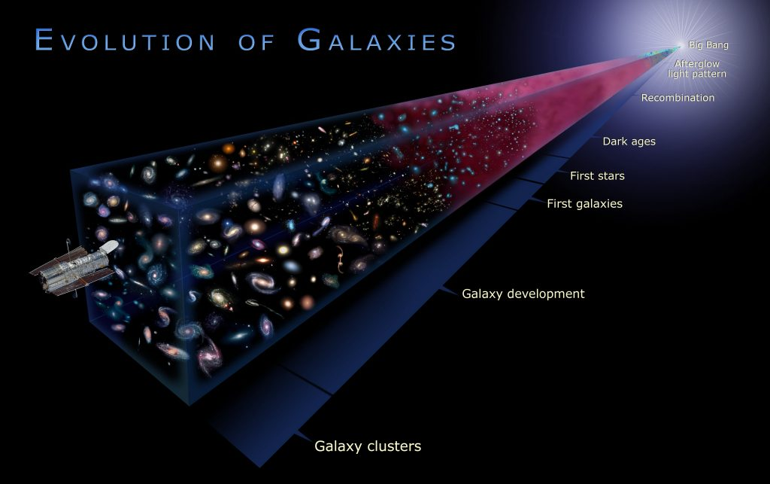
More Elements
Older stars are metal poor stars!
Means that this star has 1/10 of the iron fraction of the Sun.
Notes:
----- Meeting Notes (8/3/17 12:59) -----
change this to an equal sign
----- Meeting Notes (8/9/17 23:00) -----
So what are these metal poor stars:
Well, the universe started at high temperatures, with quarks, gluons, etc... and as it cools down, heavier elements were forming. When the first stars were born, we "more or less" just had hydrogen and helium around. Of course, in astro anything beyond helium is a metal, so these stars are metal poor stars.
Just to understand the notation, we compute the metallicity as a log of metal fraction with respect to the SUN, so for example, [Fe/H] = -1 means that this star has a tenth of the iron fraction of the Sun.

Slide 6
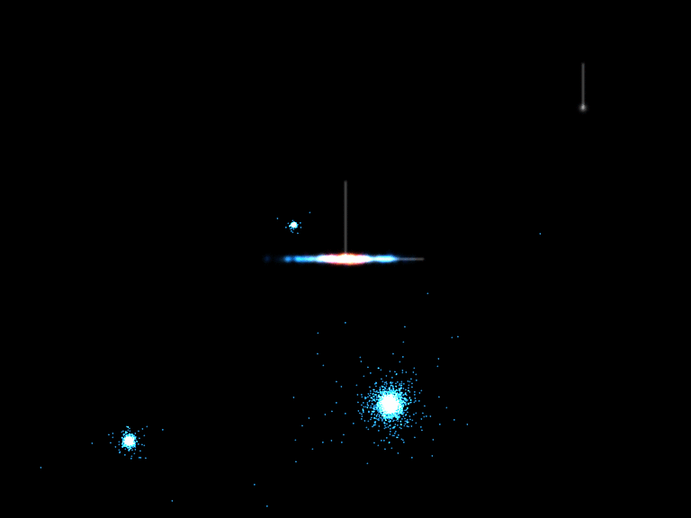
These old stars merged with our Milky Way along with the Dark Matter!
Notes:
----- Meeting Notes (8/9/17 23:00) -----
so what about these stars.
Today, we see things that we call streams, which are ripped group of stars that is slowly merging with our galaxy, just like this one.
The formation history of our halo is through more and more of these mergers. The stars that formed our halo earlier on came with some dark matter for the ride, and therefore, these actually share the same kinematics.

Slide 7
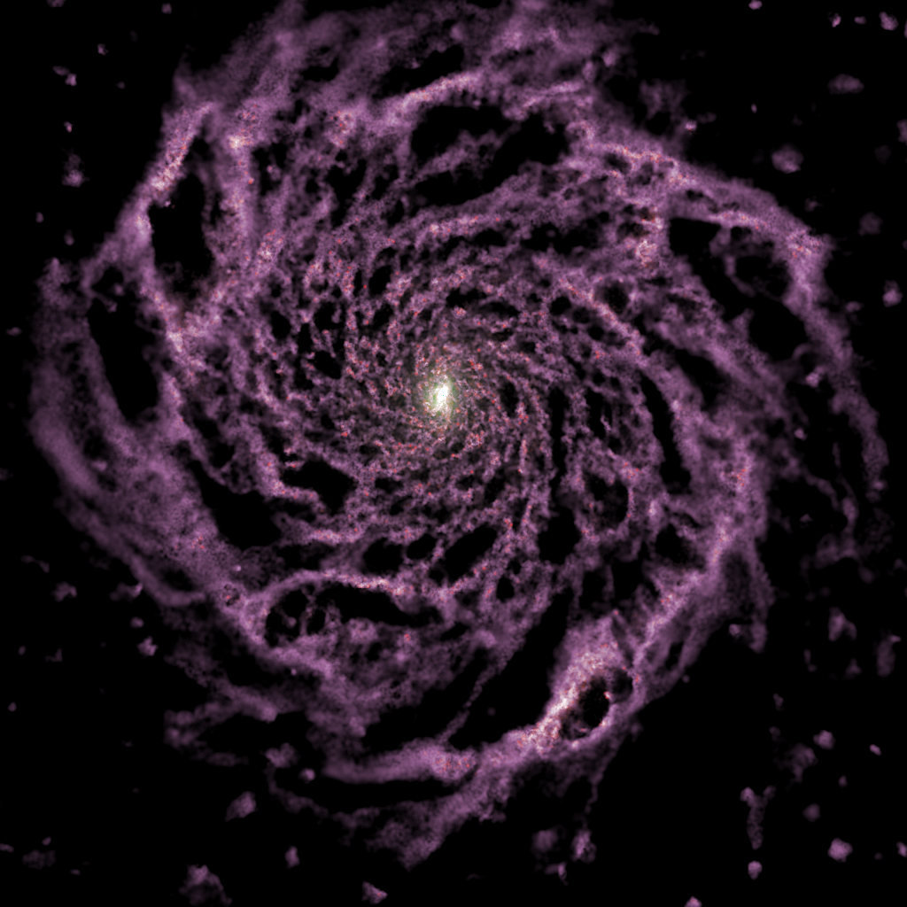
Eris Simulation
This is being further studied in other simulations.
Notes:
----- Meeting Notes (8/9/17 23:00) -----
To check that, we looked at the Eris simulation, which is a milky way simulation, and found that indeed as you cut more and more harshly on the metallicity, the distribution of the velocity of the stars approaches that of the dark matter.

Slide 8
Where do we find these Metal Poor Stars?
Notes:
----- Meeting Notes (8/9/17 23:00) -----
so we are these stars you might wonder.

Slide 9
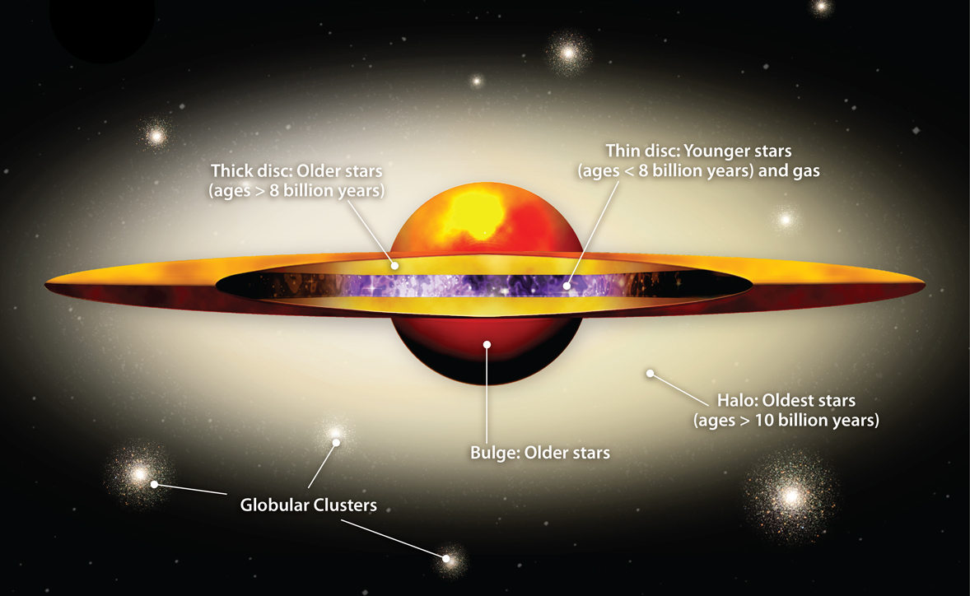

Notes:
----- Meeting Notes (8/9/17 23:00) -----
Well, this is our milky way, and this is where we are. There are many components to the milky way, but the older stars that formed along with our dark matter halo are these stars.

Slide 10
Notes:
----- Meeting Notes (8/9/17 23:00) -----
We call this the stellar halo.

Slide 11
Gaia DR1: Lindergren et al. (2016)
RAVE heliocentric velocities: Kunder et al. (2017)
TGAS (Tycho-Gaia) proper motions: Michalik et al.( 2015)
RAVE-on chemical properties: Casey et al. (2016)
Distances: McMillan et al. (2017)
Notes:
----- Meeting Notes (8/3/17 12:59) -----
what does RAVE stand for?
----- Meeting Notes (8/9/17 23:00) -----
Now we use data to actually pick out these stars.
We are using the first gaia data release, which combines different catalogs: So we got the heliocentric velocities from RAVE, the proper motions from TGAS, the chemical properties (the iron fraction) from RAVE-on and the distances from the McMillan et al analysis published a month ago.
Putting all of this together, we get this map of stars with their metallicity color coded.
As you might remember, we wanted the halo stars.

Slide 12
Cut on |z|
Cut on [Fe/H]
Gaia DR1: Lindergren et al. (2016)
RAVE heliocentric velocities: Kunder et al. (2017)
TGAS (Tycho-Gaia) proper motions: Michalik et al.( 2015)
RAVE-on chemical properties: Casey et al. (2016)
Distances: McMillan et al. (2017)
Notes:
----- Meeting Notes (8/9/17 23:00) -----
to do that, we cut on |z|, and on the metallicity.
You might notice these beautiful stars, but let's get back to these a little later :-)

Slide 13
Kinematic Outliers
Stellar Halo
Notes:
----- Meeting Notes (8/3/17 12:59) -----
explain why no disk contamination
----- Meeting Notes (8/9/17 23:00) -----
So, to understand the kinematics of our stars, we try to fit them in two sets: the stellar halo, and the kinematic outliers.

Slide 14
We use a Markov Chain Monte Carlo to find the best fit parameters for the halo, and any kinematic outliers.
Kinematic Outliers
Stellar Halo
Notes:
----- Meeting Notes (8/9/17 23:00) -----
we use an MCMC to find the best fit parameters for these two groups, as well as the relative fraction between the two groups.

Slide 15
3 Dimensional Gaussian
Kinematic Outliers
Stellar Halo
3 Dimensional Gaussian
Notes:
----- Meeting Notes (8/9/17 23:00) -----
we model each group with a 3 dimensional gaussian function in velocity, in spherical coordinates.

Slide 16
Kinematic Outliers
Best Fit Halo
Notes:
----- Meeting Notes (8/9/17 23:00) -----
We the best fit parameters fo the halo here in the vr, vtheta, vphi space. On the right side here, we have the probability associated with each star to belong to the halo. You can see that we identified 4 of these stars with pretty low probability to be in the halo. We think these are kinematic outliers, and might be hint of substructure ;-) (add this!!!!)

Slide 17
Hints of dark matter substructure?
Kinematic Outliers
Best Fit Halo
Notes:
----- Meeting Notes (8/9/17 23:00) -----
We the best fit parameters fo the halo here in the vr, vtheta, vphi space. On the right side here, we have the probability associated with each star to belong to the halo. You can see that we identified 4 of these stars with pretty low probability to be in the halo. We think these are kinematic outliers, and might be hint of substructure ;-) (add this!!!!)

Slide 18
Local Velocity Distribution
**Drum Roll**
Notes:
----- Meeting Notes (8/9/17 23:00) -----
Now, the velocity distribution (which also was in the first slide :D)

Slide 19
Posterior Distribution of |v|
Notes:
----- Meeting Notes (8/9/17 23:00) -----
Here it is. This is the posterior distribution of the norm of |v|. We worked out two analyses, [Fe/H]<-1.5 and -1.8, and theu are consistent with each other.

Slide 20
Posterior Distribution of |v|
The Maxwell Boltzmann distribution we are taught at school!
Notes:
----- Meeting Notes (8/9/17 23:00) -----
the interesting this is that this is the standard halo model, and the maxwell boltzmann distribution we are taught at school!!!

Slide 21
Posterior Distribution of |v|
The Maxwell Boltzmann distribution we are taught at school!
6-sigma discrepancy between the two distributions!
Notes:
----- Meeting Notes (8/9/17 23:00) -----
More explicitely, these distributions are 6 sigma discrepant!!!

Slide 22
Direct Detection Rate
The DM velocity distribution is part of the computation of the expected direct detection rate.
Astrophysical Parameters:
Dark matter density, velocity.
Particle Physics Parameters:
Scattering cross section, mass of the dark matter.
Experimental Parameters:
Form factors, mass of the nucleus (also experimental mass/exposure should be added)
Notes:
\frac{dR}{dQ} = \frac{\sigma_0 {\color[rgb]{1.000000,0.000000,0.000000}\rho_0}}{\sqrt{\pi} {\color[rgb]{1.000000,0.000000,0.000000}v_0} m_\chi m_r^2} F^2(Q) {\color[rgb]{1.000000,0.000000,0.000000}T(Q)}
Vmin = sqrt{Q mN/(2 mu^2)}
----- Meeting Notes (5/18/17 12:06) -----
More explicitely, the detection rate is given as follows: where there are 3 sets of parameters:
astrophysical parameters in red, that depend on the local dark matter density, as well as the dm velocity,
particle physics scenario, such as the scattering cross section (which is basically the probability that dark matter interacts with our experiment) as well as the mass of the dark matter
and finally some experimental features such as the type of material that the experiment is based on
----- Meeting Notes (8/9/17 23:00) -----
In terms of direct detection rate:
The expected rate depends on astrophysics, particle physics, and the experimental set up.

Slide 23
Direct Detection Rate
The DM velocity distribution is part of the computation of the expected direct detection rate.
v_{min} depends on the experimental threshold, and the dark matter mass.
Notes:
\frac{dR}{dQ} = \frac{\sigma_0 {\color[rgb]{1.000000,0.000000,0.000000}\rho_0}}{\sqrt{\pi} {\color[rgb]{1.000000,0.000000,0.000000}v_0} m_\chi m_r^2} F^2(Q) {\color[rgb]{1.000000,0.000000,0.000000}T(Q)}
T(Q) = \frac{\sqrt{\pi}}{2} v_0 \int_{v_{\text{min}}}^\infty \frac{{\color[rgb]{1.000000,0.000000,0.000000}f(v)}}{v}dv
Vmin = sqrt{Q mN/(2 mu^2)}
----- Meeting Notes (5/18/17 12:06) -----
the quantity that we will focus on is T(Q), or the velocity distribution of dark matter
this is related to the integral of the velocity distribution
You see here that we are integrating from a particular value v_min to infinity.
----- Meeting Notes (8/9/17 23:00) -----
What I will focus on is this dependence on the velocitu distribution. Vmin here depends on the threshold of the experiment and the dark matter mass. Basically for a fixed dark matter mass and a fixed experimental threshold, you will get a value for this function g(vmin)

Slide 24
In terms of Direct Detection Experiments
Notes:
----- Meeting Notes (8/9/17 23:00) -----
putting things together, for a 10 GeV mass, we find that gvmin is plotted like this (this is a log plot in terms of vmin). Althrough the two analyses are consistent with each other, we find that at v_min values higher than 200 km/s they are below the SHM curve.

Slide 25
In terms of Direct Detection Experiments
A factor of 2!
Notes:
----- Meeting Notes (8/9/17 23:00) -----
So much that this is actually a factor of 2 too low, which means that the limits that we are putting using these experiments are a factor of 2 too strong in the low mass range of dark matter.

Slide 26
First Empirical Velocity Distribution of Dark Matter
Error bars will decrease with the next Gaia releases.
Kinematic outliers sign of DM substructure?
Notes:
----- Meeting Notes (8/9/17 23:00) -----
Now let's conclude: we got a new velocity distribution for dark matter: so far the error bars are large, but they will get better with future gaia releases, and the kinematic outliers of earlier might be hints of dark matter substructure as we'll continue to study :-)

Slide 27
Thank you!

Slide 30
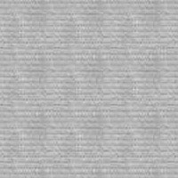
Eris
Hydrodynamic zoom in simulation of the Milky way.
Softening length 120pc.
Evolution tracked from redshift 90 to present day, though we will focus on z=0.
7 10⁶ DM particles
3 10⁶ gas particles
8.6 10⁶ star particles.
M_{DM} = 9.8 10⁴ Solar mass
M_{gas} = 2 10⁴ Solar mass
Halo mass= 8 10¹¹ Solar mass.
Notes:
----- Meeting Notes (5/18/17 12:06) -----
let me pause and tell you that we used a hydrodynamic simulation for this work, and tell you more about this simuation.
It is a zoom in simulation of the milky way, with a resolution of 120 pc, with particle masses around 10^5 solar masses, etc...
This is a close realization of the milky way, since it is able to simulate the spiral arms, and get pretty close to the mass of the halo.

Slide 31
Stellar and Dark Matter Distributions
Notes:
----- Meeting Notes (5/18/17 12:06) -----
now in this simulation, we look at the distribution of all stars in blue, as well as progresssively making stronger and stronger cuts on the metallicity of stars, adn find that the orange line follows quite closely the black distribution of dark matter. The plot on the left is for the radial component, and the one of the right is for the z component, and there is fair agreement. You might wonder, what about phi?

Slide 32
Stellar and Dark Matter Distributions
Prograde rotation found in Eris
DM
Notes:
----- Meeting Notes (5/18/17 12:06) -----
well, phi is special. First, let's look at what regular (disk) stars do. They are peaked at about 200 km/s, and that makes sense because that's the rotation of the disk. Now, looking at the orange line like earlier, we find that there is an excess for positive values over negative ones. We call that prograde rotation. Dark Matter exhibits though to a lesser extend similiar behavior. In order to understand what's going on, we can think that a dark matter/or a star particle coming in to collide with the disk. If it is already going in the direction of the disk rotation, then it preferentially gets sucked in, versus if it wass going the other way. You might worry about this behavior, but don't

Slide 33
Stellar and Dark Matter Distributions
Prograde rotation found in Eris
There is no evidence for significant prograde rotation for metal poor stars in data.
Notes:
----- Meeting Notes (5/18/17 12:06) -----
there has been no evidence of prograte rotation of metal poor stars in data. So we do not expect this to be happening in our galaxy.
Now that we're done with simulations, let's see what the world has to say

