Slide 1
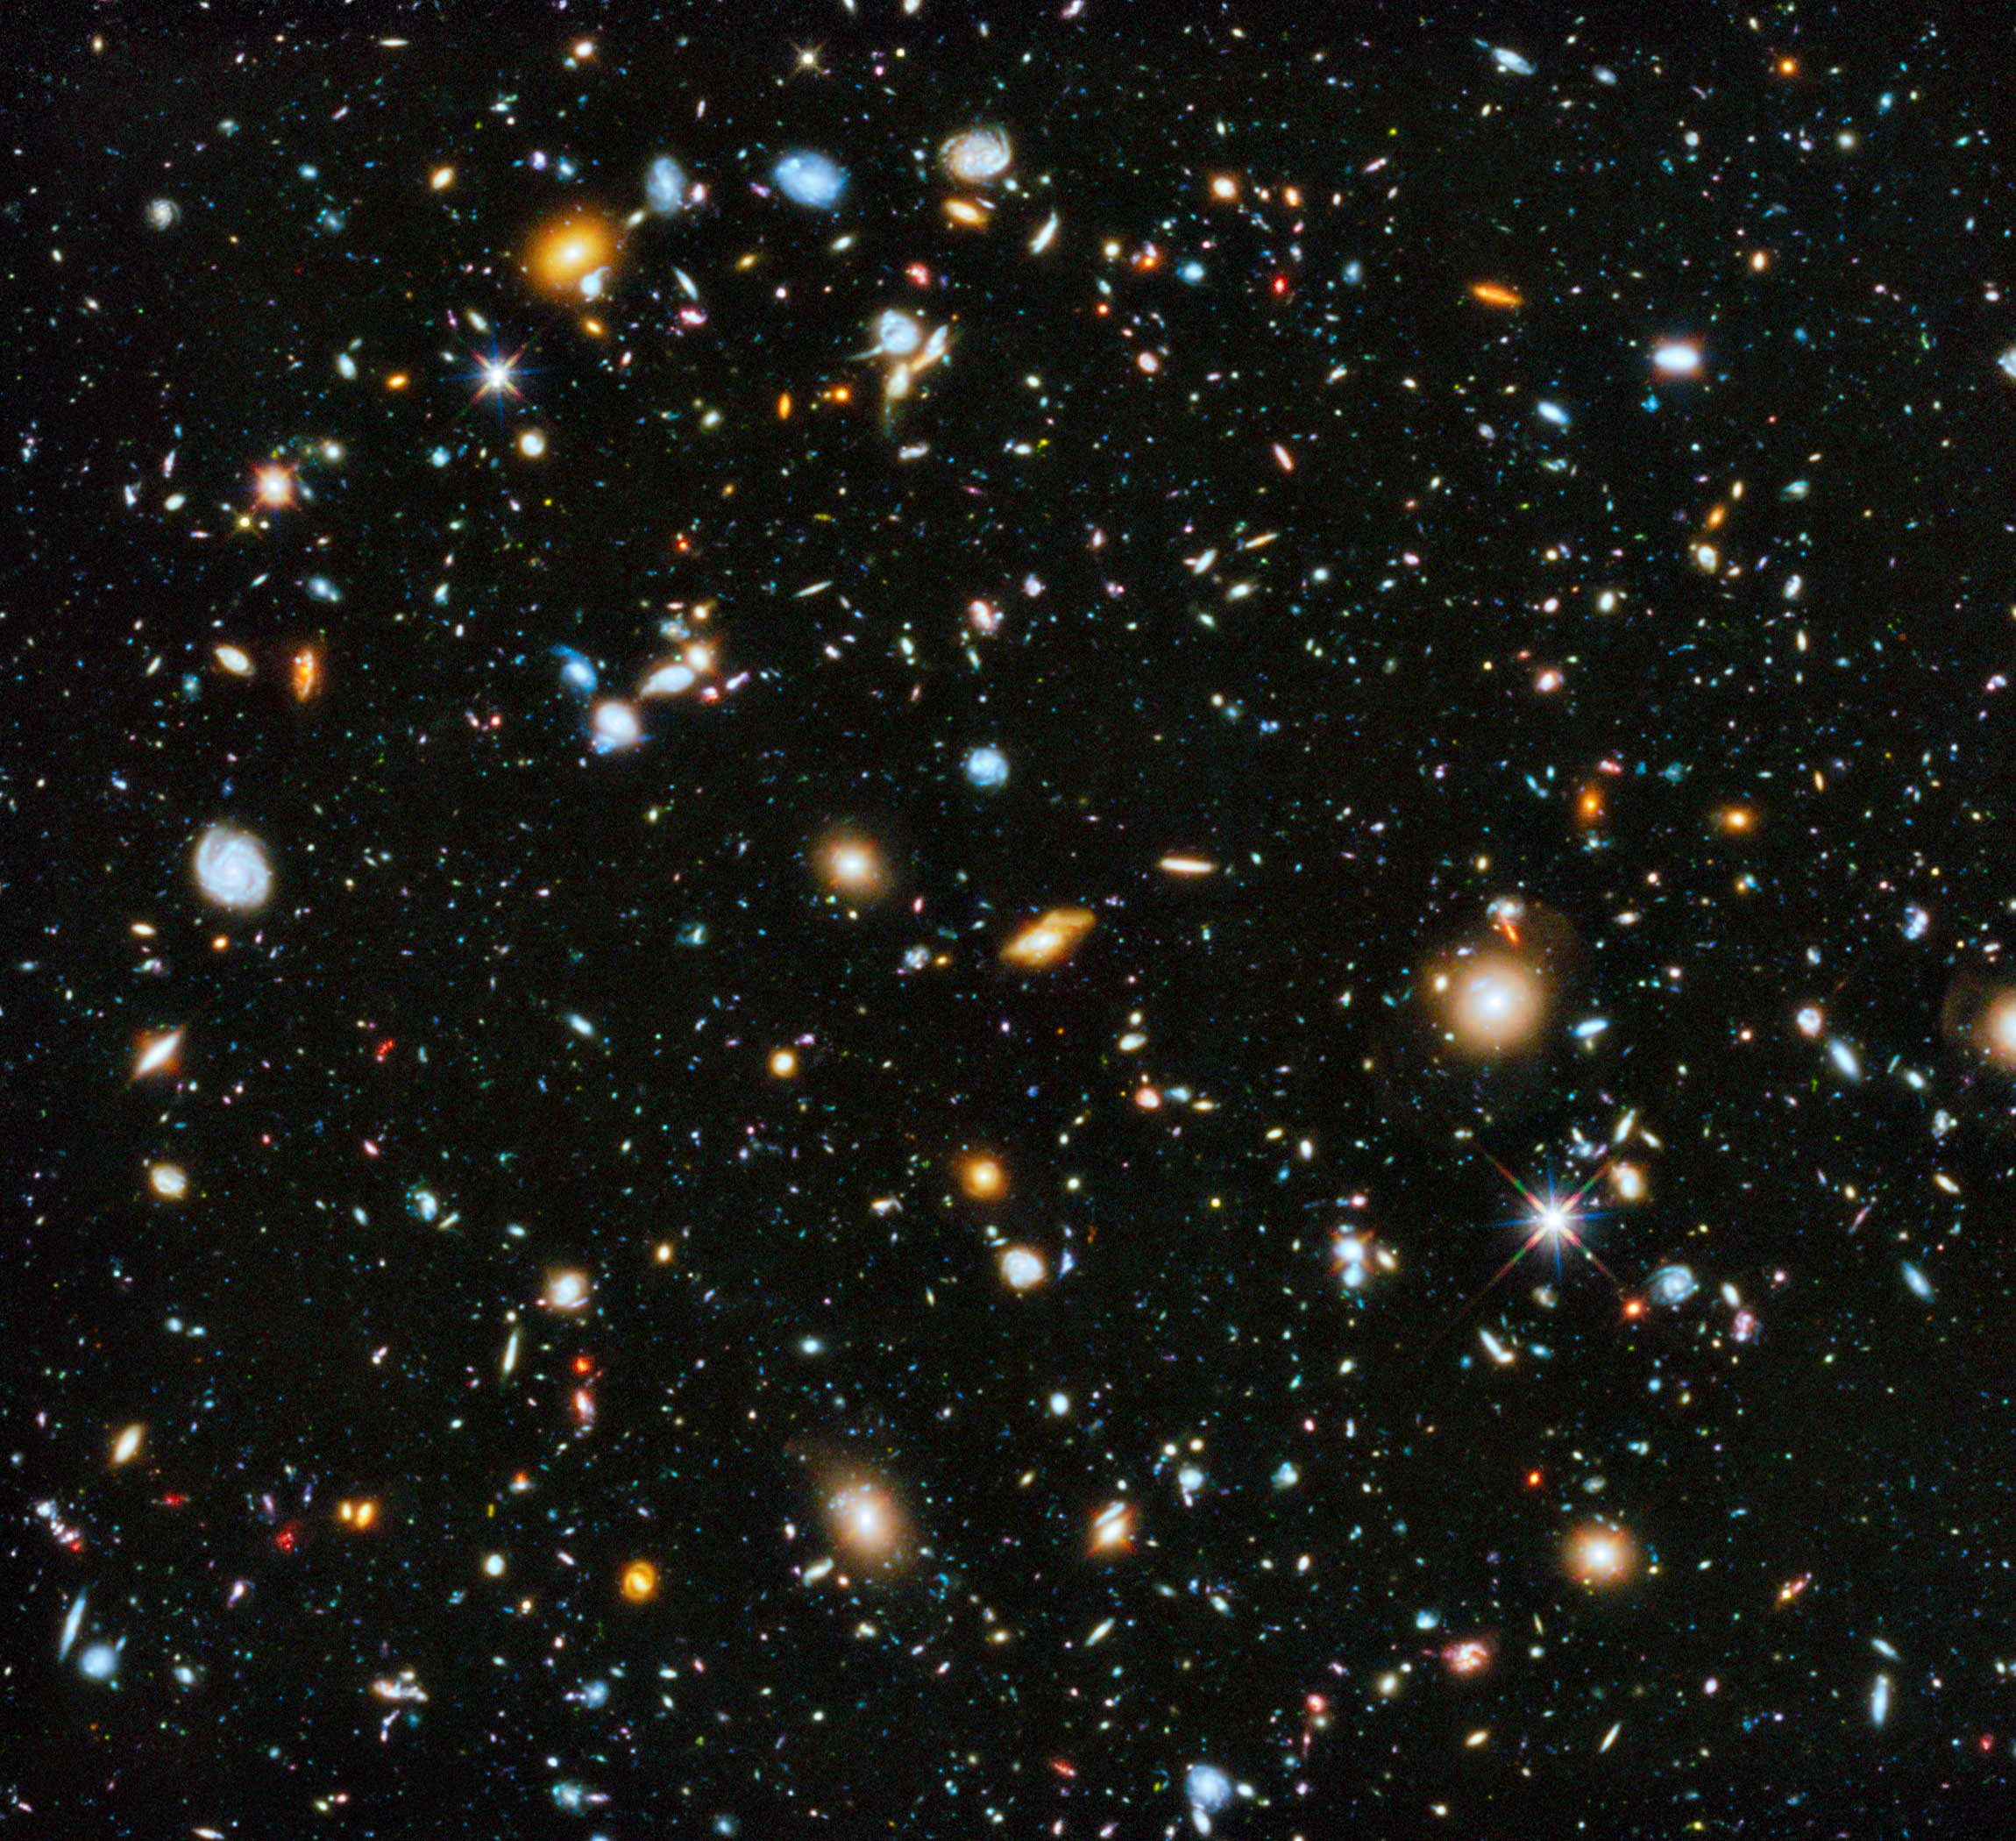


Phenomenological Cosmology
Tanvi Karwal
PHENO 2025, University of Pittsburgh
19th May, 2025

Slide 2
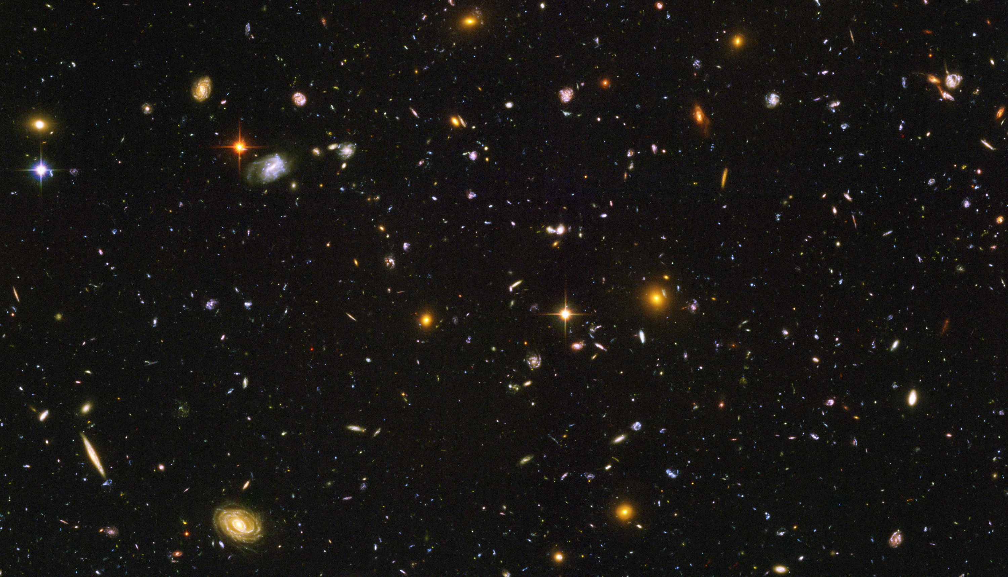
Phenomenological cosmology
Observables
Hubble tension
Evolving dark energy
Neutrinos
S8 tension

Slide 3
Phenomenological cosmology
Observables
Hubble tension
Evolving dark energy
Neutrinos

Slide 4
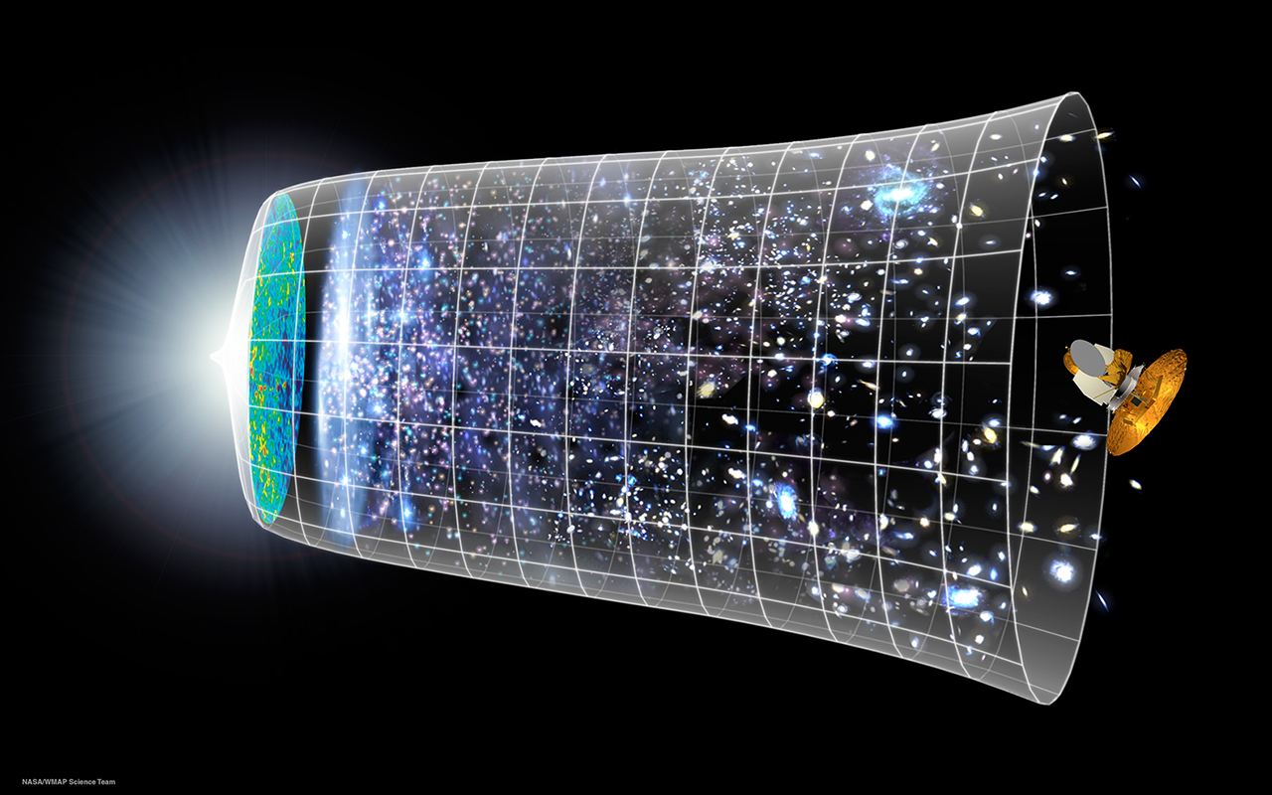
Cosmic observables
CMB spectra
Light element abundances
CMB gravitational lensing
Reionisation
Baryon acoustic oscillations / Galaxy power spectra
Weak lensing
Redshift space distortions
Supernovae
Distance ladder
Strong lensing time-delays
Standard sirens
Notes:
Non-comprehensive smattering of cosmic observables
There’s even more:
Spectral distortions
SZ – tSZ and kSZ
LIM

Slide 5
Cosmic observables
CMB spectra
CMB gravitational lensing
Baryon acoustic oscillations
Supernovae
Distance ladder

Slide 6
Cosmic observables
Observable | Parameters probed | Physics sensitivity
CMB primary anomalies
CMB lensing
BAO
Supernovae
Distance ladder

Slide 7
Cosmic observables
Observable | Parameters probed | Physics sensitivity
CMB primary anomalies |  | Background
CMB lensing
BAO
Supernovae
Distance ladder

Slide 8
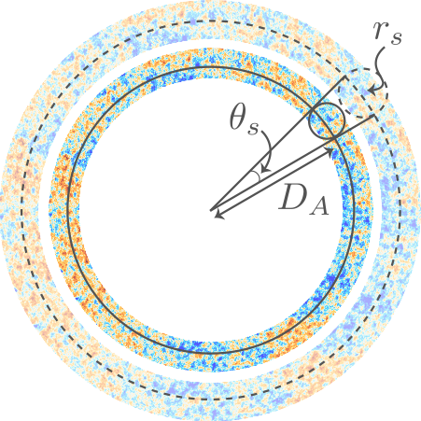








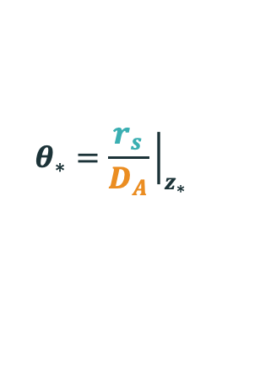
The CMB is sensitive to the background universe
Precisely measured $θ_{∗}$ is an approximate proxy for CMB peak locations
Distance to CMB
$$D_{A}∝1/H_{post}$$
$$r_{s}$$
$$D_{A}$$
$$r_{s}$$
Sound horizon
physical size
$$r_{s}∝1/H_{pre}$$
Energy densities
$$D_{A}$$
$$θ_{∗}=\frac{r_{s}}{D_{A}}{\left.​\right|}_{z_{∗}}$$
$$z_{∗}$$
Cartoon by Tristan L. Smith
Notes:
It is the CMB measurement which is model dependent, which we seek to shift into agreement with the other measurement
So let’s again think about the CMB and make a straightforward geometric argument
Preferred angular scale of the cmb depends on the physical size of the feature it tracks and the distance of that feature away from us
Just like a house in the distance – angular scale determined by size of the house and its distance from us
Going back to evolution of the universe,
The distance from us depends on post-cmb expansion
How the universe has expanded between the CMB an us, and how fast it’s expanding today
While the size of the feature depends only on pre-cmb physics, the physics of the plasma that produced this feature
So Theta_* looks like ~ r_s H_0
This makes sense – if the size of the fluctuations is bigger, the angle we observe them to be would be bigger
If the universe is expanding faster, this size would be stretched out to be bigger again
We are really good at measuring angles and this one is extremely precisely measured
It’s a fixed measurement, that our model must fit
So, to keep theta_* fixed, and increase H_0 to solve the Hubble tension
We’d have to decrease r_s
Because r_s depends on the early, pre CMB universe, that’s where the new physics must take effect
------
Make the size smaller so it needs the universe to expand faster to maintain that one degree scale we see
-----
In support of an early universe modification:
Planck [1807.06209]
Bernal et al [1607.05617]
Evslin et al [1711.01051]
Aylor et al [1811.00537]
We’re interested in early universe modifications that the CMB will be sensitive to

Slide 9
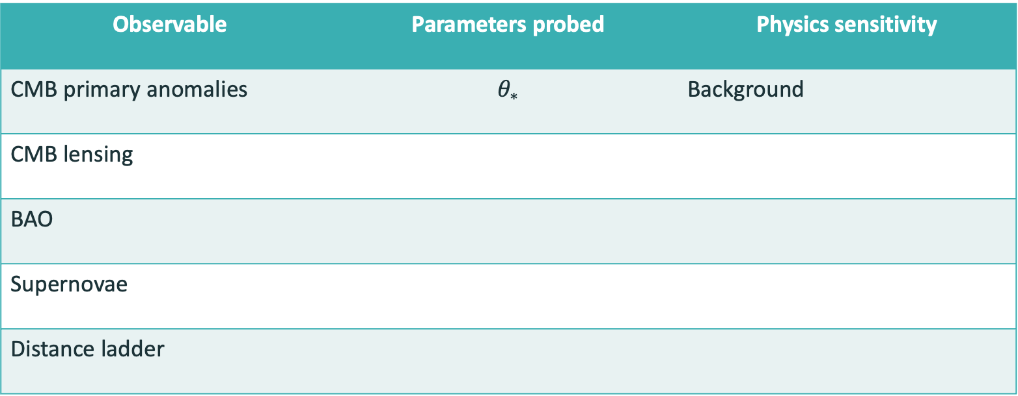
Cosmic observables
Observable | Parameters probed | Physics sensitivity
CMB primary anomalies | $$θ_{∗}$$ | Background
CMB lensing
BAO
Supernovae
Distance ladder

Slide 10
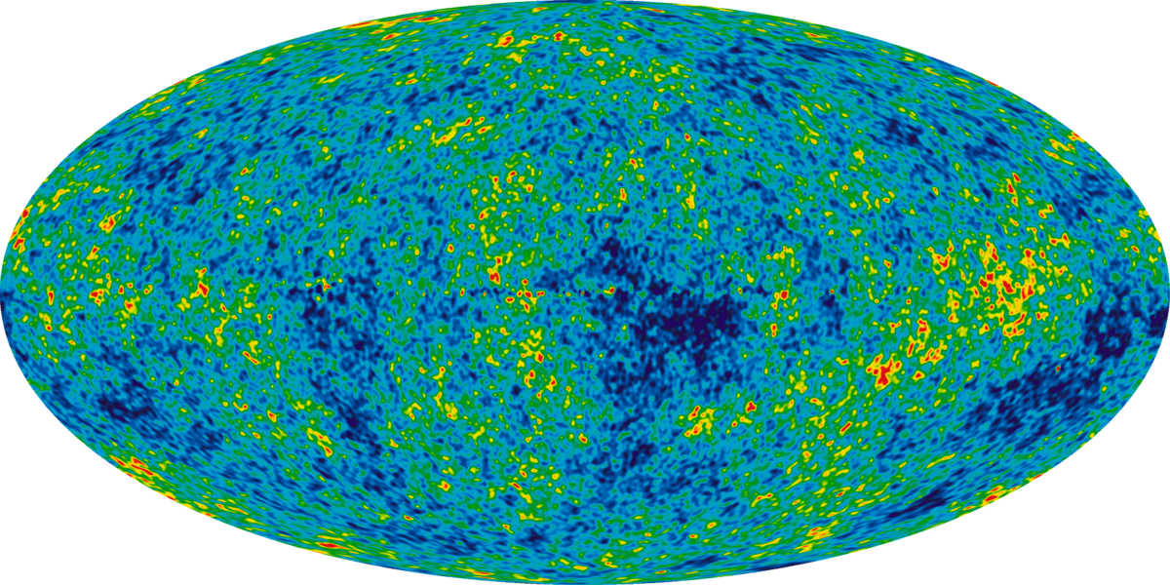
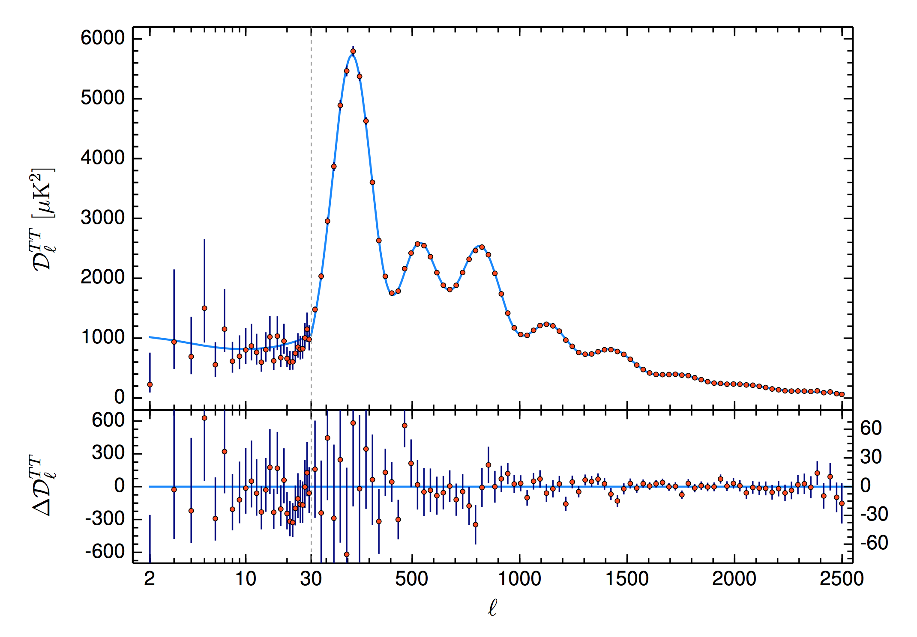



The CMB is sensitive to perturbations
Planck data
$Λ$CDM
Power spectrum
Planck [1807.06209]
Precisely measured $θ_{∗}$ is an approximate proxy for CMB peak locations
Maximum variation at
$θ_{∗}∼1^{∘}$scales
$$θ_{∗}$$
Inverse angular scale
Notes:
We can take the CMB, the oldest light in the universe
And learn a lot from it
This map can be transformed into a power spectrum – a 2D fourier transform
A power spectrum is then the variance of the amplitude of your fourier transform at various scales
So this plot is telling you that the most variation you get in the map of the CMB
Is at roughly scales of 1 degree on the sky
This scale corresponds to the farthest distance that pressure waves travelled in the early universe
Or the sound horizon
The map we see and the data on this plot are fixed measurements
Any model of cosmology must fit this data
With how many every parameters, eg LCDM has 6 independent variables to fit this data with
Effectively, the CMB peaks won’t move, need to adjust parameters to them

Slide 11
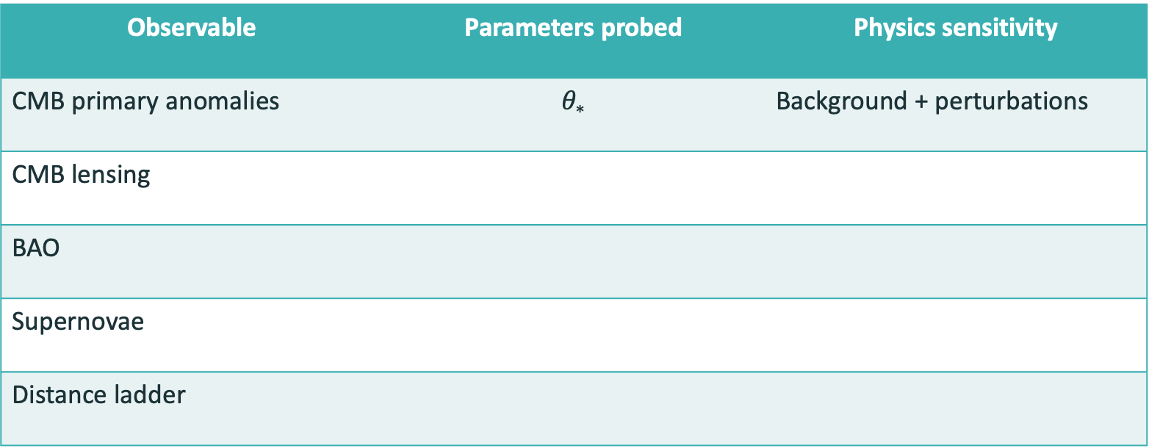
Cosmic observables
Observable | Parameters probed | Physics sensitivity
CMB primary anomalies | $$θ_{∗}$$ | Background + perturbations
CMB lensing
BAO
Supernovae
Distance ladder

Slide 12



CMB can probe $Λ$CDM Parameters
$θ_{∗}$ - angular size of the sound horizon
$ω_{b}= Ω_{b}h^{2}$ - the fractional density of baryons
$ω_{c}= Ω_{c}h^{2}$ - the fractional density of cold dark matter
$ln⁡({10}^{10}A_{s})$ – amplitude of the primordial power spectrum
$n_{s}$ - primordial spectrum power-law index
$τ$ - the optical depth to reionization
$$θ_{∗}$$
Planck [1807.06209]
Notes:
These are the main cosmological parameters of the model
H_0 – expansion rate of the universe
A_s = amplitude of p spect at $k=0.05Mpc^{−1}$
Armed with the Lambda CDM model and constraints on its parameters from the CMB, we can make predictions about what we might expect the universe today to look like
If it’s correct, it should predict this exactly right

Slide 13


CMB can probe $Λ$CDM Parameters
$θ_{∗}$ - angular size of the sound horizon
$ω_{b}= Ω_{b}h^{2}$ - the fractional density of baryons
$ω_{c}= Ω_{c}h^{2}$ - the fractional density of cold dark matter
$ln⁡({10}^{10}A_{s})$ – amplitude of the primordial power spectrum
$n_{s}$ - primordial spectrum power-law index
$τ$ - the optical depth to reionization
$$ω_{b}$$
$$θ_{∗}$$
Planck [1807.06209]
Notes:
These are the main cosmological parameters of the model
H_0 – expansion rate of the universe
A_s = amplitude of p spect at $k=0.05Mpc^{−1}$
Armed with the Lambda CDM model and constraints on its parameters from the CMB, we can make predictions about what we might expect the universe today to look like
If it’s correct, it should predict this exactly right

Slide 14

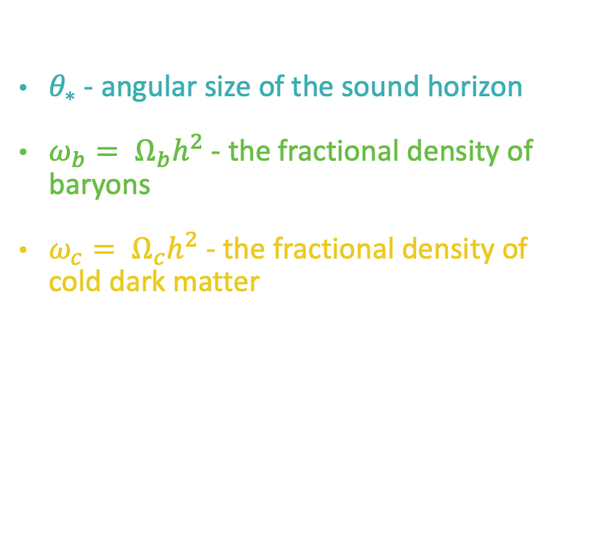
CMB can probe $Λ$CDM Parameters
$θ_{∗}$ - angular size of the sound horizon
$ω_{b}= Ω_{b}h^{2}$ - the fractional density of baryons
$ω_{c}= Ω_{c}h^{2}$ - the fractional density of cold dark matter
$ln⁡({10}^{10}A_{s})$ – amplitude of the primordial power spectrum
$n_{s}$ - primordial spectrum power-law index
$τ$ - the optical depth to reionization
$$ω_{c}$$
$$ω_{b}$$
$$θ_{∗}$$
Planck [1807.06209]
Notes:
These are the main cosmological parameters of the model
H_0 – expansion rate of the universe
A_s = amplitude of p spect at $k=0.05Mpc^{−1}$
Armed with the Lambda CDM model and constraints on its parameters from the CMB, we can make predictions about what we might expect the universe today to look like
If it’s correct, it should predict this exactly right

Slide 15
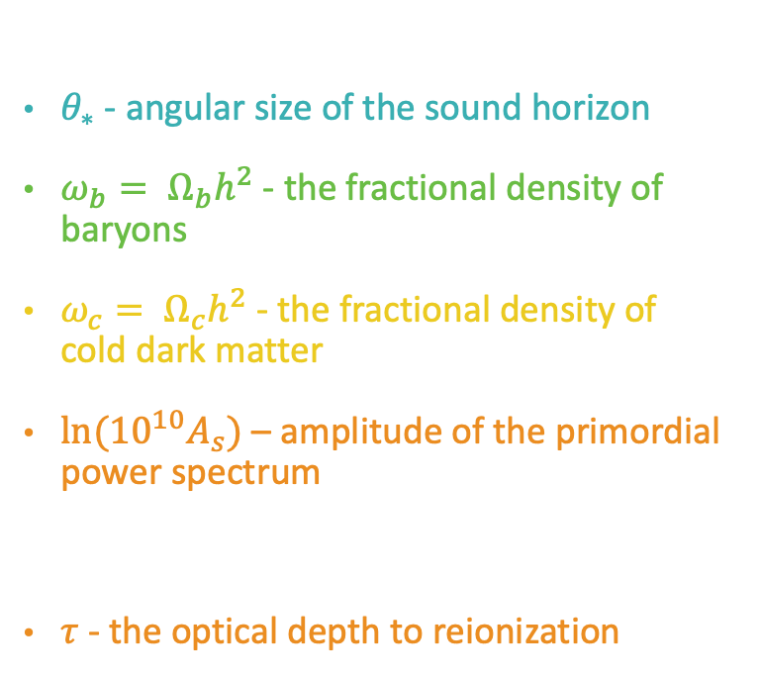

CMB can probe $Λ$CDM Parameters
$θ_{∗}$ - angular size of the sound horizon
$ω_{b}= Ω_{b}h^{2}$ - the fractional density of baryons
$ω_{c}= Ω_{c}h^{2}$ - the fractional density of cold dark matter
$ln⁡({10}^{10}A_{s})$ – amplitude of the primordial power spectrum
$n_{s}$ - primordial spectrum power-law index
$τ$ - the optical depth to reionization
$$ω_{c}$$
$$A_{s}e^{−2τ}$$
$$ω_{b}$$
$$θ_{∗}$$
Planck [1807.06209]
Notes:
These are the main cosmological parameters of the model
H_0 – expansion rate of the universe
A_s = amplitude of p spect at $k=0.05Mpc^{−1}$
Armed with the Lambda CDM model and constraints on its parameters from the CMB, we can make predictions about what we might expect the universe today to look like
If it’s correct, it should predict this exactly right

Slide 16

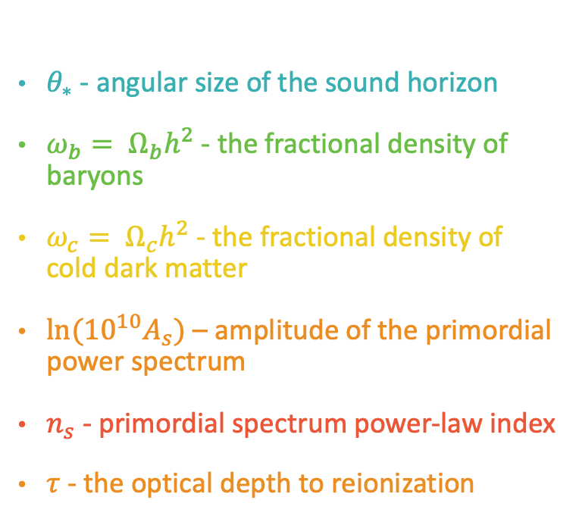
CMB can probe $Λ$CDM Parameters
$θ_{∗}$ - angular size of the sound horizon
$ω_{b}= Ω_{b}h^{2}$ - the fractional density of baryons
$ω_{c}= Ω_{c}h^{2}$ - the fractional density of cold dark matter
$ln⁡({10}^{10}A_{s})$ – amplitude of the primordial power spectrum
$n_{s}$ - primordial spectrum power-law index
$τ$ - the optical depth to reionization
$$ω_{c}$$
$$A_{s}e^{−2τ}$$
$$ω_{b}$$
$$n_{s}$$
$$θ_{∗}$$
Planck [1807.06209]
Notes:
These are the main cosmological parameters of the model
H_0 – expansion rate of the universe
A_s = amplitude of p spect at $k=0.05Mpc^{−1}$
Armed with the Lambda CDM model and constraints on its parameters from the CMB, we can make predictions about what we might expect the universe today to look like
If it’s correct, it should predict this exactly right

Slide 17
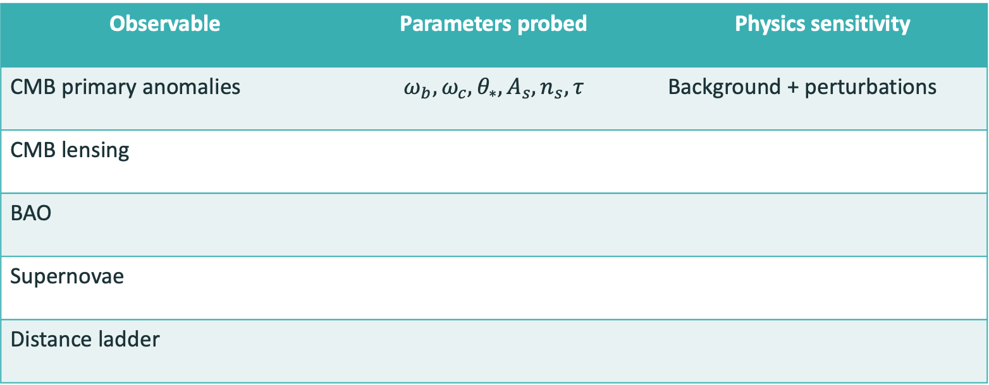
Cosmic observables
Observable | Parameters probed | Physics sensitivity
CMB primary anomalies | $$ω_{b}, ω_{c}, θ_{∗}, A_{s}, n_{s}, τ$$ | Background + perturbations
CMB lensing
BAO
Supernovae
Distance ladder

Slide 18
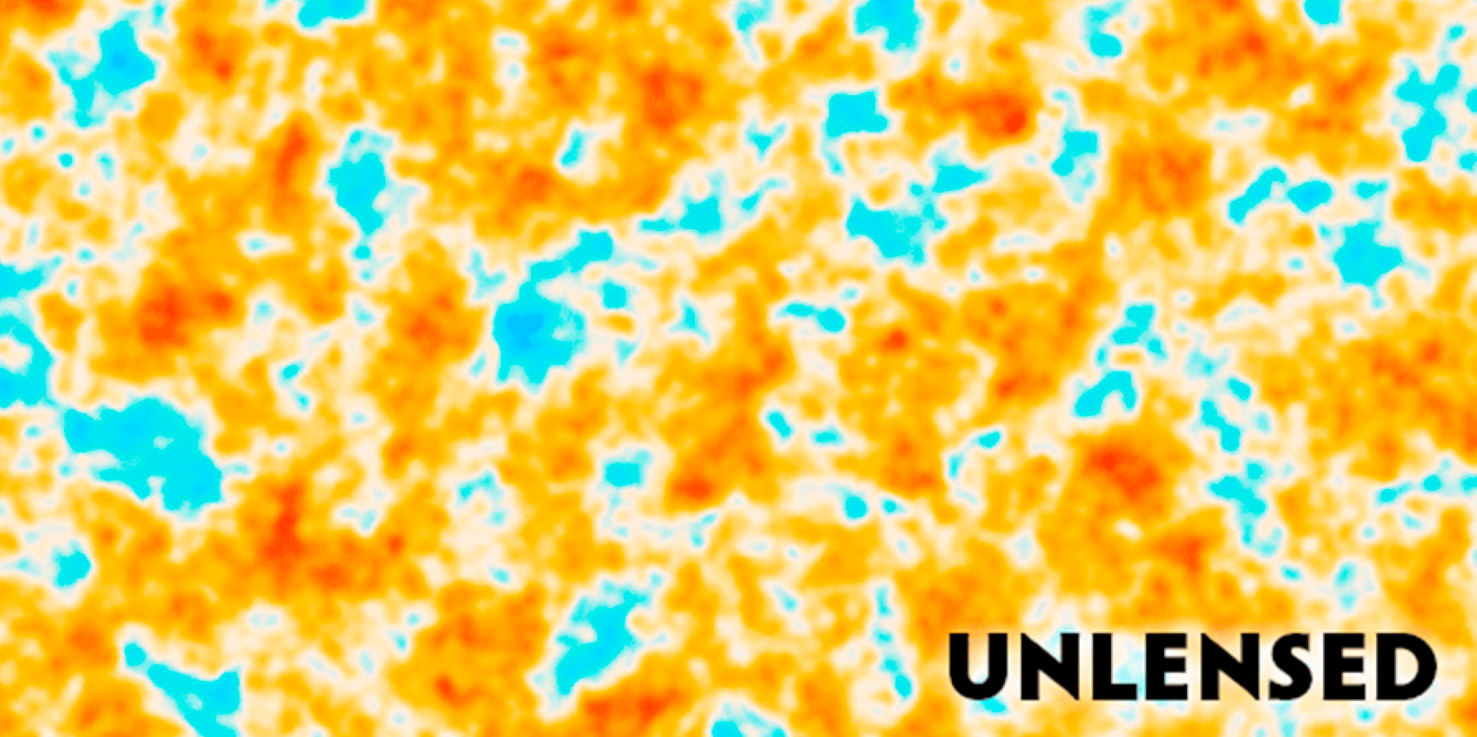
CMB lensing

Slide 19
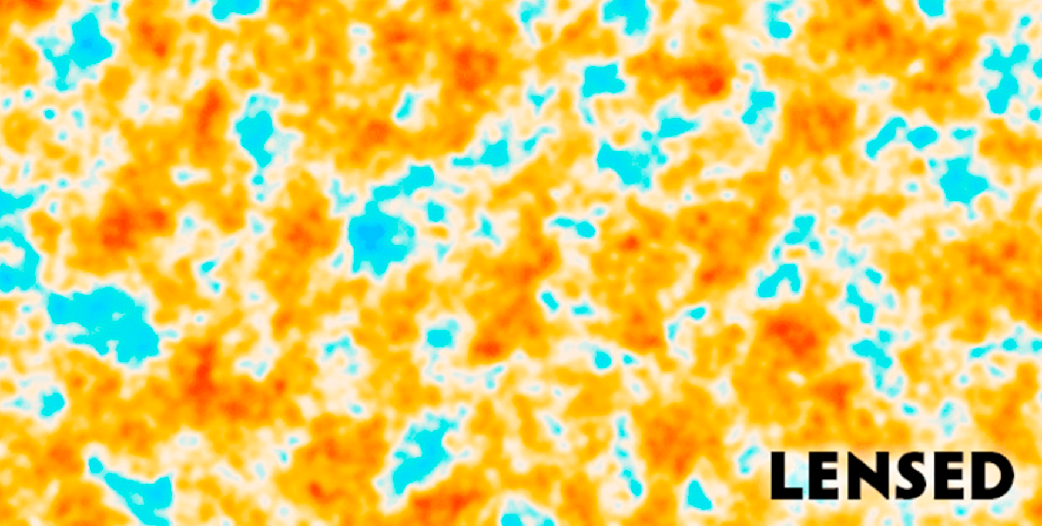
CMB lensing

Slide 20
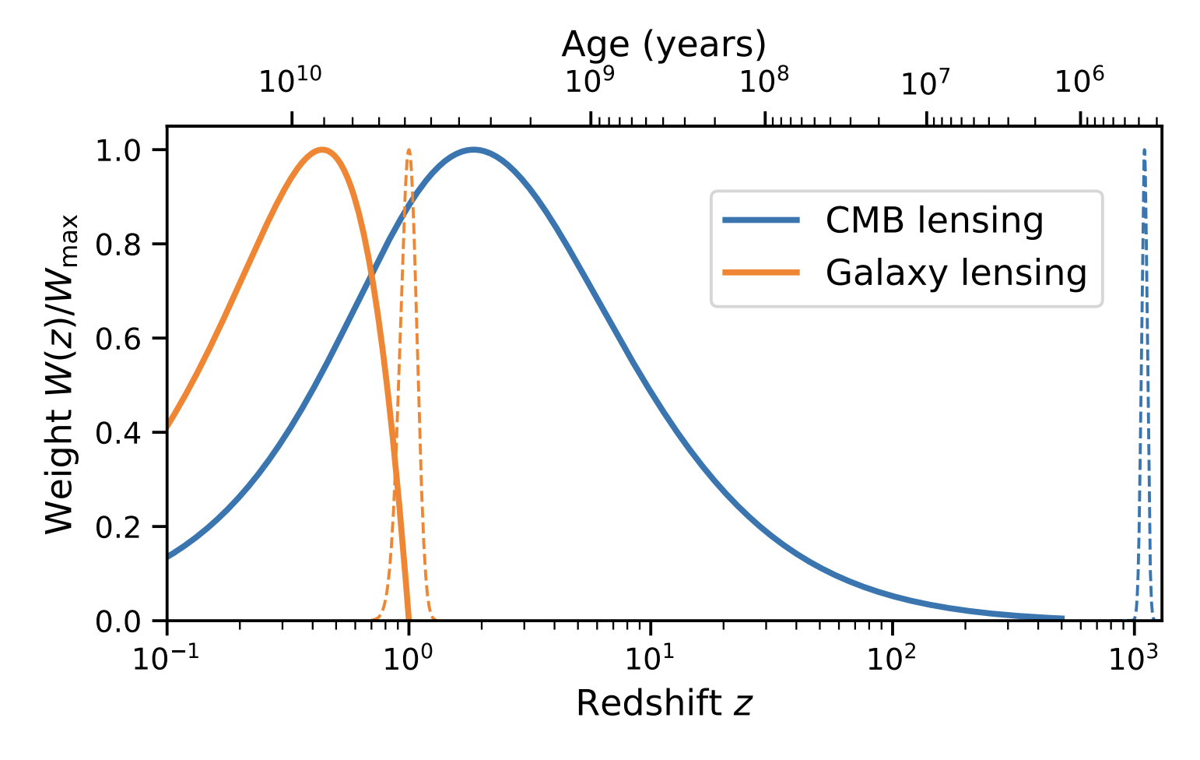
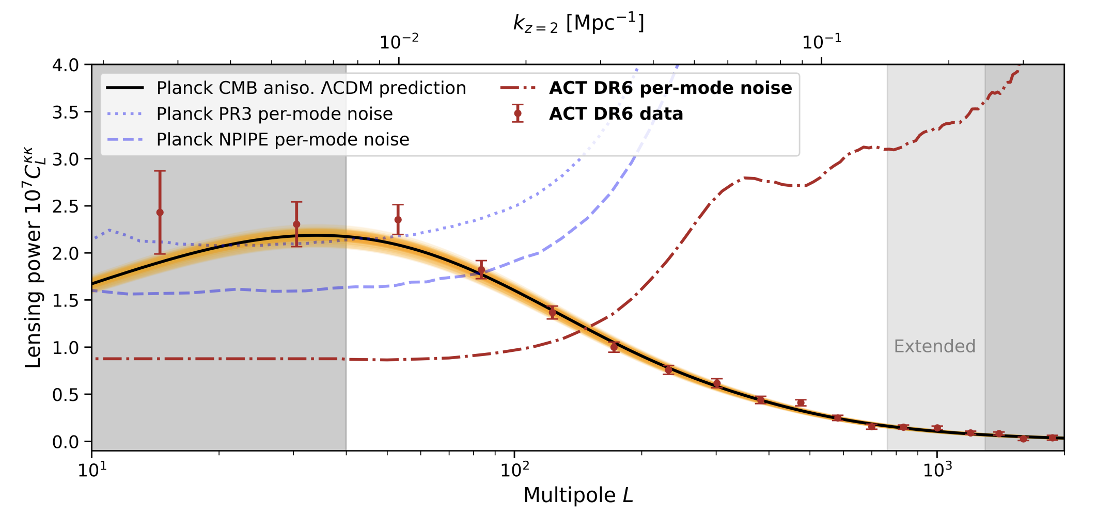
CMB lensing is sensitive to background and perturbations
Lensing kernel for CMB – sensitivity in redshift
CMB lensing power spectrum
ACT [2304.05203]

Slide 21
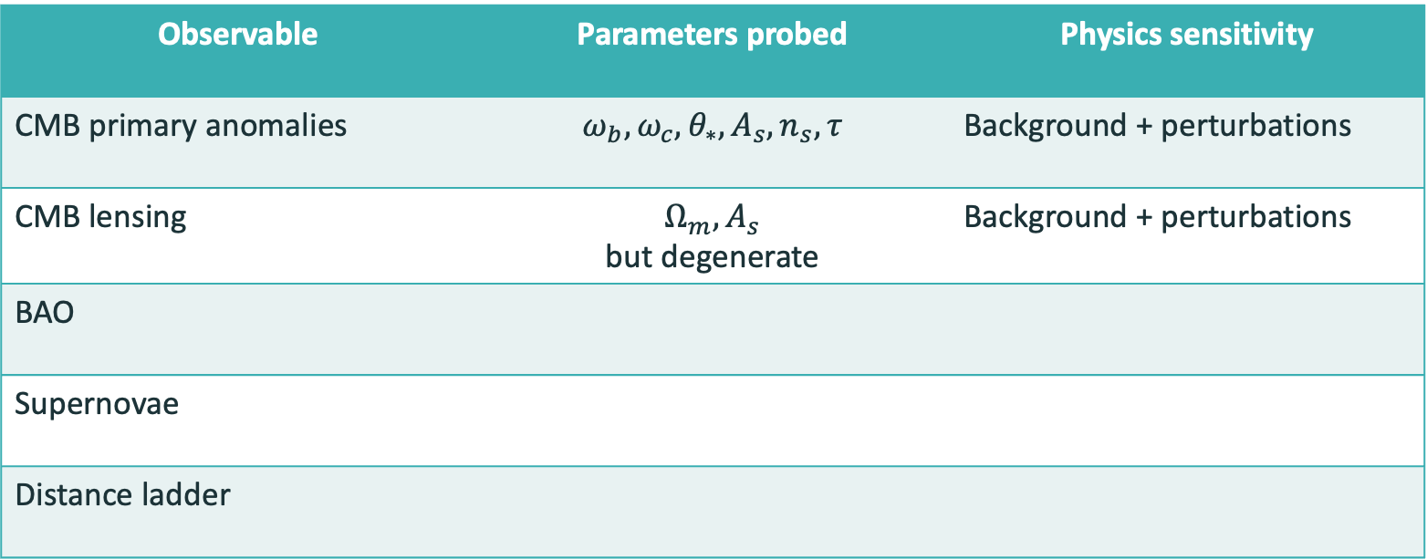
Cosmic observables
Observable | Parameters probed | Physics sensitivity
CMB primary anomalies | $$ω_{b}, ω_{c}, θ_{∗}, A_{s}, n_{s}, τ$$ | Background + perturbations
CMB lensing | $$Ω_{m}, A_{s}$$ but degenerate | Background + perturbations
BAO
Supernovae
Distance ladder

Slide 22
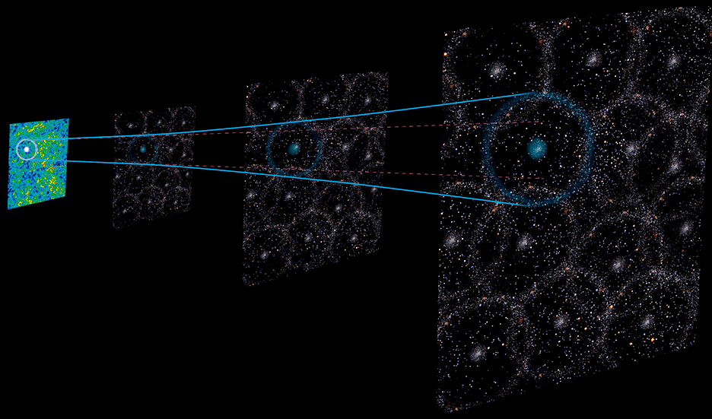



Baryon acoustic oscillations trace the same physics as the CMB at nearer redshifts
$$r$$
$$θ_{∗}$$
$$D$$
DESI Hee-Jong Seo’s talk
Notes:
the preferred separation between galaxy clusters

Slide 23
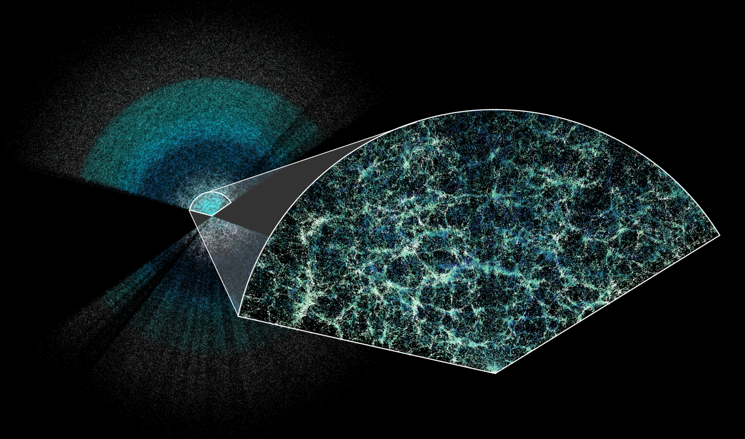


Standard ruler in galaxy clusters
Dark Energy Spectroscopic Instrument
Otavio Alves
U Michigan

Slide 24
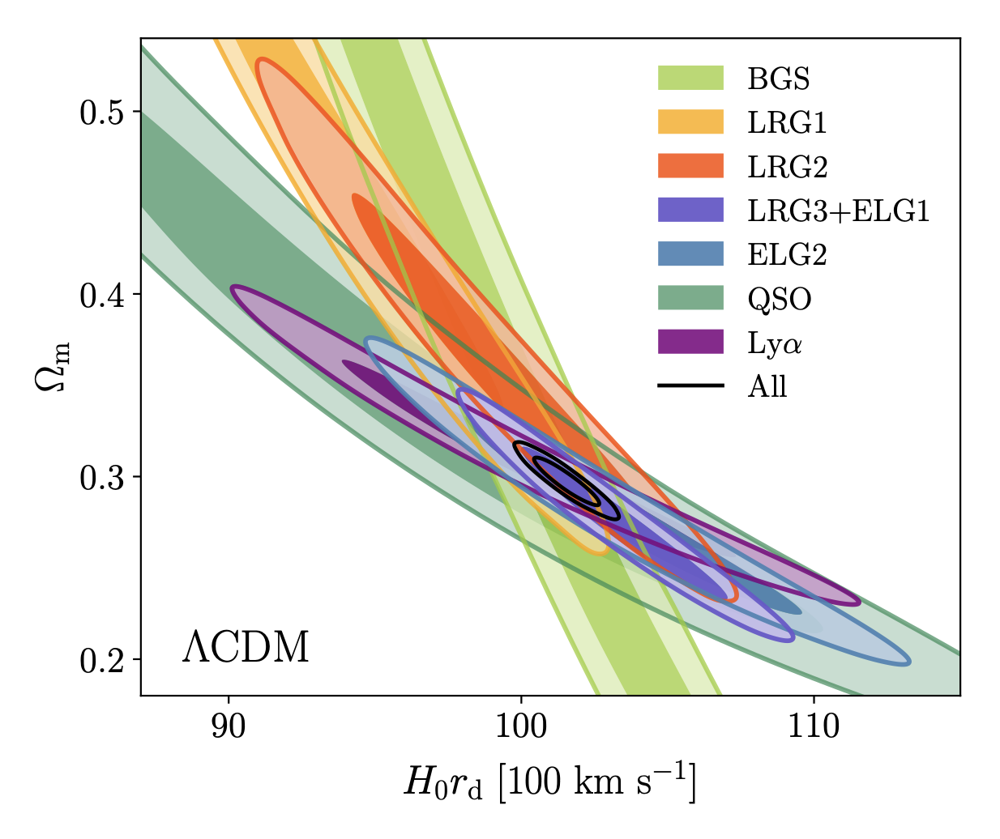

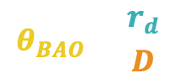
BAO are sensitive the the background universe
$$θ_{BAO}=\frac{r_{d}}{D}$$
Distance to BAO
$$D∝\frac{1}{H\left(z\right)}∝\frac{1}{H_{0}}$$
and $Ω_{m}$ dependence
Drag scale $r_{d}$ rom CMB
BAO measure angles
$$θ_{BAO}∝\frac{r_{d}}{1/H_{0}}=H_{0}r_{d}$$
and $Ω_{m}$ dependence
DESI [2503.14738]

Slide 25
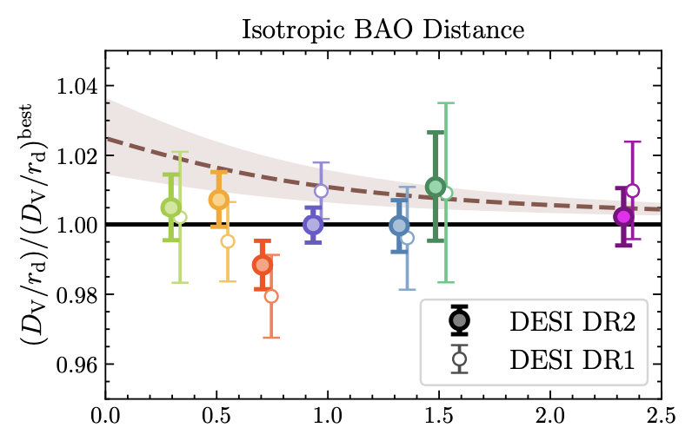


BAO probe $H\left(z\right)$
Distance to BAO
$$D∝\frac{1}{H\left(z\right)}$$
DESI [2503.14738]

Slide 26
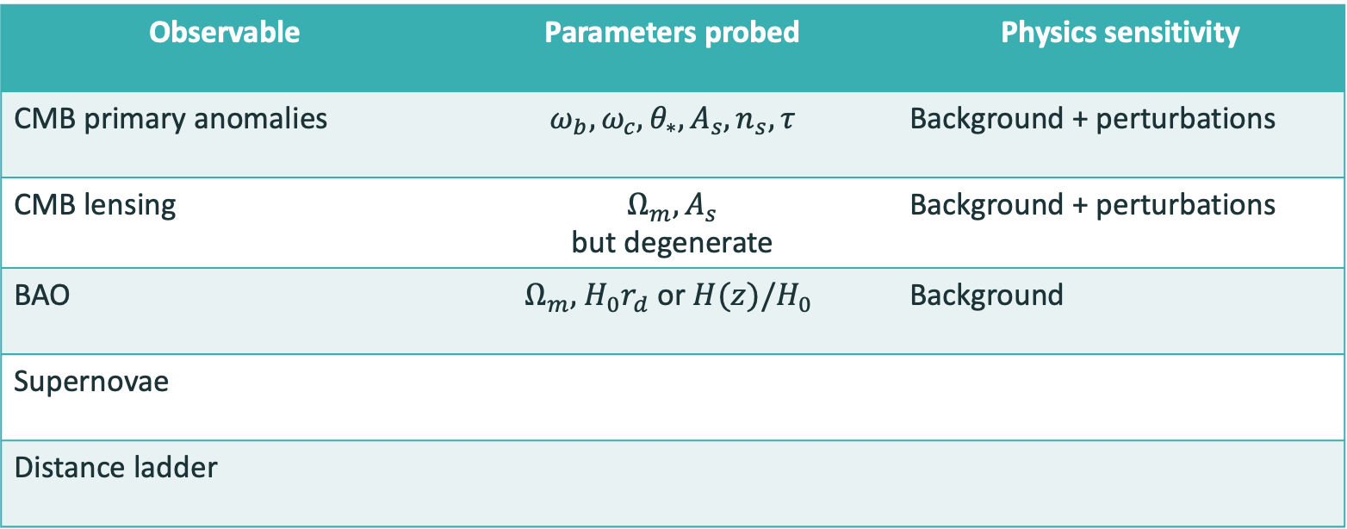
Cosmic observables
Observable | Parameters probed | Physics sensitivity
CMB primary anomalies | $$ω_{b}, ω_{c}, θ_{∗}, A_{s}, n_{s}, τ$$ | Background + perturbations
CMB lensing | $$Ω_{m}, A_{s}$$ but degenerate | Background + perturbations
BAO | $$Ω_{m}\text{, }H_{0}r_{d} \text{or} H(z)/H_{0}$$ | Background
Supernovae
Distance ladder

Slide 27
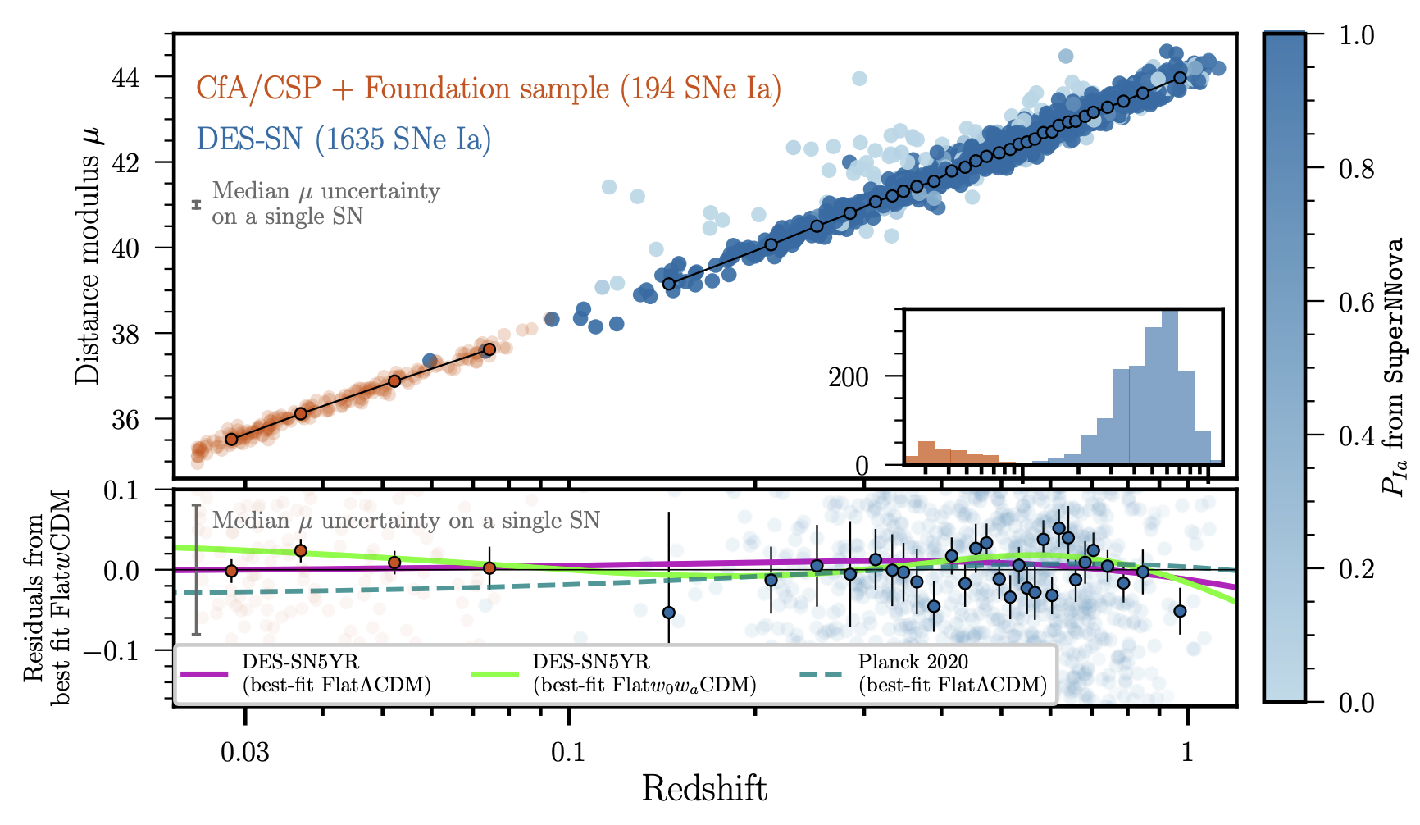


Supernovae probe $H\left(z\right)$
$$μ\left(z\right)=5\log_{10}D_{L}+25$$
$$D_{L}∝\frac{1}{H\left(z\right)}$$
DES [2401.02929]
Notes:
the absolute magnitude of SNe Ia (M) and the H0 parameter (which appears in the luminosity distance) are completely degenerate and therefore they are combined in the single parameter M = M + 5 log10(c/H0)

Slide 28
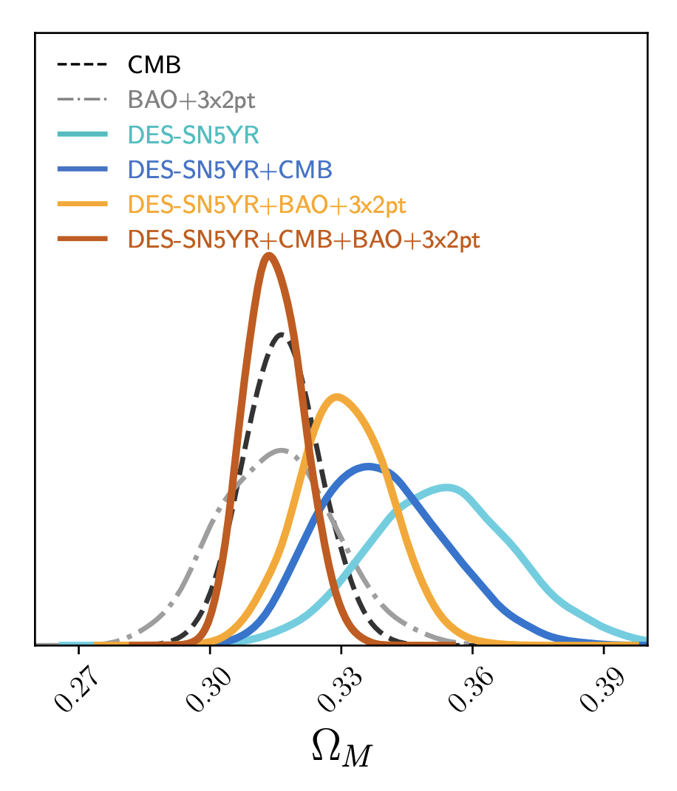

Supernovae are sensitive to the background universe
Within flat $Λ$CDM,
supernovae probe $Ω_{m}$
$H_{0}$ is completely degenerate with their absolute magnitude $M$
DES [2401.02929]

Slide 29
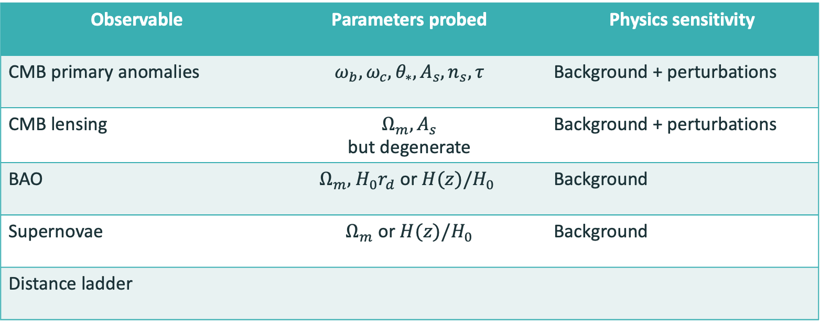
Cosmic observables
Observable | Parameters probed | Physics sensitivity
CMB primary anomalies | $$ω_{b}, ω_{c}, θ_{∗}, A_{s}, n_{s}, τ$$ | Background + perturbations
CMB lensing | $$Ω_{m}, A_{s}$$ but degenerate | Background + perturbations
BAO | $$Ω_{m}\text{, }H_{0}r_{d} \text{or} H(z)/H_{0}$$ | Background
Supernovae | $Ω_{m}$ or $H(z)/H_{0}$ | Background
Distance ladder

Slide 30
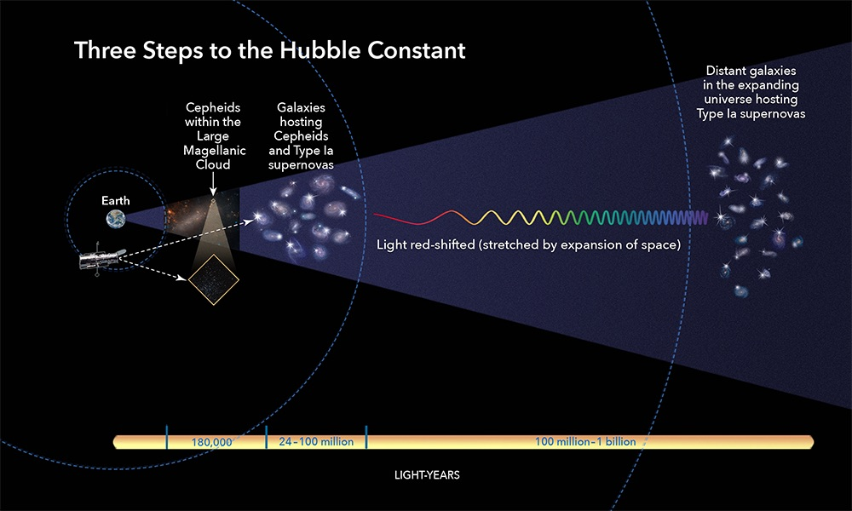


The distance ladder probes only the background $H_{0}$
Our own galaxy:
Parallax distance
Calibrate brightness
Nearby galaxies:
Cepheid brightness
Calibrate distance
Faraway galaxies:
Supernova brightness
Calibrate distance
at $z≃0.15$
Source: Hubble Space Telescope
Notes:
In reality, similar to the early universe observation, this winds up being a lot more complicated
It’s done using a distance ladder
You star with a certain type of star of know brightness in our own galaxy
These are called standard candles, because they have a standard brightness
Based on that brightness, you determine the distance to the same type of stars in other galaxies
These galaxies have the extremely bright supernovae – a certain type of exploding star
Which you can see to really far out in the Universe
From the known brightness of these in closer galaxies
You calibrate the distance to faraway galaxies also with supernovae in them
You effectively measure distances further away by calibrating to closer objects

Slide 31
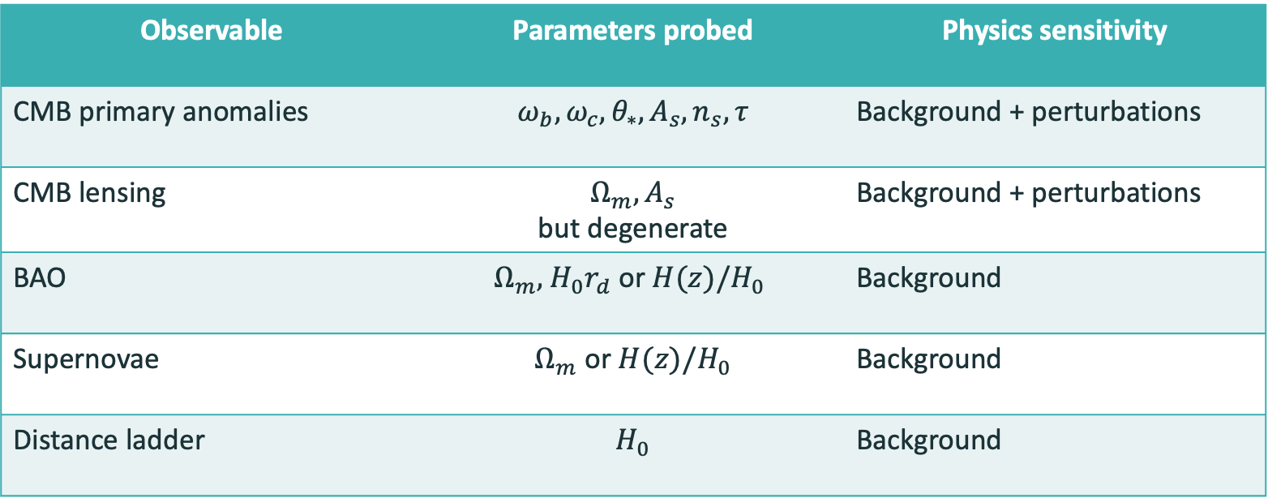
Cosmic observables
Observable | Parameters probed | Physics sensitivity
CMB primary anomalies | $$ω_{b}, ω_{c}, θ_{∗}, A_{s}, n_{s}, τ$$ | Background + perturbations
CMB lensing | $$Ω_{m}, A_{s}$$ but degenerate | Background + perturbations
BAO | $$Ω_{m}\text{, }H_{0}r_{d} \text{or} H(z)/H_{0}$$ | Background
Supernovae | $Ω_{m}$ or $H(z)/H_{0}$ | Background
Distance ladder | $$H_{0}$$ | Background

Slide 32
Phenomenological cosmology
Observables
Hubble tension
Evolving dark energy
Neutrinos

Slide 33
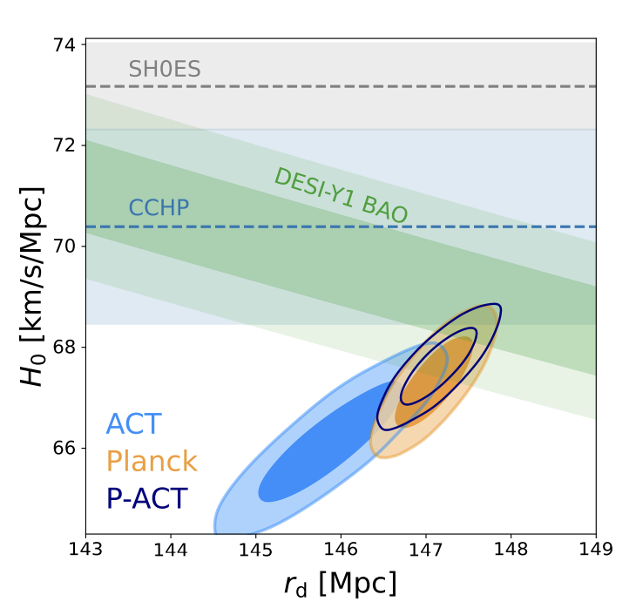

Hubble tension current status
Tension persists between the two most precise measurements
Using the distance ladder – SH0ES
Using $Λ$CDM and the CMB – Planck + ACT
ACT [2503.14452]

Slide 34
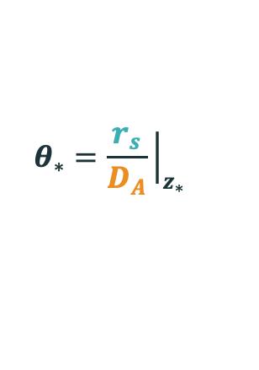








Phenomenological insight to resolve the Hubble tension
$$D_{A}∝1/H_{post}$$
Precisely measured $θ_{∗}$ is an approximate proxy for CMB peak locations
$$r_{s}∝1/H_{pre}$$
For precisely measured $θ_{∗}$
$$θ_{∗}∼\frac{r_{s}}{1/H_{post}}∼r_{s}H_{0}$$
$$r_{s}$$
$$D_{A}$$
$$r_{s}$$
Energy densities
$$D_{A}$$
$$r_{S}∝1/H_{0}$$
$$θ_{∗}=\frac{r_{s}}{D_{A}}{\left.​\right|}_{z_{∗}}$$
$$z_{∗}$$
In support of an early universe modification:
Karwal et al [1608.01309]
Planck [1807.06209]
Bernal et al [1607.05617]
Evslin et al [1711.01051]
Aylor et al [1811.00537]
Raveri et al [2002.11707]
…
Cartoon by Tristan L. Smith
Notes:
It is the CMB measurement which is model dependent, which we seek to shift into agreement with the other measurement
So let’s again think about the CMB and make a straightforward geometric argument
Preferred angular scale of the cmb depends on the physical size of the feature it tracks and the distance of that feature away from us
Just like a house in the distance – angular scale determined by size of the house and its distance from us
Going back to evolution of the universe,
The distance from us depends on post-cmb expansion
How the universe has expanded between the CMB an us, and how fast it’s expanding today
While the size of the feature depends only on pre-cmb physics, the physics of the plasma that produced this feature
So Theta_* looks like ~ r_s H_0
This makes sense – if the size of the fluctuations is bigger, the angle we observe them to be would be bigger
If the universe is expanding faster, this size would be stretched out to be bigger again
We are really good at measuring angles and this one is extremely precisely measured
It’s a fixed measurement, that our model must fit
So, to keep theta_* fixed, and increase H_0 to solve the Hubble tension
We’d have to decrease r_s
Because r_s depends on the early, pre CMB universe, that’s where the new physics must take effect
------
Make the size smaller so it needs the universe to expand faster to maintain that one degree scale we see
-----
In support of an early universe modification:
Planck [1807.06209]
Bernal et al [1607.05617]
Evslin et al [1711.01051]
Aylor et al [1811.00537]
We’re interested in early universe modifications that the CMB will be sensitive to

Slide 35
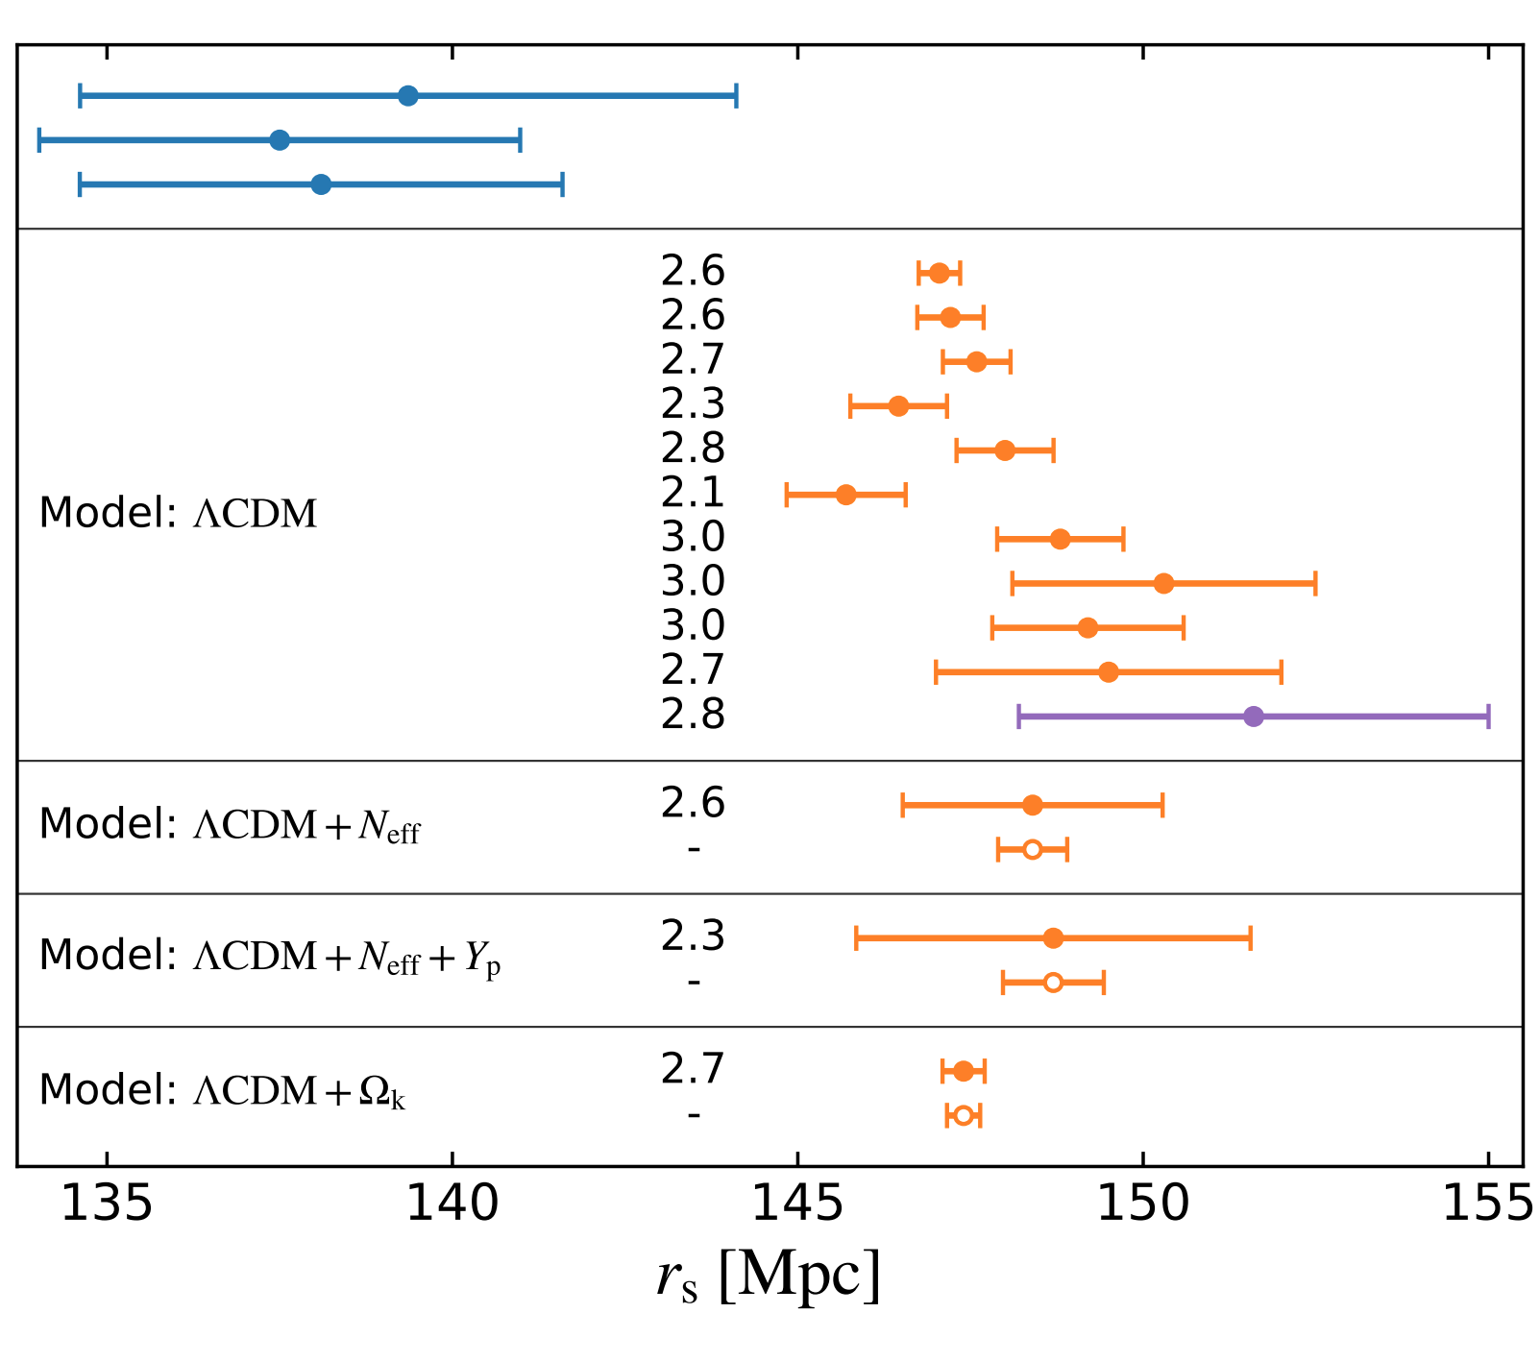




Hubble tension ⟷ sound horizon tension
Distance ladder and other late universe
Higher $H_{0}$ measured
CMB,
early universe
Lower $H_{0}$ inferred
No CMB data,
early universe
Lower $H_{0}$ inferred
$$r_{S}∝1/H_{0}$$
Aylor et al [1811.00537]
Notes:
That r_s and H0 are inversely proportional is supported by data
So effectively, the H0 tension can be recast into a sound horizon tension
Shown here is the sound horizon determined by different datasets at different epochs of the universe
Late measurements which measure a higher H0 predict a lower r_s
Hubble tension remains between early and late universe constraints even without CMB data at all
This is exactly what we’re trying to exploit to resolve the Hubble tension
Considering new physics to decrease the sound horizon and bring the orange points to match the blue

Slide 36


Hubble constant ⟷ sound horizon
Increase $H_{0}$
Disagreement with observed CMB
Combined effect
Observed CMB
Observed CMB
Decrease $r_{s}$
Notes:
Visually, something like this happens
We have the observed CMB that LCDM fits
If we add EDE and keep everything else fixed, the early universe expands faster
The CMB is emitted sooner and r_s decreases
Exaggerated, this would made the fluctuations in the CMB appear smaller
We can then increase H_0 and magnify these fluctuations again to the observed size
We continue to fit data well and we solve the Hubble tension
--------
This simultaneously addresses both the H_0 and r_s discrepancies which are related but a resolution could affect one more than the other

Slide 37

Phenomenological insight to resolve the Hubble tension
Decrease the sound horizon $r_{s}$ to increase the predicted $H_{0}$.
New physics must be added before the CMB.
New physics must vanish post recombination
Notes:
H0 tension recast into rs tension is why modifications must disappear at late times
CMB and BAO trace the same physics – the physical and angular size of the sound horizon
The excellent agreement between them constrains physics between the CMB and BAO redshifts

Slide 38
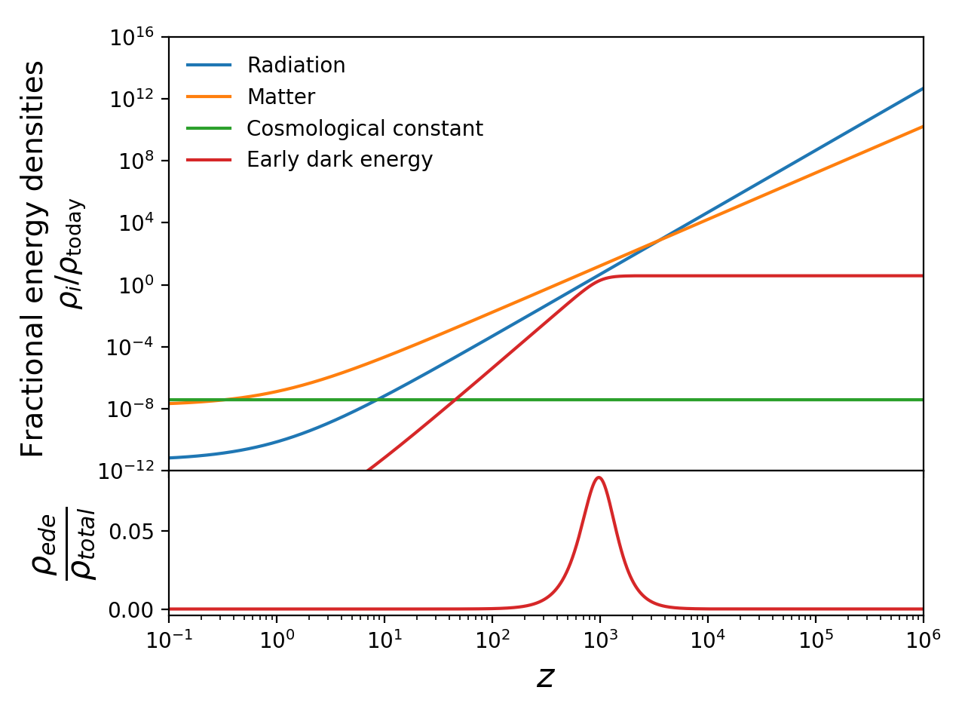
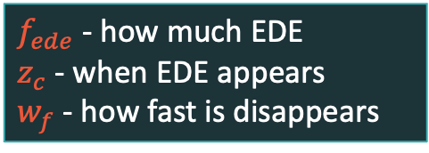




Early dark energy fits this phenomenology
Additional energy component that increases the pre-CMB expansion rate
$Λ$-like behaviour initially
Then dilutes faster than matter at $w_{f}$
Localised peak in $f_{ede}=\frac{ρ_{ede}}{ρ_{total}}$ at $z_{c}$
Energy densities
$$w_{f}$$
$$z_{c}$$
$f_{ede}$ - how much EDE
$z_{c}$ - when EDE appears
$w_{f}$ - how fast is disappears
$$f_{ede}$$
TK and Kamionkowski [1608.01309]
Notes:
The plot shows the energy densities of various components of the universe in the LCDM + EDE scenario
Remember, the expansion rate depends on the energy content
If we add energy to the universe, it expands faster
EDE is disjoint from late time DE
The early dark energy we add behaves like a CC at early times
Like a CC or the DE causing the universe to expand faster today
This EDE too makes the universe expand faster for a short amount of time
It then rapidly dissipates, the EDE shown here goes as size ^-6
But we also investigate EDEs that dissipate like radiation, so the line would be parallel to the blue line
And EDEs that dissipate somewhere in between the blue and red lines
This addition has two parameters, the amount of EDE in the universe
And the time at which its behaviour switches
Relative to the rest of the contents of the universe
The EDE density is pretty small at all times except near z_c, the knee in this curve
Which means, such a model can not only increase the early universe expansion rate
But also leave the late universe unchanged
-------
Slowly rolling scalar field
initially frozen due to Hubble friction
and then dilutes faster than matter

Slide 39
Numerous EDEs fit this phenomenology
Non-comprehensive list:
Rock 'n' Roll Solutions to the Hubble Tension. Agrawal et al [1904.01016]
Axion-Dilaton Destabilization and the Hubble Tension. Alexander & McDonough [1904.08912]
Acoustic Dark Energy: Potential Conversion of the Hubble Tension. Lin, Raveri, Hu [1905.12618]
Oscillating scalar fields and the Hubble tension: a resolution with novel signatures. Smith, Poulin, Amin [1908.06995]
New Early Dark Energy. Neidermann & Sloth [1910.10739]
Early Dark Energy from Massive Neutrinos as a Natural Resolution of the Hubble Tension. Sakstein & Trodden [1911.11760]
Unifying Inflation with Early and Late-time Dark Energy in F(R) Gravity. Nojiri et al [1912.13128]
Is the Hubble tension a hint of AdS phase around recombination? Ye & Piao [2001.02451]
Unified framework for early dark energy from α-attractors. Braglia et al [2005.14053]
A novel early Dark Energy model. Garcia, Castaneda, Tejeiro [2009.07357]
Neutrino-Assisted Early Dark Energy: Theory and Cosmology. Gonzalez et al [2011.09895]
The Early Dark Sector, the Hubble Tension, and the Swampland. McDonough et al [2112.09128]
Effects of a Geometrically Realized Early Dark Energy Era on the Spectrum of Primordial Gravitational Waves, Oikonomou et al [2206.00721]
Early dark energy and the screening mechanism, Sadjadi et al [2205.15693]
Early Dark Energy from a Higher-dimensional Gauge Theory, Kojima et al [2205.13777]
Unifying inflation with early and late dark energy with multiple fields: Spontaneously broken scale invariant two measures theory, Guendelman et al [2201.06470]
Quintessential early dark energy, Sohail et al [2408.03229]
Thermo-Coupled Early Dark Energy, Kamionkowski and Mathur [2411.09747]
Interacting Early Dark Energy, Bisabr [2409.08548]
…
Early Dark Energy, the Hubble Parameter, and the String Axiverse
TK & Kamionkowski [1608.01309]
Cosmological Implications of Ultralight Axionlike Fields
Poulin, TK et al [1806.10608]
Early Dark Energy Can Resolve The Hubble Tension
Poulin, TK et al [1811.04083]
Thermal Friction as a Solution to the Hubble Tension
Berghaus & TK [1911.06281]
Chameleon Early Dark Energy and the Hubble Tension
TK, Raveri, Jain, Khoury, Trodden [2106.13290]
Thermal Friction as a Solution to the Hubble and
Large-Scale Structure Tensions
Berghaus & TK [2204. 09133]
An Attractive Proposal for Resolving the Hubble Tension: Dynamical Attractors that Unify Early and Late Dark Energy
Ramadan, TK & Sakstein [2309.08082]

Slide 40
Numerous EDEs fit this phenomenology
Non-comprehensive list:
Rock 'n' Roll Solutions to the Hubble Tension. Agrawal et al [1904.01016]
Axion-Dilaton Destabilization and the Hubble Tension. Alexander & McDonough [1904.08912]
Acoustic Dark Energy: Potential Conversion of the Hubble Tension. Lin, Raveri, Hu [1905.12618]
Oscillating scalar fields and the Hubble tension: a resolution with novel signatures. Smith, Poulin, Amin [1908.06995]
New Early Dark Energy. Neidermann & Sloth [1910.10739]
Early Dark Energy from Massive Neutrinos as a Natural Resolution of the Hubble Tension. Sakstein & Trodden [1911.11760]
Unifying Inflation with Early and Late-time Dark Energy in F(R) Gravity. Nojiri et al [1912.13128]
Is the Hubble tension a hint of AdS phase around recombination? Ye & Piao [2001.02451]
Unified framework for early dark energy from α-attractors. Braglia et al [2005.14053]
A novel early Dark Energy model. Garcia, Castaneda, Tejeiro [2009.07357]
Neutrino-Assisted Early Dark Energy: Theory and Cosmology. Gonzalez et al [2011.09895]
The Early Dark Sector, the Hubble Tension, and the Swampland. McDonough et al [2112.09128]
Effects of a Geometrically Realized Early Dark Energy Era on the Spectrum of Primordial Gravitational Waves, Oikonomou et al [2206.00721]
Early dark energy and the screening mechanism, Sadjadi et al [2205.15693]
Early Dark Energy from a Higher-dimensional Gauge Theory, Kojima et al [2205.13777]
Unifying inflation with early and late dark energy with multiple fields: Spontaneously broken scale invariant two measures theory, Guendelman et al [2201.06470]
Quintessential early dark energy, Sohail et al [2408.03229]
Thermo-Coupled Early Dark Energy, Kamionkowski and Mathur [2411.09747]
Interacting Early Dark Energy, Bisabr [2409.08548]
…
Early Dark Energy, the Hubble Parameter, and the String Axiverse
TK & Kamionkowski [1608.01309]
Cosmological Implications of Ultralight Axionlike Fields
Poulin, TK et al [1806.10608]
Early Dark Energy Can Resolve The Hubble Tension
Poulin, TK et al [1811.04083]
Thermal Friction as a Solution to the Hubble Tension
Berghaus & TK [1911.06281]
Chameleon Early Dark Energy and the Hubble Tension
TK, Raveri, Jain, Khoury, Trodden [2106.13290]
Thermal Friction as a Solution to the Hubble and
Large-Scale Structure Tensions
Berghaus & TK [2204. 09133]
An Attractive Proposal for Resolving the Hubble Tension: Dynamical Attractors that Unify Early and Late Dark Energy
Ramadan, TK & Sakstein [2309.08082]

Slide 41
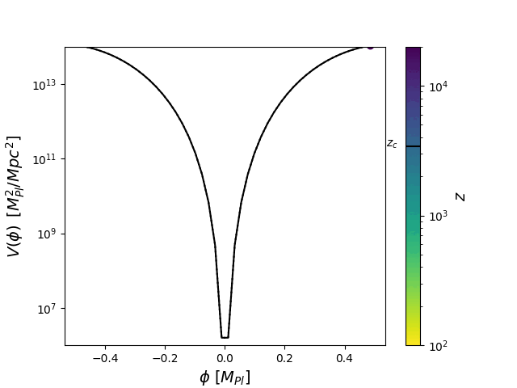
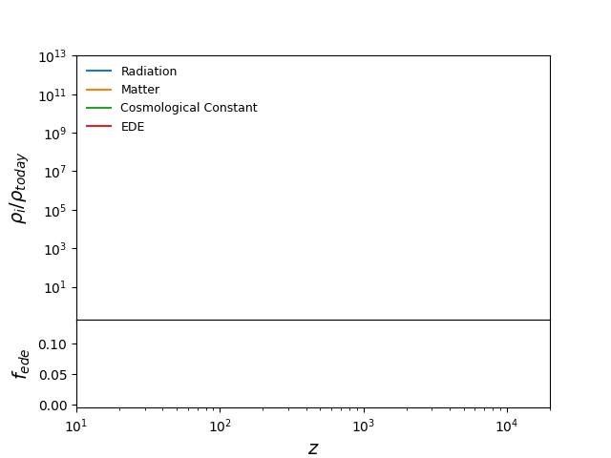

Ultra-light-axion-inspired EDE
$$V\left(φ\right)∝{\left(1−cos\left(φ\right)\right)}^{n}$$
Based on Poulin,.. TK, et al [1806.10608]
Notes:
EDE has issues
Most EDE models are fine-tuned to appear around matter radiation equality
This specific potential for EDE itself has fine-tuning issues

Slide 42
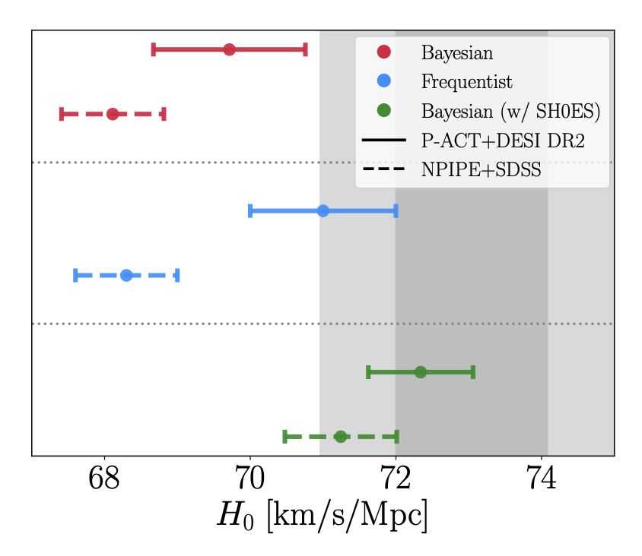
EDE still a viable solution after DESI and ACT
See also
Allali, Praniti Singh et al [2503.05691]
Poulin et al [2505.08051]
Notes:
EDE actually fits just CMB data better than LCDM

Slide 43
Phenomenological cosmology
Observables
Hubble tension
Evolving dark energy
Neutrinos

Slide 44
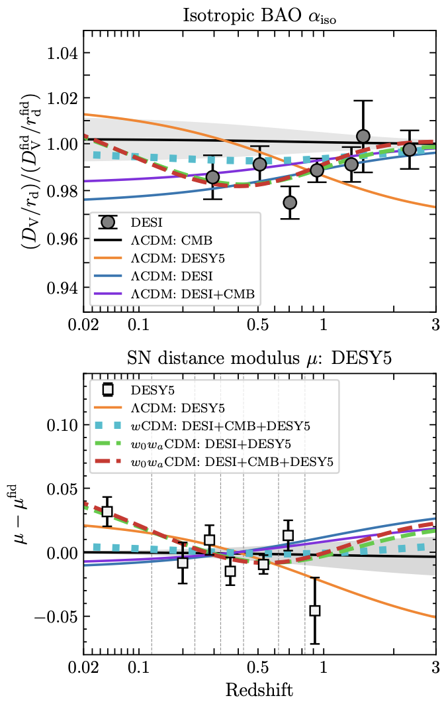


BAO and supernovae need more flexibility than just $Ω_{m}$
$Λ$CDM cannot fit both BAO and SNe
with the sole freedom of $Ω_{m}$
More freedom is needed, eg through freeing $w_{0}w_{a}$
to fit both simultaneously
DESI [2503.14738]

Slide 45
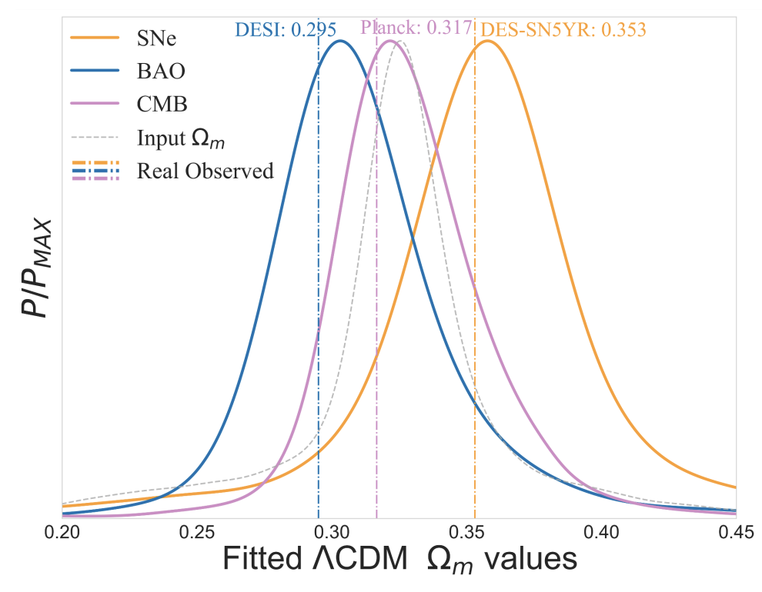


Discrepancies in $Ω_{m}$ under $Λ$CDM
Under $Λ$CDM, data prefer
$$Ω_{m}^{BAO}<Ω_{m}^{CMB}<Ω_{m}^{SNe}$$
Mock data generated in
data-preferred $w_{0}w_{a}$ cosmology
echoes the same variation in $Λ$CDM $Ω_{m}$
See also Berghaus et al [2404.14341]
Tang, Brout. TK, et al [2412.04430]
Notes:
Planck CMB, SDSS BAO, DESY5 SNe, DES 3x2

Slide 46
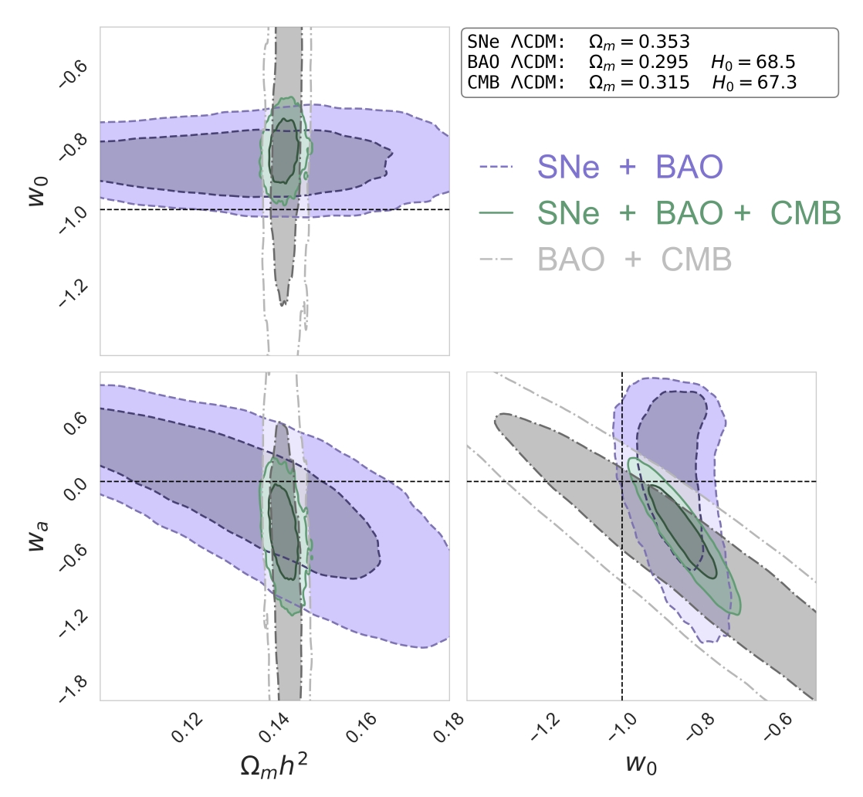

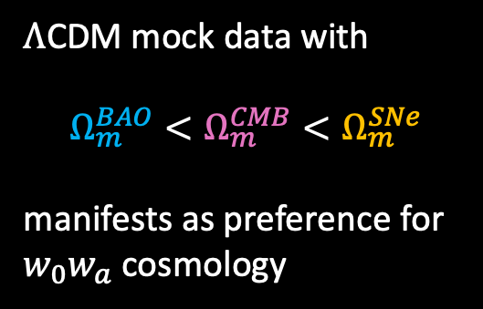
Discrepancies in $Ω_{m}$ under $Λ$CDM ⟷ preference for $w_{0}w_{a}$
$Λ$CDM mock data with
$$Ω_{m}^{BAO}<Ω_{m}^{CMB}<Ω_{m}^{SNe}$$
manifests as preference for
$w_{0}w_{a}$ cosmology
Tang, Brout. TK, et al [2412.04430]

Slide 47
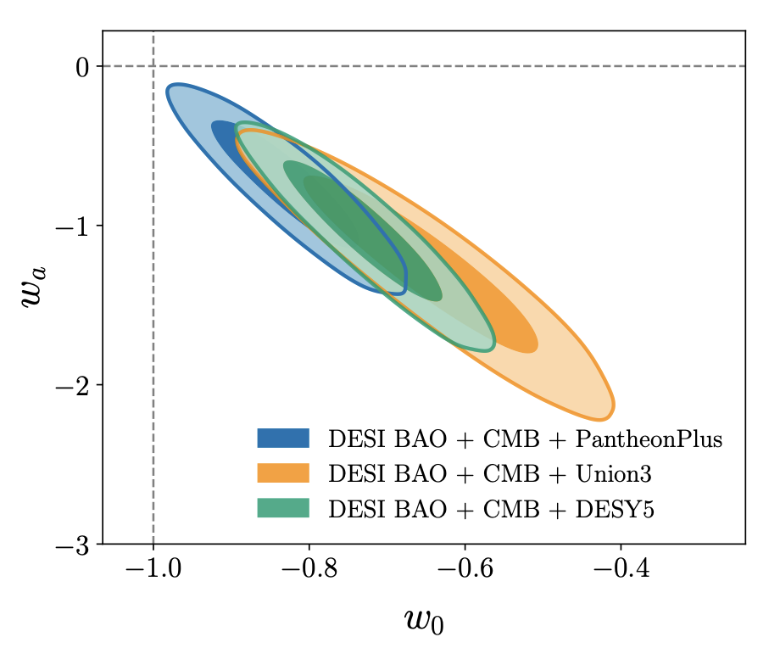


Preference for $w_{0}w_{a}$ is stable across DR1 and DR2
DESI [2404.03002]
DESI [2503.14738]

Slide 48



Preference for $w_{0}w_{a}$ is not a prior volume effect
$Λ$CDM mock data analysed under $w_{0}w_{a}$ recover $Λ$CDM
Tang, Brout. TK, et al [2412.04430]

Slide 49


Data prefers a phantom crossing
$w_{0}w_{a}$ allows phantom crossing
It does not phenomenologically trace scalar-field dark energy
DESI [2503.14738]
Notes:
Urge against w0wa because it is unphysical
Thawing chi2 = −13.2
Phantom chi2 = −21.0

Slide 50
Phenomenological cosmology
Observables
Hubble tension
Evolving dark energy
Neutrinos

Slide 51

ΛCDM cosmology prefers negative neutrino masses
DESI DR2 BAO + DESI DR1 full shape [2503.14744]
Notes:
Smaller Omm than at CMB

Slide 52



BAO preference for low $Ω_{m}$ drives $M_{ν}≡Σm_{ν}$ constraint
Tanisha Jhaveri,
U Chicago
Jhaveri, TK, Hu [2504.21813]
Notes:
Others have made these points before, but I will be pulling from my own work to demonstrate it

Slide 53



Freedom in $A_{lens}$ , $τ$ or $w_{0}w_{a}$ brings $Σm_{ν}$ into agreement with terrestrial experiments
Jhaveri, TK, Hu [2504.21813]
DESI DR2 BAO + DESI DR1 full shape [2503.14744]

Slide 54



Freedom in $A_{lens}$ , $τ$ or $w_{0}w_{a}$ brings $Σm_{ν}$ into agreement with terrestrial experiments
The $Ω_{m}↔A_{s}$ degeneracy is further degenerate with $A_{lens }$
$w_{0}w_{a}$ freedom relaxes preference for small $Ω_{m}$
$τ$is degenerate with $A_{s}$ which
through CMB lensing tied to $Ω_{m}$
Jhaveri, TK, Hu [2504.21813]
DESI DR2 BAO + DESI DR1 full shape [2503.14744]

Slide 55



Freedom in $τ$ or $w_{0}w_{a}$ brings $Σm_{ν}$ into agreement with terrestrial experiments
Jhaveri, TK, Hu [2504.21813]
DESI DR2 BAO + DESI DR1 full shape [2503.14744]

Slide 56



Takeaways
Observable | Parameters probed | Physics sensitivity
CMB primary anomalies | $$ω_{b}, ω_{c}, θ_{∗}, A_{s}, n_{s}, τ$$ | Background + perturbations
CMB lensing | $Ω_{m}, A_{s}$ but degenerate | Background + perturbations
BAO | $$Ω_{m}\text{, }H_{0}r_{d} \text{or} H(z)/H_{0}$$ | Background
Supernovae | $Ω_{m}$ or $H(z)/H_{0}$ | Background
Distance ladder | $$H_{0}$$ | Background
Hubble tension
Evolving dark energy
Neutrino masses
The Hubble tension persists with DESI BAO and ACT CMB
Likely requires an
early-universe solution
Early dark energy
remains viable
Discrepancies in $Ω_{m}$ across BAO, CMB and SNe lead to preference for $w_{0}w_{a}$
Preference is stable and
free of prior-volume effects
BAO preference for low $Ω_{m}$ leads to strong constraint on $Σm_{ν}$
Freeing $A_{lens}$ , $τ$ or $w_{0}w_{a}$ shifts $Σm_{ν}$ back into agreement with normal ordering

Slide 58
Back-up slides

Slide 59


Several $w_{0}w_{a}$ cosmologies can generate the observed differences in $Λ$CDM $Ω_{m}$ across CMB, SNe and BAO data
Tang, Brout. TK, et al [2412.04430]

Slide 60


$τ$ freedom can reconcile minimal mass neutrinos from the CMB with either BAO or SNe but not both
Jhaveri, TK, Hu [2504.21813]

Slide 61
EDE and data

Slide 62




Early dark energy
Sound-horizon free data
P1 = ACT + Planck CMB lensing + priors on $A_{s}$ and $n_{s}$, and prior on $Ω_{b}h^{2}$ from BBN
$Λ$CDM
EDE
A sound-horizon free determination of $H_{0}$ is model-dependent
EDE opens degeneracy directions that still permit a resolution to
the Hubble tension
Also
work from Oliver Philcox
and Smith et al [2208.12992]
Kable and Miranda [2403.11916]

Slide 63


Early dark energy
JWST early massive galaxies
EDE modifications to $Λ$CDM parameters enhances halo and galaxy abundances at high $z$
Shen et al [2406.15548]
Notes:
which has the potential to alleviate the UVLF tension
And another tension raised by JWST regarding potentially overly-massive galaxies at 𝑧 ≳ 5

Slide 64




Early dark energy
Detection in the CMB
Poulin et al [2109.06229]
Smith et al [2309.03265]
ACT data alone and in combination with low $ℓ$ Planck data favours EDE.
Some tension between ACT and Planck around $1000∼ℓ∼1500$
EDE is consistent with $Λ$CDM under SPT and Planck data

Slide 65

EDE and ACT
ACT [2503.14454]

Slide 66
Early dark energy and the dark sector

Slide 67




EDE and dark matter
Chameleon EDE coupled to dark matter
Conformally couple a scalar field to dark matter
$$ρ_{total}+=ρ_{dm}A(φ)$$
$$V_{eff}\left(φ\right)=V\left(φ\right)+ρ_{dm}A(φ)$$
Modifies DM evolution → $S_{8}$ ?
Tie the redshift of EDE to $z_{eq}$ through coupling $A(φ)$
$$V\left(φ\right)∼φ^{4}$$
$$A\left(φ\right)∼e^{βφ}$$
TK et al [2106.13290]
Notes:
Coupling a scalar field to DM will have implications for clustering of matter

Slide 68

EDE and dark energy
Attractive EDE coupled to dark energy
$$V\left(φ\right)=V_{α}e^{−α\frac{φ}{M_{Pl}}}+V_{β}e^{−β\frac{φ}{M_{Pl}}}$$
For $α>β$, early and late dark energy attractors
EDE saddle point in the radiation era
Transition to a matter saddle in the matter era
Settle into dark energy attractor
Ramadan, TK et al [2309.08082]
Notes:
EDE saddle-point in the radiation epoch,
transition to a matter saddle with some fraction of dark matter composed of the (non-clustering) scalar,
and will ultimately settle into the LDE attractor.

Slide 69

EDE and dark energy
Attractive EDE coupled to dark energy
$$V\left(φ\right)=V_{α}e^{−α\frac{φ}{M_{Pl}}}+V_{β}e^{−β\frac{φ}{M_{Pl}}}$$
Too much contribution from @EDE during the matter era strongly constrains this model, preventing a Hubble solution
@EDE presence at early times increases the early ISW effect, requiring an increase in $ω_{c}$
@EDE contribution post-recombination decreases $D_{A}$ requiring a decreases in $ω_{c}$
Model-building guidance - minimise the contribution of @EDE during matter-domination
Ramadan, TK et al [2309.08082]
Notes:
Alternatives:
non-minimal scalar theories such as coupled quintessence, where the scalar is conformally coupled to dark matter.
The fixed points of these theories are similar to those found in the uncoupled case
but the equation of state for the scalar at each point depends on the strength of the dark matter coupling.
Models where the equation of state at the dark matter saddle is wφ > 0
so that the scalar redshifts during the matter era
K-essence theories, where the scalar has a non-canonical kinetic term
or disformal quintessence where the scalar is derivatively coupled to dark matter.

Slide 70
DER at late times

Slide 71


EDE and dark radiation
Dissipative axion EDE coupled to dark radiation
Uncoupled scalar experiences Hubble friction. Uncoupled DR dilutes as ${\left(1+z\right)}^{4}$
$$\ddot{φ}+\left(3H\right) \dot{φ}+V_{φ}=0$$
$${\dot{ρ}}_{dr}=−4Hρ_{dr}$$
$$V\left(φ\right)$$
Berghaus & Karwal [1911.06281]

Slide 72

EDE and dark radiation
Dissipative axion EDE coupled to dark radiation
Scalar coupled to DR additionally experiences thermal friction
$$\ddot{φ}+\left(3H+Υ\right) \dot{φ}+V_{φ}=0$$
$${\dot{ρ}}_{dr}=−4Hρ_{dr}+Υ{\dot{φ}}^{2}$$
$$V\left(φ\right)$$
Berghaus & Karwal [1911.06281]
Notes:
Robust against potential choice,
Only parameters that matter are m, Y, phi_i

Slide 73




EDE and dark radiation
Dissipative axion EDE coupled to dark radiation
$$\ddot{φ}+\left(3H+Υ\left(T_{dr}\right)\right) \dot{φ}+V_{φ}=0$$
$${\dot{ρ}}_{dr}=−4Hρ_{dr}+Υ\left(T_{dr}\right){\dot{φ}}^{2}$$
$$m, φ_{i}→f_{ede}$$
$$m, Υ\left(T_{dr}\right)→z_{c}$$
$$w_{f}=1/3$$
Robust to choice of $V(φ)$
$$f_{ede}$$
$$w_{f}=1/3$$
$$z_{c}$$
Berghaus & Karwal [1911.06281]
Notes:
With the DA we are interested in the regime where the scalar is overdamped
In the overdamped regime, m and Y determine z_c
Robust against potential choice,
Only parameters that matter are m, Y, phi_i

Slide 74


EDE and dark radiation
DA EDE coupled to DR
Fit to CMB+BAO+SNe+H0+DES
Higher Hubble than $Λ$CDM and $N_{eff}$
Similar $S_{8}$ to $Λ$CDM and $N_{eff}$
Extra radiation preferred over EDE-like injection
Similar fit to CMB as $Λ$CDM, but worse than $Λ$CDM fit to concordant data
Dissipative axion performs better than $N_{eff}$ but suffers the same CMB constraints as other extra radiation
Berghaus & Karwal [2204.09133]

Slide 75


EDE and dark radiation
Dark energy radiation
Scalar coupled to DR additionally experiences thermal friction
$$\ddot{φ}+\left(3H+Υ\right) \dot{φ}+V_{φ}=0$$
$${\dot{ρ}}_{dr}=−4Hρ_{dr}+Υ{\dot{φ}}^{2}$$
$$V\left(φ\right)$$
Berghaus, Karwal et al [2311.08638]

Slide 76




EDE and dark radiation
Dark energy radiation
Initial constraints:
Planck CMB + BAO + Pantheon SNe
$V\left(φ\right)=Cφ$
$Ω_{DER}≃0.03$ at $2σ$
$100 × Λ$CDM radiation $Ω_{γ}∼{10}^{−4}$
$5000 × ΔN_{eff}$ radiation $Ω_{N_{eff}}∼{10}^{−5}$
Berghaus, Karwal et al [2311.08638]
Minimal DER
$$Υ∝ρ_{DER}^{3/4}$$
Toy DER
$Υ=$ constant
Quintessence
$Υ=0$
Future data:
SO CMB + BAO + Roman SNe
$Ω_{DER}≃1\%$ at $2σ$
DESI DR1 data:
CMB + DESI + Pan+
$Ω_{DER}≃0.03$ at 1$σ$ with
Berghaus et al [2404.14341]

Slide 77


EDE and dark radiation
Dark energy radiation
$Λ$CDM
Minimal DER
Toy DER
Quintessence
DER produced dynamically in the late universe evades early-universe DR bounds where $Ω_{DER}≃0$
Constraints are dominated by the impact of DER on the background expansion $H\left(z\right)=H_{0} E(z)$
Berghaus, Karwal et al [2311.08638]
Notes:
Constraints primarily arise from impact to bg universe

Slide 78


EDE and dark radiation
Dark energy radiation
$Λ$CDM
Minimal DER
Toy DER
Quintessence
Neither current or future CMB and SNe data will able to distinguish these models in
$$E\left(z\right)=\frac{H\left(z\right)}{H_{0}}$$
or
$$w\left(z\right)$$
Test with dark radiation experiments?
Berghaus, Karwal et al [2311.08638]
Notes:
detection and differentiation in current and future bg data unlikely, but may be interesting for LSST / Euclid

Slide 79
S8 tension

Slide 80


Slide 81





Early dark energy worsens the weak-lensing $S_{8}$ tension
Impact of EDE on LSS tension
Officially
HSCY3, DESY3
KiDS-1350
say no tension
$$S_{8}=σ_{8}\sqrt{Ω_{m}/0.3}$$
Amplitude $σ_{8}$ of matter density fluctuations
Secco, TK et al [2209.12997]

Slide 82

The $S_{8}$ tension
Lensing survey sensitivities
$$S_{8}=σ_{8}\sqrt{Ω_{m}/0.3}$$
Amplitude $σ_{8}$ of matter density fluctuations
Secco, TK et al [2209.12997]
Doux, TK et al [2505.XXXXX]
Notes:
Here the tension is projected to just one dimension
But these surveys probe a broad range in redshift and scales – WL surveys and CMB lensing
Some but not all these scales overlap, so we usually project the tension on to one parameter
But there is a lot of useful information and model-building insight hidden by that approach
tomographic surveys that constrain cosmology over two decades in wavenumber

Slide 83



Lensing power spectra $C_{ℓ}$ and the matter power spectrum $P\left(k\right)$
$$C_{ℓ}^{ab}=∫ⅆχ \frac{q_{a}\left(χ\right)q_{b}\left(χ\right)}{χ^{2}} P\left(k= \frac{ℓ+\frac{1}{2}}{χ}, z\left(χ\right)\right)$$
$$P\left(k,z\right)=[1+α\left(k\right)]P_{fid}^{NL}\left(k,z\right)$$
with window functions $q_{a}$and comoving distance $χ$
Based loosely on Tegmark and Zaldarriaga [0207047]
Data
Model
Fiducial cosmology at Planck 2018
Deviations from a $Λ$CDM $P\left(k\right)$
Doux, TK et al [2505.XXXXX]
Notes:
Model independent deviations from Planck LCDM

Slide 84


Lensing sensitivity
$$q_{a}(χ) = \frac{3 Ω_{m} H_{0}^{2}}{2c^{2}}\frac{χ}{a\left(χ\right)}\int_{χ}^{χ_{∗}}{ⅆχ^{′} n_{a}\left(χ^{′}\right)} \frac{χ−χ′}{χ′}$$
DESY3
Doux, TK et al [2505.XXXXX]
Notes:
Source galaxy distributions

Slide 85

Lensing power spectra $C_{ℓ}$ and the matter power spectrum $P\left(k\right)$
$$C_{ℓ}^{ab}=∫ⅆχ \frac{q_{a}\left(χ\right)q_{b}\left(χ\right)}{χ^{2}} P\left(k= \frac{ℓ+\frac{1}{2}}{χ}, z\left(χ\right)\right)$$
$$P\left(k,z\right)=[1+α\left(k\right)]P_{fid}^{NL}\left(k,z\right)$$
with window functions $q_{a}$and comoving distance $χ$
Based loosely on Tegmark and Zaldarriaga [0207047]
Data
Model
Fiducial cosmology at Planck 2018
Deviations from a $Λ$CDM $P\left(k\right)$
Doux, TK et al [2505.XXXXX]

Slide 86


Projecting $S_{8}$ onto $P(k,z)$
Validation
DES-like mock data with various injected deviations from
a non-linear, Planck-$Λ$CDM matter power spectrum
Suppression of the non-linear matter power spectrum based on Preston et al [2305.09827]
Impact of baryons – AGN feedback
Modified gravity $μ−Σ$
Doux, TK et al [2505.XXXXX]
Notes:
𝜇(𝑎, 𝑘) quantifies the strength of the gravitational interaction, related to the behaviour of non-relativistic particles and which modifies the growth of structure
Σ(𝑎, 𝑘) is proportional to the Weyl potential (Φ + Ψ)/2 and hence it quantifies deviations from GR associated with the response of massless particles in the gravitational lensing effect

Slide 87


Projecting $S_{8}$ onto $P(k,z)$
Validation
DES-like mock data with various injected deviations from
a non-linear, Planck-$Λ$CDM matter power spectrum
Suppression of the non-linear matter power spectrum based on Preston et al [2305.09827]
Impact of baryons – AGN feedback
Modified gravity $μ−Σ$
Scale-dependent deviations fully recovered
Redshift-dependent deviations recovered at the redshift at which the experiment has peak sensitivity
$$P\left(k,z\right)=[1+α\left(k\right)]P_{fid}^{NL}\left(k,z\right)$$
Doux, TK et al [2505.XXXXX]
Notes:
𝜇(𝑎, 𝑘) quantifies the strength of the gravitational interaction, related to the behaviour of non-relativistic particles and which modifies the growth of structure
Σ(𝑎, 𝑘) is proportional to the Weyl potential (Φ + Ψ)/2 and hence it quantifies deviations from GR associated with the response of massless particles in the gravitational lensing effect

Slide 88



Projecting $S_{8}$ onto $P(k,z)$
Results lensing surveys
$$P\left(k,z\right)=[1+α\left(k\right)]P_{fid}^{NL}\left(k,z\right)$$
DES, KiDS**, HSC prefer less power on small scales $k ≳0.03 1/Mpc$
ACT is consistent with Planck
Both conclusions match expectations
Identified specific scales at which suppression is preferred
PRELIMINARY RESULTS
Doux, TK et al [2505.XXXXX]

Slide 89
Procoli: profiles of cosmological likelihoods

Slide 90
Early dark energy
Phenomenology
Additional energy component that increases the pre-CMB expansion rate
$Λ$-like behaviour initially
Then dilutes faster than matter at $w_{f}$
Localised peak in $f_{ede}=\frac{ρ_{ede}}{ρ_{total}}$ at $z_{c}$
Energy densities
$$w_{f}$$
$$z_{c}$$
$f_{ede}$ - how much EDE
$z_{c}$ - when EDE appears
$w_{f}$ - how fast is disappears
$$f_{ede}$$
TK and Kamionkowski [1608.01309]
Notes:
The plot shows the energy densities of various components of the universe in the LCDM + EDE scenario
Remember, the expansion rate depends on the energy content
If we add energy to the universe, it expands faster
EDE is disjoint from late time DE
The early dark energy we add behaves like a CC at early times
Like a CC or the DE causing the universe to expand faster today
This EDE too makes the universe expand faster for a short amount of time
It then rapidly dissipates, the EDE shown here goes as size ^-6
But we also investigate EDEs that dissipate like radiation, so the line would be parallel to the blue line
And EDEs that dissipate somewhere in between the blue and red lines
This addition has two parameters, the amount of EDE in the universe
And the time at which its behaviour switches
Relative to the rest of the contents of the universe
The EDE density is pretty small at all times except near z_c, the knee in this curve
Which means, such a model can not only increase the early universe expansion rate
But also leave the late universe unchanged
-------
Slowly rolling scalar field
initially frozen due to Hubble friction
and then dilutes faster than matter

Slide 91



Alternate statistical frameworks
Early dark energy
Bayesian posteriors
- - - - Likelihood profile
Prior volume increases as $f_{ede}→0$
$z_{c}$ and $w_{f}$ become unconstrained
$f_{ede}$ - how much EDE
$z_{c}$ - when EDE appears
$w_{f}$ - how fast is disappears
Fit to CMB+BAO+SNe,
no $H_{0}$ prior
Poulin, Smith and TK [2302.09032]

Slide 92


Alternate statistical frameworks
Bayesian inference
$$𝒫\left(θ|d\right)=\frac{Π\left(θ\right) ℒ\left(d|θ\right)}{ℰ(d)}$$
Profile likelihoods
No dependence on prior
$$ℙ\left(θ_{i}\right)= max ℒ\left(θ | θ_{i}=θ_{i}^{′}\right) ∀ θ_{i}′$$
See Planck [1311.1657]
$Λ$CDM fit to CMB+BAO+SNe
Notes:
Bayesian inference in practice, without infinite MCMC chains, approximates the posterior through Bayes’ theorem
It relies on and incorporates prior knowledge
A likelihood profile maximises the likelihood for every given value of a parameter
So this is a profile of the maximum likelihood in a specific parameter direction
It is completely independent of priors
Agree in the limit of infinite data
Also agree in cases where priors are truly uninformative and the data is sensitive enough to model parameters that they are well constrained, away from prior boundaries
This is the case in LCDM

Slide 93




Alternate statistical frameworks
Bayesian inference
$$𝒫\left(θ|d\right)=\frac{Π\left(θ\right)ℒ\left(d|θ\right)}{ℰ(d)}$$
Profile likelihoods
No dependence on prior
$$ℙ\left(θ_{i}\right)= max ℒ\left(θ | θ_{i}=θ_{i}^{′}\right) ∀ θ_{i}′$$
Prior volume increases as $f_{ede}→0$
$z_{c}$ and $w_{f}$ become unconstrained
Fit to CMB+BAO+SNe,
no $H_{0}$ prior
Poulin, Smith and TK [2302.09032]

Slide 94

Alternate statistical frameworks
Bayesian inference
$$𝒫\left(θ|d\right)=\frac{Π\left(θ\right)ℒ\left(d|θ\right)}{ℰ(d)}$$
Profile likelihoods
No dependence on prior
$$ℙ\left(θ_{i}\right)= max ℒ\left(θ | θ_{i}=θ_{i}^{′}\right) ∀ θ_{i}′$$
Model with several parameters that become irrelevant as one $→0$ will have a large prior volume in that direction
Fit to CMB+BAO+SNe,
no $H_{0}$ prior
Poulin, Smith and TK [2302.09032]

Slide 95



Profiles of cosmological likelihoods
Also pinc from JHU’s Laura Herold
Yashvi Patel
Yale
Alexa Bartlett UC Berkely
TK, YP, AB, et al [2401.14225]
Notes:
Procoli wraps MontePython so you automatically have access to any likelihoods in MP
Working on expanding it to encompass other samplers too

Slide 96
Procoli
Optimisers
Profile likelihood with simulated annealing – Procoli
Profile likelihood without stochastic algorithm - Minuit
Posterior profile
TK et al [2401.14225]

Slide 97


Procoli
Simulated annealing optimisation
Temperature $T$
Step size $δ$
Optimization for noisy, high-dimensional parameter spaces
If $1<\frac{ℒ_{new}}{ℒ_{old}}$
accept
Else draw a random number $x ∈ [0, 1]$ from a uniform distribution
If $x<{\left(\frac{ℒ_{new}}{ℒ_{old}}\right)}^{\frac{1}{T}}$
accept
Else
reject
TK, YP, AB, et al [2401.14225]

Slide 98
TK et al [2401.14225]
Procoli
Optimiser validation
Notes:
Input mock cosmology recovered
Mock CMB data at a fiducial EDE cosmology
Procoli recovered input cosmology with good and bad initial guesses, within ~0.1% level of the fiducial

Slide 99

Procoli
$χ^{2}$ per experiment breakdown
TK et al [2401.14225]

Slide 100


Procoli
Independent applications
Data are insensitive to a parameter
Impact of a prior boundary
Greene and Cyr-Racine [2403.05619]
Some data sets are insensitive to free-fall, amplitude, and Thomson (FFAT) re-scaling
Naredo-Tuero et al [2407.13831]
Preferences for neutrino masses are impacted by different CMB data

Slide 101





Procoli
Independent applications

Slide 102



Procoli
2D profiles on DM-b scattering
Dark matter-baryon scattering has prior volume effects in two parameter directions – fraction of DM that interacts and interaction cross section
Maria Straight,
UT Austin
Gluscevic and Boddy [1712.07133]

