Slide 1

Physics with Deep Underground Dark Matter Detectors
Jianglai Liu
Tsung-Dao Lee Institute and School of Physics and Astronomy
Shanghai Jiao Tong University
Disclaimer: This is a very vast field, so I have to make hard and personal choices on what’s covered here.

Slide 2
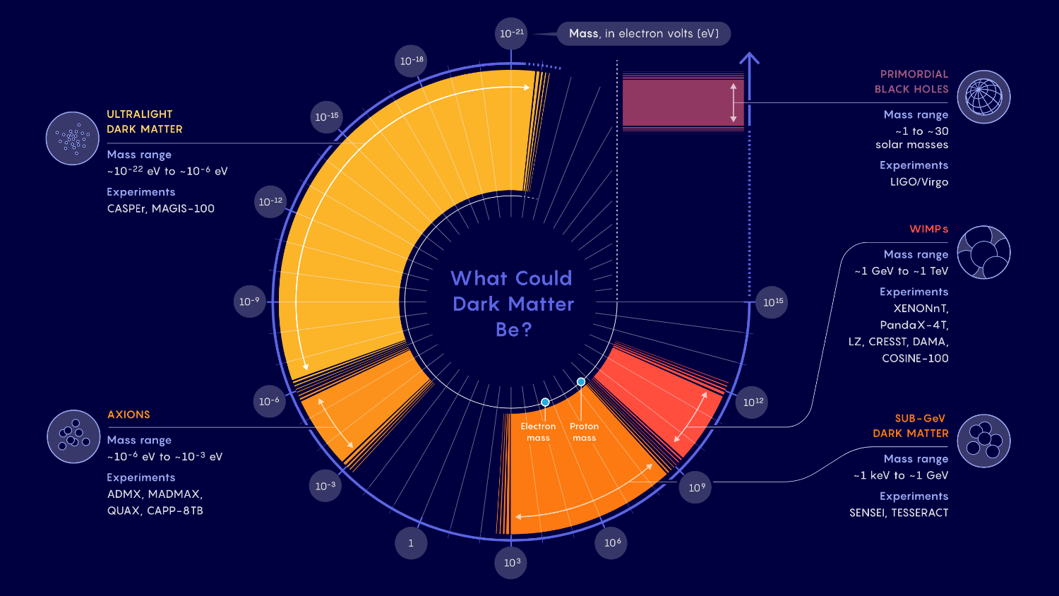
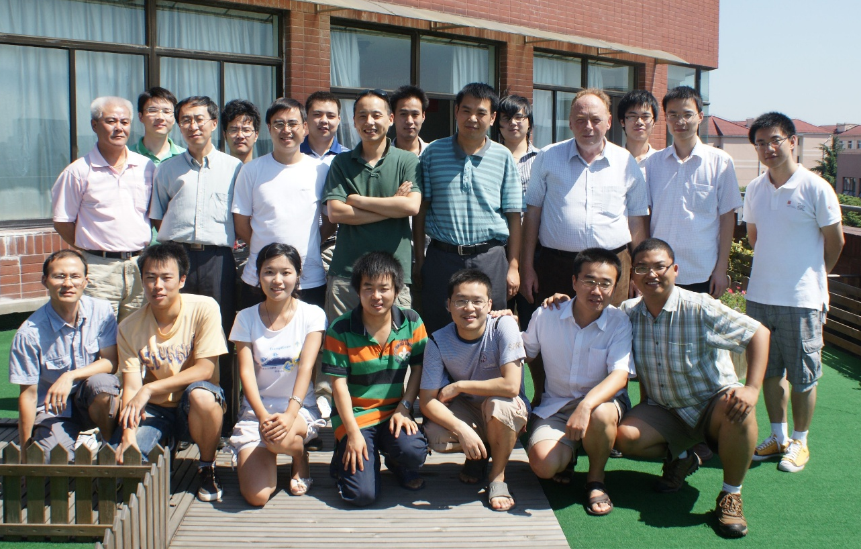
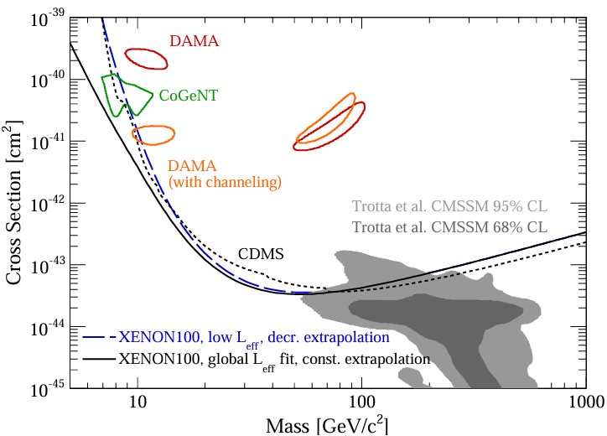
DM: low hanging fruit?
Xiangdong Ji
Kaixuan Ni
Me
Karl Giboni
PRL 105,131302 (2010)
Sanford Lab, LZ, 7 ton

Slide 3

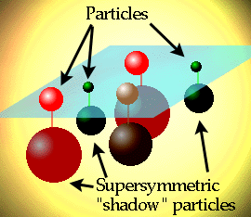
The WIMP Miracle
Beyond SM Particle Theories
DM relic density
Weakly Interacting Massive Particle (WIMP) Miracle!
Massive, mediator heavy ⇒ point-like interaction

Slide 4
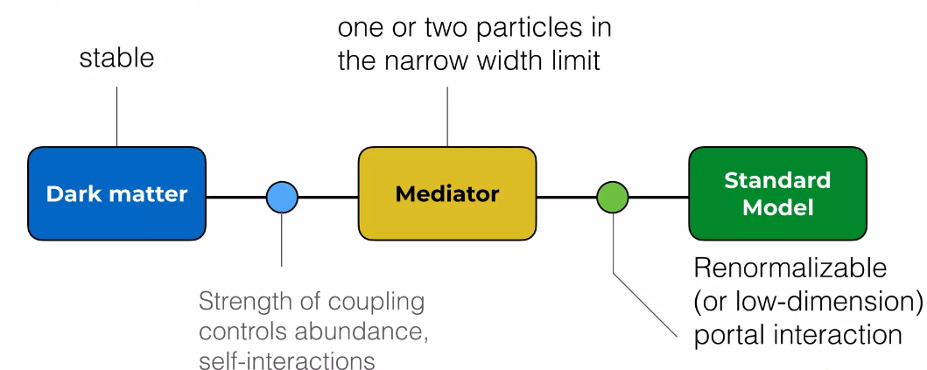
Away from Standard WIMP: the dark sector
Credit: Flip Tanedo
Bottom-line: the prejudice of “massive” particle and “electroweak-ly” is eliminated, wide search for sub-GeV dark matter (and mediators)

Slide 5
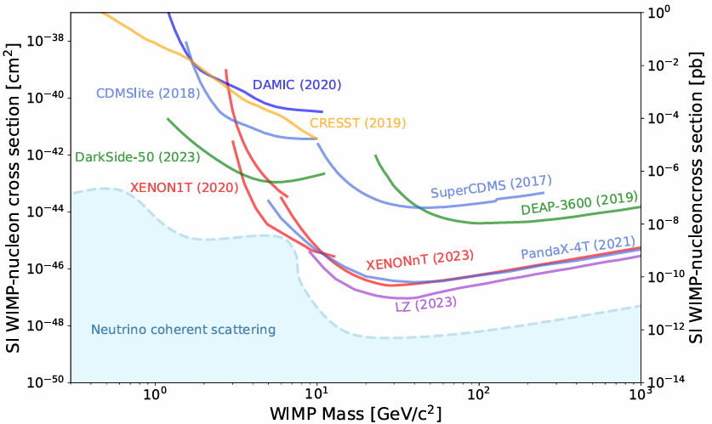
Global status: hide & seek
Elastic spin-independent cross section
Lower E_{r}
Scalable large detectors
PDG 2023 Dark Matter Review

Slide 6
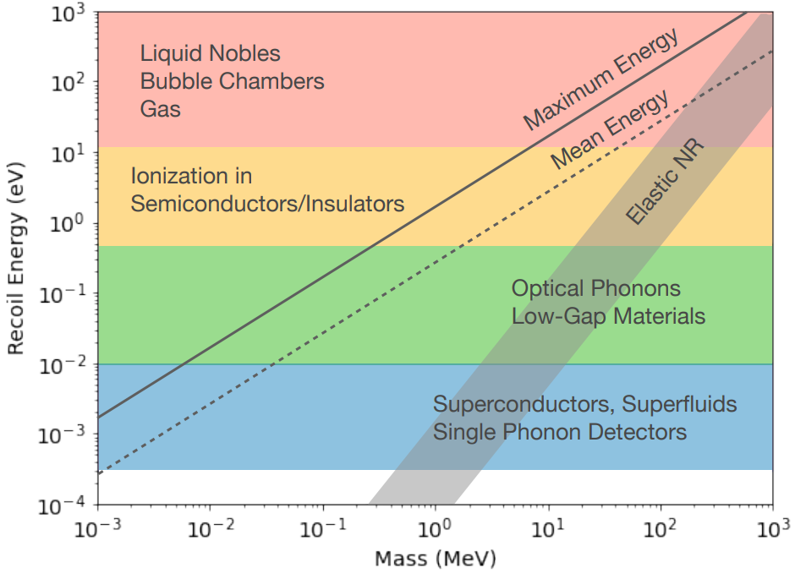
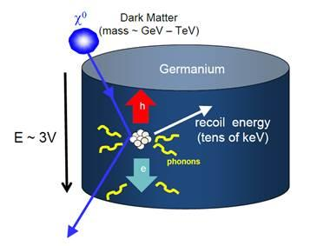
Low mass DM detection techniques
2203.08297 US Snowmass
Approach1: Energy deposition converted to phonon
Phonons can be measured, e.g., by transitional edge sensor (TES)
Some accompanying energy in ionization or photons: particle ID

Slide 7
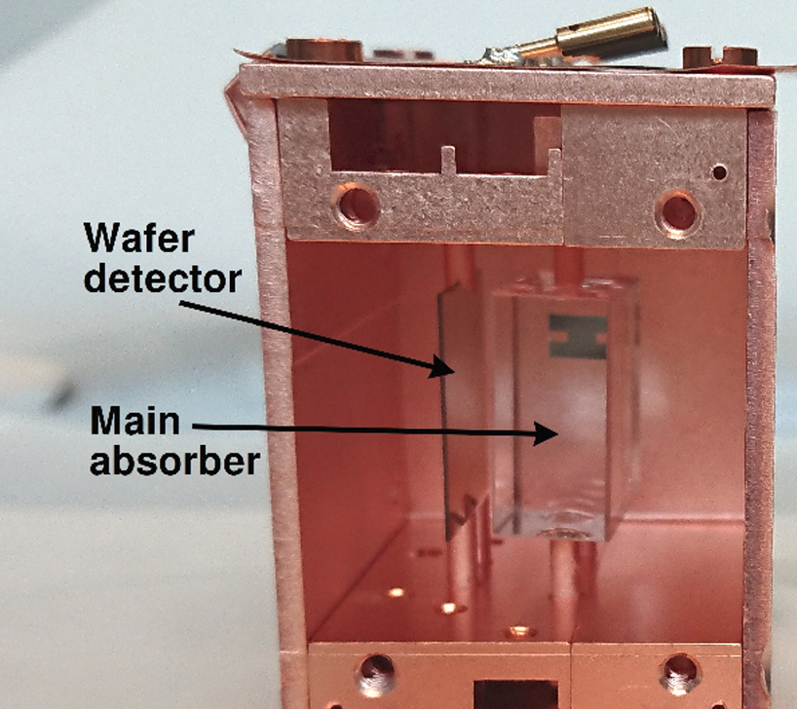
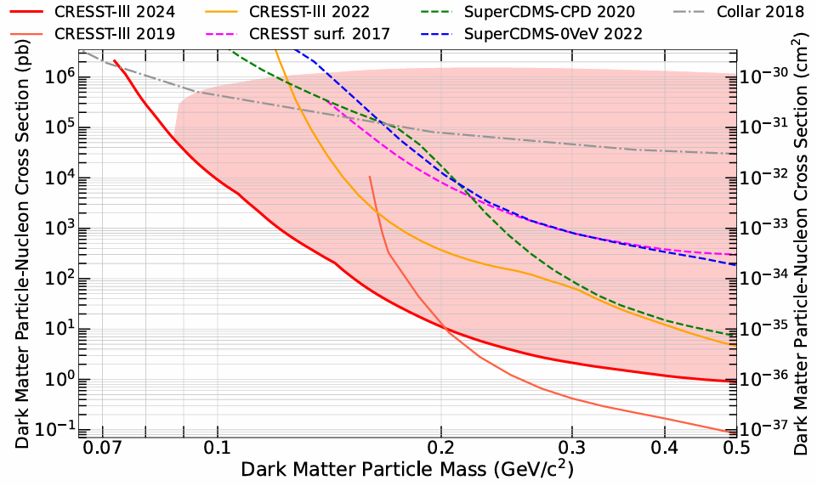
CRESST-III (phonon+light)
Si on Sapphire, 0.6 g, 138 g*day, threshold 6.7 eV; single 7.6 eV luminescence photon observed first time
PRD 110, 083038 (2024), arXiv:2405.06527
Notes:
Here are some representative effort. The SuperCDMS izip, measuring both phonon and ionization, and HV modules, sensitive so call Luke phonon (proportion to the ionization). This is the CRESST-III detectors, sensitive to both heat and photons.

Slide 8
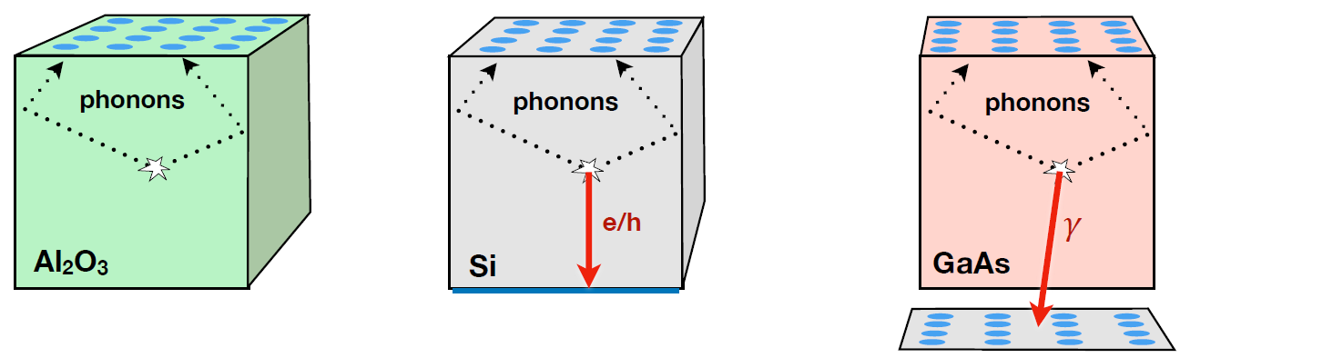
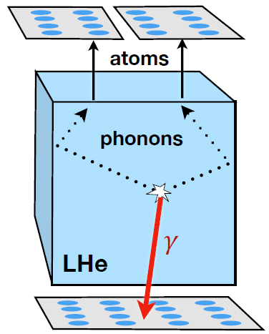
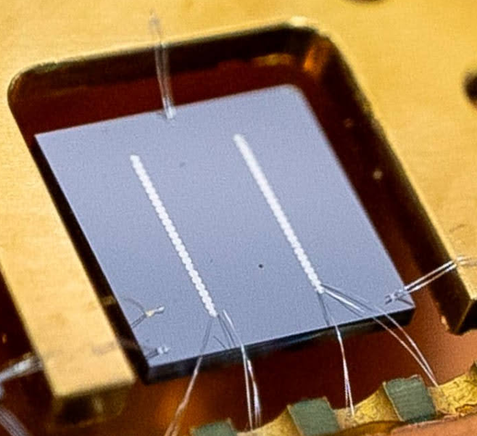
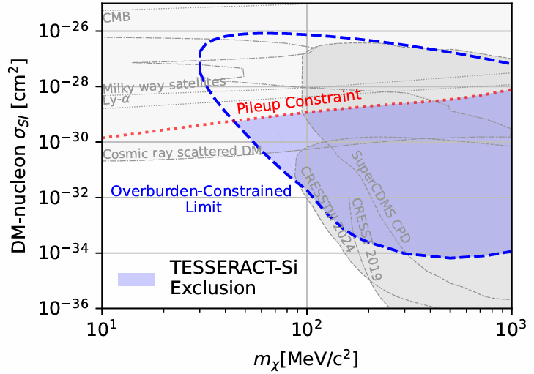
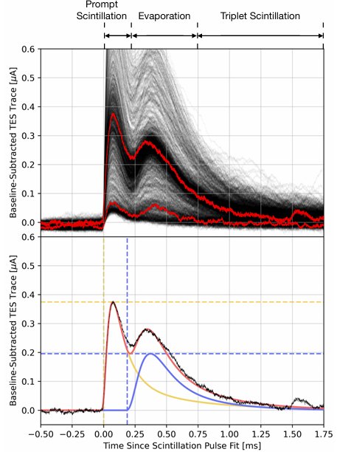
TESSERACT
Scott Hertel, UCLA DM 2025
Phonon-only
Phonon-ionization
Phonon-light
Phonon-light
arxiv:2503.03683
TES on Si
2-TES coinc
0.23g*12 hour
Threshold: 1.5 eV
PRD 110, 072006 (2024)
arXiv:2307.11877

Slide 9
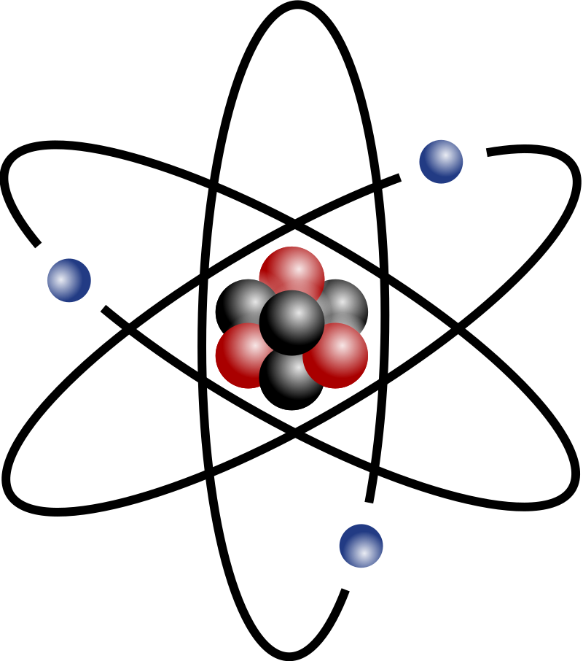

Low mass DM detection techniques
2203.08297 US Snowmass
Approach2: electron as target, with atomic inelastic scattering: accessing full DM KE-binding.
Essig, Mardon, Volansky, PRD 85, 076007 (2012)
DM’
DM
e’

Slide 10
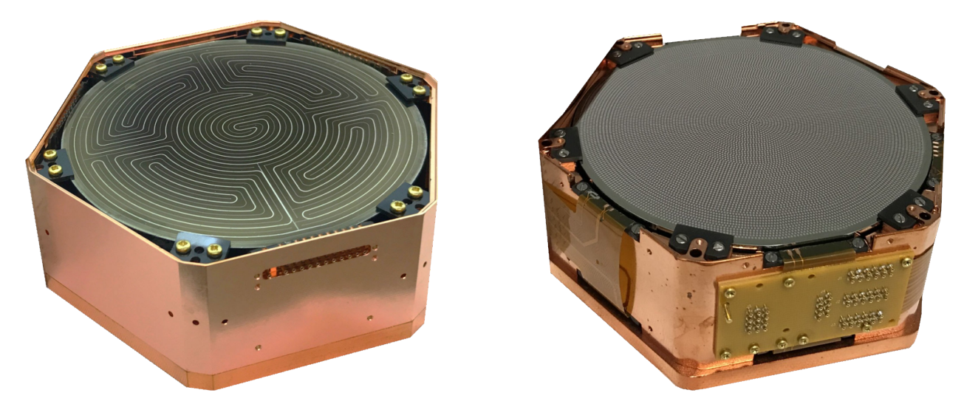
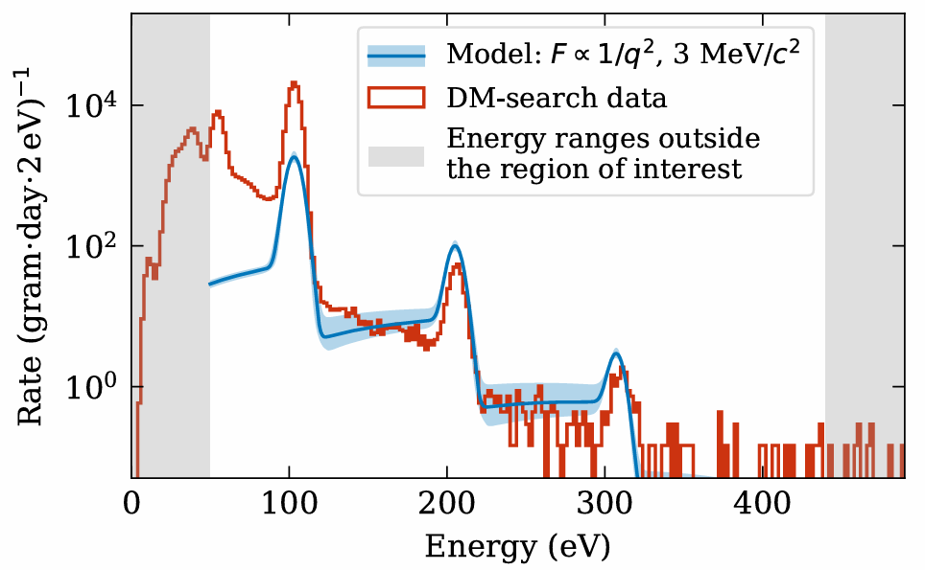
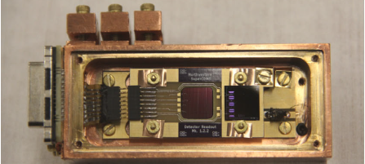
SuperCDMS
Sunil Golwala, UCLA DM 2025
iZIP (kg)
HV (kg)
Phonon+ionization
ionization
0VeV/HVeV (g)
HVeV underground run, 7.6 g*day, structure below first eh peak not yet understood
PRD 111, 012006 (2025), arXiv:2407.08085
Phonon-only or ionization-only
Notes:
Here are some representative effort. The SuperCDMS izip, measuring both phonon and ionization, and HV modules, sensitive so call Luke phonon (proportion to the ionization). This is the CRESST-III detectors, sensitive to both heat and photons.

Slide 11
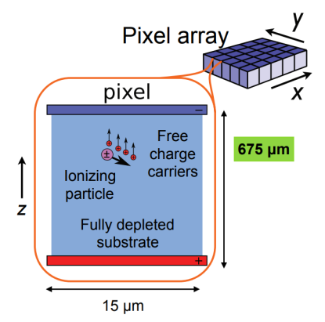
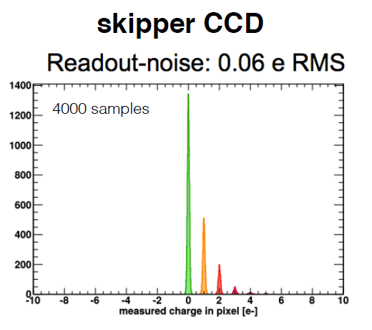
Skipper CCD
Small amount of energy converted to e-h pairs in CCD pixels
Si: 1.2 eV for an e-h pair production
Repeated readout to reduce noise <<1e-h
Ongoing effort:
SENSEI (40 g)
DAMIC SNOLAB (42 g)
DAMIC-M (26g->~kg)
Oscura: 10 kg
PRL 119 (2017) 13, 131802
Notes:
Somewhat similar to noble gas, CCD can convert amount of energy to electron-hole pairs. Recently, a special type of CCD, so-called skipper-CCD technology, enabling an extremely low noise read out capable to a tenth of an electron. Two competing experiments, SENSEI and DAMIC are being developed in parallel.

Slide 12
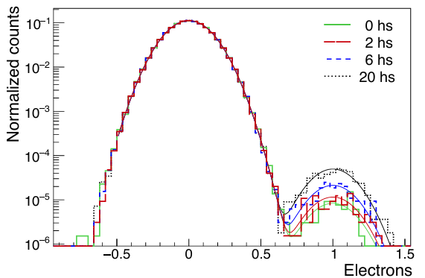
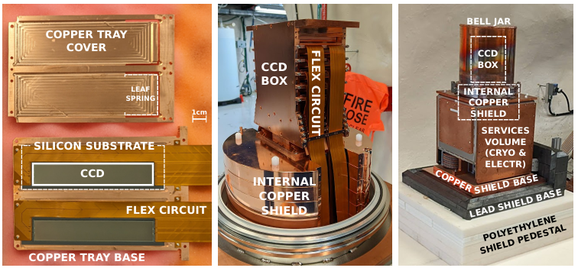
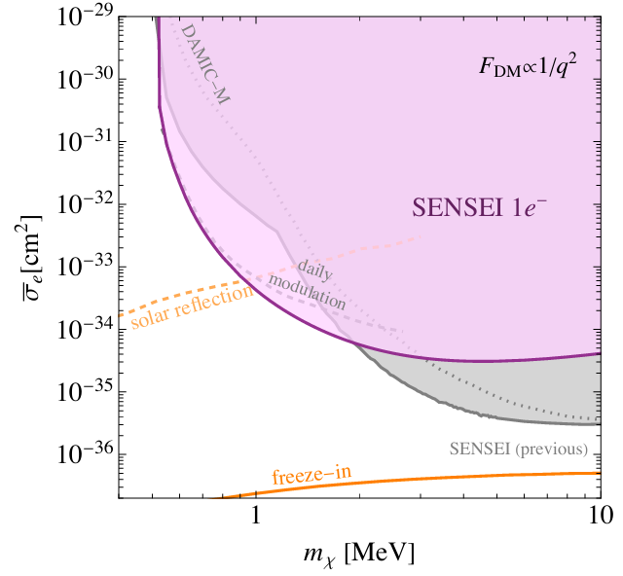
SENSEI @ SNOLab
PRL 134, 011804 (2025), PRL 134, 161002 (2025)
Lowest dark rate achieved: 40 e-/gram/day
Analysis performed with 1e- data!

Slide 13
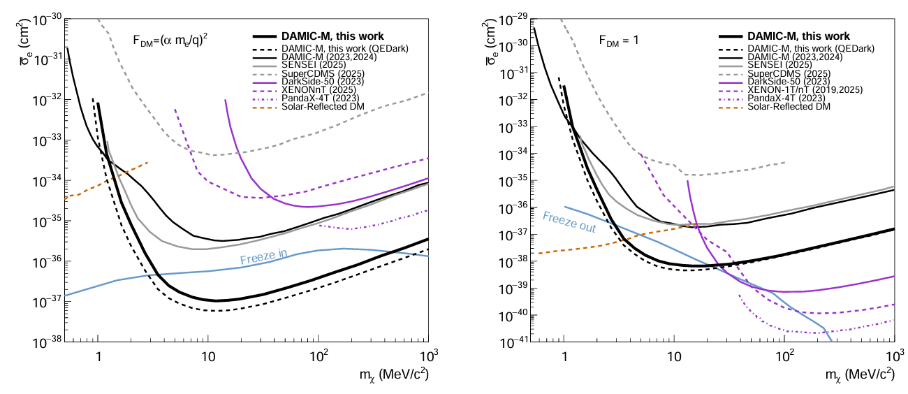
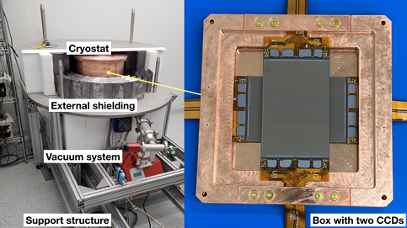
DAMIC-M
PRL 130, 171003 (2023)
arXiv:2503.14617: 1.3 kg*day, Dark rate: ~400 /g/day (improved 50-fold)
Significant freeze-in parameter space probed!

Slide 14
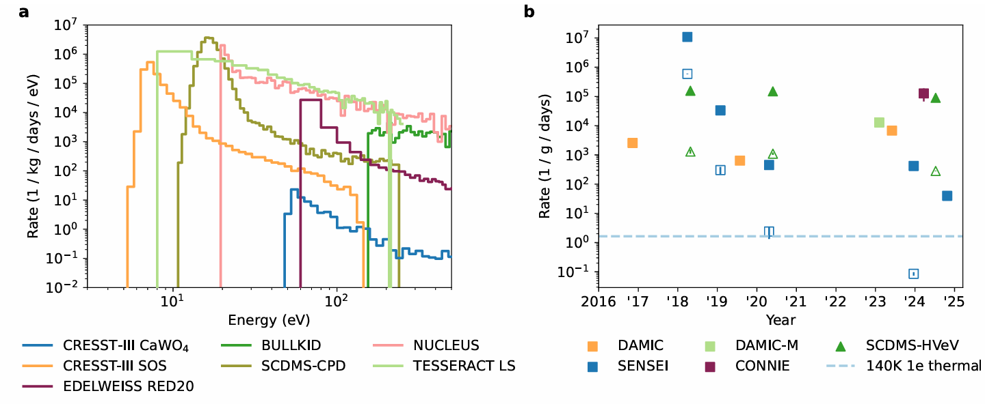
Challenge: low energy excesses
Phonon detectors
Ionization detectors
Physics? No!
Background?
  Phonon: Stress/defects, +…
  Ionization: “spurious” photon background + …
Major challenge for the DM physics
The Excess Workshop: 2202.05097
Review: 2503.08859
Notes:
Understanding the response is one thing, the background is even more difficult. It has been realized for a while a number of low threshold detector (ionization, microblometer), all seemed to exhibits some events rising at low energy. The shape/rate looks different, so a common physics origin is highly unlikely. Suspicious are environmental background or some structural issues such as stress. The excellent news is that these collaborations are forming a consortium (Excess Workshop) trying to understand these detectors in a deeper way.

Slide 15
Global status: hide & seek
Elastic spin-independent cross section
Lower E_{r}
Scalable large detectors
PDG 2023 Dark Matter Review

Slide 16
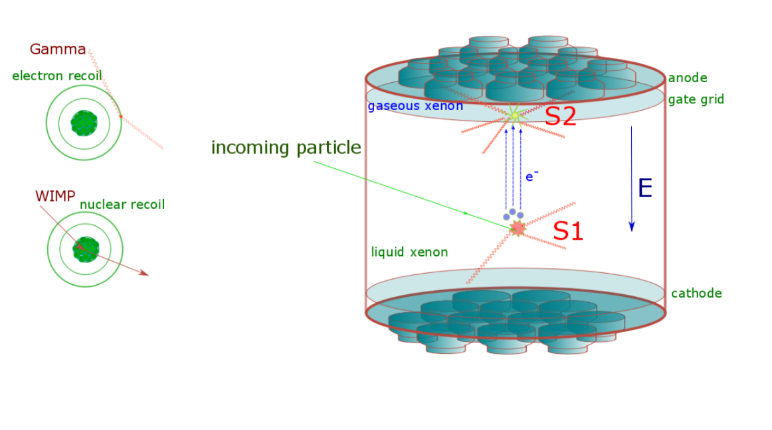
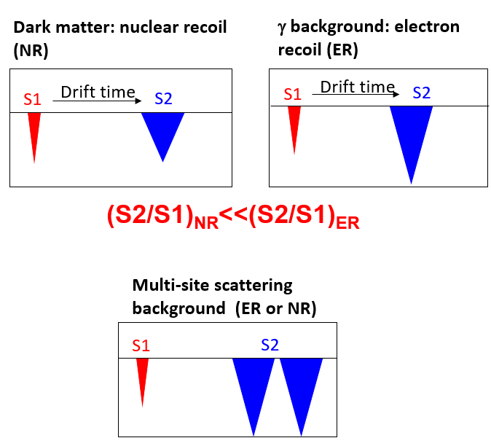
Nobel-liquid dual-phase time projection chamber
In the case of Ar, significant pulse-shape discrimination ability to differentiate ER/NR

Slide 17
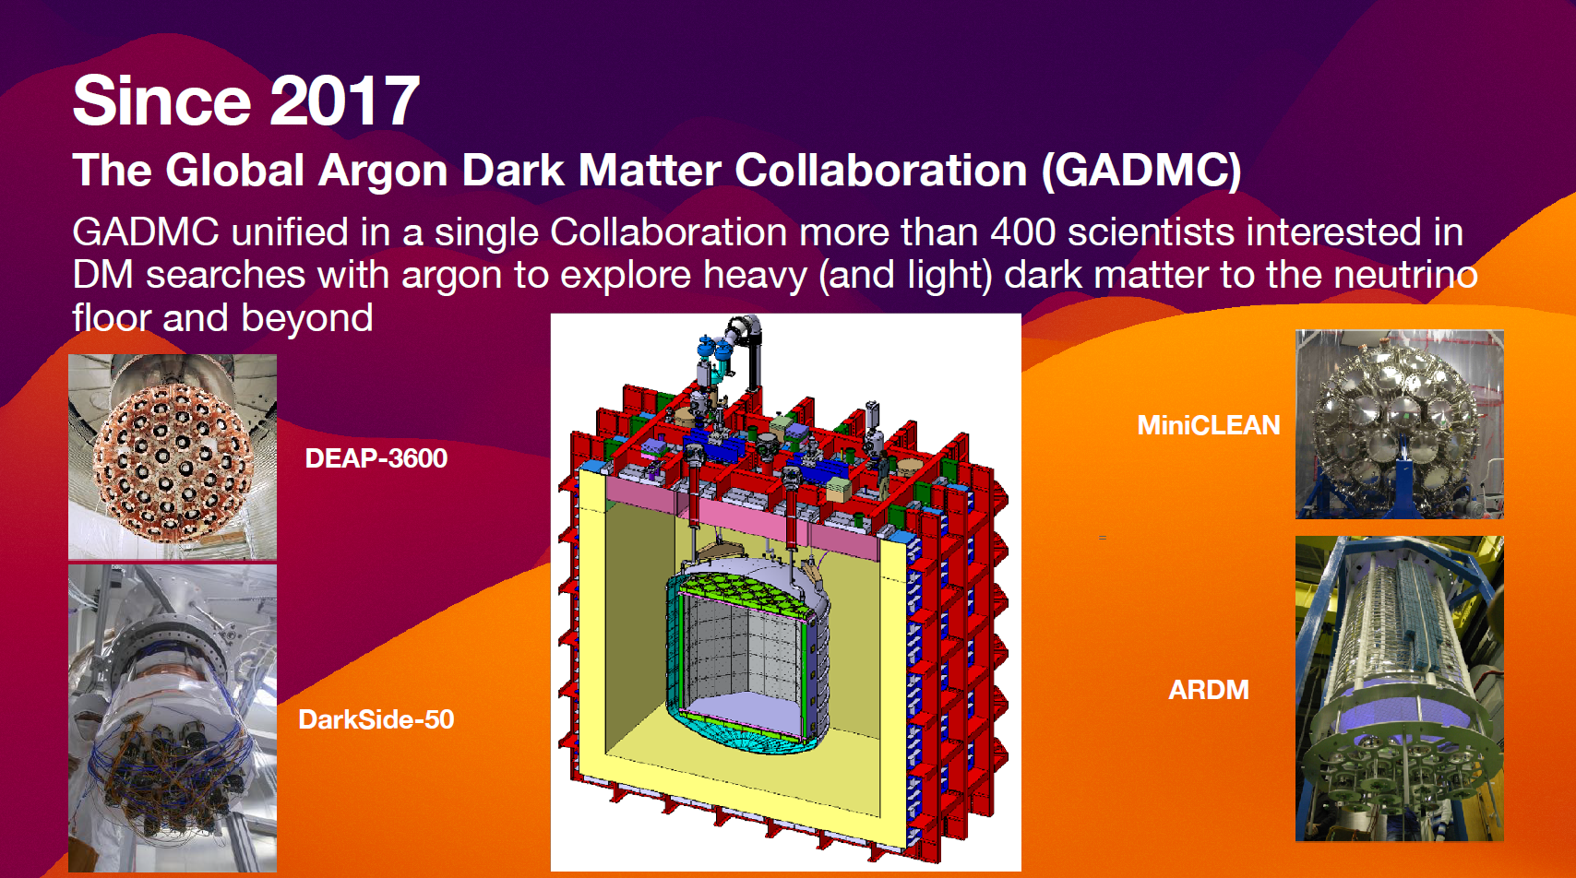
Global Ar Collaboration
C. Galbiati, UCLA-DM 2025
DarkSide-20k => ARGO=>DS-LM

Slide 18
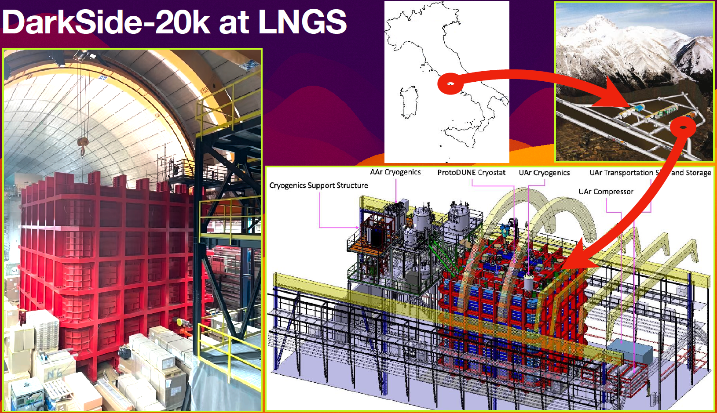
Progress of DS-20K @ LNGS
C. Galbiati, UCLA-DM 2025

Slide 19
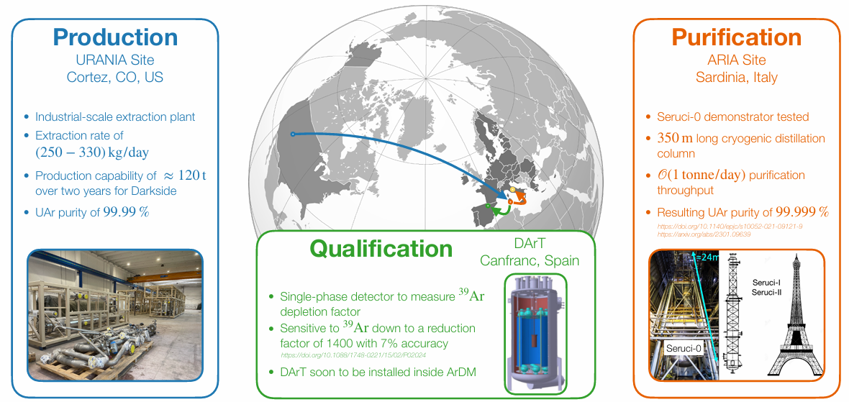
Underground Ar (suppress ³⁹Ar)!
C. Galbiati, UCLA-DM 2025

Slide 20
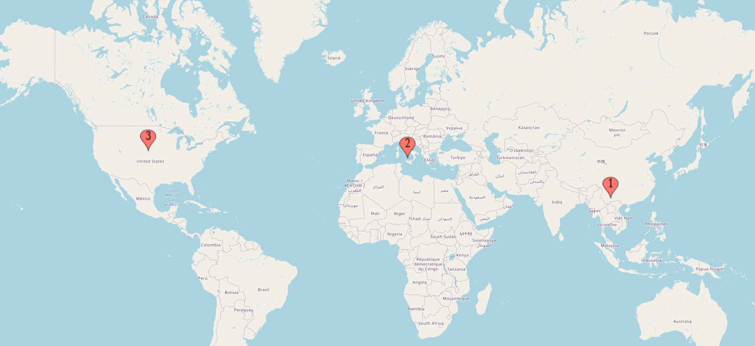
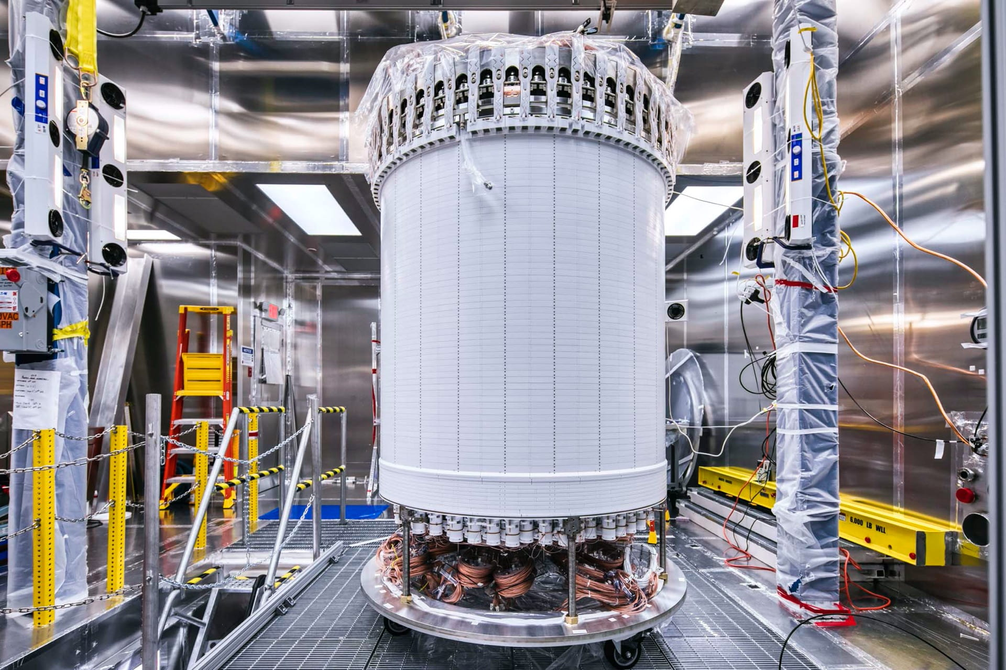
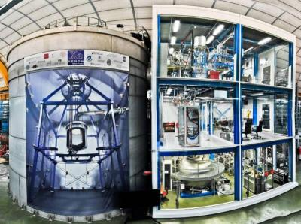
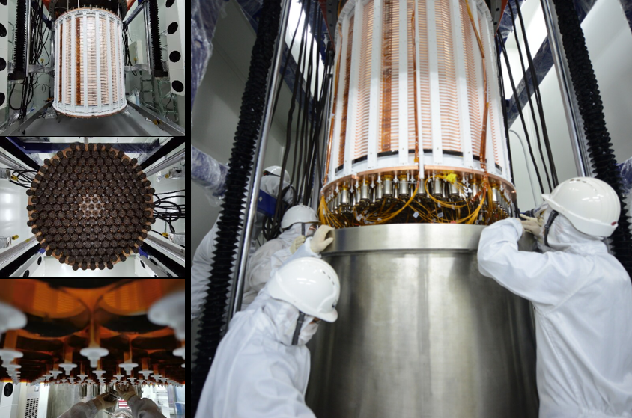
Liquid xenon experiments
Sanford Lab, LZ, 7 ton
LNGS, XENONnT, 6.5 ton
CJPL, PandaX-4T, 3.7 ton

Slide 21
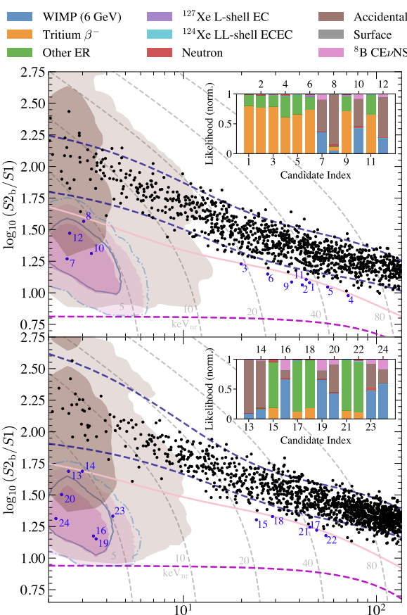
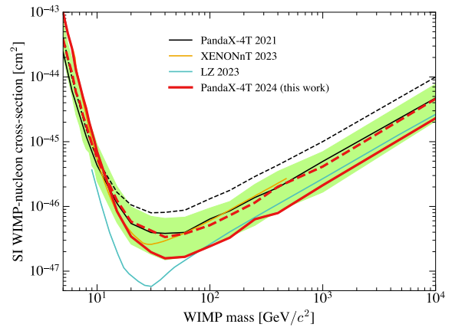
PandaX-4T, 1.5 tonne*year, blinded analysis，Run0+1
PRL 134, 011805 (2025), arXiv:2408.00664

Slide 22
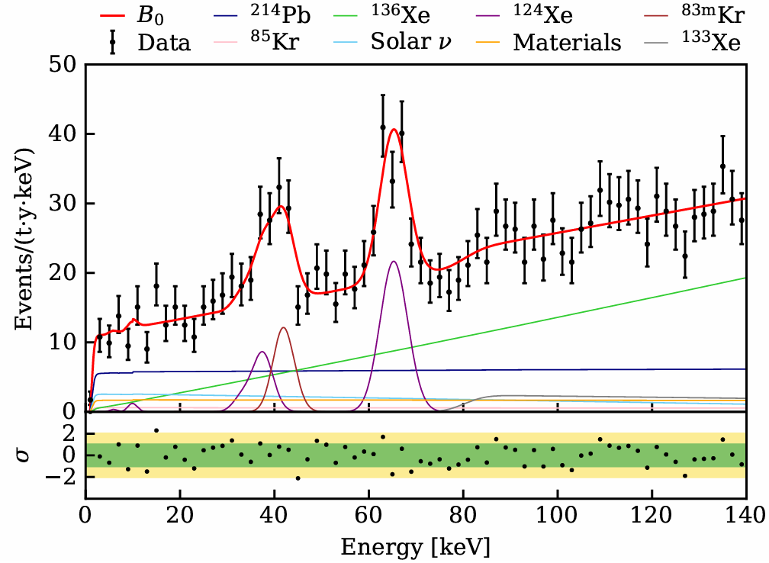
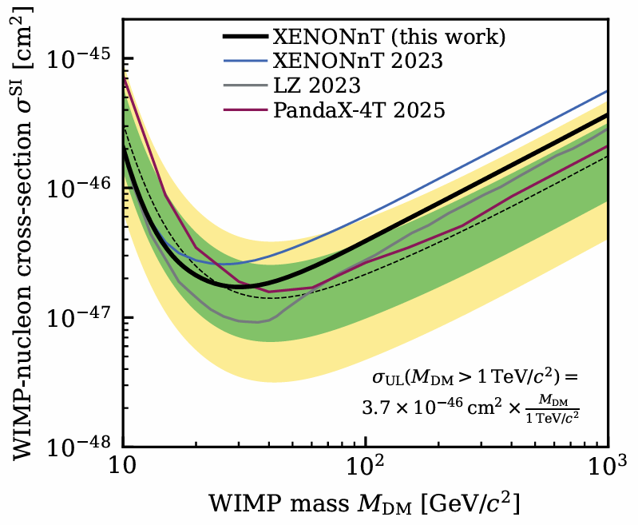
XENONnT: 3.1tonne*year
Record-low ER background: PRL 129, 161805 (2022), arXiv:2207.11330
Rn distillation removal: <1 μBq/kg, 2502.04209
New result: 2502.18005, 3.1 tonne*year

Slide 23
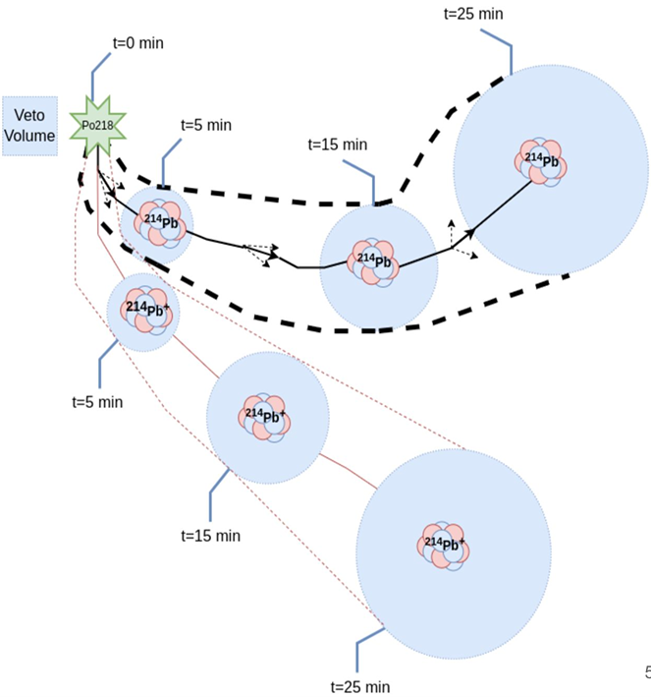
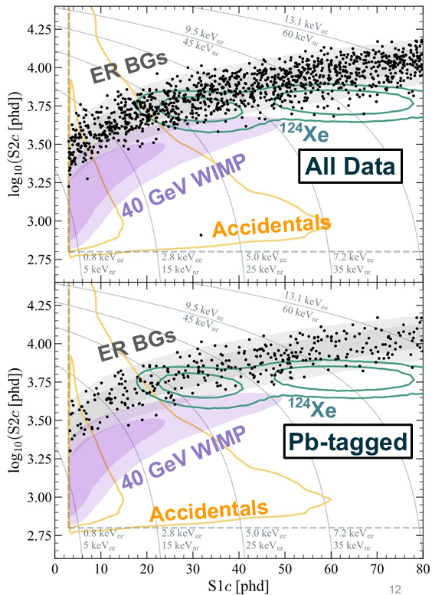
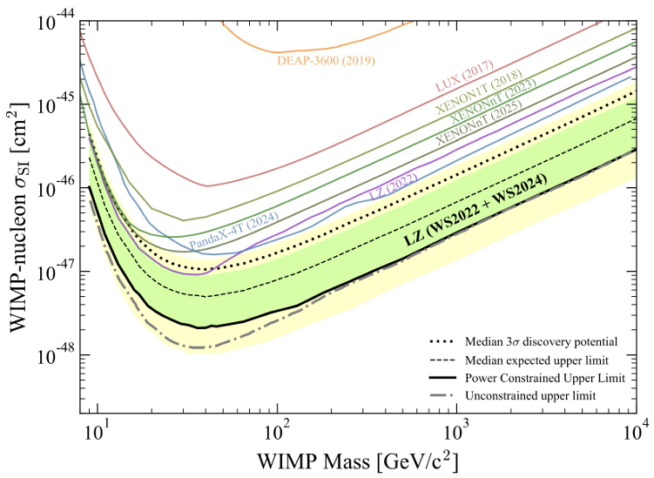
LZ 4.2 tonne*year
Tag radon daughter Pb214 via Po218-Pb214 (t_{1/2} = 27 min)
Untagged Rn rate: 1.8 micro-Bq/kg
Latest results: arXiv:2410.17036
Leading DM exclusion

Slide 24
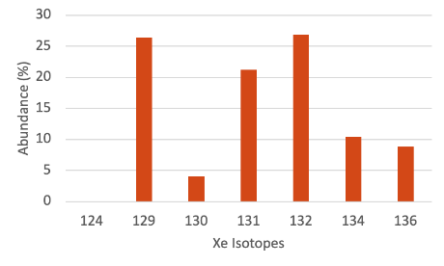
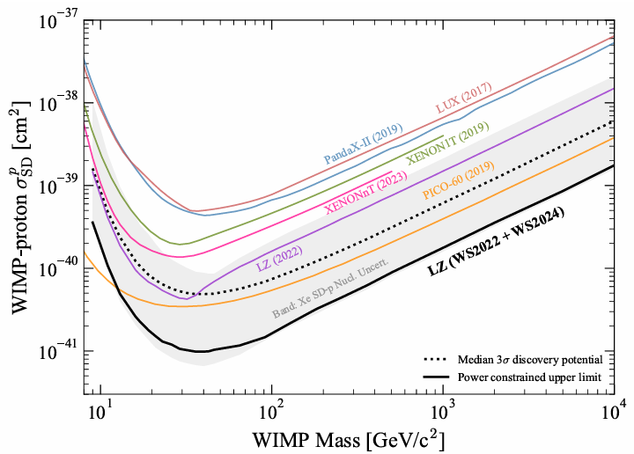
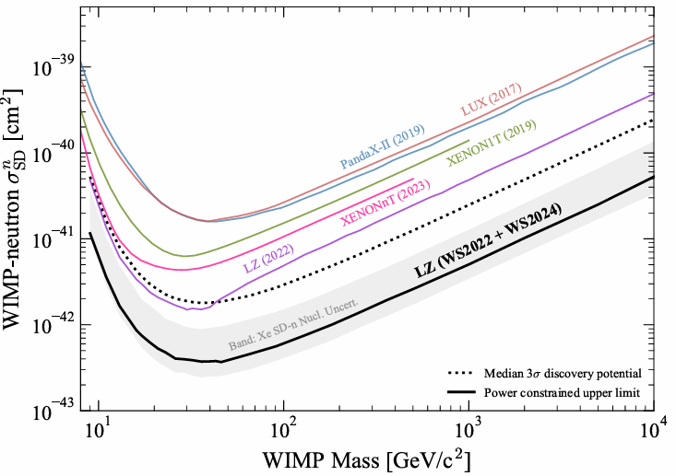
Spin-dependent interactions
LZ 4.2 tonne*year, arXiv:2410.17036

Slide 25
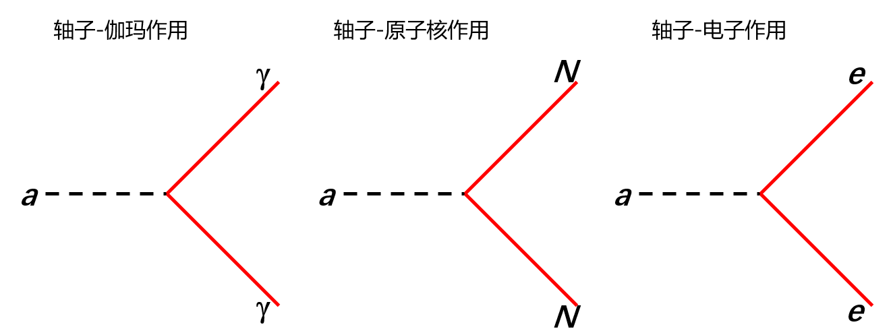
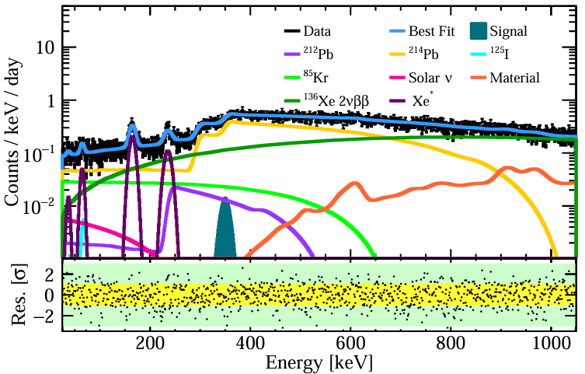
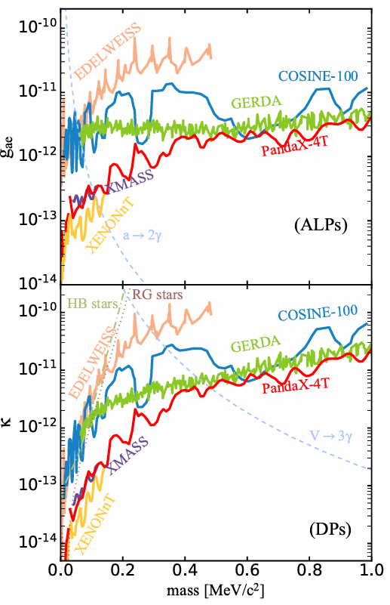
ER data also powerful
PandaX-4T, PRL 134, 071004 (2025), arXiv:2409.00773

Slide 26
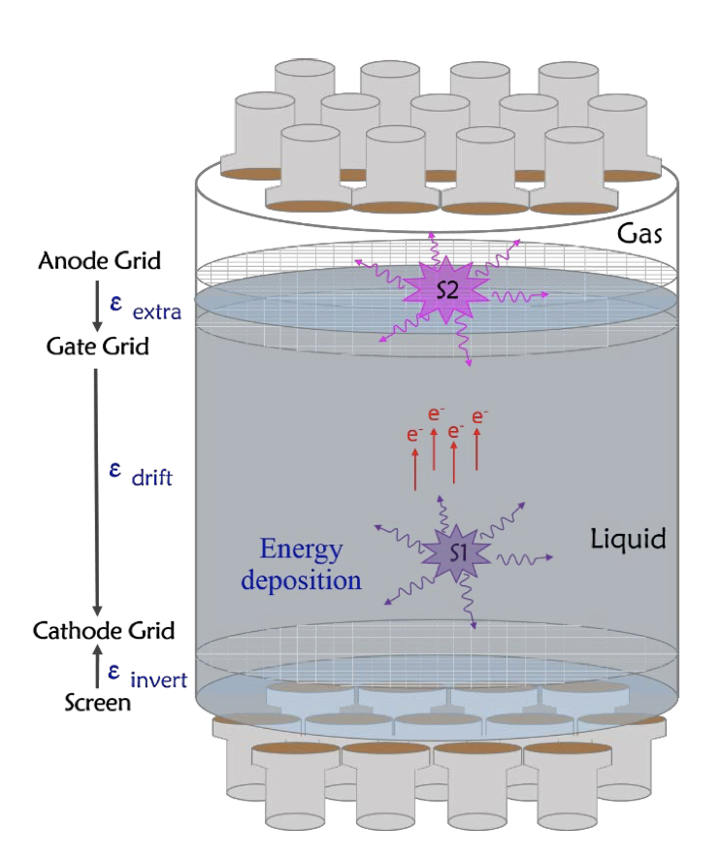

Accessing light DM: S2-only

Slide 27

Tight limits on DM-e scattering
PandaX-4T, PRL 130, 261001 (2023)

Slide 28

Accessing light DM: Migdal effect
Reformulated: Ibe et al., JHEP 2018, 194 (2018); Dolan et al., PRL 121, 101801 (2018)
Direct DM-e ionization and Midgal-induced ionization probability are closely related, Essig, Pradler, Sholapurkar, and Yu, PRL 124, 021801 (2020)
Notes:
Related, if a nuclear recoil happens, there is also probability that some electronic excitation energy can be deposited since there is a sudden offset between the nucleus and the electron cloud – an effect known as the Migdal effect.

Slide 29

S2-only + Migdal
Migdal effect now widely used in light DM searches
E.g. PRL 130, 261001 (2023), arXiv:2212.10067
J. Xu et al, 2307.12952
Notes:
Such an effect is calculated using the known atomic physics, and has been widely used by many experiments to extend their search to low mass. However, recent attempt trying to observe it in a high stat neutron calibration in Lxe has gone empty handed. Therefore this is still a hot and active area of research.

Slide 30

Grain-of-salt: seeing Migdal?
Many experimental efforts (with neutron beam)
Gas TPC
                MIGDAL experiment: Astropart.Phys. 151,102853(2023), arXiv:2207.08284
                PTEP, Vol 2021, 1, 013C01
Semi-conductor: PRD 107, 4, L041303 (2024), arXiv:2210.04917
Liquid xenon: PRD 109, L051101 (2024), arXiv: 2307.12952

Slide 31



Boosting via nucleon or electron
Bringmann and Pospelov, PRL 122, 171801 (2019)
PRL 134, 161003 (2025), arXiv:2412.19970
An, Pospelov, Pradler, Ritz, PRL 120, 141801 (2018）

Slide 32
What else can be done with these large LXe detectors?

Slide 33





Coherent Neutrino-Nucleus Scattering
Quantum mechanics: 200 MeV ~ 1 fm
So MeV neutrino cannot resolve individual atomic nucleus
The experimental idea that motivated DM direct detection 40 some years ago!

Slide 34


Solar B8 neutrinos!
PandaX-4T uses S2-only data (~1 ton×year)
Best-fit B8 events: 75±28 (S2 only) and 3.5±1.3 (S1-S2 paired)
Reject background-only hypothesis with significance of 2.64σ
PRL 133, 191001 (2024), Editors’ Suggestion
XENONnT results in same issue of PRL (191002), similar significance
Physics Magazine highlights of the year 2024

Slide 35




Majorana Neutrino and 0vDBD
DESI 2025：
Σm_{v}<0.064 eV
Majorana or Dirac
Lepton number violation
Measures effective Majorana mass: relate 0νββ to absolute neutrino mass (and origin)
Leptogenesis!

Slide 36
Natural xenon: multiple DBD targets
0.1%
ECEC
DBD
DBD
Enriched Xe136 observatories: KamLAND-Zen, EXO, NEXT
Challenges: background, energy resolution, MS event selections etc

Slide 37



¹³⁴Xe: a unique blessing
PandaX-4T, PRL 132, 152502 (2024)

Slide 38



Precise measurement of ¹³⁶Xe 2vDBD
Region 1
PandaX-4T ¹³⁶Xe 2vDBD half-life: 2.27 ± 0.03(stat.) ± 0.10(syst.) × 10²¹ y
FV: 0.65 ton of natural xenon
Research vol 2022, 9798721, arXiv:2205.12809

Slide 39



Search for Xe136 0vDBD
Science Bulletin accepted
arXiv:2412.13979
Lifetime
$>2.1×{10}^{24}$year 90% CL
Median sensitivity
2.7 $×{10}^{24}$year

Slide 40

Global efforts on Majorana neutrino mass

Slide 41

Next Generation
DARWIN/XLZD
40/60-ton LXe TPC
General-purpose observatories on
Dark matter
Neutrinos
Neutrinoless double beta decay (¹³⁶Xe)
Other ultra-rare phenomena

Slide 42



Next Generation
PandaX-xT: step-wise strategy to a 40-ton-scale LXe observatory
PandaX-40T
PandaX-20T (2027, mostly funded)
PandaX-4T

Slide 43


Physical background dominated
PandaX-xT
8.4 tonne FV
Low energy: dominated by ²²²Rn, pp neutrino, ¹³⁶Xe （34.2 ton FV)
High energy: dominated by ²²²Rn, ⁸B neutrino, and ²³⁸U in material (8.4 ton FV)

Slide 44


Scientific potential

Slide 45


Scientific potential
Li, Ramsey-Musolf, Vasquez, PRL 126, 151801 (2021)

Slide 46

Scientific potential

Slide 47


Next future development
Xenon with artificially modified isotopic abundance (AMIA), either via a split of odd and even nuclei, or further enrichment of ¹³⁶Xe, to improve sensitivity to spin-dependence of DM-nucleon interactions and NLDBD (Y. Suzuki，arXiv:hep-ph/0008296, 2000)
AMIA1
AMIA2
Discovery smoking gun！

Slide 48
Summary
DM direct detections: huge experimental processes in the past few decades years
  Significant “traditional” WIMP parameters unexplored (with known experimental techniques!)
  Light DM parameter space remain open for innovations
Large xenon-based detectors rich physics potentials (particularly on neutrinos)
  Searching every corners => make use of all xenon isotopes at once!

Slide 49


Detector characterization highlights
SuperCDMS, PRL 131, 091801 (2023)
Ionization yield to NR for Si down to 100 eV
Nucleus, PRL 130, 211802 (2023)
First observation of n-W capture NR energy

Slide 50

CONUS+
2501.05206
CONUS+: First observation of reactor antineutrinos by coherent scattering
Threshold: 170 eV, 119 operation close to nuclear reactor

