Slide 1
Update on the muon g-2:
White Paper 2(025)
Tom Blum (UConn/RBRC)
Pheno 2025
Pittsburgh
May 19, 2025

Slide 2
Preface
The Muon g-2 Theory Initiative will post White Paper 2025 on the arXive on Thursday, May 22. Therefore I will not be able to share averages or quote a standard model value in this talk. I will however share our expectations about the comparison between the Fermilab experiment E989 and the standard model value. E989 is also expected to announce final results soon.

Slide 3
Outline
Introduction
Muon g-2 Theory Initiative WP2
  Hadronic Vacuum Polarization (HVP)
  Hadronic Light-by-light (HLbL) scattering
  QED and EW
Summary

Slide 4
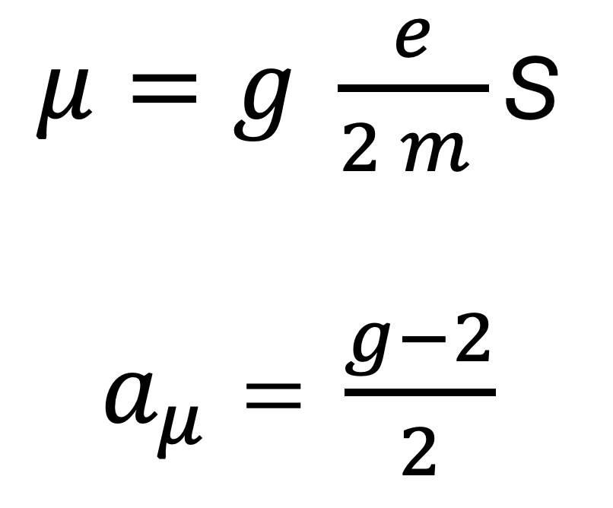
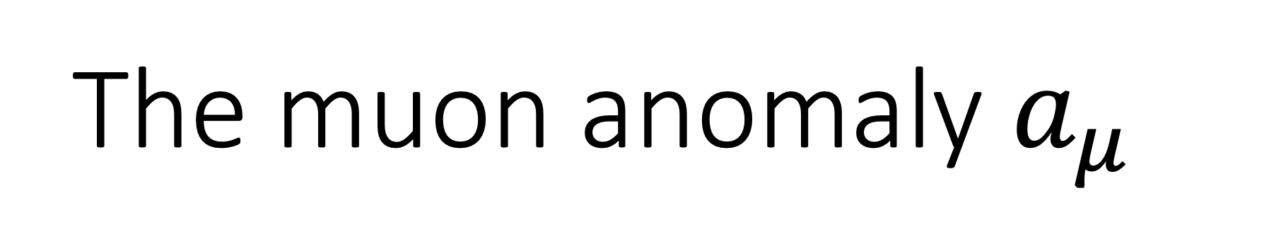
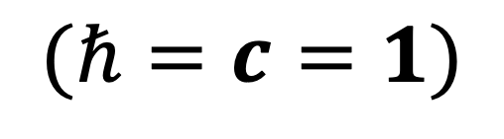
The muon anomaly $a_{μ}$
The muon is a spin ½ elementary particle with
$μ=g \frac{e}{2 m }$ S
$a_{μ}$ = $\frac{g−2}{2}$
$$(ℏ=c=1)$$

Slide 5
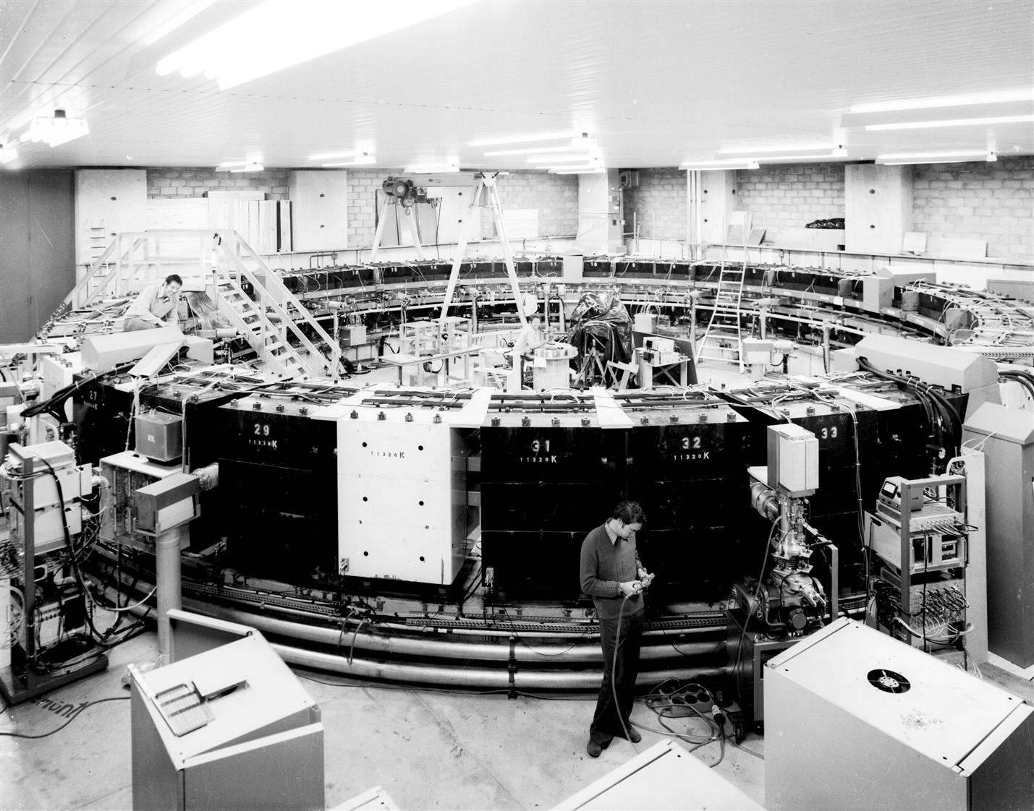
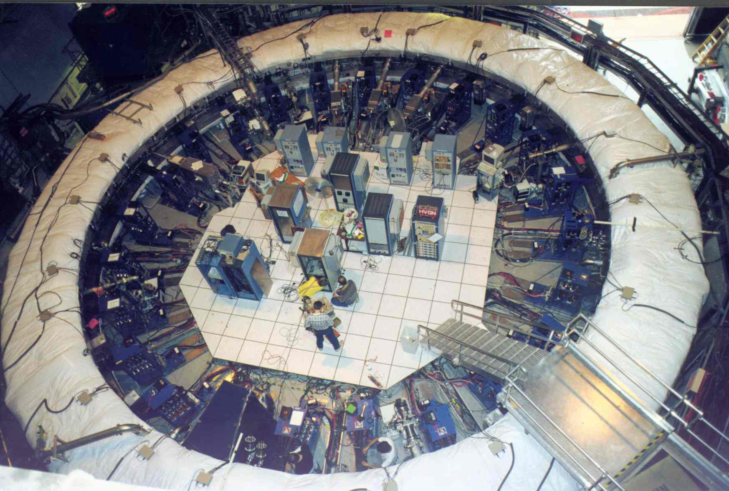
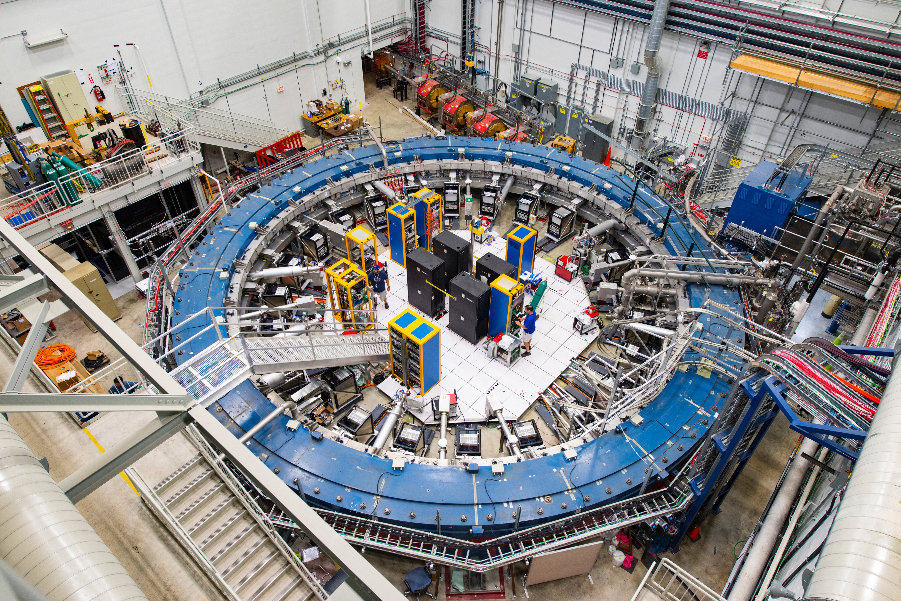
Muon g-2 experiments
CERN (1959-1979)
(7 ppm)
BNL E821(1997-2001)
(0.54 ppm)
FNAL E989 (2018-)
(0.46 ⟶ 0.14 ppm)
(c.f. electron: 0.11 ppb)
Notes:
Storage ring experiments. Muons decay, live longer in experiment if moving

Slide 6
Muon g-2/EDM
experiment
at J-PARC
Features:
Low emittance muon beam (1/1000)
No strong focusing (1/1000) & good injection eff. (x10)
Compact storage ring (1/20)
Tracking detector with large acceptance
Commissioning JPY 2029
Credit: T. Mibe

Slide 7
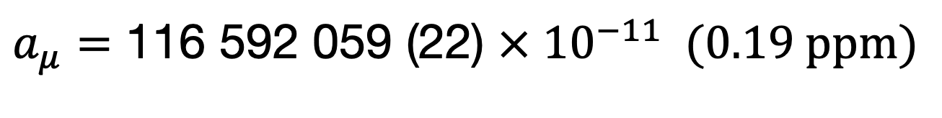
BNL+FNAL Average
Muon g-2 Collaboration, PHYSICAL REVIEW LETTERS 131, 161802 (2023)
Final results for runs 1-6 anytime after May 23rd
$$a_{μ}=\text{116 592 059}\text{ (}\text{22}\text{) }× {10}^{−11} (0.19 ppm)$$

Slide 8
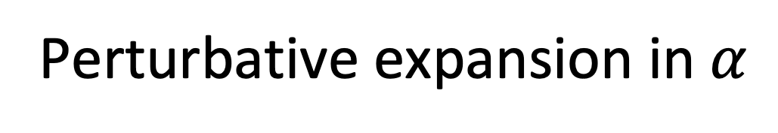
QED (5 loops)
EW (two loops)
QCD (non-perturbative)
Perturbative expansion in $α$

Slide 9
Muon g-2 Theory Initiative
Started in June 2017
First white paper in 2020

Slide 10
Muon g-2 Theory Initiative White Paper 2020 Summary
(discrepancy between WP20 and experiment is now 5.0 standard deviations)

Slide 11
Outline
Introduction
Muon g-2 Theory Initiative WP2
  Hadroinc Vacuum Polarization (HVP)
  Hadronic Light-by-light (HLbL) scattering
  QED and Electroweak
Summary

Slide 12
Muon g-2 Theory Initiative White Paper 2025

Slide 13
Outline
Introduction
Muon g-2 Theory Initiative WP2
  Hadronic Vacuum Polarization (HVP)
  Hadronic Light-by-light (HLbL) scattering
  QED and Electroweak
Summary

Slide 14
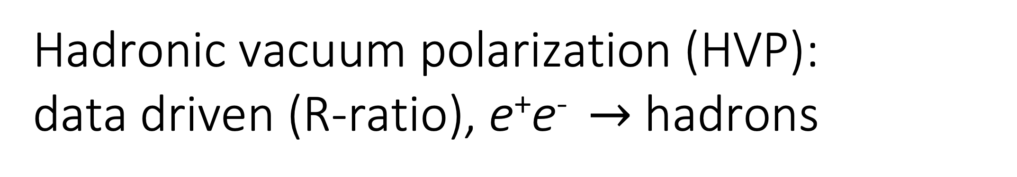
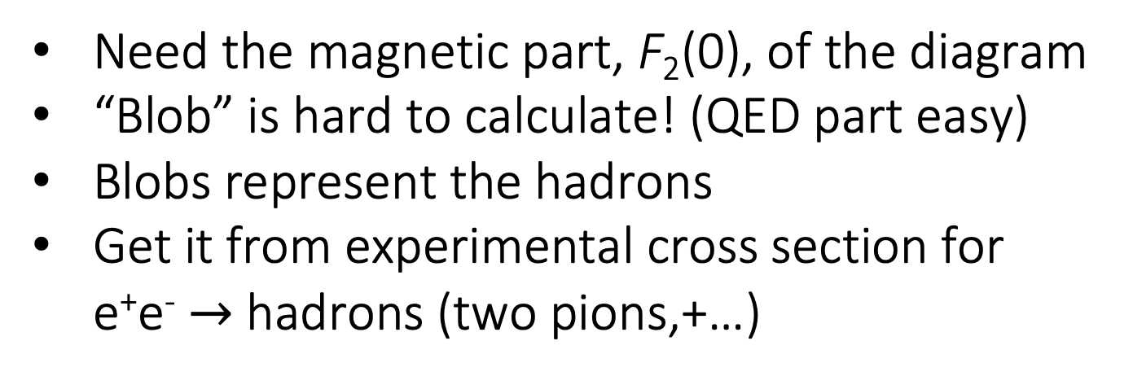
Hadronic vacuum polarization (HVP):
data driven (R-ratio), e⁺e⁻ $→$ hadrons
Need the magnetic part, F₂(0), of the diagram
“Blob” is hard to calculate! (QED part easy)
Blobs represent the hadrons
Get it from experimental cross section for
  e⁺e⁻ $→$ hadrons (two pions,+…)
Dispersion relation
Optical theorem
Credit: T. Teubner
Notes:
Re part from imaginary part. Imaginary part is related to cross section by optical theorem

Slide 15
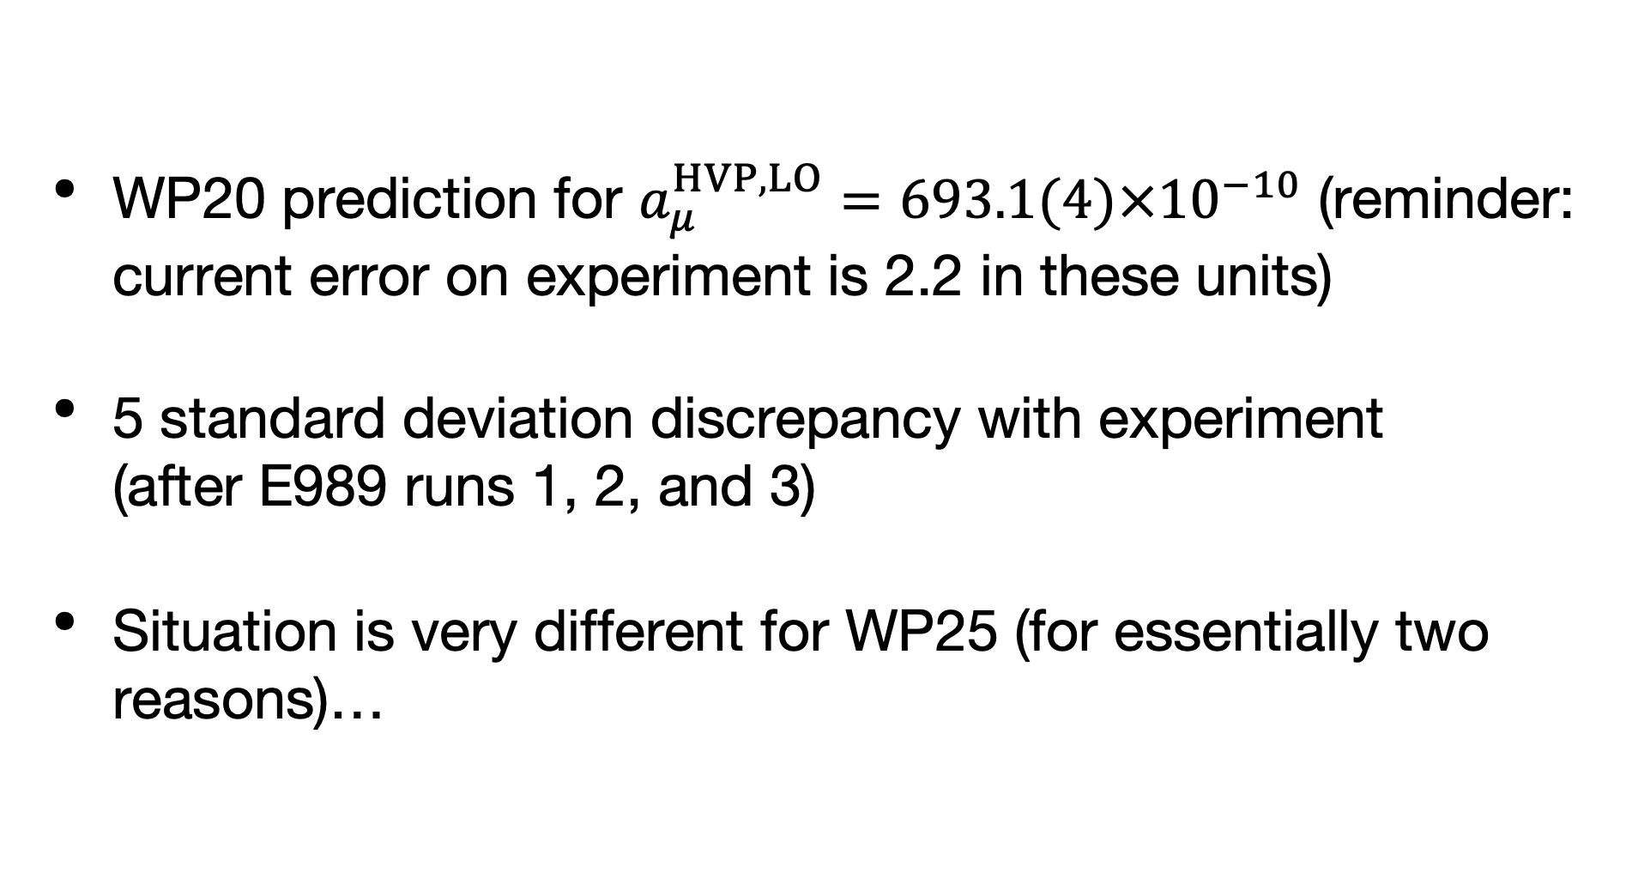
HVP: Data Driven
WP20 prediction for $a_{μ}^{HVP,LO}=693.1(4)×{10}^{−10}$ (reminder: current error on experiment is 2.2 in these units)
5 standard deviation discrepancy with experiment (after E989 runs 1, 2, and 3)
Situation is very different for WP25 (for essentially two reasons)…

Slide 16
HVP: Data Driven
(CMD-3 Phys. Rev. Lett. 132, 231903 (2024), arXiv:2309.12910 [hep-ex])

Slide 17
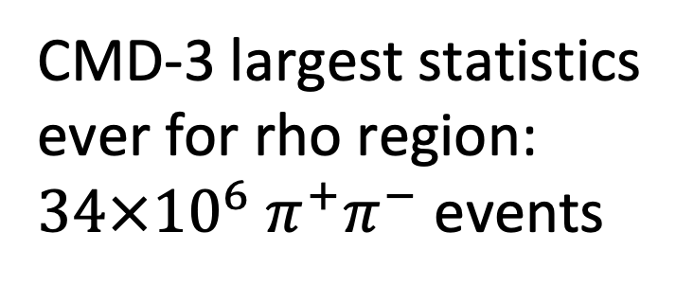
HVP: Data Driven
PHYS. REV. D 109, 112002 (2024)
CMD-3 largest statistics
ever for rho region:
$34×{10}^{6}{ π}^{+}π^{−}$ events
(before 2004)
Many standard deviations
higher than average of
previous results
No resolution
(2024)

Slide 18
HVP: Data Driven
New CMD-3 result is significantly higher than WP20 average
Experiments differ substantially outside quoted uncertainties, can not be resolved by inflating errors/combining various experiments as before
Until resolved, no new DD average in WP25 (but extensive discussion!)
Possible paths to a resolution:
  Improved (higher order) radiative corrections and MC generator(s)
  New data from BaBar, Belle II, BESIII, CMD-3, KLOE, SND
Also renewed attention on tau decay (and isospin corrections)

Slide 19
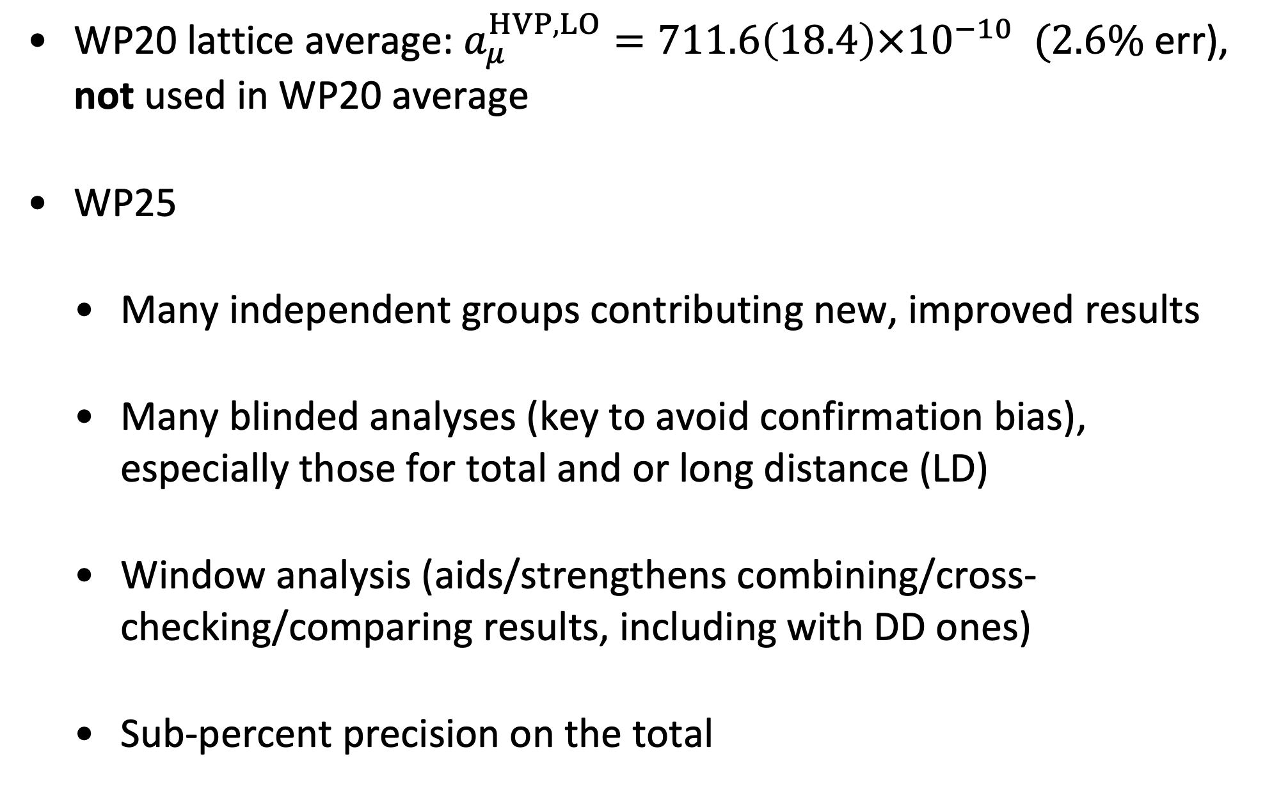
HVP: Lattice
WP20 lattice average: $a_{μ}^{HVP,LO}=711.6\left(18.4\right)×{10}^{−10} (2.6\%$ err), not used in WP20 average
WP25
  Many independent groups contributing new, improved results
  Many blinded analyses (key to avoid confirmation bias), especially those for total and or long distance (LD)
  Window analysis (aids/strengthens combining/cross-checking/comparing results, including with DD ones)
  Sub-percent precision on the total

Slide 20


HVP contribution from Lattice QCD
Quark-connected
disconnected
Isospin breaking corrections
$$O(α^{2})$$
$$O(α^{3})$$
The EM current j^{𝛍} on the lattice can be conserved or local
They have different O(a²) corrections
Local: finite renormalization, Z_{V}
Notes:
Straightforward calculation on lattice

Slide 21
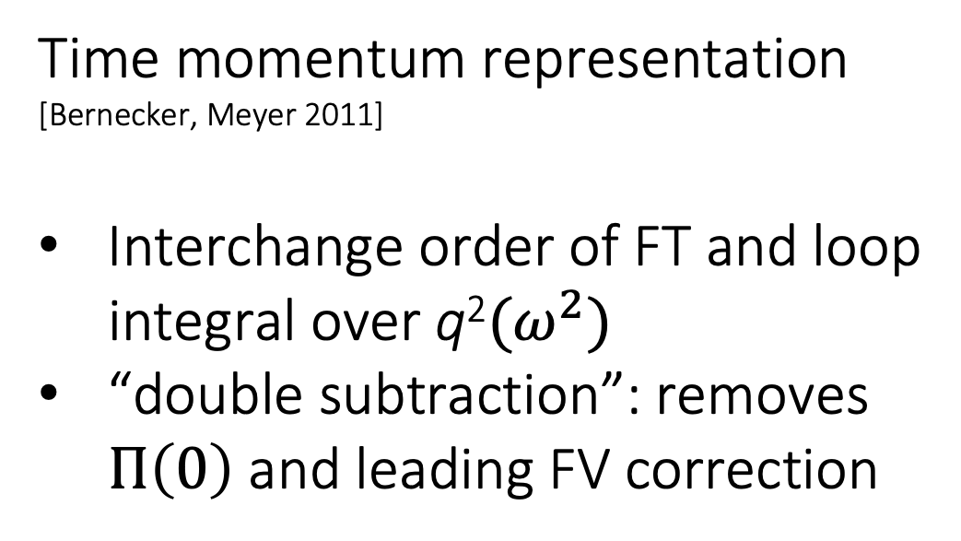
Hadronic vacuum polarization contribution from Lattice QCD
Quark-connected
disconnected
Isospin breaking corrections
$$O(α^{2})$$
$$O(α^{3})$$
Time momentum representation
[Bernecker, Meyer 2011]
Interchange order of FT and loop
integral over q²$(ω^{2})$
“double subtraction”: removes
$Π\left(0\right)$ and leading FV correction

Slide 22
HVP: Lattice Windows

Slide 23
Summand w(t) C(t)
RBC/UKQCD 2018
Windows in Euclidean and
time-like regions:
Fig.: G. Colangelo, PWA12/ATHOS7 2021
Fig.: RBC/UKQCD 2018

Slide 24
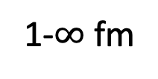
HVP: Lattice Windows
Light quark, connected, isospin symmetric SD, W, LD windows
0-0.4 fm
0.4-1 fm
1-$∞$ fm
very precise
all 3 blinded analyses
DD (w/o CMD-3) consistently below lattice
Many standard deviations discrepant with old data driven dispersive results

Slide 25
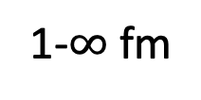
HVP: Lattice Windows
Light quark + strange, disconnected, isospin symmetric SD, W, LD windows
0-0.4 fm
0.4-1 fm
1-$∞$ fm
blinded analyses

Slide 26
HVP: Lattice isospin-breaking corrections
(2020)
(some numbers
out of date)
Many contributions
that largely cancel
Now five collaborations
but only BMW has
calculated all diagrams

Slide 27
HVP: Lattice isospin-breaking corrections
BMW20 complete calculation (corrected in BMW-DMZ 24, WP25) (not shown)
Mainz 24 estimates missing contributions: increased error
RBC/UKQCD and ETM 19 corrected for QED sea and disconnected diagrams using BMW (not shown)
Total is very small

Slide 28
HVP: Lattice Total
Five different averaging procedures used in WP25
  Sum of window averages + IB correction avg.
  Sum of flavor averages (a) + IB correction avg.
  Sum of flavor averages (b) + IB correction avg.
  Sum of individual, published isospin symmetric totals + IB correction avg.
  Average of individual, published totals
All are quite consistent. WP25 quotes the window average,
has largest number of independent results and smallest error

Slide 29
HVP: Lattice Total
(not published,
not in average)
Isospin symmetric total (IB corr’s to be added)
Published totals
Large shift up from WP 20 average based solely on data driven result

Slide 30
Outline
Introduction
Muon g-2 Theory Initiative WP2
  Hadronic Vacuum Polarization (HVP)
  Hadronic Light-by-light (HLbL) scattering
  QED and Electroweak
  Summary

Slide 31
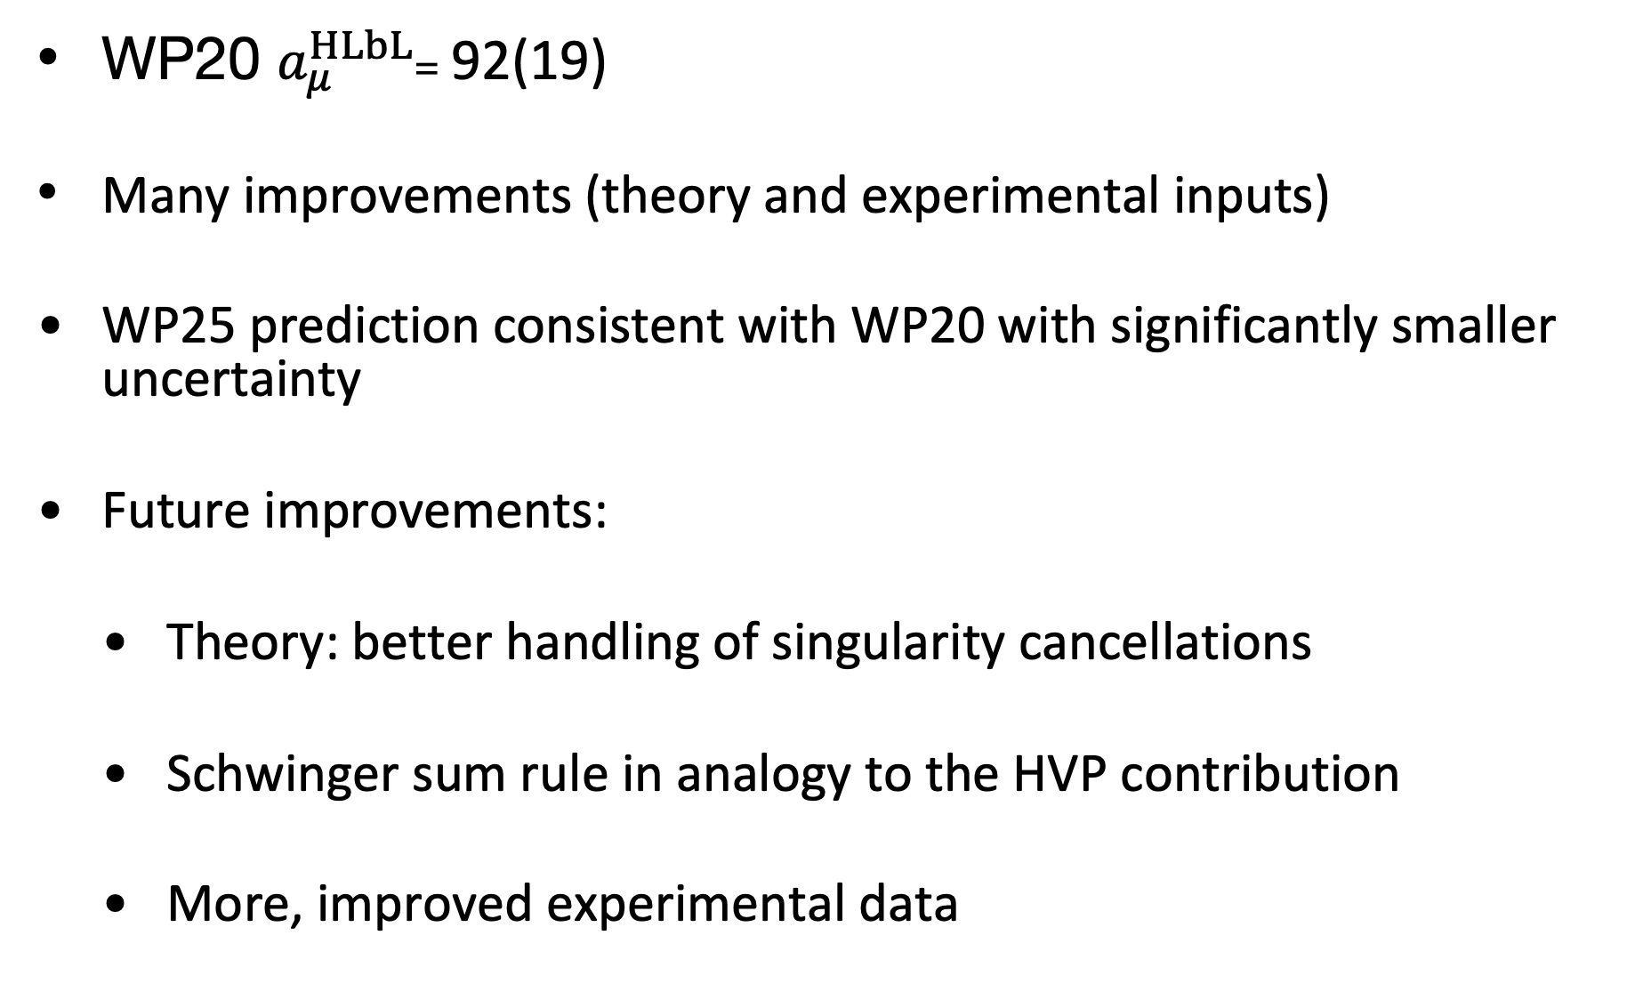
HLbL: Data Driven
WP20 $a_{μ}^{HLbL}$= 92(19)
Many improvements (theory and experimental inputs)
WP25 prediction consistent with WP20 with significantly smaller uncertainty
Future improvements:
  Theory: better handling of singularity cancellations
  Schwinger sum rule in analogy to the HVP contribution
  More, improved experimental data

Slide 32
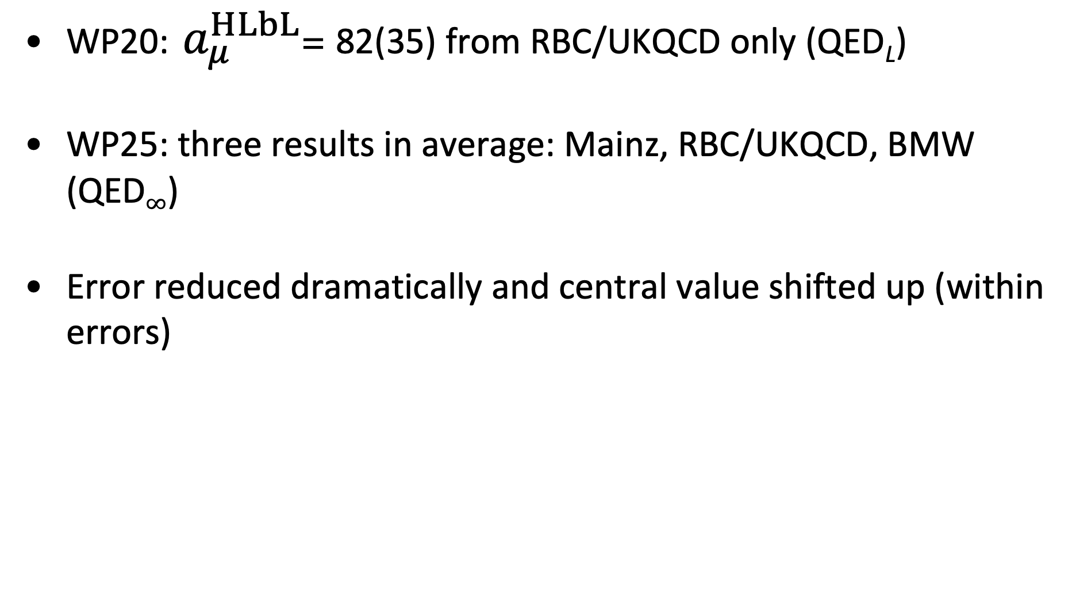
HLbL Lattice
WP20: $a_{μ}^{HLbL}$= 82(35) from RBC/UKQCD only (QED_{L})
WP25: three results in average: Mainz, RBC/UKQCD, BMW (QED$∞$)
Error reduced dramatically and central value shifted up (within errors)

Slide 33
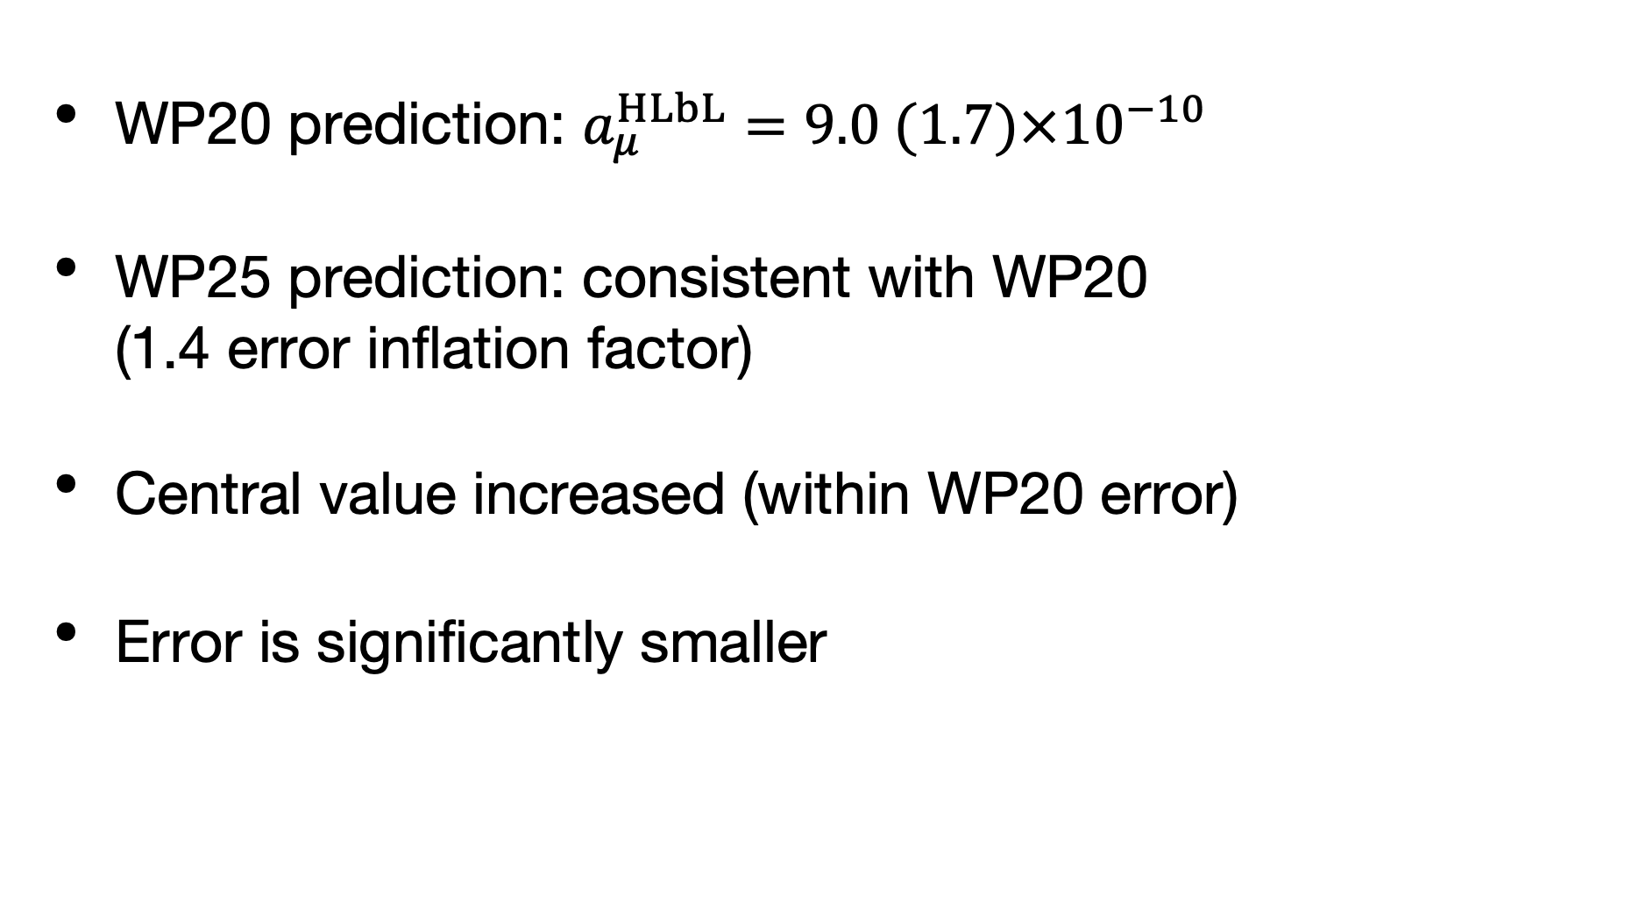
HLbL: Combined Average of Data Driven and Lattice
WP20 prediction: $a_{μ}^{HLbL}=9.0 (1.7)×{10}^{−10}$
WP25 prediction: consistent with WP20 (1.4 error inflation factor)
Central value increased (within WP20 error)
Error is significantly smaller

Slide 34
Outline
Introduction
Muon g-2 Theory Initiative WP2
  Hadronic Vacuum Polarization (HVP)
  Hadronic Light-by-light (HLbL) scattering
  QED and Electroweak
  Summary

Slide 35
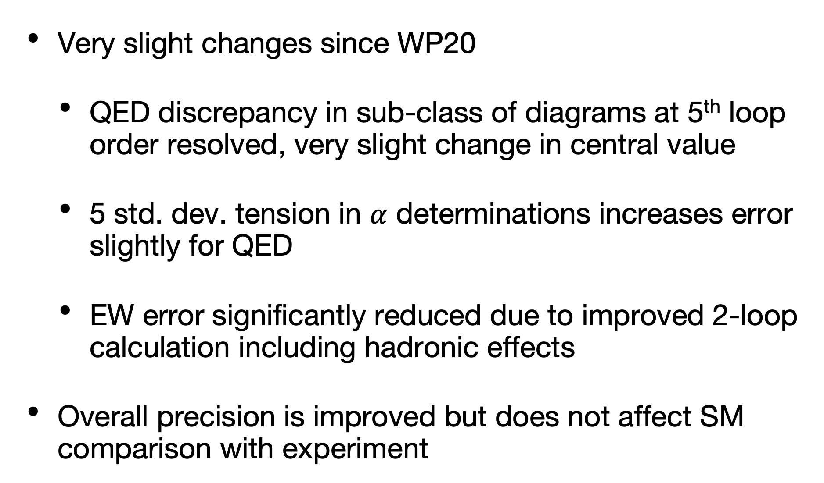
QED and Electroweak
Very slight changes since WP20
  QED discrepancy in sub-class of diagrams at 5th loop order resolved, very slight change in central value
  5 std. dev. tension in $α$ determinations increases error slightly for QED
  EW error significantly reduced due to improved 2-loop calculation including hadronic effects
Overall precision is improved but does not affect SM comparison with experiment

Slide 36
Outline
Introduction
Muon g-2 Theory Initiative WP2
  Had. Vacuum Polarization (HVP)
  Had. Light-by-light (HLbL) scattering
  QED and Electroweak
  Summary

Slide 37
Summary
WP 2025 out (on the arXive) Thursday May 22nd
  Many improvements/updates
  Significant changes from WP 2020
    Data driven, dispersive results inconsistent, under intense scrutiny, no new average
    Lattice HVP total contribution with sub-percent errors, enters total SM value as sole HVP determination, dominates SM error
  SM value is very well compatible with experiment
Fermilab to announce final results soon (after May 23rd)

Slide 38
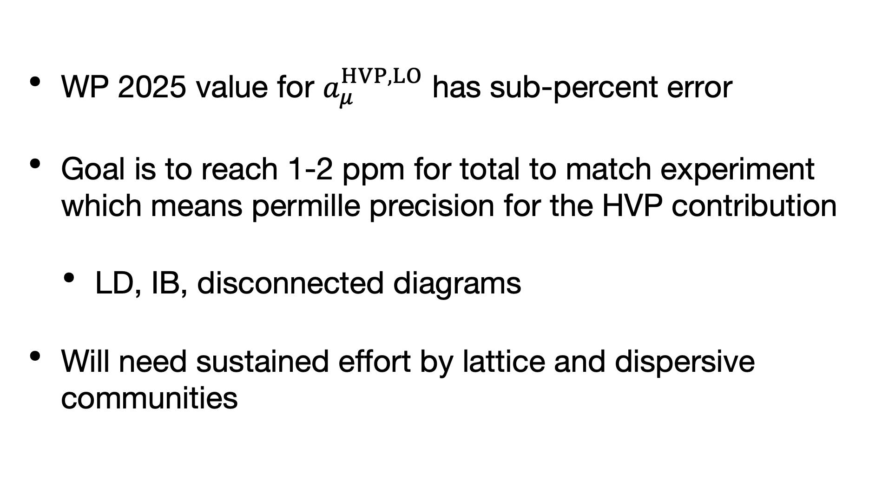
Future Plans
WP 2025 value for $a_{μ}^{HVP,LO}$ has sub-percent error
Goal is to reach 1-2 ppm for total to match experiment which means permille precision for the HVP contribution
  LD, IB, disconnected diagrams
Will need sustained effort by lattice and dispersive communities

Slide 39
Acknowledgements
TB partially supported by US Department of Energy (DOE)
Aubin, et al., RBC/UKQCD computations done on
  ALCF at Argonne (MIRA, Aurora), OLCF at Oakridge (Summit, Frontier), Booster (Julich), LUMI-g (Kajaani)
  Bridges2 at PSC, Expanse at SDSC, and Stampede2 and Frontera at TACC under XSEDE and ACCESS (US NSF)

