Slide 1
Millisecond Pulsar in Galactic Center
Shengyi Liu
University of Utah
Pheno 2025
Based on Continuous Gravitational Wave group paper: 25xx.xxxxx

Slide 2
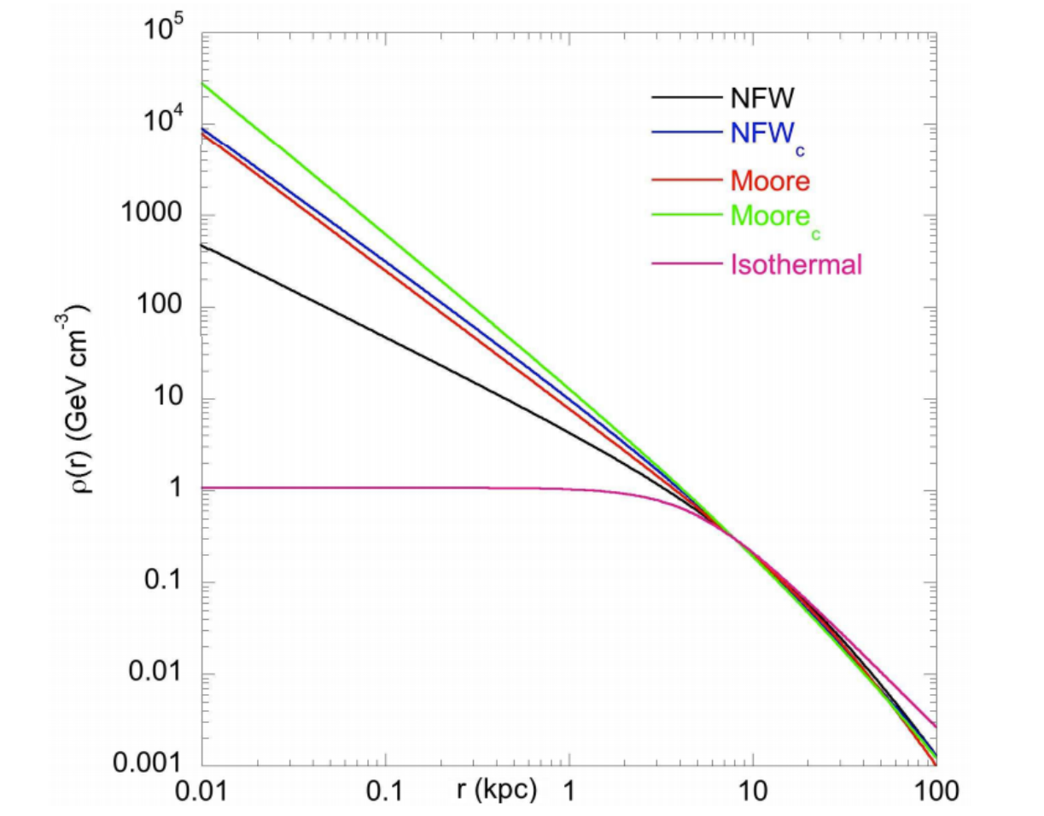
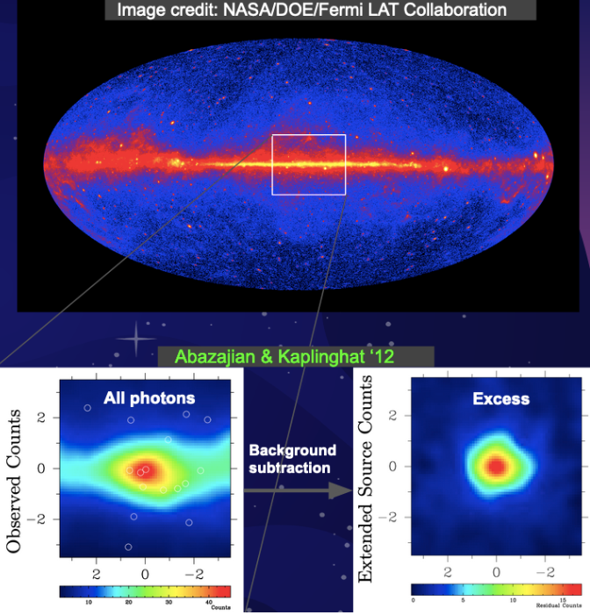

A GeV excess at the Galactic Center:

Slide 3
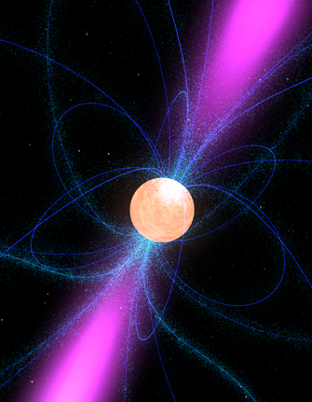
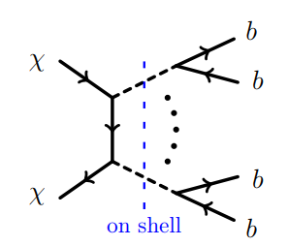
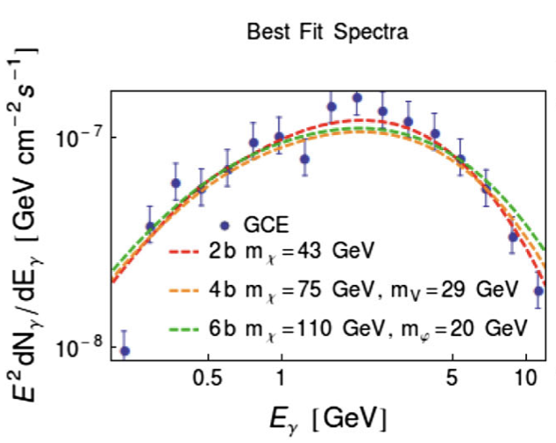
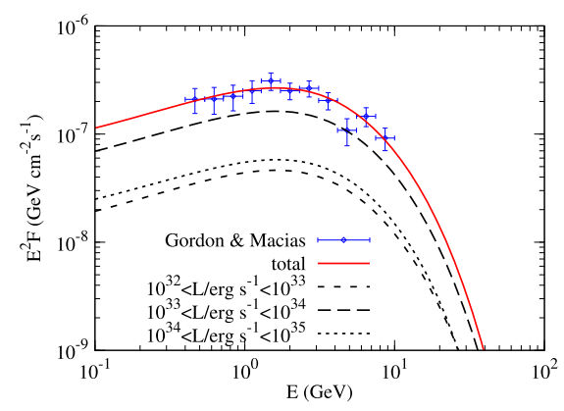
Two explanations:
Abdullah, et. al.
Phys. Rev. D 90, 035004 (2014)
Yuan, et. al.
JHEAp 3 (2014)

Slide 4
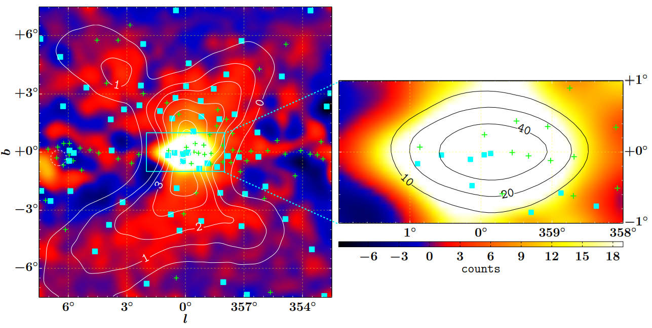
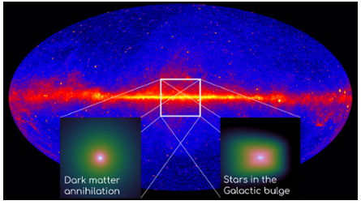
Efforts to distinguish these two explanations:
• Smoothness: Point Source v.s. Smeared Distribution
• Morphology: Spherical v.s. Bulge-like

Slide 5
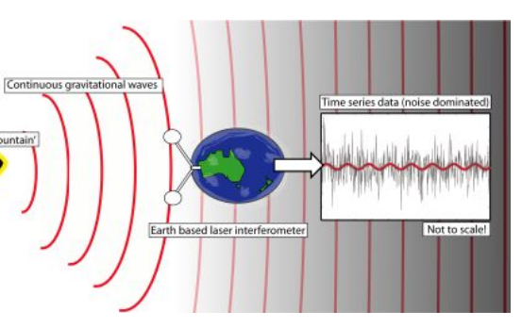
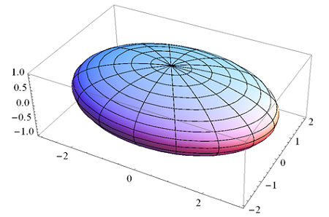

GW channel can be useful:
principal moments of inertia
ellipticity
residual crustal deformation
non-axisymmetric distribution of magnetic field
Modern Physics Letters A 32, 39, 1730035 (2017)

Slide 6
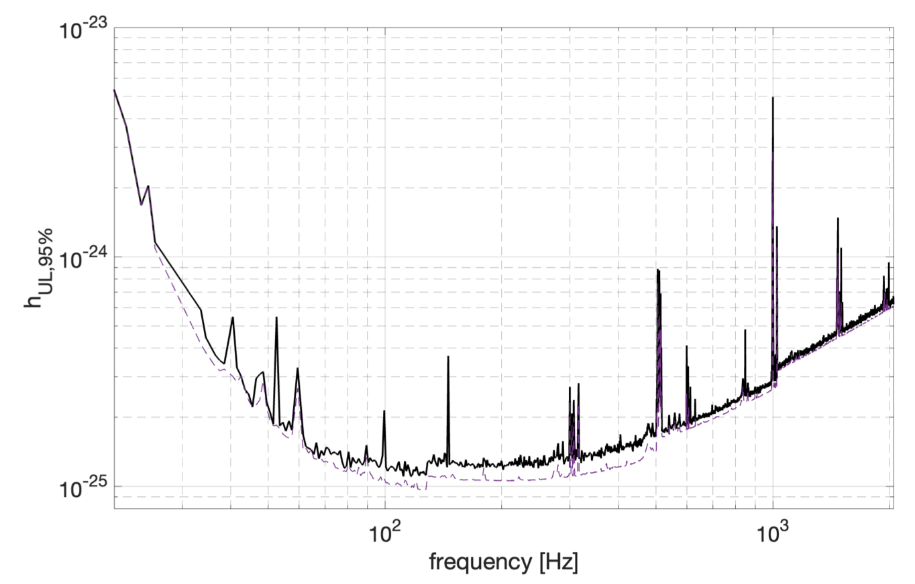
Existing search:
The LVK collaboration
Phys. Rev. D 106, 102008 (2022)
All-sky pulsar search

Slide 7

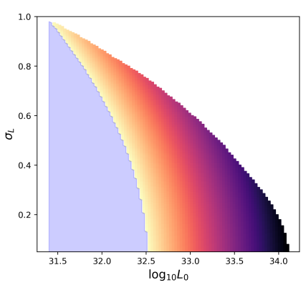
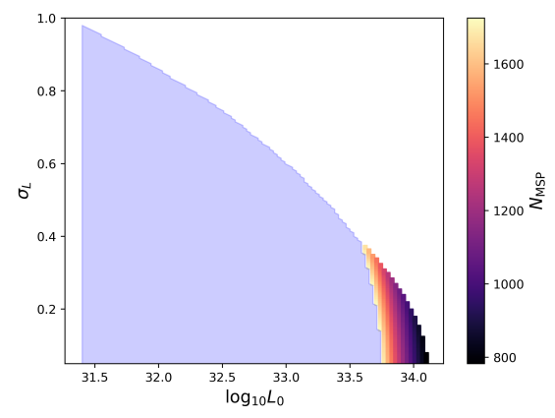



Number of MSP:
Andrew Miller, Y.Z.
Phys.Rev.Lett. 131 (2023) 8, 081401
1% energy loss through GW
$$I_{zz}={10}^{38}kg⋅m^{2}$$
$$I_{zz}=5 × {10}^{38}kg⋅m^{2}$$
Notes:
. Exclusion regions (light blue) based on the upper limits of the O3 Freuquency-Hough all-sky search for the log-normal
(left) and power-law (right) luminosity functions, employing a probability density function for the ellipticity that assumes 1%
of the rotational energy loss of the star goes into gravitational waves. We take d = 8 kpc and Izz = 1038kg·m2 in this analysis.
The upper-right white region on the left-hand plot has been excluded by Fermi.

Slide 8
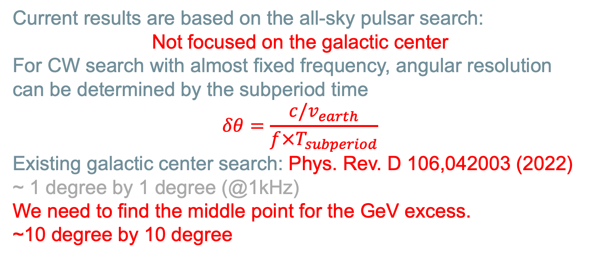
Search for Pulsar from Milky Way center
Current results are based on the all-sky pulsar search:
Not focused on the galactic center
For CW search with almost fixed frequency, angular resolution can be determined by the subperiod time
$$δθ=\frac{c/v_{earth}}{f×T_{subperiod}}$$
Existing galactic center search: Phys. Rev. D 106,042003 (2022)
~ 1 degree by 1 degree (@1kHz)
We need to find the middle point for the GeV excess.
~10 degree by 10 degree

Slide 9
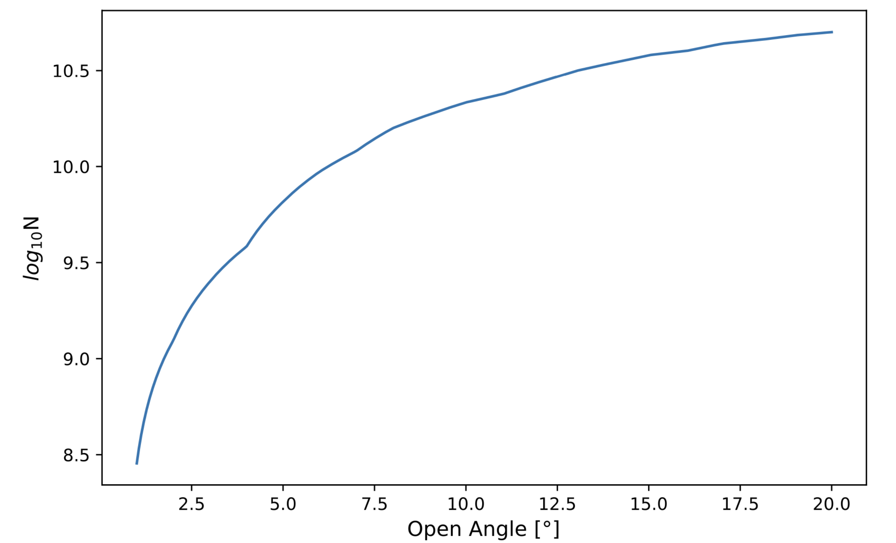


Theoretical expectation:
We can estimate the MSP distribution assuming it traces that of stars in the bulge.
The density of stars in the bulge can be modeled as a triaxial Gaussian profile:
Only covered 1% of the potential MSPs.
Notes:
principal moments of inertia
I = Σ m_{i}r_{i}²

Slide 10
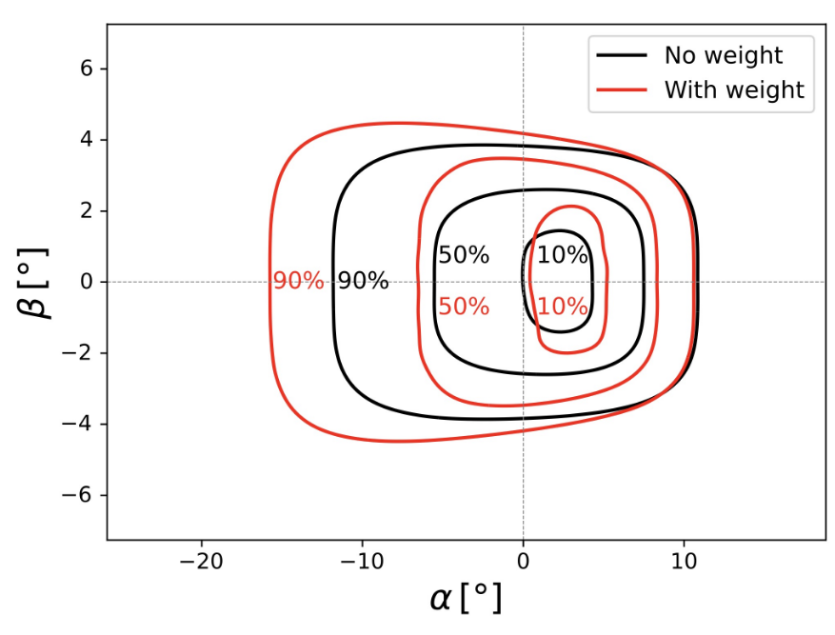
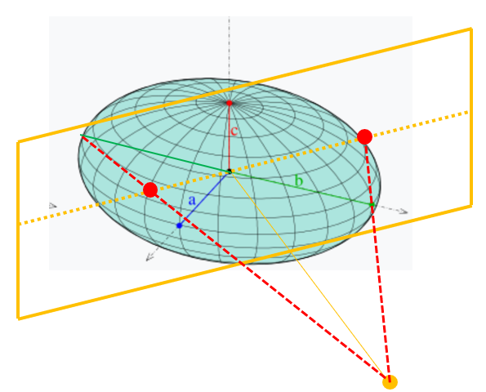
Theoretical expectation:
Projected MSP distribution
Weighting by 1/r^2

Slide 11
Outlook
Optimize the search strategy:
Current searches:
All-sky: Not focused on the galactic center
Galactic center search: ~ 1 degree by 1 degree
We need to find the middle point for the GeV excess.
~10 degree by 10 degree
Complementarity between CW search vs Stochastic search:
If none of the MSP is bright enough to be identified individually,
we can look for the broad band incoherent SGWB.
Notes:
principal moments of inertia
I = Σ m_{i}r_{i}²

Slide 12
Summary
    MSP could be an explanation for GeV excess
    Continuous gravitational wave would be a useful tool to detect pulsar
    There are pulsar numbers constrain for GeV excess
    Existing search only covers small portion of potential pulsar
    More result would be there after LIGO O4

Slide 13
Thank you!
Question time!

