Slide 1

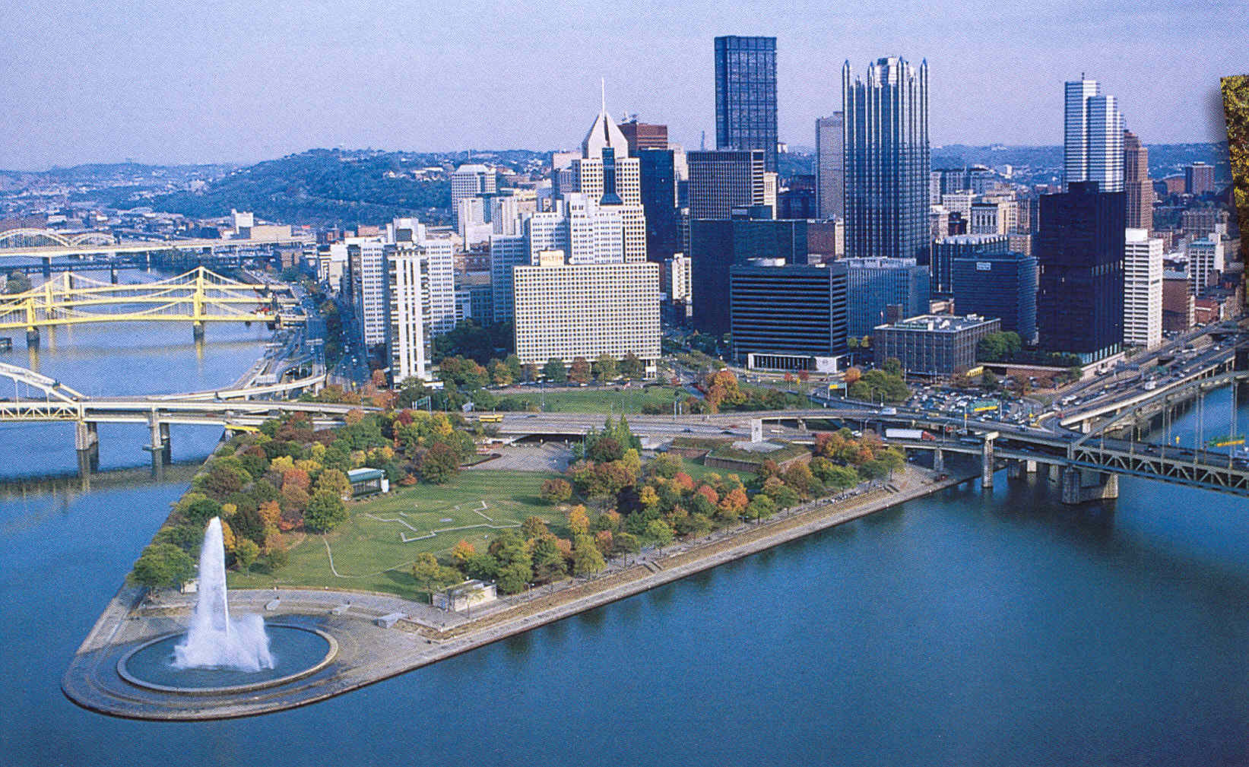
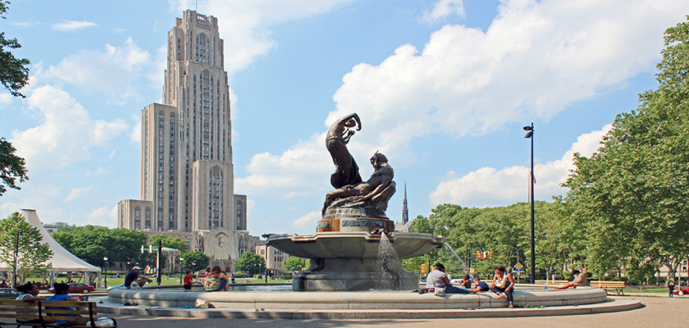
A Welcoming Story
Tao Han
University of Pittsburgh
Exploring QM Workshop
March 7, 2024

Slide 2
Welcome To Pittsburgh!

Slide 3
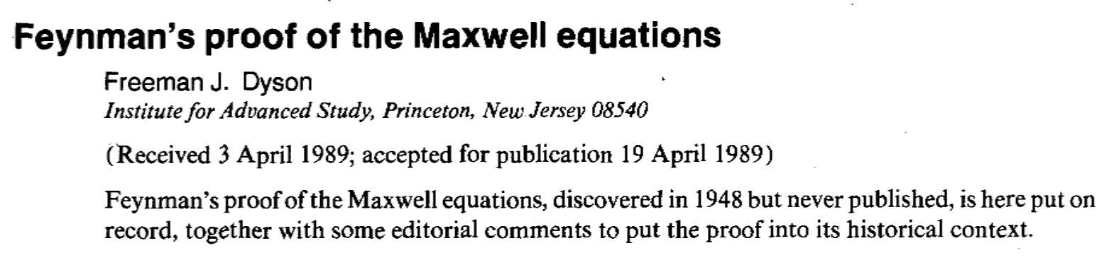

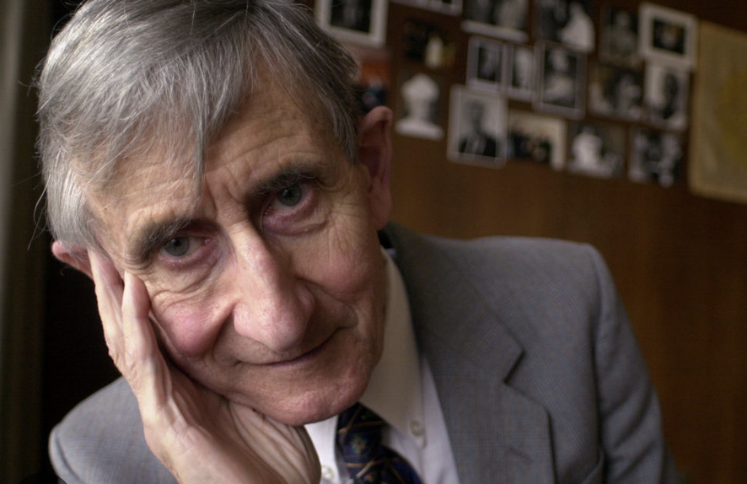
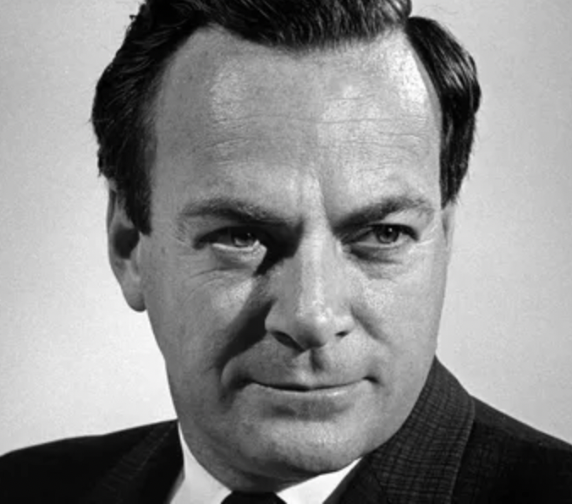
“If you think you understand quantum mechanics, you don’t understand quantum mechanics.”
-- Richard P. Feynman
“… it is my task to convince you not to turn a
way because you don’t understand it. You see my physics students don’t understand it. That’s because I don’t understand it. Nobody does.”

Slide 4
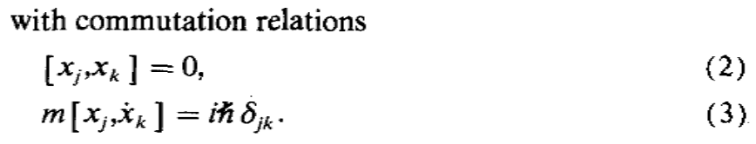

A. Feynman’s derivation
For a single particle classical mechanics:
“Nature isn’t classical, dammit ...” -- Richard P. Feynman
(position-velocity!)
uncertainty principle,
wave-particle duality, …
Now, Eqs. (1) & (3) imply: (4)
0
0
Using the Jacob identity
Eqs. (3) & (4) imply: [x_{l}, [x_{j}, F_{k}]]=0 . (5)

Slide 5





[x_{l}, [x_{j}, F_{k}]]=0 implies :
[x_{j}, F_{k}] is a space-time function, independent of
from Eq. (4) → anti-symmetric under (l,j,k):
(6)
To satisfy the commutation relation
the general form of F:
(7)
This is of the Lorentz force on m by E & H!

Slide 6

More over: Maxwell’s Eq (1)
Eq.(6) plus
Definition of the field H:
Consequently: ← Maxwell’s Eq. (1) !
existence of vector fields H & A,
satisfying the Maxwell Eq. !

Slide 7
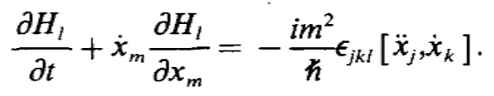
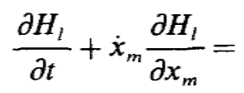
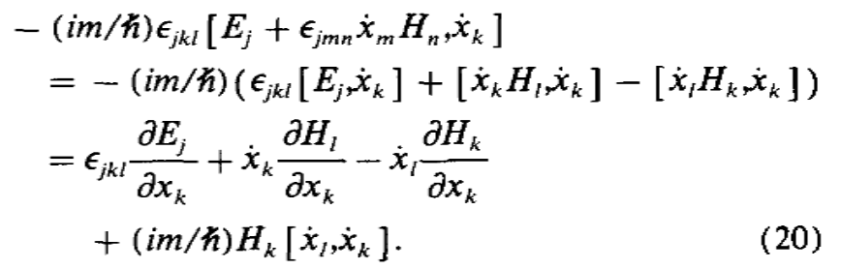
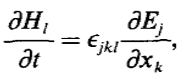
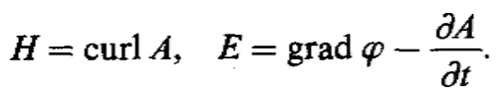
More over: Maxwell’s Eq (2)
From definition of the field H:
Total derivative w.r.t. time:
Apply Newton’s law (1) + Lorentz force (7) on the right:
0
0
Feynman arrived at
Or ← Maxwell’s Eq.(2)
To cast them to a manifestly Lorentz invariant form:

Slide 8





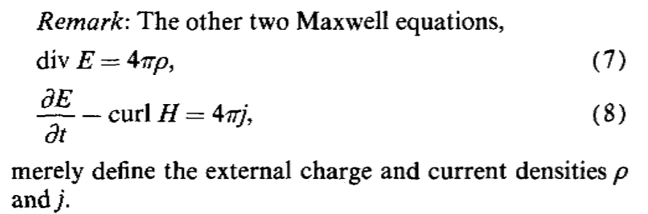

B. Dyson’s commentary
Feynman’s proof: Imposing the position-velocity uncertainty
on Newton’s law
immediately implies the existence of fields E & H,
satisfying Maxwell’s equations, leading to the Lorentz force.
Feynman’s derivation was not standard.
Traditionally:
Euler-Lagrange eq leads to Newton’s law with Lorentz force,
associated with the fields
(dynamics)

Slide 9
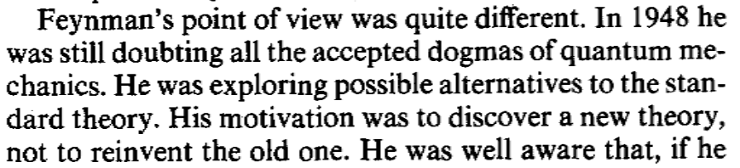

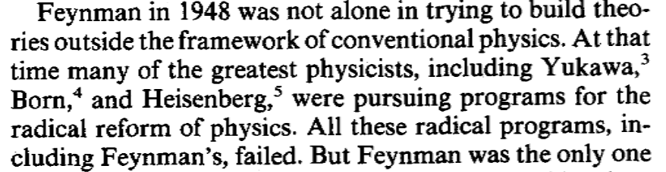
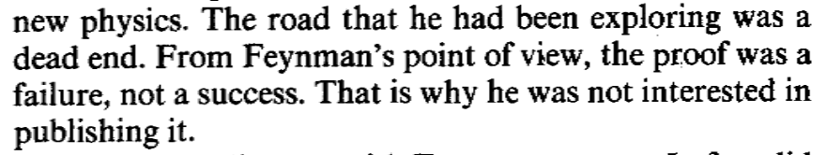
B. Dyson’s commentary

Slide 10
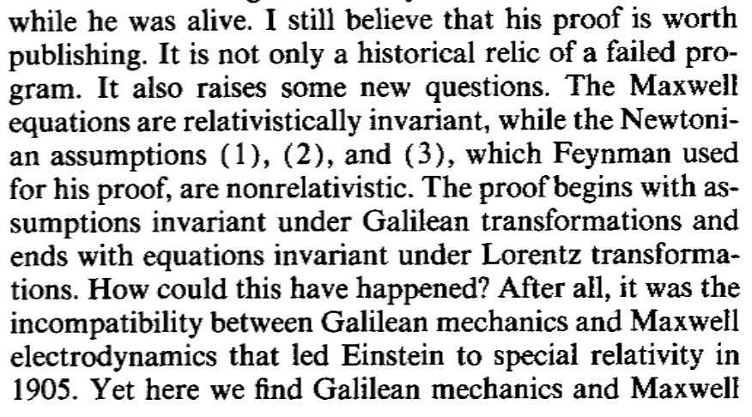
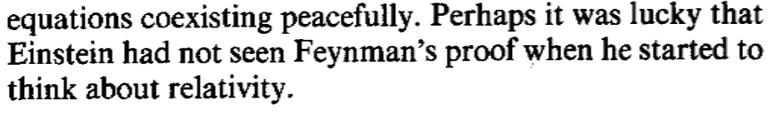
B. Dyson’s commentary

Slide 11
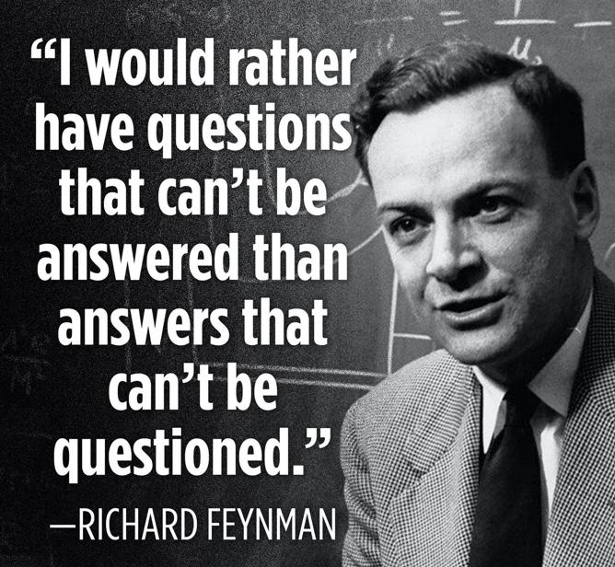

Slide 12
“Quantum mechanics describes nature as absurd from the point of view of common sense. And yet it fully agrees with experiment. So I hope you can accept nature as She is -- absurd.”
-- Richard P. Feynman

