Slide 1


Dimension-eight Operator Basis for Universal Standard Model Effective Field Theory
Jay Desai
T. Corbett, J. Desai, O. J. P. Éboli, M. C. Gonzalez-Garcia,
M. Martines, and P. Reimitz arXiv:2304.03305
T. Corbett, J. Desai, O. J. P. Éboli, M. C. Gonzalez-Garcia | arXiv:2404.03720
Notes:
In this work, we present a consistent and non-redundant basis of dimension-eight operators associated with Universal theories.

Slide 2
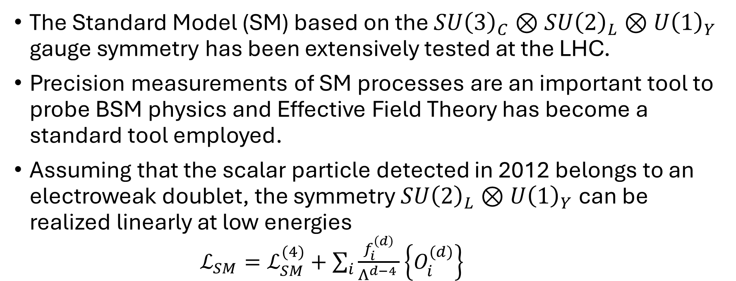
Standard Model Effective field theory
The Standard Model (SM) based on the $SU{\left(3\right)}_{C}⊗SU{\left(2\right)}_{L}⊗U{\left(1\right)}_{Y}$ gauge symmetry has been extensively tested at the LHC.
Precision measurements of SM processes are an important tool to probe BSM physics and Effective Field Theory has become a standard tool employed.
Assuming that the scalar particle detected in 2012 belongs to an electroweak doublet, the symmetry$SU{\left(2\right)}_{L}⊗U{\left(1\right)}_{Y}$ can be realized linearly at low energies
$ℒ_{SM}=ℒ_{SM}^{(4)}+\sum_{i}{\frac{f_{i}^{\left(d\right)}}{Λ^{d−4 }}\left\{O_{i}^{(d)}\right\} }$
Notes:
Paradigmatic advantage of EFT for BSM searches is its model-independence.
The resulting model is the so called Standard Model Effective Field Theory.
Where, f_i are the Wilson coefficients

Slide 3
Universal theories
The advantage of the model-independent approach becomes a limitation as the number of Wilson coefficients becomes too large to handle.
Identifying physically motivated hypotheses which reduce the EFT parameter space while still capturing a large class of BSM theories presents a motivated route to predictability.
Universality, the assumption that NP mainly couples to SM bosons, is one such hypothesis. The low-energy effective operators can be chosen to involve exclusively SM bosons.
Notes:
Taking flavor into account, there are 2499 operators at dimension 6; and 44,807 operators at dimension 8.
For SMEFT, Universal theories refer to BSM models where the low-energy effective operators can be chosen to involve exclusively the SM bosons, i.e. bosonic operators.

Slide 4

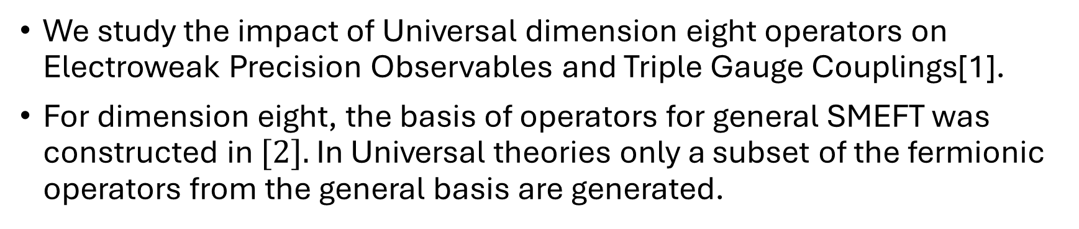

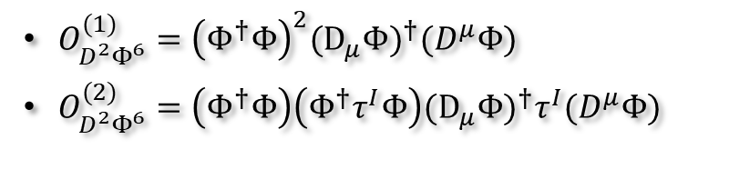
EWPO and TGC analysis
We study the impact of Universal dimension eight operators on Electroweak Precision Observables and Triple Gauge Couplings[1].
For dimension eight, the basis of operators for general SMEFT was constructed in $[2].$ In Universal theories only a subset of the fermionic operators from the general basis are generated.
Dimension 6
$O_{WW}=Φ^{†}{\hat{W}}_{μν}{\hat{W}}^{μν}Φ$
$O_{BB} =Φ^{†}{\hat{B}}_{μν}{\hat{B}}^{μν}Φ$
$O_{BW} =Φ^{†}{\hat{W}}_{μν}{\hat{B}}^{μν}Φ$
$O_{D^{2}Φ^{6}}^{(1)}= ({D_{μ}Φ)}^{†}Φ{ Φ}^{†}(D_{μ}Φ)$
Dimension 8
$O_{W^{2}φ^{4}}^{(1)}=\left(Φ^{†}Φ\right)Φ^{†}{\hat{W}}_{μν}{\hat{W}}^{μν}Φ$
$O_{B^{2}φ^{4}}^{(1)}=\left(Φ^{†}Φ\right)Φ^{†}{\hat{B}}_{μν}{\hat{B}}^{μν}Φ$
$O_{BWφ^{4}}^{(1)}=\left(Φ^{†}Φ\right)Φ^{†}{\hat{W}}_{μν}Φ{\hat{B}}^{μν}$
$O_{W^{2}φ^{4}}^{(3)}=\left(Φ^{†}{\hat{W}}_{μν}Φ\right){(Φ}^{†}{\hat{W}}^{μν}Φ)$
$O_{D^{2}Φ^{6}}^{(1)}={\left(Φ^{†}Φ\right)}^{2}({D_{μ}Φ)}^{†}(D^{μ}Φ)$
$O_{D^{2}Φ^{6}}^{(2)}=\left(Φ^{†}Φ\right)\left(Φ^{†}τ^{I}Φ\right)({D_{μ}Φ)}^{†}τ^{I}(D^{μ}Φ)$
[1] arXiv:2304.03305 [2] Murphy, arXiv:2005.00059 [3] Wells, J.D., Zhang, Z. arXiv:1510.08462
Notes:
The basis of operators for Universal theories at dimension six was introduced in the reference. In this reference, certain bosonic operators were traded for fermionic operators
First introduced in the context of interpreting the Oblique Parameters within the EFT framework
In general, a given SMEFT basis trades some of the bosonic operators for other bosonic operators and operators involving fermions, hereon called fermionic operators, to keep only independent operators.
Most of the relevant operators for our analysis are bosonic operators from the general SMEFT-8 basis.
Canonically renormalize Kinetic terms, can remove kinetic mixing terms using field redefinitions. Will contribute to higgs vev terms and mass of the gauge bosons.

Slide 5
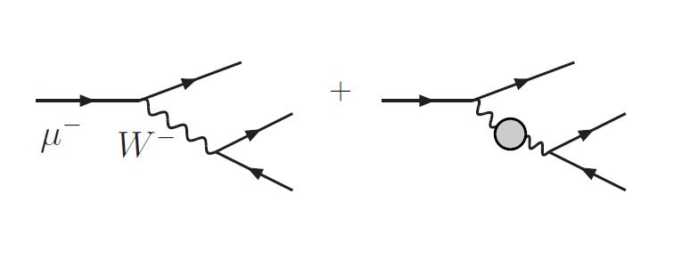

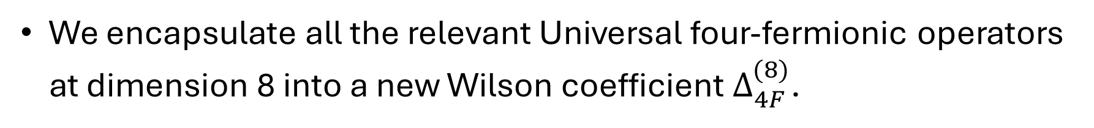
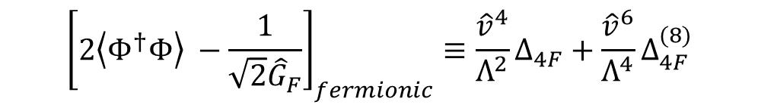
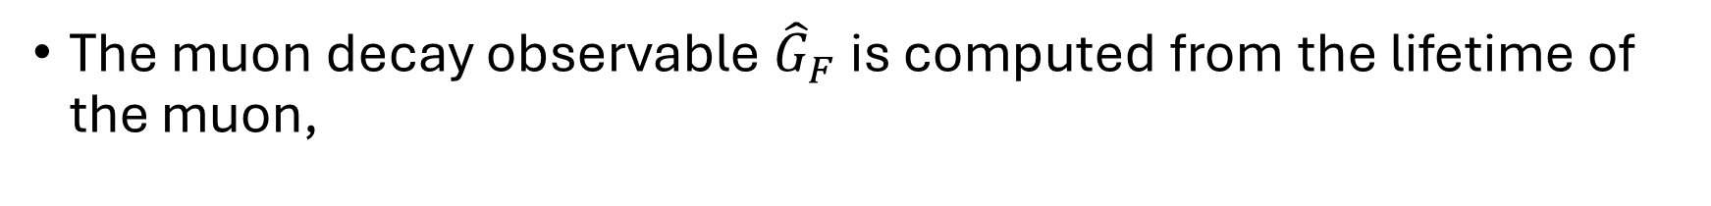
Fermionic Operators: Finite Renormalization of $G_{F}$
The muon decay observable ${\hat{G}}_{F}$is computed from the lifetime of the muon,
$${\left[2\left\langle Φ^{†}Φ\right\rangle −\frac{1}{\sqrt{2}{\hat{G}}_{F}}\right]}_{fermionic}≡\frac{{\hat{v}}^{4}}{Λ^{2}}Δ_{4F}+\frac{{\hat{v}}^{6}}{Λ^{4}}Δ_{4F}^{(8)}$$
$$Δ_{4F}∼O_{2JW}=\sum_{f,f^{′}ε \{Q,L\}}{\left(\overline{f}γ_{μ}\frac{τ^{I}}{2}f\right)\left({\overline{f}}^{′}γ^{μ}\frac{τ^{I}}{2}f′\right)}$$
We encapsulate all the relevant Universal four-fermionic operators at dimension 8 into a new Wilson coefficient $Δ_{4F}^{(8)}$.
ref: Wells, J.D., Zhang, Z. arXiv:1510.08462
Notes:
The place where fermionic operators contribute is the finite renormalization of G_F, one input parameter for our analysis. At dimension 6, we know all of the four-fermion operators that contribute to this process, that we include in Delta 4F.

Slide 6
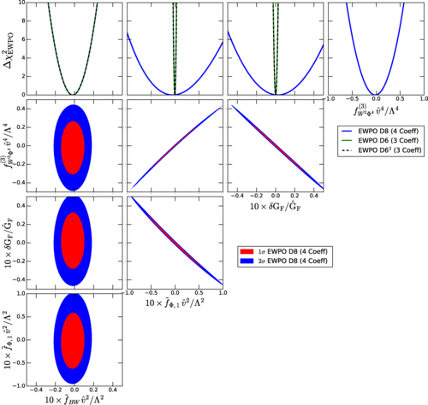
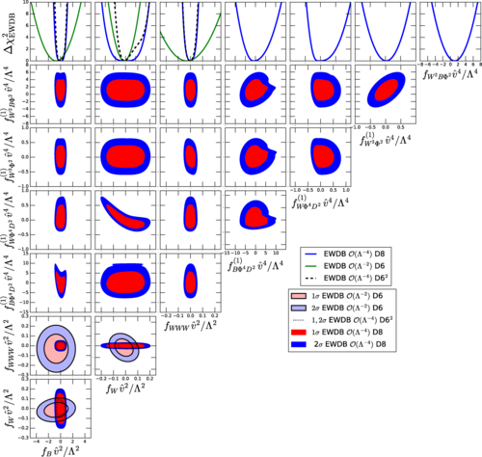
EWPO RESULTS
EWDB RESULTS
Notes:
Using this assumption, we see that this parameter space is closed. EWPO and EWDB data constrain the full parameter space of the operators. Once the dimension8 coefficients are included, bounds on dim6 operators are loosened.
This leads us to the motivation behind the second paper. We wanted to construct a basis of operators for Universal theories at dimension 8, and generate the relevant fermionic operators that we included in Delta_4F at dim8 so we can test our physics assumption.
One and two-dimensional projections of $Δχ_{EWPO}^{2}$ for the coefficients${ \tilde{f}}_{BW}{\hat{v}}^{2}/Λ^{2},{\tilde{f}}_{φ,1}{\hat{v}}^{2}/Λ^{2},{{δG_{F}/G_{F},f}_{W^{2}Φ^{4}}^{\left(3\right)},{\hat{v}}^{4}/Λ^{4}\tilde{Δ}}_{4F}$
The Results show that the dimension-six squared terms are dominant over the dimension-eight ones. (for EWDB)
The physical reason for this can be traced to the dependence of the partonic center-of-mass energy ($\hat{S}$) of the contribution to the relevant squared amplitudes from dimension-six squared and dimension-eight terms.

Slide 7
EWPO RESULTS
EWDB RESULTS
EWPO and EWDB data constrains the full parameter space of the operators.
This motivates us to construct a complete basis for Universal SMEFT at dimension eight and generate the relevant fermionic operators.
Notes:
Using this assumption, we see that this parameter space is closed. EWPO and EWDB data constrain the full parameter space of the operators. Once the dimension8 coefficients are included, bounds on dim6 operators are loosened.
This leads us to the motivation behind the second paper. We wanted to construct a basis of operators for Universal theories at dimension 8, and generate the relevant fermionic operators that we included in Delta_4F at dim8 so we can test our physics assumption.
One and two-dimensional projections of $Δχ_{EWPO}^{2}$ for the coefficients${ \tilde{f}}_{BW}{\hat{v}}^{2}/Λ^{2},{\tilde{f}}_{φ,1}{\hat{v}}^{2}/Λ^{2},{{δG_{F}/G_{F},f}_{W^{2}Φ^{4}}^{\left(3\right)},{\hat{v}}^{4}/Λ^{4}\tilde{Δ}}_{4F}$
The Results show that the dimension-six squared terms are dominant over the dimension-eight ones. (for EWDB)
The physical reason for this can be traced to the dependence of the partonic center-of-mass energy ($\hat{S}$) of the contribution to the relevant squared amplitudes from dimension-six squared and dimension-eight terms.

Slide 8
Construction of Universal basis at dim-8
We create the complete SMEFT operator basis for Universal theories at dimension eight, and the relations implied among the Wilson coefficients of the general dimension eight basis*.
Obtain the number of independent bosonic operators before applying EOM using packages BASISGEN and a modified version of ECO.
Use Fierz relations and IBP relations to construct independent dimension-eight operators involving only SM bosons.
*ref: Murphy, arXiv:2005.00059
Notes:
(**don’t say**)In the EFT framework, operators that are distinct a priori, can lead to the same S-matrix elements.
Operators related using classical Equations of Motion (EOM) or Integration-by-parts (IBP) give the same on-shell S-matrix.

Slide 9
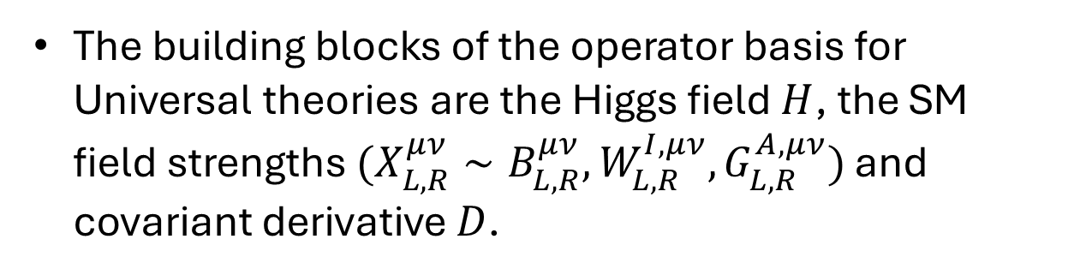
Construction of Universal basis at dim-8
We create the complete SMEFT operator basis for Universal theories, and the relations implied among the Wilson coefficients of the general dimension eight basis*.
The building blocks of the operator basis for Universal theories are the Higgs field $H$, the SM field strengths $(X_{L,R}^{μν}{∼B}_{L,R}^{μν},W_{L,R}^{I,μν},G_{L,R}^{A,μν})$ and covariant derivative $D$.
*ref: Murphy, arXiv:2005.00059

Slide 10
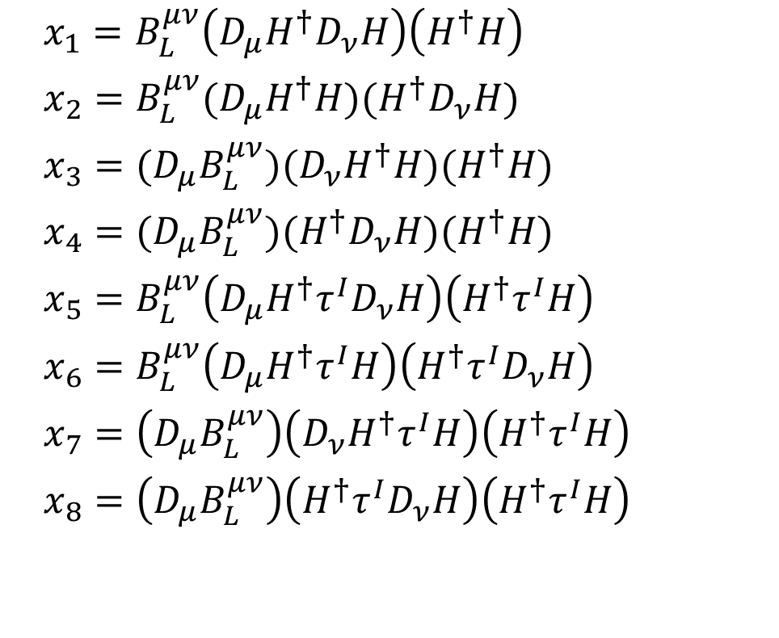
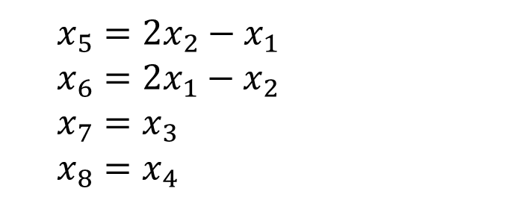

Consider class of operators of $D^{2}B_{L}H^{2}$
$x_{1}=B_{L}^{μν}\left(D_{μ}H^{†}D_{ν}H\right)\left(H^{†}H\right)$
$x_{2}=B_{L}^{μν}(D_{μ}H^{†}H)(H^{†}D_{ν}H)$
$x_{3}=(D_{μ}B_{L}^{μν})(D_{ν}H^{†}H)(H^{†}H)$
$x_{4}=(D_{μ}B_{L}^{μν})(H^{†}D_{ν}H)(H^{†}H)$
$x_{5}=B_{L}^{μν}\left(D_{μ}H^{†}τ^{I}D_{ν}H\right)\left(H^{†}τ^{I}H\right)$
$x_{6}=B_{L}^{μν}\left(D_{μ}H^{†}τ^{I}H\right)\left(H^{†}τ^{I}D_{ν}H\right)$
$x_{7}=\left(D_{μ}B_{L}^{μν}\right)\left(D_{ν}H^{†}τ^{I}H\right)\left(H^{†}τ^{I}H\right)$
$x_{8}=\left(D_{μ}B_{L}^{μν}\right)\left(H^{†}τ^{I}D_{ν}H\right)\left(H^{†}τ^{I}H\right)$
Linear SU(2) Fierz relations
$x_{5}=2x_{2}−x_{1}$
$x_{6}=2x_{1}−x_{2}$
$x_{7}=x_{3}$
$x_{8}=x_{4}$
Notes:
So, we eliminate 4 operators from these 4 linear relations,

Slide 11
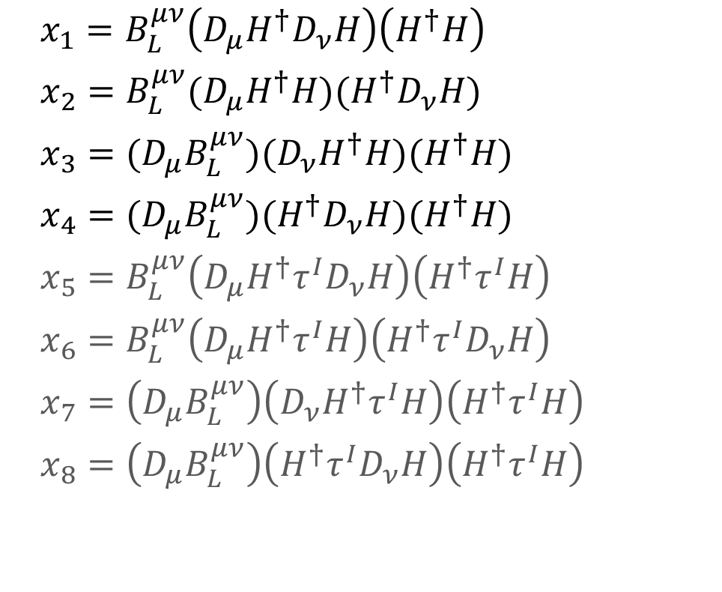
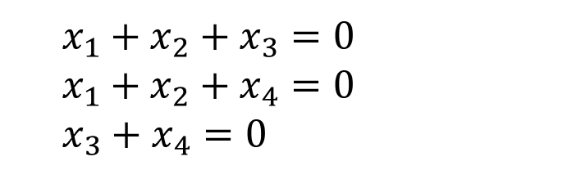
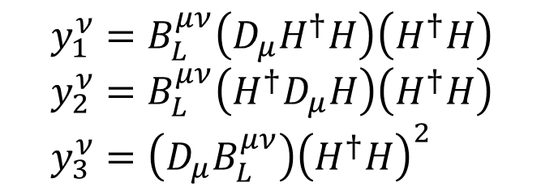
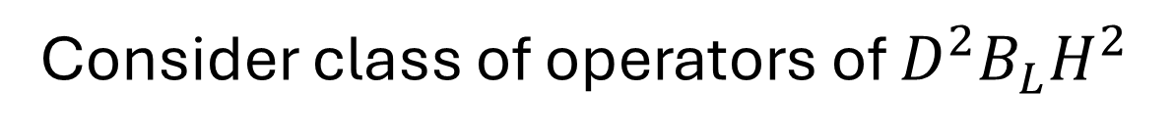
Consider class of operators of $D^{2}B_{L}H^{2}$
$x_{1}=B_{L}^{μν}\left(D_{μ}H^{†}D_{ν}H\right)\left(H^{†}H\right)$
$x_{2}=B_{L}^{μν}(D_{μ}H^{†}H)(H^{†}D_{ν}H)$
$x_{3}=(D_{μ}B_{L}^{μν})(D_{ν}H^{†}H)(H^{†}H)$
$x_{4}=(D_{μ}B_{L}^{μν})(H^{†}D_{ν}H)(H^{†}H)$
$x_{5}=B_{L}^{μν}\left(D_{μ}H^{†}τ^{I}D_{ν}H\right)\left(H^{†}τ^{I}H\right)$
$x_{6}=B_{L}^{μν}\left(D_{μ}H^{†}τ^{I}H\right)\left(H^{†}τ^{I}D_{ν}H\right)$
$x_{7}=\left(D_{μ}B_{L}^{μν}\right)\left(D_{ν}H^{†}τ^{I}H\right)\left(H^{†}τ^{I}H\right)$
$x_{8}=\left(D_{μ}B_{L}^{μν}\right)\left(H^{†}τ^{I}D_{ν}H\right)\left(H^{†}τ^{I}H\right)$
$y_{1}^{ν}=B_{L}^{μν}\left(D_{μ}H^{†}H\right)\left(H^{†}H\right)$
$y_{2}^{ν}=B_{L}^{μν}\left(H^{†}D_{μ}H\right)\left(H^{†}H\right)$
$y_{3}^{ν}=\left(D_{μ}B_{L}^{μν}\right){\left(H^{†}H\right)}^{2}$
$x_{1}+x_{2}+x_{3}=0$
$x_{1}+x_{2}+x_{4}=0$
$x_{3}+x_{4}=0$
Notes:
Now, we take care of Integration-by-parts relations. So, first we list down all possible operators that we can write with one less derivative. Taking the derivative of the y operators and equating it to zero gives us the IBP relations that we need.
We see that we have two independent relations. So, we are left with 2 operators, in agreement with predictions from Hilbert series.

Slide 12
Consider class of operators of $D^{2}B_{L}H^{2}$
$x_{1}=B_{L}^{μν}\left(D_{μ}H^{†}D_{ν}H\right)\left(H^{†}H\right)$
$x_{2}=B_{L}^{μν}(D_{μ}H^{†}H)(H^{†}D_{ν}H)$
$x_{3}=(D_{μ}B_{L}^{μν})(D_{ν}H^{†}H)(H^{†}H)$
$x_{4}=(D_{μ}B_{L}^{μν})(H^{†}D_{ν}H)(H^{†}H)$
$x_{5}=B_{L}^{μν}\left(D_{μ}H^{†}τ^{I}D_{ν}H\right)\left(H^{†}τ^{I}H\right)$
$x_{6}=B_{L}^{μν}\left(D_{μ}H^{†}τ^{I}H\right)\left(H^{†}τ^{I}D_{ν}H\right)$
$x_{7}=\left(D_{μ}B_{L}^{μν}\right)\left(D_{ν}H^{†}τ^{I}H\right)\left(H^{†}τ^{I}H\right)$
$x_{8}=\left(D_{μ}B_{L}^{μν}\right)\left(H^{†}τ^{I}D_{ν}H\right)\left(H^{†}τ^{I}H\right)$
Already in the general SMEFT basis.
Notes:
This allows us to identify the independent universal fermionic operators. We identify 2 Universal fermionic operators. Delta contains all of the genuinely bosonic operators from the SMEFT-8 basis.

Slide 13
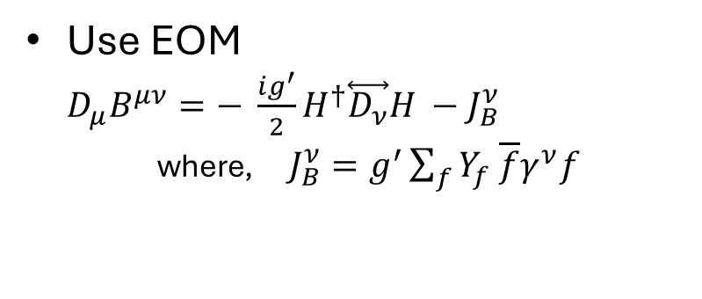
Consider class of operators of $D^{2}B_{L}H^{2}$
$x_{1}=B_{L}^{μν}\left(D_{μ}H^{†}D_{ν}H\right)\left(H^{†}H\right)$
$x_{2}=B_{L}^{μν}(D_{μ}H^{†}H)(H^{†}D_{ν}H)$
$x_{3}=(D_{μ}B_{L}^{μν})(D_{ν}H^{†}H)(H^{†}H)$
$x_{4}=(D_{μ}B_{L}^{μν})(H^{†}D_{ν}H)(H^{†}H)$
$x_{5}=B_{L}^{μν}\left(D_{μ}H^{†}τ^{I}D_{ν}H\right)\left(H^{†}τ^{I}H\right)$
$x_{6}=B_{L}^{μν}\left(D_{μ}H^{†}τ^{I}H\right)\left(H^{†}τ^{I}D_{ν}H\right)$
$x_{7}=\left(D_{μ}B_{L}^{μν}\right)\left(D_{ν}H^{†}τ^{I}H\right)\left(H^{†}τ^{I}H\right)$
$x_{8}=\left(D_{μ}B_{L}^{μν}\right)\left(H^{†}τ^{I}D_{ν}H\right)\left(H^{†}τ^{I}H\right)$
Already in the general SMEFT basis.
Use EOM
$D_{μ}B^{μν}=− \frac{ig^{′}}{2}H^{†}\overset{⃡}{D_{ν}}H −J_{B}^{ν}$
where, $J_{B}^{ν}=g^{′}\sum_{f}{Y_{f} \overline{f}γ^{ν}f }$
Notes:
The action of the EOM for Universal basis is not to remove redundant operators but rotate from one basis to another.
This allows us to identify the independent universal fermionic operators. We identify 2 Universal fermionic operators. Delta contains all of the genuinely bosonic operators from the SMEFT-8 basis.

Slide 14
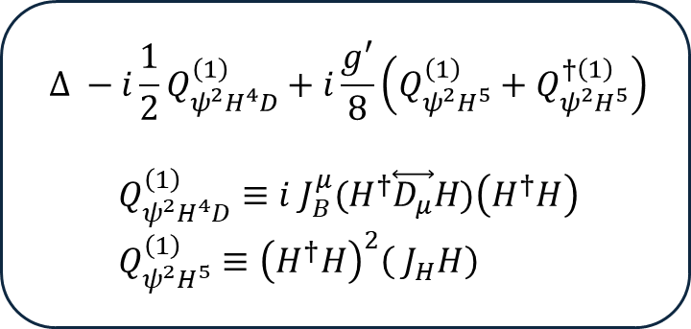
Consider class of operators of $D^{2}B_{L}H^{2}$
$x_{1}=B_{L}^{μν}\left(D_{μ}H^{†}D_{ν}H\right)\left(H^{†}H\right)$
$x_{2}=B_{L}^{μν}(D_{μ}H^{†}H)(H^{†}D_{ν}H)$
$x_{3}=(D_{μ}B_{L}^{μν})(D_{ν}H^{†}H)(H^{†}H)$
$x_{4}=(D_{μ}B_{L}^{μν})(H^{†}D_{ν}H)(H^{†}H)$
$x_{5}=B_{L}^{μν}\left(D_{μ}H^{†}τ^{I}D_{ν}H\right)\left(H^{†}τ^{I}H\right)$
$x_{6}=B_{L}^{μν}\left(D_{μ}H^{†}τ^{I}H\right)\left(H^{†}τ^{I}D_{ν}H\right)$
$x_{7}=\left(D_{μ}B_{L}^{μν}\right)\left(D_{ν}H^{†}τ^{I}H\right)\left(H^{†}τ^{I}H\right)$
$x_{8}=\left(D_{μ}B_{L}^{μν}\right)\left(H^{†}τ^{I}D_{ν}H\right)\left(H^{†}τ^{I}H\right)$
Already in the general SMEFT basis.
$$Δ −i\frac{1}{2}Q_{ψ^{2}H^{4}D}^{\left(1\right)}+i\frac{g^{′}}{8}\left(Q_{ψ^{2}H^{5}}^{\left(1\right)}+Q_{ψ^{2}H^{5}}^{†\left(1\right)}\right)$$
$$Q_{ψ^{2}H^{4}D}^{\left(1\right)}≡i J_{B}^{μ}{(H}^{†}\overset{⃡}{D_{μ}}H)\left(H^{†}H\right) \\ Q_{ψ^{2}H^{5}}^{\left(1\right)}≡{\left(H^{†}H\right)}^{2}\left( J_{H}H\right)$$
Use EOM
$D_{μ}B^{μν}=− \frac{ig^{′}}{2}H^{†}\overset{⃡}{D_{ν}}H −J_{B}^{ν}$
where, $J_{B}^{ν}=g^{′}\sum_{f}{Y_{f} \overline{f}γ^{ν}f }$
Notes:
This allows us to identify the independent universal fermionic operators. We identify 2 Universal fermionic operators. Delta contains all of the genuinely bosonic operators from the SMEFT-8 basis.

Slide 15
Obtain the number of independent bosonic operators before applying EOM using packages BASISGEN and a modified version of ECO.
Use Fierz relations and IBP relations to construct independent dimension-eight operators involving only SM bosons.
86 bosonic operators
fermionic operators in general SMEFT-8 basis.
86 independent combinations
in Universal SMEFT-8 basis
We find 175 independent operators at dim8.
89 bosonic operators already in general SMEFT-8 basis.
86 operators rotated to fermionic ops using EOM.
Notes:
To show that our basis is consistent,
We derive relations between the 86 independent couplings of the Universal fermionic operators and the Wilson coefficients of the fermionic operators of the general SMEFT basis.
This constitutes our “fermionic” basis of operators for Universal theories of SMEFT at dimension 8. Through this consistency check we show that our basis is a subset of the general SMEFT-8 basis in the literature.

Slide 16
Conclusions and Outlook
Universal Effective field theories, present a physically motivated hypothesis which reduces the EFT parameter space while still capturing a large class of BSM theories.
We studied the impact of Universal dimension-eight operators on Electroweak Precision Observables and Triple Gauge Couplings.
In the following work, we constructed the dimension-eight Universal SMEFT operator basis which encodes the low-energy effects of Universal extensions of SM.
Wish to study the impact of Universal dimension eight operators on Drell-Yan.
Notes:
Possible contributions to TGV and EWPD analysis from additional fermionic universal operators but most likely we still closed parameters space fit.

Slide 17
THANK YOU.
QUESTIONS?

Slide 19
BACKUP SLIDES

Slide 20
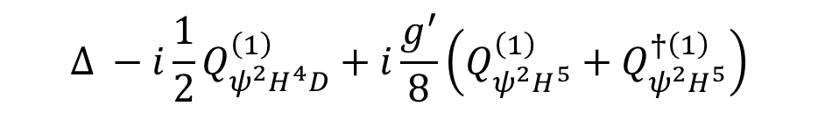


Universal Fermionic Operators
Once, we apply the EOM, we identify 86 independent fermionic operators thereby completing our Universal “fermionic” basis.
We derive relations between the 86 independent couplings of the Universal fermionic operators and the Wilson coefficients of the fermionic operators of the general SMEFT basis*.
$$Δ −i\frac{1}{2}Q_{ψ^{2}H^{4}D}^{\left(1\right)}+i\frac{g^{′}}{8}\left(Q_{ψ^{2}H^{5}}^{\left(1\right)}+Q_{ψ^{2}H^{5}}^{†\left(1\right)}\right)$$
$$\left(D_{μ}B^{μν}\right)\left(D_{ν}H^{†}H\right)\left(H^{†}H\right)$$
$$Q_{ψ^{2}H^{4}D}^{\left(1\right)}≡i J_{B}^{μ}{(H}^{†}\overset{⃡}{D_{μ}}H)\left(H^{†}H\right) \\ Q_{ψ^{2}H^{5}}^{\left(1\right)}≡{\left(H^{†}H\right)}^{2}\left( J_{H}H\right)$$
*ref: Murphy, arXiv:2005.00059
Notes:
After using EOM, lots of fermionic operators are generated. We identify 86 independent fermionic operators from the set of operators generated. Thus, creating a non-redundant basis for Universal SMEFT, in agreement with Hilbert series results.
To show that our basis choice is consistent, ……. This shows that the Universal SMEFT basis is a subset of the general SMEFT basis, which we should expect.
We have 62 two-fermion operators and 24 four-fermion operators in our “fermionic basis”

Slide 21
Future Phenomenology
In our previous work*, we studied the impact of Universal dimension-eight operators on Electroweak Precision Observables and Triple Gauge Couplings.
We assumed that only Four-fermion Universal operators contributed to muon decay, and thus modifying the Higgs field v.e.v.
For future work, we wish to study the impact of the dimension eight Universal Operators on Drell-Yan.
*ref: arXiv:2304.03305
Notes:
Most of the relevant operators for these processes where in the bosonic part of the general SMEFT basis. At the time, there was no study done to construct a complete fermionic basis of Universal operators. So, we did not know what fermionic operators from the general SMEFT basis are part of the Universal SMEFT basis.
We introduced a Wilson coefficient that encapsulated the effect of the 4-fermion operators on the Higgs vev

Slide 22
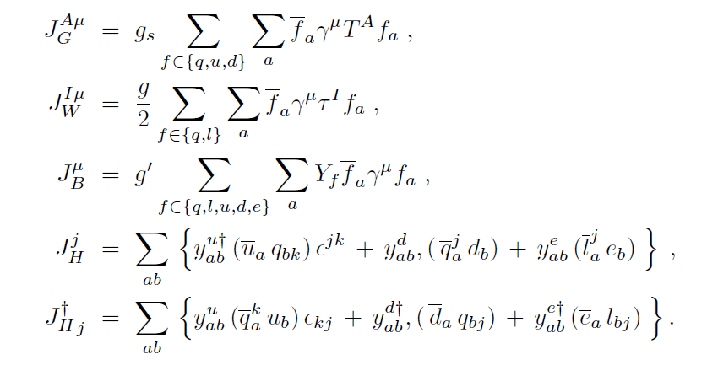

Slide 23
$$x_{3}=\left(D_{μ}B^{μν}\right)\left(D_{ν}H^{†}H\right)\left(H^{†}H\right) \left(\right)$$
$$x_{3}=\left(− \frac{ig^{′}}{2}H^{†}\overset{⃡}{D_{ν}}H −J_{B}^{ν}\right)\left(D_{ν}H^{†}H\right)\left(H^{†}H\right)$$
$$x_{3}=Δ −i\frac{1}{2}Q_{ψ^{2}H^{4}D}^{\left(1\right)}+i\frac{g^{′}}{8}\left(Q_{ψ^{2}H^{5}}^{\left(1\right)}+Q_{ψ^{2}H^{5}}^{†\left(1\right)}\right)$$

