Slide 1

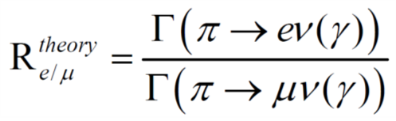
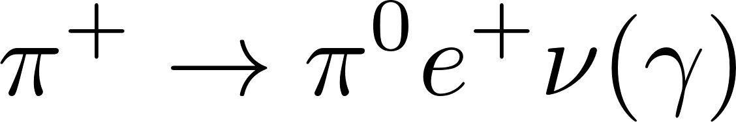
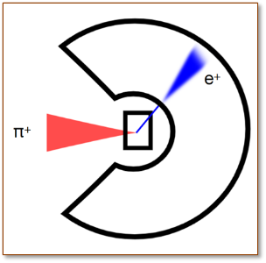
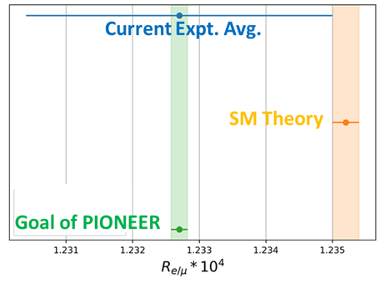
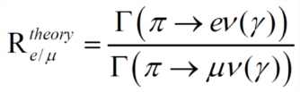
Measurements of a LYSO Crystal Array for a Rare
Pion Decay Experiment (PIONEER)
David Hertzog; University of Washington
Physics Goals
Lepton Flavor Universality (e vs μ to <10⁻⁴ in BR)
Cabibbo Angle Anomaly (V_{ud}) pion beta decay)
Sterile neutrinos and exotic decays:
illustrate challenge with this channel
10 x Improvements in precision
All of these involve high-resolution calorimetry in the (unusual) “below 100 MeV” range
What is this?
LXe?
LYSO?
x 10⁻⁴
2D cartoon of experiment
Interested in growing PIONEER Collaboration? Contact me: hertzog@uw.edu

Slide 2
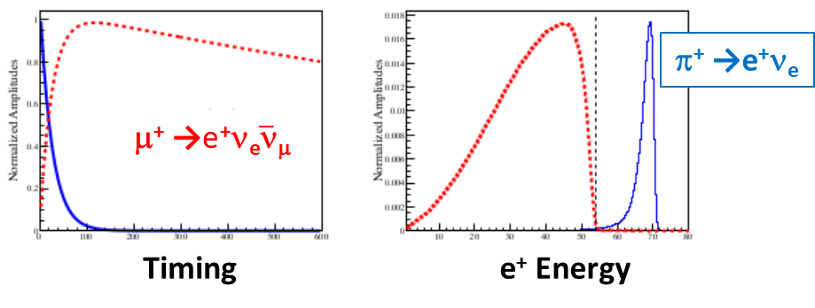
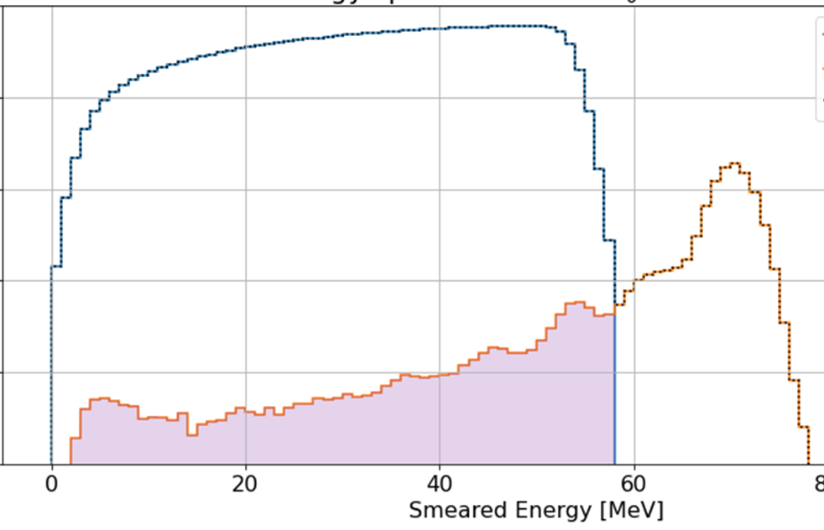
How the Calorimeter is used in a pi-e-nu measurement
70 MeV
The key is to minimize the fraction of π → e events that hide below the Michel spectrum: “The Tail”, and determine that fraction well
Must measure (and model) the full line shape
Resolution makes Hi / Lo boundaries more distinct
τ_{μ} = 2197 ns
τ_{π} = 26 ns
Tail
20 X₀ deep calorimeter: Tail fraction <0.5%
Use a highly segmented, 5D tracking pion stopping detector to reject Michel and other low-energy events
(subject of a separate talk)
Tail fraction uncertainty <0.01%
π → μ → e
π → e
The Tail
Resolution and Depth are important
See Y. Zhang; Pioneer presentation
Room 121 at 3 PM today

Slide 3
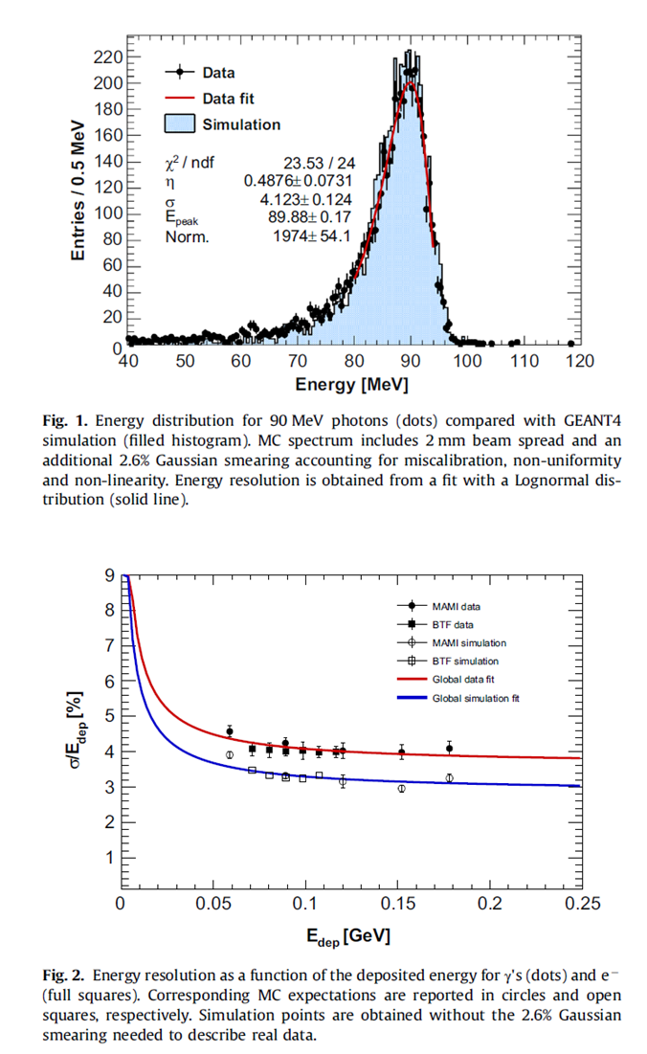
What material might work?
Lutetium–yttrium oxyorthosilicate (LYSO):
By weight: 72% Lutetium, 17% Oxygen, 6% Silicon, 3% Cerium (dopant), 2% Yttrium
X₀ = 1.14 cm , R_{M} = 2.07 cm
Decay time = 40 ns
Light yield 30,000 γ/MeV
λ_{peak} 420 nm -> conventional PMTs
Radioactive (< 1 MeV constant rumble)
Non hygroscopic
No Temp dependence
n = 1.82
Not so cheap … ☹
LXe (used in MEG II) has excellent properties, but cannot be segmented
LYSO crystals look promising, but no one has yet achieved needed resolution
Goal of this R&D: Test newer LYSO formulation with attention to details to achieve the resolution promised by the intrinsic properties.
History: Some arrays tested, obtained 4.5% @70 MeV, which met their goals
  Can we do better?
A test by Mu2e

Slide 4
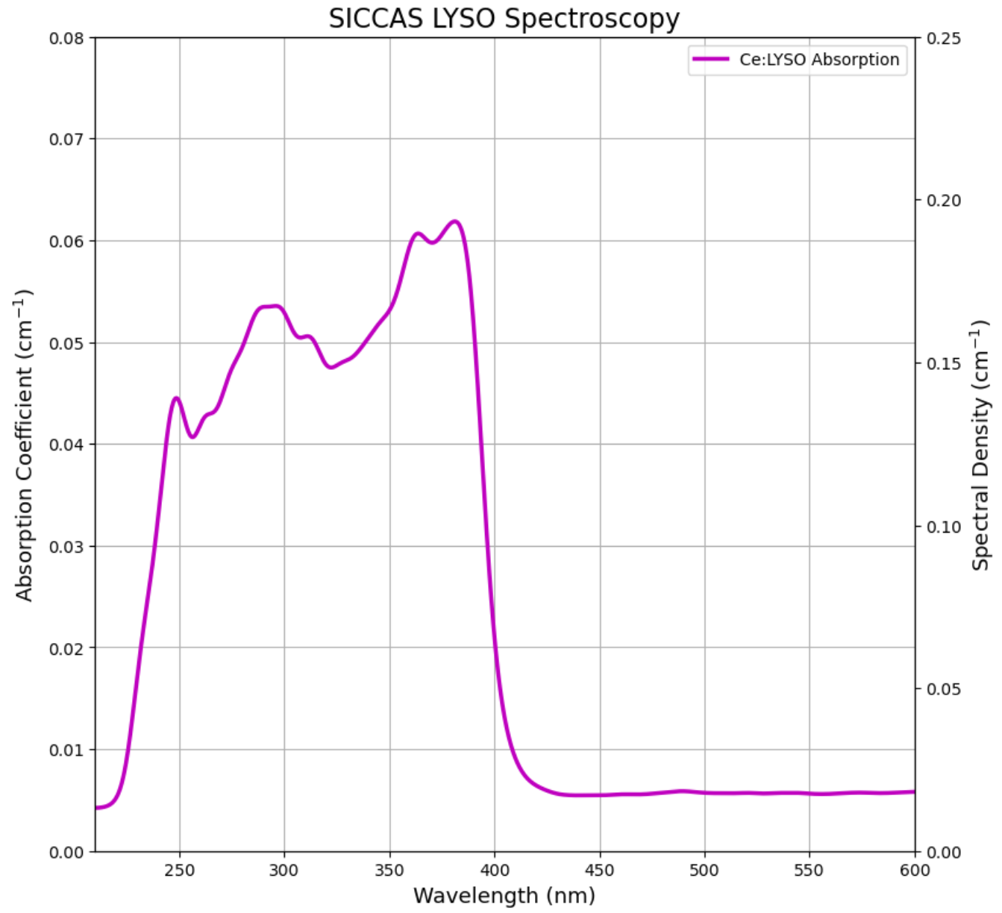
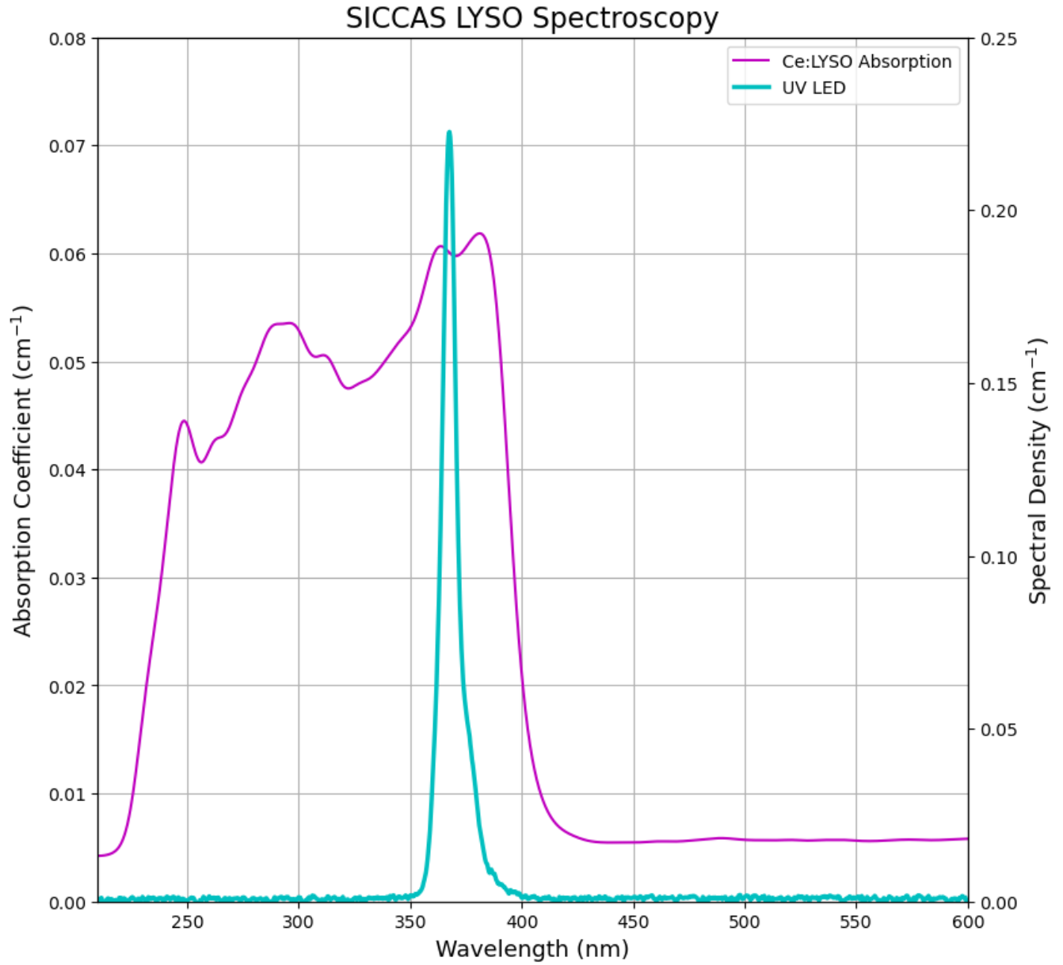
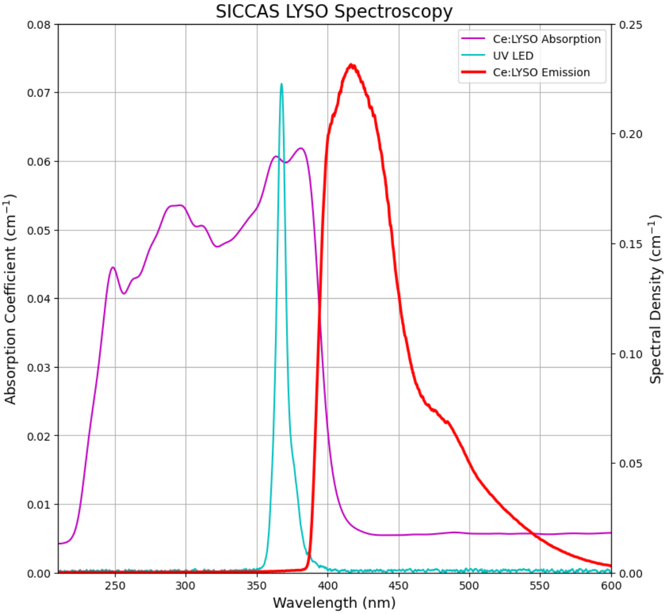
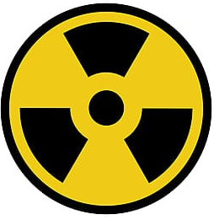
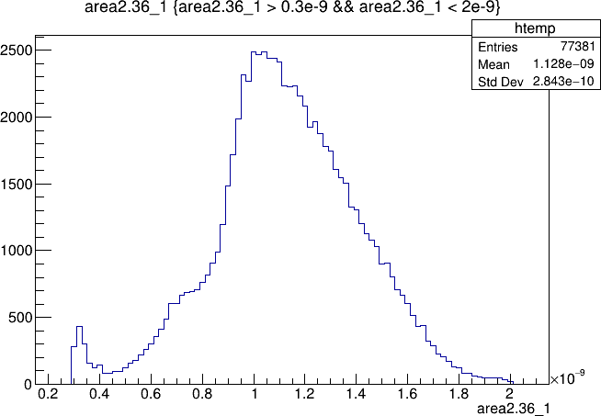
LYSO Intrinsic Light Properties
An interesting fact, LYSO intrinsic radioactivity.
Built in calibration!
Slight concern when seeking best resolution at low energies from an array
→ From the beta decay of Lu-176
Can extend transmission by using Wrattan 3E yellow filters at the cost of light
Absorption
Emission
0.1 0.6 1.2 MeV
300 350 400 450 500 550 600
Wavelength (nm)
Alva-Sánchez et al. Understanding the intrinsic radioactivity energy spectrum from 176Lu in LYSO/LSO scintillation crystals. Sci Rep 8, 17310 (2018).
Notes:
Emission spectra is measured by excitation with a UV LED (spectra shown). The ‘spectral density’ scale is intensity (counts in 180 ms) divided by the crystal length.
Transmission is the percentage of light that passes through the crystal. A pulsed xenon light source was used
Because of the high index of refraction, the light spreads out less in LYSO than in air, so the reference spectrum of air has to be rescaled. Using Snell’s Law, the corrected reference is the original reference spectrum times the LYSO index of refraction squared.
Absorbance is defined as the negative (base 10) log of transmission. The result is also scaled by crystal length.
Absorption and emission are consistent across all SICCAS crystals, transmission varies more widely

Slide 5
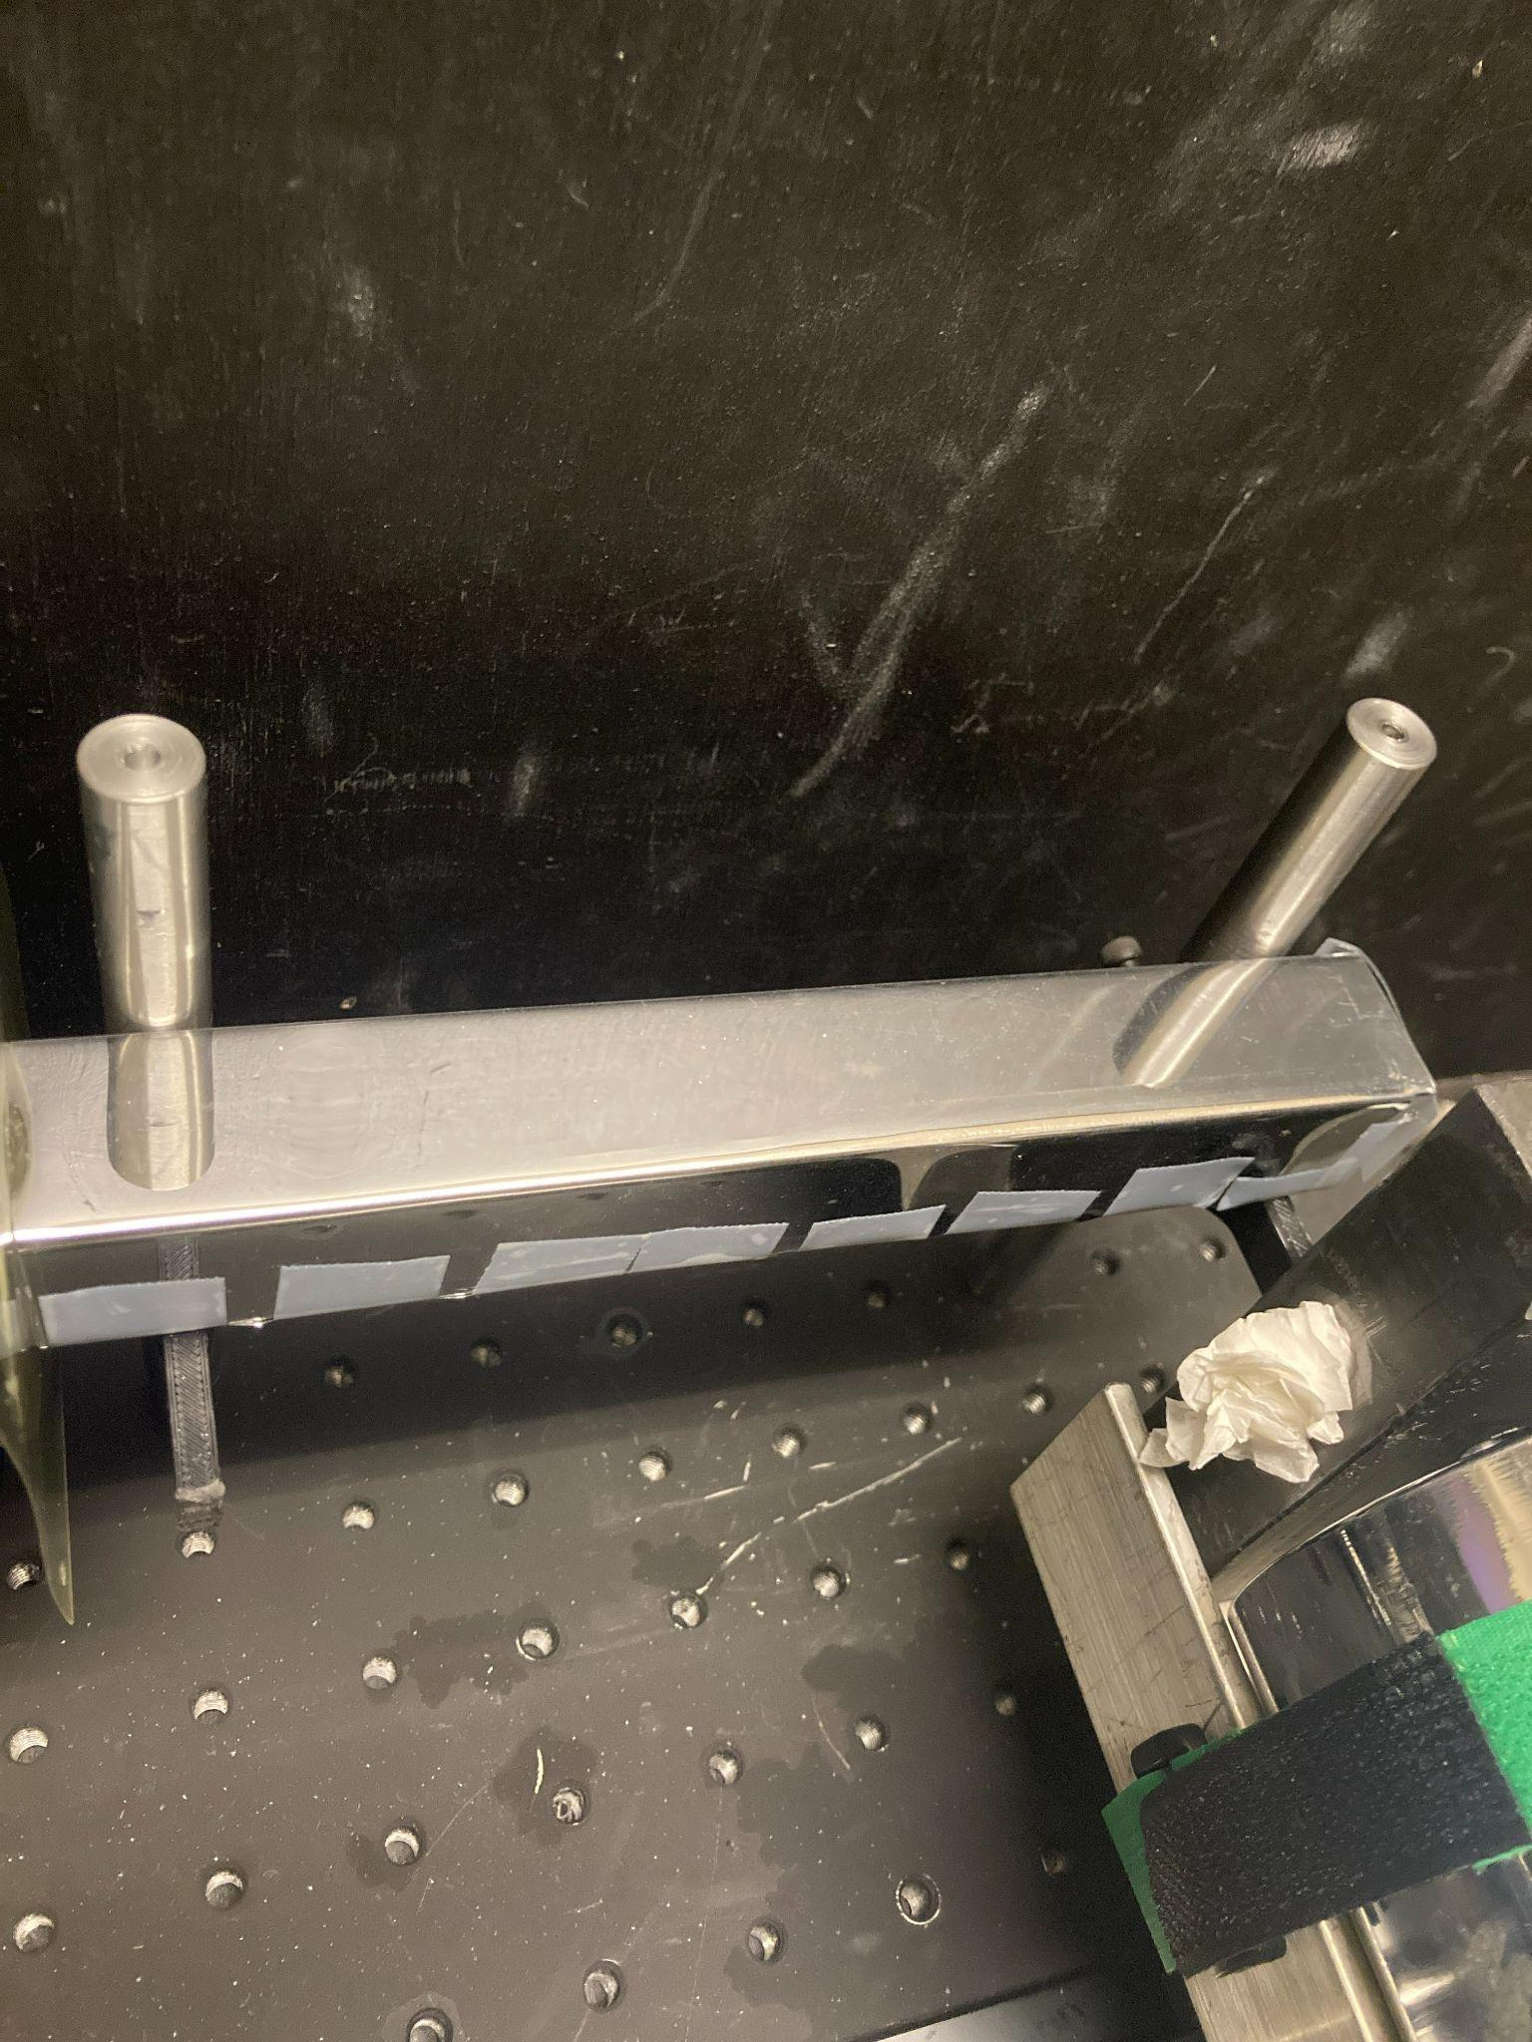
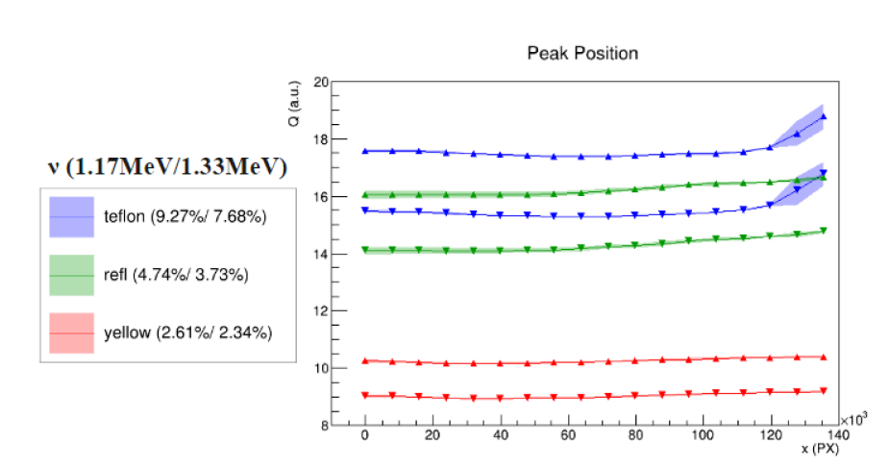
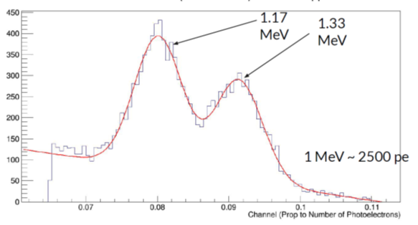
Single crystal tests of recent SICCAS* formulation
2.5 × 2.5 × 18 cm³ (15.7 X0)
Co-60 tomography to measure longitudinal uniformity / attenuation
ESR-wrapped LYSO crystal
⁶⁰Co
(The Trigger)
Measure Peak Positions vs Impact along crystal
red
Distance from PMT
*Shanghai Institute of Ceramics (made our PbF₂ crystals for g-2)

Slide 6
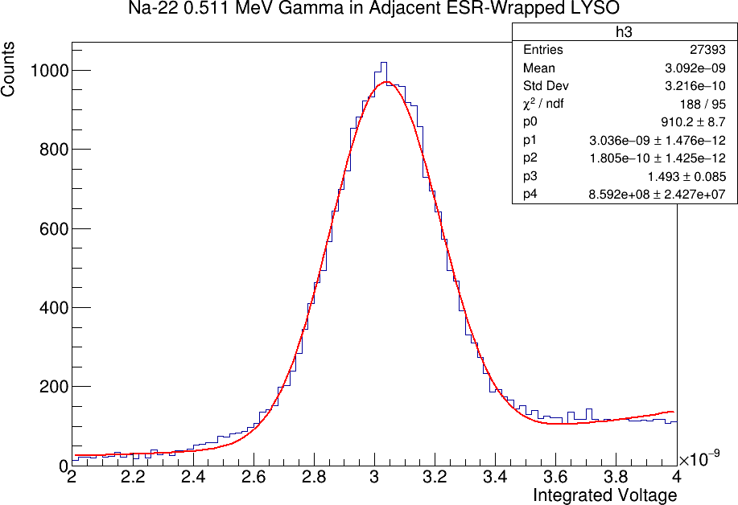
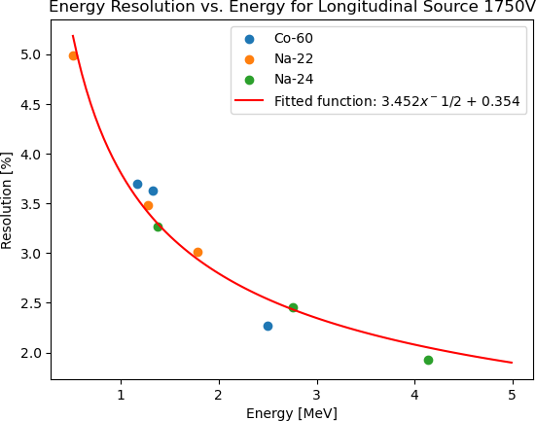
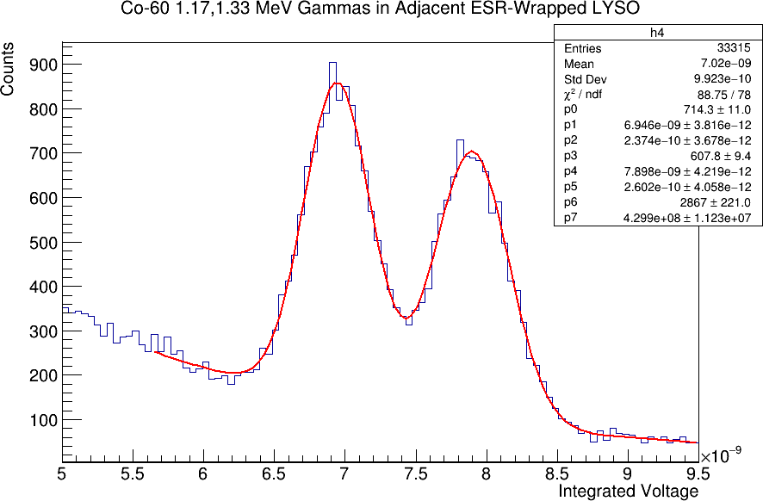
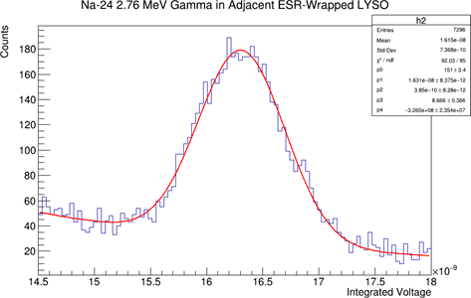
Energy resolution with “bench” sources
511 keV
(this is why they are used in most PET scanners now)
Na22
Co-60
Na-24*
  1.38, 2.76 MeV
2γ implies coincidences of lower energy lines
1.17 & 1.33 MeV
(2γ sum)
2.76 MeV
(2γ sum)
(2γ sum)
*Short lived (15 hr half life); emits a series of γ
Source made by bombarding 18 MeV deuterons, produces neutrons that strike an Al button (done at CENPA Van de Graaff)
(Resolution is sigma of a Gaussian)

Slide 7
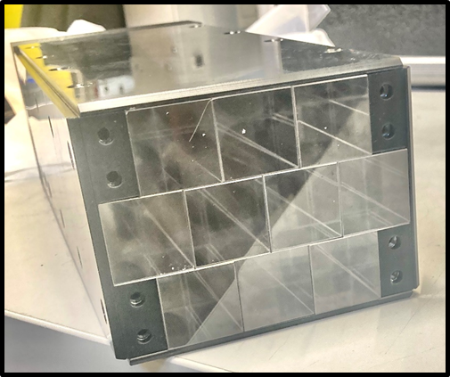
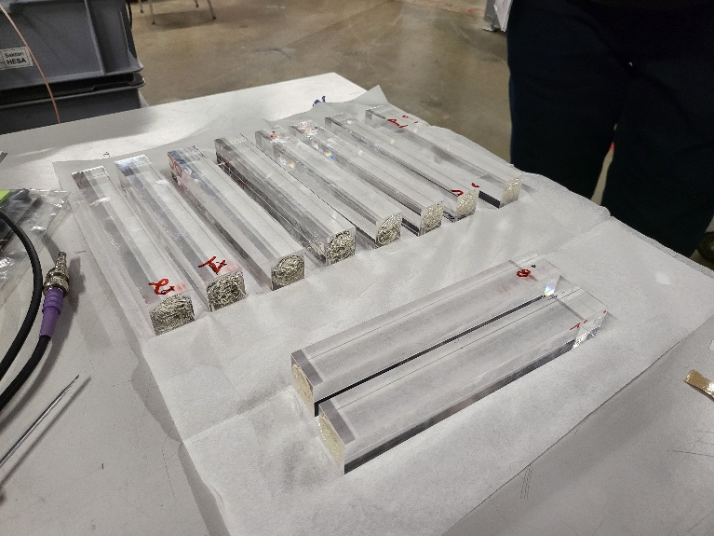
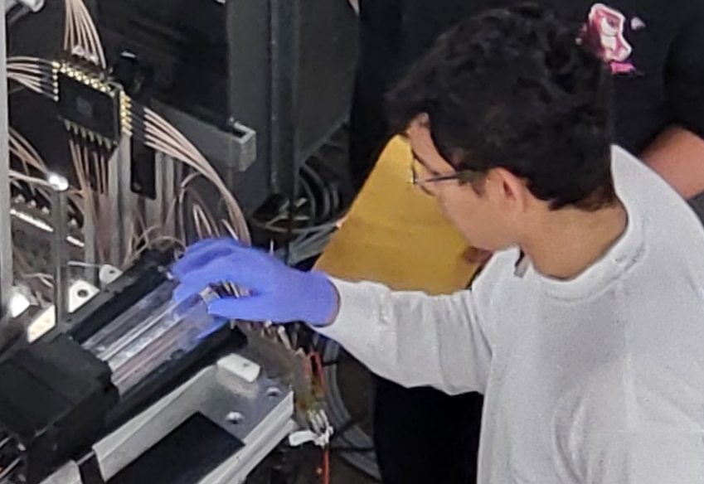
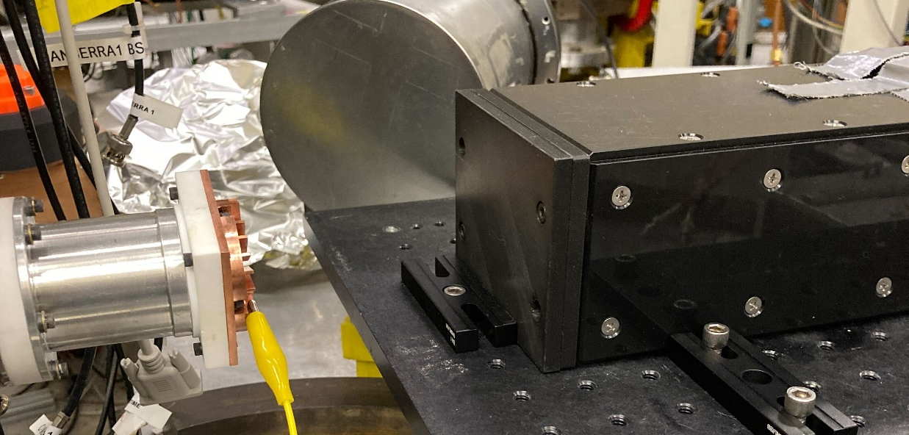
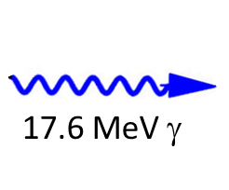
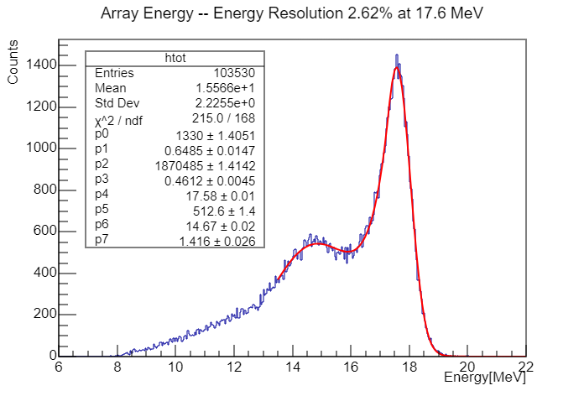
Measurements with 10 crystals
LiF
1.4 MeV p
Read out with R1450 Hamamatsu 19-mm PMTs using a customized, tapered voltage divider
p-Li calibration following L3 @ LEP and MEG-II.
We use a 1.4 MeV proton beam degraded and impinging on a LiF foil. @440 keV it excites a resonance, which decays with a 17.6 MeV gamma (and other lower energy lines)
2.6% at 17.6 MeV
This is state-of-the art resolution

Slide 8
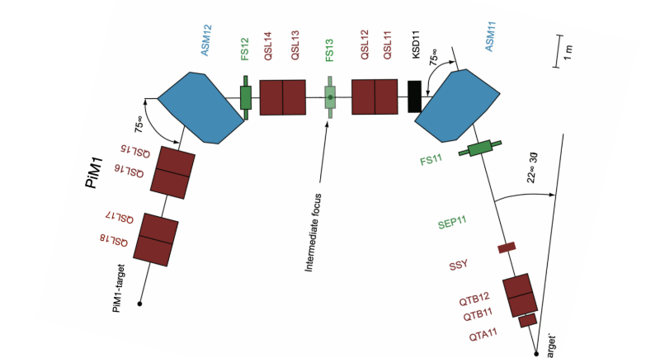
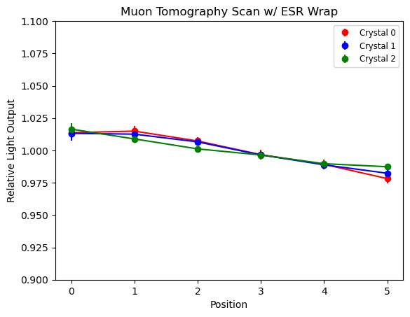
Next, π/μ/e beam at PSI
PiM1 is ideal up to a few hundred MeV/c
  ΔP/P measured to be <0.6% for range of measurements
  Positrons energy scan: 30 – 100 MeV
  Muons @ 210 MeV/c used for transverse tomography
Expt
T0
PMT
3%
PMT
PMT
μ
1 4 7 10 13 16 cm
Distance from PMT
Scint

Slide 9
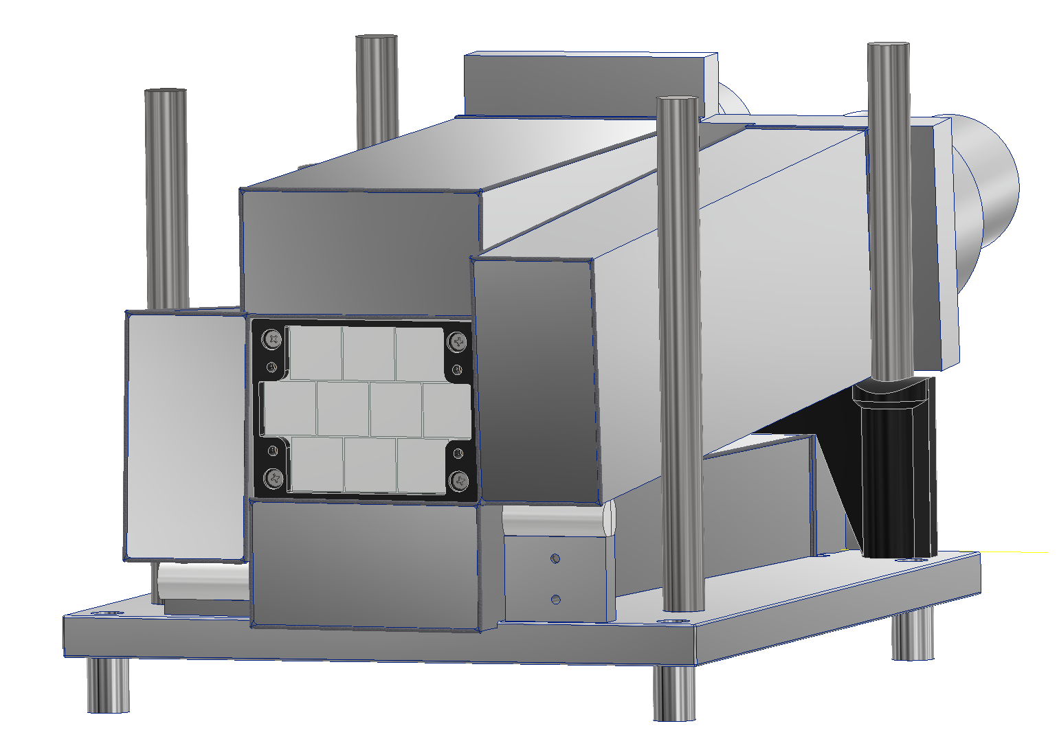
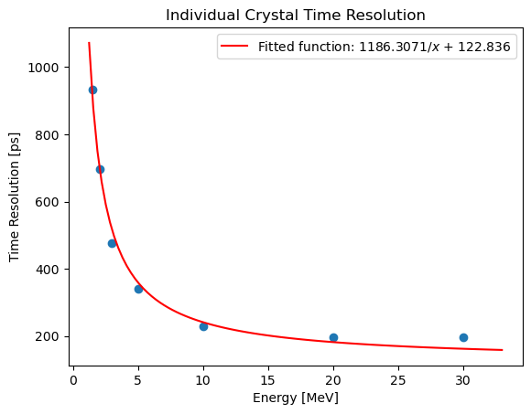
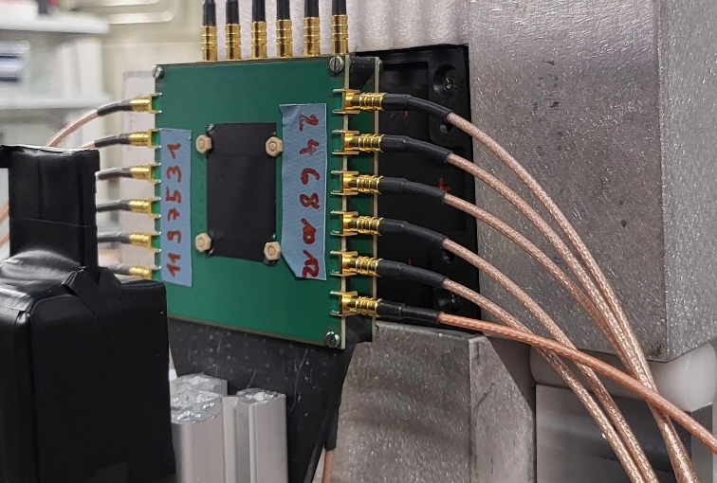
Timing Resolution vs Positron Energy
Use T0 vs fitted Crystal waveform time
  Plot is Xtal to Xtal time diff
Time Difference between adjacent crystals
Divide by root(2) for individual timing
LYSO array
T0
NaI border
e⁺
X-Y
Hodoscope
Easily meets our goal

Slide 10
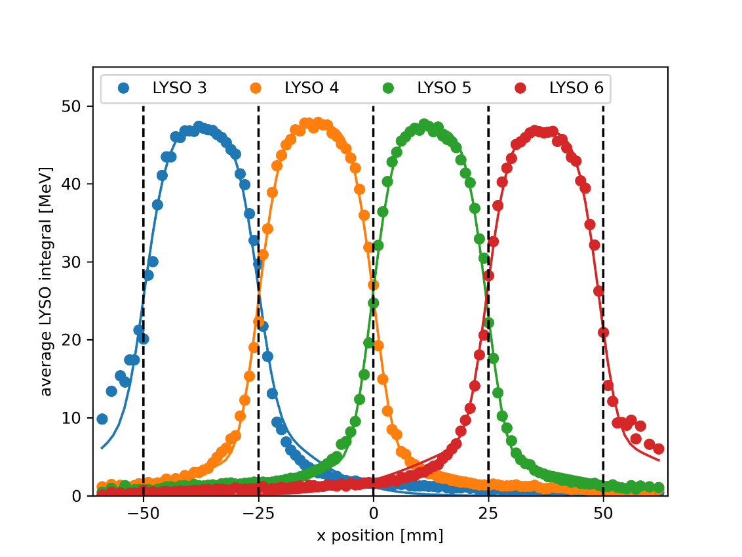
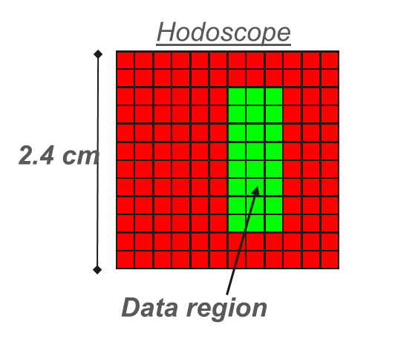
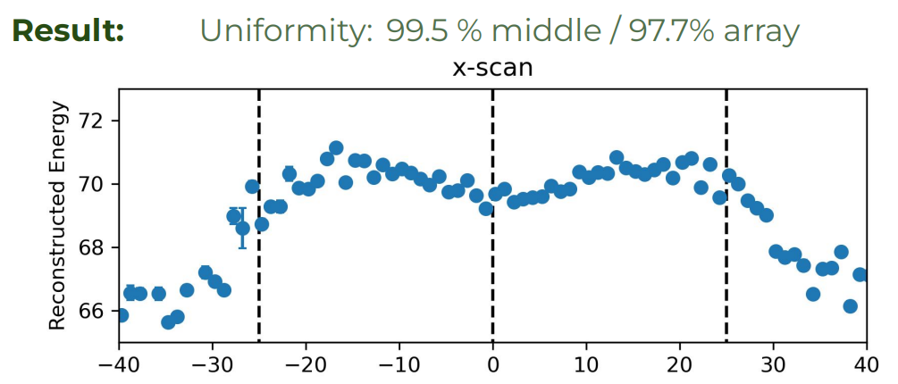
Uniformity across Crystal Boundary at 70 MeV
Used X-Y hodoscope and moving table to scan front of array

Slide 11
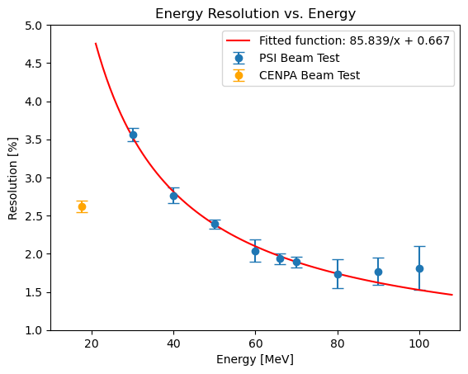
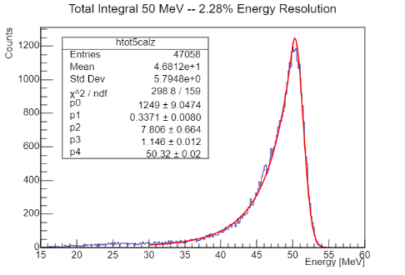
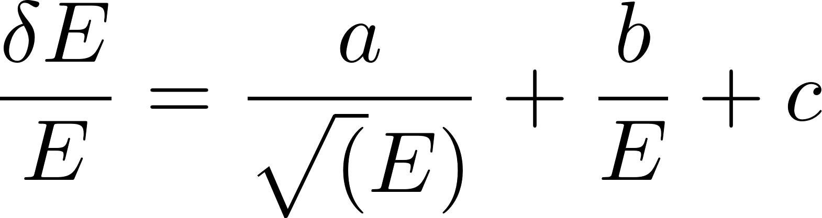
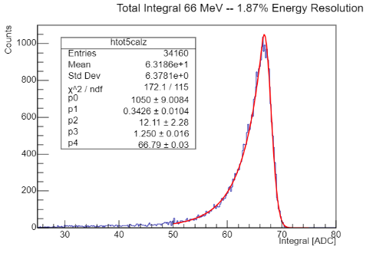
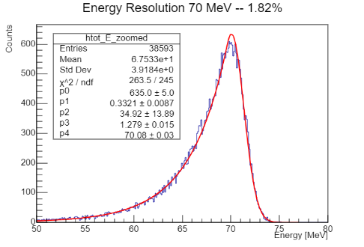
Energy Resolution vs Positron Energy
Fits using Crystal Ball function
Resolution is sigma of high-side Gaussian
Electronics / PMT non-linearity at PSI
0
50 MeV
66 MeV
MEETs GOAL
70 MeV
The 17.6 γ measured after the PMT dividers were upgraded
Notes: Many configurations were tested. Yellow filters (out/in); PMT dividers (built-in vs tapered);
Only 7 tapered dviders were available at PSI; later made 10 made for follow-up run with p-Li source @CENPA

Slide 12
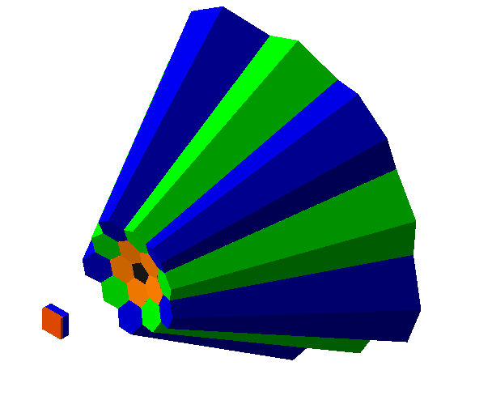
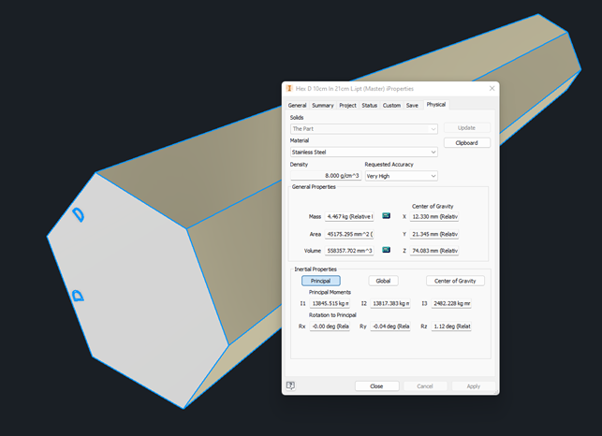
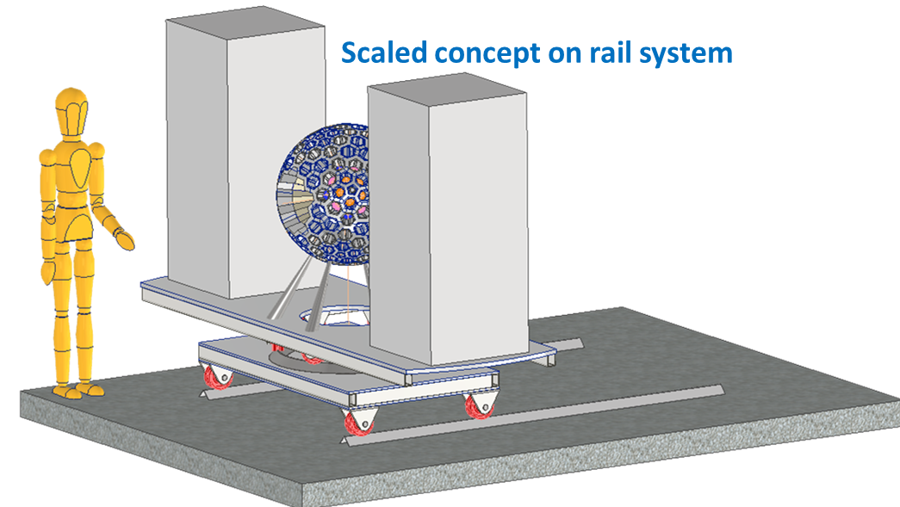
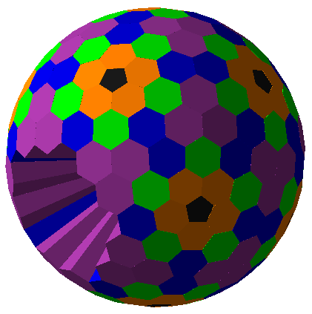
Next: Test 3 tapered crystals in a realistic final geometry for the experiment (concepts shown)

Slide 13
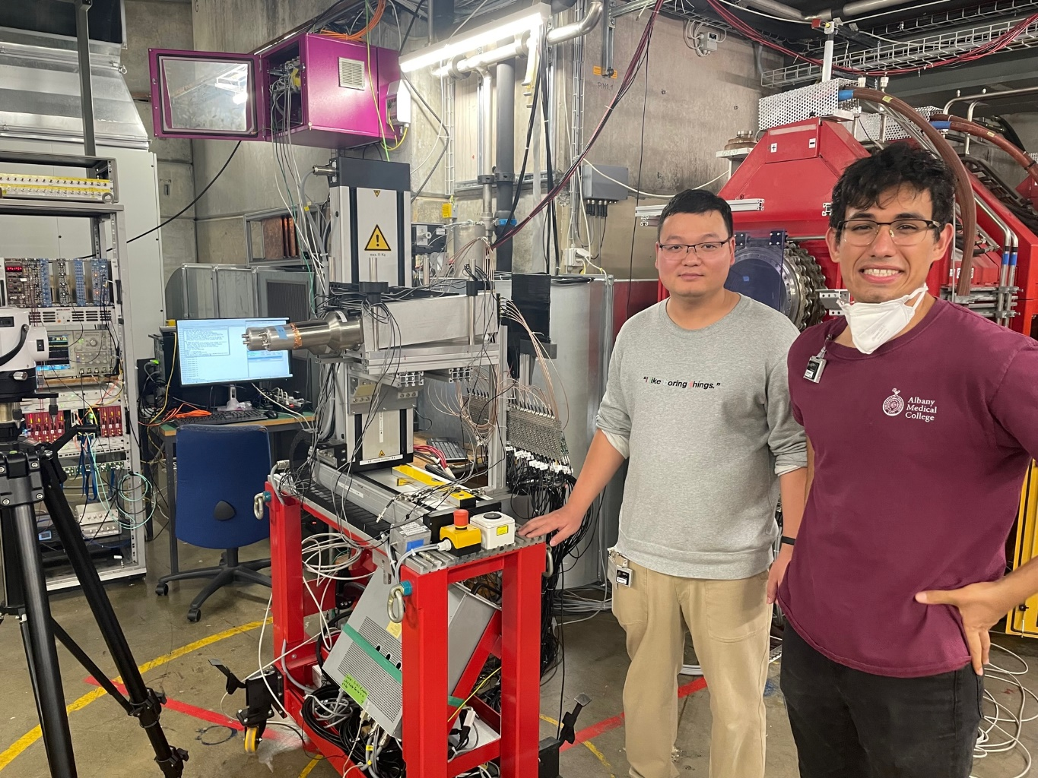
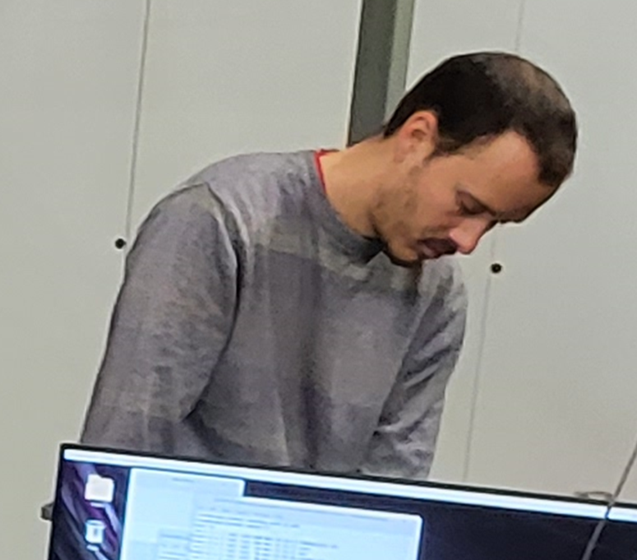
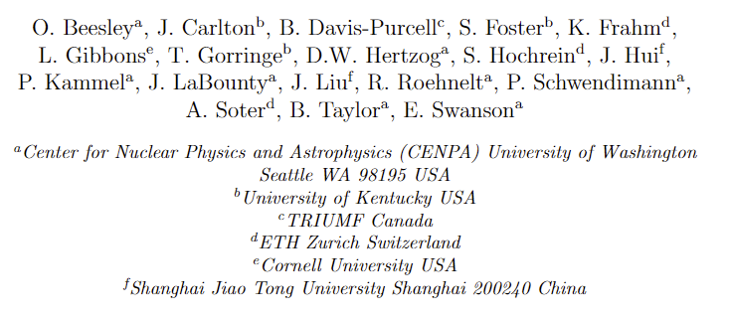
Summary
LYSO tests of single crystals and array of 10 confirm performance expectations
  Fast, Dense, Uniform, Bright
Timing resolution <200 ps
Energy resolution <2% at 70 MeV
  Meets our target for π−>e decay
A paper is being written
Next Steps: Explore tapered crystals
The Team
Grad students
Undergrad

Slide 14
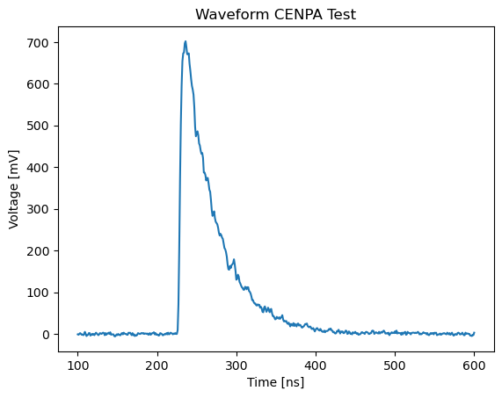
Pulse shape

Slide 15
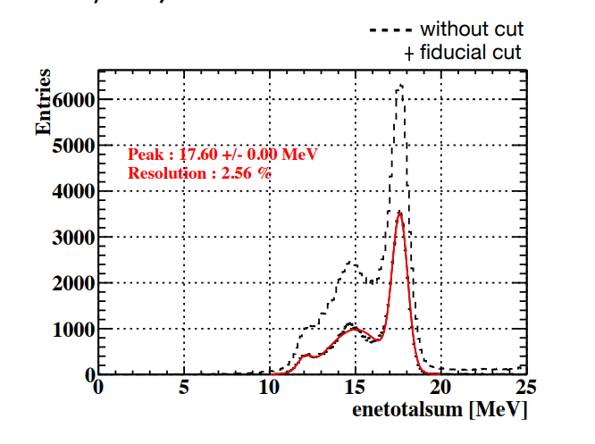
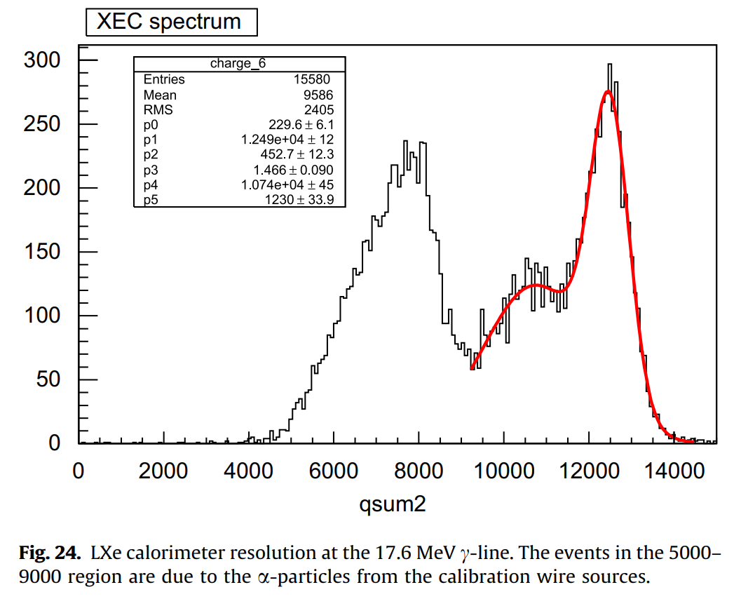
MEG resolution with p-Li
3.6% Energy Resolution
MEG 1
MEG 2

Slide 16
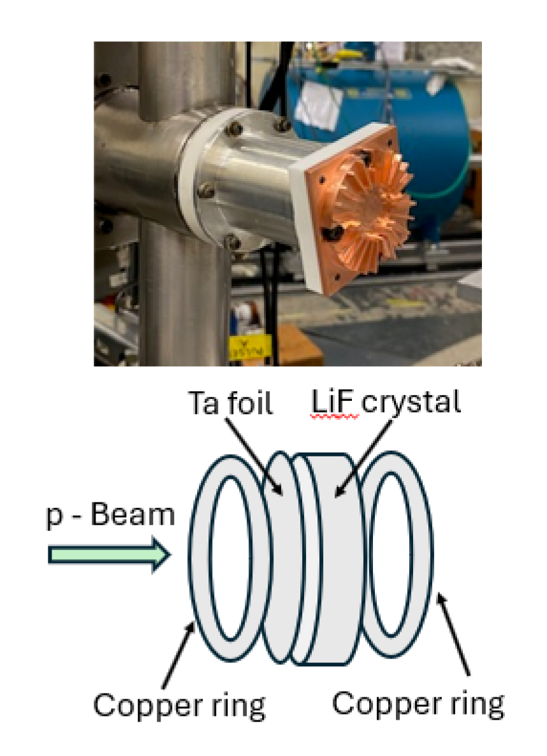
Details of the p-Li method
A 440 keV proton excites the 17.6 MeV level which decays to both the ground state and to a 3 MeV level with a 14.6 MeV gamma.
We use a 1.4 MeV proton beam, which is appropriate degraded through theta foil and the LiF crystal itself to the resonance energy

Slide 17

Ren-yuan Zhu, Caltec

Slide 18



LYSO Intrinsic radioacivity

