Slide 1
Accelerator R&D for HEP:
The Next Decade and Beyond
Vladimir SHILTSEV
DPF-PHENO’2024 · May 14, 2024 · U. Pittsburgh & Carnegie Mellon U.

Slide 2
Acknowledgements
Kathleen Amm
Mei Bai
Sergey Belomestnykh
Steve Gourlay
Michiko Minty
Mark Palmer
Sam Posen
Pantaleo Raimondi
Tor Raubenheimer
Thomas Roser
Diktys Stratakis
Sasha Valishev
Frank Zimmermann, et al.
Snowmass’21:
Accelerator Frontier WPs
Accelerator Frontier Report
Snowmass’21 Summary Report
P5 Report

Slide 3
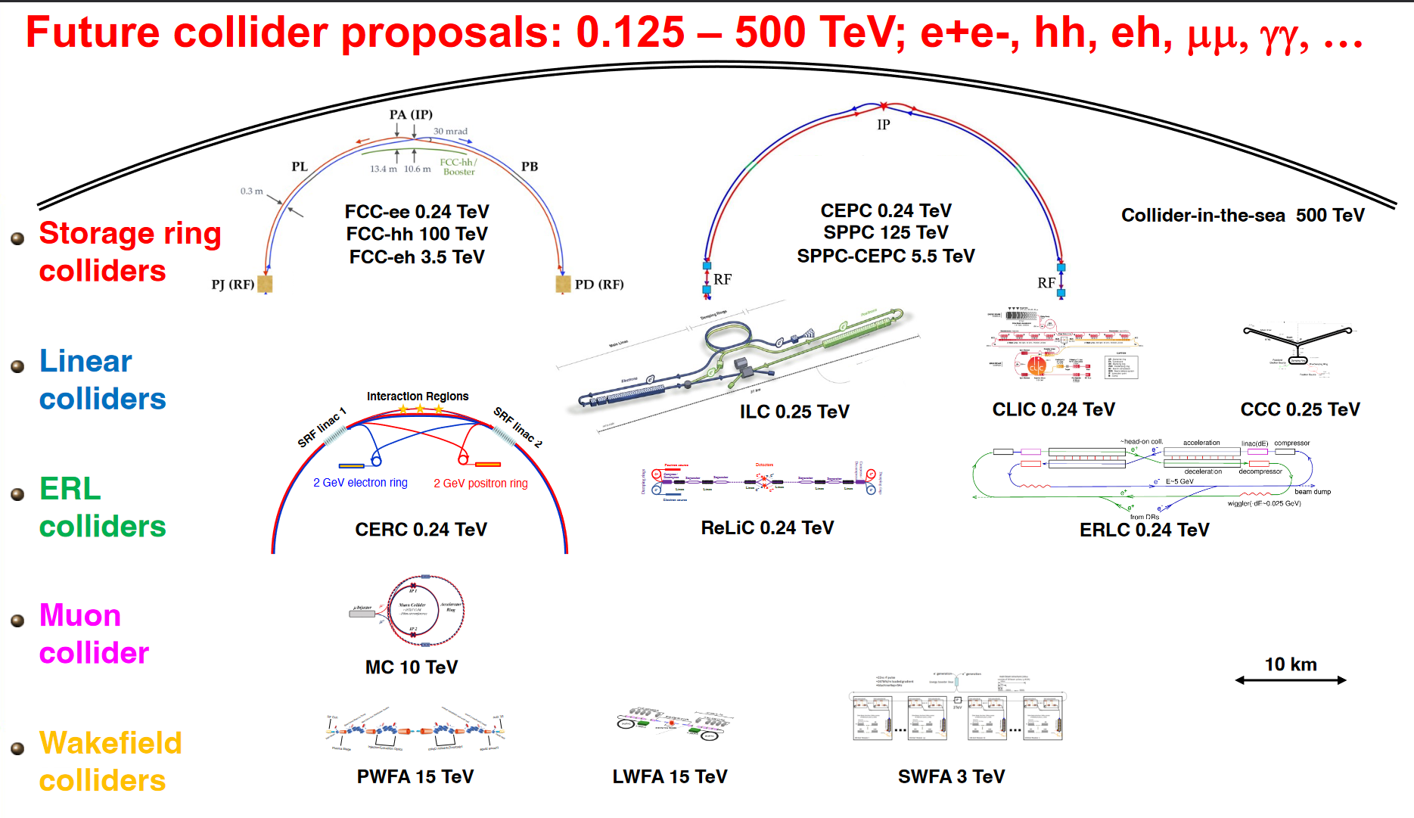

Thomas Roser et al 2023 JINST 18 P05018

Slide 4
P5 Recommendations
Recommendation 2c: An off-shore Higgs factory, realized in collaboration with international partners, in order to reveal the secrets of the Higgs boson. The current designs of FCC-ee and ILC meet our scientific requirements. The US should actively engage in feasibility and design studies. […]
Recommendation 4a: Support vigorous R&D toward a cost-effective 10 TeV pCM collider based on proton, muon, or possible wakefield technologies, including an evaluation of options for US siting of such a machine, with a goal of being ready to build major test facilities and demonstrator facilities within the next 10 years […]
Wakefield concepts for a collider are in the early stages of development. A critical next step is the delivery of an end-to-end design concept, including cost scales, with self-consistent parameters throughout. This will provide an important yardstick against which to measure progress with this emerging technology path.

Slide 5
P5 Area Recommendations
 | Now (FY23 $) | P5 recomm.
General Accelerator R&D * | ~50M$/yr | +10 M$/yr
Targeted Collider R&D | 0 M$/yr | +35 M$/yr
FNAL Accel.Complex Plan | 0 M$/yr | +10 M$/yr
~ 1B$
combined
over
the next
decade
* Note: in addition, Accelerator Test Facilities are supported at ~40M$/yr – these are of great relevance for R&D and projects (eg tests and pre-project R&D)

Slide 6
Accelerator R&D in the US
General Accelerator R&D (GARD, OHEP program):
Supports ~30 university grants and 7 DOE national labs
Advanced Accelerator Concepts
Superconducting Magnets and Materials
RF Accelerator Technology (NC and SC)
Accelerator and Beam Physics
Particle Sources and Targets
Very successful in the past: Nb3Sn magnets → LARP → HL-LHC, etc
Targeted Accelerator R&D (to be org’d, see May’24 HEPAP mtg)
More focused; certain timeline… used to exist (ILC, LARP, MAP)
Of relevance are (smaller) programs/support from other offices: NP, BES, FES, ASCR, NSF…

Slide 7
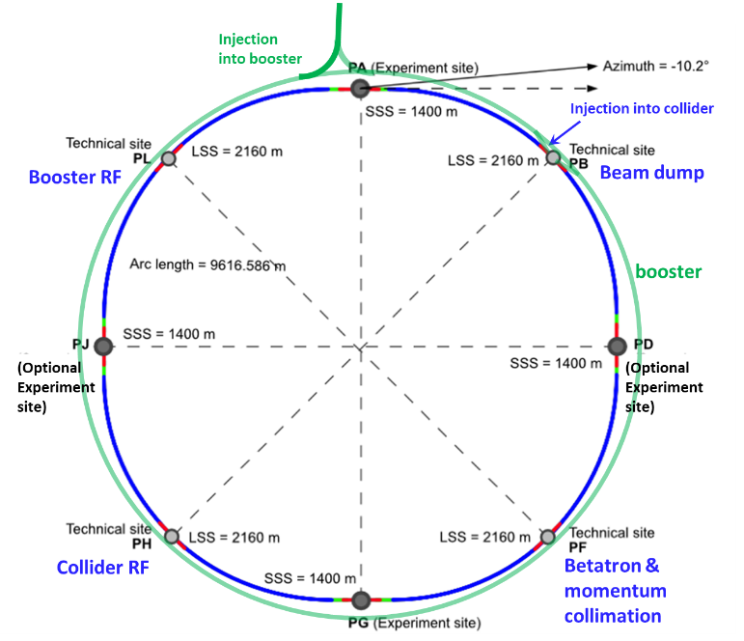
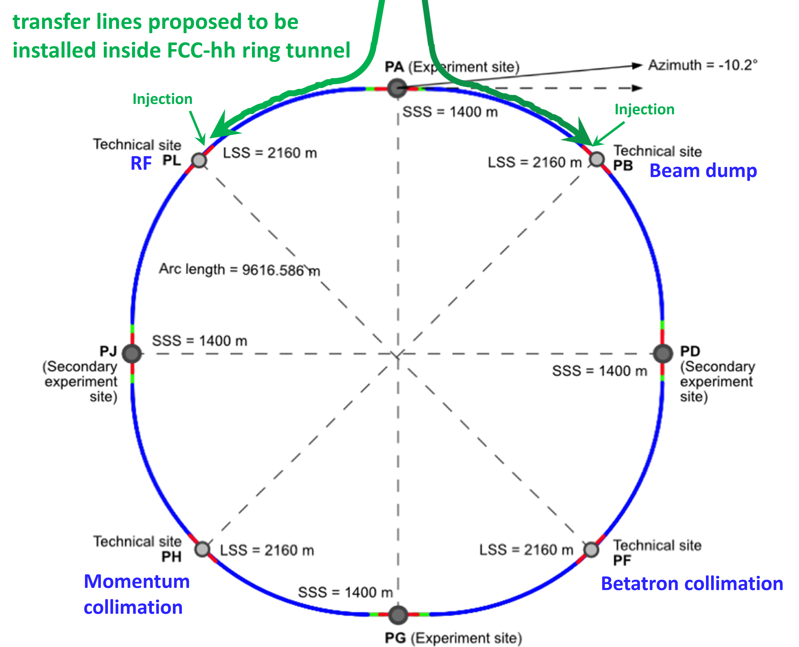
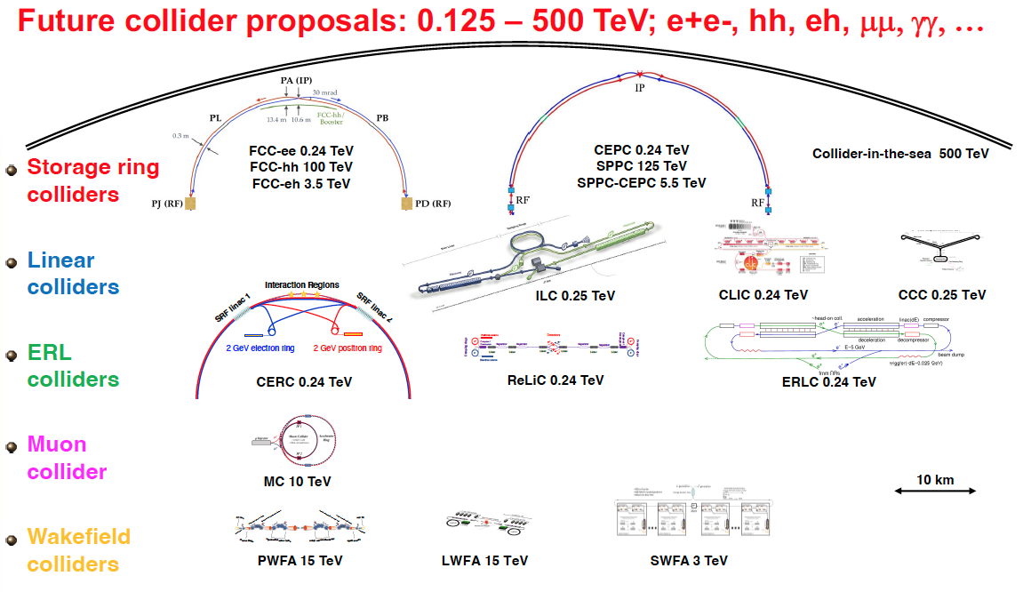
Scale & Timeline for HEP colliders
ILC250
FCC-ee
FCC-hh
10 km
2040
2050
2060
2070
CEPC
ILC
FCC-ee
Muon Collider
FCC-hh
Possible years to start collider operation – according to proponents

Slide 8
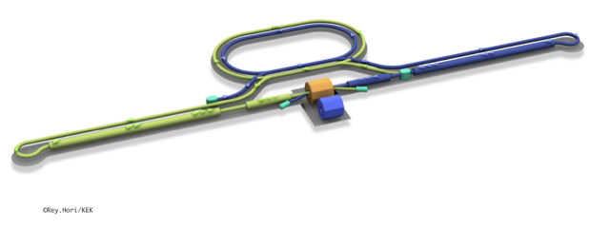
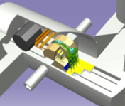

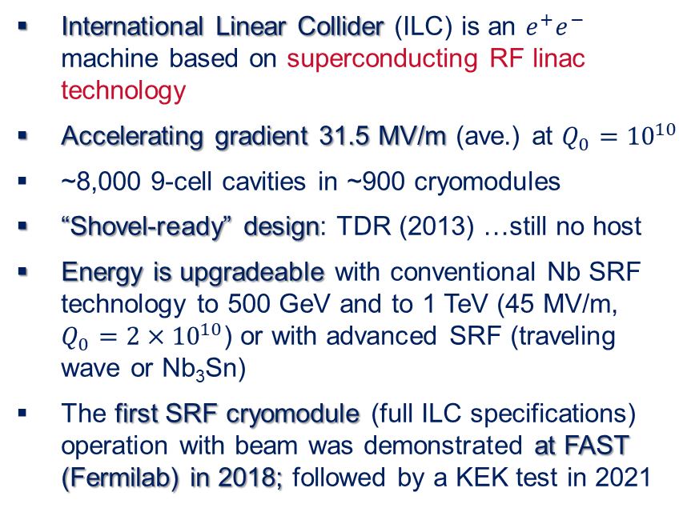
ILC
Interaction point
Damping Ring
e+ Source
e- Source
e- Main Linac
Beam dump
Physics Detectors
International Linear Collider (ILC) is an $e^{+}e^{−}$ machine based on superconducting RF linac technology
Accelerating gradient 31.5 MV/m (ave.) at $Q_{0}={10}^{10}$
~8,000 9-cell cavities in ~900 cryomodules
“Shovel-ready” design: TDR (2013) …still no host
Energy is upgradeable with conventional Nb SRF technology to 500 GeV and to 1 TeV (45 MV/m, $Q_{0}={2×10}^{10}$) or with advanced SRF (traveling wave or Nb₃Sn)
The first SRF cryomodule (full ILC specifications) operation with beam was demonstrated at FAST (Fermilab) in 2018; followed by a KEK test in 2021
e+ Main Liinac
*
* AC plug-power may be further reduced (10 ~ 20 %), if the RF (Klystron) and SRF/Cryogenics (Q-value) Efficiency may be improved.

Slide 9
ILC Remaining R&D Topics
While the ILC is at TDR (“shovel-ready”) since 2013, some R&D is still ongoing to demonstrate beam parameters (nano-beams in ATF2 at KEK), further improve performance and demonstrate industrialization of the SRF linac, develop alternative concepts (e-linac-based positron source)
SRF technology • Nano-beam technology (damping ring and final focus) • Positron source
Nano-Beam Technology
SRF Technology

Slide 10
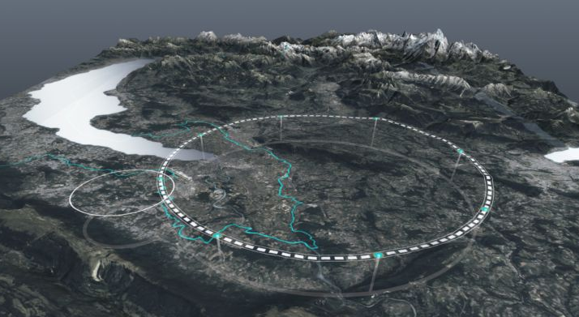
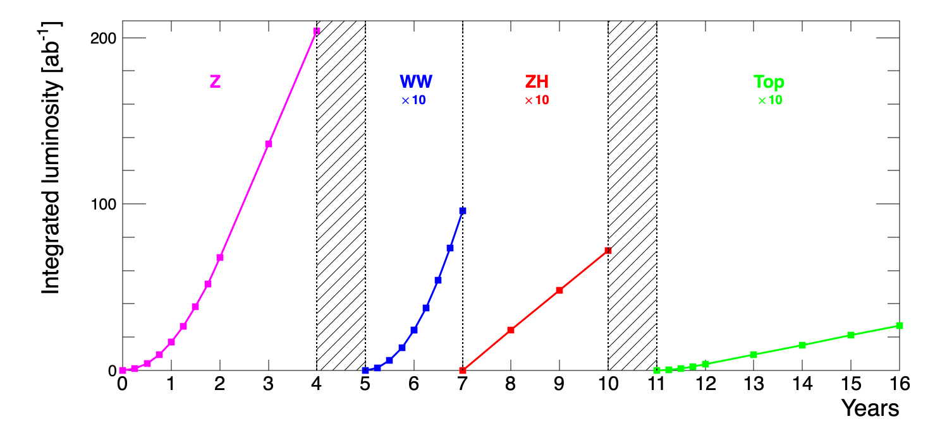

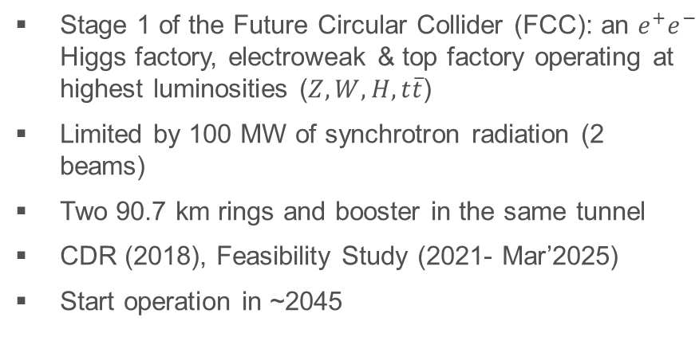
FCC-ee
Stage 1 of the Future Circular Collider (FCC): an $e^{+}e^{−}$ Higgs factory, electroweak & top factory operating at highest luminosities ($Z, W, H, t\overline{t}$)
Limited by 100 MW of synchrotron radiation (2 beams)
Two 90.7 km rings and booster in the same tunnel
CDR (2018), Feasibility Study (2021- Mar’2025)
Start operation in ~2045
Parameter | Z | WW | H (ZH) | ttbar
beam energy [GeV] | 45.6 | 80 | 120 | 182.5
beam current [mA] | 1270 | 137 | 26.7 | 4.9
number bunches/beam | 11200 | 1780 | 440 | 60
bunch intensity [10¹¹] | 2.14 | 1.45 | 1.15 | 1.55
SR energy loss / turn [GeV] | 0.0394 | 0.374 | 1.89 | 10.4
total RF voltage 400/800 MHz [GV] | 0.120/0 | 1.0/0 | 2.1/0 | 2.1/9.4
long. damping time [turns] | 1158 | 215 | 64 | 18
horizontal beta* [m] | 0.11 | 0.2 | 0.24 | 1.0
vertical beta* [mm] | 0.7 | 1.0 | 1.0 | 1.6
horizontal geometric emittance [nm] | 0.71 | 2.17 | 0.71 | 1.59
vertical geom. emittance [pm] | 1.9 | 2.2 | 1.4 | 1.6
horizontal rms IP spot size [μm] | 9 | 21 | 13 | 40
vertical rms IP spot size [nm] | 36 | 47 | 40 | 51
beam-beam parameter ξ_{x} / ξ_{y} | 0.002/0.0973 | 0.013/0.128 | 0.010/0.088 | 0.073/0.134
rms bunch length with SR / BS [mm] | 5.6 / 15.5 | 3.5 / 5.4 | 3.4 / 4.7 | 1.8 / 2.2
luminosity per IP [10³⁴ cm⁻²s⁻¹] | 140 | 20 | 5.0 | 1.25
total integrated luminosity / IP / year [ab⁻¹/yr] | 17 | 2.4 | 0.6 | 0.15
beam lifetime rad Bhabha + BS [min] | 15 | 12 | 12 | 11
* Site AC power is 290 MW at CM energy 240 GeV

Slide 11
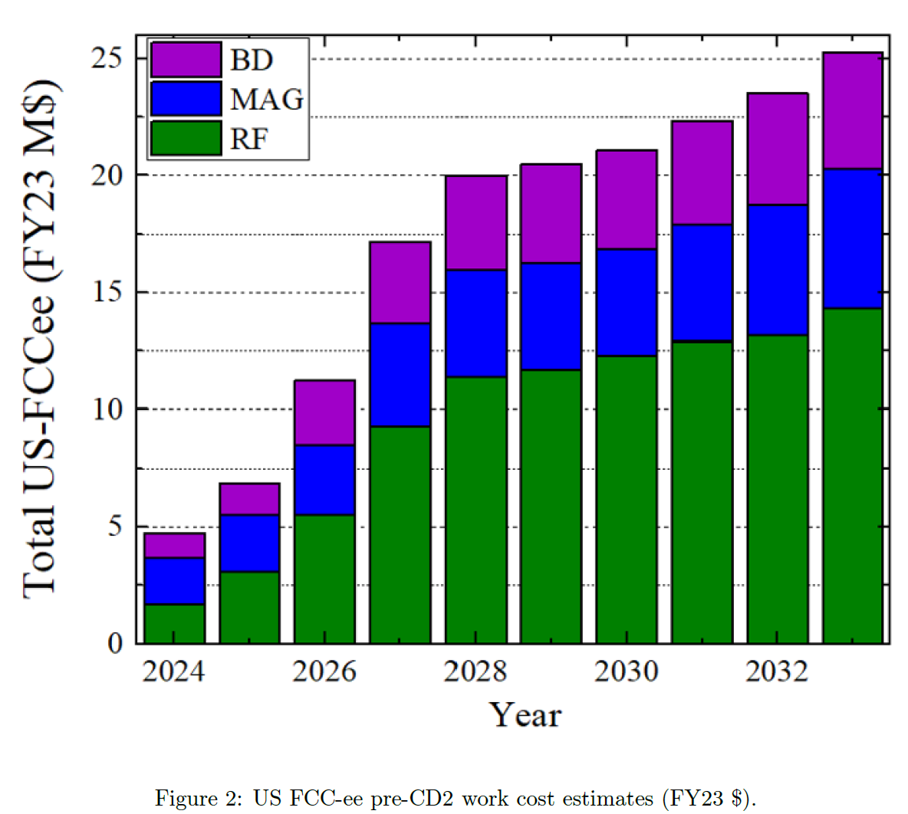
US-FCC Plan (2023)
Proposed scope - RF Systems
  800 MHz SRF for Booster and Collider (28 CMs → 244 CMs)
  800 MHz RF power sources (klystrons >80% eff.)
  RF for 6-20 GeV e+/e- injector linac (C3 tech.)
Proposed scope - Magnets Systems
  IR magnets and cryostats (for 4 IRs)
  Collider ring and Booster ring magnets (low field)
  FCC-hh collider ring magnets (14-20 T)
Proposed scope – Optics/Design/Instr.
  Interaction region design, and integrated machine design
  Polarization (simul., wigglers, etc)
  Beam Instrumentation (BPMs, feedback, etc)
?
?

Slide 12
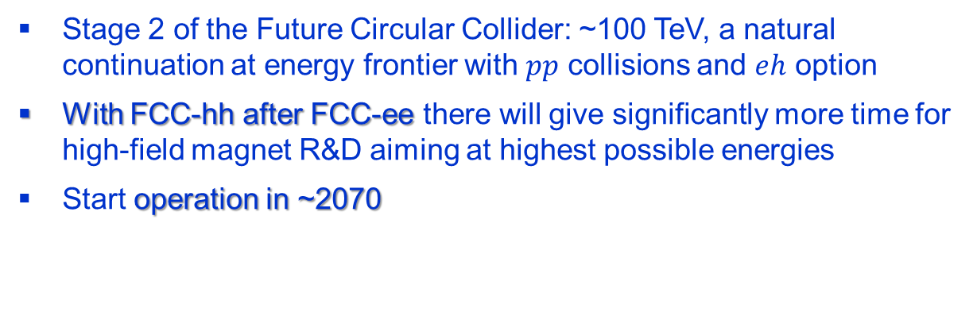
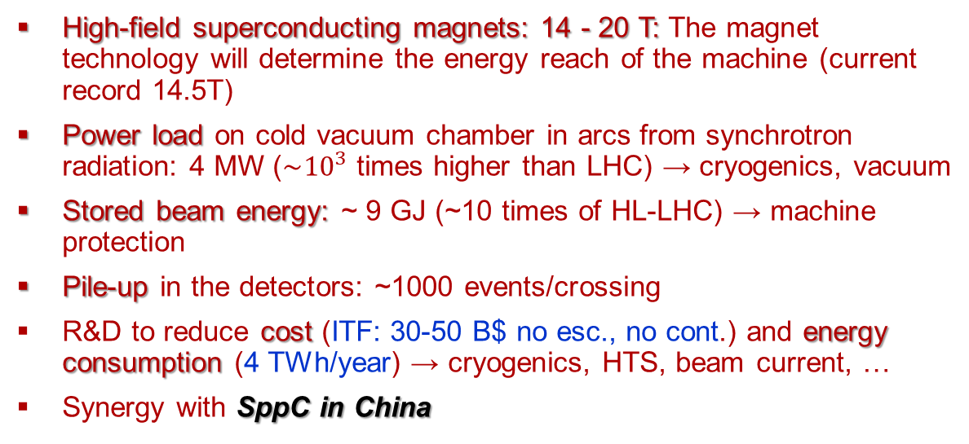
FCC-hh: Key Issues
Stage 2 of the Future Circular Collider: ~100 TeV, a natural continuation at energy frontier with $pp$ collisions and $eh$ option
With FCC-hh after FCC-ee there will give significantly more time for high-field magnet R&D aiming at highest possible energies
Start operation in ~2070
parameter | FCC-hh
collision energy cms [TeV] | 81 - 115
dipole field [T] | 14 - 20
circumference [km] | 90.7
arc length [km] | 76.9
beam current [A] | 0.5
bunch intensity [10¹¹] | 1
bunch spacing [ns] | 25
synchr. rad. power / ring [kW] | 1020 - 4250
SR power / length [W/m/ap.] | 13 - 54
long. emit. damping time [h] | 0.77 – 0.26
peak luminosity [10³⁴ cm⁻²s⁻¹] | ~30
events/bunch crossing | ~1000
stored energy/beam [GJ] | 6.1 - 8.9
Integrated luminosity/main IP [fb⁻¹] | 20000
High-field superconducting magnets: 14 - 20 T: The magnet technology will determine the energy reach of the machine (current record 14.5T)
Power load on cold vacuum chamber in arcs from synchrotron radiation: 4 MW ($\sim {10}^{3}$ times higher than LHC) → cryogenics, vacuum
Stored beam energy: ~ 9 GJ (~10 times of HL-LHC) → machine protection
Pile-up in the detectors: ~1000 events/crossing
R&D to reduce cost (ITF: 30-50 B$ no esc., no cont.) and energy consumption (4 TWh/year) → cryogenics, HTS, beam current, …
Synergy with SppC in China
* Estimated operating AC power is ~560 MW

Slide 13
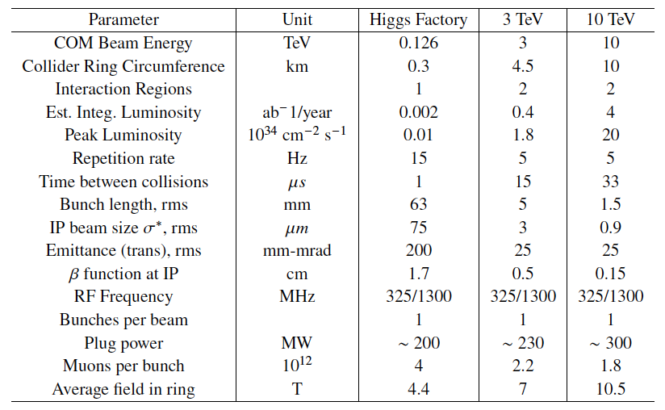
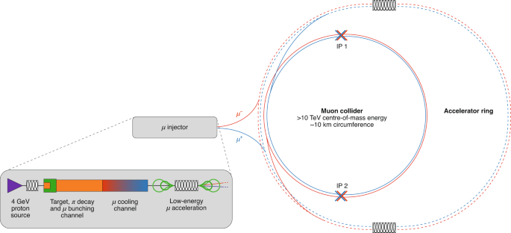



Muon Collider
$$ℒ=\frac{N_{+}N_{−}n_{eff}f_{rep}}{4πσ_{x}^{∗}σ_{y}^{∗}}$$
Muon collider combines precision and energy reach needed to test the deepest questions of particle physics
x(4-7) smaller footprint than pp-collider for the same pCM energy
Muons are 207 times heavier than electrons and are not limited by synchrotron radiation and beamstrahlung → energy efficiency
BUT muons decay (2.2 µs lifetime at rest), hence many issues →
4-6 years to design of demonstration facility → muon beam R&D
(10-20)x MICE at RAL (2020)
$n_{eff}≈150\overline{B}$ ≈ 1600 turns
Tentative parameters based on U.S. Muon Accelerator Program studies
Schematic layout of a 10-TeV muon collider complex
The muon collider concept was developed by NFMCC in 1990s-2000s and by the U.S. MAP (2011-2016)
In 2022 International Muon Collider Collaboration (IMCC) was formed, hosted by CERN
Aug.2024: inaugural US-MCC Meeting (at Fermilab) *
Nature Physics | VOL 17 | March 2021 | 289–292 |
www.nature.com/naturephysics

Slide 14
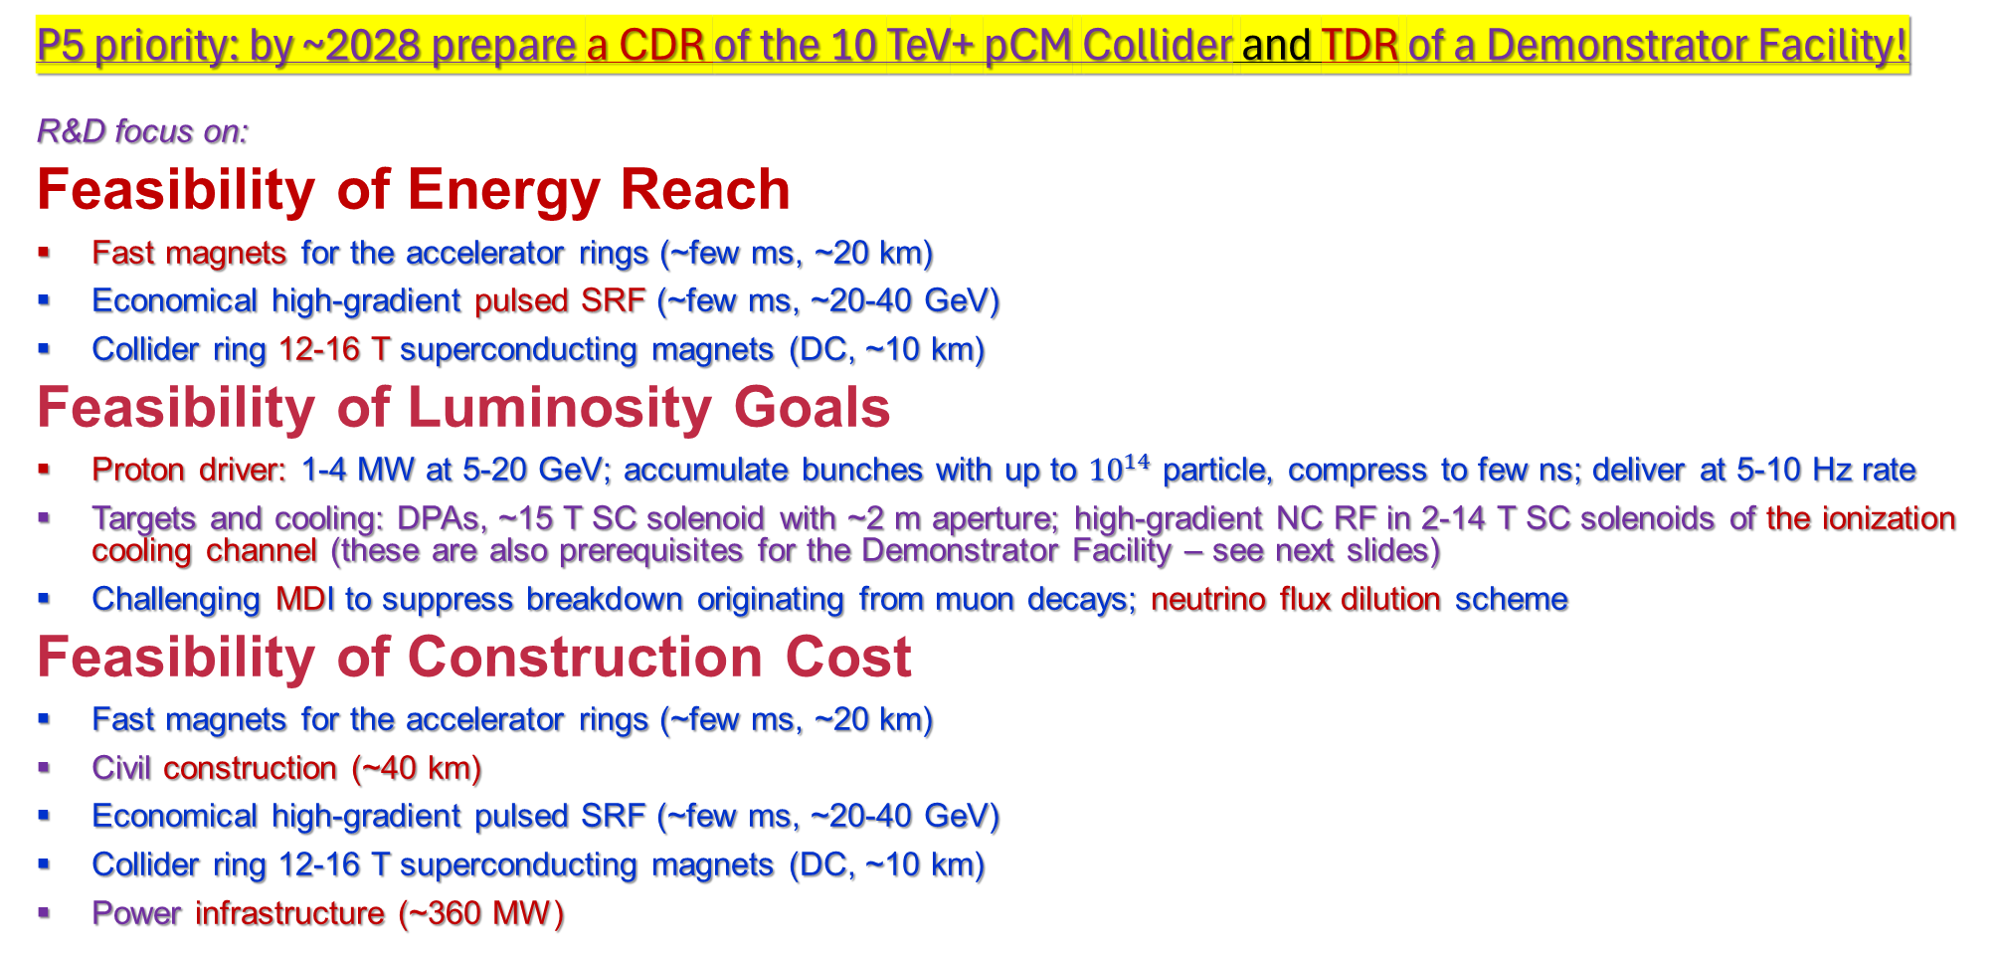
μμCollider Challenges and R&D Topics
P5 priority: by ~2028 prepare a CDR of the 10 TeV+ pCM Collider and TDR of a Demonstrator Facility!
R&D focus on:
Feasibility of Energy Reach
Fast magnets for the accelerator rings (~few ms, ~20 km)
Economical high-gradient pulsed SRF (~few ms, ~20-40 GeV)
Collider ring 12-16 T superconducting magnets (DC, ~10 km)
Feasibility of Luminosity Goals
Proton driver: 1-4 MW at 5-20 GeV; accumulate bunches with up to ${10}^{14}$ particle, compress to few ns; deliver at 5-10 Hz rate
Targets and cooling: DPAs, ~15 T SC solenoid with ~2 m aperture; high-gradient NC RF in 2-14 T SC solenoids of the ionization cooling channel (these are also prerequisites for the Demonstrator Facility – see next slides)
Challenging MDI to suppress breakdown originating from muon decays; neutrino flux dilution scheme
Feasibility of Construction Cost
Fast magnets for the accelerator rings (~few ms, ~20 km)
Civil construction (~40 km)
Economical high-gradient pulsed SRF (~few ms, ~20-40 GeV)
Collider ring 12-16 T superconducting magnets (DC, ~10 km)
Power infrastructure (~360 MW)

Slide 15
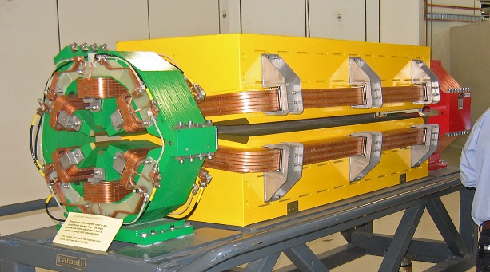
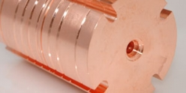
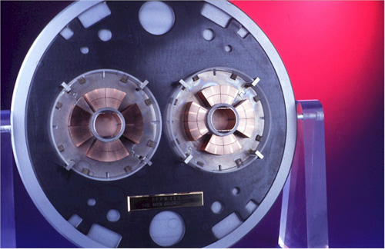
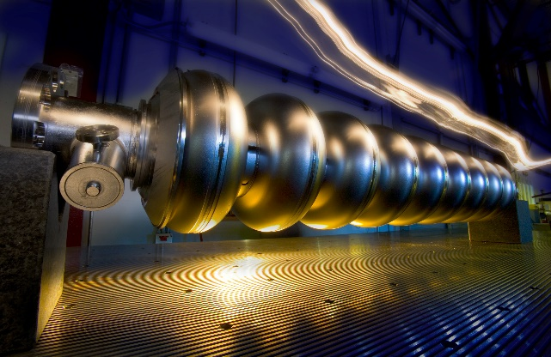
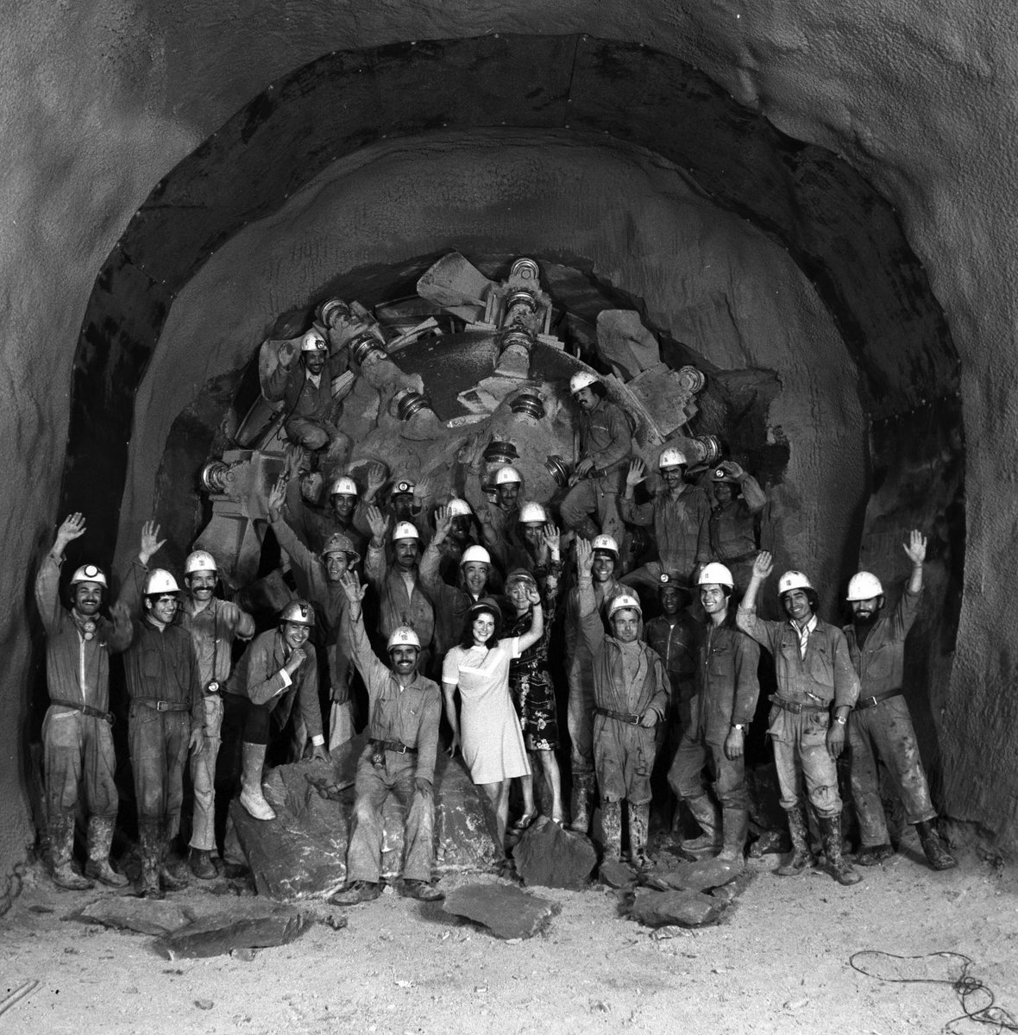
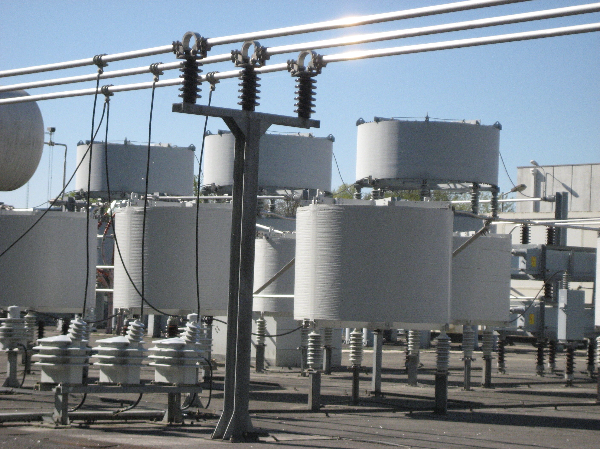
Normal Conducting Magnets
Cost is set by the scale (energy, length, power) and technology
  Accelerator technology (magnets NC and SC, RF and SCRF, vacuum, etc)
  Civil construction technology
  Electric power production, delivery
  and distribution technology
~50±10 %
~35±15 %
~15±10 %
Normal Conducting RF
SC RF
SC magnets

Slide 16
Muons Give Us A Unique Chance!
(due to that factor of ~7 in “equivalent pCM”)
The smallest footprint for “traditional core technologies”
  less total cost for technology and tunnels
(due to absence of synchrotron radiation → multi-turn acceleration in rings, rather than one-time in linear colliders)
The lowest power consumption:
  per ab⁻¹ and total among 10+ TeV pCM colliders
All in all – “lowest cost + feasible/traditional technologies + fastest”
  Snowmass’21 ITF estimates “>10 yrs of pre-project R&D” and “19-24 yrs to 1st physics” after the start of the program (not started yet)
  “just do it!” = CDR → the Demonstrator → TDR → Construction)

Slide 17
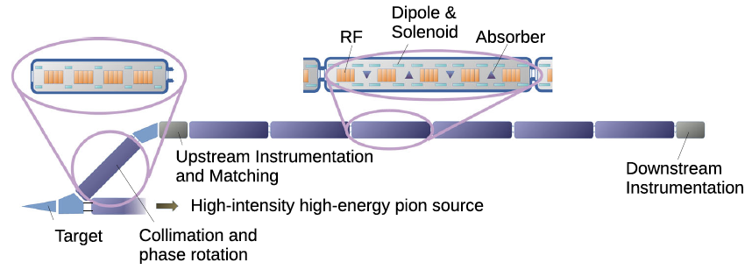
Ionization Cooling Demonstrator
https://doi.org/10.1140/epjc/s10052-023-11889-x
MC ionization cooling channel consists of ~800 muon cooling cells
The cooling of muons requires very compact assembly of normal conducting RF cavities, superconducting solenoids, and either liquid hydrogen or LiH absorbers
Large bore solenoids: from 2 T (D=1 m) to 20+ T (D=0.05 m)
RF cavities (300-800 MHz) must operate in multi-Tesla fields
Wedge-shaped absorbers must and large muon beam intensities
Schematic of the muon cooling demonstrator
 | Muon energy, MeV | Total length, m | Total # of cells | B_max, T | 6D emm. reduction | Beam loss, %
Full scale MC | 200 | ~980 | ~820 | 2-14 | x 1/10⁵ | ~70%
Demonstrator | 200 | 48 | 24 | 0.5-7 | x 1/2 | 4-6%
■ Timeline: 2029-2034 ■ Location: Fermilab or CERN ■ Cost: 200-300 M$

Slide 18
R&D Synergies for Future HEP Colliders
Off-shore Higgs Factory
~100 TeV Hadron Collider
10 TeV Muon Collider
Beam optics
Collective effects
MDI + collimation
Machine efficiency
RF power efficiency
SRF systems
Examples of synergies with U.S. projects and accelerators:
EIC (a NP machine in the DOE lingo): MDI, SRF, beam polarization, collective effects…
PIP-II: SRF, proton driver
LCLS-II: SRF
LBNF: targetry
SNS: proton driver
FCC-ee and –hh have many synergies with similar projects in China: CEPC and SppC
High-field SC magnets

Slide 19

Hard “Simple” Question
Why does it (“your accelerator R&D”) take so long?
  1990’s: SLAC linac had 17 MV/m → Now: XFEL has ~25 MV/m (ILC 31.5 MV/m)
  Muon collider R&D since 1990s → Now: still no CDR
  2000s: LHC 8 T NbTi SC magnets → Now: still no 16 T magnets
  2006: 1 GeV plasma acceleration stage → Now : sill no demo of multistage
No “simple” answer …combination of:
  Our modern-day technologies are too far from industrial applications
  Chasing “pCM dreams”: 100 GeV → 1 TeV → 10 TeV → 100 TeV → PeV ??
    Higher energy, higher luminosity, larger [size, cost, power, complexity] → more [$$, people, time] for R&D
  Always – limited budget… more and more often - inadequate expertise:
    bigger scale + “brain drain” to other fields + beam physics abandoned at Universities (in the US)

Slide 20
US Accelerator S&T Workforce:
DOE Office of Sciences, P5, EPP2024 recognize diminishing expertise in accelerators (design, projects and operation) in the US and increased demand:
  DESPITE – several recent initiatives: Particle Accelerators for Science and Society and Workforce Training (2021); RENEW: Reaching a New Energy Sciences Workforce (2023); FAIR: Funding for Accelerated, Inclusive Research (2023); MIni-Workshop on Accelerator Scientist / Engineer Workforce of National Labs (2024)
  DESPITE – there are several select institutes : Center for Advanced Studies of Accelerators, CASA (JLab/ODU); Cornell Laboratory for Accelerator-based ScienceS and Education, CLASSE, and the Center for Bright Beams (NSF); Center for Accelerator Science and Education, CASE, at Stony Brook University (HEP); MSU cryo-initiative – collaboration between FRIB and MSU College of Engineering (NP); Virginia Innovative Traineeships in Accelerators, VITA (DOE)
YET – the AS&T workforce situation is actually worsening
  Barely enough to keep up with current projects and operations (NP, BES, HEP, …)
  Plus, the level of expertise required for the future HEP facilities/colliders is much higher

Slide 21

The US HEP Community Must Act!
Next big HEP facilities (Higgs Factories, 10+ TeV pCM colliders, etc) will not be “off-the-shelf” particle accelerators, they require numerous innovative breakthroughs over a range of beam physics topics and accelerator technologies – over the next O(20 years)
That requires the leading US universities to get intellectually involved:
  E.g. out of ~70 Universities represented at this meeting, only 6 have some elements of accelerator R&D (besides major National labs)
  Need more accelerator/beam physics faculty!
min $N_{AST faculty}≥\left[\frac{N_{part. phys. faculty}}{4}\right]$

Slide 22

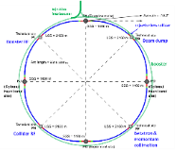
Summary
P5 recommended to actively engage in feasibility and design studies of two off-shore Higgs factories, ILC and FCC-ee
Also, P5 recommended to support vigorous R&D toward a cost-effective 10 TeV pCM collider based on proton, muon, or possible wakefield technologies
The collider designs are at different stages of maturity, but all require quite extensive R&D efforts covering a wide range of challenging topics from beam optics to MDI to beam polarization to positron production to muons ionization cooling, high-field SC magnet and RF technologies…
  Any future collider will require very high AC power to operate, special attention should be given to R&D topics that would improve efficiency of various systems
  There are synergies between the colliders and with other projects and accelerators.
Situation with the accelerator science and technology workforce is very worrisome, there are concerns whether the required challenging R&D for HEP colliders can be finished successfully in a reasonable time. Besides the $$ (OHEP prerogative), serious intellectual involvement of universities is critical.

Slide 23
Thanks for your attention!
Thank you for your attention!
Questions?

Slide 24

Thanks for your attention!
Back Up Slides… Not Covered:
Plasma and other advanced methods. Are they really helpful for HEP?
What about China? The CEPC can get approval next year or about.
Connections to other fields using accelerators? There’s a lot with NP (EIC), FES (magnetic confinement setups), and BES (light sources and spallation neutron sources).
How much AST research $$ available now?

Slide 25
Thanks for your attention!
These synergies once again emphasize importance of “General Accelerator R&D”

Slide 26

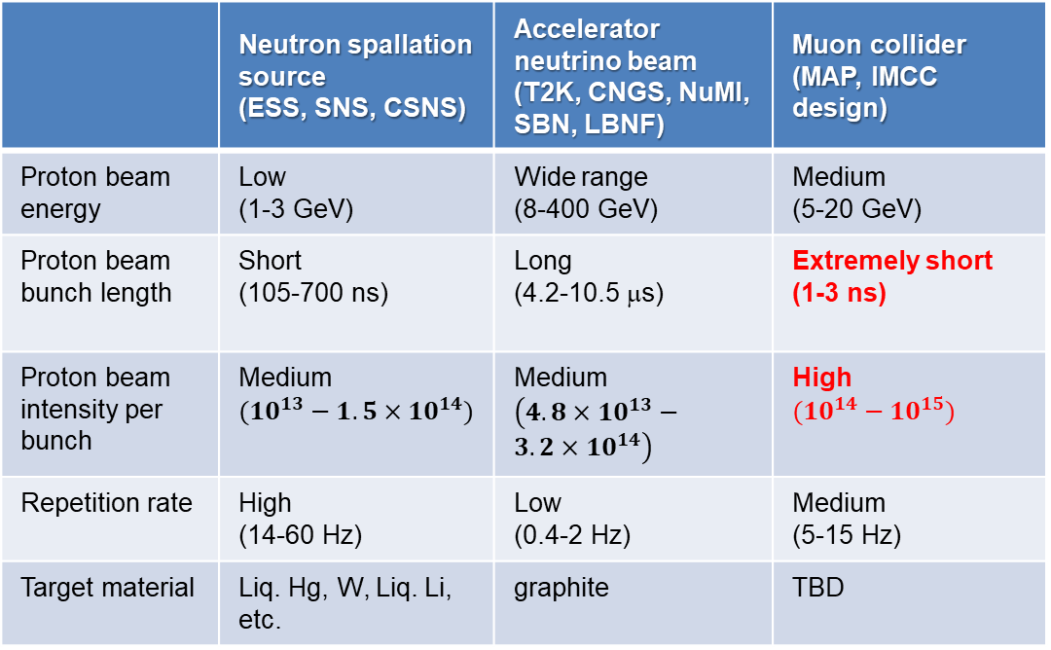
High Power Targetry R&D
Metal rod exploded by beam impact
Multi-MW targets are needed for neutron spallation sources, accelerator neutrino beam facilities and muon colliders
Currently: 1-1.5 MW targets exist (FNAL, SNS, …)
Huge challenges above that level:
  DPAs
  Thermal shock
Need to design a target capable of withstanding such an exceptionally high thermal shock
 | Neutron spallation source (ESS, SNS, CSNS) | Accelerator neutrino beam (T2K, CNGS, NuMI, SBN, LBNF) | Muon collider (MAP, IMCC design)
Proton beam energy | Low (1-3 GeV) | Wide range (8-400 GeV) | Medium (5-20 GeV)
Proton beam bunch length | Short (105-700 ns) | Long (4.2-10.5 μs) | Extremely short (1-3 ns)
Proton beam intensity per bunch | Medium $({10}^{13}−{1.5×10}^{14})$ | Medium $\left({4.8×10}^{13}−{3.2×10}^{14}\right)$ | High $({10}^{14}−{10}^{15})$
Repetition rate | High (14-60 Hz) | Low (0.4-2 Hz) | Medium (5-15 Hz)
Target material | Liq. Hg, W, Liq. Li, etc. | graphite | TBD
Need to be explored:
New materials (graphite, liquid lead, tungsten powder)
New forms: wheels, rolling balls, fibers, etc
Similar issues with horns, baffles, windows, etc
Modeling and simulation tools
Dedicated facilities for irradiation studies, pion yield measurements, target survivability/lifetime

Slide 27
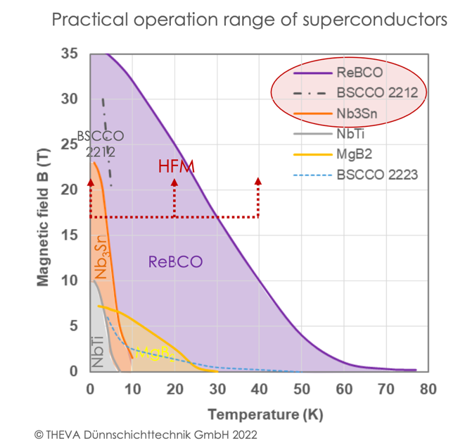
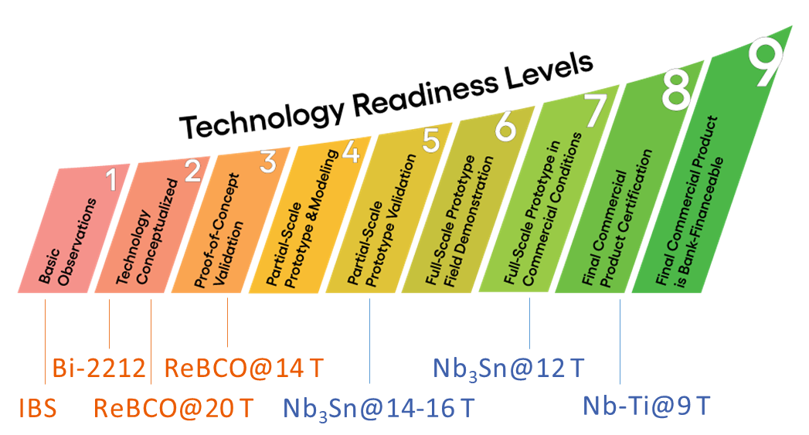
Magnet Technology R&D
FCC-hh & muon collider require beyond state-of-the-art magnet technology
High field dipoles – up to 17 T (and perhaps 20 – 24 T)
Large aperture with fields up to 13 T (or more)
(Very) fast ramping magnets
Large aperture, high field solenoids (> 30 T)
Large aperture interaction region quadrupoles
High radiation environment
  Radiation Damage
  Heat deposition
Manage stress
Conductor ultimately determines magnet performance
Six different technological superconductors
Low Temperature Superconductors (LTS)
  NbTi, Nb₃Sn, MgB₂
High Temperature Superconductors (HTS), also high field
  Bi₂Sr₂CaCu₂O₈ (Bi-2212 or BSCCO), Bi₂Sr₂Ca₂Cu₃O₁₀ (Bi-2223), rare-earth Ba₂Cu3O₇ (ReBCO)
Plus, a new family of iron-based superconductors (IBS), not yet commercially available

Slide 28
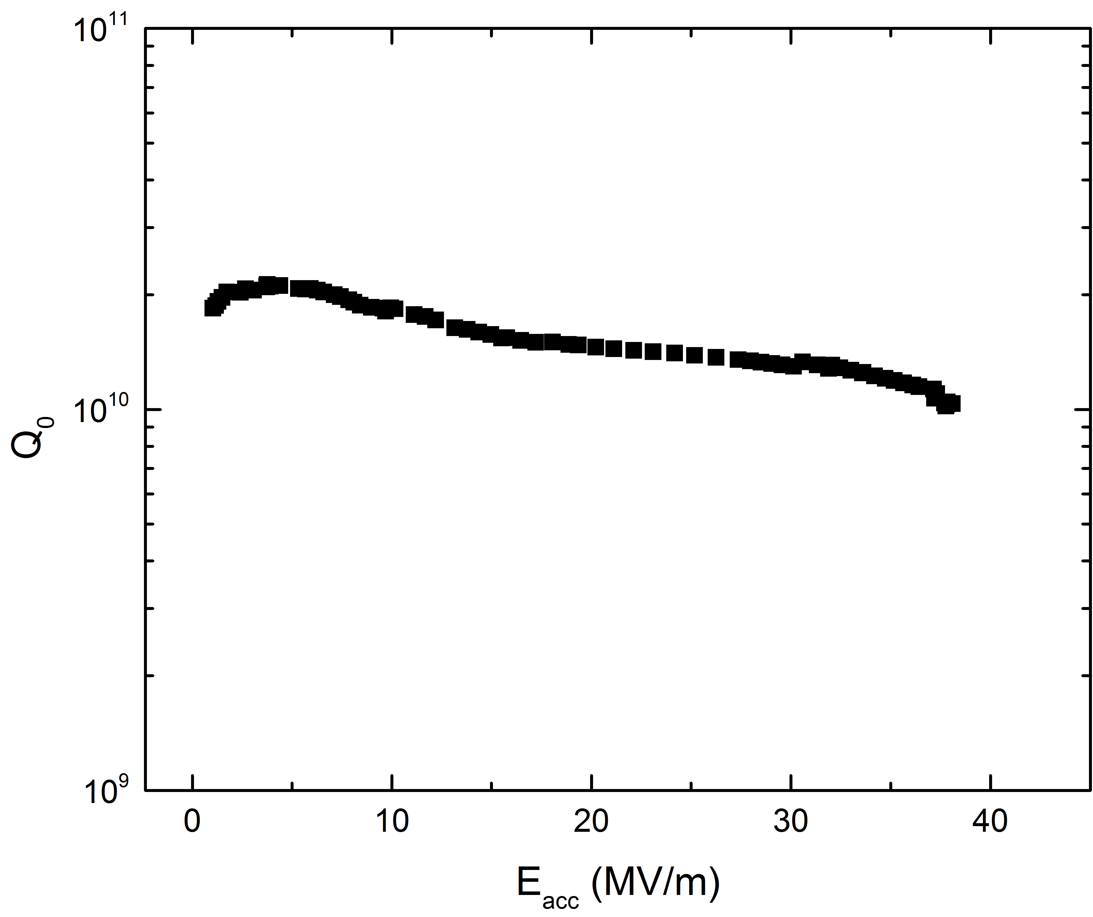
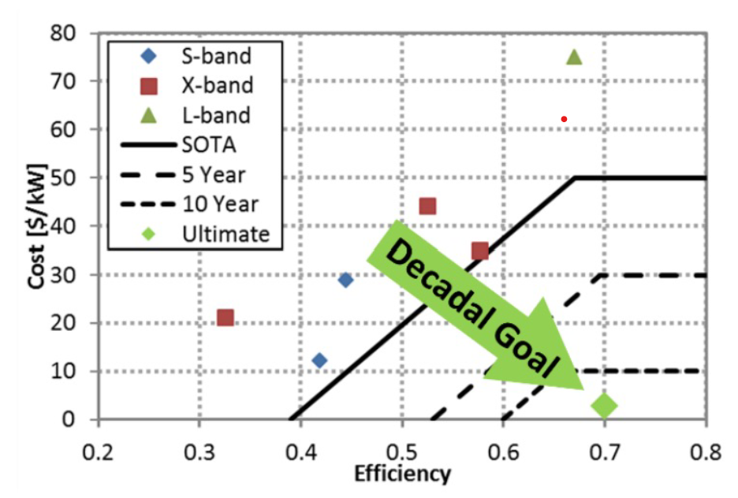



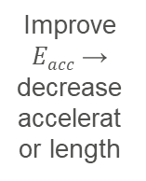
RF Technology R&D Thrusts
Three RF technology R&D thrusts
Superconducting RF (SRF) technology will be used in all colliders that we discuss in this presentation. FCC-ee, ILC, and muon collider will have very large installations. Improving SRF cavity performance is critical.
High-gradient normal conducting RF – incl. C3 technology and operating RF in high magnetic fields as part of the muon ionization cooling channel
High-efficiency RF sources (FCC-ee, ILC) to reduce overall AC power consumption of the machine
Typical ILC cavity at T = 2 K
Increase $Q$ → reduce
cryogenic load
Improve $Eacc$ → decrease accelerator length
$$P_{cav}=\frac{{\left(E_{acc}L_{cav}\right)}^{2}}{{(R}/{Q)}∙Q_{0}}$$
$R/Q$ is a geometric parameter
From the decadal NC conducting RF structure
and RF source 10-year roadmap (2017):
RF source cost including modulators in $ per peak KW vs. efficiency for mature RF source technologies.

