Slide 1

DOE-HEP Response to P5
Michael Procario
Director of Facilities Operations
Office of High Energy Physics
Meeting of the Division of Particles and Fields
May 13, 2024
Energy.gov/science

Slide 2
Outline
Introduction
General response to major recommendations
Specific comments related to :
  Off-shore Higgs Factory
  DUNE Phase II
  Evolution of the Fermilab Complex
  ASTAE
  G-3 Dark Matter
  CMB-S4
Assumptions about the budget
Conclusions
Final Version is available at
https://www.usparticlephysics.org/2023-p5-report/

Slide 3




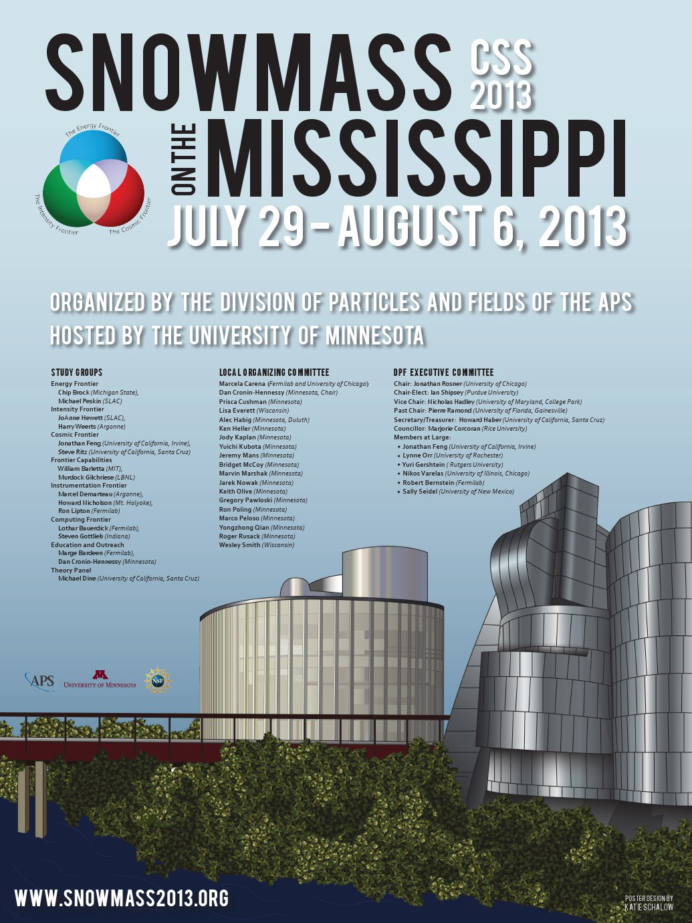

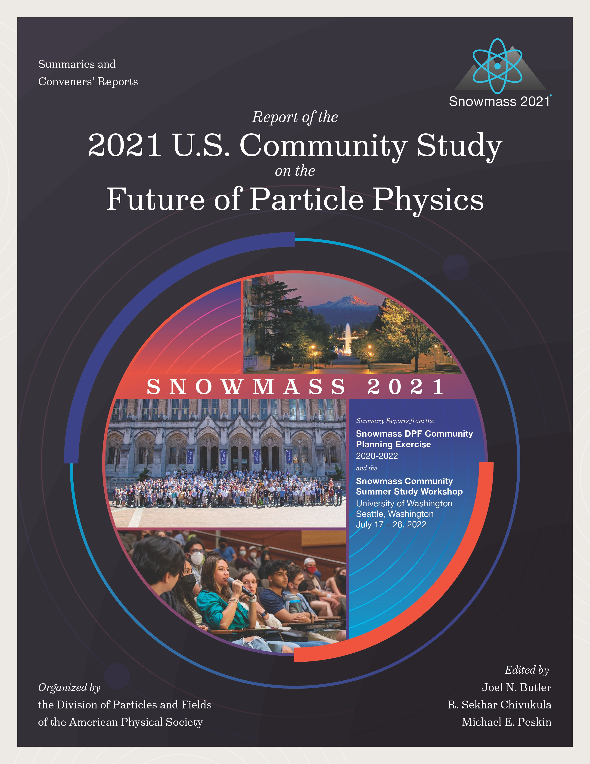
U.S. Particle Physics Strategic Planning Process
2008
2014
2023

Slide 4
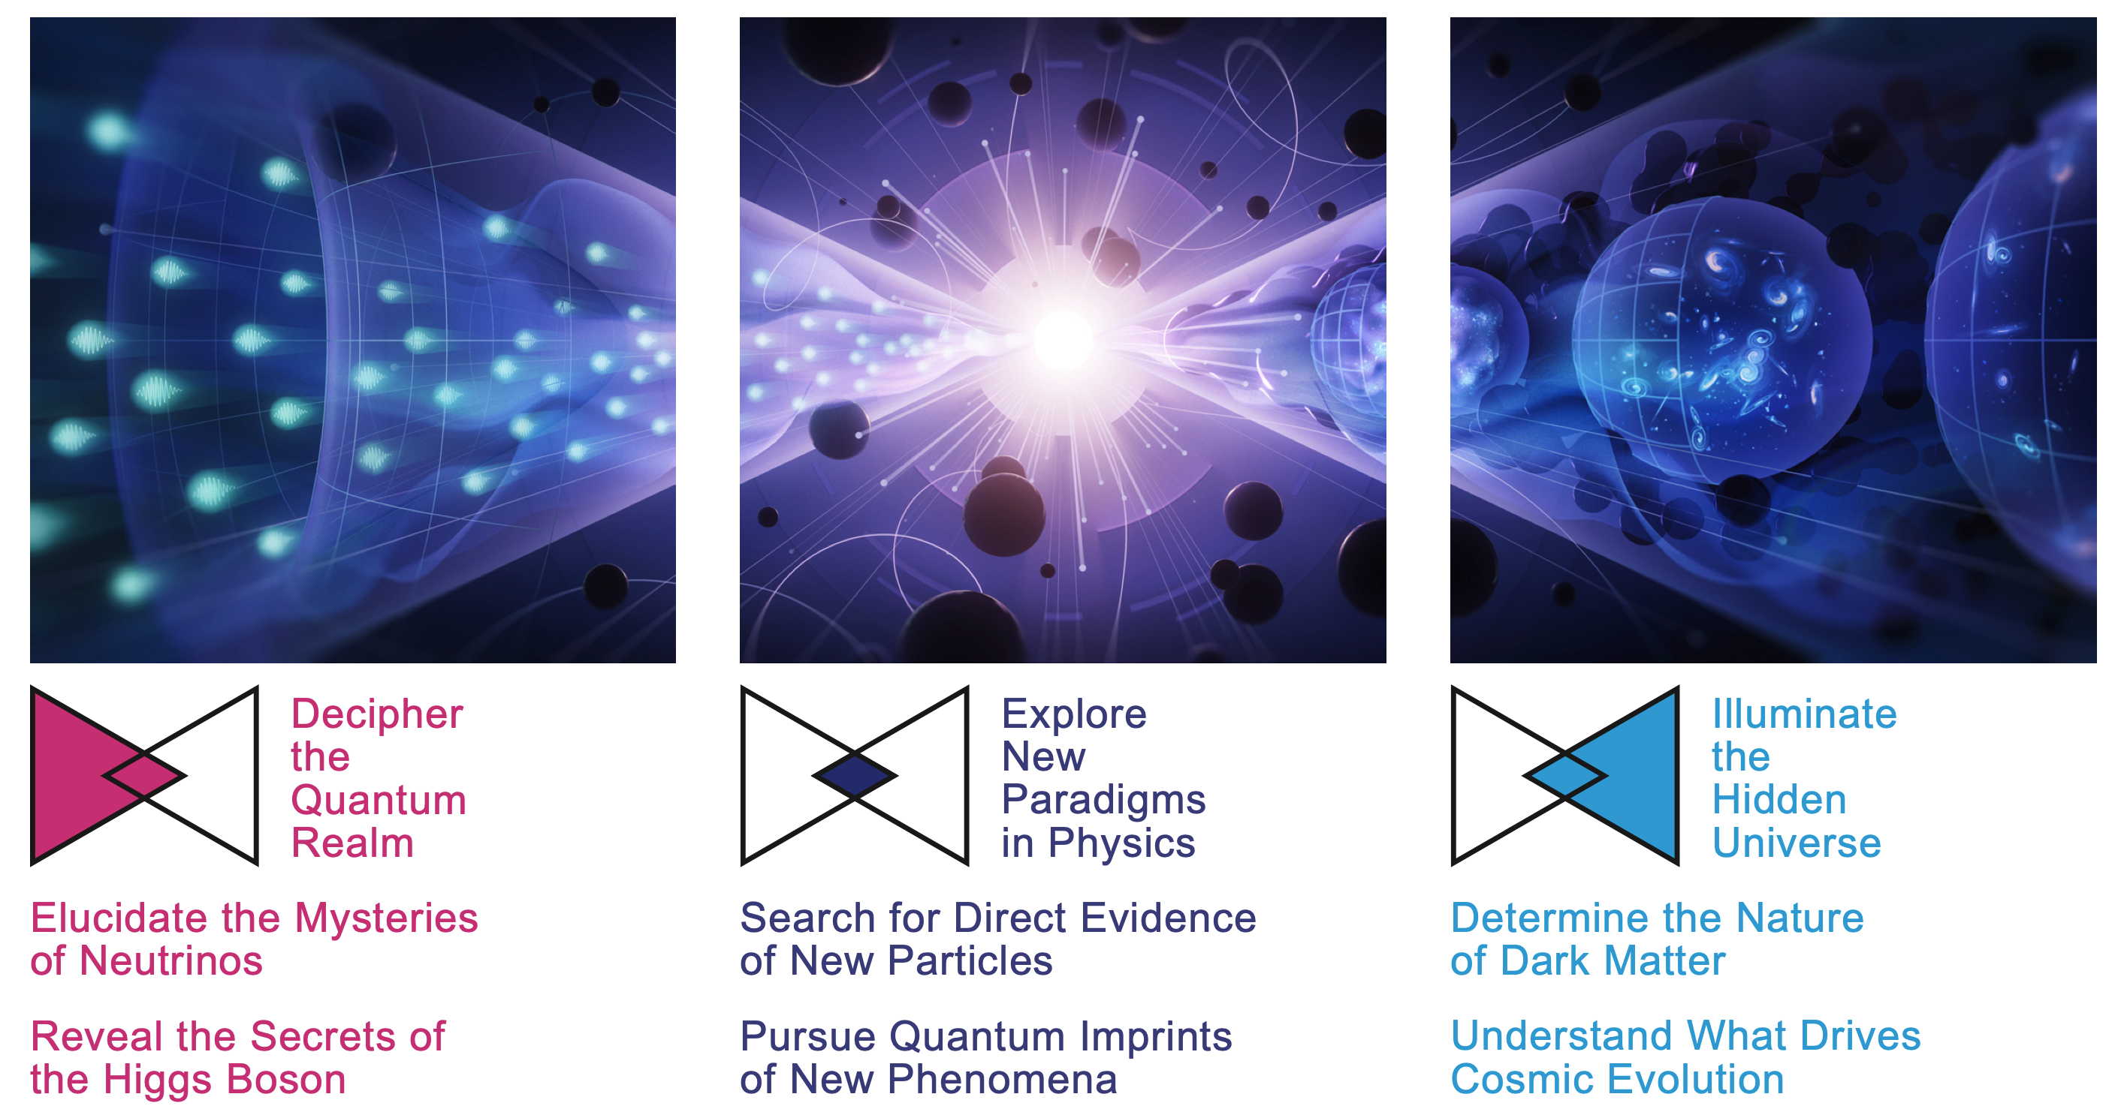
P5 2023 Science Drivers

Slide 5
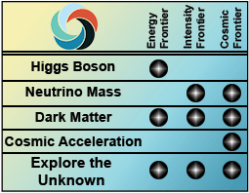






Evolution of the key questions in particle physics
2014 Science Drivers
2023 Science Drivers
2008 Frontiers of
Particle Physics
We now have more details on
how to explore the unknown.

Slide 6
Recommendation 1
As the highest priority independent of the budget scenarios, complete construction projects and support operations of ongoing experiments and research to enable maximum science. We reaffirm the previous P5 called out these major existing projects:
  HL-LHC ATLAS, CMS, and Accelerator Upgrade Project
  The first phase of DUNE and PIP-II
  The Vera C. Rubin Observatory to carry out the Legacy Survey of Space and Time (LSST)
In addition, we recommend continued support for the following ongoing experiments at the medium scale including completion of construction, operations and research on:
  NOvA, SBN, and T2K
    elucidate the mysteries of neutrinos
  DarkSide-20k, LZ, SuperCDMS, and XENONnT
    determine the nature of dark matter
  DESI
    understand what drives cosmic evolution
  Belle II, LHCb, and Mu2e
    pursue quantum imprints of new phenomena

Slide 7
Recommendation 2
In priority order
Construct a portfolio of new major projects
  CMB-S4, which looks back at the earliest moments of the universe to probe physics at the highest energy scales. It is critical to install telescopes at and observe from both the South Pole and Chile sites to achieve the science goals.
  Re-envisioned second phase of DUNE with an early implementation of an enhanced 2.1 MW beam (ACE-MIRT), a third far detector, and an upgraded near-detector complex as the definitive long-baseline neutrino oscillation experiment of its kind.
  An off-shore Higgs factory, realized in collaboration with international partners, in order to reveal the secrets of the Higgs boson. The current designs of FCC-ee and ILC meet our scientific requirements. The US should actively engage in feasibility and design studies. Once a specific project is deemed feasible and well-defined (see also Recommendation 6), the US should aim for a contribution at funding levels commensurate to that of the US involvement in the LHC and HL-LHC, while maintaining a healthy US on-shore program in particle physics.
  An ultimate Generation 3 (G3) dark matter direct detection experiment reaching the neutrino fog, in coordination with international partners and preferably sited in the US.
  IceCube-Gen2 for study of neutrino properties using non-beam neutrinos complementary to DUNE and for indirect detection of dark matter covering higher mass ranges using neutrinos as a tool.

Slide 8
Recommendation 3
Create an improved balance between small-, medium-, and large-scale projects to open new scientific opportunities and maximize their results, enhance workforce development, promote creativity, and compete on the world stage.
  Implement a new small-project portfolio at DOE, Advancing Science and Technology through Agile Experiments (ASTAE), across science themes in particle physics with a competitive program and recurring funding opportunity announcements. This program should start with the construction of experiments from the Dark Matter New Initiatives (DMNI) by DOE-HEP (section 6.2).
  Continue Mid-Scale Research Infrastructure (MSRI) and Major Research Instrumentation (MRI) programs as a critical component of the NSF research and project portfolio.
  Support DESI-II for cosmic evolution, LHCb upgrade II and Belle II upgrade for quantum imprints, and US contributions to the global Cherenkov Telescope Array (CTA) Observatory for dark matter (sections 4.2, 5.2, and 4.1). Support for Belle-II includes contribution to SuperKEKB .
    DESI*-II
    LHCb
    Belle-II*, SuperKEKB
    CTA
* Falls into the DOE portfolio.

Slide 9
General response to recommendations 1, 2, and 3
Recommendation 1:
  DOE fully supports this recommendation and puts it as the highest priority in planning our allocation of funding.
Recommendation 2:
  DOE forwarded each of the projects listed in red on slide 7 to the Facilities sub-panel.
  These are all large undertakings and will comment on each one separately.
Recommendation 3:
  DOE will implement and execute a plan to address the ASTAE recommendation.
  DOE will NOT support scope towards the LHCb Upgrade II.
  DOE will continue to meet its on-going commitments to Belle-II; contributions towards SuperKEKB will be considered in the context of accelerator R&D toward e⁺e⁻ luminosity improvements.
  DOE will work with the DESI Collaboration to carefully decide a scope, schedule and cost envelope for the DESI-II upgrade.

Slide 10
Recommendations 4 and 5
Recommendation 4 :
  Support a comprehensive effort to develop the resources – theoretical, computational and technological – essential to our 20-year vision for the field. This includes and aggressive R&D program that, while technologically challenging, could yield revolutionary accelerator designs that chart a realistic path to a 10 TeV pCM collider.
Recommendation 5 :
  Invest in initiatives aimed at developing the workforce, broadening engagement, and supporting ethical conduct in the field. This commitment nurtures an advanced technological workforce not only for particle physics, but the nation as a whole.
We will incorporate actions to address these recommendations in our on-going planning

Slide 11
Recommendation 6
Convene a targeted panel with broad membership across particle physics later this decade that makes decisions on the US accelerator-based program at the time when major decisions concerning an off-shore Higgs factory are expected, and/or significant adjustments within the accelerator-based R&D portfolio are likely to be needed. A plan for the Fermilab accelerator complex consistent with the long-term vision in this report should also be reviewed.
  The panel would consider the following: The level and nature of US contribution in a specific Higgs factory including an evaluation of the associated schedule, budget, and risks once crucial information becomes available.
  The panel would consider the following: Mid- and large-scale test and demonstrator facilities in the accelerator and collider R&D portfolios.
  The panel would consider the following: A plan for the evolution of the Fermilab accelerator complex consistent with the long-term vision in this report, which may commence construction in the event of a more favorable budget situation.
DOE does not envision a single panel to address this recommendation; rather we will work with NSF, the DOE Laboratories and community at large to convene three separate panels that each will address one of the topics.
Initial thoughts on the following slides ….

Slide 12
DOE’s Response to Recommendation 6.1
The panel prescribed for the Higgs Factory is envisioned to be a separate panel from the ones in accelerator test facilities and the evolution of the Fermilab Accelerator Complex.
We likely will precede this panel with a task force to evaluate the status of activities that have been addressed over the last many years
  The task force is anticipated to run in-parallel to the next update of the European Strategy for Particle Physics
  The U.S. community has strong proponents of both circular and linear Higgs factories as well as a vision for a future muon collider that can be potentially hosted in the United States
We have been asked by KEK (Japan) to support ILC development through the ILC Technology Network (ITN)
  DOE has decided that we, including our DOE national labs, will be observers and not officially join the ITN
  Instead, we plan to consider R&D efforts for ILC technologies under our existing U.S.-Japan Cooperation Program
Regarding FCC-ee, we will continue to support and expand our participation in the feasibility studies, including expanding efforts to work on the 800 MHz SRF accelerator cavities as well as other technical topics and studies as they arise
  These efforts are aligned with topics contemplated under the 2020 DOE-CERN FCC feasibility study agreement
Within the U.S. community, we are actively working to bring together the linear and circular collider communities wanting to develop detectors for a future Higgs factory
  Our goal is to have our community work together, along with the international partners, to converge on an optimum solution to realize a future collider

Slide 13
Off-shore Higgs Factory
From P5 Recommendation 2, Priority 3 out of 5: An off-shore Higgs factory, the current designs of FCC-ee and ILC meet our scientific requirements. The US should actively engage in feasibility and design studies. Once a specific project is deemed feasible and well-defined (see also P5 Recommendation 6), the US should aim for a contribution at funding levels commensurate to that of the US involvement in the LHC and HL-LHC, while maintaining a healthy US on-shore program in particle physics.
DOE response and actions (thus far):
  In Feb 2024, we presented our approach to MEXT to be observers in the ITN while considering, at some fraction, associated R&D efforts under the existing U.S.-Japan Cooperation Program.
  In Mar 2024, we presented DOE’s view on participating in any potential FCC-ee to the CERN Council.
  Through interagency coordination, led by The White House Office of Science and Technology Policy (OSTP) and which included the U.S. Department of State, DOE, NSF, and NASA, a Statement of Intent was signed in Apr 2024 between the U.S. Government and CERN.
    Statement expresses an intent for the U.S. to collaborate on the FCC-ee should the CERN Member States determine it is likely to be CERN’s next research facility following the HL-LHC (more next slide).
  Jointly with NSF, we’ve initiated forming a U.S. based organization for Higgs Factory development efforts for the Physics, Experiment, and Detectors (more in a couple of slides).
    At DOE we are also beginning to develop a similar approach for the accelerator side.

Slide 14
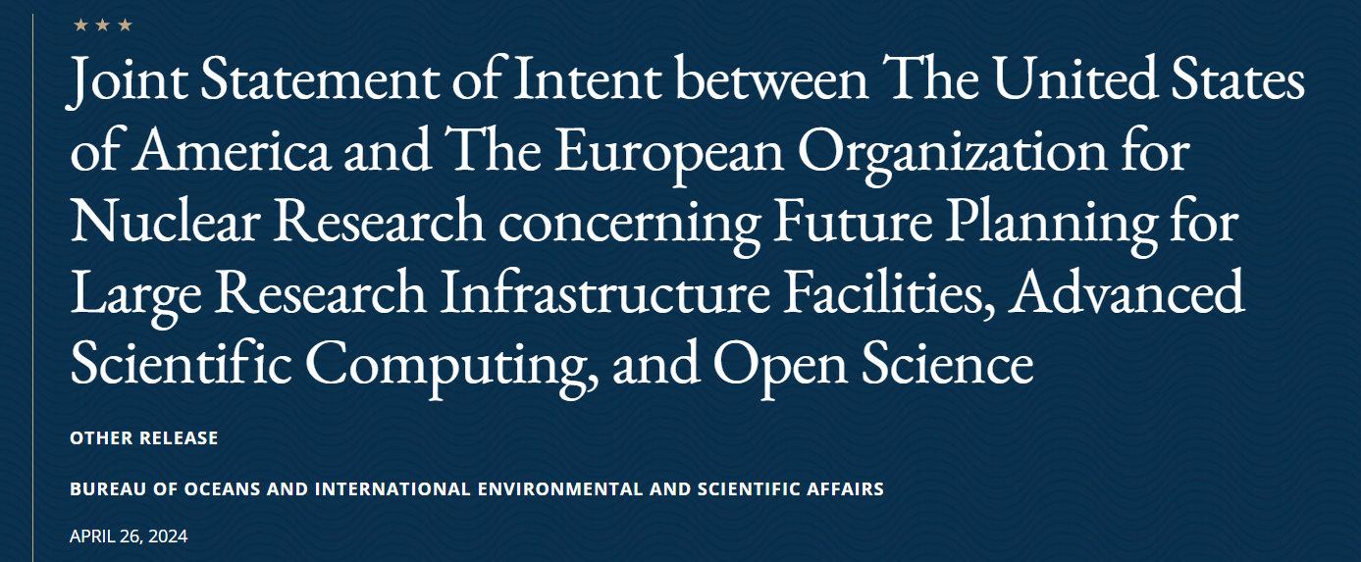
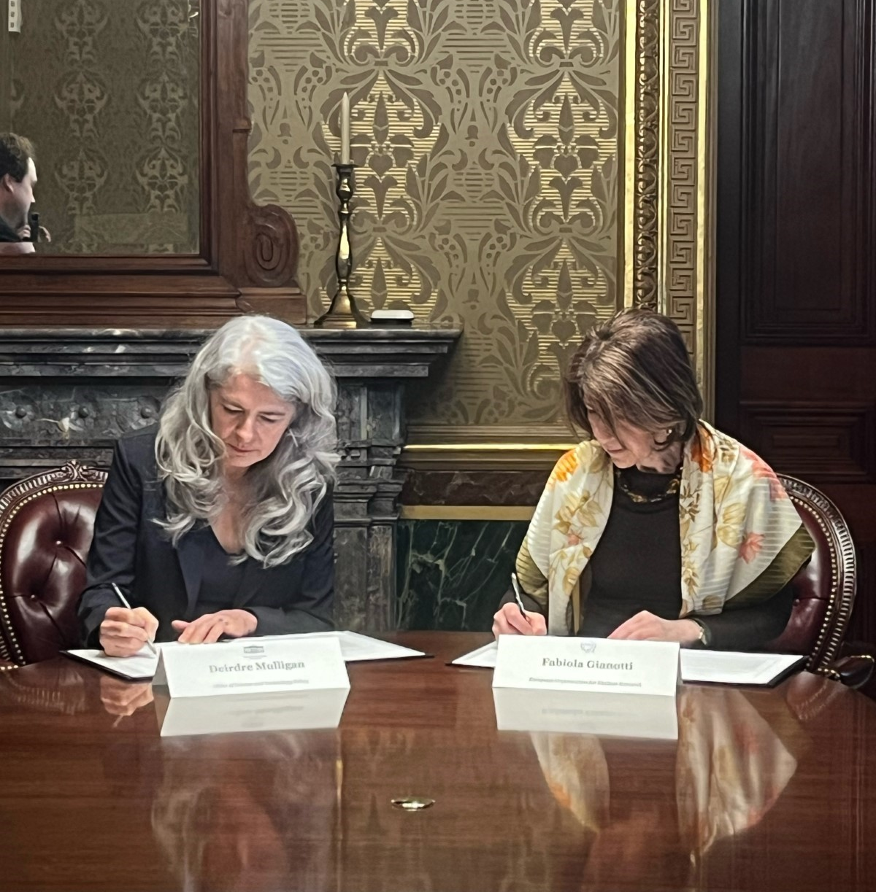
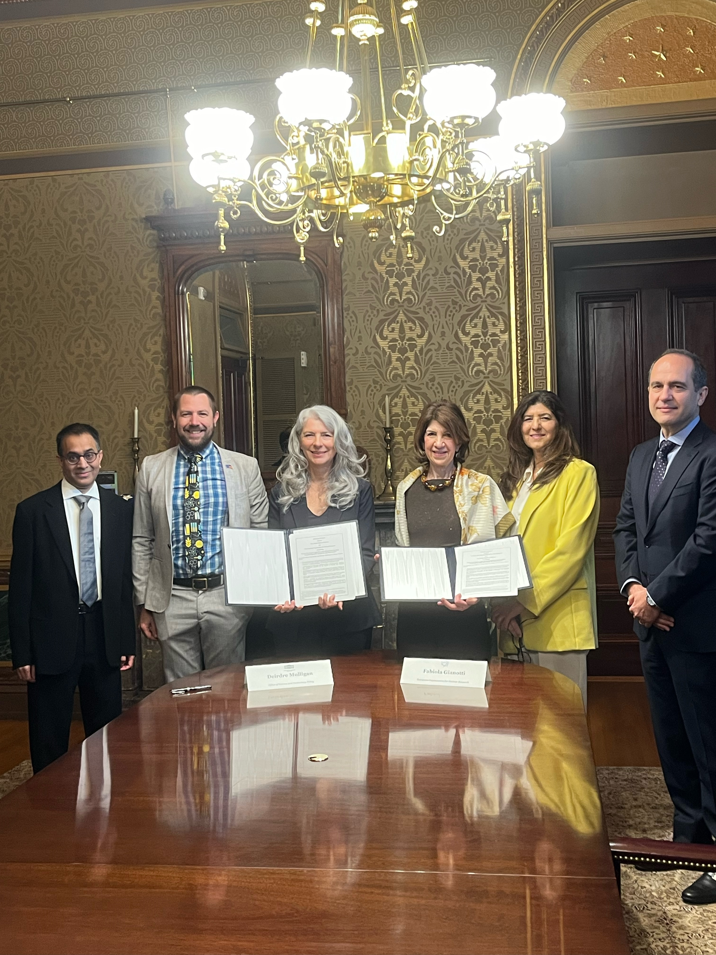
U.S.-CERN Statement of Intent
The text of the following statement was released by the Government of the United States of America and the European Organization for Nuclear Research (CERN), an Intergovernmental Organization having its seat at Geneva, Switzerland. White House Office of Science and Technology Policy Principal Deputy U.S. Chief Technology Officer Deirdre Mulligan signed for the United States while Director-General Fabiola Gianotti signed for CERN.
Text available at: U.S. Department of State Remarks & Releases site
Among the topics in the Statement,
  Expresses intentions by the U.S. and CERN to continue collaborating in the FCC Higgs Factory feasibility study
  Subject to appropriate processes, the intention for the U.S. to collaborate on the FCC-ee, should the CERN
  Member States determine the FCC-ee is likely to be CERN’s next research facility following the HL-LHC
Statement aligned with P5: should FCC-ee receive a “green-light” following the next update of the European Strategy, U.S. intends to collaborate; and nature of the contributions to be discussed by the panel prescribed in 6.1.

Slide 15
U.S. Organization for Higgs Factory Development
Jointly with NSF, we are preparing a charge that forms a nationally coordinated U.S. Higgs Factory Coordination Consortium (HFCC) for developing the physics, experiment, and detector (PED) program.
  A similar approach by DOE is envisioned for developing the Higgs factory accelerator program.
The proposed U.S. HFCC plans to include 1) Higgs Factory Steering Committee (HFSC); 2) a Lab Coordination Group (LCG); and 3) various detector systems that report to the HFSC & naturally map onto CERN’s DRD structure.
  Ensure collaborations by the U.S. with our partners are cost-effectively carried out for Higgs factory initiatives.
The LCG includes reps from: ANL, BNL, FNAL, JLAB, LBNL, ORNL, and SLAC.
  Partners include CPAD in the U.S. and the CERN-hosted Detector R&D (DRD) initiative.
Charge to be available soon; example tasks and goals could include:
  physics and technical feasibility studies pre-project R&D
  software and computing framework to advance the physics and R&D

Slide 16
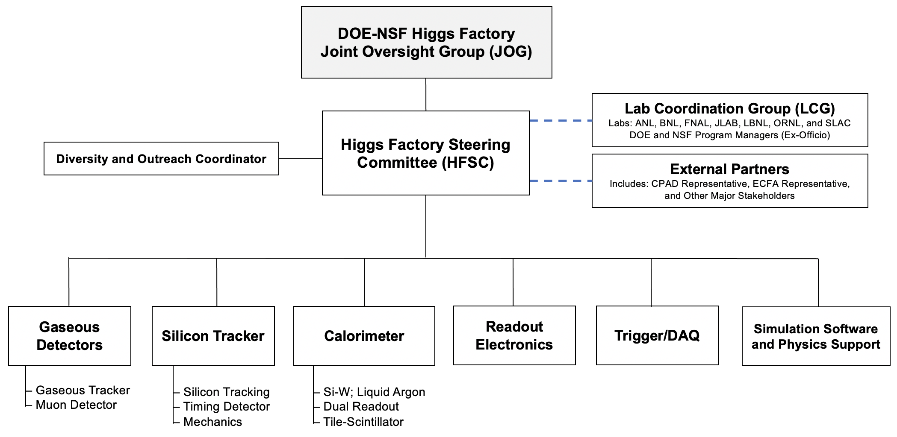
Higgs Factory Coordination Consortium

Slide 17
DUNE Phase-II
From P5 Recommendation 2, Priority 2/5 : Re-envisioned second phase of DUNE with an early implementation of an enhanced 2.1 MW beam (ACE-MIRT), a third far detector, and an upgraded near-detector complex as the definitive long-baseline neutrino oscillation experiment of its kind (section 3.1).
DOE response and actions :
  ACE-MIRT: one element of the near-term evolution of the Fermilab Complex (see next slide)
  Far Detector 3: to be planned and proposed by the DUNE Collaboration in consultation and partnership with DOE and international partners; top priority is to secure an understanding of how the cryostat is funded.
  Upgraded near-detector complex (MCND): to be planned and proposed by the DUNE Collaboration in consultation and partnership with DOE and international partners; top priority is to finalize a baseline plan for the Phase 1 Near Detector

Slide 18
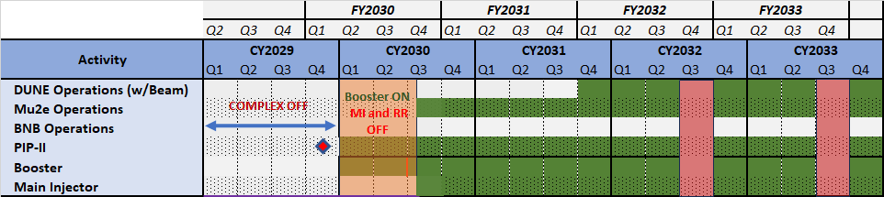
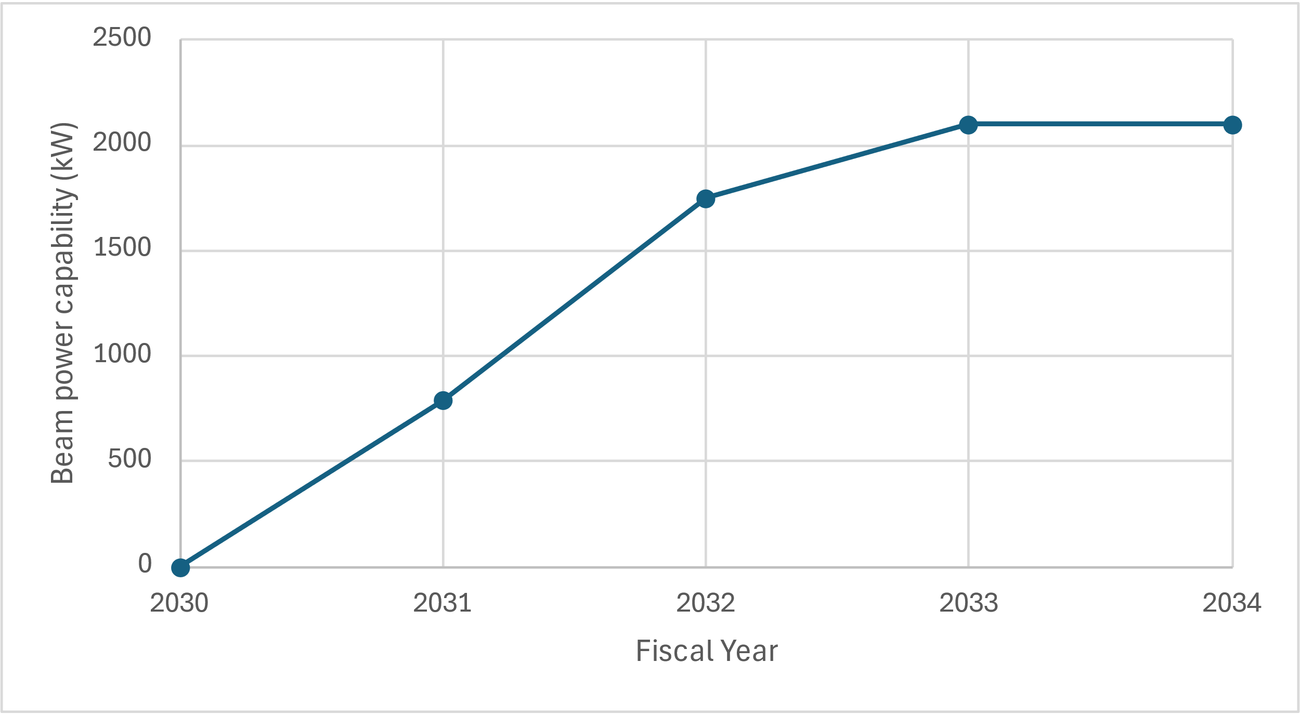
Evolution of the Fermilab Complex – part 1
From Fermilab
First consider the accelerator capability at completion of PIP-II Project
A three-step path to reach 2.1MW for the early operation of the DUNE experiment :
  Post-PIP-II instrumentation and booster improvements to handle beam power
  ACE-MIRT
    Main Injector upgrade to operate at 0.7 sec cycle time
    Target to handle 2 MW
  Booster improvements to insure reliable operation

Slide 19
ASTAE
From P5 Report recommendation #3 : Implement a new small-project portfolio at DOE, Advancing Science and Technology through Agile Experiments (ASTAE), across science themes in particle physics with a competitive program and recurring funding opportunity announcements. This program should start with the construction of experiments from the Dark Matter New Initiatives (DMNI) by DOE-HEP.
DOE response and actions:
  DOE will initiate fabrication of 1-3 DMNI projects
    5 projects remain under consideration
  The key word for new projects is AGILE.
P5’s call for agile implies that we should complete these experiments quickly, and shift course when it comes time to start new ones.
  2 years for R&D, 2-3 for fabrication, 2-3 to operate, and then decommission.
    This is still 6-8 years.
  Start a new projects fabrication every year.

Slide 20
AGILE
HEP is developing a plan on how implement ASTAE. Using lessons learned from DMNI.
What we have concluded so far.
This requires actions from DOE:
  Limit the number of reviews. Select a just few concepts at a time to develop into projects.
  Tailor the oversight to the size of the project.
  Provide adequate funding to complete the work on a technically limited schedule.
  Protect the budget envelope for the program.
And the community:
  Concentrate R&D on the critical enabling technology.
  Do the necessary up-front planning
  Arrange for adequate resources be available when needed: engineering, procurement, etc.

Slide 21
DMNI Status
Concept | DM type | Mass range | Lead lab | Orig R&D request ($K) | R&D $K thru FY24 | Est. Fab. cost ($M)
ADMX-EFR | Axions | 9-17 μeV | FNAL | 1,976 | 3,140 | $20
DM-Radio | Axions | <μeV | SLAC | 993 | 1,560 | $24
LDMX | Hidden sector | 10-300 MeV | SLAC | 1,960 | 1,950 | $21
OSCURA | WIMPs | 1MeV-1GeV | FNAL | 3,943 | 3,544 | $15
TESSERACT | WIMPs | >10 MeV | LBNL | 3,975 | 1,815 | <$10
Total |  |  |  | 12,847 | 12,309 | $90
These are the remaining DMNI proposals.
  CCM at LANL was funded, fabricated and is operating.
The French have funded a proposal to host TESSERACT.
DOE has decided to fund TESSERACT starting in FY25 based on its cost effectiveness and the French offer to host.
  These considerations made it the ideal concept to go next.
We are still working on the process to select other DMNI proposals.
  Most likely start will be in FY 26
HEP will try to select 2 additional DMNI’s to move to fabrication, with the rest folded into the ASTAE program competition. This will also allow new dark matter proposals to be considered.

Slide 22
G3 Dark Matter
From P5 Recommendation 2, Priority 4 out of 5 :
  An ultimate Generation 3 (G3) dark matter direct detection experiment reaching the neutrino fog, in coordination with international partners and preferably sited in the US.
DOE response and actions:
  At the present time, based on the Snowmass Community Summer Study, there have been two proposals for G3 Dark Matter detectors : XLZD and ARGO
  P5 recommended a domestic site for the experiment in the higher funding scenario and an international site in the lower funding scenario.
  Start with site independent R&D as we understand the funding that will be available.
    Engage with partners who are interested in hosting.
  DOE will entertain proposals by U.S. groups for pre-project R&D.

Slide 23
Accelerator Test Facilities
From P5 Recommendation 6.2 : The panel would consider the following: Mid- and large-scale test and demonstrator facilities in the accelerator and collider R&D portfolios.
DOE response and actions :
  As a first step in developing a response to this recommendation, DOE will be conducting a review of the GARD program this August.
  This will be followed by an Accelerator Test Facilities comparative review of existing facilities at ANL, BNL, FNAL, LBNL and SLAC; tentative time frame is Fall 2024; more information will be forthcoming.
  In 2025 a panel will be convened to develop a roadmap towards a test facility plan that will be well supported and meet the needs of the emerging directions for future colliders and development of the workforce that will be needed over a 20-30 year time frame.

Slide 24
Evolution of the Fermilab Accelerator Complex – part 2
From P5 Recommendation 6.3 : The panel would consider the following: A plan for the evolution of the Fermilab accelerator complex consistent with the long-term vision in this report, which may commence construction in the event of a more favorable budget situation.
DOE response and actions :
  The panel = A Task Force, led by Fermilab, and drawn from the US HEP community and interested international partners
  The time frame for convening such a Task Force is no sooner than in calendar year 2026 and most likely following the panel initiated to consider the Higgs Factory evaluation.
  This gives priority to detailed planning towards the Fermilab accelerator complex evolution – Part 1
  Further planning for the complex evolution must include demonstration that the elements of the plan are compatible with the long-term vision towards a 10TeV pCM collider.

Slide 25
CMB-S4
From P5 Recommendation 2, Priority 1 out of 5 : CMB-S4, which looks back at the earliest moments of the universe to probe physics at the highest energy scales. It is critical to install telescopes at and observe from both the South Pole and Chile sites to achieve the science goals.
Input from the NSF :
  There is a serious issue with South Pole infrastructure that has led the NSF to a difficult decision (which you will hear about in the next two talks)
DOE response and actions :
  We are working with the Project team and the NSF to develop alternatives that achieve the science results that we are seeking.

Slide 26
2023 P5 Budget Scenarios
Inflation Reduction Act of 2022 provided supplemental funding of +303.6M for HEP projects

Slide 27
Prescriptive P5 area recommendations
P5 recommendation | Funding/year
ASTAE | 35
Detector R&D | 20
Theory | 15
GARD | 10
EF Frontier detectors | 20
EF Frontier accelerator | 35
Total | 135
FY 2024 enacted ($M) | 1,200
FY 2025 PRB ($M) | 1,230
Initiative fraction | 11%
The P5 area recommendations for budgets is 11% of the current budget. At this moment, 11% increases in the budget look very unlikely.
Our analysis shows the recommended ASTAE funding can support a steady stream of 1 new project starting per year, so it looks quite appropriate.
The other recommendations have not been fully studied.
In order, to prevent strain on the core research budget and facility ops we will need to build up to these levels as current projects ramp down.
We need to emphasize that funding priorities will be towards execution of Recommendation #1.

Slide 28
Conclusion
The 2023 P5 Report :
Provides a vision of an exciting path into the future for high energy/particle physics
Provides us with actionable recommendations that will keep us on that path
The vision is long-term and will take long-term planning

Slide 29
P5 Area recommendations regarding small projects
Area Recommendation 2: For the ASTAE program to be agile, we recommend a broad, predictable, and recurring (preferably annual) call for proposals. This ensures the flexibility to target emerging opportunities and fields. A program on the scale of $35 million per year in 2023 dollars is needed to ensure a healthy pipeline of projects.
Area Recommendation 3: To preserve the agility of the ASTAE program, project management requirements should be outlined for the portfolio and should be adjusted to be commensurate with the scale of the experiment.
Area Recommendation 4: A successful ASTAE experiment involves 3 phases: design, construction, and operations. A design phase proposal should precede a construction proposal, and construction proposals are considered from projects within the group that have successfully completed their design phase.
Area Recommendation 5: The DMNI projects that have successfully completed their design phase and are ready to be reviewed for construction, should form the first set of construction proposals for ASTAE. The corresponding design phase call would be open to proposals from all areas of particle physics.
→ We have considered these recommendations and how to most effectively carry out an ASTAE program.

