Slide 1
Perspectives on Future Energy Frontier Colliders
Muon Collider Physics Benchmarking Workshop
University of Pittsburgh
Mark Palmer
Director, Accelerator Facilities Division
Advanced Technology Research Office
November 16, 2023
ATRO – Accelerator Facilities Division

Slide 2
Some Introductory Comments
High Energy Physics completed its community planning process, “Snowmass 2021” last year (a 1-year delay due to the pandemic)
The Particle Physics Project Prioritization Panel is just wrapping up
  The 2023 P5 report will be released at the next High Energy Physics Advisory Panel Meeting on December 7-8 https://science.osti.gov/hep/hepap/Meetings
  Town halls (in-person and virtual) for discussion will follow
    Fermilab-hosted Town Hall on December 11
    Others to be announced
  I’m afraid I can’t say anything about the contents of the P5 report…
  and the opinions expressed in this talk are strictly my own!

Slide 3
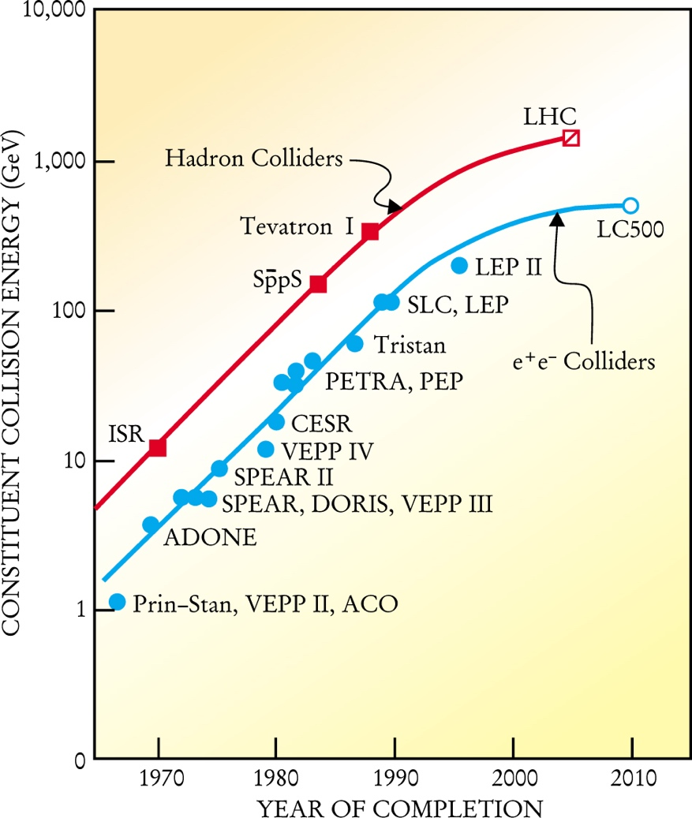
A Look at Where We Are
Today
Livingston Plot in 2001
[M. Tigner, Physics Today 54 , 1, 36 (2001)]
  Through the 1900s, progress
  driven by critical technology
  developments for many decades
  (1940s –)
  CoM Energies increasing by
  ~2 orders of magnitude every
  25 years
Where are we now?
  Progress has become much
  more challenging
    Machine Complexity
    Costs (R&D and capital)
  What are our options and
  priorities for the next HEP
  machine?
100,000
The “Livingston Plot”
at the turn of the century…
~100 TeV pp Machines
Muon
Colliders
Linear Colliders
Advanced Linear Colliders (WFA)
Large Circular e⁺e⁻ Colliders
All dates are
speculative
Note: ECFA, for the European
Strategy Update, labeled eras as:
2020-2040: HL-LHC era
~2040-2060: Z/W/H/top-factory era
2060(?)-2080: Energy Frontier era
2020 2030 2040 2050 2060

Slide 4
Acknowledgements
This draws from various Snowmass collider whitepaper contributions
Modern and Future Colliders (arXiv:2003.09084)
Study Overview for Super Proton-Proton Collider (arXiv:2203.07987)
Future Circular Hadron Collider FCC-hh: Overview and Status (arXiv:2203.07804)
The International Linear Collider: Report to Snowmass 2021 (arXiv:2203.07622)
The CLIC Project (arXiv:2203.09186)
A Muon Collider Facility for Physics Discovery (arXiv:2203.08033)
C³: A “cool” Route to the Higgs Boson and Beyond (arXiv:2110.15800)
Future Circular Lepton Collider FCC-ee: Overview and Status (arXiv:2203.08310)
Snowmass 2021 White Paper AF3-CEPC (arXiv:2203.09451)
Linear Collider Based on Laser-Plasma Accelerators (arXiv:2203.08366)
Continuous and Coordinated Efforts of Structure Wakefield Acceleration (SWFA) Development for an Energy Frontier Machine (arXiv:2203.08275)
AWAKE, Plasma Wakefield Acceleration of Electron Bunches for Near and Long Term Particle Physics Applications (arXiv:2203.09198)
The ReLiC – Recycling Linear e⁺e⁻ Collider (arXiv:2203.06476)
High Energy & High Luminosity γγ Colliders (arXiv:2203.08353)
The Potential of a TeV-Scale Muon-Ion Collider (arXiv 2203.06258)
A 500 TeV Collider in the Sea
Also draws on participation in the MAP, MICE, and IMCC collaborations

Slide 5
Outline
Setting the Context
The Landscape
What has changed since the last US HEP Community Planning Process (Snowmass 2013)?
An overview of the (conventional) HEP Collider technologies
The proposed machines to address specific questions
Impacts of Accelerator Science & Technology Developments
What developments offer the potential of a cost-effective future Energy Frontier (Discovery) Collider?

Slide 6
Setting the Context

Slide 7
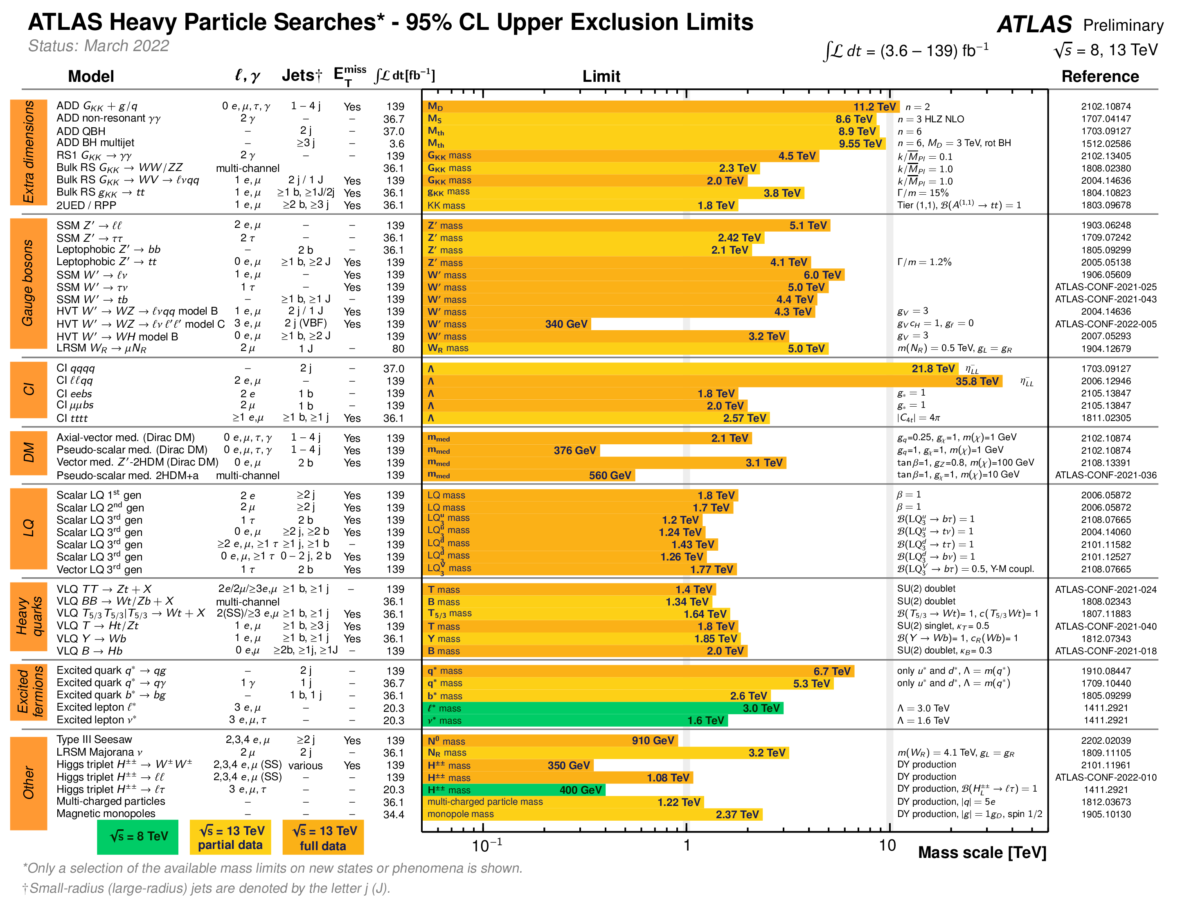
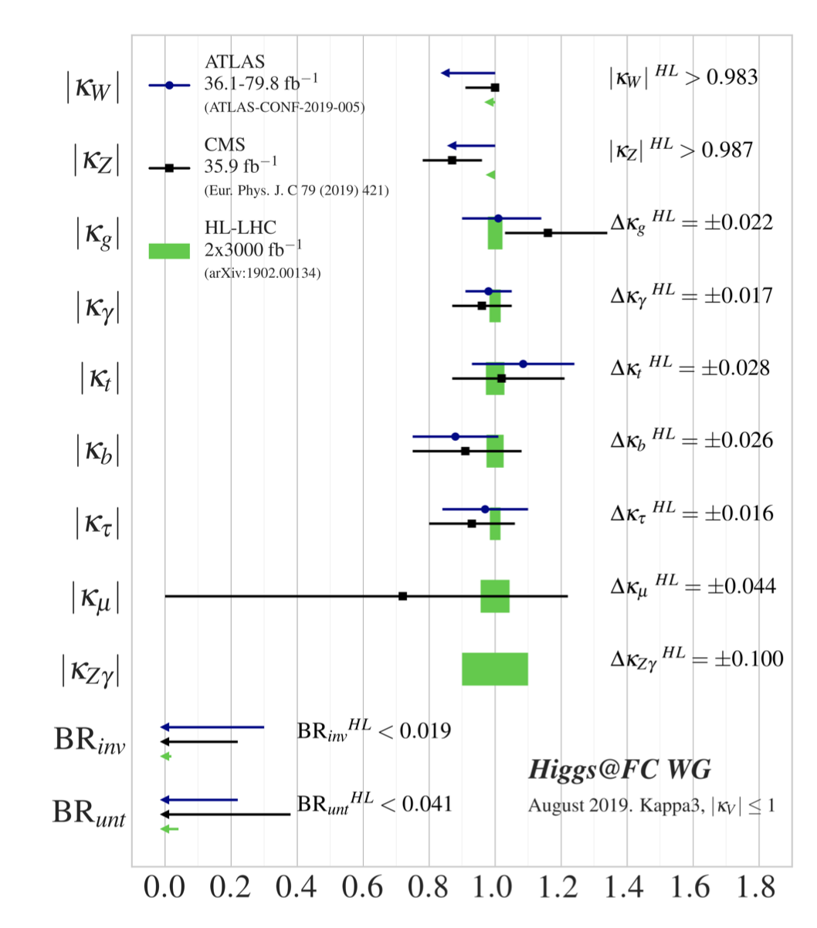
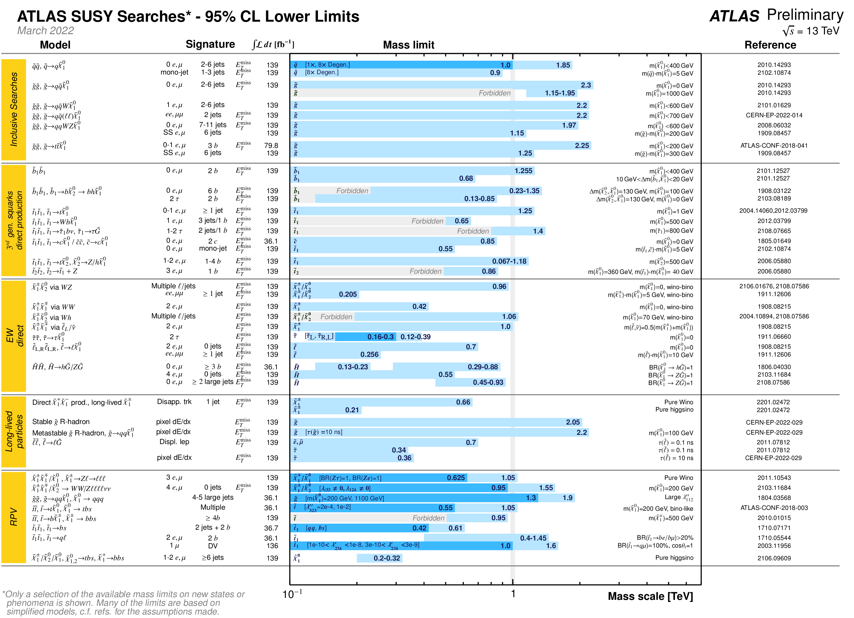
Generic Lessons from LHC?
The physics landscape has significantly changed since 2013
There could still be New Physics at LHC/HL-LHC…
However, data suggests
generically there is a gap from
EW scale to scale of New Physics
We need to be able to probe
>>1 TeV
10 TeV is interesting as a step
into the unknown but also for
physics targets
1 TeV
~1% tests on the Higgs
Implies roughly the ~ TeV scale for New Physics which could cause such a deviation
Courtesy Patrick Meade (SBU)
1 TeV

Slide 8
Opportunities for Future HEP Colliders
In 2013, the collider facility focus was very much on:
A precision lepton collider to explore the Higgs and explore new physics identified at the LHC
This would be followed by a high energy pp machine to continue exploring the energy frontier
Since that time, we have seen:
Limits from particle searches that move the discovery potential into the multi-TeV regime
This has driven the following questions:
Is there a more economical and efficient route to a precision lepton machine?
What would be the benefits of a high energy lepton collider, O(10 TeV)?
Are there accelerator technology advancements that provide a path to the next (US?) Energy Frontier Collider?

Slide 9
Overview of “Conventional” HEP Collider Technologies

Slide 10
Some Key Themes - I
Strong interest remains in providing a precision measurement e⁺e⁻ machine complementary to the HL-LHC
2 classes of reasonably mature (CDR-level) technologies
  Linear colliders: ILC and CLIC
  Circular colliders: FCC-ee and CEPC
3 emerging discussions based on technology advances (pre-CDR)
  Cool Copper RF structures for improved performance to go beyond CLIC
  Further advances in SRF technology to go beyond the ILC
  ERL techniques to improve large circular collider (or LC) performance
    Power
    Luminosity
Of course, the electron isn’t the only lepton we may want to consider...

Slide 11
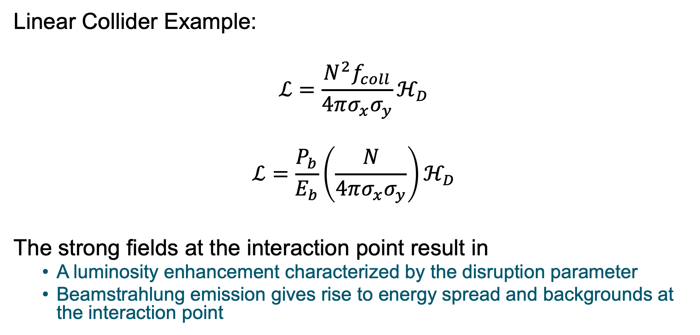
Luminosity in e⁺e⁻ Colliders
Linear Collider Example:
$$ℒ=\frac{N^{2}f_{coll}}{4πσ_{x}σ_{y}}ℋ_{D}$$
$$ℒ=\frac{P_{b}}{E_{b}}\left(\frac{N}{4πσ_{x}σ_{y}}\right)ℋ_{D}$$
The strong fields at the interaction point result in
  A luminosity enhancement characterized by the disruption parameter
  Beamstrahlung emission gives rise to energy spread and backgrounds at the interaction point

Slide 12
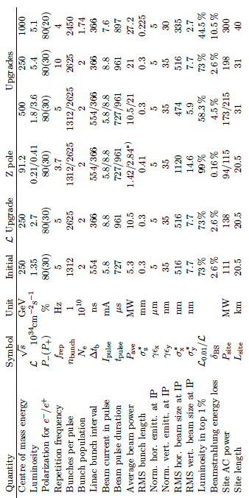
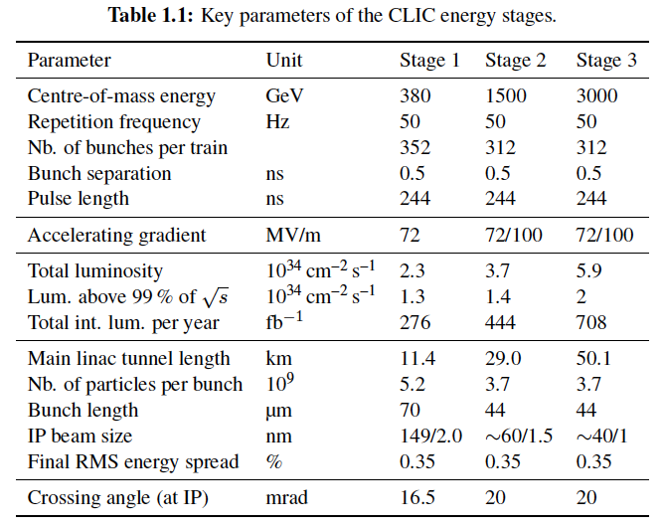
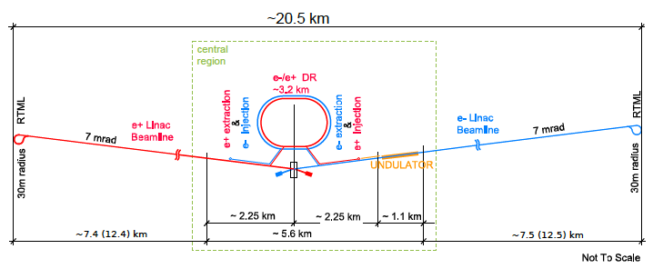
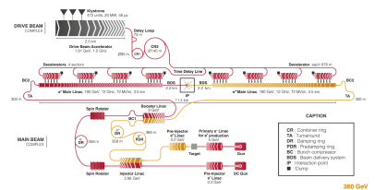
Linear Collider Parameters (w/CDR)
ILC
CLIC
250 GeV

Slide 13
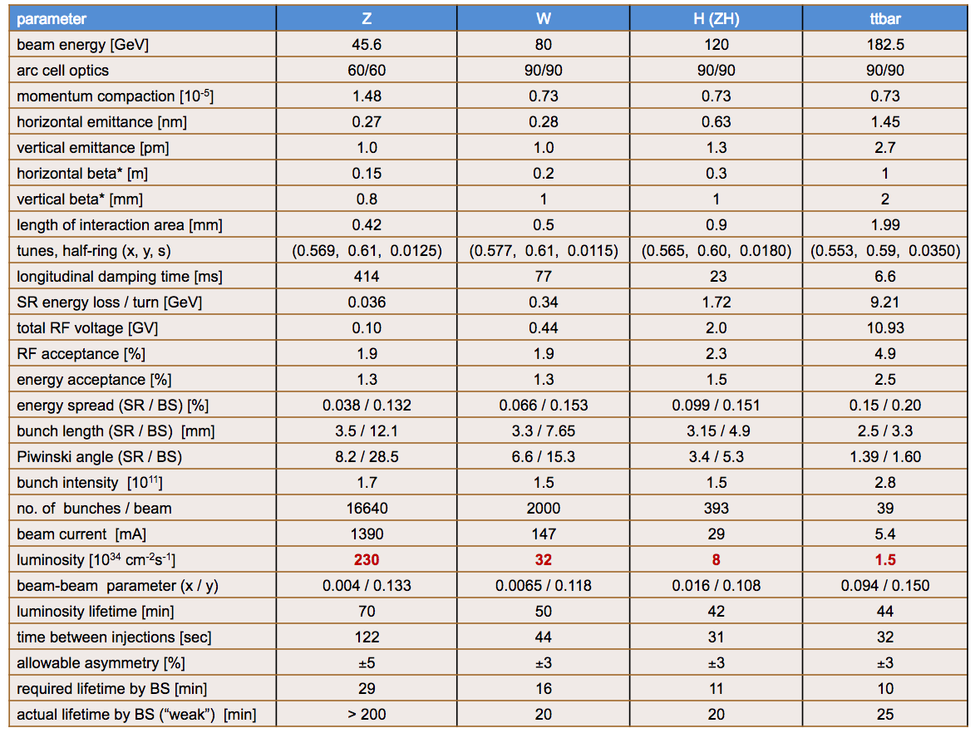
100 km Circular e+e- Parameters
CEPC CDR
FCC-ee CDR

Slide 14
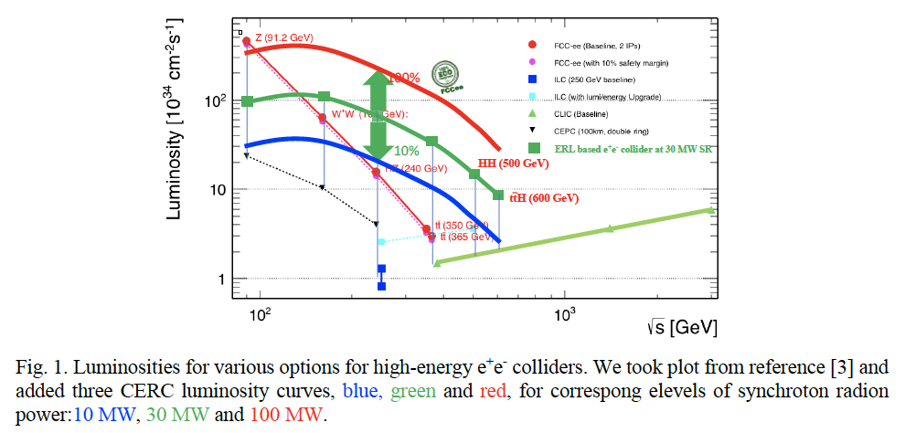
Potential Performance Improvement Incorporating ERL Technologies (CERC)

Slide 15
Some Key Themes - II
A proton-proton collider remains a leading candidate to push back the energy frontier
2 CDR-level proposals
  FCC-hh
  SppC
Also some less mature suggestions…
And we shouldn’t forget that there are other possibilities such as lepton-ion colliders

Slide 16
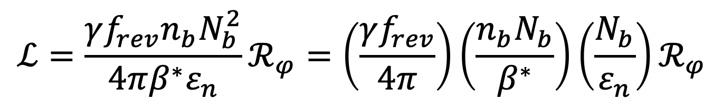
Luminosity Constraints*
Total Current, limited by
instabilities (eg, e-cloud)
machine protection issues!
“Brightness”, limited by
Space charge effects
Instabilities
Beam-beam tune shift (ultimate limit)
number of bunches
Bunch size
$$ℒ=\frac{γf_{rev}n_{b}N_{b}^{2}}{4πβ^{∗}ε_{n}}ℛ_{φ}=\left(\frac{γf_{rev}}{4π}\right)\left(\frac{n_{b}N_{b}}{β^{∗}}\right)\left(\frac{N_{b}}{ε_{n}}\right)ℛ_{φ}$$
Geometric factor related to crossing angle and hourglass effect
β*, limited by
magnet technology
chromatic effects
*a la Frank Zimmermann

Slide 17
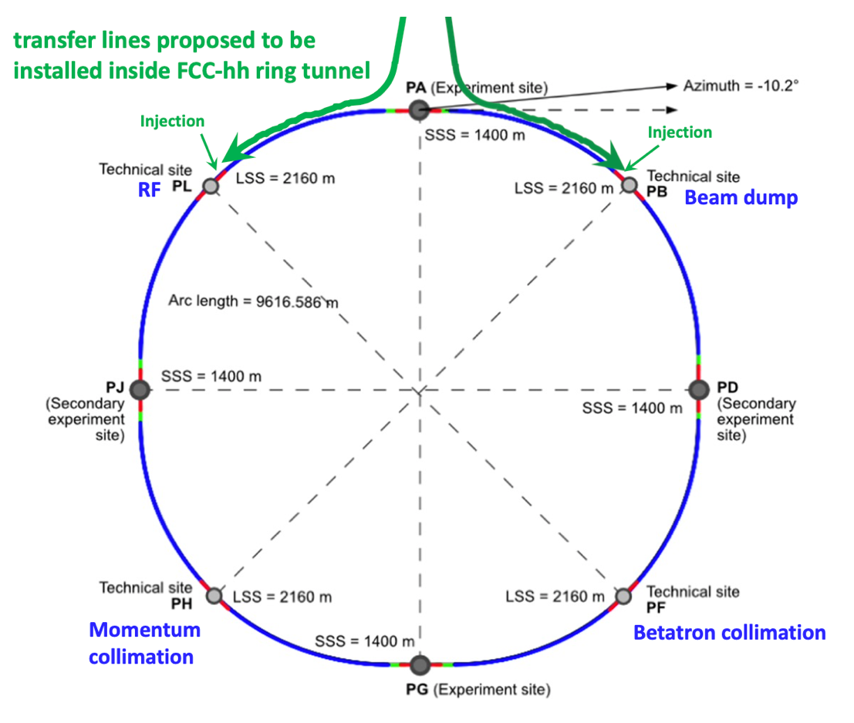
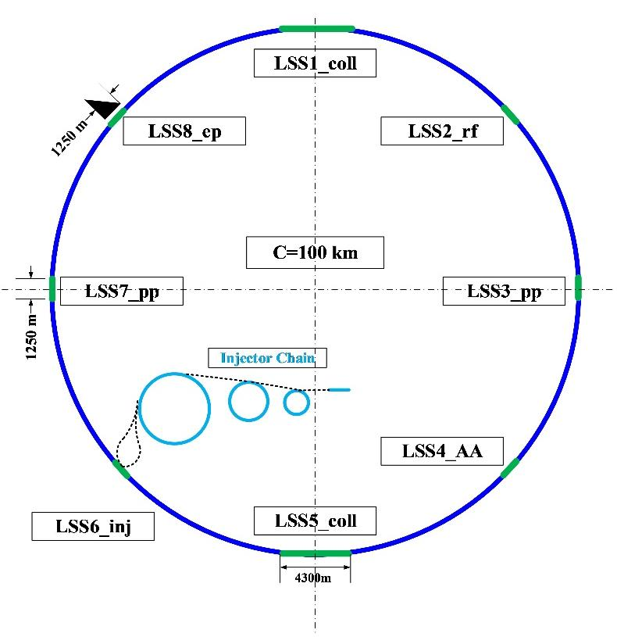
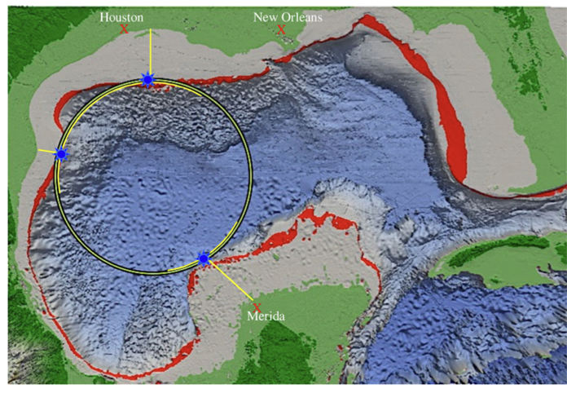
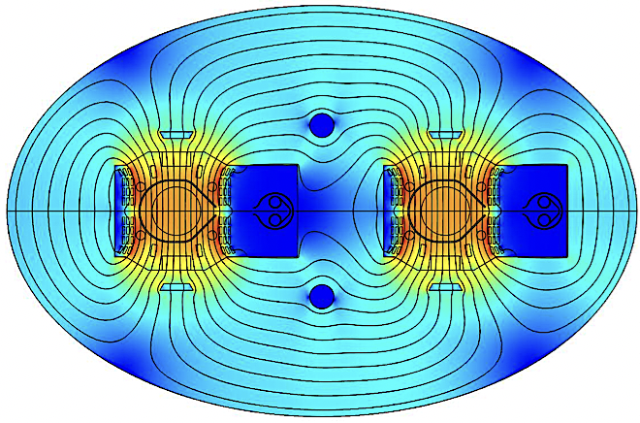
Proton-Proton
Energy Frontier Machines
FCC-hh
SppC
Collider-in-Sea
FCC-hh
100 km
100 TeV
16T Dipoles
SppC
100 km
125 TeV
20T Dipoles
Collider-in-Sea
1,900 km
500 TeV
3.5T Dipoles

Slide 18
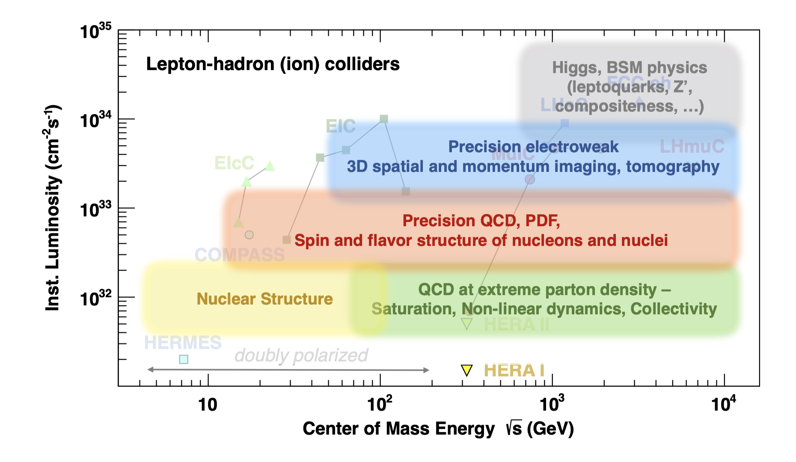
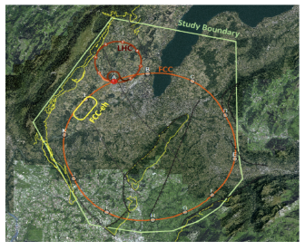
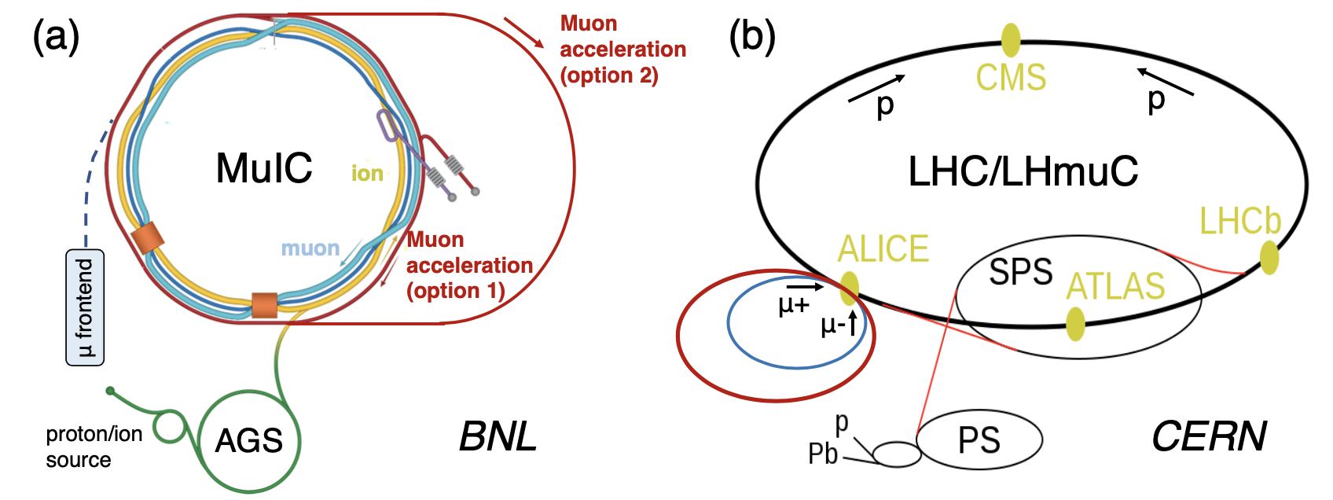
lepton-hadron (ion) colliders
LHeC, FCC-eh
1.3 TeV, 3.5 TeV
Precision DIS
L > 1ab⁻¹
Options for SpeC
as well
μIC, LHμC
1 TeV (BNL) 6.5 TeV (CERN)
Precision DIS in new regimes

Slide 19
Path to a 100 TeV Machine
 | LHC (Design) | HL-LHC | FCC-hh baseline ultimate
Main parameters and geometrical aspects
c.m. Energy [TeV] | 14 |  | 100
Circumference C [km] | 26.7 |  | 100
Dipole field [T] | 8.33 |  | 16
Arc filling factor | 0.79 |  | 0.79
Straight sections | 8 x 528 m |  | 6 x 1400 m + 2 x 4200 m
Number of IPs | 2 + 2 |  | 2 + 2
Injection energy [TeV] | 0.45 |  | 3.3
Physics performance and beam parameters
Peak luminosity* [10³⁴ cm⁻²s⁻¹] | 1 | 5 | 5 | < 30.0
Optimum run time [h] | 15.2 | 10.2 | 12.1
Optimum average integrated lumi / day [fb⁻¹] | 0.47 | 2.8 | 2.2
Assumed turnaround time [h] |  |  | 5 | 4
Overall operation cycle [h] |  |  | 17.4
Peak no. of inelastic events / crossing at - 25 ns spacing - 5 ns spacing | 27 | 135 (lev.) | 171 34 | 1026 204
Init. beam lifetime due to burn off [h] | 45 | 15.4 | 19.1 | 4.75
Beam parameters
Number of bunches n at - 25 ns - 5 ns | 2808 |  | 10600 53000
Bunch population N [10¹¹] - 25 ns -5 ns | 1.15 | 2.2 | 1 0.2
Nominal transverse normalized emittance [µm] - 25 ns - 5 ns | 3.75 | 2.5 | 2.2 0.44 | 2.2 0.44
Number of IPs contributing to ΔQ | 3 | 2 | 2 | 2
Maximum total b-b tune shift ΔQ | 0.01 | 0.015 | 0.01 | 0.03
Beam current [A] | 0.584 | 1.12 | 0.5
RMS bunch length [cm] | 7.55 |  | 8
IP beta function [m] | 0.55 | 0.15 (min) | 1.1 | 0.3
RMS IP spot size [µm] -25 ns -5 ns | 16.7 | 7.1 (min) | 6.8 3 | 3.5 1.6
Full crossing angle [µrad] -25 ns -5 ns | 285 | 590 | 91 | 175** 175**
Other beam and machine parameters
Stored energy per beam [GJ] | 0.392 | 0.694 | 8.4
SR power per ring [MW] | 0.0036 | 0.0073 | 2.4
Beam stored energy more than an order of magnitude greater than has been dealt with
  Materials
  Collimation Systems
Requires next generation SC magnets
  International R&D program
  Working towards the necessary 16T demonstration
US MDP - FNAL

Slide 20
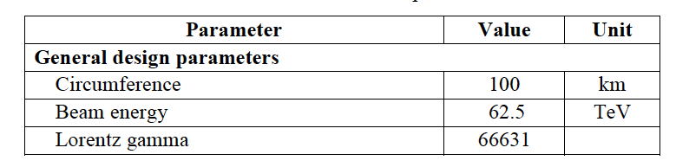
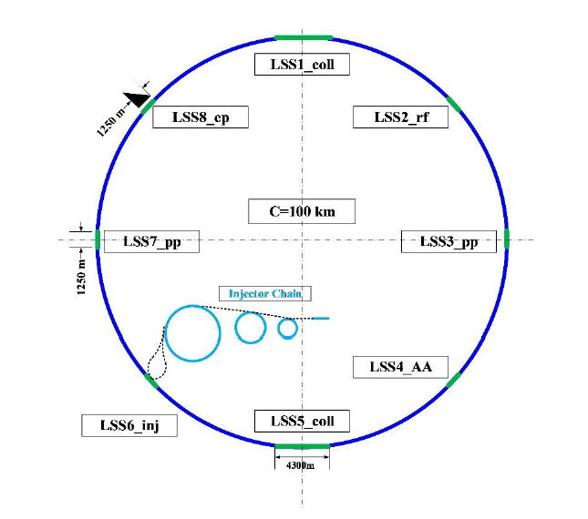
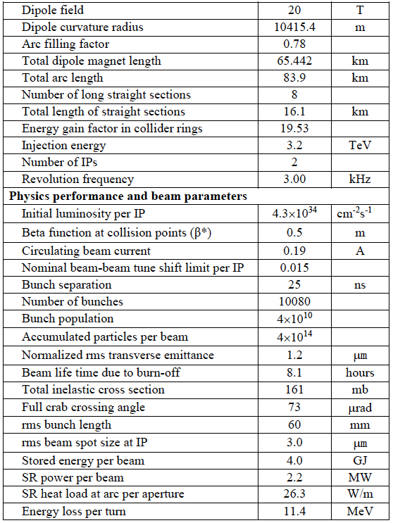
SppC

Slide 21
Impacts of Accelerator Science & Technology Developments

Slide 22
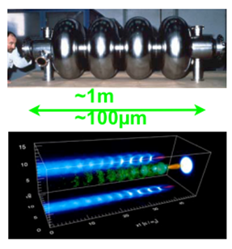
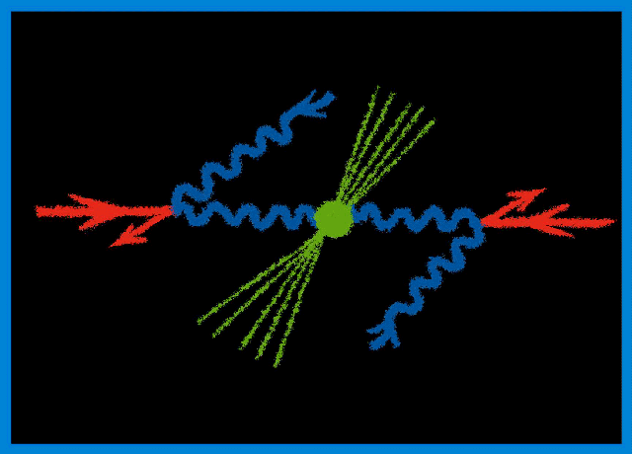
Other LC Possibilities
Advances in conventional cavity technologies
Wakefield Accelerators:
Potential for very high energies
Possibly could be used for LC afterburner
Significant R&D remains
γ−γ: High power laser/FEL beams
Compton backscattered from e⁻ or e⁺ beams
  γγaH cross section ~200fb
  Concept could provide a complementary
  interaction point at an e⁺e⁻ machine –
  or a standalone solution for WFA if cannot
  achieve the desired e⁺ beam parameters

Slide 23
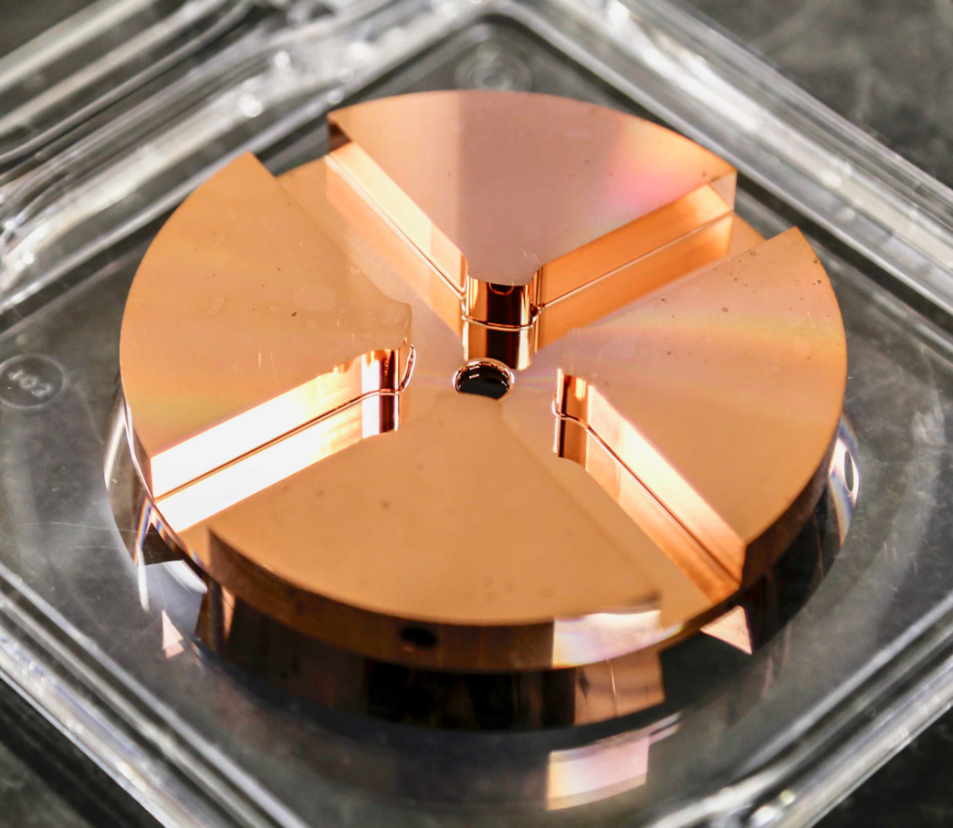
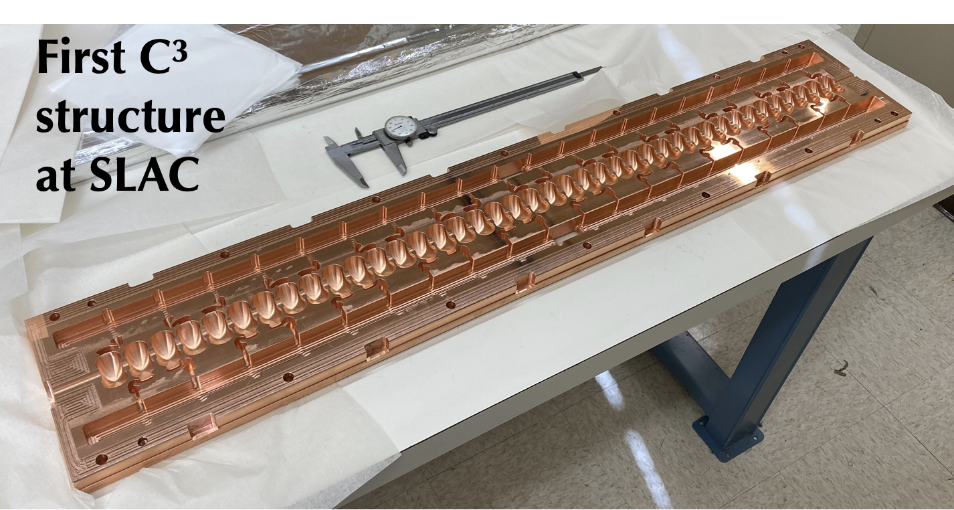
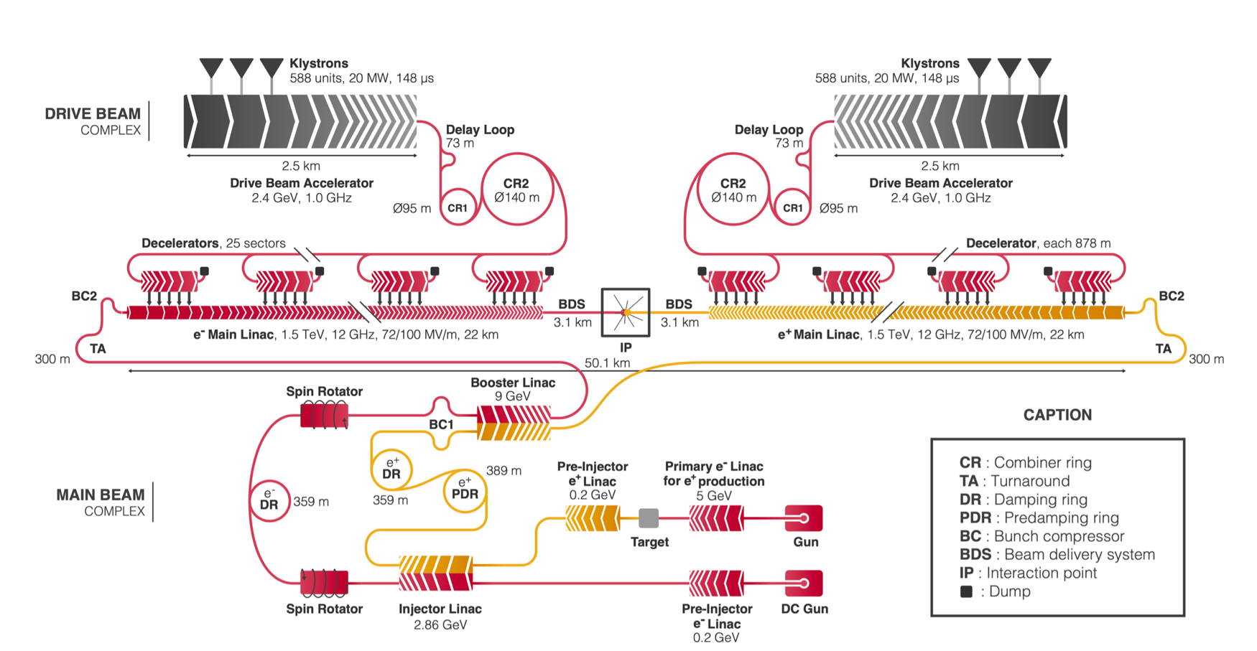
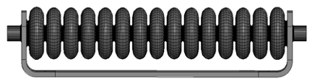
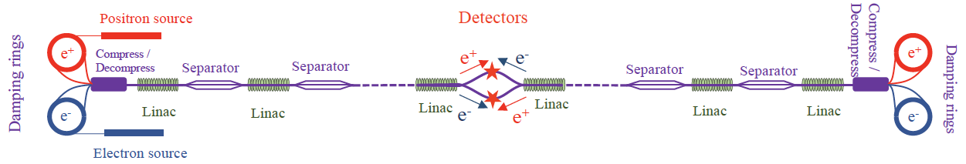
TeV-Class Extensions for
Conventional Linear Colliders
ILC
CLIC

Slide 24
Wakefield Accelerators
Plasma Wakefield Accelerators
  Beam-Driven Plasmas
    Electron Beam Driven – FACET/FACET-II at SLAC
    Proton Beam Driven – AWAKE at CERN
  Laser-Driven Plasmas
    Many facilities operating with near-IR (~1 μm) lasers – e.g. BELLA at LBNL (major efforts underway in Europe and Asia)
    Long-wave IR (~10 μm) lasers benefit from λ-scaling, but less mature – BNL-ATF
Structure-based Wakefield Accelerators (Beam and Laser Driven)
  Dielectrics
  Metamaterials
In all cases, the efficiency with which we can deliver power to the beam is crucial

Slide 25
Selected LWFA Results
>4 GeV single-stage acceleration
in discharge capillary
Optimization of plasma channel to provide ~8 GeV
100 MeV scale staged acceleration Proof of Principle
Leemans et al., Phys. Rev. Lett. (2014)
Gonsalves et al., Phys. Plasmas (2015)
~150 μm FWHM
Gonsalves et al., PRL (2019)
S. Steinke et al., Nature (2016)

Slide 26
Selected PWFA Results
Doche et al., Scientific Reports 2017
9 GeV energy gain
demonstration
Acceleration with e⁺ drive
and witness bunch
Demonstration of Seeded Self Modulation of proton beam at AWAKE
Courtesy P. Muggli, F. Batsch
9 GeV ENERGY
GAIN IN ~1 M
IN PWFA
Nature 2014
PPCF 2015
Doche et al., Scientific Reports 2017

Slide 27
Wakefield Acceleration Comments
Significant research progress has been made over the last 5 years in each of the wakefield accelerator thrusts
Major research programs underway in the US, Europe and Asia
  FACET-II program is underway
  Continued LWFA effort with near-IR laser systems at BELLA and at other facilities around the world
    Long-wave IR studies underway at BNL-ATF
  DWFA activities ongoing at AWA and other world-wide locations
Still a tremendous amount of work needed to lay the groundwork for potential HEP applications
  Support for the R&D effort over the next decade is critical
  No fully self-consistent set of collider parameters presently exists

Slide 28
A 10-TeV Class Muon Collider
A Muon Collider with ≥ 10 TeV CoM Energy
offers a unique pathway to the next physics scale of
interest in our exploration of the Energy Frontier
IP 1
μ⁻
Muon Collider
>10TeV CoM
~10km circumference
Accelerator
Ring
μ Injector
μ⁺
IP 2
4 GeV
Proton
Source
Target, π Decay
& μ Bunching
Channel
μ Cooling
Channel
Low Energy
μ Acceleration
The muon injector chain provides cooled muons with
roughly 100 GeV/c for acceleration to the multi-TeV scale

Slide 29
Parameter Sets for the International MC Collaboration
Performance Aims:
  Achieve the target
  integrated luminosity
  in ~5 years of running
Energy Efficiency
Compare: 28 MW for 3 TeV CLIC

Slide 30
Proton-Driven MC Concept
Short & intense proton
bunches to deliver
hadronic showers
p→π◊μ
◊ bunched
beams
Ionization cooling reduces
the transverse &
longitudinal emittance
Rapid acceleration to
high energy to avoid
μ losses. Multi-pass
acceleration offers
energy efficiency.
Accelerator design is driven by the short muon lifetime

Slide 31
Muon Collider Comments
Muon collider concept is pre-CDR
  Critical concept R&D completed
  Concepts for all sub-systems have been developed
  Ready to move into prototyping and full system R&D/ development phase (~TRL 4-5)
The International Muon Collider Collaboration, hosted by CERN, is now preparing a full baseline design
  Building on conceptual framework pioneered by MAP
  Critical for the US to be able to engage with this effort if we are to fully assess this concept for a future machine

Slide 32
Multi-TeV Concepts From Snowmass
The AF4 evaluation of the maturity level of various concepts. Further details for the evaluation of the various concepts can be found in the “Concept Assessments” Section. The color code is that the concepts shown in blue offer a path to constituent center-of-mass energies >10 TeV, while those shown in orange are electron-hadron machines, and those shown in black are lepton collider concepts which will reach only into the 1-few TeV range.

Slide 33
Conclusion
The HEP accelerator landscape:
  As the field takes its next steps, we have a set of options based on conventional technologies that have a clearly defined technical path forward
    Particularly for a Higgs Factory
    Unfortunately, no future collider can be considered low cost
  BUT there is great potential in advanced concepts currently under development
  The Livingston plot in the 20th century, along with the HEP discoveries/measurements that resulted from HEP accelerators, was constantly driven by transformational improvements in accelerator technology
3 key takeaways for the MC community:
  Each of the concepts that can help us push back the energy frontier relies on at least one major technology (and typically several) that is at a low technology readiness level
  a The field can’t yet make a reliable choice!
  Continued R&D towards the next transformation is required if we want to have new HEP collider options for the particle physics (US & international) community
  This is a competitive environment with multiple options under study
  a It is critical to fully & rapidly develop the case (accelerator + detector + physics)
  for a Muon Collider if we want it to emerge as the winning concept!

Slide 34
Thank you for your attention

Slide 35
Additional Slides

Slide 36
Cool Copper Collider – Advances in Cu Cavity Technology
Concept that could be
deployed on the FNAL
site
Key extension of copper cavity parameter space
Leverages extensive NLC and ILC design experience
Relies on LN₂ cryogenics instead of LHe

Slide 37
Cool Copper Collider Parameters

Slide 39
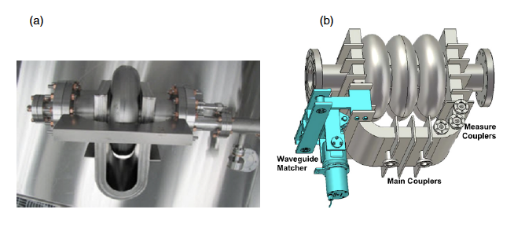
Advances in SRF Cavities
ILC Traveling Wave Structures
Traveling Wave Structures –
Considerable development remaining
Provide route to more than doubling the ILC baseline of 31.5 MV/m to ~70 MV/m
Could deliver a 3 TeV ILC
Nb₃Sn Cavities –
Offer a nominal limit of 95 MV/m

Slide 40
Energy Frontier
Lepton Collider
An Energy Frontier
Muon Collider
Currently being pursued
by the International Muon
Collider Collaboration
Emerging Options
  Muon Collider with strong dependence on advanced magnet technology
  Wakefield Acceleration
    Laser-Driven Plasma
    Beam-Driven Plasma
    Beam-Driven Structure
LWFA
PWFA
SWFA

Slide 41
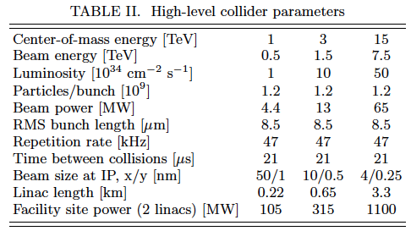
Target Parameters for a Wakefield Accelerator
Key elements of a machine remain at the initial demonstration stage
An integrated design effort is required in order to fully evaluate the potential of these
technologies
  Integrated design to evaluate beam transport and emittance preservation
    Full study of staging
  A beam delivery scheme capable of delivering both e⁻ and e⁺ is necessary
  IP parameters appear challenging
    Tolerances
    Stability
  Power requirements for a single-pass collider remain quite challenging
Investment required to carry out the required evaluations
Alternative: use high energy e⁻ beams to deliver a γγ option

Slide 42
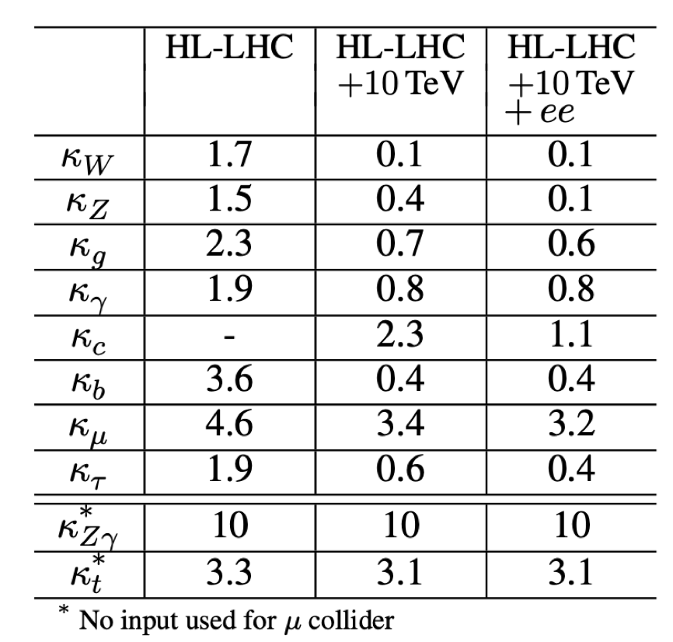
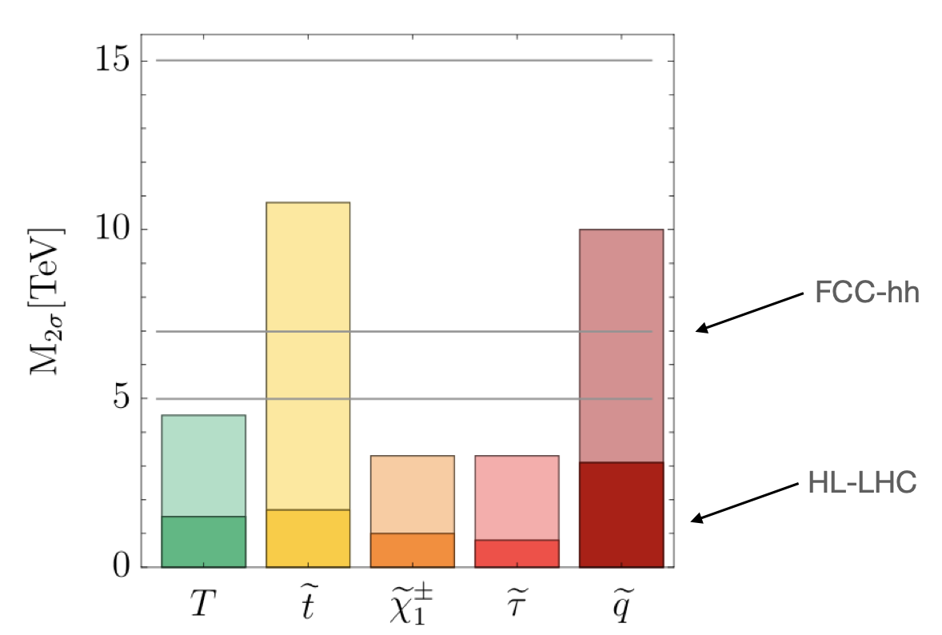
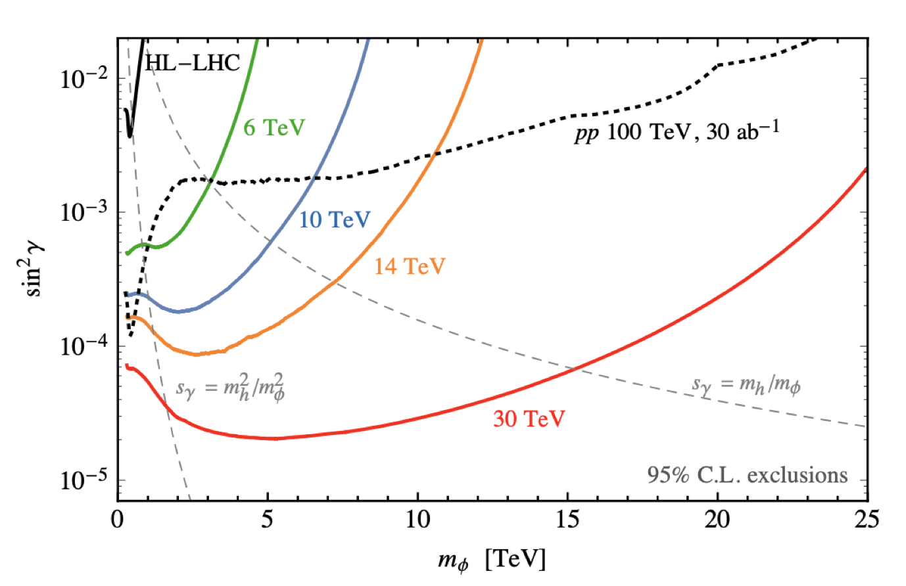
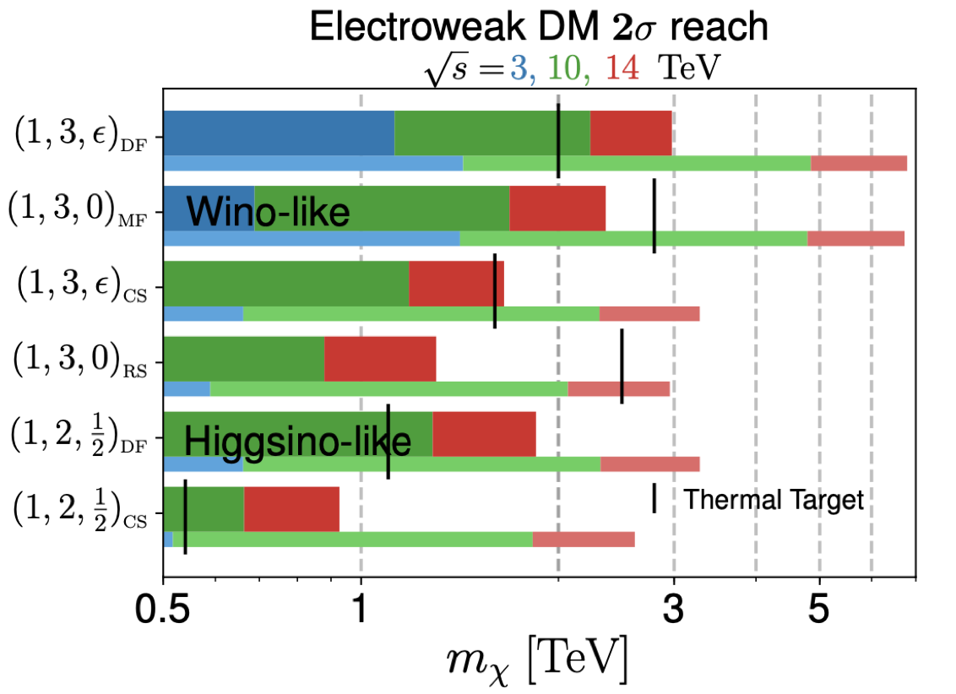
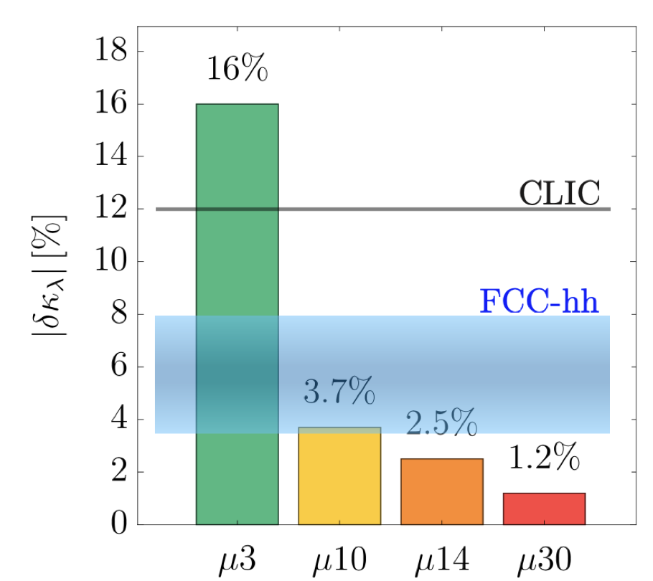
Physics Reach of a 10 TeV Muon Collider
10 TeV MC
Direct production at higher scales –
strongly motivated targets up to 10 TeV
Qualitatively improved reach into
Higgs Portal
Order of magnitude
in Higgs precision
and
can directly probe
the scale implied
in same machine!
Courtesy
Patrick Meade (SBU)
Covers simplest WIMP candidates –
hard or impossible with next generation DM direct detection
Turn Higgs potential into precision science
(e.g., needed for EW
phase transition)

Slide 43
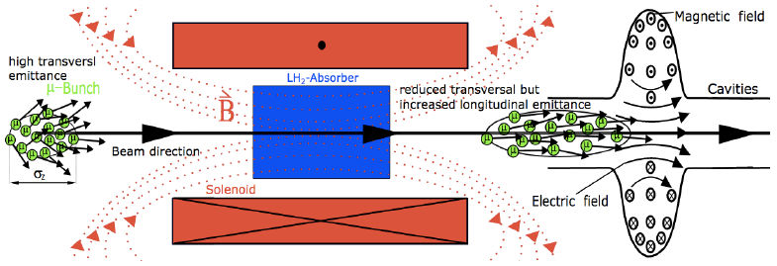
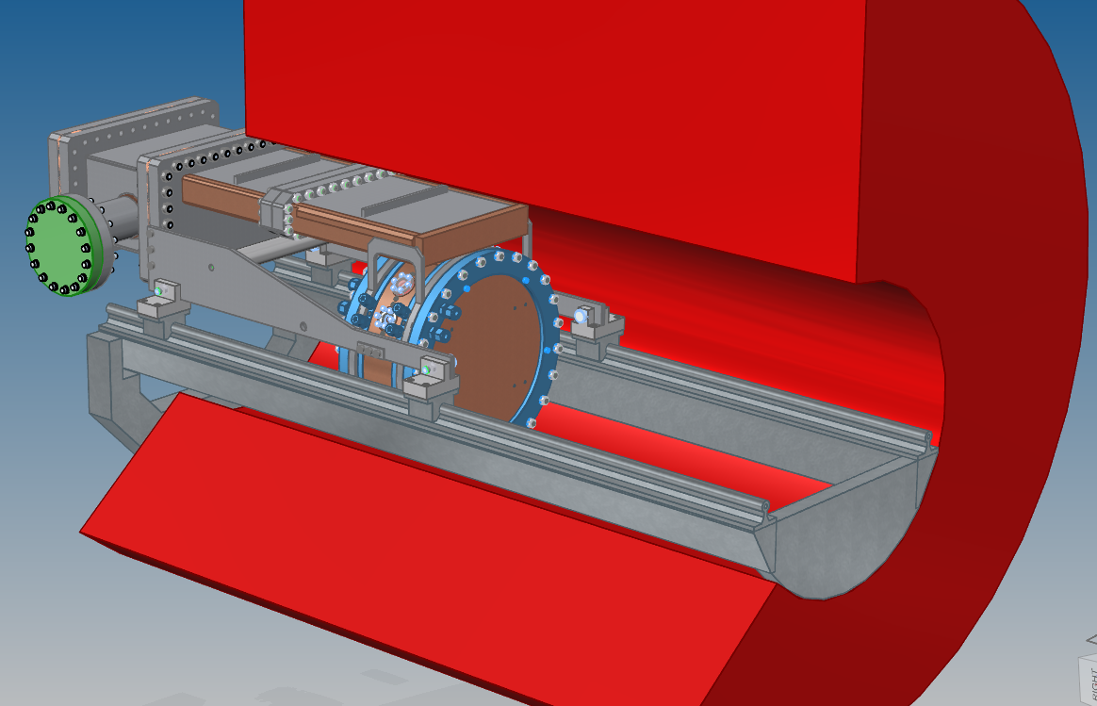
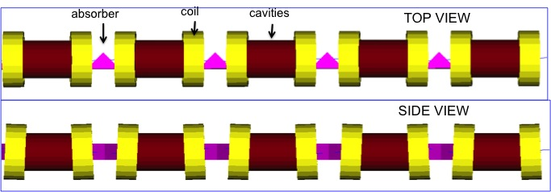
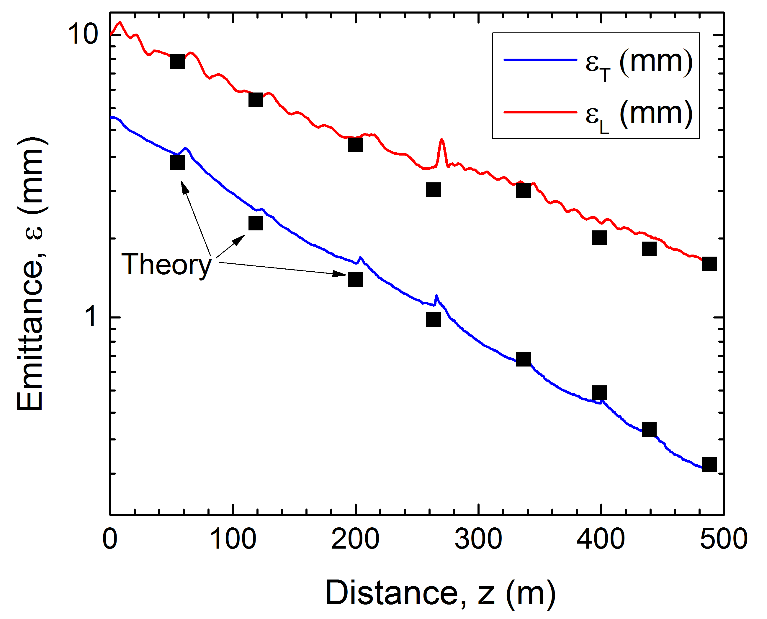
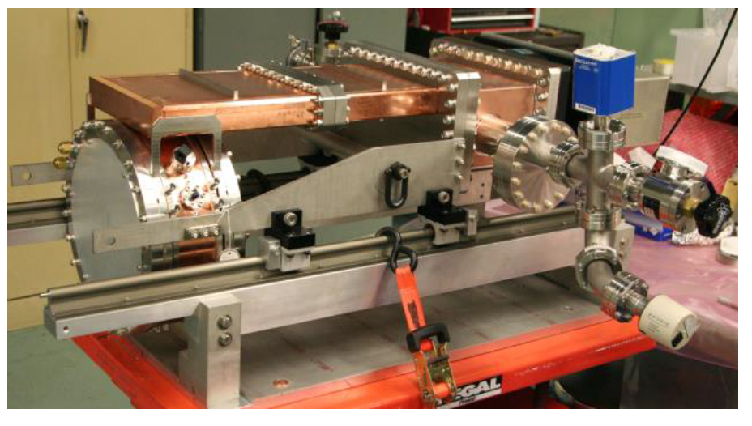
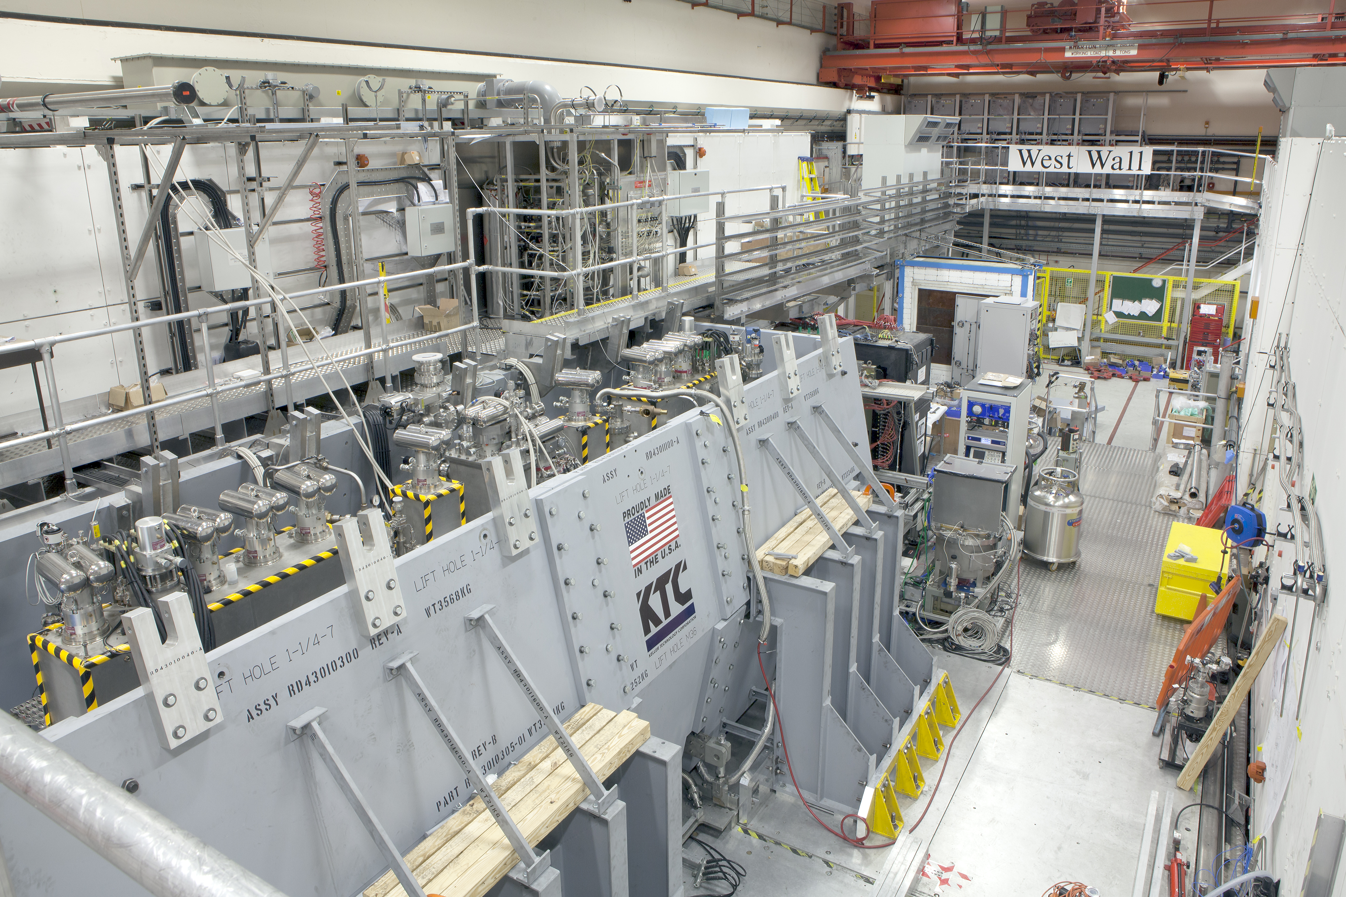
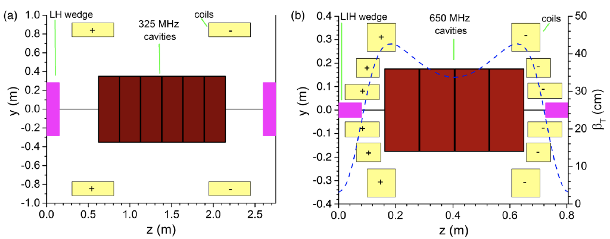
What has changed? Concept Maturity
One Example: Ionization Cooling
Cooling designs with good performance and significant
room for improvement based on recent R&D
Rectilinear Cooling Channel – PRSTAB 18, 031003 (2015)
>50MV/m operation
in up to 5 T B-field
MICE Cooling Channel
MICE Demo of
Ionization Cooling
Nature 578, 53–59 (2020)
RF in Magnetic Fields
~2.5x improvement over
current designs
Phys. Rev. Accel. Beams 23, 072001
2018 JINST 13 P01029

