Slide 1
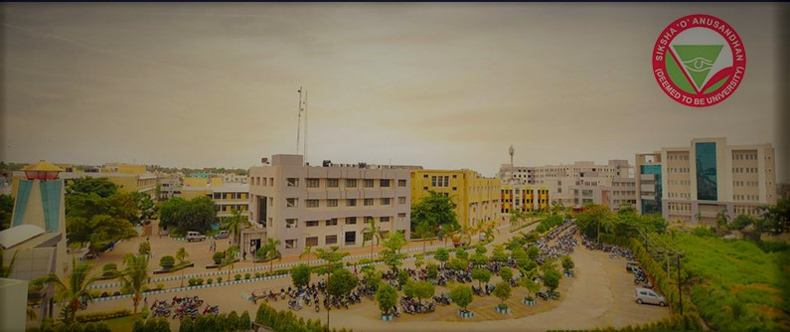
Lepton Mass Effect in
Semileptonic Bc Meson Decays
WHEPP-2019 (IIT GUWAHATI)
Sonali Patnaik
Guided by- Prof. Purendra Ch. Dash

Slide 2
INTRODUCTION
The description of physical phenomena such as the decay processes have not yet been possible from the first principle QCD application which involves strong interaction between quarks and antiquarks.
Theoretical attempts have been made to describe hadronic phenomena using various phenomenological models like Bag Model, Cloud Bag Model, LFQM, Bethe-Salpeter approach, QCD Sum Rule, and Non-relativistic and Relativistic Model etc. Ours is a Relativistic Independent Quark (RIQ) Model.
Last 35 years we have established this phenomenological model describing wide ranging hadronic phenomena.

Slide 3
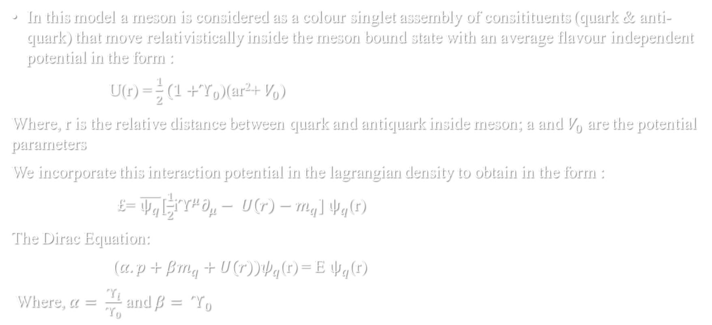
Relativistic independent quark model

Slide 4

Solving the Dirac equations we get positive and negative energy solutions known as quark and antiquark orbitals respectively in the general form:
$ψ_{nlj}^{+}(\vec{r}$)=$\left(\begin{aligned}\frac{ig_{nlj}\left(r\right)}{r} \\ \vec{(σ.}\hat{r})\frac{f_{nlj}\left(r\right)}{r}\end{aligned}\right)φ_{ljmj}$($\hat{r})$
$ψ_{nlj}^{−}(\vec{r}$)= $\left(\begin{aligned}i\vec{σ.}\frac{\hat{r }f_{nj}\left(r\right)}{r} \\ g_{nlj}(r)/r\end{aligned}\right){(−1)}^{j+m_{j}−l}φ_{ljmj}$($\hat{r})$
Where , $g_{nlj}\left(r\right)$=N_{q}${\left(\frac{r}{r_{nl}}\right)}^{l+1}e^{{{−r}^{2}}/{{2r}_{nl}^{2}}}{ L}_{n−1}^{l+1/2}\left(\frac{r2}{r_{nl}^{2}}\right)$
and $f_{nlj}\left(r\right)$= -N_{q}$\frac{1}{r_{nl}λ_{nl}}{\left(\frac{r}{r_{nl}}\right)}^{l+2}e^{{{−r}^{2}}/{{2r}_{nl}^{2}}}{ [ L}_{n−2}^{l+3/2}\left(\frac{r2}{r_{nl}^{2}}\right)$ +${ L}_{n−1}^{l+3/2}\left(\frac{r2}{r_{nl}^{2}}\right) ]$

Slide 5

The condition required to be satisfied in obtaining these quark orbitals is binding energy condition i.e
$\sqrt{{λ_{nl}}/a}$ ($E_{nl}^{,}$ - m,) = (4n+2l – 1) where ${E′}_{q}^{}$= E - $V_{0}$/2 and ${m′}_{q}^{}$ = m - $V_{0}$/2
Which for the ground state (n=1 and l=0) is reduced to the form:$\sqrt{{λ_{10}}/a}$ ($E_{10}^{,}$ - m,) = 3
The solutions in ground state can be written as
$ψ_{q}^{+}(\vec{r}$) =$\frac{1}{\sqrt{4π}}\left(\begin{aligned}\frac{ig_{q}\left(r\right)}{r} \\ \vec{(σ.}\hat{r})\frac{f_{q}\left(r\right)}{r}\end{aligned}\right)$χ_{λ}
$ψ_{q}^{−}(\vec{r}$) = $\frac{1}{\sqrt{4π}}\left(\begin{aligned}i\vec{(σ.}\hat{r})\frac{f_{q}\left(r\right)}{r} \\ g_{q}(r)/r\end{aligned}\right)\tilde{\text{χ}\text{λ}}$
Here χ_{λ}and $\tilde{\text{χ}\text{λ}}$ stand for $χ_{↑}$=$\left(\begin{matrix}1 \\ 0\end{matrix}\right)$, $χ_{↓}$=$\left(\begin{matrix}0 \\ 1\end{matrix}\right)$ and $\tilde{χ_{↑}}$=$\left(\begin{matrix}0 \\ −i\end{matrix}\right)$ ,$\tilde{χ_{↓}}$=$\left(\begin{matrix}i \\ 0\end{matrix}\right)$
$g_{q}\left(r\right)$=N_{q}${\left(\frac{r}{r_{0q}}\right)}^{2}e^{\left({{−r}^{2}}/{{2r}_{0q}^{2}}\right)}$
$f_{q}\left(r\right)$= - $\frac{\text{N}\text{q}}{λ_{q}r_{0q}}{\left(\frac{r}{r_{0q}}\right)}^{2}e^{\left({{−r}^{2}}/{{2r}_{0q}^{2}}\right)}$
$N_{q}^{2}$ = $\frac{8λ_{q}}{r_{0q}\sqrt{π }}\frac{1}{\left(3E_{q}^{՚}+m_{q}^{՚}\right)}$

Slide 6
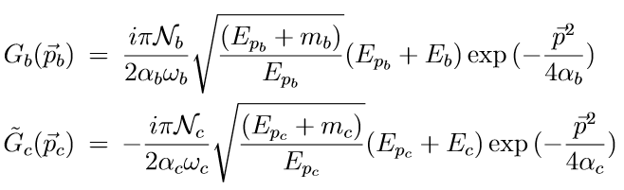
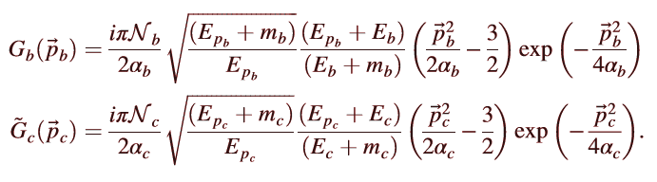
Momentum Probability Amplitudes

Slide 7
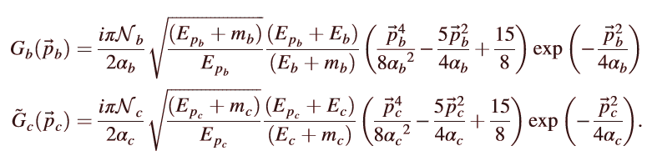

Using the momentum probability amplitudes for quarks and antiquarks we write the momentum profile function for meson as :

Slide 8

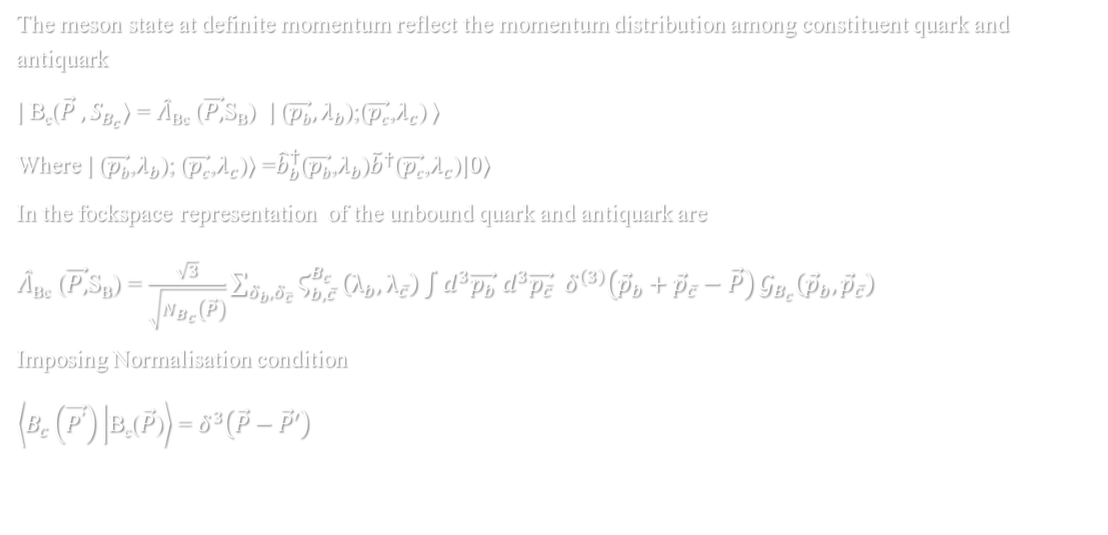
Meson states and NorMalization
The meson state at definite momentum reflect the momentum distribution among constituent quark and antiquark
$|$B_{c}($\vec{P} , S_{B_{c}}⟩$ = $\hat{Λ}$_{Bc} ($\vec{P,}$S_{B}) $|$($\vec{pb},λ_{b}$);($\vec{pc}$,$λ_{c}$) $⟩$
Where $|$($\vec{pb}$,$λ_{b}$); ($\vec{pc}$,$λ_{c}$)$⟩$ =${\hat{b}}_{b}^{†}$($\vec{pb}$,$λ_{b}$)${\tilde{b}}^{†}$($\vec{pc}$,$λ_{c}$)$|0⟩$
In the fockspace representation of the unbound quark and antiquark are
$\hat{Λ}$_{Bc} ($\vec{P,}$S_{B}) = $\frac{\sqrt{3}}{\sqrt{N_{B_{c}}\left(\vec{P}\right)}}\sum_{δ_{b},δ_{\overline{c}}}{Ϛ_{b,\overline{c}}^{B_{c}}}\left(λ_{b},λ_{\overline{c}}\right)\int{d^{3}\vec{p_{b}}{ d}^{3}\vec{p_{\overline{c}}}{ δ}^{\left(3\right)}\left({\vec{p}}_{b}+{\vec{p}}_{\overline{c}}−\vec{P}\right)}𝒢_{B_{c}}\left({\vec{p}}_{b},{\vec{p}}_{\overline{c}}\right)$
Imposing Normalisation condition
$\left\langle B_{c}\left(\vec{P^{՚}}\right) | \text{B}\text{c}\text{(}\vec{P}\text{)}\right\rangle$ = $δ^{3}\left(\vec{P}−\vec{P}′\right)$

Slide 9
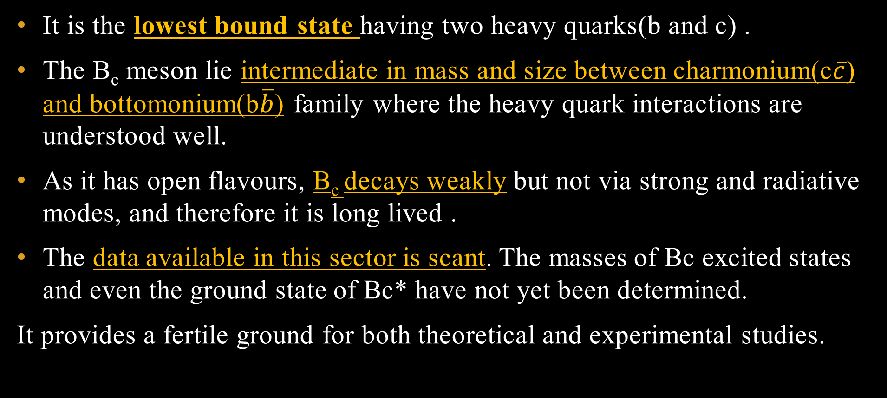
Why B_{c} DECAYS ?
It is the lowest bound state having two heavy quarks(b and c) .
The B_{c} meson lie intermediate in mass and size between charmonium(c$\overline{c}$) and bottomonium(b$\overline{b}$) family where the heavy quark interactions are understood well.
As it has open flavours, B_{c} decays weakly but not via strong and radiative modes, and therefore it is long lived .
The data available in this sector is scant. The masses of Bc excited states and even the ground state of Bc* have not yet been determined.
It provides a fertile ground for both theoretical and experimental studies.

Slide 10
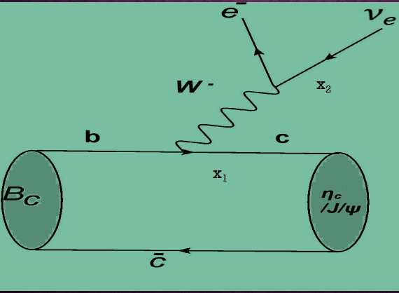

$$B_{c} → η_{c}, {J/}_{Ψ} e θ_{e}$$

Slide 11
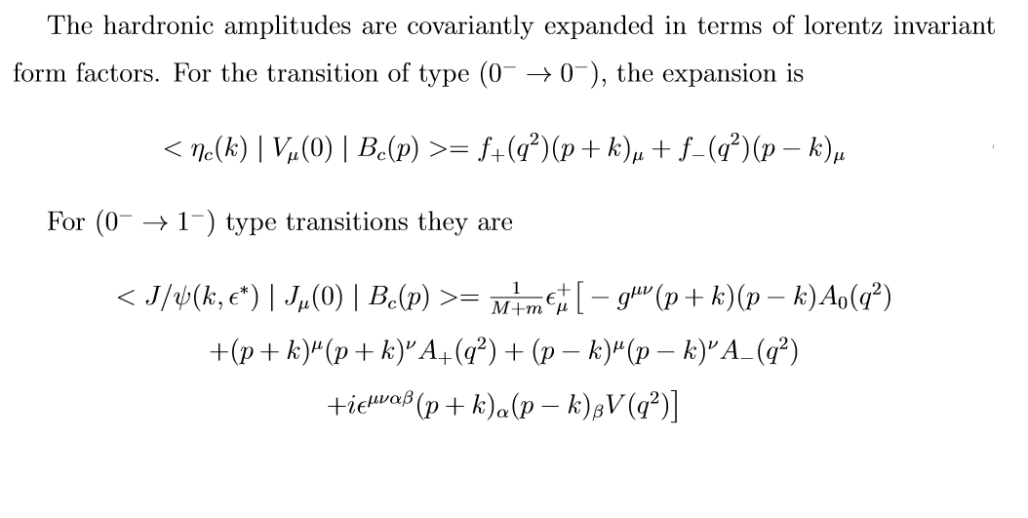
FORMFACTOR COVARIANT EXPANSION

Slide 12

S_{fi}= ${\left(2π\right)}^{4}δ^{4}\left(p−k−k_{1}−k_{2}\right)\frac{\left(−M_{fi}\right)}{\sqrt{{\left(2π\right)}^{3}2M{\left(2π\right)}^{3}2E_{k}{\left(2π\right)}^{3}{2E_{k_{1}}\left(2π\right)}^{3}2E_{k_{2}}}}$
$M_{fi}$= $\frac{{−G}_{F}}{\sqrt{2}}V_{q_{1}q_{1}^{,}}H^{μ} L_{μ}^{l}$
where $H^{μ}$= $\sqrt{\frac{{4ME}_{k}}{N\left(\vec{k}\right)N\left(\vec{p}\right)}}\int{\frac{d^{3}p_{1}}{\sqrt{2E_{p_{1}}2E_{\left(\vec{k}−\vec{P}+\vec{P_{1}}\right)}}}}\sum_{q_{1}q_{1}^{,}q_{2}}{Ϛ_{q_{1}^{,}q_{2}}}\left(λ_{1}^{,}λ_{2}\right)Ϛ_{q_{1}^{}q_{2}}\left(λ_{1}^{}λ_{2}\right)$
$$𝒢_{M}\left(\vec{K}−\vec{P}{+\vec{P}}_{1},\vec{P}−{\vec{P}}_{1} \right)𝒢_{M}\left({\vec{P}}_{1},\vec{P}−{\vec{P}}_{1} \right)$$
and$L_{μ}^{l}$=$\overline{U}\left(k_{e},δ_{e}\right)Γ_{μ}$V$\left(k_{ν},δ_{ν}\right)$
$${\left|M_{fi}\right|}^{2}=\frac{{G_{F}}^{2}}{2}V_{q_{1}q_{1}^{,}}H^{μθ}L_{μθ}^{l}$$

Slide 13
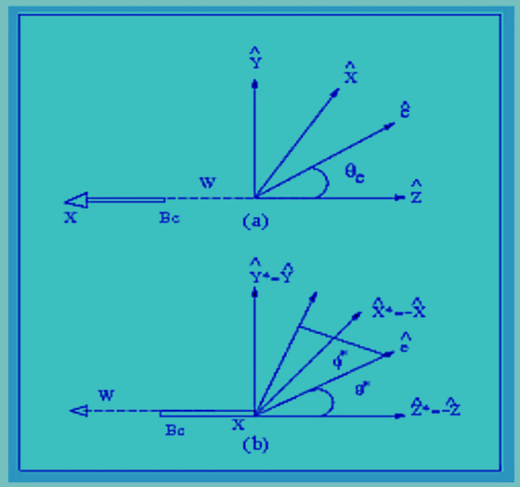
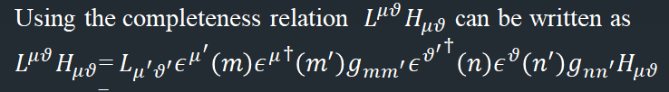
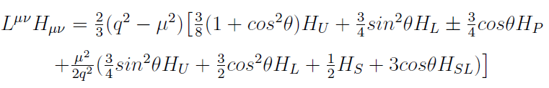
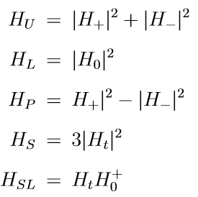
Lepton Hadron correlation function & Helicity components
Lepton rest frame
Vector meson helicity frame

Slide 14
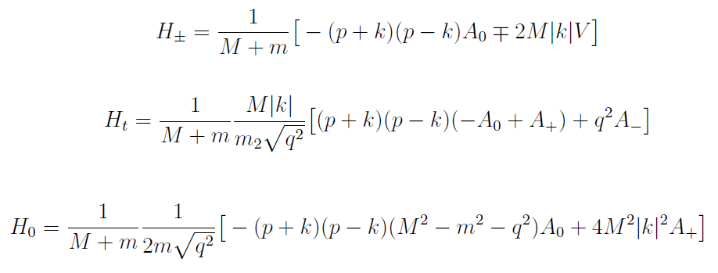
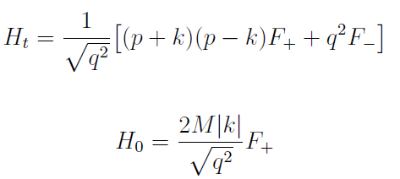
Helicity Amplitudes for Vector & Psuedoscalar meson

Slide 15
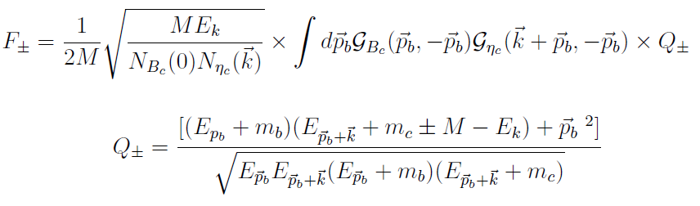
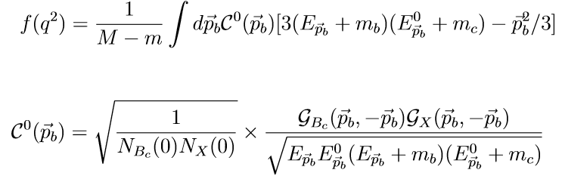
FORMFACTORS FOR PSUEDOSCALAR AND VECTOR MESON

Slide 16
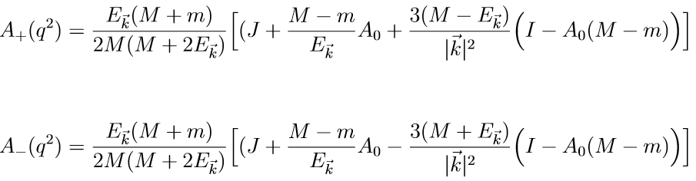
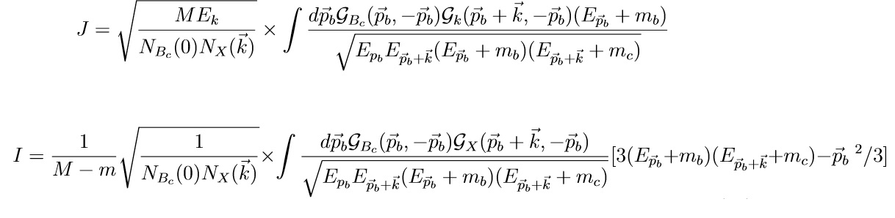

Slide 17

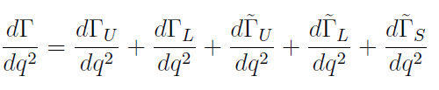
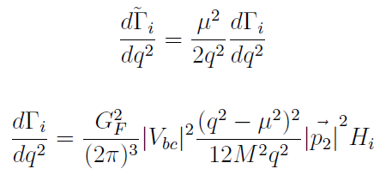
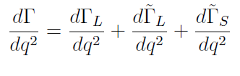
Partial decay width for the transitions
For vector meson:
: FOR PSEUDOSCALAR MESON:
Where I = U, L, P, S, SL given by linear combination of helicity amplitudes

Slide 18
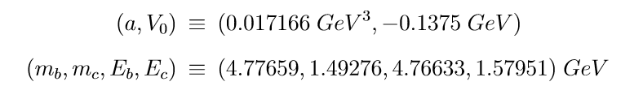
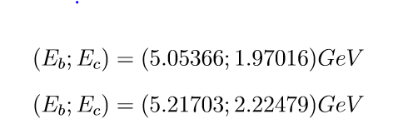
MODEL PARAMETERS
For ground state we take the quark masses, corresponding binding energies and potential parameters:
For 2s and 3s states respective quark masses, binding energies and potential parameter is
-0.01545 GeV

Slide 19
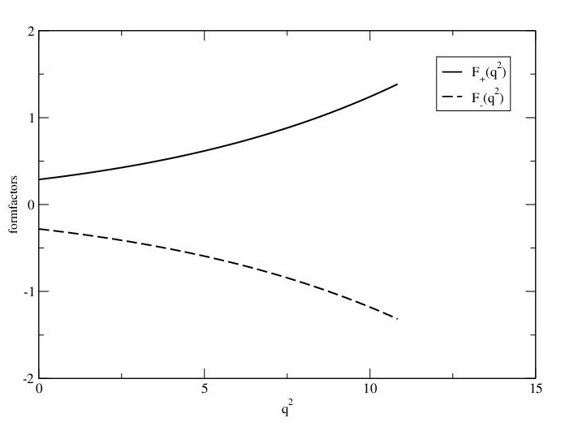
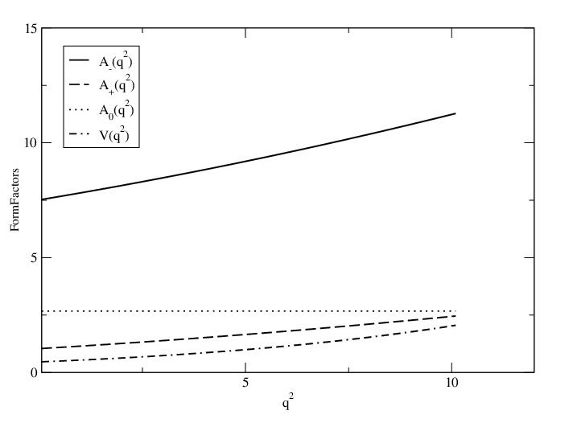
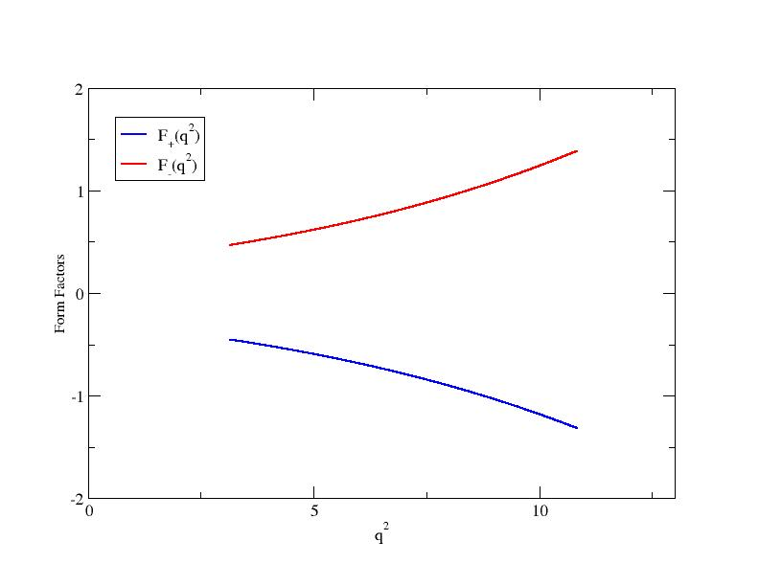
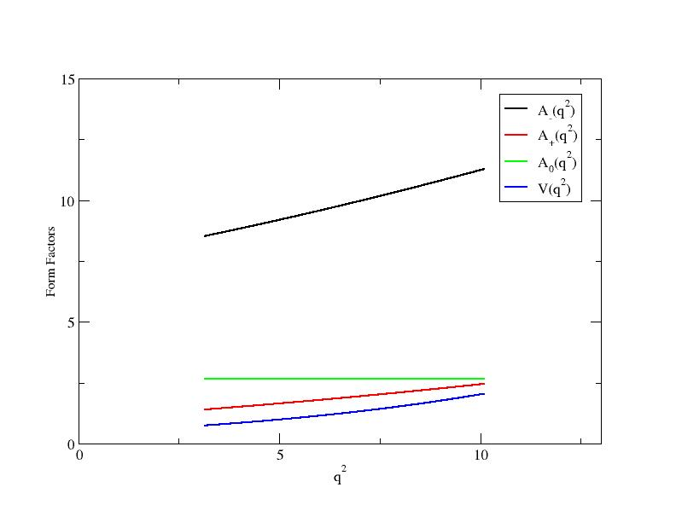
q² dependence of the form factorS

Slide 20
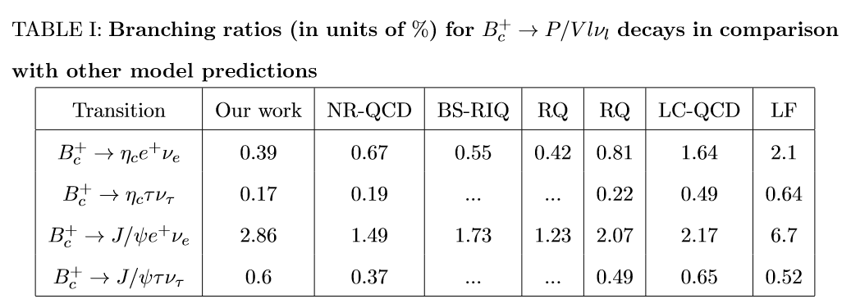
COMPARISON WITH OTHER MODEL PREDICTIONS

Slide 21
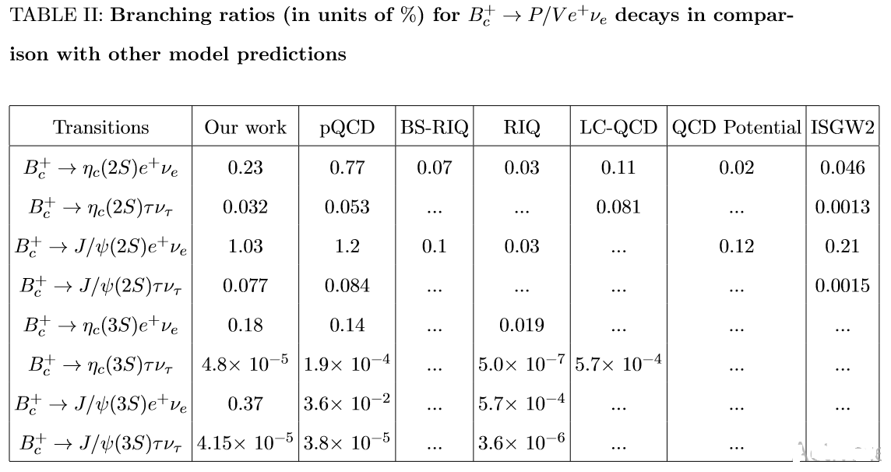

Slide 22
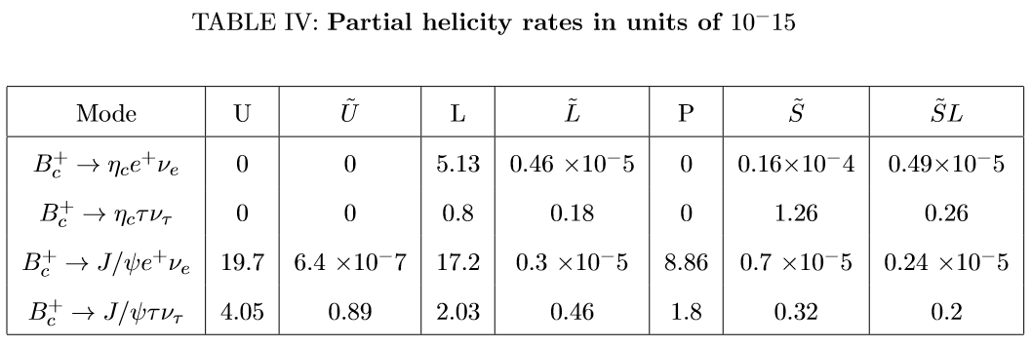
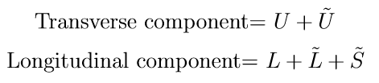
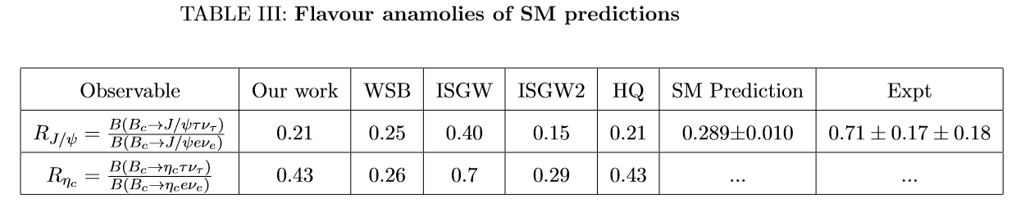

Slide 23

CONCLUSION
Prediction of BR in S-wave in ground and excited states are in good agreement with other model predictions.
We also investigated the $q^{2}$ dependence of relevant form factors and found that the formfactors are becoming larger with increasing $q^{2}$.
The $τ$ mode is generally down ($\sim$10 order) than the e mode.
For the transition, , $0^{−}$ $→1^{−}$ the transverse mode dominates by a factor of $\sim$ 8 for both the electron and tau mode.
For the transition, $0^{−}$ $→$ $0^{−}$ is more sensitive to lepton mass effects due to strong scalar current excitations.
The charge current anamoly observables $R_{j/Ψ}$ in this RIQ model is in good agreement with SM predictions and 2$σ$ down with the LHCb data.

Slide 24
                THANK YOU

Slide 25
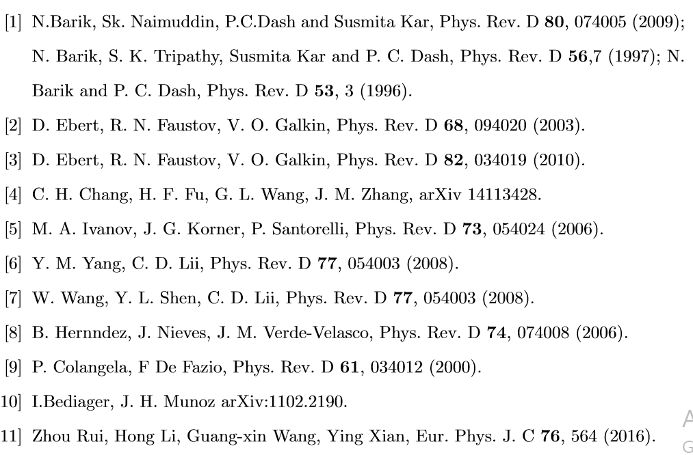
REFERNCES

Slide 26
SUMMARY & FUTURE WORK
We have predicted the electromagnetic and weak decay of Bc meson in reasonable agreement with other standard model predictions.
Of course in some cases there have been disagreements with other model predictions, which is due to inherent constraints of all model dependent (phenemenological) studies.
The future experiemnts ( LHC, Z-factory, Tevatron etc) can only infer the efficacy of our model .
Currently we extend our model application to study the effect lepton mass on semi-leptonic decay modes of Bc meson.
In extension I have also planned to undertake the non-leptonic decay of heavy flavored meson in the framework of RIQ model.

Slide 27

LIST OF PUBLICATION
Sonali Patnaik, P.C.Dash, Susmita Kar and N.Barik; Magnetic dipole transitions of Bc mesons, Phys. Rev. D 96, 116010 (2017).
Sonali Patnaik, P.C.Dash, Susmita Kar and N.Barik; Electromagnetic transitions of b$\overline{c}$ bound systems, Phys. Rev. D 97, 056025 (2018) .
Sonali Patnaik, Lopamudra Nayak, P.C.Dash, Susmita Kar and N.Barik; Semi-leptonic decays of Bc meson to charmonium states, (communicated to Phys. Rev. D)

Slide 28
conferences attended
Presented a poster in the 16th Conference on Flavor physics and CP Violation (FPCP 2018) during 14th-18th July 2018 held at Univ. of Hyderabad.
Delivered a talk in International Meeting on High Energy Physics (IMHEP 2019) during 17th -22nd January 2019 at IOP BBSR.

Slide 29
WORK TIMELINE
Months 0 - 6 | Coursework
Months 7 – 12 | Coursework, Literature survey & identification of problem
Months 13 – 15 | Study on RIQ Model.
Months 16– 19 | Study on magnetic dipole transition
Months 20 – 21 | Result analysis, manuscript preparation & submission
Months 22 – 25 | Study on electromagnetic decay
Months 26 – 27 | Result analysis, manuscript preparation & submission
Months 28 – 33 | Study on semileptonic decay in vanishing lepton mass limit
Months 34 – 36 | Result analysis, manuscript preparation & submission
Months 37 – 40 | Study on semileptonic decay in non- vanishing lepton mass limit
Months 41 - 42 | Result analysis, manuscript preparation & submission
Months 43 – 48 | Thesis preparation & submission

Slide 30
RESULTS
 | TOTAL REGION |  |  | REGION--I |  |  | REGION--II
 | 1s | 2s | 3s | 1s | 2s | 3s | 1s | 2s | 3s
Decay width | 2.96725266E-014 | 1.11309856E-014 | 4.55658688E-015 | 1.19438478E-014 | 4.9020167E-015 | 2.39613021E-015 | 1.74545798E-014 | 6.01389562E-015 | 2.07185721E-015
Branching ratio | 0.0229910566 | 0.00862458136 | 0.00353056376 | 0.00925440847 | 0.0037982119 | 0.00185658492 | 0.013524269 | 0.00465972503 | 0.00160532964
Longitudinal width | 9.93047888E-015 | 5.11037581E-015 | 2.55476691E-015 | 4.46441771E-015 | 2.64390696E-015 | 1.62960918E-015 | 5.37487198E-015 | 2.36547907E-015 | 8.74460549E-016
Transverse width | 1.19438478E-014 | 6.02060976E-015 | 2.00181997E-015 | 7.47943011E-015 | 2.25810974E-015 | 7.66521026E-015 | 1.20797078E-014 | 3.64841655E-015 | 1.19739666E-015
Ratio-lt | 0.503011594 | 0.84881366 | 1.27622211 | 0.596892764 | 1.17084963 | 2.12598106 | 0.444950497 | 0.64835773 | 0.730301477

Slide 31
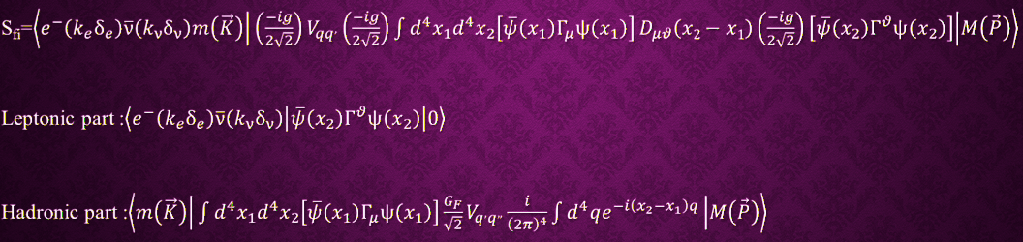
S-MATRIX AND INVARIANT TRANSITION AMPLITUDE

