Slide 1
Status of ILC
Yasuhiro Okada
Executive Director
High Energy Accelerator Research Organization (KEK)
WHEPPP XVI
December 5, 2019, IIT Guwahati, India

Slide 2
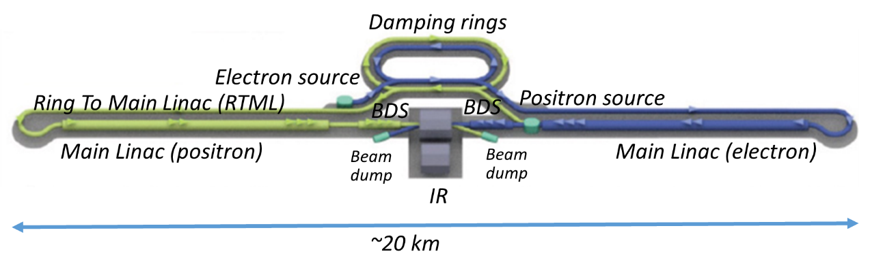
International Linear Collider (ILC)
The next energy-frontier electron-positron collider to explore physics laws in the early Universe.
Collisions of 125 GeV electrons and positrons
in a 20 km tunnel. (250 GeV ILC)
It can produce a large number of the Higgs particles (a Higgs factory).
It has a good potential to discover new particles/phenomena such as dark matter particles.

Slide 3
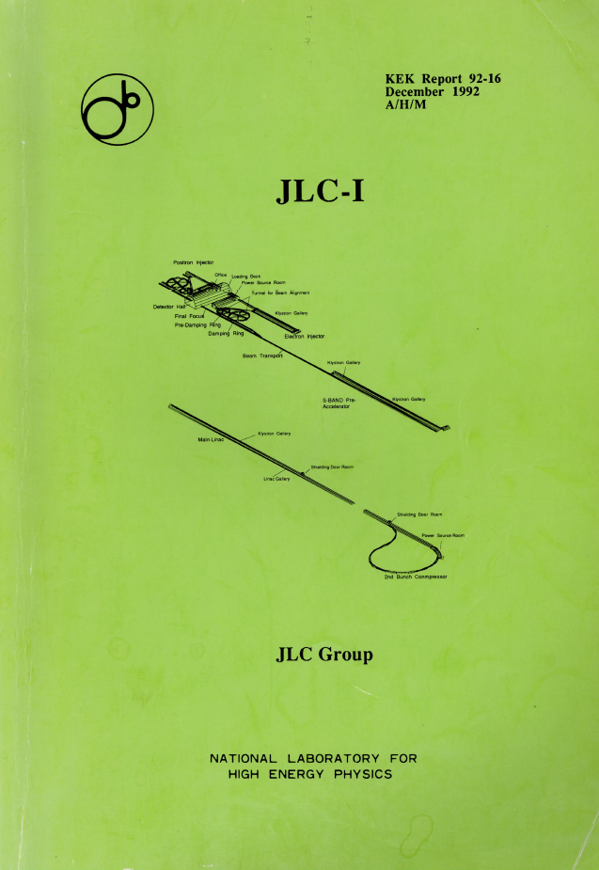
A long history of Linear Collider physics study
JLC-I
December 1992
(before the discovery of the Top quark)

Slide 4
GLC Project proposed by the Asian Community
GLC Project
September 2003
(before the discovery of the Higgs boson)

Slide 5
ILC since 2004
ICFA chose the cold technology for LC as a global project in 2004, and set up a global team (GDE) for design and coordination of R&D for the ILC.
TDR of the ILC was published in June 2013. ICFA set up the Linear Collider Collaboration for engineering design phase.

Slide 6
LC promotion structure in ICFA
FALC
Chair: M. Procario
ICFA
Chair: G.Taylor
LCB
Chair: T. Nakada
KEK Planning Office for the ILC
LCC
LCC Director
Lyn Evans
Deputy
Hitoshi Murayama
CLIC
Collaboration
Public Relations
ILC
Associate Director:
Shin Michizono
CLIC
Associate Director: Steinar Stapnes
Physics & Detectors
Associate Director:
Jim Brau

Slide 7
ILC site candidate location in Japan: KItakami
A site -specific design has proceeding since then.

Slide 8
Recent history of ILC in Japan
In October 2012, after the discovery of the Higgs boson at LHC, Japanese HEP community proposed to host the ILC in Japan as a global project. This proposal was welcomed by the HEP communities across the world. Ex. European Strategy for Particle Physics Update 2013, US P5 Report (2014), ICFA and ACFA statements.
MEXT set up the ILC Advisory Panel in May 2014.
Japanese HEP community proposed to construct the ILC as a 250GeV Higgs factory. This proposal was strongly endorsed by LCB/ICFA (November 2017).
MEXT’s ILC Advisory Panel report (July 2018), SCJ ILC committee’s report (December 2018).
March 2019: MEXT presented its view with regard to the ILC project at the LCB meeting in Tokyo. Also, ILC Federation of Diet Members presented supplemental message to the LCB.
MEXT= Ministry of Education, Culture, Sports, Science & Technology in Japan
SCJ=Science Council of Japan

Slide 9
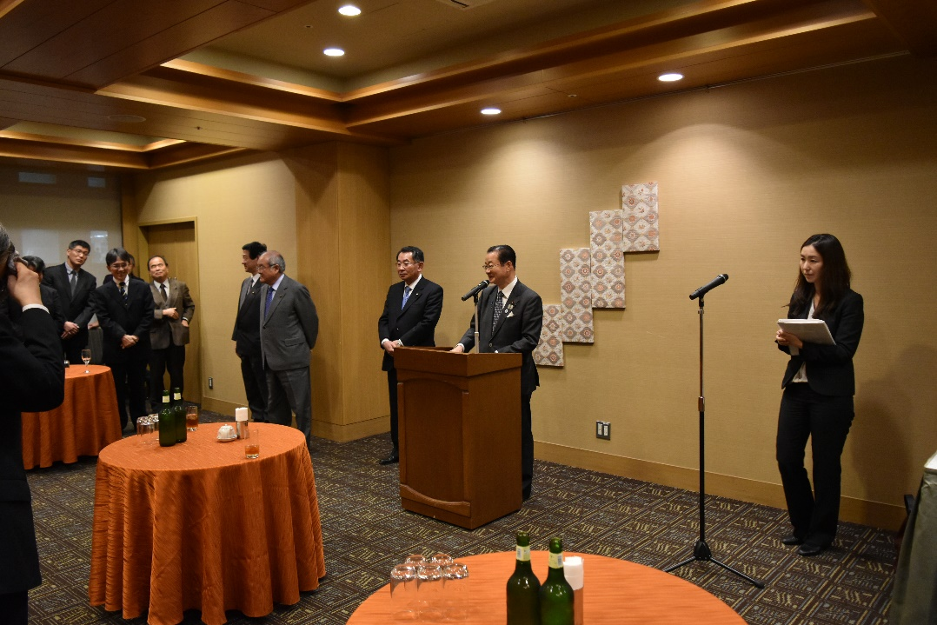
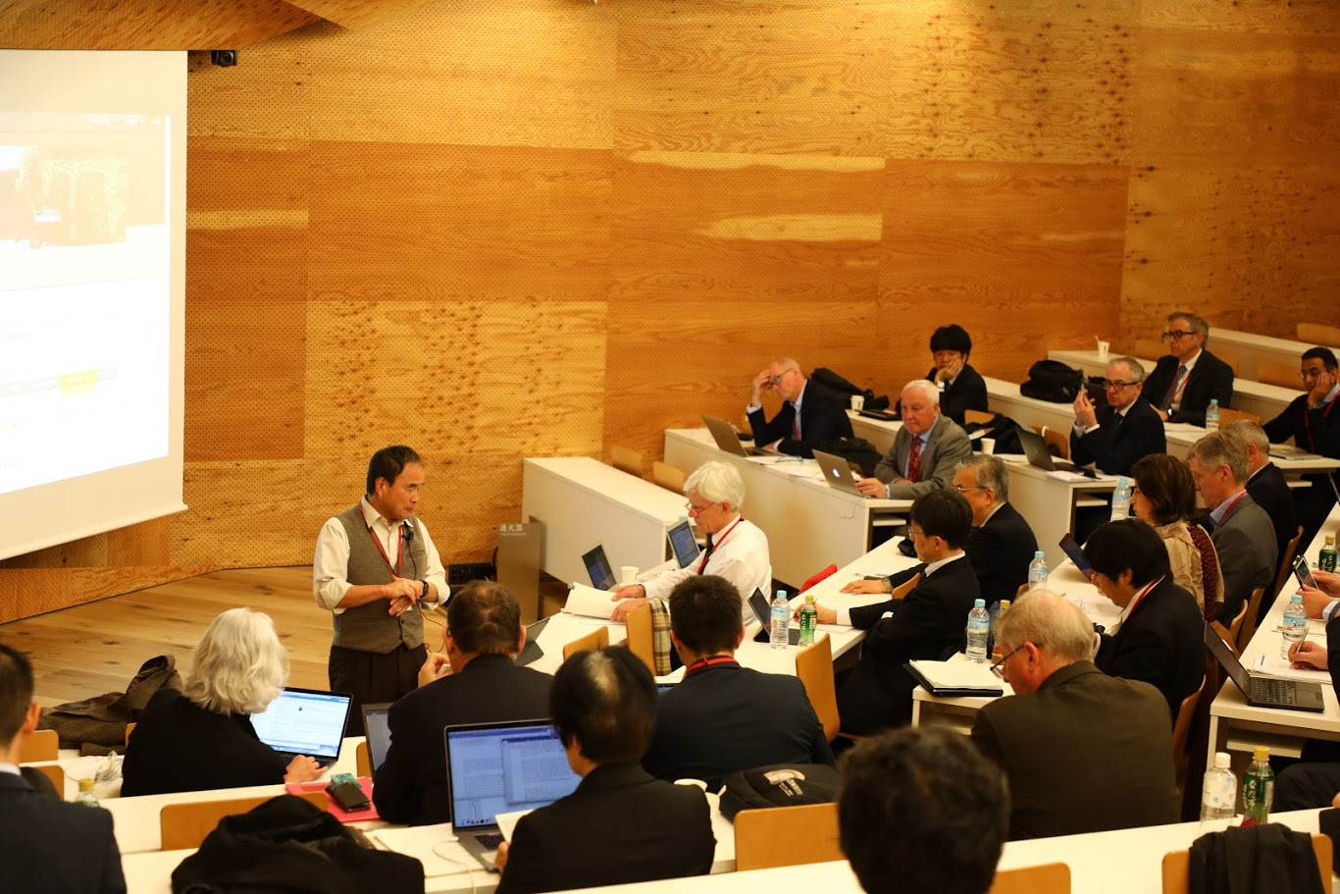
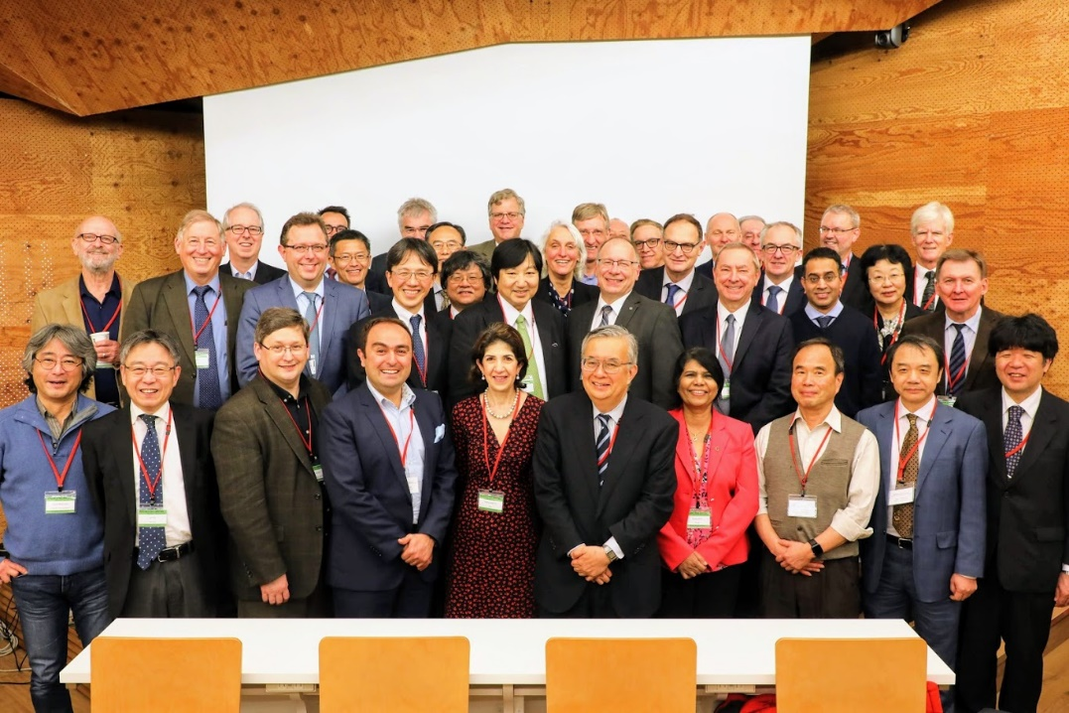
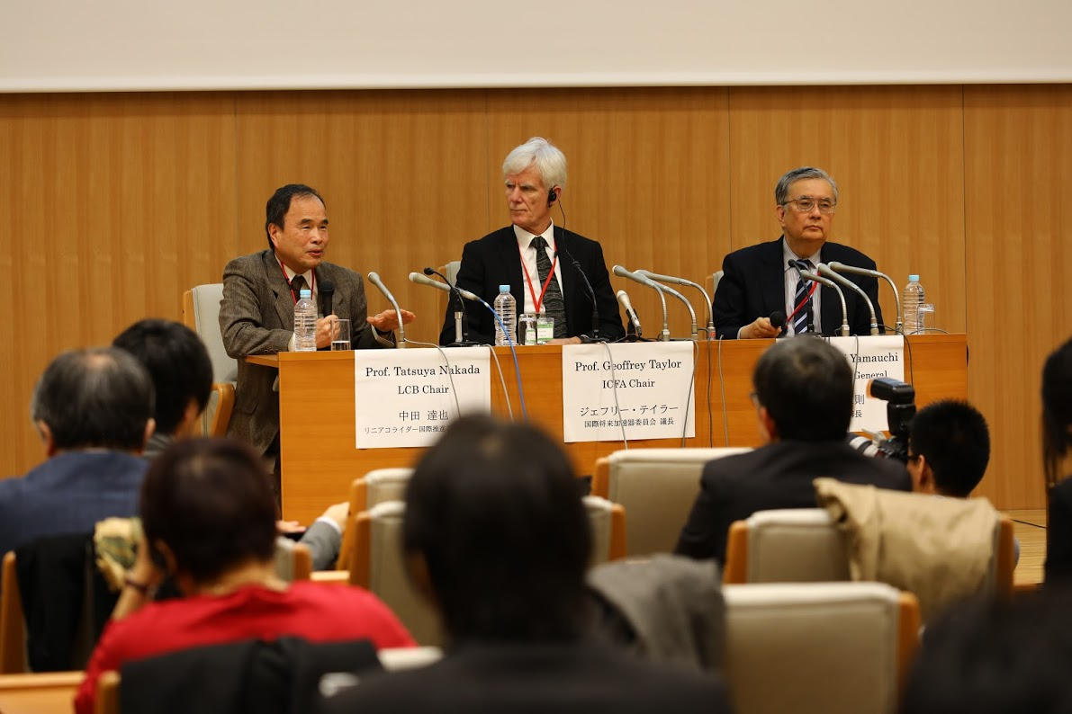
LCB and ICFA meetings in Tokyo

Slide 10
Statement by MEXT at LCB Meeting in March 2019
Following the opinion of the SCJ, MEXT has not yet reached declaration for hosting the ILC in Japan at this moment. The ILC project requires further discussion in formal academic decision-making processes such as the SCJ Master Plan, where it has to be clarified whether the ILC project can gain understanding and support from the domestic academic community.
MEXT will pay close attention to the progress of the discussions at the European Strategy for Particle Physics Update.
The ILC project has certain scientific significance in particle physics particularly in the precision measurements of the Higgs boson, and also has possibility in the technological advancement and in its effect on the local community, although the SCJ pointed out some concerns with the ILC project. Therefore, considering the above points, MEXT will continue to discuss the ILC project with other governments having an interest in the ILC project.

Slide 11
Message from the Federation of the Diet Members for ILC
I believe the ILC should be realized through politically-led efforts, cutting across different ministries and agencies. As such, we’re proceeding to realize a budgeting as a national project with a separate budget outside of the regular science and technology budget.
On the international cost sharing, we have to separate the infrastructure part of civil engineering and conventional equipment that is natural to be taken up by the host country and the apparatus part that is natural to be internationally cost-shared among technically competent countries.
As the environment has ripened socially, politically, and administratively, the next mission for politics is to secure the budget for the construction. In parallel, with the government’s administrative process, we will begin in earnest from our role as political and legislative body to obtain the necessary budget for construction.

Slide 12
Actions stated by MEXT in a Diet session
Answers given by MEXT at the Diet session on March 13, 2019.
In the future, while paying close attention to the progress of discussions on the European Elementary Particle Physics Strategy, we would like to deepen discussions with France and Germany at the governmental level, by proposing, for instance, to establish a standing discussion group similar to the one with the US. (Mr.Isogai)
So, also for the ILC project, we expect there will be a working group set up in the High Energy Accelerator Research Organization, so-called KEK, and at its initiative, discussions within the community of domestic and foreign researchers will proceed regarding international cost sharing, etc. (Mr.Isogai)
As I mentioned earlier, I am also aware that this is a project of great significance both from the academic research point of view and from the perspective of regional revitalization. Therefore, I would like to continue our investigations, closely collaborating with related communities while keeping an eye on the international situation. (Minister Shibayama)

Slide 13
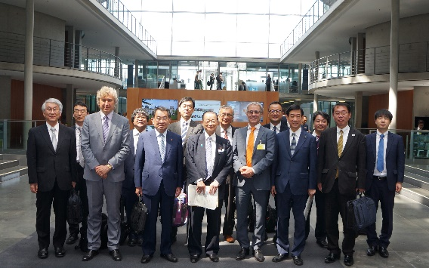
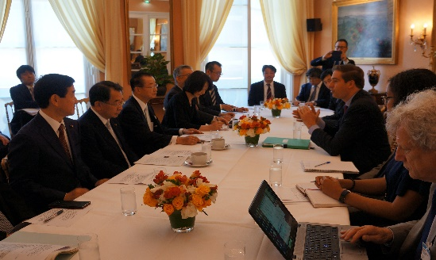
Discussions between MEXT and foreign governments
MEXT and US-DOE established a Discussion Group on the ILC in 2016. US-Japan cooperation on ILC cost reduction R&D has been carried out between KEK and US laboratories under this framework.
MEXT officials Berlin and Paris together with the members of the Japanese National Diet to discuss with BMBF (Germany )and MESRI (France) on July 1-2, 2019.
Japanese delegation
  Three members of the National Diet: Kawamura, Shionoya and Itoh
  Two from MEXT: Masuko and Todoroki
  Seven from Japanese physics community and Tohoku
Both BMBF and MESRI agreed to start bilateral discussion groups with MEXT. BMBF suggested that trilateral meeting would be useful.
Visit to Berlin
Visit to Paris

Slide 14
SCJ Master Plan
SCJ produce a large-sale research plan (Master Plan) every three years. This include proposals from all academic disciplines.
KEK proposed the ILC Project to the SCJ call for Master Plan 2020.
SCJ selected ILC as one of proposals invited for interview in September (after ~1/3 screening).
The “priority projects” (short list) will be selected after another ~1/3 selection by the interview.
In the previous masterplan process in 2017, MEXT made its own selection starting from projects advanced to the interview process and made the MEXT Roadmap.

Slide 15
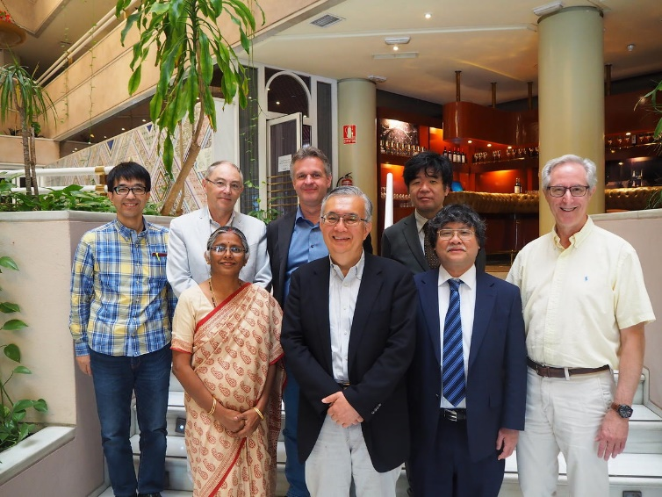
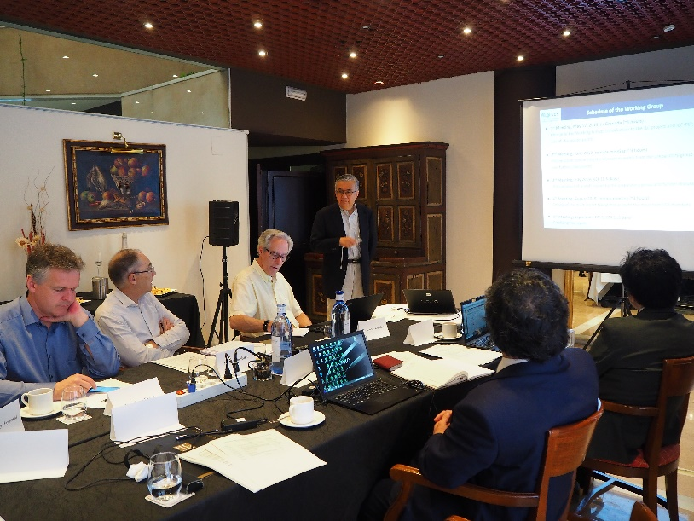
ILC International Working Group
KEK organizes the international working group for ILC with close consultation with MEXT.
  Members:
    Klaus Desch (Bonn)
    Andy Lankford (UC Irvine)
    Kajari Mazumdar (TIFR)
    Patricia McBride (Fermilab)
    Shin Michizono (KEK)
    Yasuhiro Okada (KEK, Chair)
    Claude Vallee (Marseille)
  Mandate: Update ILC-PIP to describe:
    Model of international cost-sharing for construction and operation of ILC
    Organization and governance of the ILC Laboratory
    International share of the remaining technical preparation
  KEK received the report from the Working Group, and released KEK’s recommendations on ILC Implementation on October 2. This is an input for discussions at governmental level.
First meeting in Granada, Spain (May 17)

Slide 16
Outline of the KEK’s recommendations
https://www.kek.jp/en/newsroom/2019/10/02/1000/
International cost-sharing
  Civil engineering and land acquisition are responsibility of the host state.
  Accelerator components should be provided by all the member states as in-kind contributions
  The operational cost should be shared among the member states.
Organization and governance
  An evolutionary model: ILC Pre-Lab to ILC Laboratory
  Pre-Lab should be promptly established through laboratory-label MoU’s. Its mandate is to coordinate the preparatory tasks and to assist the inter-governmental negotiations.
  After an inter-governmental agreement, the Pre-Lab is expected to transition into a full ILC Laboratory.
  Planning of the Pre-Lab should start as soon as possible.
Intentional sharing of the remaining technical preparation
  A technical preparation plan is presented with identification of potential international collaboration partners.

Slide 17
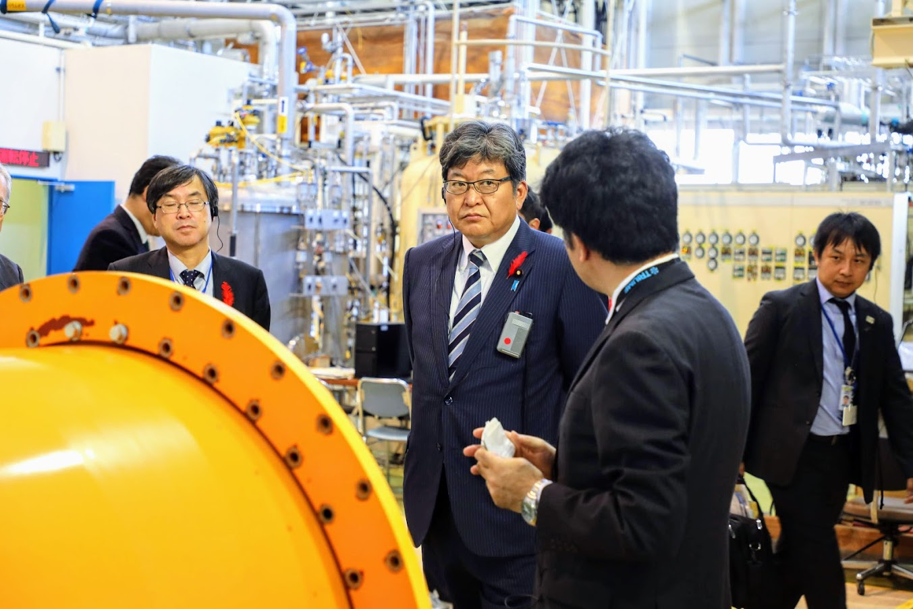
New MEXT Minister, Mr. Hagiuda visited STF
Mr. Murata
Director of Research
Promotion Bureau, MEXT
Hon. Hagiuda

Slide 18
MEXT statement will be updated in Feb. 2020
LCB had a plan to have the next meeting on December 20 in Tokyo, and requested MEXT to attend it to give an update of the statement.
MEXT, after some considerations, decided not to attend the December LCB meeting, because:
  Result of the SCJ master plan will not be available before December 20, and,
  Three months is too short to do preparation and discussion with the other relevant Ministries in Japan.
Instead, MEXT is willing to attend the LCB meeting in February 2020 at SLAC to update the ILC status in Japan after the SCJ master plan has become available.

Slide 19
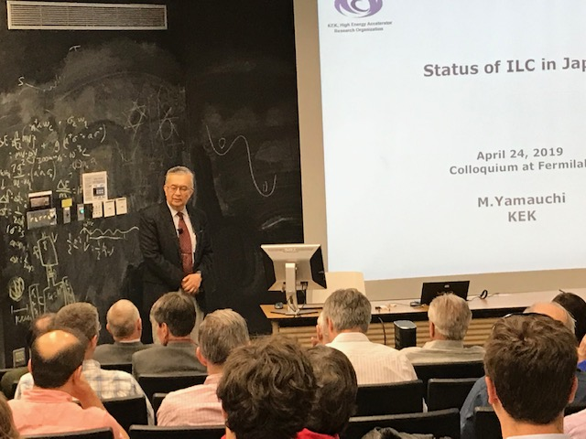
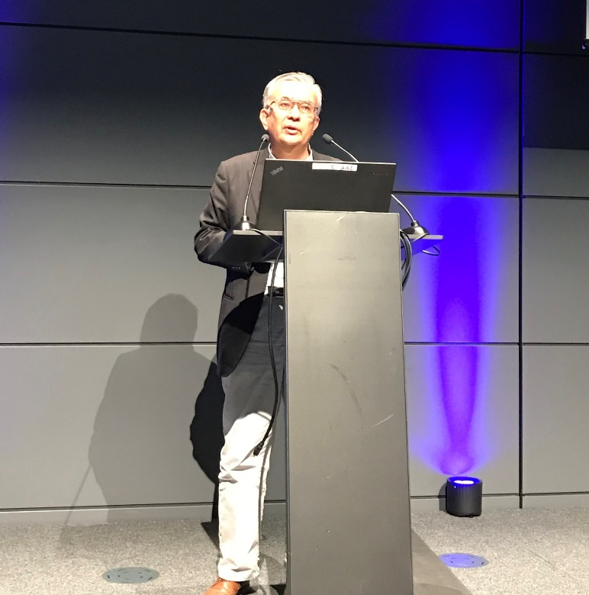
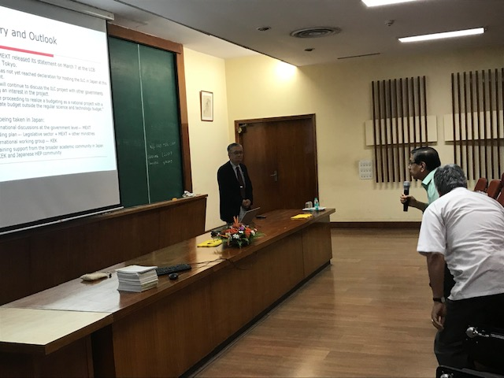
KEK /Japan’s efforts to Worldwide HEP communities
FNAL Special Colloquium on April, 2019
Presentation of KEK Action Plan
at Lausanne meeting on April 8, 2019
https://events.fnal.gov/colloquium/events/event/status-of-ilc-in-japan/
Workshop on ILC at TIFR on August 2, 2019
https://www.kek.jp/en/newsroom/2019/04/12/1700/

Slide 20
European Strategy for Particle Physics Update
Letter to ESG from Chair of HEPC in Japan
The update of European Strategy for Particle Physics is ongoing under CERN Council.
At the Granada meeting on May, 2019, a consensus emerged that a Higgs Factory is the most important next large HEP facility. Four proposals (ILC, CLEC, FCC-ee, CEPC) have a similar physics potential for Higgs physics at the first stage.
KEK and the HEP community in Japan are making effort to provide correct input to European Strategy Group.
The drafting session will be held on January 2020,and the final approval will be sought at the CERN Council in May 2020.
http://www.jahep.org/files/ESG_Japan_Nov06_signed.pdf

Slide 21
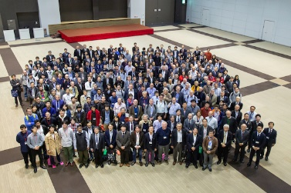
LCWS 2019
LCWS 2019 was held on October 28- November 1 in Sendai
Very successful !
http://epx.phys.tohoku.ac.jp/LCWS2019/
“Sendai Statement”
https://www.kek.jp/en/newsroom/2019/11/01/1300/
More than 440 participants
Strong interest from Industrial sector
Keynote speech by Hon. Ryo Shionoya
Talk by Dr Gediminas Ramanauskas (EU delegation in Tokyo
Talk by Melinda Pavek (US Embassy in Tokyo)

Slide 22
Process toward Realization of ILC
Presented by KEK at the Lausanne meeting on April 8, 2019

Slide 23
Summary and Outlook
MEXT gave a statement on ILC at the LCB meeting in March, 2019, and some actions are taking place following the statement:
  MEXT and three members of the Japanese National Diet visited Berlin and Paris to talk with BMBF and MESRI. They agreed to begin bilateral discussion groups.
  A working group was formed at KEK to discuss ILC implementation. The report from the WG has been sent to MEXT as a recommendation from KEK. Hope this is used as an input to the international discussions.
  SCJ is now working on “the master plan”. We are doing our best to obtain the priority in the master plan.
MEXT will come to the next LCB meeting in February at SLAC, and update the statement there.
The next step of the ILC project is a preparation for ILC Pre-Lab.
We are making all efforts to Japanese government to move forward in order to realize the ILC hosted in Japan.
We would like ask Indian colleagues to give consideration to the ILC project in their planning of future HEP programs.

