Slide 1


Accelerated Fully-coherent Search for compact binary coalescences
Soumya D. Mohanty
Dept. of Physics and Astronomy
The University of Texas Rio Grande Valley
U.S. Dept. of Defense

Slide 2
Objectives
GW astronomy has seen spectacular success since 2015
Data analysis algorithms form a critical component of the technological base behind these successes
We will walk through a key data analysis challenge for ground-based IFOs to illustrate the critical role of data analysis in GW astronomy
Techniques developed for solving these challenges have broad applicability

Slide 3
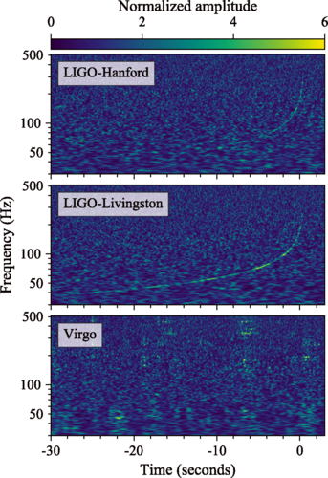
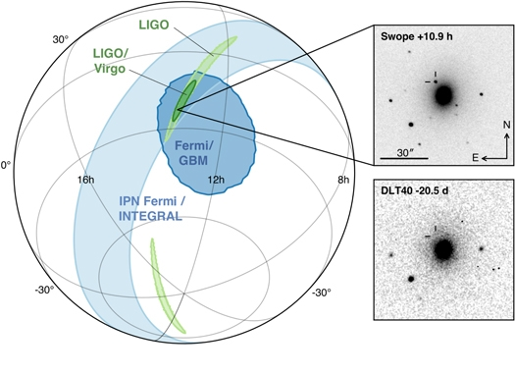
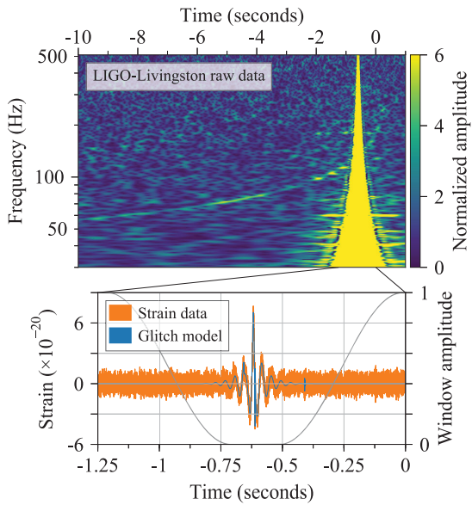
GW170817: Double neutron star inspiral and merger
•Noise dominated data
•2nd Gen detectors: signals appear rarely
•Localization needs data from a network of detectors
•Multi-messenger astronomy: Low-latency GW detection needed
Data artifacts, such as glitches, must be mitigated for better sensitivity
B. P. Abbott et al. (LIGO Scientific Collaboration and Virgo Collaboration), Phys. Rev. Lett. 119, 161101
Notes:
Ingredients: Network analysis, dealing with artifacts, low latency for MMA.

Slide 4
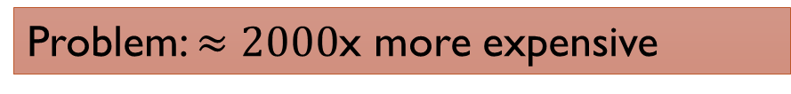
Detector 1
Search
Candidate
Search
Detector 2
Search
Coincidence
Detector 3
Search
Candidate
Coherent analysis
Pai, Bose, Dhurandhar, Physical Review D, 64, 042004 (2001)
Klimenko, Mohanty, Rakhmanov, Mitselmakher, Physical Review D 72, 122002 (2005)
Semi-coherent analysis
Most current flagship pipelines (GstLAL, PyCBC, MBTA)
SPIIR uses coherent analysis for candidate events (plus a segmented time-domain matched filter approach)
In theory: more sensitive, simpler
In theory: less sensitive, complex
Problem: $≈2000$x more expensive

Slide 5
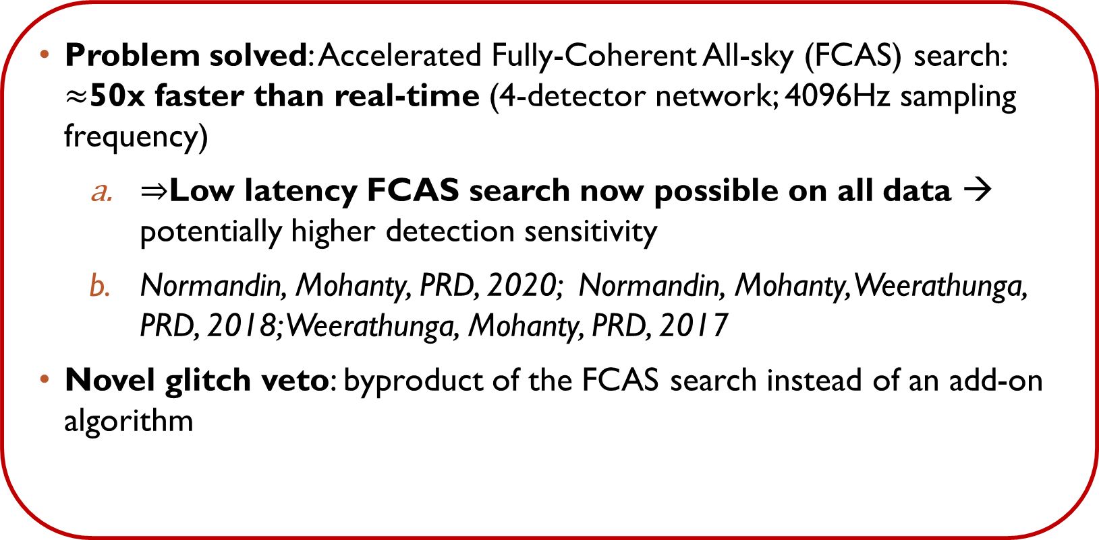
Highlights
Problem solved: Accelerated Fully-Coherent All-sky (FCAS) search: $≈$50x faster than real-time (4-detector network; 4096Hz sampling frequency)
    $⇒$Low latency FCAS search now possible on all data → potentially higher detection sensitivity
    Normandin, Mohanty, PRD, 2020; Normandin, Mohanty, Weerathunga, PRD, 2018; Weerathunga, Mohanty, PRD, 2017
Novel glitch veto: byproduct of the FCAS search instead of an add-on algorithm
Notes:
BINARIES code (Binary Inspiral Network Analysis Rapid Implementation Enabled by Swarm Intelligence)

Slide 6
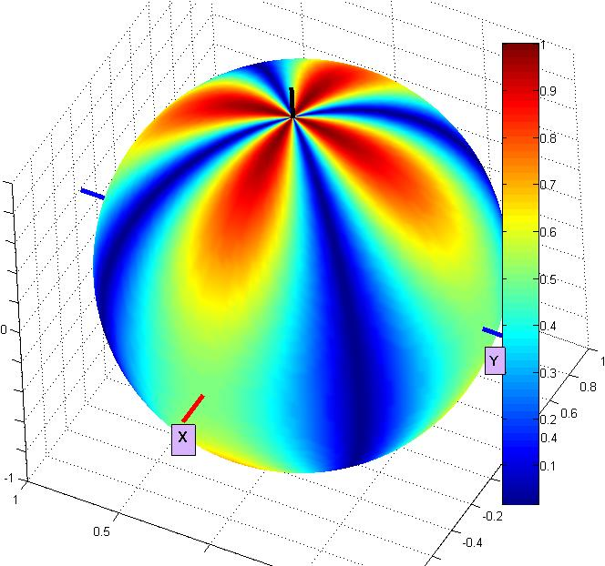
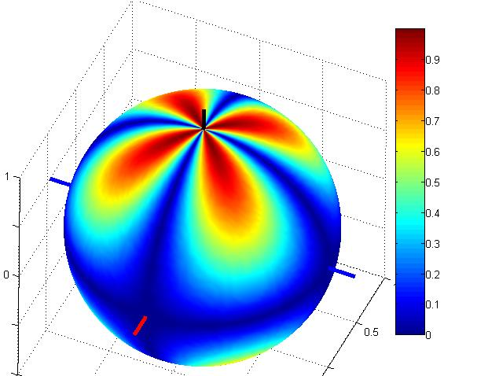
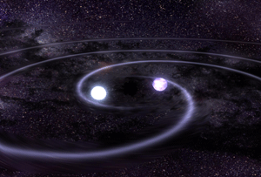
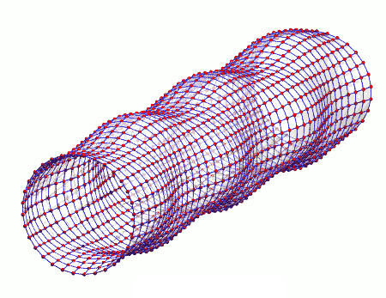
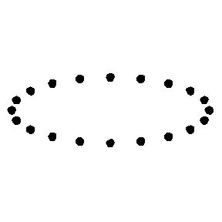
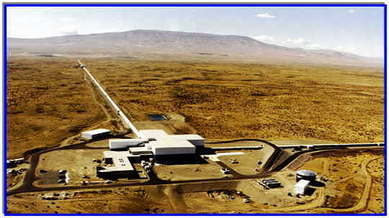
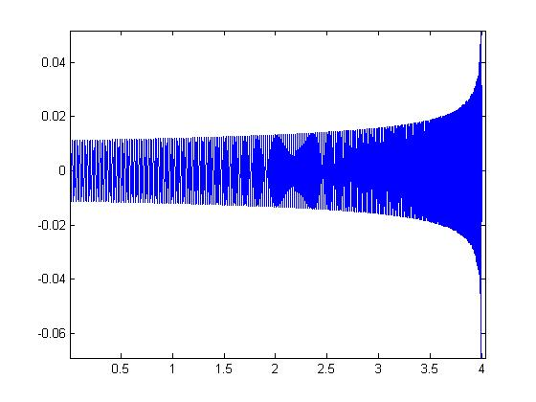
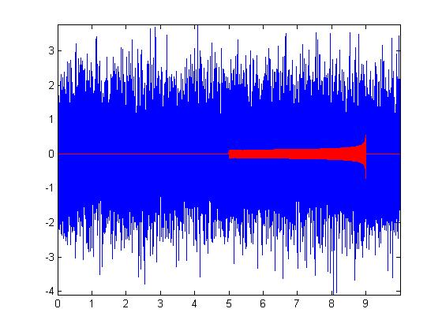
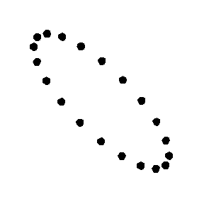

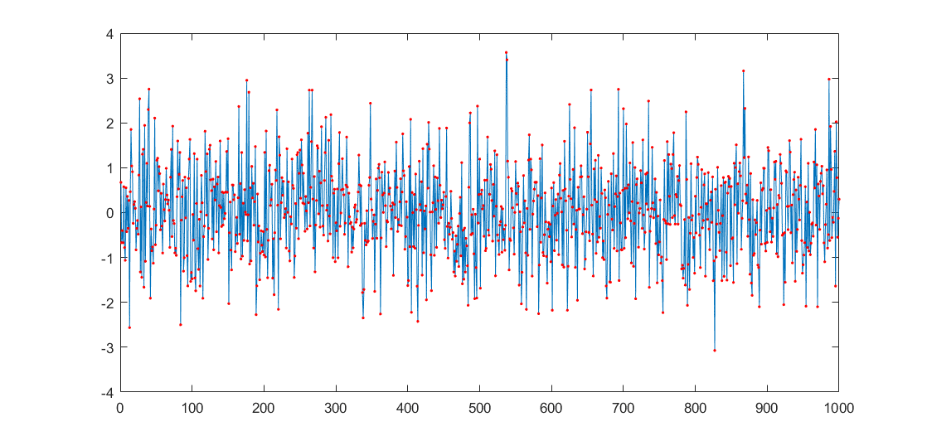



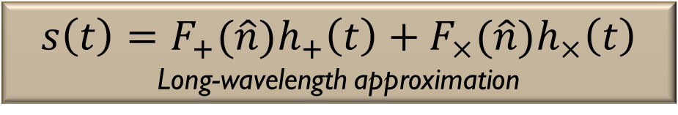


$$F_{+}(\hat{n})$$
$$F_{×}(\hat{n})$$
$$s\left(t\right)=F_{+}(\hat{n})h_{+}\left(t\right)+F_{×}(\hat{n})h_{×}\left(t\right)$$
Long-wavelength approximation
$$\hat{n}$$
$$h_{+}$$
$$h_{×}$$
Notes:
As you have learnt, a single GW detector responds to an incoming plane gravitational wave by producing a linear combination, through the antenna pattern functions, of the two GW polarizations. This signal passes through the detector’s transfer function, an estimate of which is found through calibration and the estimate is taken out from the measured output to give us the calibrated data or GW strain. This strain signals is embedded in the instrumental noise and the combined signal and noise is what constitutes the data recorded for analysis. Now the binary inspiral type of signals are transient and, for the current detectors, appear about once a week. So, compared to the noise that is present all the time in the data, these signals are rare. The first analysis task then is to take a segment of data and decide whether it contains a signal or not. This is the detection task. Once, a segment is found that we think contains a signal, the next task is to estimate the signal waveform. This is the estimation task.

Slide 7
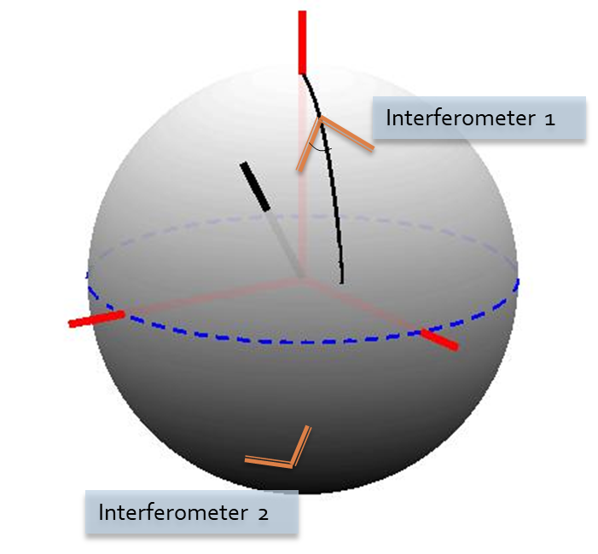
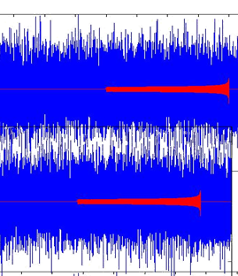
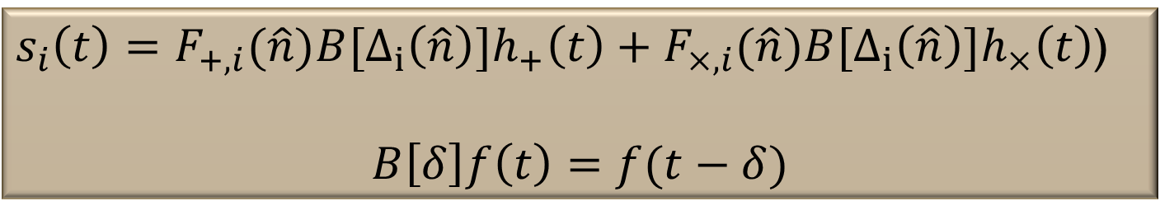
$s_{i}\left(t\right)=F_{+,i}(\hat{n})B[Δ_{i}\left(\hat{n}\right)]h_{+}\left(t\right)+F_{×,i}(\hat{n}){B[Δ_{i}\left(\hat{n}\right)]h}_{×}\left(t\right)$)
$$B\left[δ\right]f\left(t\right)=f(t−δ)$$
Notes:
As you have learnt, a single GW detector responds to an incoming plane gravitational wave by producing a linear combination, through the antenna pattern functions, of the two GW polarizations. This signal passes through the detector’s transfer function, an estimate of which is found through calibration and the estimate is taken out from the measured output to give us the calibrated data or GW strain. This strain signals is embedded in the instrumental noise and the combined signal and noise is what constitutes the data recorded for analysis. Now the binary inspiral type of signals are transient and, for the current detectors, appear about once a week. So, compared to the noise that is present all the time in the data, these signals are rare. The first analysis task then is to take a segment of data and decide whether it contains a signal or not. This is the detection task. Once, a segment is found that we think contains a signal, the next task is to estimate the signal waveform. This is the estimation task.

Slide 8
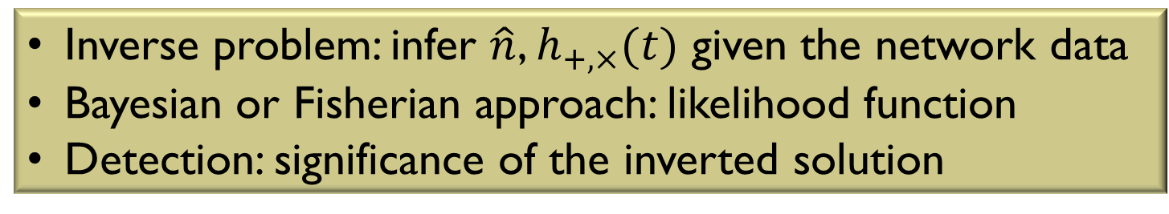
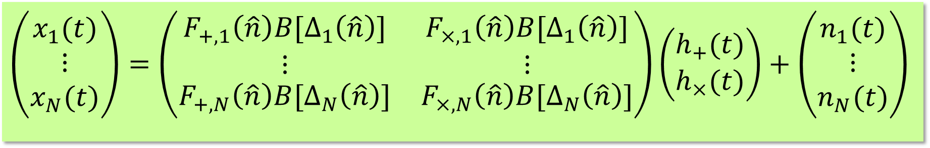
NETWORK analysis Inverse problem
$$\left(\begin{matrix}x_{1}(t) \\ ⋮ \\ x_{N}(t)\end{matrix}\right)=\left(\begin{matrix}\begin{matrix}F_{+,1}\left(\hat{n}\right)B[Δ_{1}\left(\hat{n}\right)] \\ ⋮\end{matrix} & \begin{matrix}F_{×,1}\left(\hat{n}\right)B[Δ_{1}\left(\hat{n}\right)] \\ ⋮\end{matrix} \\ F_{+,N}\left(\hat{n}\right)B[Δ_{N}\left(\hat{n}\right)] & F_{×,N}\left(\hat{n}\right)B[Δ_{N}\left(\hat{n}\right)]\end{matrix}\right)\left(\begin{matrix}h_{+}(t) \\ h_{×}(t)\end{matrix}\right)+\left(\begin{matrix}n_{1}(t) \\ ⋮ \\ n_{N}(t)\end{matrix}\right)$$
GW network data
GW strain signal
Noise
Inverse problem: infer $\hat{n}$, $h_{+,×}(t)$ given the network data
Bayesian or Fisherian approach: likelihood function
Detection: significance of the inverted solution

Slide 9




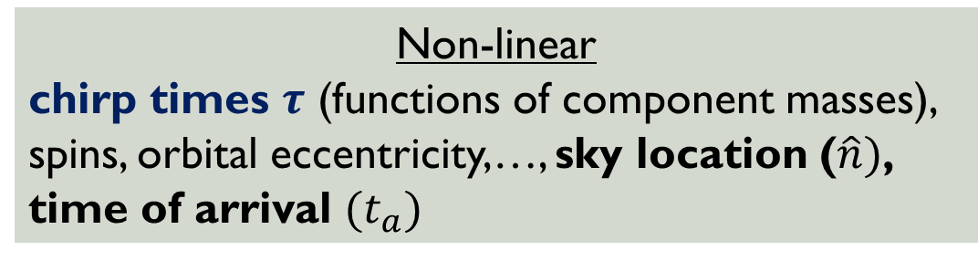
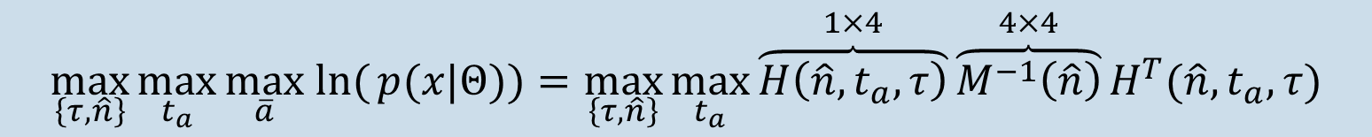
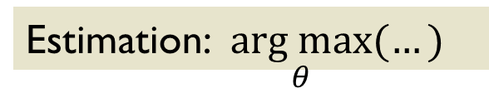
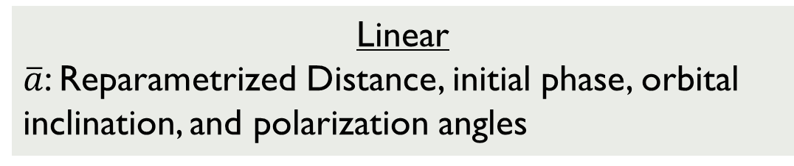
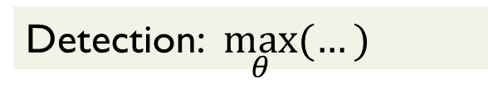
Network Log-likelihood
$$x_{1}, x_{2}, …, x_{D}∈ℝ^{N}$$
    Linear
    $\overline{a}$: Reparametrized Distance, initial phase, orbital inclination, and polarization angles
Joint PDF
$$p\left(x | Θ\right)=p_{Noise}(x−s\left(θ\right))$$
    Non-linear
    chirp times $τ$ (functions of component masses), spins, orbital eccentricity,…, sky location ($\hat{n})$, time of arrival $(t_{a})$
Detection: $\max_{θ}{(…)}$
Estimation: $\underset{θ}{arg max}{(…)}$
$$\max_{\left\{τ,\hat{n}\right\}}{\max_{t_{a}}{\max_{\overline{a}} \text{ln}({p(x|Θ)}})}=\max_{\left\{τ,\hat{n}\right\}}{\max_{t_{a}}}\overset{1×4}{\overbrace{H\left(\hat{n},t_{a},τ\right)}}\overset{4×4}{\overbrace{M^{−1}\left(\hat{n}\right)}}H^{T}(\hat{n},t_{a},τ)$$
Gaussian noise
$\hat{n}$ dependent linear combinations of $\text{IFFT}({\tilde{z}}_{i}.∗{\tilde{q}}_{r}^{†}(τ))$, $r=1,2$
$$\tilde{b}=\text{FFT}(b)$$
$${\tilde{z}}_{i}[k]={\tilde{x}}_{i}[k]/PSD_{i}[k]$$
Quadrature templates (0 and $\frac{π}{2}$ initial phase signals)

Slide 10
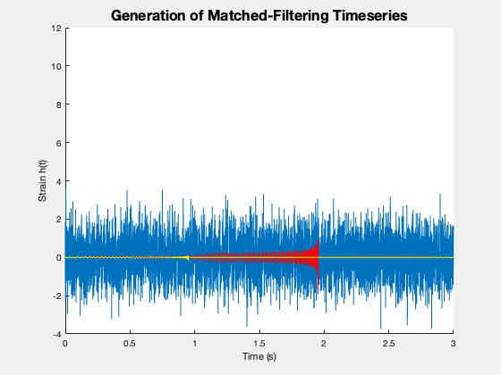
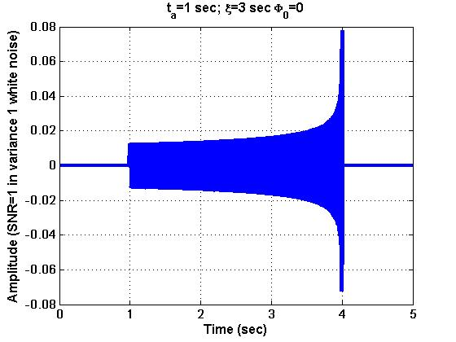
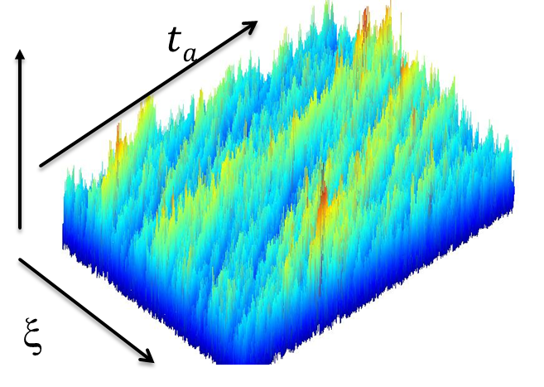

Global optimization challenge
Single detector search
Newtonian signal model
${\text{IFFT}({\tilde{z}}_{i}.∗{\tilde{q}}_{0}^{†}(ξ))}^{2}$+ ${\text{IFFT}({\tilde{z}}_{i}.∗{\tilde{q}}_{1}^{†}(ξ))}^{2}$
t_{a} : time of arrival
ξ : Chirp time

Slide 11
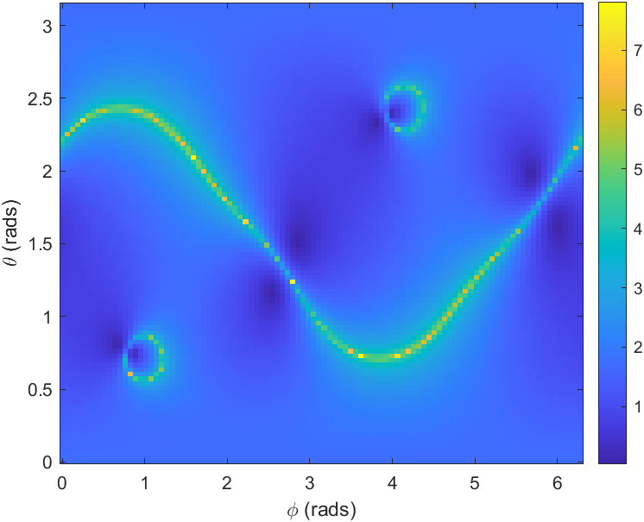
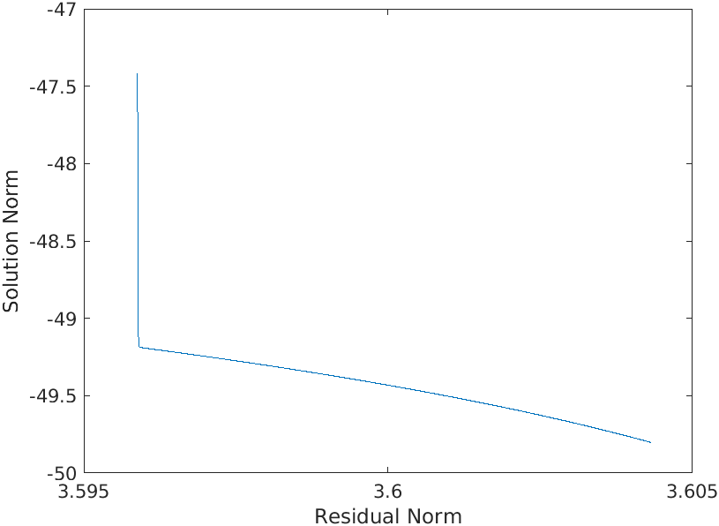
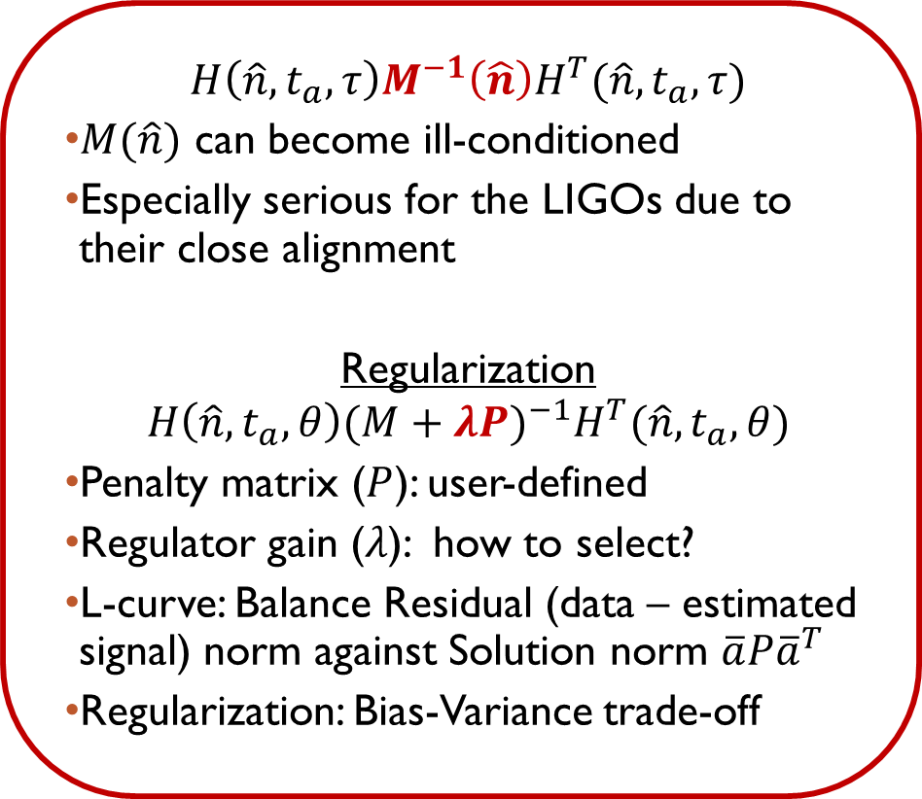
Regularization
$$H\left(\hat{n},t_{a},τ\right)M^{−1}\left(\hat{n}\right)H^{T}(\hat{n},t_{a},τ)$$
$M(\hat{n})$ can become ill-conditioned
Especially serious for the LIGOs due to their close alignment
Regularization
$${H\left(\hat{n},t_{a},θ\right){(M+λP)}^{−1}H}^{T}(\hat{n},t_{a},θ)$$
Penalty matrix ($P$): user-defined
Regulator gain ($λ$): how to select?
L-curve: Balance Residual (data – estimated signal) norm against Solution norm $\overline{a}P{\overline{a}}^{T}$
Regularization: Bias-Variance trade-off

Slide 12
Accelerating Coherent network analysis
Deterministic searches
Grid-based:
Gradient-based methods: Trapped by local maxima
Stochastic searches
Markov Chain Monte Carlo (MCMC): Currently used (LALInference) for parameter estimation
Surrogates of full MCMC (e.g., BayeStar) by imposing some approximation on the posterior
Not scalable
Exponential growth in cost with number of parameters
Particle Swarm Optimization (Kennedy, Eberhart, IEEE, 1995; 88,885 citations)
  10x fewer likelihood evaluations compared to grid-based searches
Graphics Processing Units (GPUs)

Slide 13
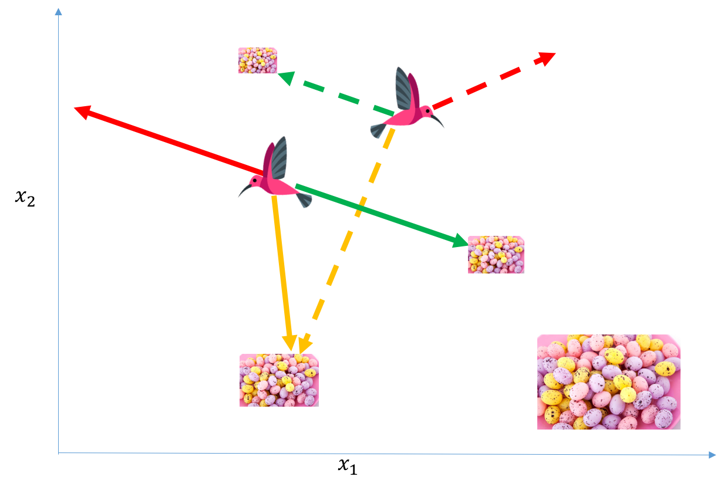
Particle swarm optimization
Global optimization algorithm inspired by emergent behavior of bird flocks
Evolution of flocking behavior driven by optimization challenges

Slide 14
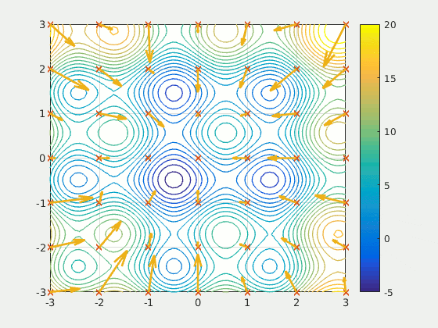
Particle swarm optimization
Swarm Intelligence methods for statistical regression, Mohanty, CRC press (2019)

Slide 15
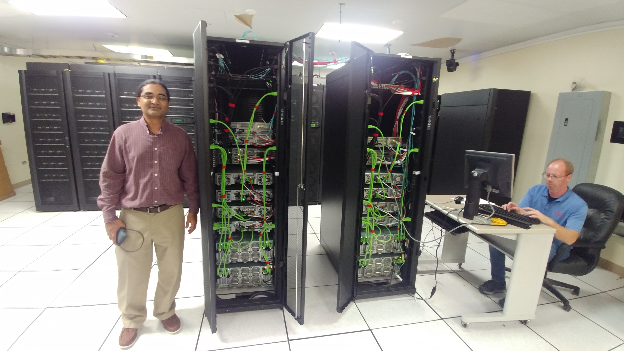
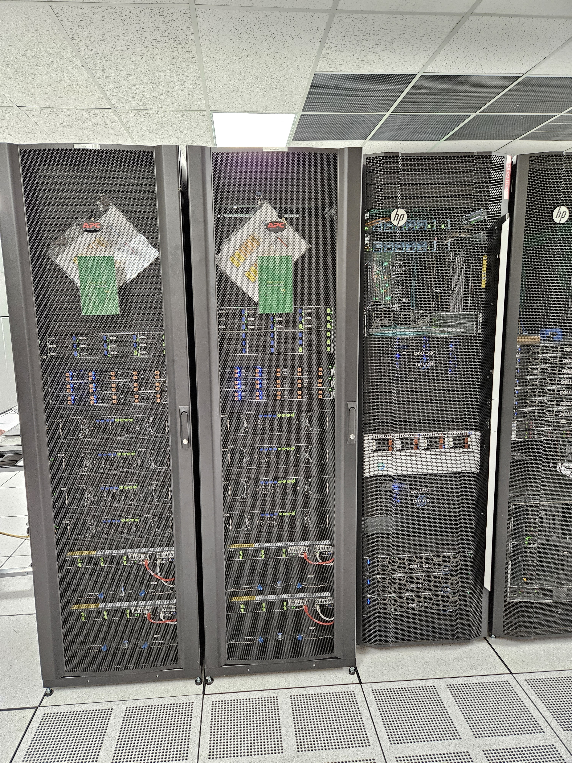
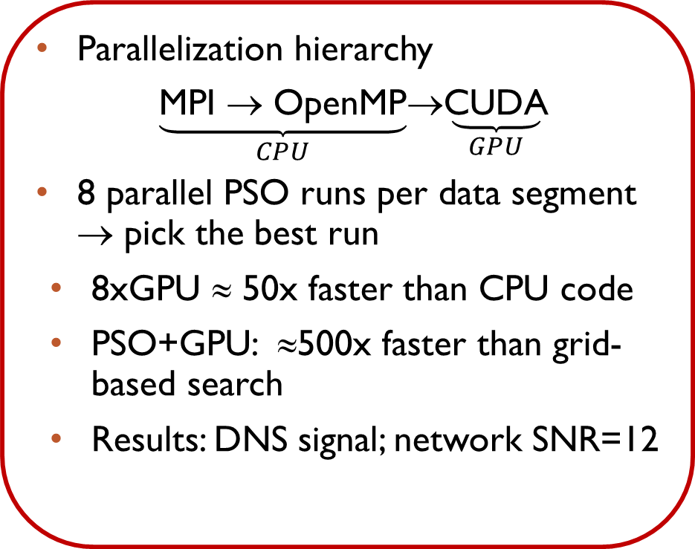
Implementation
Parallelization hierarchy
$\underset{CPU}{\underbrace{\text{MPI} → \text{OpenMP}}}$→$\underset{GPU}{\underbrace{\text{CUDA}}}$
8 parallel PSO runs per data segment → pick the best run
8xGPU ≈ 50x faster than CPU code
PSO+GPU: ≈500x faster than grid-based search
Results: DNS signal; network SNR=12
CRADLE
NSF + DoD: $1.25 million
Total: 96 NVIDIA A100
  32 GPUs interlinked with NVLink: AI workloads
Dedicated
  64 NVIDIA A100 80GB
  8 GPUs per node

Slide 16
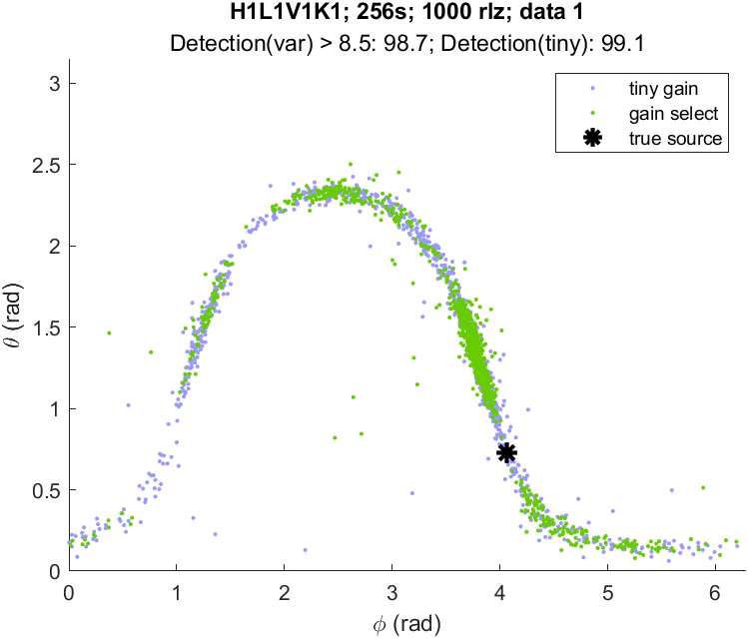
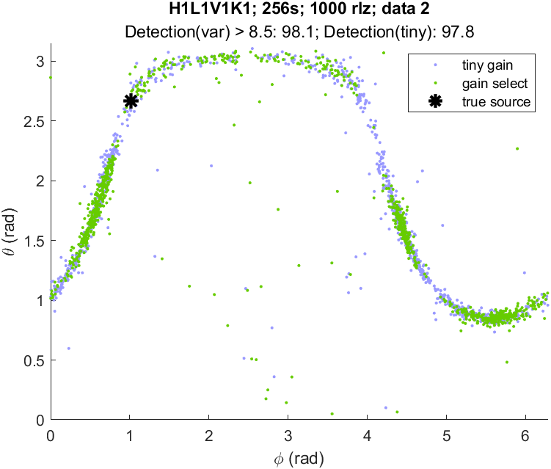
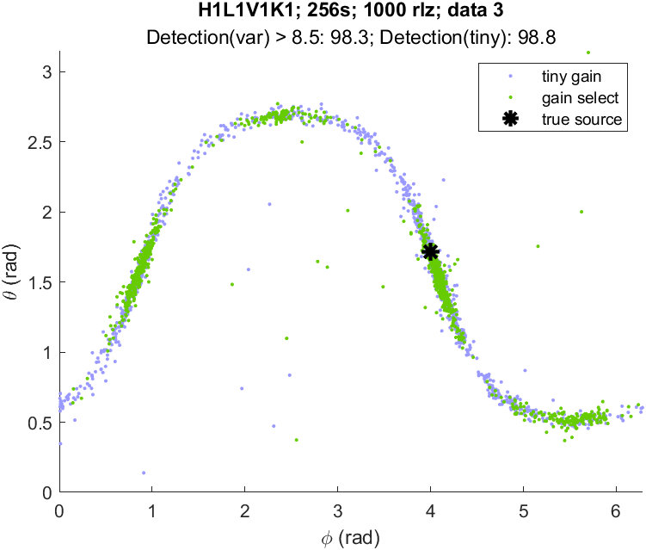
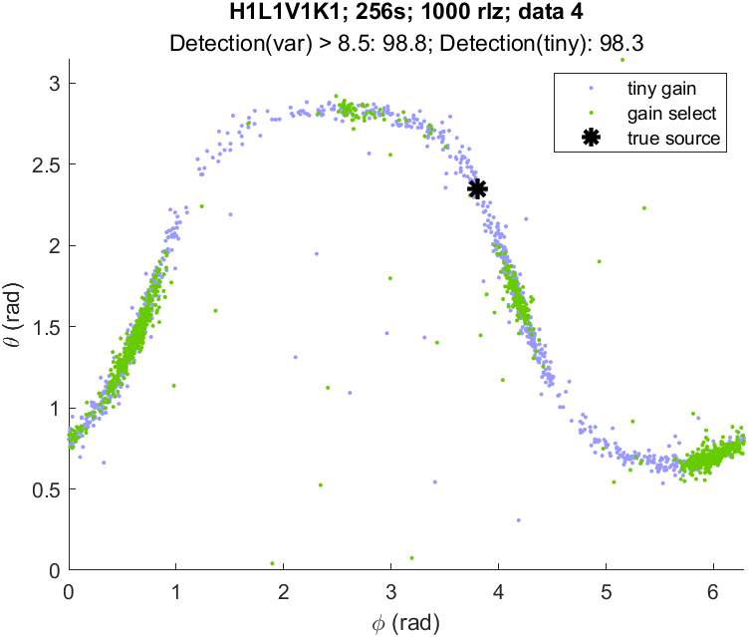
2-detector network
LIGO-Hanford, LIGO-Livingston
Sky localization with and without gain selection
Simulated Gaussian stationary noise with design Power Spectral Densities

Slide 17
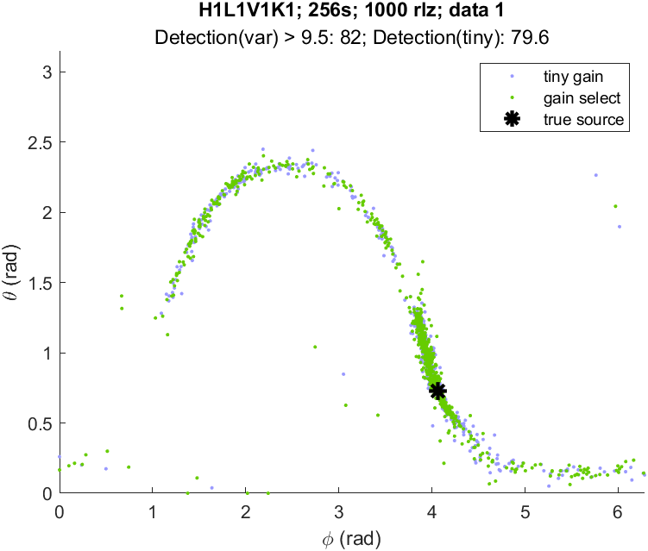
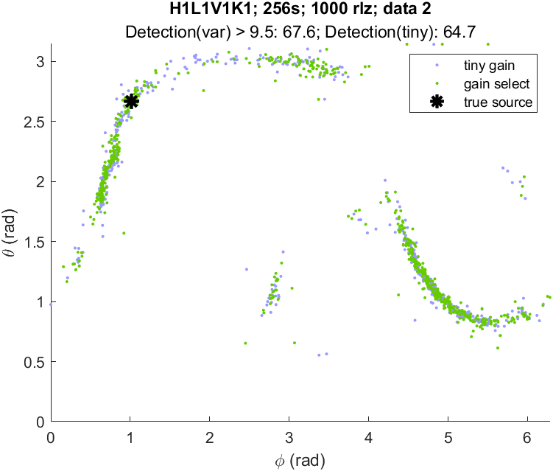
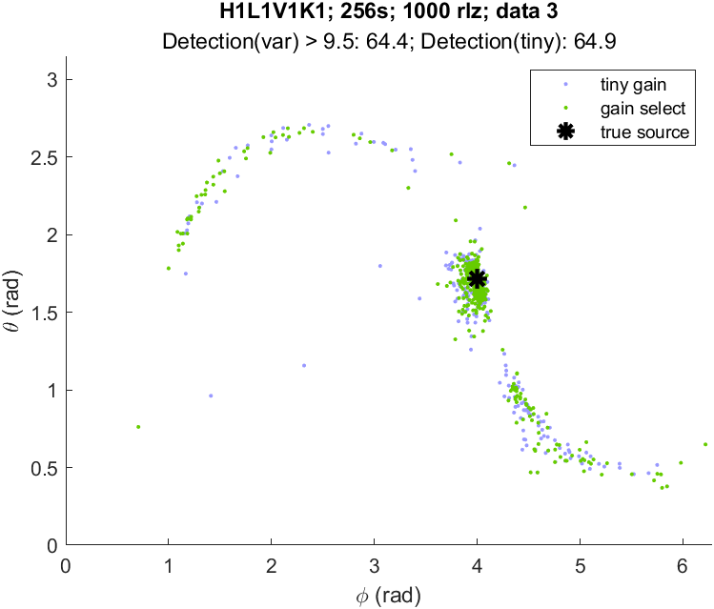
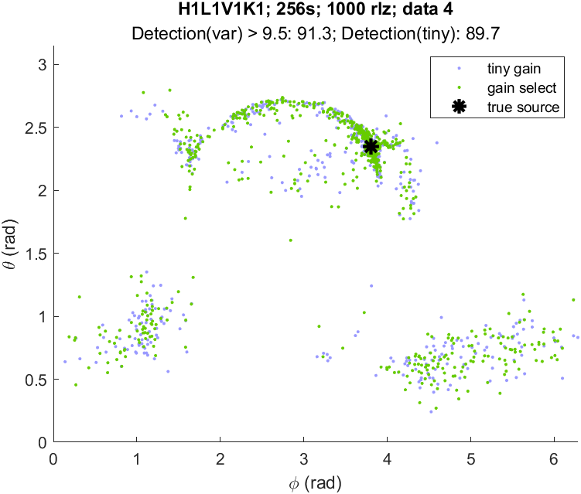
4-detector network
LIGO-Hanford, LIGO-Livingston, Virgo, KAGRA
Sky localization with and without gain selection
Simulated Gaussian stationary noise with design Power Spectral Densities
Realistic error estimation beyond Fisher Information

Slide 18
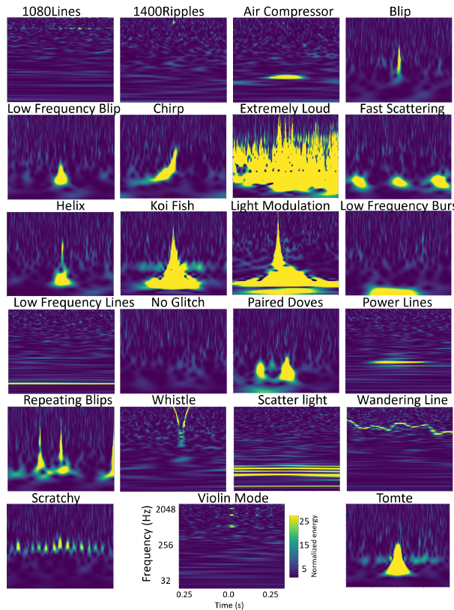
Glitch mitigation
Ground-based IFOs are affected by frequent interference signals from instrumental and environmental sources.
Wu et al, ArXiv: 2401.12913v1

Slide 19
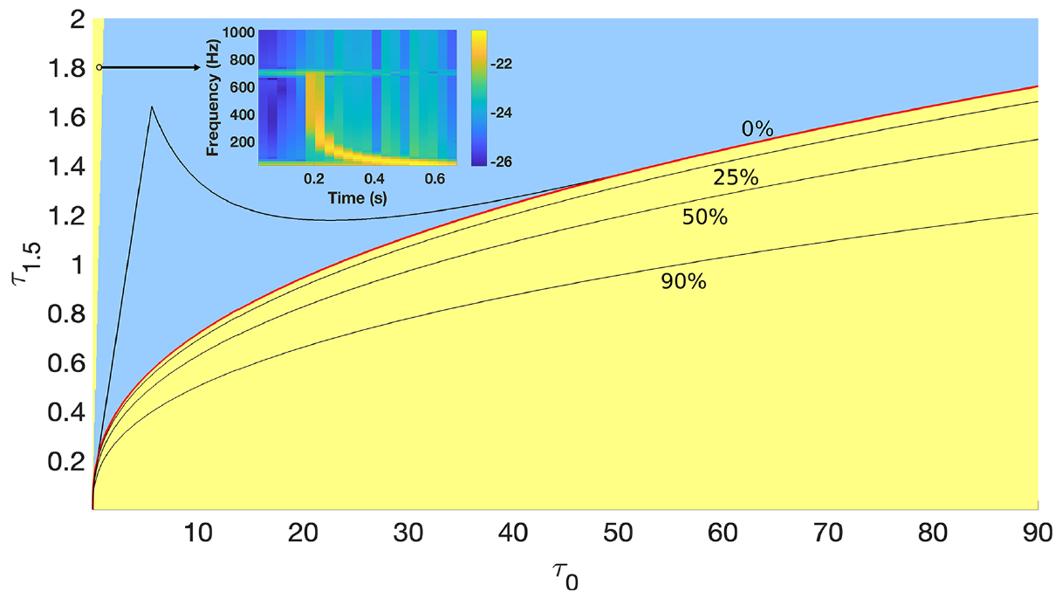
Glitch VETO using unphysical Templates
Masses to chirp times map is one-to-one but not onto ⇒ unphysical sectors in chirp time space
PSO performs better for hypercubical spaces ⇒ unphysical sectors covered at no extra cost
One can augment the search space using the negative chirp time quadrant
Glitches match physical & unphysical templates; GW signals do not

Slide 20
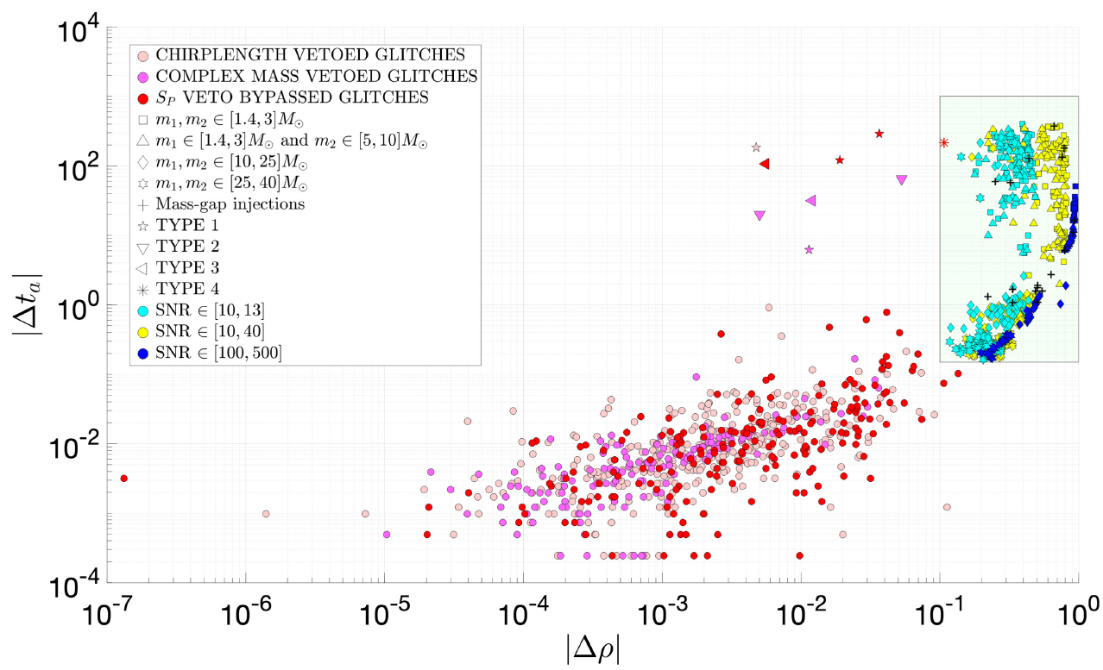
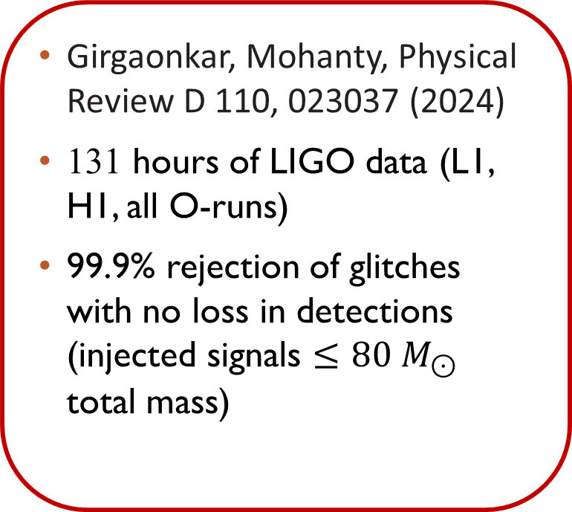
GLITCH VETO using unphysical templates
Girgaonkar, Mohanty, Physical Review D 110, 023037 (2024)
131 hours of LIGO data (L1, H1, all O-runs)
99.9% rejection of glitches with no loss in detections (injected signals $≤80 M_{⊙}$ total mass)

Slide 21
Summary
Data analysis is a critical component of GW astronomy and computational bottlenecks often limit us from reaching higher search sensitivity
Nature inspired optimization heuristics are powerful techniques for addressing some of the key challenges
GPU acceleration is extremely significant and should be adopted where possible
Open challenges abound. Examples:
  3rd generation detectors: longer signals with higher rate → Glitch mitigation problem becomes harder
  Space-based detectors: Embarrassment of riches but only if the data analysis problems are solved

Slide 22
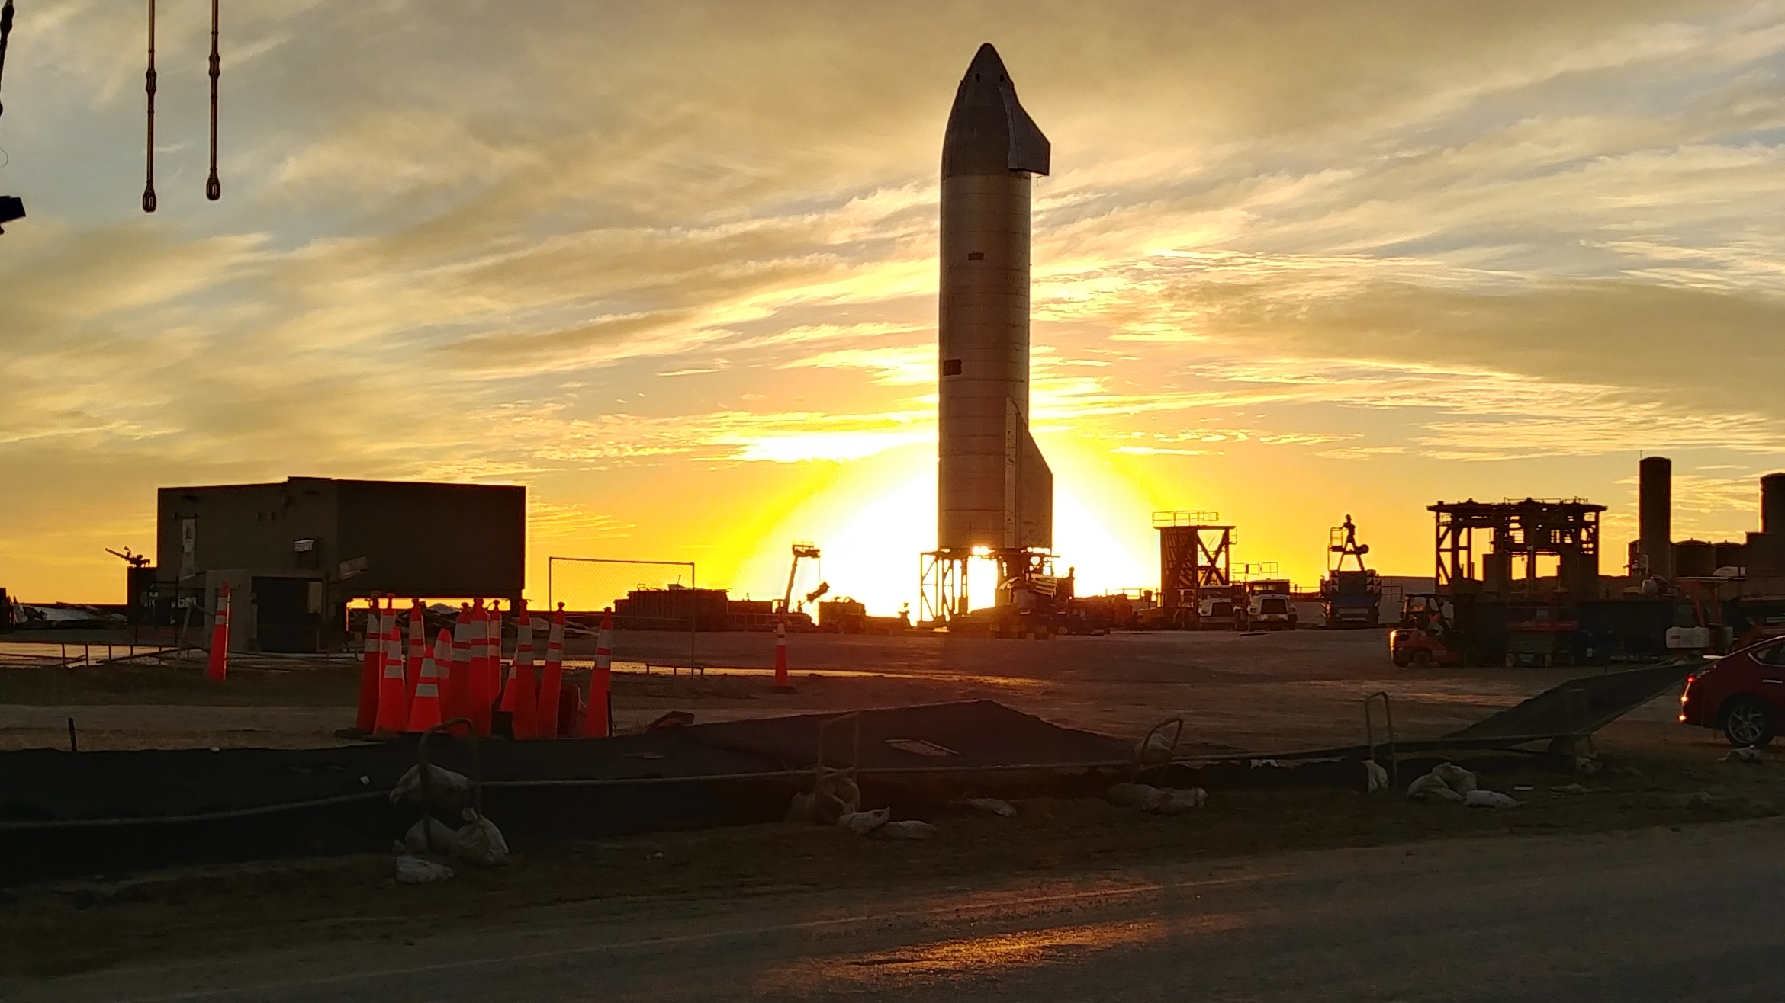
Thank You!
Questions?
Notes:
Thank you for your attention! Time for questions?

Slide 23



Effect of glitches on detection sensitivity
histogram of single detector triggers in SNR. The tail of this distribution extends beyond SNR = 100.
histogram of single detector triggers in re-weighted SNR using $χ^{2}$-veto.
arXiv:1710.02185v3 [gr-qc]
Histograms of single detector PyCBC triggers from the Livingston (L1) detector.

