Slide 1




Efficient model selection with Bayesian optimisation
Jan Hamann
based on JCAP 03 (2022) 03, 036 [arXiv:2112.08571] with Julius Wons
and work in progress with Nathan Cohen and Ameek Malhotra

Slide 2
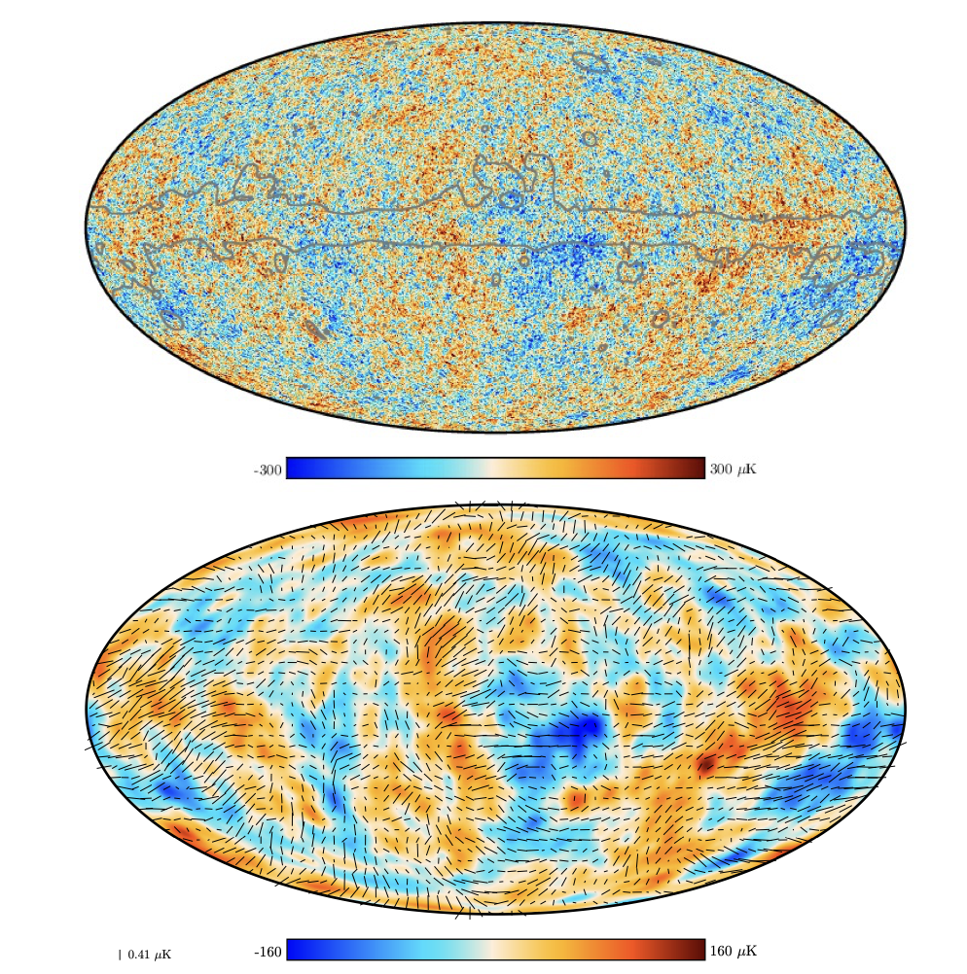
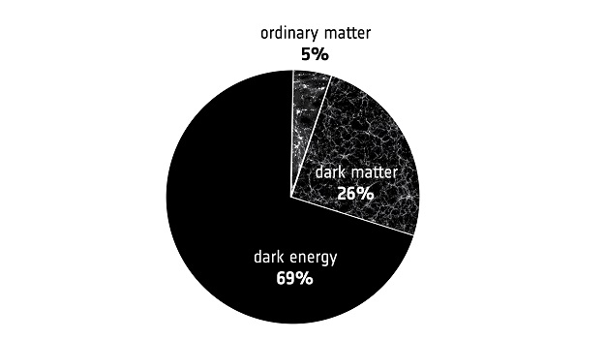

?

Slide 3
Parameter inference/optimisation
Cosmological model ℳ
Parameters 𝜃
For instance:
Standard LCDM
𝜃 = (𝜔_{b}, 𝜔_{cdm} ,H₀, 𝜏, A_{s}, n_{s})
or
LCDM + Neff
𝜃 = (𝜔_{b}, 𝜔_{cdm} ,H₀, 𝜏, A_{s}, n_{s}, N_{eff})
etc.

Slide 4
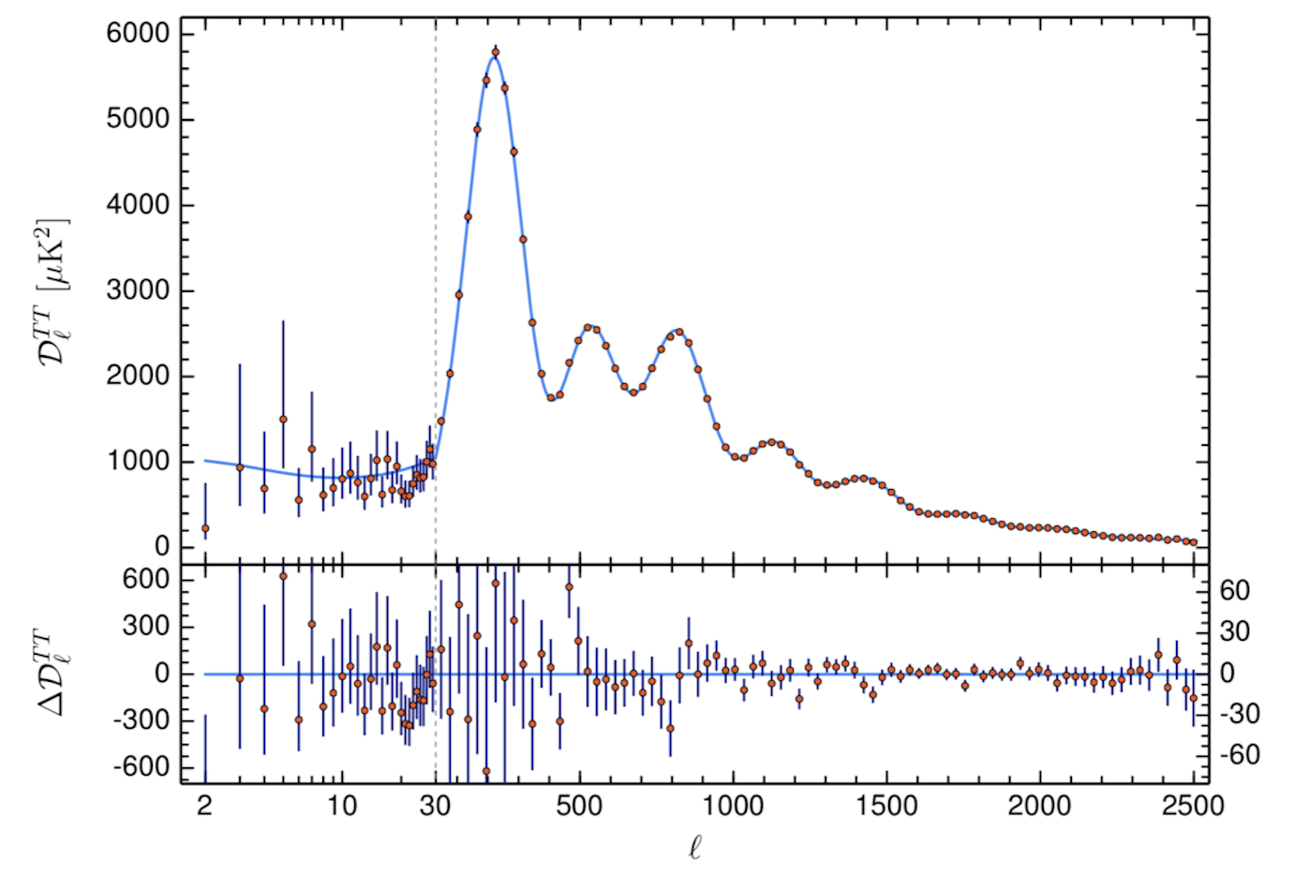
Parameter inference/optimisation
Cosmological model ℳ
Parameters 𝜃
Theoretical prediction
(CMB angular power spectra)
Boltzmann code
(CAMB/Class)

Slide 5
Parameter inference/optimisation
Cosmological model ℳ
Parameters 𝜃
Theoretical prediction
(CMB angular power spectra)
Boltzmann code
(CAMB/Class)
Data 𝒟
Likelihood
ℒ(𝒟|𝜃, ℳ)
Probability of the data given the model and specific values of the parameters
For uncorrelated Gaussian measurements:
theory
data
error

Slide 6
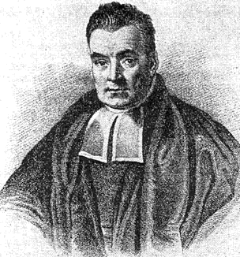
Parameter inference/optimisation
Cosmological model ℳ
Parameters 𝜃
Theoretical prediction
(CMB angular power spectra)
Boltzmann code
(CAMB/Class)
Data 𝒟
Bayes’ Theorem
Likelihood
ℒ(𝒟|𝜃, ℳ)
Prior 𝜋(𝜃|ℳ)
Posterior probability
𝒫(𝜃|𝒟, ℳ)

Slide 7
Parameter inference/optimisation
Cosmological model ℳ
Parameters 𝜃
Theoretical prediction
(CMB angular power spectra)
Boltzmann code
(CAMB/Class)
Data 𝒟
For instance:
Grid scan
MCMC
Nested sampling
…
Likelihood
ℒ(𝒟|𝜃, ℳ)
Prior 𝜋(𝜃|ℳ)
Select next 𝜃
to evaluate 𝒫 at
Posterior probability
𝒫(𝜃|𝒟, ℳ)

Slide 8
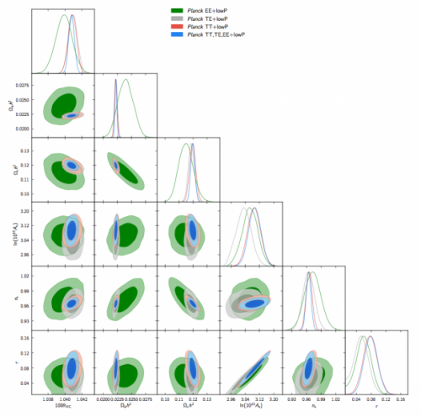
Parameter inference/optimisation
Cosmological model ℳ
Parameters 𝜃
Theoretical prediction
(CMB angular power spectra)
Boltzmann code
(CAMB/Class)
Data 𝒟
Likelihood
ℒ(𝒟|𝜃, ℳ)
Parameter constraints
(best-fits, means, variances, etc.)
Prior 𝜋(𝜃|ℳ)
Posterior probability
𝒫(𝜃|𝒟, ℳ)
termination
criterion

Slide 9
The usual approach: Markov chain Monte Carlo
Basic idea: random walk in parameter space that explores 𝒫(𝜃)
posterior
isocontours
Markov chain:
Density of samples proportional to 𝒫(𝜃)

Slide 10
The usual approach: Markov chain Monte Carlo
[Metropolis et al. (1953)]
Metropolis-Hastings algorithm:
  1. Start at point 𝜃 in parameter space
  2. Save 𝜃 to Markov chain
  3. Propose a step to a new point 𝜃’
  4. Decide whether to accept the proposal and take the step:
  If 𝒫(𝜃’) ≥ 𝒫(𝜃), accept the proposal
  If 𝒫(𝜃’) < 𝒫(𝜃), accept the proposal with a probability p = 𝒫(𝜃’)/𝒫(𝜃), otherwise reject
  5. If step was accepted set 𝜃’ = 𝜃
  6. Go to 2.
Animated illustration:
http://chi-feng.github.io/mcmc-demo/app.html?algorithm=RandomWalkMH&target=standard
[Feng et al., Github]

Slide 11
Pros and cons of MCMC
+ easily implemented
+ easily parallelisable
+ essentially zero overhead
+ mild scaling of number of required samples with dimension N of parameter space (power law ∼N^{𝛼} rather than exponential)
+ works great for near-Gaussian posteriors (most of cosmology)
o not very good at finding the maximum
o typically requires 𝒪(10⁴) function evaluations for N = 𝒪(10)
− struggles with complicated (multi-modal, non-Gaussian, non-linearly correlated, etc.) posteriors
− not very smart: most of the information is ignored!

Slide 12
Bayesian optimisation
Step 1: Regression
Guess the shape of the function based on known function values (“data”)
Step 2: Selection
Decide at which point to evaluate the next function value

Slide 13
Gaussian Process Regression (GPR)
Non-parametric probabilistic regression model

Slide 14
Gaussian Process Regression (GPR)…
…is a non-parametric probabilistic regression model
[Rasmussen & Williams 2006]
Input
data points
covariance of data
Output
interpolation
uncertainty

Slide 15
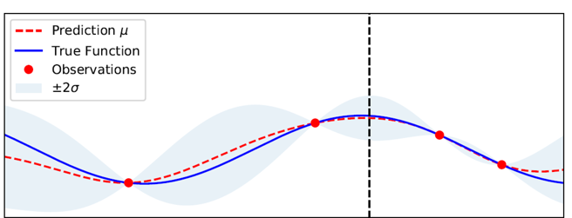
Gaussian Process Regression

Slide 16
Where to draw the next sample?
Exploration?
Exploitation?

Slide 17
Where to draw the next sample?
Define an acquisition function dependent on GPR mean and uncertainty
Pick value that maximises acquisition function
For example:
Expected Improvement
Exploration?
Exploitation?

Slide 18
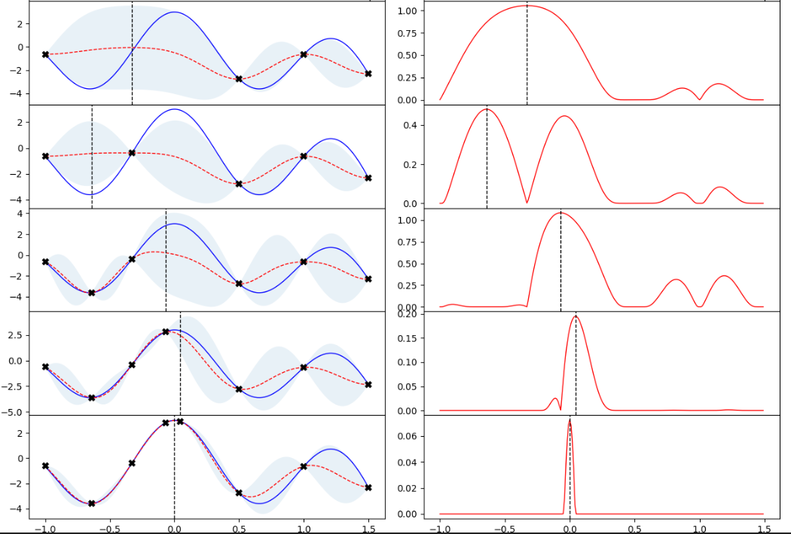
Bayesian optimisation
Gaussian Process Regression
Expected improvement
iteration #
data
GPR mean
uncertainty
1
true function

Slide 19
Bayesian optimisation
Gaussian Process Regression
Expected improvement
iteration #
data
GPR mean
uncertainty
1
true function
2

Slide 20
Bayesian optimisation
Gaussian Process Regression
Expected improvement
iteration #
data
GPR mean
uncertainty
1
true function
2
3

Slide 21
Bayesian optimisation
Gaussian Process Regression
Expected improvement
iteration #
data
GPR mean
uncertainty
1
true function
2
3
4

Slide 22
Bayesian optimisation
Gaussian Process Regression
Expected improvement
iteration #
data
GPR mean
uncertainty
1
true function
2
3
4
5

Slide 23
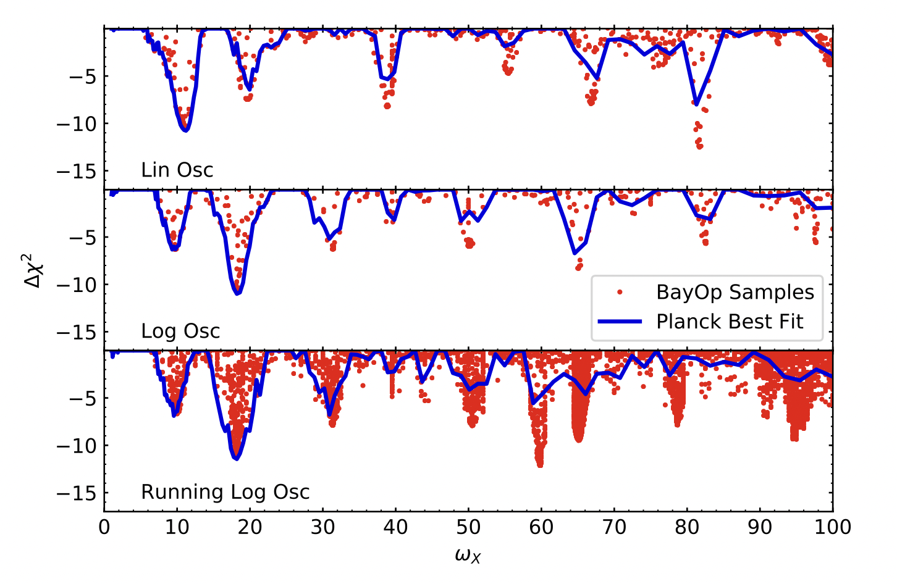
An example application: inflation models with modulated primordial power spectra
[Planck inflation 2018]
using nested sampling, O(10⁵) samples
red dots: our results with BO
Two orders of magnitude fewer function evaluations
Much better at finding global and local extrema
[JH & Wons, 2021]

Slide 24
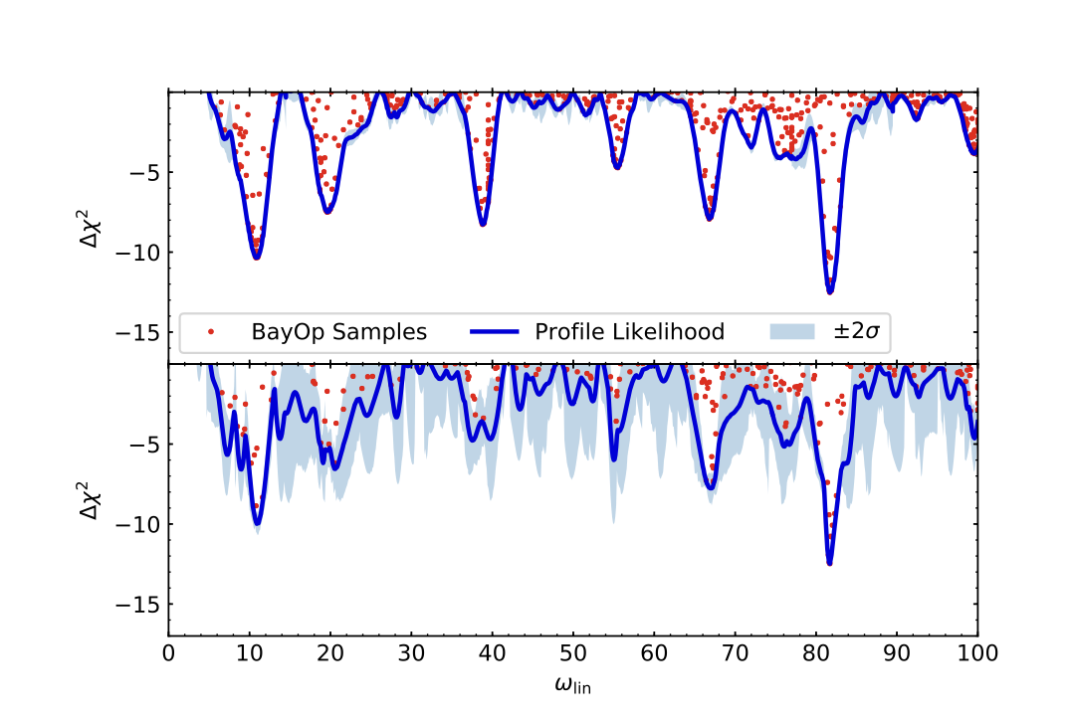
BayOp – not only good for optimisation
1700 samples
8 frequency bins
… it also learns the global shape of the function
[JH & Wons, 2021]

Slide 25
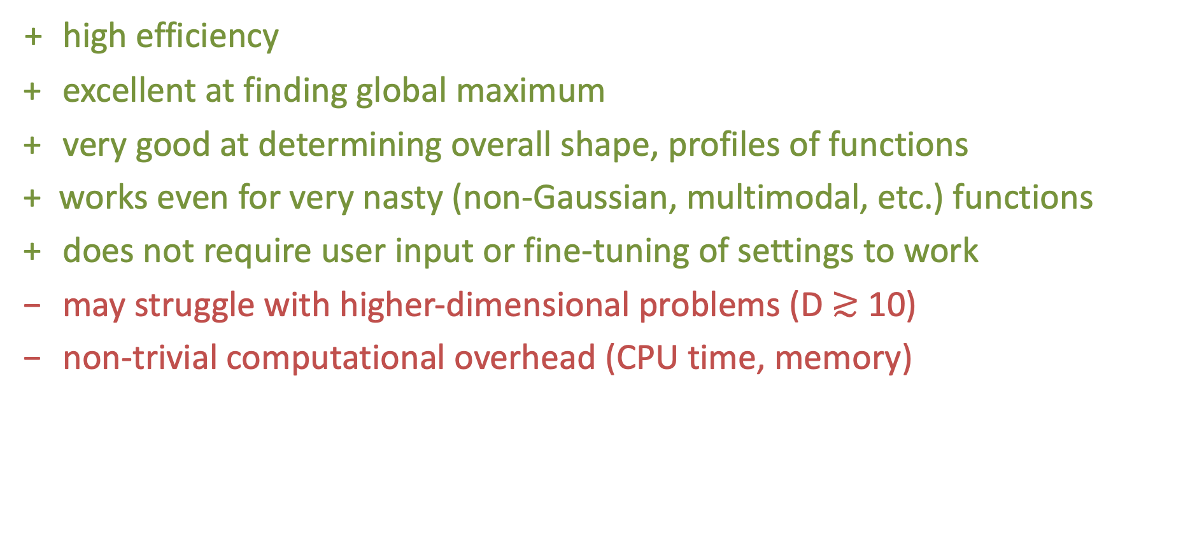
Pros and cons of Bayesian Optimisation
+ high efficiency
+ excellent at finding global maximum
+ very good at determining overall shape, profiles of functions
+ works even for very nasty (non-Gaussian, multimodal, etc.) functions
+ does not require user input or fine-tuning of settings to work
− may struggle with higher-dimensional problems (D $≳$ 10)
− non-trivial computational overhead (CPU time, memory)

Slide 26
Bayesian optimisation for parameter inference
Learn shape of posterior probability density
Replace (potentially expensive) calculation of theoretical prediction and likelihood evaluation with (cheap!) GPR emulation
Implemented in a Python package: GPry
[El Gammal et al., 2022]

Slide 27
But this assumes we know the right model…

Slide 28
Model selection: Bayesian method
Probability of model ℳ
given the data 𝒟
Bayesian evidence
Comparing two models:
Bayes factor B₁₂
“Model ℳ₁ is B₁₂ times more probable than ℳ₂”

Slide 29
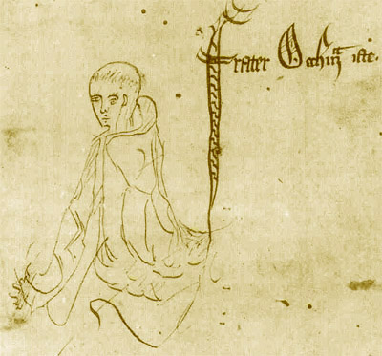
Model selection: Bayesian method
Bayesian evidence
Integral over entire parameter space
Rewards models that make risky predictions and get it right over generic models that can fit anything
Natural implementation of Occam’s razor:
Numquam ponenda est pluralitas sine necessitate
Plurality must never be posited without necessity
(Don’t make things unnecessarily complicated)

Slide 30
Bayesian model selection
Multi-dimensional integration is a challenging task
Standard approach: Nested sampling algorithm
typically requires 𝒪(10⁵-10⁶) function evaluations for features models
[Skilling 2004, Feroz et al. 2013, Handley et al. 2015]
This is even harder than parameter inference
Can Bayesian Optimisation help?

Slide 31
Evidence calculation with Bayesian optimisation
Goal is to select next function value to be evaluated in such a way that it maximises the expected reduction in uncertainty of the integral
Use a different acquisition function: Integrated Mean Square Prediction Error (IMSPE)
GPR uncertainty
Pretend to take a sample at 𝜃, then do a new GPR
Very convenient:
gives estimate of the uncertainty of the evidence integral

Slide 32
Evidence calculation with Bayesian optimisation
Our code still in development…
Code based largely on existing Python frameworks (BoTorch)
Uses clever method for dealing with hyperparameters and acquisition function maximization (Sparse Axis-Aligned Subspace Bayesian Optimisation (SAASBO))
Sampling from hyperparameter space PDF instead of maximizing (overengineering? – but more Bayesian in spirit)
[Balandat et al. (2019)]
[Eriksson & Jankowiak (2021)]

Slide 33
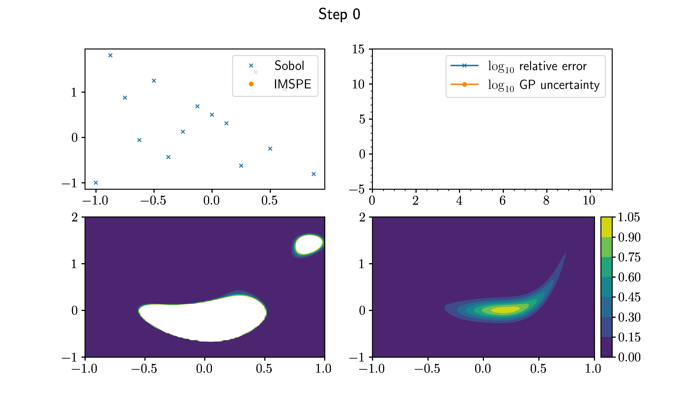

Slide 34
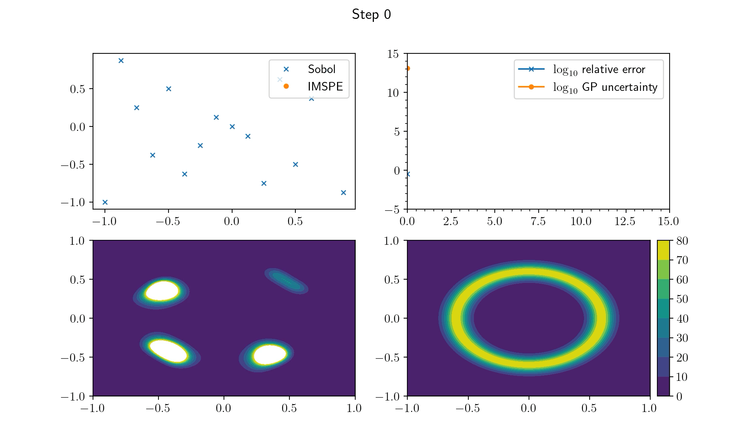

Slide 35
Conclusions
Bayesian optimisation is a machine-learning technique for extremising unknown functions
It can also be applied to cosmological parameter estimation and Bayesian model comparison
Very efficient: in our examples it requires factor O(100) fewer function evaluations compared to random sampling-based methods
Most useful for expensive-to-calculate likelihoods and complicated posterior distributions
Paper and code for Bayesian evidence calculation out soon!

