Slide 1
Welcome to the IQ Initiative/PITT PACC Workshop:
Axions, Fundamental and Synthetic
W. Vincent Liu
Interdisciplinary Quantum Initiative
Department of Physics and Astronomy
April 6, 2023

Slide 2
What is IQ Initiative
Interdisciplinary Quantum Science for Fundamental Physics Initiative [IQ]
Created in August 2022
Website under construction
http://iq.pitt.edu/

Slide 3
Who are we?
IQ People
Steering: Hrvoje Petek (chair), Brian Batell, W. Vincent Liu, Vittorio Paolone
Advisory: Tao Han, Adam Leibovich

Slide 4
IQ People Background
Multiple disciplinary
  Non-relativistic quantum physics: qCM + AMO +QIS
    Quantum Quantum CM
    AMO
    Q information science
    Artificial “engineered” quantum simulators
  Nano Engineering
  High Energy Physics
  Astrophysics
  Philosophy of Science
Experiment, Theory, & Computation
  HEP experimentalists and theorists
  Quantum exp and theorists

Slide 5
IQ Mission
Goal: to become the center for
inquiry, training, and exchange
in fundamental quantum physics
Stimulating ideas from High Energy, Cosmology, and Astro physics
to
Condensed Matter & AMO physics, Quantum Info Science & Engineering
and back!

Slide 6
IQ Areas
Interdisciplinary Work: qCM+ AMO+ HEP
Fundamental physics:
  Probes new physics beyond the Standard Model of particle physics through precision many-body measurements by table-top experiment
  Targets low energy scale ---complementary to high energy accelerators …
Quantum Simulation:
  Emergent analogues of fundamental particles in quantum simulation platforms.
  Realization of QFT concepts by next-generation quantum materials and technologies.
Quantum system inspired problems for Particle Physics
  Particle physics theory in particular
  Particle & Astro-physics exp design

Slide 7
IQ as Quantum-HEP Bridge
PQI
CM, AMO
Quantum info science,
Quantum computing, engineering, and devices
PittPACC
Particle, astrophysics, cosmoligy
IQ Initiative
University of Pittsburgh Physics, Astrophysics and Cosmology Center
Pittsburgh Quantum Institute

Slide 8

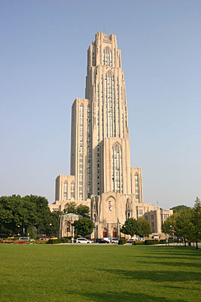

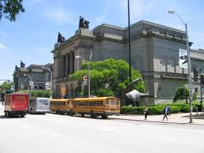

Pittsburgh made the National Geographic Traveller’s 19 for 2019 Cool List. The British edition of the publication names Pittsburgh as a destination set to hit the headlines in 2019. Pittsburgh, the only U.S. city to make the list, was ranked third among the coolest places to travel in the coming year.
Hope to see you in–person
in Pittsburgh before long!
Cathedral of Learning
Soldiers & Sailors Museum
1787
Phipps of Conservatory
Carnegie Museum

Slide 10
This Workshop
GOALS
Novel ideas for axion detection using quantum systems.
Overview of exciting developments in the rapidly emerging field of axion electrodynamics in condensed matter systems.
Bring together people working on these two disparate topics for creative new ideas & collaborations both in fundamental axion detection and the emergence of axionic quasi-particles in materials.
Thank you all !
Look forward to & wish you a fruitful workshop!

