Slide 1
Detection of Ultraweak Forces from DM using Stimulated Emission
Aaron S. Chou
Fermilab
April 6, 2023

Slide 2
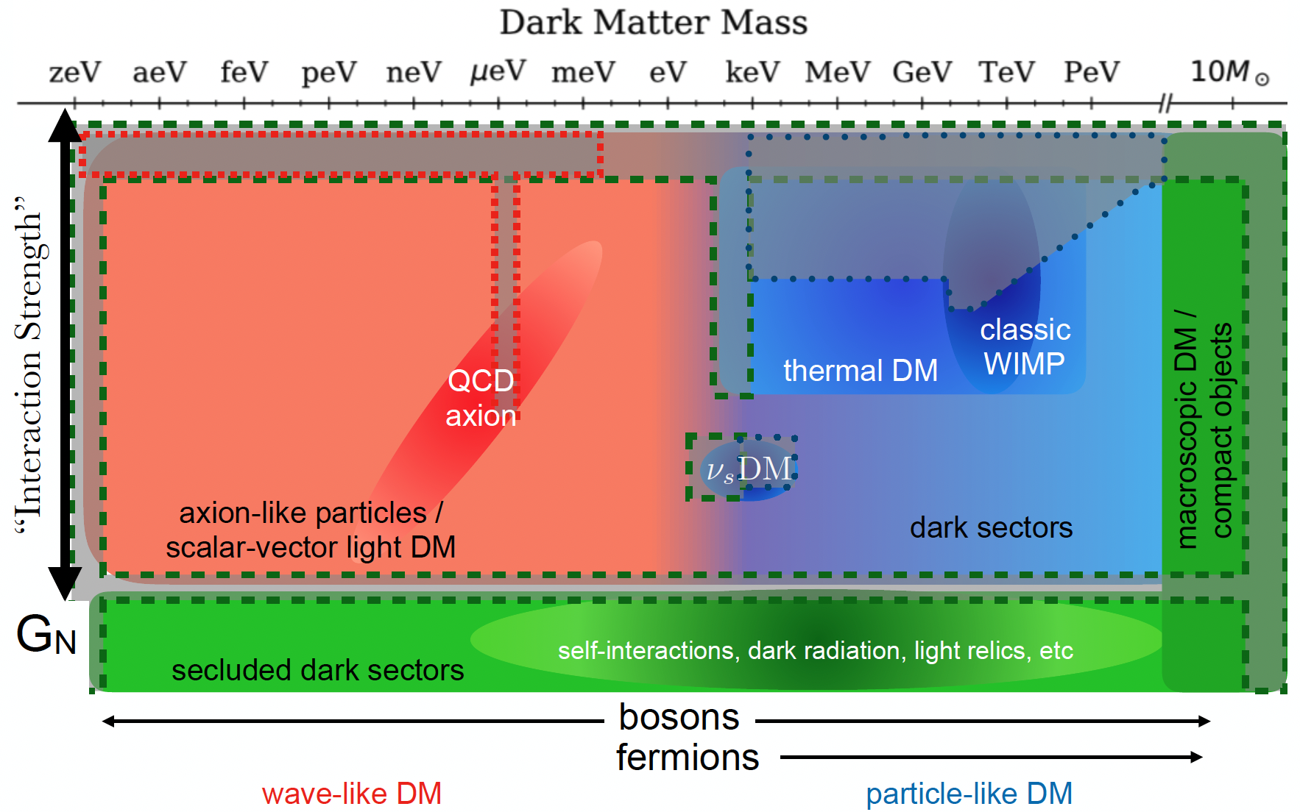
Quantum sensors: E < 1 eV
Conventional tech:
E > 1 eV
E&M
Cartoon from Snowmass

Slide 3
Quantum sensors: E < 1 eV
Conventional tech:
E > 1 eV
E&M
Atomic IFOs, clocks
Transmon qubits,
quantum amps, transducers, SRF cavities, SNSPDs, NMR
Single phonon sensors, quantum materials
Xe, Ar,
Si, Ge, colliders, fixed target
Cartoon from Snowmass

Slide 4
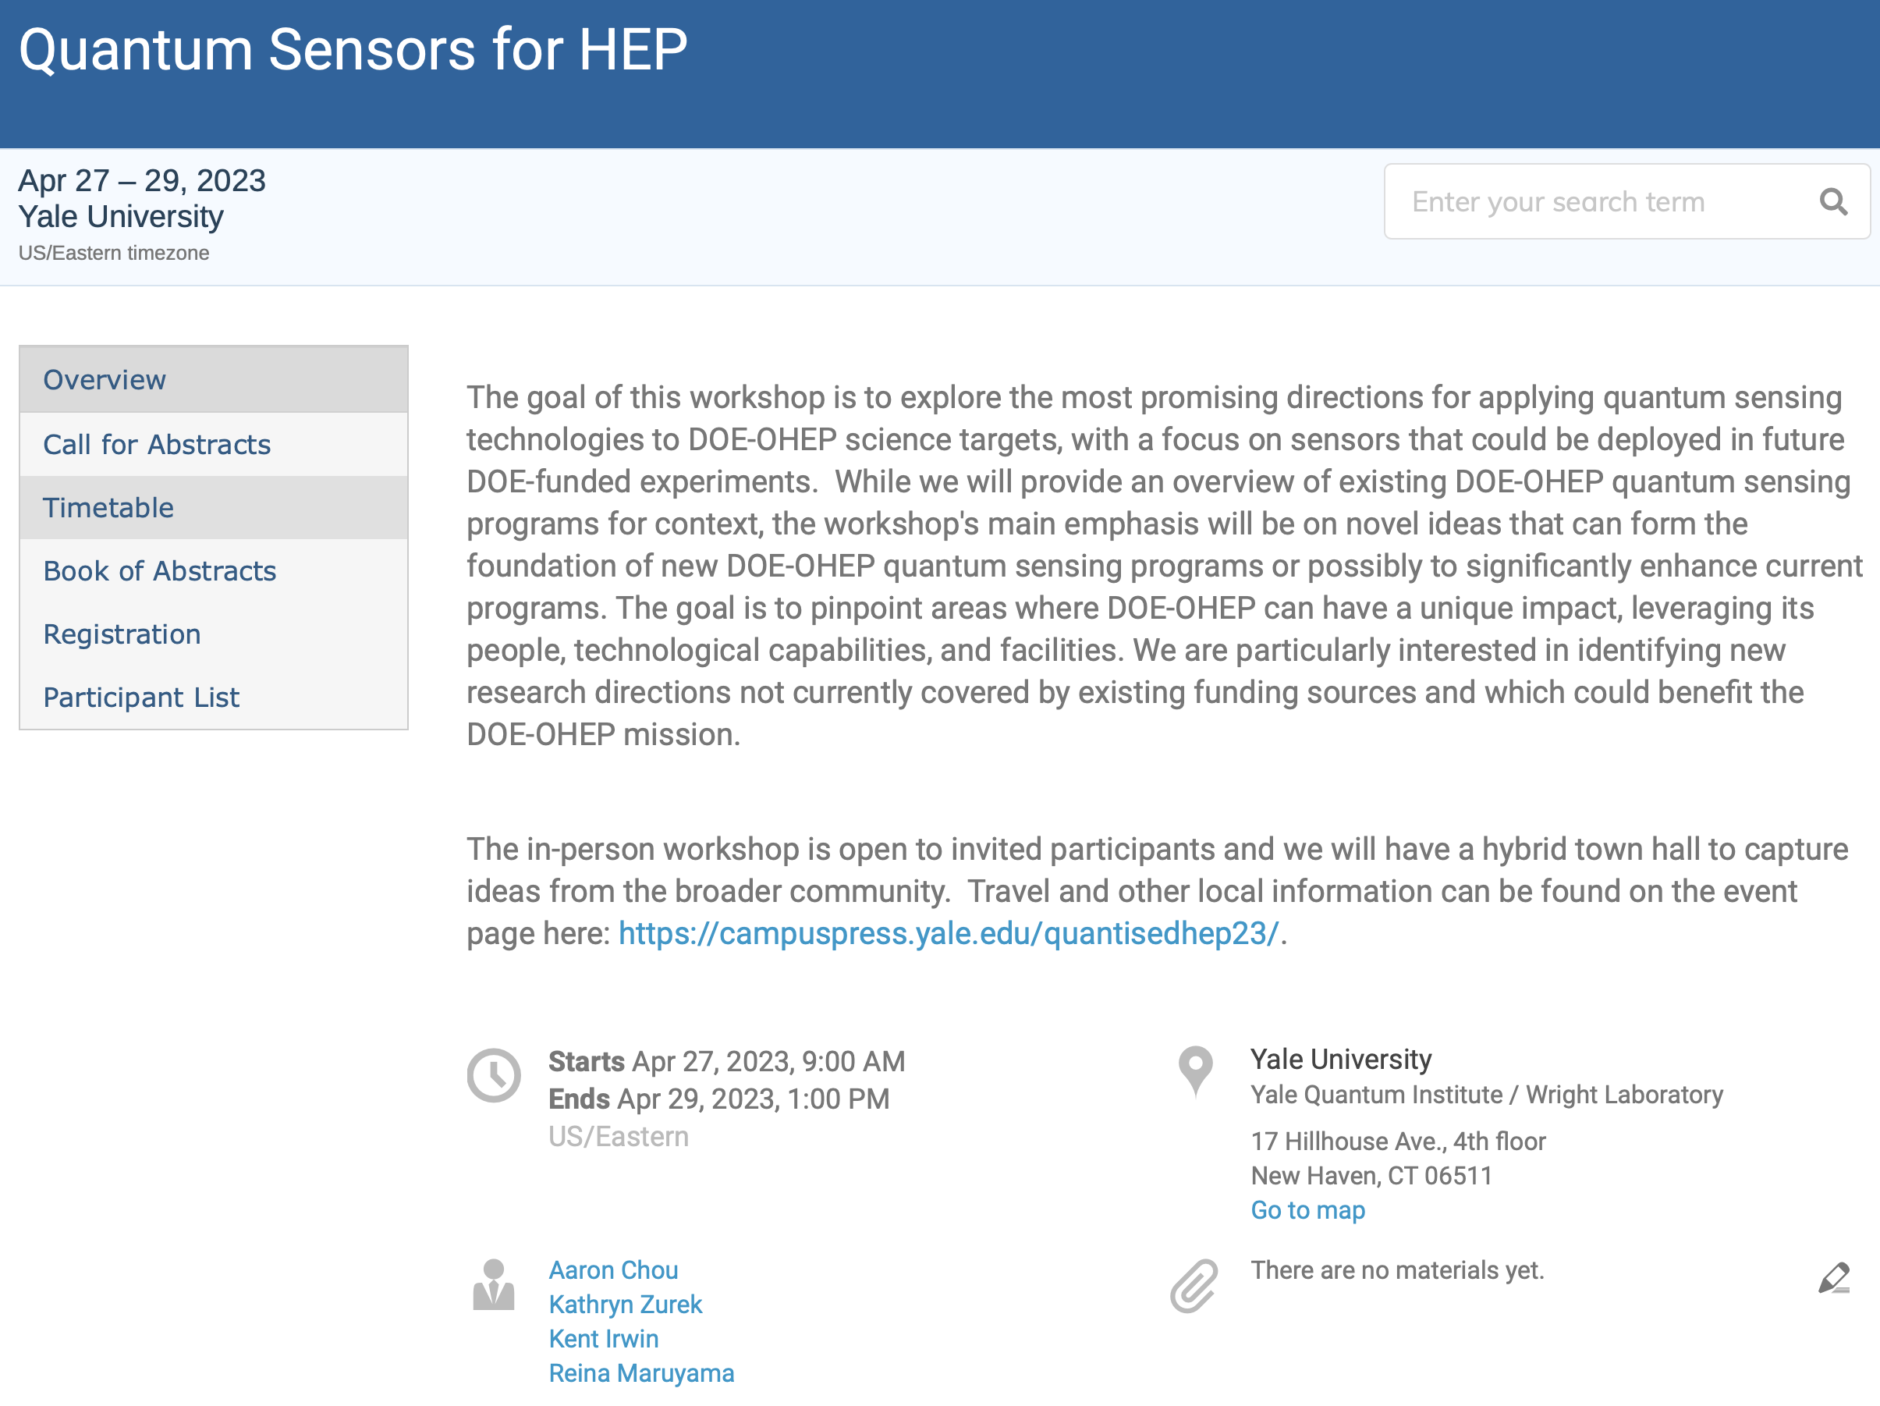
Hybrid Town Hall on Quantum Sensors for HEP
April 27 afternoon
Abstract submission is open for 2-slide presentations on new ideas,
i.e. not previously discussed at Snowmass or other past community meetings, and not already fundable by some existing program
https://indico.fnal.gov/event/59102/

Slide 5
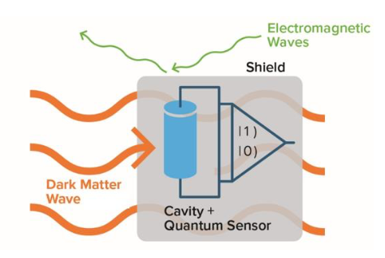
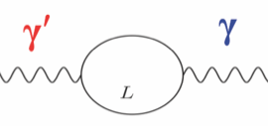
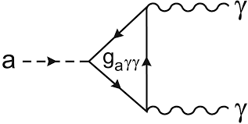
Bosonic DM waves: dark photons, spin-0 particles like the QCD axion
Flavor mixing
Heavy fermion loop
Topological magneto-electric effect
E
Forces from classical dark matter waves can deliver energy/momentum in the form of single photons that mysteriously appear in your well-shielded apparatus.
B

Slide 6
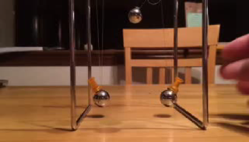
Energy transfer between two coupled oscillators
Weak coupling -- takes many swings to fully transfer the wave amplitude.
In real life, the number of swings is limited by coherence time and one only gets the transfer of an occasional single quantum of energy.

Slide 7
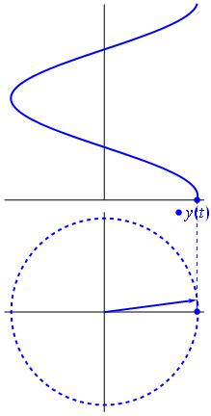
Sine waves are described by phasors
Quantum mechanics:
Endpoint of phasor in X, P phase space has uncertainty principle
∆X×∆P ≥ ½.
In polar coordinates this becomes:
∆N×∆𝜑 ≥ ½.

Slide 8
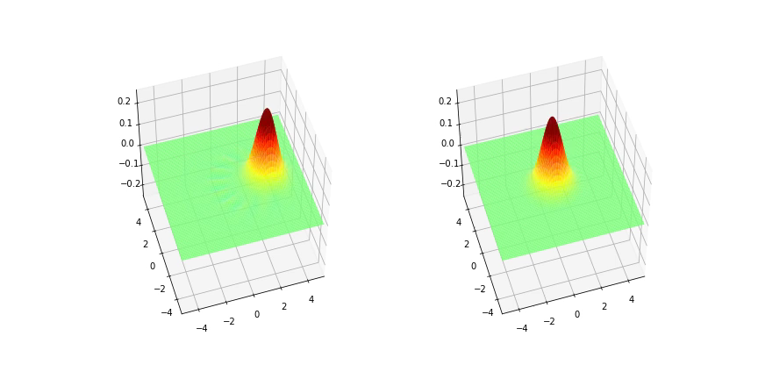
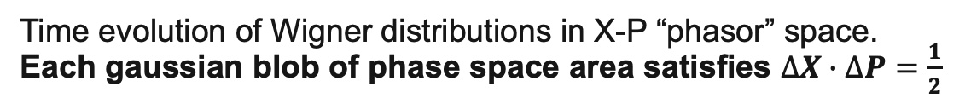
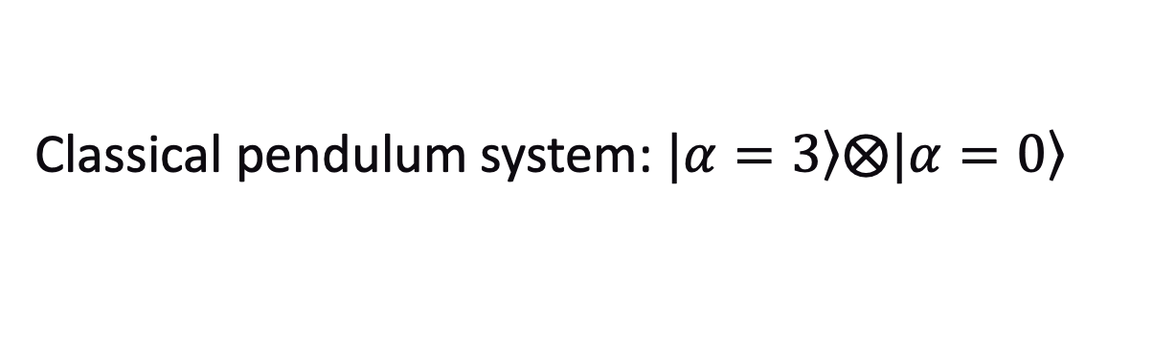
Classical pendulum system: $\left.|α=3\right\rangle ⨂\left.|α=0\right\rangle$
Time evolution of Wigner distributions in X-P “phasor” space.
Each gaussian blob of phase space area satisfies $∆X∙∆P=\frac{1}{2}$
P
X
Simulated with QuTIP
Given enough time, the two pendula swap their coherent states.
Real experiments are limited by coherence time so only get the occasional single quantum of signal

Slide 9
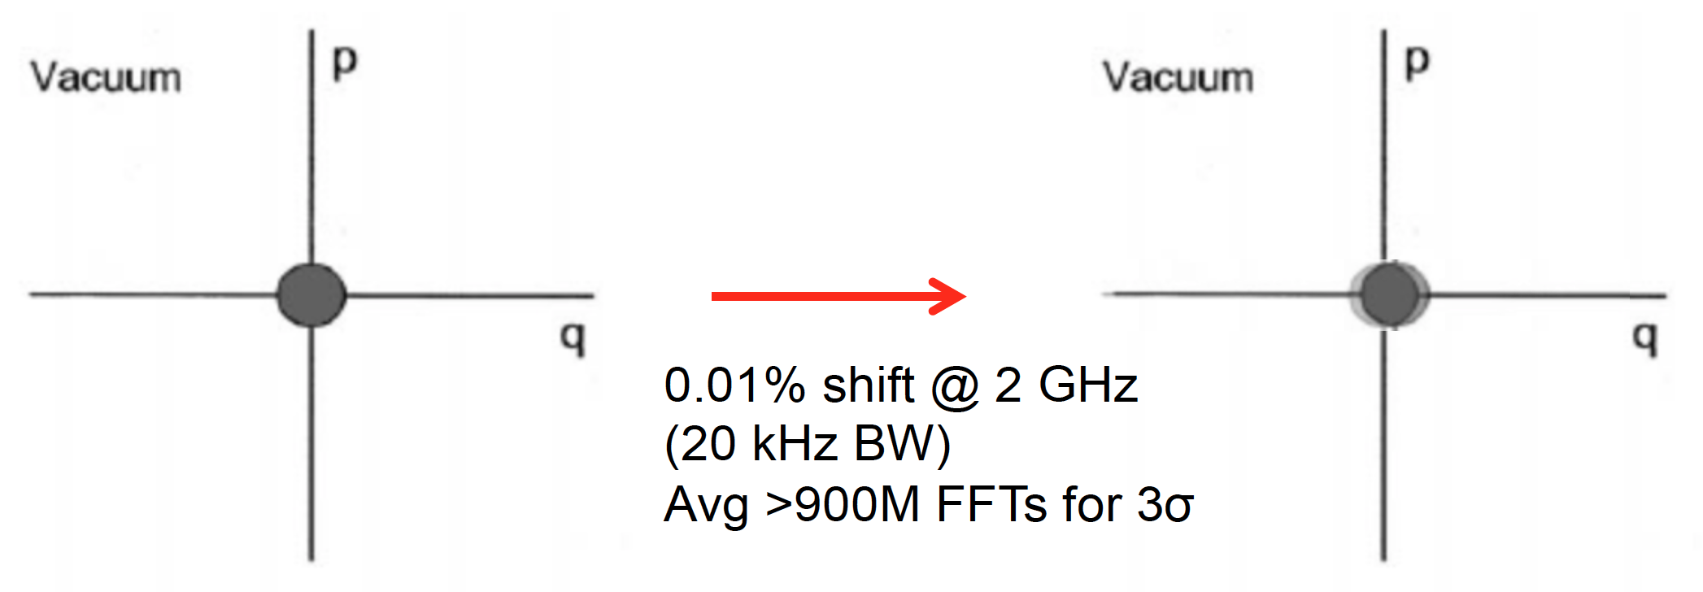
Big Problem: Signal/Noise Ratio
p
Gaussian distribution of endpoint of phasor
p
Initial state:
x
Force over limited coherence time
x
Coherent state
phase space area = ½ħ
(Exaggerated) displacement <10⁻³ of zero-point noise
𝛼=10⁻²
The Gaussian blob is also effectively the probe resolution when using a linear amplifier to resolve the tiny signal sine wave. Simultaneous measurement of non-commuting observables N and 𝜑 incurs the Heisenberg uncertainty principle ∆N×∆𝜑 ≥ ½.
Need millions of standard-quantum-limit measurements to average away the zero-point noise to resolve the tiny displacement signal.

Slide 10

To reduce readout noise, use photon counting to project displacements into the Fock basis, i.e. number eigenstates
Previously we measured both amplitude and phase, but this is dumb since the dark matter phase is random and not interesting. Useless information obtained at high cost!
Instead, measure only displacement amplitude
no zero-point noise since we are not simultaneously measuring non-commuting observables
Measurement noise, e.g. from dark counts can be arbitrarily low
Blue rings give the probe resolution
1
2
3
Displaced vacuum state exponentially leaks into non-zero Fock number.
Detect displacement by counting the occasional single photon.

Slide 11
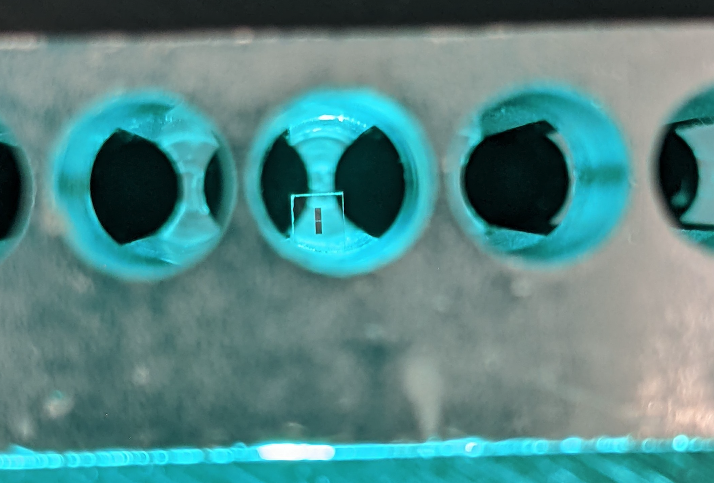
Transmon qubit in 6 GHz aluminum cavity
Image credit: Akash Dixit
Cavity = quantum RAM
Qubit = nonlinear LC oscillator
Dark matter waves scatter on walls of cavity, depositing occasional single photons whose electric field drives the qubit nonlinear. → Measure AC Stark shift of the qubit’s frequency.

Slide 12
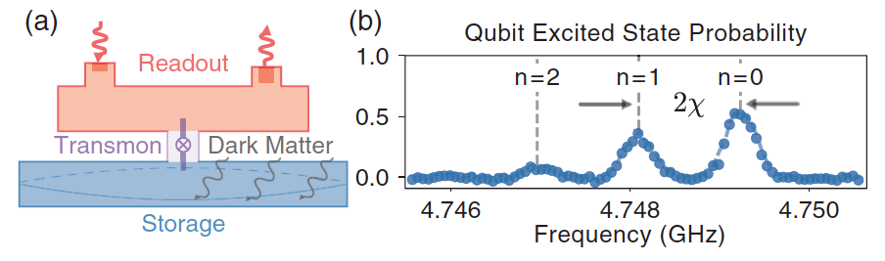
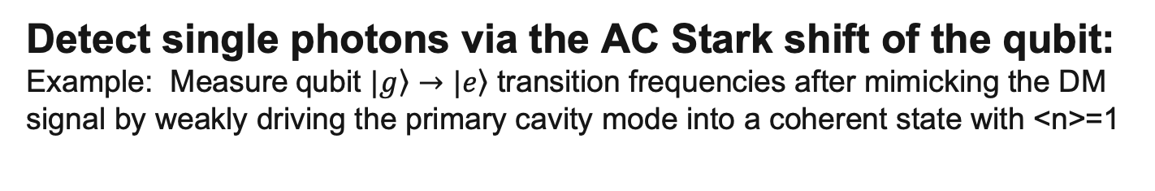
Detect single photons via the AC Stark shift of the qubit:
Example: Measure qubit $|\left.g\right\rangle →|\left.e\right\rangle$ transition frequencies after mimicking the DM signal by weakly driving the primary cavity mode into a coherent state with <n>=1
Akash V. Dixit, et.al, Phys.Rev.Lett. 126, 141302 (2021)
The measured qubit response spectrum exhibits a distribution of resonances which are in 1-1 correspondence with the Poisson distribution of the cavity’s coherent state.
Non-destructively count photons by measuring the qubit’s quantized frequency shift via this “quantum non-demolition” measurement.
Repeat many times for high fidelity single photon detection.
Demonstrated reduction in noise levels to 40x below the Standard Quantum Limit

Slide 13

More stupid qubit tricks:
Increase signal rate by stimulated emission of photons from DM waves
Start the photon wave swinging so it can more easily accept energy from the DM.
Power = $\vec{Force}∙\vec{velocity}$
Good!
Waiting…
Oops, wrong phase
Phase offset determines the direction of energy flow.
Wait ... but we don’t know the instantaneous phase of the DM wave!

Slide 14
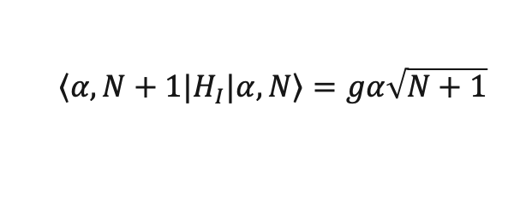

What happens if we initialize the probe to a Fock state instead of a Gaussian blob?
A Fock state is a superposition of an oscillator in all possible phases of its sinusoidal motion: ∆N×∆𝜑 ≥ ½
responds equally well to pushes at any time.
It also has definite occupation number N
→ no Poisson noise!
… and force × velocity still works:
$H_{I}$ = $g(a^{†}b$+${ab}^{†}$) →
$${\left\langle α,N+1|\right.H}_{I}|α,\left.N\right\rangle =gα\sqrt{N+1}$$
N=1 Fock state
Idea from Konrad Lehnert
(JILA/U.Colorado)

Slide 15
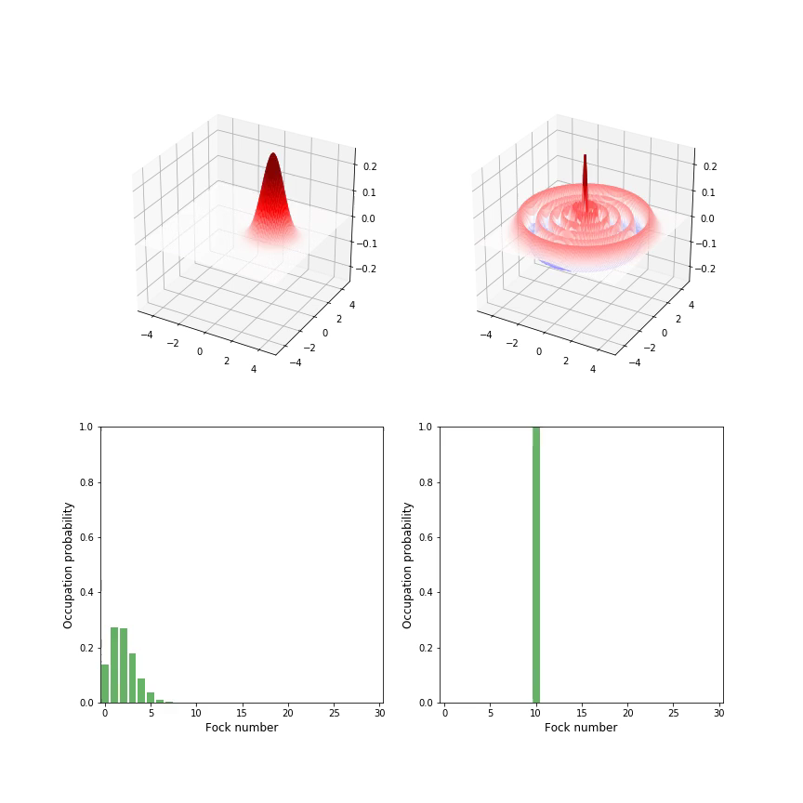
Mixing between a coherent state and a Fock state
The dark matter wave is a sine wave described by a Glauber coherent state
The cavity photon mode has been prepared as a N=10 Fock state, highly sensitive to environmental disturbances
X
P
The two oscillators swap states!
This can be understood by decomposing the Fock state into a linear superposition of coherent states (which form an overcomplete basis for the phase space).
QuTiP simulation

Slide 16
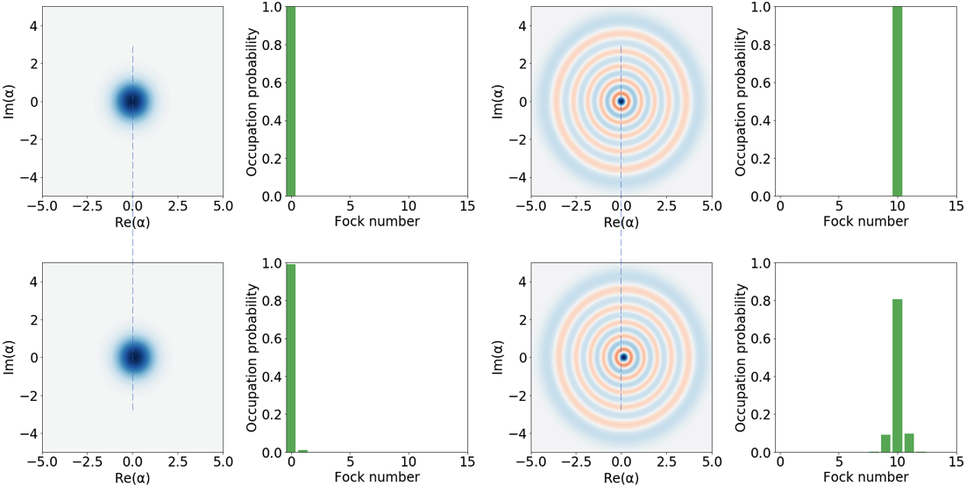

For small amplitudes 𝜶, the transfer of quanta from DM to photons is enhanced by a factor (n+1)
N=0
N=10
Displacement
Displacement
Stimulated emission / absorption signals
Spontaneous emission signal
QuTiP simulation
$${\left|\left\langle n+1 | \hat{D}\left(α\right) | n\right\rangle \right|}^{2}\sim { α}^{2}(n+1)$$

Slide 17
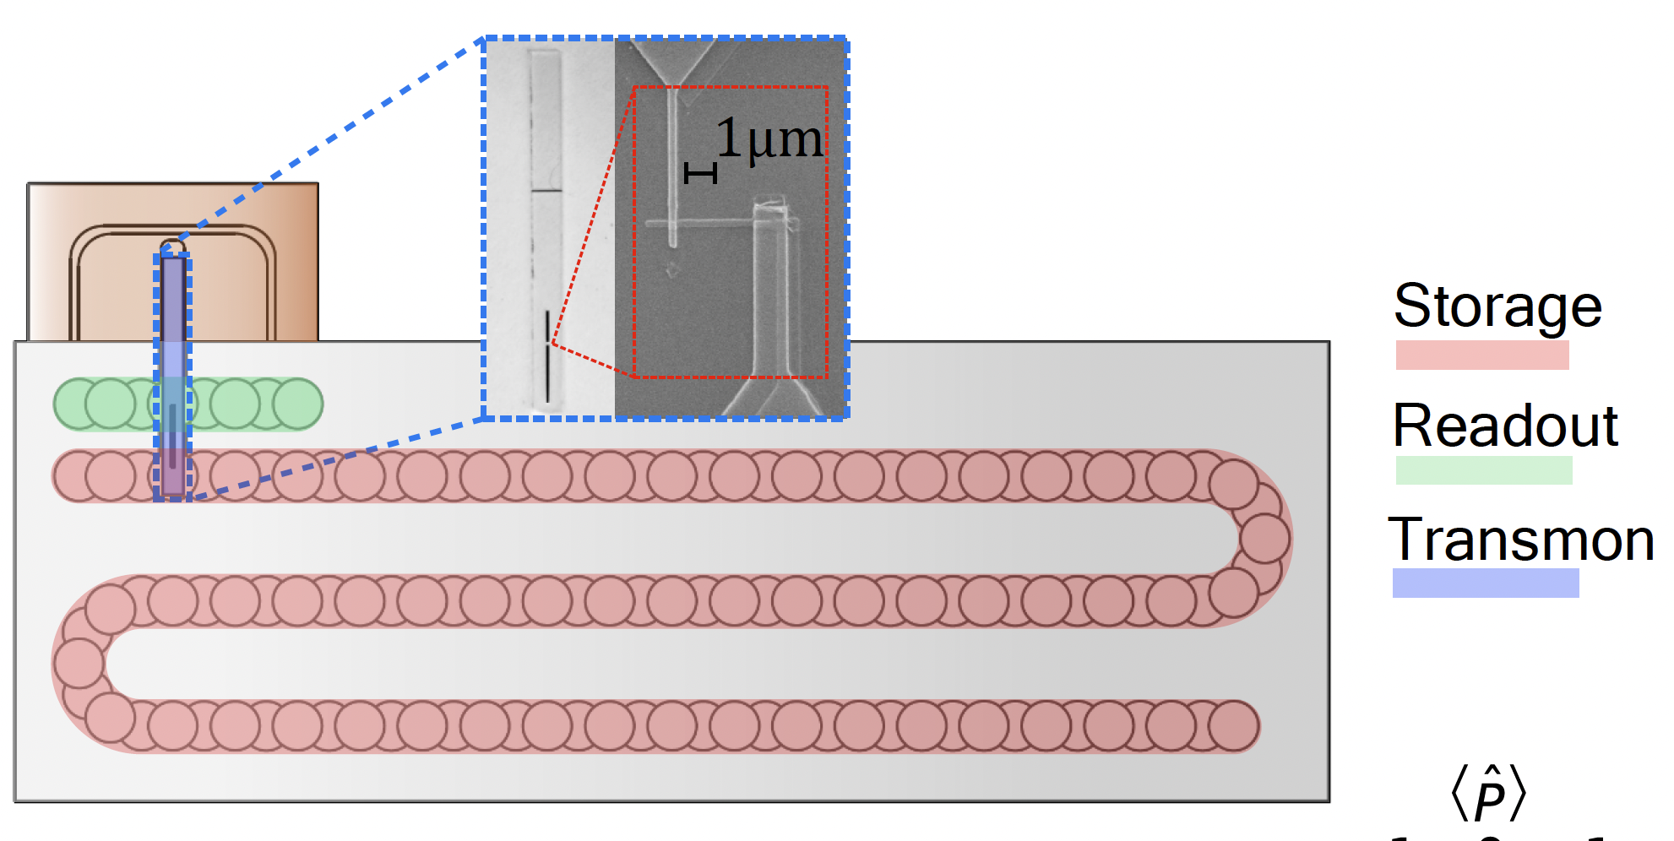
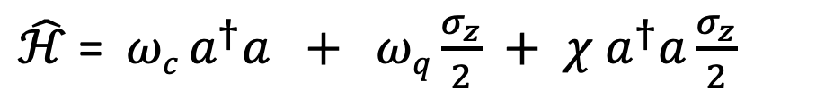
Qubit-cavity system
6.011 GHz
8.052 GHz
4.749 GHz
$\hat{ℋ}$=${ωc}^{ }a^{†}a + ωq\frac{σ_{z}}{2} + χ{ a}^{†}a\frac{σ_{z}}{2}$
Flute cavity: Phys. Rev. Lett. 127, 107701 (2021)
Notes:
So how do we prepare Fock states in a cavity?
We couple a a high-Q 3D superconducting cavity to a transmon qubit. This cavity stores the signal photon converted from the dark matter. At the same time, the qubit is dispersively coupled to a low Q readout cavity to measure the state of the qubit as shown in the left.
We machine the cavity out of 6N Al block using a flute method, developed in our lab . It a very clever technique to obtain a desired cavity geometry without any seams.
The Hamiltonian of this system which describes the interaction between different elements is shown here. It is also known as Jaynes-Cummings Hamiltonian. The first term represents the cavity mode, the second term represents the qubit mode and the last term describes the dispersive interaction between the qubit and the cavity.
I have listed the mode frequencies here for your reference.

Slide 18
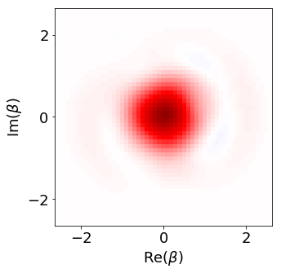
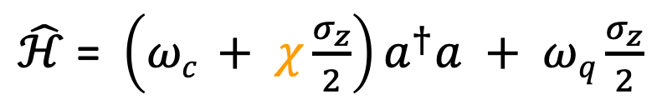
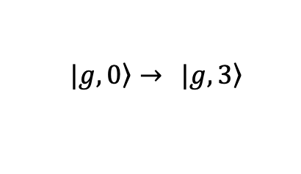
Creating Fock states in a (non)linear system
“Optimal control” sequence of drives at both the qubit and cavity frequencies,
determined by “gradient ascent pulse engineering”
$\hat{ℋ}$ = ${\left({ωc}^{ }+ χ\frac{σ_{z}}{2}\right)a}^{†}a + ωq\frac{σ_{z}}{2}$
$\left. |g, 0\right\rangle →$ $\left. |g, 3\right\rangle$
Slide/data from Ankur Agrawal
Notes:
Fock states are quantum state of light which cannot be created in a linear system such as a cavity. However, if we rewrite the Hamiltonian again, we see that the cavity frequency is dependent on the state of the qubit. This non-linearity allows us to prepare the cavity in any quantum state.
I used an optimal control package which was developed in our lab to solve an inversion problem. Given a Hamiltonian, it uses machine learning algorithm to generate a set of qubit and cavity control drives to perform a non-trivial state transfer. I used a 3D multimode cavity coupled to a transmon as shown in the image here for the experiment.
Here is an example of such a state transfer from the ground state to n=1 Fock state. We can see the cavity’s wave function evolve from n=0 to n=1 in this movie.
Wigner function is a quasi-distribution function which represents the wavefunction of the oscillator. Parity operator is an effective experimental tool to compute the density matrix.

Slide 19
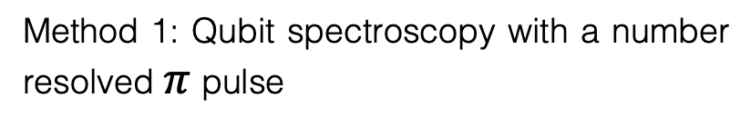
Verifying the state preparation
Sweep pi pulse frequency
Method 1: Qubit spectroscopy with a number resolved $π$pulse
Method 2: Wigner tomography to reconstruct the density matrix
Slide/data from Ankur Agrawal
Notes:
We can use this method to verify the preparation of cavity in a Fock state.
Method 1 is a qubit spectroscopy with a number resolved pi pulse which I had described earlier. On the left, we see the qubit spectrum and a single peak in each spectrum confirms the cavity state in a definite photon number.
The other method is Wigner tomography which is slightly more involved and requires multiple measurements to reconstruct the state of the cavity.
Hence, for the rest of this talk, I am going to use a number resolved qubit pi pulse to probe the cavity state.
I would like to point out that the information that we obtain from a resolved pi pulse and the Wigner tomography is the same, as there is no phase information associated with the cavity state. Henceforth, we will just use resolved pi pulse to probe the cavity state.

Slide 20


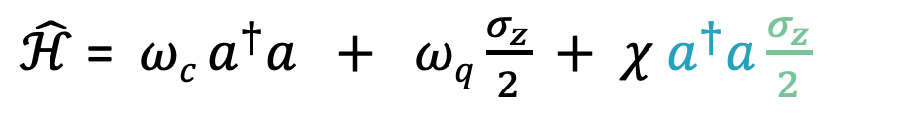
Repeated measurements to mitigate errors
$\hat{ℋ}$=${ωc}^{ }a^{†}a + ωq\frac{σ_{z}}{2} + χ{ a}^{†}a\frac{σ_{z}}{2}$
1st pi pulse if successfully flips the qubit, collapses cavity wavefunction into definite
Oops
Subsequent pi pulses to measure n are quantum non-demolition since [H,n]=0
AV Dixit, AA et al.
PRL 126, 141302, 2021
Ask the qubit same question multiple times to boost the confidence and assign a probability for tagging the photon
Notes:
If we stare at the Hamiltonian for a while then we can check that it commutes with the number operator of the cavity and the qubit. It means that we can measure the same photon multiple times without actually destroying it.
This quantum non-demolition nature of the measurement allows us to make repeated measurements of the same photon, significantly bringing down the error rate as compared to a single measurement.
Akash, my former colleague, developed a fancy majority voting analysis which tells you the likelihood that a cavity contains a photon or not based on the observed readout sequence.

Slide 21
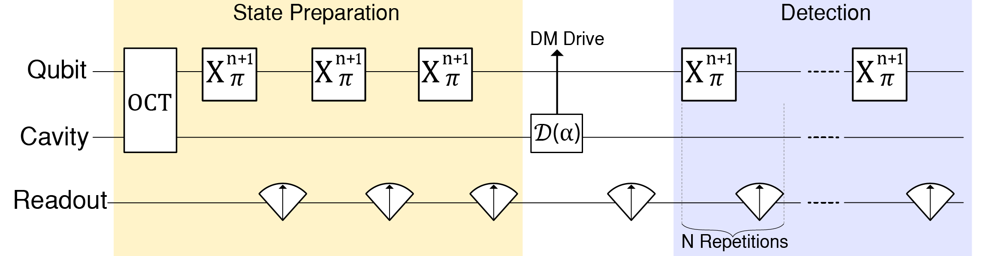

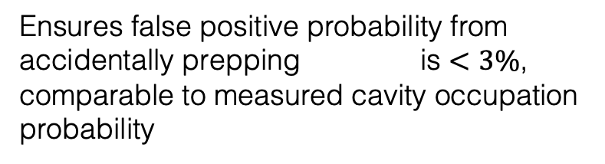
Stimulated emission protocol
Mock Injection
Ensures false positive probability from accidentally prepping is $<3\%$,
comparable to measured cavity occupation probability
Hidden Markov model analyzes probability of observed sequence of yes’s and no’s from repeated pi pulses.
Notes:
After preparing the Fock states, let me describe the stimulated emission protocol, where we have divided the sequence into two.
First part involves the state preparation and false positive reduction by conditionally pi pulsing the qubit at |n+1> peak and if and only if the answer is a series of 3 no’s do, we proceed. This is to check that the cavity didn’t accidentally start in |n+1> Fock state.
By doing so, we can suppress false positive errors below 3%.
In the next part, we inject a fake dark matter signal and then measure the cavity occupation probability being in n+1 Fock state with conditional repeated measurements using the qubit.
We then apply a Hidden Markov Model that I described in the previous section to reconstruct the state of the cavity after the coherent drive and count the number of positive events which cross a certain likelihood ratio.
I would like to point out one of the key difference in the protocol between photon counting and stimulated emission: in the photon counting we were interested in the state of the cavity before we started the first measurement where as, in this case we have to be very certain that the cavity is still in the correct Fock state before we apply the coherent displacement. And thus, it took a lot of time to come up with this sequence to balance the state preparation fidelity and the false positives.
We perform active reset of the qubit and update pulse parameters to correct for higher order terms in the Hamiltonian as they start to matter as we higher in photon numbers.

Slide 22
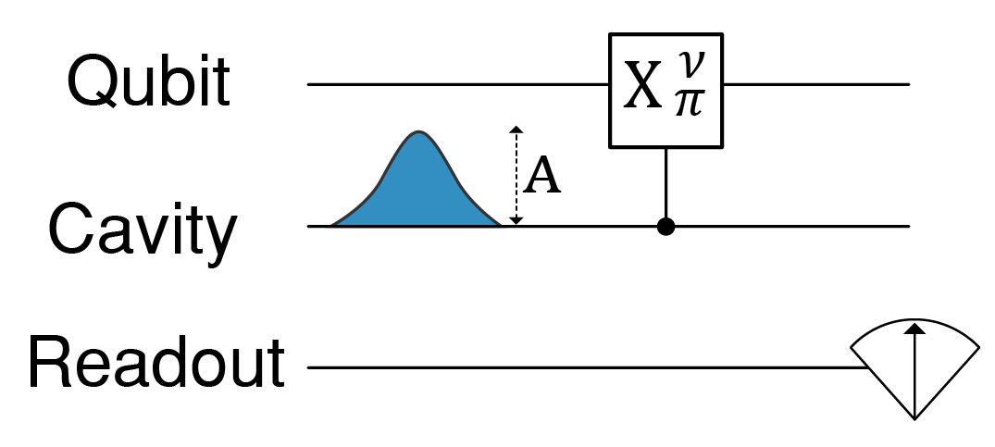
Absolutely calibrated photon injection
Measure resulting Poisson distribution of cavity occupation number
Inject sine wave in Gaussian envelope.
Slide/data from Ankur Agrawal,
Preprint in prep.
4.955 4.960 4.965
Frequency (GHz)
Notes:
In order to characterize the detector, we calibrate the injected photon number by varying the amplitude of the cavity drive tone and performing a qubit spectroscopy. The measured cavity occupation is then fitted to a Poisson distribution to extract the mean photon number in the cavity.

Slide 23
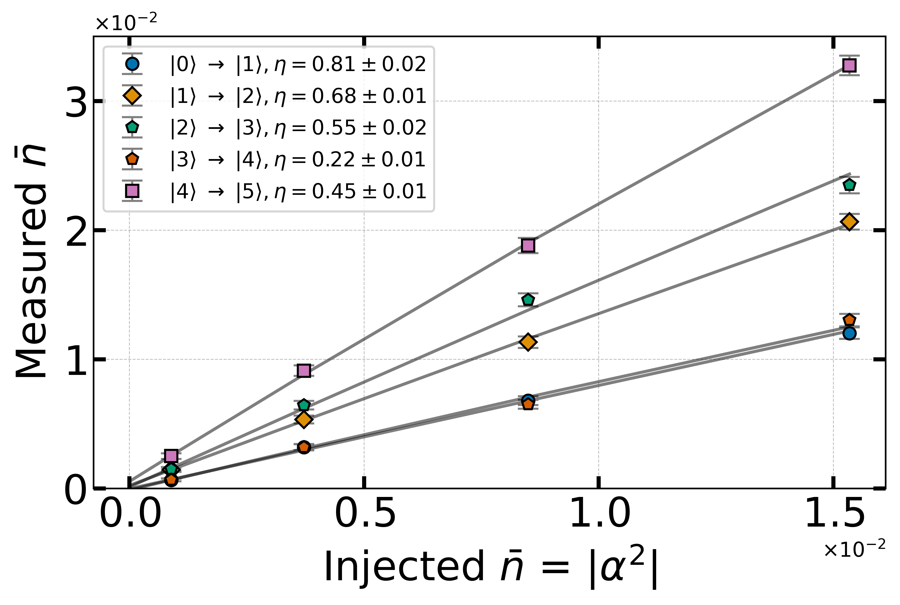
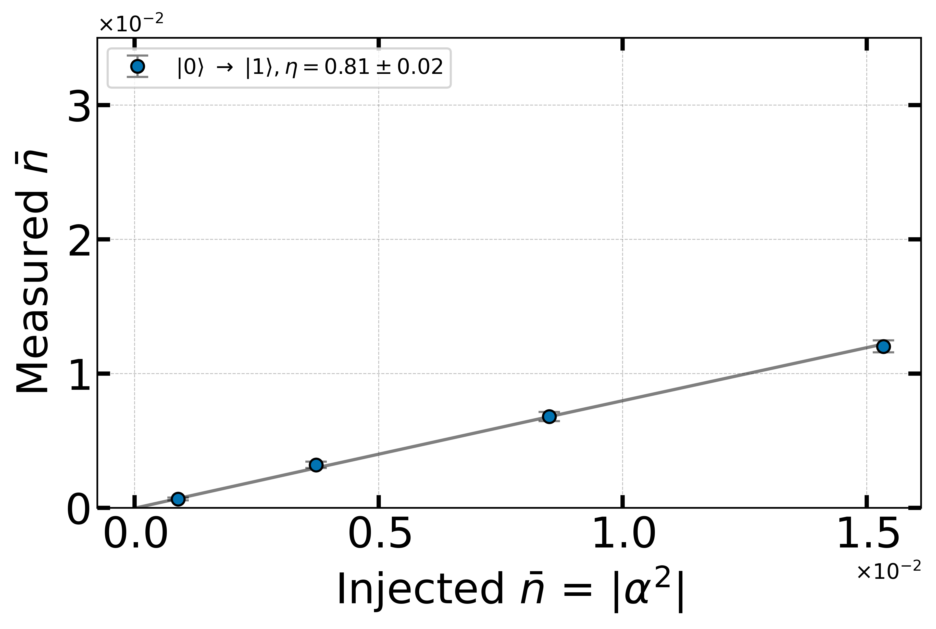
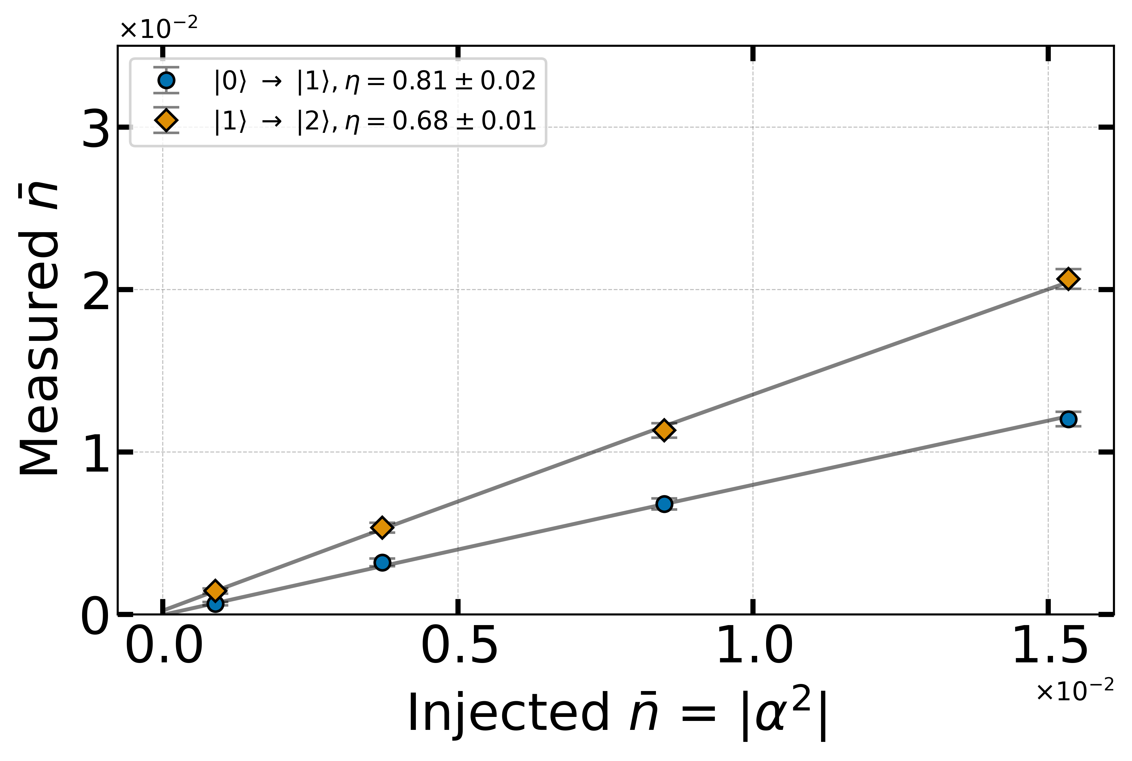
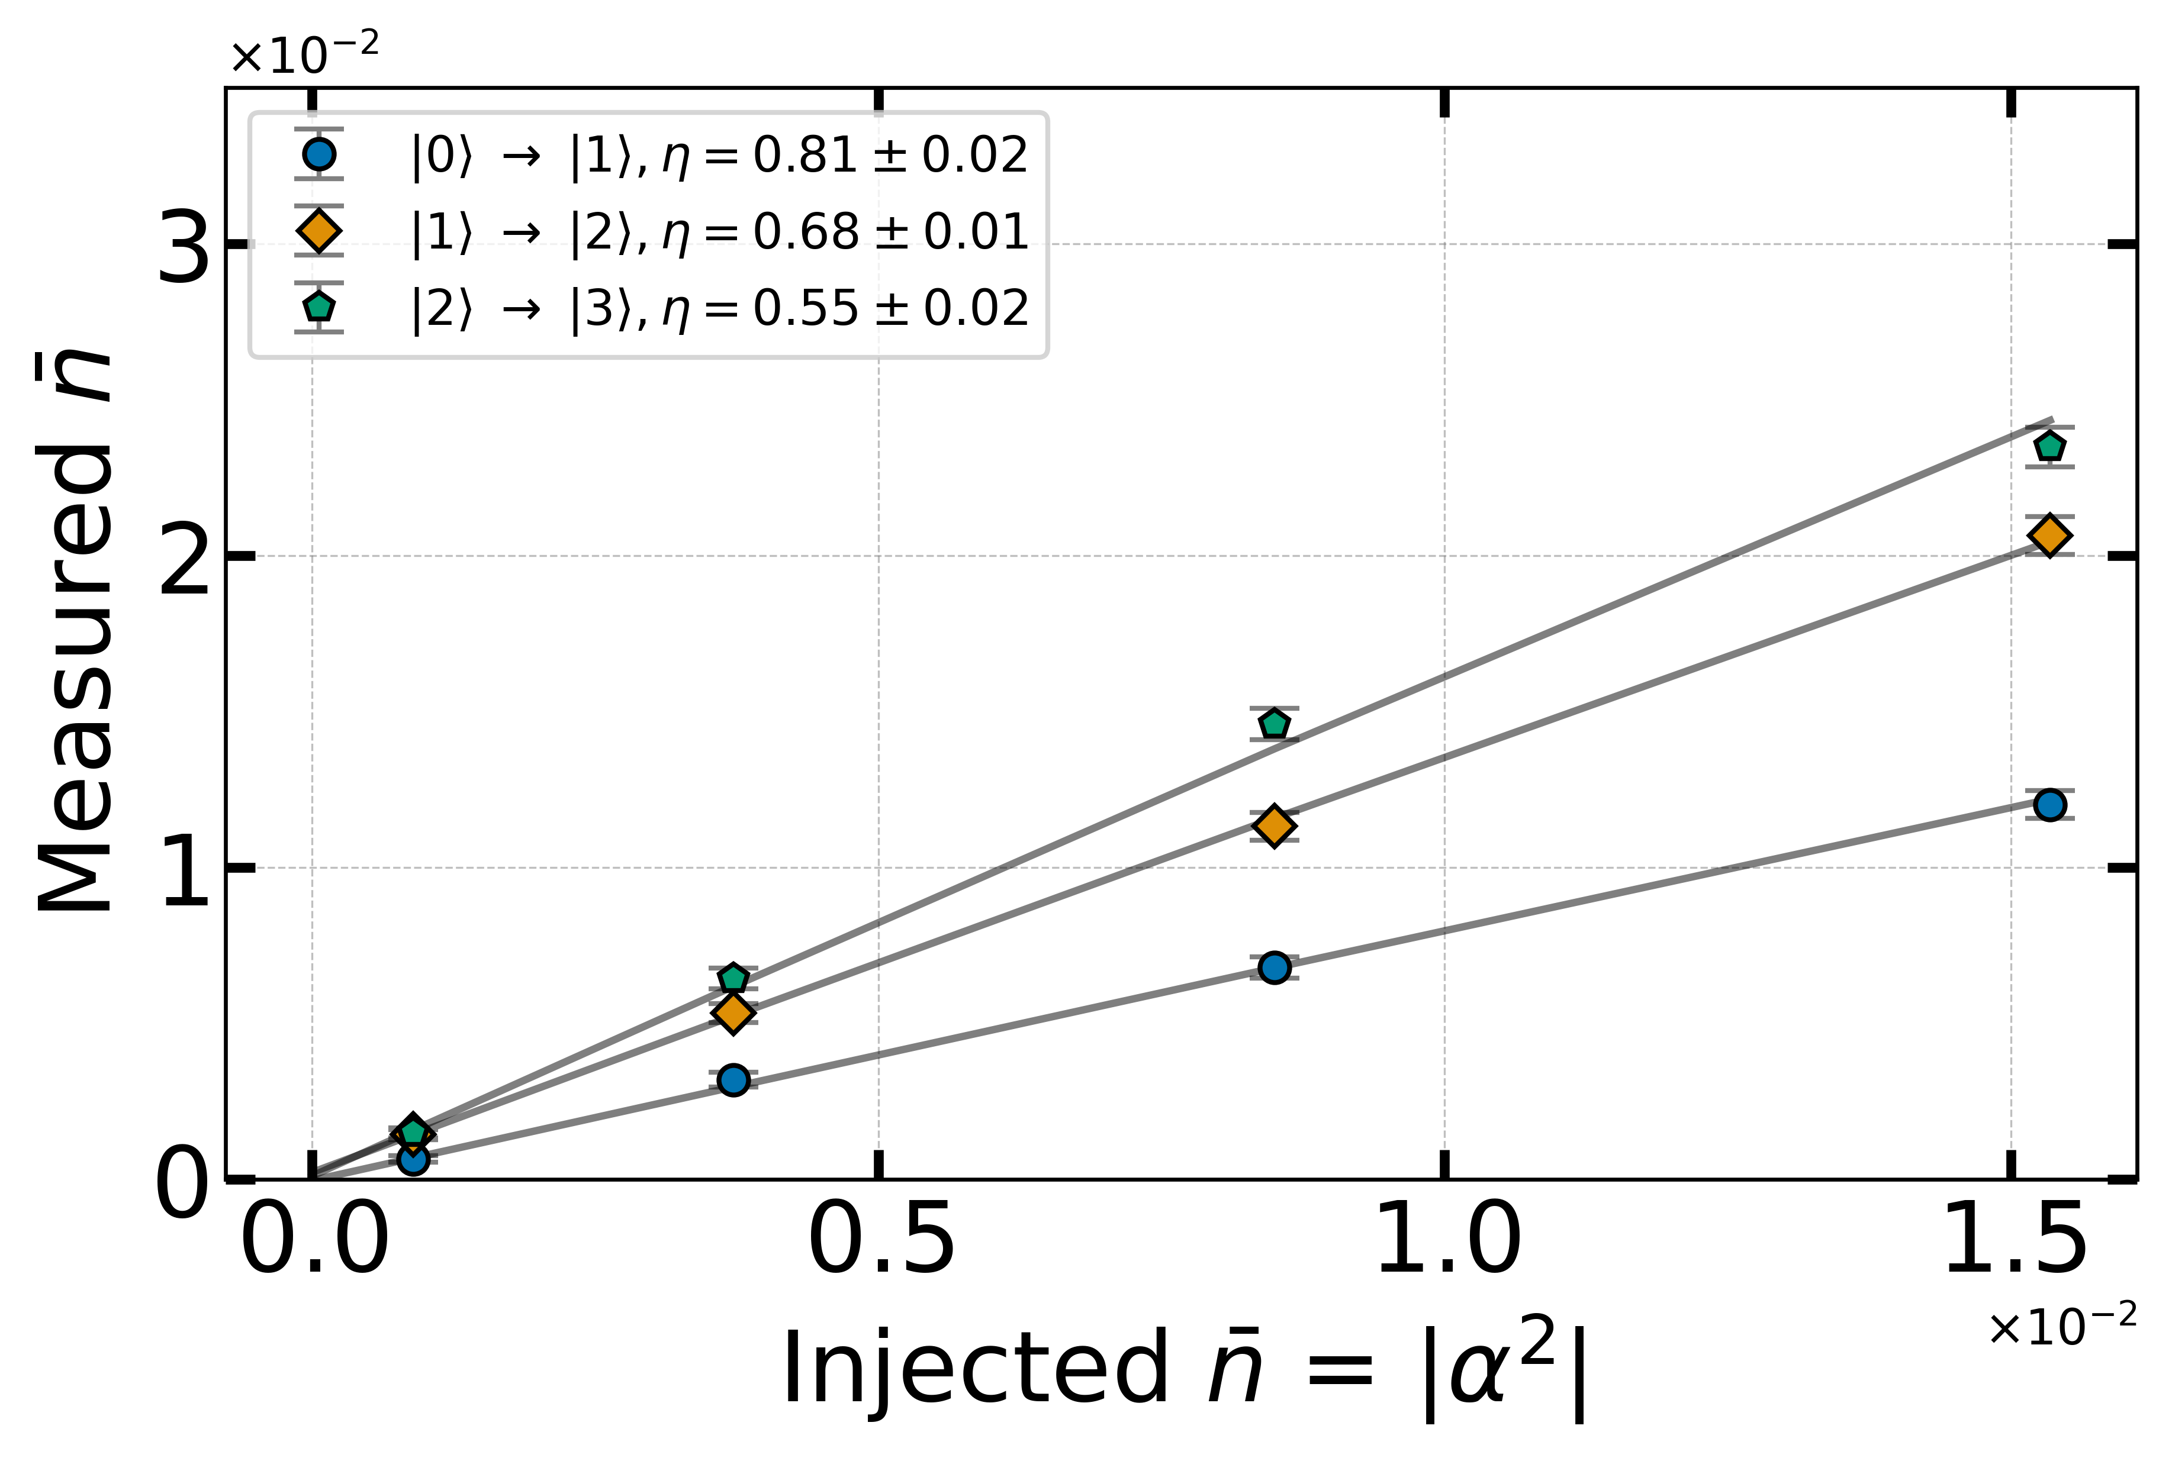
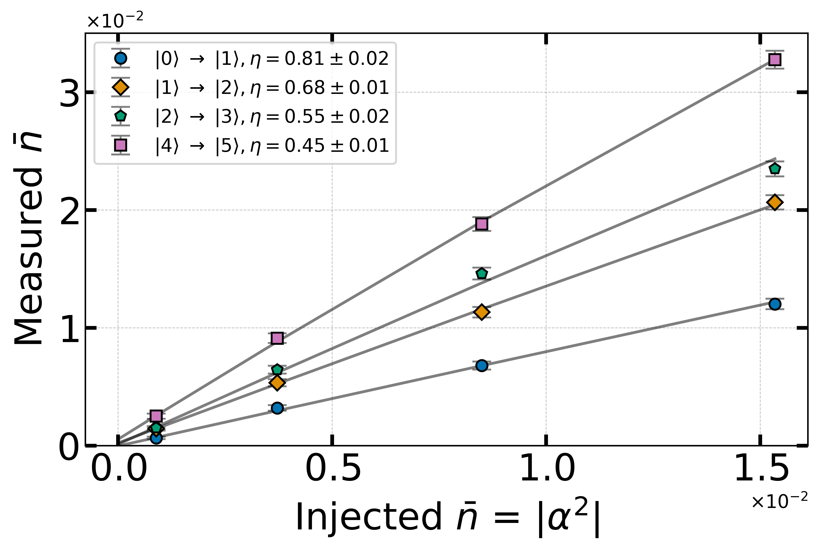
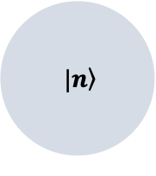
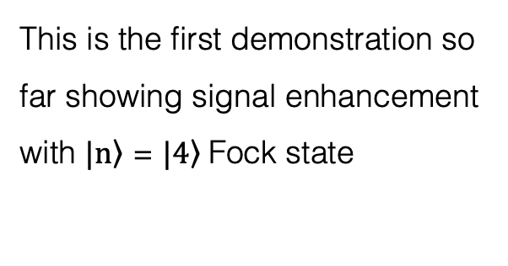

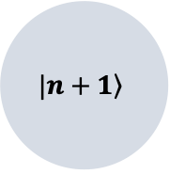
Signature of enhancement
$$\left. |n\right\rangle$$
$$n_{inj}$$
$$\left.|n+1\right\rangle$$
This is the first demonstration so far showing signal enhancement with $\left.|n\right\rangle$ = $\left.|4\right\rangle$Fock state
Less than a factor of (n+1) due to measurement inefficiencies, e.g. photon decays during measurement, QND has small demolition probability, etc. HMM optimized for small background rate n_{bkgd}<1%
Slide/data from Ankur Agrawal,
Preprint in prep.
Notes:
Given this experimental protocol, let me describe how we characterize the detector.
After initializing the cavity in a particular Fock state, we inject a mean photon number shown on the x-axis. Y-axis is the probability of finding the cavity in (n+1) given that the cavity started in the correct Fock state.
So, let’s start with the cavity in its ground state. As we inject more photons, we measure more as expected. Now, if we initialize the cavity in n=1 Fock state then we should see higher occupation probability.
And, we do! Let’s go even higher.
As we can see, the stimulated emission does enhance the signal.
In a previous work such enhancement with n=1 was reported in an ion-trap system.
However, this is the first demonstration of enhancing weak signals using n=4 Fock state.
You may be asking why n=3 is missing. Unfortunately, we see some anomalous behaviour with n=3 and we suspect it is due to leakage to other modes in the cavity. We have identified a couple of potential transition with other modes which could explain this.

Slide 24
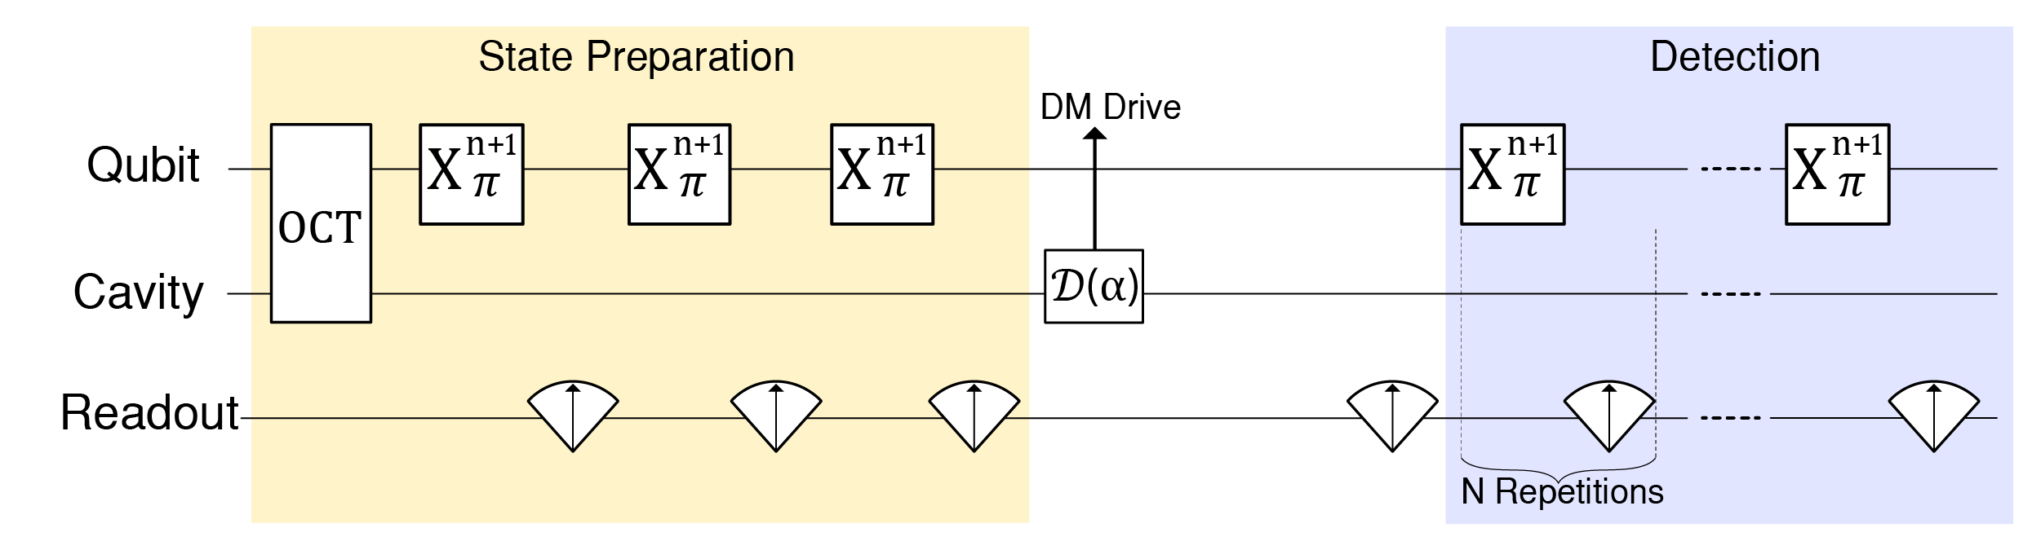
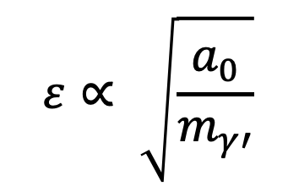
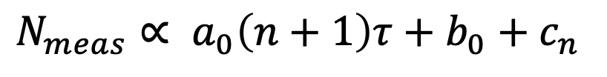

Backgrounds
Could be dark matter?
$$τ$$
$N_{meas}∝ a_{0}\left(n+1\right)τ+b_{0}+$ $c_{n}$
Coherent
$$ε∝ \sqrt{\frac{a_{0}}{m_{γ′}}}$$
Incoherent
State prep.
∼ 20000 trials for each point. 𝝉∼10 us, 𝝉_{DM}∼ 100 us, 𝝉_{cav}∼ 1ms
Slide/data from Ankur Agrawal,
Preprint in prep.
Notes:
In order to understand the source of background counts and conduct a hidden photon search, we collect another dataset with different Fock states where we turn off the fake injection and vary the time between preparation and detection.
We divide the number of measured counts into three bins, first is coherent source which will have an (n+1) enhancement factor, second, incoherent source and last a state dependent error which could be different for each Fock state.
Here are the measured counts as function of dwell time for different Fock states. By performing a global fit to the data, we extract the different fit coefficients. It is possible that the coherent source is a dark matter wave? We can convert the coefficient to hidden photon mixing angle.

Slide 25
Hidden photon search
Not optimized. Just using data from zero injected signal.
Dark matter drive is always on. If too large, this would have screwed up the Fock state prep.
Conservative limit set by assuming all background counts are dark matter
Preliminary
Agrawal et. al.
(Preprint on arxiv soon)
Slide/data from Ankur Agrawal,
Preprint in prep.
Notes:
We convert a_0 into kinetic mixing angle and compute 90% confidence limit via standard error propagation formula. In this curve, we see two regions. The region between blue and red line is excluded via stimulated emission as explained earlier. And the region above that is excluded based on the fact that a large coherent drive will inject enough photons to mess up the Fock state preparation, which can easily be observed in the experiment.

Slide 26
Hidden photon search
Stimulated emission
Preliminary
Slide/data from Ankur Agrawal,
Preprint in prep.
Notes:
On a wider scale, the photon counting, and stimulated emission techniques probed a new frequency space with unprecedented sensitivity, shown in the band here.

Slide 27
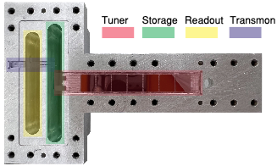
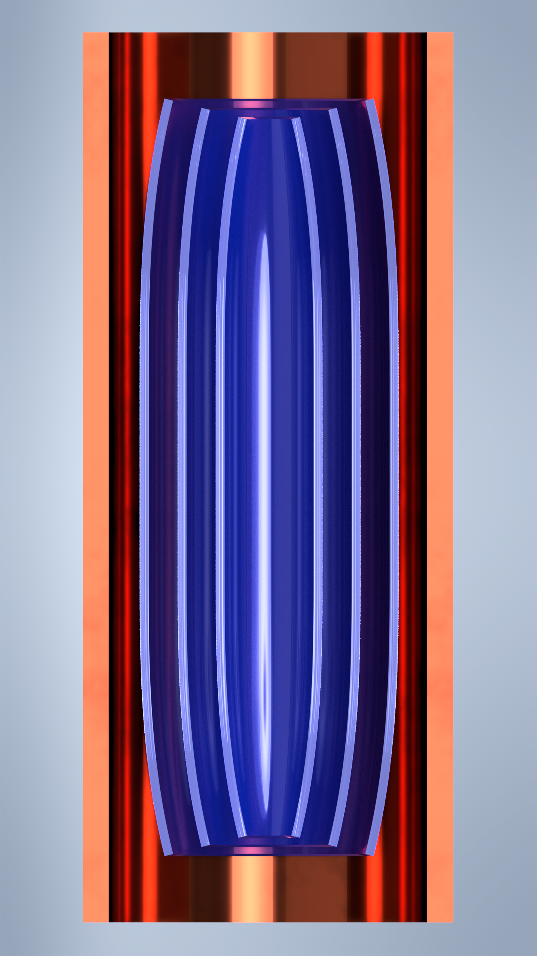

To make compatible with large B fields for axions
Magnetic shielding
Tuning rod
Tunable photon counter
Tunable photonic cavity
$$\vec{B}$$
State swap
Notes:
I would like to show a few interesting prototypes which the next generation of students and post-docs are working on to cover a wide range of frequencies. Fang and Morgan are working on a tunable photon counter where the storage cavity frequency is tuned electronically using a SQUID loop.
We are working on a mechanical design to tune the frequency of the photonic bandgap haloscope and in parallel, brainstorming how to swap the cavity state between axion and detection cavity to integrate all the three techniques.

Slide 28
Summary
SNR for resonant detectors plummets at higher frequencies as cavity volume shrinks and SQL noise increases
Photon counting measurements have no Heisenburg uncertainty limit and can achieve 10⁻² SQL.
  Increases scan speed by (SNR)² = 10⁴.
Signal can be boosted using stimulated emission with Fock states
  Potentially increase scan speed by factor (n+1)
  Demonstrated in hidden photon search
TBD: transport of Fock state via state swap for axion search, demonstration of improvement in scan speed

Slide 29
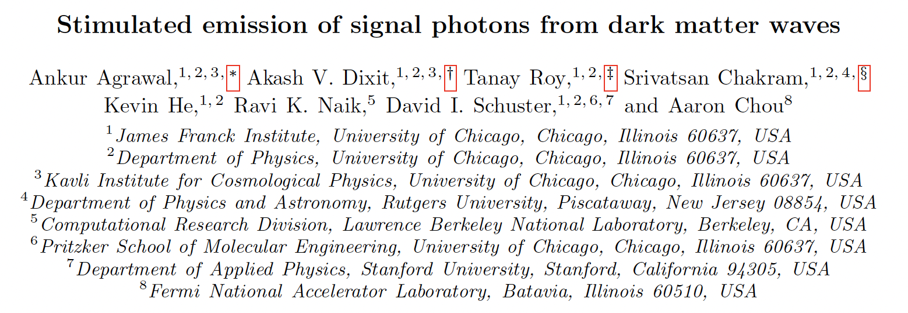
Paper coming soon!

Slide 30
Backup slides

Slide 31
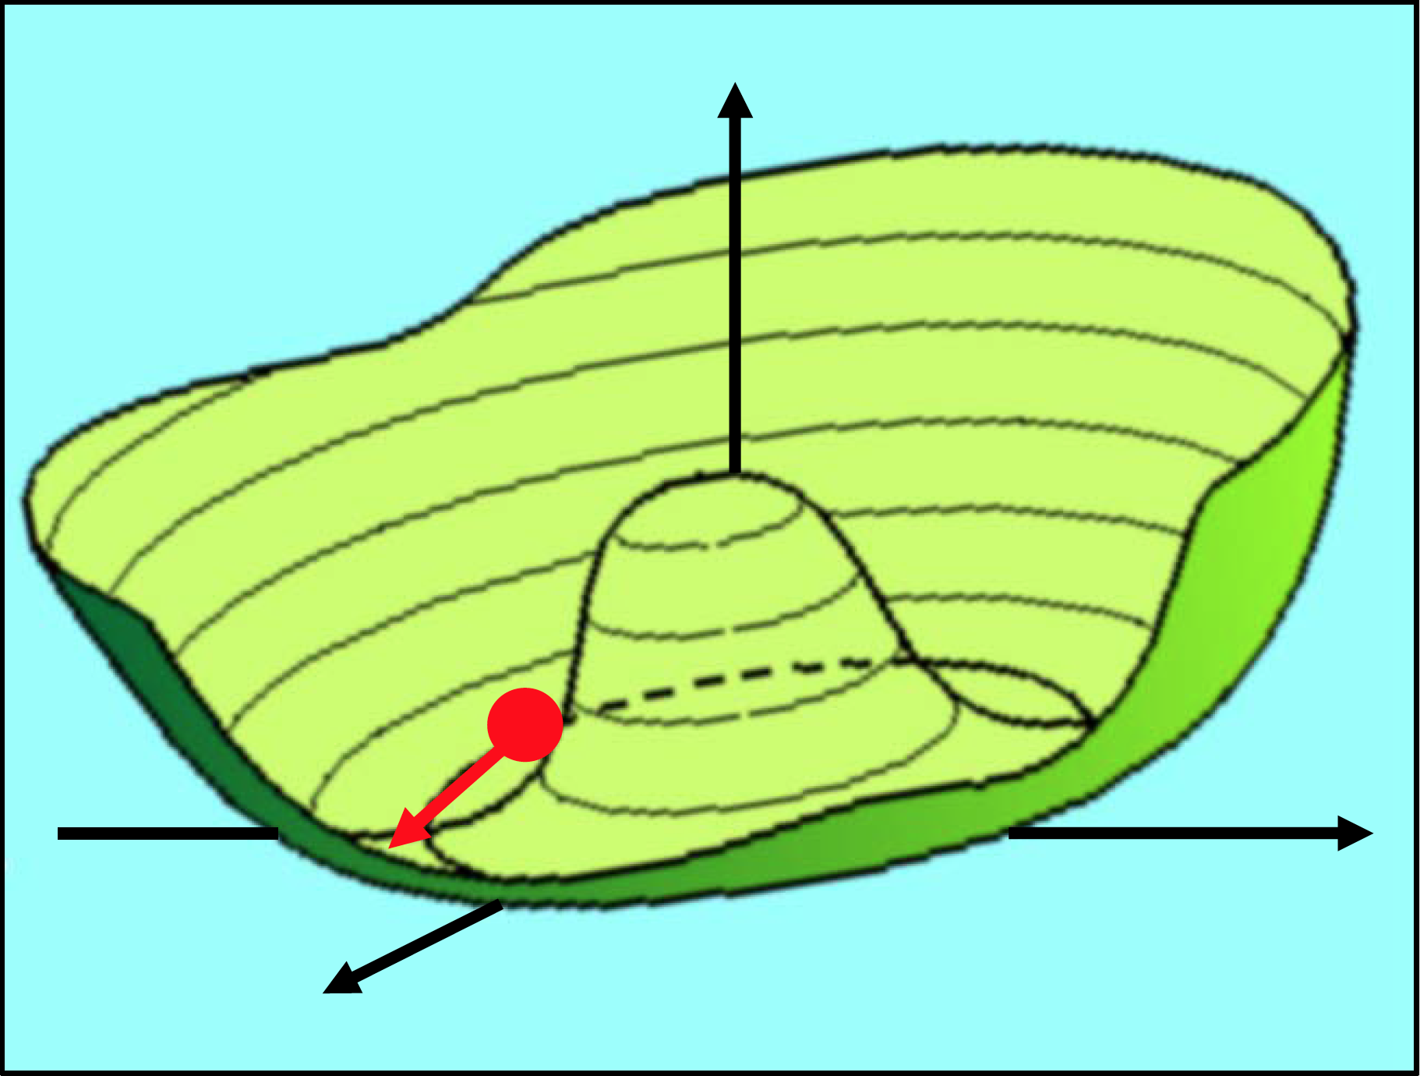
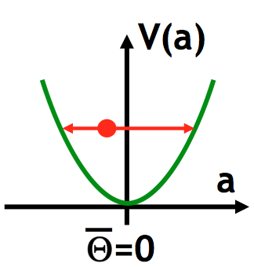
Axion mass = harmonic oscillator frequency
Axion
Λ_{QCD}⁴
VEV f_{a} > 10⁹ GeV
m_{a} = Λ_{QCD}² / f_{a} < 10⁻³ eV
Single parameter model for axions

Slide 32
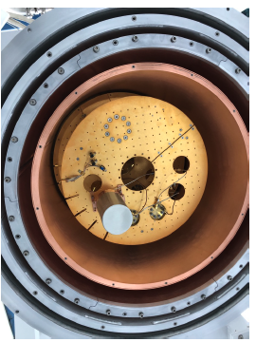
Hmmm… quantum computing platforms look just like dark matter searches:
DOE-OHEP Basic Research Needs white paper, 2018
Sensitive single-quantum devices are operated in a cryostat and/or vacuum system and well-shielded from external disturbances (heat, light, sound) in order to maximize their coherence time.
Impossible to shield from the dark matter – the DM interacts so weakly that it flies right through the walls.
If your quantum computer crashes, it could be due to dark matter!
… but as consolation, you’ll get a Nobel prize anyway for the discovery.

Slide 33
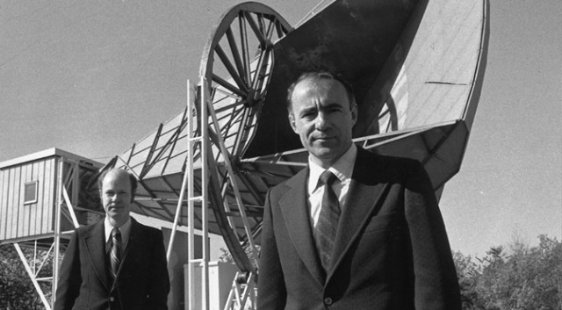
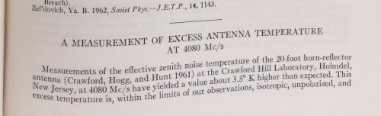
Mystery noise in your experimental apparatus is not necessarily mundane
Penzias and Wilson, 1965:
After chasing away nesting birds with a shotgun, discovered the cosmic microwave background
– They had no idea that this was first evidence for the big bang theory
– Nobel Prize, 1978
N.B. Discovery of color photography would have to wait until the 1970’s.

Slide 34
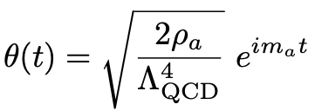

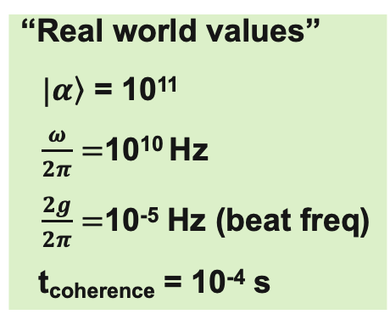
Need 10⁵ seconds to completely convert the axion wave into a photon wave. But only have 10⁻⁴ s of cavity time…
“Real world values”
$\left.|α\right\rangle$ = 10¹¹
$\frac{ω}{2π}=$10¹⁰ Hz
$\frac{2g}{2π}=$10⁻⁵ Hz (beat freq)
t_{coherence} = 10⁻⁴ s
Axion = classical wave
Beat frequency (derive this!)

Slide 35
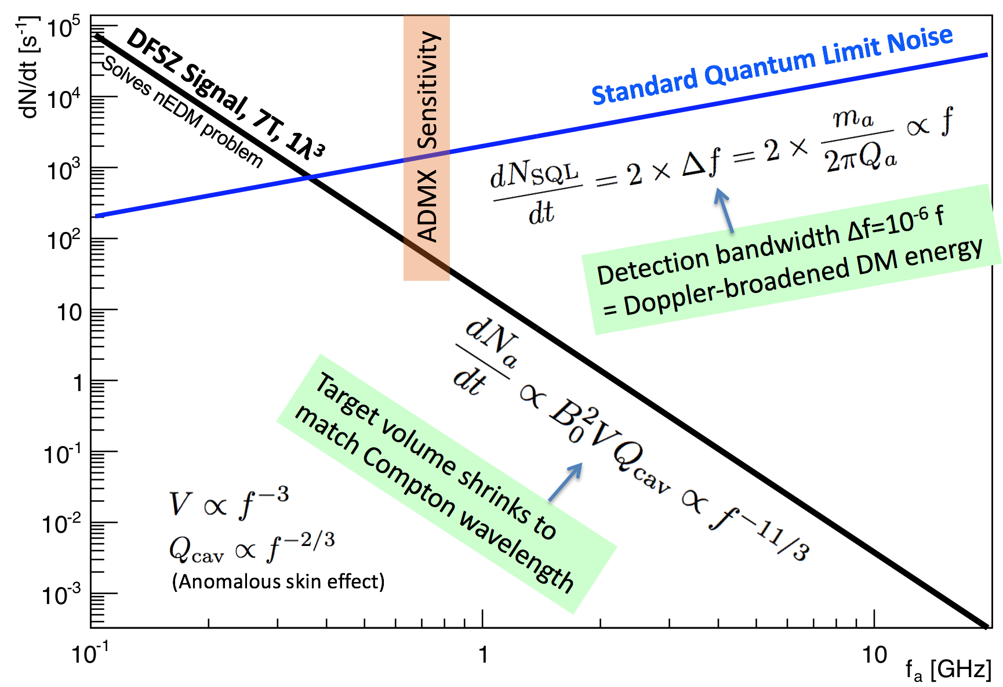
The predicted axion DM signal/noise ratio plummets as the axion mass increases → SQL readout is not scalable.
Photon rate
Photon frequency

Slide 36








The Glauber displacement operator and coherent states
Generates translations in position
Generates translations in momentum
$$=\sqrt{n}$$
Generate translations in an arbitrary direction in x-p phase space
Exponentiate differential operator to get finite translation 𝛼 in complex plane:
Phasor of amplitude 𝛼 is generated as:
Classical sine wave
This is an eigenstate of the annihilation operator:
Prove this!

