Slide 1
The INO project
V.M. Datar
INO Cell, Tata Institute of Fundamental Research
Mumbai-400005
EILH-2016, AMU, Nov 2-6, 2016

Slide 2
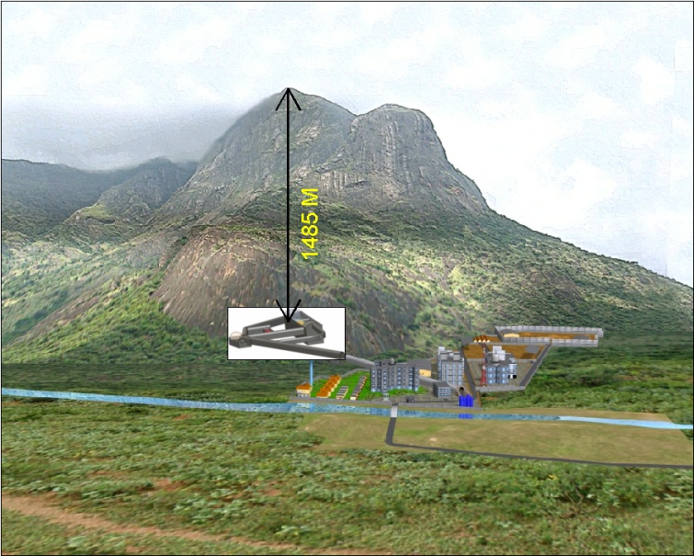
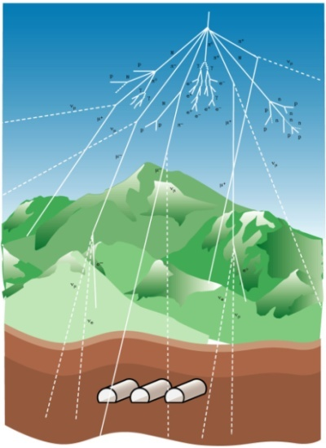
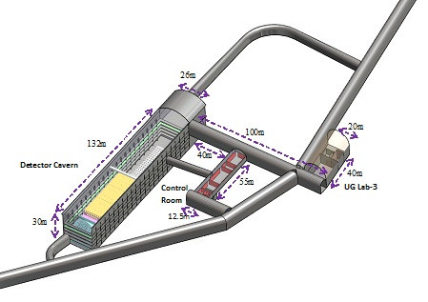
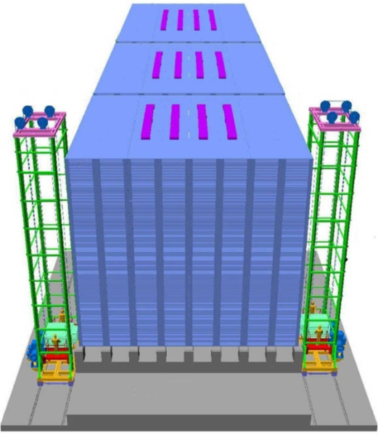
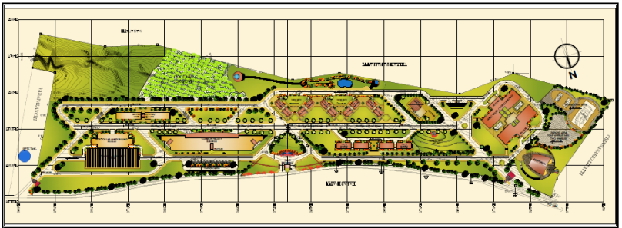
INO at Pottipuram (Theni)
1270m
Underground complex
Area: 27 ha
51 kton ICAL Neutrino Detector
3×17 kton ICAL modules
2×2m²×28800 glass RPCs
∼3.7M electronic channels
IICHEP, Madurai (Area: 12.6 ha)

Slide 3
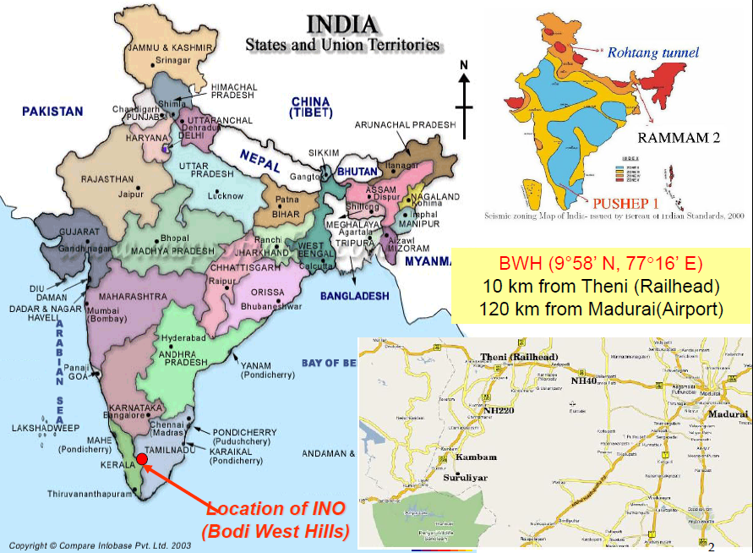
∼25 institutions (national labs, Universities, IITs) participating

Slide 4
Why INO?
An underground lab to study neutrinos, dark matter…
Measure neutrino mass ordering, will help us understand how universe evolved (matter-antimatter asymmetry)
Help us go beyond Standard Model of Particle Physics
Development of biggest electromagnet, state of art technologies for particle detectors, electronics …
Will involve students to participate in building, testing detector components. Will spread experimental culture in area of HEP in particular, science in general
Pottipuram best place to do it – for TN and India

Slide 5
Outline
1. Iron Calorimeter (ICAL) detector
2. Current status of ICAL and INO
3. Other experiments at INO

Slide 6
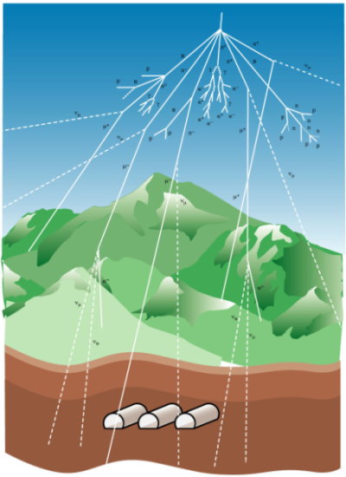
1. Iron Calorimeter (ICAL) detector
Atmospheric neutrinos – provide a range
of energies (E_{ν}∼1-10 GeV) and matter
propagation lengths ∼ 1 – 13000 kms
(free!)
Measurements hitherto did not distinguish between neutrinos ( ν ) and anti-neutrinos ( ν )
ν_{μ} , ν_{μ} identified via charged current interaction
ν_{μ} + n → μ⁻ + p , ν_{μ} + p → μ⁺ + n

Slide 7
Why does one need a huge magnet?
Neutrinos cannot be detected directly but only via charged particles produced in ν-matter weak interaction
Muon neutrinos interact (CC) with Fe of magnet producing μ± with opposite curvature in B-field
Range of 1 GeV muon in Fe/H₂O : 0.6 m/5m
Radius (bending) of muon in B=1 Tesla: 1 m
Up/Down direction using timing information

Slide 8
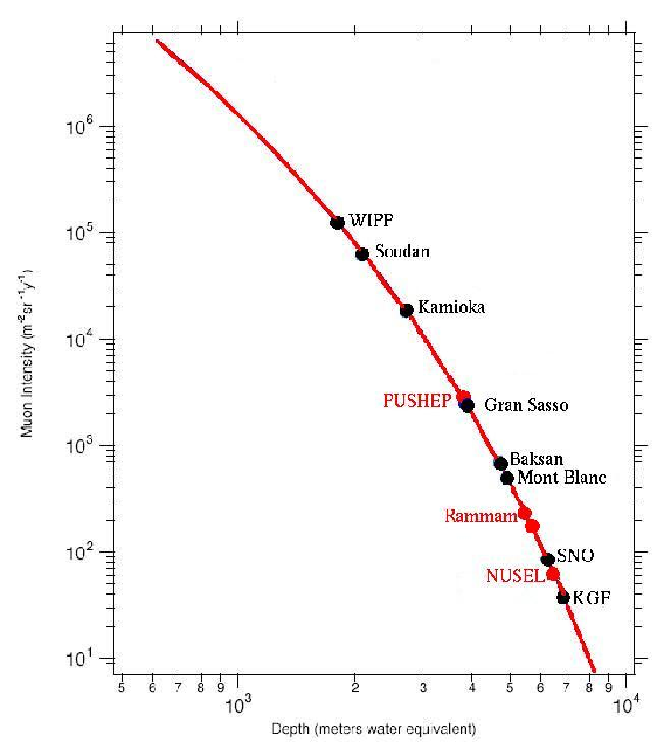
Muon flux as a function of depth
How deep underground ?
Low ν event rates ∼ 3/day Cosmic muons most important background, reduced by ∼10⁶ if detector depth = 1 km, deeper, the better ⇒
mines or tunnels
Muon intensity (m⁻² sr⁻¹ yr⁻¹)
Pottipuram
Depth (metres water equivalent)

Slide 9
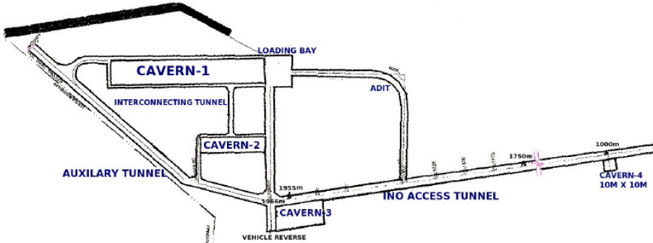
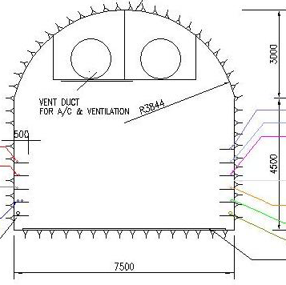
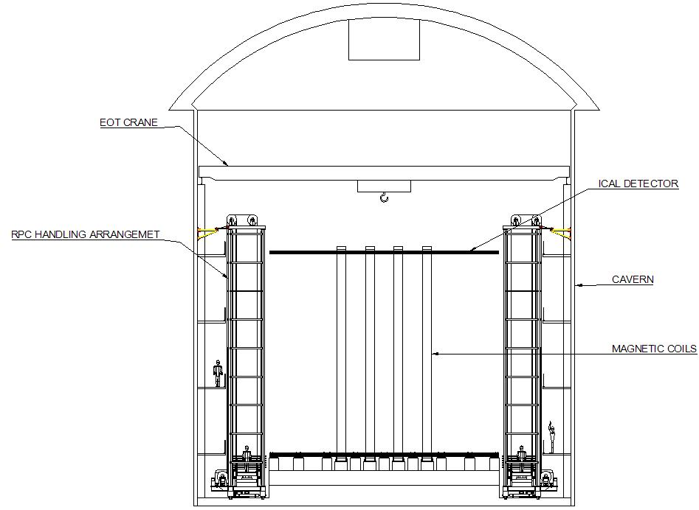
Access tunnel and caverns
2 km long tunnel , D-shape 7.5 m wide, down-slope at 1 in 13.5
1270 m vertical rock cover, 1 km on all sides
~3 yrs for making tunnel, caverns
ICAL cavern

Slide 10
Choice of detector
Possible detectors:
liq. Argon (“modern” cloud chamber based on
ionization chamber) - magnetic field difficult
sampling calorimeter with Iron - magnetic field easy
Iron + plastic scintillator (MINOS)
Iron + Resistive Plate Chamber (ICAL@INO)

Slide 11
Choice of configuration
Magnet for target material and B-field
Iron based electromagnet is natural choice
Permanent magnet too expensive, reversing field too time consuming! High T_{c} SC based magnet complicated.
Two possibilities:
Toroidal field with axial conductor (MINOS, Soudan)
Layered magnet with rectangular coil (as in
MONOLITH @ Gran Sasso)

Slide 12
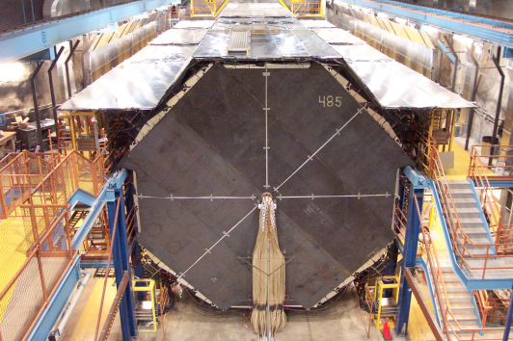
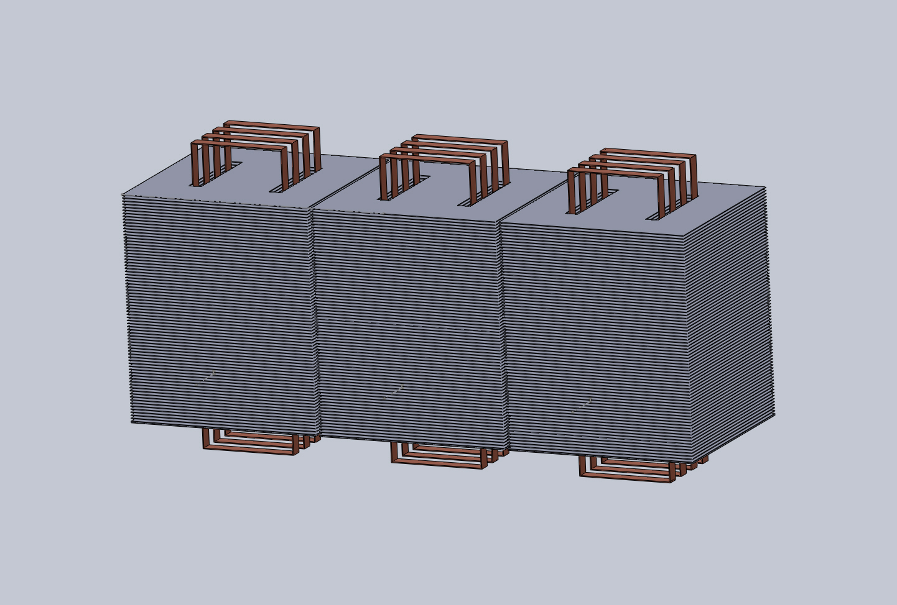
MINOS Far detector
(5.4 kton)
Schematic of ICAL modules (3×17 kton)

Slide 13
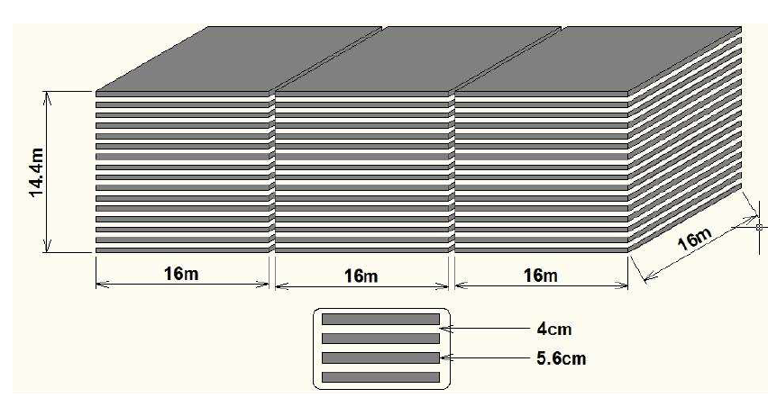
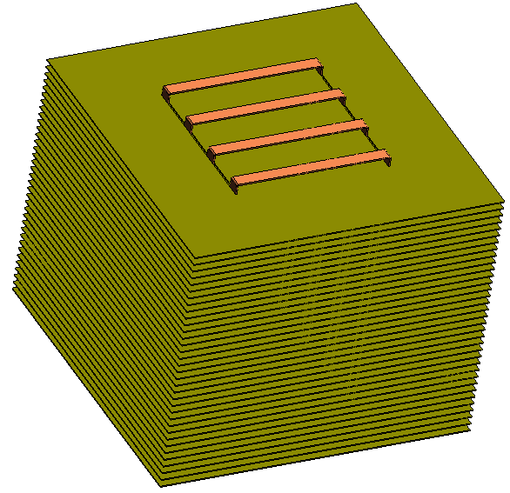
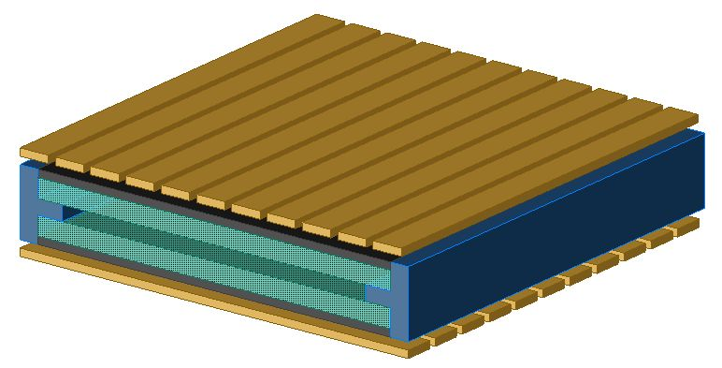
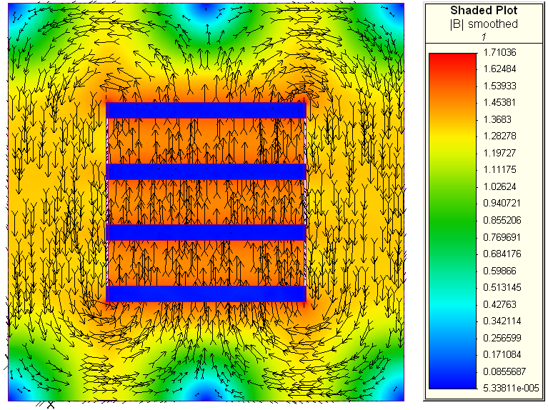
Schematic of Iron Calorimetric detector
3 modules × 17 kton
Each with 150 layers Fe+RPC
B-field > 1 Tesla (90%)
X
Signal pickup
Y
Glass RPC for detecting charged particles
B-field for 60 kA-turns, typical low C steel

Slide 14
Features of 17 kton ICAL magnet
Different from normal gap magnets with field between pole pieces – here field is essentially within the Fe plates
Each module ∼ 17 kton (will be largest Fe based electromagnet in world!)
150 layers of soft iron (low carbon steel) of dimensions 16m × 16m tiled with 4m × 2m × 56mm
Gap between successive layers of soft iron : 40mm
for glass Resistive Plate Chambers ∼ 35mm thick
Magnetic field > 1 Tesla, 1.5 Tesla desirable

Slide 15
Challenges and Issues
Large size (3 nos of 16m×16m×14m)
Large copper coils (8m×15m, 80 kA turns, ∼150 tons)
Large mass (largest electromagnet) 3 × 17 kton
Assembly minimizing gaps, preserving planarity
Piece-wise uniformity of B-field (> 1 T over 90% area)
Measurement of interior B-field (open problem)
Stability – mechanical, B-field (∼1%)
Large no. of RPCs ∼ 30,000 (World total ∼ 10K)
Electronics ∼4 M channels, fast (nsec), P/ch < 50mW

Slide 16
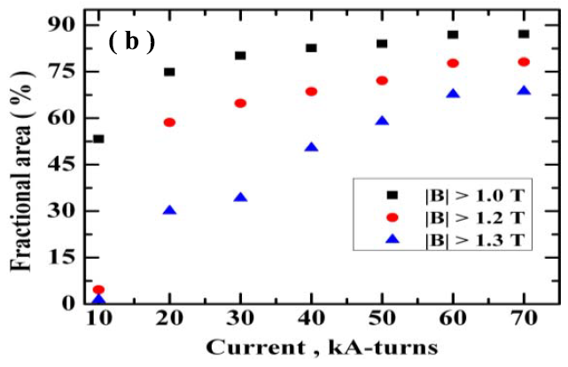
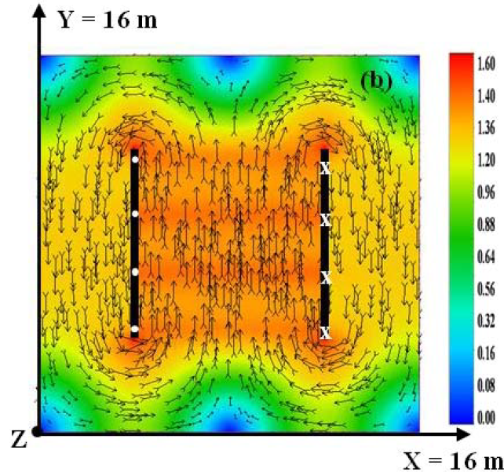
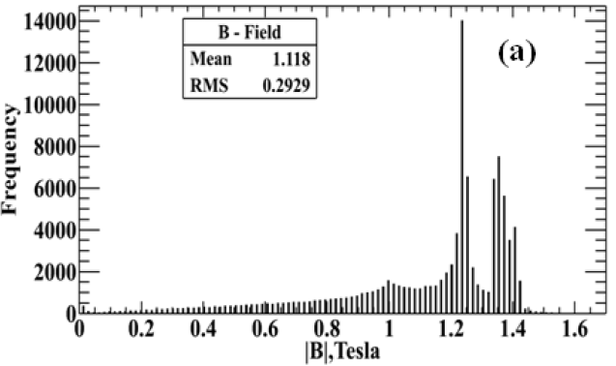
Electromagnetic simulation study of ICAL magnet
B-field simulation using 3D finite element commercial software
B-field uniformity studied for various plate thicknesses, tiling configurations, air gaps, slots (for Cu coils), coil configurations. NI, 2 low carbon steels
Muon momentum response (from reconstructed trajectory) studied for a few coil currents, plate thicknesses

Slide 17
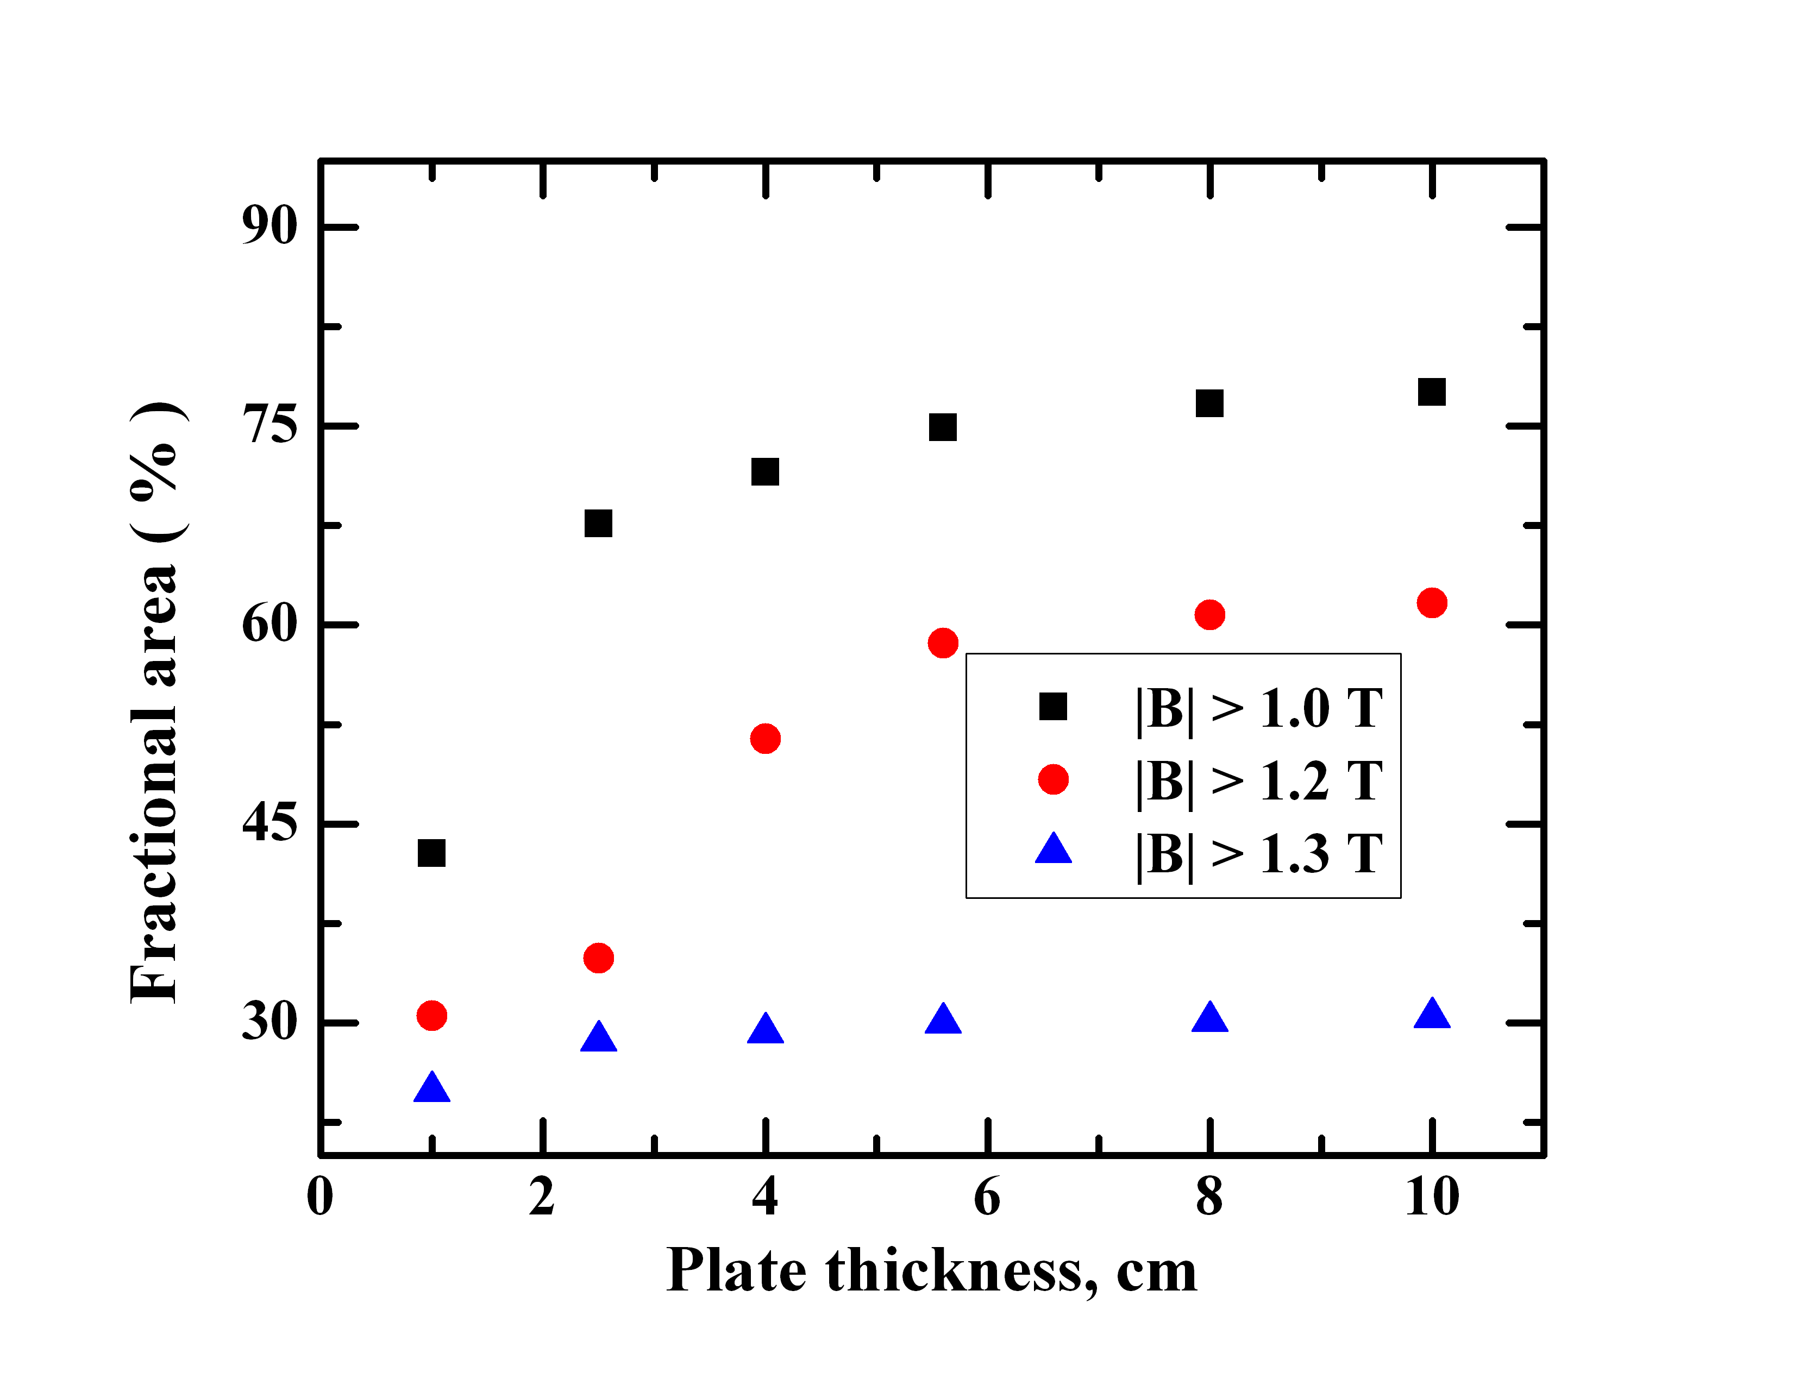
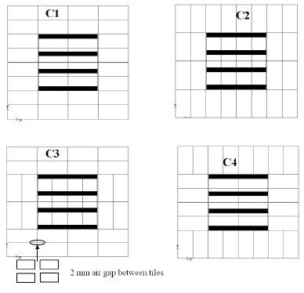
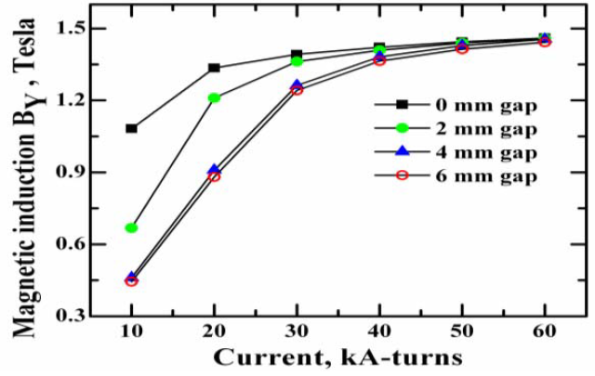
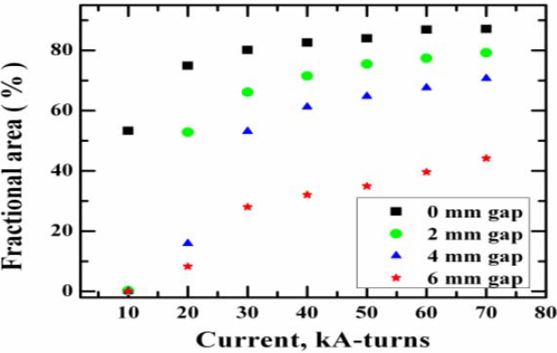
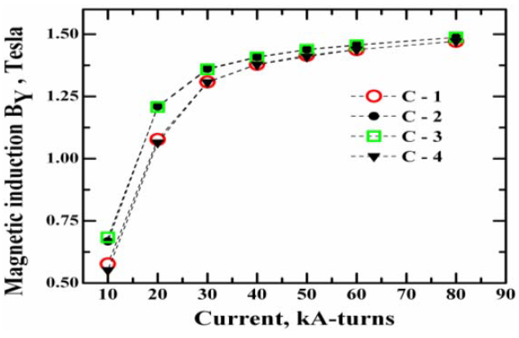
C2 for different gaps
B-field uniformity for
NI=20 kA.turns
S.P. Behera et al., IEEE Magnetics 51, 7000409 (2015)
Fractional area with B > 1 T

Slide 18
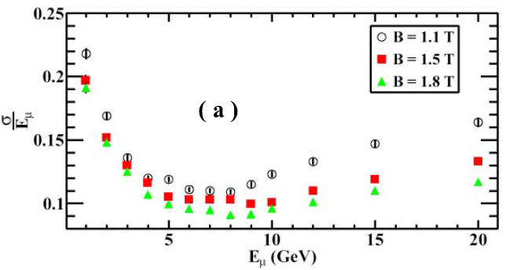
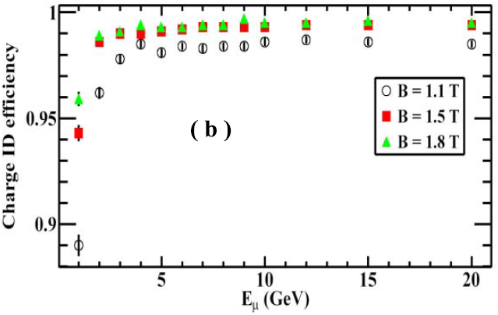
Muon response of ICAL for various B-field strengths

Slide 19
Physics with Iron Calorimeter detector
ICAL will measure atmospheric muon neutrinos and muon-antineutrinos
Energy range: 1 GeV ≤ E_{ν} ≤ 20 GeV
Zenith angles: 0° ≤ θ _{ν} ≤ 70°, 110° ≤ θ _{ν} ≤ 180°
Neutrino mass hierarchy – normal or inverted
Neutrino mixing parameters (Δm₂₃² , θ₂₃)
Non-standard interactions
Ultra high energy cosmic muons
White paper on “Physics Potential of the ICAL detector at INO”
under review in Pramana (2016); arXiv:1505.07380

Slide 20
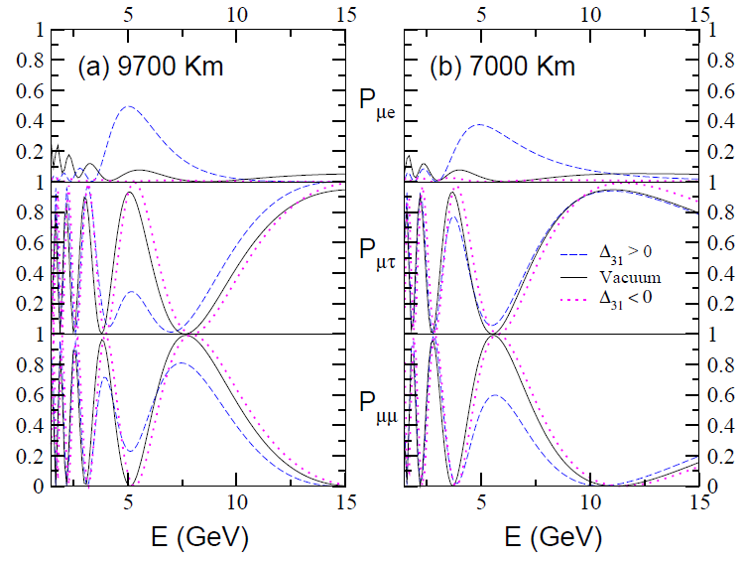
Matter effect on oscillation probabilities vs. E_{ν}
R. Gandhi et al., PRL 94, 051801 (2005)

Slide 21
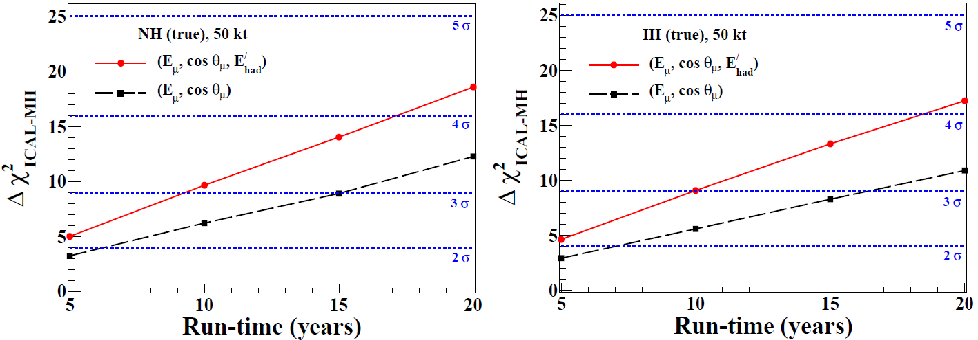
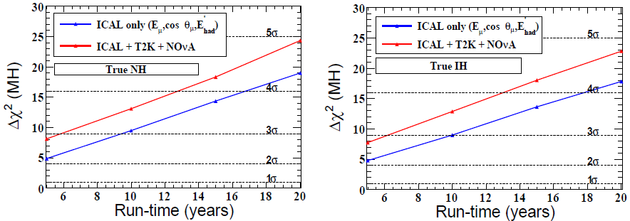
Mass hierarchy of neutrinos – sensitivity of ICAL
m₁ < m₂ < m₃ (NH) or m₃ < m₁ < m₂ (IH) ?
ICAL can identify MH using matter effect on atmospheric ν_{μ ,} ν_{μ}
(at 3σ level with ICAL alone: ∼ 9 years, +acc. Expts: 6 years)
With accelerator based expts. can probe CP violation in ν-sector
ICAL only
ICAL + T2K + NovA

Slide 22
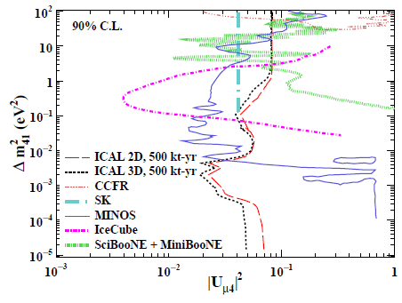
Other physics possibilities
Long range forces with L_{e} − L_{μ} gauge: limits of . α∼10 ⁻⁵² may be obtained (IOP group)
Sterile neutrinos: ICAL can probe very low Δm₁₄²
(IOP, TIFR)

Slide 23
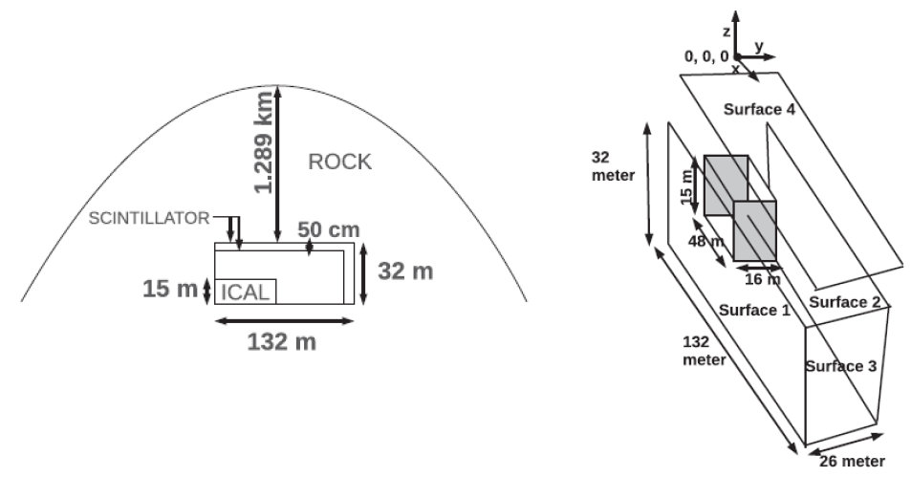
Searching magnetic monopoles at ICAL@INO
MM
MM

Slide 24
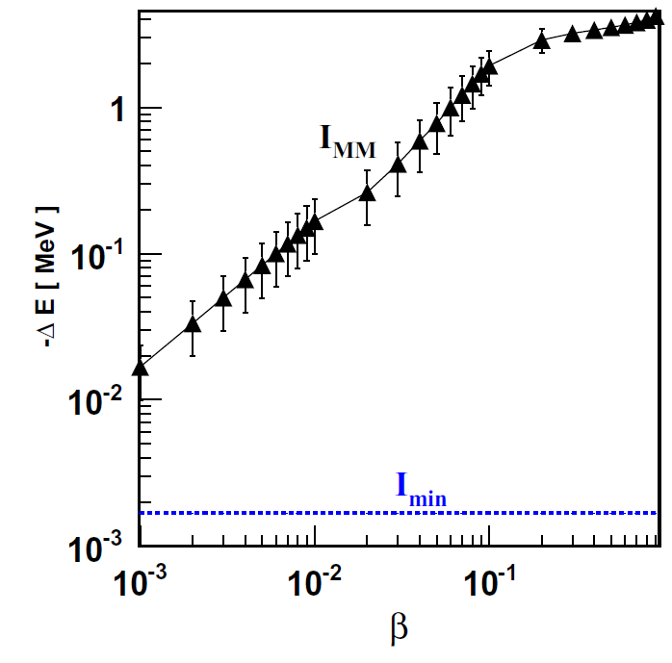
Energy loss of MM in 2mm RPC gas
KE (β=10⁻³) for m_{MM}=10¹⁵ GeV/c²
10⁹ GeV !
ΔE (10m Fe) ∼ 10² GeV
ΔE (2R_{E}) ∼ 10⁸ GeV

Slide 25
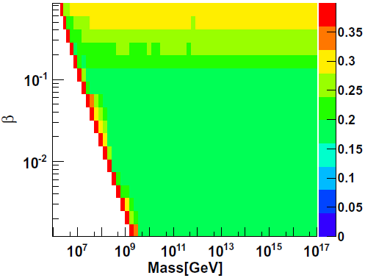
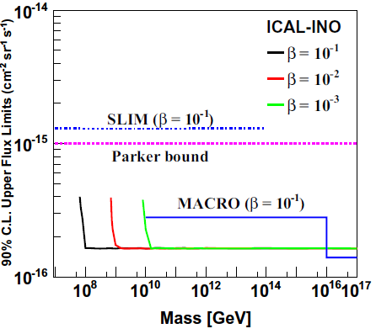
Upper bound on MM flux for 10 yrs of ICAL
(10⁻¹⁵ cm⁻² sr ⁻¹ s⁻¹ )
Upper bound on MM flux for 0 observed events
N. Dash et al., Astroparticle Physics 70, 33 (2015)

Slide 26
Searching for anomalous KGF events at ICAL
About 7 anomalous events found during 25 years of running the proton decay experiment – multiple tracks leading back to an origin not in detector or rock but in air
If KGF events are genuine, we should see many more with ICAL as cavern & detector ∼ 10 times larger
With additional detectors on 4 sides, should be able to provide data for/against KGF events in 2-3 years of running time

Slide 27
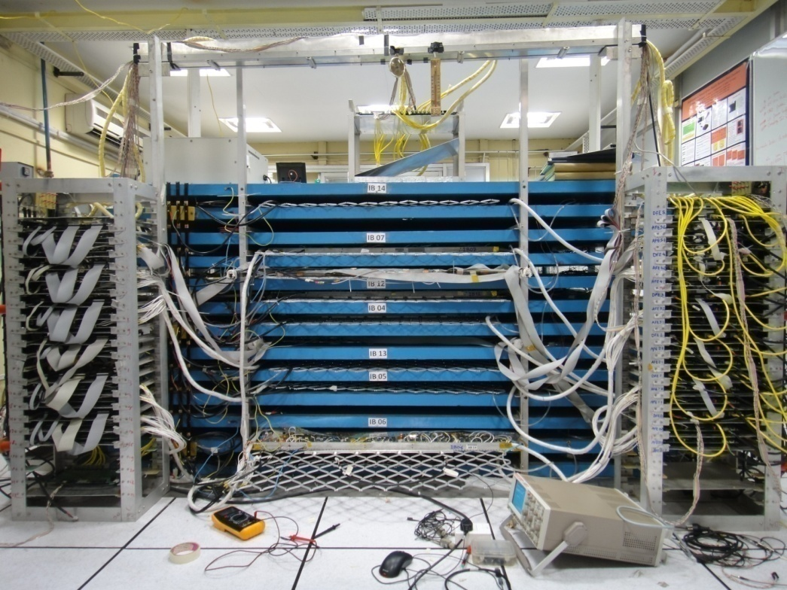
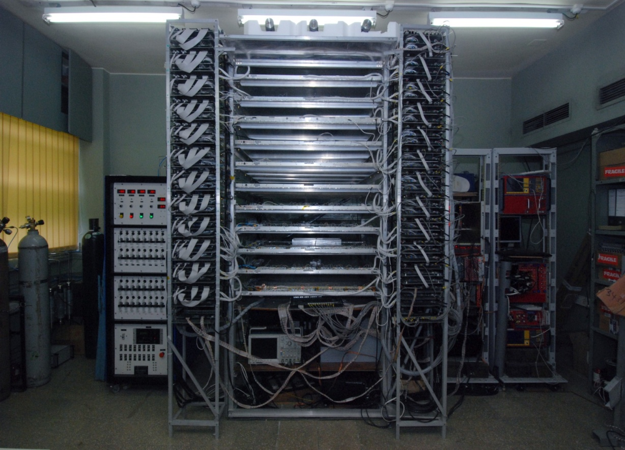
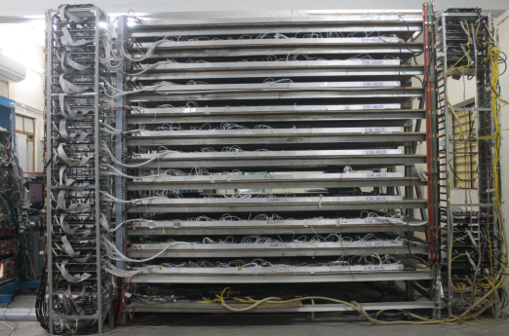
2. Current status of ICAL and INO
Magnet: 35 ton 1st prototype ICAL detector
@ VECC, Kolkata with B_{max} ∼ 1.5 Tesla.
8m×8m×20 layers prototype ICAL design ready for
IICHEP, on hold. 600T steel, OFHC Cu procured.
Building 70 ton mini-ICAL (4m×4m×11 layers)
RPCs: 2m ×2m (12 nos) industry made glass RPCs
working @ Madurai lab. ~60/400 nos. delivered
Electronics: FE boards with ASIC, DAQ boards,
DC-DC HV units, Trigger system, DAQ software: testing or under fabrication.

Slide 28
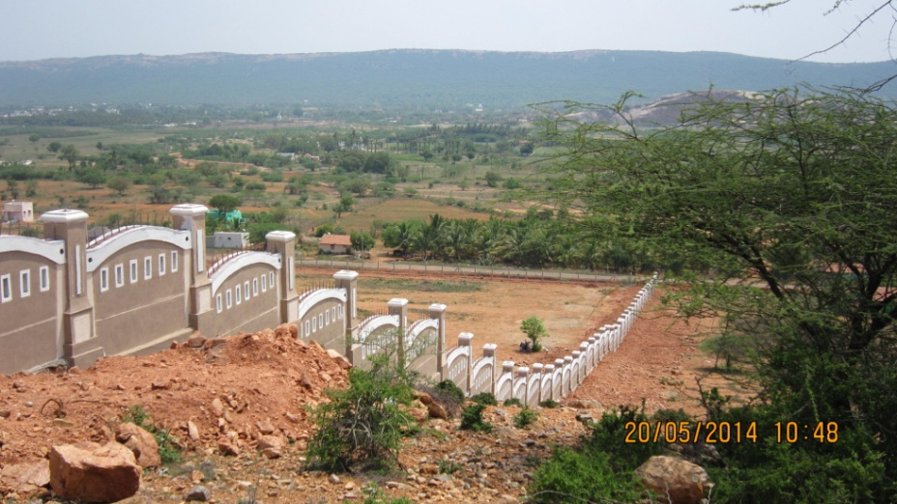
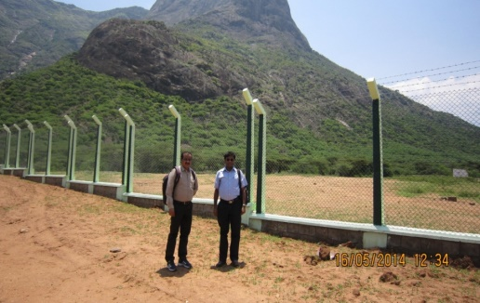
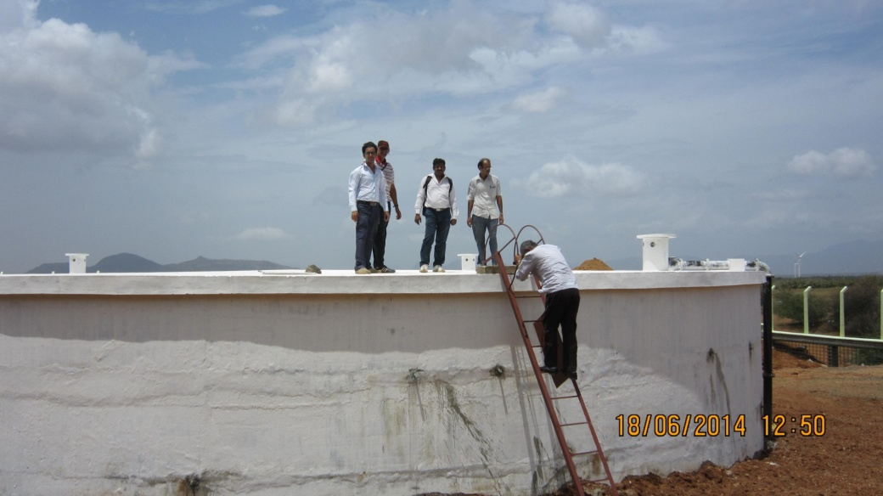
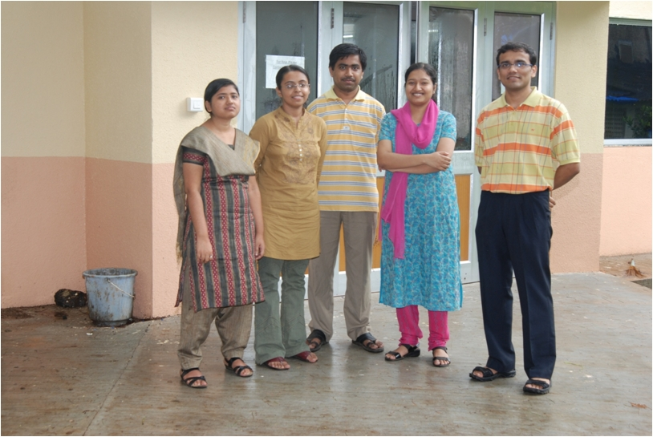
IICHEP site @ Madurai: 12.6 ha plot fenced
Awaiting reclassification.
INO underground lab site @ Pottipuram:
27 ha plot fenced. Water storage tank completed.
Pre-project infrastructure work
(road, water, electric power) partly done. Work
halted due to PIL in Madurai bench of Madras HC.
Financial approval for INO project in Dec 2014 given by Union Cabinet (∼ Rs. 1583 crores)
30 PhD students (BARC@HBNI)
have been part of INO-GTP
1st batch 2008-2009

Slide 29
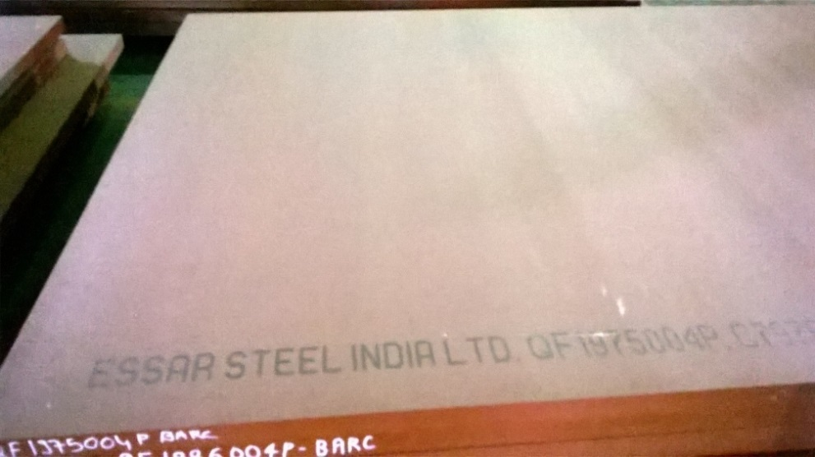
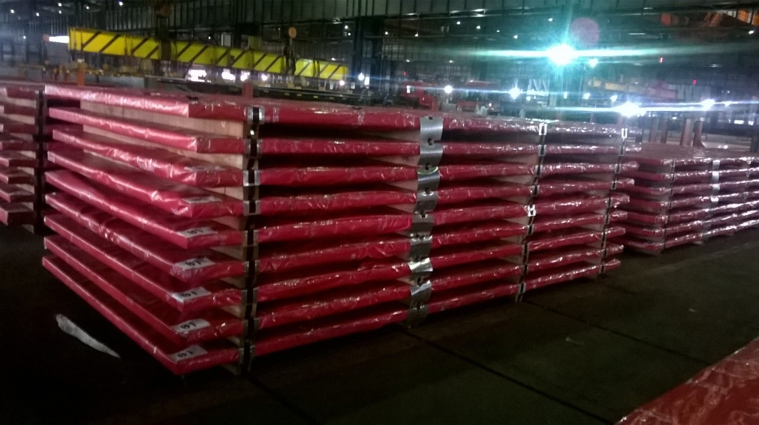
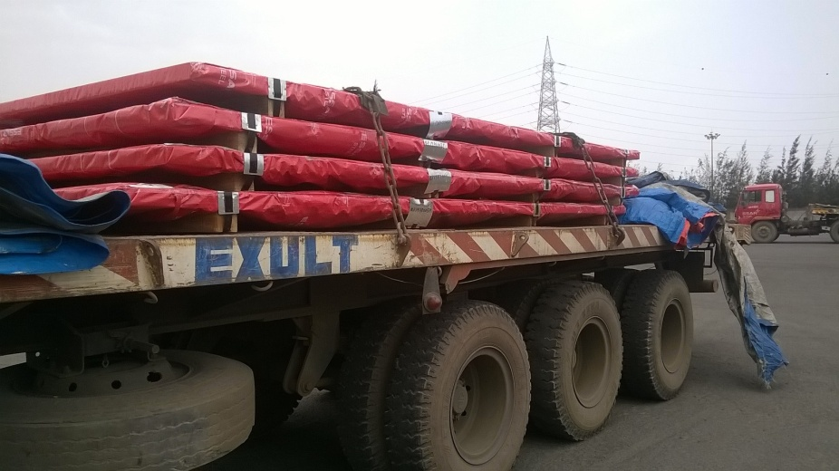
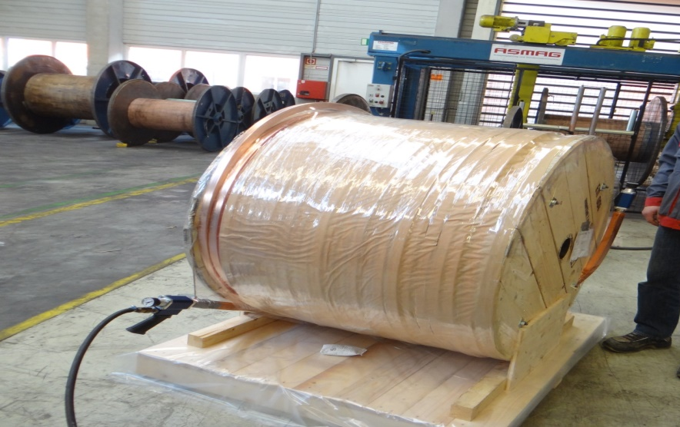
Soft Iron Plates for IICHEP, Madurai
168 (for 21 layers) soft iron plates, OFHC Cu coil procured
Soft iron plate
Soft iron plates at M/S Essar
8 plates in 32 ton trailer/trip
OFHC Cu coil
Notes:
Packed soft iron plate

Slide 30
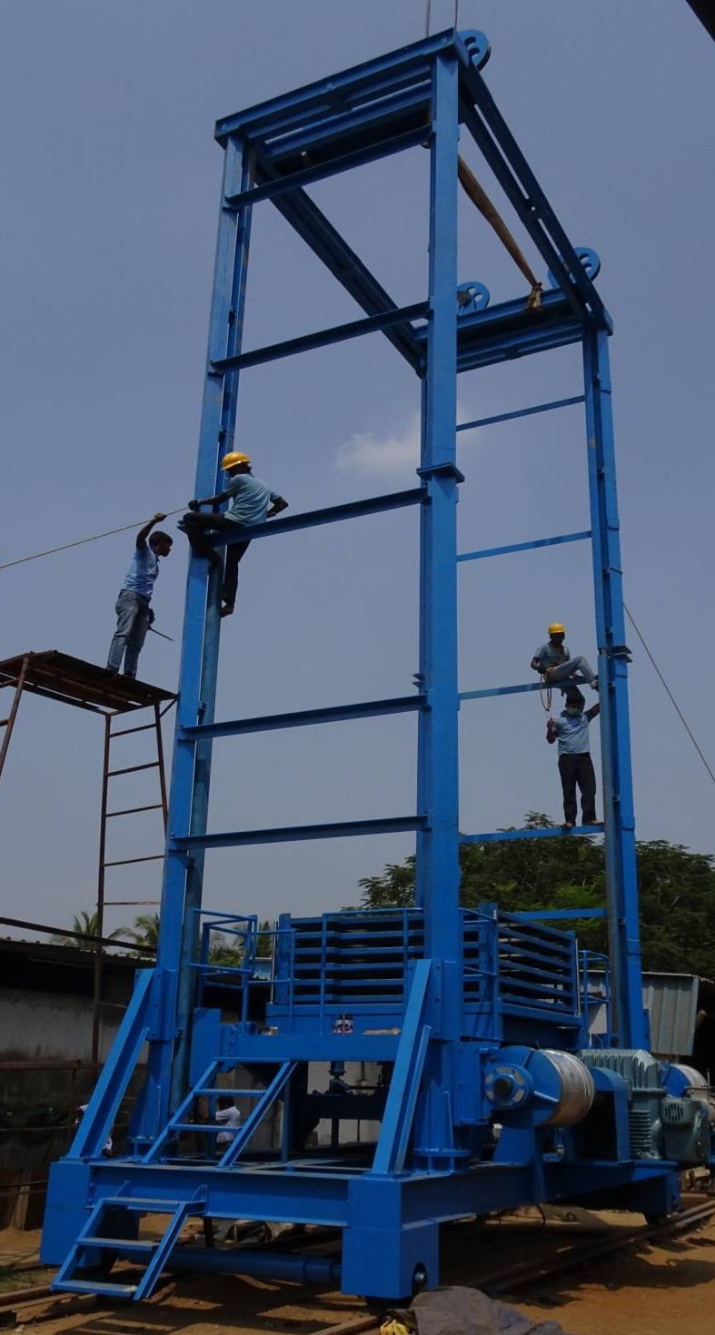
RPC handling trolley for engg. module
Parameters | Prototype
Weight | 19 ton
Size | 6.5 m x 3m x 12.5 m
Rail | A75
Horizontal travel | 13.5 m
Vertical travel | 8 m
Vertical speed | 4 m/min max
Horizontal speed | 4 m/min max
RPC shelf (Elec. operated) | Stroke length 750 mm
Shelf speed | 92 mm/min max
Modular type lift support structure
RPC handling trolley delivered at IICHEP Madurai in April 2016

Slide 31
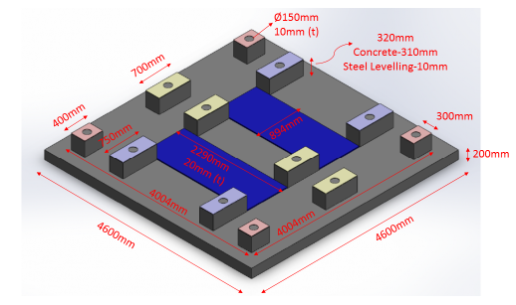
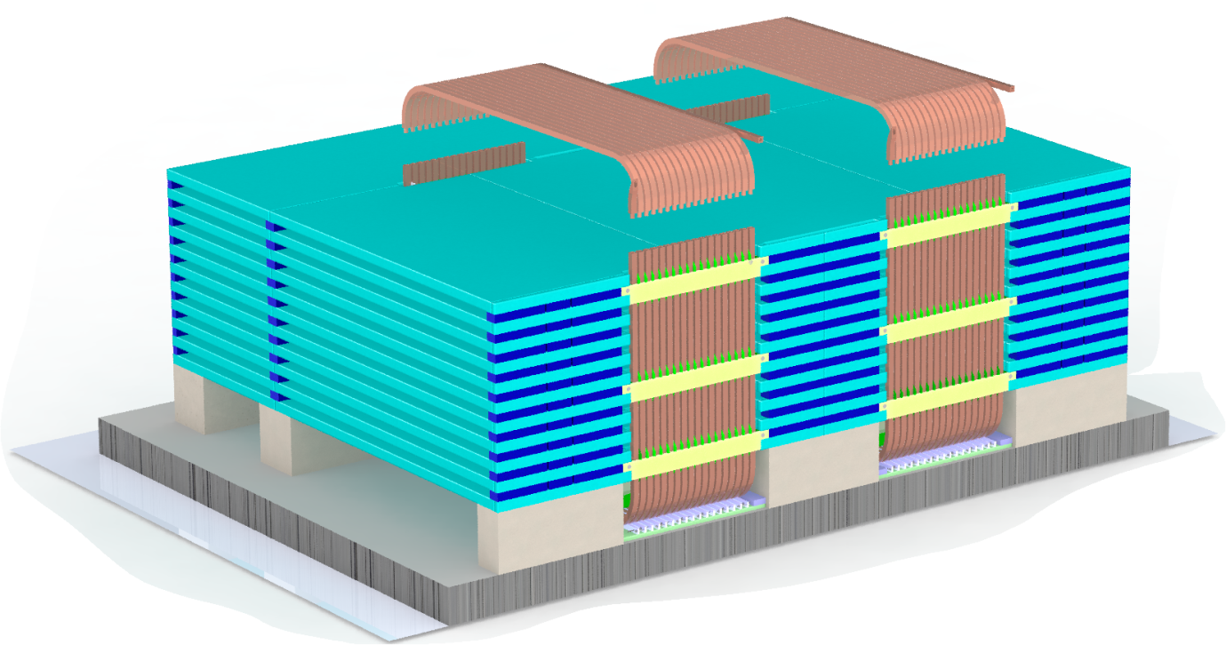
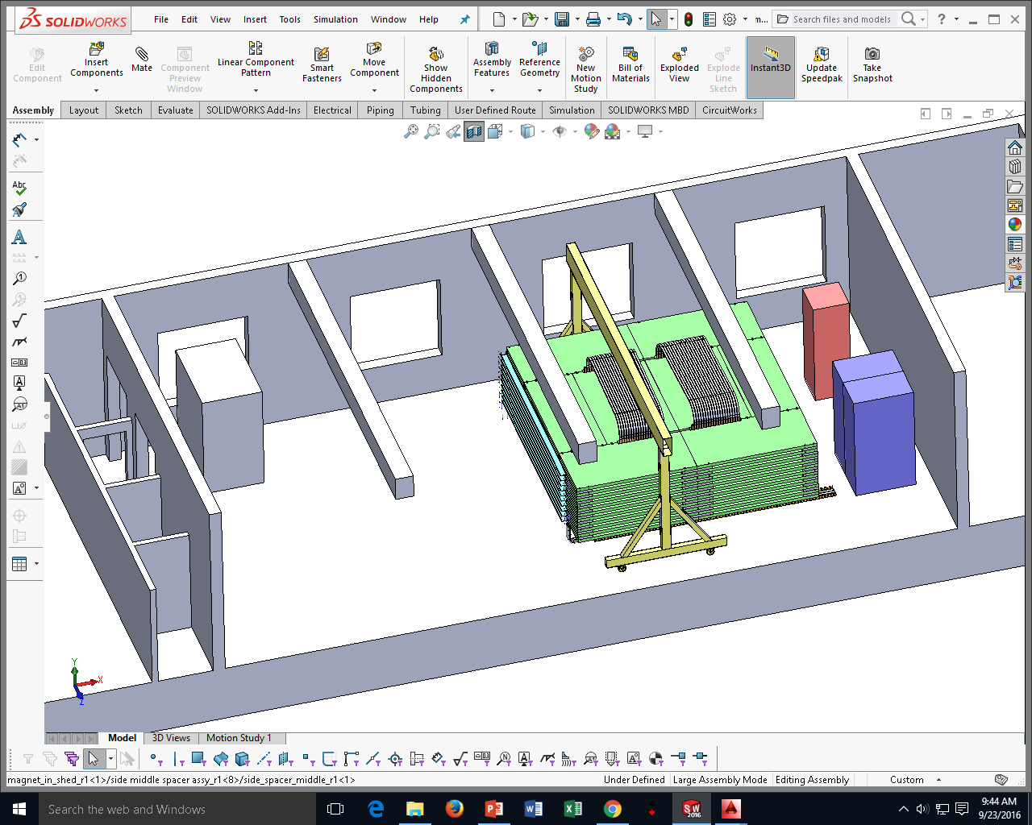
mini-ICAL at IICHEP (rented premises)
PA
PC
Plate B
PD
PB
Pedestals
Target date: 31 March 2017

Slide 32





Making the Cu coil
Straighten
Bend
In-situ silver brazing
Induction brazing tool

Slide 33

RPCs, Electronics & Trigger, DAQ

Slide 34


Slide 35




RPC-DAQ corner board + NINO FE
On board DC-DC HV module

Slide 36
3. Other experimental possibilities at INO
Neutrinoless Double Beta Decay in ¹²⁴Sn using a cryogenic bolometric detector (R&D ongoing for TINTIN)
Dark Matter search using a cryogenic CsI detector for low mass WIMPs (5-30 GeV/c²) (R&D ongoing for DINO)
Low energy accelerator for nuclear reaction cross sections ~ Gamow energy of astrophysical interest (Univ. groups working on proposal)

Slide 37

Neutrinoless double beta decay – is ν = ν ?
_{Z}A → _{Z+2}A + 2β⁻ + 2ν_{e} Normal lepton#-conserving DBD
_{Z}A → _{Z+2}A + 2β⁻ Lepton#-violating DBD
Maria Goeppart Mayer, Phys. Rev. 48, 512 (1935)
Why measure NDBD?
Majorana or Dirac ?
Absolute mass scale of ν
NDBD ⟨m_{ν}⟩_{ββ} = | U_{ei}² m_{i} e^{iϕ(i)} |
β-decay ⟨m_{ν}⟩_{β} = {Σ |U_{ei}|² m_{i} ² }^{1/2}
Γ_{2β0ν} ∝ [Q_{0ν}]⁵ × [NME]² × ⟨ m_{ν} ⟩ ²
Large Q-value preferred
⁴⁸Ca, ¹⁵⁰Nd, ¹⁰⁰Mo, ¹¹⁶Cd, ¹²⁴Te

Slide 38



Cryogenic bolometer for NDBD
Insulators at low T, specific heat C ∝ T³
ΔT_{rise} = E/(mC) ∝ 1/T³
In SC at T<T_{c}, C_{e} drops, so lattice C ∝ T³
Cryogen free dilution refrigerator @ TIFR
Base Temp. ~7 mK
Refrig power 1.4 mW @ 120mK
Goal: 1 kg ^{nat}Sn bolometer with NTD Ge sensor

Slide 39



Rise time ~ 50 ms
Fall time ~ 2 s
Preliminary results with improved electronics (Oct. 2015)
V. Nanal, INO Collab meeting 25th Oct 2016

Slide 40


Dark Matter search at INO – DINO (SINP)
Dark Matter believed to consist of Weakly Interacting Massive Particles (WIMPs) of mass 5-100 GeV/c²

Slide 41

from Pijushpani Bhattacharjee (INO Collab meeting 25 Oct 2016)

Slide 42

Future Possibilities
Low energy ion accelerator for Nuclear Astrophysics for measuring reactions going on in core of stars

Slide 43

A cryogenic Indium detector for solar ν_{e} ?
100 Ton 8% In-loaded liquid scintillator for solar ν_{e} proposed by Raghavan (1976, 2007) to measure T_{core} directly via shift + broadening of pp, ⁷Be energy spectrum (Bahcall 1993)
Cryogenic detector (qp current): Compact (1m³), High resolution (few keV), segmented.
Events/(20 keV.5yr.10T In)
Single E_{e} (MeV)

Slide 44

India based Neutrino Observatory (INO) in Nature (13 Aug 2015)

Slide 45
Acknowledgements
INO Collaboration
TINTIN, DINO collaborations
ICAL Magnet: Shiba Behera, M.S. Bhatia, D. Badodkar, S.P. Prabhakar, N. Dalal and DRHR colleagues
MM, DMP decay sensitivity of ICAL: Nitali Dash, Gobinda Majumder

Slide 46

Thank you!

