Slide 1
Neutrino Oscillations: discovery, status and prospect
Nov 02, 2016
Aligarh Muslim Univ.
Takaaki Kajita
Institute for Cosmic Ray Research, Univ. of Tokyo
Notes:
30min public lecture

Slide 2
Outline
Introduction:
  - What are neutrinos?
  - atmospheric neutrinos
Discovery of neutrino oscillations
Status of neutrino oscillation studies
Future
Summary
(apology: This talk is biased to atmospheric neutrino oscillations)
2

Slide 3
Introduction
3

Slide 4
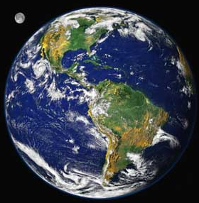
What are neutrinos?
Neutrinos;
  are elementary particles like electrons and quarks,
  have no electric charge,
  have, like the other particles, 3 types (flavors), namely electron-neutrinos (ν_{e}), muon-neutrinos (ν_{μ}) and tau-neutrinos (ν_{τ}),
  are produced in various places, such as the Earth’s atmosphere, the center of the Sun, ….
  can easily penetrate through the Earth,
  can, however, interact with matter very rarely. A ν_{μ} interaction produces a muon. A ν_{e} interaction produces an electron.
In the very successful Standard Model of particle physics, neutrinos are assumed to have no mass.
Neutrino
4

Slide 5
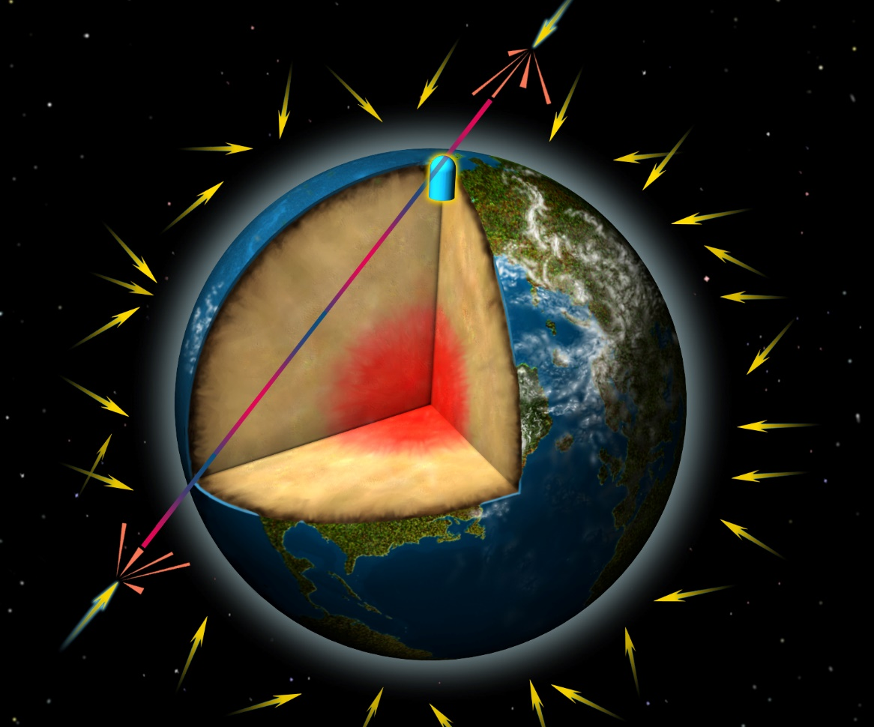
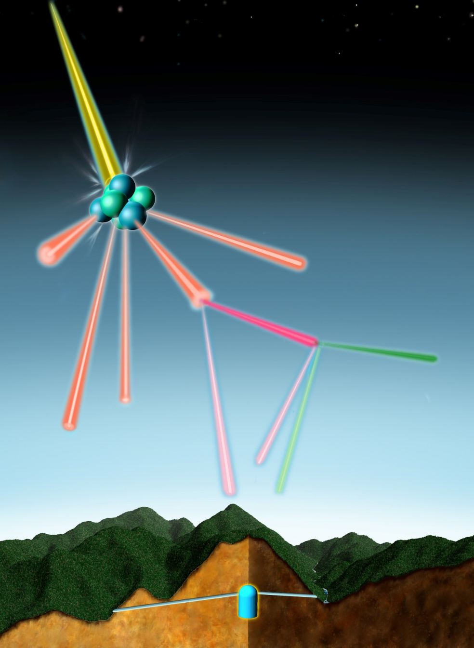
Atmospheric neutrinos
COSMIC RAY
INCOMING
COSMIC RAYS
AIR NUCLEUS
PION
Oscillating neutrino
MUON
ELECTRON
2 muon-neutrinos
1 electron-neutrino
© David Fierstein, originally published in Scientific American, August 1999
5

Slide 6
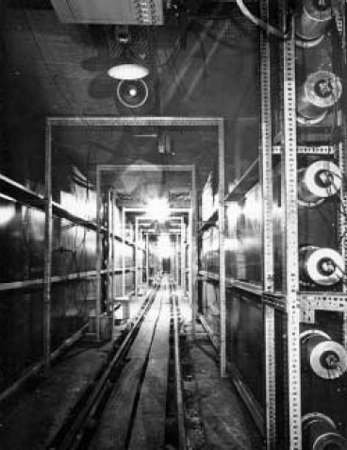
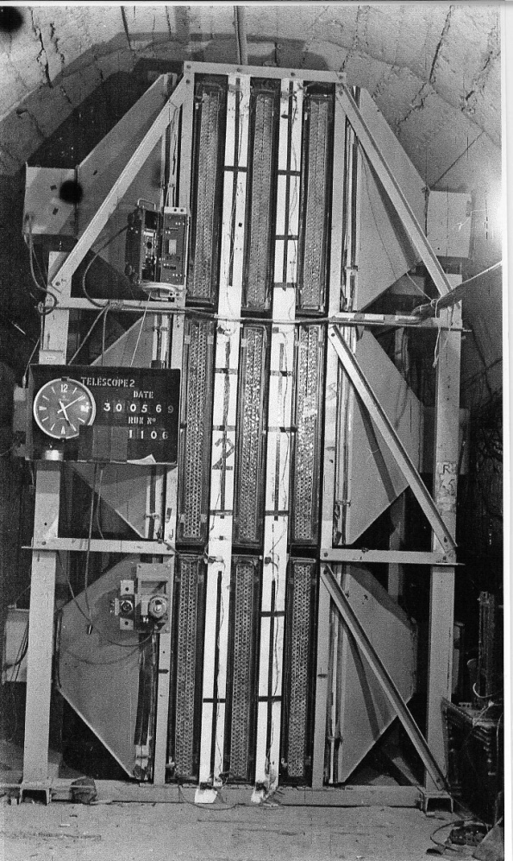
Discovery of atmospheric neutrinos (1965)
In 1965, atmospheric neutrinos were observed for the first time by detectors located very deep underground.
⬅In South Africa
F. Reines et al., PRL 15, 429 (1965)
➔ In India
C.V. Achar et al., PL 18, 196 (1965)
Photo by H.Sbel
Photo by N. Mondal
6

Slide 7
Discovery of neutrino oscillations
7

Slide 8
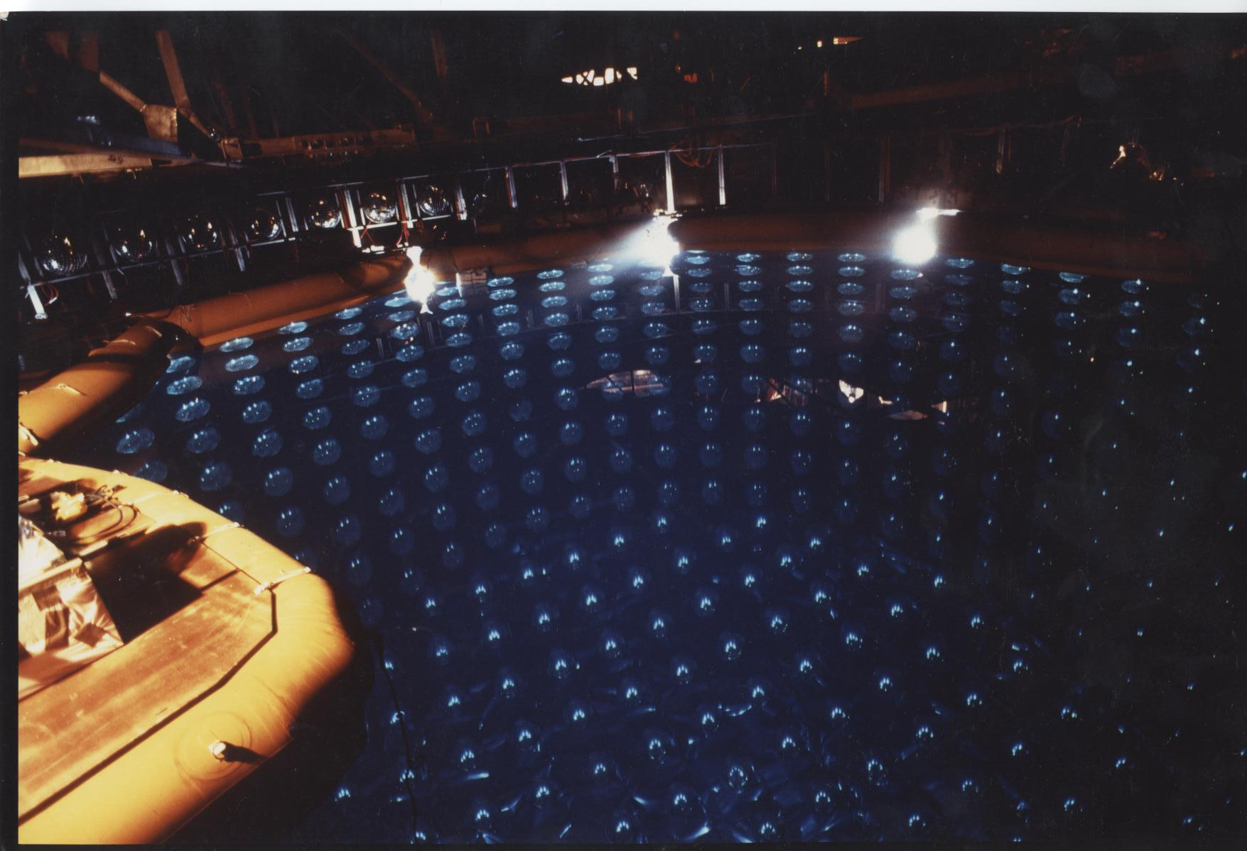
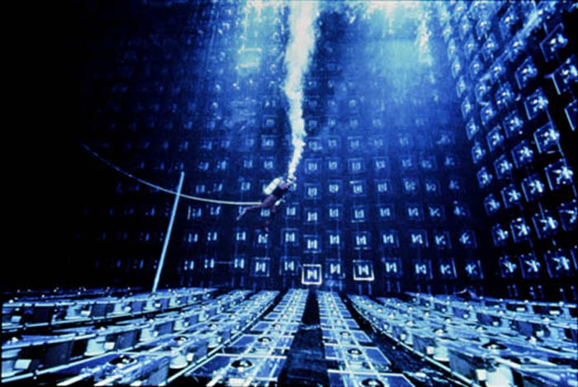
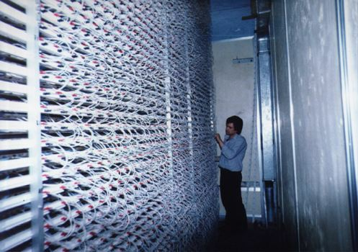
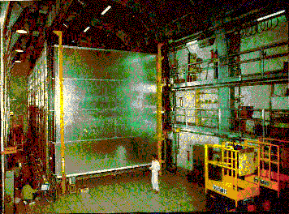
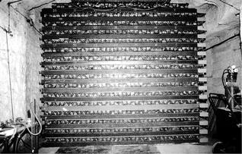
Proton decay experiments (1980’s)
Grand Unified Theories (in the 1970’s) ➔ τ_{p}=10^{30±2} years
Kamiokande (1000ton)
IMB (3300ton)
These experiments observed many contained atmospheric neutrino events (background for proton decay).
KGF (100tons)
NUSEX (130ton)
Frejus (700ton)
8

Slide 9
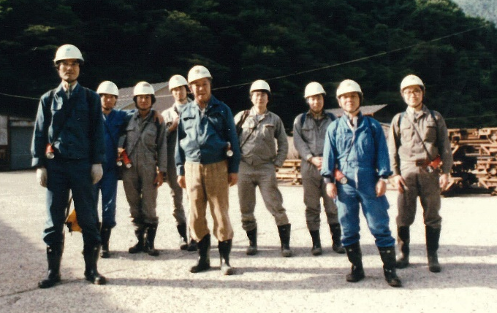
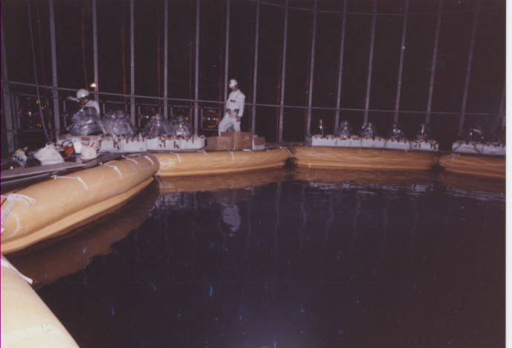
Constructing the Kamiokande detector (Spring 1983)
M. Takita
TK
M. Nakahata
K. Arisaka
Y. Totsuka
M. Koshiba
(2002 Nobel Prize)
T. Kifune
9

Slide 10
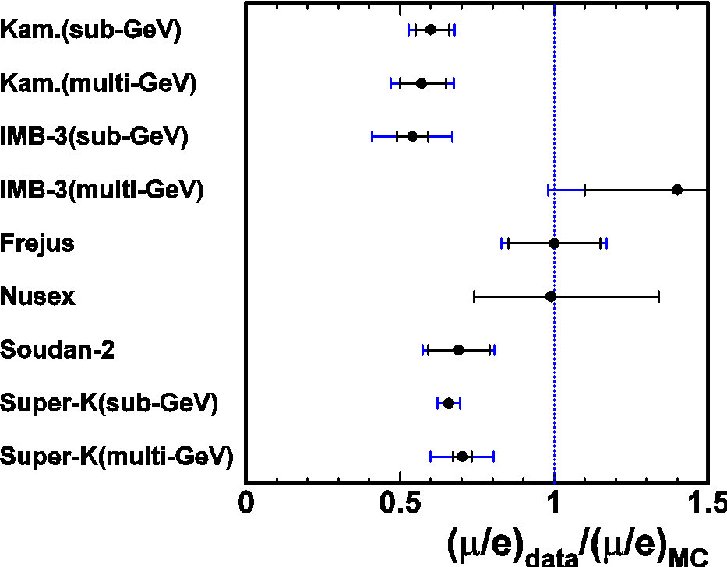
Atmospheric ν_{μ} deficit (1980’s to 90’s)
Because atmospheric neutrinos are the most serious background to the proton decay searches, it was necessary to understand and reduce the atmospheric neutrino background. During these studies, a significant deficit of atmospheric muon-neutrino events was found….
Kamiokande (1988, 92, 94)
IMB (1991, 92)
It was suspected that neutrino oscillations might explain the data…
10

Slide 11
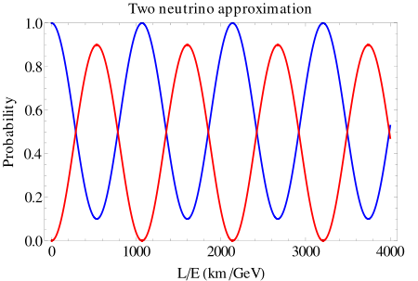
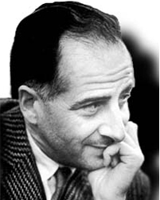
Neutrino oscillations
If neutrinos have masses, neutrinos change their flavor (type) from one flavor (type) to the other. For example, oscillations could occur between ν_{μ} and ν_{τ}.
Theoretically predicted by;
Probability:
ν_{μ} to remain ν_{μ}
Sakata Memorial Archival Library
arXiv:0910.1657
B. Pontecorvo
Probability:
ν_{μ} toν_{τ}
S. Sakata, Z. Maki, M. Nakagawa
L is the neutrino flight length (km),
E is the neutrino energy (GeV).
Wikipedia
If neutrino mass is smaller, the oscillation length (L/E) gets longer.
11

Slide 12
What will happen if the ν_{μ} deficit is due to neutrino oscillations
Cosmic ray
Not long enough to oscillate
Down-going
Probability
(ν_{μ} remain ν_{μ})
Long enough to oscillate
Up-going
1 10 100 1000 10⁴
L(km) for 1GeV neutrinos
We should observe a deficit of upward going ν_{μ}’s! We needed much larger detector. ➔ Super-Kamiokande
12

Slide 13
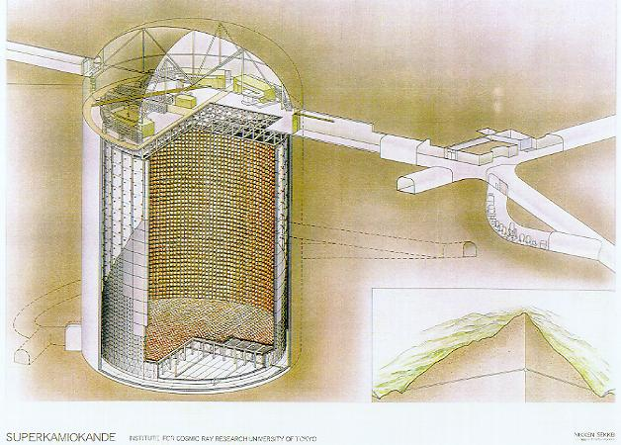
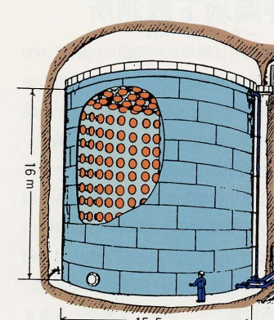








Super-Kamiokande detector
50,000 ton water Cherenkov detector (22,500 ton fiducial volume)
Exit
More than 20 times larger mass
~140 collaborators from:
４２ｍ
３９ｍ
１０００ｍ underground
13

Slide 14
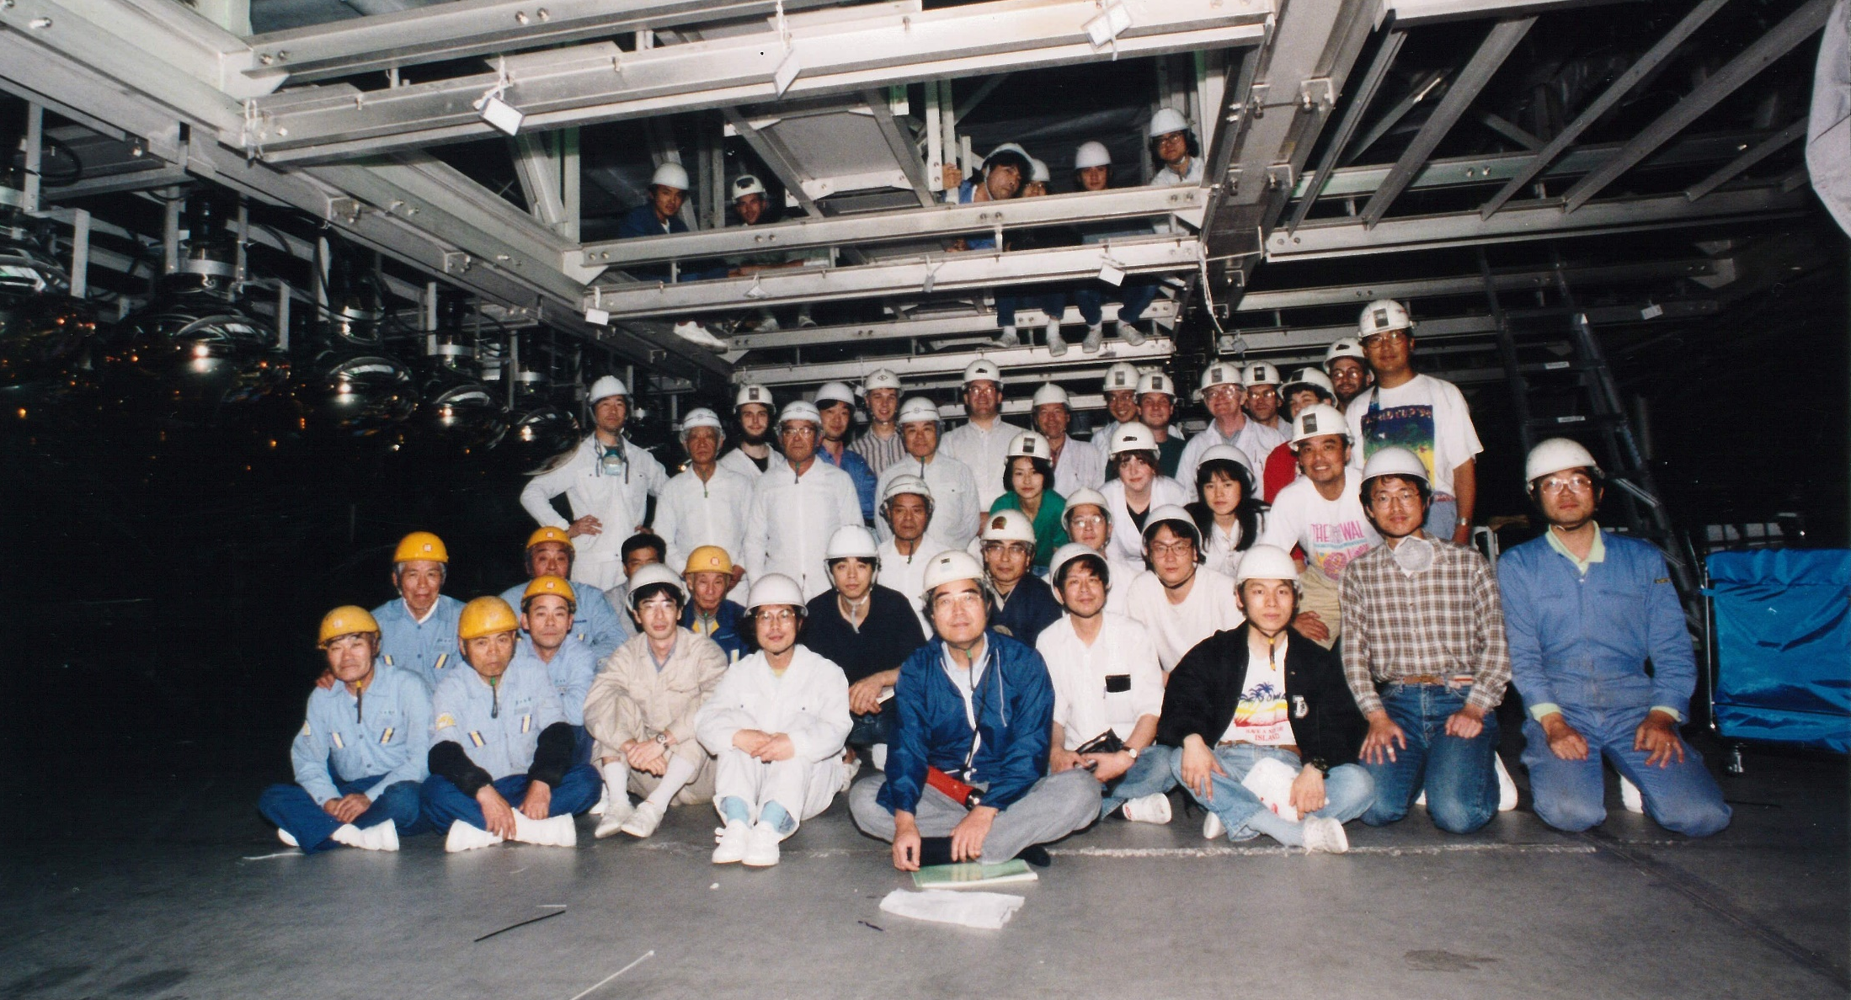
Constructing the Super-Kamiokande detector (spring 1995)
Y. Totsuka
14

Slide 15
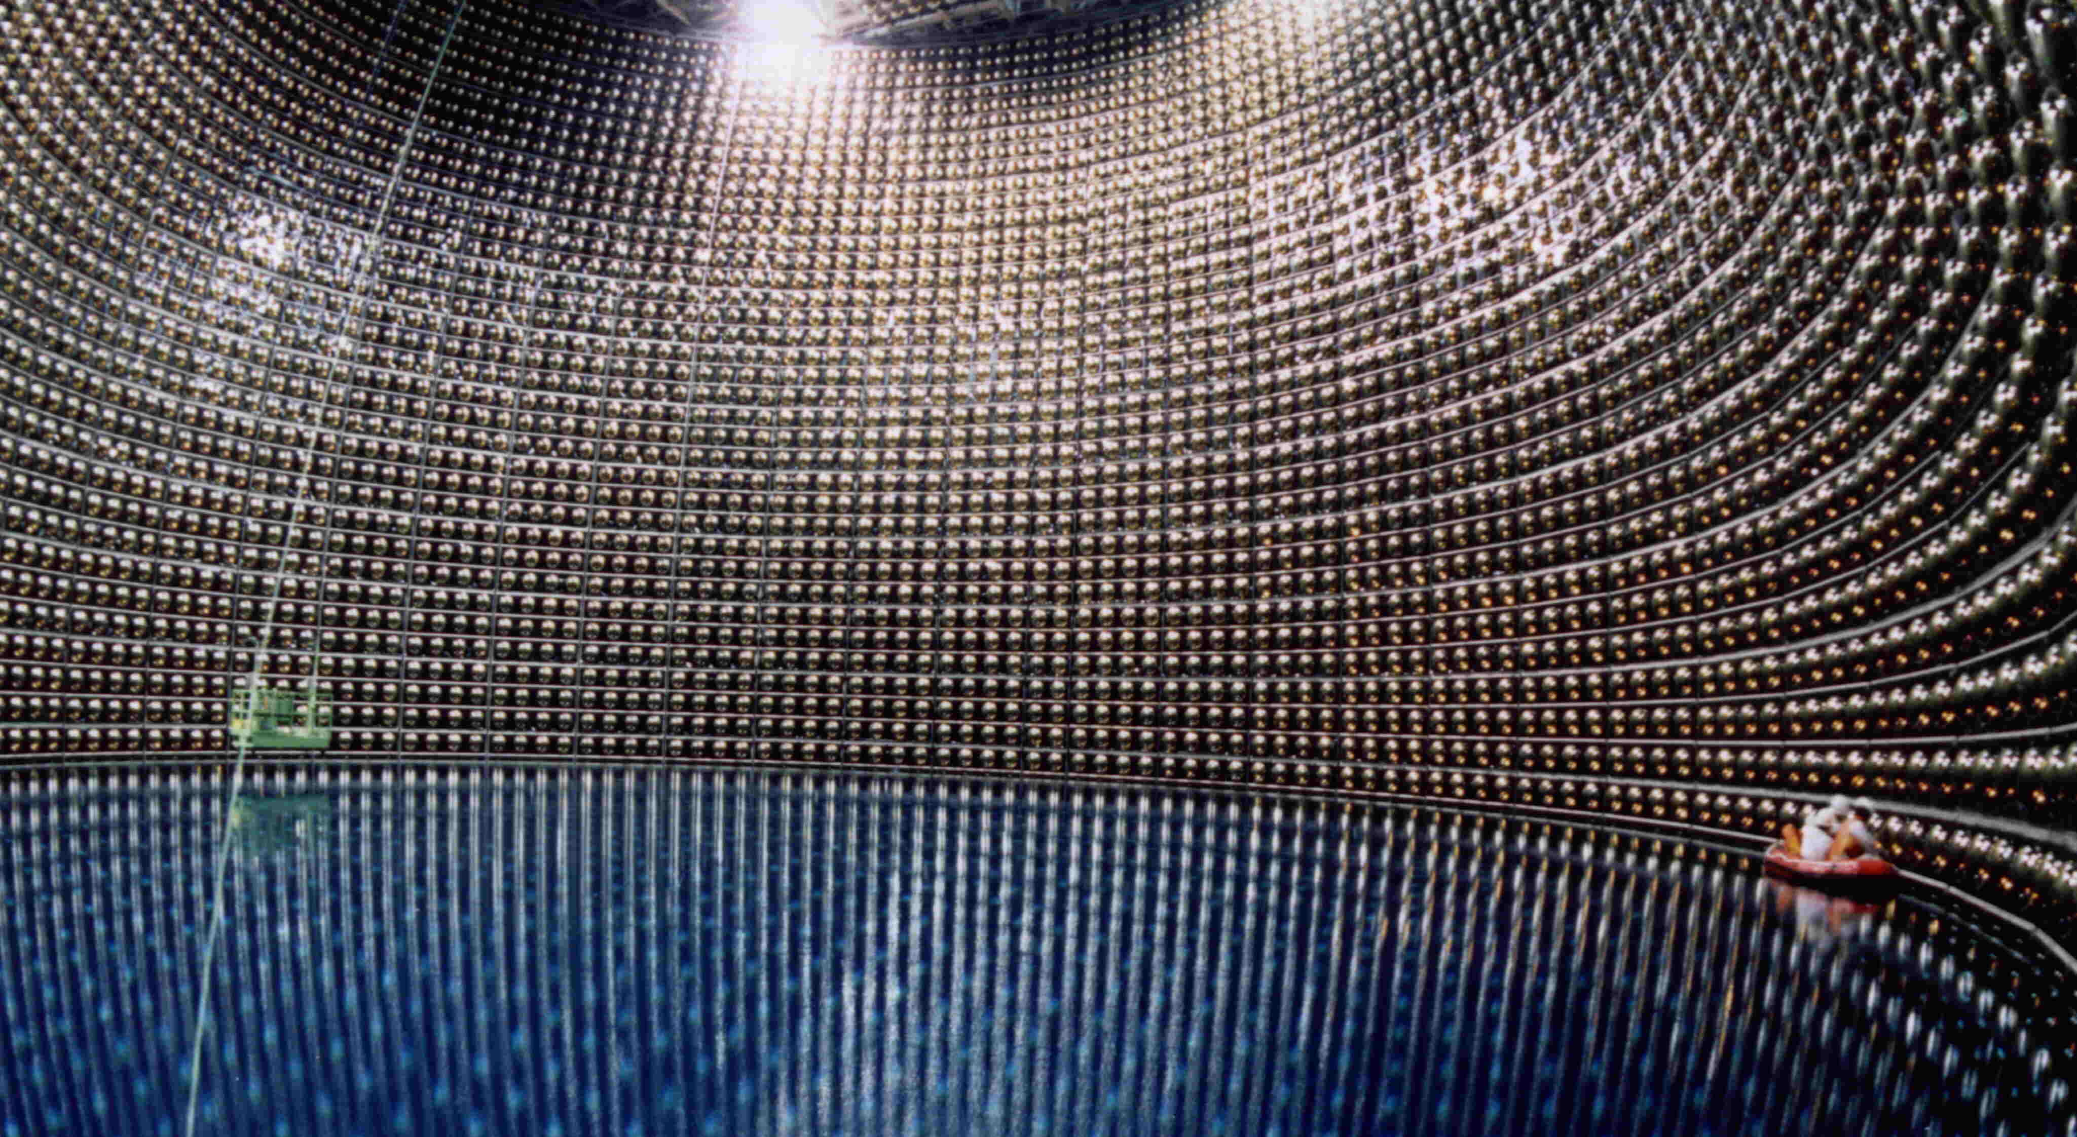
Filling water in Super-Kamiokande
Jan. 1996
15

Slide 16
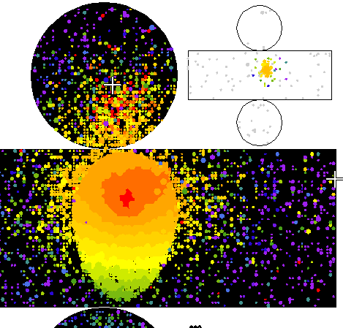
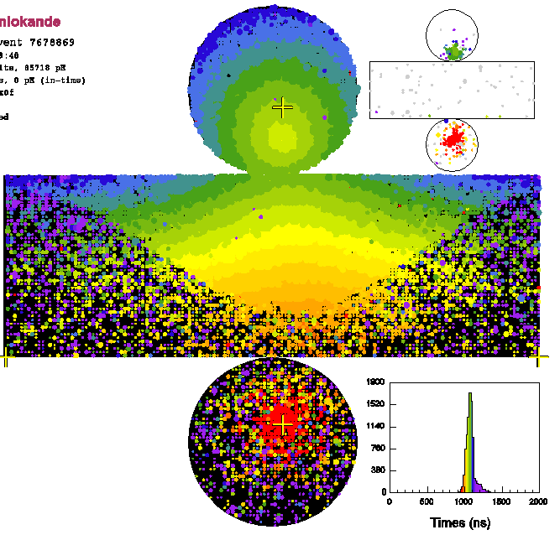
Event type and neutrino energy
Partially contained
1 ring μ-like
1 ring e-like
Upward going μ
All these events are used in the analysis.
16

Slide 17
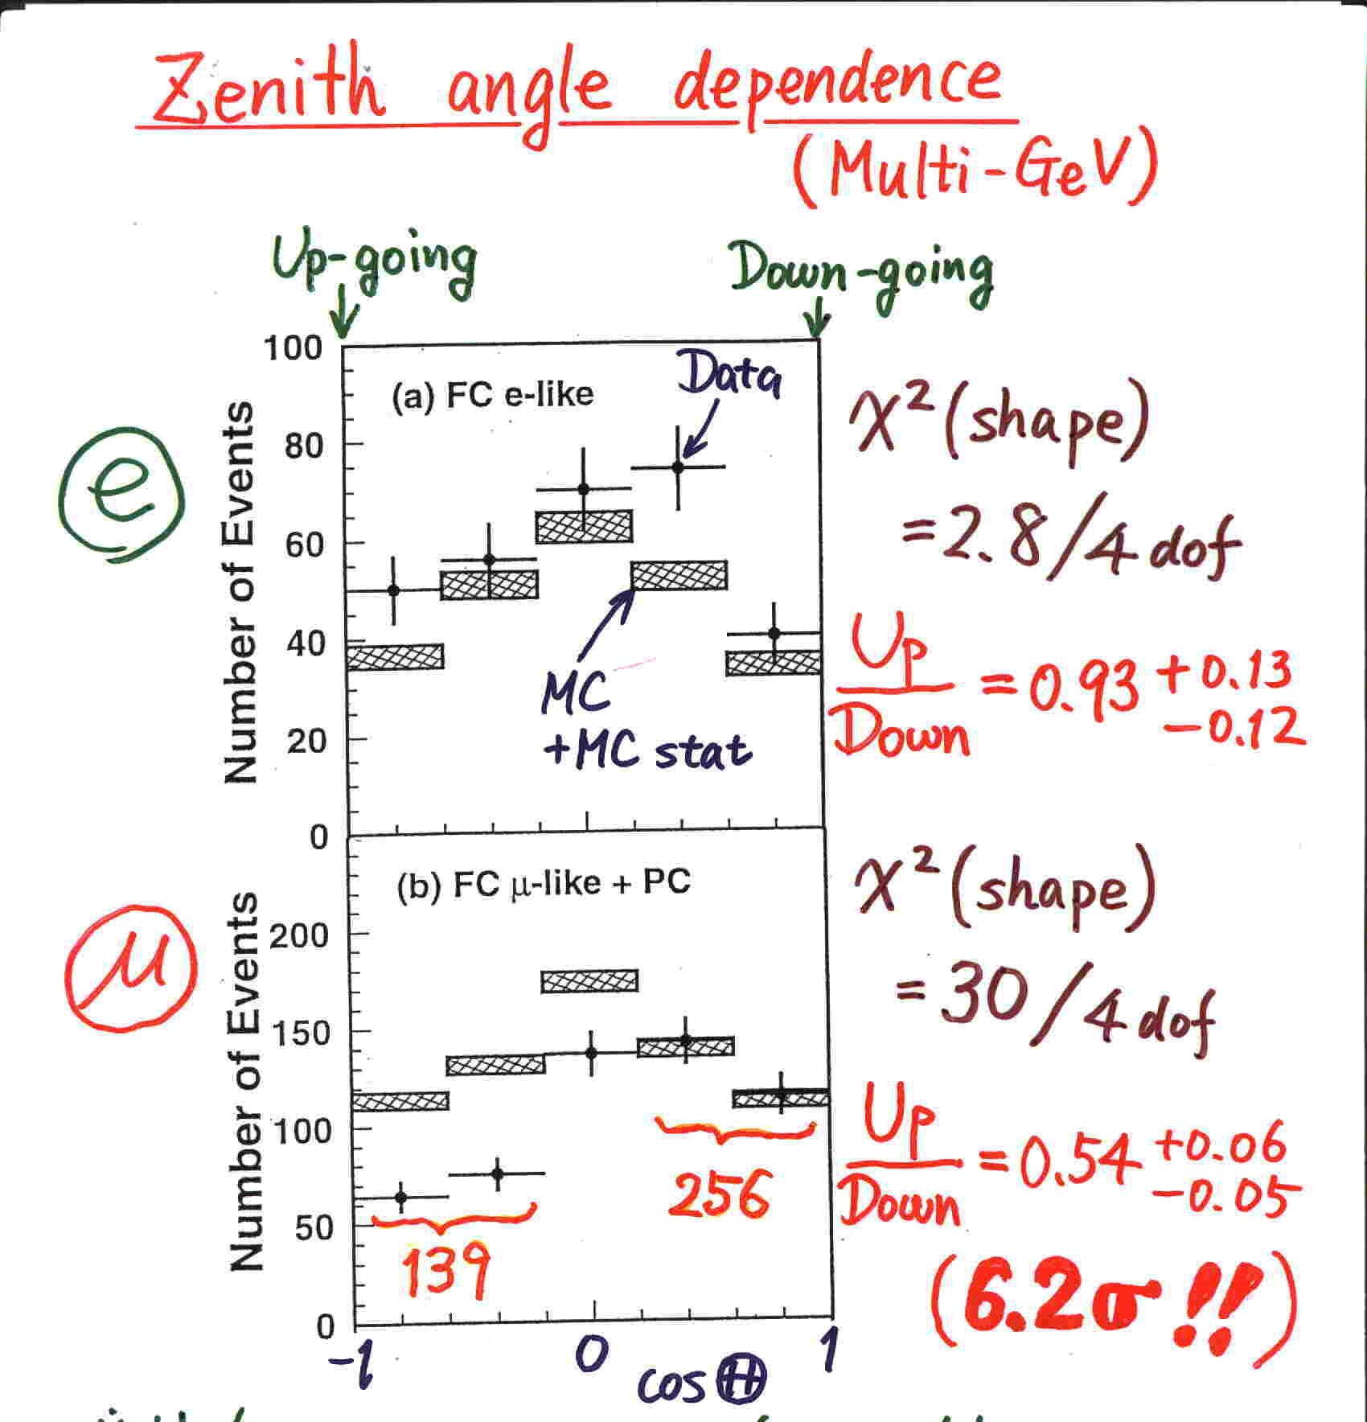
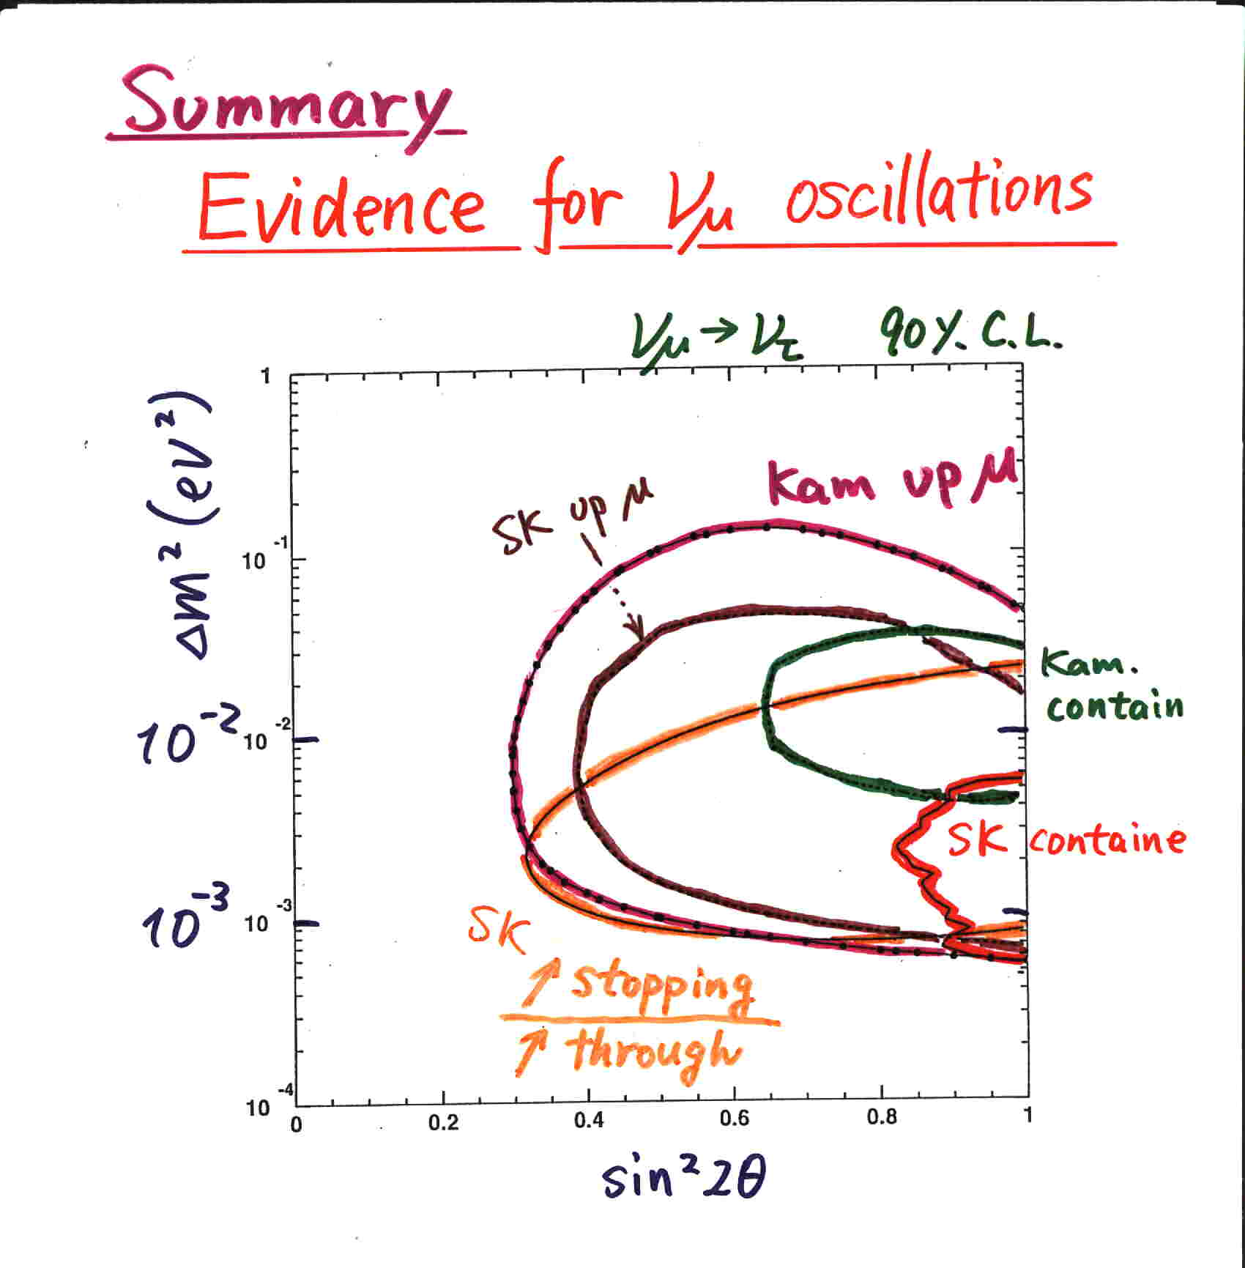
Evidence for neutrino oscillations (Super-Kamiokande @Neutrino ’98)
Y. Fukuda et al., PRL 81 (1998) 1562
Super-Kamiokande concluded that the observed zenith angle dependent deficit (and the other supporting data) gave evidence for neutrino oscillations.
17

Slide 18
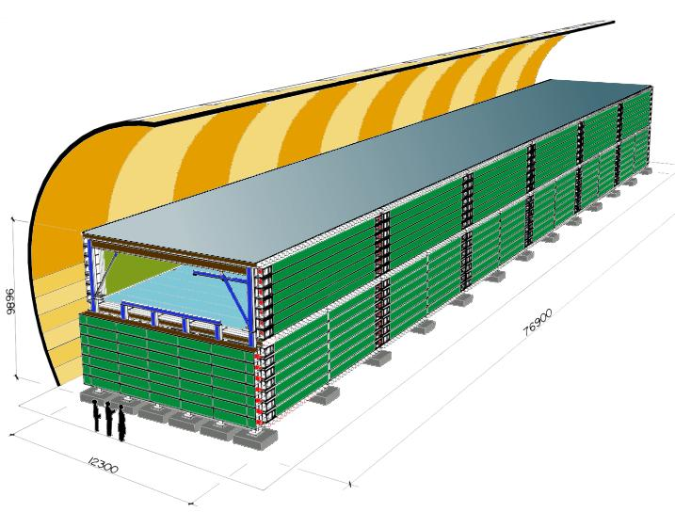
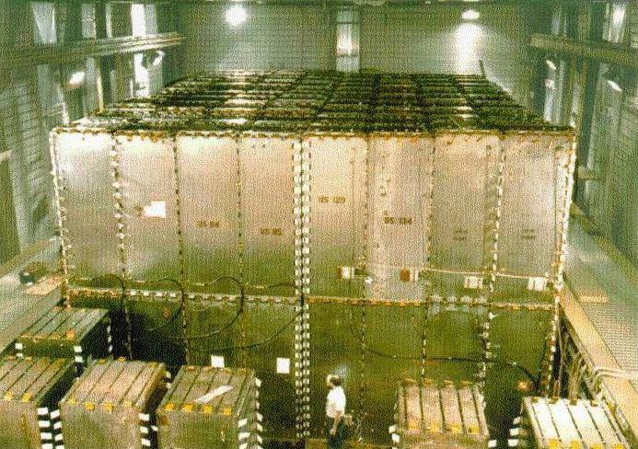
Results from the other atmospheric neutrino experiments
MACRO
Soudan-2
No osc.
Oscillation
Δm² =2.5×10⁻³
These experiments observed atmospheric neutrinos and confirmed neutrino oscillations.
(Accelerator based LBL experiments also have confirmed and studied oscillations.)
18

Slide 19
Status of neutrino oscillation studies
19

Slide 20
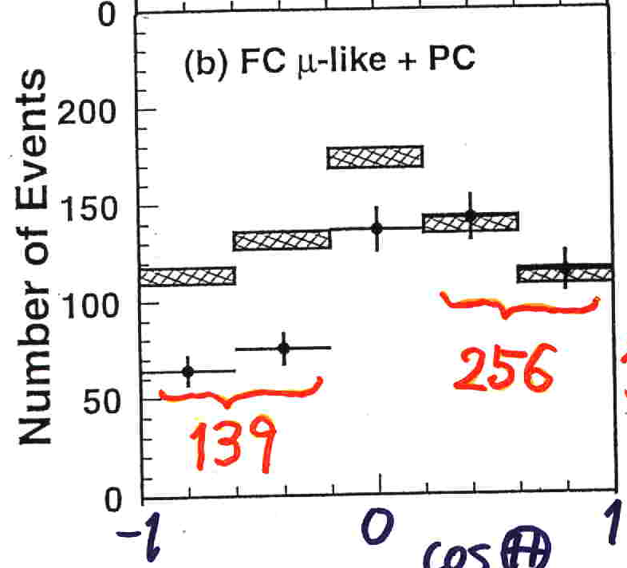
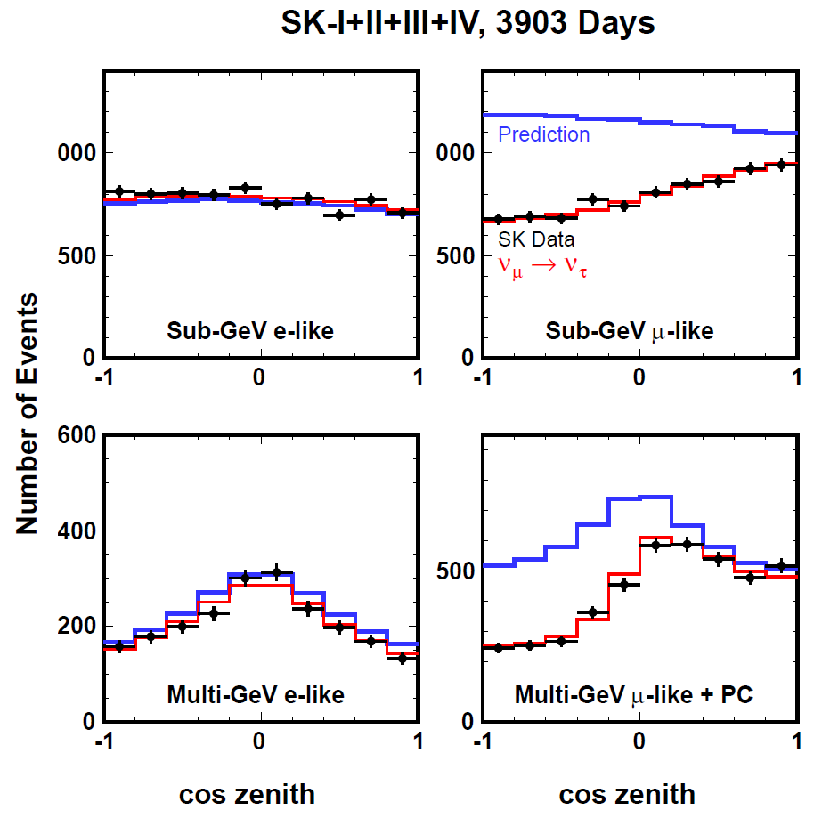
Data updates
Super-K @Neutrino98
Super-K (2016)
ν_{μ}◊ν_{τ}
oscillation
Number of events plotted:
531 events
5932 events
Various studies of neutrino oscillations have been carried out with these data!
20

Slide 21
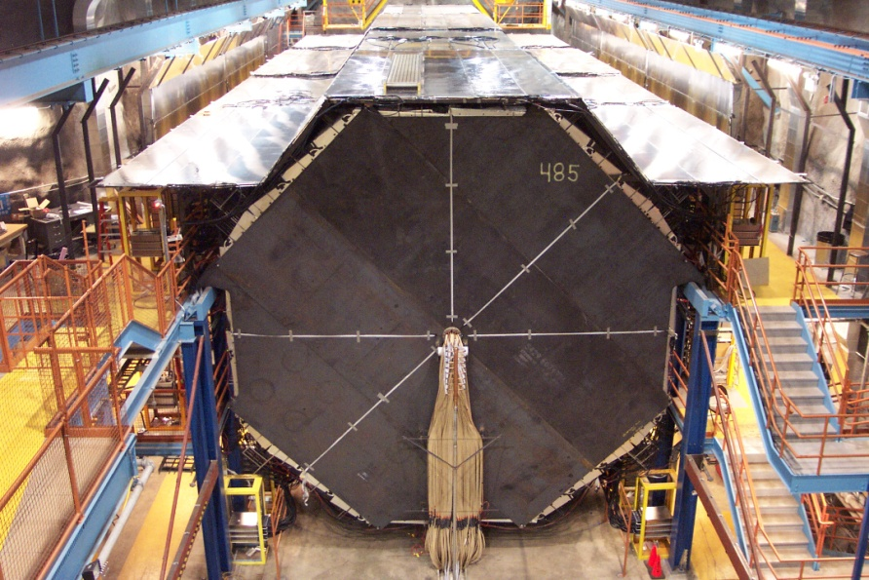
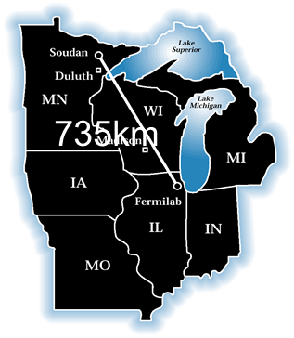

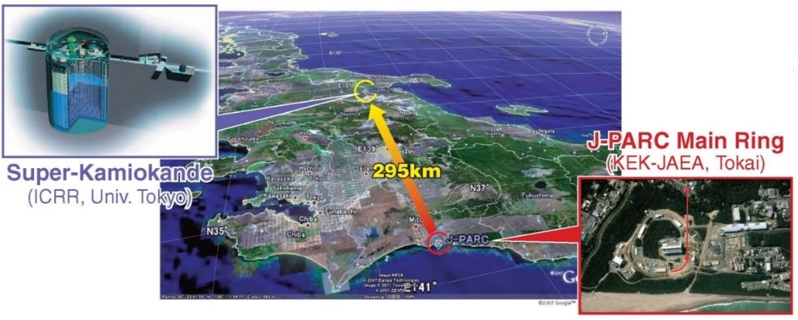
Neutrino oscillation studies
In addition to atmospheric neutrino experiments, various accelerator based long baseline neutrino oscillation have been studying neutrino oscillations in detail.
K2K
MINOS (USA)
OPERA
T2K
NOvA
21

Slide 22
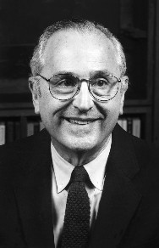
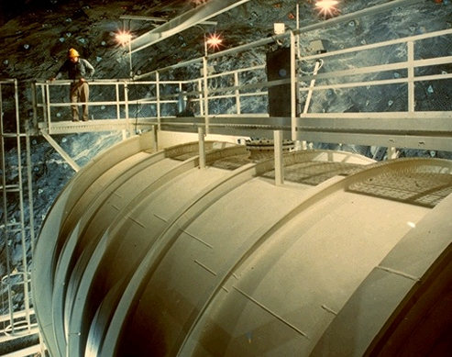
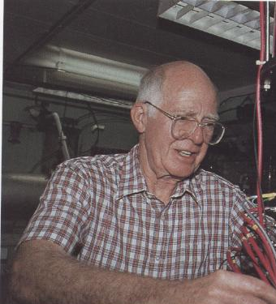
Solar neutrino problem
R. Davis Jr.
J. N. Bahcall
600ton
C₂Cl₄
Pioneering Homestake solar neutrino experiment observed only about 1/3 of the predicted solar neutrinos (1960’s).
This problem was confirmed by the subsequent experiments in the 1980’s and 90’s.
22

Slide 23
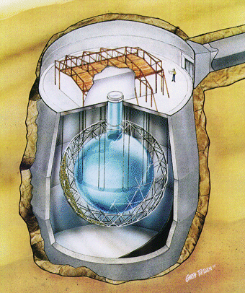
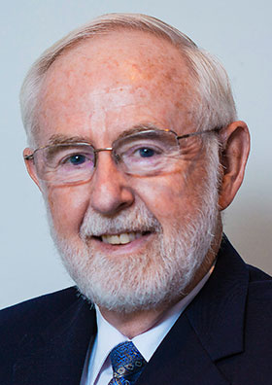
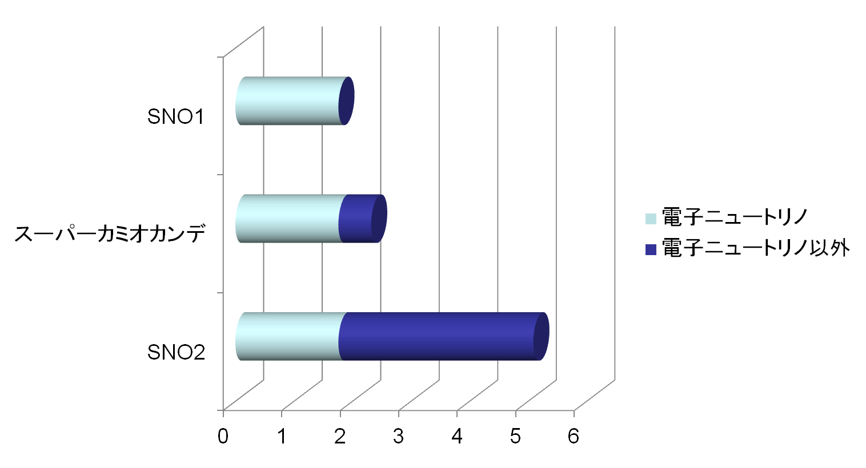
Solving the solar neutrino problem (2001-2002)
SNO
SNO
ν_{e} flux
ν_{e}D→e⁻pp
ν_{μ} +ν_{τ} flux !!
Super-K ES
(ν_{e} +ν_{μ} +ν_{τ}
flux)
νe→νe
SNO
ν_{e} +ν_{μ} +ν_{τ}
flux
νD→νpn
Flux (10⁶/cm2/sec)
1000 ton of heavy water (D₂O)
Neutrino oscillation: electron neutrinos to the other neutrinos.
Art McDonald
23

Slide 24
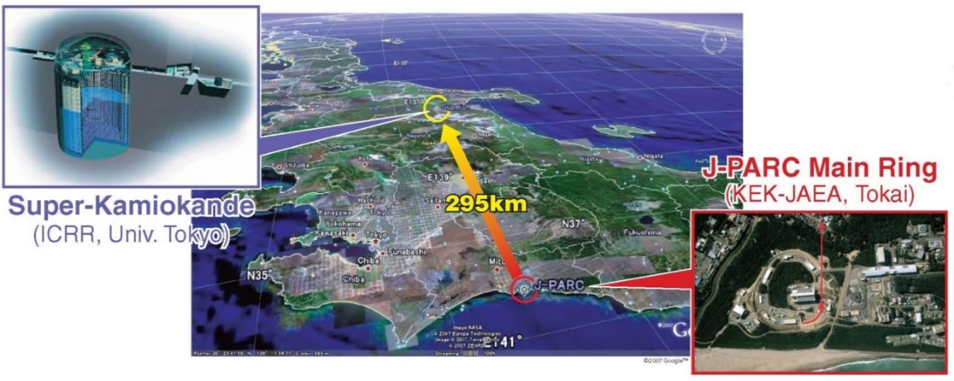
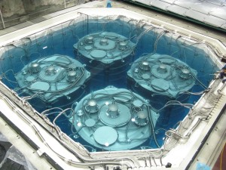
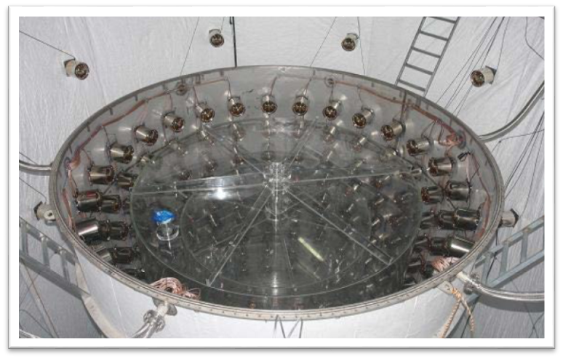
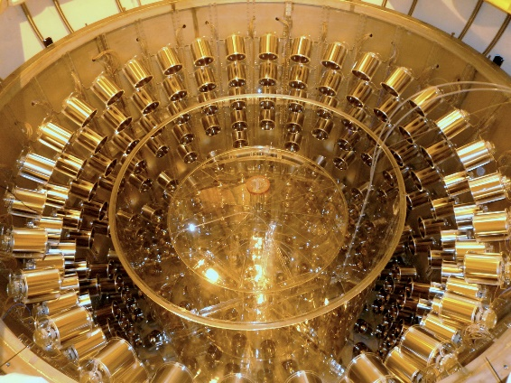
Discovery of the third neutrino oscillations (2011-2012)
Accelerator based long baseline neutrino oscillation experiments
NOν A（USA）
T2K (Japan)
MINOS (USA)
Reactor based (short baseline) neutrino oscillation experiments
Double Chooz（France）
Daya Bay（China）
RENO（Korea）
24

Slide 25
What have we learned?
Why are neutrinos important?
3rd generation
2nd generation
Neutrinos
(with some assumptions)
Quarks
1st generation
？
Charged leptons (electrons, etc.)
0.01 1 100 10⁴ 10⁶ 10⁸ 10¹⁰ 10¹² 10¹⁴
Mass（eV/c²）
The neutrino masses are approximately (or more than) 10 billion (10 orders of magnitude) smaller than the corresponding masses of quarks and charged leptons!
We believe this is the key to understand the nature at the smallest and the largest scales.
25

Slide 26
Future
26

Slide 27
Neutrino mass
3rd generation
2nd generation
？
1st generation
？
0.01 1 100 10⁴ 10⁶ 10⁸ 10¹⁰ 10¹² 10¹⁴
Mass（eV/c²）
Or
0.01 1 100 10⁴ 10⁶ 10⁸ 10¹⁰ 10¹² 10¹⁴
Mass（eV/c²）
27

Slide 28
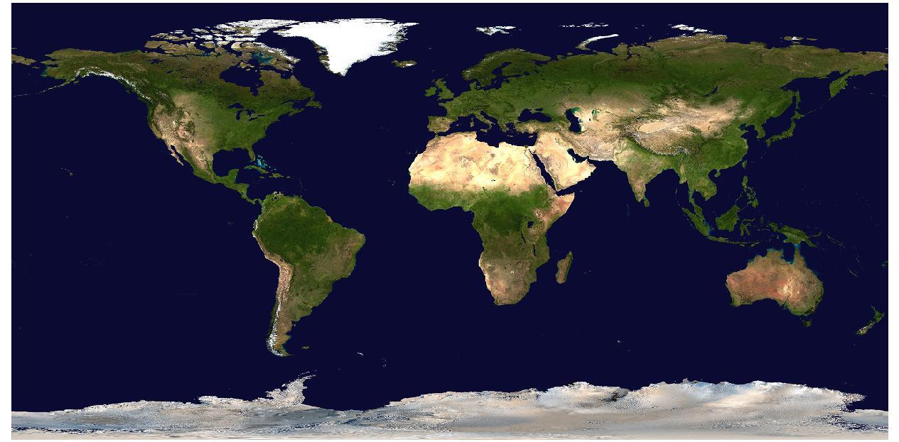
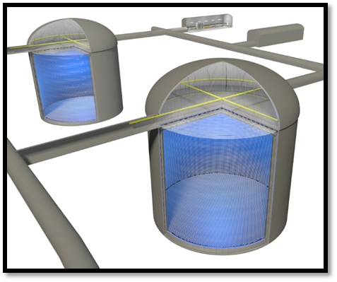
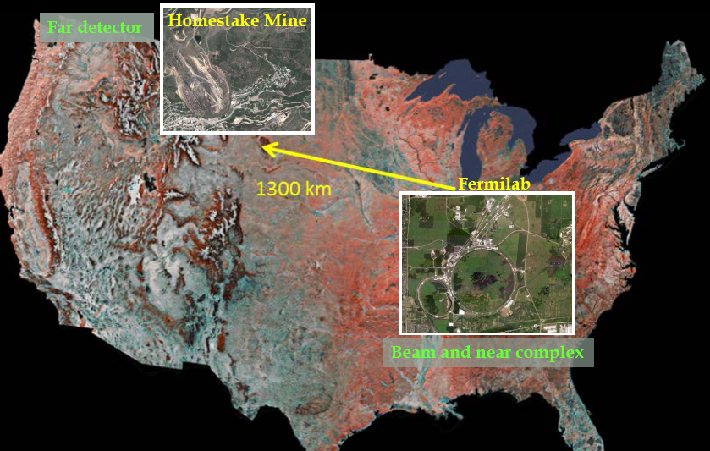
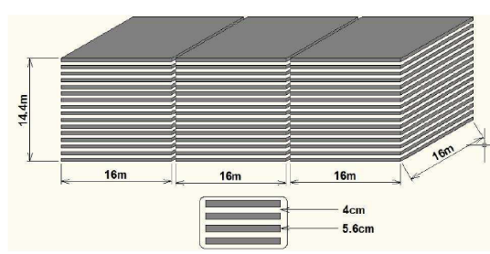
Future experiments that will tell us the order of the neutrino masses
RENO-50
Hyper-K
KM3NeT
/ORCA
LBNF/DUNE
JUNO
PINGU
INO
RENO-50
28

Slide 29
Comment: Importance of “Interactions of neutrinos and hadrons”
Neutrino oscillation experiments are very important.
Now neutrino oscillation experiments enter into the precision measurement stage.
In order to get the most from these experiments, we have to understand the “Interactions of neutrinos and hadrons” much better than before.
➔ This meeting !
29

Slide 30
Summary
About 50 years ago, atmospheric neutrinos was observed for the first time.
“Proton decay experiments” in the 1980’s observed many contained atmospheric neutrino events, and discovered the atmospheric ν_{μ} deficit.
In 1998, Super-Kamiokande discovered neutrino oscillations, which shows that neutrinos have mass.
Since then, various experiments, including solar neutrino experiments, have studied neutrino oscillations.
The discovery of non-zero neutrino masses opened a window to study physics beyond the Standard Model of particle physics.
There are still many things to be observed in neutrinos. Atmospheric neutrino experiments are likely to continue contributing to neutrino studies. ➔ I am looking forward the contribution of ICAL-INO.
30

Slide 31
Back up

Slide 32
Some highlights (ν_{τ} appearance)
OPERA
Super-Kamiokande
5 tau-neutrino candidates observed.
Expected BG = 0.25 evens. (5.1σ)
Super-K (S.Moriyama) @nu2016
See also, SK PRL 110(2013)181802
OPERA PRL 115 (2015) 121602
τ-appearance signal at 4.6σ
ν_{τ}-signal
The fifth candidate event
32

Slide 33
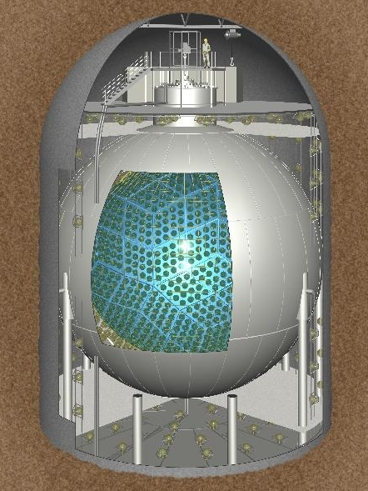
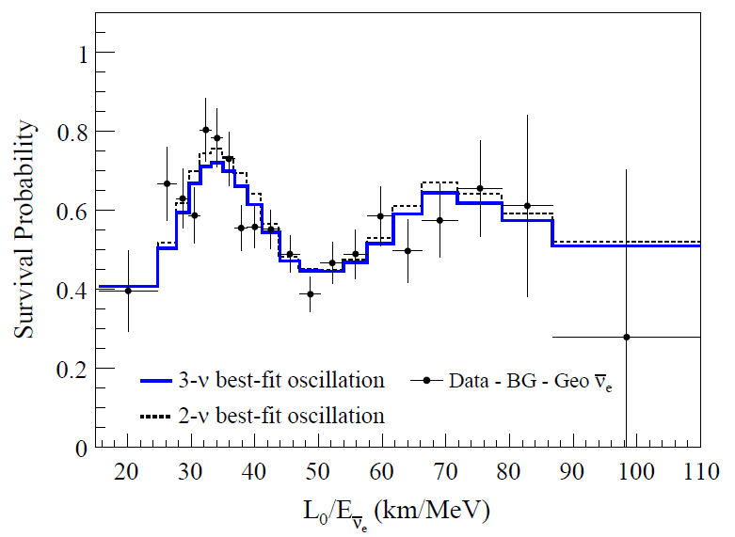
Really neutrino oscillations !
KamLAND observed neutrinos from nuclear power stations.
KamLAND
KamLAND, PRD 83, 052002 (2011)
Reactors
33

