Slide 1

Spectrum and Decay Properties of The Ds Meson
By
Dr. Ajay Kumar Rai
Department Of Applied Physics
Sardar Vallabhbhai National Institute of Technology
SURAT, Gujarat-395007

Slide 2
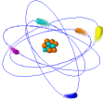
Outline
Introduction
Theoretical Framework and Results of
  Mass Spectrum
  Decay Constants
  Electromagnetic Transitions
  Leptonic Branching Fractions and
  Radiative Leptonic Branching Fractions
Conclusions
References

Slide 3
Group
Heavy-Heavy flavour meson
Naynesh Devlani
V. H. Kher
Dharmesh Rathaud
Zalak U Shah
Raghav Chaturvedi
Heavy–light flavour mesons
Exotic Hadrons(molecular structure)
Baryons

Slide 4
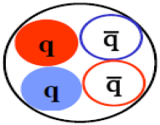
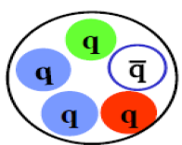
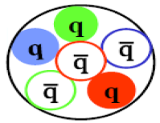
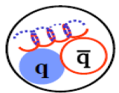
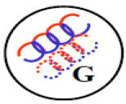
Exotic States
Tetraquark quark
Pentaquark
Hexaquark
Hybrid
Molecular
Structure
Glueball

Slide 5
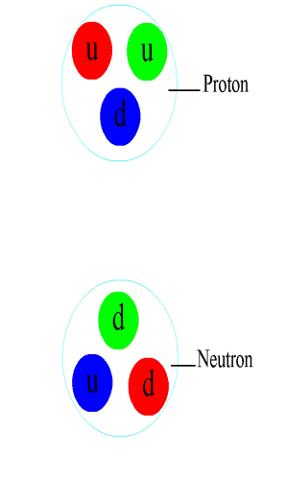

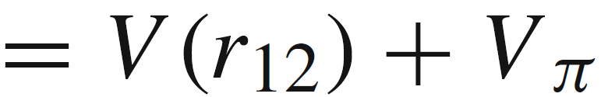
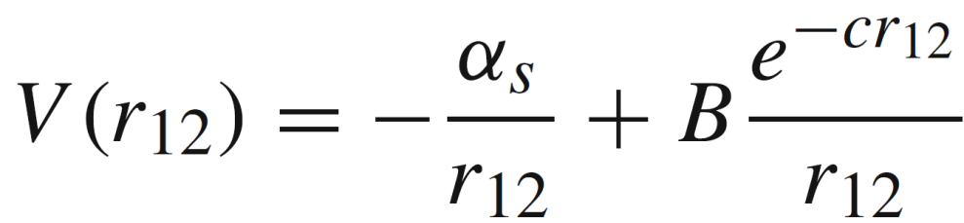
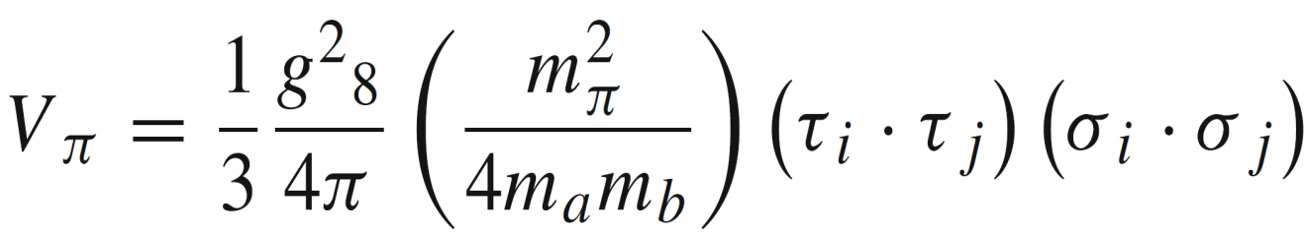
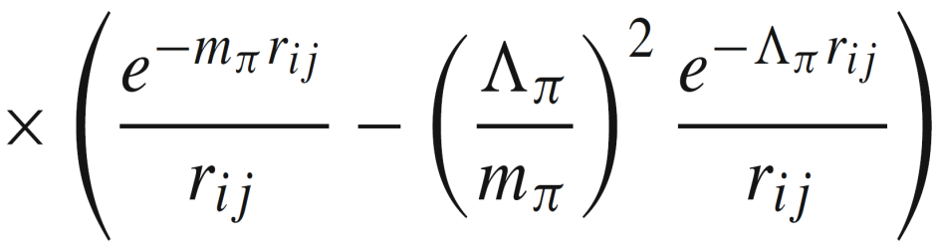
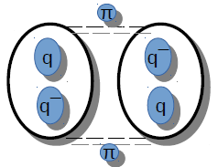
Dimesonic States
Potential used for Dimesonic sates
Hellmann Potential
One Pion Exchange Potential

Slide 6
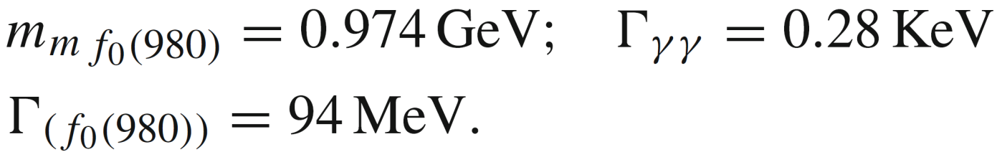
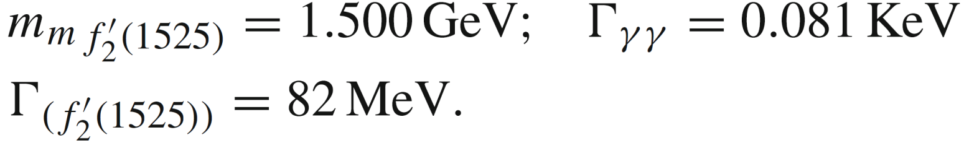
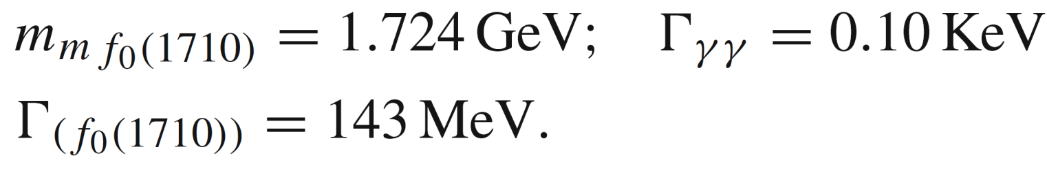
Some Results: Dimesonic states
A. K. Rai and D. P. Rathaud, Eur. Phys. J. C 75 (2015) 462

Slide 7
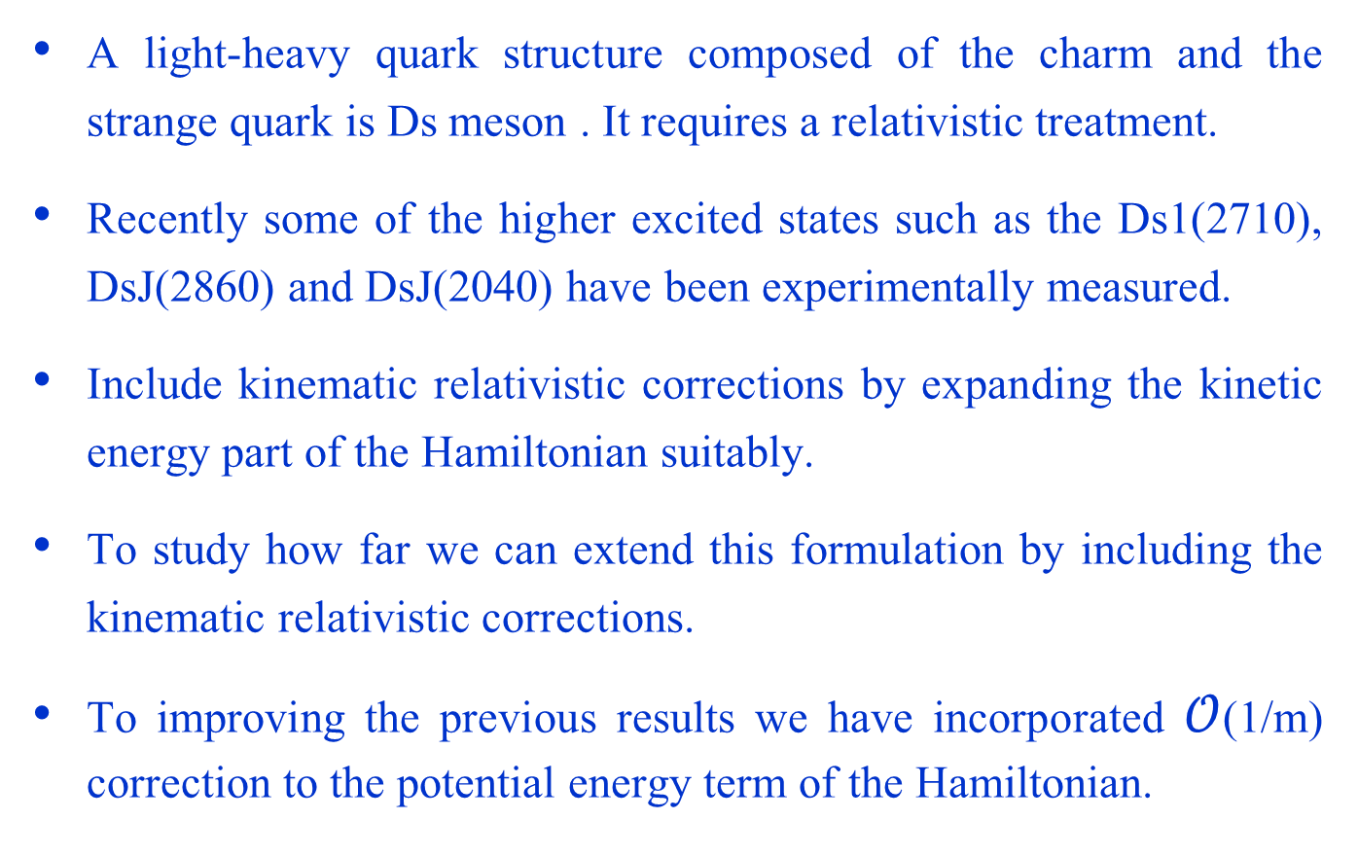
Introduction
A light-heavy quark structure composed of the charm and the strange quark is Ds meson . It requires a relativistic treatment.
Recently some of the higher excited states such as the Ds1(2710), DsJ(2860) and DsJ(2040) have been experimentally measured.
Include kinematic relativistic corrections by expanding the kinetic energy part of the Hamiltonian suitably.
To study how far we can extend this formulation by including the kinematic relativistic corrections.
To improving the previous results we have incorporated $𝒪$(1/m) correction to the potential energy term of the Hamiltonian.

Slide 8
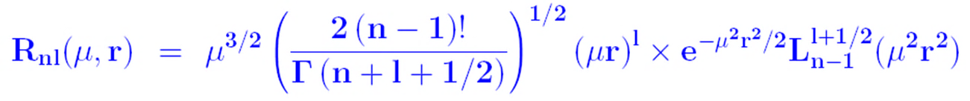

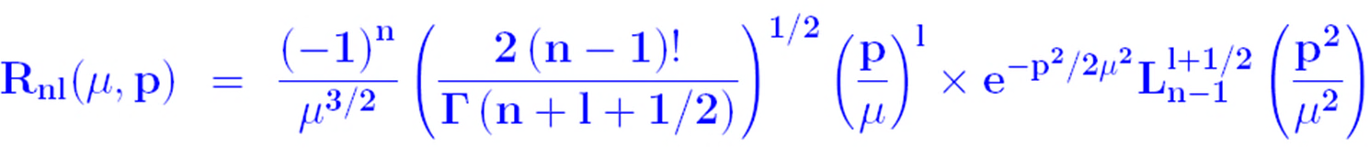
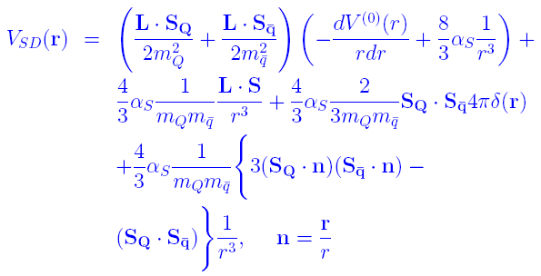
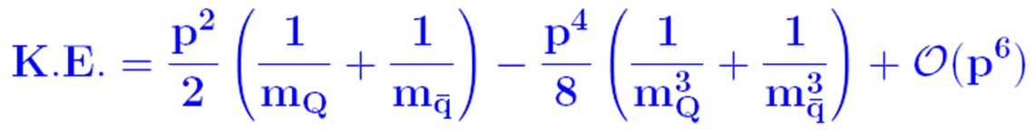

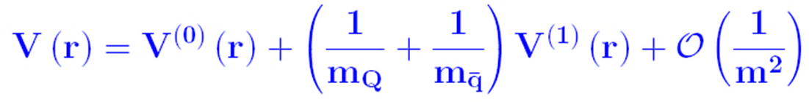


Theoretical Framework
Mass spectrum
Gaussian Wave function in Position Space
Relativistic Hamiltonian
K.E. Part
For computing the hyperfine and spin-orbit shifting of the low-lying S, P and Ds-states (splitting of the nL levels), introduces additional term “ Spin-dependent one gluon exchange potential (OGEP) between the quark anti quark” in the Hamiltonian
P.E. Part
Heavy
Light
Gaussian Wave function in Momentum Space
Expanded using Binomial theorem
The spin averaged mass for the ground state matched using the equation….
Relativistic corrections to potential
Value of the constant V₀ (GeV)
ν | V₀
1.0 | -0.178
1.5 | -0.566
2.0 | -1.218
The parameters used to calculate masses are
A = 0.137,
mc = 1.40 GeV,
ms = 0.586 GeV and
Spin-spin interaction part
Spin orbital interaction
Stands for tensor interaction
C_{F} and C_{A} are Casimir charges of the fundamental and adjoint representation resp.
8

Slide 9
Spin Averaged Mass
Results
S wave spin averaged masses
nL | ν | µ (GeV) | |R(0)| GeV^{3/2} | E(µ) (GeV) | Expt. (GeV) | Theory (GeV)
1S | 1.0 | 0.477 | 0.495 | 2.076 | 2.076[1] | 2.076[21]
 | 1.5 | 0.495 | 0.524 | 2.076 |  | 2.082[22]
 | 2.0 | 0.517 | 0.559 | 2.076 |  | 2.074[23]
 |  |  |  |  |  | 2.072[6]
 |  |  |  |  |  | 2.075[24]
2S | 1.0 | 0.339 | 0.242 | 2.709 |  | 2.779[21]
 | 1.5 | 0.379 | 0.286 | 3.743 |  | 2.700[22]
 | 2.0 | 0.417 | 0.330 | 6.146 |  | 2.706[23]
 |  |  |  |  |  | 2.695[6]
 |  |  |  |  |  | 2.720[24]
 |  |  |  |  |  | 2.713[2]
3S | 1.0 | 0.282 | 0.164 | 3.261 |  | 3.323[21]
 | 1.5 | 0.326 | 0.204 | 5.643 |  | 3.165[22]
 | 2.0 | 0.365 | 0.242 | 11.942 |  | 3.076[23]
 |  |  |  |  |  | 3.236[24]
 |  |  |  |  |  | 3.175[2]
4S | 1.0 | 0.249 | 0.126 | 3.772 |  | 3.356[24]
 | 1.5 | 0.293 | 0.161 | 7.744 |  | 3.665[23]
 | 2.0 | 0.332 | 0.194 | 19.322 |  | 3.567[2]
P and D wave spin averaged masses
nL | ν | µ (GeV) | E(µ) (GeV) | Expt. (GeV) | Theory (GeV)
1P | 1.0 | 0.368 | 2.542 | 2.514[1] | 2.531[22]
 | 1.5 | 0.418 | 3.003 |  | 2.538[23]
 | 2.0 | 0.457 | 3.915 |  | 2.511[6]
 |  |  |  |  | 2.537[24]
 |  |  |  |  | 2.545[2]
2P | 1.0 | 0.274 | 3.028 |  | 3.008[22]
 | 1.5 | 0.320 | 4.952 |  | 2.954[23]
 | 2.0 | 0.358 | 9.867 |  | 2.991[6]
 |  |  |  |  | 3.119[24]
 |  |  |  |  | 3.026[2]
1D | 1.0 | 0.326 | 2.871 |  | 2.917[21]
 | 1.5 | 0.385 | 3.835 |  | 2.873[22]
 | 2.0 | 0.428 | 5.910 |  | 2.850[23]
 |  |  |  |  | 2.814[6]
 |  |  |  |  | 2.852[2]
2D | 1.0 | 0.276 | 3.383 |  | 3.288[22]
 | 1.5 | 0.329 | 5.713 |  | 3.236[6]
 | 2.0 | 0.370 | 11.698 |  | 3.436[24]
 |  |  |  |  | 3.277[2]

Slide 10
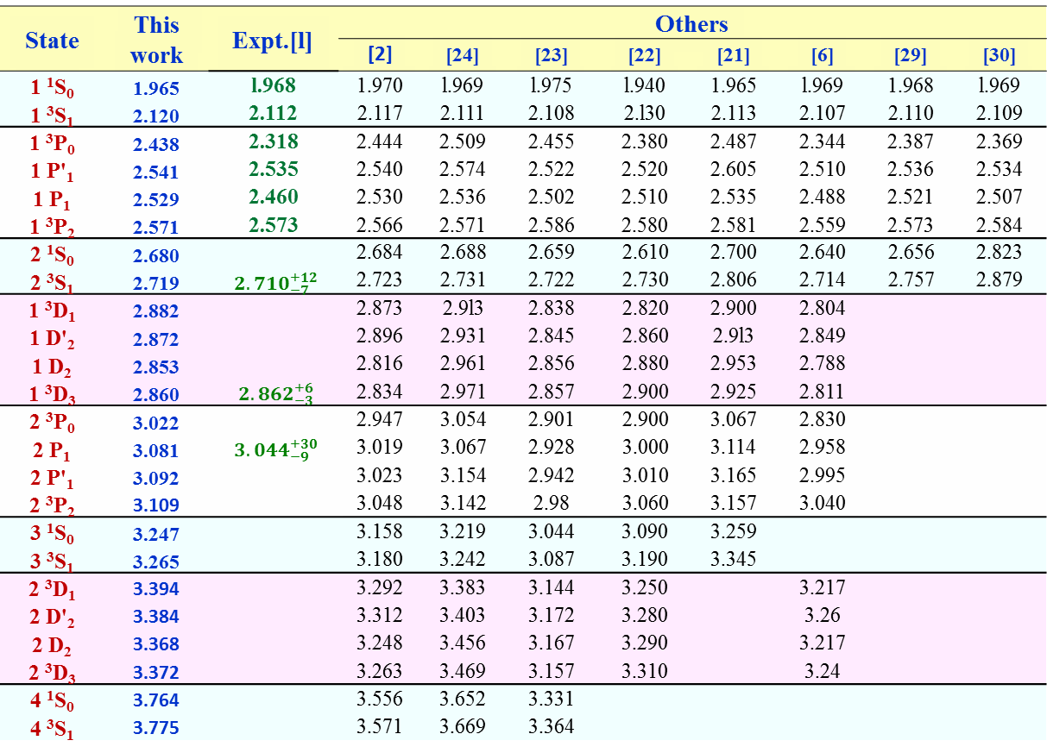
Mass Spectrum ( in GeV)
Results
State | This work | Expt.[l] | Others
 |  |  | [2] | [24] | [23] | [22] | [21] | [6] | [29] | [30]
1 ¹S₀ | 1.965 | l.968 | 1.970 | l.969 | l.975 | l.940 | 1.965 | l.969 | 1.968 | l.969
1 ³S₁ | 2.120 | 2.112 | 2.117 | 2.111 | 2.108 | 2.l30 | 2.113 | 2.107 | 2.110 | 2.109
1 ³P₀ | 2.438 | 2.318 | 2.444 | 2.509 | 2.455 | 2.380 | 2.487 | 2.344 | 2.387 | 2.369
1 P'₁ | 2.541 | 2.535 | 2.540 | 2.574 | 2.522 | 2.520 | 2.605 | 2.510 | 2.536 | 2.534
1 P₁ | 2.529 | 2.460 | 2.530 | 2.536 | 2.502 | 2.510 | 2.535 | 2.488 | 2.521 | 2.507
1 ³P₂ | 2.571 | 2.573 | 2.566 | 2.571 | 2.586 | 2.580 | 2.581 | 2.559 | 2.573 | 2.584
2 ¹S₀ | 2.680 |  | 2.684 | 2.688 | 2.659 | 2.610 | 2.700 | 2.640 | 2.656 | 2.823
2 ³S₁ | 2.719 | ${2.710}_{−7}^{+12}$ | 2.723 | 2.731 | 2.722 | 2.730 | 2.806 | 2.714 | 2.757 | 2.879
1 ³D₁ | 2.882 |  | 2.873 | 2.9l3 | 2.838 | 2.820 | 2.900 | 2.804
1 D'₂ | 2.872 |  | 2.896 | 2.931 | 2.845 | 2.860 | 2.9l3 | 2.849
1 D₂ | 2.853 |  | 2.816 | 2.961 | 2.856 | 2.880 | 2.953 | 2.788
1 ³D₃ | 2.860 | ${2.862}_{−3}^{+6}$ | 2.834 | 2.971 | 2.857 | 2.900 | 2.925 | 2.811
2 ³P₀ | 3.022 |  | 2.947 | 3.054 | 2.901 | 2.900 | 3.067 | 2.830
2 P₁ | 3.081 | ${3.044}_{−9}^{+30}$ | 3.019 | 3.067 | 2.928 | 3.000 | 3.114 | 2.958
2 P'₁ | 3.092 |  | 3.023 | 3.154 | 2.942 | 3.010 | 3.165 | 2.995
2 ³P₂ | 3.109 |  | 3.048 | 3.142 | 2.98 | 3.060 | 3.157 | 3.040
3 ¹S₀ | 3.247 |  | 3.158 | 3.219 | 3.044 | 3.090 | 3.259
3 ³S₁ | 3.265 |  | 3.180 | 3.242 | 3.087 | 3.190 | 3.345
2 ³D₁ | 3.394 |  | 3.292 | 3.383 | 3.144 | 3.250 |  | 3.217
2 D'₂ | 3.384 |  | 3.312 | 3.403 | 3.172 | 3.280 |  | 3.26
2 D₂ | 3.368 |  | 3.248 | 3.456 | 3.167 | 3.290 |  | 3.217
2 ³D₃ | 3.372 |  | 3.263 | 3.469 | 3.157 | 3.310 |  | 3.24
4 ¹S₀ | 3.764 |  | 3.556 | 3.652 | 3.331
4 ³S₁ | 3.775 |  | 3.571 | 3.669 | 3.364

Slide 11


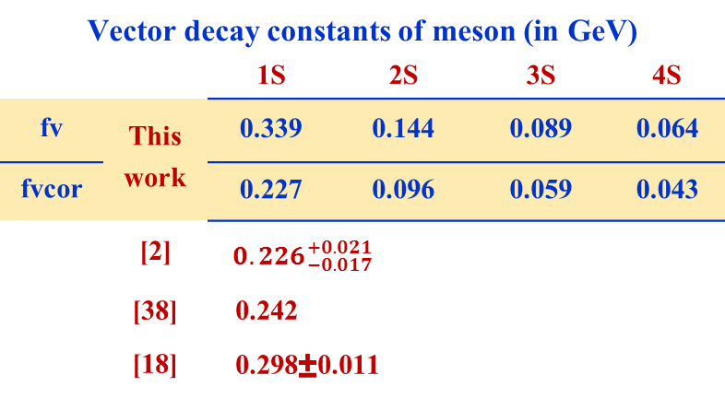
Decay Constants
Results
Decay constants of pseudoscalar (f_{P} ) and vector (f_{V} ) mesons
Important parameters in study of leptonic/ non-leptonic weak decay processes
We compute the decay constants using the relation
Vector decay constants of meson (in GeV)
 |  | 1S | 2S | 3S | 4S
fv | This work | 0.339 | 0.144 | 0.089 | 0.064
fvcor |  | 0.227 | 0.096 | 0.059 | 0.043
 | [2] | ${ 0.226}_{−0.017}^{+0.021}$
 | [38] | 0.242
 | [18] | 0.298±0.011
Pseudoscalar decay constants of meson (in GeV)
 |  | 1S | 2S | 3S |  | 4S
fp | This work | 0.324 | 0.143 | 0.089 |  | 0.064
fpcor |  | 0.217 | 0.096 | 0.059 |  | 0.042
 | [2] | 0.224
 | [35] | 0.254±0.006
 | [36] | 0.248±0.002
 | [37] | 0.235±0.024
Ground state wave function at the origin
QCD correction factor

Slide 12

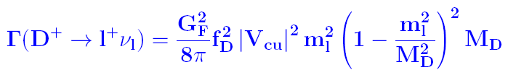
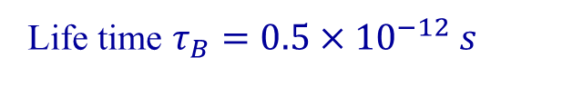
Leptonic Branching Fraction
The leptonic branching fractions for the meson are obtained using the formula
Γ= Leptonic decay width
Life time $τ_{B}=0.5×{10}^{−12} s$
τ_{D} = 0.410 x 10⁻¹² sec
Calculated values of decay constants
Calculated Masses of mesons
Results
Ds⁺ → τ⁺ n_{τ} | Ds⁺ → µ⁺ n_{µ} | Ds⁺ → e⁺ n_{e}
BR_{τ} x 10⁻² | BR_{µ} x 10⁻³ | BR_{e} x 10⁻⁸
3.784 | 4.0015 | 9.414
(5.54 ± 0.24)x10⁻² [1] | (5.56 ± 0.25)x10⁻³ [1] | < 8.5 x 10⁻⁵ [1]

Slide 13


Radiative Leptonic Branching Fraction
The radiative leptonic decay width Γ for the meson are obtained using the formula
Where,
Results
 | fp |  | fpcort
This work | Γx10⁻¹⁸ | BR x 10⁻⁶ | Γ x10⁻¹⁸ | BR x 10⁻⁶
1S | 4.74 | 3.60 | 2.13 | 1.62
2S | 45.77 | 34.77 | 20.63 | 15.67
3S | 91.15 | 69.24 | 40.06 | 30.43
4S | 139.51 | 105.98 | 60.08 | 45.64
5S | 187.67 | 142.56 | 85.12 | 64.66
6S | 249.37 | 189.43 | 113.62 | 86.31
 |  | fp |  | fpcort
 | ν | Γx10⁻¹⁸ | BR x 10⁻⁶ | Γ x10⁻¹⁸ | BR x 10⁻⁶
This work | 1 | 4.74 | 3.60 | 2.13 | 1.62
 | 1.5 | 4.93 | 3.75 | 2.20 | 1.67
 | 2 | 5.21 | 3.96 | 2.33 | 1.77
[40] |  |  |  | 2.3 x 10⁻¹⁷ | 1.8 x 10⁻⁵

Slide 14


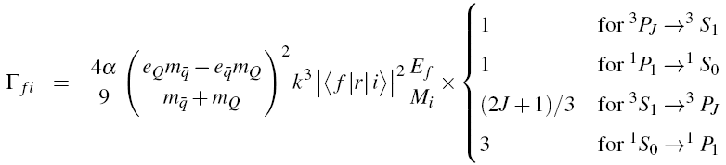




Theoretical Framework
Electromagnetic Transitions
Electric Dipole Transitions
Magnetic Dipole Transitions
Magnetic transitions flip the quark spin.
The M1 rate for transitions between S-wave levels is given by
Electric transitions do not change quark spin.
The lowest nonrelativistic order transition.
These transitions have $∆l =± 1$and$∆s = 0$.
The E1 matrix elements are determined by using the vibrational radial wave functions of initial and final state and explicitly performing the angular integration.
The transition width given by
Quark charges
Photon energy
Spherical Bessel Function
Magnetic dipole moment
Fine structure constant
Energy of the final meson state
Quark masses
Mass of the initial meson state
Final total angular momentum
Wave function

Slide 15
Electromagnetic Transitions
Results
The E1 radiative transition widths are
The M1 transitions between S-wave levels are
Transitions |  |  | κ (Gev) | Γ (keV) | [7] | [41] | [42] | [6]
1 ³P₂ | → | 1 ³S₁ γ | 0.410 | 5.90 | 8.8 | 44.1 | 19
1 P₁' | → | 1 ³S₁ γ | 0.401 | 5.53 | 4.76 | 8.9 | 5.6
1 P₁' | → | 1 ¹S₀ γ | 0.502 | 0.011 | 3.49 | 54.5 | 15
1 P₁ | → | 1 ¹S₀ γ | 0.483 | 9.63 | 4.9 | 12.8 | 6.2
1 P1 | → | 1 ³S₁ γ | 0.381 | 0.02 | 0.13 | 15.5 | 5.5
1 ³P₀ | → | 1 ³S₁ γ | 0.327 | 2.999 | 1.0 | 4.92 | 1.9
2 ³S₁ | → | 1 ³P₂ γ | 0.180 | 0.717 |  |  |  | 0.1
2 ³S₁ | → | 1 P₁' γ | 0.190 | 0.503
2 ³S₁ | → | 1 P₁ γ | 0.212 | 0.696
2 ³S₁ | → | 1 ³P₀ γ | 0.269 | 0.478 |  |  |  | 6.9
2 ¹S₀ | → | 1 P₁' γ | 0.159 | 0.881
2 ¹S₀ | → | 1 P₁ γ | 0.181 | 1.301
Transitions |  |  | κ (Gev) | Γ (keV) | [7] | [45] | [46]
 |  |  |  |  |  |  | NR | R
1 ³S₁ | → | 1 ¹S₀ γ | 0.122 | 0.112 | 1.8 | 0.90±0.02 | 1.38 | 0.08
2 ³S₁ | → | 2 ¹S₀ γ | 0.033 | 0.002
2 ³S₁ | → | 1 ¹S₀ γ | 0.654 | 2.552
2 ¹S₀ | → | 1 ³S₁ γ | 0.535 | 4.093

Slide 16
Conclusions
The spin-averaged masses are in good agreement with other estimates and experimental measurements at potential index ν=1.0
The Ds meson masses are fairly in agreement with experimental results as well as other theoretical model predictions and improvement over our previous estimates
The various decay constants obtained are in good agreement with other theoretical model predictions. However, experimental measurements are indeed required for further testing of the model.
Leptonic branching fractions are well within the range of experimental measurement and the calculated values for the radiative leptonic decay widths for the 1S state are overestimated.
The of predicted values of E1 and M1 transition rates are differ with different model predictions, as these decay widths are sensitive to the quark masses employed. Due to the lack of available experimental data it becomes difficult to justify the validity of the calculations.

Slide 17
References
[1] K. Olive, P.D. Group, Chinese Physics C 38(9), 090001 (2014)
[2] N. Devlani, A.K. Rai, Phys. Rev. D 84, 074030 (2011)
[3] N. Devlani, A. Rai, Int. J. Theor. Phys. 52, 2196 (2013), ISSN 0020-7748
[4] B. Aubert, Y. Karyotakis, J.P. Lees, Poireau, Phys. Rev. D 80(9), 092003 (2009)
[5] P. Colangelo, F. De Fazio, S. Nicotri, M. Rizzi, Phys. Rev. D 77(1), 014012 (2008)
[6] D.M. Li, P.F. Ji, B. Ma, Eur. Phys. J. C71, 1 (2011)
[7] F.E. Close, E.S. Swanson, Phys. Rev. D 72(9), 094004 (2005)
[8] N. Isgur, M.B. Wise, Phys. Rev. Lett. 66(9), 1130 (1991)
[9] J. Link et al. (FOCUS Collaboration), Phys. Lett. B586, 11 (2004)
[10] N. Devlani, A. Rai, Eur. Phys. J. A48, 104 (2014)
[11] Y. Koma, M. Koma, H. Wittig, Phys. Rev. Lett 97, 122003 (2006)
[12] A.K. Rai, R.H. Parmar, P.C. Vinodkumar, J. Phys. G: Nucl. Part. Phys. 28(8), 2275 (2002)
[13] A.K. Rai, J.N. Pandya, P.C. Vinodkumar, J. Phys. G: Nucl. Part. Phys. 31(12), 1453 (2005)
[14] A.K. Rai, B. Patel, P.C. Vinodkumar, Phys. Rev. C 78(5), 055202 (2008)
[15] A.M. Badalian, A.I. Veselov, B.L.G. Bakker, Phys. Rev. D 70, 016007 (2004)
[16] Y.A. Simonov, Physics of Atomic Nuclei 58, 107 (1995)
[17] D. Ebert, R.N. Faustov, V.O. Galkin, Phys. Rev. D 79, 114029 (2009)
[18] D.S. Hwang, G.H. Kim, Phys. Rev. D 55(11), 6944 (1997)
[19] D. Ebert, R. Faustov, V. Galkin, Eur. Phys. J. C71, 1825 (2011)
[20] B. Patel, P.C. Vinodkumar, J. Phys. G. 36(3), 035003 (2009)
[21] M. Di Pierro, E. Eichten, Phys. Rev. D 64(11), 114004 (2001)
[22] J. Zeng, J.W. Van Orden, W. Roberts, Phys. Rev. D 52(9), 5229 (1995)
[23] T. Lahde, C. Nyfalt, D. Riska, Nucl. Phys. A674, 141 (2000)
[24] D. Ebert, R. Faustov, V. Galkin, Eur. Phys. J. C66, 197 (2010)
[25] E.J. Eichten, C. Quigg, Phys. Rev. D 49(11), 5845 (1994)
[26] D. Gromes, Z. Phys. C26, 401 (1984)
[27] S. Gershtein, V. Kiselev, A. Likhoded, A. Tkabladze, Phys. Usp. 38, 1 (1995)
[28] G.T. Bodwin, E. Braaten, G.P. Lepage, Phys. Rev. D 51, 1125 (1995)
[29] S.N. Gupta, J.M. Johnson, Phys. Rev. D 51(1), 168 (1995)
[30] Y.b. Dai, C.S. Huang, H.Y. Jin, Phys. Lett. B331, 174 (1994)
[31] D. Ebert, V.O. Galkin, R.N. Faustov, Phys. Rev. D 57(9), 5663 (1998)
[32] D. Ebert, V.O. Galkin, R.N. Faustov, Phys. Rev. D 59(1), 019902 (1998)
[33] R. Van Royen, V. Weisskopf, Nuovo Cim. A50, 617 (1967)
[34] E. Braaten, S. Fleming, Phys. Rev. D 52(1), 181 (1995)
[35] D. Asner et al. (Heavy Flavor Averaging Group) (2010)
[36] C.T.H. Davies et al. (HPQCD Collaboration), Phys. Rev. D 82, 114504 (2010)
[37] S. Narison, Phys. Lett. B520, 115 (2001)
[38] C. Albertus et al., Phys. Rev. D 71(11), 113006 (2005)
[39] D. Silverman, H. Yao, Phys. Rev. D 38(1), 214 (1988)
[40] C.D. Lu, G.L. Song, Phys. Lett. B. 562, 75 (2003)
[41] S.F. Radford, W.W. Repko, M.J. Saelim, Phys. Rev. D 80(3), 034012 (2009)
[42] S. Godfrey, Phys. Rev. D72, 054029 (2005)
[43] W.A. Bardeen, E.J. Eichten, C.T. Hill, Phys. Rev. D 68(5), 054024 (2003)
[44] N. Brambilla et al., Eur. Phys. J. C71, 1534 (2011)
[45] H.M. Choi, C.R. Ji, Phys. Rev. D 59(7), 074015 (1999)
[46] O. Lakhina, E.S. Swanson, Phys. Lett. B650, 159 (2007)

Slide 18


