Slide 1

Dimuon Measurement in CBM Experiment
Anand Kumar Dubey
VECC, Kolkata

Slide 2
Outline
Dilepton measurements
CBM experiment at FAIR
Schematic of dimuon measurements in different expt.
Muon Chamber (MUCH) system of CBM
-- Simulation results
-- Detailed R&D
Summary

Slide 3
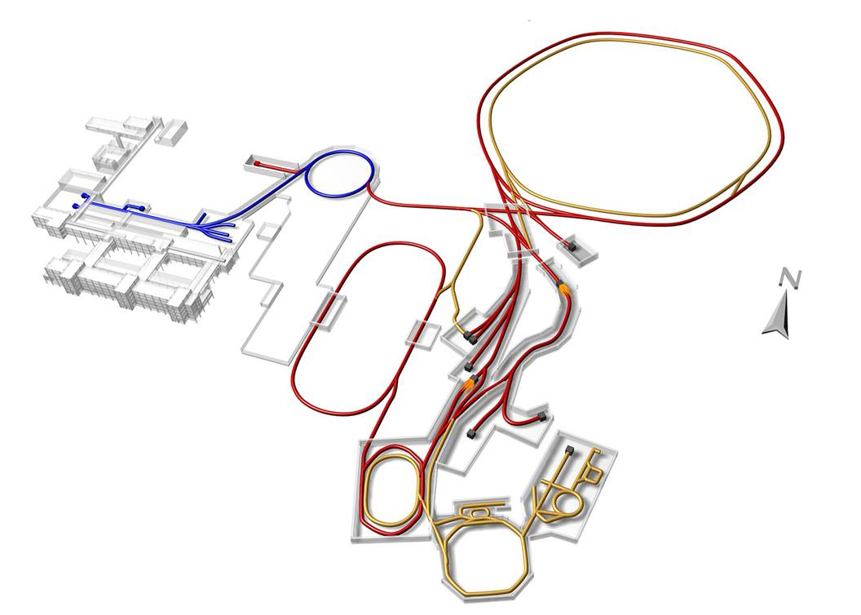
Facility for Antiproton & Ion Research
Primary Beams
10¹²/s; 1.5 GeV/u; ²³⁸U²⁸⁺
10¹⁰/s ²³⁸U⁹²⁺ up to 11 (35) GeV/u
3x10¹³/s 30 (90) GeV protons
SIS18
SIS100/300
p-Linac
Technical Challenges
cooled beams
rapid cycling superconducting magnets
dynamical vacuum
Compressed Baryonic Matter
HESR
Secondary Beams
Anti-Proton Physics
radioactive beams up to
1.5 - 2 GeV/u; up to factor 10000
higher in intensity than presently
antiprotons 3 - 30 GeV
Super Fragment-Separator:
Nuclear Structure and Astrophysics
Storage and Cooler Rings
CR
radioactive beams
10¹¹ antiprotons 1.5 - 15 GeV/c,
stored and cooled
FAIR phase 1
FAIR phase 2
100 m

Slide 4
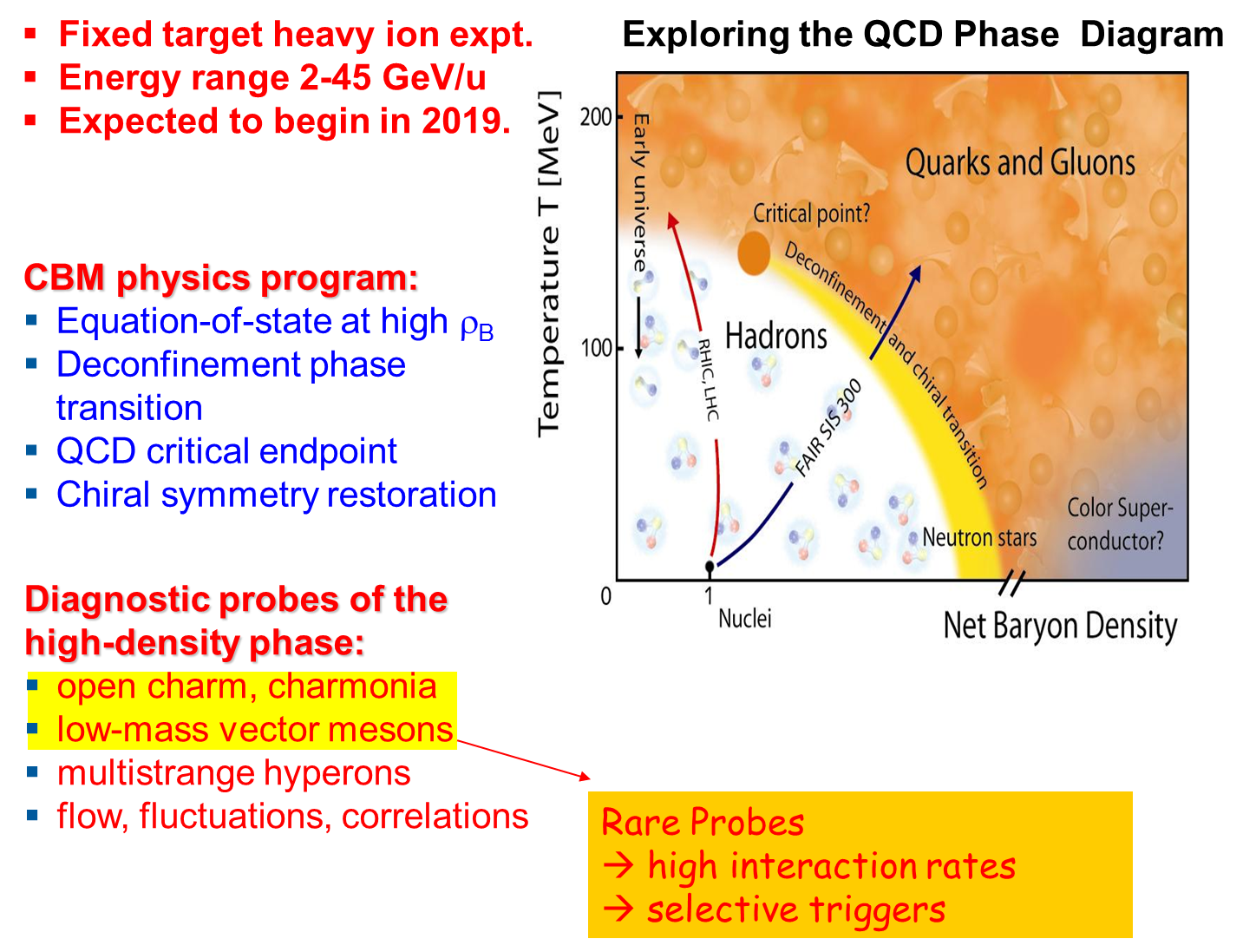
The Compressed Baryonic Matter Experiment (CBM)@FAIR
2021

Slide 5
The Dileptons
Dilepton pairs emitted in energetic heavy-ion collisions provide valuable information on the evolution and on the properties of the hot and dense fireball.
Comparison of charmonium yields measured in proton-nucleus and nucleus-nucleus collisions has led to the observation of an anomalous dissociation of charmonium in central collisions of heavy nuclei which was explained by color screening in the quark-gluon phase.
Till today, this observation still has remained one of the most convincing experimental facts hinting towards the existence of partonic degrees of freedom in the fireball at top SPS energies.
The dilepton measurements at the CERN-SPS have been performed mainly at 158 A GeV, except for one spectrum taken in Pb+ Au at 40 A GeV by the CERES collaboration where even an increased excess yield has been observed

Slide 6
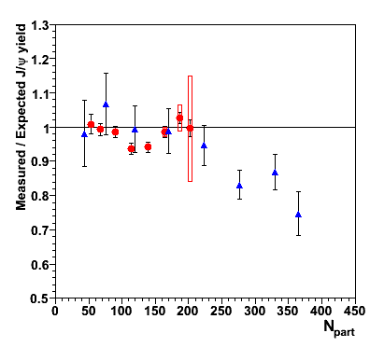
Anomalous suppression
In-In 158 GeV (NA60)
Pb-Pb 158 GeV (NA50)
Using the previously defined reference:
Central Pb-Pb:
→ still anomalously
suppressed
In-In:
almost no anomalous
suppression
B. Alessandro et al., EPJC39 (2005) 335
R. Arnaldi et al., Nucl. Phys. A830 (2009) 345
R.Arnaldi, P. Cortese, E. Scomparin Phys. Rev. C 81 (2009), 014903

Slide 7
A systematic beam energy scan in order to search for the onset of in-medium mass modifications of vector mesons or for partonic contributions to the dilepton yield has not been performed yet.
With the dilepton measurements in heavy-ion collisions at FAIR energies the CBM collaboration will open a new era of dilepton experiments in the energy range between 2 and 40 A GeV where the highest net- baryon densities can be created in the laboratory,
no dileptons have been measured in heavy ion collisions at these energies.
The CBM collaboration will systematically measure both dielectrons and dimuons in p+p, p+A and A+A collisions as function of beam energy and size of the collision system.
The dielectron and dimuon high-precision data will complement each other, and will provide a complete picture on dilepton radiation off dense baryonic matter. Also gamma conversion contamination is largely suppressed in case of dimuons.
.

Slide 8
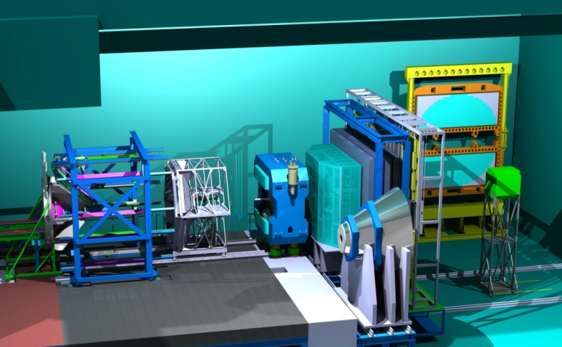
The CBM experiment
Tracking, momentum, V⁰: MVD+STS+dipole magnet
Event characterization: PSD
Hadron id: TOF
Lepton id: RICH+TRD or MUCH
γ, π⁰: EMC
High speed DAQ & trigger
EMC (park. pos.)
TOF
TRD
HADES
MVD + STS
RICH
PSD
Muon detector
(parking position)
dipole magnet
SIS 100 setup

Slide 9
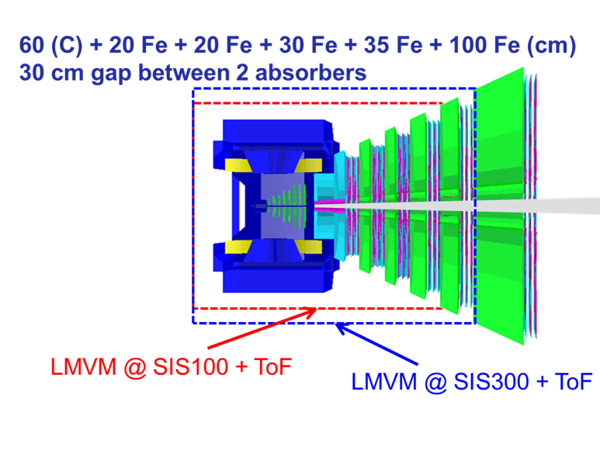
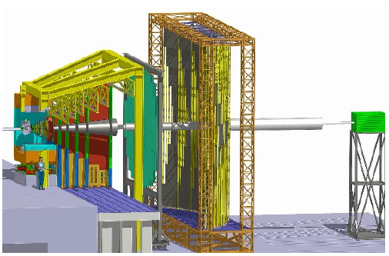
Muon Chamber (MUCH) system
CBM Experiment @ FAIR
TRD
RPC (TOF)
PSD
MuCh
Dipole Magnet
STS
Aim: to detect dimuon signals from low mass vector mesons and J/ψ
(13.5 λ_{I})
Novel subsystem of segmented absorbers
-- design goal being to simultaneously identify low and high momentum muons over full phase space
SIS100 : 2-4 GeV/u → 4 chambers + 4 absorbers
SIS300 : upto 45 GeV/u →5 det.stations + 6 absorbers

Slide 10
CBM @ SIS-100 & SIS-300
The first years of CBM operation will be at SIS-100 with a start setup
Beam | p_{lab, max} | √s_{NN, max}
heavy ions (Au) | 11A GeV | 4.7 GeV
light ions (Z/A = 0.5) | 14A GeV | 5.3 GeV
protons | 29 GeV | 7.5 GeV
CBM at SIS-300
Beam | p_{lab, max} | √s_{NN, max}
heavy ions (Au) | 35A GeV | 8.2 GeV
medium ions (In) (Cu) | 38A GeV 41A GeV | 8.5 GeV 8.9 GeV
light ions (Z/A = 0.5) | 45A GeV | 9.3 GeV
protons | 90 GeV | 13 GeV
…. at interaction rates up to 10 MHz (J/ψ)

Slide 11
What is the typical configuration for dimuon detection in particle physics ?

Slide 12
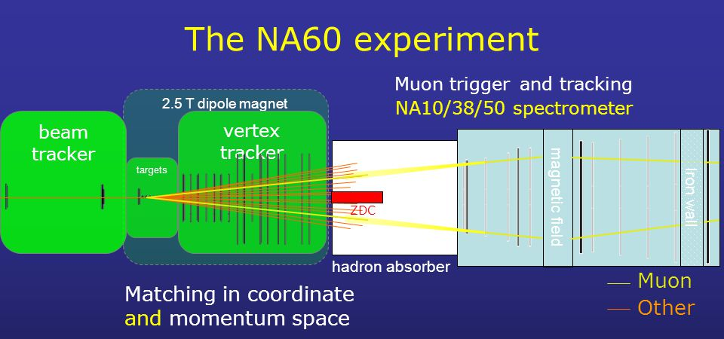

Slide 13
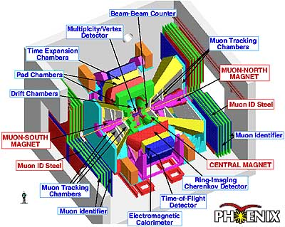
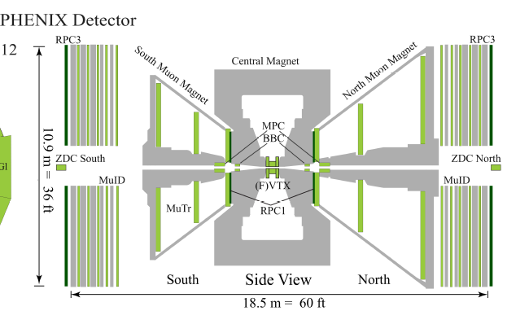
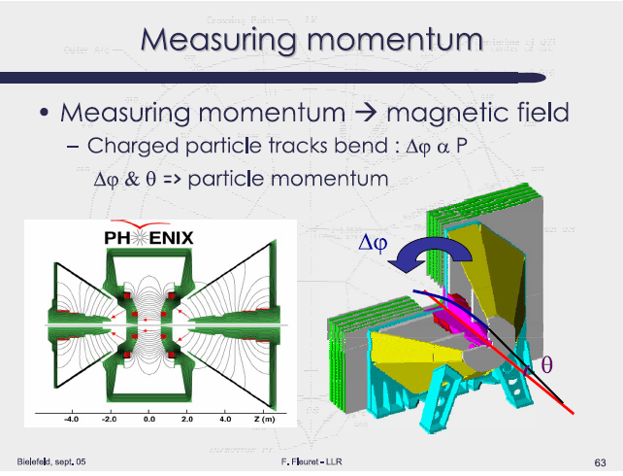
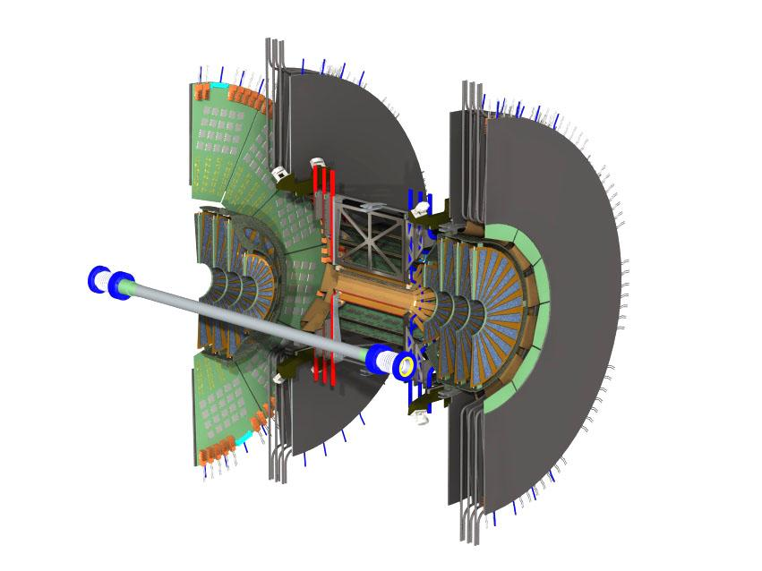

Slide 14

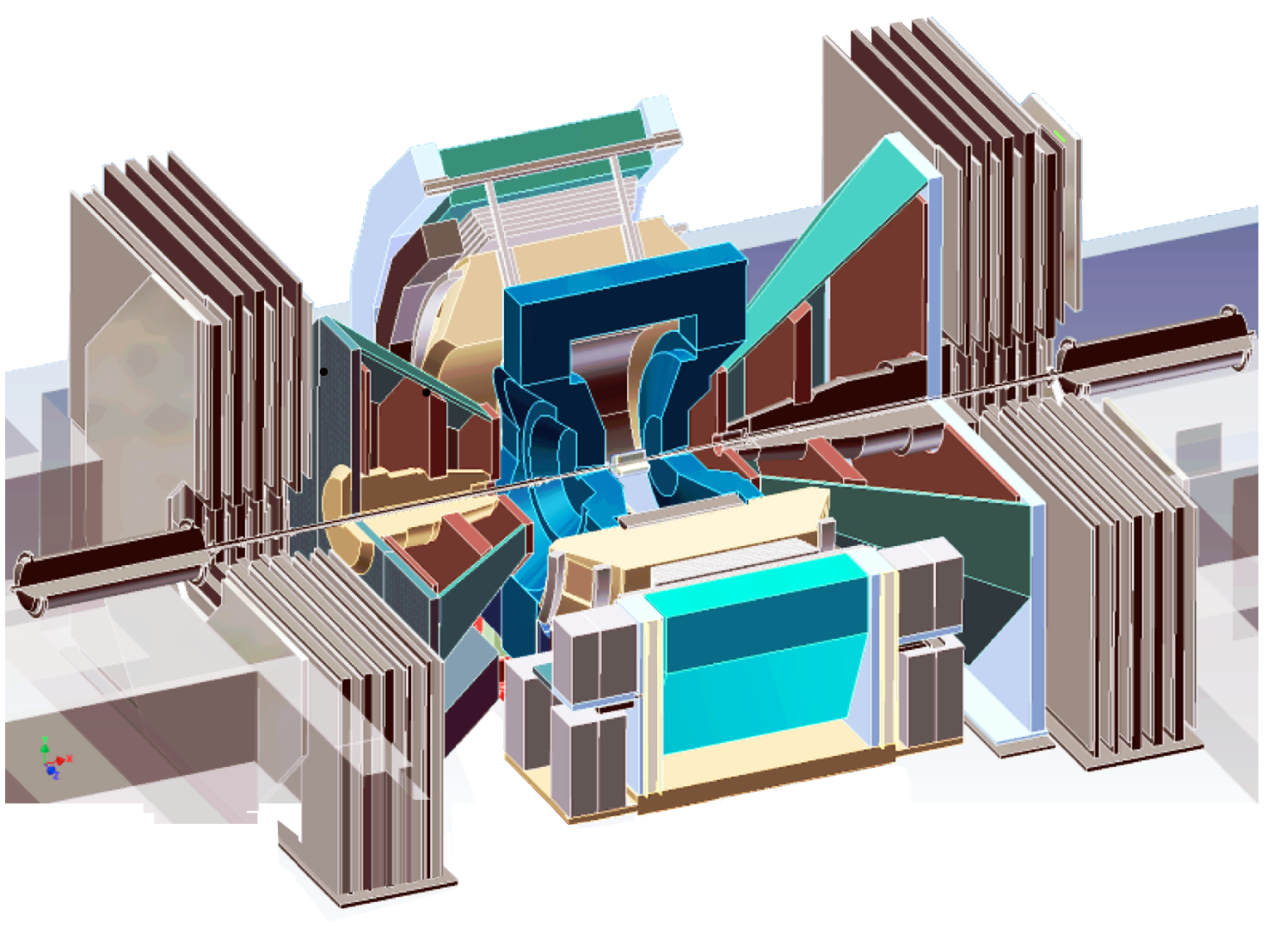
Semi-leptonic decays of HF hadrons:
Electrons: |y| <0.35
-Tracked with DC,PC
-ID with RICH, EmCal
Muons: 1.2 < |y| < 2.2
~10λ hadron absorbers
-Tracked with wire chambers
-Further muon ID with layers of steel and streamer tubes
μ
μ
Au
d

Slide 15
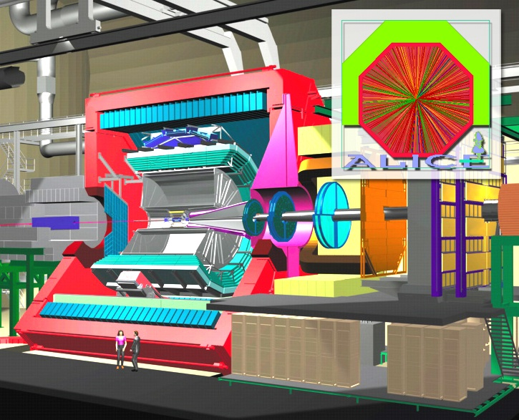
ALICE Detector
(Muon Arm)

Slide 16
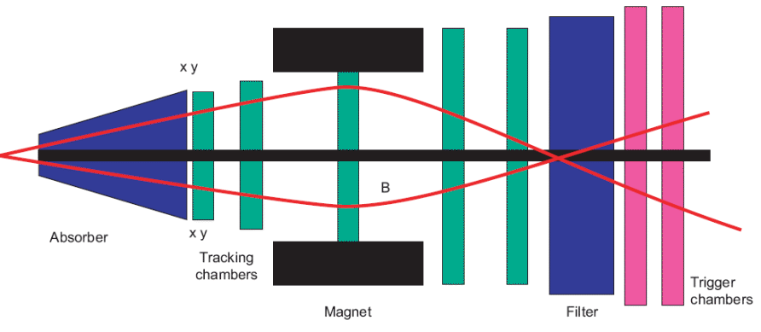
The ALICE forward muon spectrometer will study the complete spectrum of heavy quarkonia (J/Ψ, Ψ′, ϒ, ϒ′, ϒ′′) via their decay in the μ+μ– channel.
ALICE MUON ARM
The optimized design provides
--- a good shielding capability and
--- a limited multiple scattering (…mass resolution).
→ Using low-Z material in the absorber layers close to the vertex, and a high-Z shielding materials at the other end. => Pb + Boronated polyethylene & Pb + tungsten

Slide 17
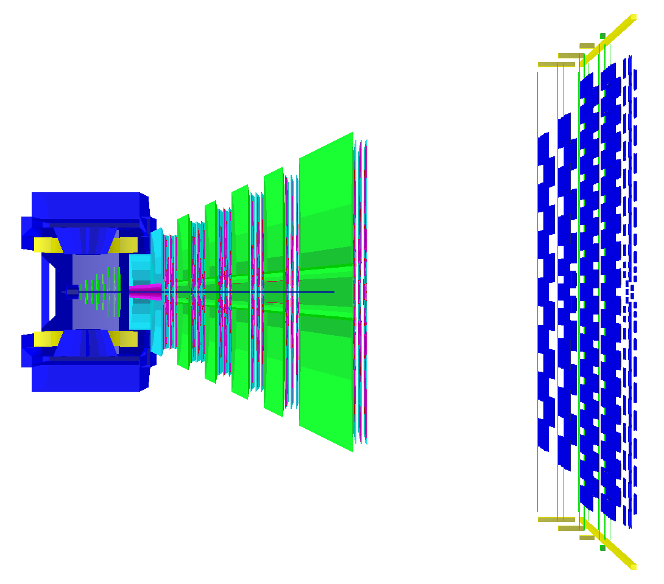
Muon detection system: MUCH
ID after hadron absorber with intermediate tracking layers
major combinatorical background from π,K decays into μν, punch through of hadrons and track mismatches
→ use excellent tracking to reject π,K decays in the STS
60 C + 20 Fe + 20 Fe + 30 Fe + 35 Fe + 100 Fe (cm)
30 cm gap between 2 absorbers
LMVM @ SIS100 + ToF
LMVM @ SIS300 + ToF
Notes:
Layout optimization!

Slide 18
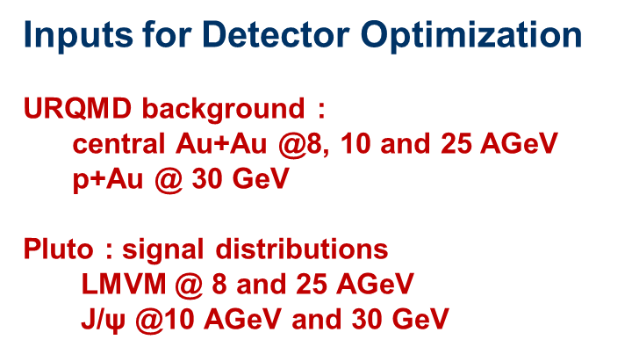
Optimizing Absorber thicknesses
Total number of particles as a function of the traversed length in iron. The particle momenta have been taken from the simulation of central Au+Au collisions at 25 A GeV, their numbers have been normalized.

Slide 19
25 AGeV
Track reconstruction efficiency for primary muon tracks from J/psi as a function of
momentum for two tracking algorithms: nearest neighbor (red) and branching (blue). Left plot
shows MUCH tracking efficiency, right plot shows STS-MUCH tracking efficiency. Horizontal
lines represent numbers integrated over momentum.

Slide 20
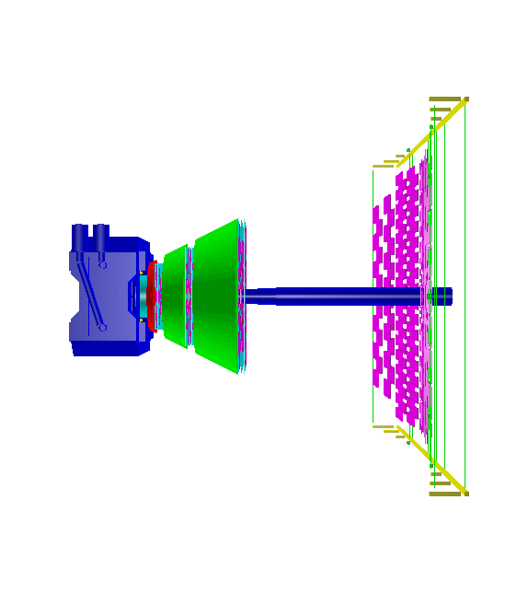


3 layout options for SIS100 and SIS300
Extended SIS100
Basic SIS100
Lengths:
6.4m (SIS100)
7.3m (SIS300)
TOF wall
SIS300

Slide 21
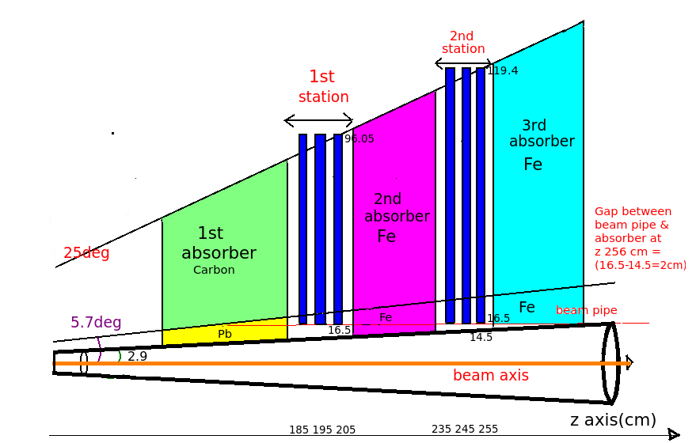

Slide 22
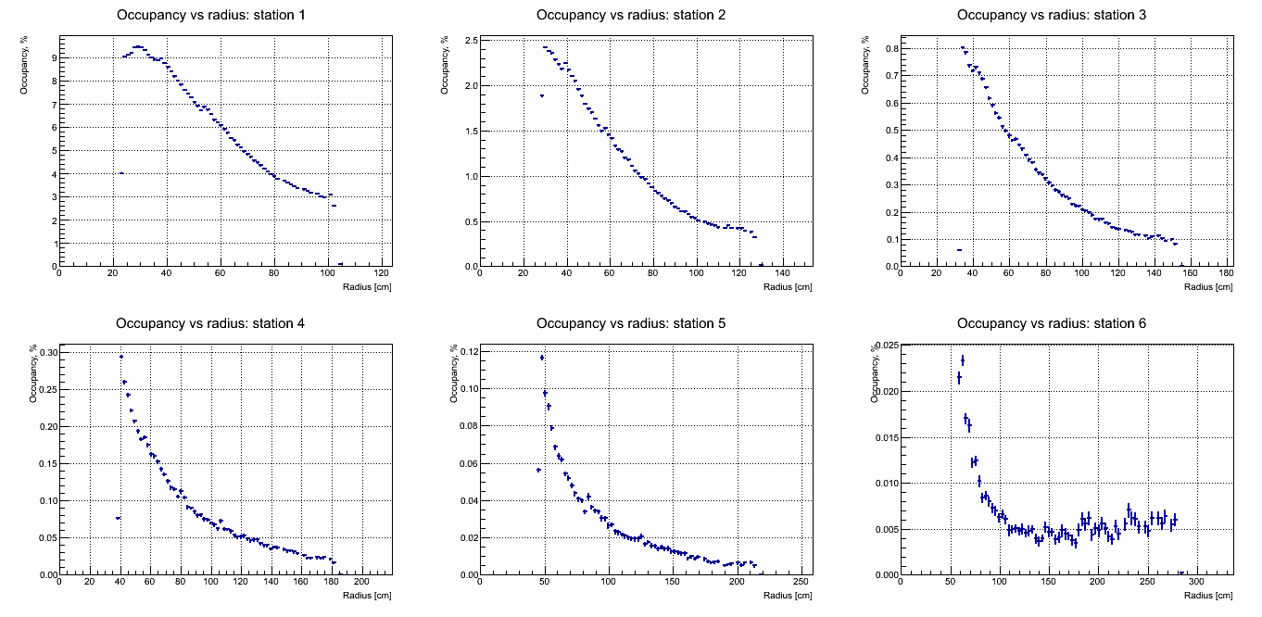
Occupancy (25 AGeV central collisions)
Detector options
One or two slides to show the
options and status
Geant3 + segmentation + GEM profile implemented

Slide 23
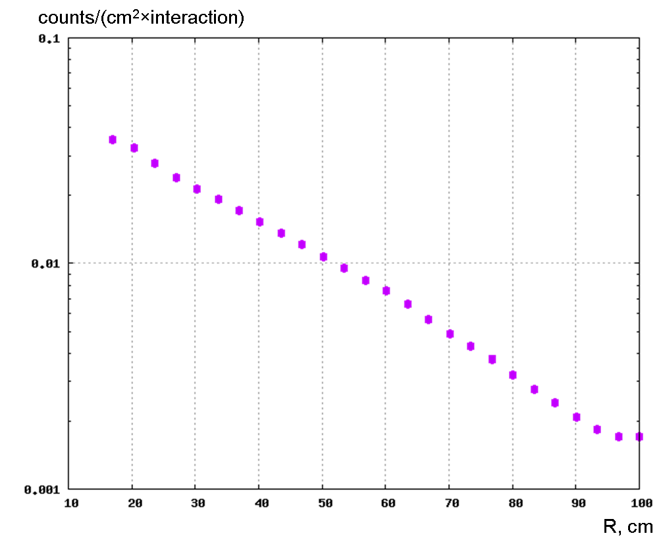
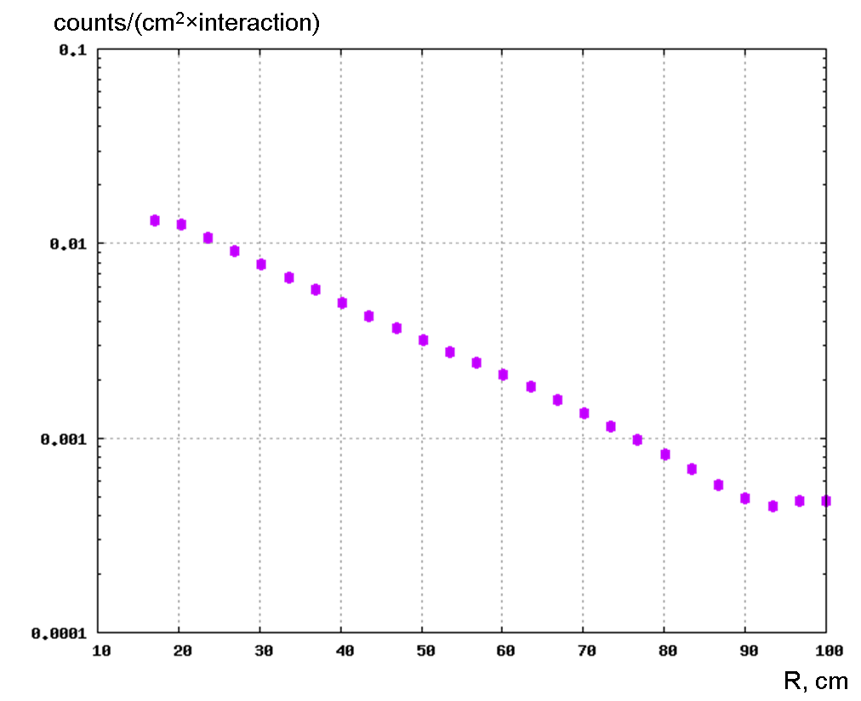
Hit density on 1st station (Carbon as first absorber)
400 KHz/cm^2
25 AGeV
10 AGeV
FLUKA calculations
(min-bias collisions)

Slide 24
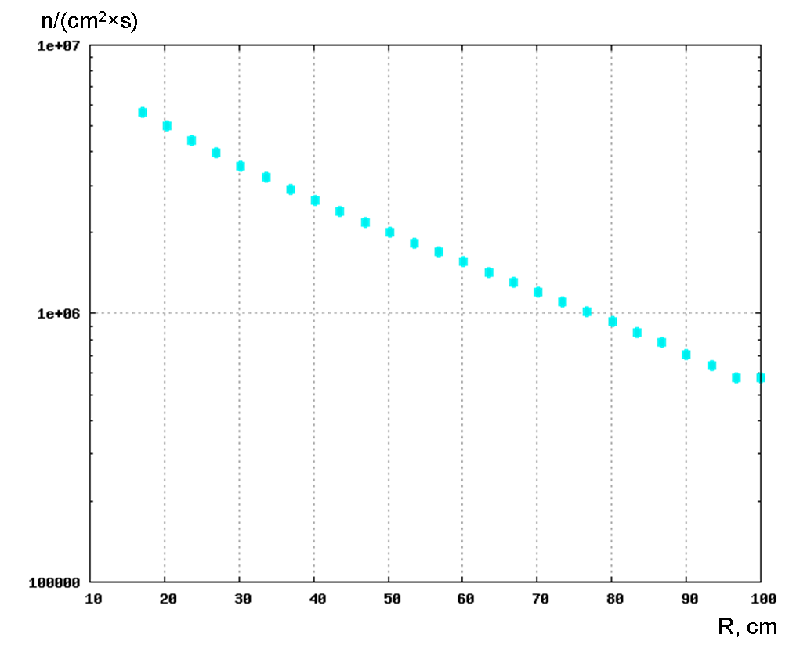
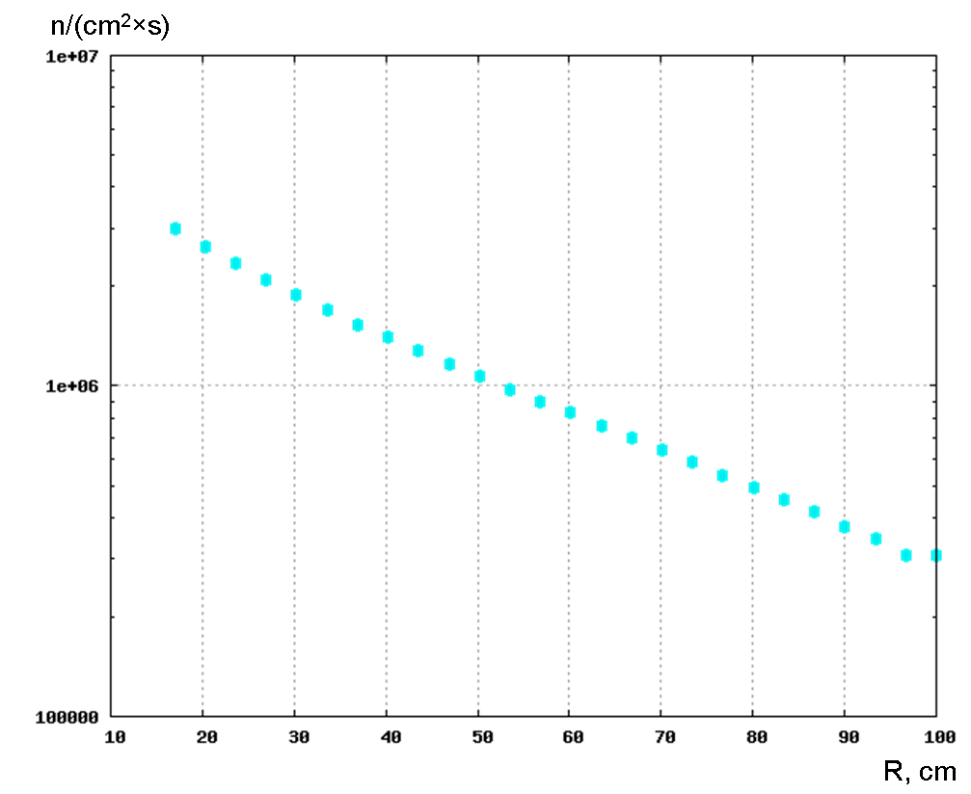
Neutron Flux on 1st station
35 AGeV
10 AGeV
FLUKA calculations

Slide 25
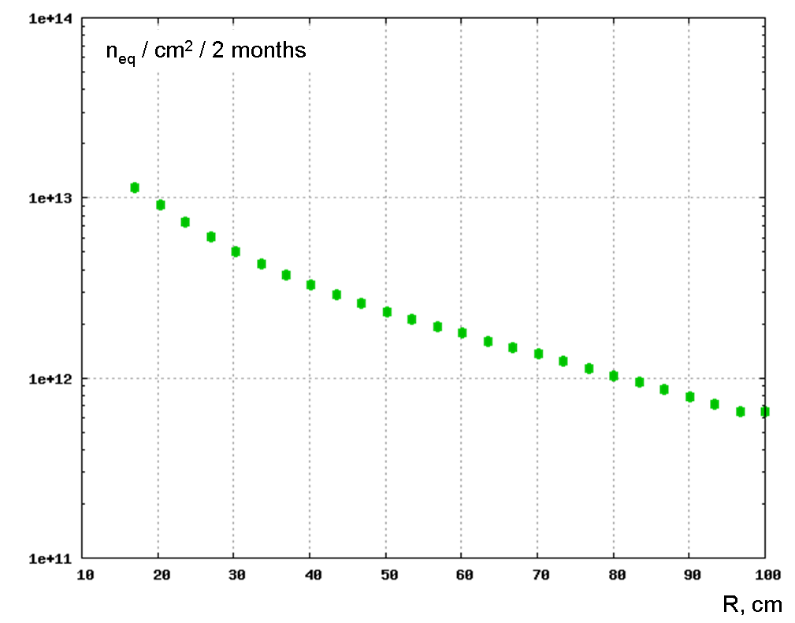
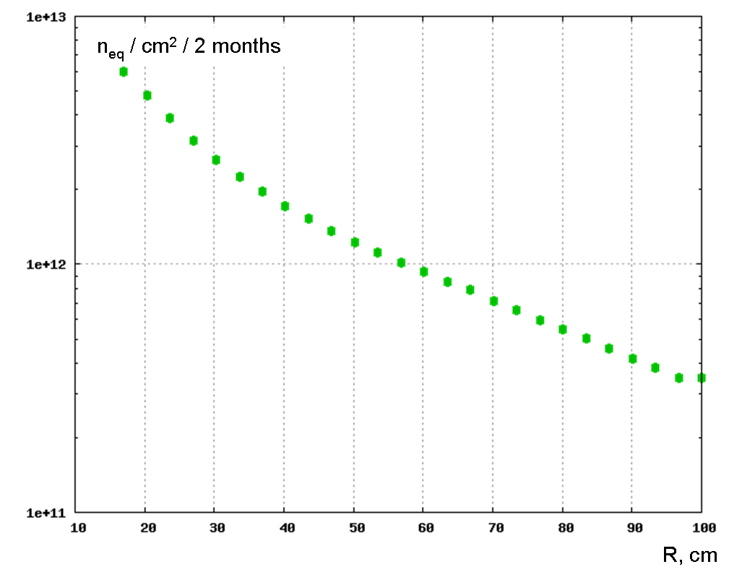
Neutron-equivalent dose
35 AGeV
10 AGeV

Slide 26
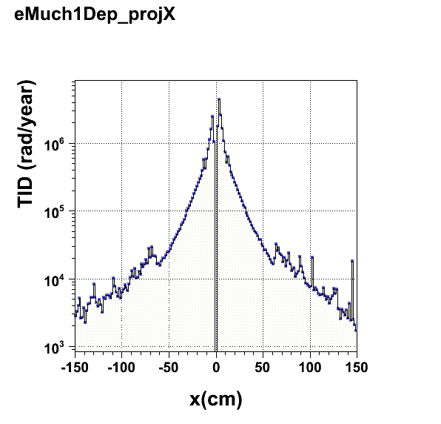
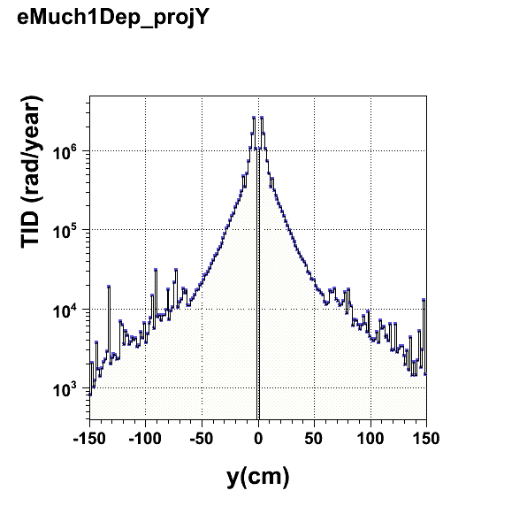
TID: Total Ionizing Dose
at the outer edge of the
detector is around 10krad
Ref : http://cbm-wiki.gsi.de/cgi-bin/viewauth/Radiationstudies/WebHome?CGISESSID=2bce338388a71f099de8d3ca43e0f2b7
26

Slide 27
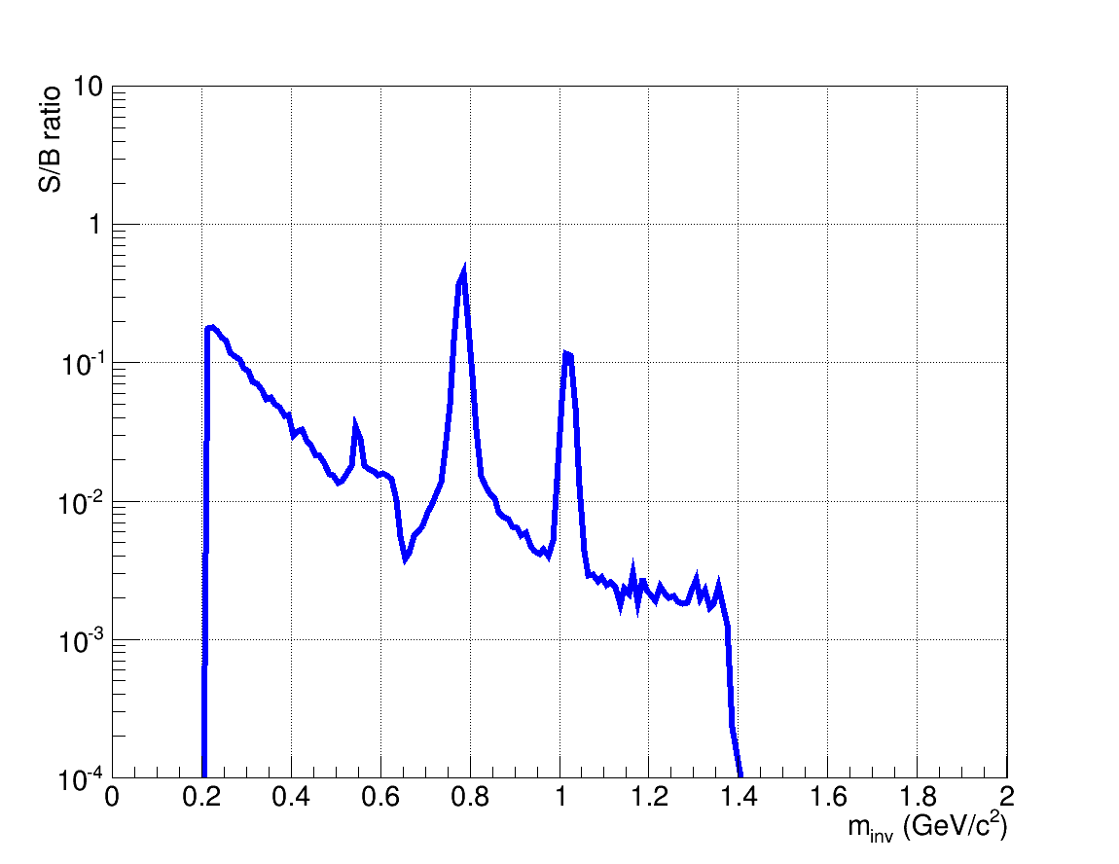
Cocktail/ Background distribution for LMVM
For both setups Cocktail/Background ratios of about 100 are reached in central Au+Au collisions at 25 AGeV for m_{inv} ~ 0.5 – 0.6 GeV/c²
muons
electrons
Cocktail/Background

Slide 28
Acceptance plots for J/psi mesons simulated for Au + Au collisions at 10 A GeV
for the PLUTO input (left) and after reconstruction (right).

Slide 29
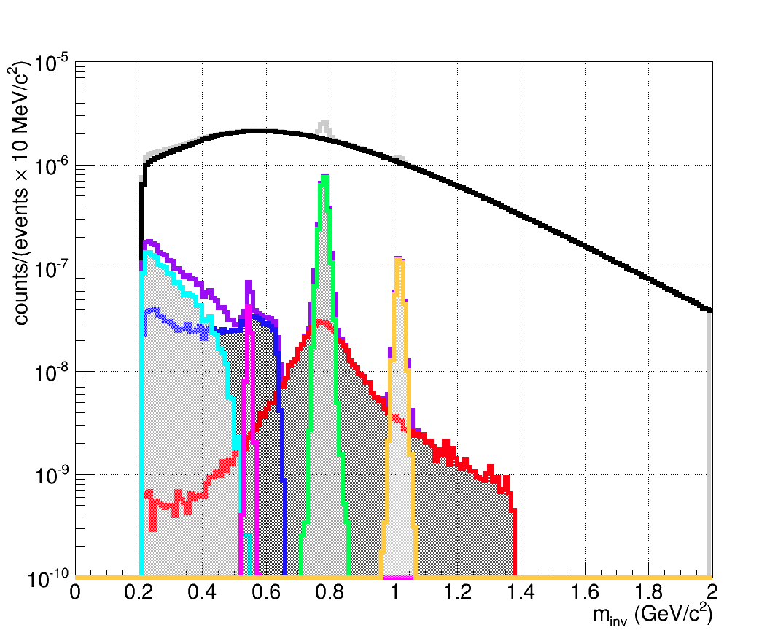
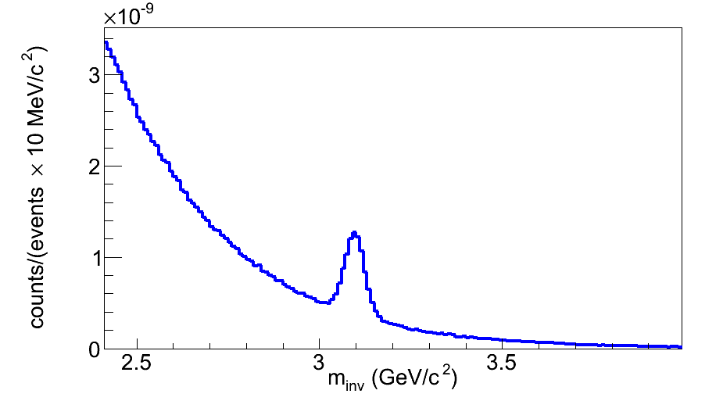
Invariant mass spectra – muons
Shown: central (b=0fm) Au+Au collisions at 25 AGeV
Mass resolution: 12 MeV (ω) and 29 MeV (J/ψ) only due to momentum determination in STS
LMVM spectra for SIS100 show similar quality
J/ψ in central pAu at 30GeV with superb S/B ratio
S/B_{2σ} = 1.68
ω
η
φ
J/ψ
ρ

Slide 30
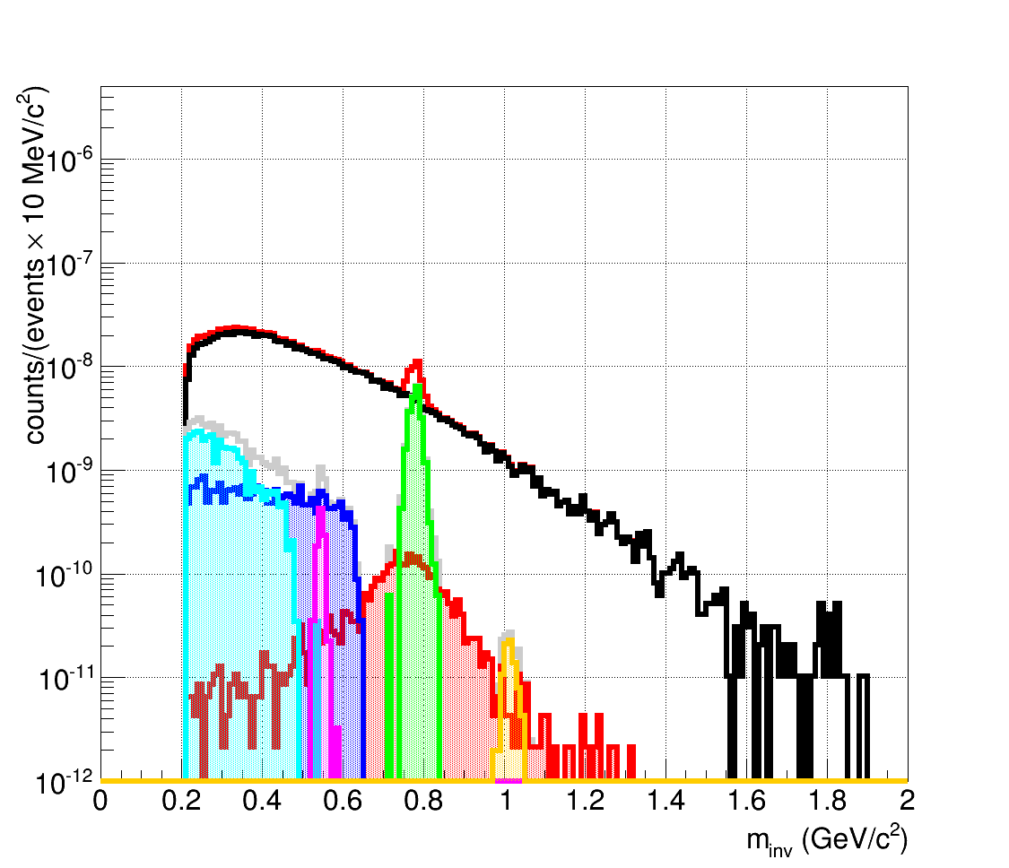
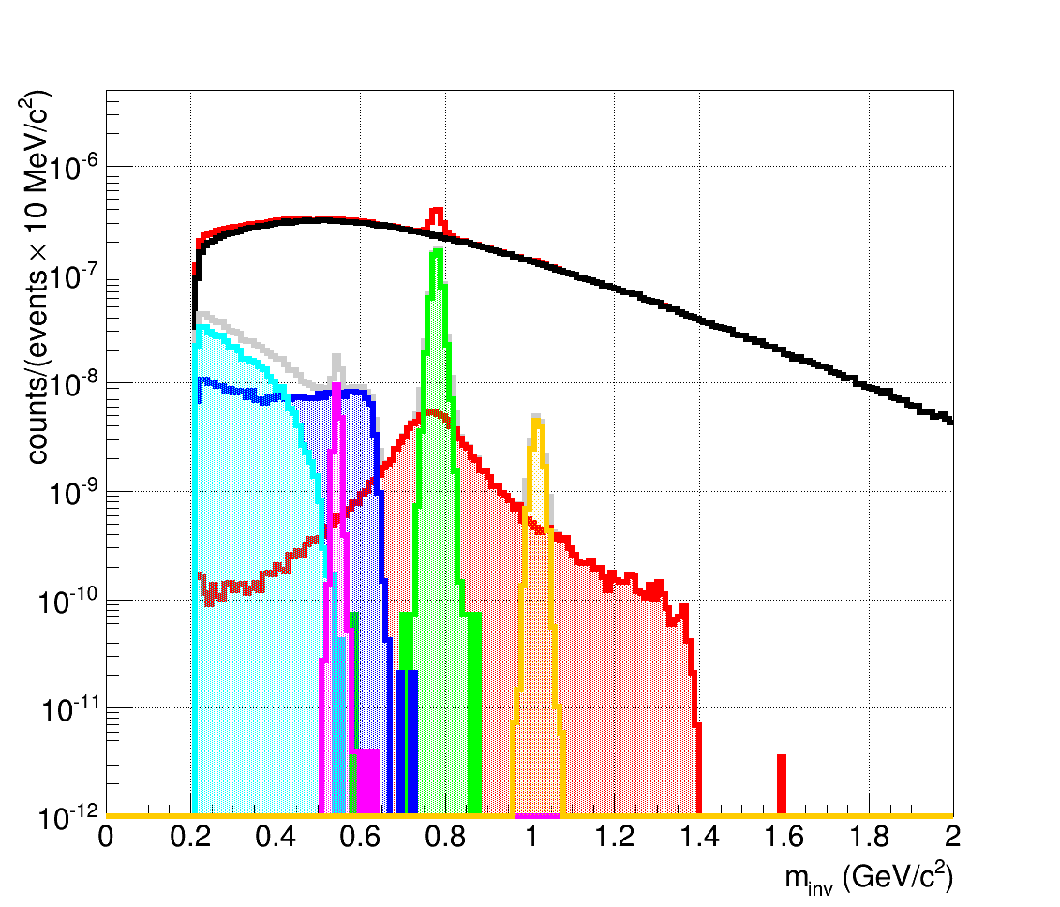
Muons in CBM at SIS100
Running scenario:
Au+Au at 4 energies (4, 6, 8, 10 A GeV) up to 1 MHz
Simulation: Signal yields from HSD, Background from UrQMD
central Au+Au at 4 A GeV
central Au+Au at 8 A GeV
2×10⁵ ω in 2 weeks
(approx. NA60 statistics)
2×10⁶ ω in 2 weeks
ω
ω
η
φ
η
ρ
ρ
φ

Slide 31
Challenges in Muon detection
Main issues:
High collision rates ~ 10 MHz
The first plane(s) have a high density of tracks
High granularity ~ average hit rate is about 0.4 hit/cm²
Should be radiation resistant –
high neutron dose → ~10¹³ n.eq./sq.cm/year
Large area detector – with modular arrangement
Data to be readout in a self triggered mode
-- a must for all CBM detectors.
-- and event reconstructed offline by grouping
the timestamps of the detector hits.

Slide 32
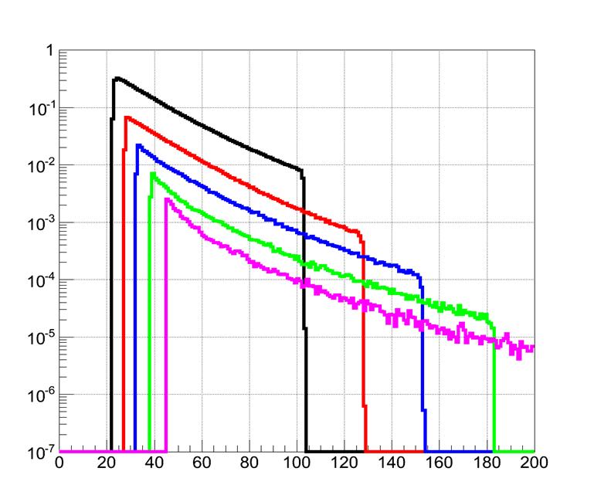
Particle Density at Different MUCH stations
Hits/sq.cm\event
Radius (cm)
A. Senger, GSI
Different detector technologies for different stations
-- For the first two stations, which demand a high rate capability, Gas Electron Multiplier technology (GEM) would be used.
-- Straw tube and TRD for the other layers.

Slide 33
Straw Tube R&D by Dubna Group
The straws with inner diameters of 4 and 9.53 mm have been tested in the SPS test beam at
CERN, with the same gas mixture of Ar/CO2 (80/20) and the gas gain 7 104 in both cases.
The efficiency was about 98% and 99% for the 4 mm and 9.53 mm straws, respectively.

Slide 35
The signal processing requirements of the straw tube have led to the design of a full-custom, analogue, bipolar ASIC. It provides eight channels of amplifier, shaper, discriminator and base line restorer.
Spatial resolution as a function of the scaled distance to the anode for the straws with 4 mm (circles) and 9.53 mm (diamonds) inner diameter.
gas mixture Ar/CO2 (80/20), and the gas gain was about 70K in both cases.

Slide 36
Triple GEM module for the first Two stations

Slide 37
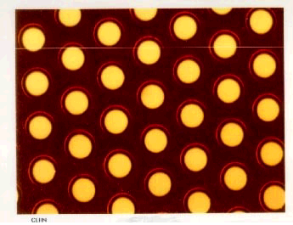
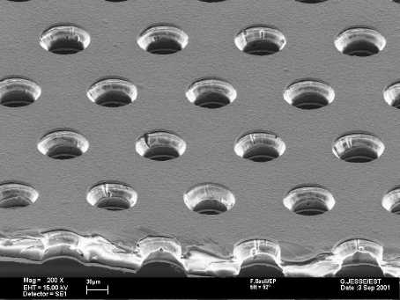
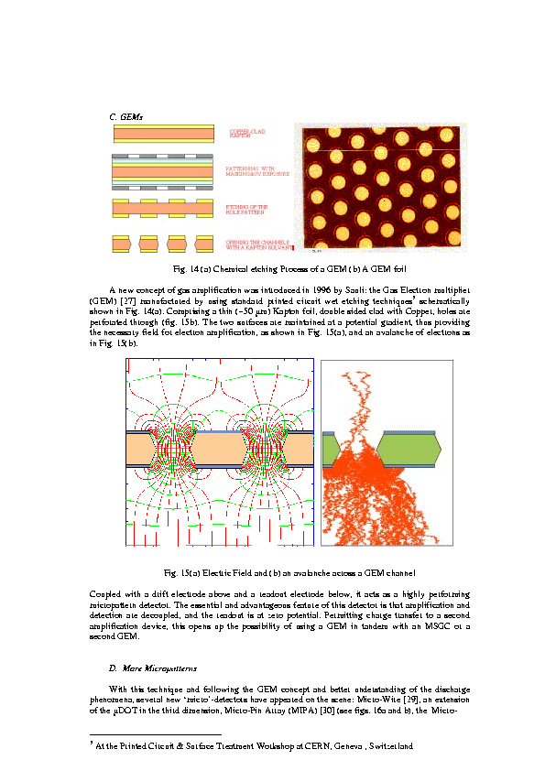
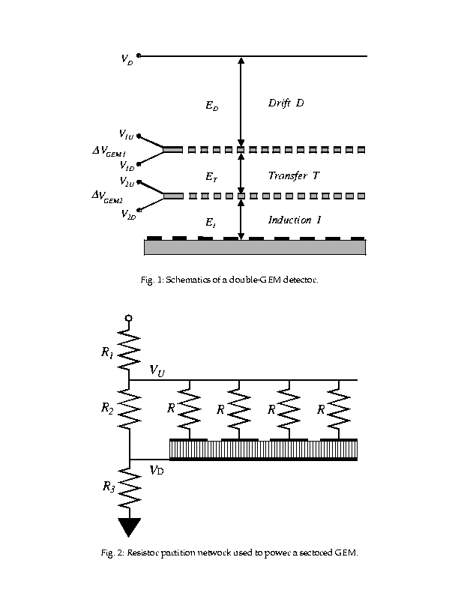
Gas Electron Multiplier (GEM) and its working principle
140μm
140um
70um
70μm
a 50 micron polyimide foil with a 5 micron Cu layer deposited
on both sides of polyimide
Basic elements of a GEM chamber:
1. Drift plane
2. Amplifying element – GEM
3. Readout Plane
Cascaded GEMs can give higher gains and have lesser spark proability
Active medium is a gas mixture.
electron multiplication takes place in holes
of two copper foils separated by kapton
Amplification may use 2 or 3 stages.
  Maximum size ~100 cm x ~50 cm

Slide 38

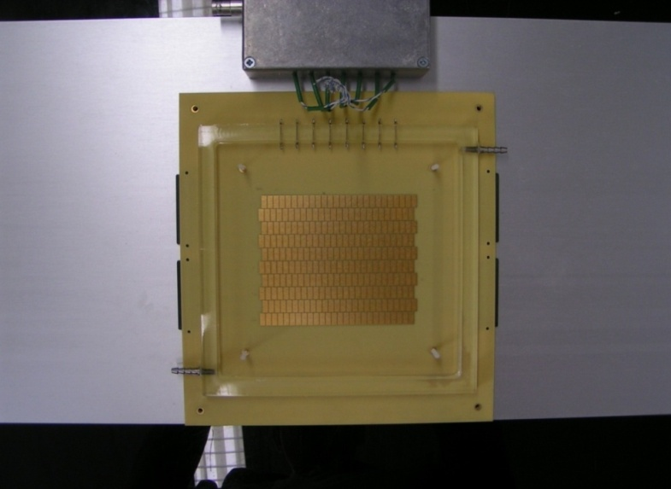


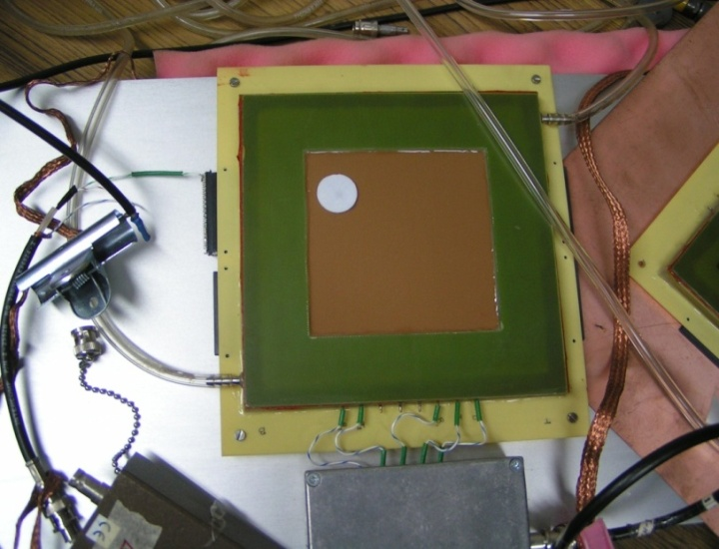




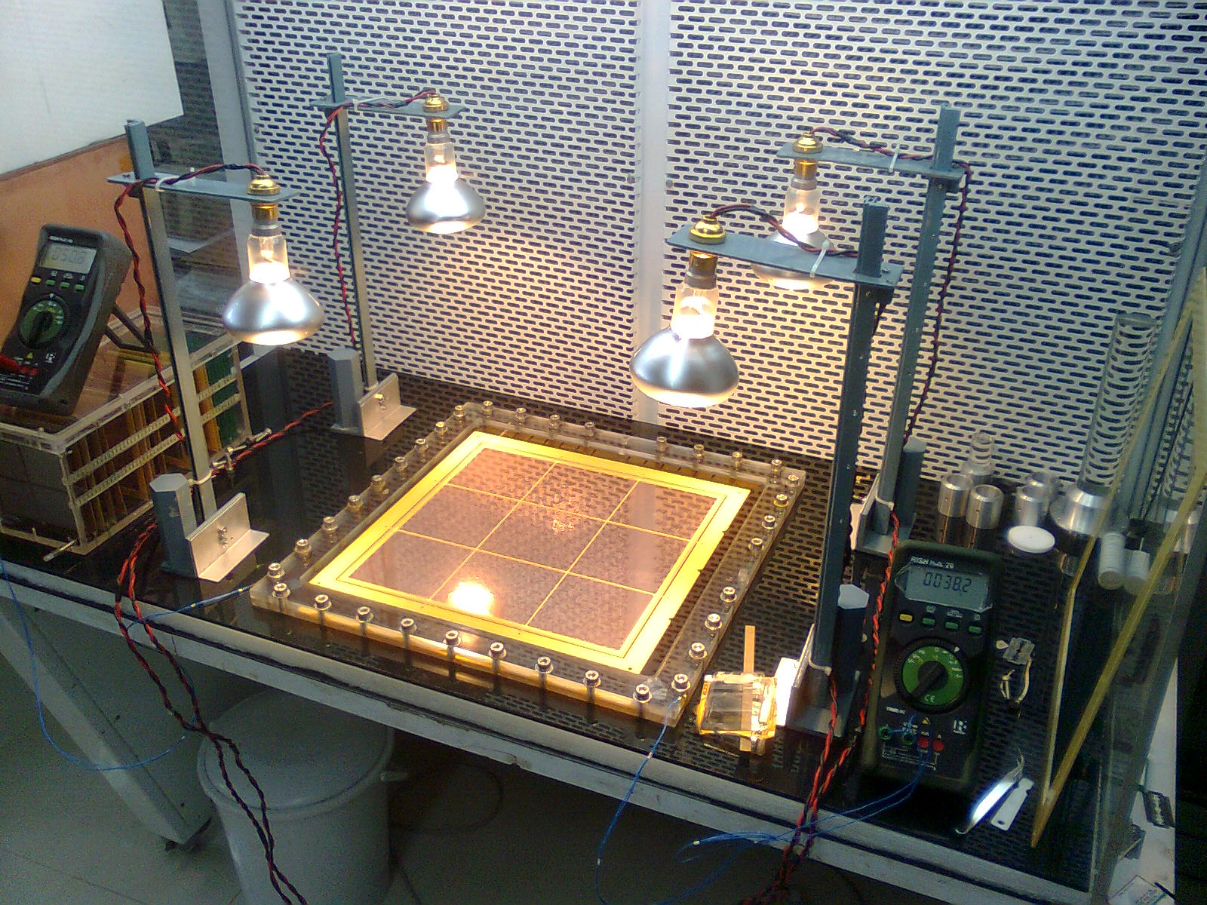
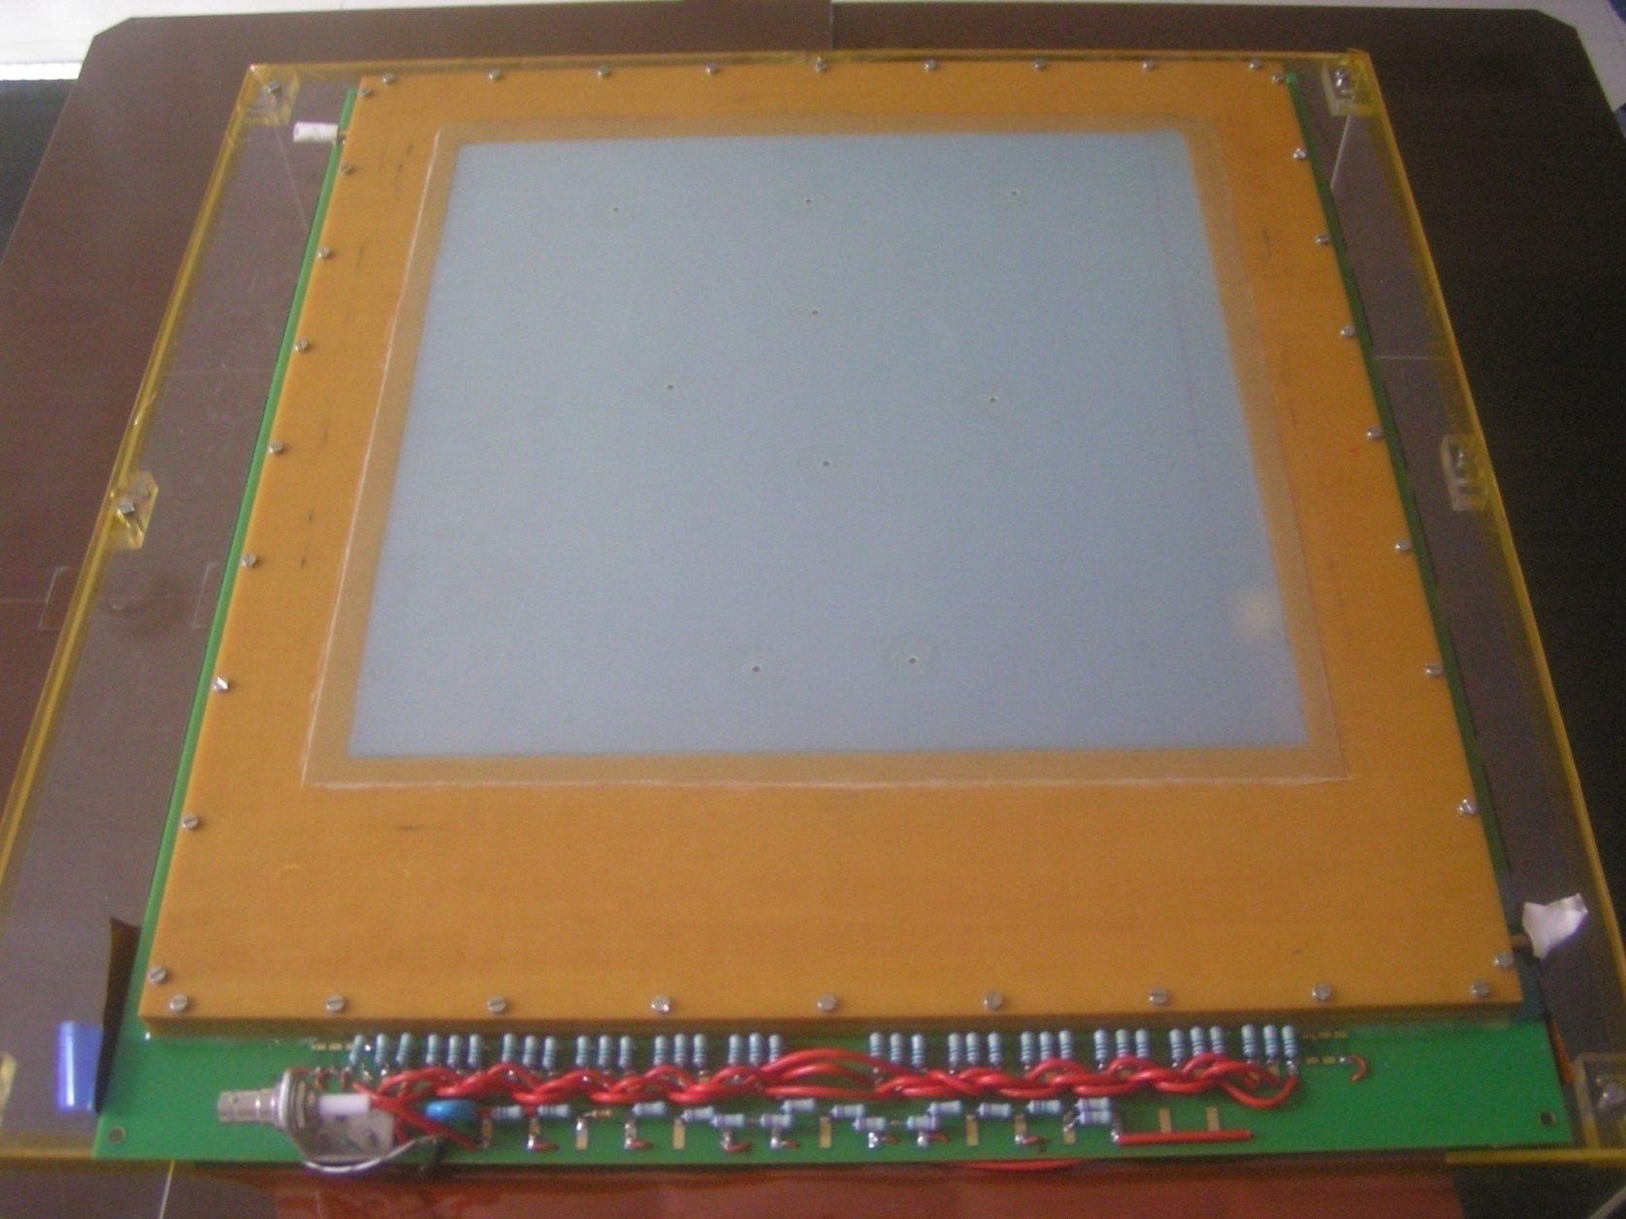
Prototype fabrication at VECC
GEMS
1 2 3
Outer side view
Readout plane
256 Pads
8 mm x 3.5 mm
CERN made framed
GEMs 10 cm x 10 cm
Gas - Ar/CO2 – 70/30
10 ohm Resistors for protection
Thermal stretching and framing of 31 cm x 31 cm
large size GEMs at VECC
inner side
512 pads 3 mm x 4 mm
Outer side view
Multilayered
Readout PCB

Slide 39
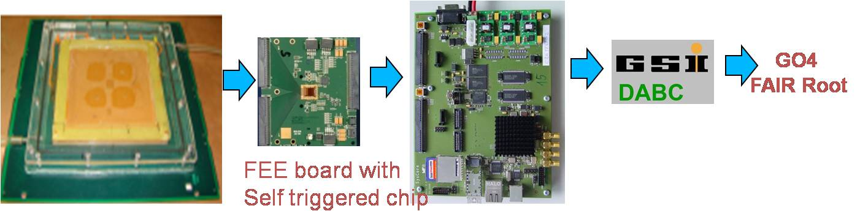
Beam test of GEM prototype chambers
Aim :
-- to test the response of the detector to charged particles. mainly in
terms of efficiency, cluster size, gain uniformity, rate handling capability
-- testing with actual electronics for CBM : nXYTER
nXYTER is a 32 MHz, 128 channel self triggered ASIC first developed by
DETNEE collaboration for neutron measurements.
– coupled to ROC(ReadOut Controller)
and then fed to the DAQ.
-- testing with the actual CBM DAQ
The nXYTER ADC spectra is inverted as compared to conventional picture,
this has to be subtracted from a baseline value channel by channel

Slide 40
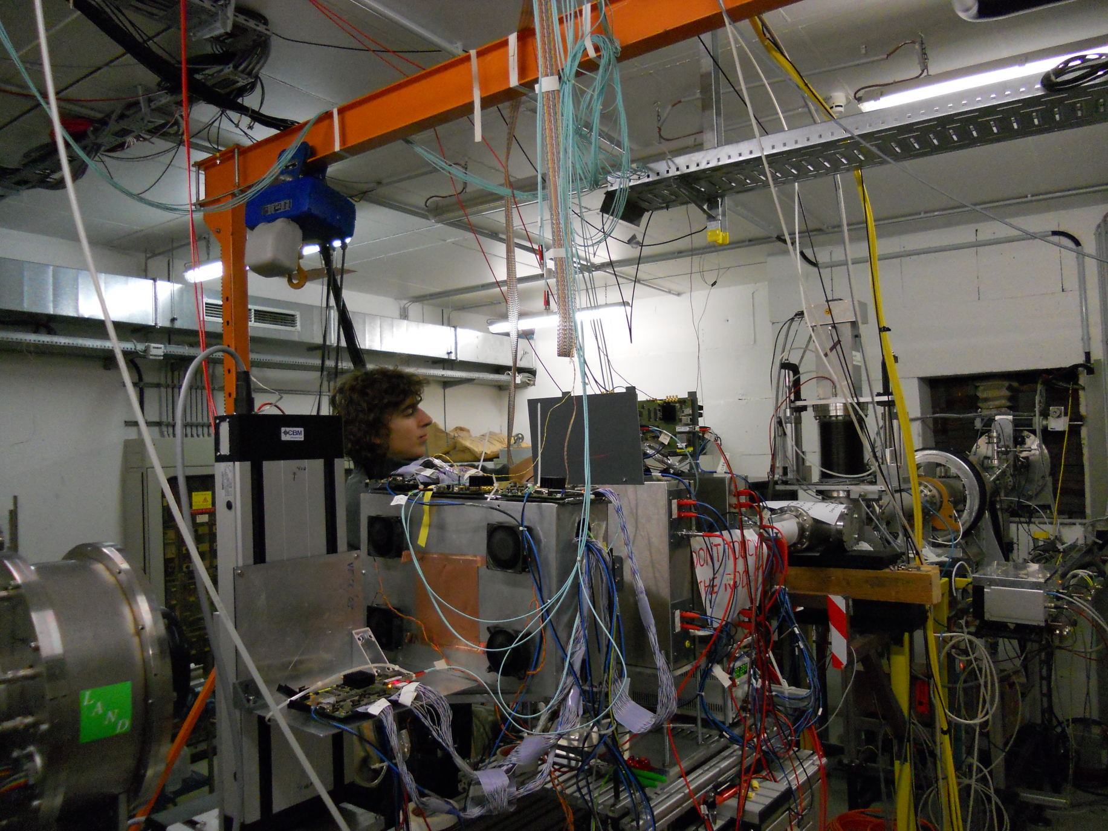
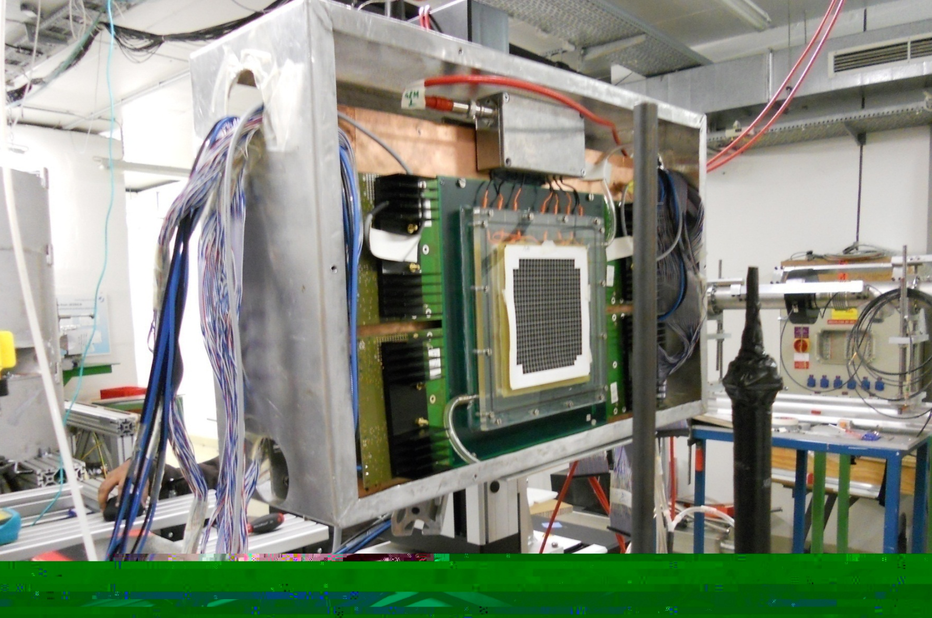
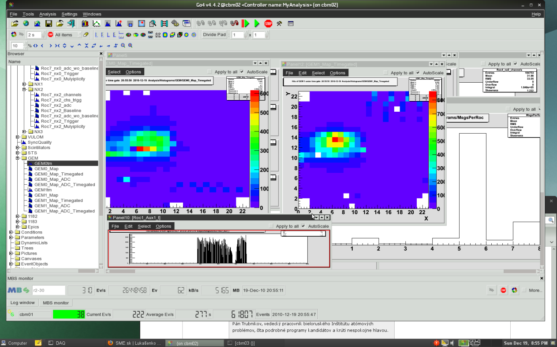
Test setup at Jessica beamline at COSY (Julich)
STS station
GEM chambers
40

Slide 41
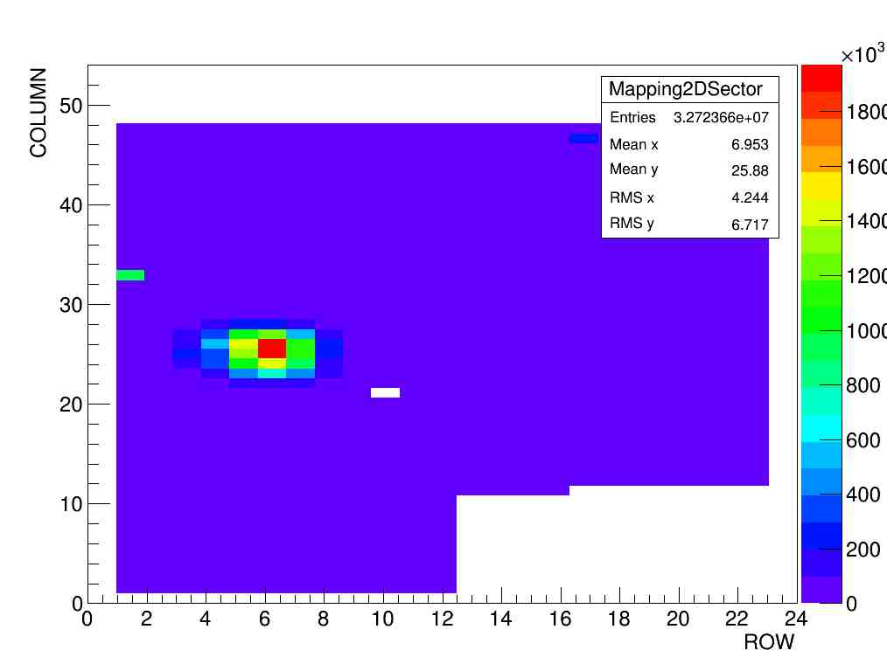
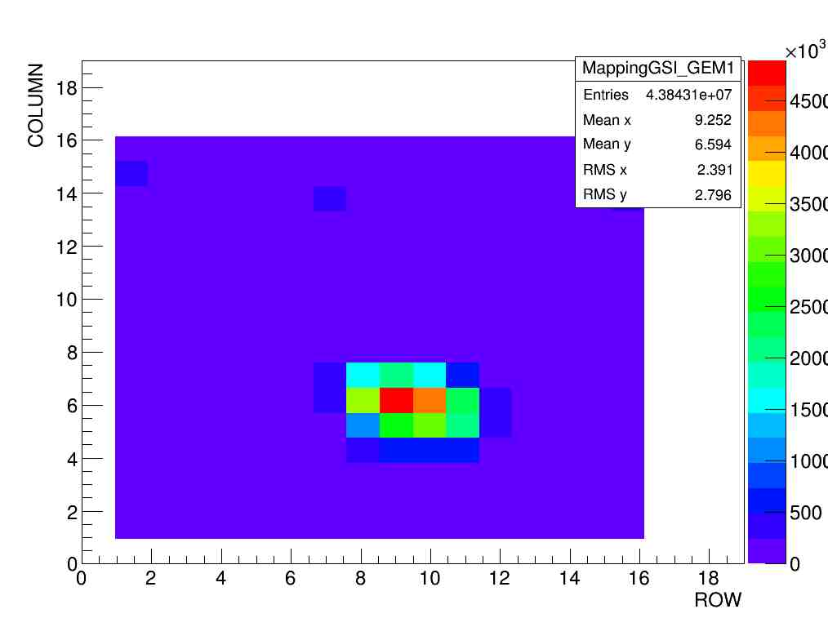
Beam spot (for high intensity runs), 2.3 GeV/c protons
GEM 2(10 cm x 10 cm)
GEM 3 (31cm x 31 cm)
Beam profiles as seen by 10 cm x 10 cm prototype and 31 cm x 31 cm prototype (right)

Slide 42
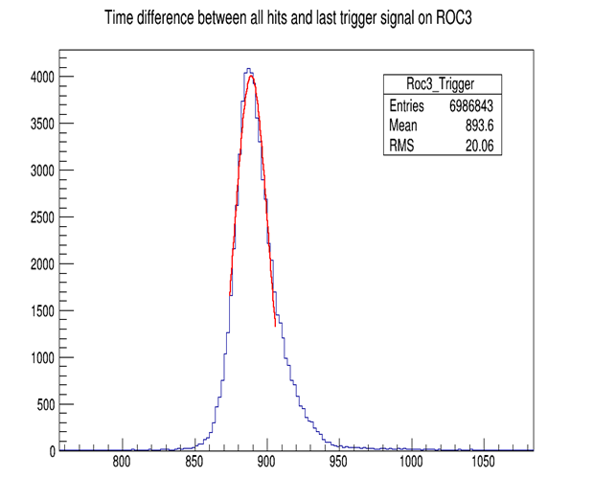
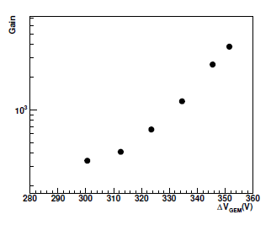
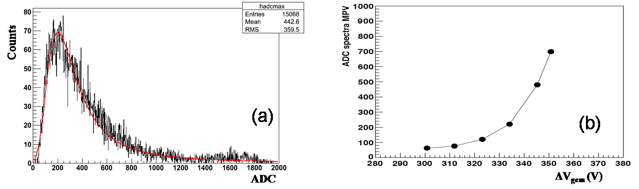




Test Results
self triggered mode
gain
Cluster size
Pulse height
spectra
Time correlation
Cluster size vs. voltage
Time difference between trigger (AUX) and detector hits
Efficiency
Published in NIMA

Slide 43


Rate test
using high intensity Cu X-ray
source in RD51 lab at CERN, with conventional
electronics
1.38 MHz/sq.cm
HV = 3200 V,
Vgem~358 V,
gas- Ar/CO2(70/30)
95 kHz/sq.cm
Gain remains almost stable with rate
Highest Rate in this picture ~ 1.4 MHz/cm²
Published in JINST-2014

Slide 44

Test with absorbers – MiniMUCH
at CERN SPS, H4 beamline. Pion beams of GeV/c(with some muons and electrons)

Slide 45


Residuals for GEM2
beam
Gem1
Gem2
Gem3
Reconstructing the track using GEM1 and GEM3 and Projecting the
hits at plane_GEM2 and finding the distribution of residuals

Slide 46
Building a Real size MUCH sector prototype

Slide 47

Layout --one layer of MUCH on a Drive

Slide 48
# of sectors, FEB, area, etc.
Station # for SIS100 | Layer # | Total no of pads | R1 (cm) | Pad size (min) | R2 (cm) | Pad size (max) | Area (sq.mt) | No of 128 channel FEB/layer (round off) | No of Sector per layer
1 | 1 | 28800 | 25 | 4.36mm | 100.25 | 17.48mm | 2.95 | 240 | 16
 | 2 | 28800 | 25 | 4.36mm | 100.25 | 17.48mm | 2.95 | 240 | 16
 | 3 | 28800 | 25 | 4.36mm | 100.25 | 17.48mm | 2.95 | 240 | 16
2 | 1 | 30600 | 34.5 | 5.9mm | 146.9 | 25.4mm | 6.4 | 240 | 24
 | 2 | 30600 | 34.5 | 5.9mm | 146.9 | 25.4mm | 6.4 | 240 | 24
 | 3 | 30600 | 34.5 | 5.9mm | 146.9 | 25.4mm | 6.4 | 240 | 24
Station # for SIS300 | Layer # | Total no of pads | R1 (cm) | Pad size (min) | R2 (cm) | Pad size (max) | Area (sq.mt) | No of 128 channel FEB/layer (round off) | No of Sector per layer
1 | 1 | 28800 | 25 | 4.36mm | 100.25 | 17.48mm | 2.95 | 240 | 16
 | 2 | 28800 | 25 | 4.36mm | 100.25 | 17.48mm | 2.95 | 240 | 16
 | 3 | 28800 | 25 | 4.36mm | 100.25 | 17.48mm | 2.95 | 240 | 16
2 | 1 | 30240 | 29.5 | 5mm | 123.5 | 21.3mm | 4.5 | 240 | 20
 | 2 | 30240 | 29.5 | 5mm | 123.5 | 21.3mm | 4.5 | 240 | 20
 | 3 | 30240 | 29.5 | 5mm | 123.5 | 21.3mm | 4.5 | 240 | 20

Slide 49



MUCH station layout

Slide 50

Sector Chamber elements – (old design)
Top Honey comb
plate
Pad plane PCB With clamping frame
GEM1
GEM spacer frame -1
GEM2
GEM spacer frame -2
GEM3
GEM spacer frame -3
Enclosure frame with ‘O’ ring seal
Drift plane PCB
HV divider

Slide 51

Real size readout PCB designed at VECC
797.2mm
471mm
708mm
J. Saini
797mm

Slide 52


Readout PCB
inner side
Readout PCB
outer side with FEB connectors

Slide 53

Real size GEM foil
31 cm x 31 cm GEM foil 12 HV seg.
~ Sector based readout.
1200 pads with progressive
increasing size
-- 9 FEBs placed at the three
sides of the board
-- coupled to 5 ROC’s
For CBM MUCH -- GEM foils having 24 HV Segmentation.

Slide 54




Stretching of GEM foils – glue-less approach – “ns2”
Now all the three layers of each clamp segment are fastened together with screws at select places. While designing the layout of the GEM foil some circular copper patterns are generated at the edges to enhance the grip of the edge clamp segments.
The clamp segments are provided with an internal groove to accommodate a stainless steel nut. Thus after assembly of the segment a screw can be inserted sideways through the segment which mates with the embedded nut Fig.xx
The outer chamber frame has provision to insert screws from side walls through a small gas tight O-ring seal and the screw can be coupled to the embedded nut in the corresponding clamp segment.
After clamping all the foils the screws on the sides of the chamber frame can be tightened to stretch the foils in-situ .The screws are tightened until optimum tension is reached in all the three GEM foils.
HV contacts are brought out of the foils through spring contacts. This needs further improvement.
For large scale production it may be possible to mould the clamp segments with some engineering plastic like PEEK.
This method completely eliminates the slow gluing procedure and suitable for large volume production of chambers. Also since the grid-spacers are absent in the active zone, sparking probability due to glass filaments on the grid edges is eliminated. The chamber is opened for GEM replacement.

Slide 55


GEM Foil segmentation and HV connection
12-14 segments on either side
Drift Plane
Total 24-28 HV segments per foil

Slide 56


GE 1/1 for CMS
GE 1/1 for CMS

Slide 57


Slide 58
Module Assembly schematic
Drift Plane
HV chain
GEM foils
Readout Plane
Spacers
FEBs
6mm slotted Al or grid
for cooling
6 mm Aluminum frame or grid with
water cooling
Readout board
39 mm
Drift board
8 mm Aluminum Base – support structures

Slide 59

GEM foils for Real-size prototype

Slide 60


Response of the real size prototype to Fe55 X-rays

Slide 61

Beamtest of real size prototype at JESSICA@COSY, Juelich

Slide 62




Beam spots at different positions of the prototype
Run133
X,Y=(16,10)
Pad size=5.46mm
Run91
X,Y=(19,16)
Pad size=5.76 mm
Run100
X,Y=(21,18)
Pad size= 5.97mm
RUN169
X,Y=(32,7)
Pad size = 7.26 mm

Slide 63






Test Results of Real Size Prototype
-- a gain uniformity of < 15 % observed

Slide 64
Technical Design Report
Submission for internal review: 21/10/13
Review: 7-8 Nov 2013
Submitted to FAIR: December 2013
Approved – December 2014
( VECC + 12 Indian Institutes, PNPI Gatchina, JINR Dubna )

Slide 65
Summary
Dimuon measurement is at the core of the CBM physics program
Feasibility studies performed for a layout with
segmented absorber and detector triplets
Different detector technologies will be implemented at different stations
SIS100 layout R&D completed, can be extended to SIS300 chambers
First Real size Prototype using “ns2” stretching assembled and tested successfully with proton beams and using self triggered nXYTER electronics. New radiation hard chip for actual experiment would be
available soon.
Mechanical design underway for superstructure and detector chambers.
GEM module production may start early next year.

Slide 66
Thank You

Slide 67
BACKUPS

Slide 68
Experiments exploring dense nuclear matter
Experiment | Energy √s_{NN} (Au/Pb beams) | Observables | Reaction rates Hz
STAR@RHIC BNL | 7 – 200 GeV | hadrons, electrons, muons | 1 – 800 (limitation by luminosity)
NA61@SPS CERN | 6.4 – 17.4 GeV | hadrons | 80 (limitation by detector)
HADES@SIS18 GSI | < 2.4 GeV | electrons, hadrons | 2·10⁴ (limitation by detector)
Future/planned Experiments:
CBM@SIS FAIR | 2.7 – 4.9 GeV 2.7 – 8.3 GeV | hadrons, electrons, muons | 10⁵ – 10⁷ (limitation by detector)
MPD@NICA Dubna | 4.0 – 11.0 GeV | hadrons | 100 - 1000 (limitation by luminosity)

Slide 69
MUCH-XYter: specifications
Input signal range of 1.5-100 fC
Charge polarity – negative
ENC – less than 0.3 fC
Detector capacitance up to 100 pF
maximum hit rate/channel – 2 MHz
Power consumption – 2 mW/ch

Slide 70
Cooled plate for FEB cooling
Chilled water In/Out connections
8mm thick Alluminum plate with internal channel for water flow

Slide 71


Background - muons
Particles identified as muons = reconstructed after MUCH (25 AGeV central Au+Au)
Total number allows for a trigger also for LMVM
LMVM setup (no TOF)
J/ψ setup (no TOF)
(70%)
min. 14 MuCh hits
min. 17 MuCh hits

Slide 72
What is the typical configuration for dimuon detection in particle physics ?
Magnet
Absorber
Muon trigger and tracking detectors

Slide 73



Slide 74


10 AGeV
Comparison between
Carbon and iron absorber
Carbon as first absorber,
Rest iron
25 AGeV
Peak particle densities for two
cases are similar
Carbon has advantages for
installation inside magnet

Slide 75

ALICE Dimuon Detector

Slide 76

New result: J/ψ cross section in pA
J/ψ production cross sections for pA data
Preliminary
Systematic error on (absolute) luminosity estimation quite high
Relative luminosity estimate between 158 and 400 GeV
much better known (~2-3% systematic error)
Normalize NA60 400 GeV cross section ratios to NA50 results
158 GeV cross sections constrained by the relative normalization

Slide 77
From aliceinfo.cern.ch/public/…chapter2….ALICE dimoun spectrometer
Hard, penetrating probes, such as heavy quarkonium states, provide an essential tool to study the early and hot stage of heavy-ion collisions. In particular they are expected to be sensitive to Quark-Gluon Plasma formation. In the presence of a deconfined medium (i.e. QGP) with high enough energy density, quarkonium states are dissociated because of colour screening. This leads to a suppression of their production rates. At the high LHC collision energy, both the charmonium states (J/Ψ and Ψ′) as well as the bottomonium states (ϒ, ϒ′ and ϒ′′) can be studied. The Dimuon spectrometer is optimized for the detection of these heavy quark resonances.
The ALICE forward muon spectrometer will study the complete spectrum of heavy quarkonia (J/Ψ, Ψ′, ϒ, ϒ′, ϒ′′) via their decay in the μ+μ– channel. The spectrometer acceptance covers the pseudorapidity interval 2.5 ≤ η ≤ 4 and the resonances can be detected down to zero transverse momentum. The invariant mass resolution is of the order of 70 MeV in the J/Ψ region and about 100 MeV close to the ϒ. These values allow to resolve and measure individually all five resonance states.
The main components of the spectrometer are shown on the following sketch.
Basic principle of the Dimuon spectrometer: an absorber to filter the background, a set of tracking chambers before, inside and after the magnet and a set of trigger chambers.
The front absorber suppresses all particles except muons coming from the interaction vertex. It is made of carbon and concrete in order to limit the multiple scattering and the energy loss of the muons. The inner beam shield protects the chambers from background originating from particles at small angles. It is made of tungsten, lead and stainless steel to minimize the background arising from primary particles emitted in the collision and from their showers produced in the beam pipe and in the shield itself.
The tracking system is made of 10 cathode pad/strip chambers arranged in 5 stations of 2 chambers each. The spatial resolution should be better than 100 mm and all the chambers are made of composite material (< 3% X0 per chamber) to minimize the scattering of the muons in order to obtain the required resolution. To limit the occupation rate to a maximum of 5% the full set of chambers has more than 1 million channels.

Slide 78

Dileptons at FAIR - the aim
[A. Drees]
Study EM radiation (+ heavy flavor) in baryon dominated matter at moderate temperature as accessible by FAIR!
Photons: access to early temperatures
Low-mass vector mesons: in-medium properties of ρ
Intermediate range: acces to fireball radiation
J/ψ: charm as a probe for dense baryonic matter
no ρ,ω,φ → e⁺e⁻ (μ⁺μ⁻) measurement between 2 and 40 AGeV
no J/ψ → e⁺e⁻ (μ⁺μ⁻) measurement below 158 AGeV

Slide 79


Decay muons
Background dominated by decay muons
Vertex-z distribution of reconstructed μ tracks in STS/ MUCH:
Successful reduction of decay muons by tracking cuts!
μ-ID in STS
μ-ID in MUCH

Slide 80


Acceptance – ρ-meson
Central (b=0fm) Au+Au collisions at 25 AGeV
Midrapidity at 2
muons
electrons

Slide 81



Muons in CBM at SIS100
Commissioning of high rate data taking (10 MHz)
Exploratory measurement: Charmonium production
central Au+Au at 10 A GeV
30 GeV p + Au
1000 J/ψ in 10¹³ events (10 days)
(multiplicity from HSD)
1000 J/ψ in 10¹² events (1 day)
(multiplicity from HSD)
J/ψ → µ+µ-
J/ψ → µ+µ-

Slide 82


Picture of the triple GEM prototype chambers
built at VECC
built by GSI Colleagues
(GEMS stretched and framed at GSI)
Parameter | GEM chamber (VECC) | GEM chamber (GSI)
Drift gap | 3 mm | 3 mm
Transfer gap-1 | 1 mm | 2 mm
Transfer gap-2 | 1 mm | 2 mm
Induction gap | 1.5 mm | 2 mm
Segmentation | 3 mm x 3 mm | 6 mm x 6 mm
Number of pads | 512 | 256

