Slide 1
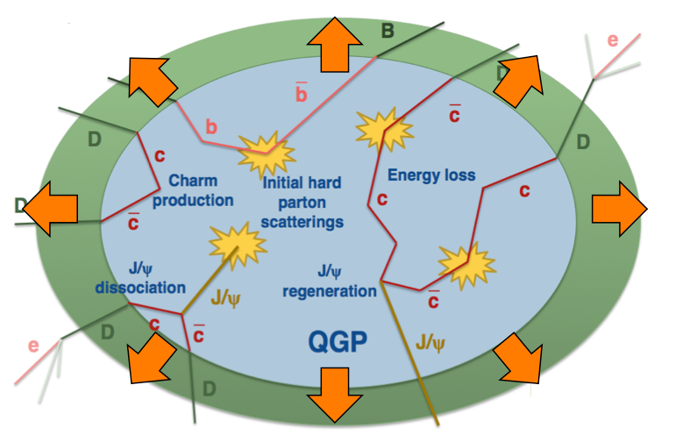



QCD matter at the LHC: what have we I learned so far?
(a personal overview)
Federico Antinori
INFN, Padova, Italy and CERN, Geneva, Switzerland

Slide 2
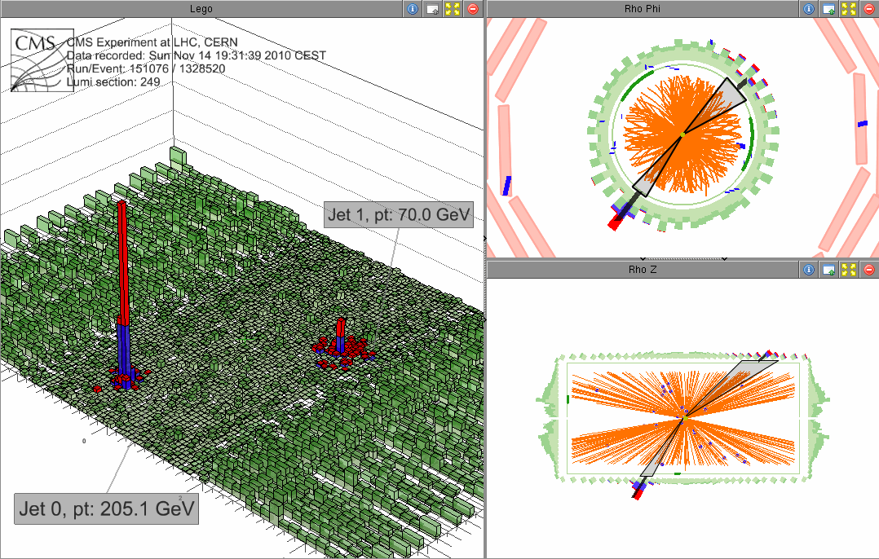
Nuclear collisions at the LHC
large cross-section for “hard probes”
novel tools to probe QCD medium
in particular: heavy flavour:
Pb
Pb
c
c
c
c

Slide 3

CMS
(general purpose, AA capabilities)
LHCb
(dedicated to beauty, joined in 2013)
ALICE
(dedicated to AA)
ATLAS
(general purpose, AA capabilities)

Slide 4
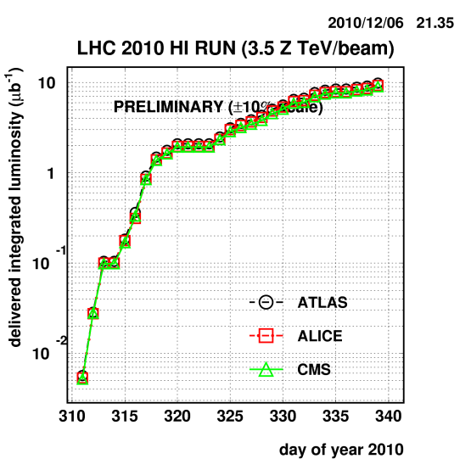
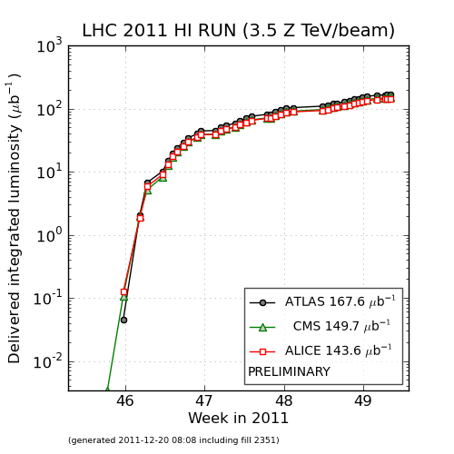
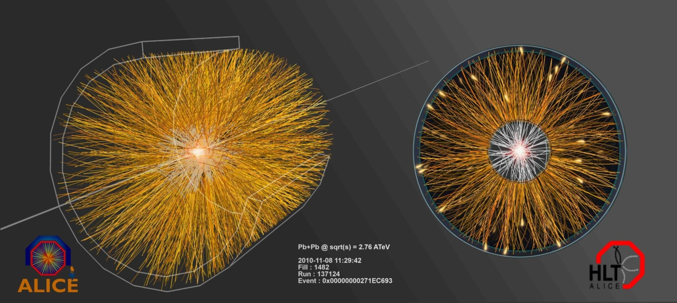
Nuclear collisions at the LHC!
three successful Pb-Pb runs already
  2010 → √s_{NN} = 2.76 TeV, L_{int} ~ 10/µb
  2011 → √s_{NN} = 2.76 TeV, L_{int} ~150/µb
  2015 → √s_{NN} = 5.02 TeV, L_{int} ~ 500/µb
+ p-Pb “control” run
  2013 → √s_{NN} = 5.02 TeV, L_{int} ~ 30/nb
+ pp “reference” runs in 2010 and 2013 (2.76 TeV), 2015 (5.02 TeV)

Slide 5
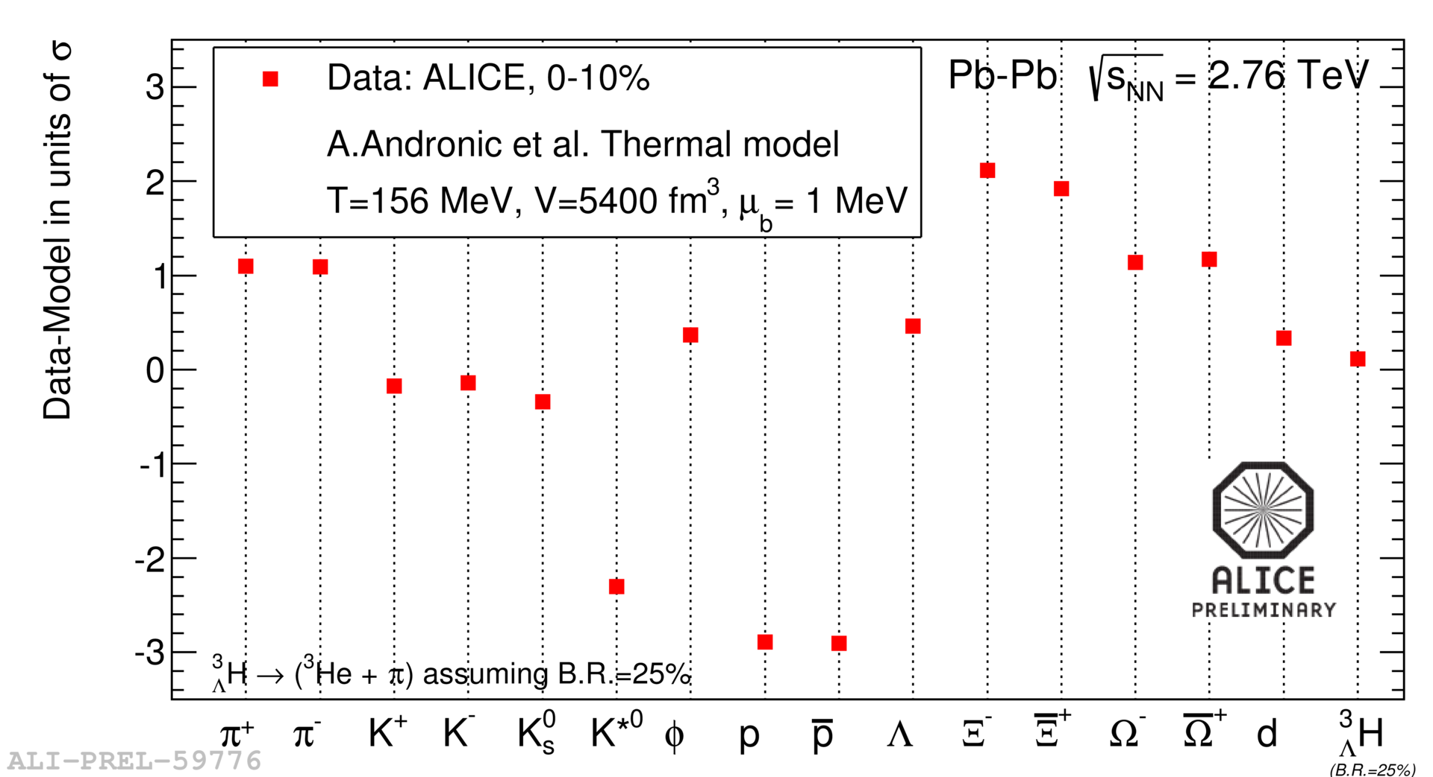
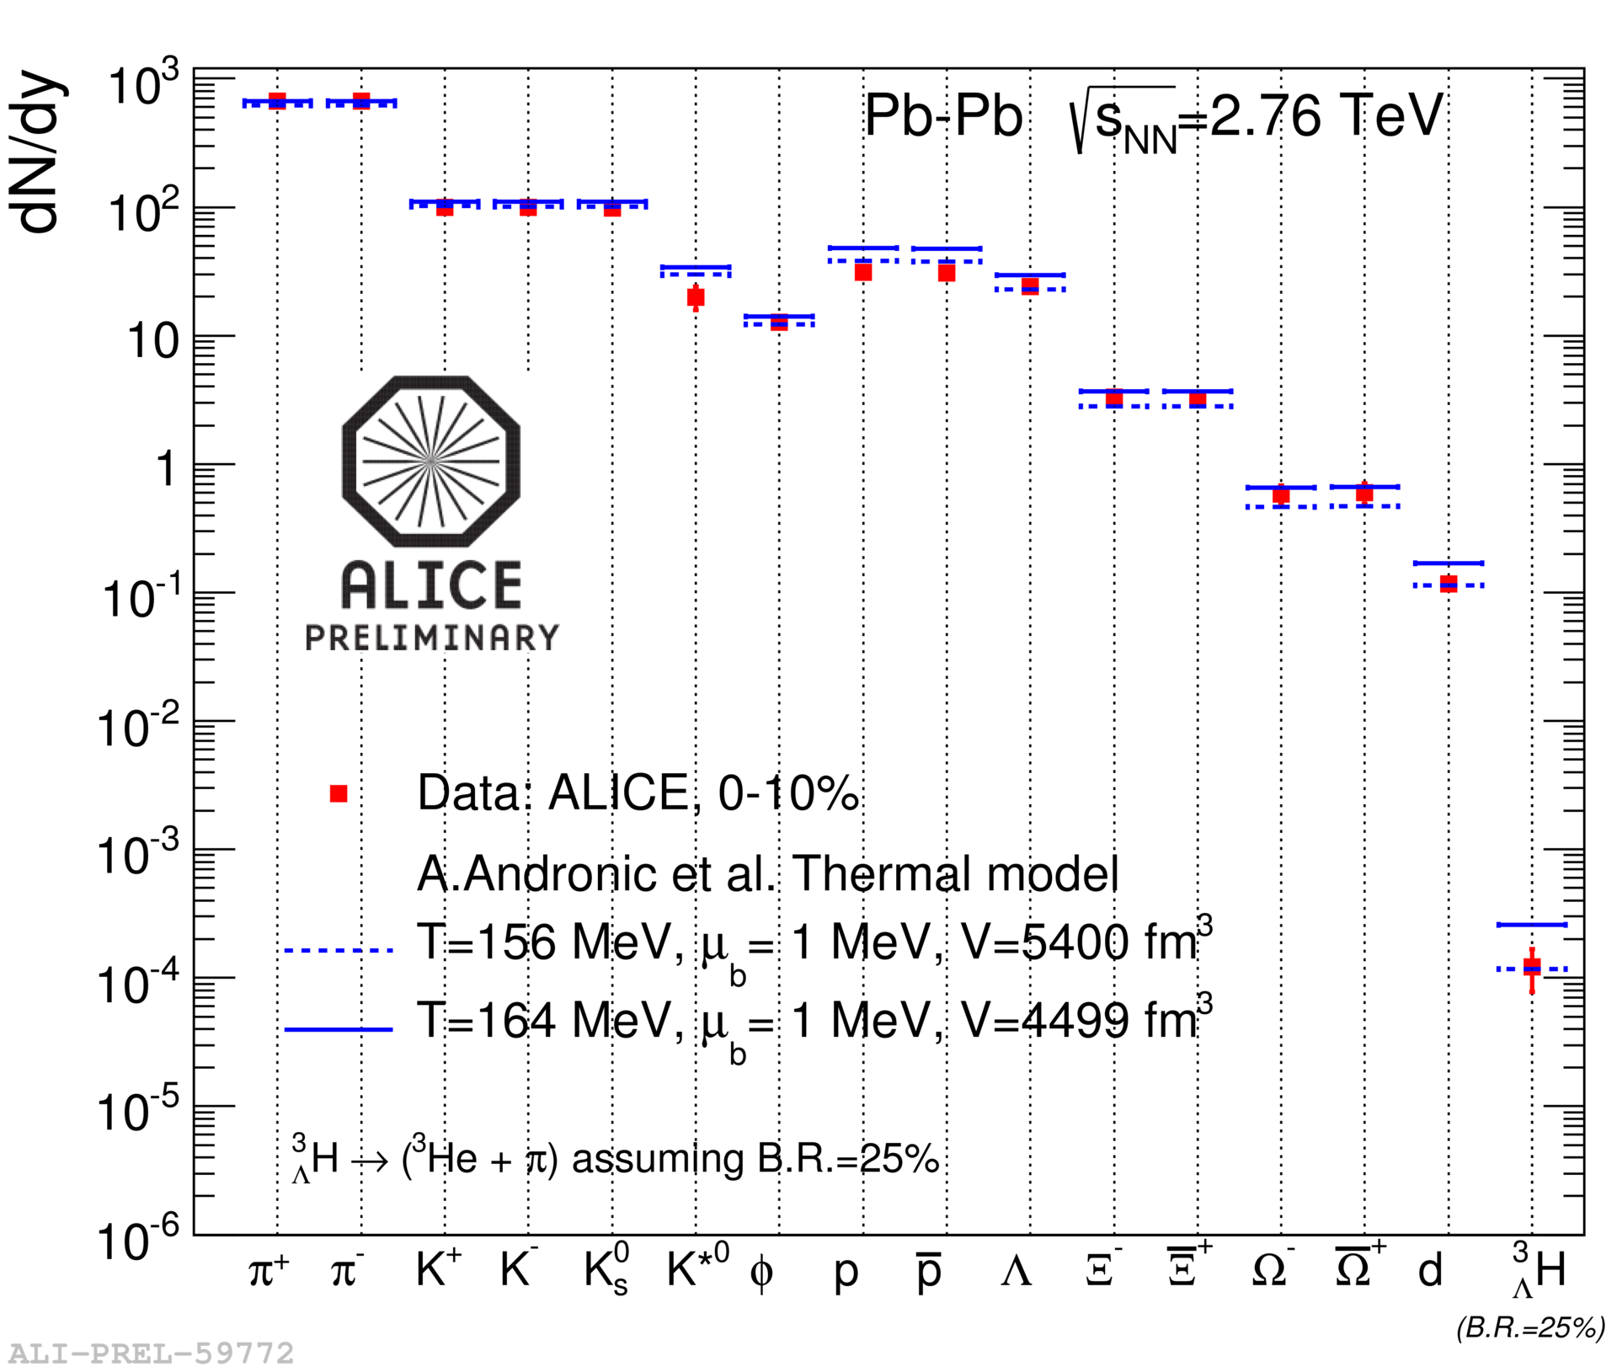
Particle yields
~ thermodynamic equilibrium
  T ~ 156 MeV
  now including ³_{Λ}H!
… but with some tension
  especially p and K*
origin of deviations?
  feed down from resonance decays?
  sequential freeze-out?
  non-equilibrium freeze-out?

Slide 6
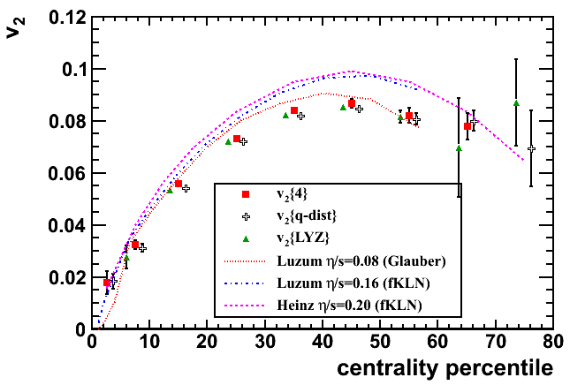
Azimuthal asymmetry
to quantify the asymmetry:
→ Fourier expansion of the angular distribution:
  in the central detector region (ϑ ~ 90º) → v₁ ~ 0 → asymmetry quantified with v₂
experimentally: v₂ ~ as large as expected by hydrodynamics

Slide 7
Identified Particles v₂
dd

Slide 8
Comparison with hydro
proton v₂ underestimated
Λ v₂ overestimated
mass ordering not preserved in VISHNU due to the hadronic cascade

Slide 9
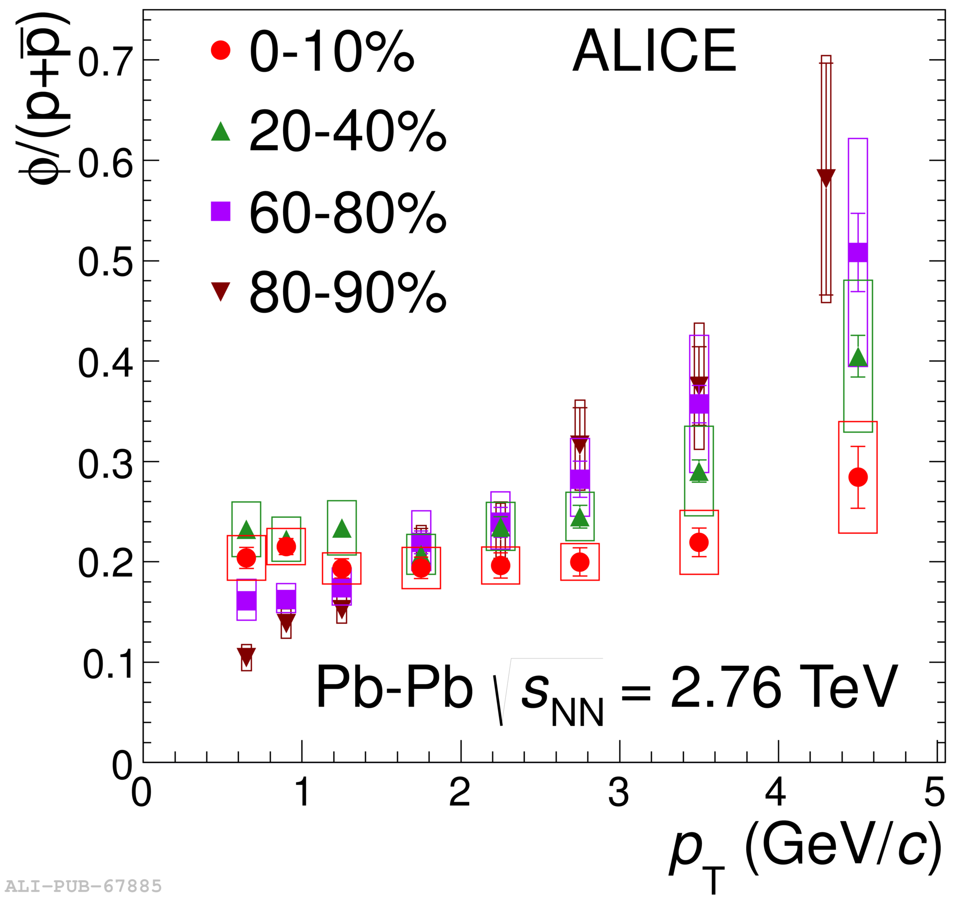
The Φ
low p_{T} (p_{T} < 2 GeV/c): mass ordering
intermediate p_{T} (2 < p_{T} < 6 GeV/c):
  in peripheral events, the Φ behaves like a pion
  but in central events, it behaves like a proton!
similar story from particle spectra →
→ it seems that m, not n_{q}, is in control

Slide 10
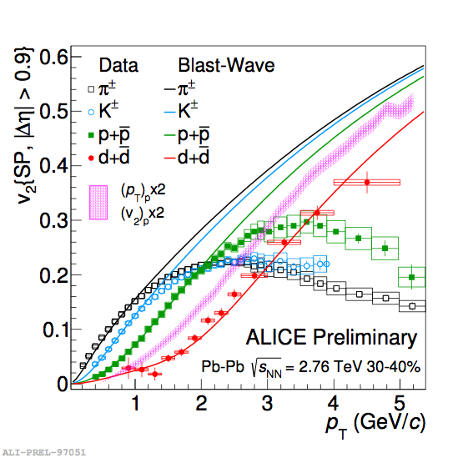
The deuteron
simple coalescence model does not describe deuteron v₂
blast-wave prediction from π/K/p fit does a decent job
how do we understand this?
  how does the fragile d flow like a π?

Slide 11
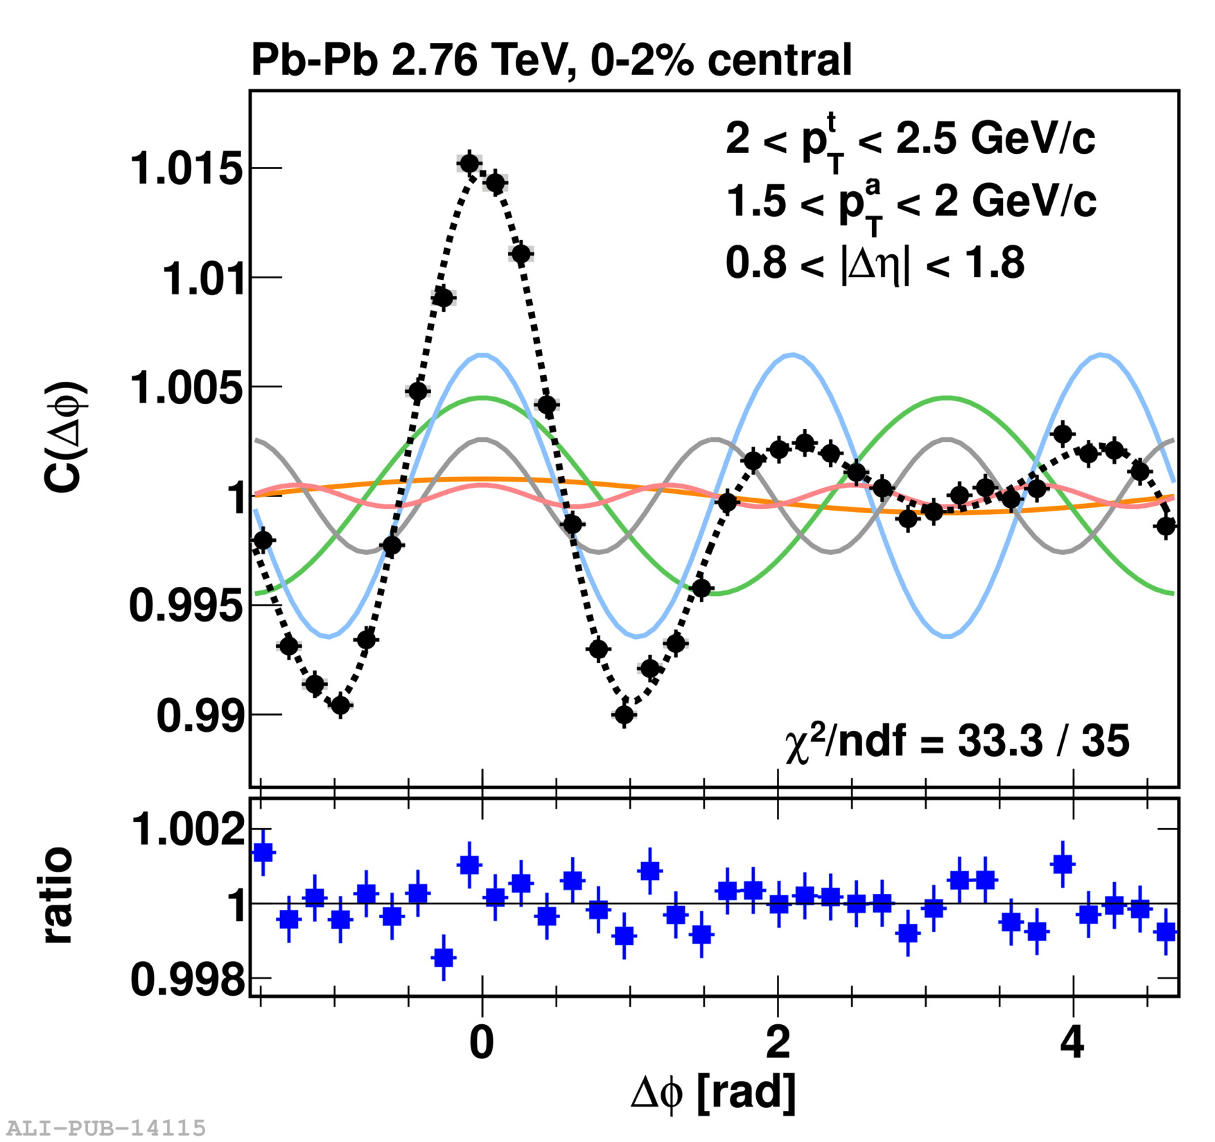
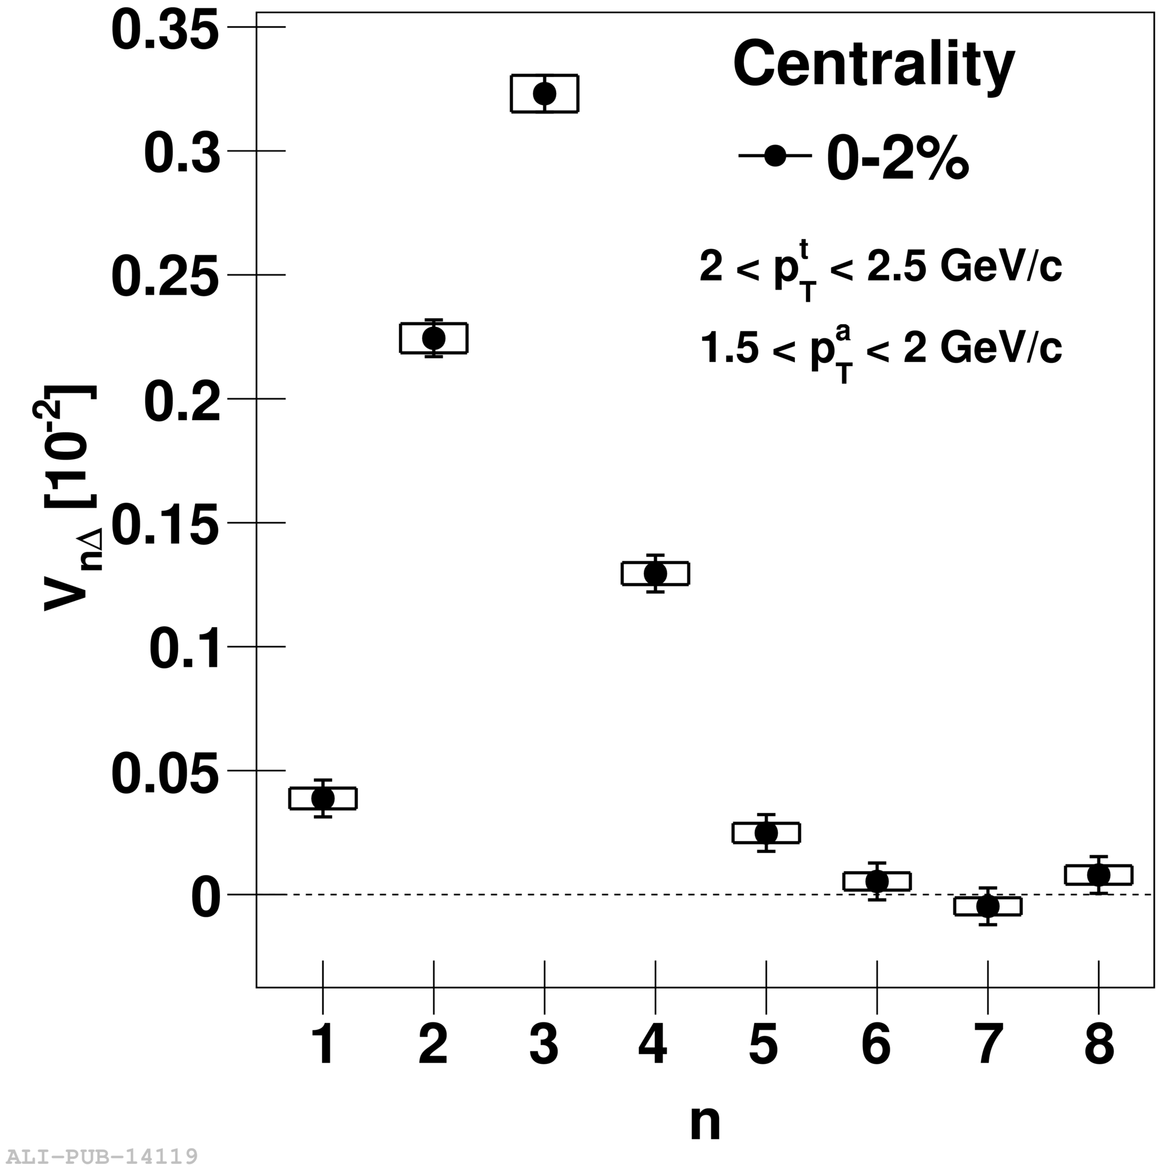
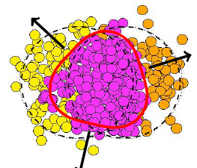
Higher harmonics
a beautiful tool…
initial state geometrical asymmetries
connects final state distribution to initial state fluctuations
  via medium transport
final state momentum asymmetries
[ALICE: PLB 708 (2012) 249]

Slide 12
Longitudinal asymmetry
event-by-event fluctuations
a new event classifier?
asymmetric events in ZDCs
effects on η distribution
α_{ZDC} = (ZDC₁ – ZDC₂) / (ZDC₁ + ZDC₂)

Slide 13
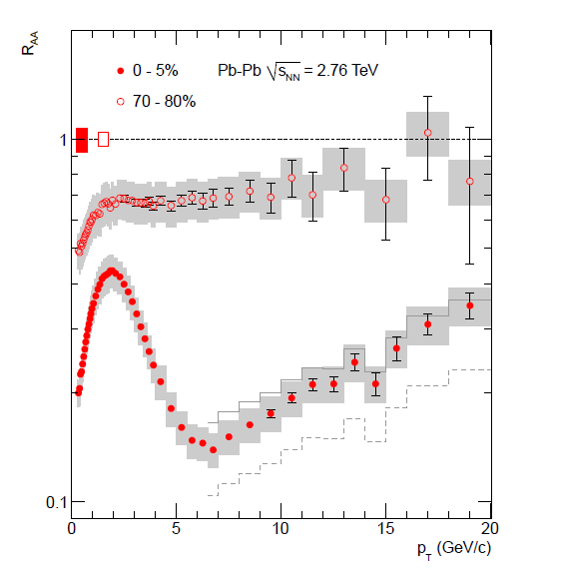
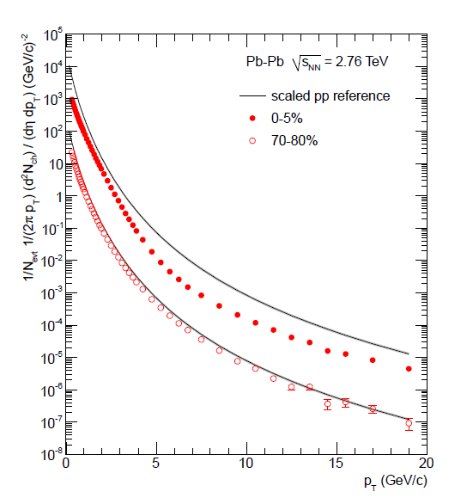
Very strong quenching
Pb-Pb significantly below scaled pp for central collisions (filled points)
R_{AA}:
  minimum around 6-7 GeV (R_{AA} ~ 0.14)
  clear increase at higher p_{T}

Slide 14
v₂ persists to very high p_{T}
angular dependence of quenching

Slide 15
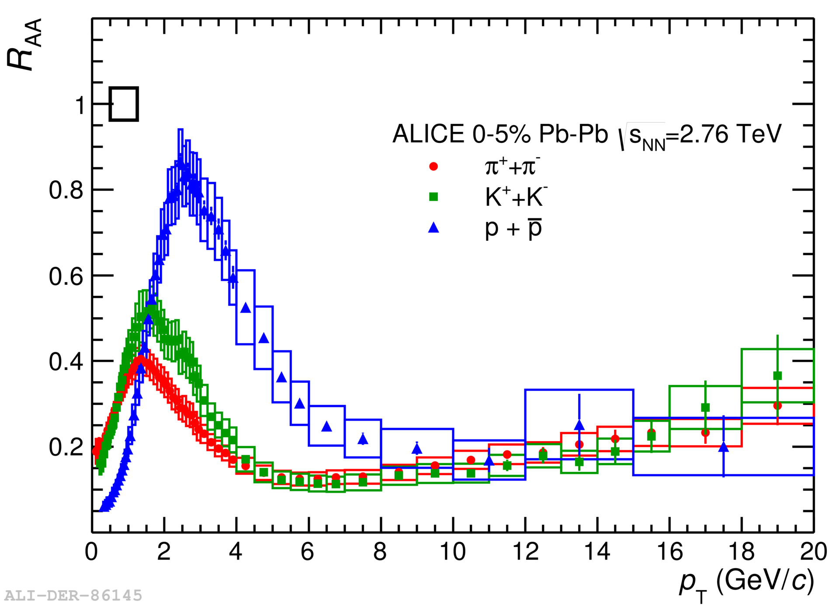
Dependence on particle species
particle mass / type (baryon/meson) dependence of suppression
  e.g.: proton enhancement
sensitivity to hadronisation in medium

Slide 16
R_{AA} for vector bosons
electroweak probes, on the other hand, are unmodified
(essential cross check!)

Slide 17
Di-jet imbalance
Pb-Pb events with large di-jet imbalance observed at the LHC
recoiling jet strongly quenched!
CMS: arXiv:1102.1957

Slide 18
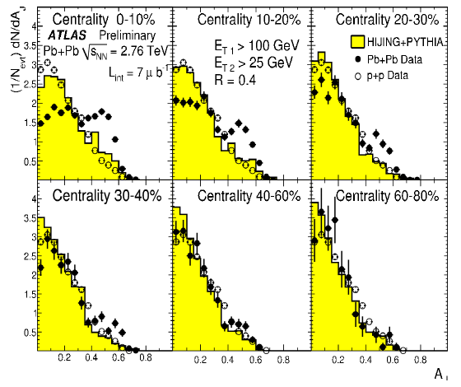
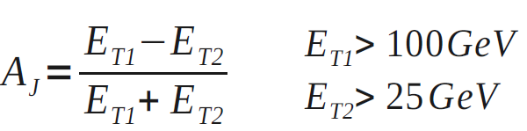
Di-jet imbalance
imbalance quantified by the di-jet asymmetry variable A_{J} :
with increasing centrality:
enhancement of asymmetric di-jets with respect to pp
  & HIJING + PYTHIA simulation
ATLAS: PRL105 (2010) 252303

Slide 19
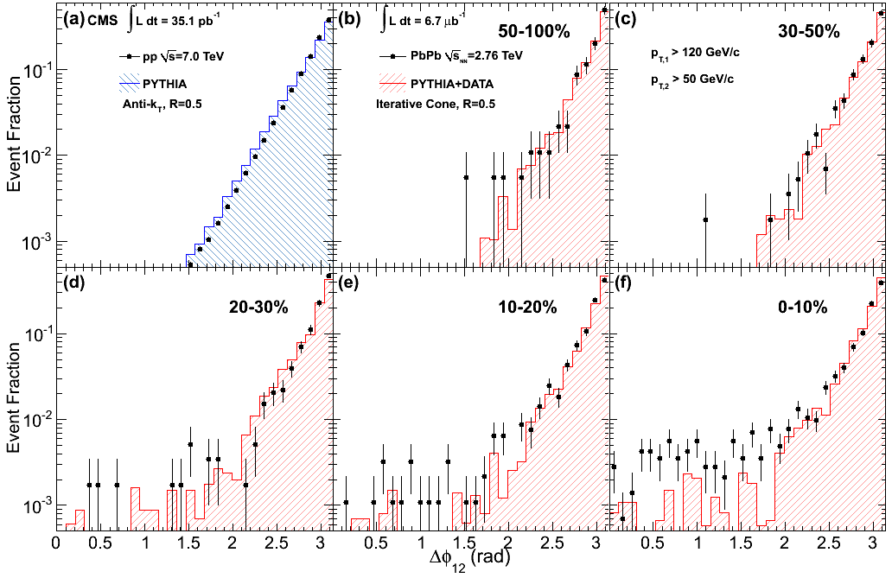
Di-jet Δφ
no visible angular decorrelation in Δφ wrt pp collisions!
→ large imbalance effect on jet energy, but very little effect on jet direction!
CMS, arXiv:1102.1957

Slide 20
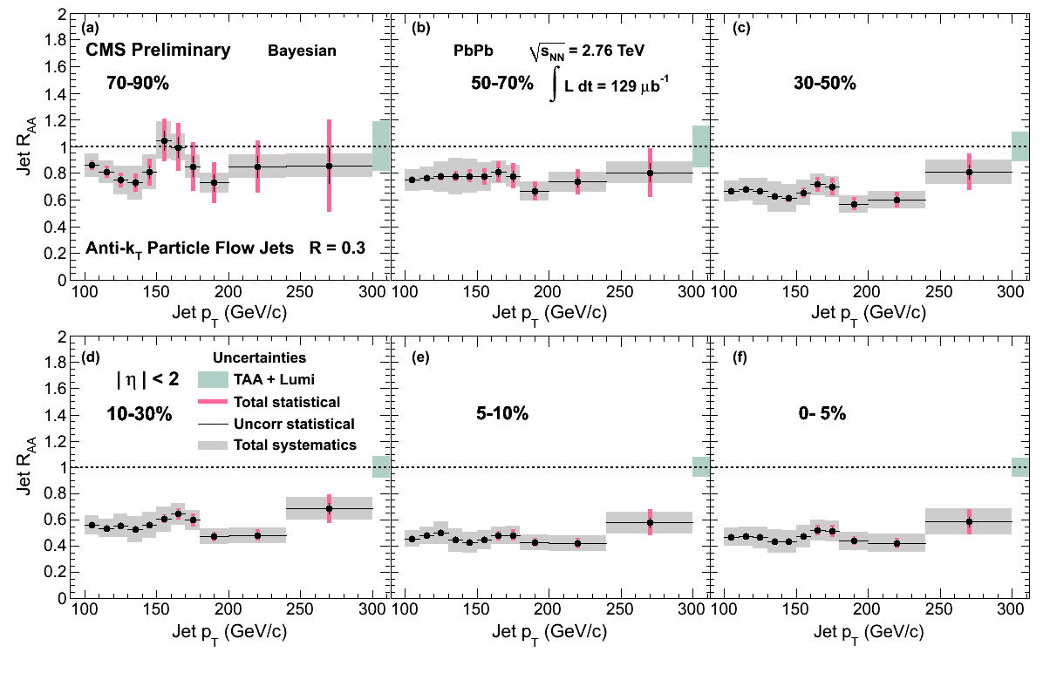
Jet R_{AA}
Pb
Pb
Pb
Pb
CMS PAS HIN-12-004

Slide 21
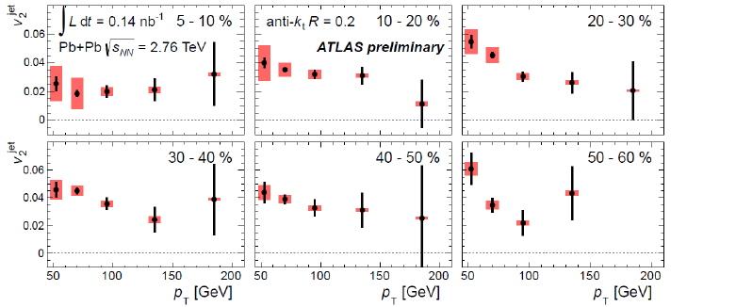
Jet v₂
ATLAS-CONF-2012-116
substantial azimuthal asymmetry up to highest jet energies!

Slide 22
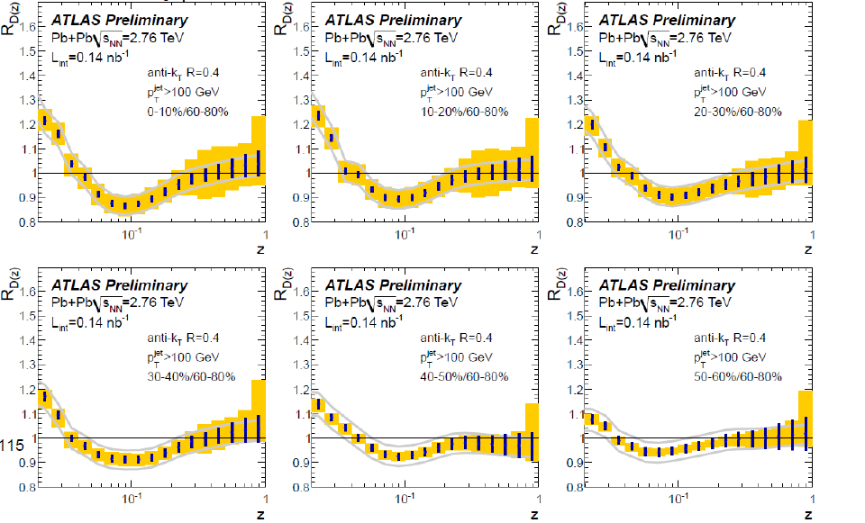
Jet fragmentation is modified
ratio of Pb-Pb and pp Fragmentation Functions
z = p_{T}(track)/p_{T}(jet)
ATLAS-CONF-2012-115

Slide 23
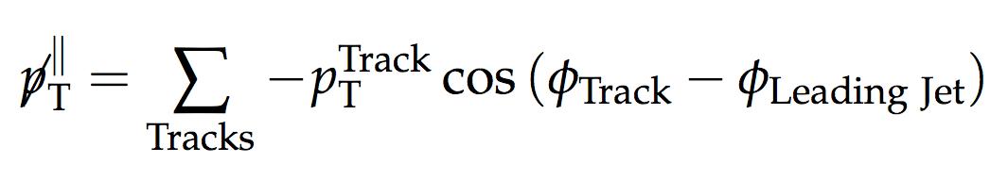
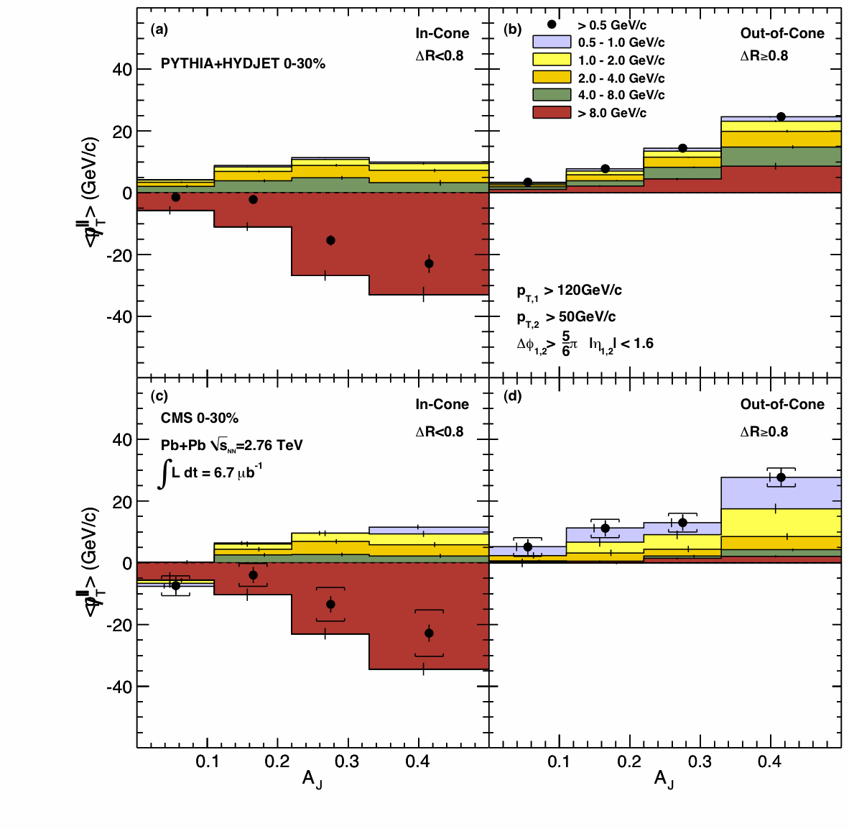
Where does the energy go?
look at missing p_{T} projected on leading jet axis
the energy reappears, degraded, outside of the jet cone…
  [CMS: PRC 84 (2011) 024906]

Slide 24
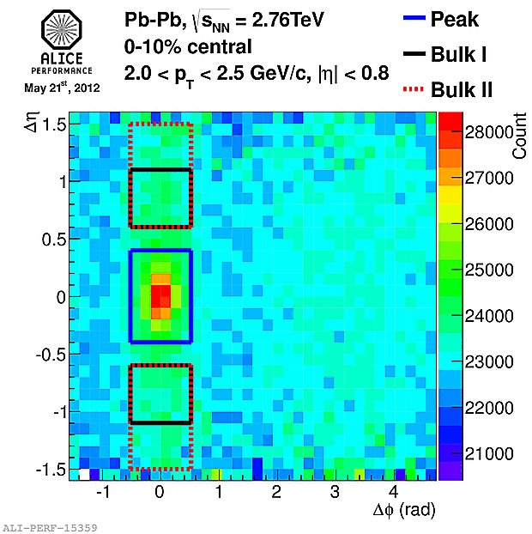
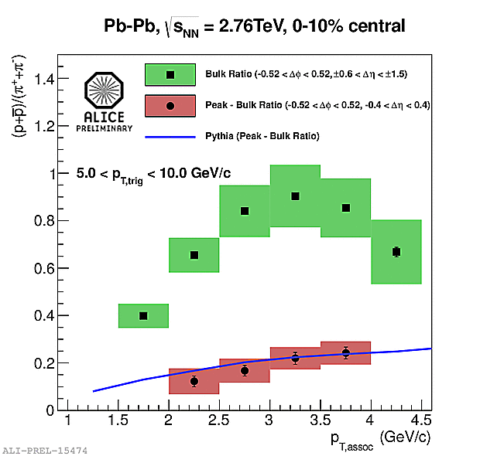
Particle composition
peak excess particle composition similar to pp!
PYTHIA pp

Slide 25
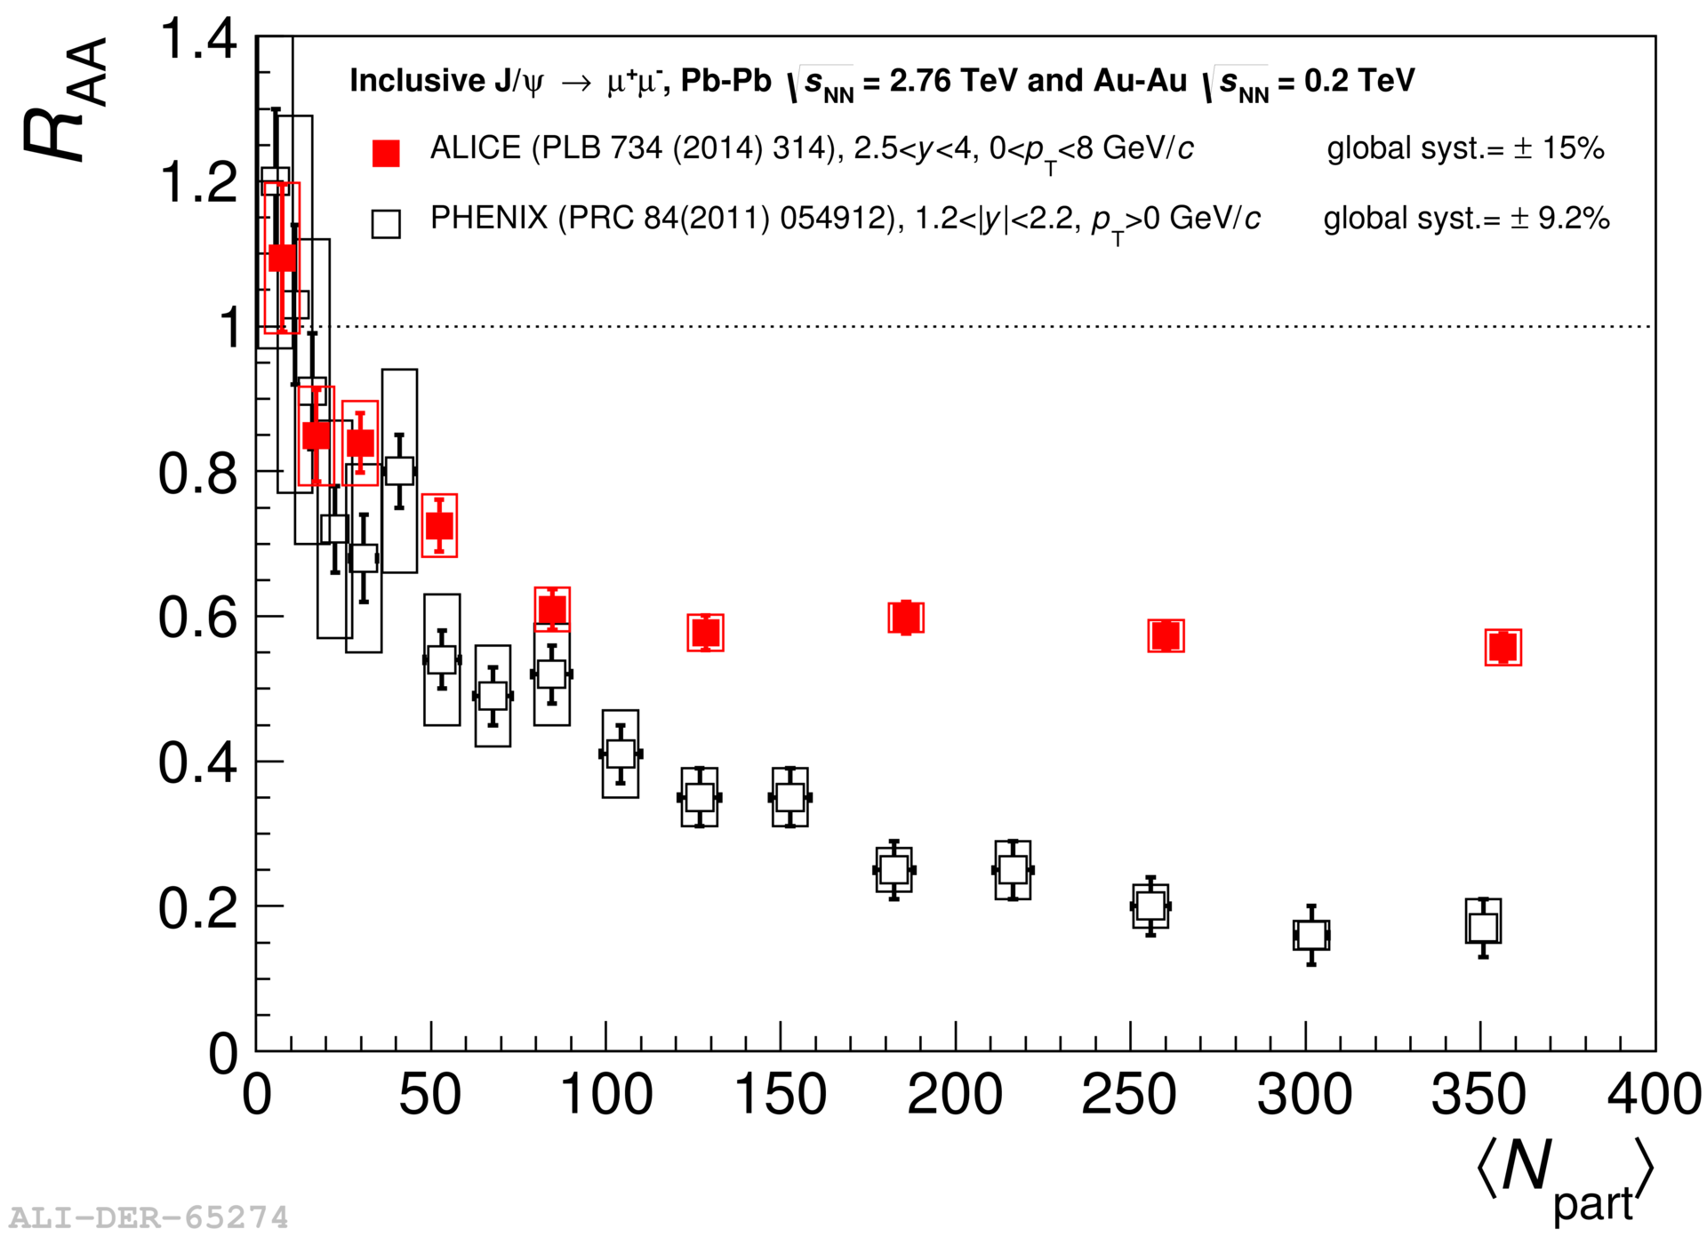
J/ψ suppression at the LHC
LHC (ALICE, 2.5 < y < 4, p_{T} > 0)
less suppression than RHIC (PHENIX, 1.2 < y < 2.2, p_{T} > 0)
weaker centrality dependence
new regime wrt RHIC!
  c-cbar coalescence?

Slide 26
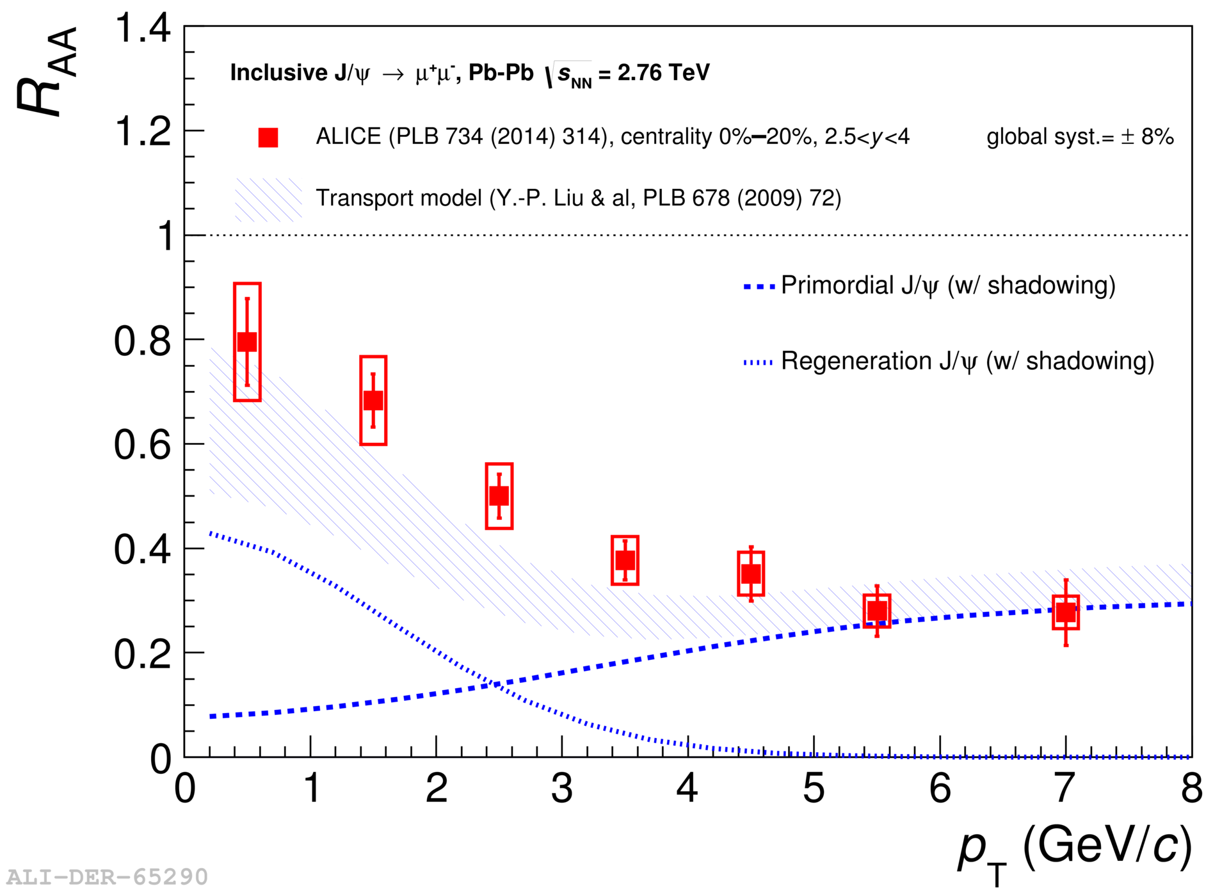
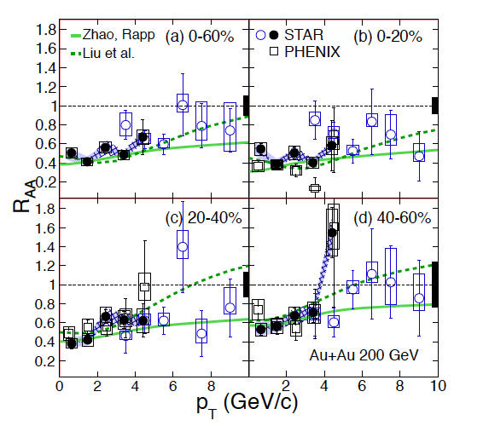
J/ψ R_{AA}: p_{T} dependence
decreases with p_{T}
consistent with regeneration models
at RHIC: opposite behaviour
[STAR, arXiv:1310.3563]

Slide 27
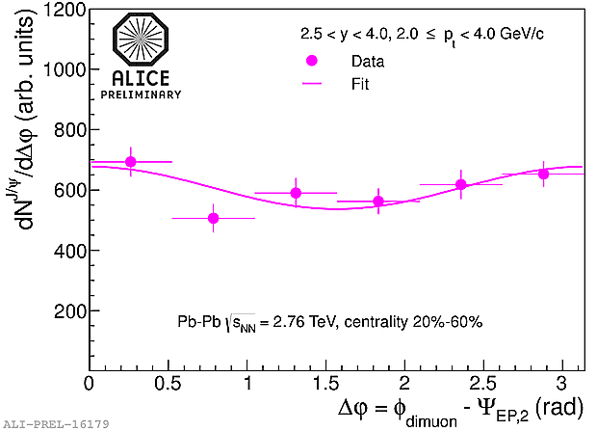
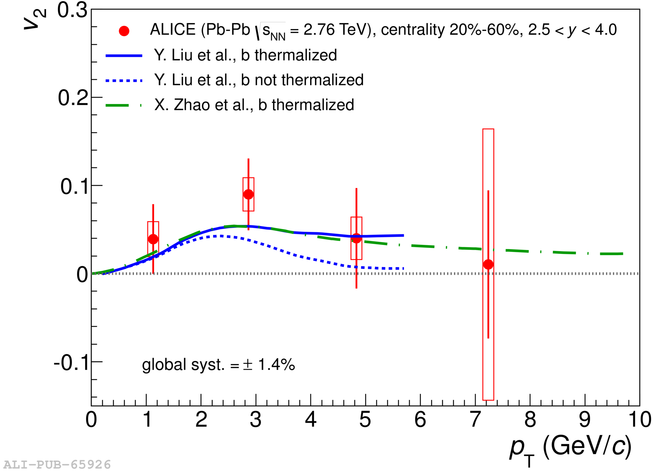
J/ψ flow?
hint for a modulation…
more statistics coming!

Slide 28
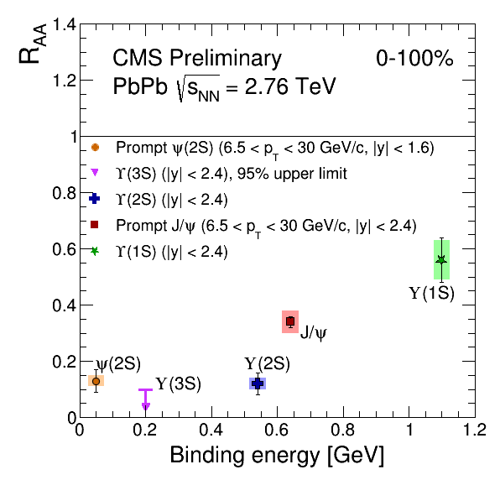
Bottomonium suppression
stronger suppression for less bound Y states
  very efficient melting: Y(3S) not measurable (upper limit only)

Slide 29
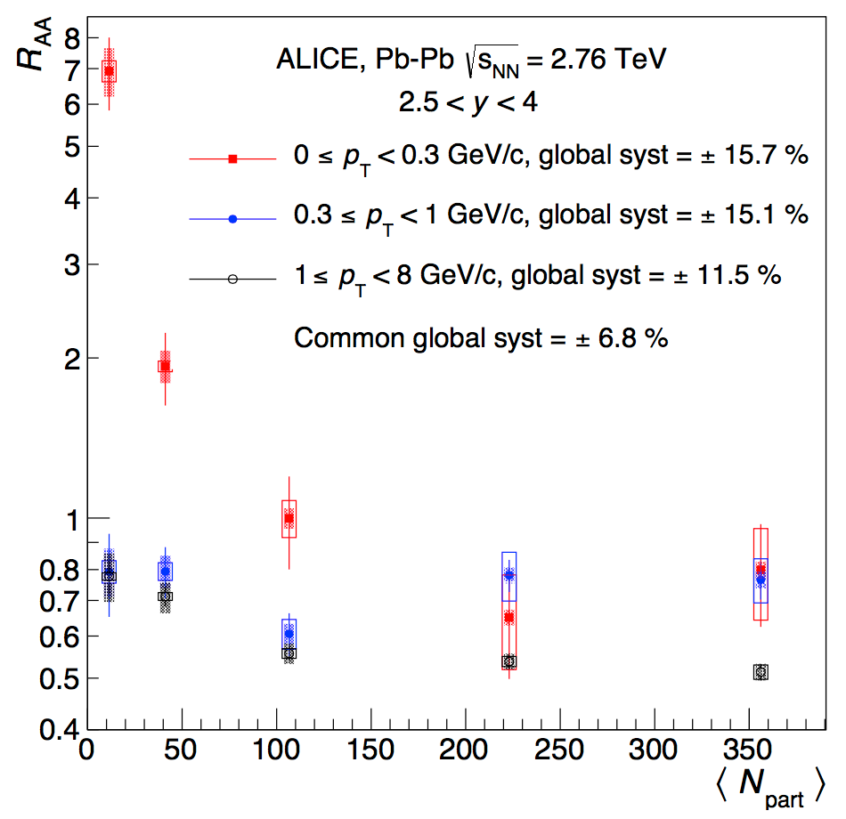
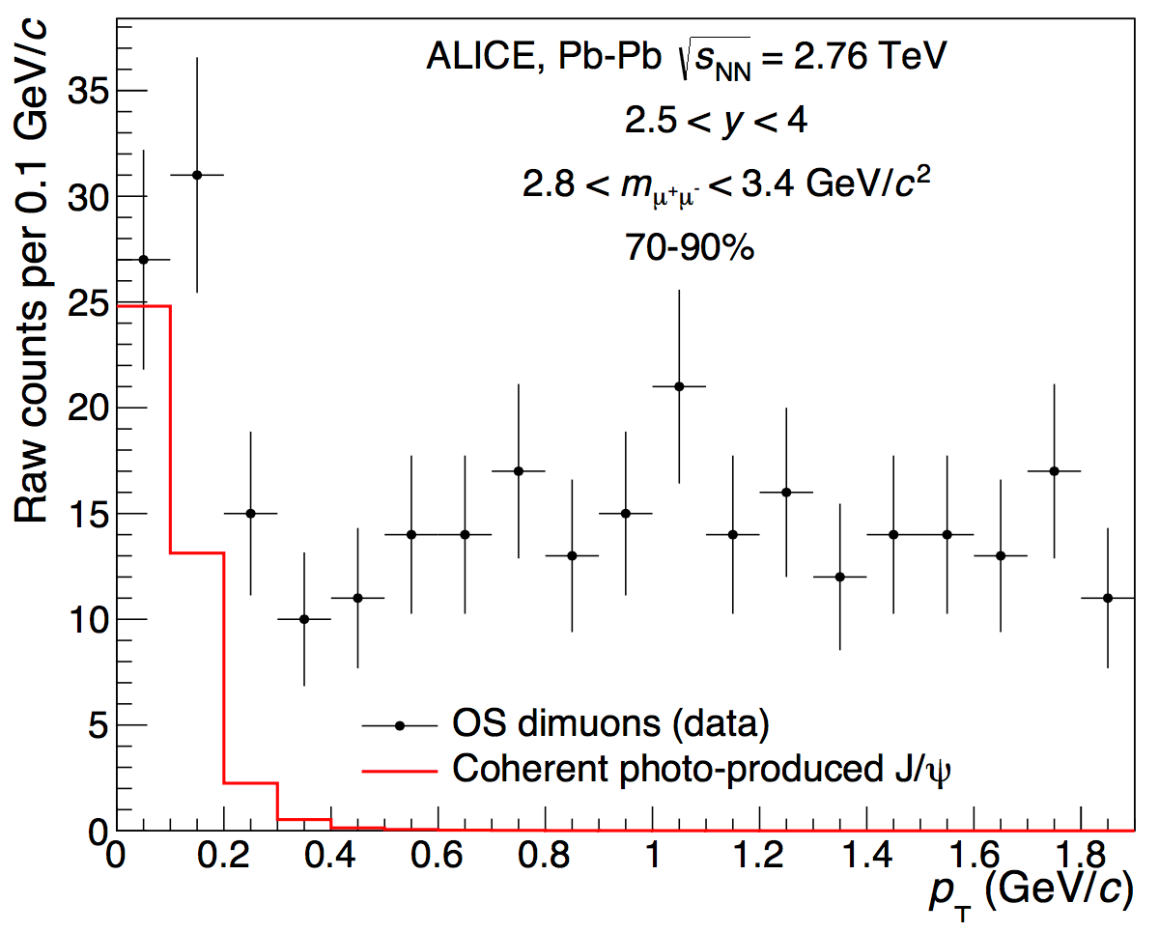
Very soft J/ψ excess
strong enhancement in R_{AA} for p_{T} < 0.3 GeV/c
p_{T}-shape consistent with STARLIGHT EM
observation of EM production in hadronic collisions?
no theoretical calculation exists!

Slide 30
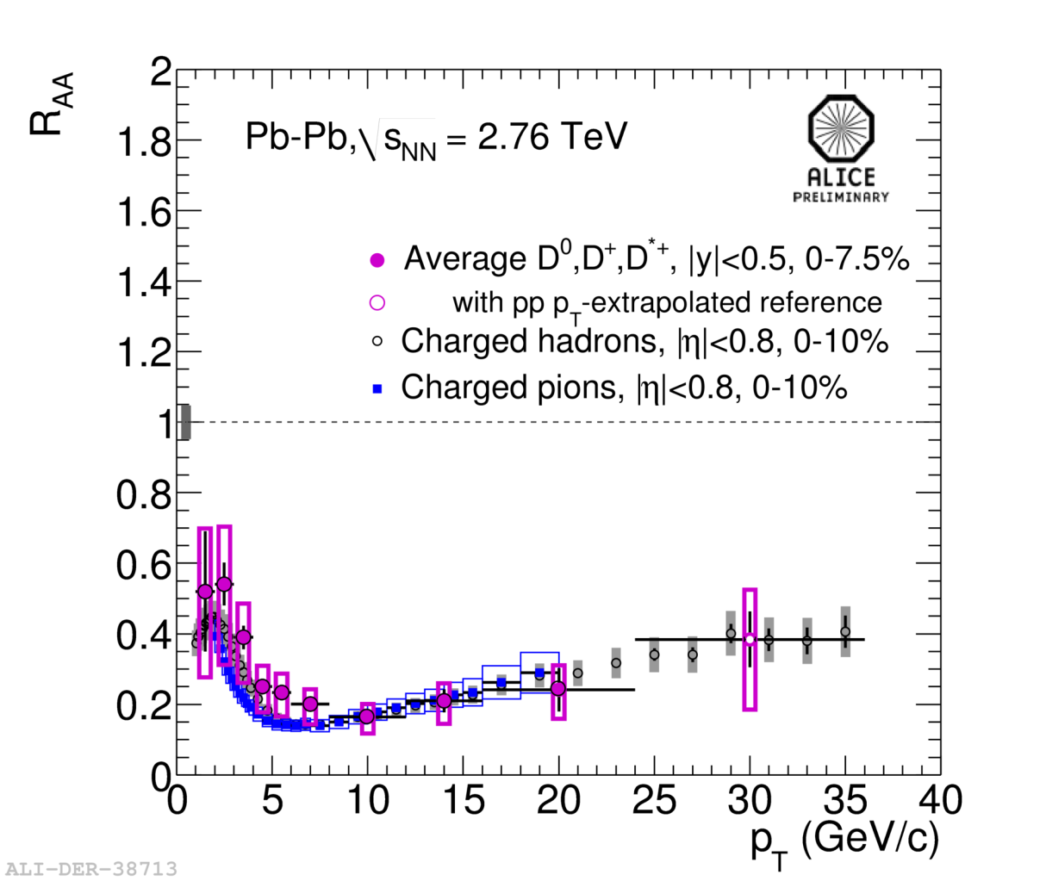
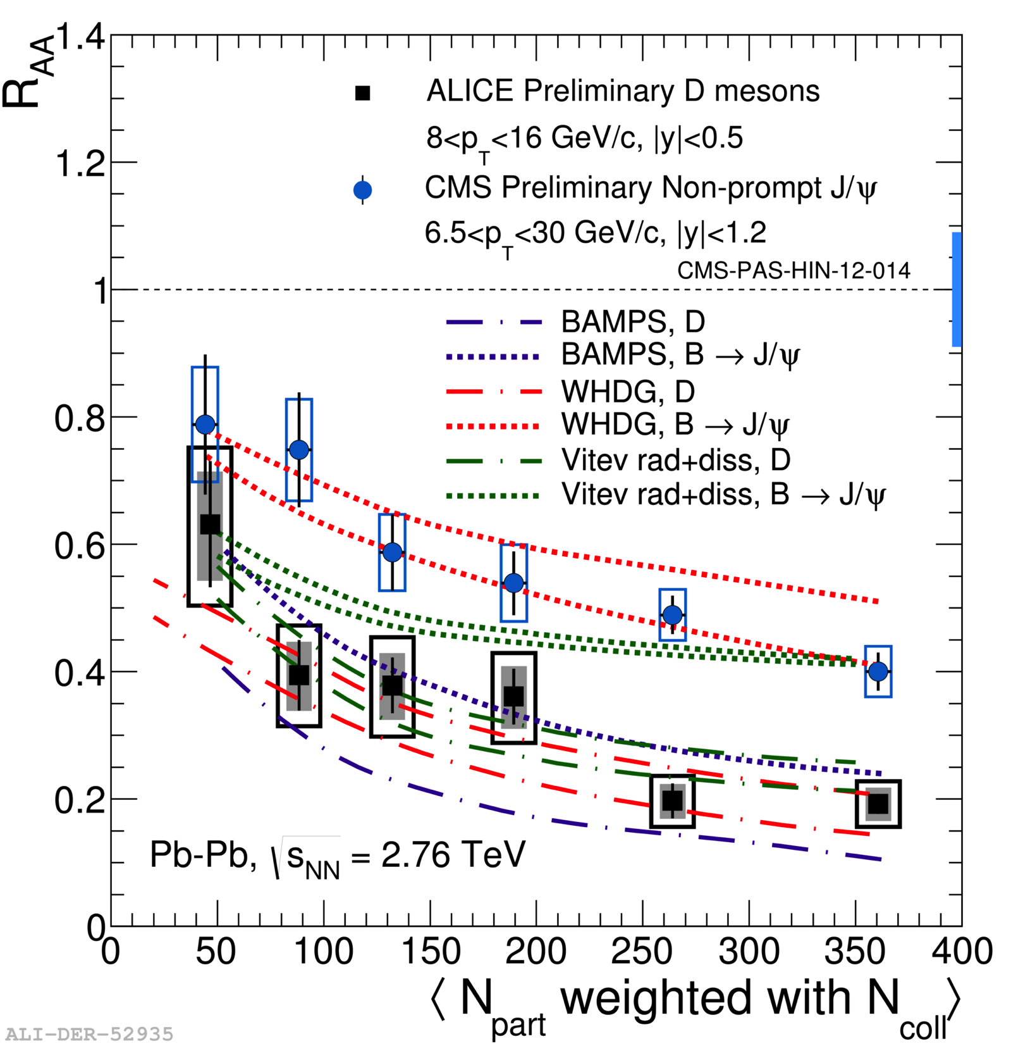
R_{AA}: Flavour Dependence!
indication of R_{AA}(b) > R_{AA}(c) !
p_{T} < 8 GeV/c:
  hint of less suppression than for π ?
p_{T} > 8 GeV/c
  same suppression as for π…

Slide 31
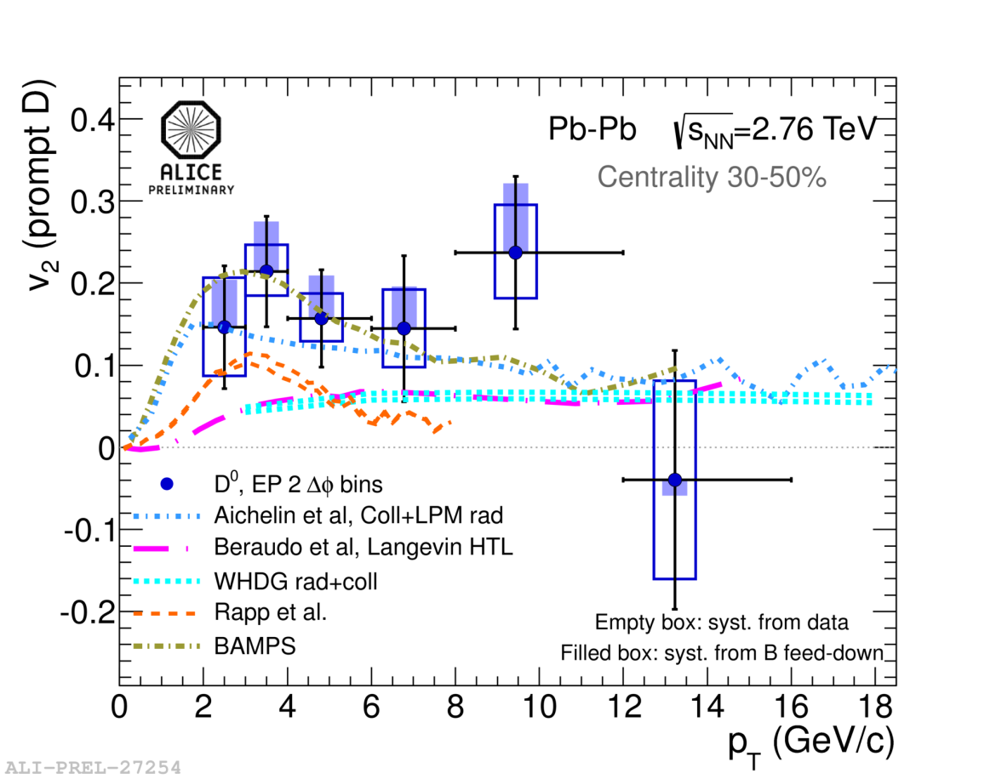
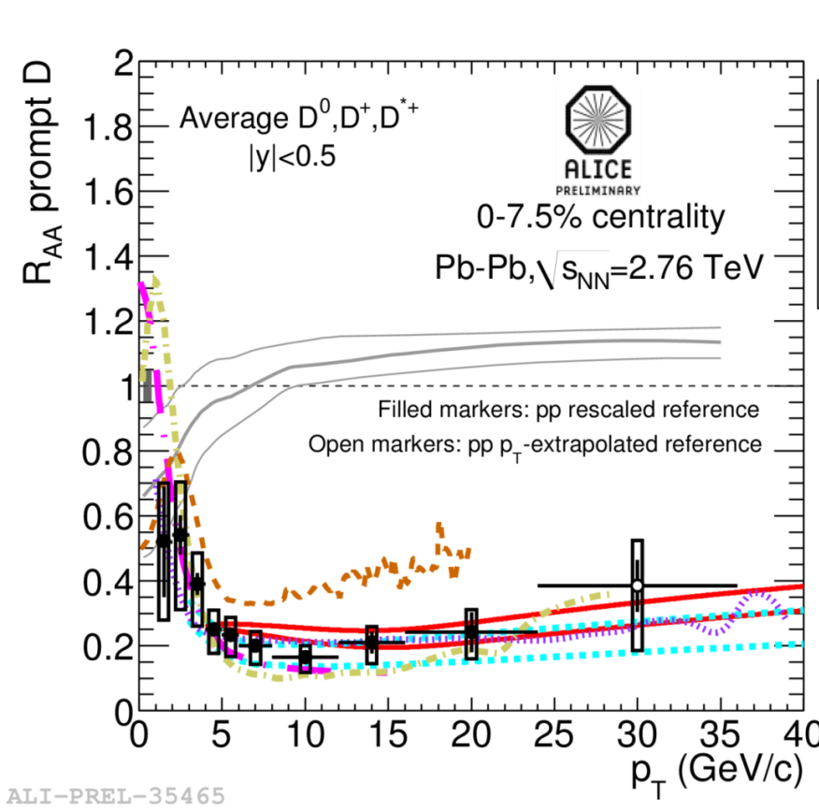

D meson v₂
indication of non-zero v₂
  consistent with strong coupling of c to medium
theory must describe simultaneously v₂ and R_{AA} …

Slide 32
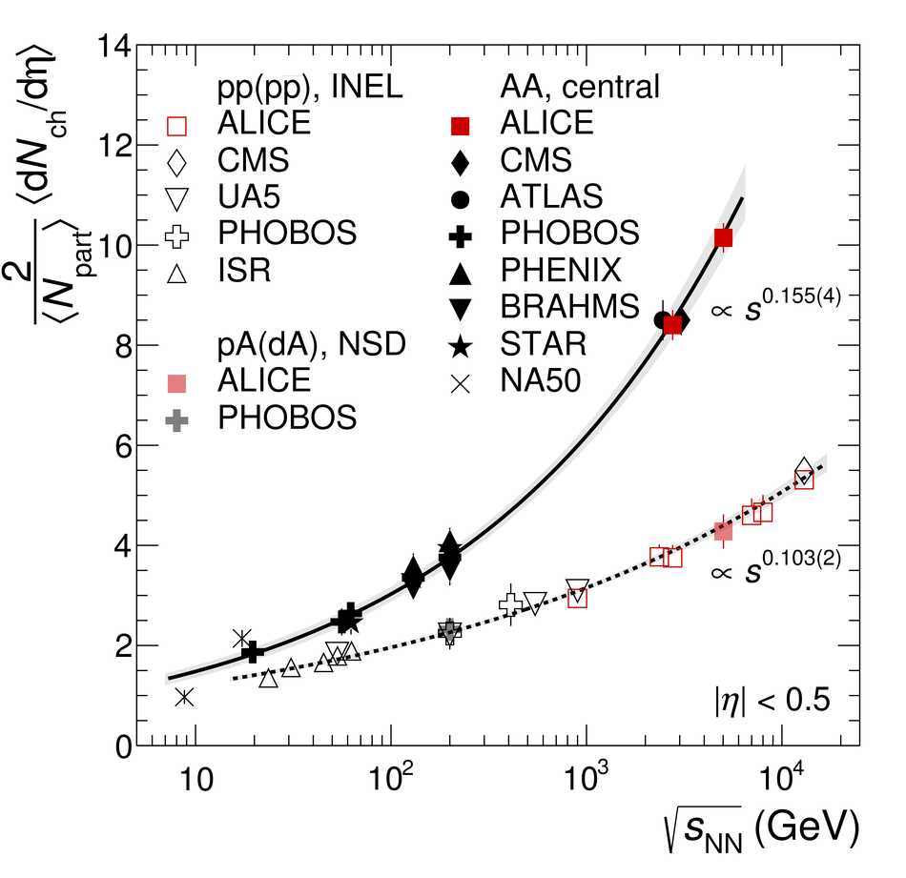
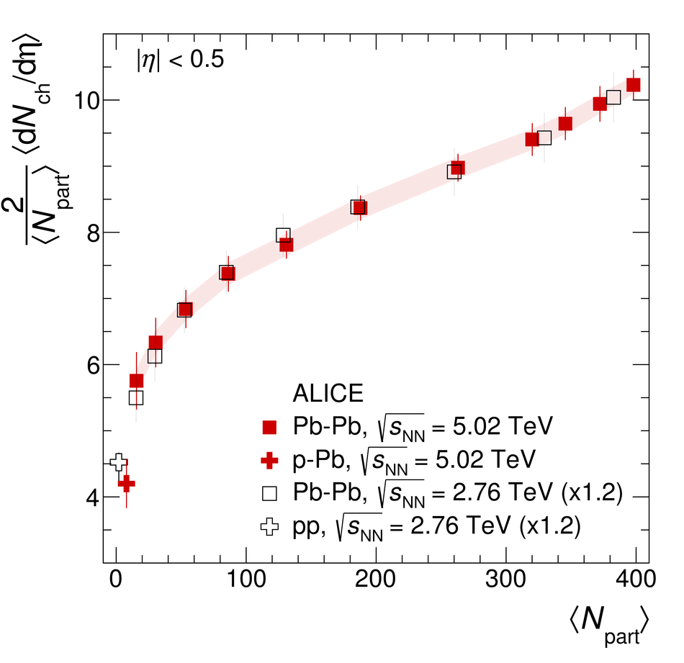
5.02 TeV: multiplicity
√s dependence steeper than pp
follows trend established at 2.76 TeV
centrality dependence ~ indep of √s
[ALICE, arXiv:1512.06104]

Slide 33
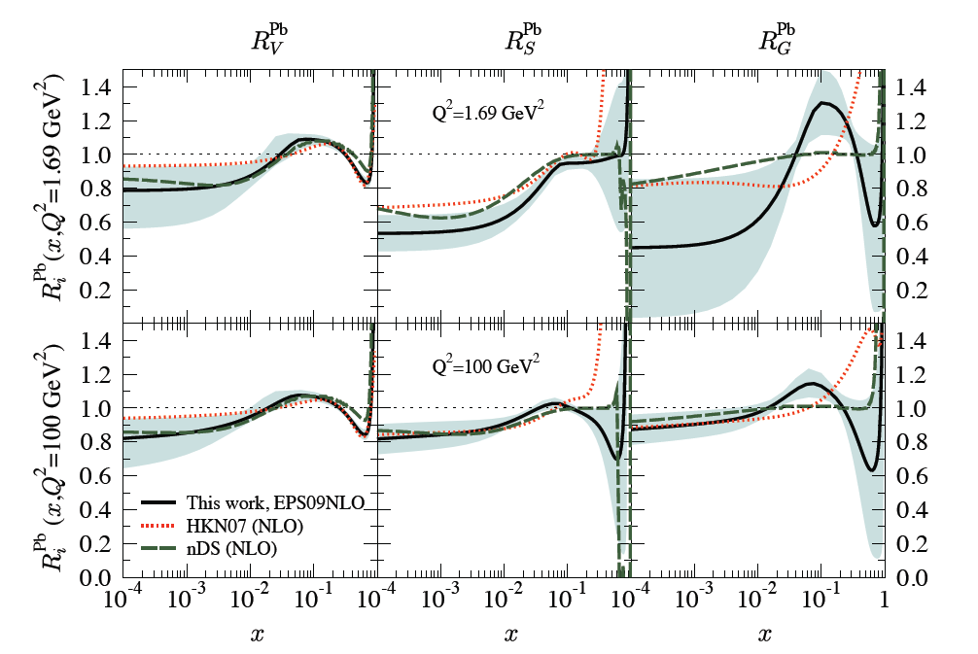
Parton shadowing…
complication in interpretation of Pb-Pb results:
different parton distribution functions in protons and nuclei
x = fraction of
nucleon momentum
carried by parton
[K J Eskola et al: JHEP04(2009)065]
→ uncertainty on “trivial” nuclear effects baseline
→ measure p-Pb collisions!!!

Slide 34
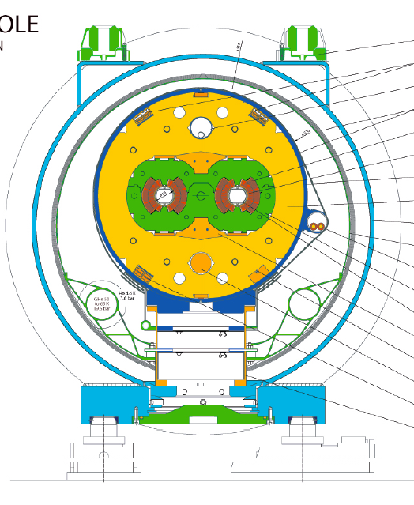
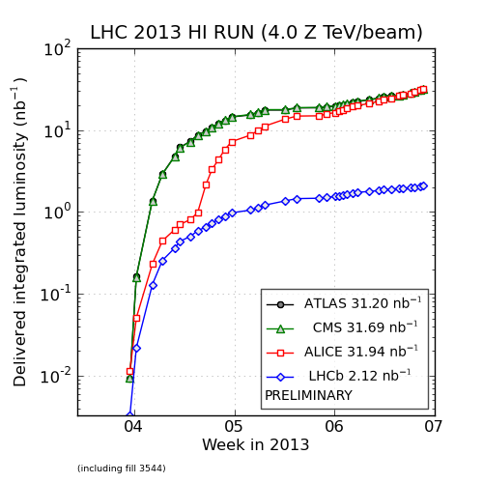
p-Pb collisions in the LHC!
tricky, but can be done…
2-in-1 design…
  identical bending field in two beams
  locks the relation between the
  two beam momenta:
  p (Pb) = Z p(proton)
  different speeds for the two beams!
adjust length of closed orbits!
  to compensate different speeds
different RF freq for two beams at injection and ramps
short low lumi pilot run (a few hours) on 12/9/2012
first run in Jan-Feb 2013!
→ ~ 30/nb

Slide 35
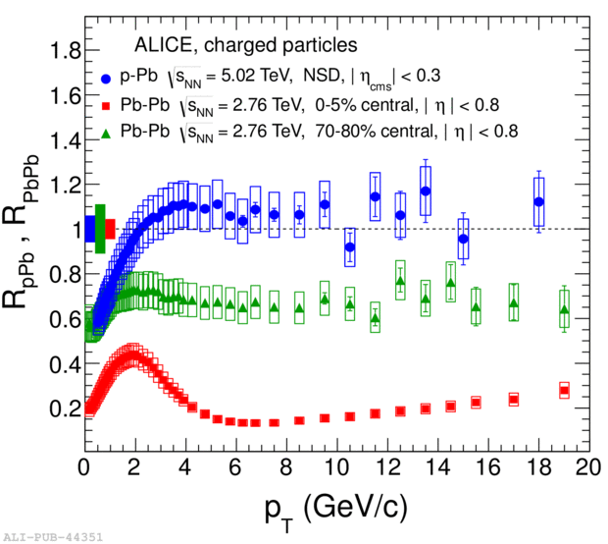
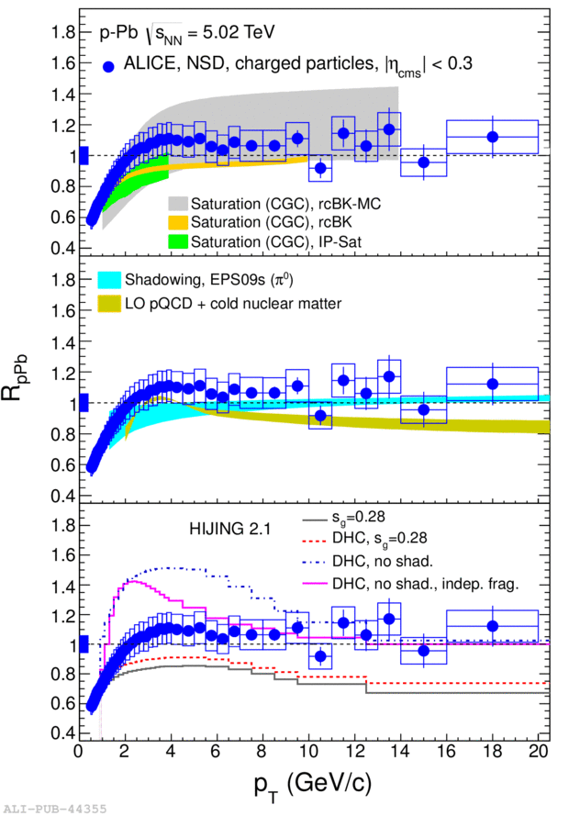
Control experiment: R_{pPb}
measurement of nuclear modifications in initial state
R_{pA} ~ 1 for p_{T}> 3 GeV/c → confirms quenching is due to QCD medium

Slide 36
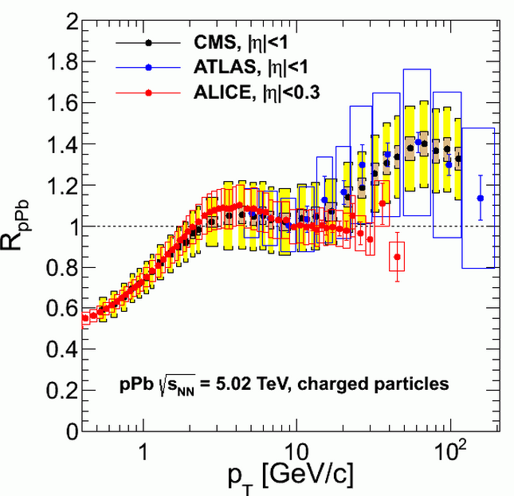
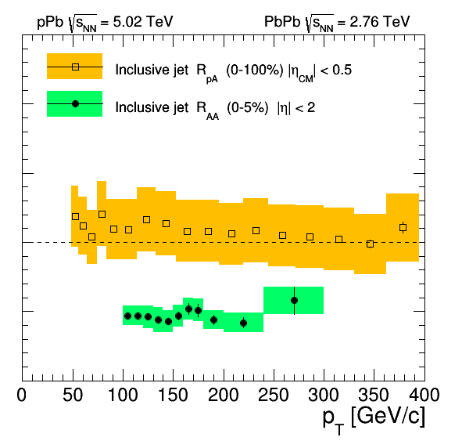
High-p_{T} puzzle!
high-p_{T} R_{pA} from CMS: enhancement??
  similar picture from ATLAS (not from ALICE)
modification of fragmentation function?
but not for jets?

Slide 37
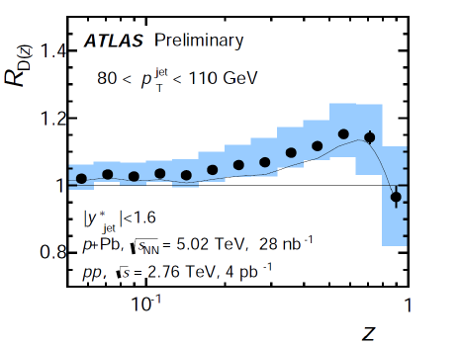
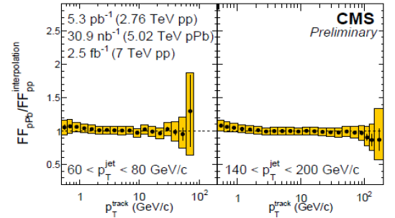
Being resolved…?
fragmentation function (Hard Probes 2015)
ATLAS sees modification…
but CMS does not…
RpPb relies on interpolated pp ref
pp reference at 5 TeV needed…

Slide 38
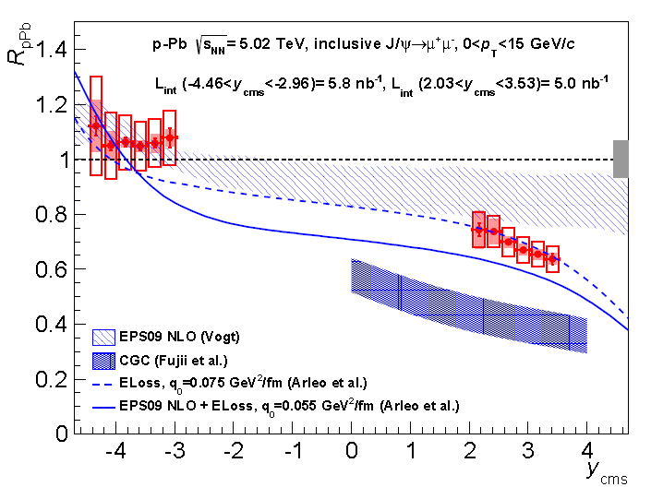


J/ψ in p-Pb
R_{pPb} consistent with shadowing
  p_{T}-integrated
R_{pPb} back to 1 at high p_{T}
  opposite behaviour for Pb-Pb!
← LHCb joins the Heavy-Ion club!

Slide 39


ψ(2S) in p-Pb
surprise: more suppressed than J/ψ!
  how can shadowing (initial state) do that?
  at odds with shadowing in Pb hemisphere
more “active” events → larger effect
  i.e.: effect increases with multiplicity
→ indication of final state effects?

Slide 40


Bottomonia in p-Pb
Υ(1S) ~ OK with shadowing
excited states more suppressed
p-Pb
Pb-Pb
Υ(2S)
Υ(3S)

Slide 41


The Ridge
2 < p_{T,trig} < 4 GeV/c
1 < p_{T,assoc} < 2 GeV/c
20% highest multiplicity
(zoomed)
Near-side jet
(Δϕ ~ 0, Δη ~ 0)
1/N_{trig} d²N_{assoc}/dΔηdΔϕ
Away-side jet
(Δϕ ~ π, elongated in Δη)
Near-side ridge
(Δϕ ~ 0, elongated in Δη)
Δη
Δϕ (rad)
PLB719 (2013) 29
in addition to near side peak and away-side recoil…
… there’s an additional near side ridge in p-Pb
first observed by CMS [PLB718 (2013) 795]

Slide 42


The Double Ridge
Can we separate the jet and ridge components?
  in 60-100% no ridge seen, similar to pp
  → what remains if we subtract 60-100%?
the ridge is doubled!
the origin of this structure is still unclear...
  similar structure observed in Pb-Pb is attributed to hydrodynamic flow…
  CGC-glasma graphs can also produce symmetric ridges?
[ALICE, PLB719 (2013) 29]
0-20%
60-100%
–
=
Δη
Δϕ (rad)

Slide 43


Identified particles
how does the correlation depend on the particle species?
p-Pb remarkably similar to Pb-Pb…
  where particle species dependence is attributed to collective flow!
p-Pb
Pb-Pb

Slide 44

Multiparticle correlations
v2 calculated with higher order cumulants
again: p-Pb very similar to Pb-Pb
azimuthal asymmetry is a true multi-particle effect, in both systems!
Pb-Pb
p-Pb

Slide 45


Ridges in pp
near side ridge first seen by CMS
ATLAS: double ridge from 13 TeV
all the way to low multiplicity?!
(depends crucially on subtraction…)
[CMS, JHEP 1009 (2010) 091]

Slide 46

Multi-strange baryons in pp, p-Pb
e.g.: Ξ/π
significant enhancement at high multiplicity
  up to Pb-Pb levels!
similar behaviour in pp, p-Pb
not described in PYTHIA
pp
p-Pb
Pb-Pb
smooth onset of collectivity from min-bias pp to p-Pb to Pb-Pb?

Slide 47

How about quenching?
should it be there?
  does collectivity imply quenching?
could it be there, just very small?
  pp, pA not so small, after all…
how about initial state effects?

Slide 48


Could charm come to rescue?
no quenching observed in RpPb
what about v₂?
  wouldn’t observation of charm v₂ in pp, pA be a signal of quenching?
  … or could charm know about geometry w/o interacting with medium? (CGC?)
in any case, observation of charm v₂ in pp, p-Pb would be a sure hit!!!

Slide 49
Conclusions
the LHC has ushered in a new era for ultrarelativistic AA collisions
  abundance of hard probes
  state-of-the-art collider detectors (ALICE, + AA capabilities in ATLAS, CMS)
Run 1: two major discoveries…
  new regime for J/ψ production → evidence for regeneration?
  double ridge in p-Pb, pp → signal of collectivity, what about quenching?
… + rich harvest of other results
  system still very close to thermodynamic equilibrium and ideal hydro behaviour
  strong jet quenching, up to highest jet energies
    no evidence of angular decorrelation
    angular dependence: sensitivity to path length dependence
  indication of parton-mass ordering in heavy flavour quenching
  hints of final-state effects in p-Pb? (ψ(2S), Y)
the future looks bright → high stats HF, stay tuned!
  Run 2: O(10) increase in statistics, int lumi for Pb-Pb, p-Pb
  Run 3: O(100) increase, ALICE 2.0 upgrade!

Slide 50
ধন্যবাদ!
धन्यवाद!
Grazie!

