Slide 1


A theoretical overview on heavy quarks in a hot and dense medium
W. A. Horowitz
University of Cape Town
February 3, 2016

Slide 2
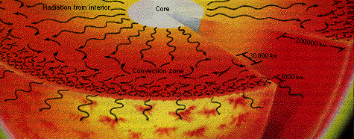
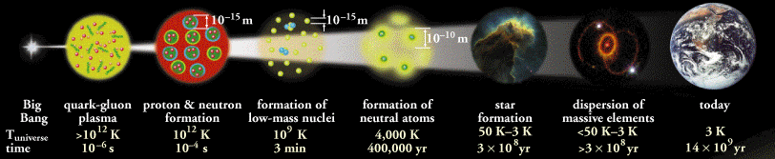
Layperson Motivation
10¹² degrees
  10⁵ times hotter than the center of the Sun
Early universe
Chaisson and McMillan,
Astronomy Today (1993)
ALICE Collaboration

Slide 3
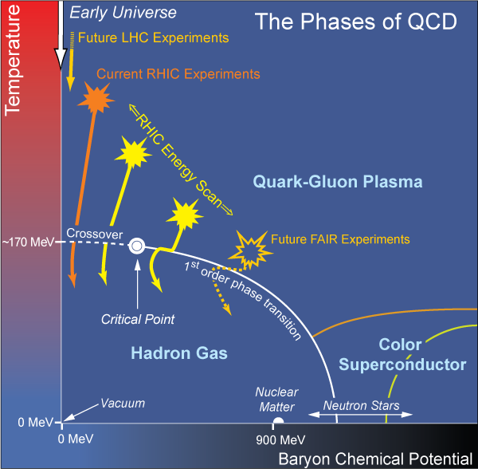
General Physicist’s Motivation
  What are the emergent, “moderate body” dynamics of non-Abelian plasma?
    Unique theory/experiment opportunity with QCD

Slide 4
Broader Appeal
Connections to:
  Particle physics
  Other strongly coupled systems
    Condensed matter
    String theory
  Other intermediate scale problems
    Condensed matter
    Weather
    …
  Mathematical physics

Slide 5
Heavy Ion Physics Motivation
Seek greater understanding of:
  Emergent scales and processes in QCD
    Confinement
    Chiral condensate
    Hadronization
    Saturation
  Dynamics in QCD
    Neither few nor many body
    Perturbative: asymptotic freedom
    Non-perturbative
    Interface of wQCD and sQCD

Slide 6
Personal Charge for the Workshop:
How can we make the connection from heavy ion experiment and theory to these fundamental questions more crisp, clear, and precise, especially through the use of heavy flavor?

Slide 7
(Some) QGP Difficulties
QGP physics is hard
  Cloud of mystery. Uncertainties from:
    Initial state
    Non-equilibrium to equilibrium (?)
    QGP dynamics
    Hadronization
    Post-hadronization, high density rescattering
Great challenges, opportunities to learn

Slide 8
Unique Heavy Quarks
True probe: not glue or light quark
  Distinguishable down to lowest momenta
    Medium/quark coupling; hydro
  Cleaner energy loss probe
Tests understanding of mass dependence
New observables
  Quarkonia: QGP thermometer
  Fluctuations: phase transition
    See P Petreczky’s talk on Fri
Keep other (non-hvy) observables in mind

Slide 9
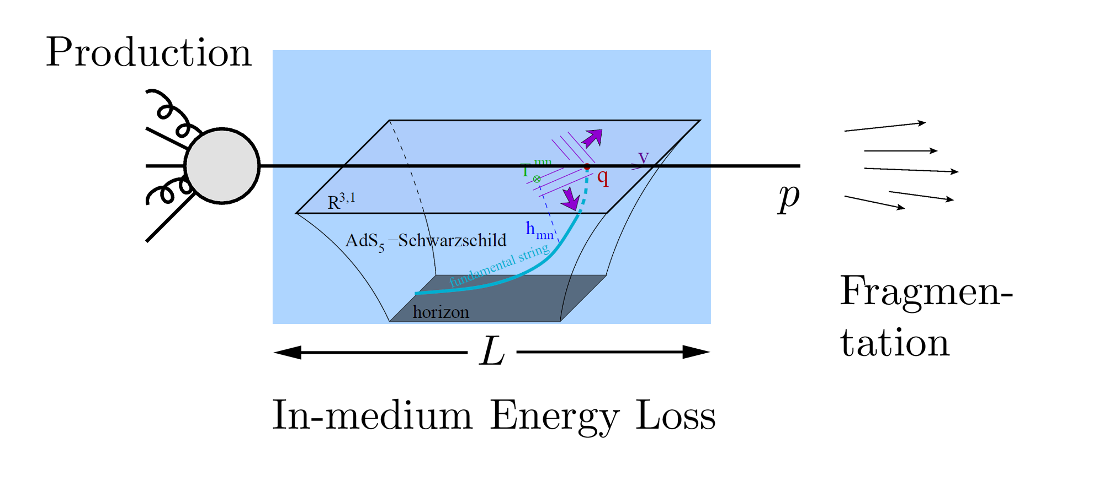
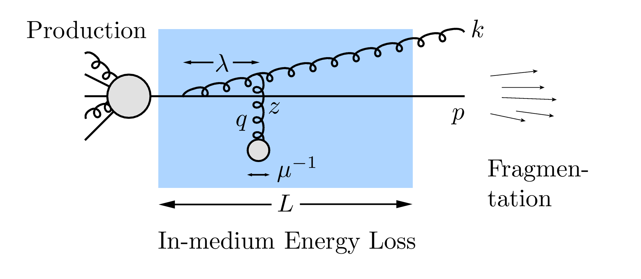
Why Energy Loss?
  Most direct probe of DOF of QGP
pQCD Picture
AdS/CFT Picture

Slide 10
Energy Loss
Valuable femtoscope
Convolution of three processes:
  Production
  In-medium energy loss
  Fragmentation
Each process affected by M_{Q}
  Wish to quantitatively understand M_{Q} dependence in a unified theoretical framework

Slide 11
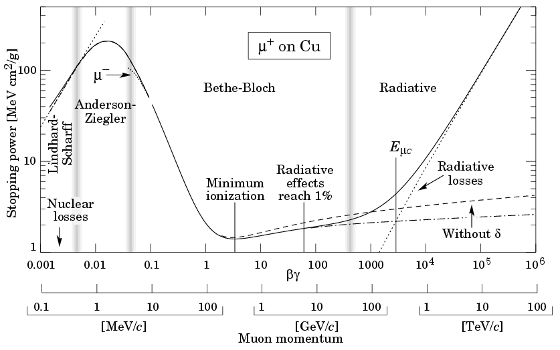
Learn About QGP from Energy Loss
Cf Bethe-Bloch

Slide 12
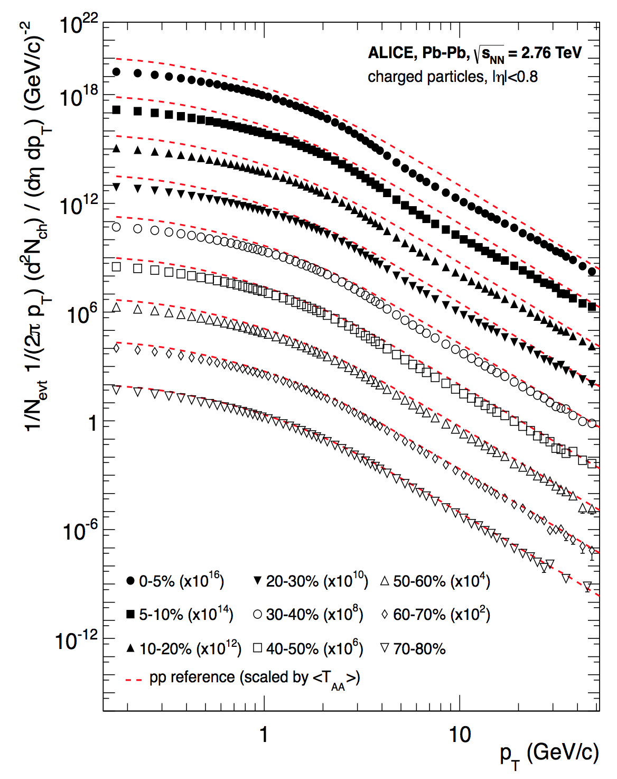
From Attenuation Pattern
one can learn from:
  Leading particle suppression, as a fcn of angle and p_{T}
  Two or more particle correlations
  Jet measurements
    Suppression and v₂
    Dijet asymmetry
  …
ALICE, PLB720 (2013) 52-62

Slide 13
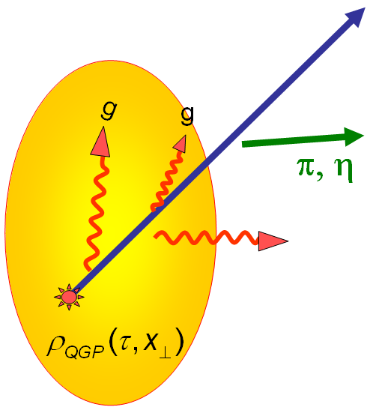
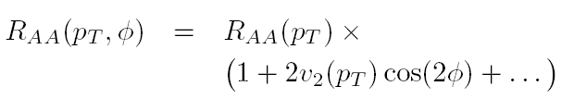

High-p_{T} Observables
    Naïvely: if medium has no effect, then R_{AA} = 1
    Common variables used are transverse momentum, p_{T}, and angle with respect to the reaction plane, φ
p_{T}
    Fourier expand R_{AA}:
φ

Slide 14
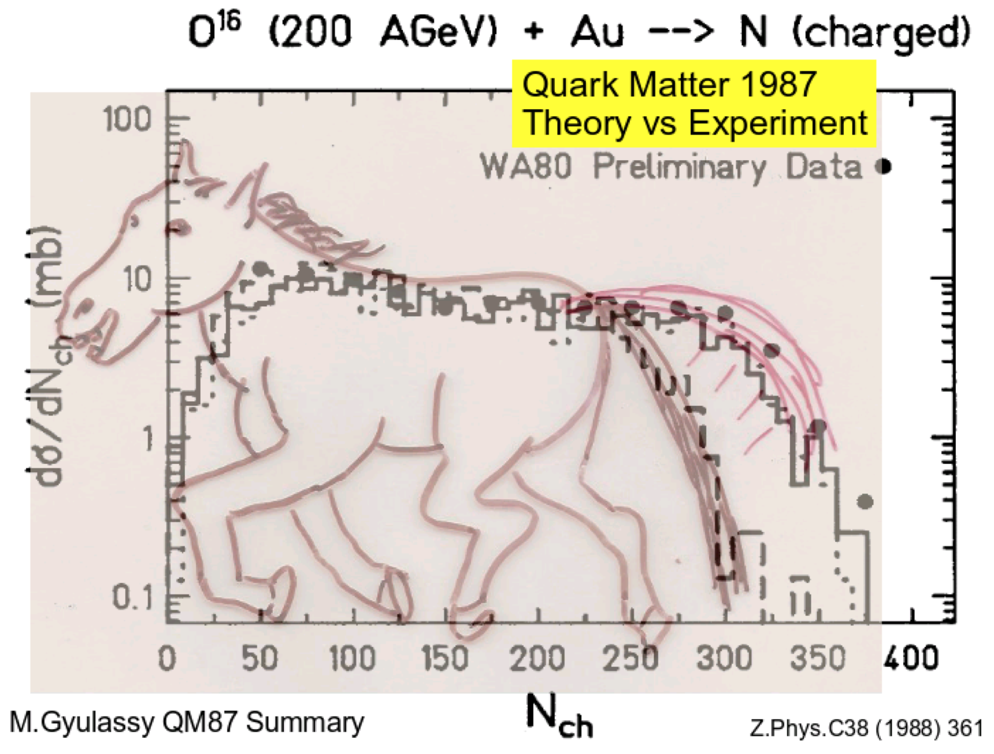
Beware of Parameterizing Ignorance
There are not useful comparisons to data

Slide 15
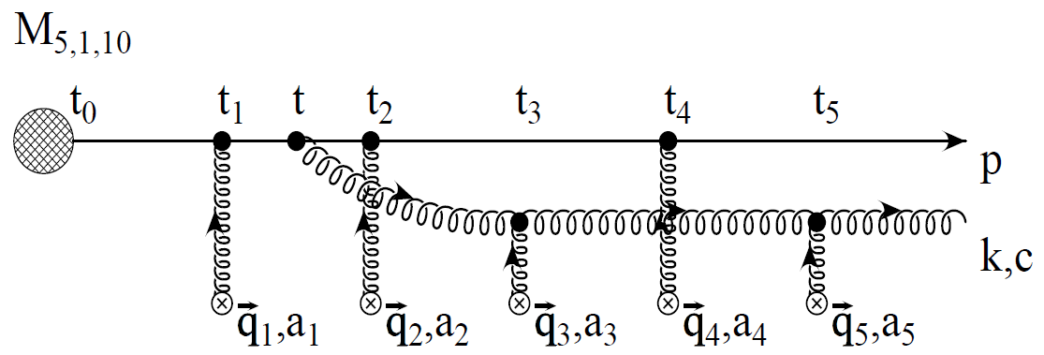
pQCD Rad Picture
Bremsstrahlung Radiation
  Weakly-coupled plasma
    Medium organizes into Debye-screened centers
  T ~ 250 MeV, g ~ 2
    μ ~ gT ~ 0.5 GeV
    λ_{mfp} ~ 1/g²T ~ 1 fm
    R_{Au} ~ 6 fm
  1/μ << λ_{mfp} << L
    mult. coh. em.
Gyulassy, Levai, and Vitev, NPB571 (2000)
  LPM
    dp_{T}/dt ~ -LT³ log(p_{T}/M_{q})
  Bethe-Heitler
    dp_{T}/dt ~ -(T³/M_{q}²) p_{T}

Slide 16
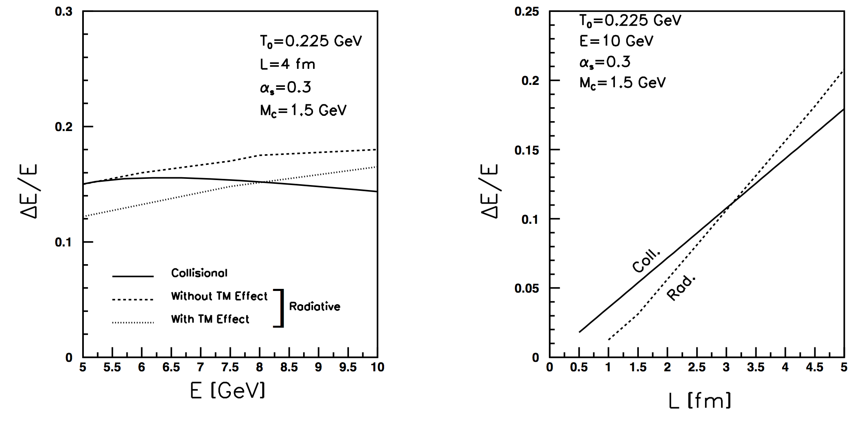
pQCD Coll Picture
M Mustafa, PRC72 (2005) 014905
Elastic E-loss:
dp_{T}/dt ~ -T² log(p_{T}/M_{Q})

Slide 17
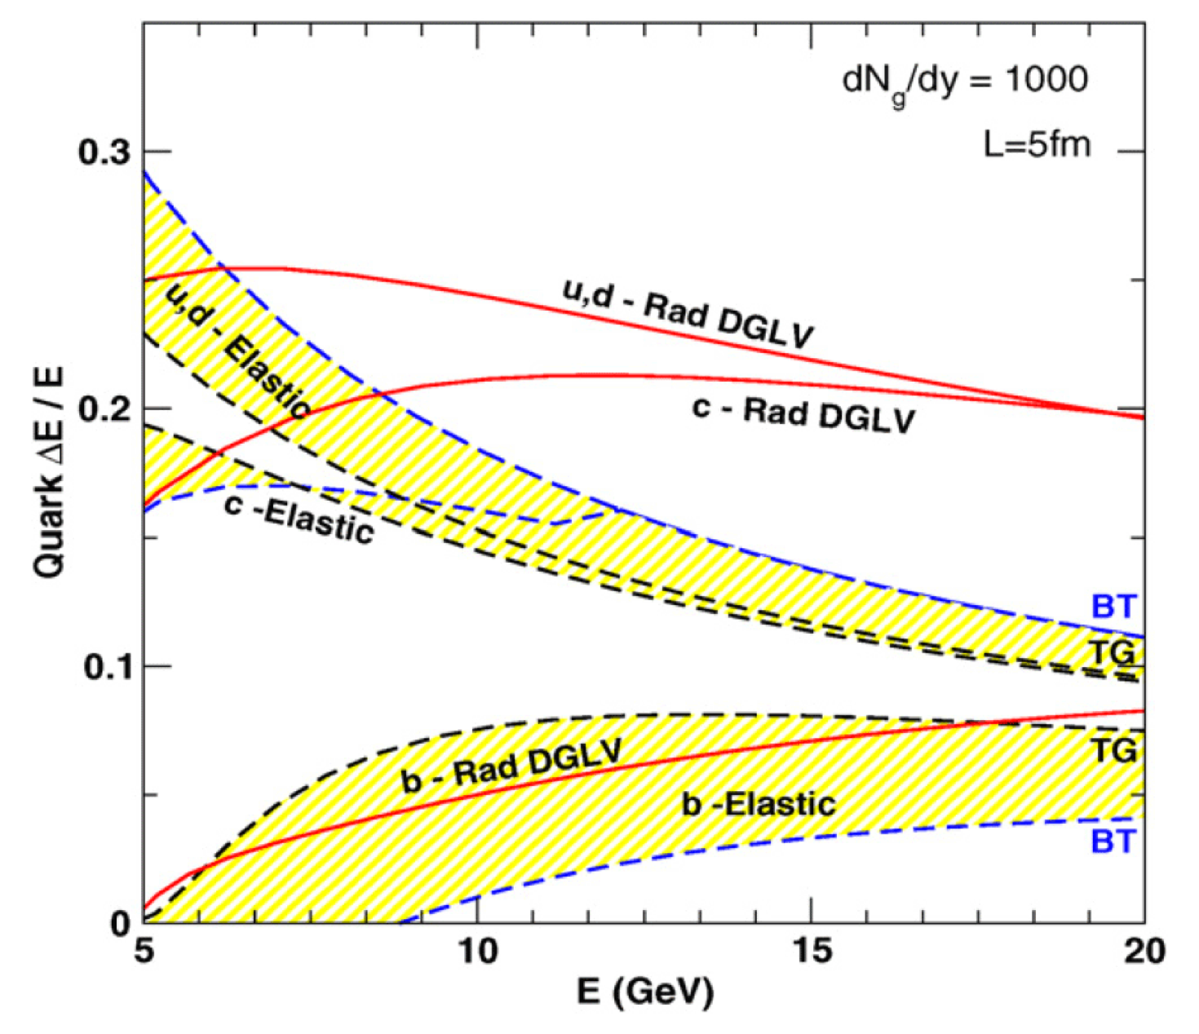
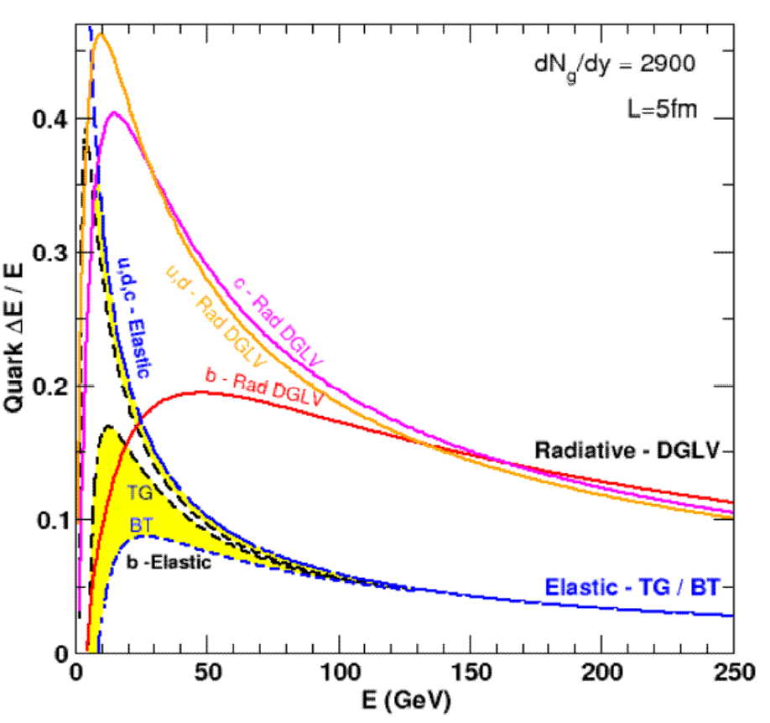
Results
Naively from QED, ΔE_{el} << ΔE_{rad} as E➞∞
RHIC
LHC
WAH, PhD Thesis, arXiv:1011.4316
Finite RHIC/LHC kinematics: both radiative and collisional energy loss processes are important for p_{T} ~ 5 GeV/c and higher

Slide 18
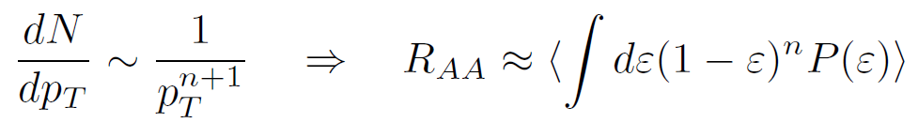
Qualitative Expectations for HF
Energy loss decreases with M_{Q}
  ΔE_{b} < ΔE_{c} < ΔE_{u,d} < ΔE_{g}
    For experts: not always true for pQCD
    (τ_{form} decreases with M_{Q})
DOES NOT IMPLY R_{AA} ORDERING
  For approx. power law production and energy loss probability P(ε), ε = (E_{i} - E_{f})/E_{i}
  Larger n => smaller R_{AA} for same energy loss

Slide 19
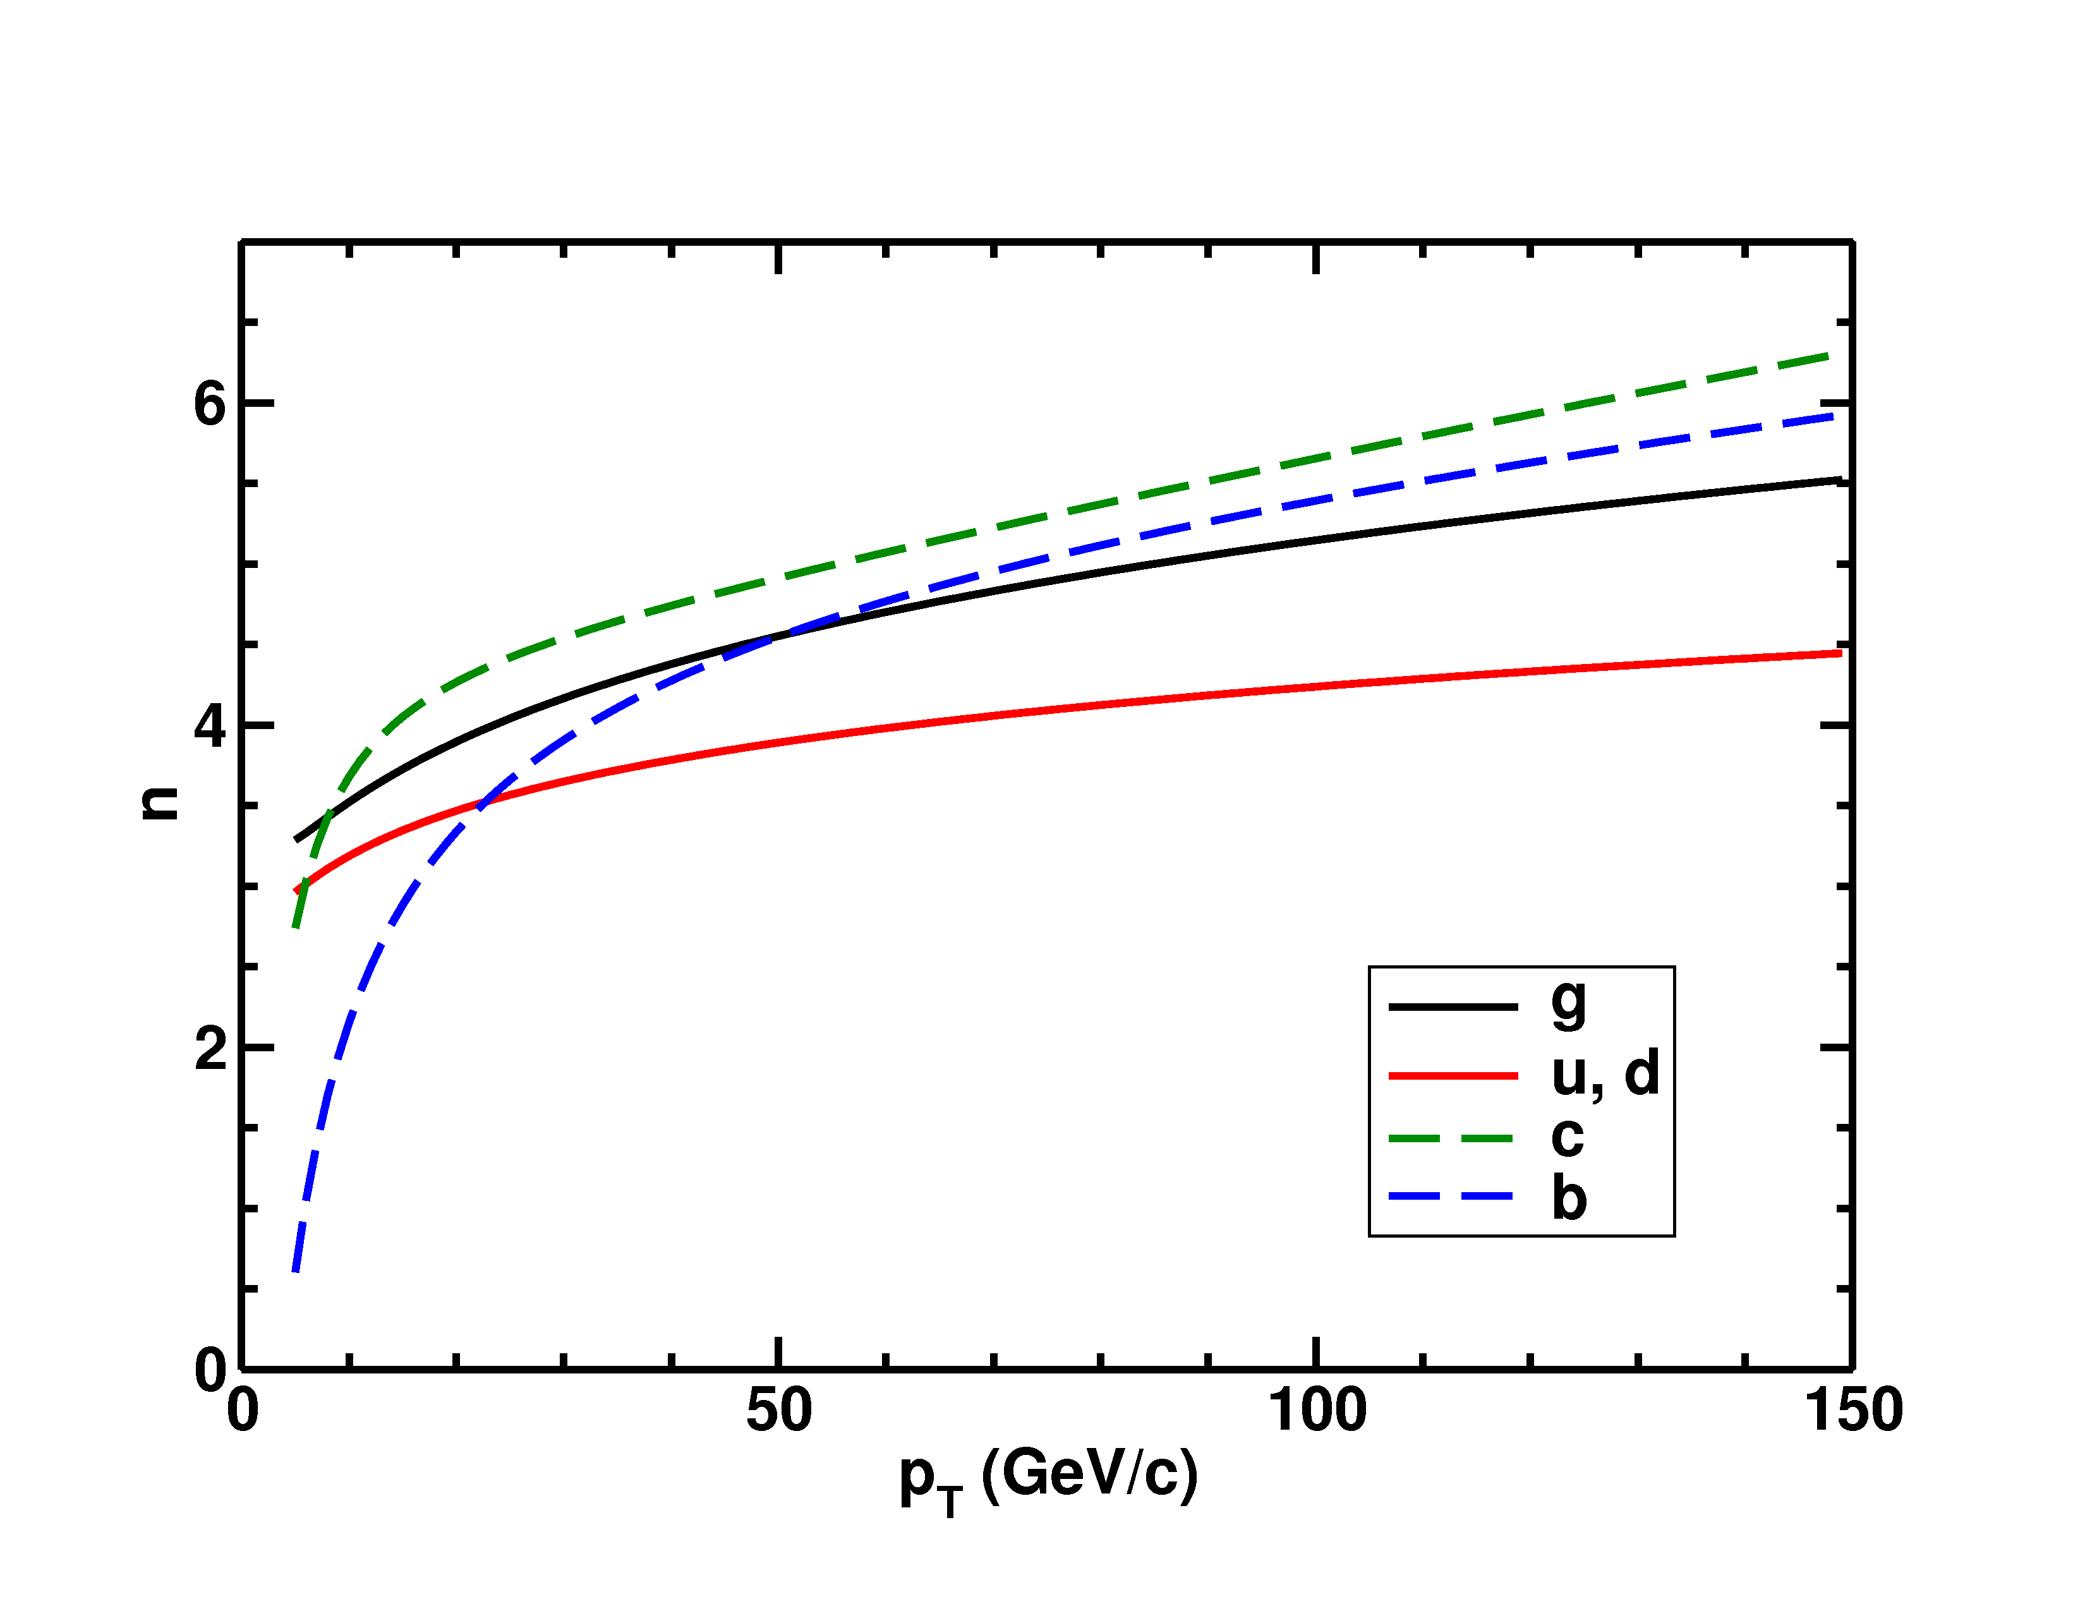
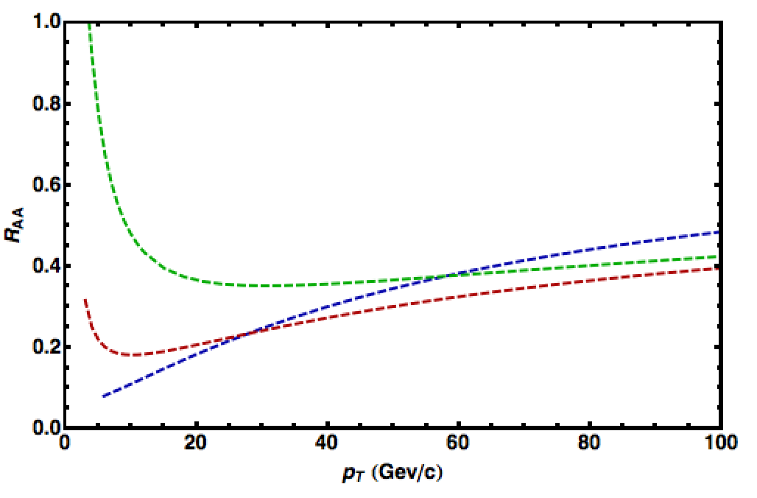
Importance of Production
HQ production spectra softer than lights
  => Nontrivial ordering of R_{AA}(p_{T})
√s = 2.76 TeV
LHC
0-20%
π⁰ WHDG
D WHDG
B WHDG

Slide 20
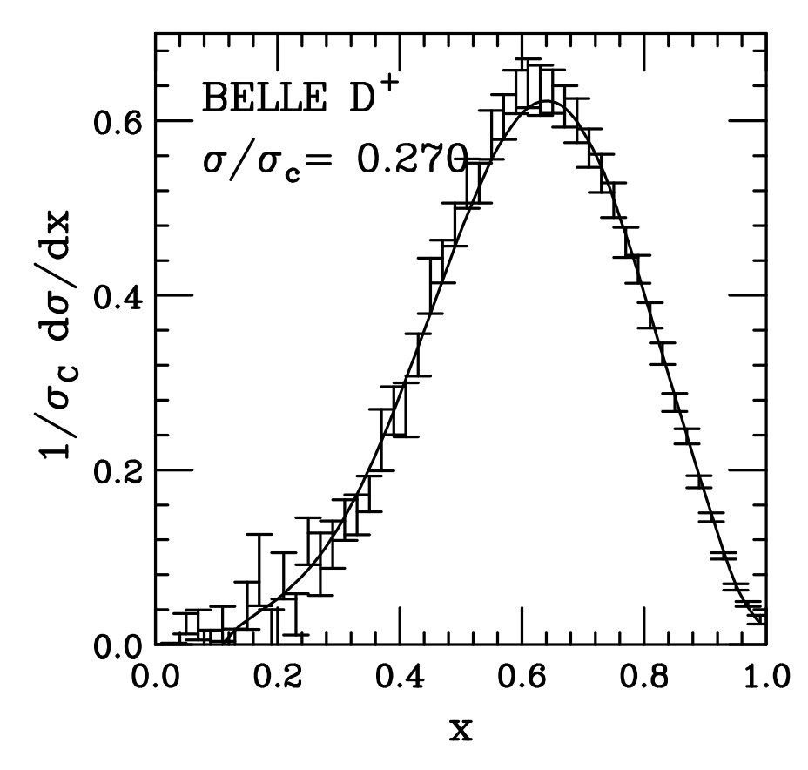
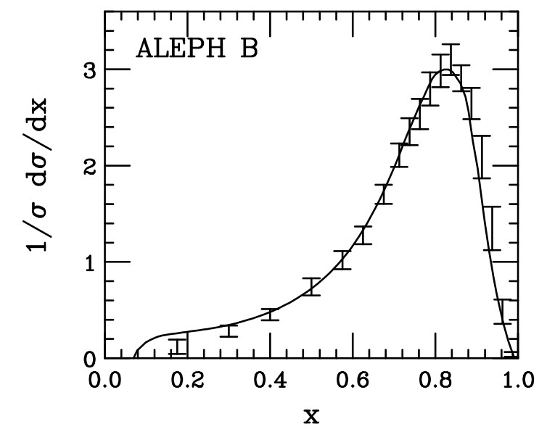
HF FFs
Measured independently from, e.g., e+e-
  Universal
Cacciari, Nason, Oleari, JHEP 0604 (2006) 006

Slide 21
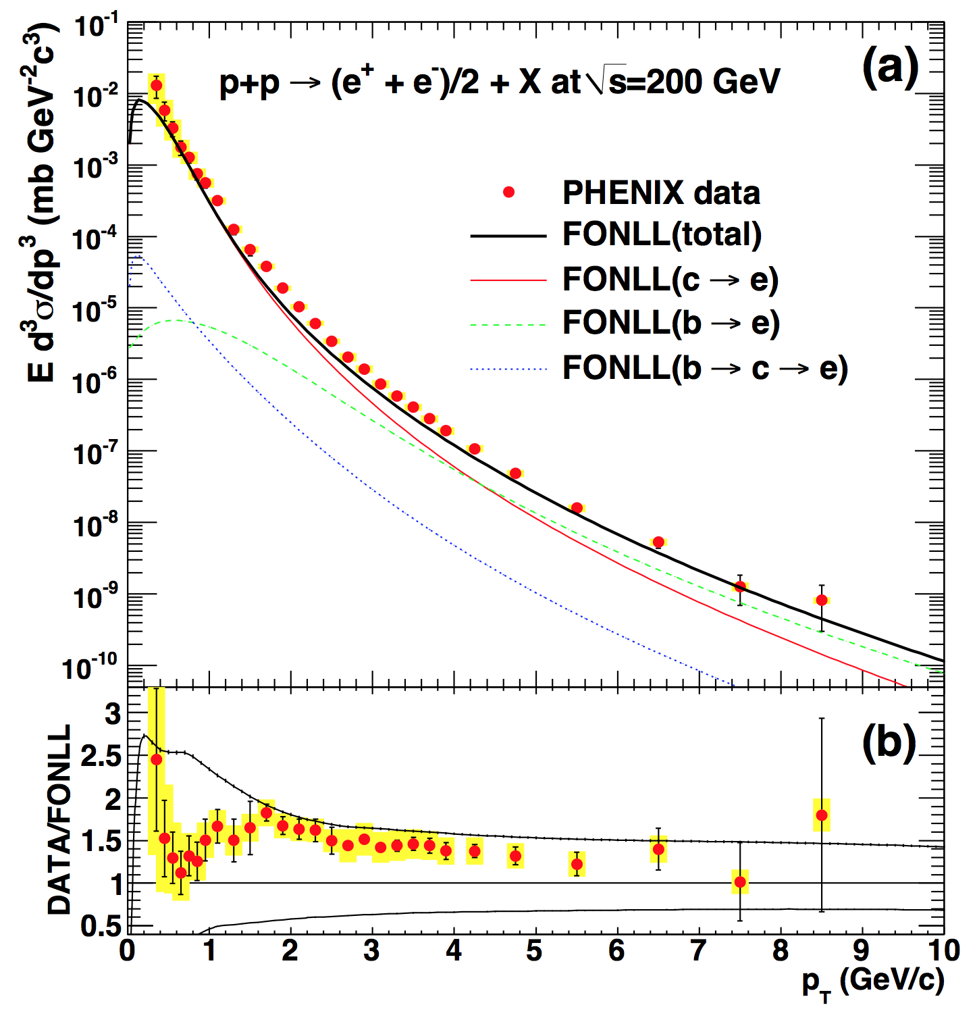
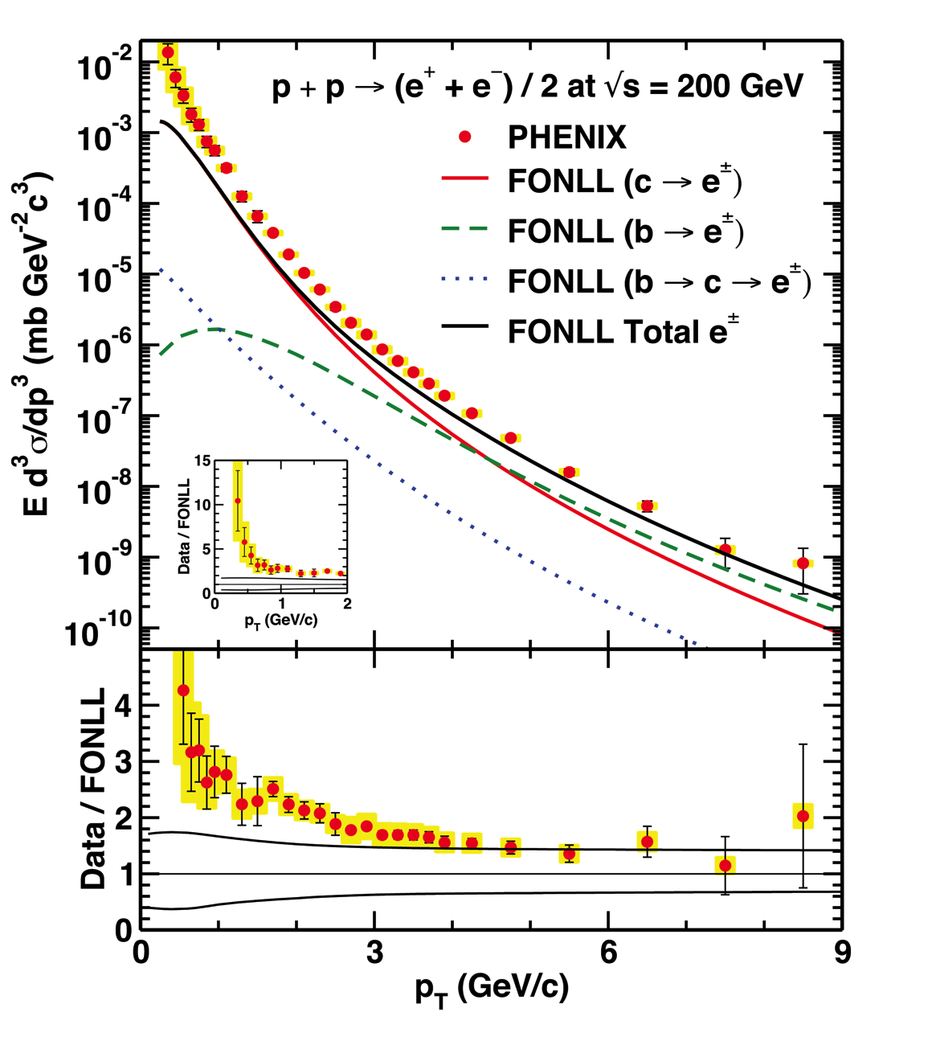
HF FFs and pp Baseline
c,b => D, B; D, B => e⁻ break down at low-p_{T}
PHENIX PRC84 (2011) 044905
WAH, PRD91 [1501.04693]

Slide 22
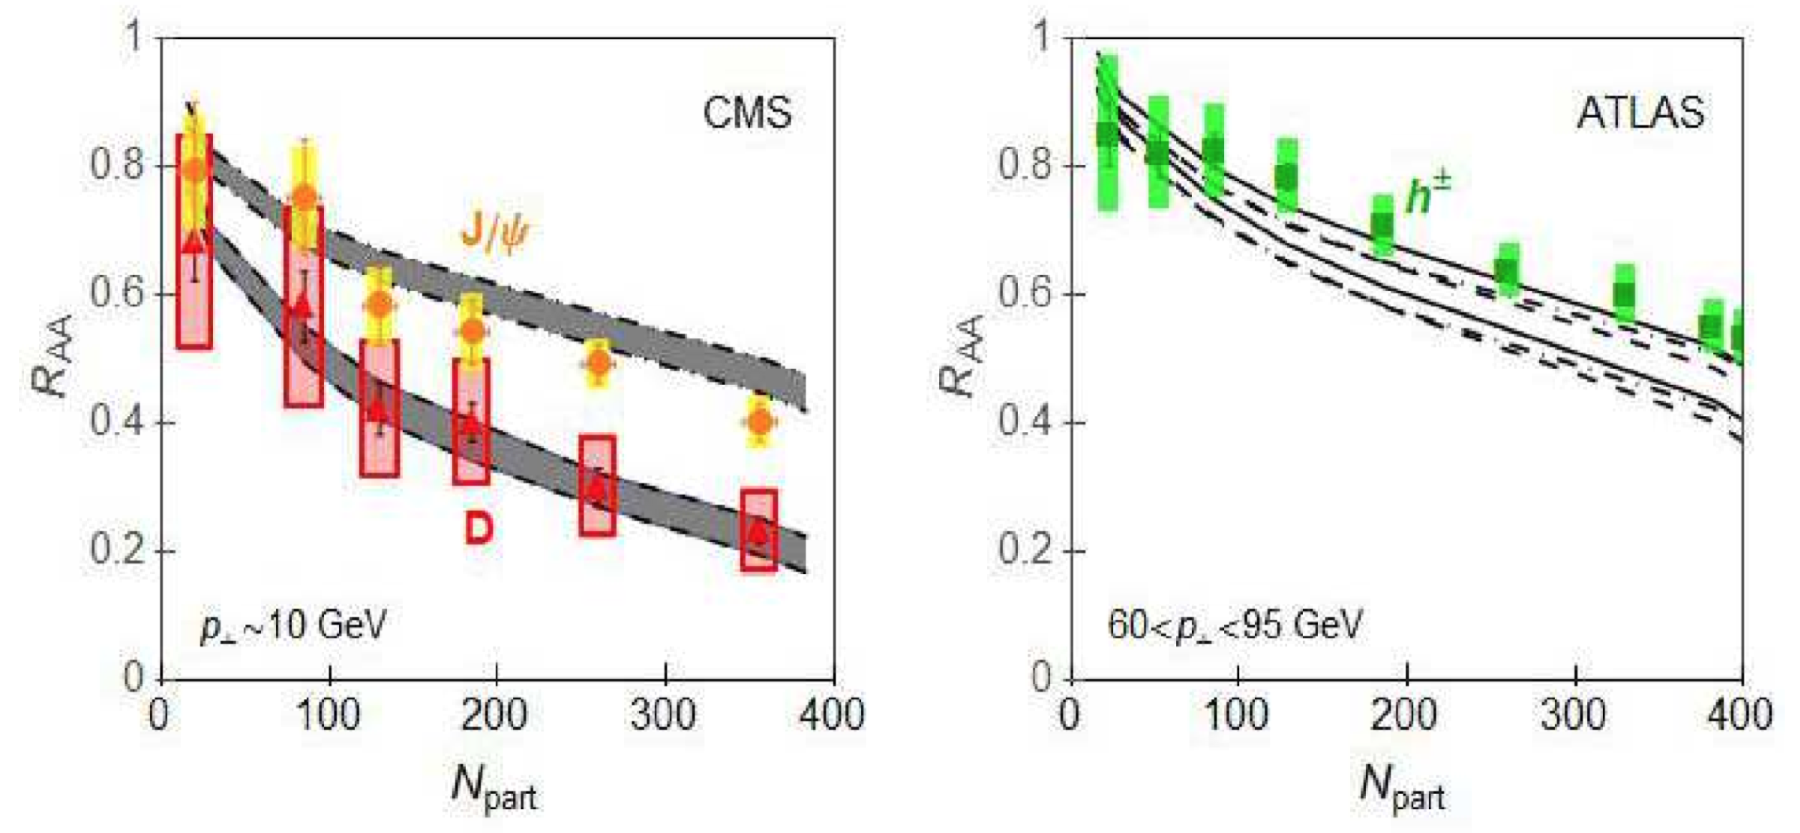
Example Theory/Exp Comparison
Djordjevic, Blagojevic, Zivkovic, arXiv:1601.07852

Slide 23
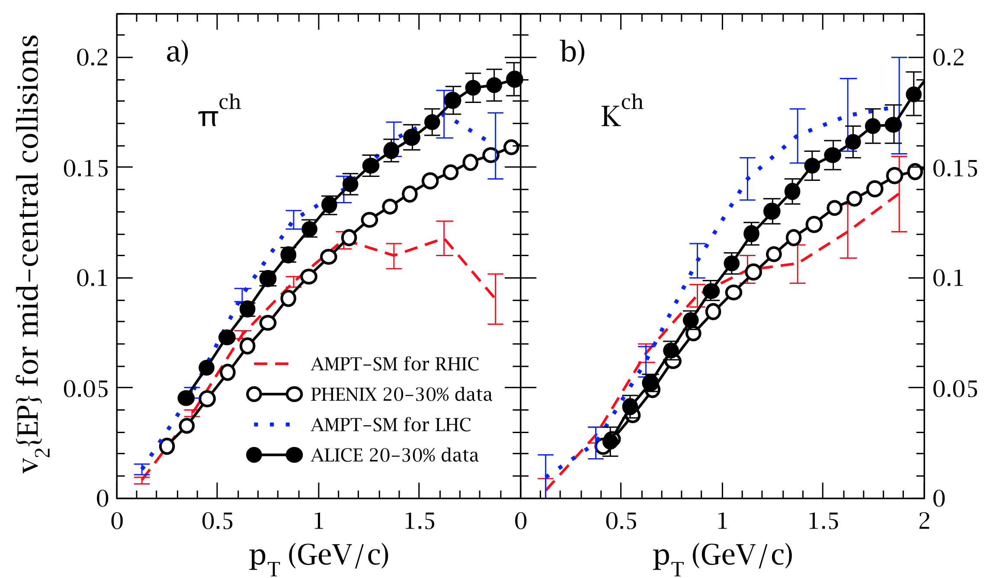
Complete Picture?
What about, e.g., low-p_{T} flow?
  Strongly coupled?
    Partonic transport with pQCD x-scns describe data
Z Lin, AMPT, Gyulassyfest 2015

Slide 24
Much Work Needed!
Must remove many simplifying approximations:
  Eikonal
  Collinear
  Large formation time
  …
Go beyond LO
  Determine relevant scale(s), applicability of pQCD theory

Slide 25
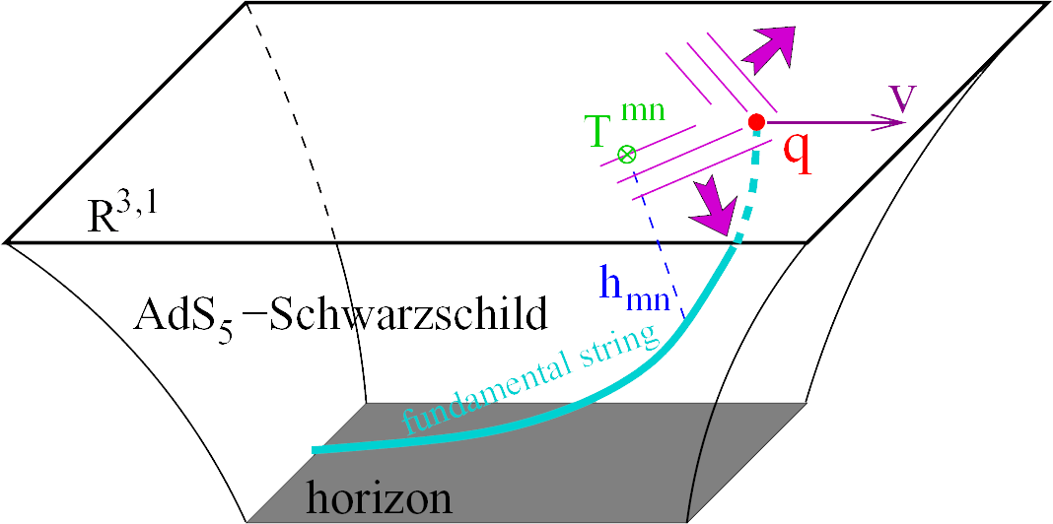
A More Traditional Approach?
Assume medium is strongly coupled
Apply AdS/CFT
conjecture
  η/s = 1/4π
Model heavy quark jet energy loss by embed-ding string in AdS space
  dp_{T}/dt = - μ p_{T}
  μ = πλ^{1/2} T²/2M_{q}
J Friess, S Gubser, G Michalogiorgakis, S Pufu, Phys Rev D75 (2007)
  Similar to Bethe-Heitler
    dp_{T}/dt ~ -(T³/M_{q}²) p_{T}
  Very different from LPM
    dp_{T}/dt ~ -LT³ log(p_{T}/M_{q})

Slide 26
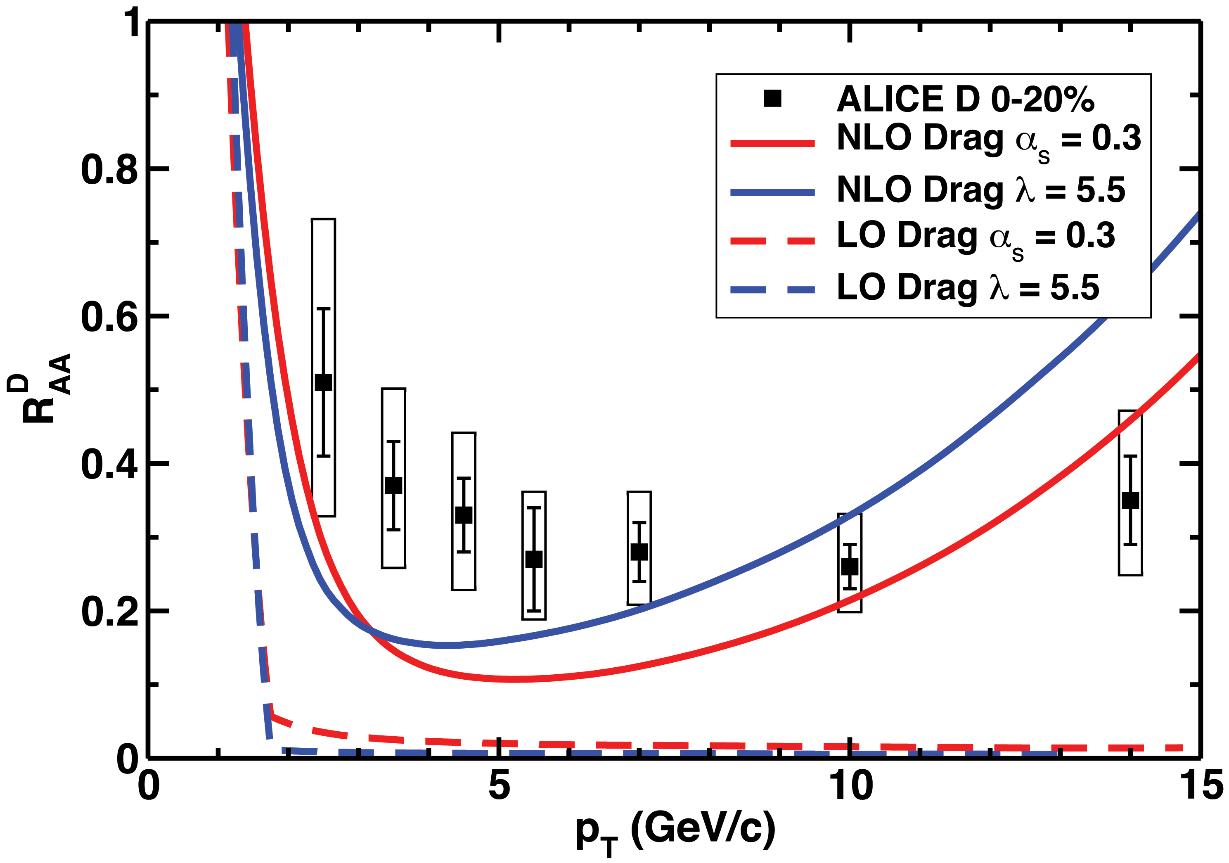
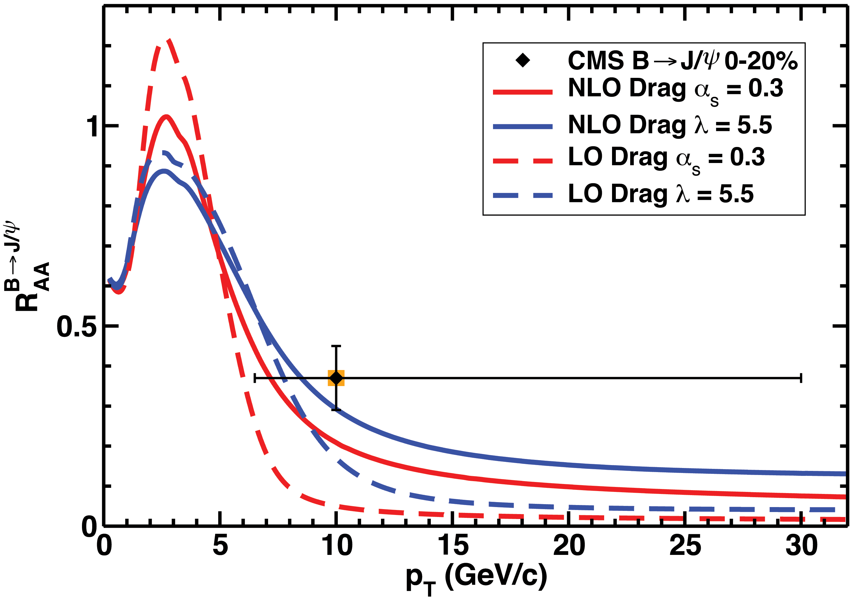
NLO Strong Coupling
Include fluctuations in energy loss
  Details on Fri
WAH, PRD91 [1501.04693]

Slide 27
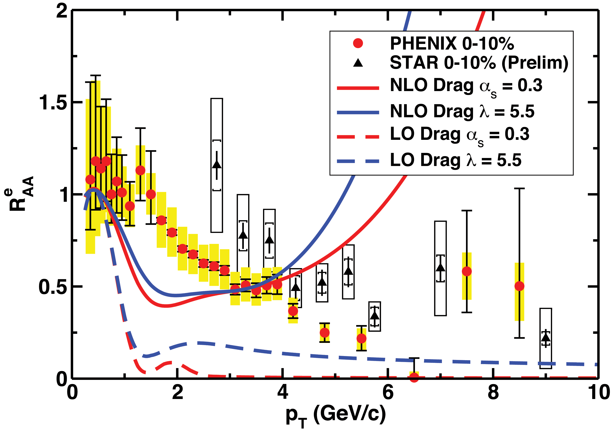
Where’s the Lepton Bump?
Generically theoretically c => e crossover domination cf b => e is abrupt
  Where’s the hump in the data?
WAH, PRD91 [1501.04693]

Slide 28
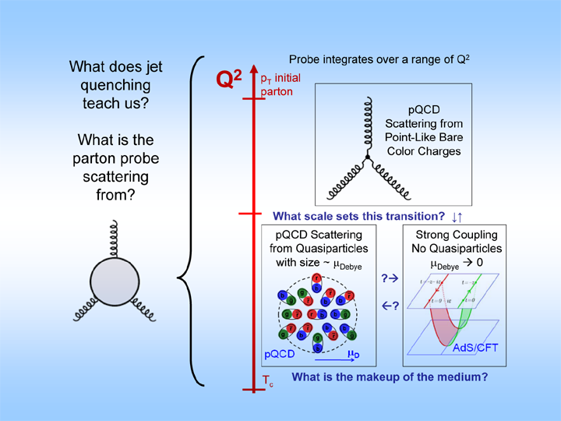

Hybrid Energy Loss?
Probe
Medium
Medium

Slide 29
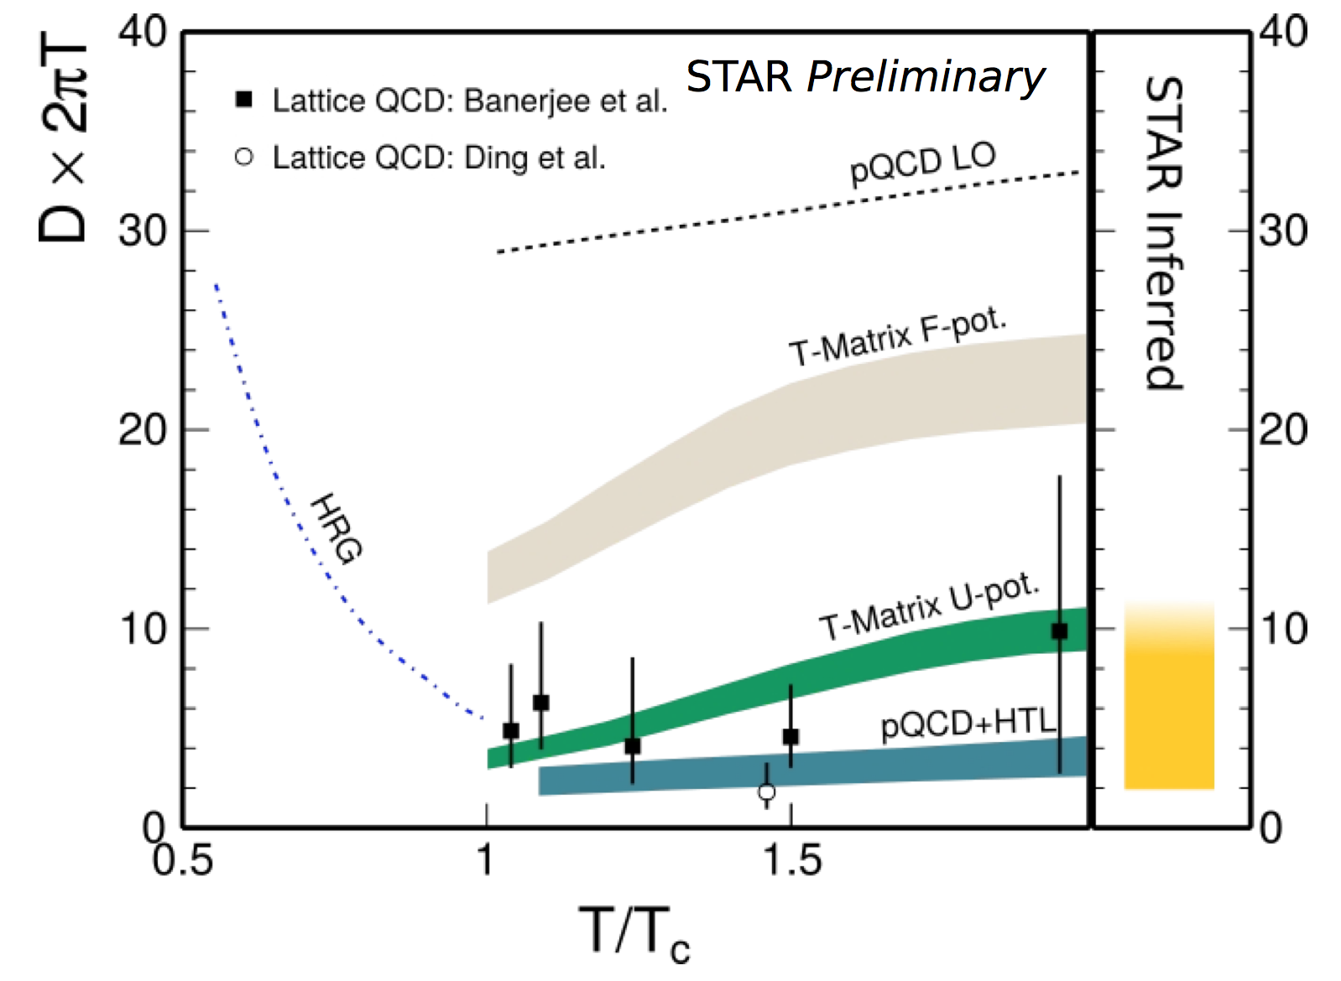
Energy Loss Connection to Lattice?
Langevin approximation of low-p_{T} HF
  Neglect rad in pQCD?
AdS/CFT
M Mustafa, QM15

Slide 30
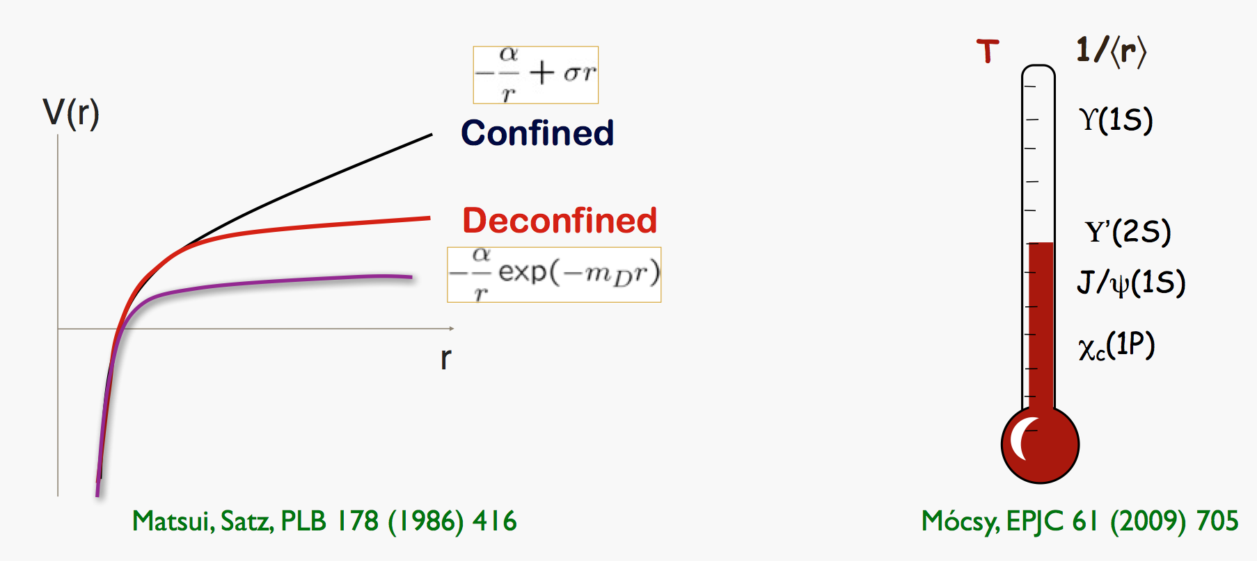
Quarkonia in HIC
Insight into non-perturbative QGP effects and T_{plasma}
Mócsy, HP2013

Slide 31
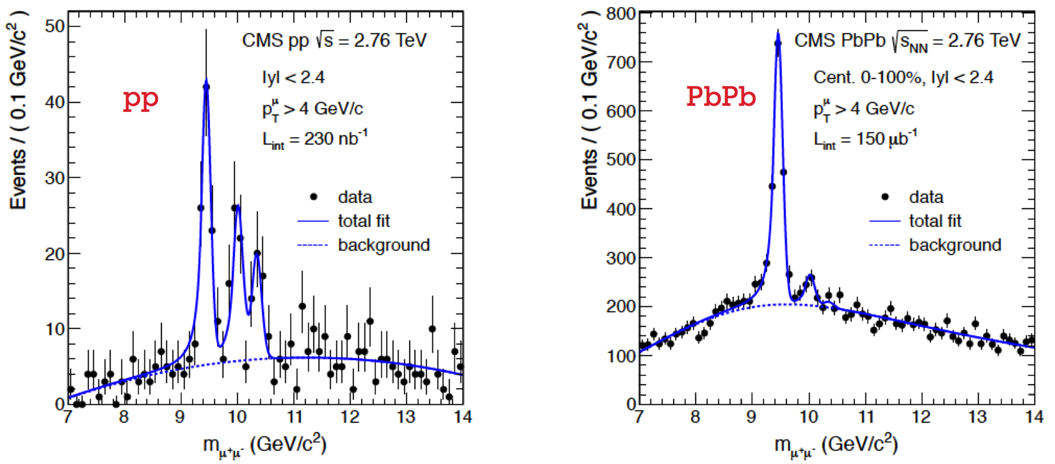
Sequential Melting Observed
CMS PRL 109 (2012) 222301
  See M Strickland on Thurs for more on bottomonia

Slide 32
Quantitative Quarkonia
Requires theoretical control over:
  Initial production mechanism
    Numerous proposals
  Final state effects (e.g. regeneration, feeddown, energy loss)
    Smaller for bottomonium
Translation from non-pert. potential to predictions
  Direct connection to lattice?

Slide 33
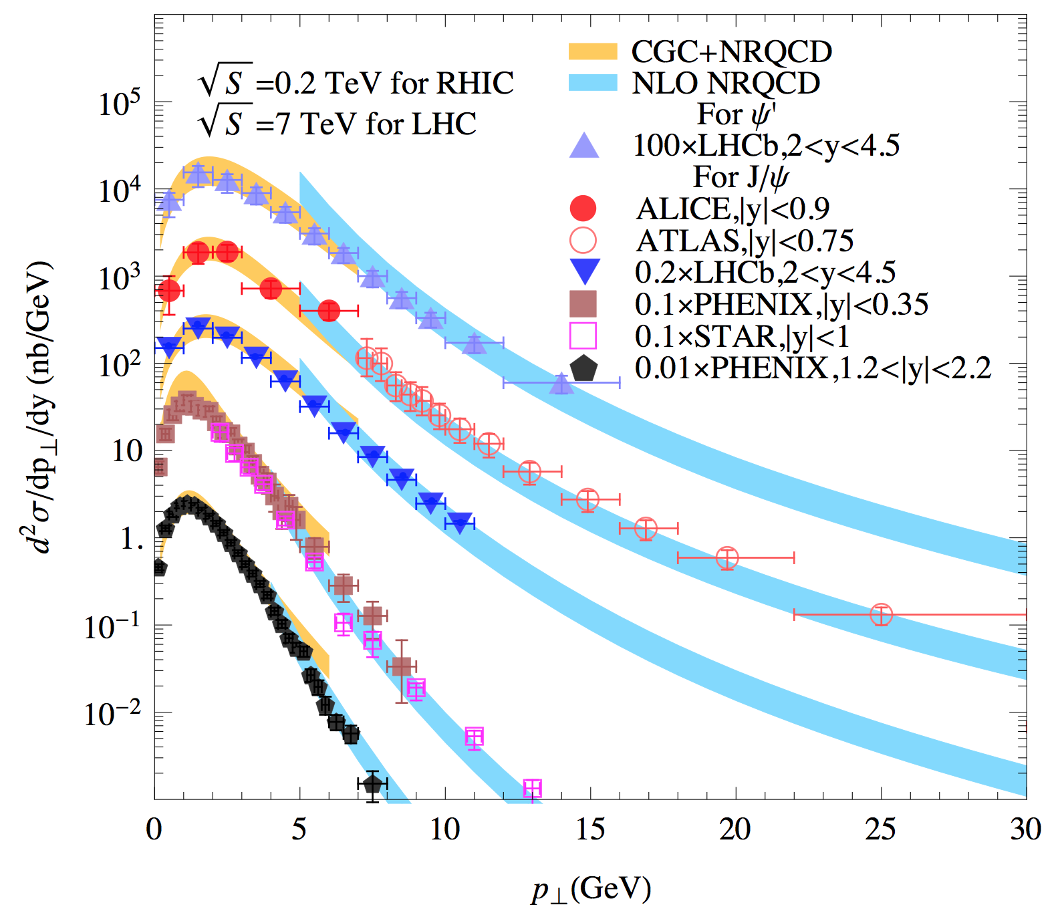
Quarkonia Production
Baseline for thermometer
Probe of saturation
  See also ultraperipheral collisions, EVMP
See also R Sharma’s talk on Thurs
Note power of LHCb
J/Ψ and Ψ ’
production
spectra
Ma and Venugopalan,
PRL 2014

Slide 34
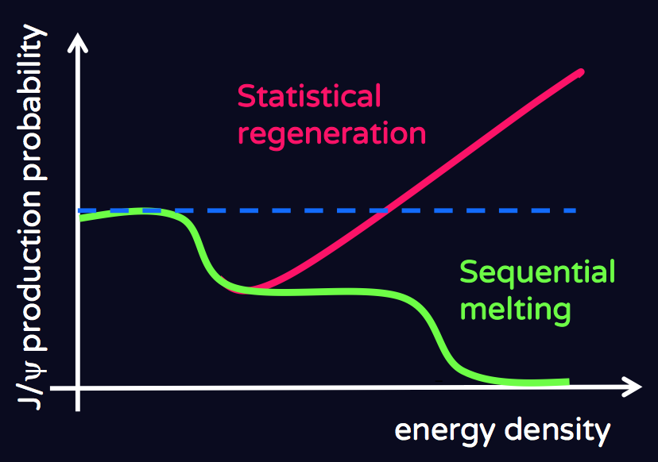
Competing Final State Effects
Suppression from melting
Enhancement from regeneration
R Arnaldi, QM15

Slide 35
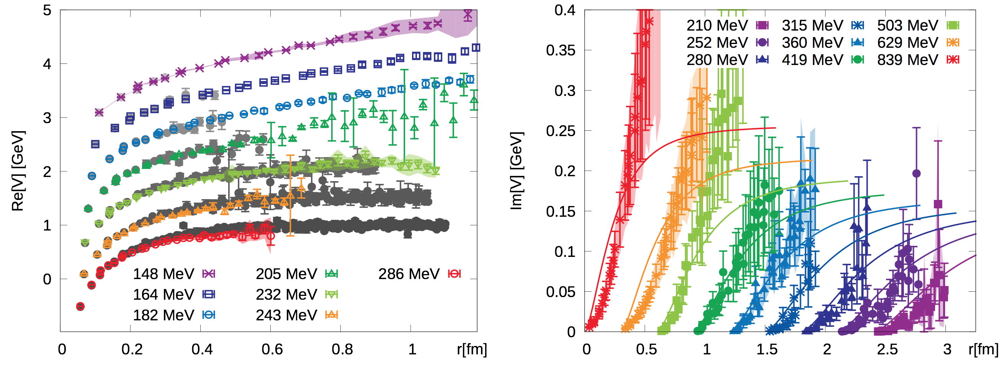
Heavy Quark Potential from Lattice
Connect to experiment via non-relativistic, t-dep Schrödinger Equation
A Francis, QM15

Slide 36
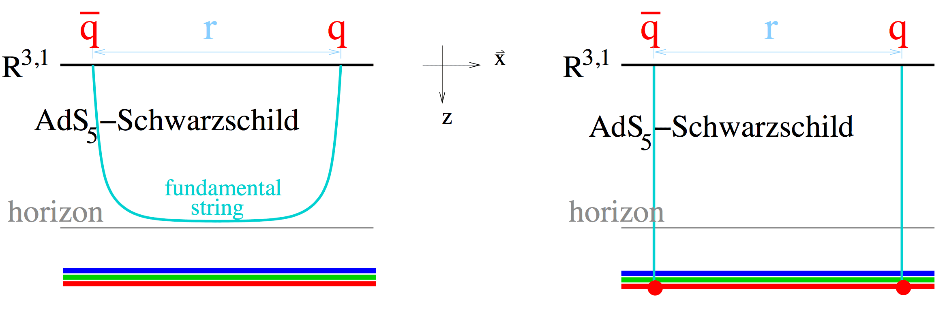
Onia in AdS/CFT
Represent onium as hanging string
  Pulled far enough apart, string (onium) breaks into two open heavy quarks
    See also S Chakraborty on Fri
Gubser, QM09

Slide 37
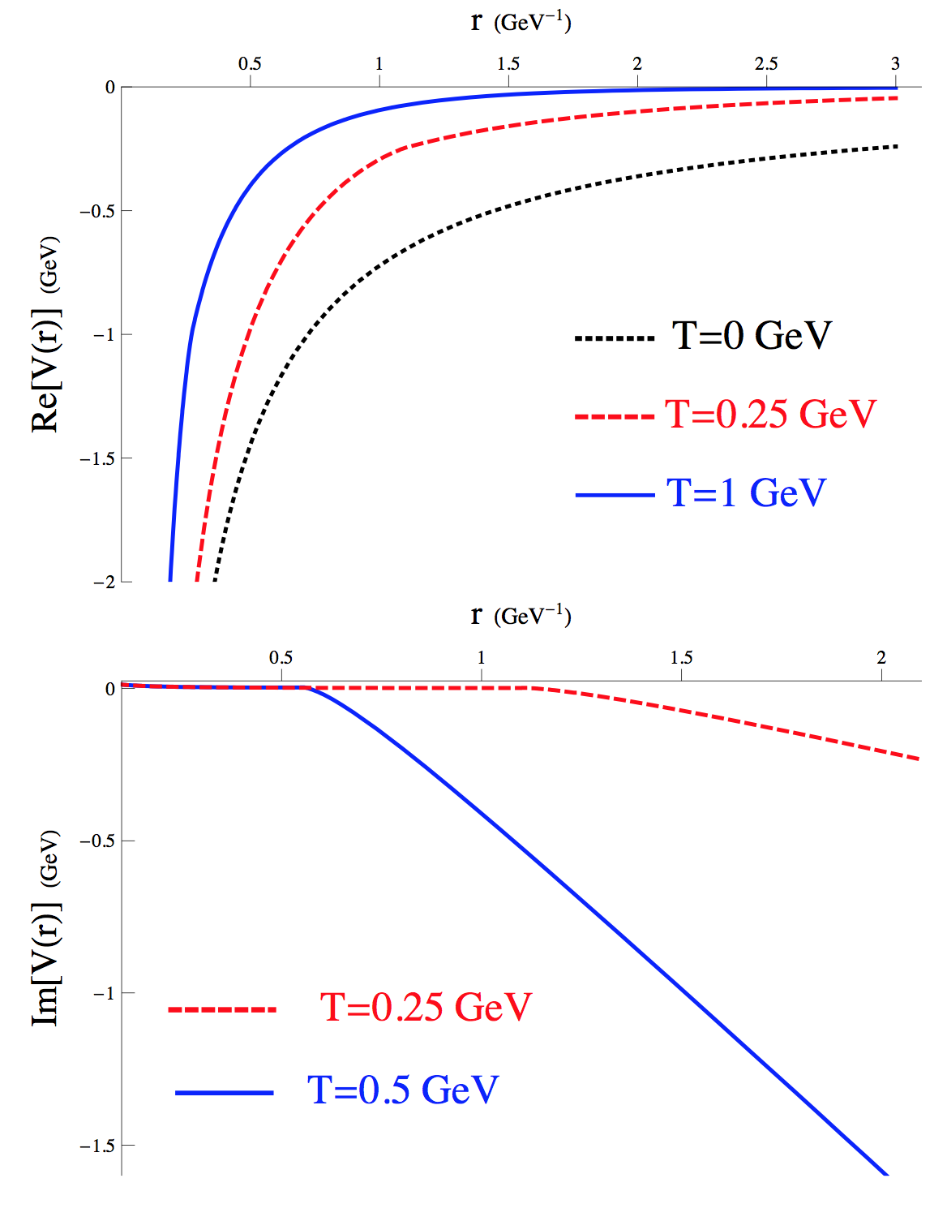
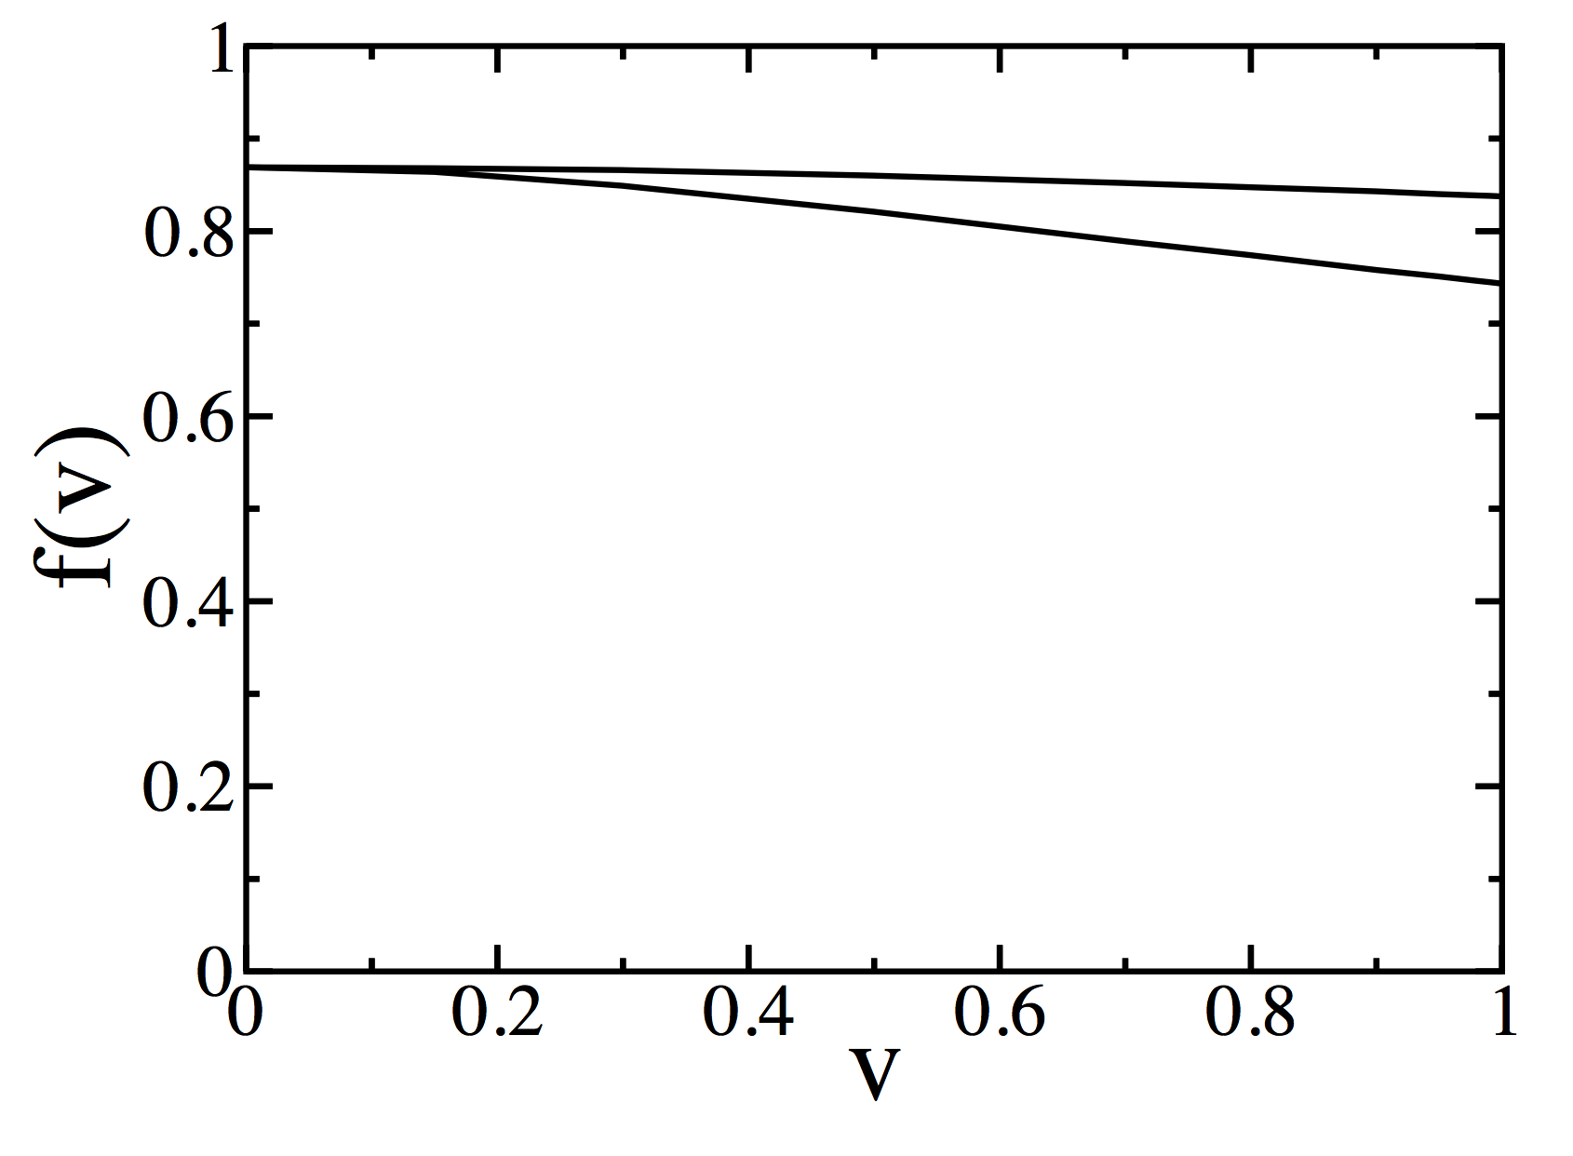
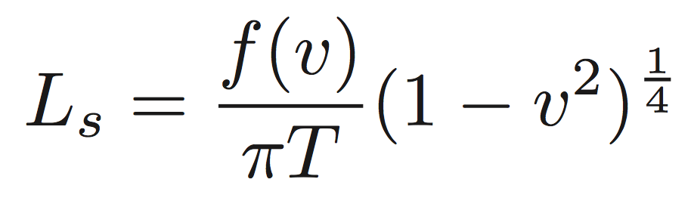
Heavy Quark Potential in AdS/CFT
Relate Polyakov loop to potential
Can study real time dynamics
  E.g. scattering length as a function of velocity
Albacete, Kovchegov, and Taliotis,
PRD 2008
Liu, Rajagopal, and Wiedemann, PRL 2007

Slide 38
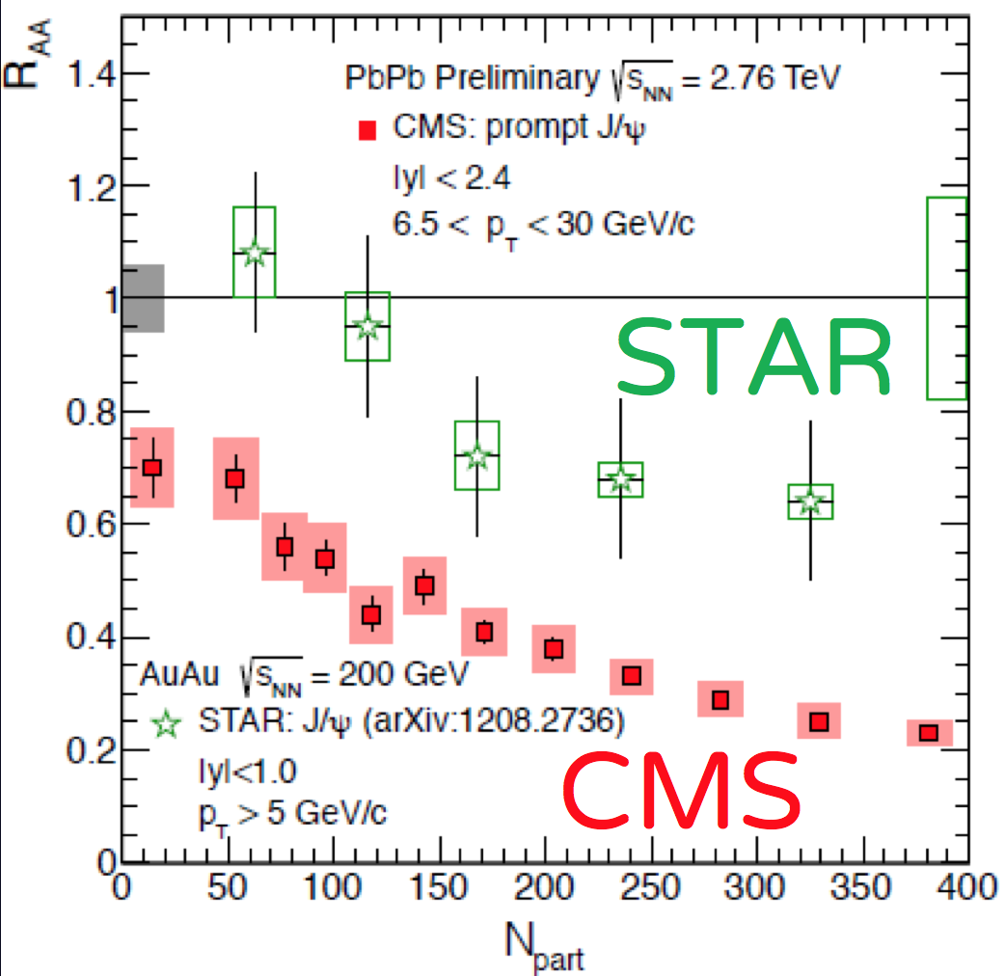
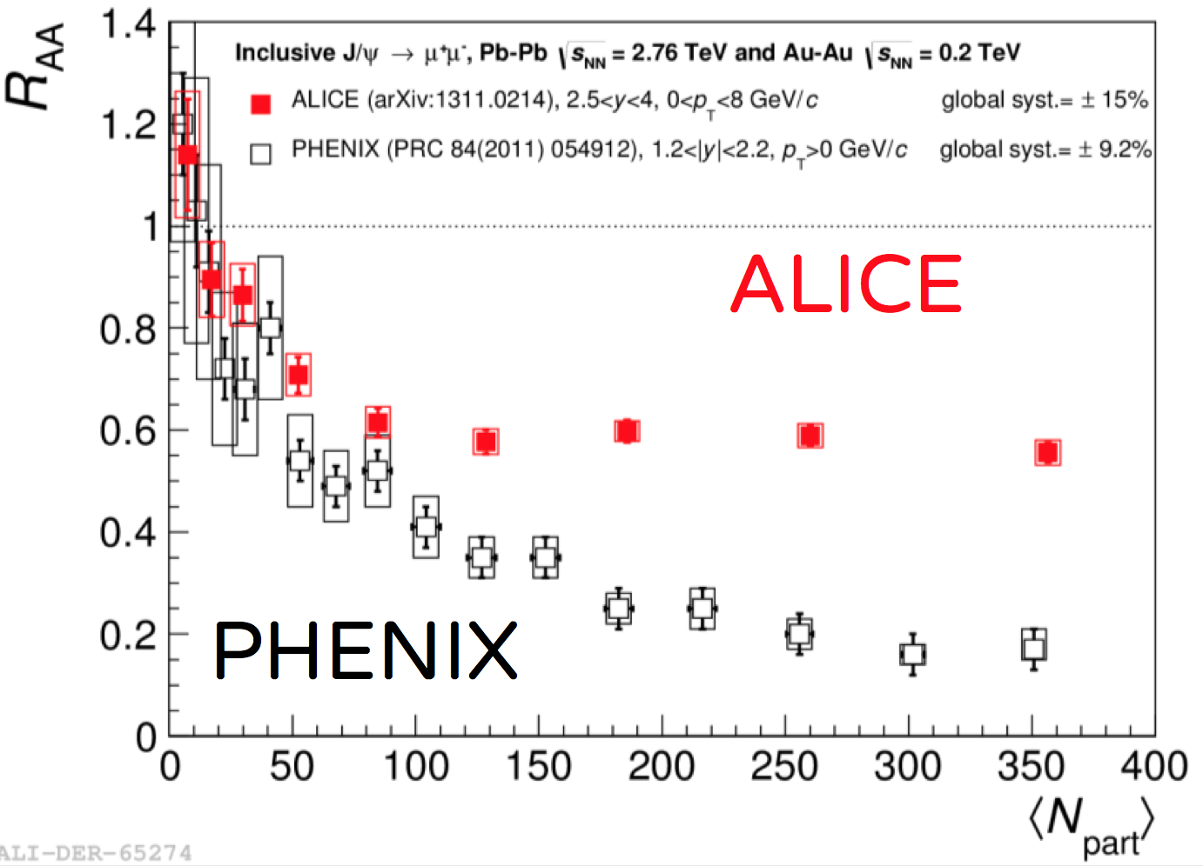
Quarkonia R_{AA}
  See many talks on Thurs:
    Sharma, Bagchi, Singh, Bhatt

Slide 39
Machines in the Future
LHC
  Higher statistics, higher √s
    Rarer probes
    More differential probes
    Multi-particle correlations of rare probes
RHIC
  Jets, upsilons
    Investigate temperature and scale dependence
FAIR
  High baryon density
EIC
  Final state (FS) cold nuclear matter effects
  Initial state (IS) saturation effects

Slide 40
Many Interesting Research Paths
Understand current experimental data
  Especially high multiplicity pp, pA, and the transition to AA
    Ex: short path length energy loss
Take advantage of future machine capabilities, esp luminosity
    Ex: heavy flavor correlations
    Photon-heavy flavor correlations
      Back-to-back for p_{T} constraint; near-side for γ-brem
    Ultraperipheral events
    Top quarks?

Slide 41
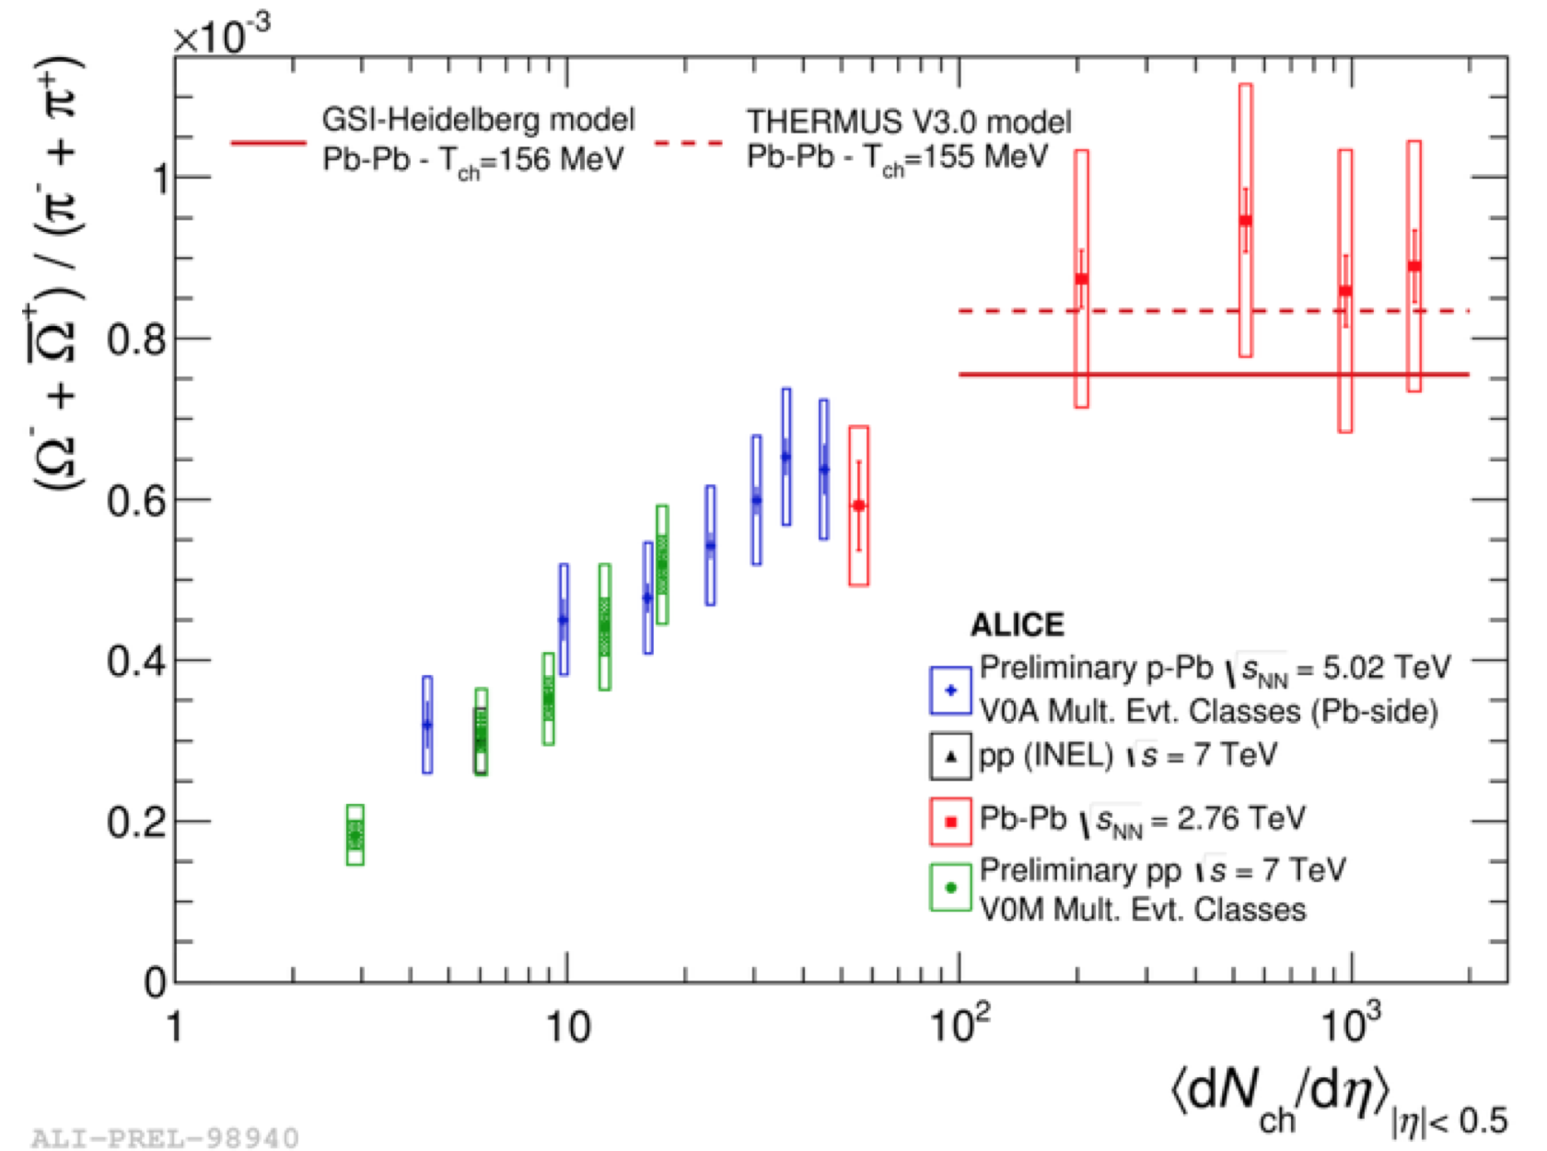
Future Challenges
Understand theoretically smooth transition from pp to pA to AA
Barnby, CERN LHC Seminar 10 Nov 2015

Slide 42
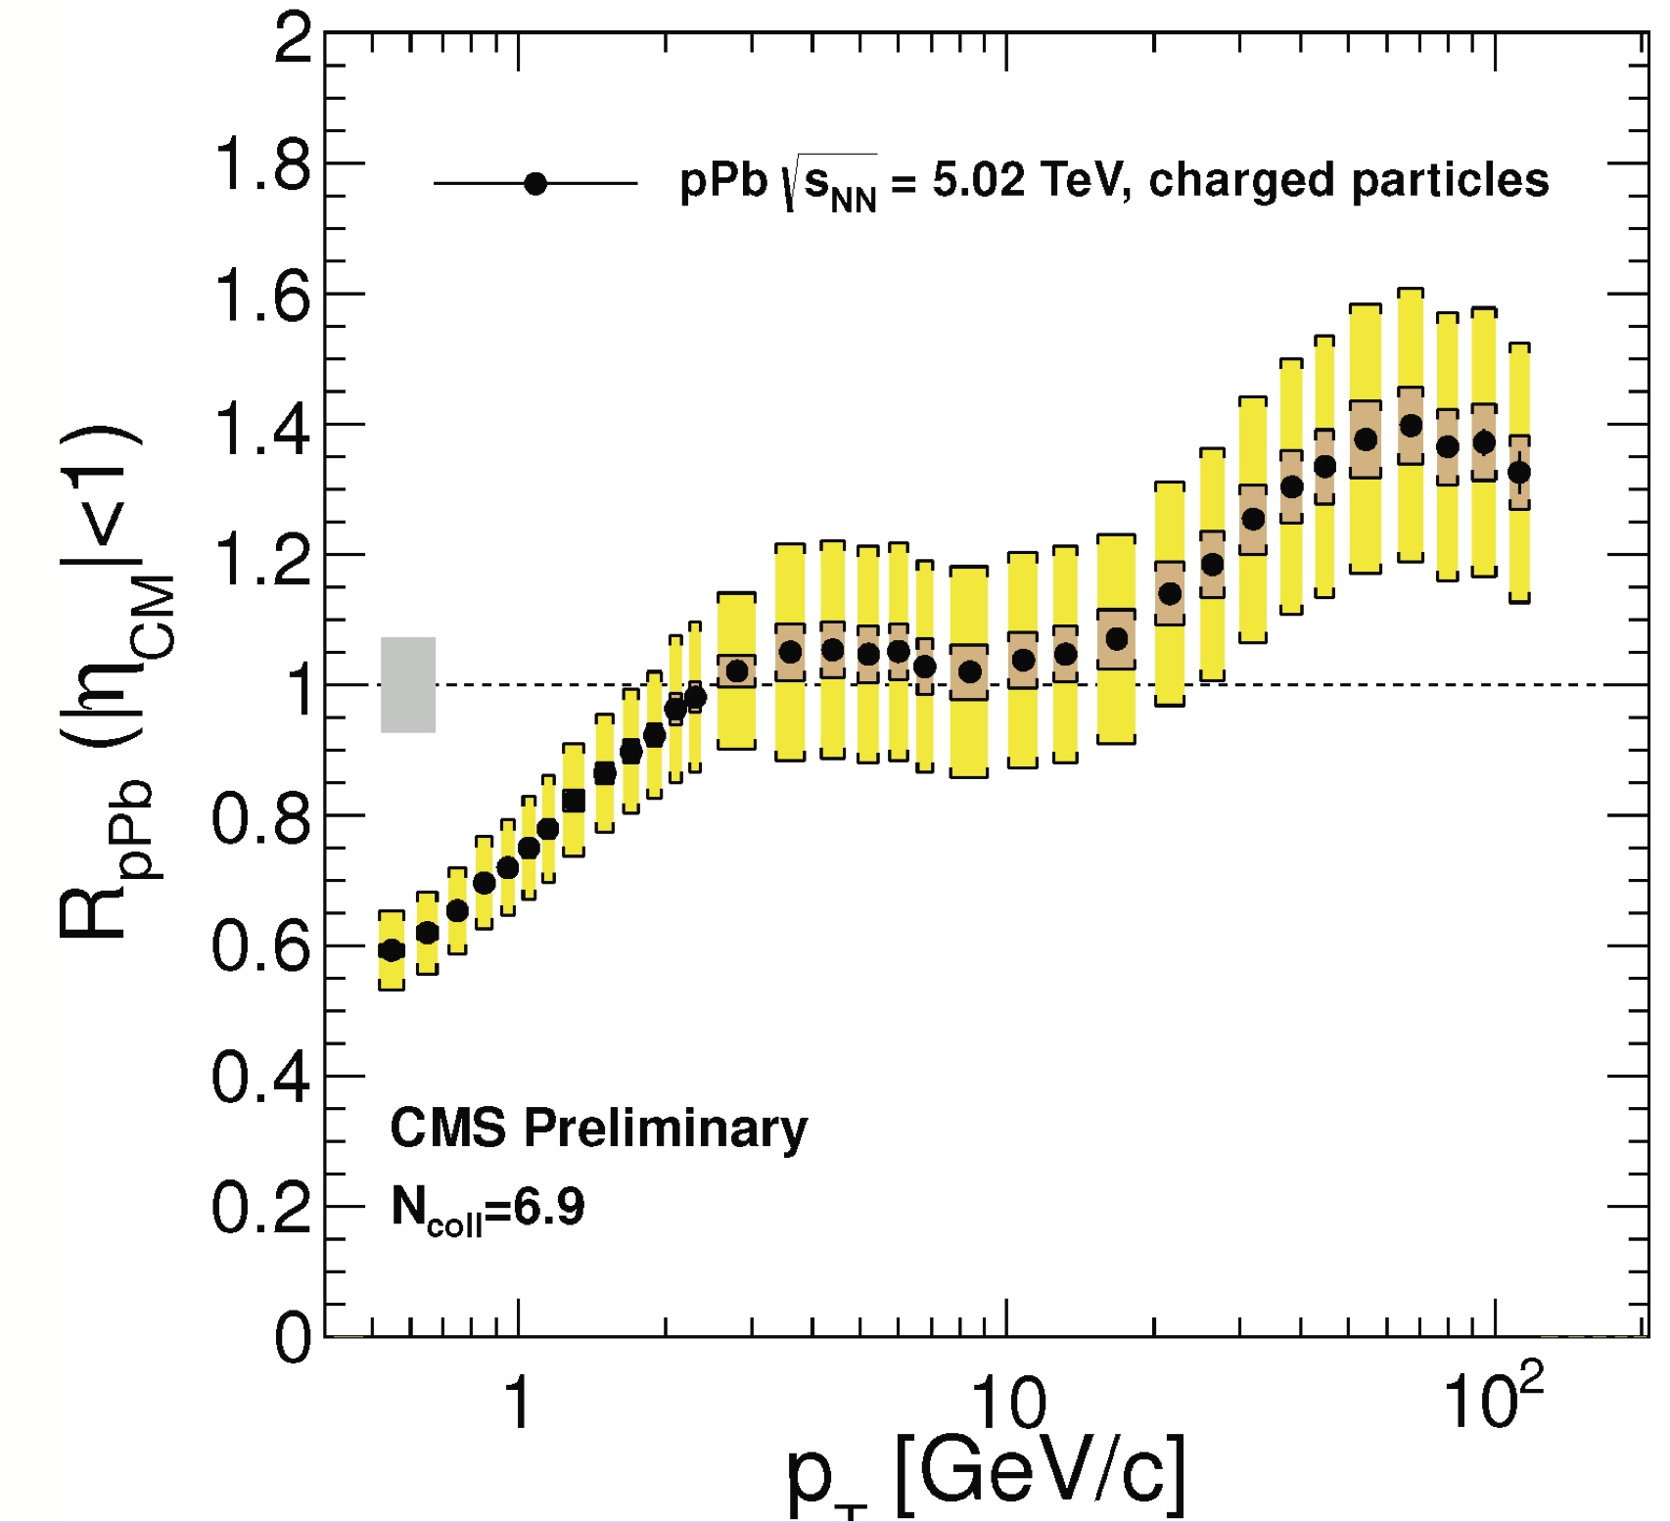
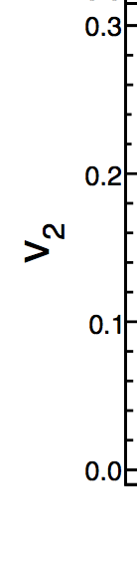
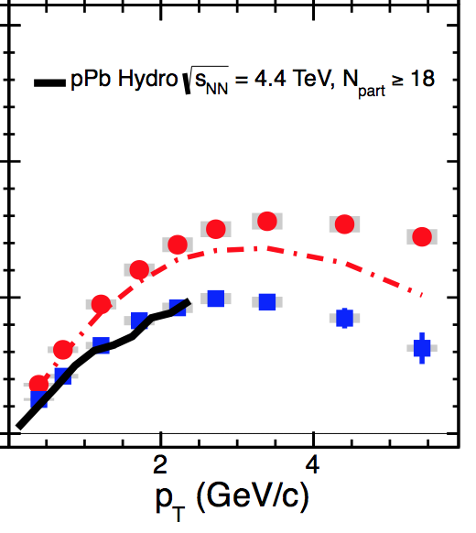
Small System Challenge to pQCD
Collectivity/hydro in pA
R_{pA} > 1 Enhancement
CMS,
PLB724 (2013)
HP2013

Slide 43
Size Doesn’t Matter?
Means of rapid thermalization?
(Non)-suppression due to change in E-loss or unclear geometry/biases?
  In future measure ratio of QCD spectra to electroweak spectra to minimize bias
    γ_{AB}, W_{AB}, Z_{AB}
  Compute small L corrections to E-loss
    Re-evaluate Feynman diagrams
    AdS/CFT appears still applicable

Slide 44
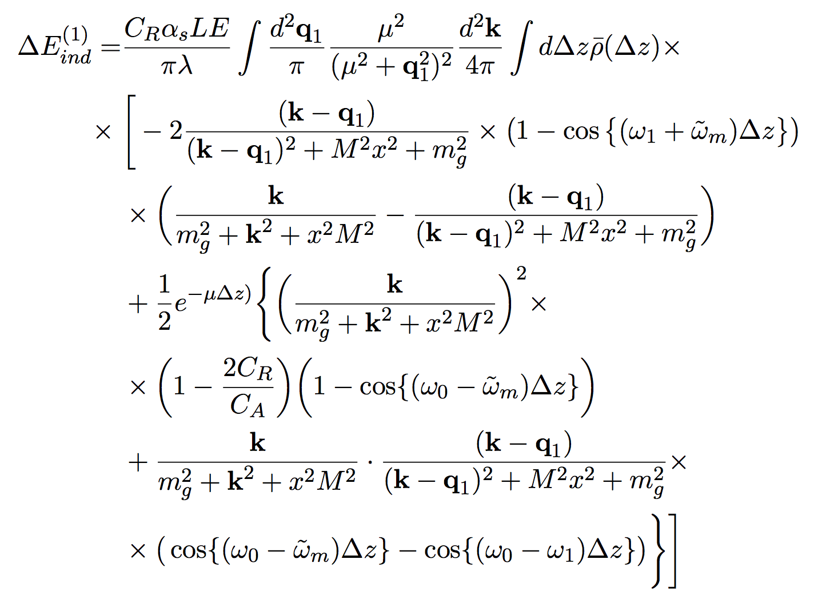
Energy Loss in Small Systems
Compute the small path length corrections to DGLV radiative energy loss in pQCD
More on Fri
DGLV
“Small L”
Correction
Kolbé and WAH, arXiv:1509.06122
and 1511.09313

Slide 45
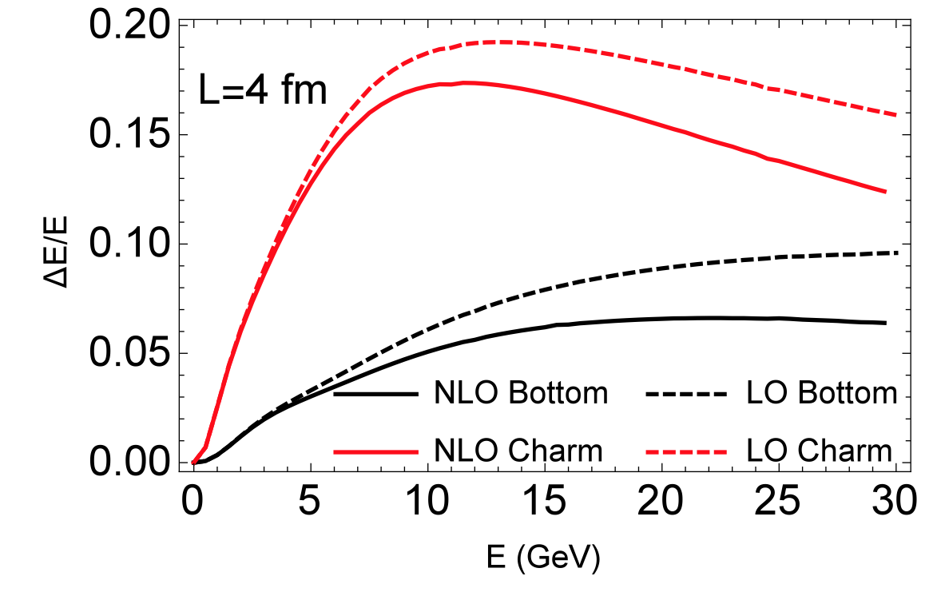
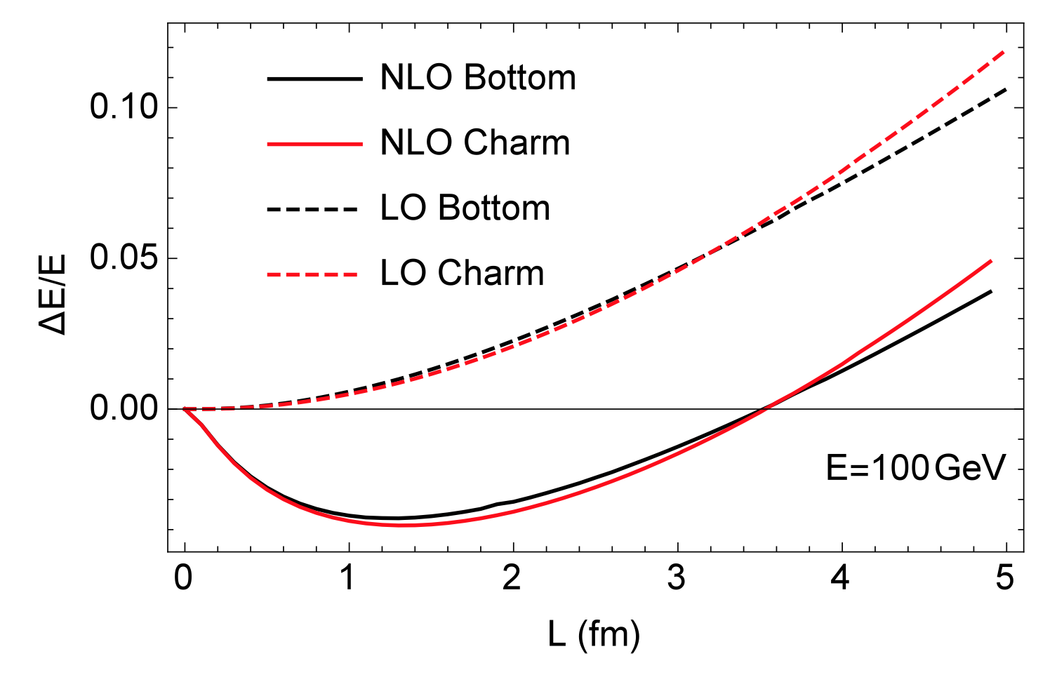
Reexamine Energy Loss Assumptions
  Surprise: Correction formally -> 0 in the large formation time approx.: 1/μ_{Debye} << τ_{form} ~ xE/(k_{perp})²
I Kolbé and WAH, arXiv:1509.06122 and 1511.09313
  Huge Surprise: Correction grows with p_{T}
    Need to reevaluate use of long formation time approx in original DGLV and all other E-loss calcs

Slide 46
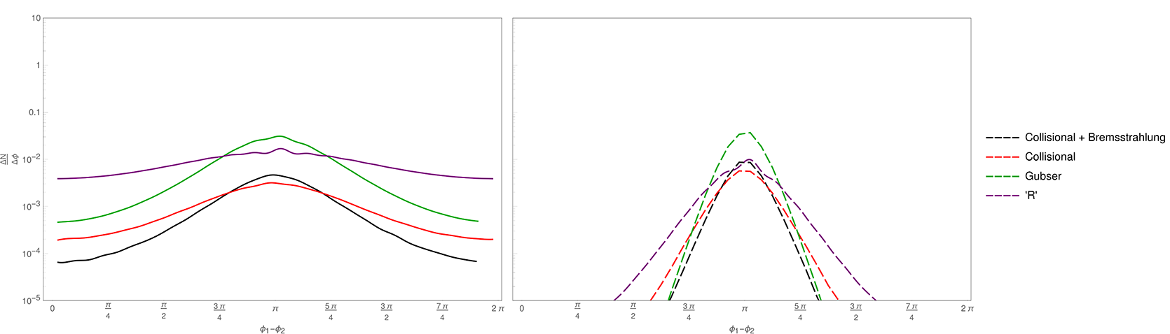
Heavy Flavor Correlations
Seek to differentiate between weak and strong coupling energy loss
  Expect large difference in angular correlations
  Find large difference in momentum correlations
R Hambrock and WAH, in prep
pQCD from Narhgang et al., PRC90 (2014)

Slide 47
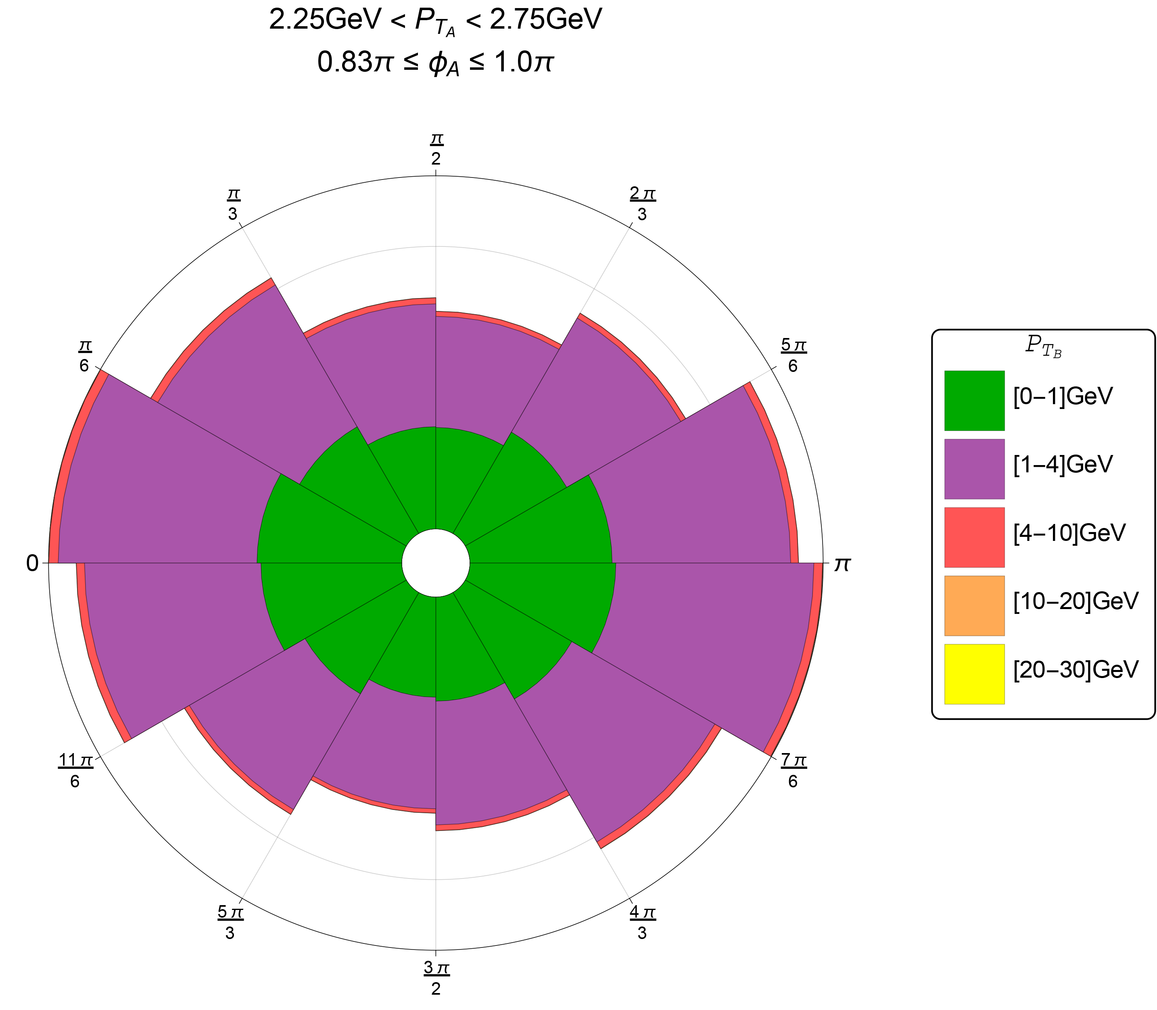
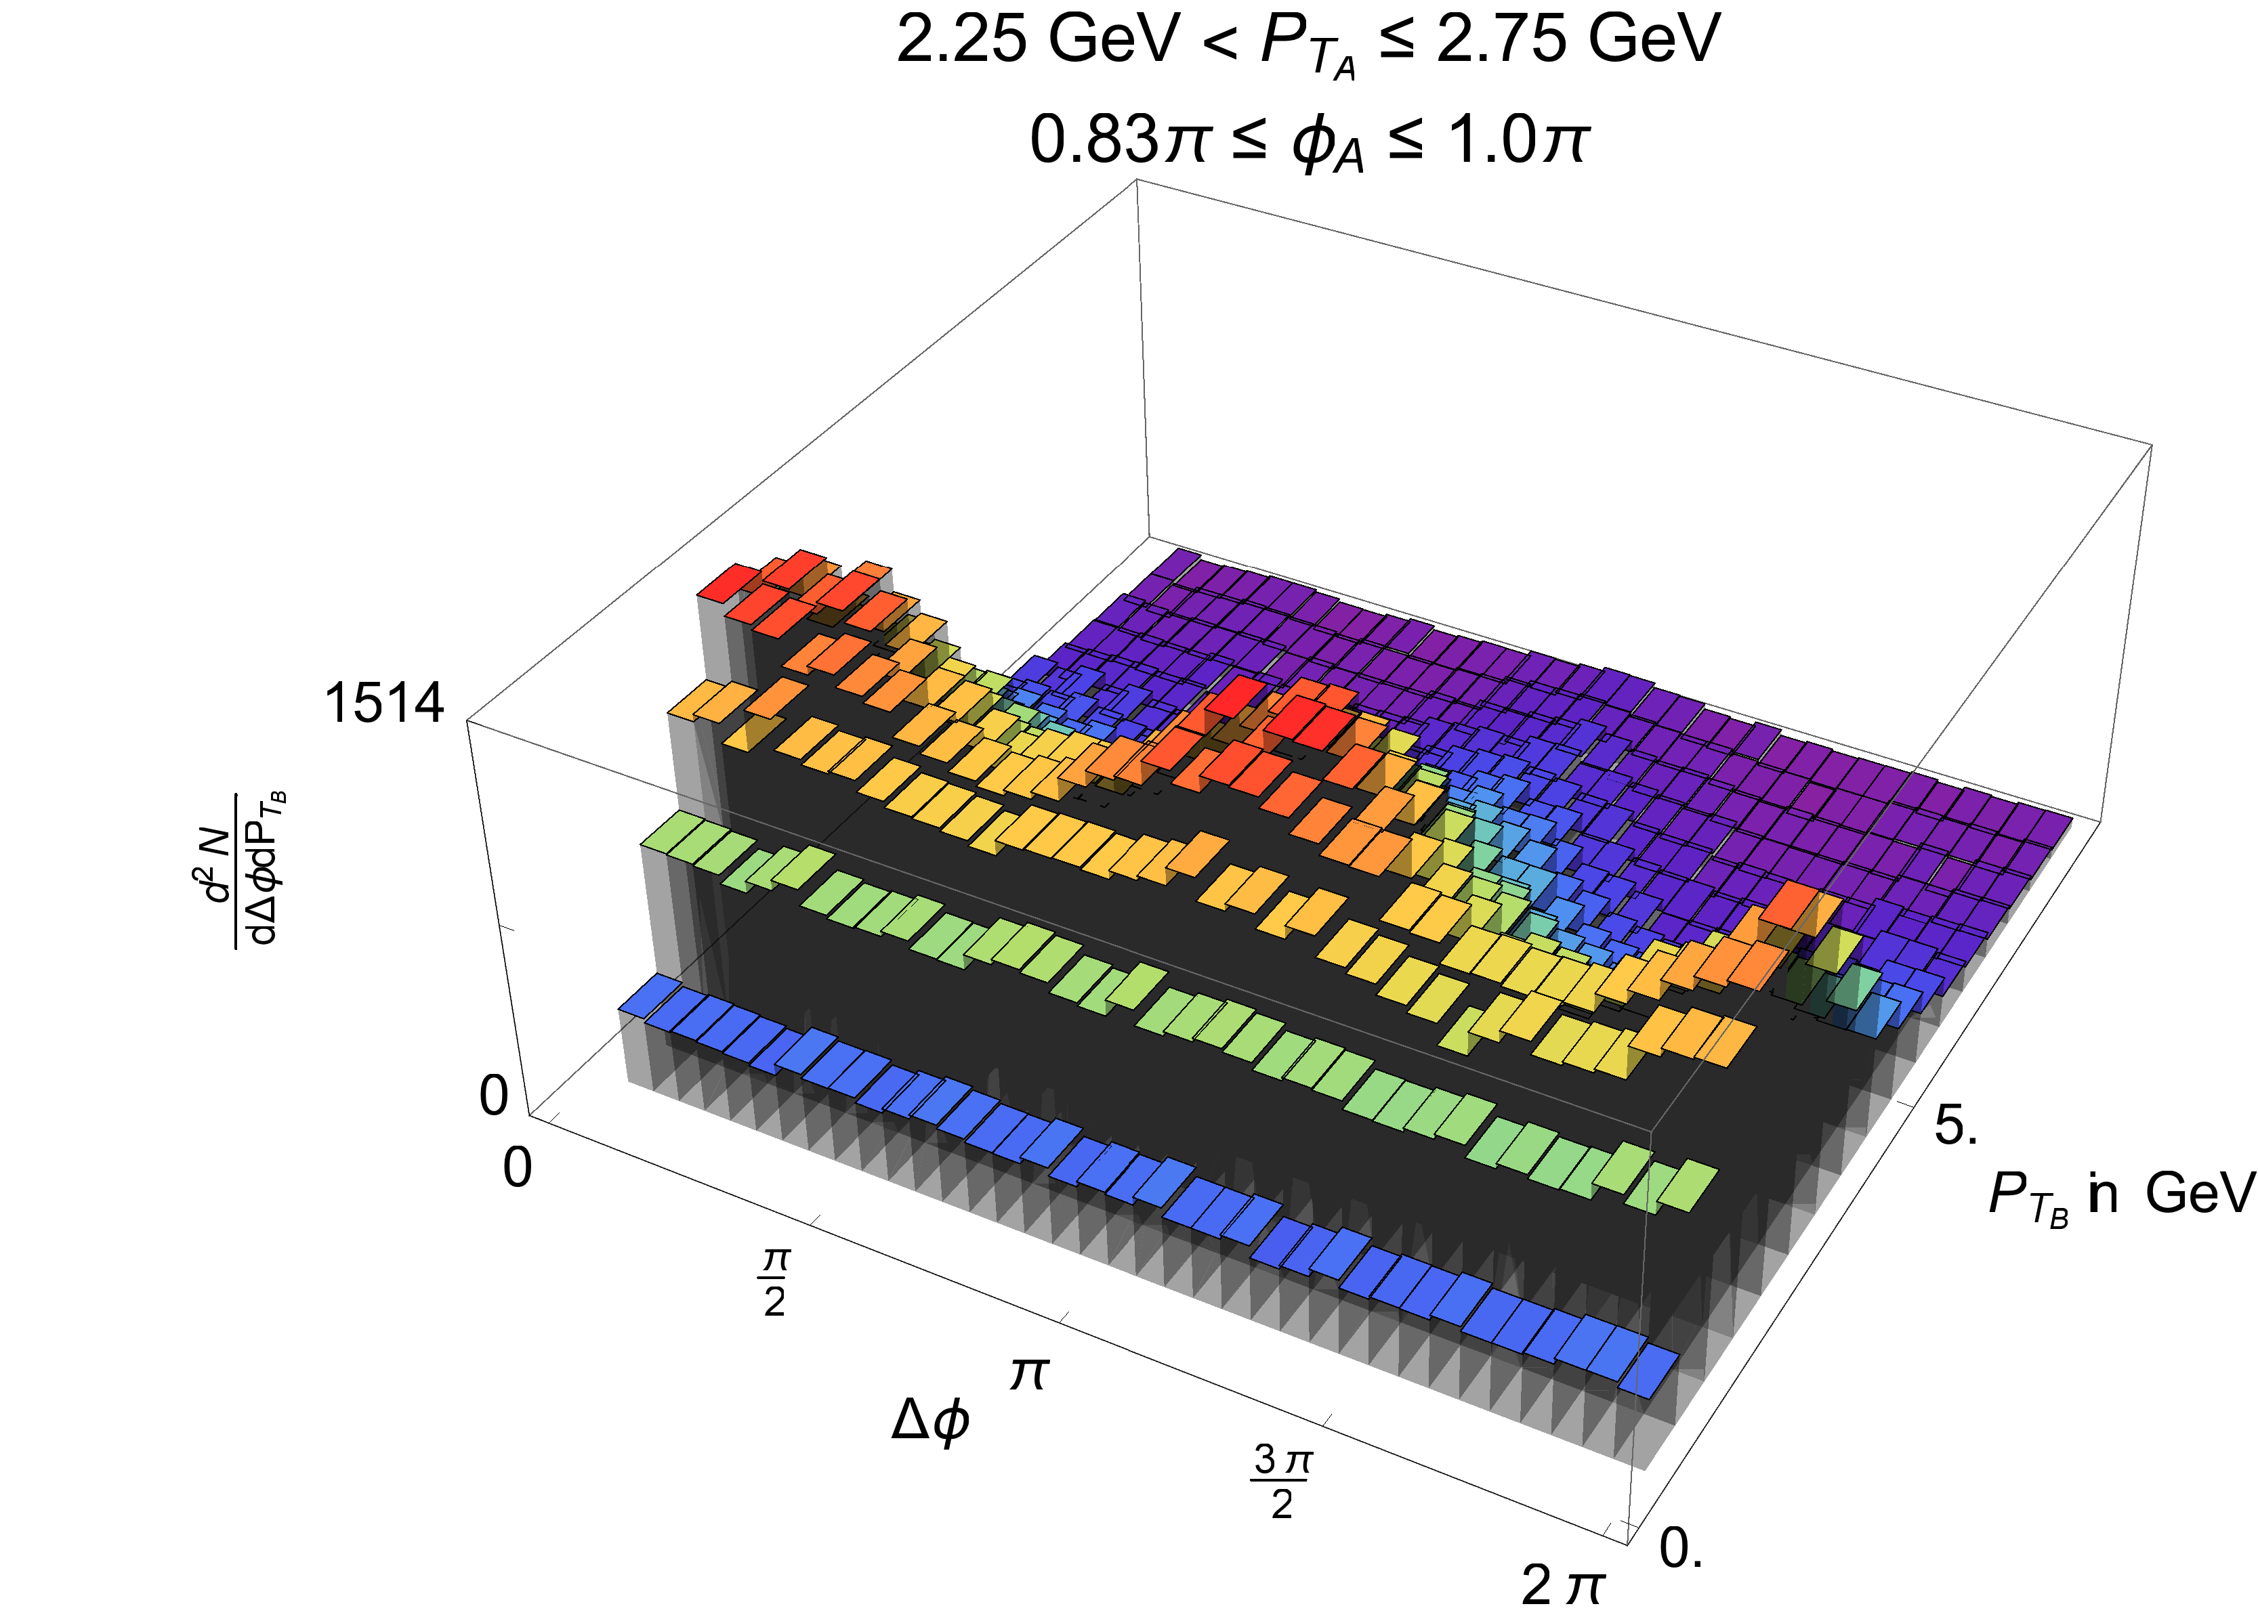
Angular and Momentum Correlations
NLO production and sQGP energy loss
  Effect of partonic wind
    Clear indication of fluid
More on Fri
Hambrock and WAH, in prep

Slide 48
Conclusions
High energy QCD is a field full of vitality
Many open questions about its emergent phenemona
  What are the moderate body dynamics as a function of temperature?
  Where does confinement come from? How does it interface with asymptotic freedom?
  Smoking gun measurements for:
    QGP formation?
    Saturation?
Heavy flavor can shed light on all the above

